Slide 1
Laboratory culture of cellular microbes Lab # 5
Describe the importance of culturing microbes to the study of microorganisms
Distinguish defined (synthetic) media from (complex) media and the uses of liquid from solid growth media
List the characteristics of agar that make it a particularly useful solidifying agent
Compare and contrast enriched, selective, and differential media, listing examples of each and describing how each is used
Prepare culture media

Slide 2
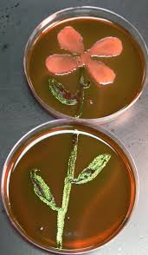
Culture media
Media provides a surface, necessary pH, nutrients that bacteria need to live
Used for transport and storage of bacteria
Isolation and storage of pure culture
Detection of possible contaminants
Examining bacteria morphologies

Slide 3
Some Media Components
Peptones
protein hydrolysates prepared by partial digestion of various protein sources
Extracts
aqueous extracts, usually of beef or yeast
Agar
sulfated polysaccharide used to solidify liquid media; most microorganisms cannot degrade it

Slide 4
Types of culture Media
Classification
Physical nature
Chemical constituents from which they are made
Function

Slide 5
Types of culture Media
Culture media is solid or liquid preparation
Must contain all the nutrients required by the organism for growth
Classification
chemical constituents from which they are made
physical nature
function

Slide 6
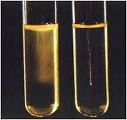
Classification base on physical nature
Liquid
Solid
Semisolid

Slide 7
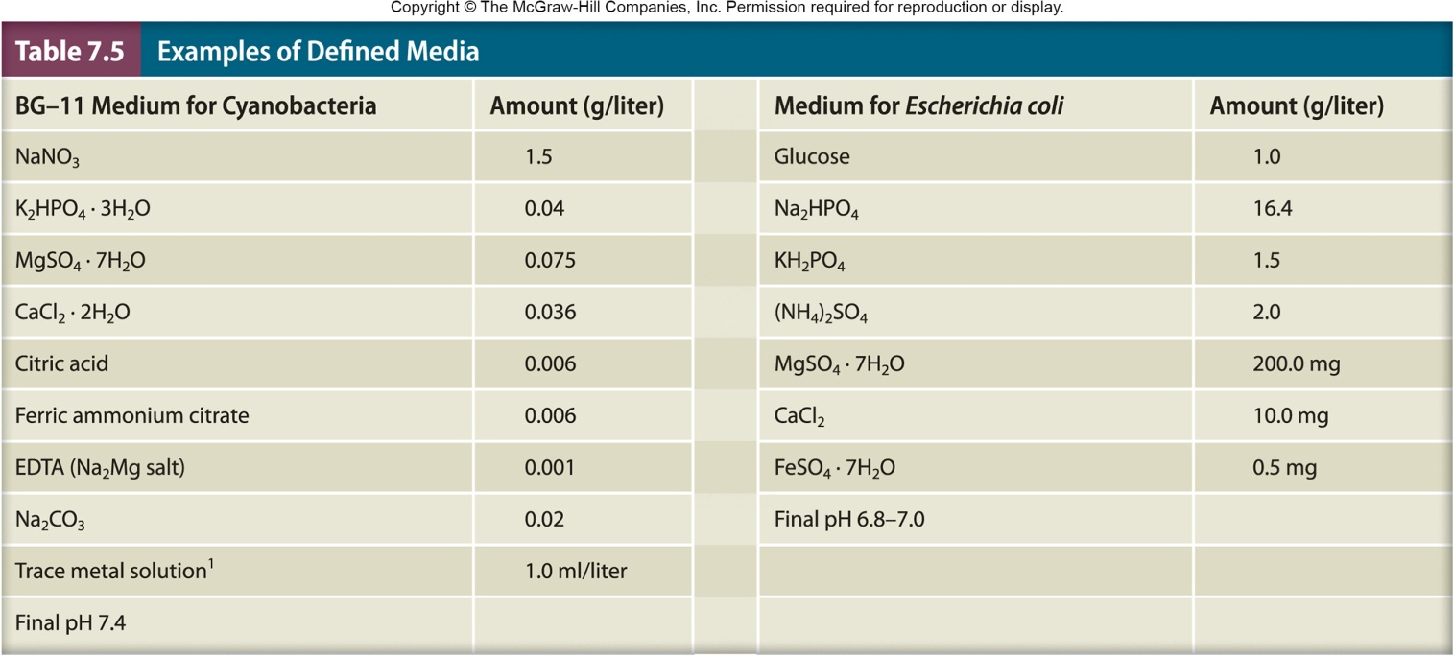
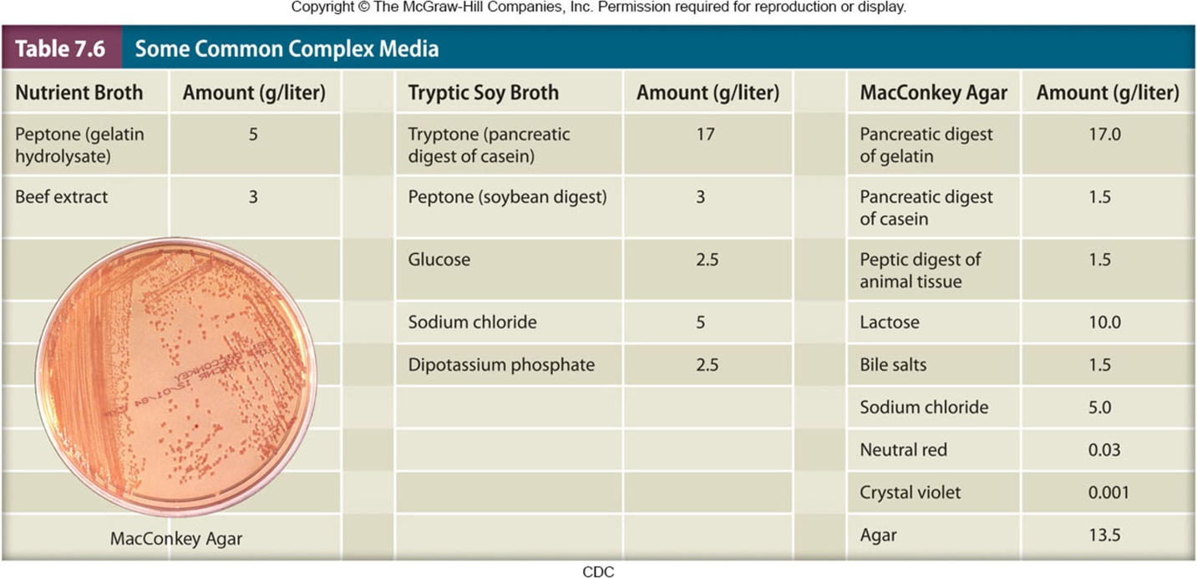
Defined or Synthetic Media
Classification based on chemical nature
Complex Media

Slide 8
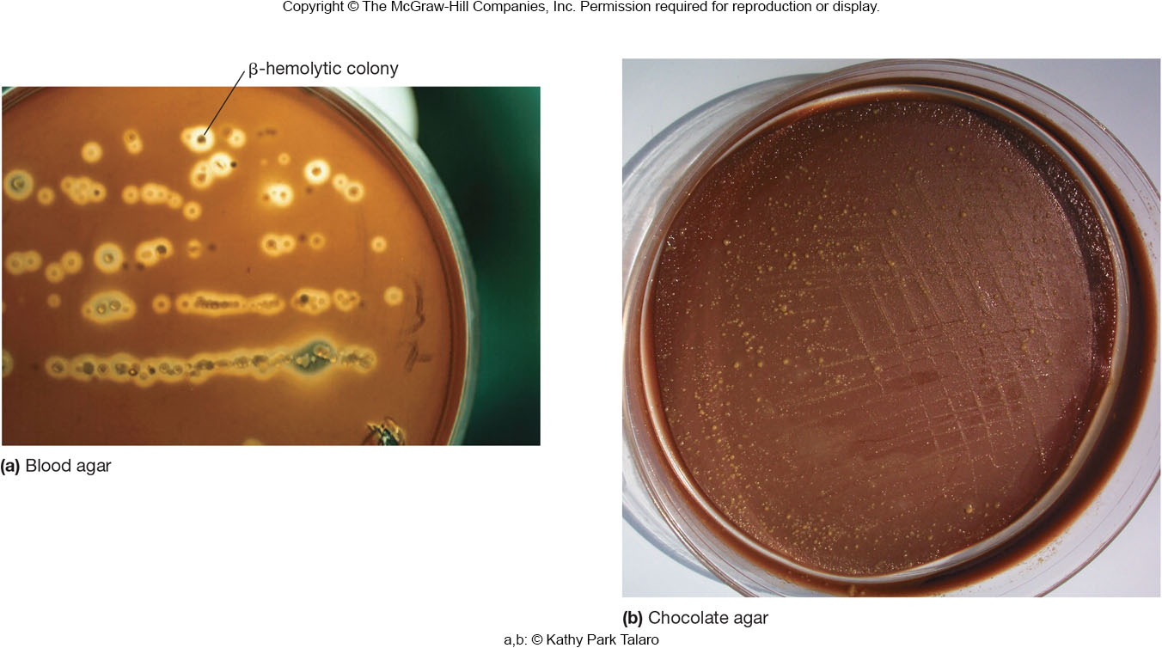
Functional Types of Media
Supportive or general purpose media (e.g. TSA)
support the growth of many microorganisms
Enriched media (e.g. blood agar)
general purpose media supplemented by blood or other special nutrients
Notes:
Enriched allow the growth of fastidious bacteria that requires specific conditions for growth such as blood agar which is enriched and differential media as it differentiate between beta hemolytic and non beta hemolytic bacteria
Different types of hemolysis such as beta alpha and gamma hemolysis

Slide 9
Selective Media
favor the growth of some microorganisms and inhibit growth of others
e.g., MacConkey agar
selects for gram-negative bacteria
e.g., Eosin methylene blue agar
selects for gram-negative bacteria
e.g., Mannitol salt agar

Slide 10
Differential Media
Distinguish between different groups of microorganisms based on their biological characteristics
e.g., blood agar
hemolytic versus nonhemolytic bacteria
e.g., MacConkey agar
lactose fermenters versus nonfermenters
e.g., Mannitol salt agar
Mannitol fermenters versus nonfermenters

Slide 11
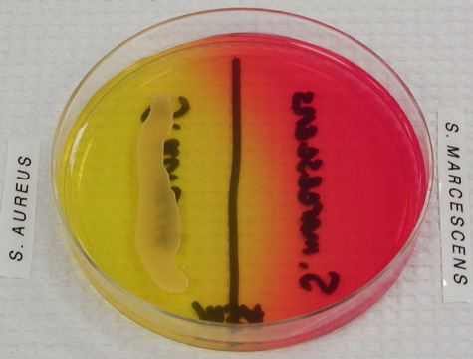
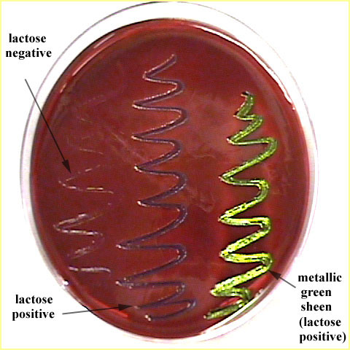
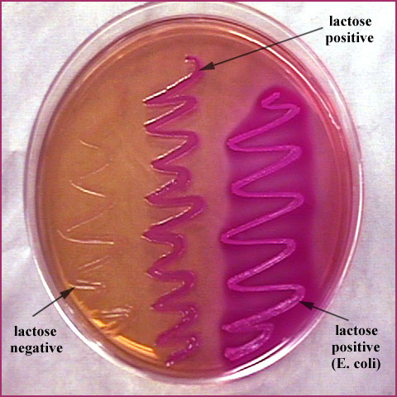
Selective and differential media
SS
MSA
EMB
MAC

Slide 12
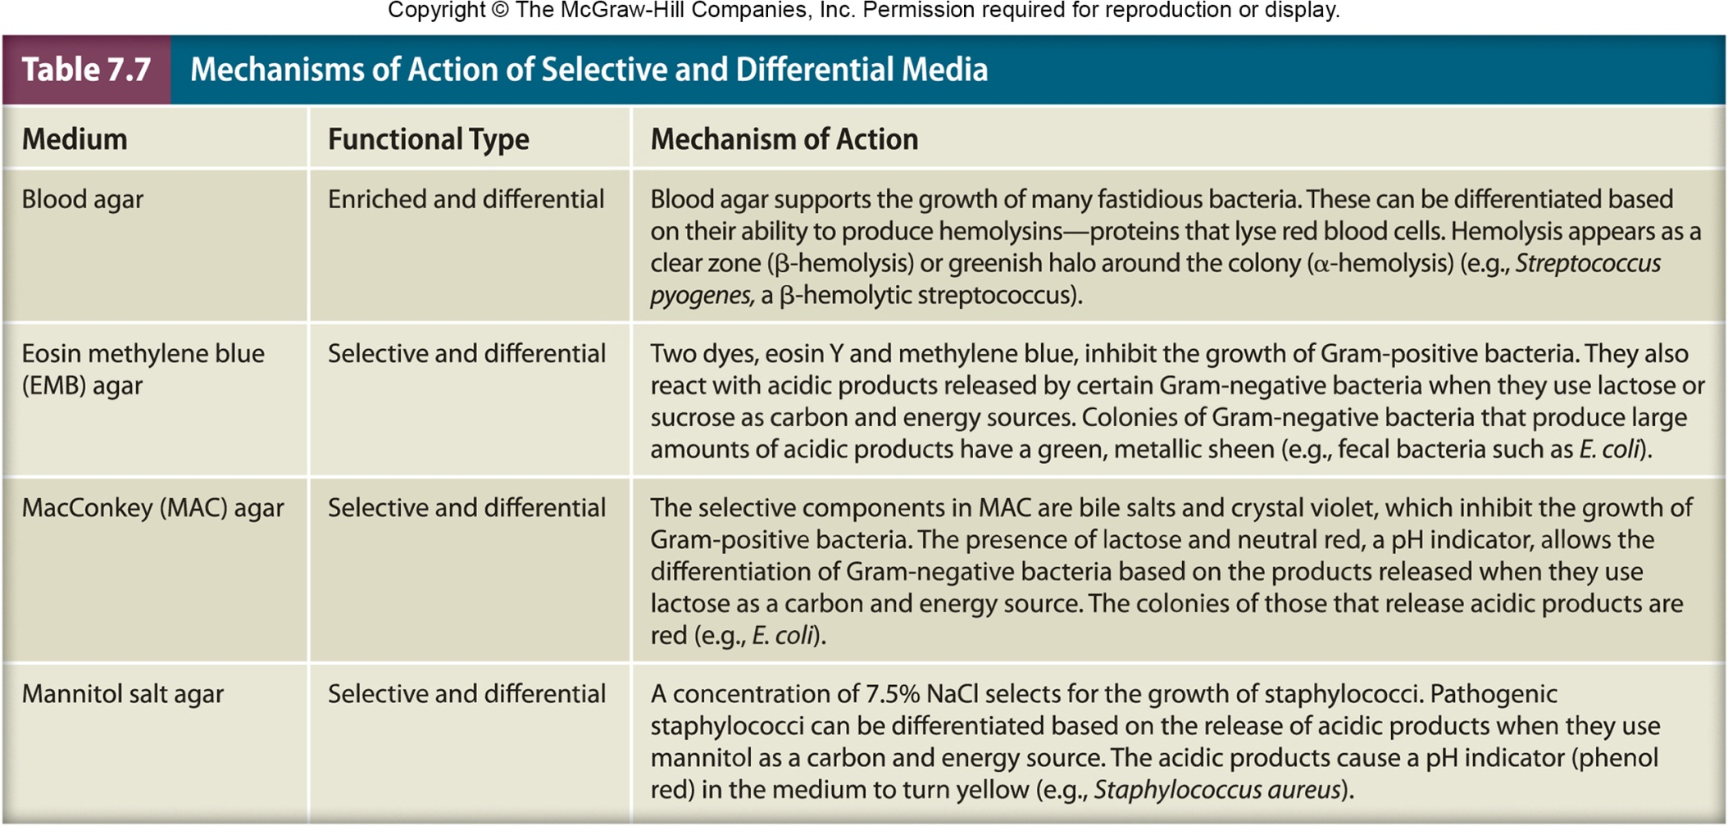

Slide 13
Chocolate agar
Enriched medium used for the isolation and cultivation of fastidious organisms such as Neisseria and Haemophilus.
Blood is added to agar when it is hot and this causes the lysis of red blood cells.

Slide 14
HiChrome Agar
Used for the identification of urinary tract infection (UTI) microorganisms. Contains several chromogenic substances that produce color when cleaved by enzymes produced by bacteria.
Blue color: action of ß-glucosidase produced by Enterococci on one of the chromogenic components
Pink color: action of ß-D galactosidase produced by E. coli on the other chromogenic component
Brown color: tryptophan deamination activity (Proteus, Morganella, and Providencia)

Slide 15
HiChrome Agar
Enterococcus faecalis: blue, small colonies
Escherichia coli: pink-purple colonies
Klebsiella pneumoniae: blue-purple mucoid colonies
Pseudomonas aeruginosa: colorless colonies (remember Pseudomonas produces green pigment)
Proteus mirabilis: light brown colonies
Staphylococcus aureus: golden yellow colonies

Slide 16
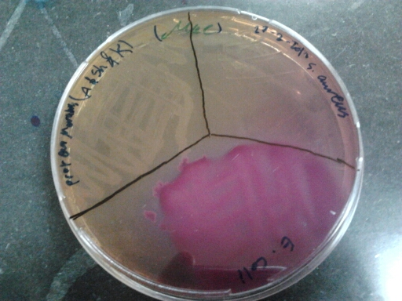
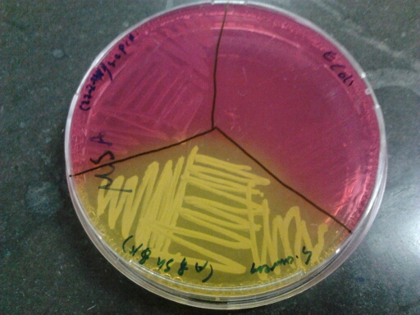
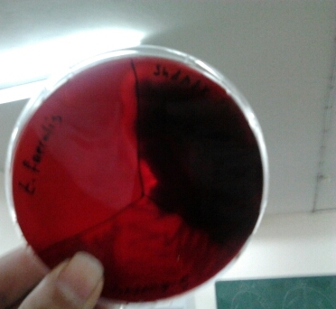
To do
Staphylococcus aureus
Proteus mirabilis
Escherichia coli
Colonies of P. mirabilis, S. aureus, and E.coli on MacConkey
Staphylococcus
epidermidis
Escherichia coli
Staphylococcus aureus
Colonies of S. aureus, S. epidermidis and E. coli on MSA
Colonies of Staphylococcus aureus, Bacillus subtilis,
and Enterococcus faecalis on blood agar

Slide 17
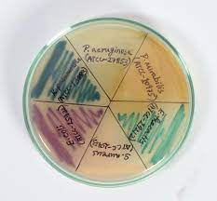
To do
Colonies of P. aeruginosa, P. mirabilis, E. faecalis,
S. aureus, E.coli, and K. pneumoniae on HiCrome UTI Agar
You will also plate S. aureus and E. faecalis on chocolate agar.
E. coli, K. pneumoniae, and P. aeruginosa on EMB Agar.

