Slide 1
Environmental plate
Lab 2 BIOL 230

Slide 2
Microorganisms
Microorganisms can be found on/in all environments. They are also associated with living organisms and can be found on their surface, secretions, and waste.
There are organisms adapted to live under all types of conditions (high salinity, low/high pH, low/high temperature)

Slide 3
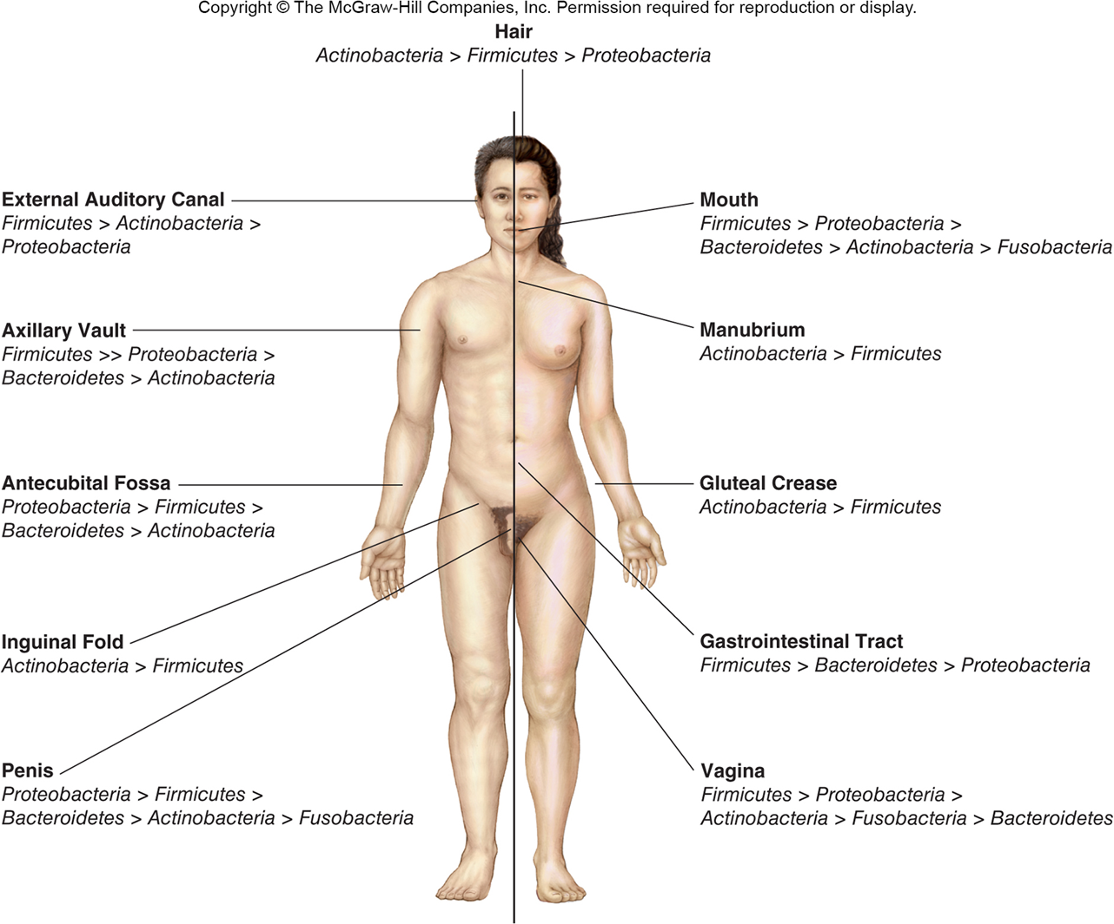
Microbiome (Microbial flora)

Slide 4
Skin
Commensal microbes include both resident and transient microbiota
Mechanically strong barrier
Inhospitable environment
slightly acidic pH
high concentration of NaCl
many areas low in moisture
Inhibitory substances (e.g., lysozyme, cathelicidins)

Slide 5
Nose and Nasopharynx
Staphylococcus aureus and S. epidermidis
predominant bacteria present
found just inside nostrils
Nasopharynx may contain low numbers of potentially pathogenic microbes
e.g., Streptococcus pneumoniae, Neisseria meningitidis, and Haemophilus influenzae

Slide 6
Respiratory Tract
No normal microbiota
Microbes moved by:
continuous stream of mucous generated by ciliated epithelial cells
phagocytic action of alveolar macrophages
lysozyme in mucus

Slide 7
Mouth
Contains organisms that survive mechanical removal by adhering to gums and teeth
contribute to formation of dental plaque, dental caries, gingivitis, and periodontal disease
Within hours of birth, the oral cavity is colonized by microorganisms from the surrounding environment

Slide 8
Stomach
Most microbes killed by acidic conditions
some survive if pass through stomach very quickly
some can survive if ingested in food particles

Slide 9
Small Intestine
Divided into three areas
duodenum
contains few organisms
jejunum
ileum
flora present becoming similar to that in colon
pH becomes more alkaline

Slide 10
Large Intestine (Colon)
Largest microbial population of body
eliminated from body by peristalsis, desquamation, and movement of mucus
replaced rapidly because of their high reproductive rate
most of the microbes present are anaerobes
Bacteroides thetaiontaomicron
colonizes exfoliated host cells, food particles, and sloughed mucus

Slide 11
Genitourinary Tract
Kidneys, ureter, and bladder
normally free of microbes
Distal portions of urethra
few microbes found
Female genital tract
complex microbiota in a state of flux due to menstrual cycle
acid-tolerant lactobacilli predominate

