Slide 1
Nosocomial Infections
David M. Parenti, M.D.

Slide 2
Definitions
sterilization: use of physical procedures or chemical agents to destroy all microbes, including spores, viruses, fungi
disinfection: use of physical procedures or chemical agents to destroy most microbes
– high, intermediate, low level
antisepsis: use of chemical agents on skin or other tissue to inhibit or kill microbes

Slide 3
Nosocomial Infections
Infection acquired in the hospital: > 48 hours after admission
$5 billion annually: increased hospital length of stay, antibiotics, morbidity and mortality
related to severity of underlying disease, immunosuppression, invasive medical interventions
frequently caused by antibiotic-resistant organisms: MRSA, VRE, resistant Gram- negative bacilli, Candida

Slide 4
Nosocomial Infection
Types of Transmission
airborne
tuberculosis, varicella, Aspergillus
contact
S. aureus, enterococci, Gram-negative bacilli
common vehicle
food contamination
Salmonella, hepatitis A

Slide 5
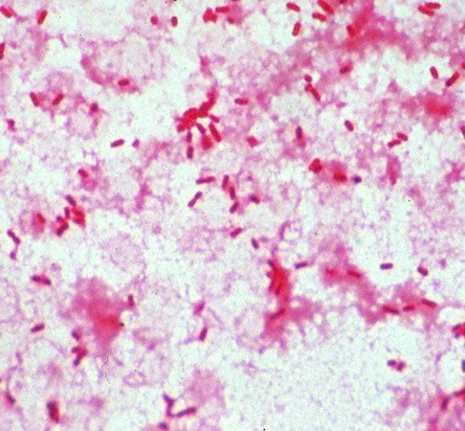
Patient 1
A 67 yo female with poorly controlled hypertension was admitted because of a right-sided stroke. She had confusion, limitation of mobility of her left leg, and urinary incontinence. A urinary (Foley) catheter was placed and she was evaluated for rehabilitation.
4 days later she developed a temp to 103º F and blood pressure of 90/60 and was transferred to the ICU. Blood and urine cultures grew resistant Klebsiella.

Slide 6
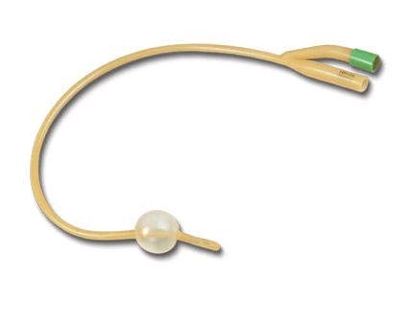
Nosocomial UTI
Up to 25% of hospitalized patients are catheterized at some time during their hospital stay.
15% colonized (bacteruria)
5-10% per day of catheterization
50% after 14 days
Gram-negative bacilli, VRE, Candida
frequent antimicrobial resistance

Slide 7
Antibiotic-Resistant
Gram-Negative Bacilli
increasingly a problem in the ICU: UTI, pneumonia
selective pressure from high-level antibiotic usage in hospital and community
E. coli, Klebsiella, Enterobacter, Pseudomonas, Serratia, Acinetobacter
resistance to extended spectrum penicillins, cephalosporins, aminoglycosides, quinolones
colonization at multiple body sites: GI, skin, pharynx

Slide 8
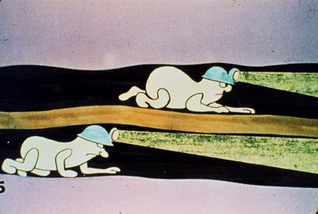
Nosocomial UTI Pathogenesis
external
most common
colonization of urethral meatus
movement of bacteria along fluid layer on external catheter surface
internal
colonization of urine in bag, ascend through catheter lumen

Slide 9
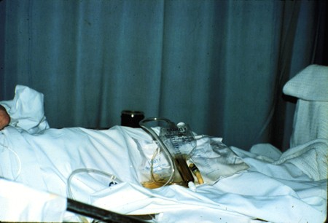
Nosocomial UTI Prevention
*avoid catheterization
minimize duration of catheterization
intermittent (“in and out”) catheterization
aseptic insertion technique
closed system
dependent drainage
silver-coated catheters

Slide 10
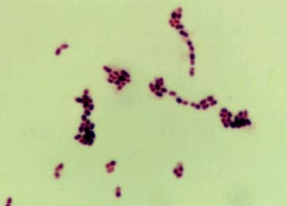
Patient 2
A 45 yo male is admitted for community-acquired pneumonia. He has a long history of iv drug use, but has not used in several years. The intern has difficulty starting a peripheral iv so places a femoral venous catheter. His cough and fever begin to improve.
On hospital day 3 he has fever, chills and a WBC of 18,000. Blood cultures are positive for vancomycin-resistant Enterococcus.

Slide 11
Vascular Device-Associated Bacteremia
major cause of morbidity and mortality in hospitalized patients
150 million intravascular devices are purchased by hospitals yearly
estimated 50,000-100,000 intravascular device- related bacteremias in U.S./year
– non-cuffed central venous catheters account for 90% of vascular catheter- related bacteremias

Slide 12
Vascular Device-Associated Bacteremia: Pathogenesis
initial step is colonization of the insertion or access hub
biofilm formation allows attachment of bacteria
development of bacteremia

Slide 13
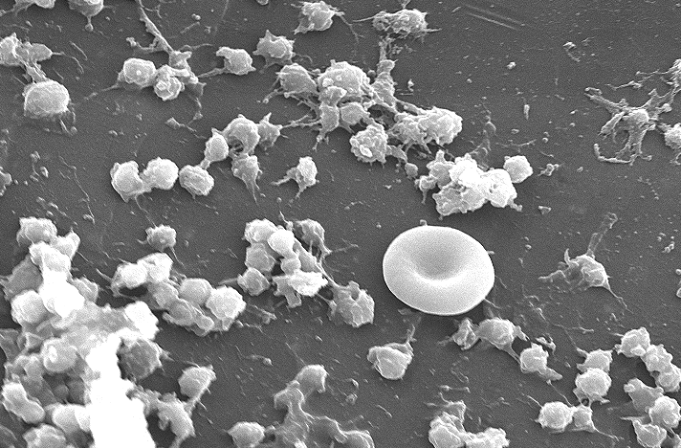
IV Catheter Biofilm 24 hours after Insertion

Slide 14
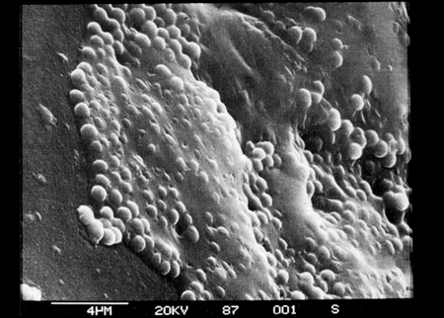
Coagulase Negative Staphylococci
Slime-producing, Catheter Surface

Slide 15
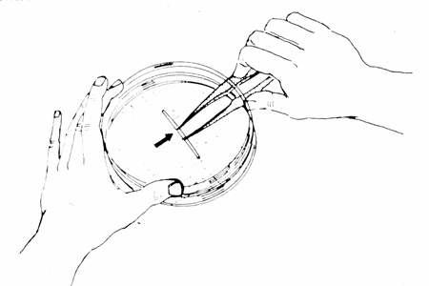
Vascular Catheter Infections
Diagnosis
Maki rollplate technique
catheter tip or intracutaneous segment is rolled on agar plate
colonies are counted
> 15 colonies correlates with colonization and potential source of bacteremia
Maki DG. NEJM 1977;296:1305

Slide 16
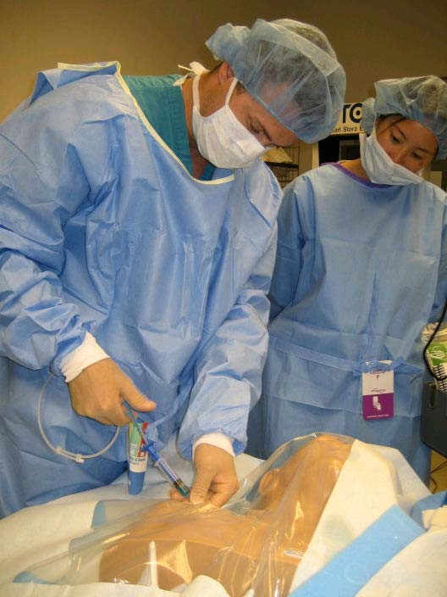
CVC-Associated Bacteremia
Prevention (Bundles)
*minimize duration of catheterization
use single vs multiple lumen catheters
site placement
meticulous insertion technique
– drapes, gown/gloves/mask
antibiotic impregnated catheters
impregnated dressing (Biopatch)
outbreak/cluster control

Slide 17
Patient 3
A 52 yo male is admitted with a severe headache and is found to have a subarachnoid hemorrhage from a ruptured aneurysm. The neurosurgeons evacuate the hematoma and clip his aneurysm. Post-op he remains on a ventilator.
On hospital day 5 he spikes a fever to 102º F and is noted to have copious secretions from his endotracheal tube. Increasing amounts of inspired O₂ are required. Blood and sputum cultures grow highly resistant Enterobacter cloacae.

Slide 18
Nosocomial Pneumonia
300,000 cases/year in U.S.
10-15% of nosocomial infections
leading cause of death from nosocomial infection
crude mortality 35-50%
ventilator-associated pneumonias occur 48- 72 h post endotracheal intubation
organisms may originate from endogenous flora, other patients, visitors, or environmental sources

Slide 19
Ventilator Associated Pneumonia
GWUH 2009
Staphylococcus aureus, MRSA
Proteus mirabilis, Serratia marcescens, Pseudomonas aeruginosa, Stenotrophomonas maltophilia

Slide 20
Patient 4
A 73 yo male is admitted with chest pain and severe coronary artery disease. He has emergent 3-vessel coronary artery bypass grafting. He recovers fairly well from the surgery but on post- op day 10 develops fever and purulent drainage from the inferior aspect of the wound.
He returns to the operating room for extensive debridement of sternal osteomyelitis. Cultures grow methicillin-resistant Staphylococcus aureus.

Slide 21
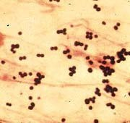
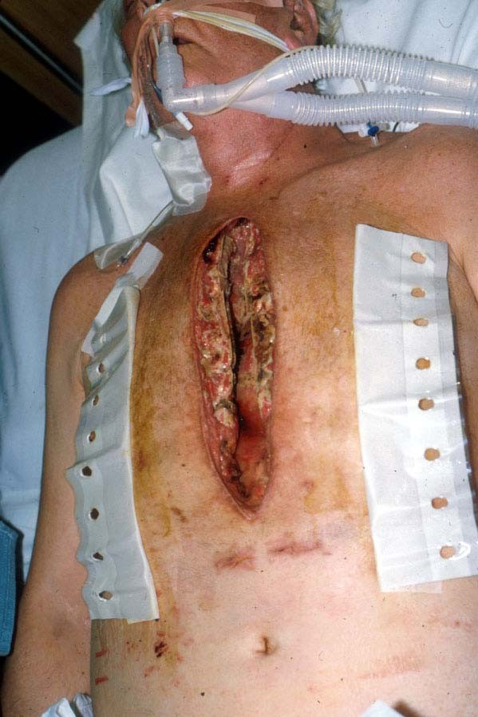
Patient 4

Slide 22
Surgical Site Infection (SSI)
usually introduction of skin organisms into the wound
S. aureus, Gram-negative bacilli
risk factors
underlying disease
skill of the operator
duration of operative procedure
may not become clinically apparent until after discharge
risk may be decreased by appropriately timed pre- operative antibiotics

Slide 23
MRSA
1960 methicillin-resistant S. aureus identified
MRSA 60% of S. aureus isolates at GW are MRSA (2007)
Community-acquired: recent increase in incidence
Hospital-acquired: > 48 h after admission
Healthcare-associated community-onset:
previous positive MRSA culture
history of hospitalization, surgery, dialysis or residence in long term care facility in the last year
indwelling catheter/percutanous device

Slide 24
Hospital-acquired MRSA
Risk factors:
prolonged hospitalization
prolonged antimicrobial therapy
location in an intensive care unit
proximity to a known MRSA case
Persistent colonization up to 4 years: nares
Contamination of environmental surfaces
up to 30%: bed rails, table, BP cuff

Slide 25
SSI Prevention
no shaving of operative site: clippers or no hair removal
hand hygiene; fastidious aseptic technique
surgical site antisepsis with chlorhexidine
prophylactic antibiotics
single dose 30-60 minutes prior to incision
second dose for prolonged surgeries
laminar air flow or HEPA filtration; limit traffic in the operating room
pre-operative screening for S. aureus

Slide 26
Patient 5
A 26 yo medical student draws blood from a patient for a classmate. He is in a hurry and sticks his thumb while recapping (?) the needle. The patient has been tested positive for HIV and hepatitis C. The student has received the hepatitis B immunization series.

Slide 27
HCW Blood/Body Fluid Exposure
Risk Factors
needlestick/sharp>>mucosal>>non-intact skin
inoculum: viral titer, volume of blood
needle type
hollow-bore needles > solid-bore
large bore > small bore
decreased risk with glove use

Slide 28
HCW Blood/Body Fluid Exposure
Prevention
SLOW DOWN
do not recap needles
dispose of sharps in the proper receptacle
use needleless systems whenever possible
heptitis B immunization

Slide 29
Isolation
to protect both patients and personnel
Standard Precautions
– routinely consider all body fluids and moist surfaces as potentially infectious
airborne precautions
droplet precautions
contact precautions

Slide 30
Isolation
Airborne Precautions
transmission of pathogen via inhalation of droplet nuclei
– tuberculosis, varicella, ? influenza
private room
negative pressure
> 10 air exchanges per hour
Staff: particulate respirators

Slide 31
Isolation
Contact Precautions
transmitted via hands of personnel, inanimate surfaces
MRSA, VRE, highly resistant GN rods
private room
gloves with patient contact
handwashing

Slide 32
Handwashing
most important means to prevent spread of nosocomial pathogens
hand cultures of medical personnel
 | GN bacilli | S. aureus
random sample | 45% | 11%
serial sample | 100% | 64%
persistent carrier | 16% | 16%

Slide 33
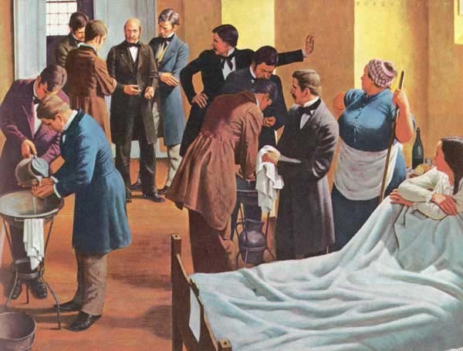
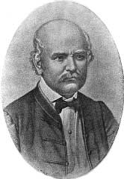
Ignaz Semmelweis
Decreased Mortality with Improved Hand Hygiene
Ignaz Semmelweis (1818-65)
Chlorinated lime hand antisepsis

