Slide 1
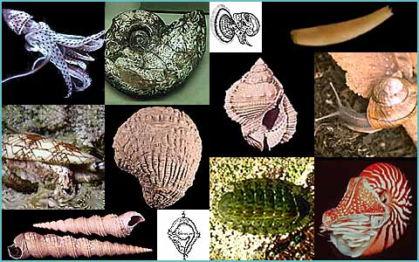
Invertebrate Zoology (Biol 242)
Chapter 12
Phylum Mollusca

Slide 2
Kingdom Animalia Phylum Mollusca
Mollusca: L.: Soft
Defining Characteristics:
Dorsal epithelium forming a mantle, which secretes calcareous spicules or a shell.
Cuticular band of teeth (radula) in the esophagus, used for feeding.
Ventral body wall muscles develop into a locomotory or clinging foot.

Slide 3
General Characteristics:
One of the largest of all animal phyla including about 100,000 living species.
It includes many dissimilar species like: clams, snails, octopuses ….. etc. Therefore, it is very difficult to describe a typical molluscan body.
However, many molluscs have shells, mantle, foot, gills and radual.

Slide 4
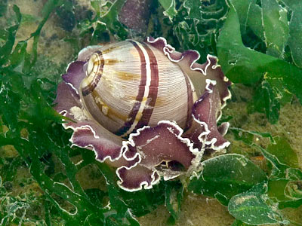
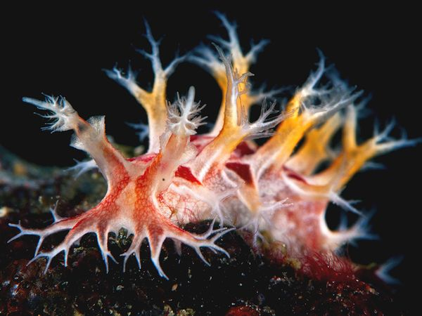
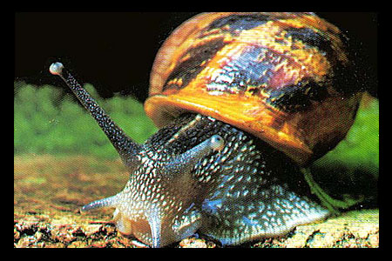
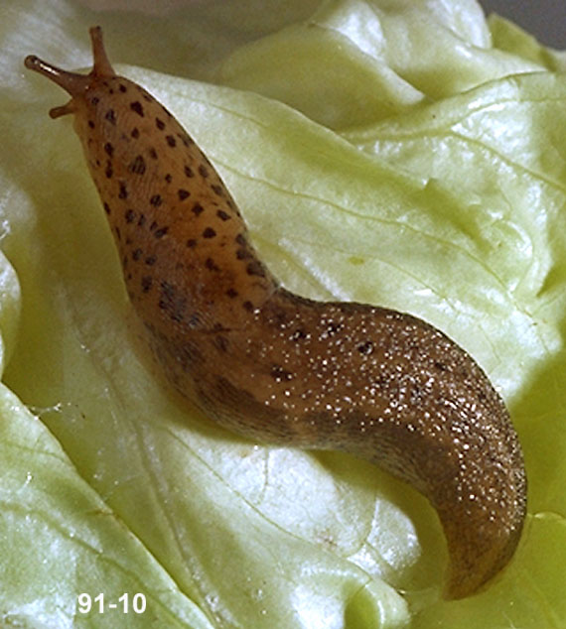
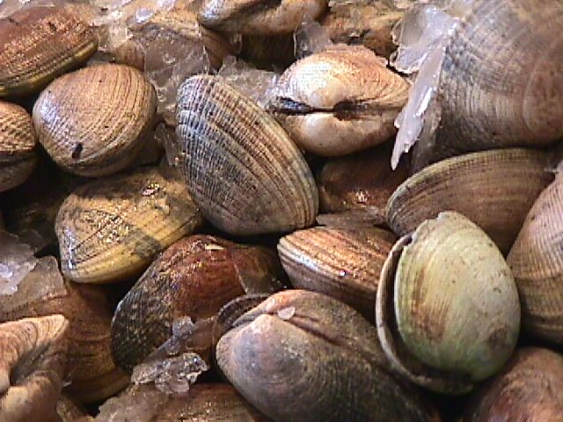
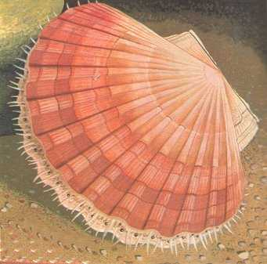
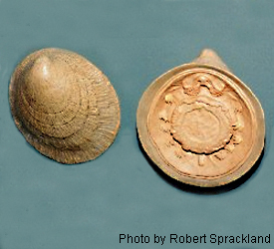
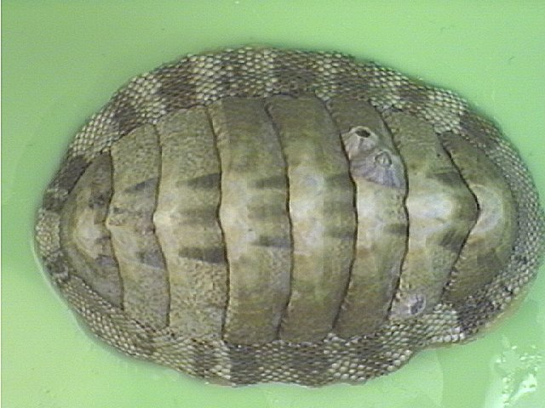
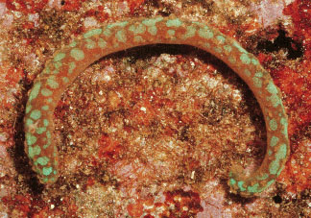
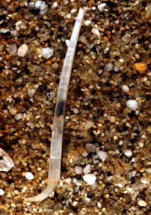
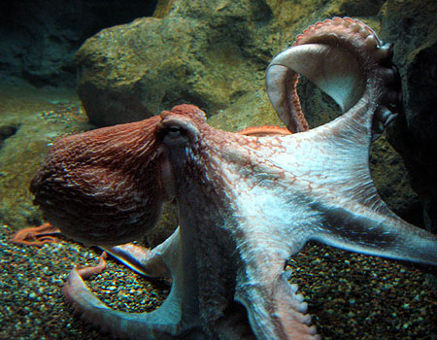
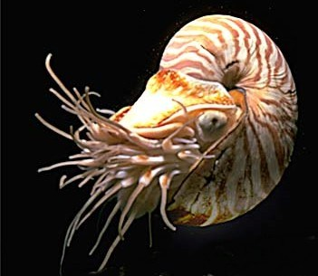

Slide 5
The Shell
Most, but not all, molluscs have shells consisting primarily of calcium carbonate set in a protein matrix.
The organic material may comprise 35%-70% of the dry weight of the shell.
Shell is composed of three layers:
Periostracum: Thin, outer organic layer.
Nacreous: Thin, innermost calcareous layer.
Prismatic: Thick, calcareous middle layer.
Shell material is secreted by specialized tissue known as the mantle.

Slide 6
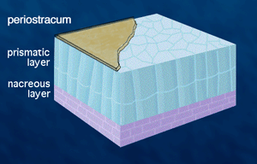
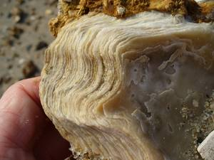
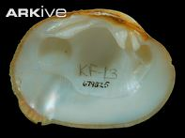
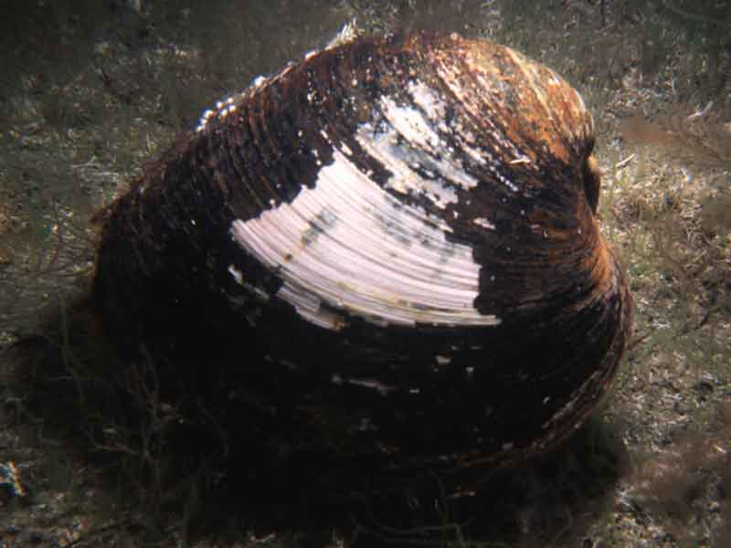

Slide 7
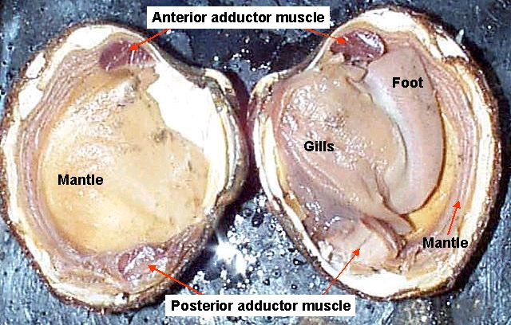
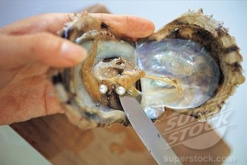
The Mantle
The mantle is the dorsal body wall which covers the visceral mass and usually protrudes in the form of flaps well beyond the visceral mass itself.
In addition to secreting and repairing the shell, the mantle could secrete pearls in oysters when sand particles become trapped between the mantle and the shell.

Slide 8
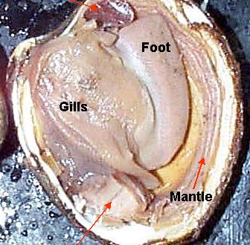
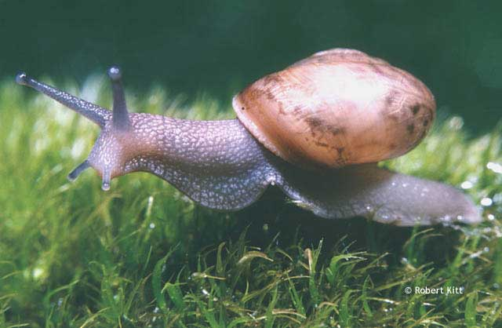
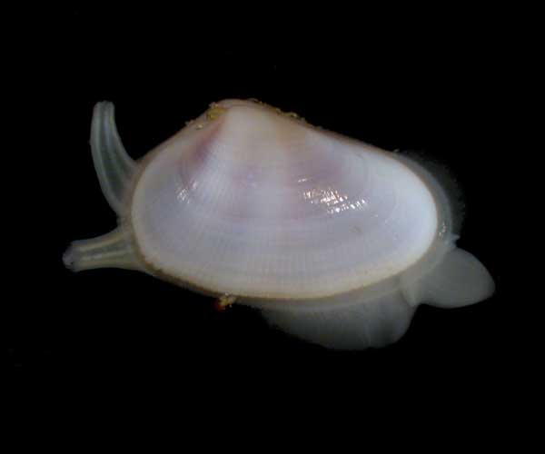
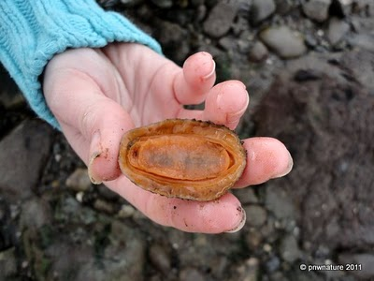
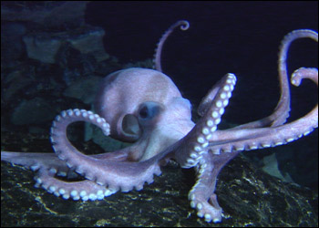
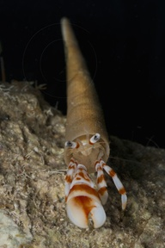
The Foot
Most molluscs have a foot, which is modified for a variety of functions in different groups.

Slide 9
The Gills
Most molluscan gill are found inside a characteristic cavity between the mantle and the viscera called the mantle cavity.
Molluscan gills are called ctenidia (comb-like) are present.
Ctenidia might have other functions rather than respiration. These include collection and sorting of food.
Chemoreceptor, called osphradium (osphra: G: smell) is located adjacent to the ctenidium.

Slide 10
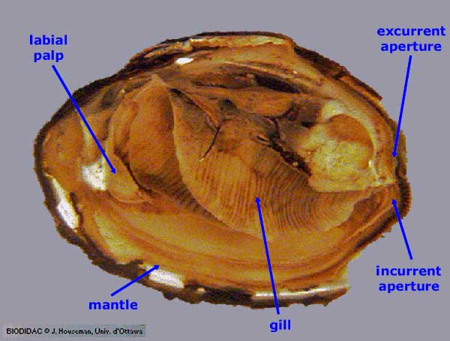
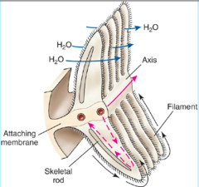
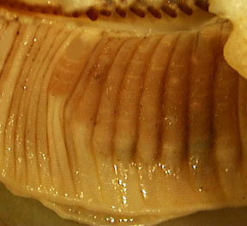
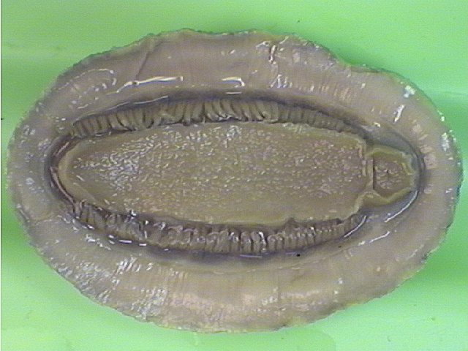

Slide 11
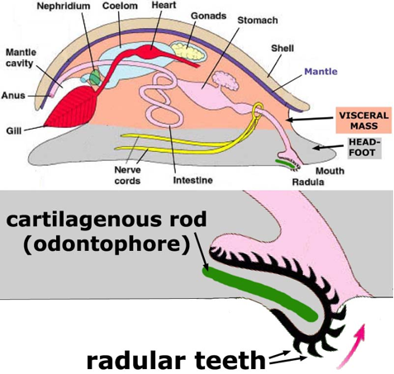
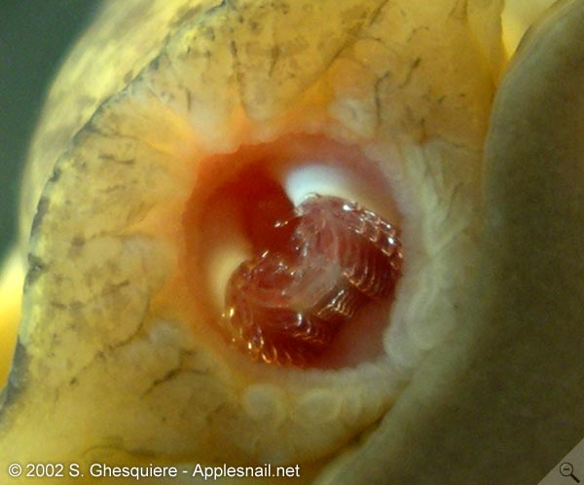
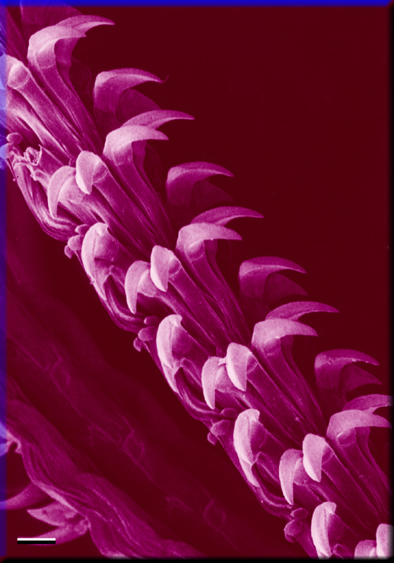
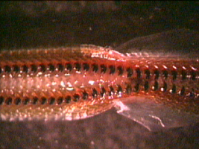
The radula
Many molluscs possess a feeding structure known as the radula.
It is provided with 2 rows of sharp chitinous teeth.

Slide 12
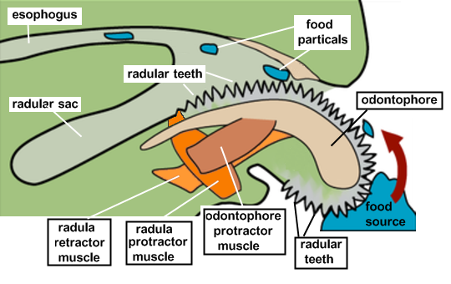
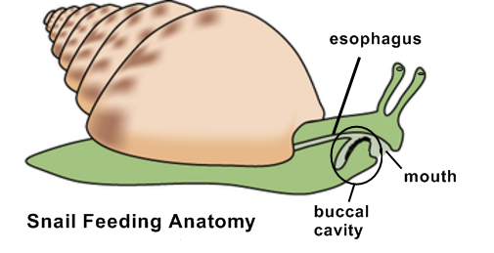
It is produced from a radular sac.
It is supported by a cartilage-like structure called the odontophore (G: Tooth-bearer).
The odontophore-radular assembly, together with its complex musculature, is known as the buccal mass or the odontophore complex.

Slide 13
1) Class Polyplacophora
Polyplacophora: G: Many-plate-bearing.
Defining Characteristic: shell takes the form of a series of 7-8 separate plates.
About 500 species called Chitons.
Size is 3-10 cm long and lives close to the shore (intertidal zone).
They are restricted to rocky shores.
Chiton’s thick lateral mantle is called the girdle.
The mantle cavity of chitons takes the form of 2 lateral grooves, one on each side of the body.

Slide 14
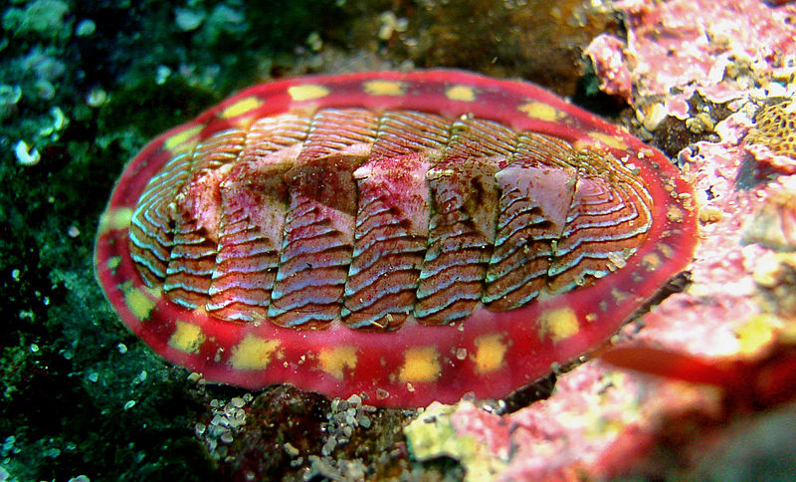
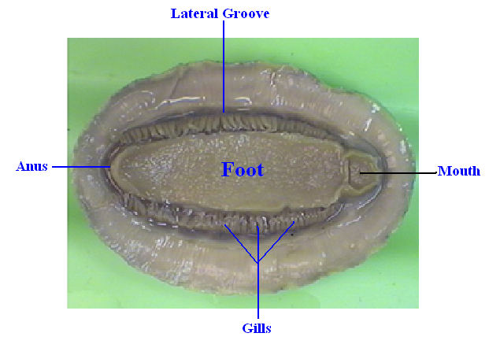

Slide 15
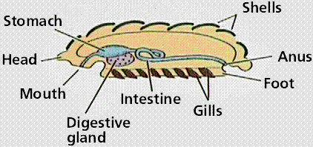
About 80 bipectinate (double-combed) ctenidia (gills) hang down from the roof of each lateral groove.
The flow of water current over the gills is in opposite direction to the flow of blood. This is called counter current exchange system.
The foot extends along the entire ventral surface and is completely covered by the shell.
Locomotion is by waves of muscular
contraction (called pedal waves).
Digestive system is linear; mouth
and anus are at opposite directions.

Slide 16
They feed usually on algae by means of the radula (some are carnivorous).
A pair of pharyngeal glands (called sugar glands) releases amylase-containing secretions into the stomach.
Chitons have fossil records extending back some 500 million years.

Slide 17
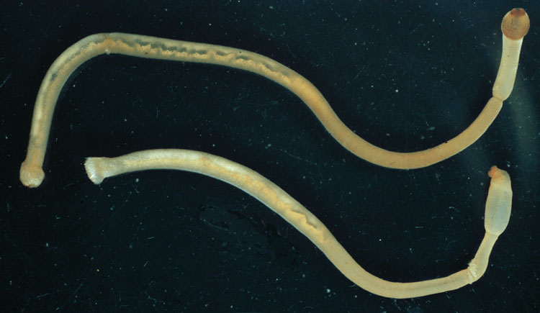
2) Class Aplacophora
Aplacophora: G: Not-shell-bearing.
Defining Characteristic: Cylindrical, vermiform body with the foot forming a narrow keel.
These are vermiform molluscs (about 320 species).
Found in all oceans, mostly in deep waters.
Most species are very small (few mm long and rarely more than few cm).

Slide 18
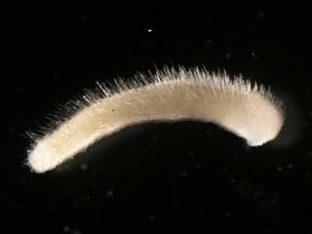
Body is unsegmented and bears numerous calcareous spines or scales embedded in an outer cuticle.
Have no true shell.
Have a radula and a small posterior mantle cavity.
Have no clear foot.

Slide 19
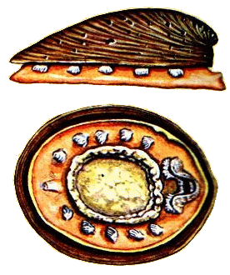
3) Class Monoplacophora:
Monoplacophora: G: One shell bearing.
Defining Characteristics:
3-6 pairs of ctenidia, 6-7 pairs of nephridia.
Multiple (usually 8) pairs of foot (pedal) retractor muscles.

Slide 20
19 living species, all are marine and live in deep water (>2000m).
A single, unhinged, cap-shaped shell is present.
Shell is flattened rather than spiral.
Shell length ranges between 1 mm- 37 mm.
The foot is flattened and covers much of the ventral surface.
The mantle cavity takes the form of 2 lateral grooves, within which 3, 5 or 6 pairs of gills are found

Slide 21
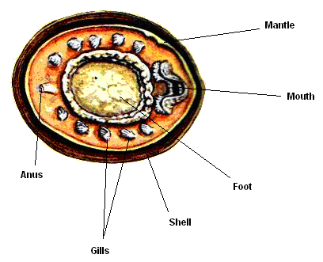
Have radula and a linear digestive system.
Mouth opens anterior and anus posterior.

Slide 22
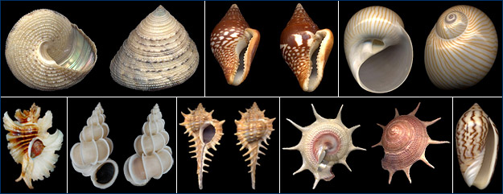
4) Class Gastropoda:
Gastropoda: G: stomach-foot.
Defining Characteristics:
Visceral mass and nervous system become twisted 90-180º (Torsion) during embryonic development.
Proteinaceous shield on the foot (operculum).

Slide 23
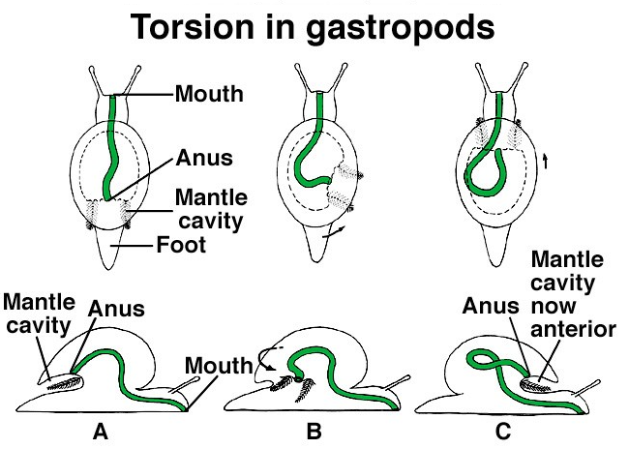

Slide 24
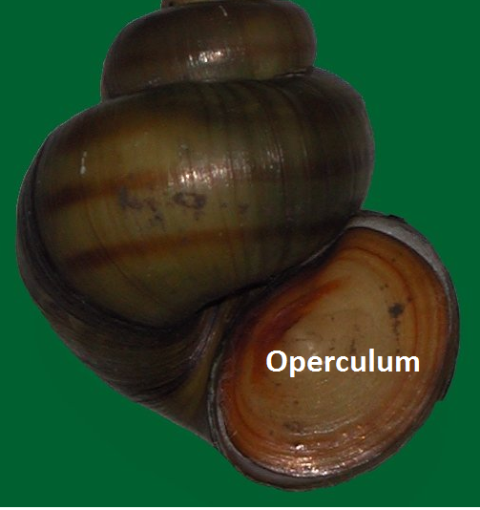

Slide 25
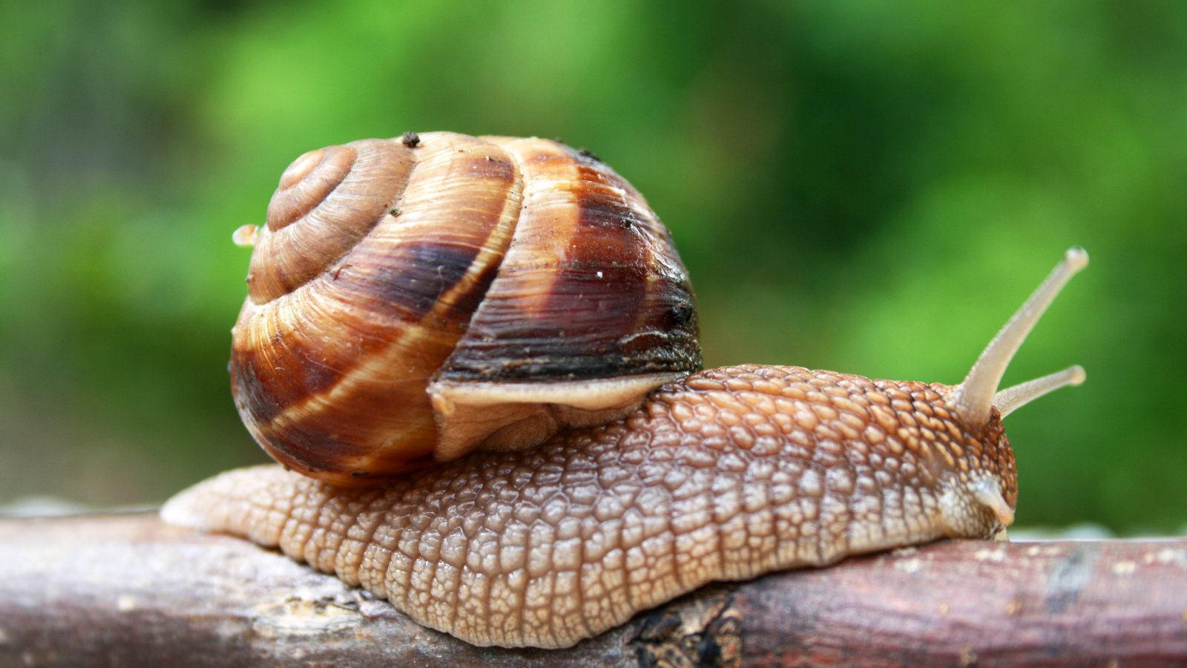
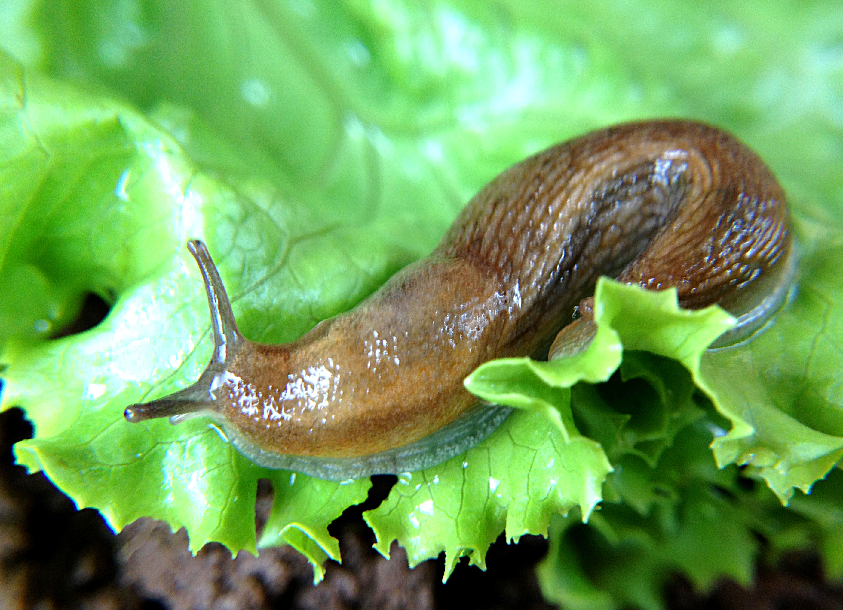
The largest class of molluscs comprising 40,000 species of snails and slugs.
A snail A slug

Slide 26
Found in freshwater, marine and terrestrial environments.
Their feeding habits are diverse: suspension-feeders, carnivorous, herbivorous, deposit-feeders and ectoparasitic species.
The typical snail consists of a visceral mass (all internal organs) sitting atop a muscular foot.
Shell size ranges between 1 mm- >60 cm.

Slide 27
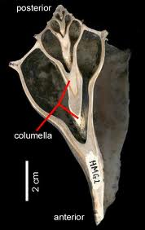
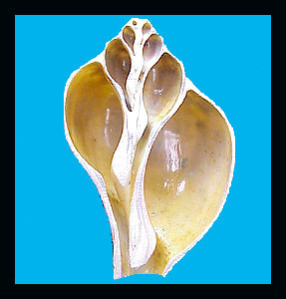
The animal is attached to the inside of its shell by a columellar muscle.
The shell has a central axis called columella.

Slide 28
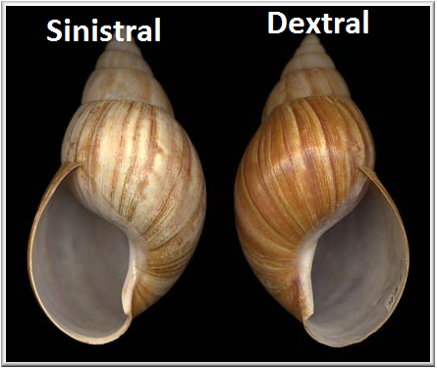
Shells of most gastropods coil to the right (clockwise) and called dextral (dextro: right hand side).
Other shells which coil to the left are called sinistral (sinister: left hand side).

Slide 29
After torsion, some gastropods exhibit detorsion.
Other gastropods exhibit limited torsion (90º only).
Significance of torsion is not clear.
Movement:
Most gastropods move by pedal waves of foot muscle contractions.
Small gastropods move by the
action of cilia on the ventral surface of the foot.

Slide 30
Class Gastropoda includes 3 subclasses:
1) Subclass Prosobranchia:
Prosobranchia: G: anterior-gills.
Defining Characteristic: Mantle cavity generally anterior, due to torsion.
The largest among the 3 subclasses (20,000 species).
Includes mostly marine species (few freshwater or terrestrial).
Feeding habits are diverse: herbivores, deposit-feeders, omnivores, suspension-feeders or carnivorous.

Slide 31
Members of this subclass are considered the most primitive gastropods (thought to be ancestor for the other 2 subclasses).
Most species have a well-developed shell, mantle cavity, osphradium and radula.
The typical prosobranch gill is a ctenidium consisting of a series of flattened, triangular sheets (filaments) lying one adjacent to the next.

Slide 33
Water enters the mantle cavity through a cylindrical canal called the siphon.
Gills are primitive (bipectinate)=gill filaments extend from both sides of the ctenidial axis.
Members of other advanced gastropods have monopectinate gills.

Slide 34
2) Subclass Opisthobranchia:
Opisthobranchia: posterior gill
Defining Characteristic: Mantle cavity lateral or posterior due to detorsion (or it could be lost).
Includes: sea hares, sea slugs.
Contains mainly marine species (2000 spp).

Slide 35
Examples:
Sea Slugs: nudibranchs
Sea Hares

Slide 36
Most species have evolved other respiratory structures, like the colored dorsal projections called cerata in sea slugs (nudibranchs).
Others have feathery gills arising from dorsal surface.

Slide 37
Head bears, in addition to 1 pair of tentacles, a second pair of chemoreceptors called rhinophores (analogous to osphradium in prosobranchs).

Slide 38
Movement:
Movement is generally by means of cilia and pedal waves of muscle contraction.
Some, like sea hares, can swim by flapping lateral folds of the foot called parapodia.

Slide 39
3) Subclass Pulmonata:
Pulmonata: L: Pulmo: Lung.
Defining Characteristic: Mantle cavity highly vascularized and modified to form a lung.
About 17,000 species. Mostly terrestrial or freshwater (only few marine).
Lung has a single opening called pneumostome (G: lung-opening), through which air and water flow.

Slide 41
Snails have a coiled shell while slugs have their shell either reduced, internalized or completely lost.

Slide 42
Most have a long radula (herbivores).
Head commonly bears 2 pairs of tentacles.
Torsion is limited to about 90º.

Slide 43
5) Class Bivalvia (=Pelecypoda):
Bivalvia: L: two-valved; Pelecypoda: G: hatchet-foot.
Defining Characteristics:
Two-valved shell.
Body flattened laterally.
Contains over 7000 species like: clams, scallops, mussels and oysters.
Bivalves are primarily marine (10-15% freshwater, no terrestrial).

Slide 44
Scallops
Clams

Slide 45
Oysters
Mussels

Slide 46
Major characteristics include:
A hinged shell: the 2 valves are jointed together by a hinge ligament.
Lateral compression of the body and foot.
Lack of cephalization (loss of head and associated organs).
A spacious mantle cavity.
Sedentary life style.
Absence of radula and odontophore complex.

Slide 47
Body structure:

Slide 48
Shell structure:

Slide 49
Based on gill structure, bivalves can bee subdivided into three subclasses as follows.
1) Subclass Protobranchia:
Protobranchia: G: First-gill.
Gills small, functioning primarily as gas exchange surfaces (do not function in food collection).
Have one pair of bipectinate gills inside the mantle cavity.
All are marine and live in soft substrates.

Slide 50
Feeding habit: Deposite feeders
Food collection is achieved through mucus on palp proboscides: long, thin, muscular extensions of the tissue surrounding the mouth.
2) Subclass Lamellibranchia:
Lamellibranchia: G: plate gills
Gills modified to collect suspended food particles, in addition to serving as gas exchange surfaces.
Secretion of Proteinaceous attachment material (byssal threads) by a specialized gland (the byssus gland) in the foot.

Slide 51
The largest subclass.
Most species are marine (all freshwater species belong to this subclass).
These are important as sea food (oysters and scallops), and a source of pearls
Feeding habit: filter feeders
Stomach is connected with a larger digestive gland (digestive diverticula), which serves as the major site of digestion and absorption.

Slide 52
3) Subclass Septibranchia:
Septibranchia: G: fence gill.
Defining Characteristic: Gills highly modified to form a muscular septum, which pumps water through the mantle cavity for respiration and feeding.
This is a small group (a few hundred species) of carnivorous bivalves that feed on small planktonic animals (Zooplankton) and on pieces of decomposing animal tissue.
All are marine and deep water organisms.

Slide 53
6) Class Scaphopoda:
Scaphopoda: G: Spade foot
Defining Characteristics:
Tusk-shaped, conical shell, open at both ends.
Development of anterior, thread-like, adhesive feeding tentacles.

Slide 54
Body structure:

Slide 55
Includes 300-400 species that are all marine.
They are sedentary and deep sea organisms.
They have the typical molluscan features: foot, mantle, mantle cavity, radula and shell.
The shell is never spiral, but rather grows linearly as a hollow, curved tube (tusk shell).

Slide 56
7) Class Cephalopoda:
Cephalopoda: head foot
Defining Characteristics:
Closed circulatory system.
Foot modified to form flexible arms and siphon.
Ganglia fused to form a large brain encased in a cartilaginous cranium.

Slide 57
Octopus
Squid
Nautilus

Slide 58
Includes: squids, octopuses and Nautilus. (600 species).
Exclusively marine, fast-moving and carnivorous organisms.
The largest cephalopod weighs about 1000kg and reaches a length of 18 m, while the smallest is less than 2 cm long.
All have ctenidia, radula, mantle cavity and foot.
Head and associated organs are well-developed.

Slide 59
Only 5-6 species of the genus Nautilus possess a true external shell.
Shell is spiral, but unlike that of gastropods, it is divided by septa into a series of compartments.
The living animal is found only within the largest outermost chamber.

Slide 60
Skin of most cephalopods has chromatophores which help organisms in camouflage.
Many have photophores that produce light (bioluminescence).

Slide 61
Octopus and squid have an ink sac, used to confuse potential predators.

Slide 62
Mantle cavity contains a pair of ctenidia.
They have a closed circulatory system with 2 hearts: systemic and branchial.
The mouth is found surrounded by 8 or 10 arms.
Have a high degree of cephalization (concentration of sensory and nervous tissue at the anterior end of the animal).
Cephalopods have a large, complex, highly differentiated brain.

Slide 63
Each cephalopod has 2 eyes.
Eyes of all octopuses and squids are image-forming and have a lens. They are similar to vertebrate eyes.
Eyes of Nautilus are image-forming but lack lens.
End of Chapter 12

