Slide 1
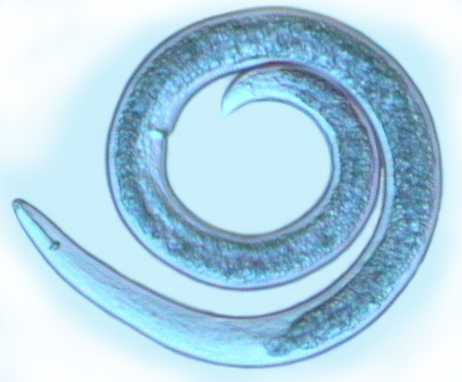
Invertebrate Zoology (Biol 242)
Chapter 13
The Nematodes

Slide 2
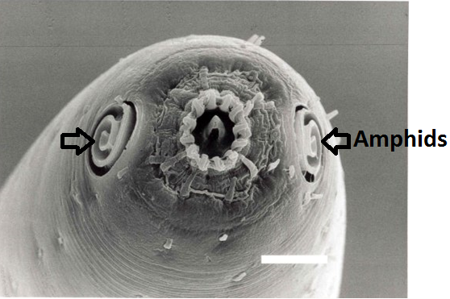
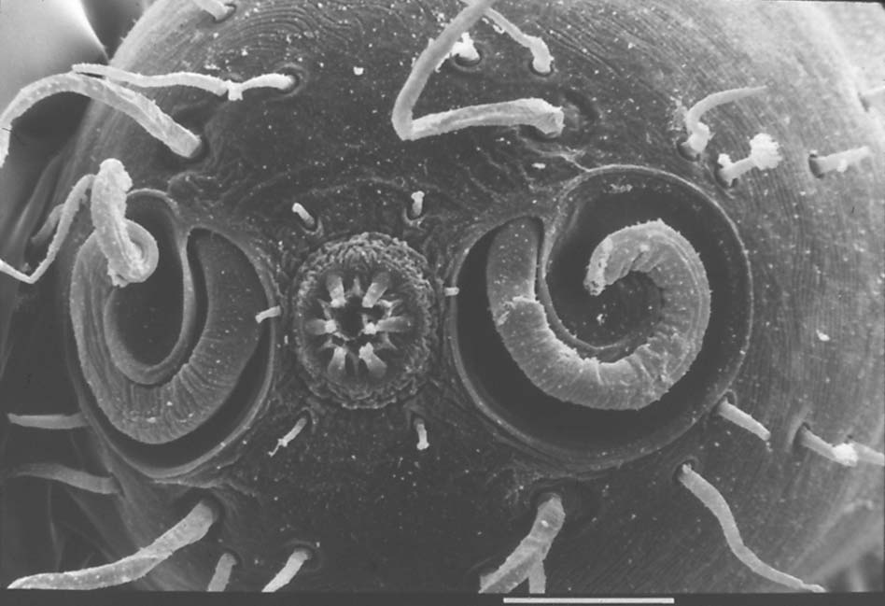
Nematoda: G.= Thread
Defining Characteristic:
Paired lateral sensory organs (amphids) on the head, derived from the cilia and opening to the outside through a small pore.

Slide 3
General Characteristics:
Nematodes are widely-distributed, unsegmented, acoelomate (mostly) and pseudocoelomate worms.
Nematodes are usually small in size (1-2 mm long).
Body is tapered (pointed) at both ends.
They could be found in high densities in sediments of aquatic habitats (1-4 Million/m²).
Live in aquatic and terrestrial habitats. (16,000 species)
Free living and parasites (of vertebrates, invertebrates and plants).

Slide 4
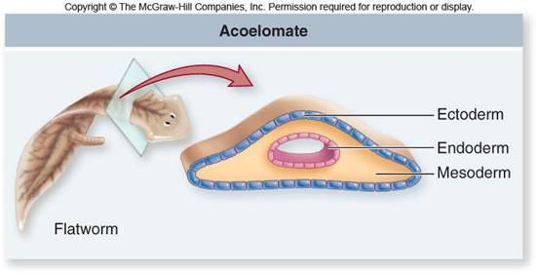
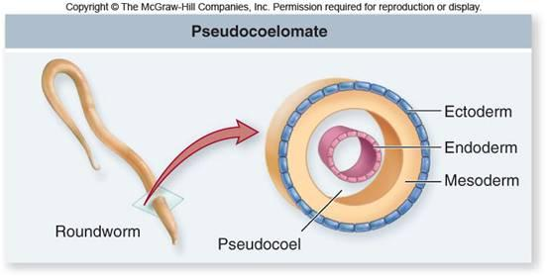
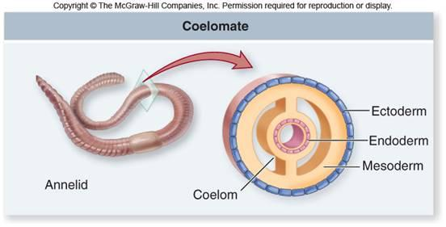

Slide 5
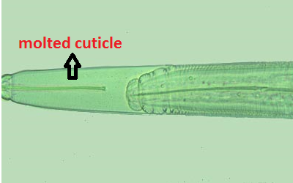
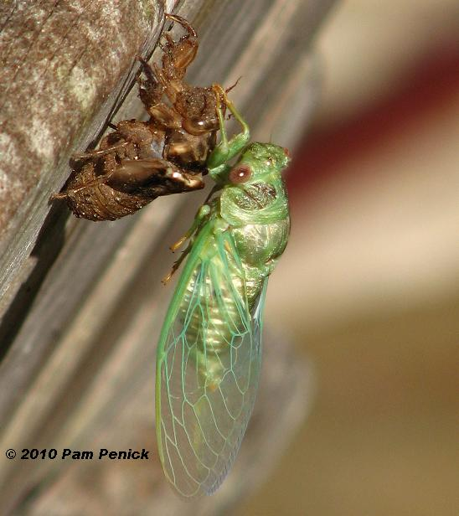
Considered close to arthropods because they molt their cuticle (like arthropods).
They are grouped together as Ecdyzoans (molting-animals).

Slide 6
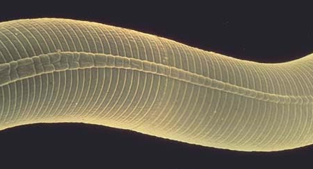
Body covering and body cavities:
Body is covered by a thick, multilayered cuticle (a noncellular covering) of collagen secreted by the underlying epidermis.
Cuticle is permeable to water and gases and selectively permeable to some ions and organic compounds.
Cuticle is shed (molted) 4 times from the juvenile to the adult stage.

Slide 7
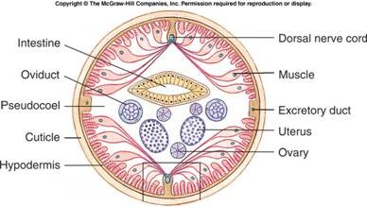
The epidermis is often syncytial.
Nematodes (unlike most arthropods) continue to grow between moltings. However, increase in size is due to increase in cell size and not #.
Cell # in adults is constant (this is called eutely).

Slide 8
Musculature, internal pressure and locomotion:
Movement of nematodes is limited by:
Body wall of nematodes contains no circular muscles. This puts limits on locomotion of nematodes, because peristaltic waves of muscle contractions cannot be generated.
The high internal hydrostatic pressure of some nematodes limits the movement ability of the nematodes.
The cuticle is rigid (cannot expand).

Slide 9
The high internal pressure gives the nematodes a very circular cross section.
Cilia are lacking.
So, nematodes must move by undulating the body into sinusoidal waves. (Through alternating contractions of the longitudinal muscles of the dorsal and ventral surfaces of the body).

Slide 10
Muscle contraction is under the control of a simple nervous system consisting of:
  1) An anterior brain (nerve ring + associated ganglia).
  2) Four or more major longitudinal nerve cords (dorsal, ventral and at least 1 pair lateral).

Slide 11
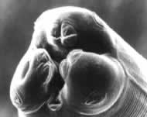
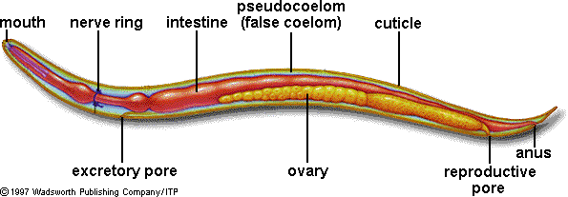
Organ Systems and behavior:
Digestive system:
Digestive system of nematodes
is linear with mouth (stoma) at the anterior end.
Mouth (anterior)→ a muscular pharynx→ intestine→ rectum → anus (posterior).

Slide 12
The muscular pharynx pumps fluids into the digestive system, preventing the digestive system from collapsing because of the high body pressure that surrounds it.
Pharynx also secretes lubricants and digestive enzymes.
Digestion is mainly extracellular and absorption takes place through the thin-walled intestine.

Slide 13
  Respiration circulation and excretion:
No specialized organs for gas exchange (simple diffusion).
No specialized circulatory system and no nephridia.
    Metabolic wastes are discharged with other materials leaving the gut through the anus.
    Some metabolic wastes may diffuse through body wall.
    Most nematodes have an excretory gland called renette.

Slide 14
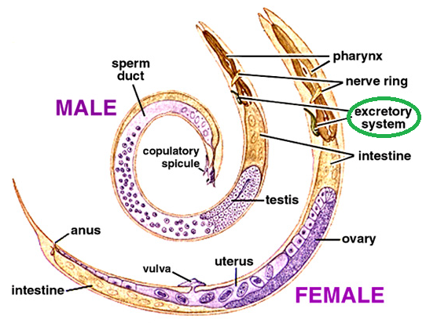

Slide 15
      Sensory organs:
  Various species are known to respond to temperature, light, mechanical stimuli and a variety of stimuli including chemicals produced by other individuals of the same species (pheromones).
  Many species have ocelli.
  However, the major chemosensory organs are the amphids.
Similar structures of chemoreception are found posteriorly of some nematodes and called phasmids.

Slide 16
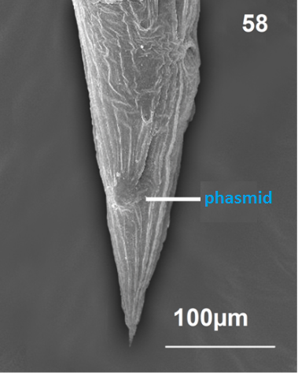
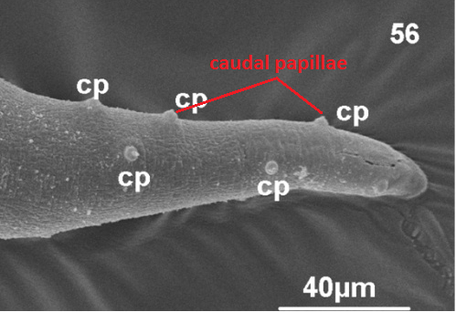
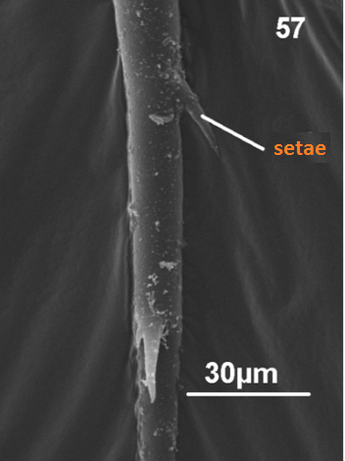
  Cephalic (anterior) and caudal (posterior)
  papillae are found and thought to be structures
  sensitive for mechanical stimulation.
  Many species have external setae at various
  location of the body; these are thought also to be mechanoreceptors.

Slide 17
Reproduction & Development:
  Most nematodes are gonochoristic (separate sexes).
  Fertilization is internal (through copulation).
  Typically, males possess 1-2 copulatory spicules posteriorly that are inserted into the female gonopore during sperm transfer.
  Sperms of nematodes are amoeboid rather than flagellated.
  Lack free-swimming larvae (Fertilized eggs give rise to miniature worms).

Slide 18
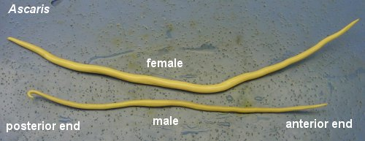
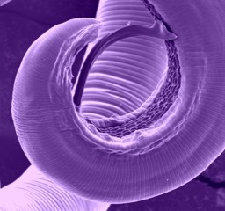
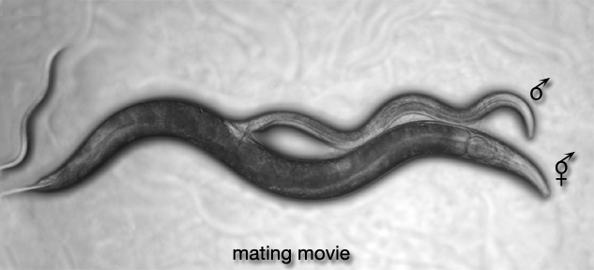

Slide 19
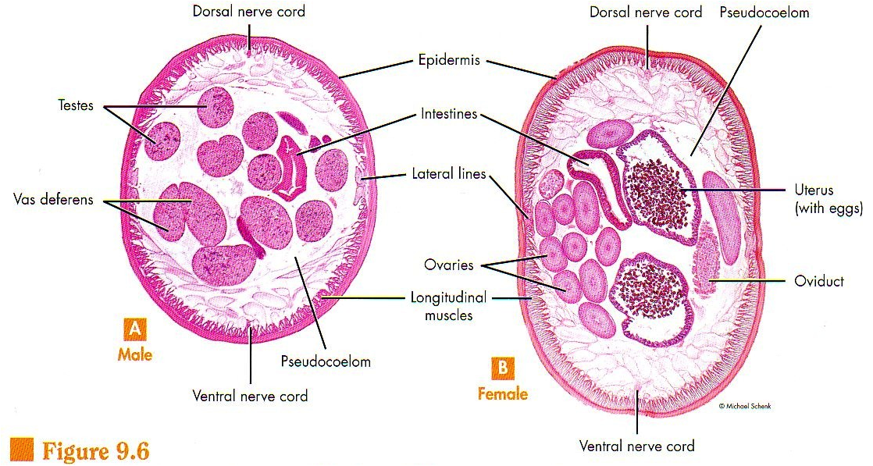

Slide 20
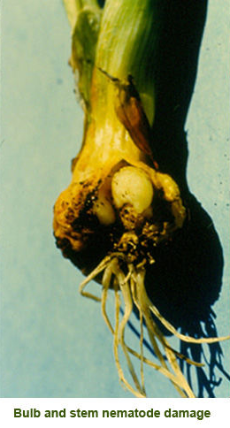
Parasitic nematodes:
  Nematodes parasitize every major animal group (from sponges to mammals).
  Nematodes are also parasites of plants (roots, leaves, stems and flowers).
  They can cause serious damage to economically important plants.
  Some parasitic nematodes can attain large size (9 m in the placenta of female sperm whales).

Slide 21
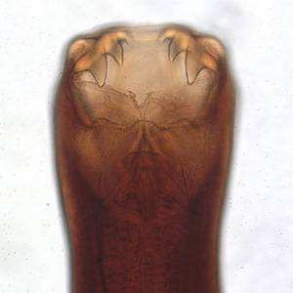
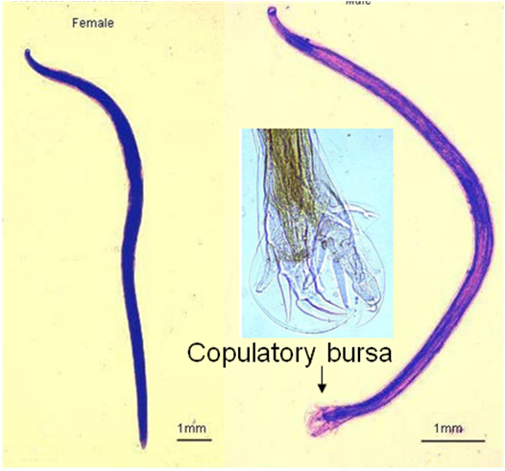
  Hookworms and pinworms are two main groups of parasitic nematodes.
  Hookworms include Ancylostoma duodenale and Necator americanus.
  Some hookworms can suck 0.6 ml/day of the host blood (this means loss of 60 ml of blood from a person infected with 100 worms).

Slide 22
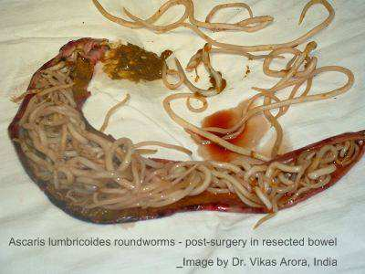
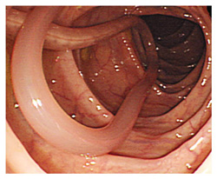
Some Ascarid nematodes, like Ascaris, can block the intestine or the bile duct of the host.
Parasitic nematodes can produce huge amounts of eggs (a female Ascaris can produce 200,000 fertilized eggs/day).

Slide 23
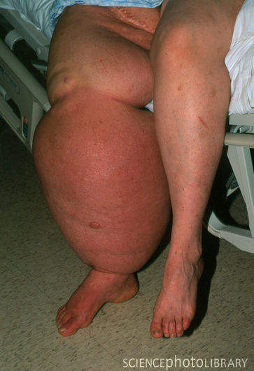
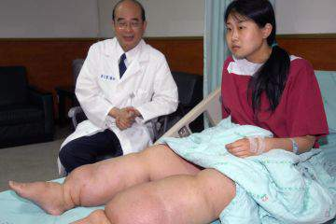
  Others, roundworms, like Wuschereria and Onchocerca, can plug the lymphatic system causing a disease called elephantiasis.

Slide 24
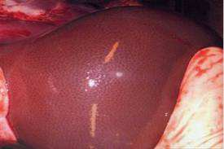
  Many nematodes make extensive migration during their development within the host: from intestine→ liver→ heart→ lungs→ esophagus→ back to intestine.
This causes damage to these organs.
Ascaris in the liver of a pig

Slide 25
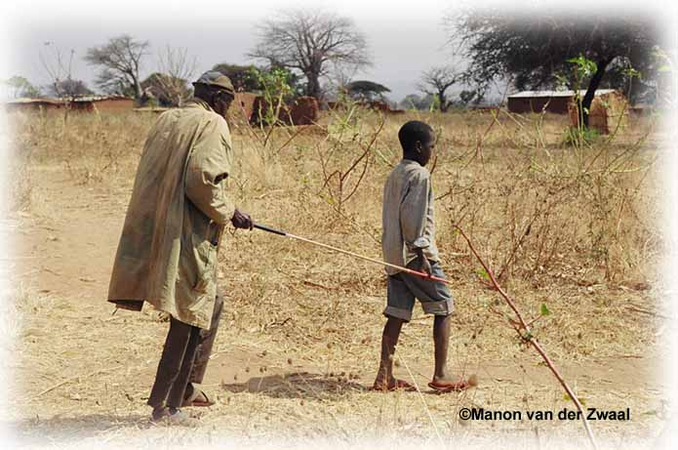
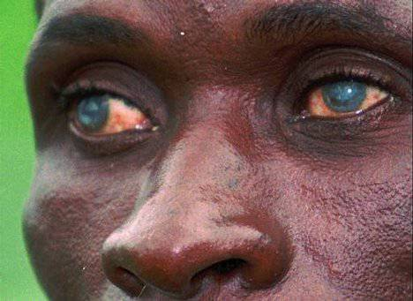
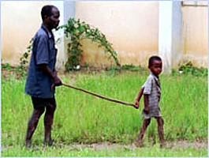
  Larvae of Onchocerca often migrate to the victim’s eye causing blindness (This is called River Blindness or onchocerciasis).
  River blindness infects about 40 million people mostly in western Africa.

Slide 26
Examples of Parasitic Nematodes:
Ascaris lumbricoides
The largest intestinal roundworm and is the most common helminth infection of humans worldwide, a disease known as ascariasis.
Causes malnourishment, intestinal blockage, verminous intoxication.

Slide 27
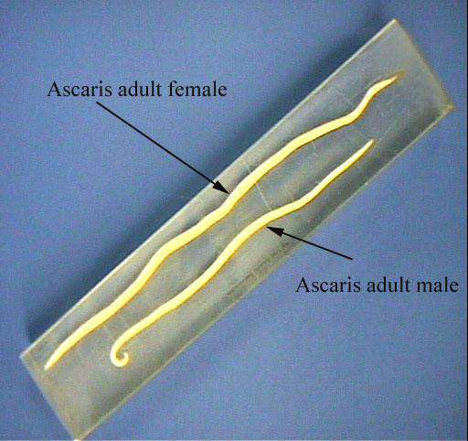
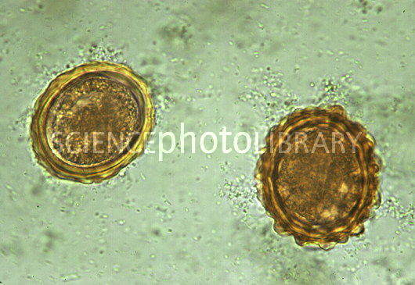

Slide 28
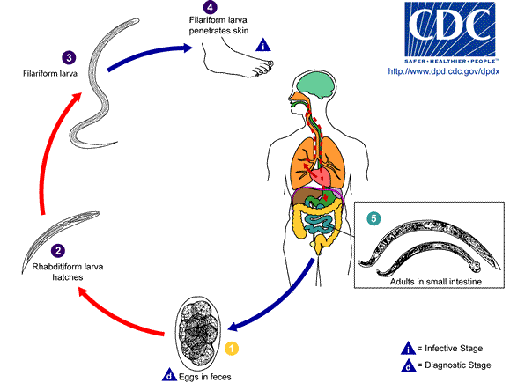
2) American Hookworm: Necator Americanus:
      Infects about 1.3 billion people worldwide.
      Has a simple life cycle with a single host (human).
      Lives in the host’s intestine.

Slide 29
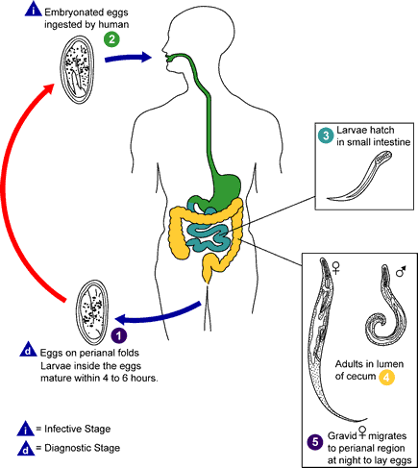
3) Pinworm: Enterobius vermicularis;
      Infects in temperate regions about 500 Million people mainly children.
      Life cycle involves no intermediate host.
      Lives in the large intestine and the colon.

Slide 30
4) The guinea worm: Dracunculus medinensis.
Found in Africa, South America and Western Asia.
The female is about 1mm thick and 1m or more long
It lives subcutaneous of humans (beneath the skin).
It releases an ulcer-producing secretion to make a small hole in the skin.
When skin comes in contact with water (bathing or swimming), the female ejects a considerable # of young (1.5 x 107/day).

Slide 31
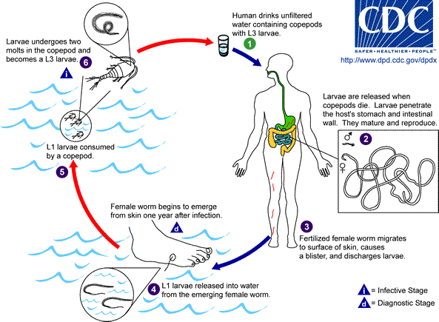
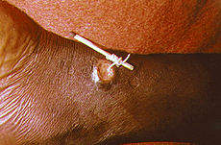

Slide 32
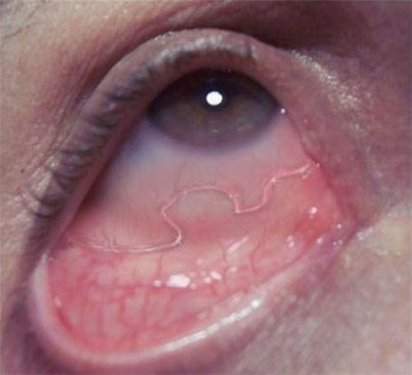
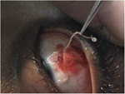
5) Loa loa (the African eye worm):
      A filarial nematode that produces a characteristic infective stage called microfilaria.
      Exhibit a complex life cycles that include an arthropod intermediate host and extensive migration within the definitive host.

Slide 33
Beneficial nematodes:
Some nematodes that require insects and various agricultural pets are increasingly used to control population size of these pets.
Most nematodes are free-living (nonparasitic) detritivores that play a valuable role in cycling of materials in ecosystems.
Some free-living nematodes serve as food for aquaculture animals like: fish, shrimps…

Slide 34
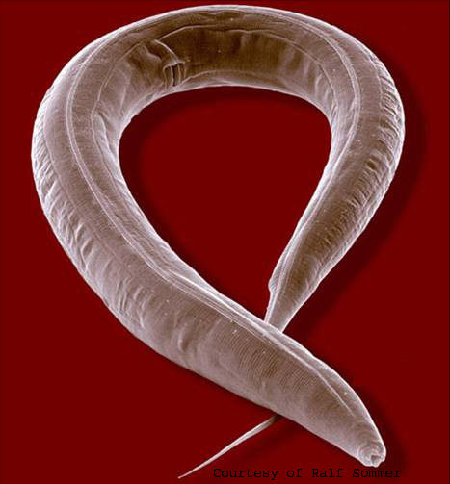
Many are used to monitor environmental pollution.
Some, like Caenorhabditis elegans, are used in genetics and molecular biology research because they have few chromosomes.

Slide 35
Classification of Nematodes:
Phylum Nematoda (Nemata) includes 3 classes.
1) Class Enoplia
    Free-living and predatory nematodes
    Terrestrial, freshwater and marine.
    No parasitic species.
    Example: Trichoris
    2) Class Dorylaimia
    Includes many free-living species and a number of plant and animal parasites.
    No marine species.
    Example: Trichuris trichuis (whipworm)
    Trichinella spiralis

Slide 36
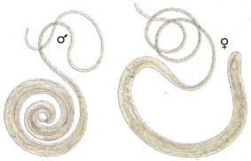
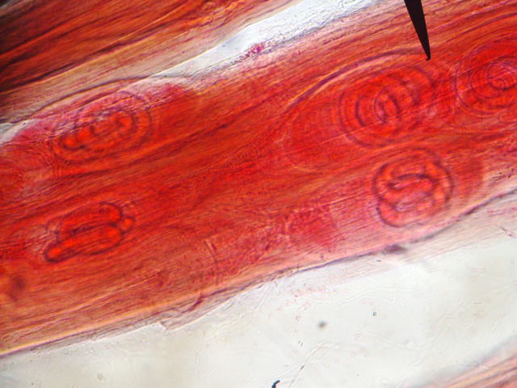
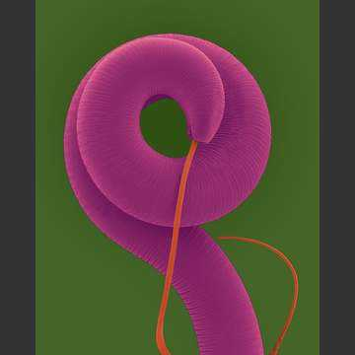
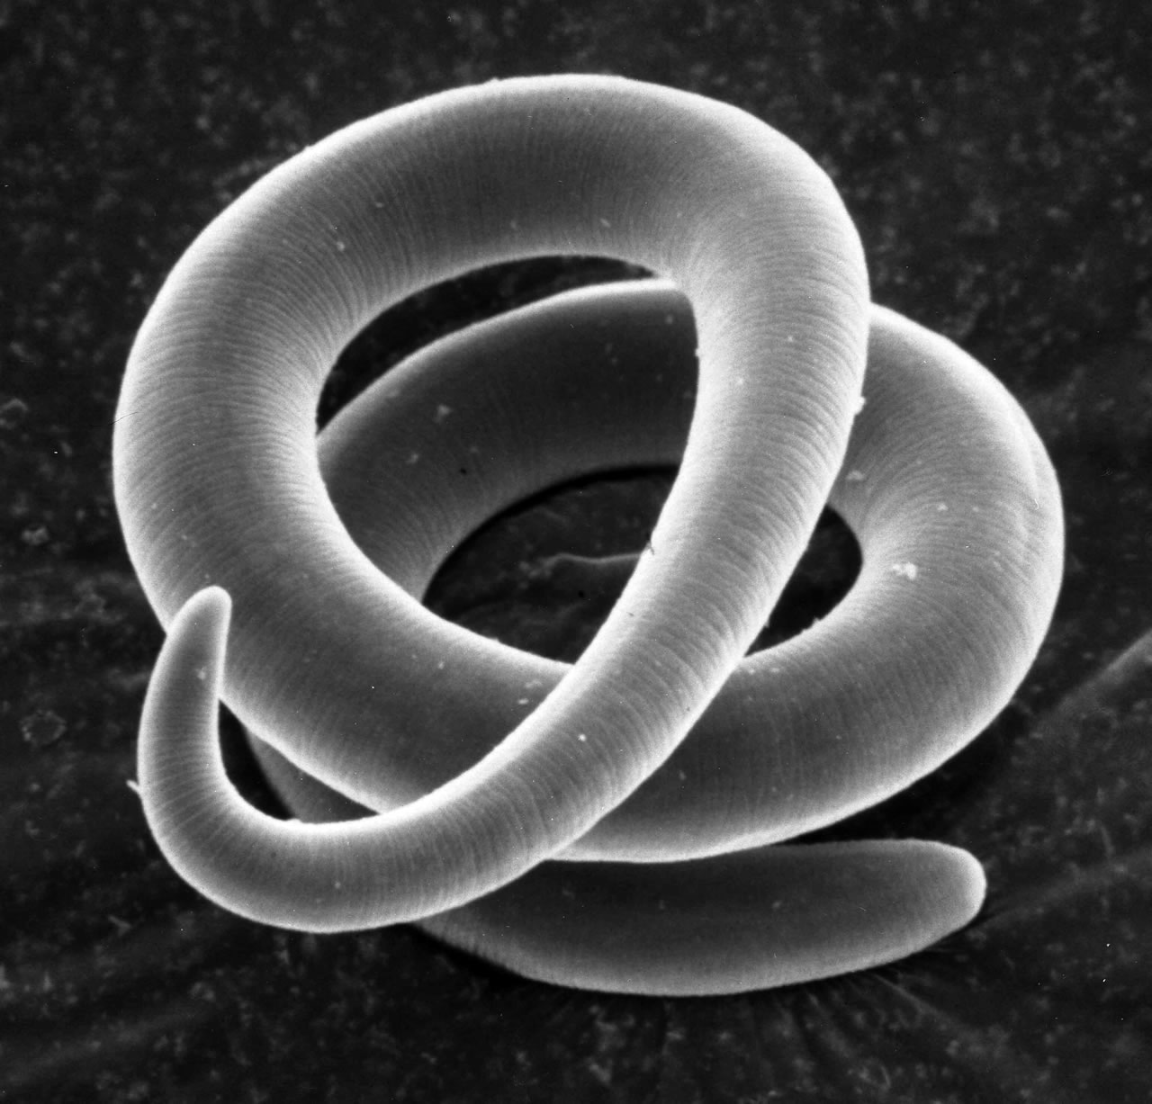
Trichuris
Trichinella

Slide 37
3) Class Chromadoria
    A huge group of great diversity
    Includes mostly free-living, terrestrial species and many marine and freshwater ones.
    Includes some parasitic species.
    Ascaris, Enterobius, Necator, Ancylostoma, Wuchereria, Brugia, Onchocerca, Loa, Dracunculus.
End of Chapter 16

