Slide 1
Chapter 3
Kingdom Protozoa
The Protozoans
(الحيوانات الأولية)

Slide 2
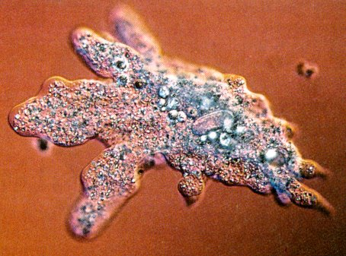
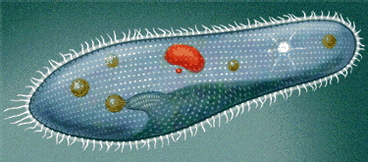
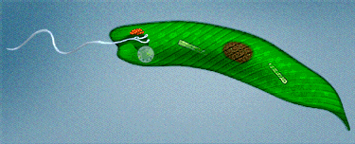
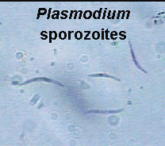
Protozoan: (Latin) = Proto: the very first Zoa : animals
Defining Characteristics:
- All are unicellular and eukaryotic lacking collagen and chitinous cell walls.
- All are non-photosynthetic (Heterotrophic)

Slide 3
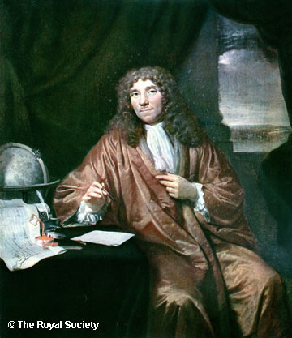
Includes about 30,000 extant species (+ 44,000 extinct)
Ancestors of animals (flagellated protozoons).
Most protozoans are microscopic (5-250 μm long).
They are important as primary producers, decomposes, causes of diseases, food for other invertebrates … etc.
Discovered اكتشفه by Leeuwenhoek (1674).

Slide 4
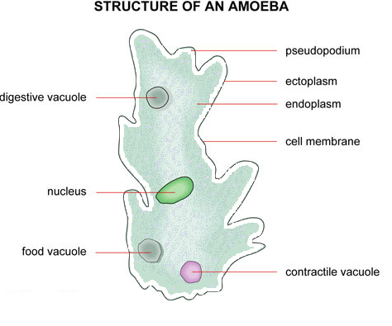
They occur where there is moisture.(تحدث حيث توجد الرطوبة ).
The body of protozoans is bound by a cell membrane.
Cytoplasm is like that in higher organisms except that it has 2 regions: ectoplasm and endoplasm.

Slide 5
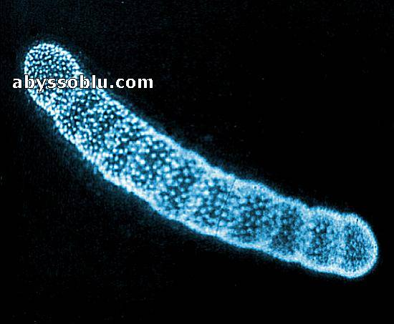
Many protozoan are colonial.
One organism divides asexually
to form a colony of attached,
genetically identical individuals.
This forms the start of multicellular life.
Have all organelles of cells of higher organisms.
In addition, they have organelles that are not found among metazoans e.g. contractile vacuoles, trichocysts and toxicysts.

Slide 6
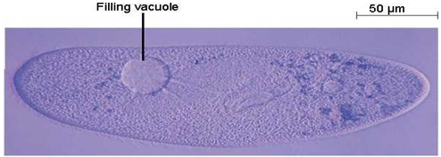
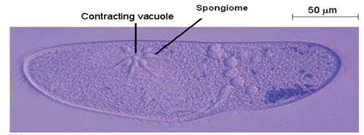
Contractile vacuoles:
Expel excess amounts of water from cytoplasm.
Fluid is collected by a system of vesicles & tubules called spongiome.

Slide 7
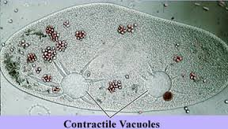
Contractile vacuoles are common in freshwater protozoans.
They function in volume & osmotic regulation.
Fill & discharge several times/ min.
One individual might have several vacuoles.

Slide 8
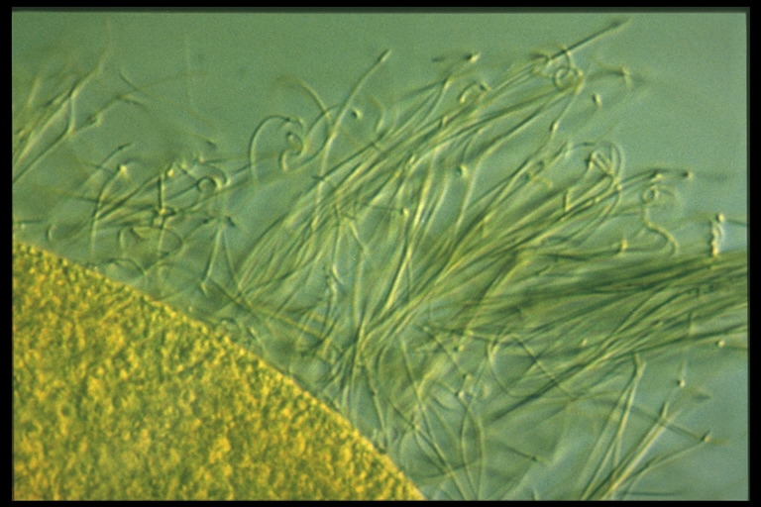
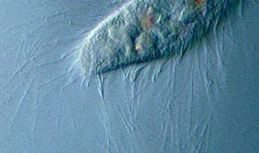
Trichocysts:
Develop within a membrane–bound vesicle inside the cytoplasm.
They have a long, thin filament that can be discharged very rapidly by mechanical and/ or chemical stimuli. لديهم خيوط طويلة رفيعة يمكن تفريغها بسرعة كبيرة عن طريق المحفزات الميكانيكية و / أو الكيميائية.
Functions: defense & anchorage.

Slide 9
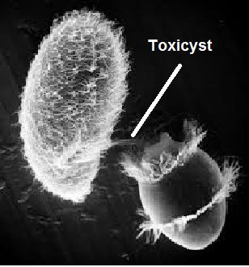
Toxicysts:
Similar to trichocysts but they are poisonous.
Involved in predation.
They paralyze the prey
& initiate digestion.

Slide 10
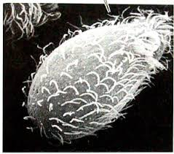
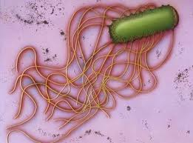
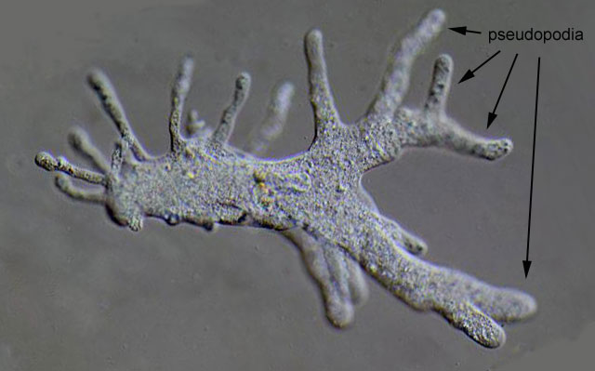
Protozoan Locomotion:
Most free living protozoa use one of the following locomotory organelles:
Cilia
Flagella
Pseudopodia

Slide 11
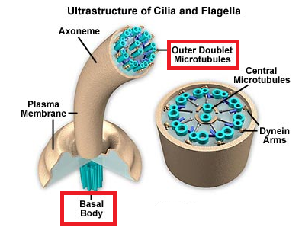
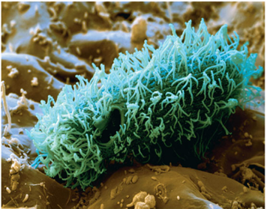
A) Cilia: structure and function
Cilia originate from basal bodies (kinetosomes).
Within cilia are microtubule rods composed of a protein called tubulin (similar to actin).

Slide 12
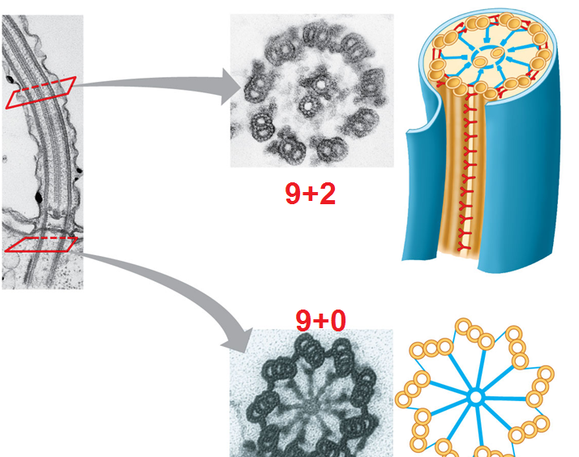
In a cross-section, cilia have a (9+2) arrangement in their part above the cell surface , and (9+0) below cell surface.
Arms of dynein project from microtubules these are similar to myosin.

Slide 13
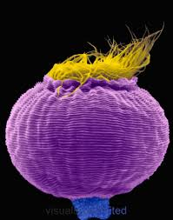
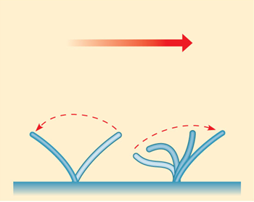
Cilia function in:
Locomotion
Help in food collection
Bringing oxygenated water towards the organism.
Ciliates are the fastest protozoans (speed=2mm/sec).

Slide 14
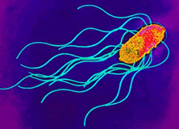
B) Flagella: structure & function:
Similar to cilia in structure and function
Flagella and cilia are called undulipodia.
Movement is fairly rapid (200 µm/sec).
This is 1/10 the speed of ciliates & 40 times faster than amoebas.

Slide 15
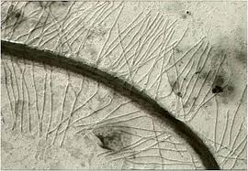
Unlike cilia,
Flagella have numerous hair-like projections called “mastigonemes”. These increase the surface area of the flagellum.
Flagella are usually longer than cilia.
The number of flagella is much less
than cilia.
Wave of movement may be initiated at the tip of the flagellum rather than the base.

Slide 16
C) Pseudopodia: Structure & function
Pseudopodia are characteristics of amoebae.
Movement by pseudopodia is extremely slow: (300 µm/min).
Functions of pseudopodia:
Locomotion
Food collection

Slide 17
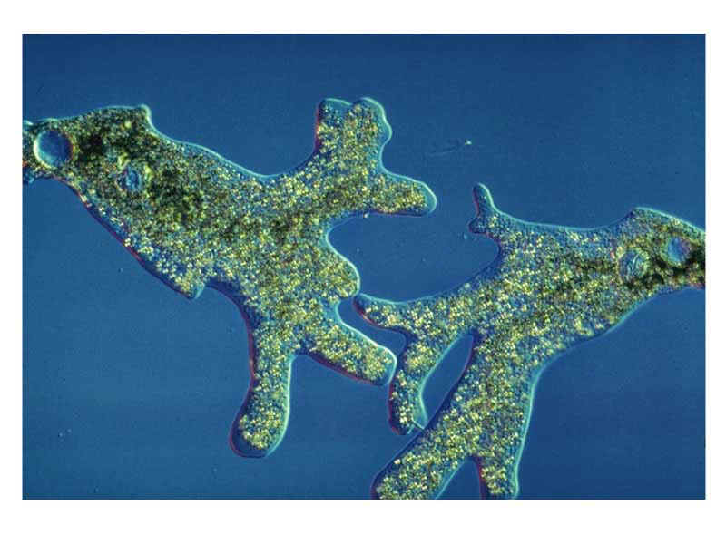
Types of pseudopodia:
1) Lobopodia: (Lobo: G: lobe)
Typical for the familiar amoeba.
Broad with rounded tips (like fingers).
Bear a distinct clear ectoplasmic area called the hyaline cap near the tip.
hyaline cap

Slide 18
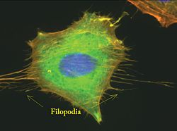
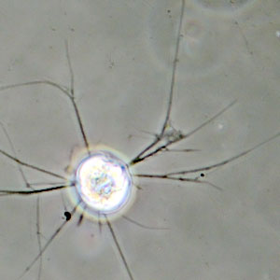
2) Filopodia: (Filo: L: Thread)
Very narrow (thread-like).
Lack a hyaline cap.
Often branched.

Slide 19
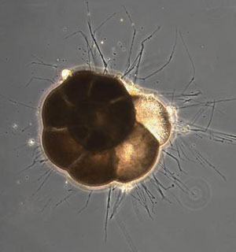
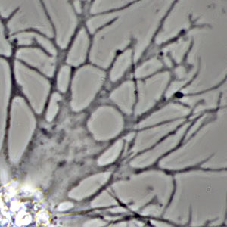
3) Reticulopodia (reticularia= L. a network)
Extremely thin, branched filaments.
Found in Foraminiferans.
Used mainly for feeding.

Slide 20
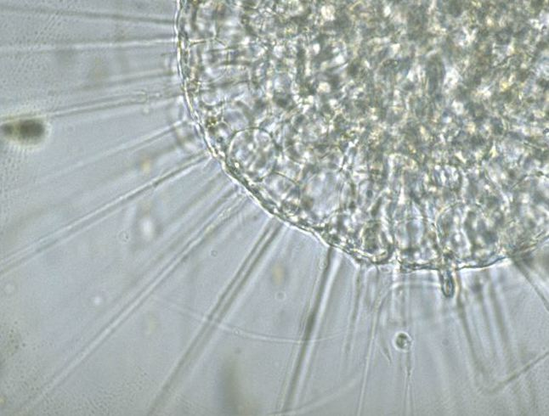
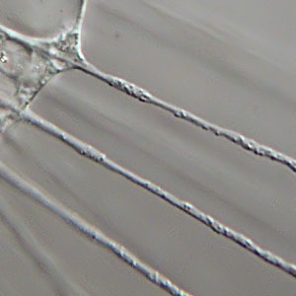
4) Axopodia (actinopodia): (axo: G: axle)
Radiate outwards along thin spines or microtubules.
Used for food collection

Slide 21
Protozoan reproduction:
A sexual reproduction is the most common type, although sexual reproduction occurs in almost all groups.
Asexual reproduction methods:
1) Fission (mitosis); could be:
a) binary (Longitudinal or Transverse).
b) multiple.

Slide 22
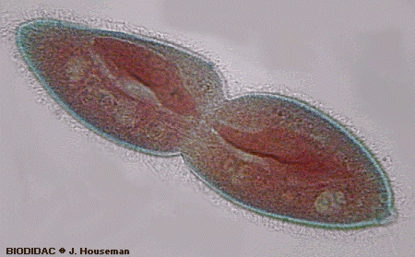
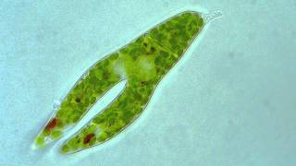
Transverse binary fission
Longitudinal binary fission

Slide 23
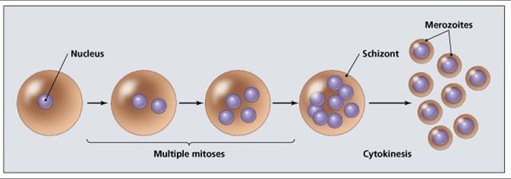
Multiple fission:

Slide 24
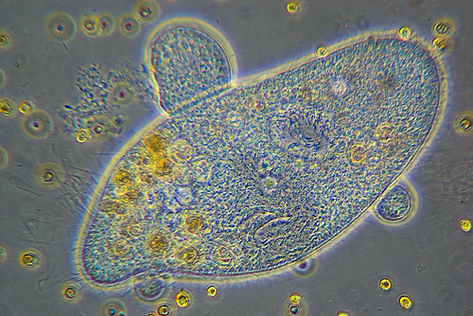
2) Budding:
After DNA replication, parent organism divides into two unequal parts:

Slide 25
Protozoa Feeding:
Protozoa feed by phagocytosis: forming food vacuoles (Phagosomes).
Vacuoles fuse with lysosomes & digestion starts under different pH values.
Soluble material diffuse outside the vacuole into the cytoplasm.
The undigested material is expelled by exocytosis.

Slide 26
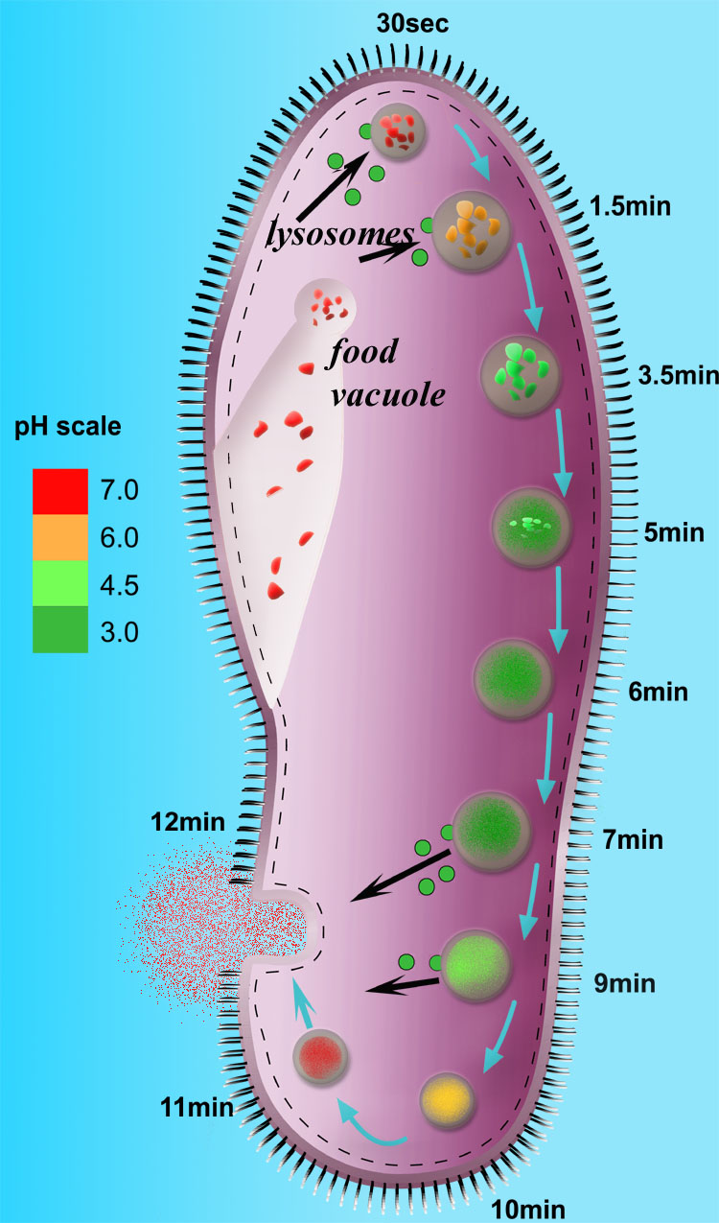
Endocytosis,
digestion
and exocytosis

Slide 27
Protozoan Classification
Kingdom protozoa is divided into
4 groups:
1) The Alveolata
2) The Amoebozoa
3) The Rhizaria
4) The Excavata

Slide 28
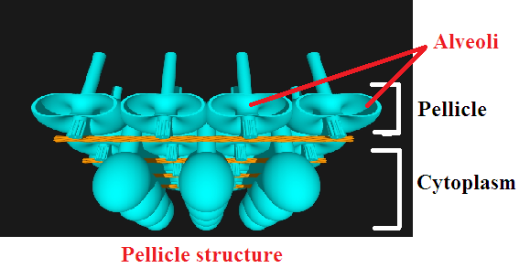
A) The Alveolate Protozoans (Alveolata)
A large and diverse group possessing very distinctive membrane-bound sacs (Alveoli) just below the outer membrane (pellicle).

Slide 29
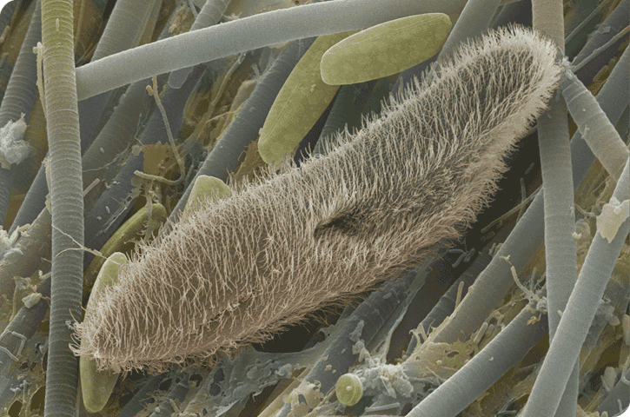
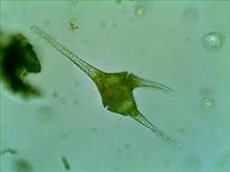
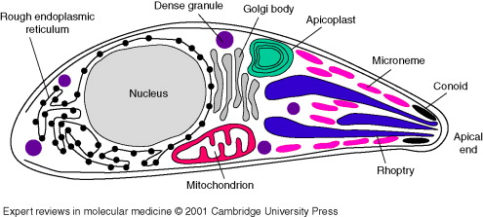
Includes 3 phyla:
Phylum Ciliophora
Phylum Dinozoa
Phylum Apicomplexa

Slide 30
1) Phylum Ciliophora
Ciliophora: G. Cilia-bearing
Defining Characteristics:
About 3500 species
Body externally ciliated in at least some life cycle stages.
All individuals possess at least one micronucleus and at least one macronucleus.
Examples: Paramecium, Stentor, Vorticella.

Slide 31
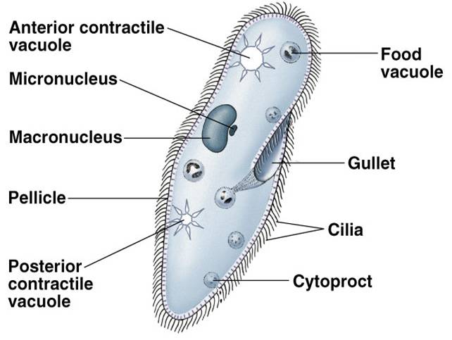
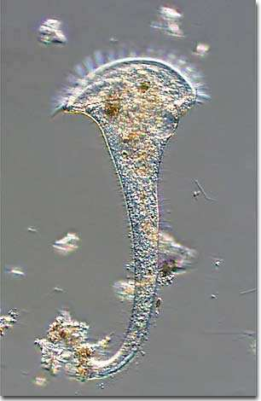
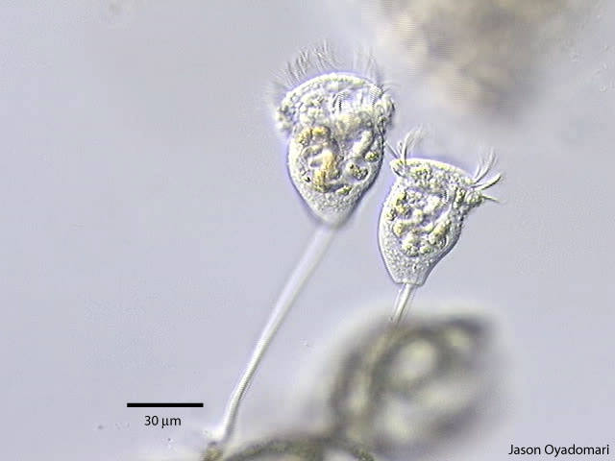
Paramecium
Vorticella
Vorticella
Stentor

Slide 32
Ciliates exhibit highest degree of sub-cellular specializations among protzoans (advanced).
Mostly free-living & uniform in body plan.
Ciliation could be partial (e. g Vorticella) or complete (e.g. Paramecium).
The mouth (cytostome) is ciliated to help in feeding.
Some sp. has a permanent opening to the outside cytoproct (procto = anus) for expelling undigested wastes.

Slide 33
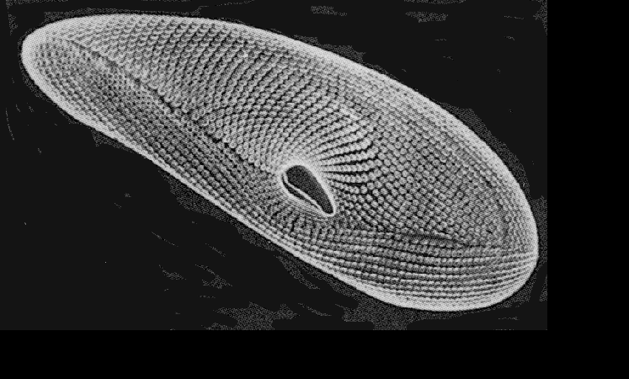
Ciliates have a series of membranes called pellicle.

Slide 34
Reproductive characteristics:
Each ciliate has 2 types of nuclei (dimorphic; heterokaryotic) (all other protozoans are monomorphic; homokaryotic).
Each ciliate contains one or more macronuclei & 1 ore more micronuclei (more abundant).
The macronucleus:
Polyploid
Contains both DNA + RNA
Controls daily activities (non reproductive)
Ciliates cannot live without it

Slide 35
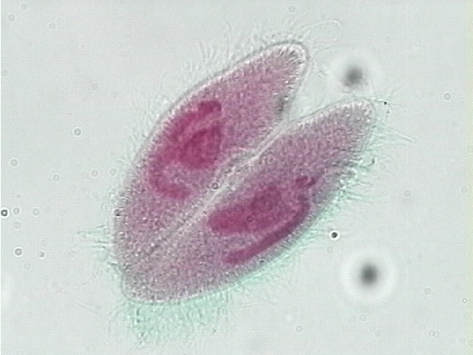
The micronucleus is:
Essential for sexual reproduction (Diploid).
Ciliates can live without it.
- Sexual reproduction of ciliates does not include gamete formation.
Instead, ciliates reproduce sexually by:
Conjugation: exchange of genetic material between 2 organisms.
Autogamy : sexual activity to produce new genotypes from one
individual.
لا يشمل التكاثر الجنسي للشركات العملاقة تكوين الأمشاج.
بدلاً من ذلك ، تتكاثر الشركات العملاقة جنسيًا عن طريق:
الاقتران: تبادل المواد الجينية بين كائنين.
Autogamy: النشاط الجنسي لإنتاج أنماط وراثية جديدة من واحد
فرد.

Slide 36
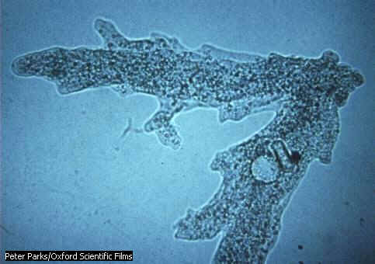
All ciliates can reproduce asexually by:
Transverse binary fission (other protozoans reproduce by longitudinal).
Budding

Slide 37
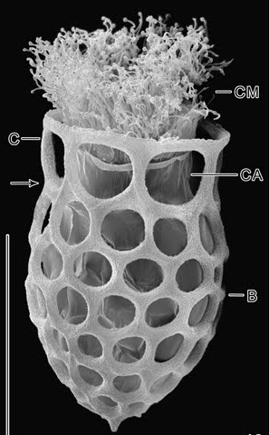
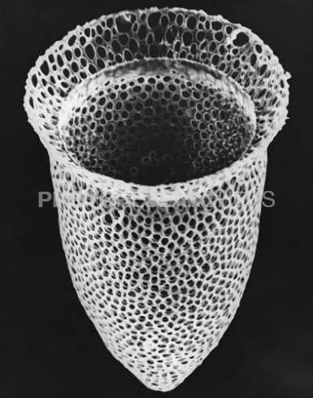
Ciliate life styles:
Most ciliates are free living and motile.
However, some are temporarily attached to surfaces and others are sessile.
All ciliates have pellicles, but some have an extra protective, rigid encasement called test or lorica (armor).

Slide 38
About 1/3 of ciliates are endosymbiotic in other invert & vertebrates.
Most free-living ciliates are holozoic: they ingest particulate foods.
Others may be raptorial: they hunt & ingest living prey.
Some may be passive suspension feeders (they are usually sedentary).
Commonly sedentary sp. have a stalk e.g. Vorticella.
The stalk may contain a spasmoneme (myoneme): a helical, membrane- bound bundle of contractile fibers.

Slide 39
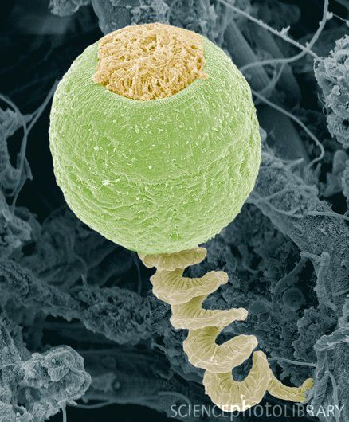
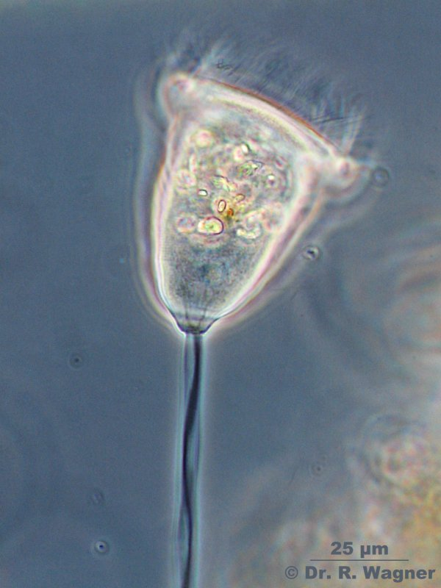

Slide 40
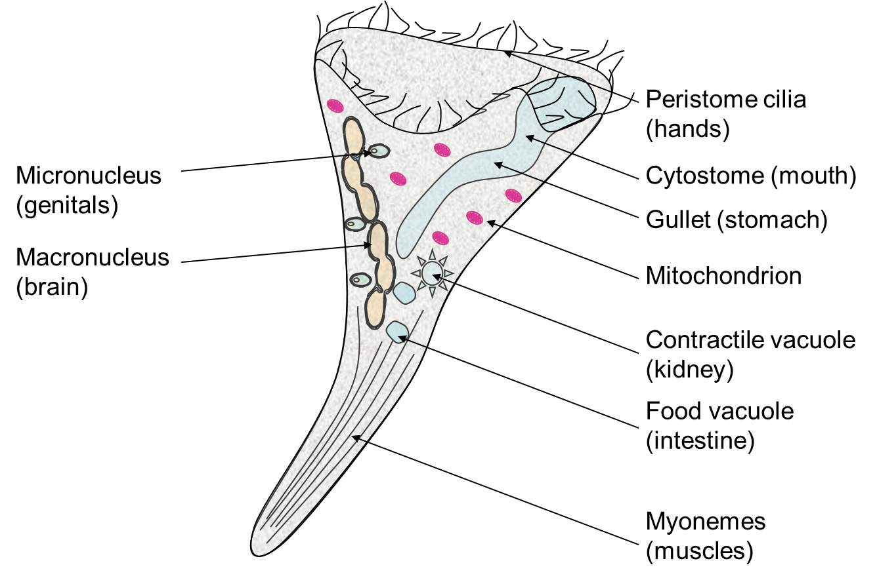
Other sedentary sp. that lack stalks, e.g. Stentor, has contractile fibers in their body ⇒ they permit shape changes.

Slide 41
2) Phylum Dinozoa (The Dinoflagellates)
Dino=G: whirling, Zoa=G: animals
Can be found in both freshwater and marine habitats.
Each organism possesses 2 flagella.
One flagellum is located within a longitudinal groove called sulcus.
The other is located within a transverse groove called the girdle.

Slide 42
The entire organism is covered by cellulose plates that are secreted within alveolar sacs that are located just below the cell membrane.
يتم تغطية الكائن الحي بأكمله بألواح السليلوز التي تفرز داخل الأكياس السنخية الموجودة أسفل غشاء الخلية مباشرة.

Slide 43
Dinoflagellates commonly produce bioluminescence.

Slide 44
Others are known to produce the highly toxic “Red tides”: where highly toxic substances are produced by certain species of Dinoflagellates. These can kill fish and human.
ومن المعروف أن البعض الآخر ينتج "المد الأحمر" شديد السمية: حيث يتم إنتاج مواد شديدة السمية بواسطة أنواع معينة من دينوفلاجيلات. هذه يمكن أن تقتل الأسماك والبشر.

Slide 45
About half of the dinoflagellates contain chlorophyll and photosynthesize.
Many of these autotrophs live in tissues of other invertebrates (endosymbiotic relationship) and are called Zooxanthellae.
Others are heterotrophs feed on particulate matter. Example: the bioluminescent Noctiluca.

Slide 46
3) Phylum Apicomplexa
Defining Characteristic:
Infective stages possess a distinctive cluster of microtubules and organelles (The Apical Complex) at one end of the cell in certain stages of the life cycle.

Slide 47
Contains more than 6000 sp.
All members are endoparasites of animals.
Adults lack locomotory organelles, however, many sp. produce flagellated gametes.
Includes 2 important groups:
The gregarines: parasitize insects and other Invertebrates.
The coccidians: includes many blood cell parasites of humans. Example: the genus Plasmodium; the malaria parasite.

Slide 48
Malaria:
Caused by 4 species of Plasmodium that transmit human malaria, the most deadly of which is P. falciparum.
Malaria is the most important disease in the world today.
Worldwide, it infects about 500 Millions/year.
2-3 Millions die/yr most of them are children. (this means 1 person dies every 10-12 seconds).
Life cycle includes: sexual reproduction (by gametes), asexual reproduction (fission), and resistant or infective spores.

Slide 49
Malaria is transmitted by a mosquito called Anopheles.

Slide 50
Notes about the life cycle:
Only gametocytes, living within the human RBCs infect the mosquito.
Only the haploid sporozoites, found in the mosquito salivary gland cells, can infect humans.
Pathological effects in humans are caused by the RBCs merozoites.
The parasite is haploid for most of its life cycle, the diploid stage occurs in the mosquito.

Slide 51
Malaria Control:
In the past:
A pesticide called DDT was used to control the mosquito population.
In addition a drug called chloroquine was used as a drug against the parasite.
With time, both mosquito and parasite became resistant to DDT and chloroquine.
Now:
other control strategies are being investigated.

Slide 52
B) The Amoebozoans
Many thousands that exhibit amoeboid movement.
Mostly free living with few human parasitic species like the Entamoeba histolytica.
Divided into 4 groups:
1) The naked amoebae (the Gymnamoeba):
Defining Characteristics: shapeless “ameoboid body”, move by pseudopodia (Lobopodia or filopodia).
Lack any covering outside their cell membranes “naked”.

Slide 53
About 200 species of mostly free living organisms.
Feed on bacteria, other protozoa and algae by means of phagocytosis and pinocytosis.
Example: Amoeba, Entamoeba

Slide 54
2) The Arcellinids and related test-bearing amoebae:
Secrete a single-chambered proteinaceous or siliceous covering called the Test: L: Shell.
Others have an agglutination of sand or detritus (this gives the body a shape).
Found in soil, lakes and rivers.
All have Lobopodia
Example: Arcella

Slide 55
3) The Slime Molds:
Includes the cellular and acellular slime molds, members of the Eumycetozoa (Fungus animals).
They have often been classified as fungi or plants.
Nevertheless:
For most of their life, slime molds exist as individual amoeboid cells.
Move and feed by pseudopodia (Lobopodia).
Most species are free-living. Example: Prostelium

Slide 57
4) The Mastigamoebae
Members possess both pseudopodia and flagella either simultaneously or in sequence.
Live in stagnant water (fresh & marine).
Close relatives to Eumycetozoa.
Example: Mastigella

Slide 58
C) The Rhizaria
Rhiza=G: root
Have filopodia or reticulopodia
Members are not united by any morphological or biochemical features.

Slide 59
It includes 3 Phyla:
1) Phylum Foraminifera:
Foramini . fera: L. bearing . Openings.
Defining Characteristics:
All secrete multi-chambered tests, generally of CaCO3.
Pseudopodia (reticulopodia) emerge through pores in the test & branch extensively to form dense networks.
Referred to as the “forams”

Slide 61
Primarily marine & benthic (small # is planktonic).
No parasitic sp. (some are ecto-commensals).
Reticulopodia is used mainly as a feeding organ.
Feeding is on:
Other protozoans, small metazoans, fungi, bacteria & organic detritus.
Some house endosymbiotic photosynthesizing organisms (dinoflagellates).
Others can take up dissolved organic matter.

Slide 62
Size: mostly less than 1mm length.
Tests are well recorded in fossils. (543 million yrs old)
Some fossil tests were 15 cm in diameter.
Fossils are important for:
- Cement industry
- Chalk industry
- Indication for oil

Slide 63
2) Phylum Radiozoa:
Radiolaria: L: ray – animals.
Defining characteristic:
Body is divided into distinct intracapsular and extracapsular zones separated by a perforated membrane.
Includes Radiolarians and Acantharians.
Support their pseudopodia with thin, radiating, microtubules that give a spiny, rayed appearance to many sp.
Pseudopodia & microtubular supports are called axopodia.

Slide 65
Have an endoskeleton of silica as in radiolarian and of strontium sulfate as in acantharians
Well recorded in fossils (7700 Radiolarian sp.)
1000 living sp of radiolarians and 160 sp of acantahrians.
All are planktonic.
Many have endosymbiotic algae & are carnivorous.

Slide 66
Body is generally spherical & divided into:
Intracapsular zone.
Extracapsular zone.
Food vacuole formation & digestion take place in the extracapsular zone.

Slide 67
3) Phylum Helizoa ??:
Helio . zoa: G. Sun . animals.
Defining characteristic:
Body is divided into distinct inner & outer regions, but regions are not separated by any physical boundary.
The 2 regions are:
Ectoplasm: with vacuoles & site of digestion.
Endoplasm: less vacuoles & contains the nucleus.
Primarily planktonic (about 100 sp)
Have axopodia.
Largely restricted to freshwater habitats.

Slide 69
D) The Excavata: Flagellated Protozoans:
Called the mastigophorans.
Have one - many flagella.
Although they differ from amoebae in morphology, molecular biology revealed that flagellates are ancestors of all amoeboid species.
Have a pellicle.
Mostly free–living & motile.
Some have a cytostome.

Slide 70
Have contractile vacuoles, especially in freshwater species. (Their position is fixed within the cytoplasm).
Divided according to lifestyle into: photosynthesizing, particle feeding and parasitic sp.
Divided into 2 groups:
Group I: The Phytoflagellated Protozoans:
Group II: The Zooflagellated Protozoans:

Slide 71
Group I: The Phytoflagellated Protozoans:
Includes the plant-like protozoa.
Some, like Euglena, have chlorophyll and do photosynthesis; others need some dissolved organic matter in addition to photosynthesis.
Neither have food vacuoles or cytostome.
If kept in darkness ⇒ many euglenids become holozoic instead of being autotrophic.
Many have a photosensitive organelle called the stigma (eye spot).

Slide 73
Group II: The Zooflagellated Protozoans.
The free-living forms:
Live in fresh and marine water or soil.
One interesting group is called the Choanoflagellates:
These are freshwater organisms.
Sessile, attached to substrates.
Each bears a single flagellum that extends for a part within a collar of protoplasmic strands called microvilli.
Mostly colonial and immobile⇒ several hundreds of cells.
They are similar to sponges?? An evolutionary relation is not certain!!

Slide 75
The Parasitic Forms:
About 25% of zooflagellates (including commensals)
Have a complex life cycles and a complex structure & function.
Need intermediate hosts (vectors) to reach the final definitive hosts.
Examples:
Trypanosoma:
A human parasite that causes African sleeping sickness.
Has a disc of DNA called kinetoplast located within a single mitochondrion.

Slide 76
About 15 million infections/yr.
Transmitted by Tsetse fly.
Parasite can avoid the immune system.

Slide 77
Leishmania donovani:
Causes extreme disfigurement & death of humans (95% death rate).
12,000,000 infected Worldwide.
Transmitted by sand fly.
Can change surface antigen to avoid the immune system.

Slide 79
Trichomonas vaginalis:
A parasite in human vagina, urethra & prostate.
Causes little or no discomfort in men, but causes considerable inflammation and irritation in women.

Slide 80
Giardia lamblia:
Causes intense nausea, diarrhea and cramps in humans.
Infection is through drinking contaminated water.

Slide 81
Classification summary:
The Alveolata
Phylum Ciliophora. Examples: Paramecium, Stentor, Vorticella.
Phylum Dinozoa. Example: Dinoflagellates like Ceratium.
Phylum Apicomplexa. Example Malaria parasite; Plasmodium.
The Amoebozoa
The Gymnamoeba. Example: Amoeba; Entamoeba.

Slide 82
The Rhizaria
Phylum Foraminifera. Examples: Foramineferal shells.
Phylum Radiozoa. Examples: Radiolarian shells.
The Excavata
Phylum Parabasalia: Examples: Trichomonas; Trichonympha.
Phylum Euglenozoa. Examples: Euglena; Trypanosoma; Leishmania.
Phylum Heterolosea: Example: Giardia.
End of Chapter

