Slide 1
Chapter 4 Phylum Porifera (The Sponges)

Slide 2
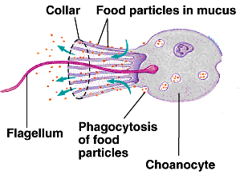
Kingdom Animalia Phylum Porifera
Porifera: (L) = Pori: pore
Fera: bearing
Defining Characteristic:
Microvillar collars surround flagella of choanocytes that could be in the form of single cells or syncytia.

Slide 3
General Characteristics:
The simplest multicelluar animals (metazoans).
Aquatic organisms: 98% marine, 2% freshwater (No terrestrial).
> 7000 species.
Lack systems (and organs): like nervous, digestive, respiratory, reproductive…
Sessile (lack the ability of movement).

Slide 4
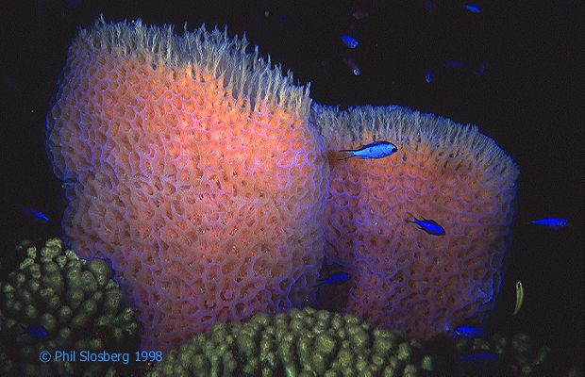
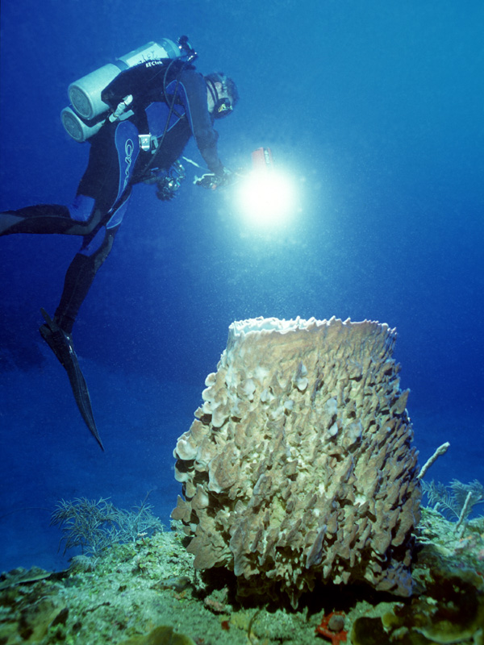
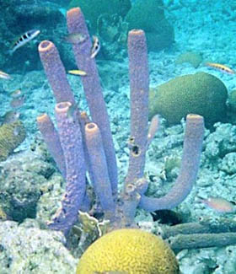
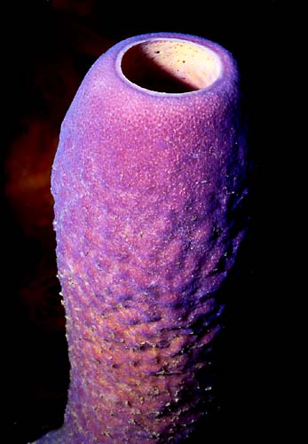
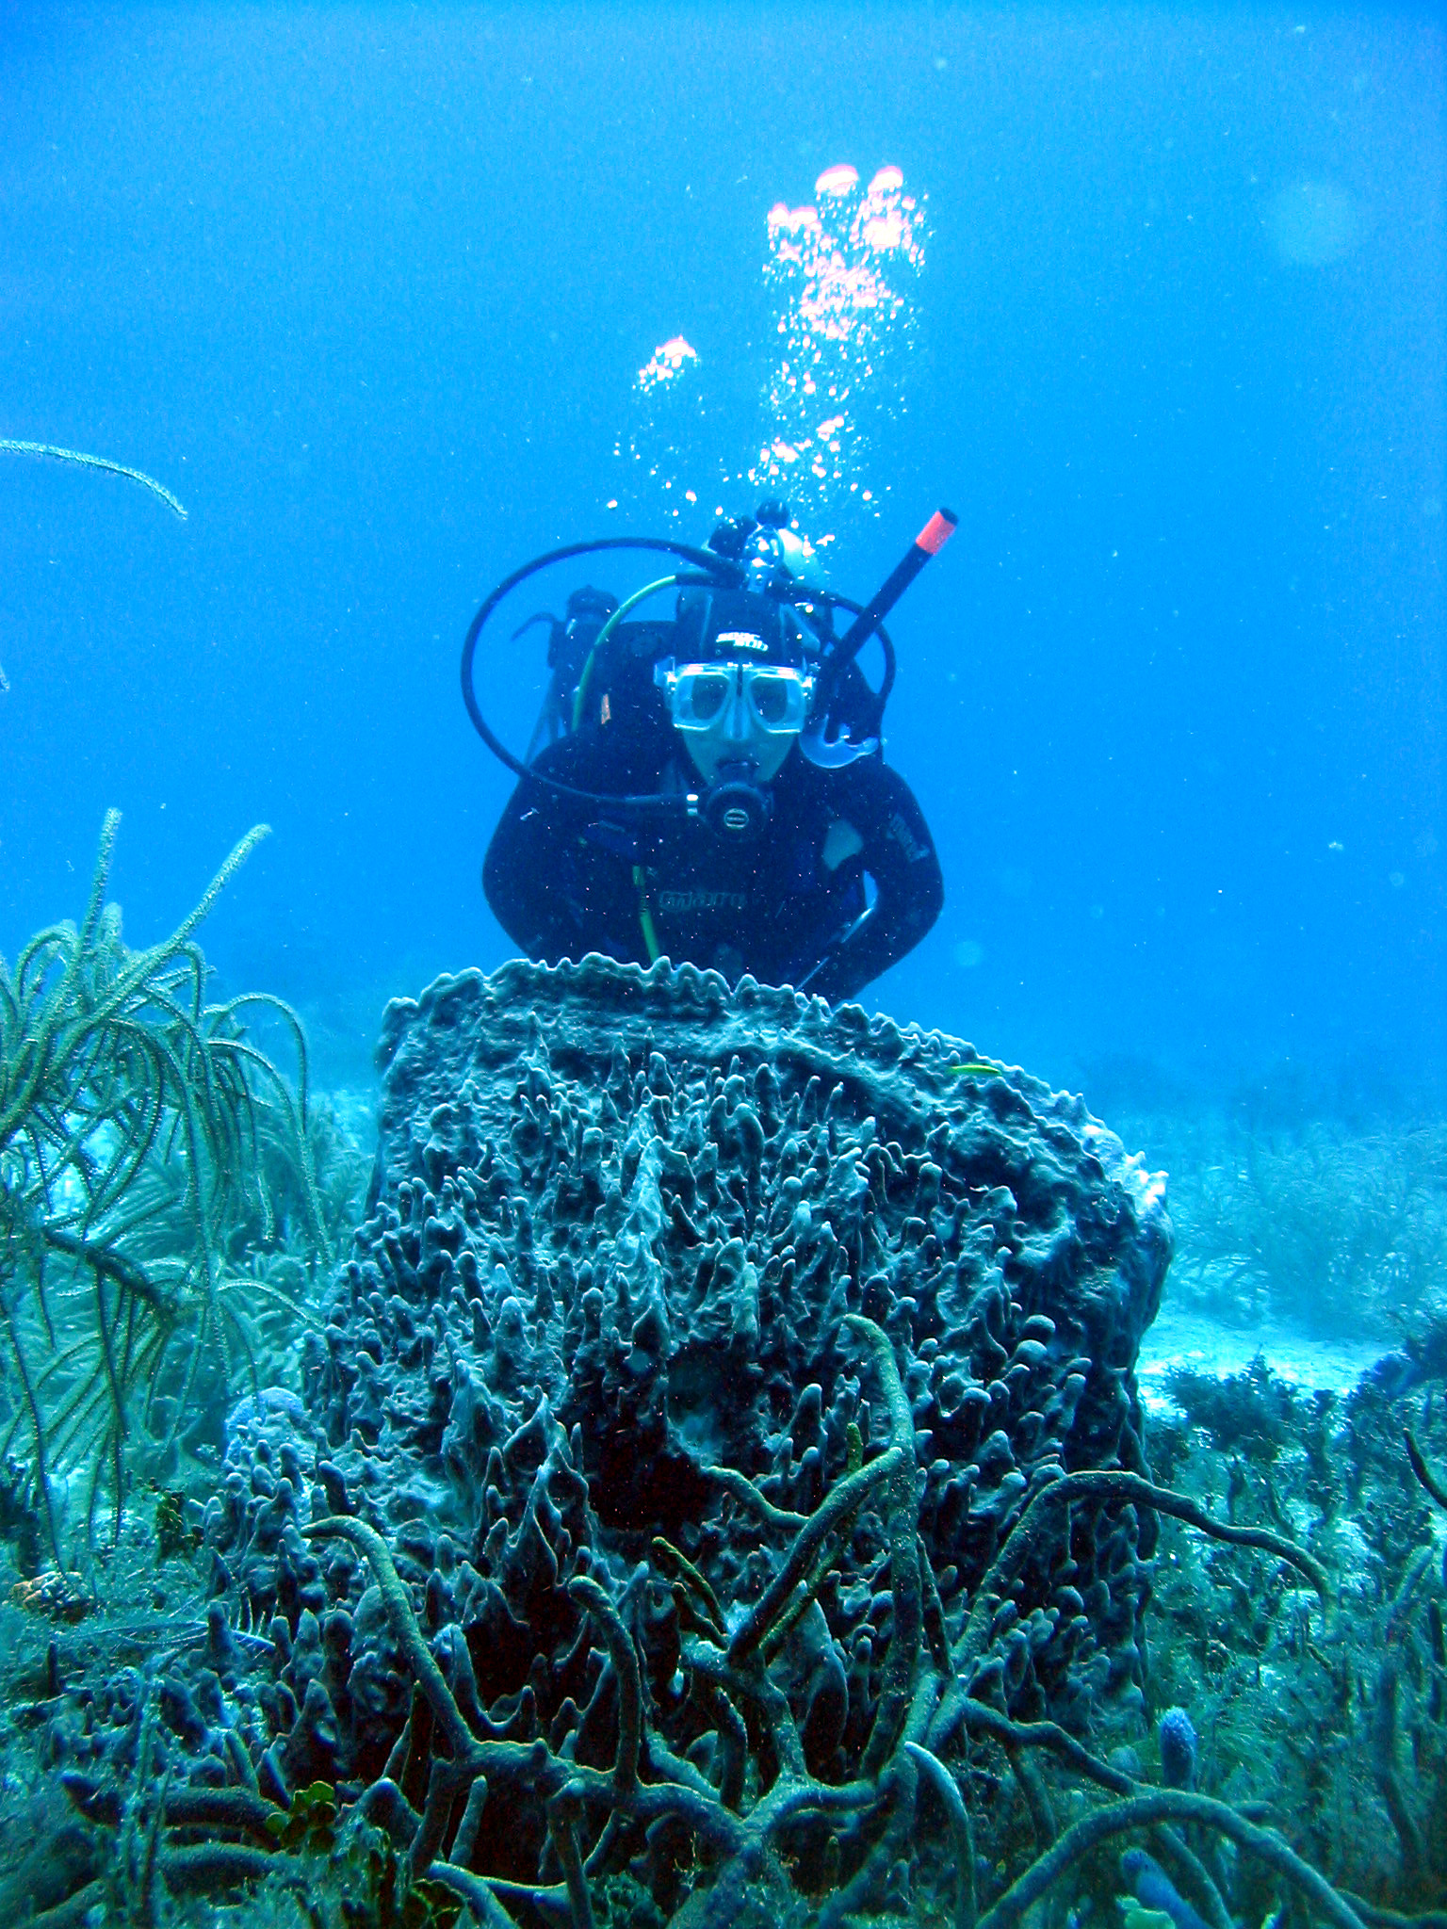
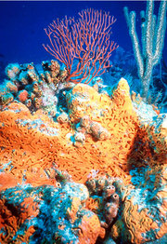
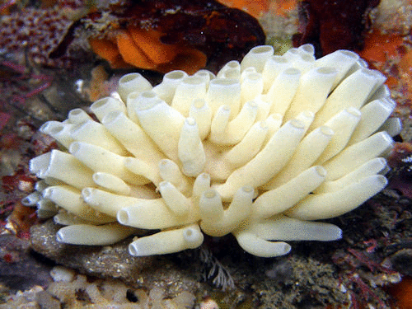
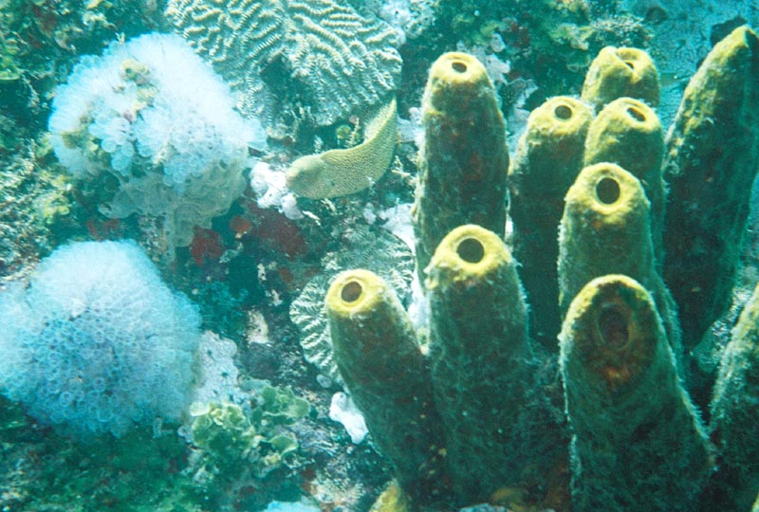
Sponge diversity:
Elephant's Ear Sponge Barrel Sponge
Tube Sponges

Slide 5
Feeding: sponges are suspension-feeders (filter-feeders): feed on particles suspended in water.
Shape: Poriferans are often amorphous and asymmetrical (with few exceptions).
Lack anything corresponding to anterior, posterior or oral surfaces.
Have only few different cell types that are almost functionally independent.
Body of a sponge is typically like a fairly rigid, perforated bag.

Slide 6
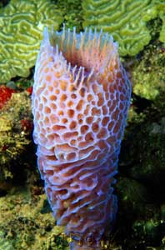
The empty space of the bag (sponge) is called Spongocoel.
Water enters the spongocoel through numerous, narrow pores in the sponge wall called Ostia and leaves through larger openings (1-many)
called Oscula.
Few sponges can reach 1 m in
diameter or height, although the
size of most sponges is usually much
Less than that.

Slide 7
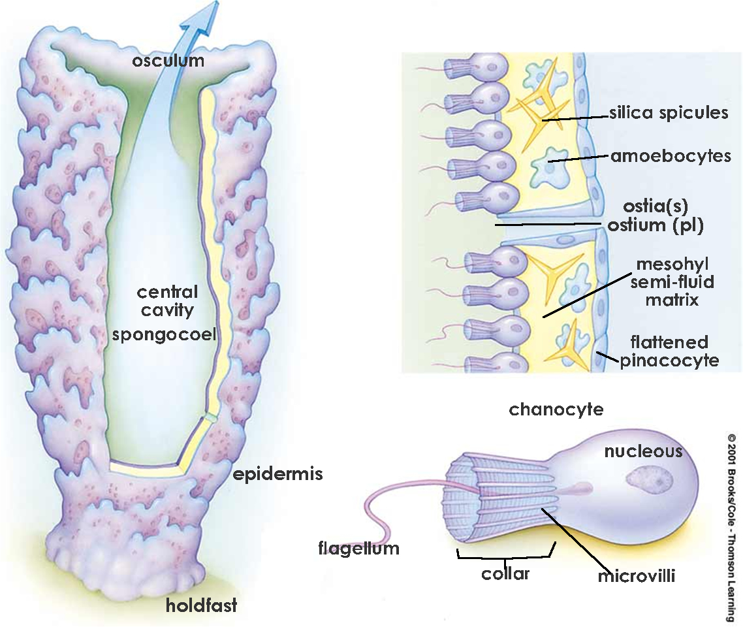
Sponge body plan (simple ascon)

Slide 8
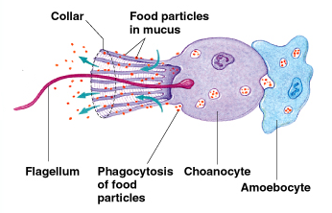
Cell types of sponges:
A) Choanocytes (funnel-cells) or the Collar cells: flagellated cells that surround the spongocoel.
Functions of Choanocytes:
Capture small food particles.
Capture incoming sperms for fertilization.
Generate water currents within
and through the sponge.

Slide 9
B) Archaeocytes (Amoebocytes): amorphous, amoeboid cells that are found in a dead gelatinous layer called mesohyl . (Meso: middle, hyl: matter)
Functions of Archaeocytes:
Digestion of food particles captured by Choanocytes.
Storage of digested food material.
May give rise to sperms
(flagellated) and eggs.

Slide 10
4) Probably play an active role in non-self-recognition reactions.
5) Eliminate wastes.
6) Can become specialized to secrete the supporting elements located in the mesohyl layer.
7) May give rise to Gemmules in some sponges.

Slide 11
C) Pinacocytes: form the outer, epithelial-like layer; composed of flattened contractile cells.
Functions of Pinacocytes:
Form an epithelial-like layer called pinacoderm.
Line the incurrent canals (Ostia) and the spongocoel in places where choanocytes are lacking.
Contract to enable the sponge to undergo minor shape changes.
Regulate water flow through the ostia by changing its diameter.

Slide 12
Sponge supporting elements:
Types of Supporting Elements:
Spicules:
Could be siliceous or calcareous.
Secreted by special archaeocyte cells called Sclerocytes.
Have different shapes.
Help in classification of sponges.
Maintain shape of a sponge.
Discourage predation.

Slide 13
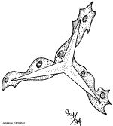
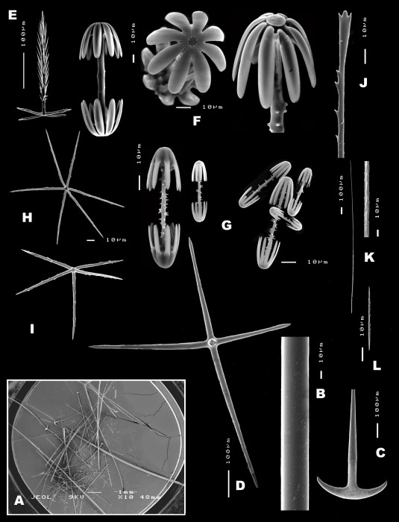
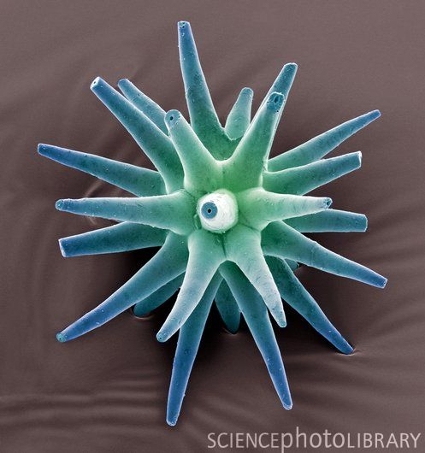
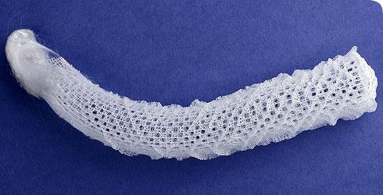
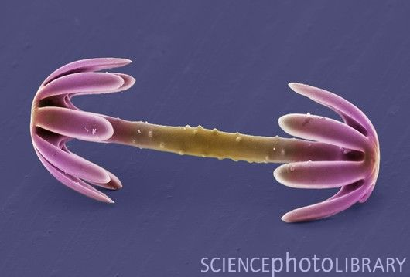

Slide 14
Spongin fibers:
Composed of collagenous protein fibers.
Secreted by special archaeocyte cells called Spongocytes
Maintain shape of a sponge.
Help in classification of sponges.

Slide 15
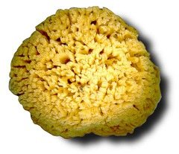
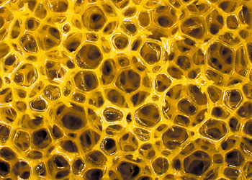
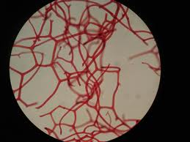
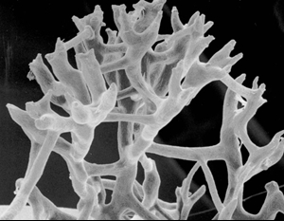

Slide 16
Gemmule formation in sponges
At certain times of the year, many freshwater sponge species (and a few marine ones) produce dormant structures called Gemmules.
These are resistant, dormant structures that are formed by archaeocytes.
Formation begins when archaeocytes accumulate nutrients by phagocytizing other cells; then certain cells secrete a thick, protective covering (capsule).

Slide 17
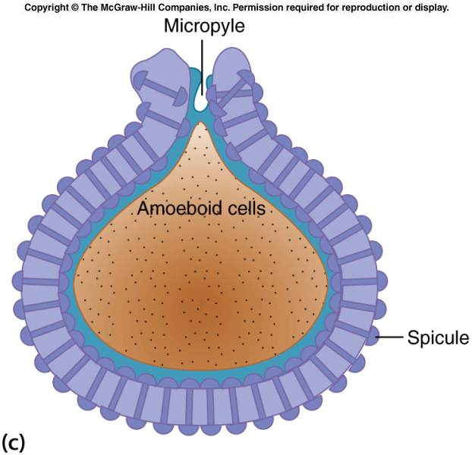
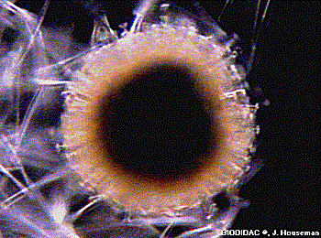
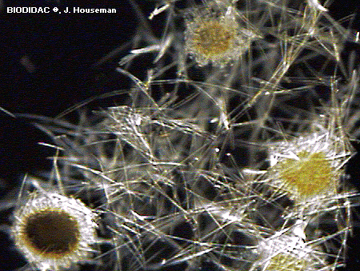
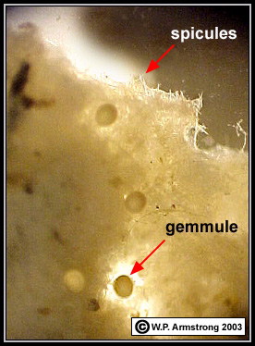

Slide 18
Gemmules are resistant to desiccation (drought), freezing, and anoxia (lack of oxygen).
Gemmules of many sponge species need few months of low temperature in order to be able to hatch (this is called Vernalization).
Gemmules could remain dormant for 25 years before hatching successfully.

Slide 19
Gemmule formation is an effective way of asexual reproduction resulting in numerous genetically identical offspring.
Under unfavorable conditions, instead of Gemmules, some freshwater and marine sponges undergo Tissue Regression: a sponge is reduced into a compact cellular mass with an outer protective covering.

Slide 20
Poriferan Diversity:
There are three basic levels of sponge construction that differ in surface area available for feeding:
1) Ascon (Asconiod shape): simple body
2) Sycon (Syconoid shape)
3) Leucon (Leuconoid shape): more complex, most common.

Slide 21
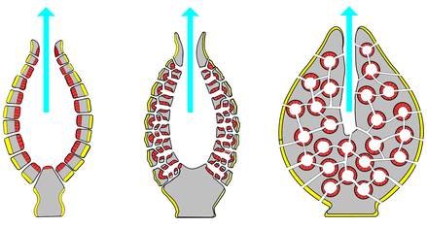
Ascon Sycon Leucon
The increase in construction complexity implies maximizing current flow through spongocoel and increasing surface area available for food collection.

Slide 22
Classification of Sponges
Depending on the chemical composition and morphology of the supporting material, sponges can be classified into:
Subphylum Cellularia
(pinacoderm is formed of cells).
Class Calcarea
Class Demospongia
2) Subphylum Symplasma
(outer layer is syncytial)
Class Hexactinellida

Slide 23
Class Calcarea:
Spicules are made up of only calcium carbonate (CaCO₃).
All body plans are represented in this class.
All are marine.
The only living asconoid forms are found in this class.
Examples: Grantia (Scypha) & Leucosolenia.

Slide 24
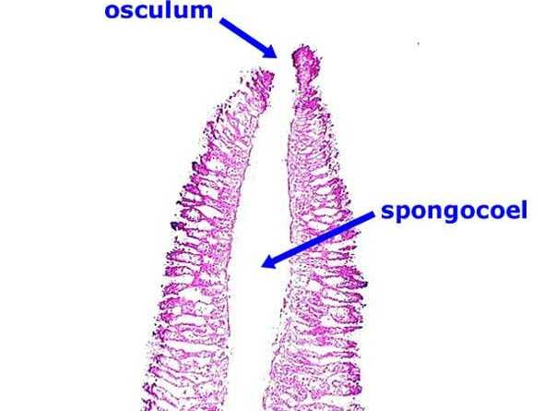
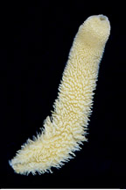
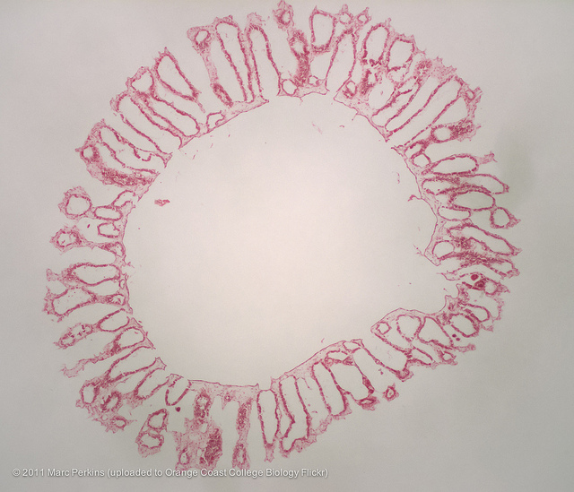
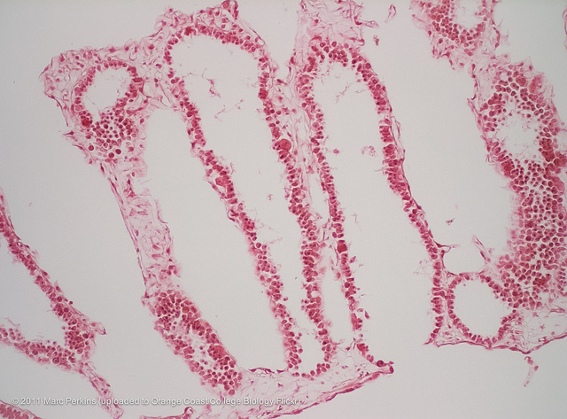

Slide 25
Class Demospongia:
The largest class; contains more than 90% of all sponge species.
All have leucon construction.
Supporting elements may be composed of spongin and/or silica but never CaCO_{3.}
(a small group # lacks fibers and spicules).
All freshwater sponges (<300 species) are found in this class.

Slide 26
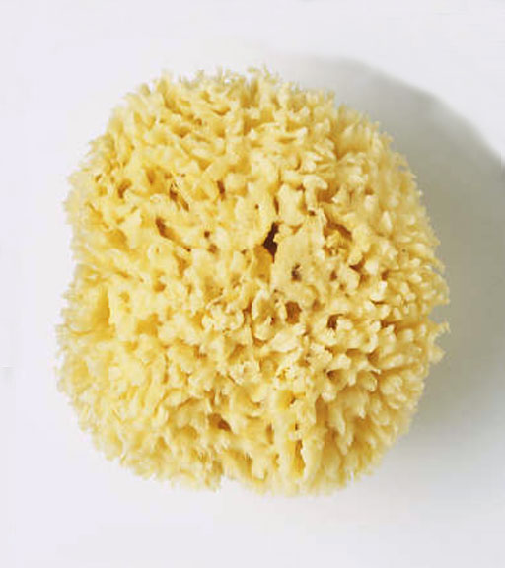
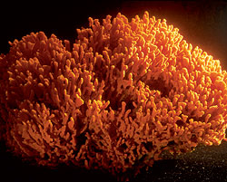
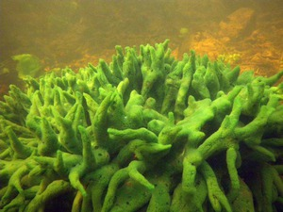
Freshwater species have contractile vacuoles that are found elsewhere only in protozoans.
Examples: Spongia, Microciona, & Spongilla.
Spongia Microciona Spongilla

Slide 27
Class Hexactinellida:
Body is supported entirely by 6-rayed siliceous spicules and pectin.
Known as Glass Sponges.
Outer layer is syncytial (many nuclei contained within a single plasma membrane) and lack contractibility (no pinacoderm layer).

Slide 28
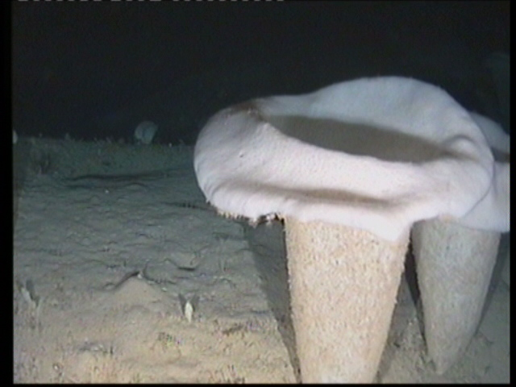
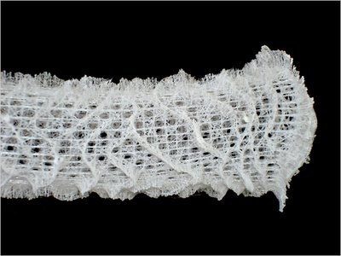
Inner flagellated layer is also syncytial.
Body construction could be sycon or leucon
Unlike members of the other two classes which live attached to solid substratum, members of this class inhabit soft sediment, anchored by tufts of spicules

Slide 29
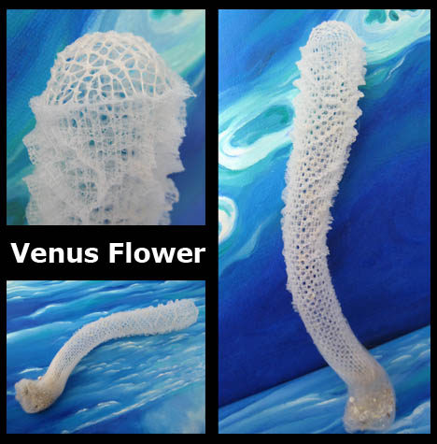
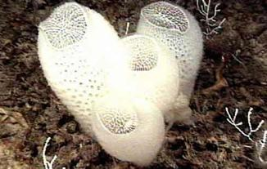
Example: Euplectella (Venus’s flower basket)

Slide 30
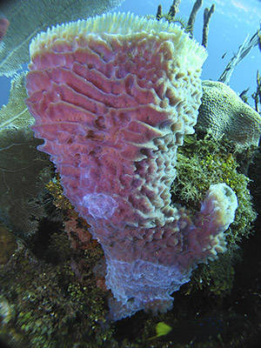
Reproduction and Development in Sponges:
Sponges reproduce asexually by:
Fragmentation
Gemmule formation
Budding

Slide 31
Sponges reproduce sexually by:
Egg and sperm production.
Many sponge species are hermaphrodites (a single individual produces both eggs and sperms).
Fertilization and early development are typically internal.
Sperms are released into surrounding water, while eggs are retained in the mesohyl where fertilization takes place

Slide 32
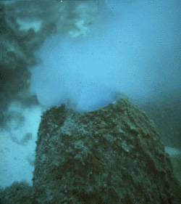
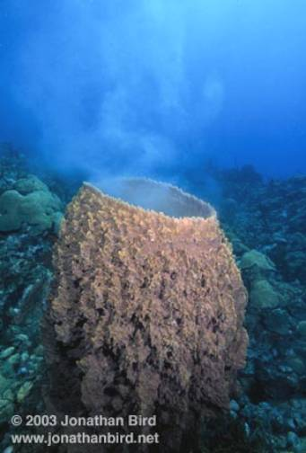
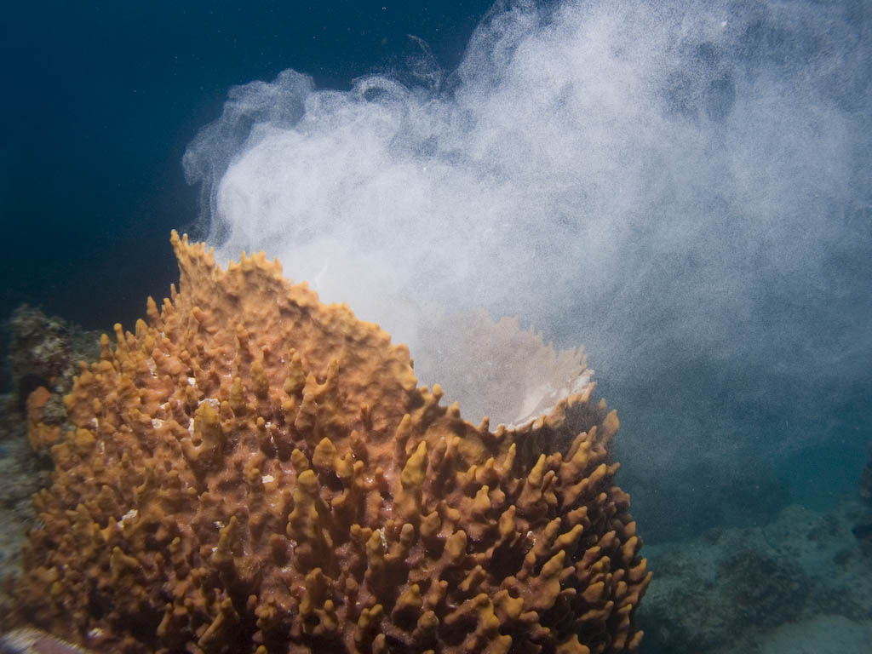
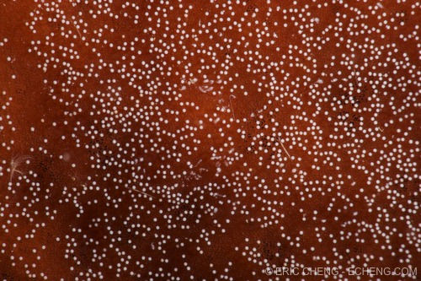

Slide 33
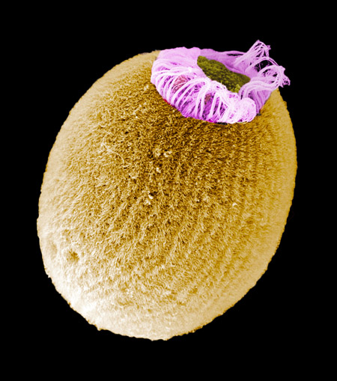
Choanocytes capture the sperms, dedifferentiate into amoebocytes and enter the mesohyl where eggs are retained.
Most sponge species retain the developing embryos for a time, releasing them later through the oscula as
swimming larvae.

Slide 34
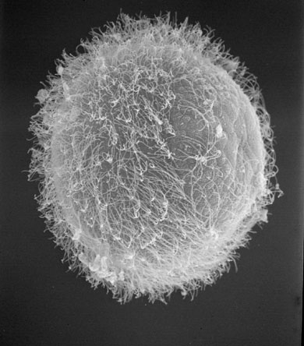
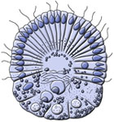
Sponge larvae Types:
Amphiblastula: flagellated at one end only.
Parenchymella (Parenchymula): extensively flagellated.
Stereobalstula: flagellated.

Slide 35
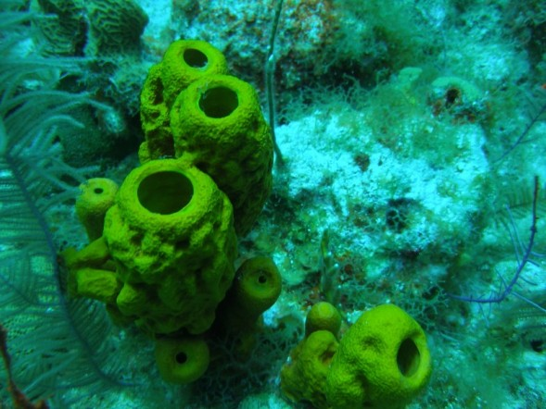
Sponge larvae are non-feeding, they swim for less than 24 hours before they start settling down and metamorphosing to adult from.
End of Chapter

