Slide 1
Chapter 8
Phylum Platyhelminthes
“The Flatworms”

Slide 2
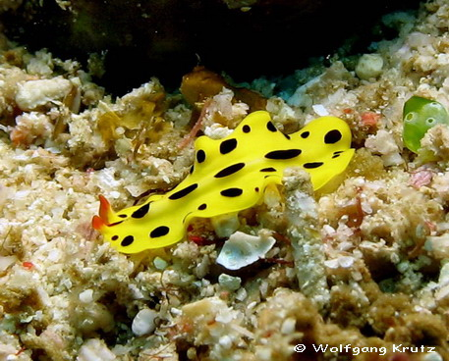
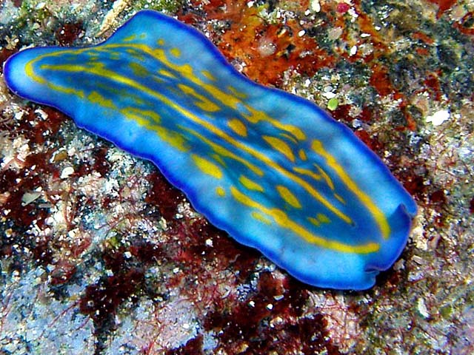
Kingdom Animalia Phylum Platyhelminthes (The Flatworms)
Platy. helminthes: G. = Flat. worms
They have a flat body.

Slide 3
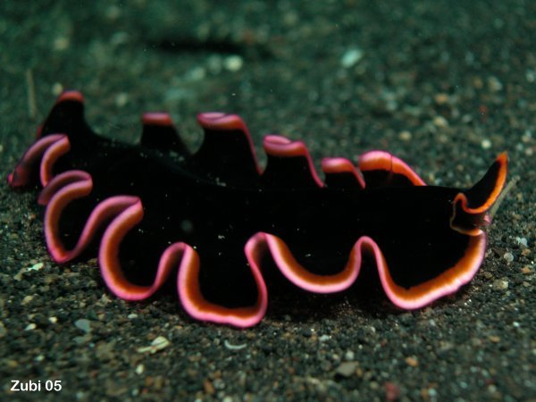
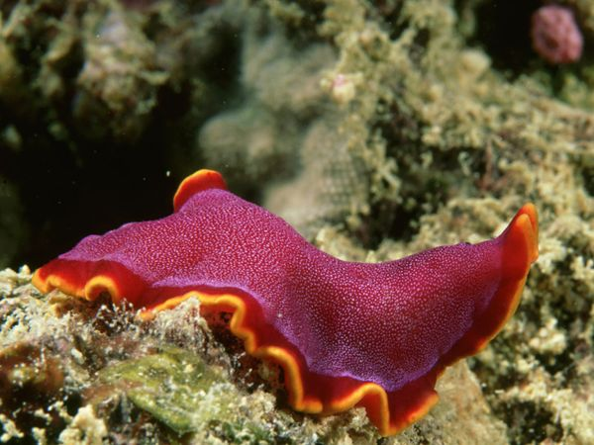
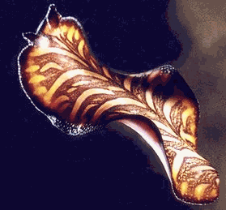
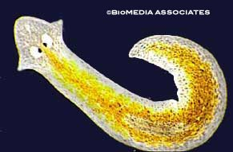
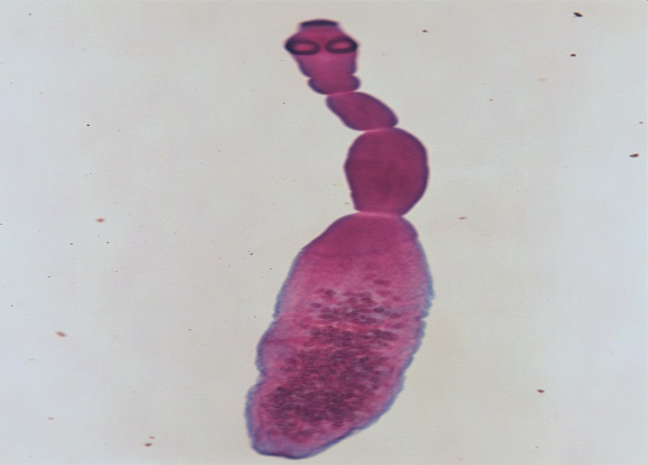
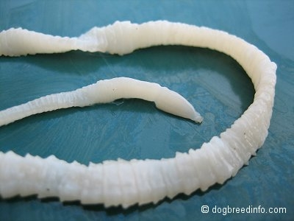

Slide 4
Includes about 34,0000 species.
Oldest fossil is about 40 Million years old.
Includes 1 class of mostly free-living individuals (the Turbellarians) and three classes of exclusively parasitic individuals (Monogeaneans, Cestodes and Trematodes).
> 80% of all flatworms are parasitic.
All are acoelomate, triploblastic and bilaterally symmetrical.
Mostly, they have an anterior brain that is connected to at least 1 pair of longitudinal nerve cords.

Slide 5
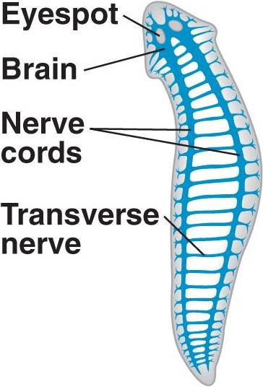
The mesoderm layer of the embryo
develops into a loose collection of
cells known as parenchyma tissue.
Most have no anus; they take in
food and remove wastes through
a single opening.
They have no specialized respiratory
or circulatory systems (few species
Have hemoglobin).
Gas exchange is through simple
diffusion across the flat body.

Slide 6
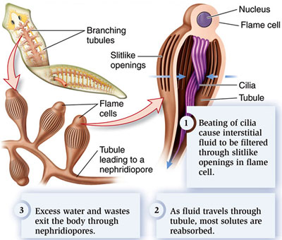
Excretion is mostly by simple diffusion across the body surface.
In addition, most species have protenephridia (G: first. Kidney).
Typical prtonephridia
Consists of a group of
cilia projecting into a
fine-meshed cup
(Flame cells).

Slide 7
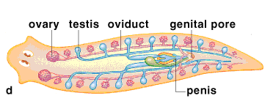
Other protonephridia take the form of Solenocytes in which a single flagellum is found within the cup.
Most species are simultaneous hermaphrodites; that is each individual can, at anytime, function as both a male and a female.
However, in most species, fertilization is cross (non-self).
The parasitic forms have nonciliated syncytial tegument.

Slide 8
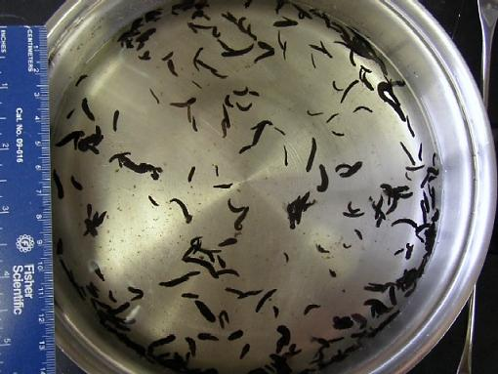
Class Turbellaria
Forms about 16% of all flatworms that are mostly aquatic.
Most of the 3000 Turbellarians are free living (About 150 species are commensal or parasitic)
Most species are marine, few freshwater or even terrestrial (in humid areas).
Mostly less than 1 cm long.

Slide 9
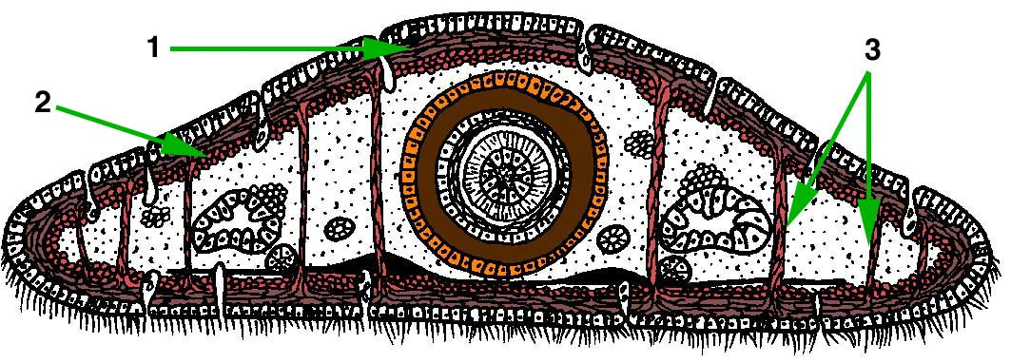
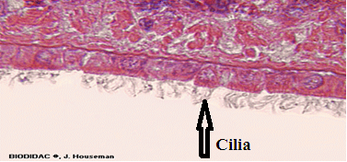
Nervous system:
Consists of a primitive brain (cerebral ganglion) plus 1-3 longitudinal nerve cords (rarely 4).
Typically, they bear 1 pair of eyes anteriorly. In addition, they have chemical, pressure and mechanical receptors.
10% have Statocysts (balance receptors).
Most aquatic species are benthic (live in or on the bottom).
Ventral surface is
ciliated.

Slide 10
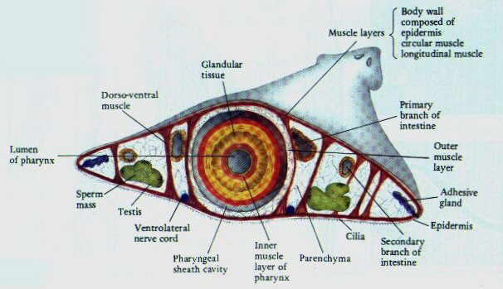
Movement: by many ways:
Most species move by cilia and mucus secretion on the ventral surface.
Others move by A) pedal waves of muscle contraction: these are unidirectional moving from anterior to posterior.
They have: longitudinal,
circular, dorsoventral
and diagonal muscles.

Slide 11
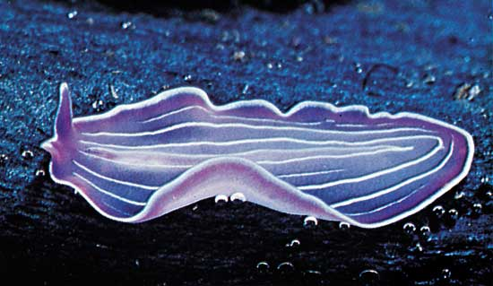
B) Looping movement: in order to be effective, flatworms must be able to adhere to the substrate. This is done by the duo-glands that secrete glue to adhere to surfaces.
C) Some can swim by cilial action or muscular contractions.

Slide 12
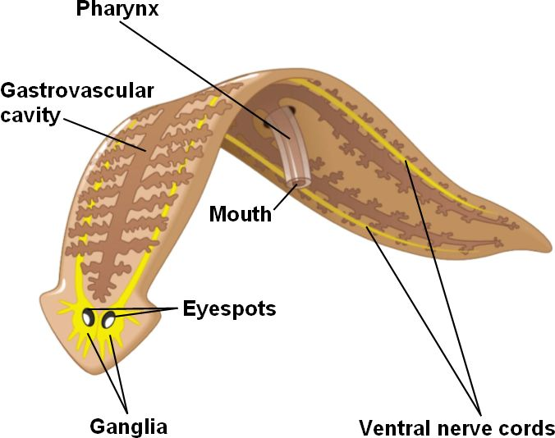
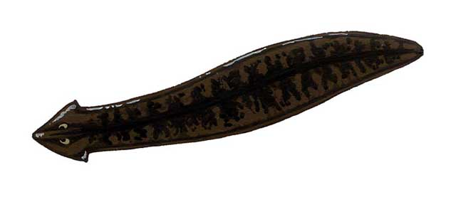
Digestive System:
Digestive system is simple and variable according to species.
Mouth is usually at the end of a protrusible pharynx.
Gut may be straight, three-branched, or multibranched.

Slide 13
Most species are active carnivorous. However, some ingest algae and detritus. Some have endosymbiotic algae.
Initially, digestion is extracellular. Thereafter, it is completed intracellularly.
Reproductive System:
Sexual reproduction
Turbellarians are hermaphrodites.
Two organisms exchange gametes (cross-fertilization).
Eggs are released after fertilization.

Slide 14
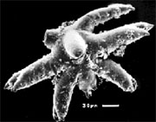
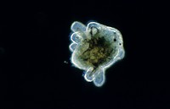
Mostly, eggs develop into miniature worms without a free-living larval stage.
However, several marine species have a free-swimming larval stage called Müller’s larva.

Slide 15
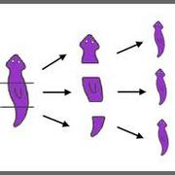
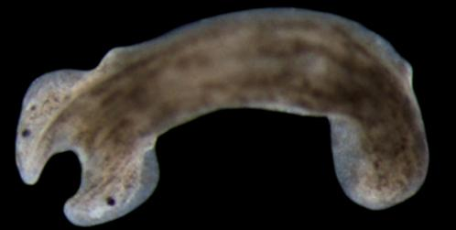
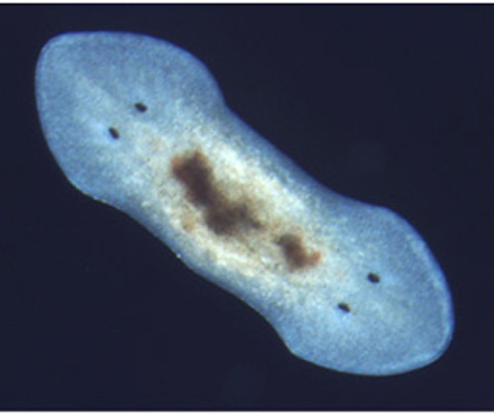
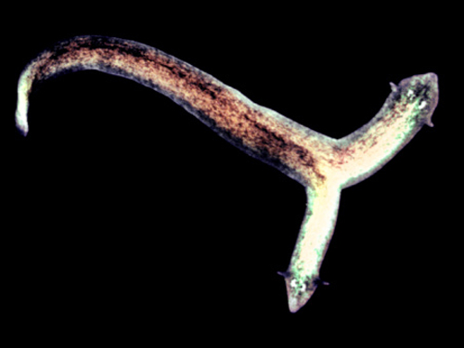
Asexual reproduction:
Regeneration.
Asexual fission.
Examples: Planaria (Dugesia )

Slide 16
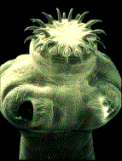
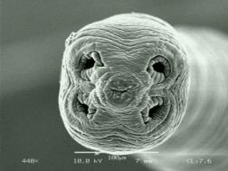
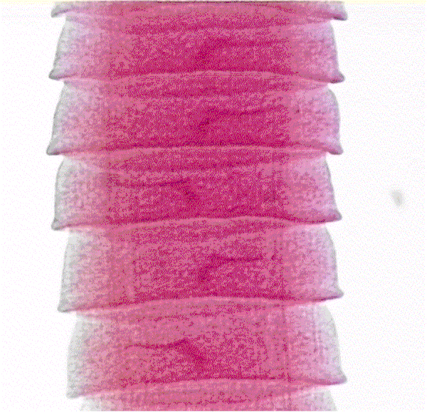
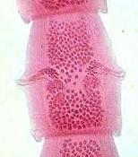
Class Cestoda
Defining characteristics:
Small hooked anterior attachment organ (scolex).
Division of body into segments (proglottids) arising from anterior end, behind the scolex.
Absence (loss) of digestive tract.

Slide 17
Most species belong to Subclass Eucestoda which includes the Tapeworms (about 5000 sp).
All are endoparasites of vertebrates (live in the digestive tract).
The number of infected persons worldwide is about 135 million.
Body is covered by a nonciliated, syncytial tegument.
Nutrients are taken across the body surface. They have no mouth or gut.
Body is composed of: scolex, neck and proglottids.
The anterior end takes the form of a scolex which is provided with hooks and/or suckers.
Hooks and suckers are used to maintain
position within the host’s gut.

Slide 18
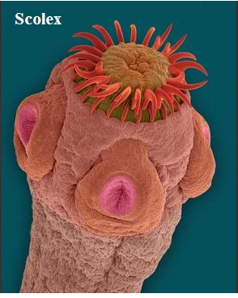
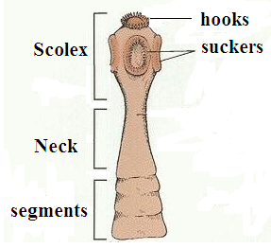
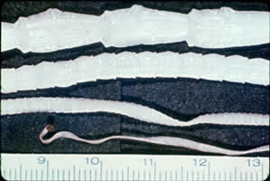
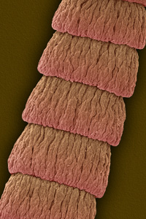
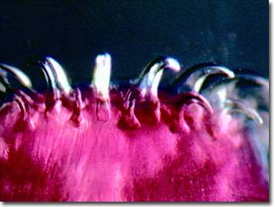
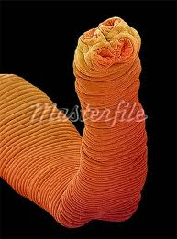

Slide 19
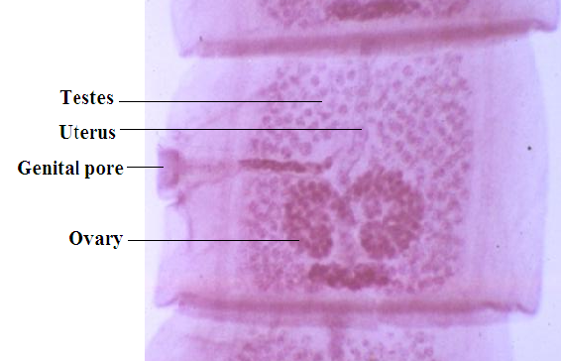
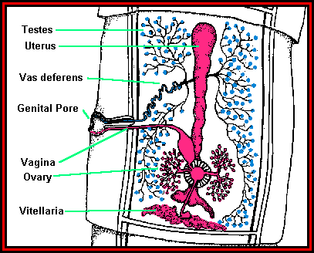
Neck divides several times/day to give the proglottids.
Each proglottid is simultaneous hermaphrodite.
Each proglottid contains numerous ovaries and about 100 testes.

Slide 20
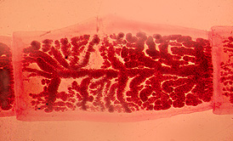
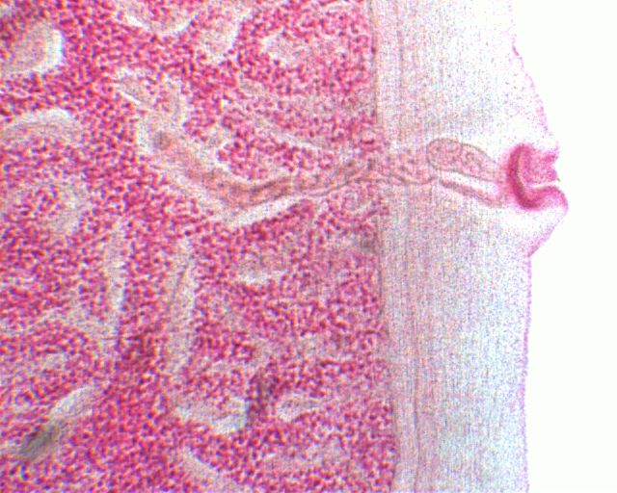
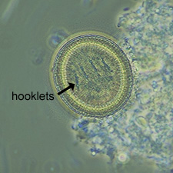
Each proglottid might contain 50,000 eggs that are fertilized by sperms from neighboring individuals or from the same one.
The length of a worm is usually 10-12 m and the length of each proglottid is 3-5 mm.
Eggs leave the digestive system of the host with feces.

Slide 21
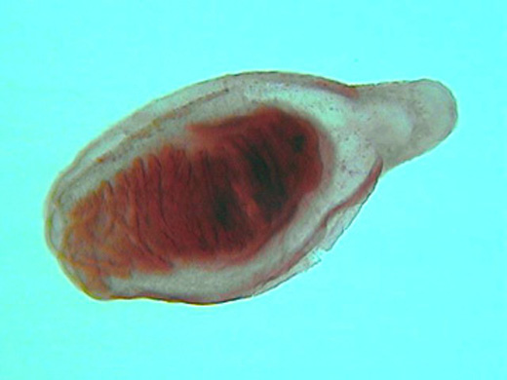
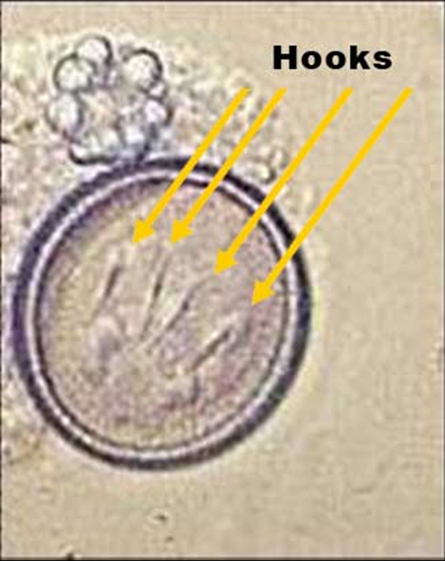
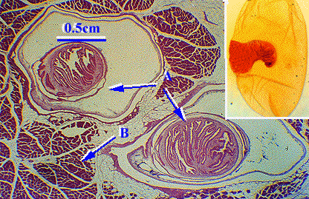
Eggs cannot infect the definitive (final) host immediately; they must enter an intermediate host first.
When eggs are ingested by an intermediate host→ an onchosphere larva hatches out. This larva is provided with 3 pairs of hooks.
Onchosphere lyses the intestinal wall→ encysts in the muscles or internal organs in the form of a cysticercus (bladder worm).

Slide 22
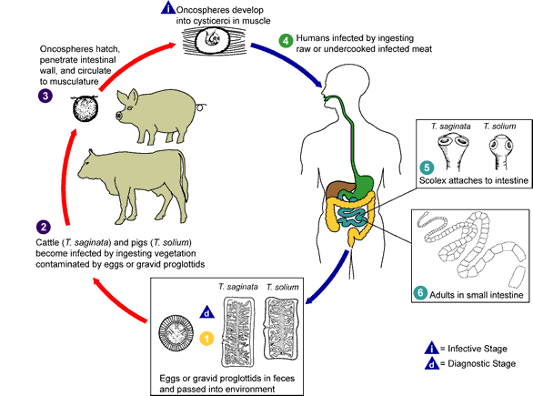

Slide 23
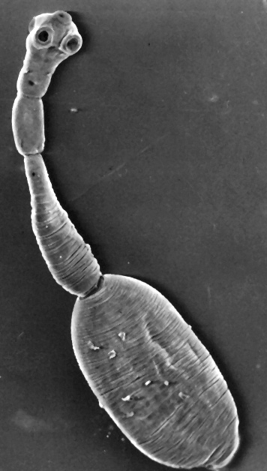
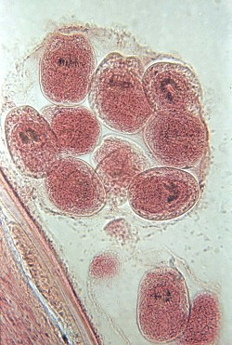
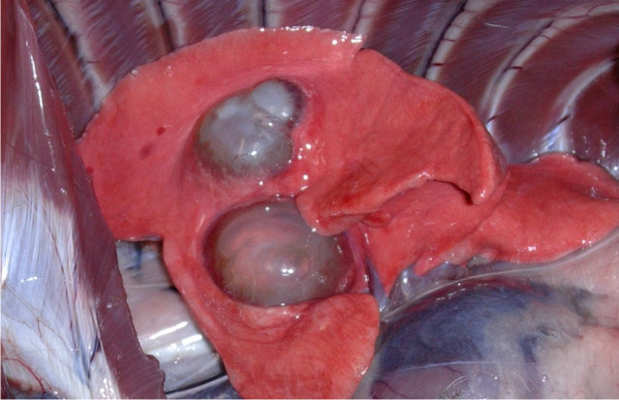
The cysticercus of some species divides asexually forming a large hydatid cyst as in the Dog Tapeworm (Echinococcus).

Slide 24
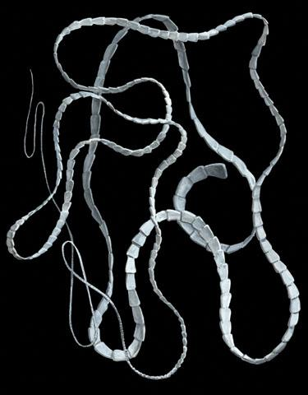
If the infected meat containing the cysticercus is ingested by another intermediate host or a definitive host→ cysticercus develops into an adult worm.
Intermediate hosts include: Fishes cows, pigs, dogs & birds, man and arthropods.
Definitive hosts include: man.
Examples: Taenia saginata,
Taenia solium.
Echinococcus granulosus,

Slide 25
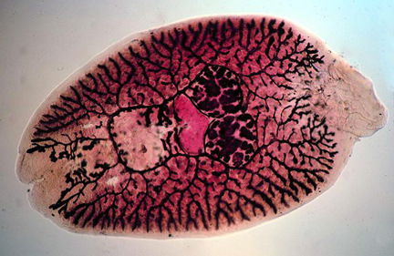
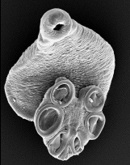
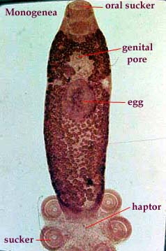
Class Monogenea:
Defining characteristics:
Posterior attachment organ (haptor=opisthohaptor) including suckers and complex hooks and sclerites.
Larva (onchomiracidium) bears 3 bands of cilia and usually 1 or 2 pairs of eyes.

Slide 26
Ectoparasites on skin or gills of fish (8000 sp).
An anterior adhesive organ (prohaptor), consisting of suckers and adhesive glands, aids the opisthohaptor in attachment.
No intermediate hosts in the life cycle.
Life cycle: Adults on fish→egg production→larval stage (onchomiracidium) →attachment to fish.
About 1100 species have been described.
They have a high level of host specificity.

Slide 27
Class Trematoda:
All members (8000 sp) are parasitic species (endo- and ectoparasites).
Members of this class are considered successful parasites that must:
Reproduce within definitive host
Get the fertilized eggs or embryos out of the host.
Contact and recognize a new, appropriate host.
Obtain entrance into the host
Locate the appropriate environment within the host.
Maintain position within the host.
Withstand anaerobic environment.
Avoid the digestive or the immune system of the host.
Avoid killing the host, at least until reproduction has been achieved.

Slide 28
Trematodes ( called Flukes) have remarkable ability to # 3 and 4 above.

Slide 29
Outer layer is a non-ciliated syncytial tegument.
They have a mouth opening and a blind ended digestive tract.
Body is not segmented (like Turbellarians).
They feed on the tissue and blood of the host.
Some Trematodes (Blood flukes) cause serious, often deadly diseases like schistosomiasis.
Infects more than 200 Millions in 77 countries (second after malaria).
Kills more than 800,000 people/year.

Slide 30
Trematodes are classified in two subclasses:
Subclass Digenea (main group)
Subclass Aspidogastrea (much smaller group)
The Digeneans:
Members require at least one intermediate before reaching the final one (Digeneans: G. : Di: two, gena: birth).
Host finding is an active process (Their larvae search for the appropriate host actively. This is a passive process in other Cestodes).

Slide 32
Schistosomes can produce >3000 fertilized eggs/day.
The digeneans are exclusively endoparasites.
They are mostly hermaphrodites (some are dioecious).
A single miracidium gives rise to > 10_{s} of thousands of cercariae.

Slide 33
The Aspidogastrea (aspidobothrea):
Defining characteristic:
Large ventral sucker divided by septa, generally forming a row of suckers.

Slide 34
A small group (80 species).
Have similarities to both mono- and digeneans, but they do not fit in any one of them.
Most have a simple life cycle with a single host (as monogeneans), mostly a mollusk.
Have no haptor (like the one found in monogeneans).
They have a large ventral adhesive sucker.
Some need an intermediate host (usually a mollusk) to reach the final host (fish, turtle). (Like digeneans).
However, life cycle has no asexual replication within the intermediate molluscan host.(unlike digeneans).
End of Chapter

