Slide 1
BIOCHEMICAL ACTIVITIES OF BACTERIA
10th lab

Slide 2
Objectives
To know some biochemical tests which are routinely used in the identification of the different types of bacteria
Tests to know
- H₂S production in SIM
- Indole
- Motility
- Lactose ,Glucose fermentation
- Starch hydrolysis
- Lipids
SIM

Slide 4
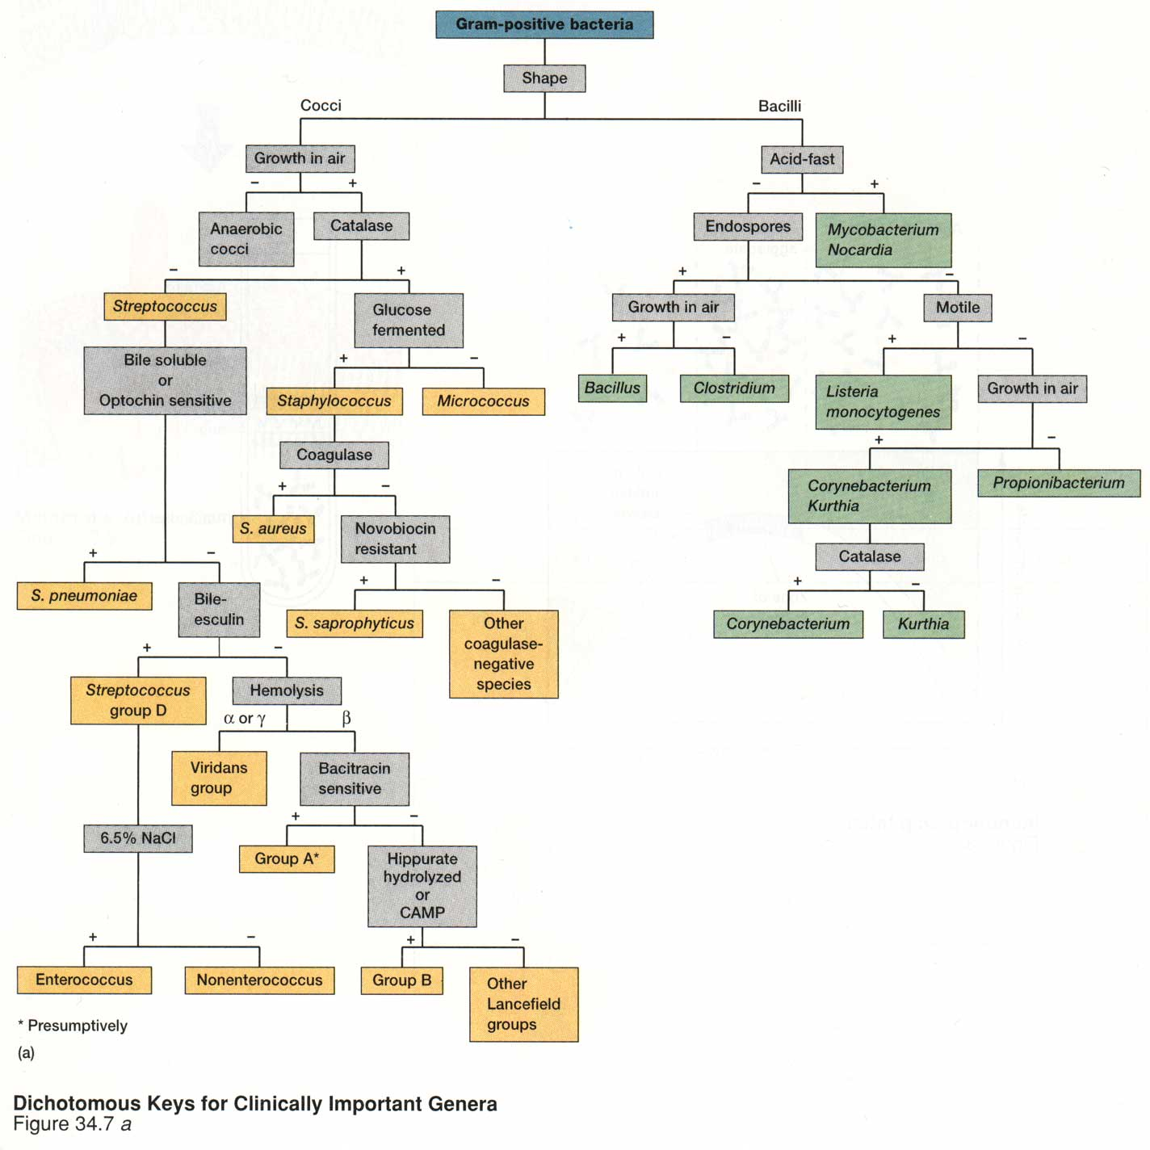
Notes:
‹#›

Slide 5
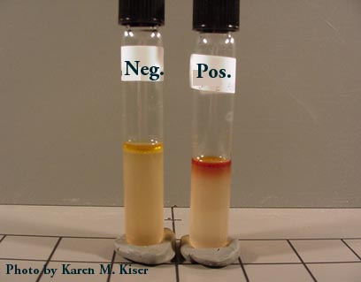
SIM
SIM Agar , a rich source of the amino acid tryptophan. Indole positive bacteria such as Escherichia coli produce tryptophanase, an enzyme that cleaves tryptophan, producing indole and other products. When Kovac's reagent (p-dimethylaminobenzaldehyde) is added to a tube with indole in it, a dark pink color develops.
Procedure
1. Using a wire needle , inoculate test organism two-thirds into the medium with stab motion.
2. Examine tubes after incubation for motility and H2S production.
3. Add 2-3 drops of Kovac’s Reagent to each tube. Record as indole positive if a pink or red color appear, or as indole negative if there is no color change.
E. coli
K. pneumonia

Slide 6
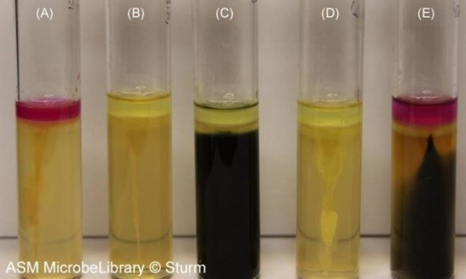
SIM results
interpretation
A: Escherichia coli - Negative for H2S, Positive for Indole, motile
B: Klebseila pneumonia- Negative for H2S, Negative for Indole, none motile
C: Salmonella arizonae - Positive for H2S, Negative for Indole, Positive for motility
D: Enterobacter aerogenes - Negative for H2S, Negative for Indole, Positive for motility
E: Proteus vulgaris - Positive for H2S, Positive for Indole, Positive for motility

Slide 7
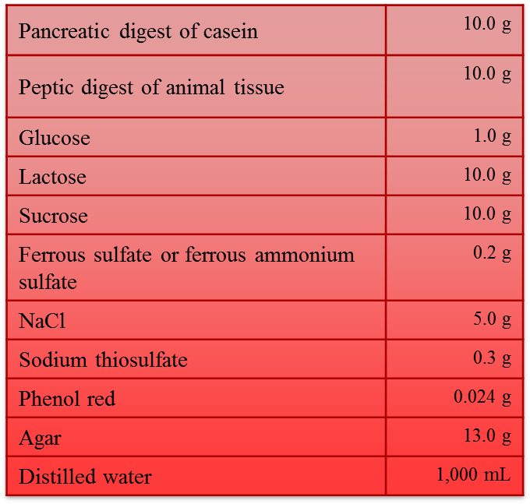
TSI
Sugar fermentations
Gas production
Hydrogen sulfide production
Purpose Triple sugar iron (TSI) agar is a differential medium used in determining carbohydrate fermentation,H₂S production and Gas from carbohydrate metabolism.
Bacteria can metabolize carbohydrates aerobically (with oxygen) or fementatively (without oxygen). TSI differentiates bacteria based on their fermentation of lactose, glucose and sucrose and on the production of hydrogen sulfide.
http://biology.uwsp.edu/faculty/TBarta/

Slide 8
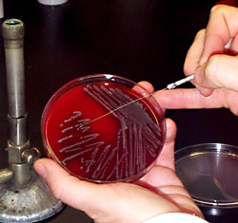
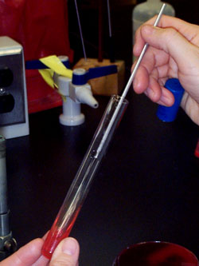
Procedure
1- Use a straight inoculating loop to pickup an isolated colony.
2- Inoculate the TSI slant by first stabbing the butt down to the bottom, withdraw the needle, and then streak the surface of the slant.
3- Read results after incubation at 37°C for 18 to 24 h.
http://www.microbelibrary.org/component/resource/laboratory-test/2842-triple-sugar-iron-agar-protocols
Notes:
‹#›

Slide 9
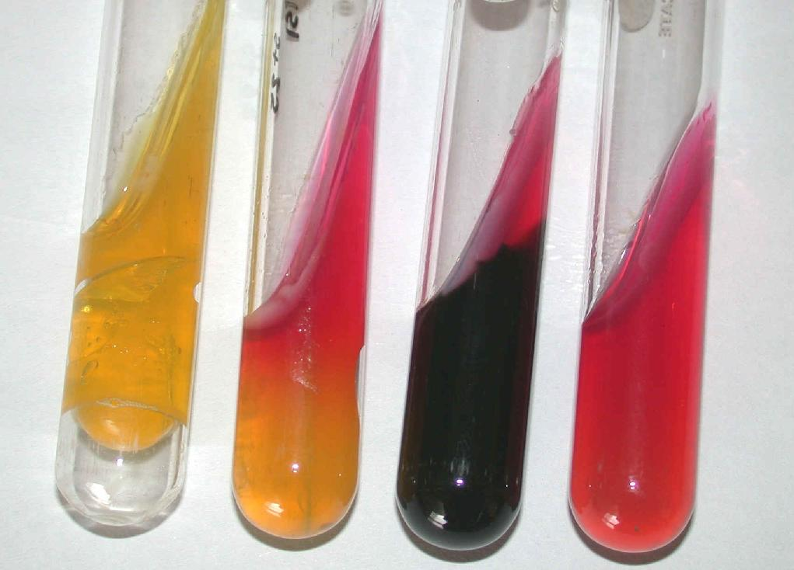
Proteus mirabilis
E.coli
http://www.mesacc.edu/~johnson/labtools/Dbiochem/kia.html

Slide 10
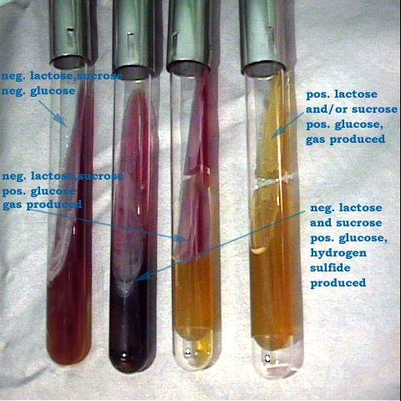
http://www.mesacc.edu/~johnson/labtools/Dbiochem/kia.html

Slide 11
Starch hydrolysis
Starch agar is a differential medium that tests the ability of an organism to produce certain exoenzymes, including a-amylase, that hydrolyze starch.
Starch agar is a simple nutritive medium with starch added. Since no color change occurs in the medium when organisms hydrolyze starch, we add Iodine to the plate after incubation. Iodine turns blue, purple, or black in the presence of starch. A clearing around the bacterial growth indicates that the organism has hydrolyzed starch.
http://biosci.usc.edu/courses/2002-fall/bisc300.html

Slide 12
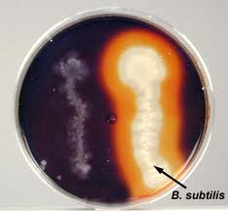
http://faculty.ccbcmd.edu/courses/bio141/labmanua/lab8/lab8.html

Slide 13
Lipid hydrolysis
Some bacteria produce enzyme that hydrolyzes triglycerides into free fatty acids and glycerol which can then be taken up by the cell and metabolized more in glycolysis.
lipase could be detected by growing the bacteria on neutral red fat agar - - Neutral red (pH indicator that turns bright red at a low pH)
E. coli
S. aureus
Notes:
‹#›

Slide 14
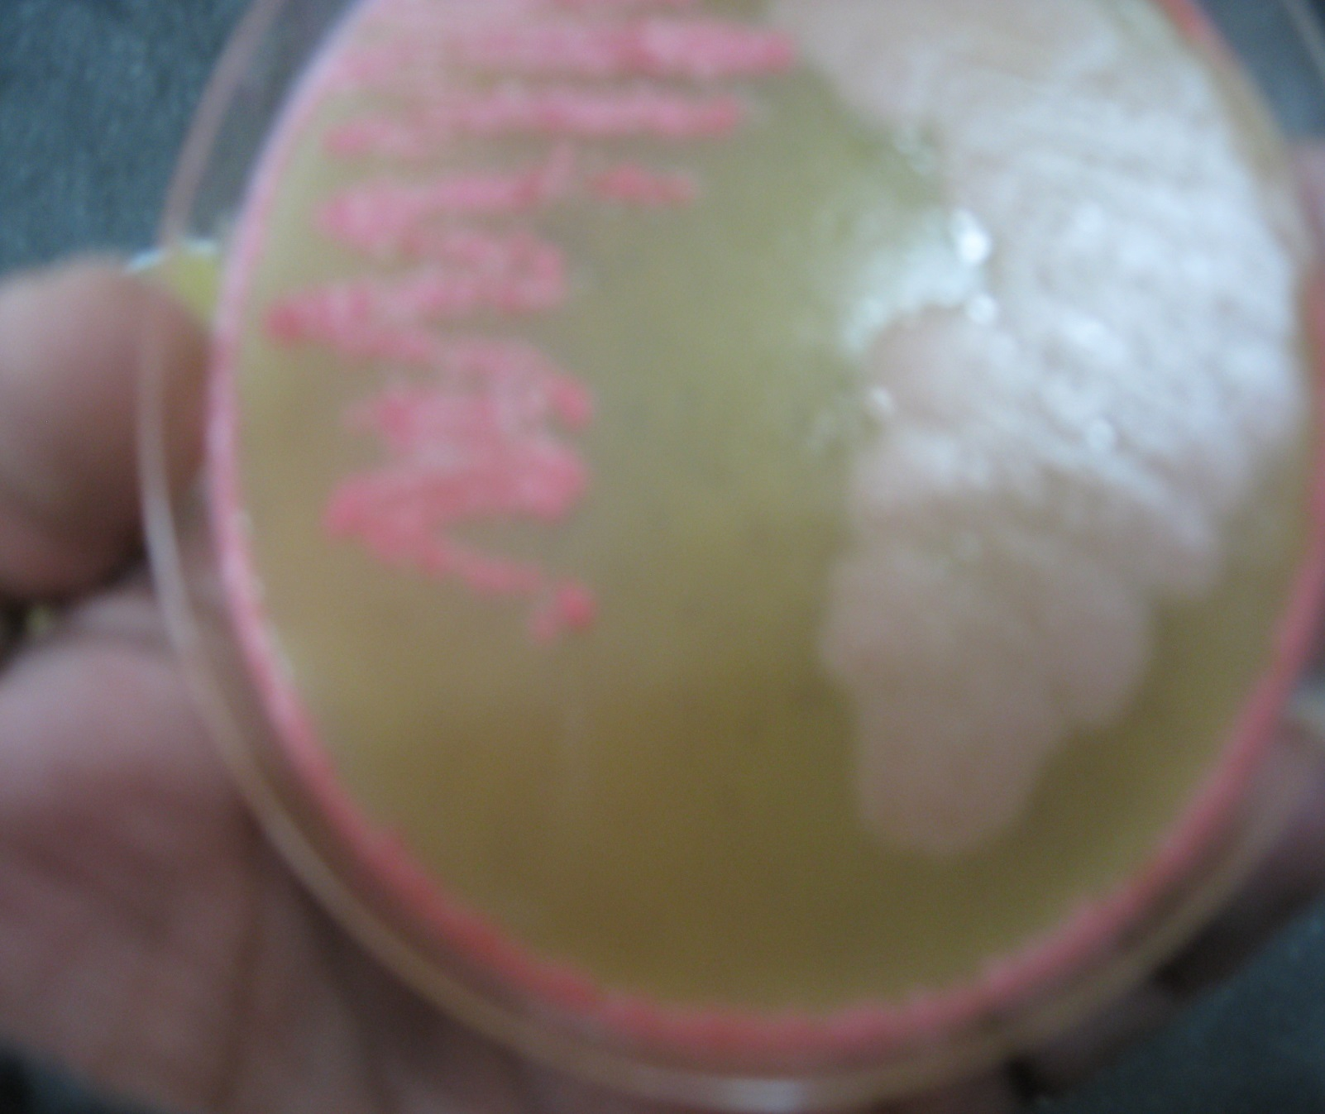
+ve
-ve
S. aureus
E.coli

Slide 15
Gelatin Liquefaction
Can bacteria use gelatin as source of carbon ?
Yes or No
How is gelatinase activity determined?
Negative result:-Solid in ice bath or refrigerator after 5 minutes.
Positive result: Liquid in ice bath or refrigerator after 5 minutes.
Stab straight to bottom with an inoculating needle. Incubate at 37C for 24 hr . Put in ice bath or refrigerator for 5 minutes, read results.

Slide 16
Citrate Utilization
Citrate is an organic molecule that can be utilized by bacteria that produce the enzyme citrase. Citrase is produced by some bacteria such as K.pneumonae, E. aerogenes but not by others like E. coli
Media and Reagent: Simmon’s Citrate Agar. It has citrate as the only carbon source and pH indicator bromothymol blue
Method: Inoculate the slant and incubate at 37°C for 24-48 hours.
Expected results:
Positive test: Growth and color changes to blue
Negative test: No growth and color remains green

Slide 17
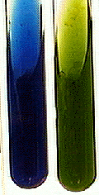
Results for Citrate Test
Negative
Positive

Slide 18
Urea Utilization
Some bacteria produce urease, an enzyme capable of breaking down urea and produce alkaline end products. This distinguishes Proteus from other bacteria
Media and Reagent: Urea Broth with phenol red
Method: Inoculate the media with a loop and incubate at 37°C for 24 hours.
Expected Results:
Positive test: production of alkaline end products = pinkish red color
Negative test: No color change

Slide 19
Results for Urea Test
Negative
Positive

Slide 20
Oxidase Activity
The oxidase test is a biochemical reaction that assays for the presence of cytochrome oxidase.
In the presence of an organism that contains the cytochrome oxidase enzyme, the reduced colorless reagent becomes an oxidized colored product

Slide 21
Oxidase Activity
The reagent:(N,N,N',N' tetramethyl –p-phenylenediamine) is used to do the test
The test must be interpreted within 10 to 20 sec, many organisms in this family can give delayed false positive reaction .
The use of metal loops ( due to iron oxide on its surface) to transfer the colonies for the test gives false positive. Only wooden applicator sticks can be used.
www.mesacc.edu

Slide 22
Nitrate Reduction
This test is used to determine the ability of an organism to reduce nitrate (NO3) to nitrite (NO2) using the enzyme nitrate reductase.

Slide 23
Nitrate Reduction
It can be done on any basal medium that support the growth of the organism and contains 0.1% KNO3.
NO3 NO2 + H2O
Detection of nitrate reduction can be done by:
Addition of alpha-naphtyl amine and sulfanilic acid will form diazonium compound (red color).
If color did not develop, it means one of two possibilities:
NO3 is not reduced to NO2 or
NO3 is reduced to NO2 and further reduced to Nitrogen gas
To check for gas production: add a pinch of zinc dust, the development of red color indicates that nitrate reduction did not take place.
No color development indicates that NO3 was reduced to NO2 and further reduced to nitrogen gas
Nitrate reductase
Notes:
‹#›

Slide 24
Nitrate Reduction
http://biosci.usc.edu/courses/2002-fall/documents/bisc300-lab_NitrateReduction.jpg

Slide 25
Catalase
Catalase is an enzyme found in most bacteria. It catalyzes the breakdown of hydrogen peroxide to release free oxygen.
2 H₂O₂ ---------> 2 H₂O + O₂
Procedure: Add one drop of H₂O₂ to a glass slide with a loopful of growth from each culture to be tested. The development of bubbles is indicative of a positive catalase test.
The test is performed on a blood-free medium. Why??

Slide 26
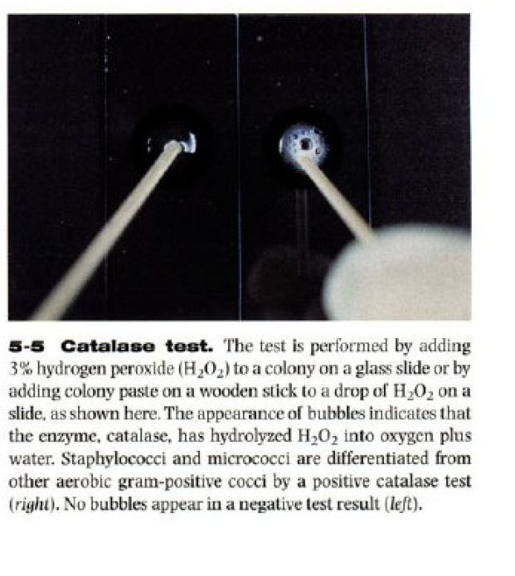
Color atlas of diagnostic microbiology
Mosby, 1997

Slide 27
Coagulase
Coagulase is an enzyme that catalyzes the formation of a fibrin clot in plasma.
The presence of coagulase can be detected by heavily inoculating the test organism into rabbit plasma and incubating the mixture for 4 to 24 hours.
Any degree of clotting during this time, from a loose clot suspended in the plasma to a solid, immovable clot is a positive result.
Staphylococcus aureus produces coagulase enzyme while Staphylococcus epidermidis does not.

Slide 28
Coagulase Results
Reading Results:
If the organism is has coagulase it will clump the plasma.
If the organism does not have coagulase it will not clump the plasma.

Slide 29
What is the purpose of the test
PAD
Proteus mirabilis --positive for PAD
Used to detect whether the bacterai produces the enzyme phenylalanine deaminase, which is needed to use the amino acid phenylalanine as a carbon and energy source for growth.

