Slide 1
1
The Evolution of Microorganisms and Microbiology
‹#›
Copyright © McGraw-Hill Global Education Holdings, LLC. Permission required for reproduction or display.
Notes:
‹#›

Slide 2
The Importance of Microorganisms
Most populous(مزدحم/كثيف بالسكان) and diverse group of organisms
Found everywhere on the planet
Play a major role in recycling essential elements
Source of nutrients and some carry out(تُنفذ/تقوم بِ) photosynthesis
Benefit society by their production of food, beverages(مشروبات), antibiotics, and vitamins
Some cause disease in plants and animals
‹#›
Notes:
‹#›

Slide 3
Members of the Microbial World
Organisms and acellular entities too small to be clearly seen by the unaided eye
some < 1 mm, some macroscopic
These organisms are relatively simple in their construction(بنائهم) and lack highly differentiated cells and distinct tissues
‹#›
Notes:
‹#›

Slide 4
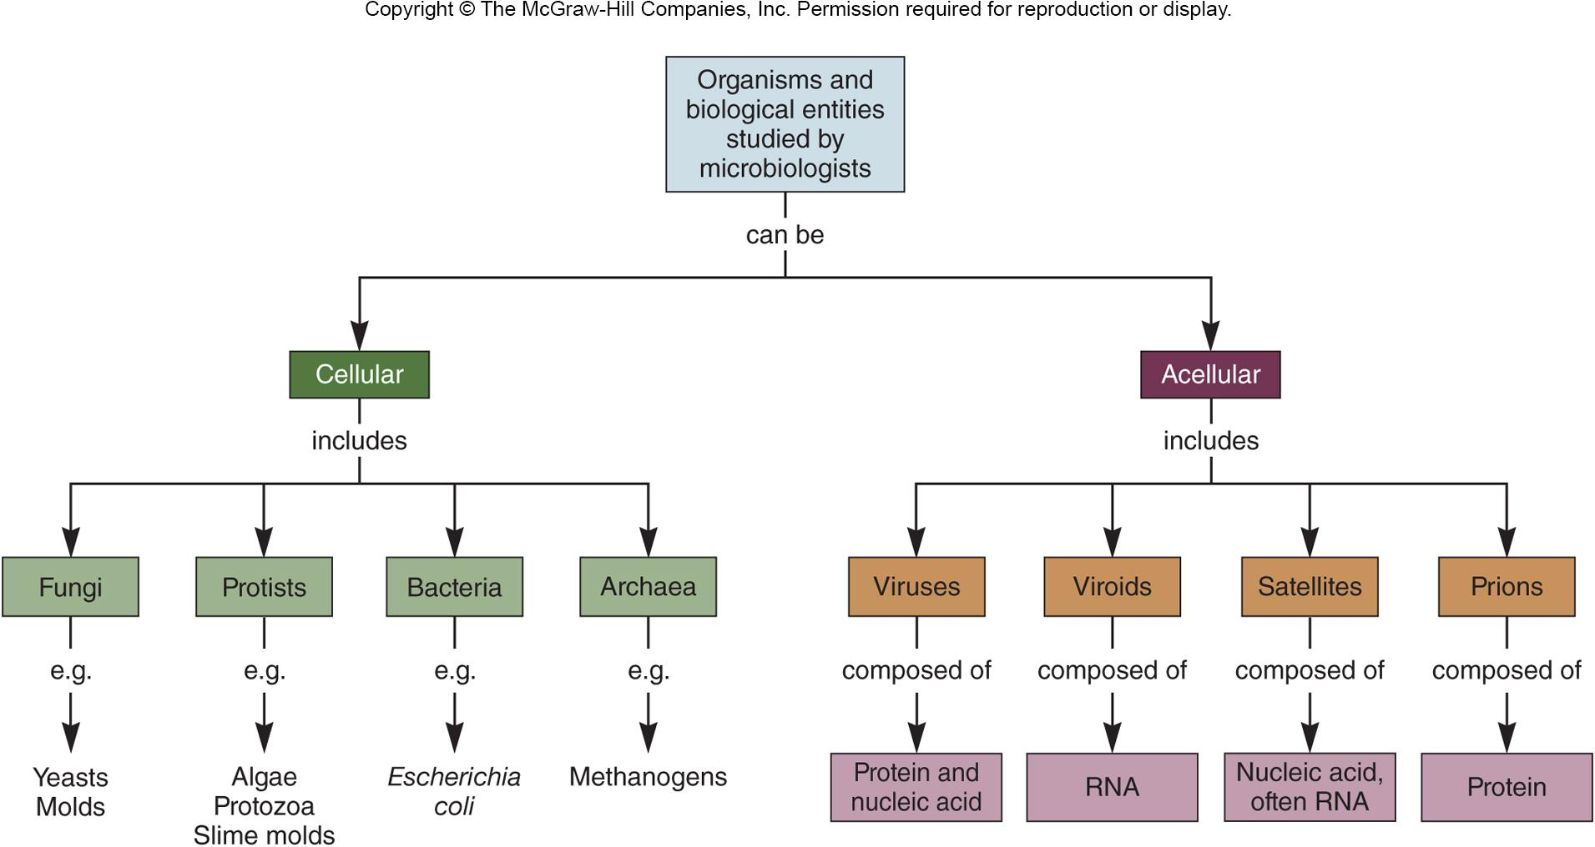
‹#›

Slide 5
Type of Microbial Cells
Prokaryotic cells lack a true membrane-delimited nucleus
this is not absolute!
Eukaryotic cells have a membrane-enclosed nucleus, are more complex morphologically, and are usually larger than prokaryotic cells
‹#›
Notes:
‹#›

Slide 6
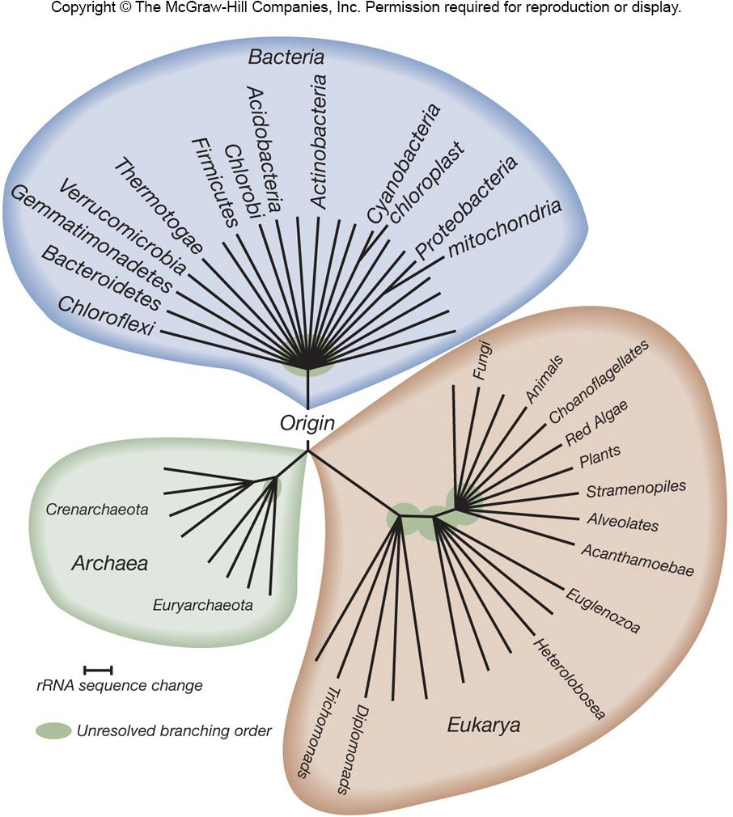
Classification Schemes
Three domain system, based on a comparison of ribosomal RNA genes, divides microorganisms into
Bacteria (true bacteria),
Archaea
Eukarya (eukaryotes)
‹#›
Notes:
‹#›

Slide 7
Domain Bacteria
Usually single-celled
Majority have cell wall with peptidoglycan
Most lack a membrane-bound nucleus
Ubiquitous(واسعة الانتشار) and some live in extreme environments
Cyanobacteria(البكتيريا الزرقاء) produce significant amounts of oxygen
‹#›

Slide 8
Domain Archaea
Distinguished from Bacteria by unique rRNA gene sequences
Lack peptidoglycan in cell walls
Have unique membrane lipids
Some have unusual metabolic characteristics
Many live in extreme environments
‹#›

Slide 9
Domain Eukarya - Eukaryotic
Protists – generally larger than Bacteria and Archaea
algae – photosynthetic
protozoa – may be motile, “hunters, grazers”
slime molds – two life cycle stages
water molds – devastating(مدمر) disease in plants
Fungi
yeast - unicellular
mold - multicellular
‹#›
Notes:
‹#›

Slide 10
Acellular Infectious Agents
Viruses
smallest of all microbes
requires host cell to replicate
cause range of diseases, some cancers
Viroids and virusoids
infectious agents composed of RNA
Prions – infectious proteins
‹#›
Notes:
‹#›

Slide 11
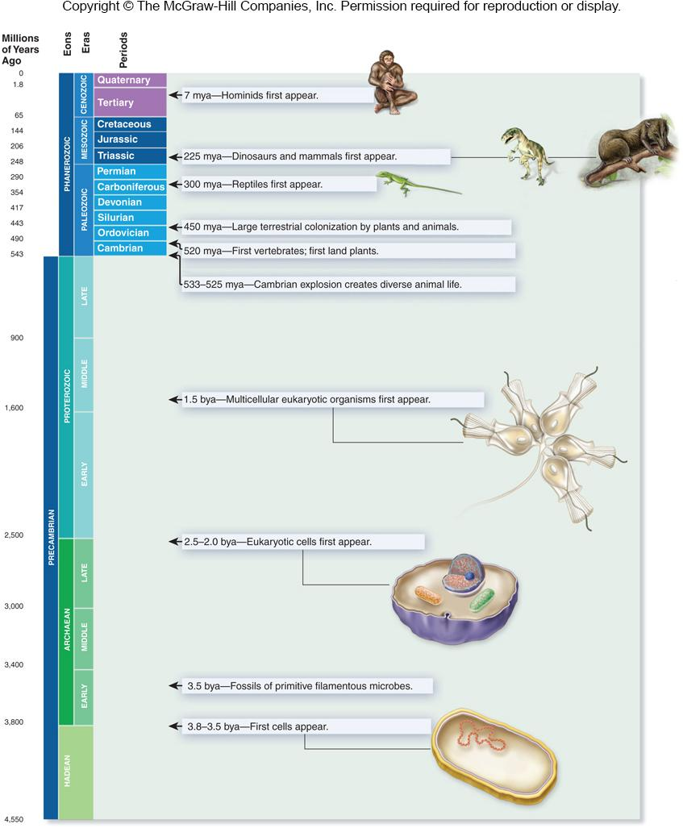
‹#›

Slide 12
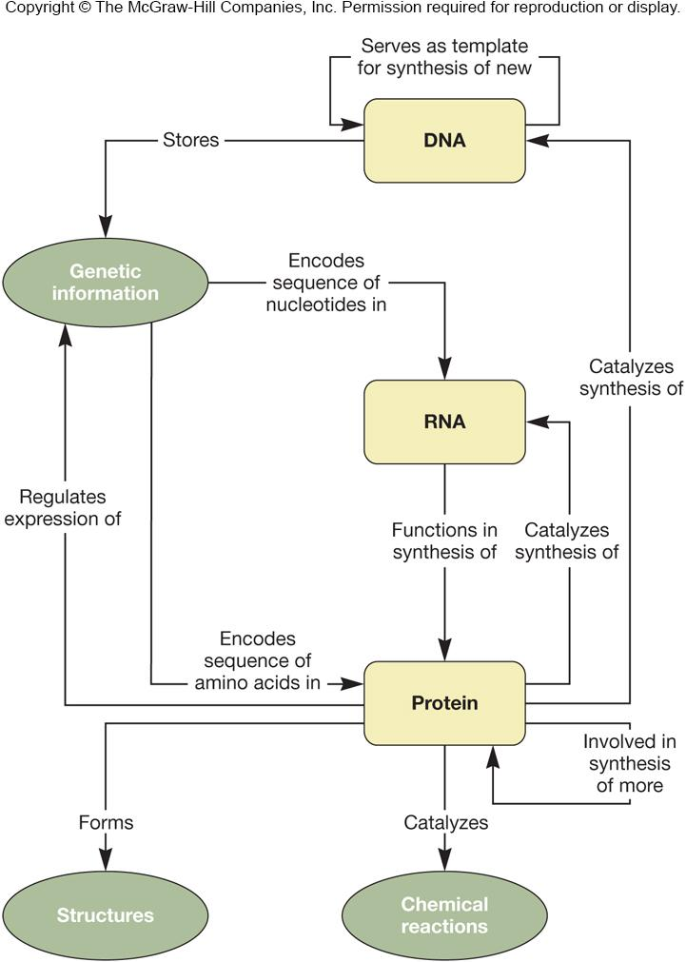
‹#›

Slide 13
Evolution of Cellular Microbes
Mutation of genetic material led to selected traits
New genes and genotypes evolved
Bacteria and Archaea increase genetic pool by horizontal gene(plasmids(في البلازميدات)) transfer within the same generation
‹#›

Slide 14
Microbial Species
Eukaryotic microbes fit definition of reproducing isolated populations
Bacteria and Archaea do not reproduce sexually and are referred to(يُشار اليها)as strains(سلالات)
a strain consists of descendents of a single, pure microbial culture
may be biovars, serovars, morphovars, pathovars
binomial nomenclature(التسميات ذات الحدين)
genus and species epithet(كنية/لقب)
‹#›

Slide 15
Microbiology - Origins
Study of microorganisms
Tools used for the study
Microscopes(المجاهر)
culture techniques
molecular genetics
genomics(المحتوى الوراثي/المجموع الوراثي)
‹#›

Slide 16
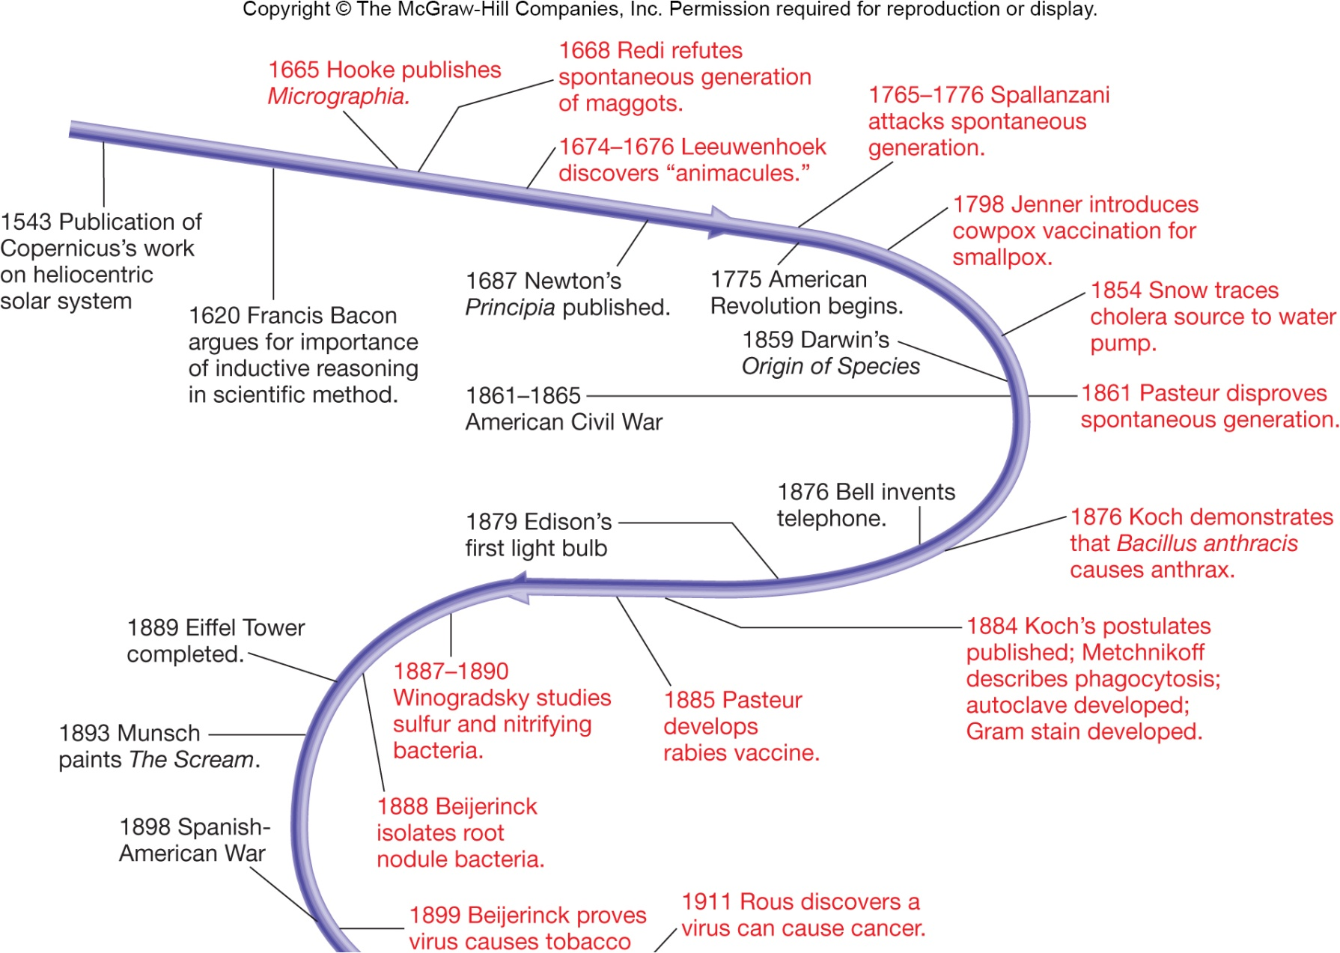
‹#›

Slide 17
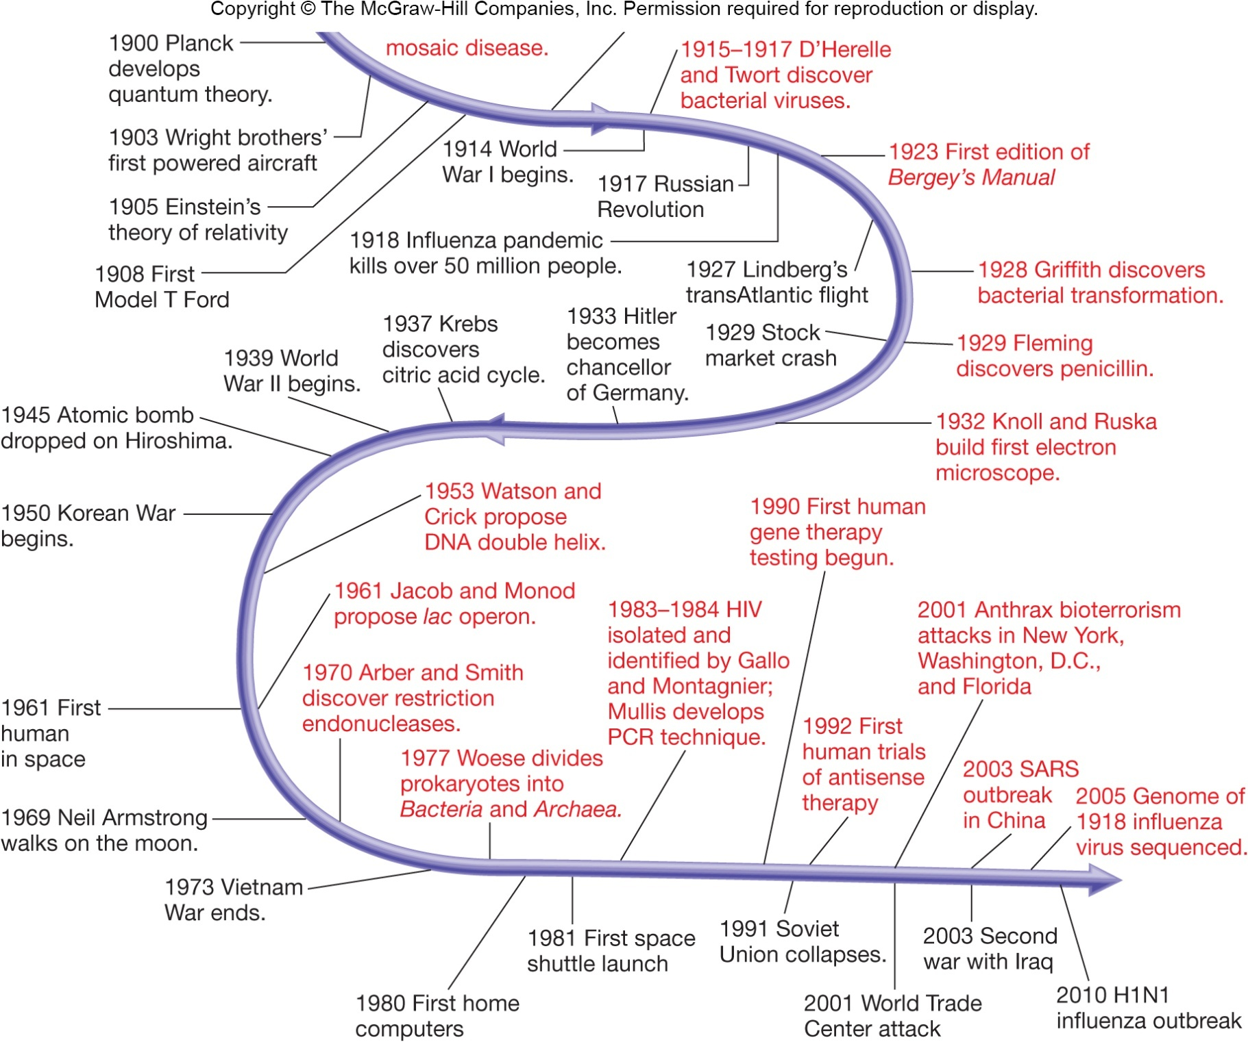
‹#›

Slide 18
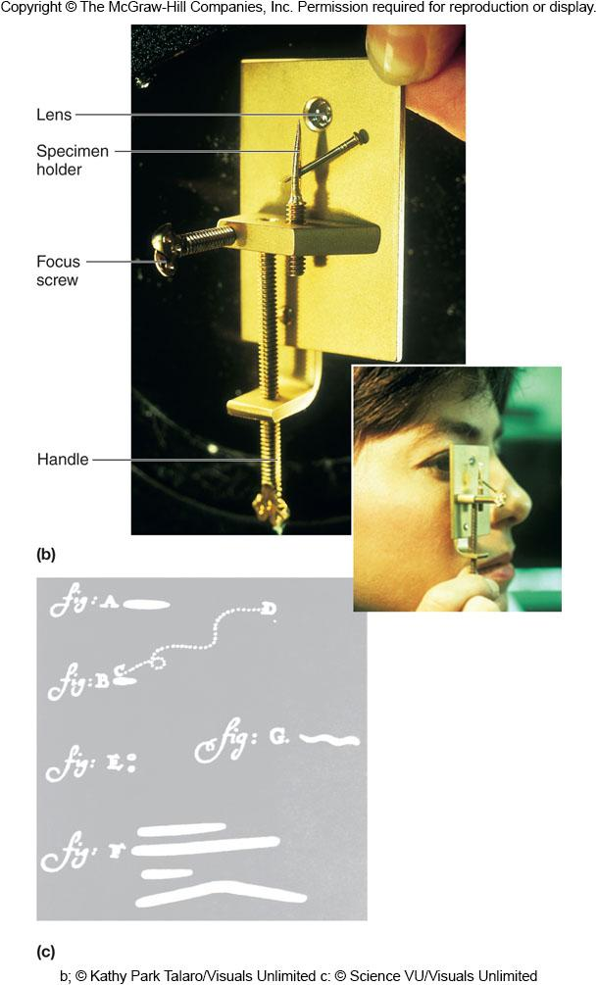
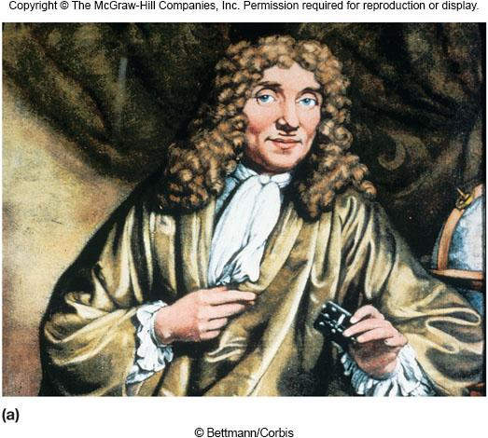
Discovery of Microorganisms
Antony van Leeuwenhoek (1632-1723)
first person to observe and describe microorganisms accurately
‹#›

Slide 19
The Conflict over Spontaneous Generation(الصراع على التولد(الخلق)الذاتي)
Spontaneous generation
Idea that living organisms can develop from nonliving or decomposing matter
Francesco Redi (1626-1697)
discredited spontaneous generation
showed that maggots(الديدان) on decaying meat(اللحوم المتحللة) came from fly eggs
‹#›
Notes:
‹#›

Slide 20
But Could Spontaneous Generation Be True for Microorganisms?
John Needham (1713-1781)
his experiment:
mutton broth in flasks → boiled →sealed
results: broth became cloudy and contained microorganisms
Lazzaro Spallanzani (1729-1799)
his experiment:
broth in flasks →sealed → boiled
results: no growth of microorganisms
‹#›
Notes:
‹#›

Slide 21
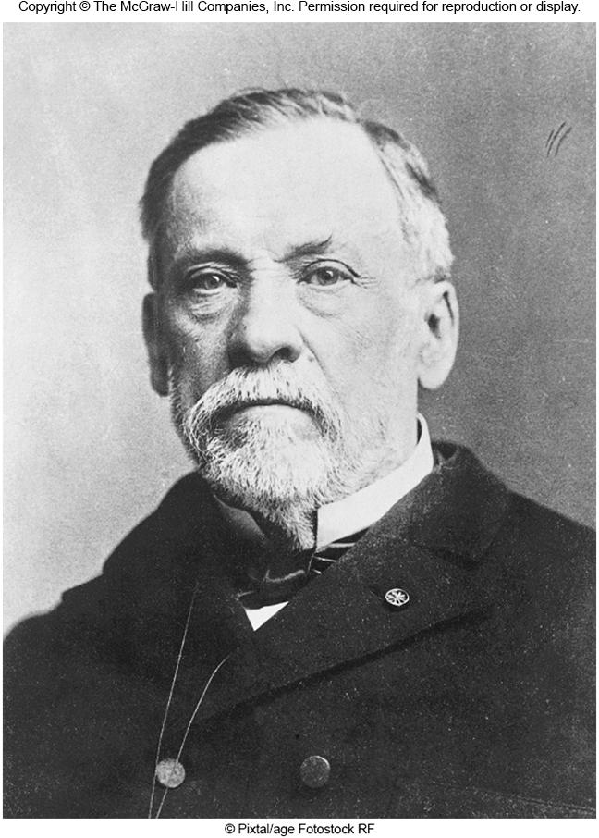
Louis Pasteur (1822-1895)(مهم جداً)
‘Swan-neck flask’ experiments
placed nutrient solution in flasks
created flasks with long, curved necks
boiled the solutions
left flasks exposed to air
results: no growth of microorganisms
‹#›
Notes:
‹#›

Slide 22
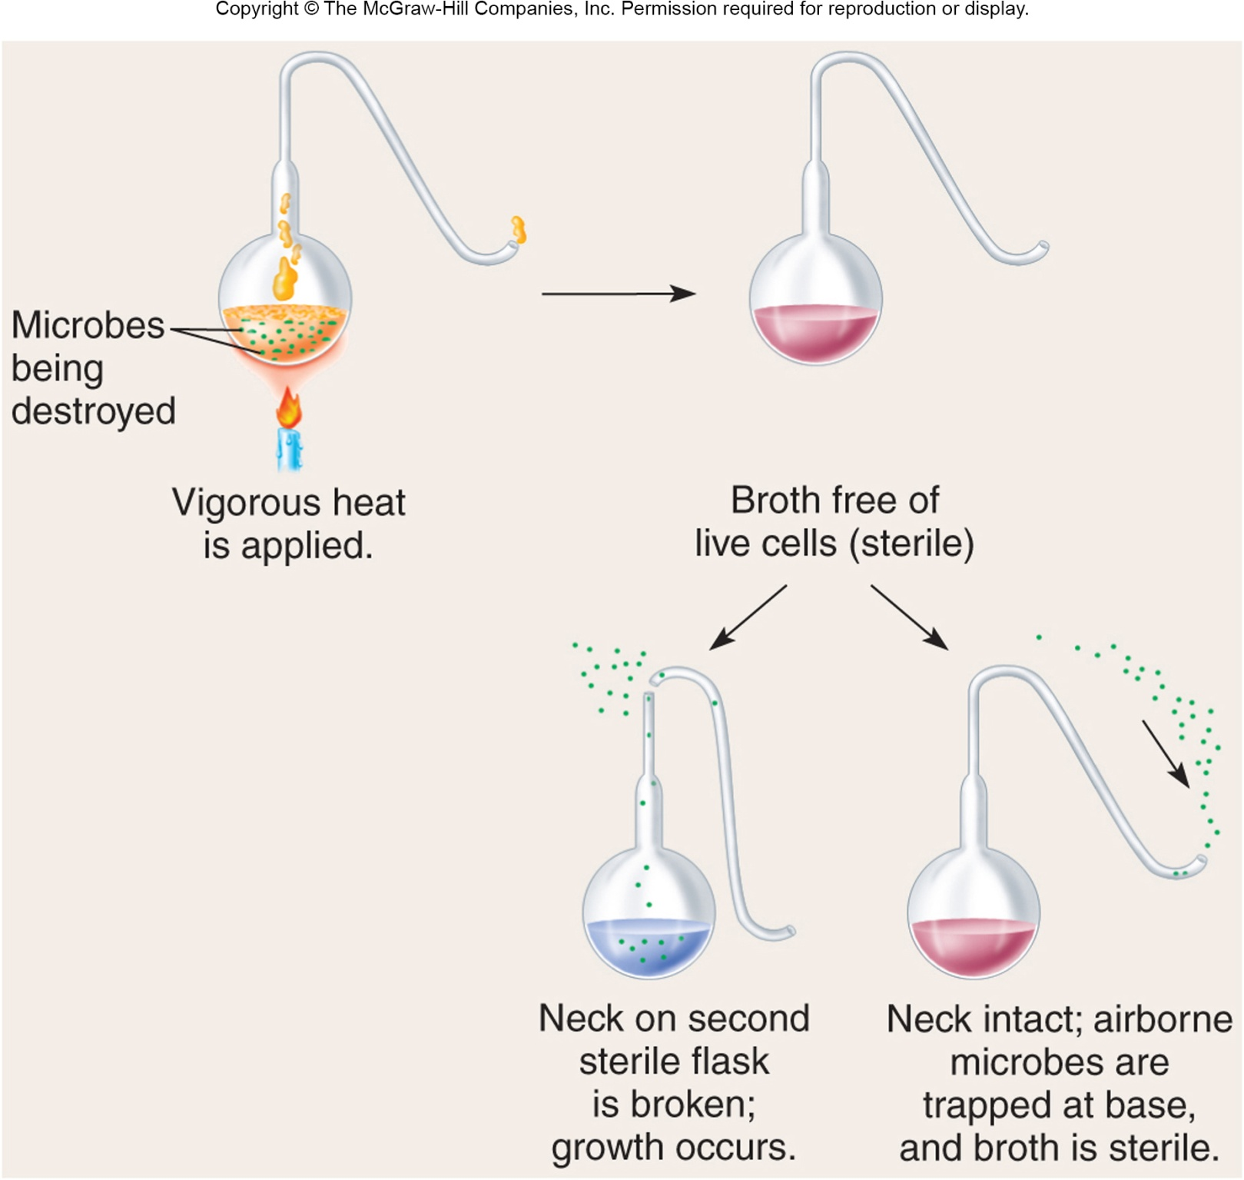
شكل رقبة وزة (Goose)
Little holes to enter air (لإدخال الهواء)
‹#›

Slide 23
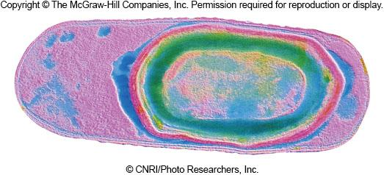
Final Blow(ضربة قاضية) to Theory of Spontaneous Generation
John Tyndall (1820-1893)
demonstrated that dust carries microorganisms
showed that if dust was absent, nutrient broths remained sterile(مُعقم), even if directly exposed to air
also provided evidence for the existence(وجود) of exceptionally heat-resistant forms of bacteria
Ferdinand Cohn (1828-1898)
heat-resistant bacteria could produce endospores(الأبواغ)
‹#›
Notes:
‹#›

Slide 24
Endospores(بوغ داخلي)
الأبواغ الداخلية أو التحوصل:هو أن تقوم الأوليات بإحاطة نفسها بغلاف سميك مكونة ما يسمى بالحوصلة وذلك في الظروف غير الملائمة مثل:
نقص الغذاء . نقص الرطوبة . نقص الأكسجين . عدم ملائمة درجة الحرارة. وجود مواد كيميائية سامة لها.
أهمية الحوصلة:تعطي الحوصلة فترة زمنية أطول للكائن للبقاء حيا وتساعده على العيش خارج جسم العائل الذي تتطفل عليه حتى تسمح لها الظروف بالعودة إلى جسم العائل فتخرج من الحوصلة.
‹#›

Slide 25
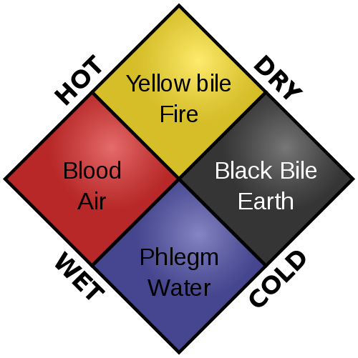
The Role of Microorganisms in Disease
Was not immediately obvious
Infectious disease believed to be due to supernatural forces or imbalances of 4 bodily-fluid ‘humors’(المزاجات)(الدم/البلغم/أسود الصفراء/الصفراوية صفراء)
Establishing connection depended on development of techniques for studying microbes
‹#›
Notes:
‹#›

Slide 26
Evidence for the Relationship between Microorganisms and Disease
Agostini Bassi (1773-1856)
showed that a disease of silkworms was caused by a fungus
M. J. Berkeley (ca. 1845)
demonstrated that the great Potato Blight of Ireland was caused by a water mold
Heinrich de Bary (1853)
showed that smut(تفحم) and rust(صدأ) fungi caused cereal crop diseases(أمراض محصول الحبوب)
‹#›
Notes:
‹#›

Slide 27
Other Evidence…
Joseph Lister
provided indirect evidence that microorganisms were the causal agents(عوامل سببية) of disease
developed a system of surgery designed to prevent microorganisms from entering wounds(الجروح) as well as methods for treating instruments and surgical dressings(الأدوات والضمادات الجراحية)
his patients had fewer postoperative infections(التهابات ما بعد الجراحة)
‹#›
Notes:
‹#›

Slide 28
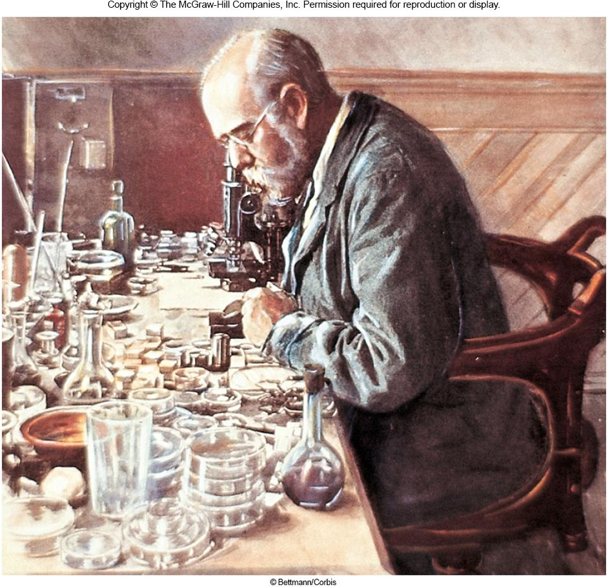
Final Proof…
Robert Koch (1843-1910)
established the relationship between Bacillus anthracis and anthrax(العصوية الجمرية(العامل المسبب للجمرة الخبيثة) و الجمرة الخبيثة)
used criteria developed by his teacher Jacob Henle (1809-1895)
these criteria now known as Koch’s postulates
still used today to establish the link between a particular microorganism and a particular disease
‹#›
Notes:
‹#›

Slide 29
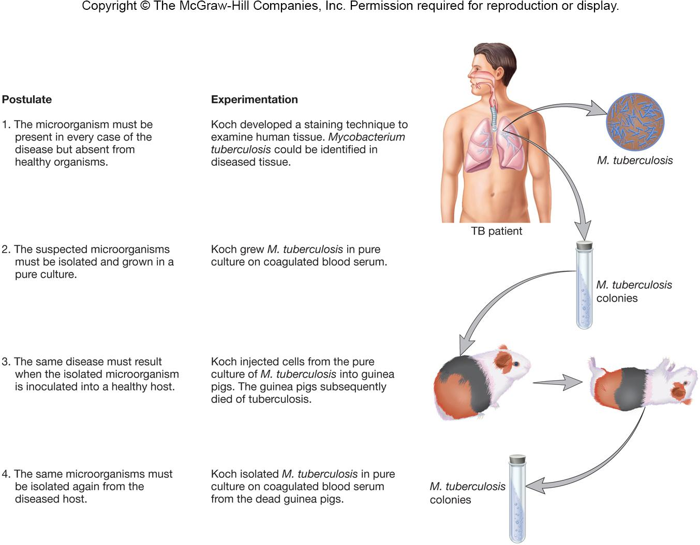
‹#›

Slide 30
Limitations of Koch’s Postulates
Some organisms cannot be grown in pure culture
Using humans in completing the postulates is unethical
Molecular and genetic evidence may replace and overcome these limits
‹#›

Slide 31
The Development of Techniques for Studying Microbial Pathogens
Koch’s work led to discovery or development of:
agar
Petri dishes
nutrient broth and nutrient agar
methods for isolating microorganisms
‹#›
Notes:
‹#›

Slide 32
Other Developments…
Charles Chamberland (1851-1908)
developed porcelain(الخزف) bacterial filters used by Ivanoski and Beijerinck to study tobacco mosaic disease(مرض تبرقش التبغ)
determined that extracts from diseased plants had infectious agents present which were smaller than bacteria and passed through the filters
infectious agents were eventually shown to be viruses
‹#›
Notes:
‹#›

Slide 33
Other Developments…
Pasteur and Roux
discovered that incubation(حضانة) of cultures for long intervals between transfers caused pathogens to lose their ability to cause disease (termed ‘attenuation(تخفيف)’)
Pasteur and his coworkers
developed vaccines(لقاحات) for chicken cholera(الكوليرا), anthrax, and rabies(داء الكلب)
‹#›
Notes:
‹#›

Slide 34
Immunological Studies(الدراسات المناعية)
once established, led to study of host defenses - immunology
Edward Jenner (ca. 1798)
used a vaccination procedure to protect individuals from smallpox
NOTE: this preceded the work establishing the role of microorganisms in disease!
‹#›
Notes:
‹#›

Slide 35
More Developments…
Emil von Behring (1854-1917) and Shibasaburo Kitasato (1852-1931)
developed antitoxins(مضادات السموم) for diphtheria(خناق) and tetanus(كزاز)
evidence for humoral (antibody-based) immunity
Elie Metchnikoff (1845-1916)
discovered bacteria-engulfing, phagocytic cells(خلايا آكلة) in the blood
evidence for cellular immunity
‹#›
Notes:
‹#›

Slide 36
The Development of Industrial Microbiology and Microbial Ecology
Louis Pasteur
demonstrated that alcohol fermentations(تخمير) and other fermentations were the result of microbial activity
developed the process of pasteurization(بسترة) to preserve(للحفاظ على) wine during storage
‹#›
Notes:
‹#›

Slide 37
Developments in Microbial Ecology
Sergei Winogradsky (1856-1953) and Martinus Beijerinck (1851-1931)
studied soil microorganisms and discovered numerous interesting metabolic processes (e.g., nitrogen fixation)
Pioneered(رائدة) the use of enrichment(مخصبة) cultures and selective media
‹#›
Notes:
‹#›

Slide 38
Microbiology Has Basic and Applied Aspects
Basic aspects are concerned with individual groups of microbes, microbial physiology, genetics, molecular biology and taxonomy
Applied aspects are concerned with practical problems – disease, water, food and industrial microbiology
‹#›
Notes:
‹#›

Slide 39
Molecular and Genomic Methods
Led to a second golden age of microbiology (rapid expansion of knowledge)
Discoveries
restriction endonucleases (Arber and Smith)
first novel recombinant molecule (Jackson, Symons, Berg)
DNA sequencing methods (Woese, Sanger)
bioinformatics and genomic sequencing and analysis
‹#›

Slide 40
Major Fields in Microbiology
Medical microbiology – diseases of humans and animals
Public health microbiology – control and spread of communicable diseases(الأمراض المعدية)
Immunology(علم المناعة) – how the immune system protects a host from pathogens(مسببات الأمراض)
‹#›

Slide 41
More Fields…
Microbial ecology is concerned with(مهتمة بِ) the relationship of organisms with their environment
less than 1% of earth’s microbial population has been cultured
Agricultural(الزراعية) microbiology is concerned with the impact of microorganisms on agriculture
food safety microbiology
animal and plant pathogens
‹#›
Notes:
‹#›

Slide 42
More Fields….
Industrial microbiology began in the 1800s
fermentation(تخمير)
antibiotic production(انتاج المضادات الحيوية)
production of cheese, bread, etc.
Microbial physiology studies metabolic pathways of microorganisms
‹#›

Slide 43
More Fields….
Molecular biology, microbial genetics, and bioinformatics study the nature of genetic information and how it regulates the development and function of cells and organisms
Microbes are a model system of genomics
‹#›

