Slide 1
11
Catabolism: Energy Release and Conservation
‹#›
Copyright © McGraw-Hill Global Education Holdings, LLC. Permission required for reproduction or display.
Notes:
‹#›

Slide 2
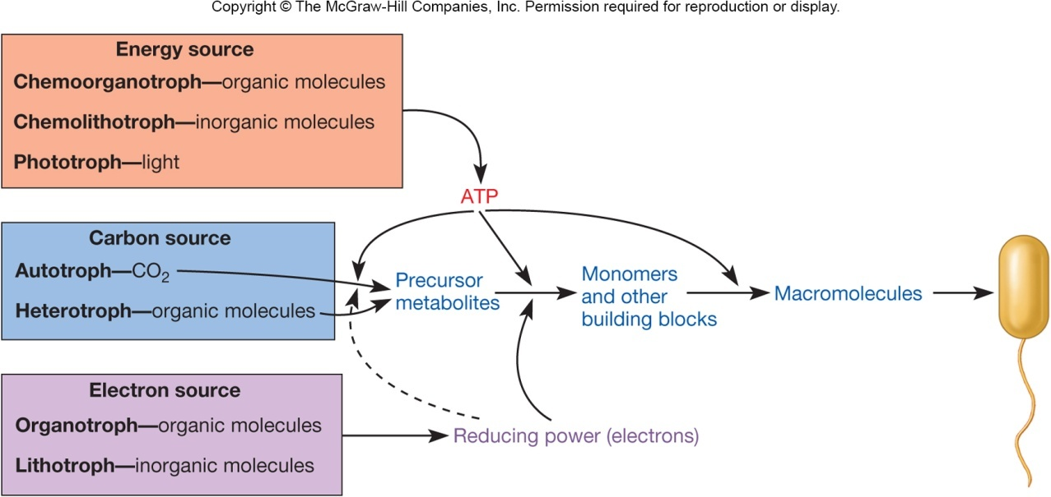
Fueling Reactions
Despite diversity of energy, electron, and carbon sources used by organisms, they all have the same basic needs
ATP as an energy currency
Reducing power to supply electrons for chemical reactions
Precursor metabolites for biosynthesis
‹#›

Slide 3
Microorganisms May Change Nutritional Type
Some have great metabolic flexibility based on environmental requirements
Provides distinct advantage if environmental conditions change frequently
‹#›

Slide 4
Chemoorganotrophic Fueling Processes
Also called chemoheterotrophs
Processes
aerobic respiration
anaerobic respiration
fermentation
‹#›

Slide 5
Catabolic(الهدم) Pathways
Enzyme catalyzed reactions whereby(بواسطة) the product of one reaction serves as the substrate for the next
Pathways also provide materials for biosynthesis
Amphibolic pathways
‹#›

Slide 6
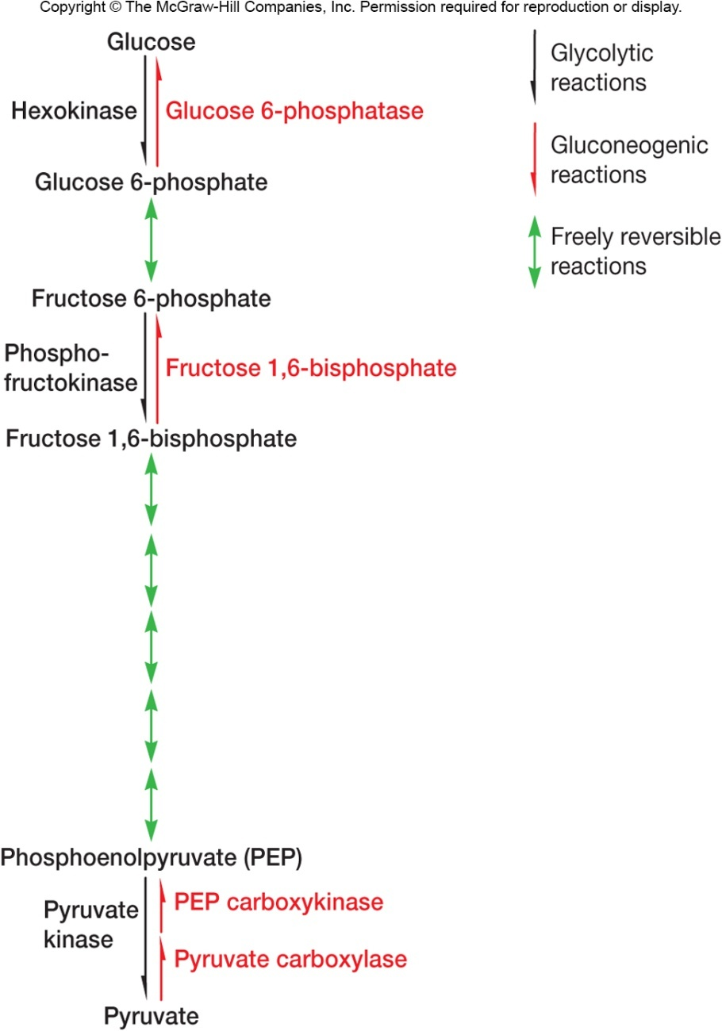
Amphibolic Pathways
Function both as catabolic and anabolic pathways
Important ones
Embden-Meyerhof pathway
pentose phosphate pathway
tricarboxylic acid (TCA) cycle
‹#›
Notes:
‹#›

Slide 7
Aerobic Respiration
Process that can completely catabolize an organic energy source to CO₂ using
glycolytic pathways (glycolysis)
TCA cycle
electron transport chain with oxygen as the final electron acceptor
Produces ATP (most of it indirectly via the activity of the electron transport chain), and high energy electron carriers
‹#›

Slide 8
The Breakdown of Glucose to Pyruvate
Three common routes
Embden-Meyerhof pathway
pentose phosphate pathway
Entner-Duodoroff pathway
‹#›
Notes:
‹#›

Slide 9
The Embden-Meyerhof Pathway
Occurs in cytoplasmic matrix of most microorganisms, plants, and animals
The most common pathway for glucose degradation to pyruvate in stage two of aerobic respiration
Function in presence or absence of O₂
Two phases
Six carbon phase
Three carbon phase
‹#›
Notes:
‹#›

Slide 10
Oxidation-Reduction Reactions
Oxidation-reduction reactions (redox)- Reactions in which electrons move from an electron donor to an electron acceptor
As an electron moves from the donor to the acceptor, the donor become less energy rich and the acceptor becomes more energy rich
Acceptor + ne⁻ donor
Standard equilibrium potential (E0)- It is the measure of the tendency of the donor to lose electrons
‹#›

Slide 11
The reduction oxidation couples
‹#›

Slide 12
Energy conservation in fermentation and respiration
‹#›

Slide 13
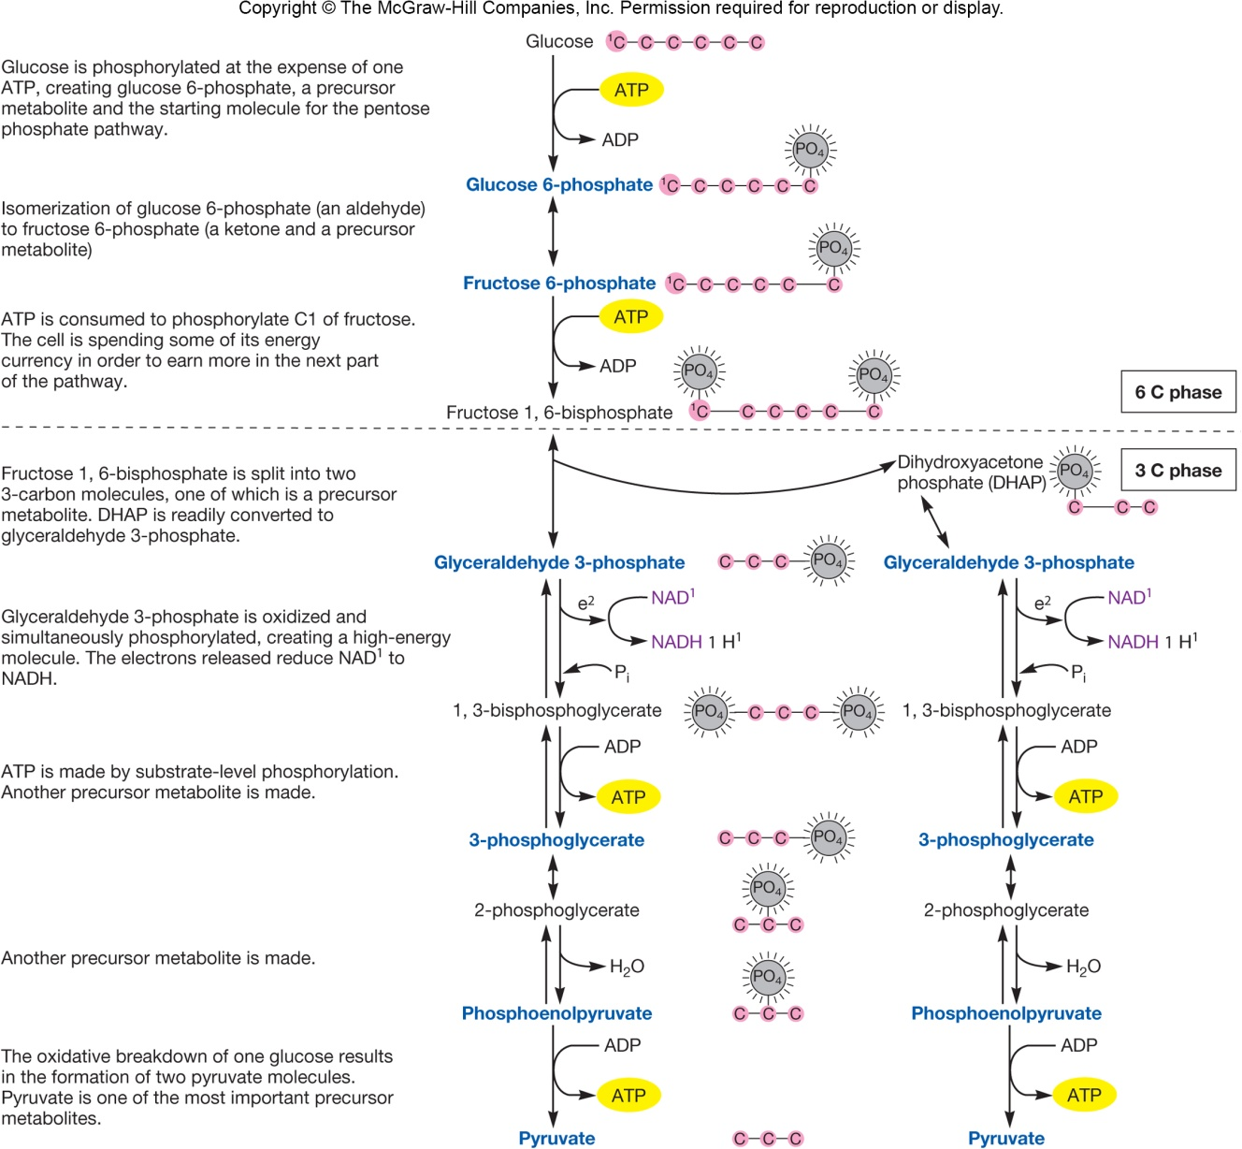
Addition of phosphates
“primes the pump”
Oxidation step – generates NADH
High-energy molecules –
used to synthesize ATP
by substrate-level
phosphorylation
‹#›
Notes:
‹#›

Slide 14
Summary of Glycolysis
glucose + 2ADP + 2P_{i} + 2NAD⁺
↓
2 pyruvate + 2ATP + 2NADH + 2H⁺
‹#›
Notes:
‹#›

Slide 15
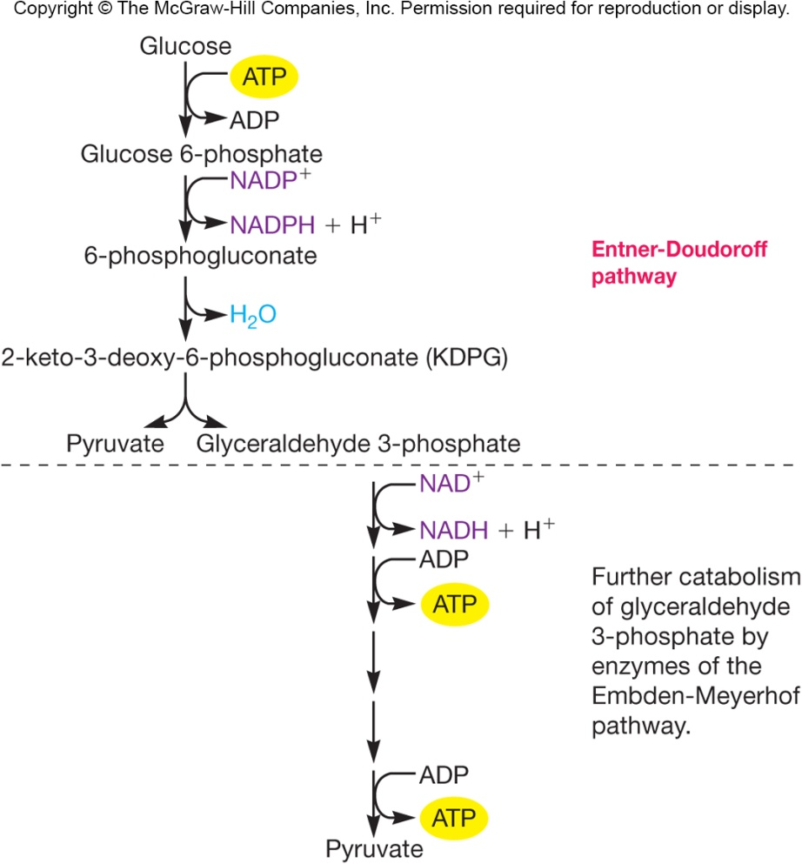
The Entner-Duodoroff Pathway
Used by soil bacteria and a few gram-negative bacteria
Replaces the first phase of the Embden-Meyerhof pathway
Yield per glucose molecule:
1 ATP
1 NADPH
1 NADH
Reactions of
glycolytic
pathway
‹#›

Slide 16
The Pentose Phosphate Pathway
Also called hexose monophosphate pathway
Can operate at same time as glycolytic pathway or Entner-Duodoroff pathway
Can operate aerobically or anaerobically
An amphibolic pathway
‹#›

Slide 17
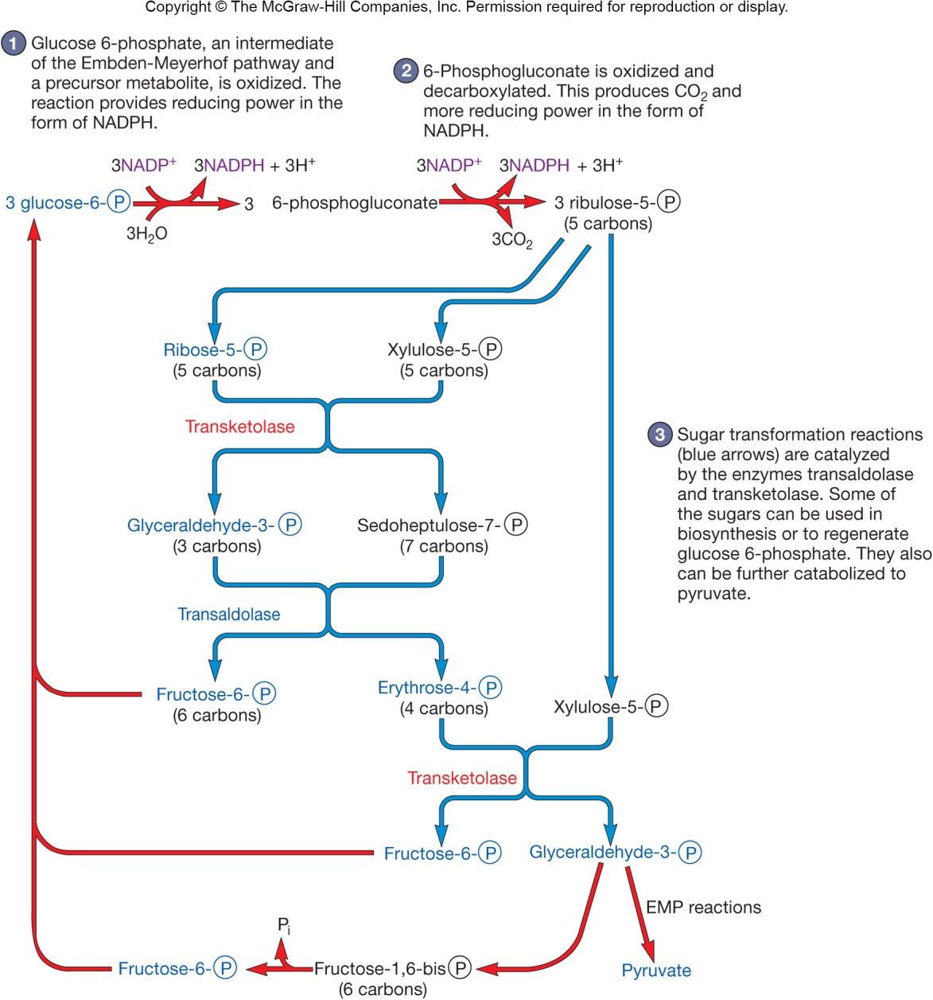
Oxidation
steps
Produce
NADPH,
which is
needed for
biosynthesis
Sugar
trans-
formation
reactions
Produce
sugars
needed
for
biosynthesis
Sugars can
also be
further
degraded
‹#›
Notes:
‹#›

Slide 18
Summary of Pentose Phosphate Pathway
glucose-6-P + 12NADP⁺ + 7H₂O
↓
6CO₂ + 12NADPH + 12H⁺ P_{i}
‹#›
Notes:
‹#›

Slide 19
The Tricarboxylic Acid Cycle
Also called citric acid cycle and Kreb’s cycle
Common in aerobic bacteria, free-living protozoa, most algae, and fungi
Major role is as a source of carbon skeletons for use in biosynthesis
‹#›
Notes:
‹#›

Slide 20
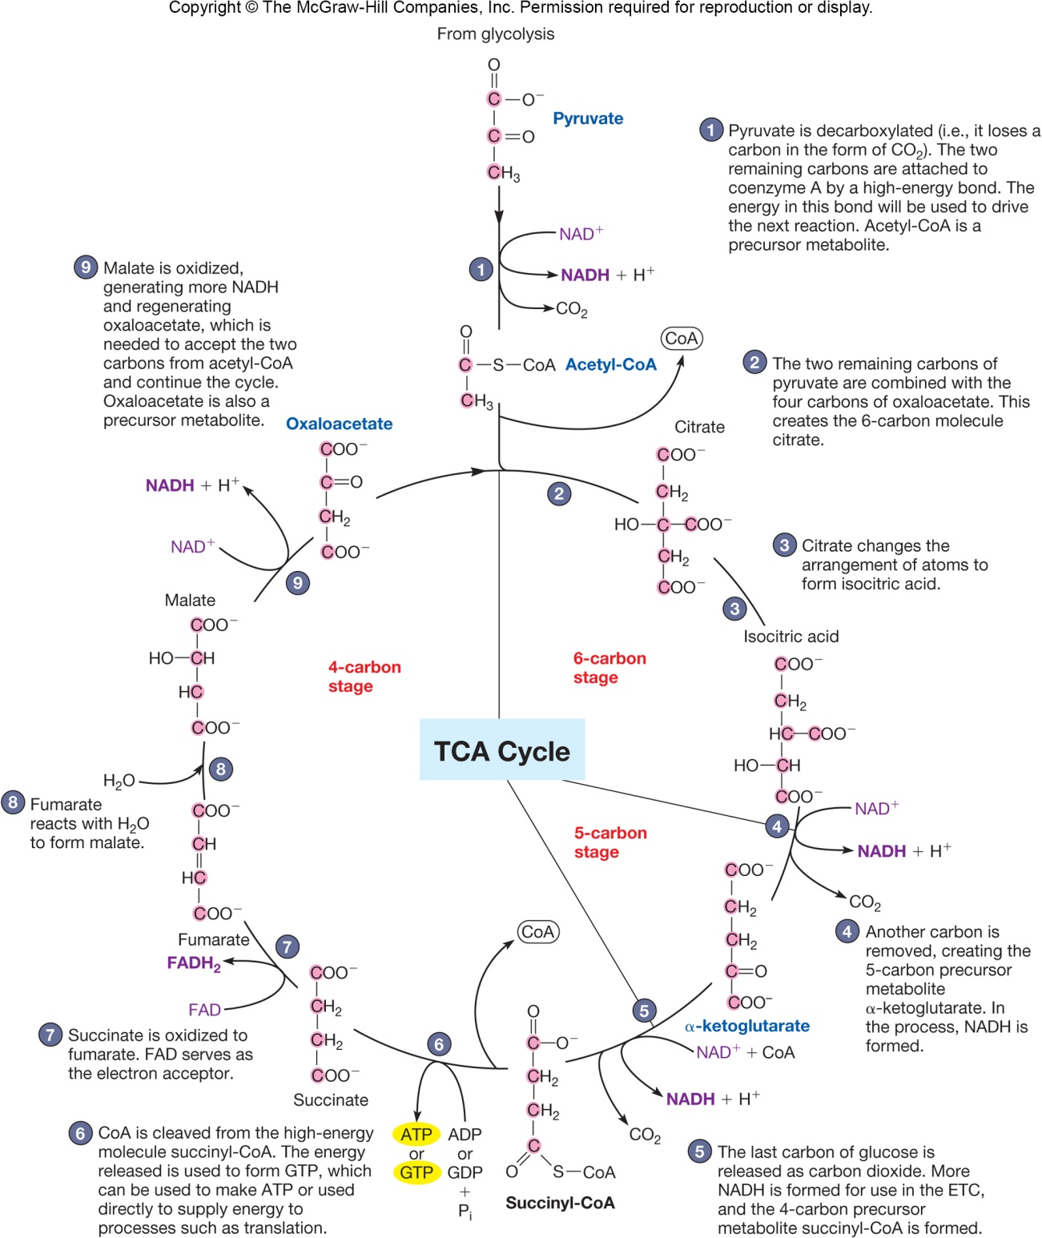
Summary TCA Cycle
for each acetyl-CoA molecule oxidized, TCA cycle generates:
2 molecules of CO₂
3 molecules of NADH
one FADH₂
one GTP
‹#›

Slide 21
Electron Transport and Oxidative Phosphorylation
Only 4 ATP molecules synthesized directly from oxidation of glucose to CO₂
Most ATP made when NADH and FADH₂ (formed as glucose degraded) are oxidized in electron transport chain (ETC)
‹#›
Notes:
‹#›

Slide 22
Bacterial and Archaeal ETCs
Located in plasma membrane
Some resemble(يشبه) mitochondrial ETC, but many are different
different electron carriers
may be branched
may be shorter
‹#›
Notes:
‹#›

Slide 23
Paracoccus denitrificans
Facultative, soil bacterium
Extremely versatile metabolically
Under oxic conditions, uses aerobic respiration
similar electron carriers and transport mechanism as mitochondria
protons transported to periplasmic space rather than inner mitochondrial membrane
can use one carbon molecules instead of glucose
‹#›

Slide 24
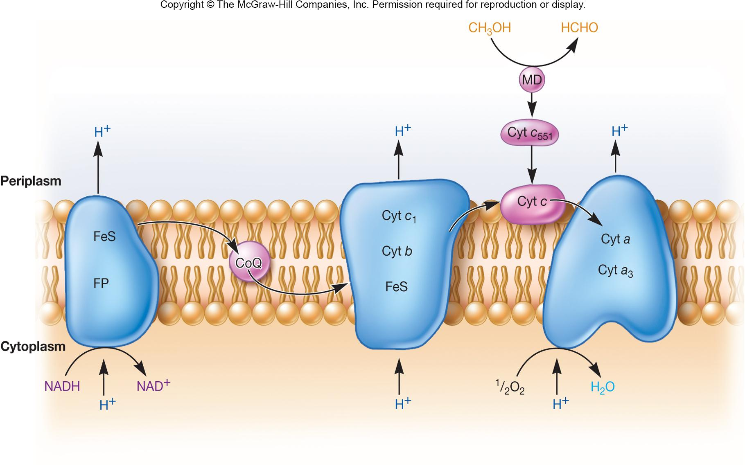
‹#›
Notes:
‹#›
Note that methanol and methylamine can also donate electrons to the chain.

Slide 25
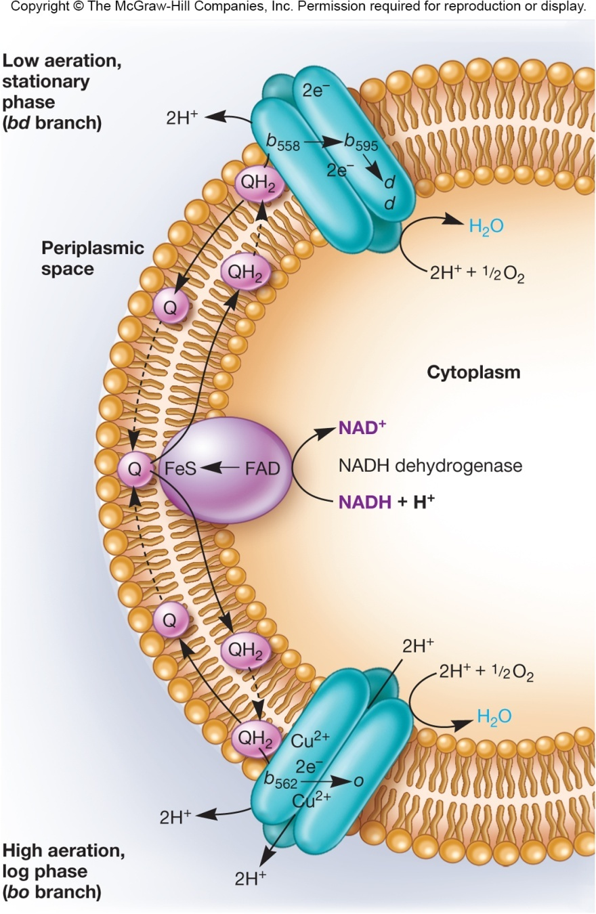
Electron Transport Chain of E. coli
Branched pathway
Different array of cytochromes used than in mitochondrial
Upper branch –
stationary phase and low aeration
Lower branch – log phase and high aeration
‹#›
Notes:
‹#›

Slide 26
Oxidative Phosphorylation
Process by which ATP is synthesized as the result of electron transport driven by the oxidation of a chemical energy source
‹#›
Notes:
‹#›

Slide 27
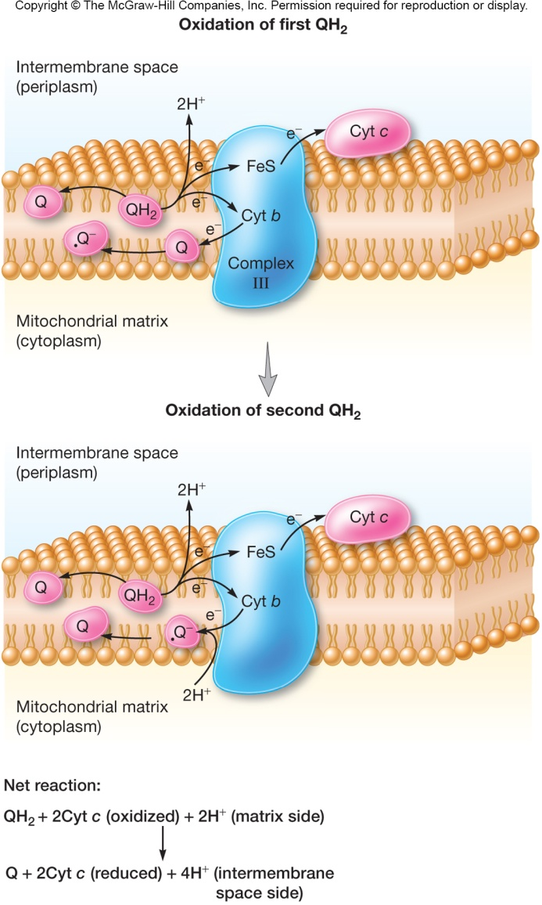
Chemiosmotic Hypothesis
The most widely accepted hypothesis to explain oxidative phosphorylation
protons move outward from the mitochondrial matrix as e⁻ are transported down the chain
proton expulsion(يطرد) during e⁻ transport results in the formation of a concentration gradient of protons and a charge gradient
the combined chemical and electrical potential difference make up the proton motive force (PMF)
‹#›
Notes:
‹#›

Slide 28
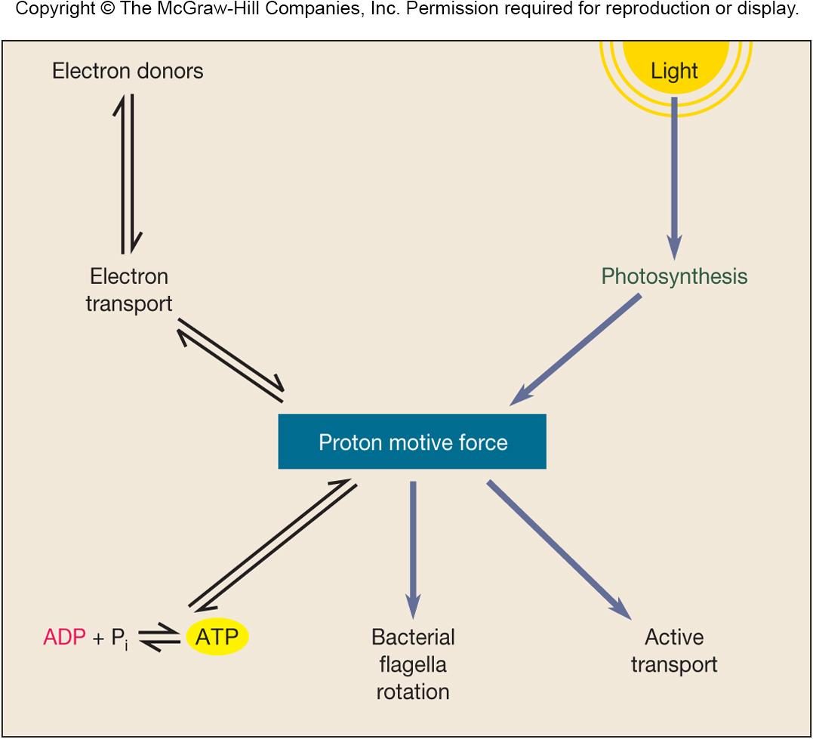
‹#›

Slide 29
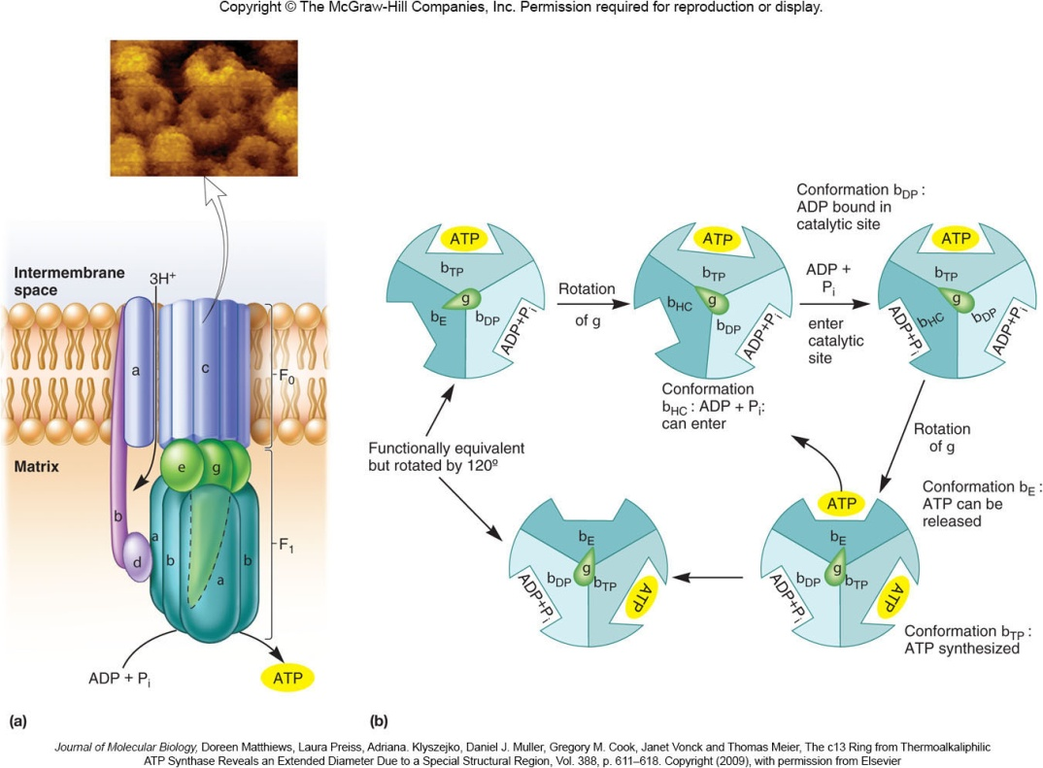
PMF Drives ATP Synthesis
Diffusion of protons back across membrane (down gradient) drives formation of ATP
ATP synthase
uses PMF down gradient to catalyze ATP synthesis
functions like rotary engine (conformational changes)
‹#›
Notes:
‹#›

Slide 30
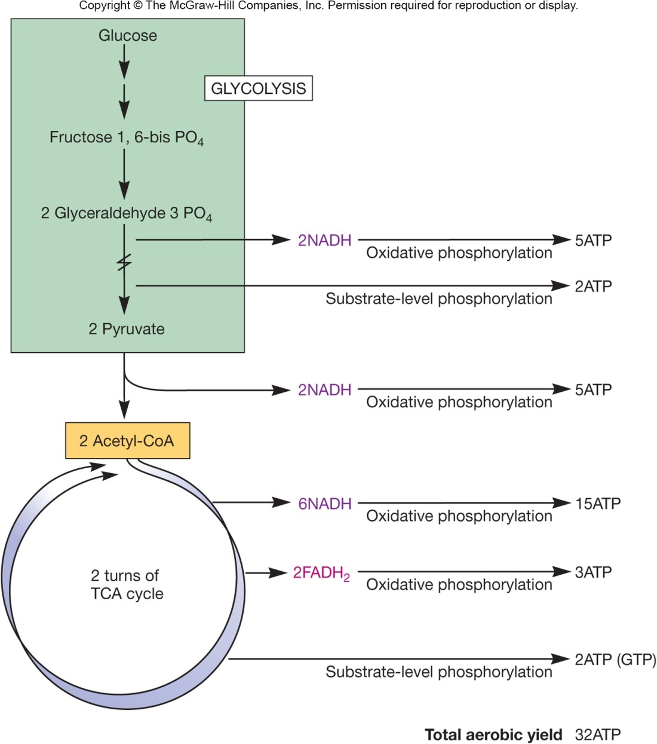
ATP Yield During Aerobic Respiration
Maximum ATP yield can be calculated
includes P/O ratios of NADH and FADH₂
ATP produced by substrate level phosphorylation
The theoretical maximum total yield of ATP during aerobic respiration is 38
the actual number closer to 30 than 38
‹#›
Notes:
‹#›

Slide 31
Theoretical vs. Actual Yield of ATP
Amount of ATP produced during aerobic respiration varies depending on growth conditions and nature of ETC
Under anaerobic conditions, glycolysis only yields 2 ATP molecules
‹#›
Notes:
‹#›

Slide 32
Factors Affecting ATP Yield
Bacterial ETCs are shorter and have lower P/O ratios
ATP production may vary with environmental conditions
PMF in bacteria and archaea is used for other purposes than ATP production (flagella rotation)
Precursor metabolite may be used for biosynthesis
‹#›

Slide 33
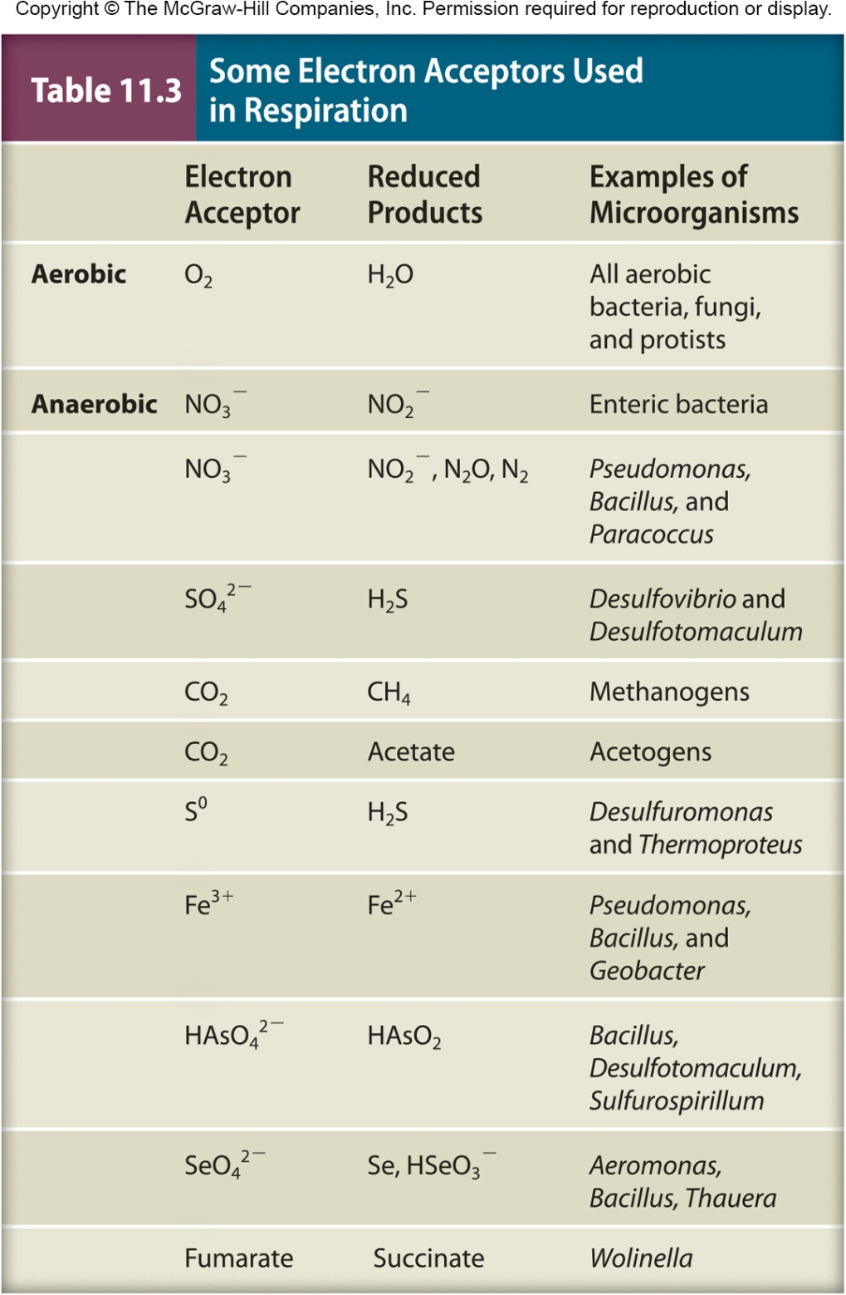
Anaerobic Respiration
Uses electron acceptors (carriersخطأ )other than O₂
Generally yields less energy because E₀ of electron acceptor is less positive than E₀ of O₂
‹#›
Notes:
‹#›

Slide 34
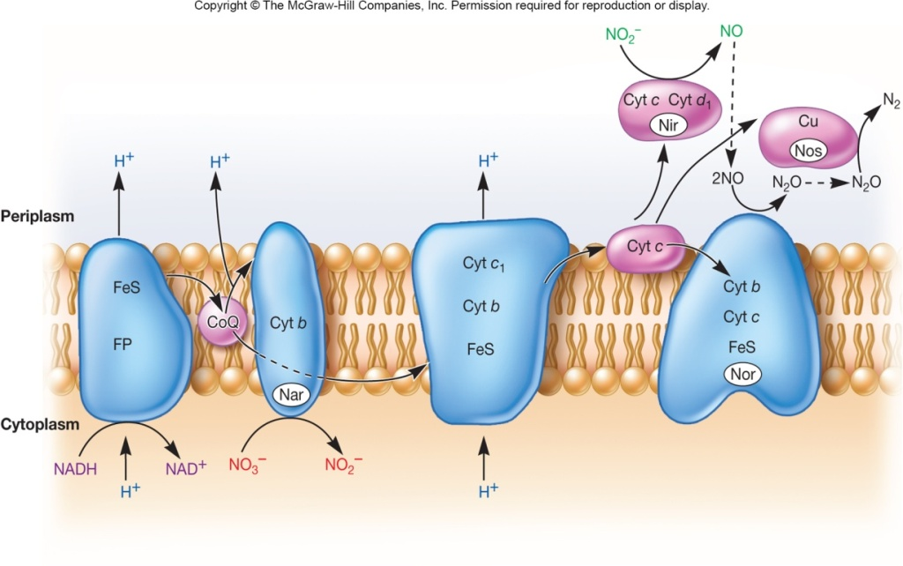
An Example…
Dissimilatory nitrate reduction
use of nitrate as terminal electron acceptor, making it unavailable to cell for assimilation(للاستيعاب) or uptake
Denitrification
reduction of nitrate to nitrogen gas
in soil, causes loss of soil fertility(خصوبة التربة)
‹#›
Notes:
‹#›

Slide 35
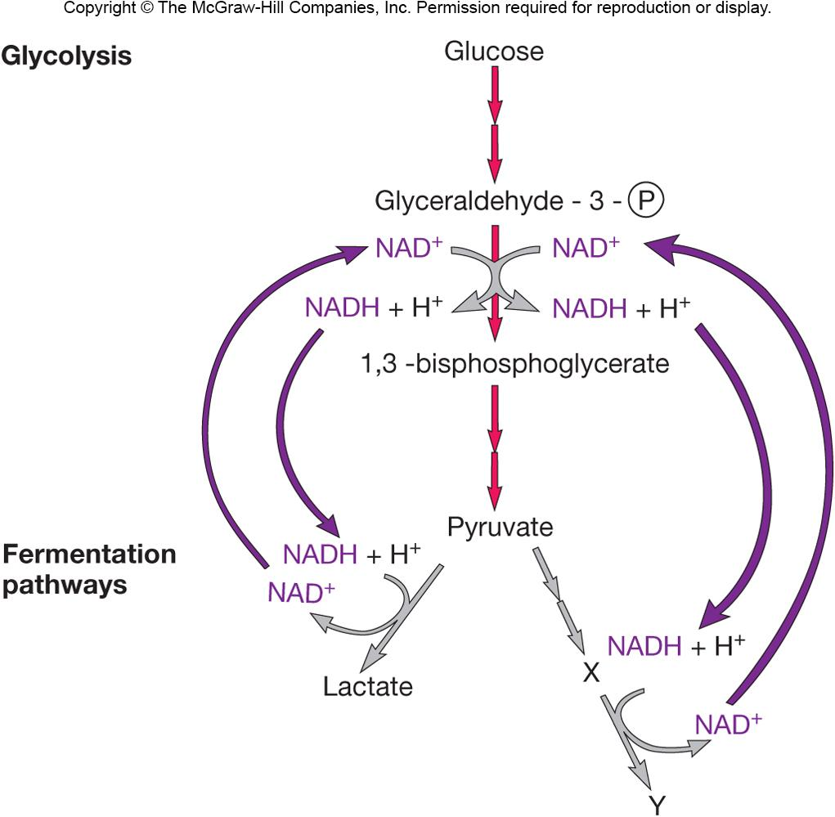
Fermentation
Oxidation of NADH produced by glycolysis
Pyruvate or derivative used as endogenous electron acceptor
Substrate only partially oxidized
Oxygen not needed
Oxidative phosphorylation does not occur
ATP formed by substrate-level phosphorylation
‹#›
Notes:
‹#›

Slide 36
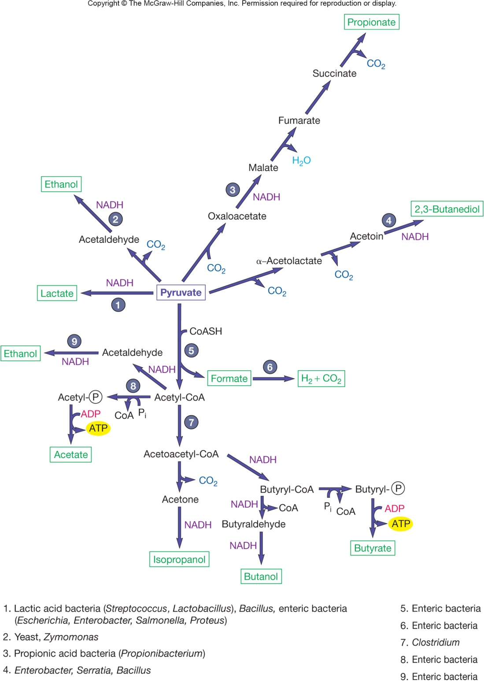
Alcoholic
fermentation
Homolactic
fermenters
Heterolactic
fermenters
Food
Spoilage(تلف المواد الغذائية)
Alcoholic
beverages,
bread, etc.
Yogurt,
sauerkraut,
pickles, etc.(زبادي(لبن)/مخلل ملفوف/مخللات)
‹#›
Notes:
‹#›

Slide 37
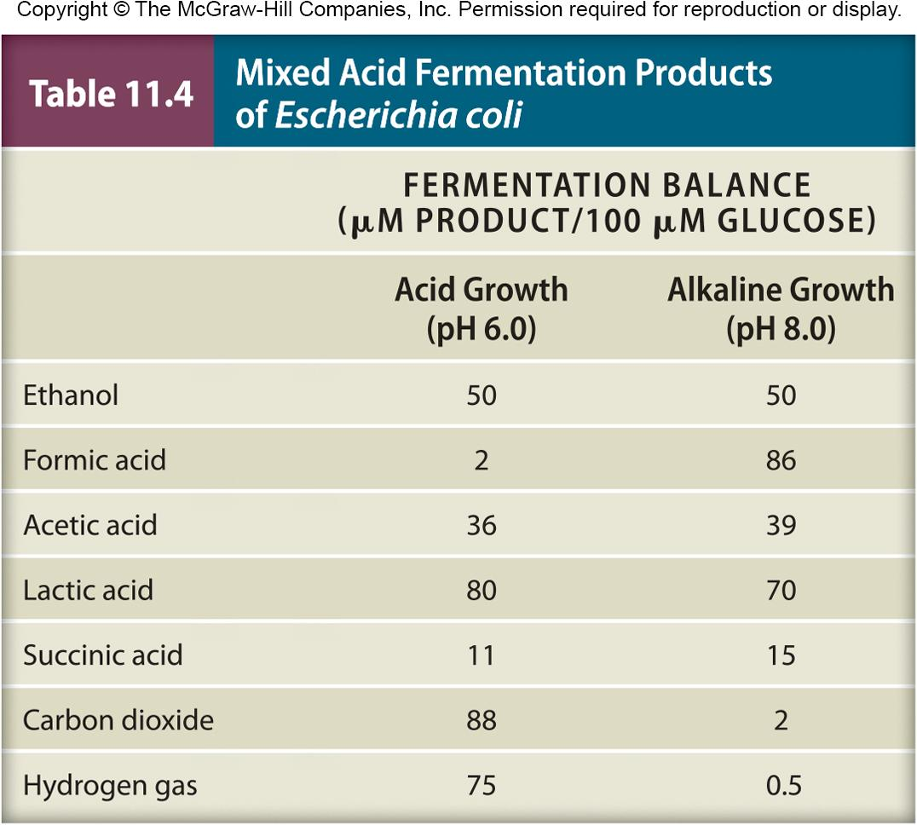
‹#›

Slide 38
Catabolism of Other Carbohydrates
Many different carbohydrates can serve as energy source
Carbohydrates can be supplied externally or internally (from internal reserves)
‹#›

Slide 39
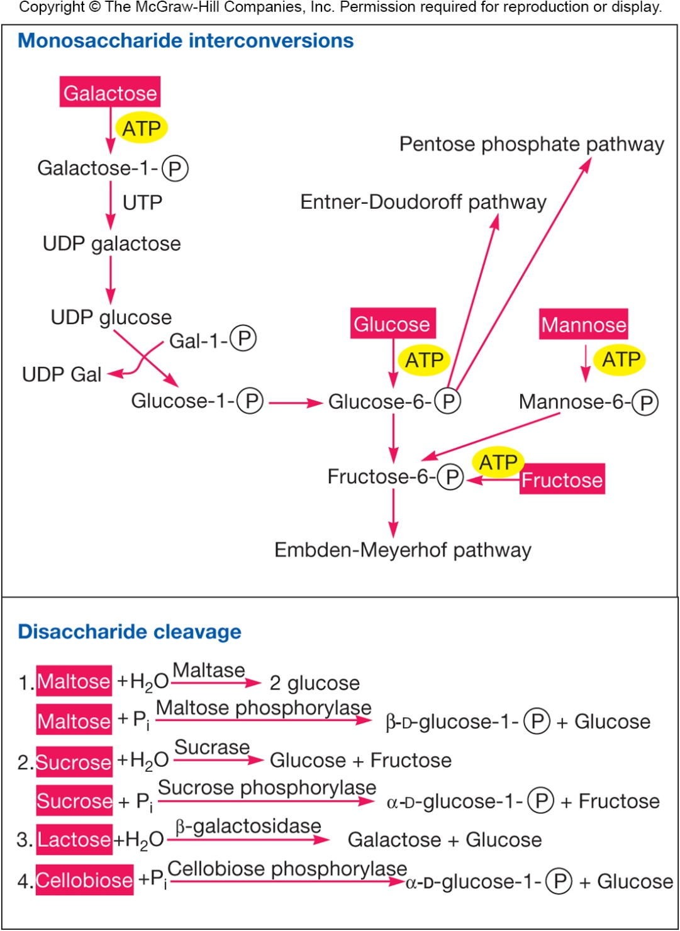
Carbohydrates
Monosaccharides
converted to other sugars that enter glycolytic pathway
Disaccharides and polysaccharides
cleaved by hydrolases or phosphorylases
‹#›
Notes:
‹#›

Slide 40
Reserve Polymers
Used as energy sources in absence of external nutrients
e.g., glycogen and starch
cleaved by phosphorylases
(glucose)_{n} + P_{i} → (glucose)_{n-1} + glucose-1-P
glucose-1-P enters glycolytic pathway
e.g., poly-hydroxybutyrate
PHB → → → acetyl-CoA
acetyl-CoA enters TCA cycle
‹#›
Notes:
‹#›

Slide 41
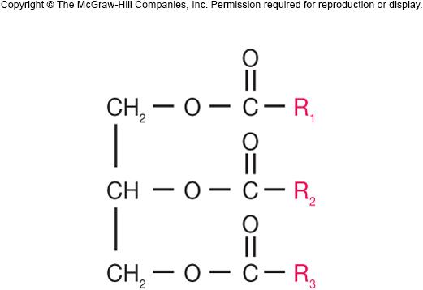
Lipid Catabolism
Triglycerides
common energy sources
hydrolyzed to glycerol and fatty acids by lipases
glycerol degraded via glycolytic pathway
fatty acids often oxidized via β-oxidation pathway
‹#›
Notes:
‹#›

Slide 42
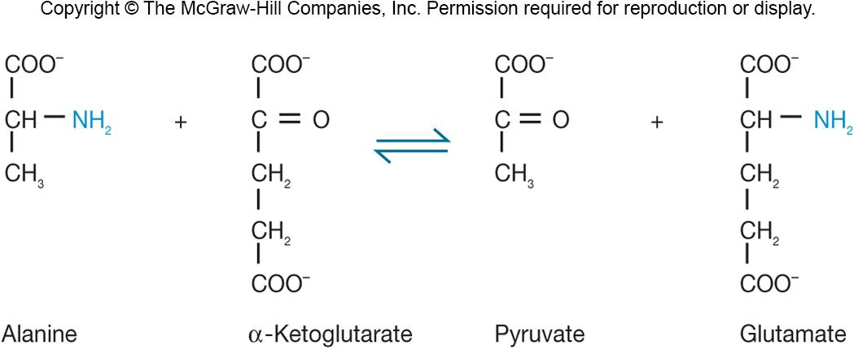
Protein and Amino Acid Catabolism
Protease: hydrolyzes protein to amino acids
Deamination: removal of amino group from amino acid
resulting organic acids converted to pyruvate, acetyl-CoA, or TCA cycle intermediate
can be oxidized via TCA cycle
can be used for biosynthesis
can occur through transamination
‹#›
Notes:
‹#›

Slide 43
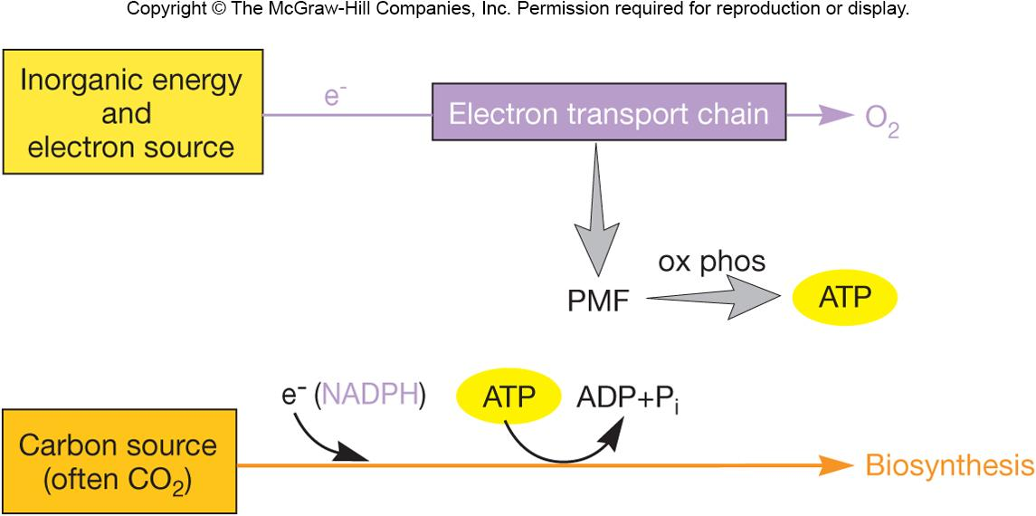
Chemolithotrophy
Carried out by chemolithotrophs
E⁻ released from energy source which is an inorganic molecule
transferred to terminal e⁻ acceptor by ETC
ATP synthesized by oxidative phosphorylation
‹#›
Notes:
‹#›

Slide 44
‹#›

Slide 45
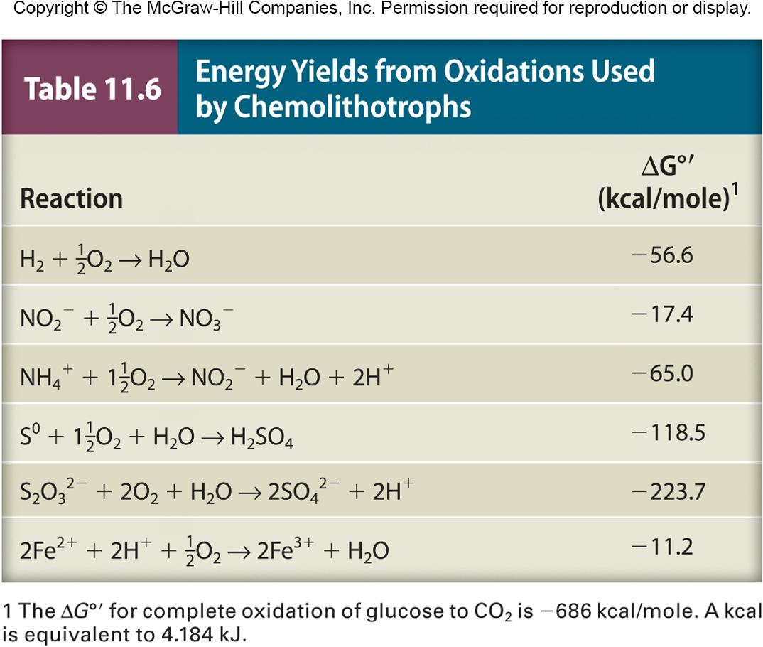
Energy Sources
Bacterial and archaeal species have specific electron donor/acceptor preferences
Much less energy is available from oxidation of inorganic molecules than glucose oxidation due to more positive redox potentials
‹#›

Slide 46
Three Major Groups of Chemolithotrophs
Have ecological importance
Several bacteria and archaea oxidize hydrogen
Sulfur-oxidizing microbes
hydrogen sulfide (H₂S), sulfur (S⁰), thiosulfate (S₂O₃²⁻)
Nitrifying bacteria oxidize ammonia to nitrate
‹#›

Slide 47
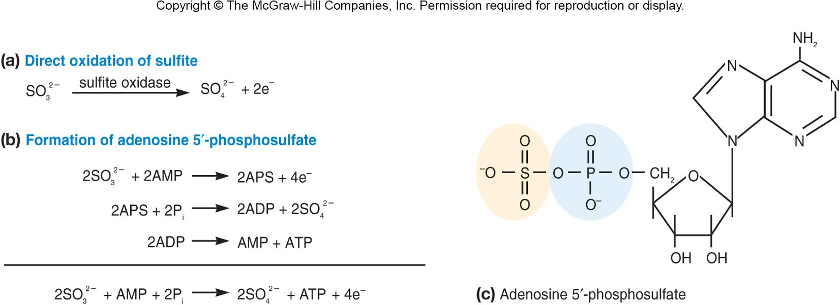
Sulfur-Oxidizing Bacteria
*ATP can be synthesized by both oxidative
phosphorylation and substrate-level phosphorylation
‹#›
Notes:
‹#›
Top: Sulfite is oxidized directly to provide electrons for electron transport and oxidative phosphorylation.
Middle: Oxidation of sulfite resulting in its conversion to APS; this reaction produces electrons for ETC and oxidative phosphorylation; in addition, APS can drive ATP synthesis by substrate-level phosphorylation.
Bottom: structure of APS (adenosine 5‘ phosphosulfate)

Slide 48
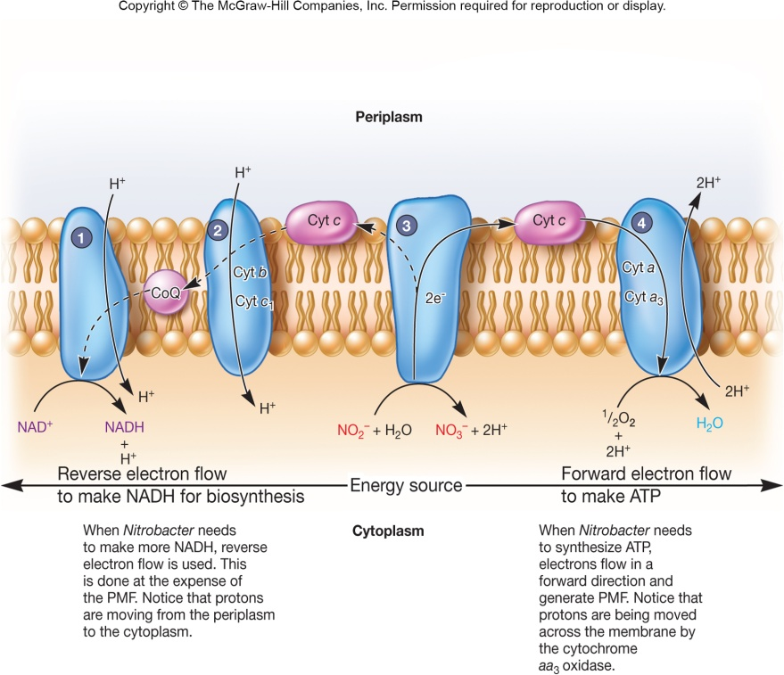
Reverse Electron Flow by Chemolithotrophs
Calvin cycle requires NAD(P)H as e⁻ source for fixing CO₂
many energy sources used by chemolithotrophs have E₀ more positive than NAD⁺(P)/NAD(P)H
use reverse electron flow to generate NAD(P)H
‹#›
Notes:
‹#›

Slide 49
Metabolic Flexibility of Chemolithotrophs
Many switch from chemolithotrophic metabolism to chemoorganotrophic metabolism
Many switch from autotrophic metabolism (via Calvin cycle) to heterotrophic metabolism
‹#›
Notes:
‹#›

Slide 50
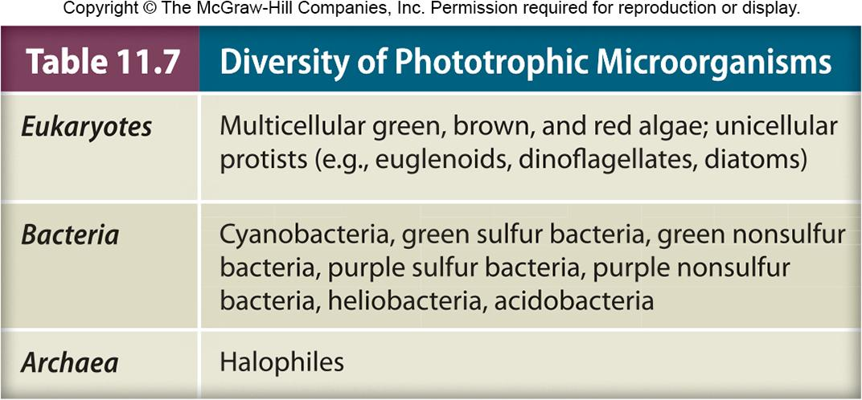
Phototrophy
Photosynthesis
energy from light trapped and converted to chemical energy
a two-part process
light reactions: light energy is trapped and converted to chemical energy
dark reactions: energy produced in the light reactions is used to reduce CO₂ and synthesize cell constituents
‹#›
Notes:
‹#›

Slide 51
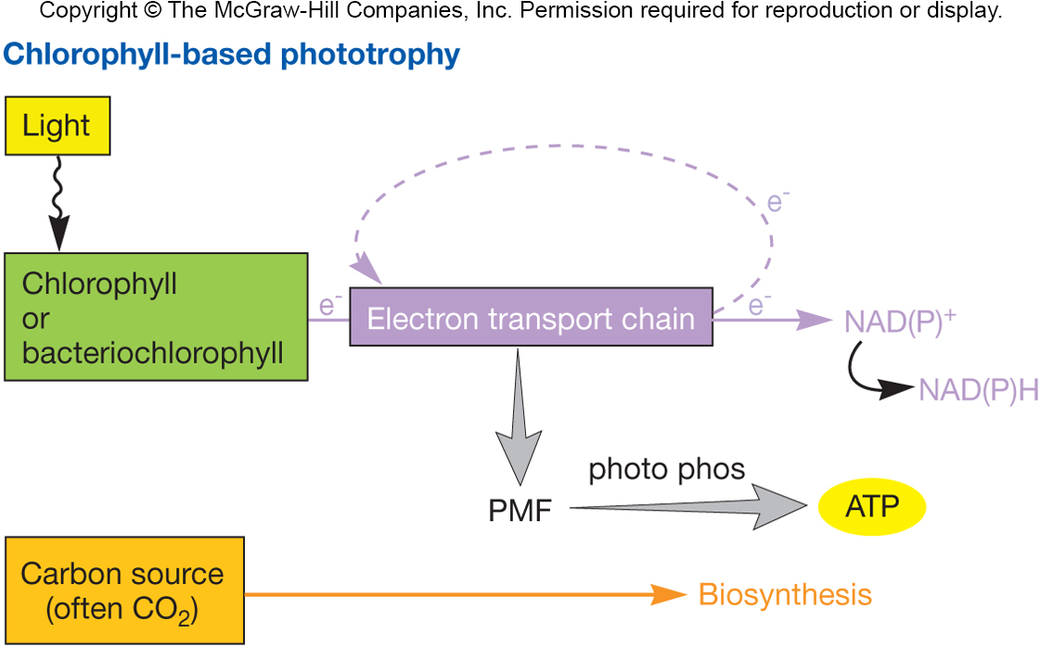
Light Reactions in Oxygenic Photosynthesis
Photosynthetic eukaryotes and cyanobacteria
Oxygen is generated and released into the environment
Most important pigments are chlorophylls
‹#›

Slide 52
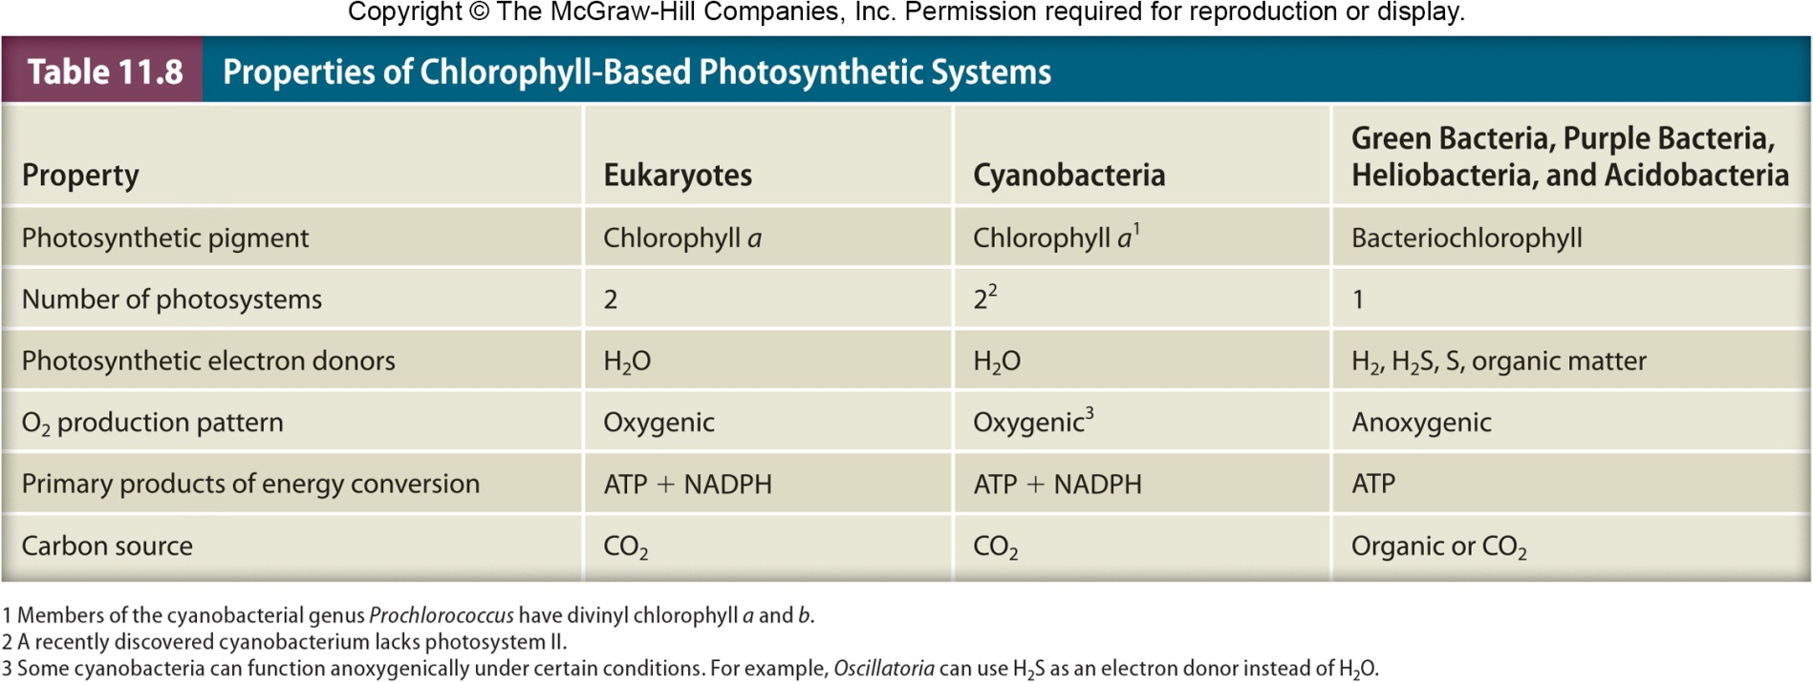
‹#›

Slide 53
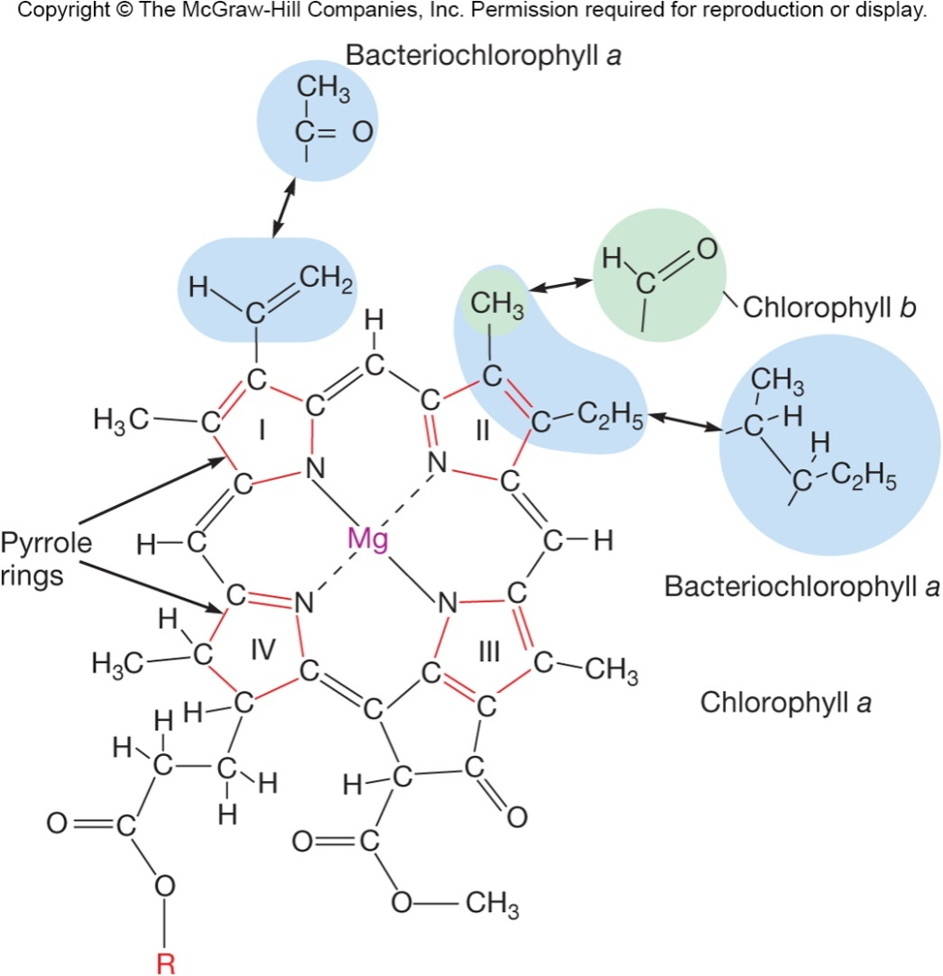
The Light Reaction in Oxygenic Photosynthesis
Chlorophylls
major light-absorbing pigments
different chlorophylls have different absorption peaks
‹#›
Notes:
‹#›

Slide 54
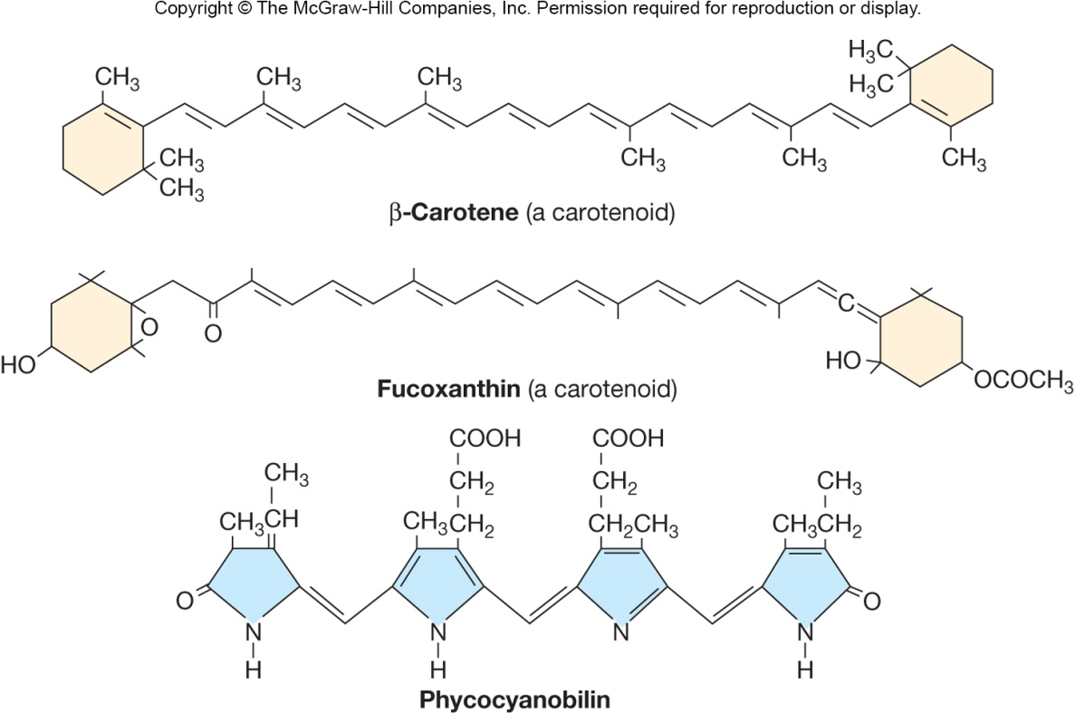
The Light Reaction in Oxygenic Photosynthesis
Accessory pigments
transfer light energy to chlorophylls
e.g., carotenoids and phycobiliproteins
accessory pigments absorb different wavelengths of light than chlorophylls
‹#›
Notes:
‹#›

Slide 55
Organization of Pigments
Antennas
highly organized arrays of chlorophylls and accessory pigments
captured light transferred to special reaction-center chlorophyll
directly involved in photosynthetic electron transport
Photosystems
antenna and its associated reaction-center chlorophyll
Electron flow → PMF → ATP
‹#›
Notes:
‹#›

Slide 56
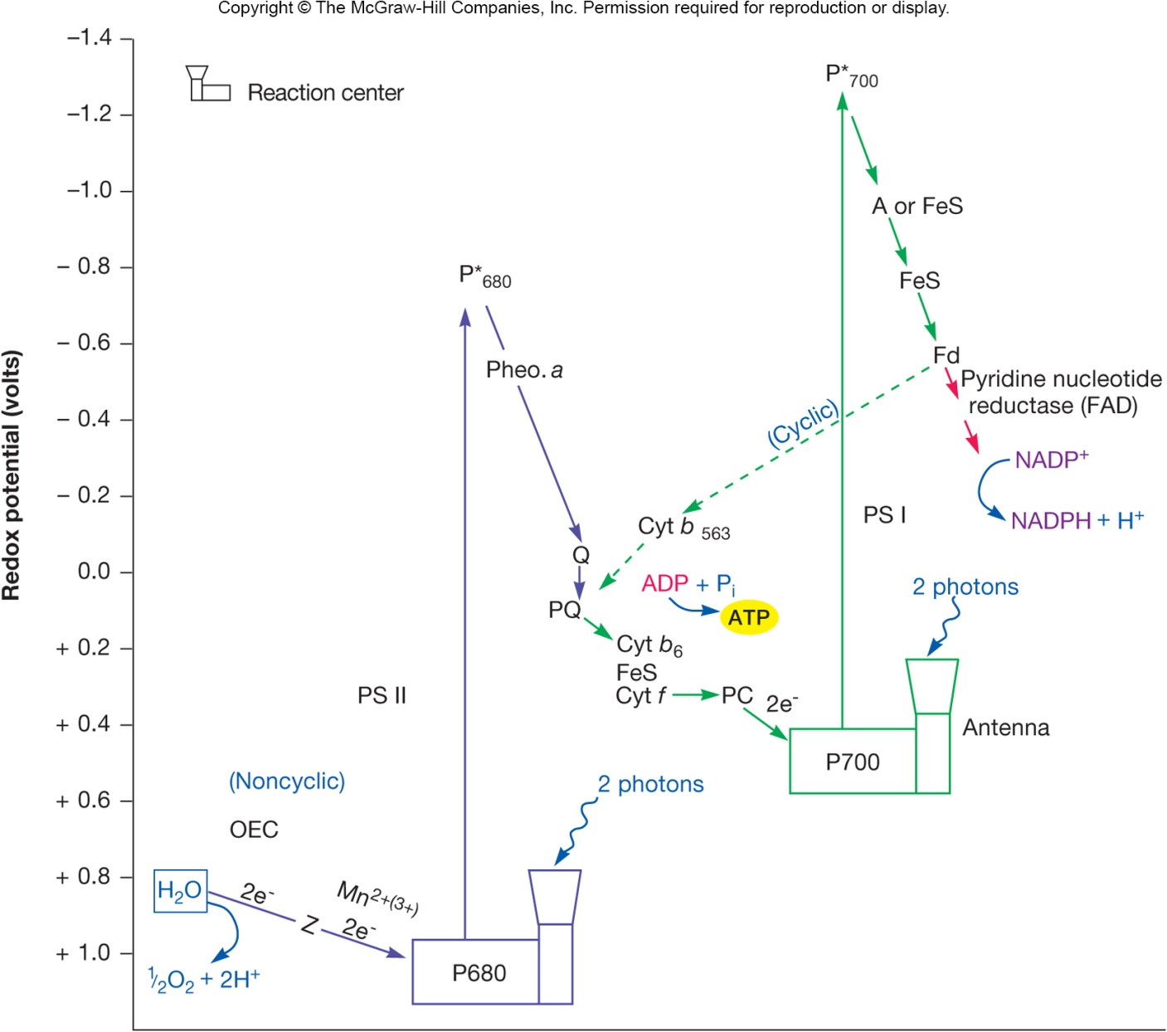
Oxygenic Photosynthesis
Noncyclic
electron flow –
ATP + NADPH
made (noncyclic
photophos-
phorylation)
Cyclic electron
flow – ATP
made (cyclic
photophos-
phorylation)
‹#›
Notes:
‹#›
Fd=ferredoxin; PQ=plastoquinone; PC=plastocyanin; Pheo. a=pheophytin a; PS I=photosystem I; PS II=photosystem II; OEC=oxygen evolving complex, extracts electrons from water and contains manganese ions and the substance Z, which transfers electrons to the PS II reaction center.

Slide 57
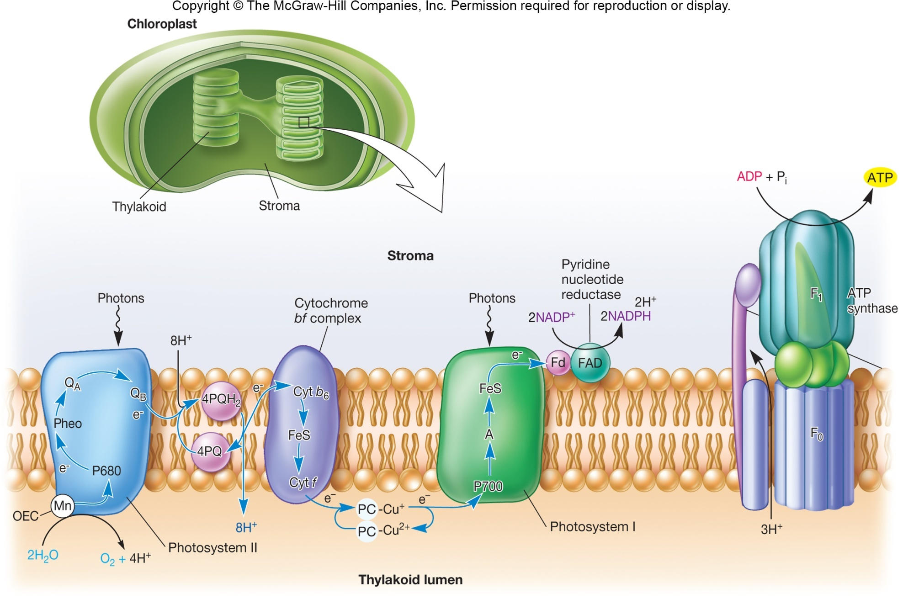
‹#›

Slide 58
The Light Reaction in Anoxygenic Photosynthesis
H₂O not used as an electron source; therefore O₂ is not produced
Only one photosystem involved
Uses bacteriochlorophylls and mechanisms to generate reducing power
Carried out by phototrophic green bacteria, phototrophic purple bacteria, and heliobacteria
‹#›
Notes:
‹#›

Slide 59
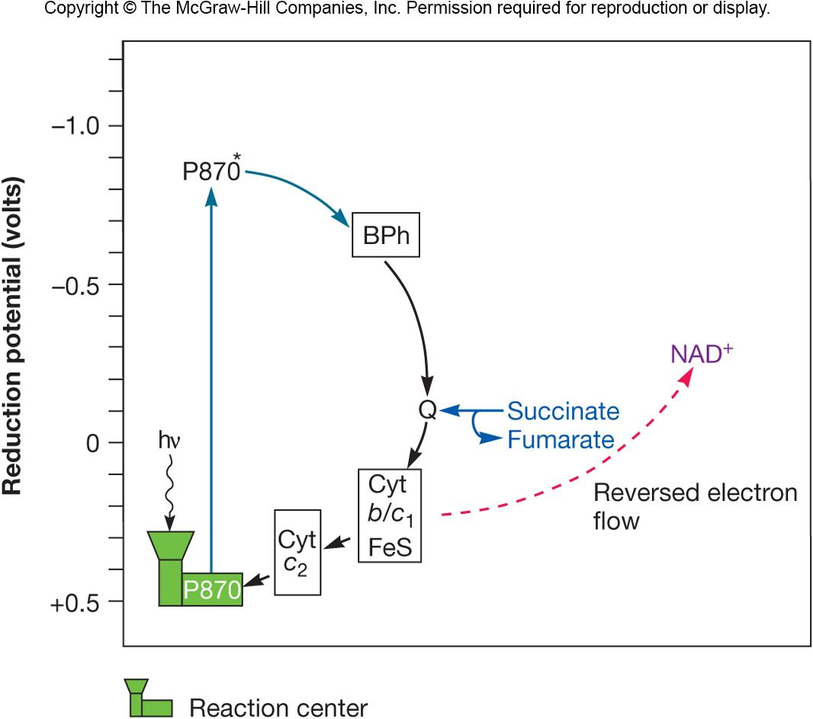
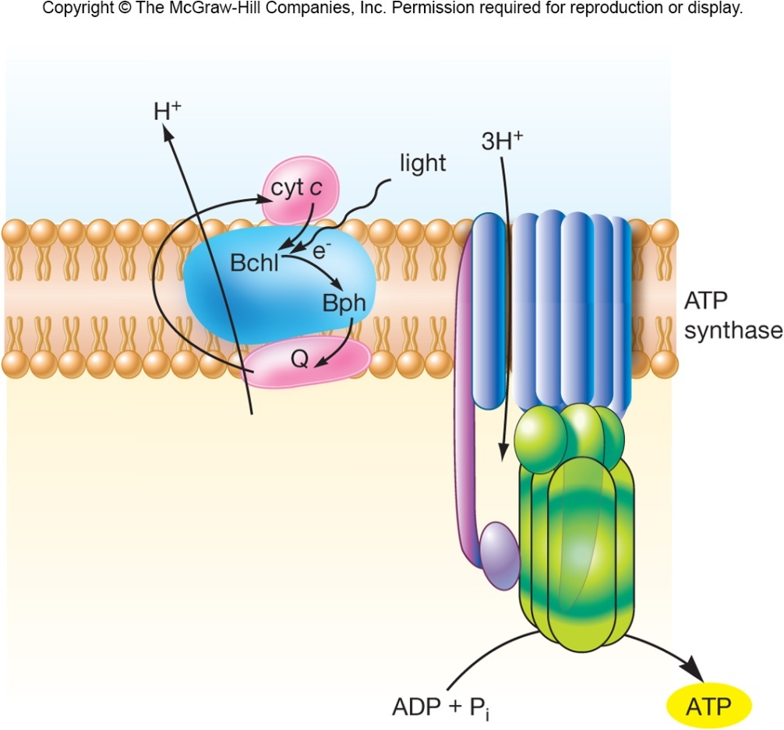
‹#›

Slide 60
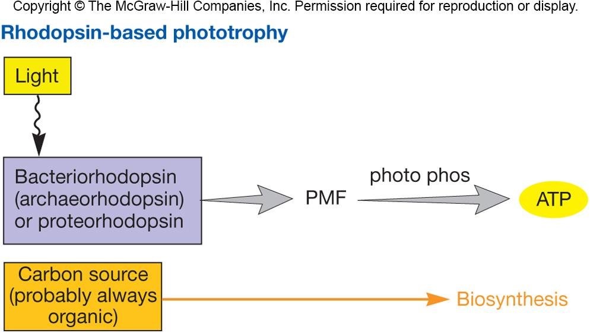
Bacteriorhodopsin-Based Phototrophy
Some archaea use a type of phototrophy that involves bacteriorhodopsin
a membrane protein
functions as a light-driven proton pump
A proton motive force is generated
An electron transport chain is not involved
‹#›
Notes:
‹#›

