Slide 1
13
Bacterial Genome Replication and Expression
‹#›
Copyright © McGraw-Hill Global Education Holdings, LLC. Permission required for reproduction or display.
Notes:
‹#›

Slide 2
Terminology and Concepts
Genome
all DNA present in a cell or virus
Bacteria and Archaea generally have one set (haploid – 1N)
eukaryotes have two sets (diploid - 2N)
Genotype
specific set of genes an organism possesses
Phenotype
collection of observable characteristics
‹#›

Slide 3
DNA and RNA Structure
The nucleic acids, DNA and RNA, are polymers of nucleotides
linked together by phosphodiester bonds
DNA and RNA differ in
the nitrogenous bases they contain
the sugars they contain
whether they are single or double stranded
‹#›
Notes:
‹#›

Slide 4
DNA Structure
Polymer of nucleotides
bases are adenine, guanine, cytosine, and thymine
sugar is deoxyribose
phosphate is esterified(مُجَمع) to sugar carbon
Sugar phosphate backbone
covalent bonds between the 3’-hydroxyl of one sugar and a 5’-phosphate attached to an adjacent sugar
‹#›
Notes:
‹#›

Slide 5
DNA Structure – Two Complementary Strands
Molecule is double stranded helix
Base pairing
adenine (purine) and thymine (pyrimidine) pair by 2 hydrogen bonds
guanine (purine) and cytosine (pyrimidine) pair by 3 hydrogen bonds
Major and minor grooves form when the 2 strands twist around each other
‹#›
Notes:
‹#›

Slide 6
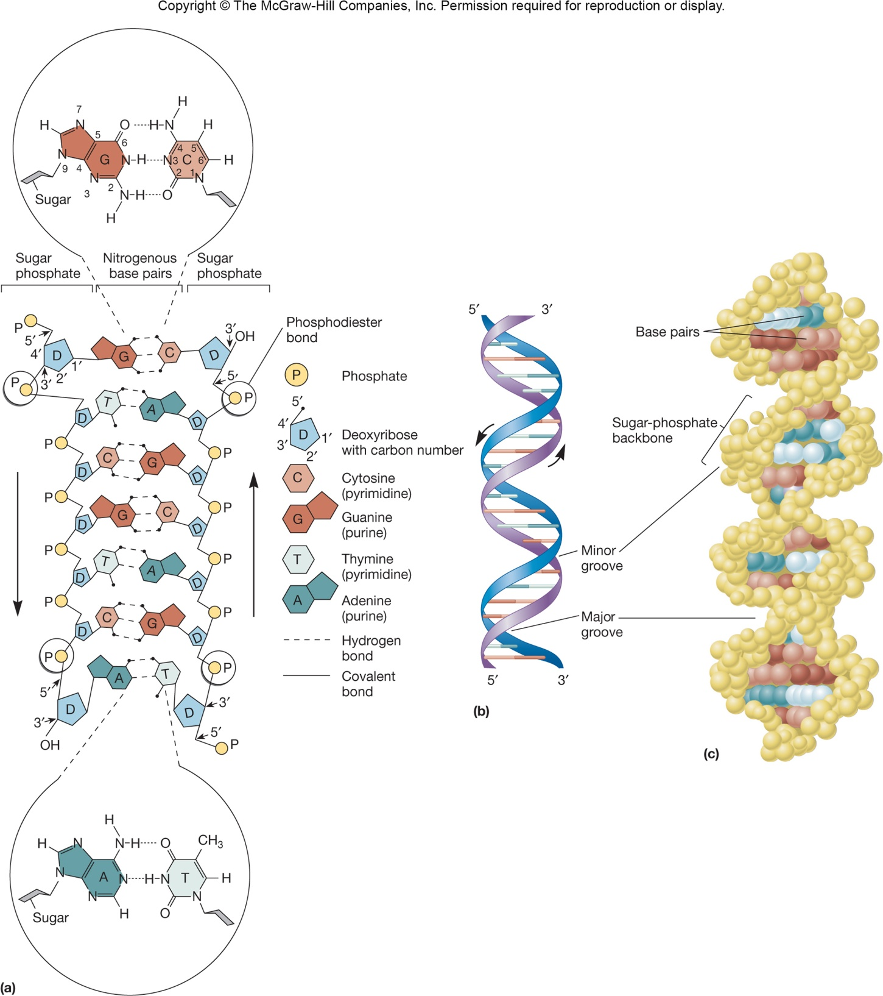
‹#›

Slide 7
RNA Structure
Polymer of nucleotides
contains the bases adenine, guanine, cytosine, and uracil
sugar is ribose
phosphodiester bonds
Most RNA molecules are single stranded; some are double stranded
‹#›
Notes:
‹#›

Slide 8
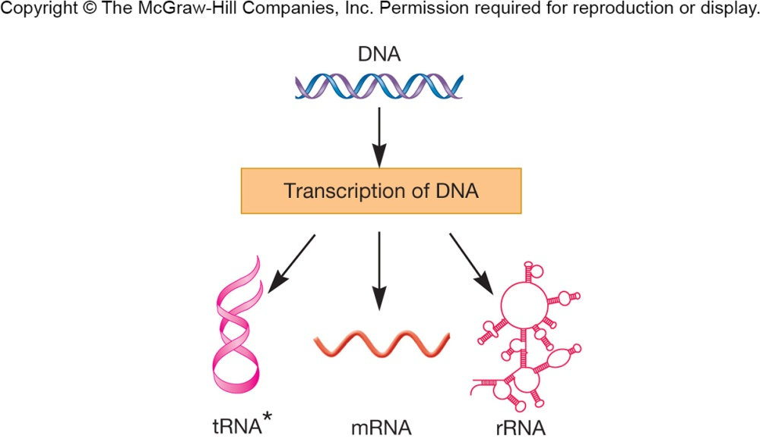
RNA Structure
Three different types which may differ from each other in function, site of synthesis, and in structure
messenger RNA (mRNA)
ribosomal RNA (rRNA)
transfer RNA (tRNA)
‹#›
Notes:
‹#›

Slide 9
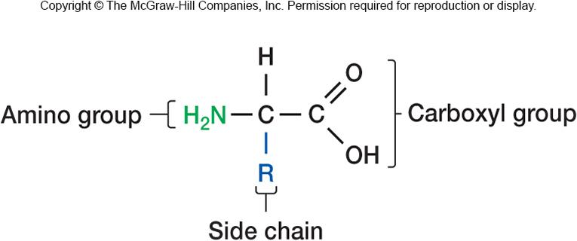
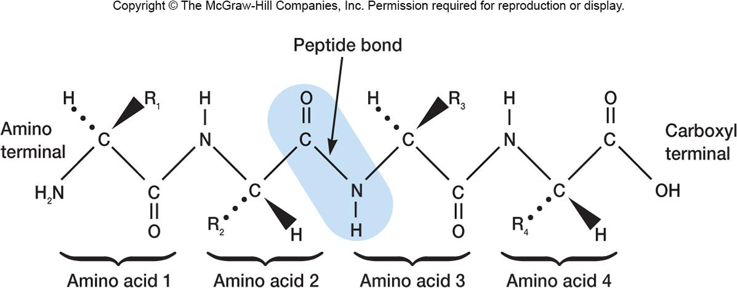
Protein Structure
Polymers of amino acids linked by peptide bonds
amino acids have central carbon
carboxy group (C-terminal)
amino group (N-terminal)
side chain
amino acids can be polar, non-polar, or charged depending on side chain
‹#›

Slide 10
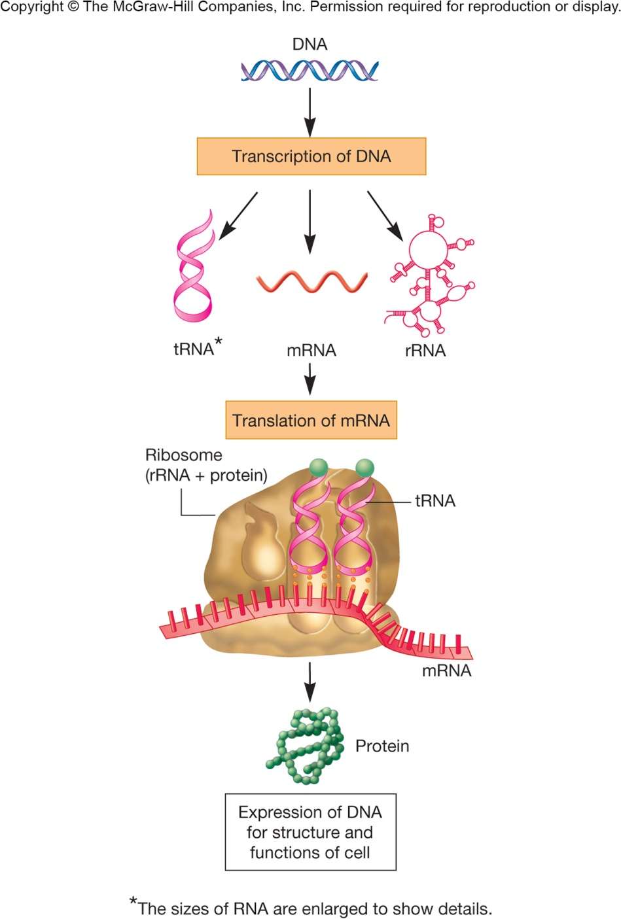
Gene Structure
Gene
the basic unit of genetic information
also defined as the nucleic acid sequence that codes for a polypeptide, tRNA or rRNA
linear sequence of nucleotides with a fixed start point and end point
codons are found in mRNA and code for single amino acids
‹#›
Notes:
‹#›

Slide 11
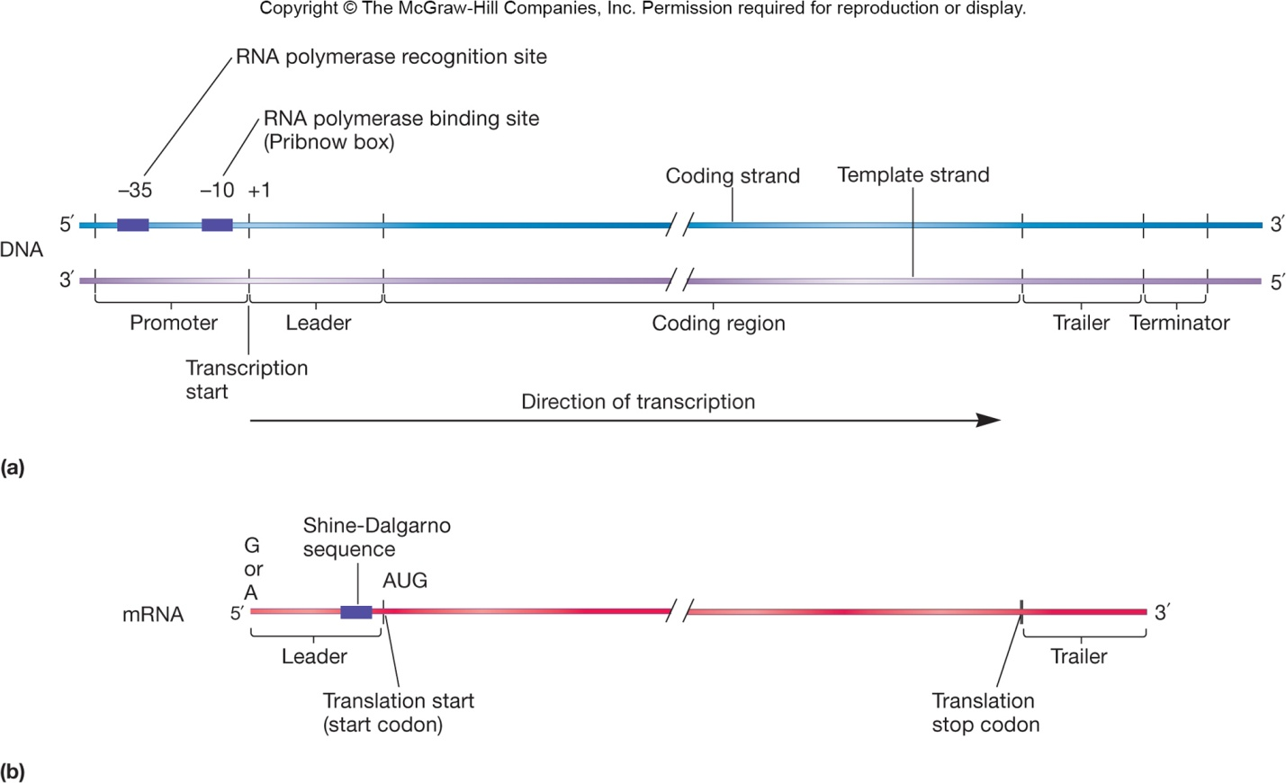
Protein-Coding Genes - 1
Template strand of DNA directs RNA synthesis
is read in the 3’ to 5’ direction
Complementary DNA strand
is coding strand, same nucleotide sequence as mRNA (except in thymine)
‹#›
Notes:
‹#›

Slide 12
Protein-Coding Genes - 2
Promoter is located at the start of the gene
is the recognition/binding site for RNA polymerase
functions to orient polymerase
Leader sequence is transcribed into mRNA but is not translated into amino acids
Shine-Dalgarno sequence important for initiation of translation
‹#›

Slide 13
Protein-Coding Genes - 3
Begins with DNA sequence 3’-TAC-5’
produces codon AUG
codes for N-formylmethionine, a modified amino acid used to initiate protein synthesis in bacteria
coding region ends with a stop codon
immediately followed by the trailer sequence which contains a terminator sequence used to stop transcription
‹#›
Notes:
‹#›

Slide 14
tRNA and rRNA Genes
DNA sequences that code for tRNA and rRNA are considered genes
genes coding for tRNA may code for more than a single tRNA molecule or type of tRNA
genes coding for rRNA are transcribed as single, large precursor
Spacers(الفواصل) between the coding regions of both are removed after transcription, some by the use of special ribonucleases called ribozymes
‹#›
Notes:
‹#›

Slide 15
Protein Maturation and Secretion
Protein function depends on 3-D shape
Occurs as post translational event
requires folding
association with other proteins
delivered to proper subcellular or extracellular site
‹#›

Slide 16
Protein Folding and Molecular Chaperones
Molecular chaperones
proteins that aid the folding of nascent polypeptides
protect cells from thermal damage
e.g., heat-shock proteins
aid in transport of proteins across membranes
‹#›
Notes:
‹#›

Slide 17
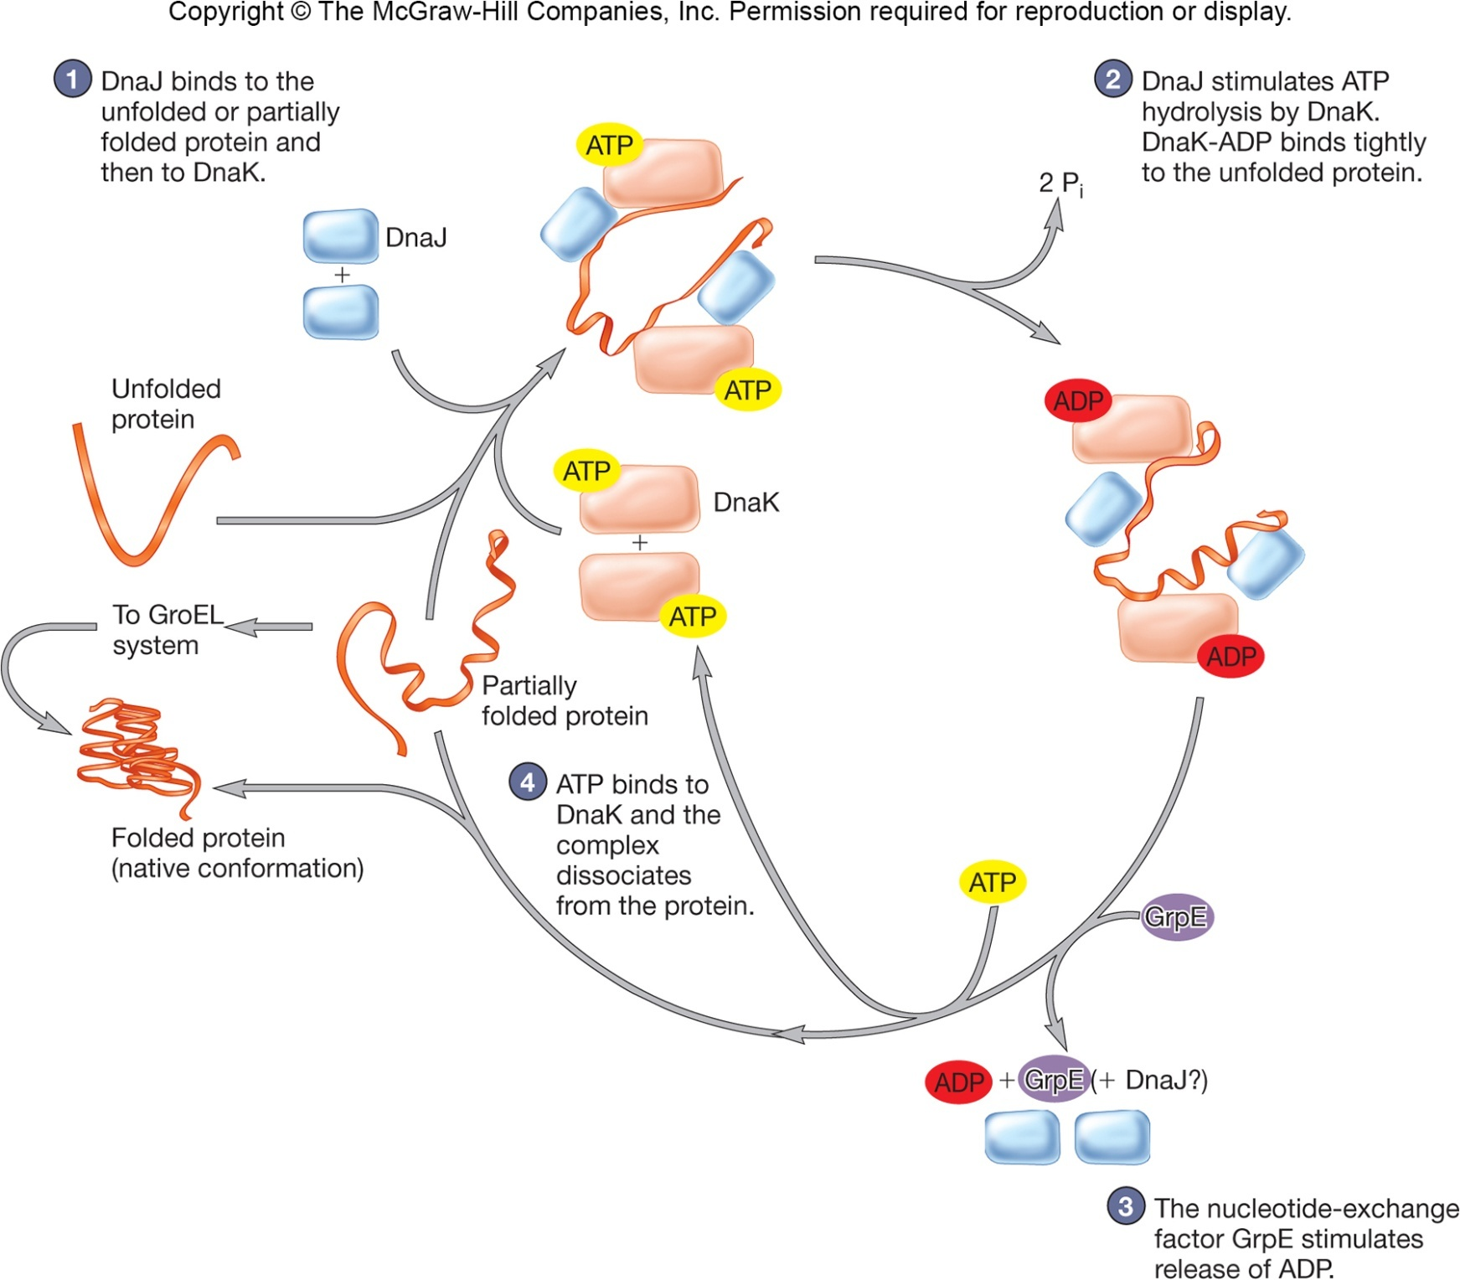
‹#›

Slide 18
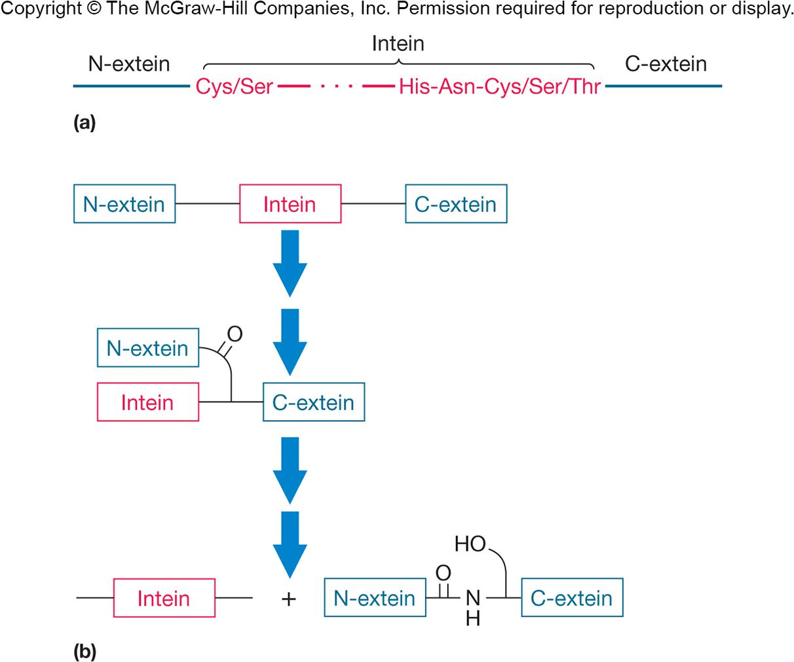
Protein Splicing
Removal of part of polypeptide before folding
Inteins – removed portion
Exteins – portions that remain in protein
‹#›
Notes:
‹#›

Slide 19
Protein Translocation and Secretion in Bacteria - 1
Numerous protein secretion pathways have been identified
some reside(يُقيم) in all 3 domains
some unique to Bacteria and Archaea
some unique to gram-negative cells
‹#›

Slide 20
Protein Translocation and Secretion in Bacteria - 2
Translocation
movement of proteins from cytoplasm to plasma membrane or periplasmic space
include transport proteins, ETC proteins, proteins involved in chemotaxis and cell wall synthesis, enzymes
Secretion
movement of proteins from the cytoplasm to external environment
hydrolytic enzymes for nutrient break down
‹#›

Slide 21
Common Translocation and Secretion Systems
Sec-dependent pathway
the major pathway for all bacteria for transporting proteins across the plasma membrane
Gram-negative bacteria
may use Sec system
also must cross the outer membrane using Types I, II, III, IV, V systems
All pathways require energy
‹#›
Notes:
‹#›

Slide 22
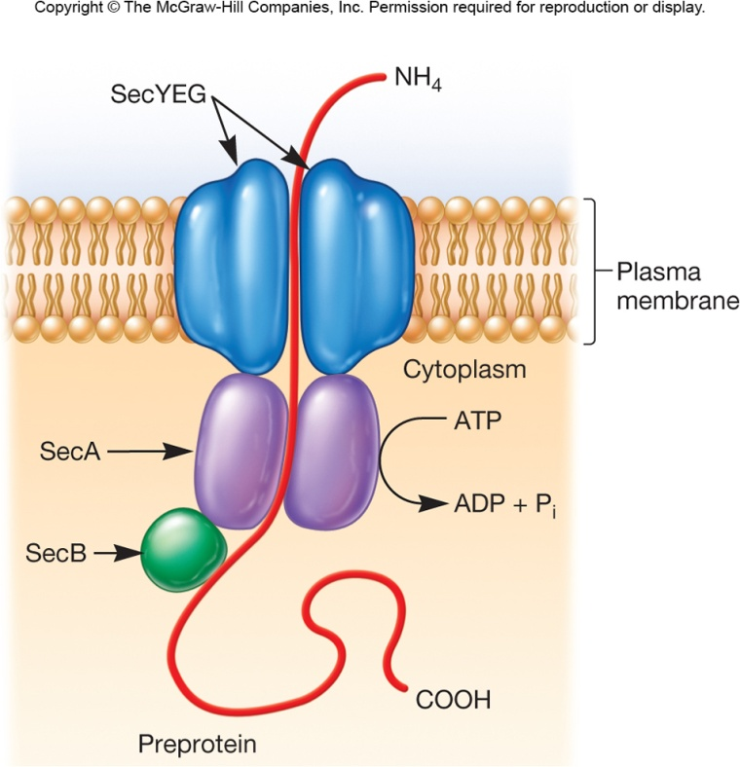
Sec-Dependent Pathway
Also called general secretion pathway
highly conserved in all domains
Translocates proteins from cytoplasm across or into plasma membrane
Secreted proteins synthesized as preproteins having amino-terminal signal peptide
signal peptide delays protein folding
chaperone proteins (SecB) keep preproteins unfolded
‹#›
Notes:
‹#›

Slide 23
Sec-Dependent Pathway
secY, secE, and secG form a channel in the membrane
secA translocates preprotein through the plasma membrane
When preprotein emerges from(يخرج من) plasma membrane a signal peptidase removes the signal peptide
‹#›
Notes:
‹#›

Slide 24
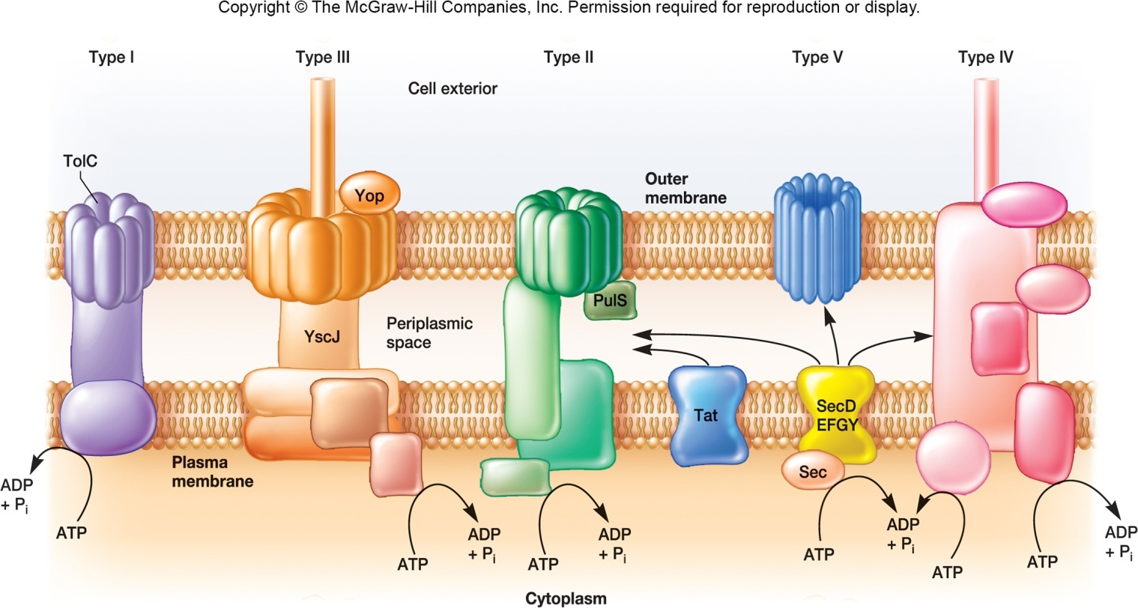
Other Protein Secretion Pathways
Type I secretion systems
related to ABC transport systems
Gram-positive/Gram-negative bacteria, and Archaea
Secretion of toxins, proteases, other proteins
‹#›
Notes:
‹#›

Slide 25
Tat System
Protein translocation system in Bacteria and some archaea
Moves across plasma membrane
Tat pathway translocated folded proteins with “twin” arginine residues in their signal sequence
Works with Type II secretion system
‹#›

Slide 26
Other Protein Secretion Pathways
Type IV secretion system
secrete proteins
secrete DNA from donor to recipient bacterium during conjugation
found in both Gram-positive and Gram- negative
‹#›

Slide 27
Protein Secretion in Gram-Negative Bacteria
Six proteins secretion systems identified
Types I and IV also in Gram-positives
Types II, III, and V are unique to Gram-negatives
most secrete virulence factors
‹#›

Slide 28
Gram-Negative Bacteria Secretion Systems
Types I and III are sec independent
forms injectisomes
transports virulence factors and other proteins
Type V are sec-dependent
autotransporters – transport themselves out
Type VI are similar to bacteriophage genome injection systems
‹#›

