Slide 1
16
Mechanisms of Genetic Variation
‹#›
Copyright © McGraw-Hill Global Education Holdings, LLC. Permission required for reproduction or display.
Notes:
‹#›

Slide 2
16.1 Mutations
Distinguish spontaneous from induced mutations, and list the most common ways each arises
Construct a table, concept map, or picture to summarize how base analogues, DNA-modifying agents, and intercalating agents cause mutations
Discuss the possible effects of mutations
‹#›

Slide 3
Mutations: Their Chemical Basis and Effects
Stable, heritable(موروثة) changes in sequence of bases in DNA
point mutations most common
from alteration of single pairs of nucleotide
from the addition or deletion of nucleotide pairs
larger mutations are less common
insertions, deletions, inversions, duplication, and translocations of nucleotide sequences
Mutations can be spontaneous or induced
‹#›
Notes:
‹#›

Slide 4
Spontaneous Mutations
Arise without exposure to external agents
May result from errors in DNA replication
due to base tautomerization resulting in transition and transversion mutations
due to insertion or deletion of nucleotides
May also result from the action of mobile genetic elements such as transposons
‹#›
Notes:
‹#›

Slide 5
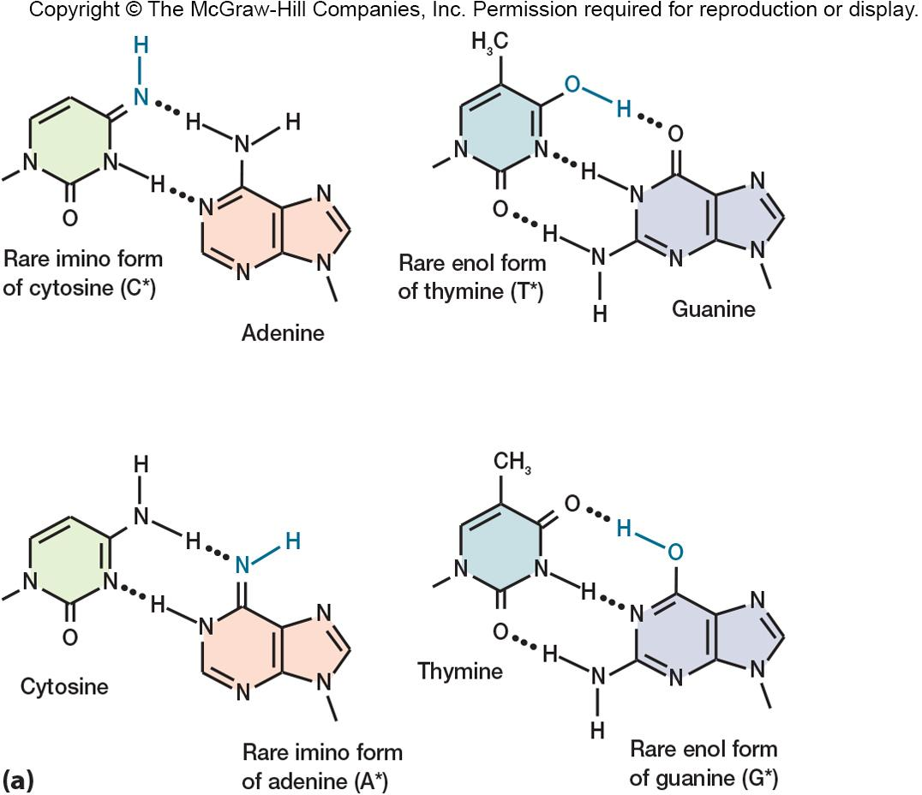
‹#›

Slide 6
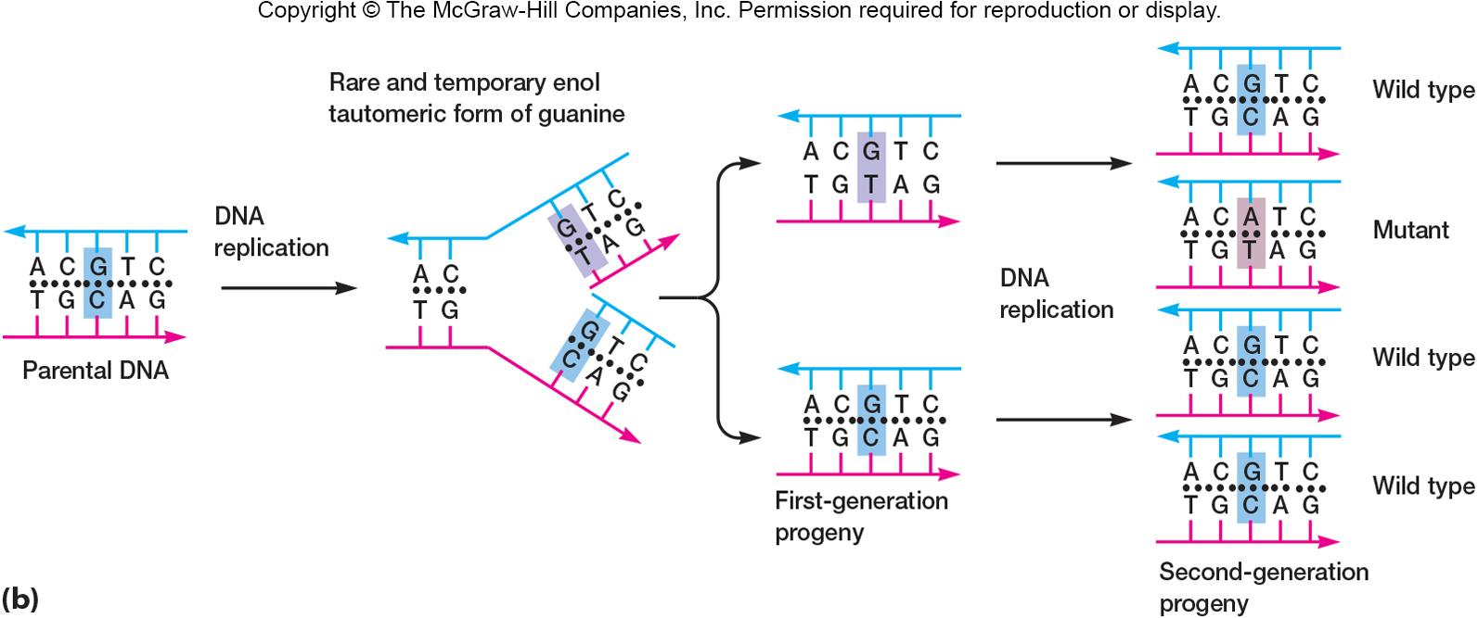
‹#›

Slide 7
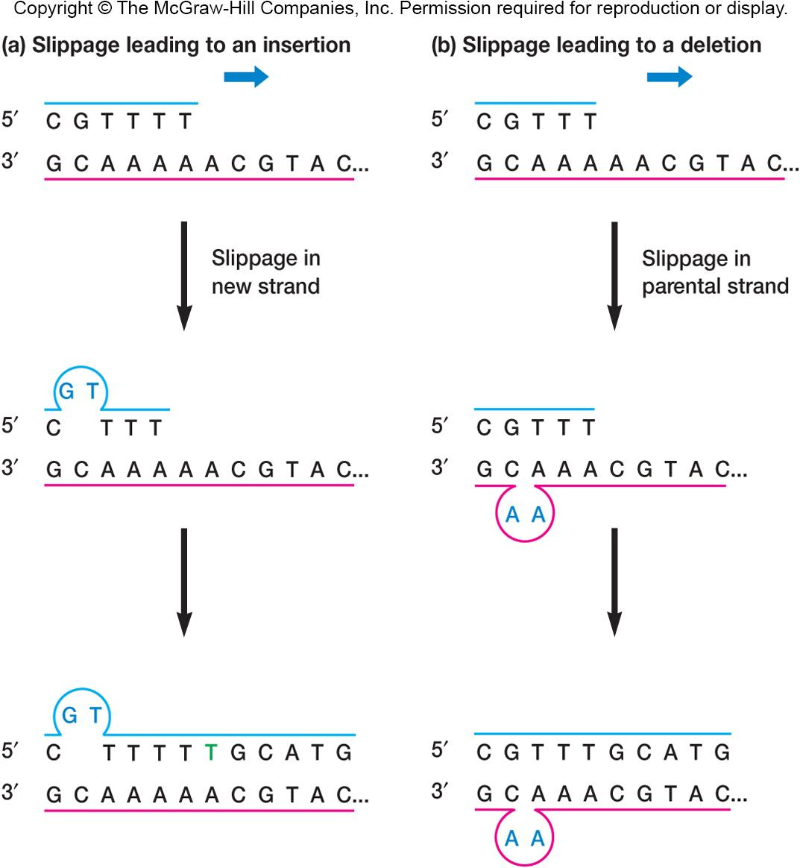
‹#›

Slide 8
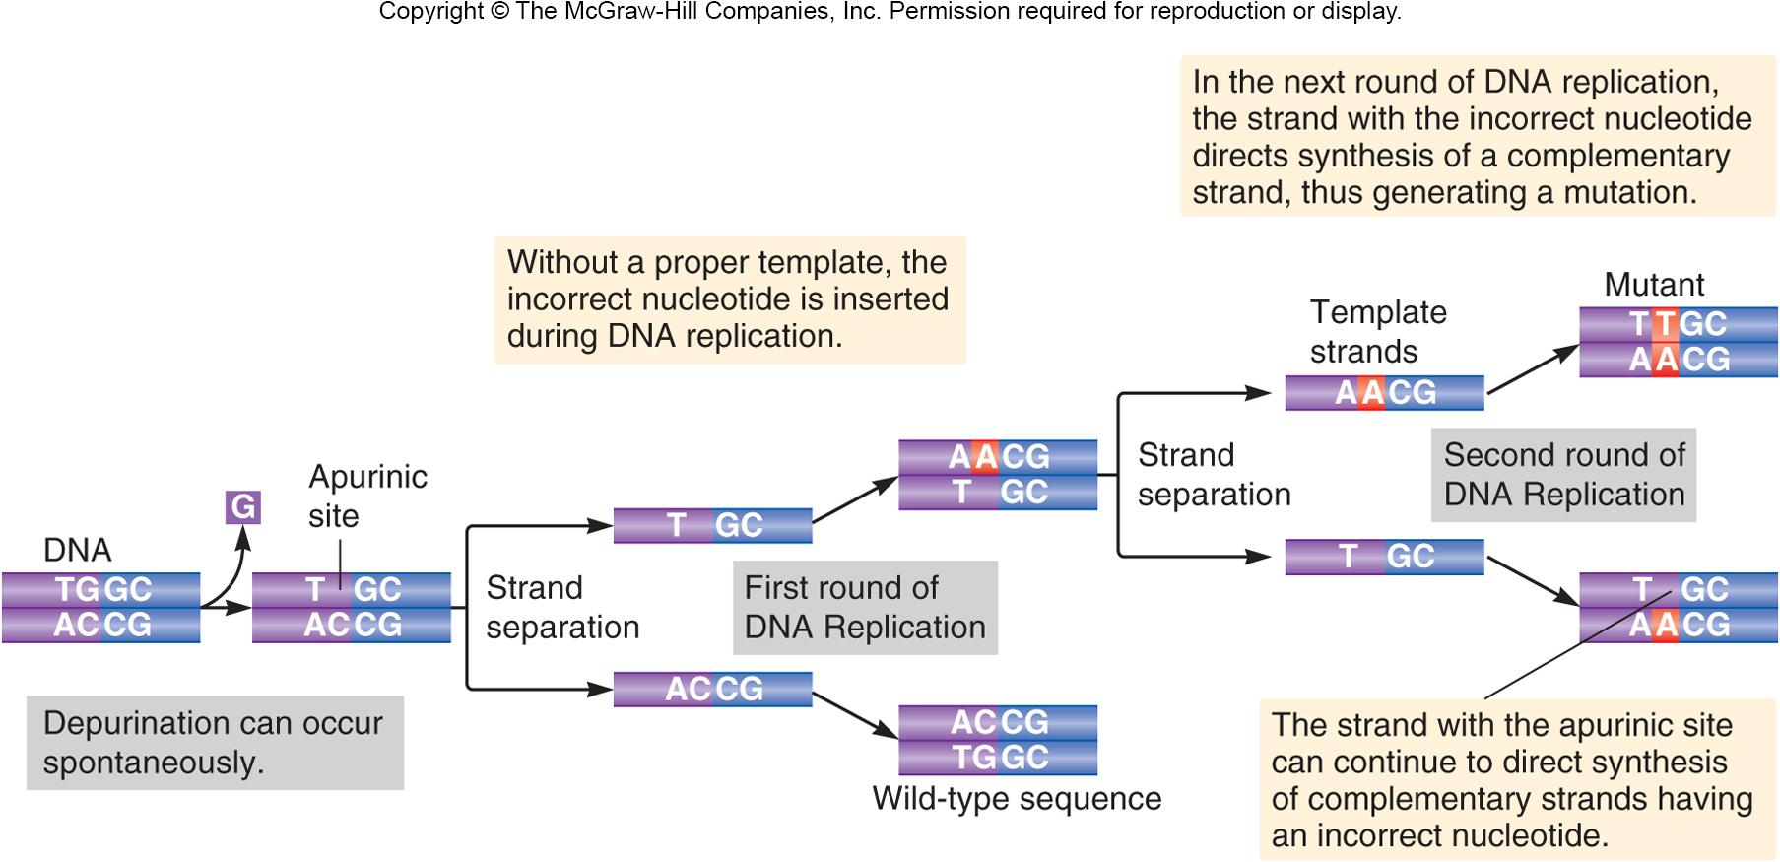
‹#›

Slide 9
Induced Mutations
Caused by agents that directly damage DNA
base analogs
structurally similar to normal bases
mistakes occur when they are incorporated into growing polynucleotide chain
DNA modifying agents
alter a base causing it to mispair
intercalating agents
Distort(شوه) DNA to induce single nucleotide pair insertions and deletions
‹#›
Notes:
‹#›

Slide 10
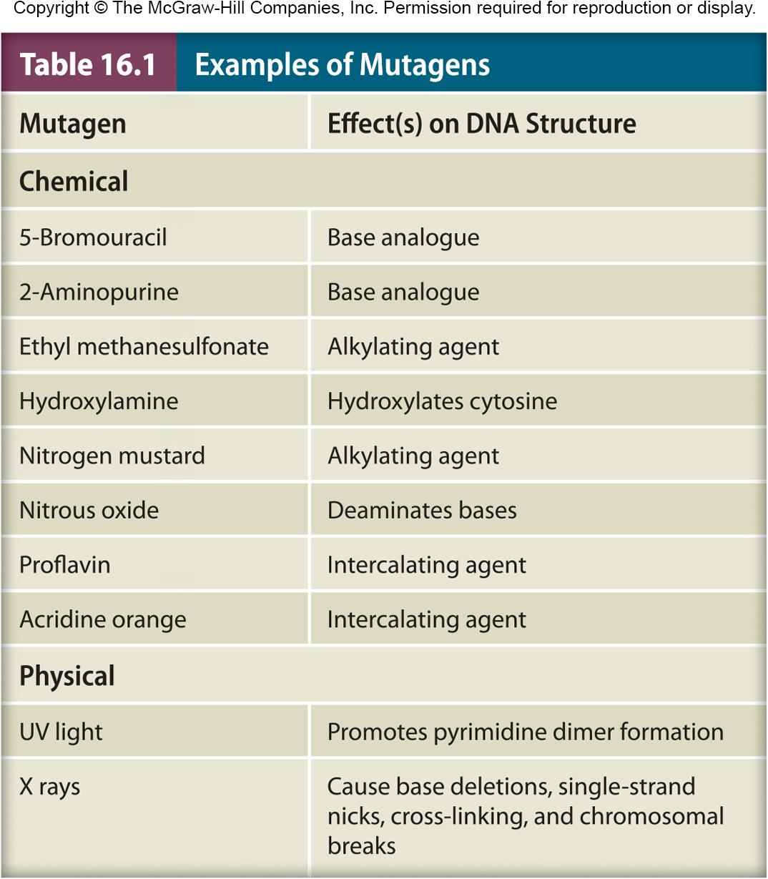
‹#›

Slide 11
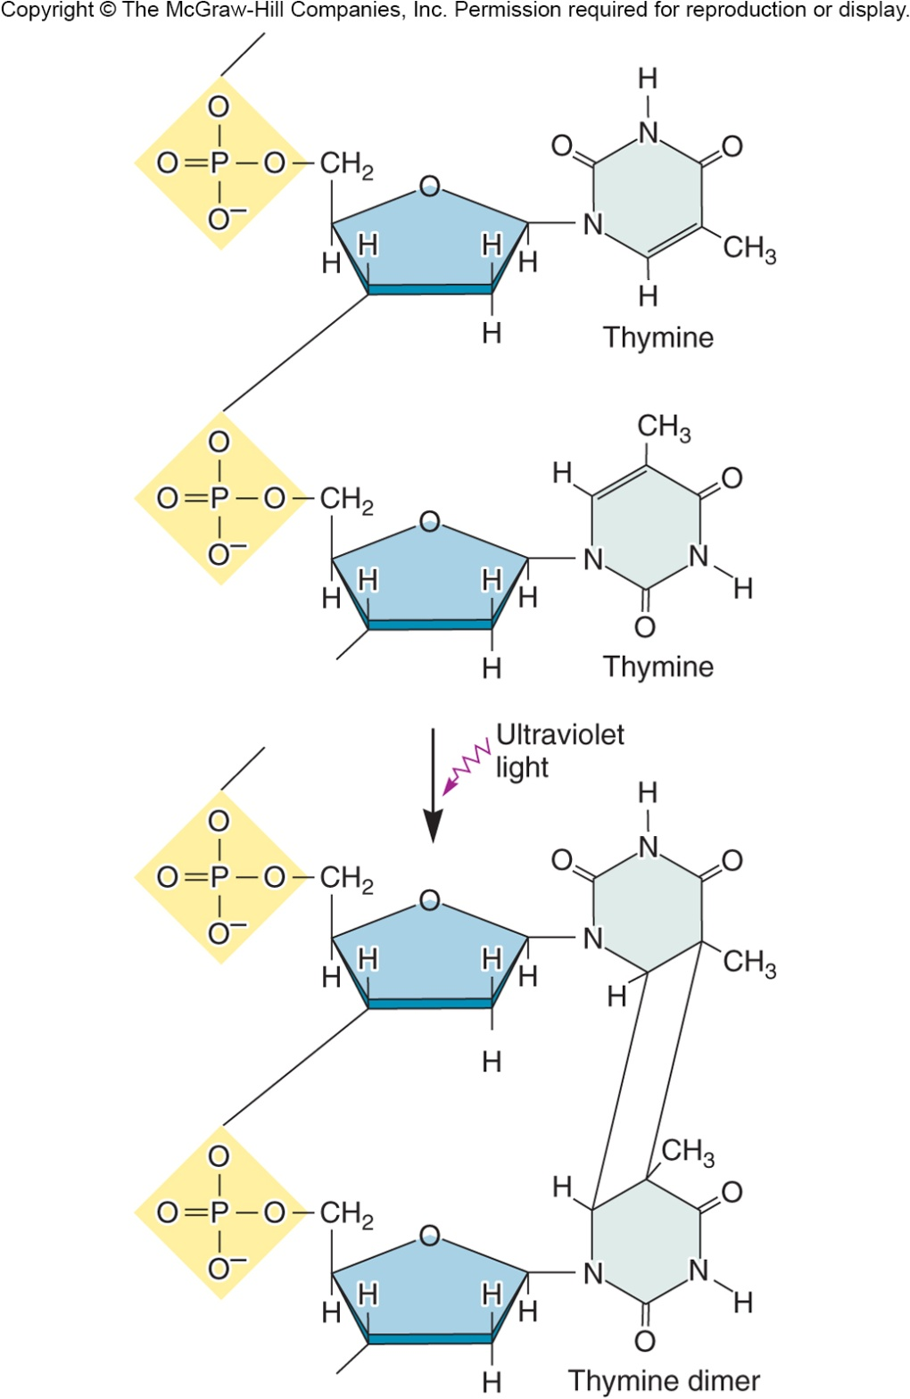
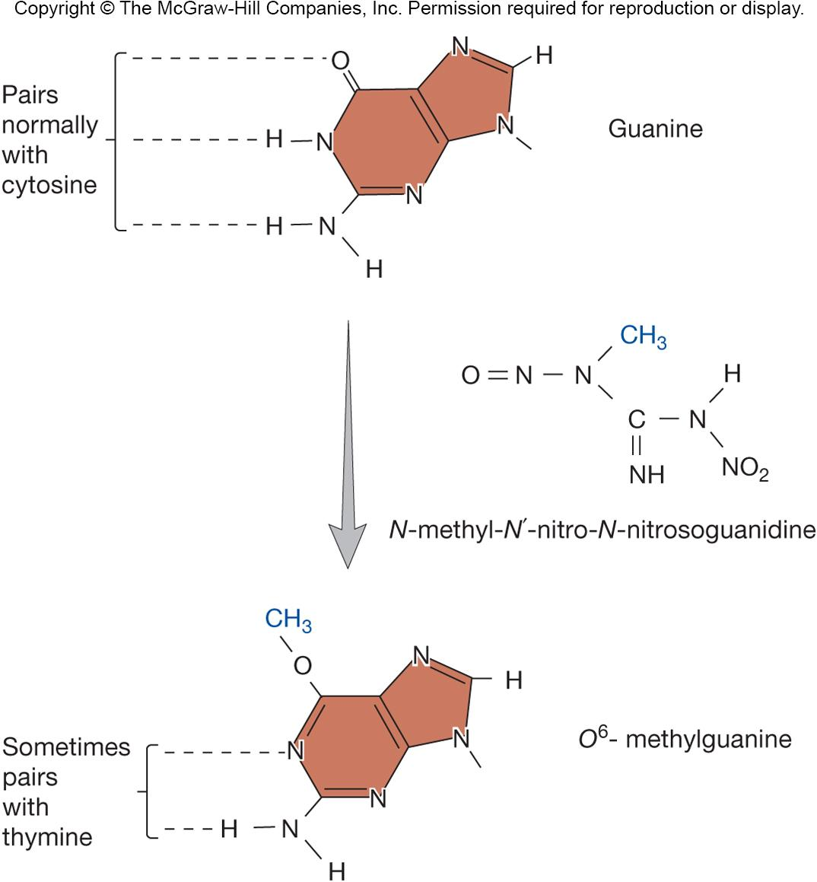
‹#›

Slide 12
Effects of Mutations
Wild type
most prevalent(الأكثر انتشاراً) form of gene
Forward mutation
wild type → mutant form
Reversion mutation
mutant phenotype → wild type phenotype
suppressor mutation
occurs when the second mutation is at a different site than the original mutation
‹#›

Slide 13
Mutations in Protein Coding Genes
Point mutations
in protein-coding genes can affect protein structure in a variety of ways
Are named according to if and how they change the encoded protein
The most common types are: silent, missense, nonsense, and frameshift mutations
‹#›
Notes:
‹#›

Slide 14
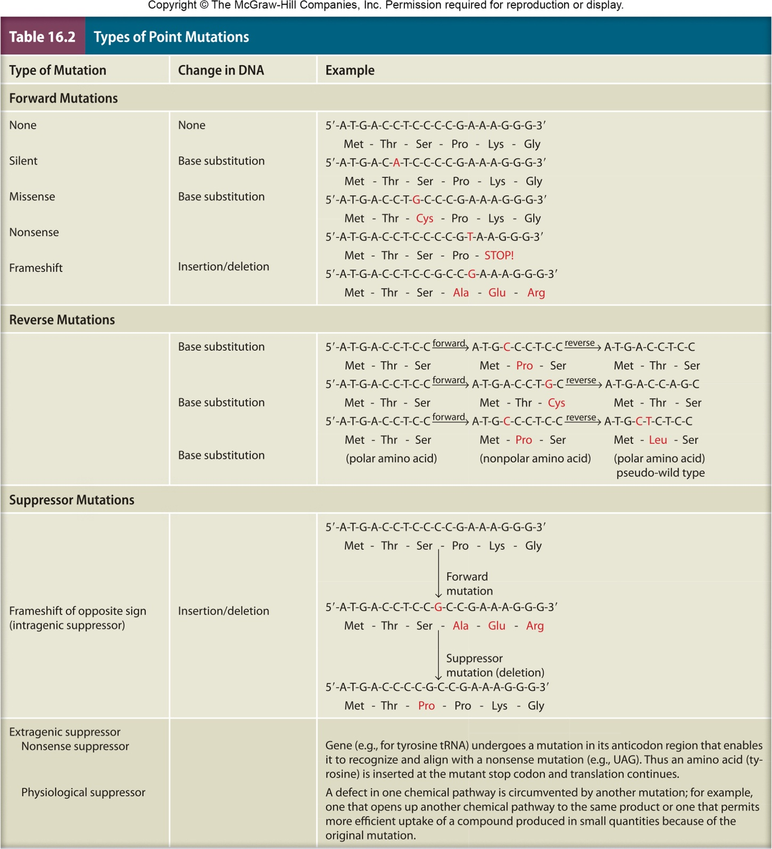
‹#›

Slide 15
Point Mutations
Silent mutation – change nucleoside sequence of codon – but not the encoded amino acid
Missense mutation – a single base substitution that changes codon for one amino acid into codon for another amino acid
Nonsense mutation – converts a sense codon to a stop codon
Frameshift mutation – results from insertion or deletion of one or two base pairs in the coding region of the gene
‹#›
Notes:
‹#›

Slide 16
Other Types of Mutations
Conditional mutations
expressed only under certain environmental conditions
Auxotrophic mutant
unable to make an essential macromolecule such an amino acid or nucleotide
has a conditional phenotype
wild-type strain from which it arose is called a prototroph
‹#›
Notes:
‹#›

Slide 17
Other Types of Mutations
Mutations in Regulatory Sequences
conditional lac operon mutants
many of these mutations map in the operator site and produce altered operator sequences not recognized by repressor
operon is always transcribed and β-galactosidase is always synthesized
Mutations in tRNA and rRNA genes
protein synthesis is disrupted
‹#›
Notes:
‹#›

