Slide 1
27
Viruses
‹#›
Copyright © McGraw-Hill Global Education Holdings, LLC. Permission required for reproduction or display.
Notes:
‹#›

Slide 2
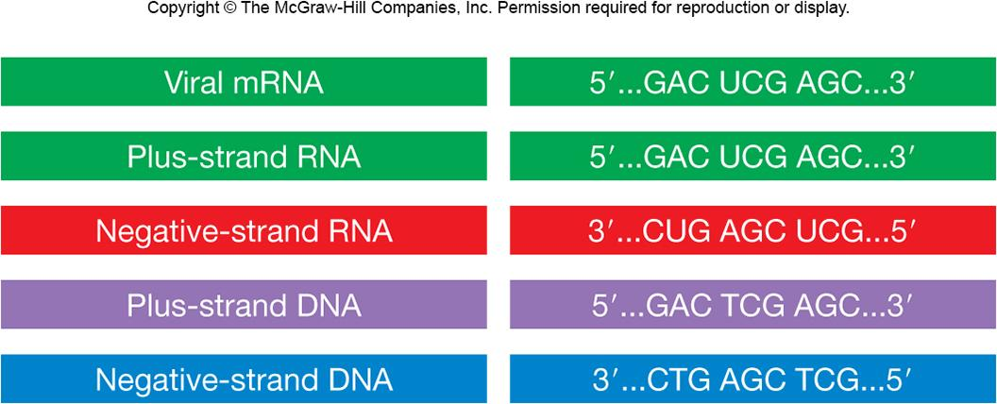
Virus Classification
Classification based on numerous characteristics
nucleic acid type
presence or absence of envelope
capsid symmetry
dimensions of virion and capsid
‹#›
Notes:
‹#›

Slide 3
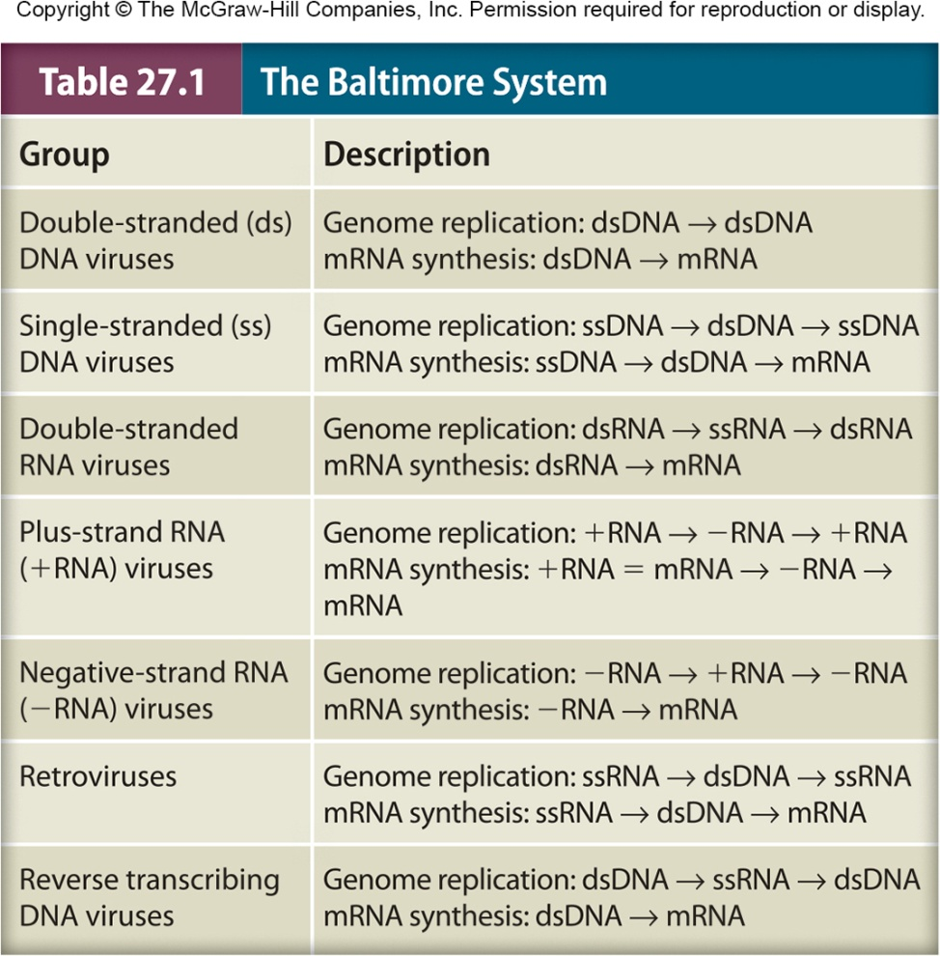
Alternative Classification Scheme
David Baltimore
focuses on viral genome and process used to synthesize viral mRNA
7 life cycle groups based on
double stranded (ds) DNA
single stranded (ss) DNA
dsRNA
ssRNA (+ or – strand)
retrovirus
‹#›
Notes:
‹#›

Slide 4
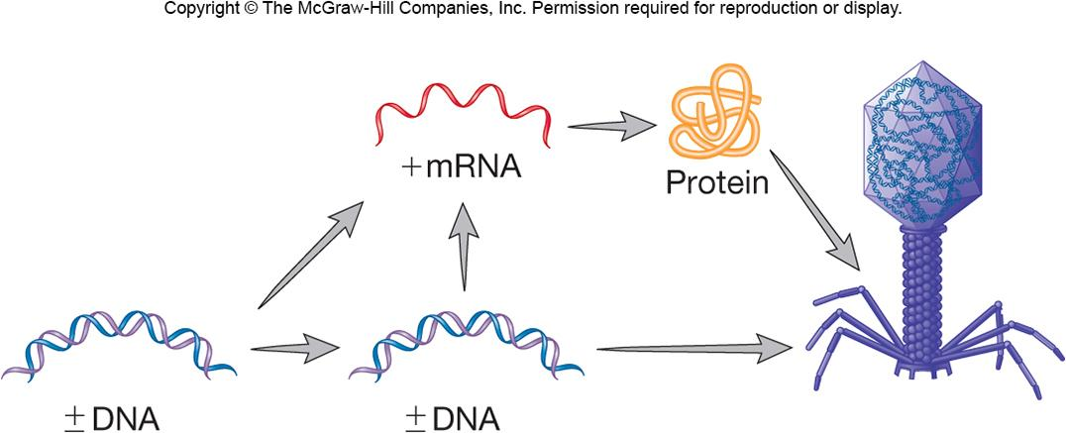
Double-stranded DNA Viruses
Largest group of known viruses
Most bacteriophages have dsDNA
Important vertebrate viruses
herpesviruses, poxviruses
Insect viruses
Some rely on host’s DNA/RNA polymerases
‹#›
Notes:
‹#›

Slide 5
Eukaryotic Viruses
Herpesviruses
Nucleocytoplasmic Large DNA Viruses
‹#›
Notes:
‹#›

Slide 6
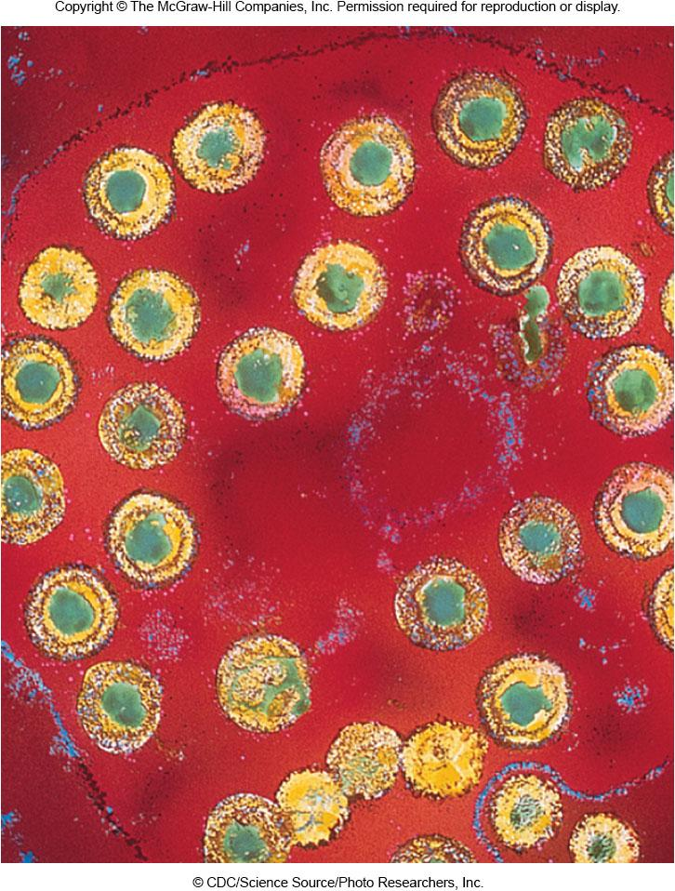
Herpesvirus Virons
Icosahedral, 120–200 nm, pleomorphic(متعدد الأشكال), enveloped, surface spikes
Envelope surrounds tegument (layer of proteins) which surrounds nucleocapsid
Linear genomes, 50–100 genes
Targets are epithelial or nerve cells
‹#›
Notes:
‹#›

Slide 7
Herpesvirus Infections
Productive (primary) infections
50,000–200,000 virions produced/cell
cell dies due to degraded DNA
Latent infections
occurs in neuronal cells
infectious virus not detected
can be reactivated in neurons
production infection recurs(يتكرر)
‹#›
Notes:
‹#›

Slide 8
Herpesvirus Productive Infection
Receptor mediated attachment
Virus envelope fuses with host cell membrane
Linear dsDNA enters nucleus, circularizes
immediate early and early proteins made
used for viral DNA replication
late gene transcription
viral structural proteins
‹#›
Notes:
‹#›

Slide 9
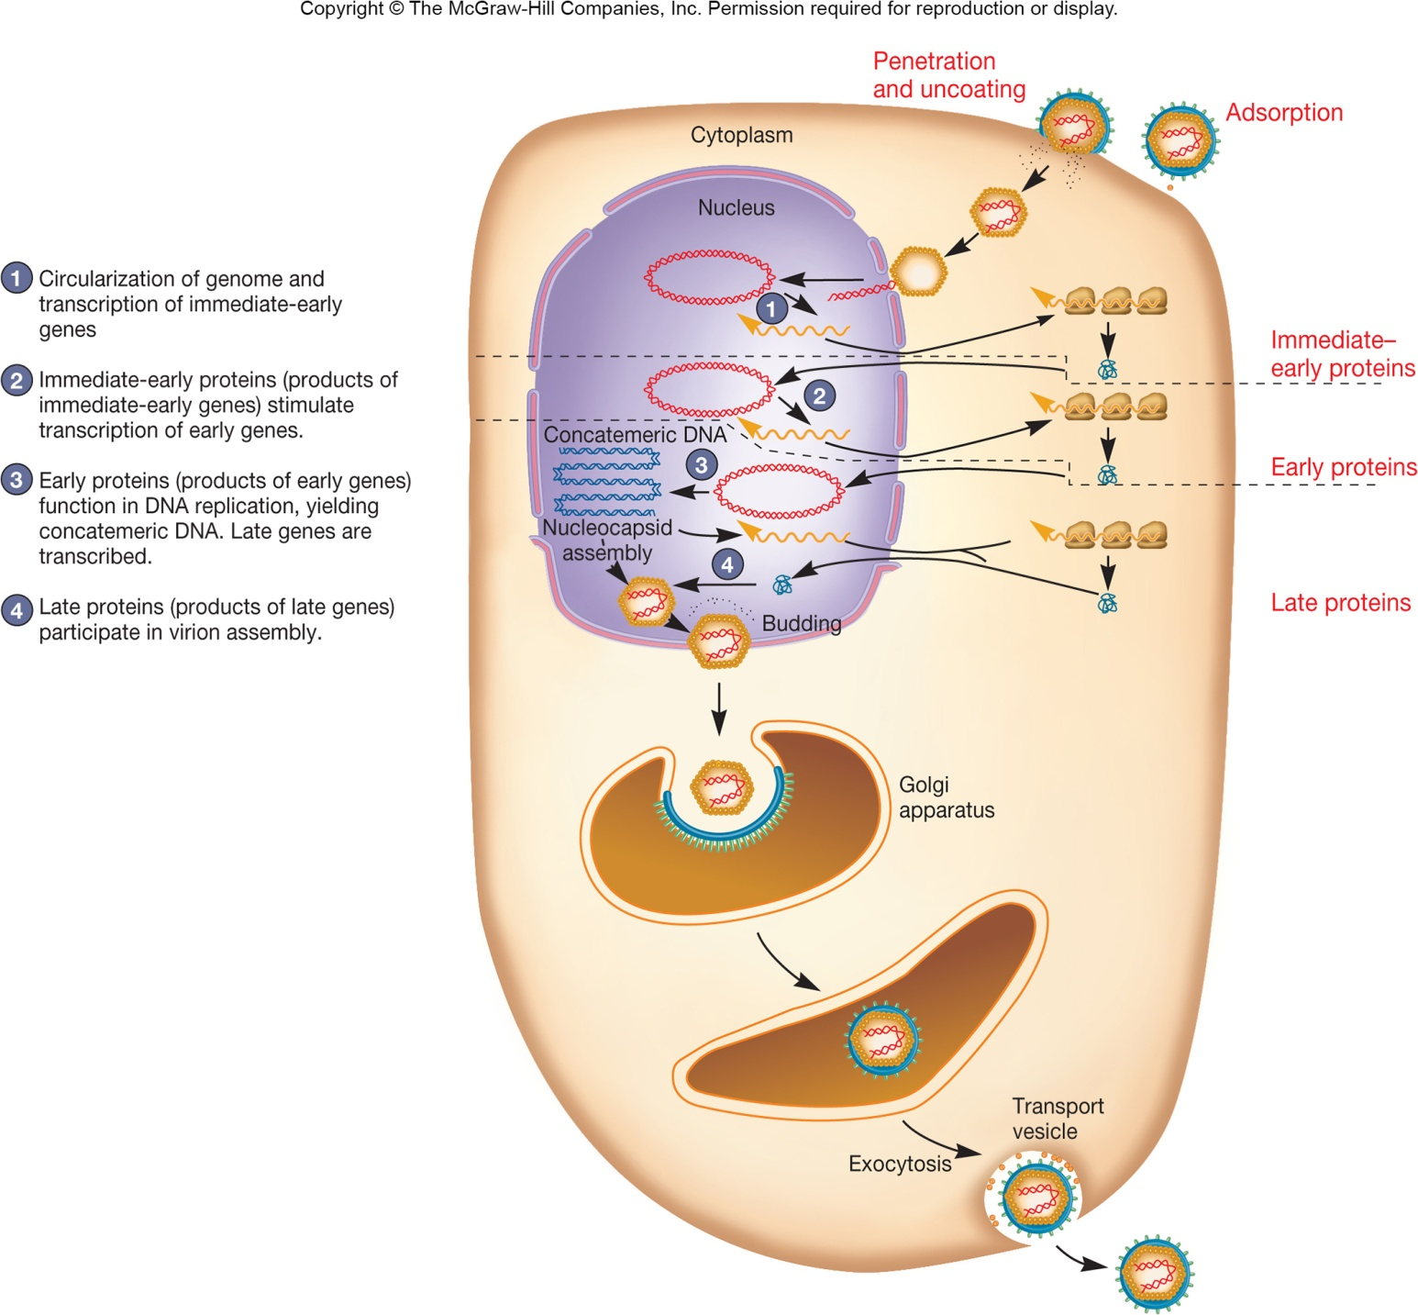
‹#›
Notes:
‹#›

Slide 10
Herpesvirus Productive Infection…
Nucleocapsid assembles and leaves nucleus
Tegument proteins associate with nucleocapsid
Virus envelope is generated by Golgi apparatus
Mature enveloped virion leaves cell
‹#›
Notes:
‹#›

Slide 11
How do RNA viruses replicate their genomes?
Methods vary from group to group
dsRNA, + sense, and - sense ssRNA viruses use an RNA-dependent RNA polymerase to create a template intermediate of their genome
This template can then be used by the same enzyme to create more genome copies
Retroviruses use reverse transcriptase enzymes to convert their RNA genome into a DNA intermediate
This intermediate is transcribed into more genome copies by a DNA-dependent RNA polymerase (often cellular in nature)
‹#›

Slide 12
How do viruses use the least genetic material to create their proteins?
Methods vary
RNA levels
polycistronic mRNA
shorter length subgenomic RNA molecules
alternative splicing of RNA molecules
Translational levels
overlapping coding regions with independent start/stop signals
different reading frames
production of large polyproteins, cleaved by proteases
‘read-through,’ not stopping at a stop codon
‹#›

Slide 13
Rotavirus
Human rotavirus kills >600,000 children worldwide each year
transmitted by fecal material
virus stable in environment
Virion
wheel-like appearance, non-enveloped, segmented genome, dsRNA, three concentric layers of proteins
virus loses outer layer of protein when it enters host cell – double layered particle (DLP)
mRNA transcription, translation
proteins form inclusion called viroplasm
RNA genome replication occurs here
third layer added in ER
‹#›
Notes:
‹#›

Slide 14
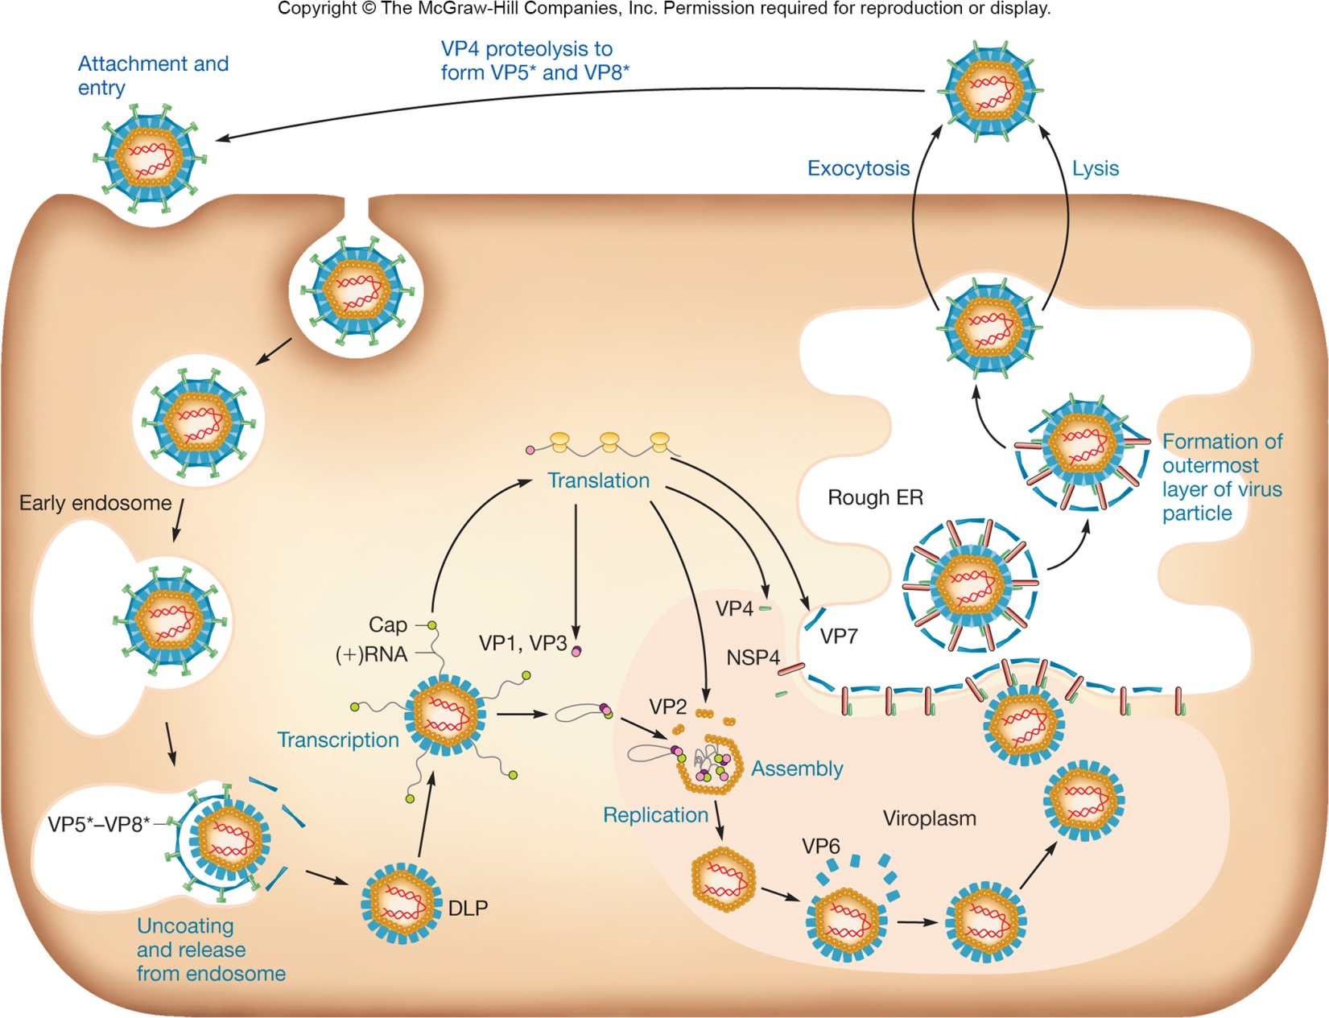
Rotavirus…
‹#›
Notes:
‹#›

Slide 15
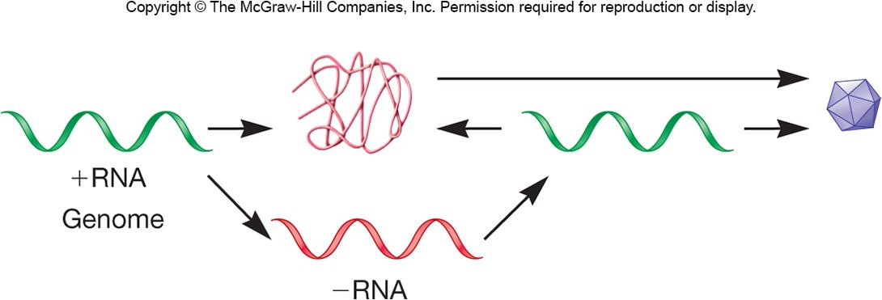
Plus-Strand RNA Viruses
Nonsegmented plus-strand RNA genomes
Replicate in cytoplasm and synthesize RNA-dependent RNA polymerase
synthesizes negative strand RNA
Replication complex for assembly
derived from different cell organelles
‹#›
Notes:
‹#›

Slide 16
Poliovirus
Causative agent of poliomyelitis
transmitted by ingestion(تنتقل عن طريق الابتلاع)
may cripple and paralyze
vaccine is eradicating the disease (اللقاح هو القضاء على المرض)
Virion
nonenveloped
‹#›
Notes:
‹#›

Slide 17
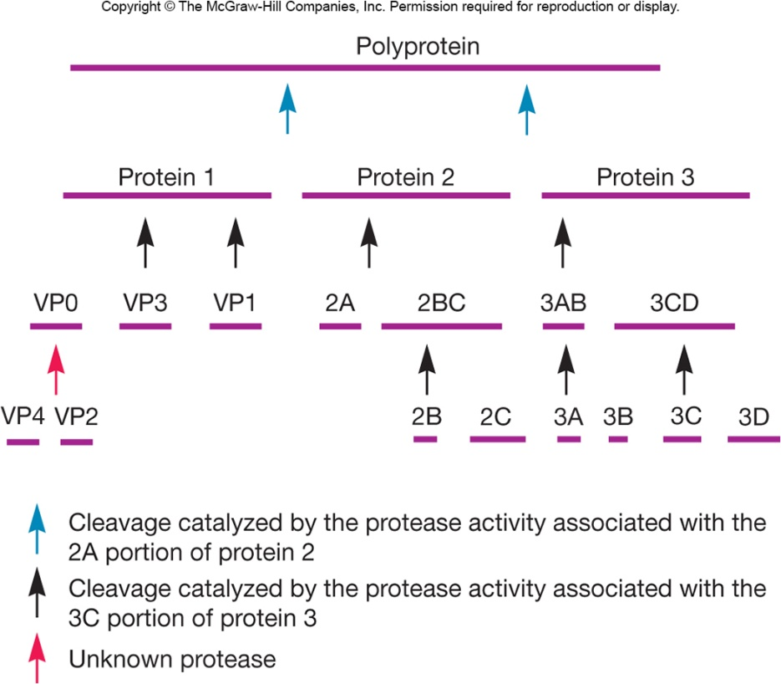
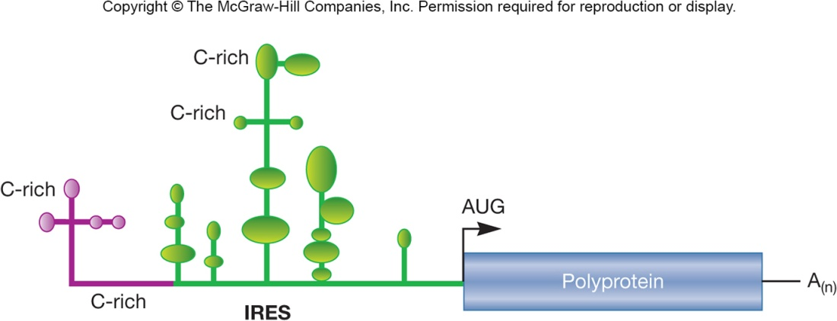
Poliovirus Life Cycle
Attaches to human PV receptor
Viral genome acts as mRNA
virus uses internal ribosome binding site (IRBS) instead of 5’ cap
polyprotein translated, cleaves itself into small proteins
genomic RNA synthesized
assembly, lysis
‹#›
Notes:
‹#›

Slide 18
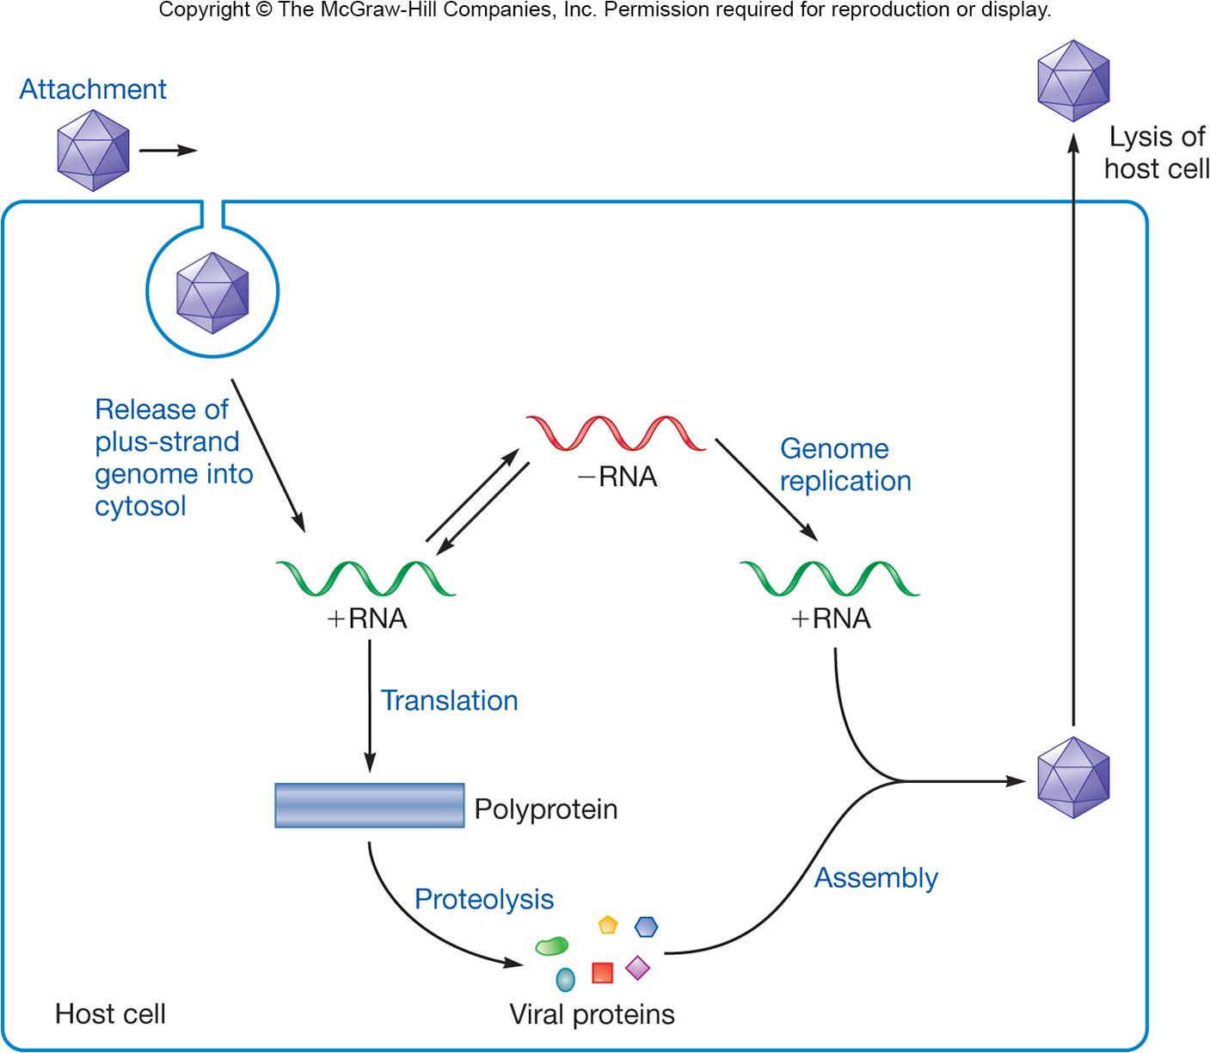
Poliovirus Life Cycle
‹#›
Notes:
‹#›

Slide 19
Minus-Sense RNA Viruses
More recent evolutionary development
Enveloped virions, pleomorphic shape
Segmented and nonsegmented genomes
segmented may have evolved from nonsegmented genomes by reduction of redundant(زائد) genetic regions
nonsegmented arranged in highly conserved order, tandemly linked separated by nontranscribed intergenic sequences
‹#›
Notes:
‹#›

Slide 20
Negative-Strand Viruses
Cannot serve as mRNA to form viral proteins
Must bring into cell preformed RNA-dependent RNA polymerase
new plus strand intermediates synthesized
the newly synthesized plus strand serves as template for genome synthesis and mRNA as well
‹#›
Notes:
‹#›

Slide 21
Influenza Virus
Causative agent of the flu
transmitted by inhalation or ingestion
Three types of viruses – A, B, and C
Seven to eight segments of linear RNA
hemagglutinin binds host receptors
neuraminidase hydrolyzes mucus, cleaves virus from host receptor
‹#›
Notes:
‹#›

Slide 22
Influenza Virus Life Cycle
Enters in endosome
low pH causes conformational change in hemagglutinin protein
hydrophobic ends swing outward and fusion of membranes
nucleocapsid released
Genome template for genome synthesis and mRNA synthesis
Virus buds from host cell acquiring envelope
‹#›
Notes:
‹#›

Slide 23
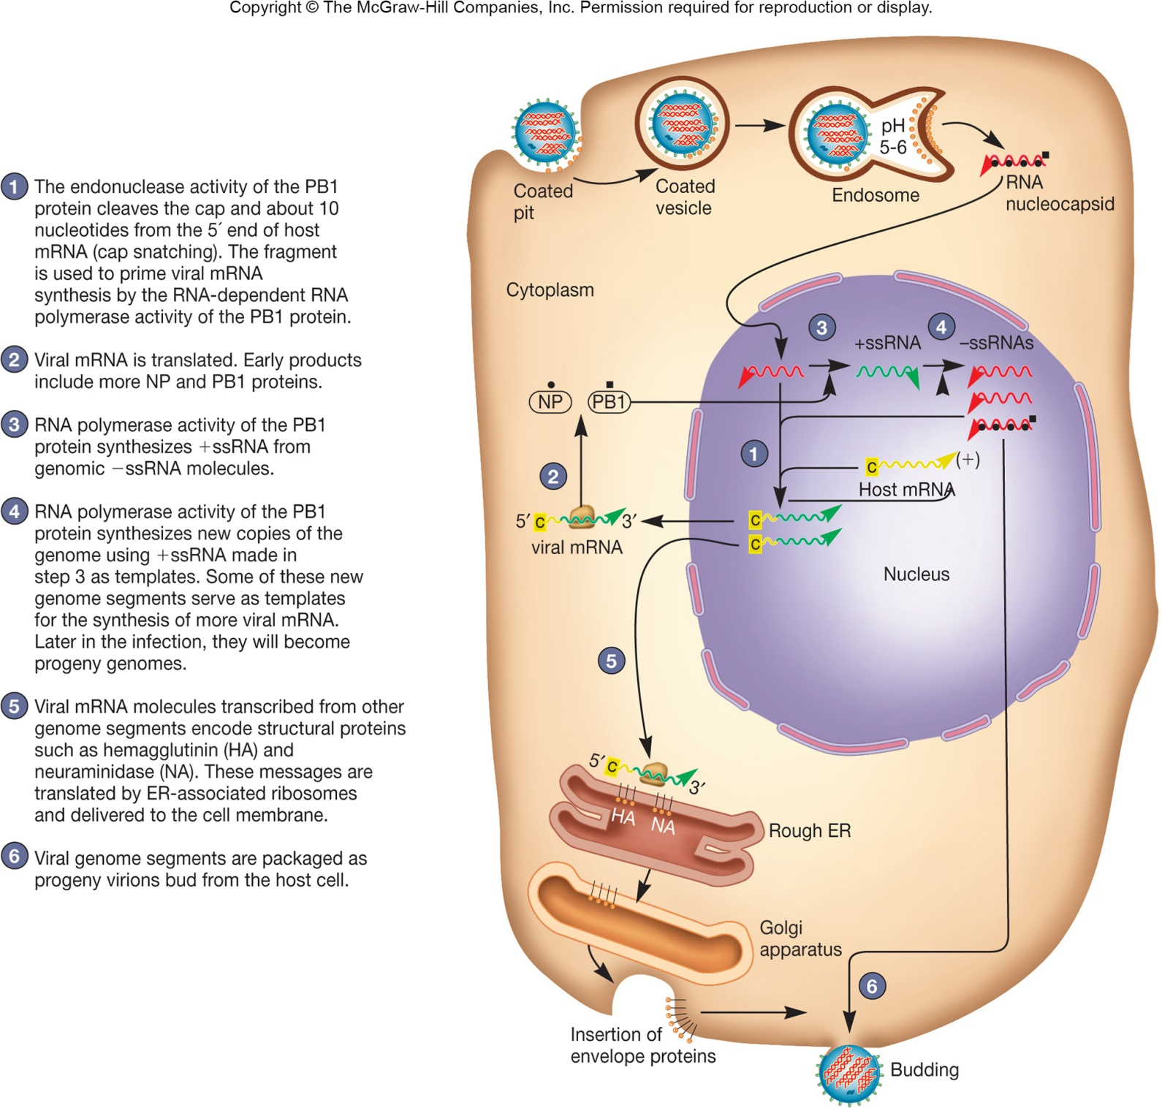
‹#›
Notes:
‹#›

Slide 24
Retroviruses
Convert ssRNA into dsDNA using reverse transcriptase
dsDNA integrates into host cell genome and serves as template for mRNA synthesis and genome synthesis
‹#›
Notes:
‹#›

Slide 25
Retroviruses - HIV
Human immunodeficiency virus (HIV)
cause of acquired immunodeficiency syndrome (AIDS)
globally important pandemic(وباء مهم عالمياً)
Member of genus Lentivirus
HIV-1 (most common cause of AIDS in US), HIV-2 (common in Africa)
HIV-1
enveloped virus
two copies of RNA genome
reverse transcriptase and integrase
‹#›
Notes:
‹#›

Slide 26
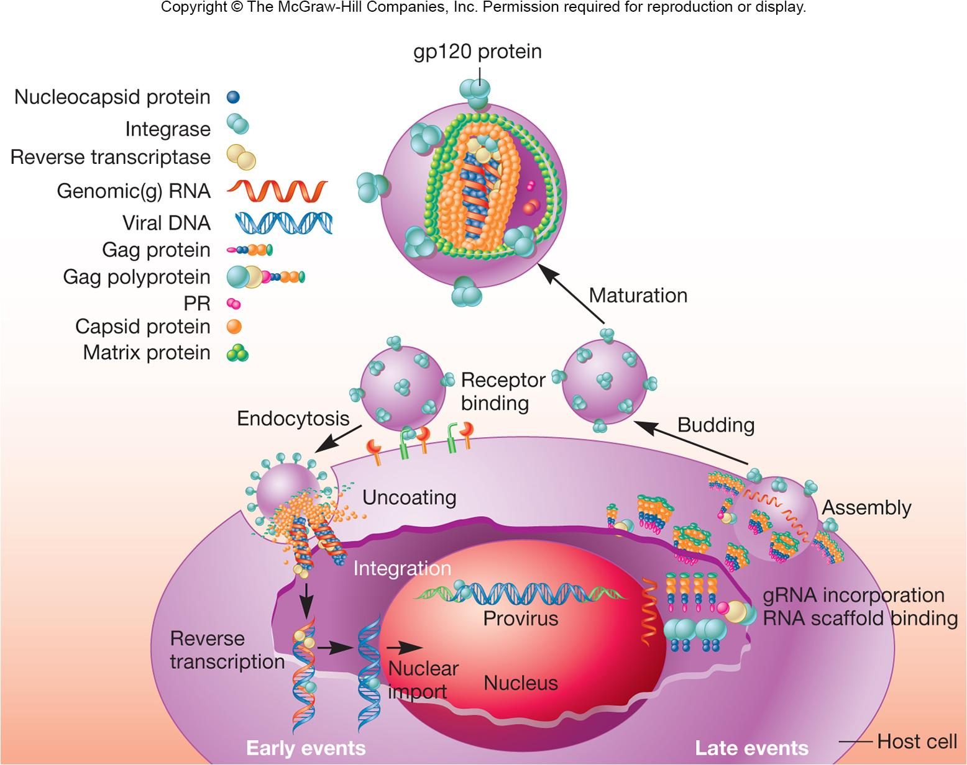
‹#›
Notes:
‹#›

Slide 27
HIV…
gp120 binds CD4⁺ T cells, macrophages, dendritic cells, and monocytes
coreceptor (which can vary) also required to gain entry into cell
virus enters by receptor-mediated endocytosis
Reverse transcriptase
RNA dependent DNA polymerase
DNA dependent DNA polymerase
ribonuclease RNase H
error prone, has no proofreading capability
‹#›
Notes:
‹#›

Slide 28
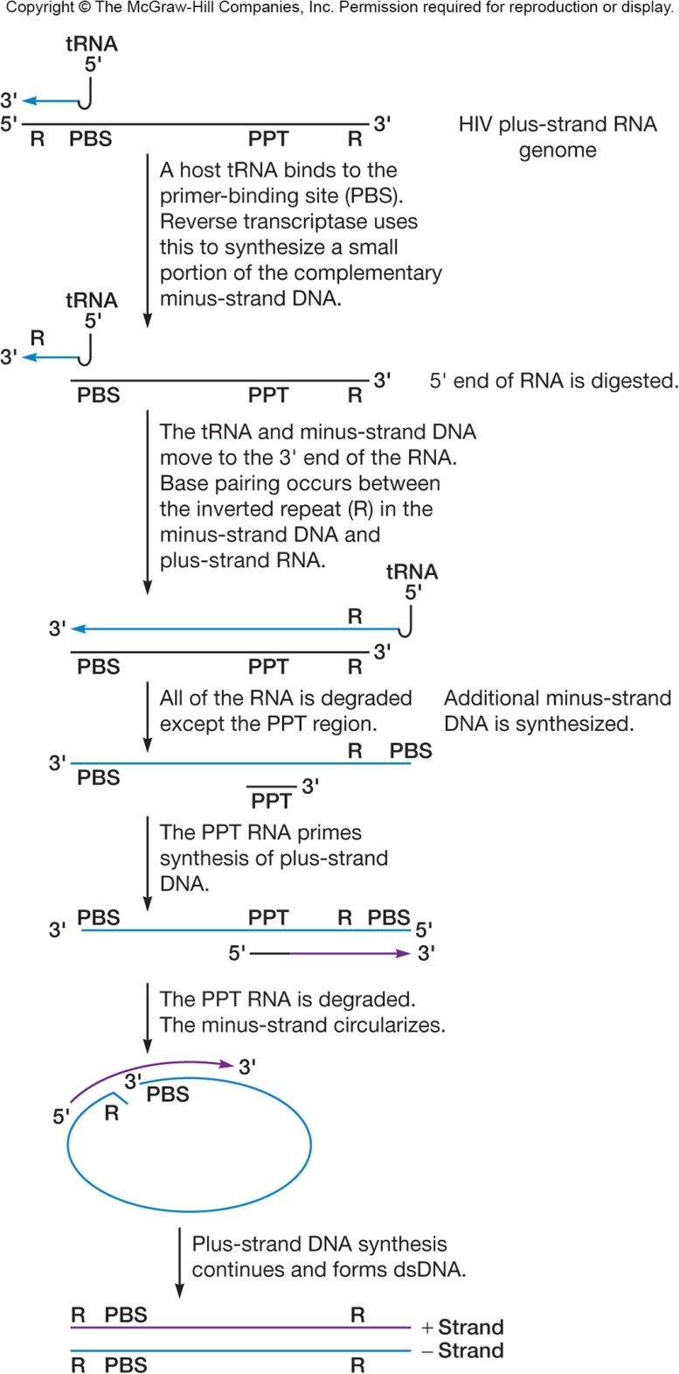
HIV Life Cycle
Reverse transcriptase
RNA dependent DNA polymerase
DNA dependent DNA polymerase
ribonuclease RNase H
error prone, has no proofreading capability
‹#›
Notes:
‹#›

Slide 29
HIV Life Cycle…
dsDNA is moved to the nucleus
integrase and other proteins integrate proviral DNA
forces cell to synthesize viral mRNA
splicing forms 10 viral transcripts
Cleavage forms viral proteins
Assembly and budding occurs
Eventually cell dies
‹#›
Notes:
‹#›

