Slide 1
33
Innate Host Resistance
‹#›
Copyright © McGraw-Hill Global Education Holdings, LLC. Permission required for reproduction or display.

Slide 2
Host Resistance Overview
Most pathogens (disease causing microbes)
must overcome surface barriers and reach underlying
overcome resistance by host
nonspecific resistance
specific immune response
‹#›

Slide 3
Host Resistance Overview…
Immune system
composed of widely distributed cells, tissues, and organs
recognizes foreign substances or microbes and acts to neutralize or destroy them
Immunity
ability of host to resist a particular disease or infection
Immunology
science concerned with immune responses
‹#›

Slide 4
Immunity
Nonspecific immune response
Aka nonspecific resistance, innate, or natural immunity
acts as a first line of defense
offers resistance to any microbe or foreign material
lacks immunological memory
Specific immune response
Aka acquired, adaptive, or specific immunity
resistance to a particular foreign agent
has “memory”
effectiveness increases on repeated exposure to agent
‹#›

Slide 5
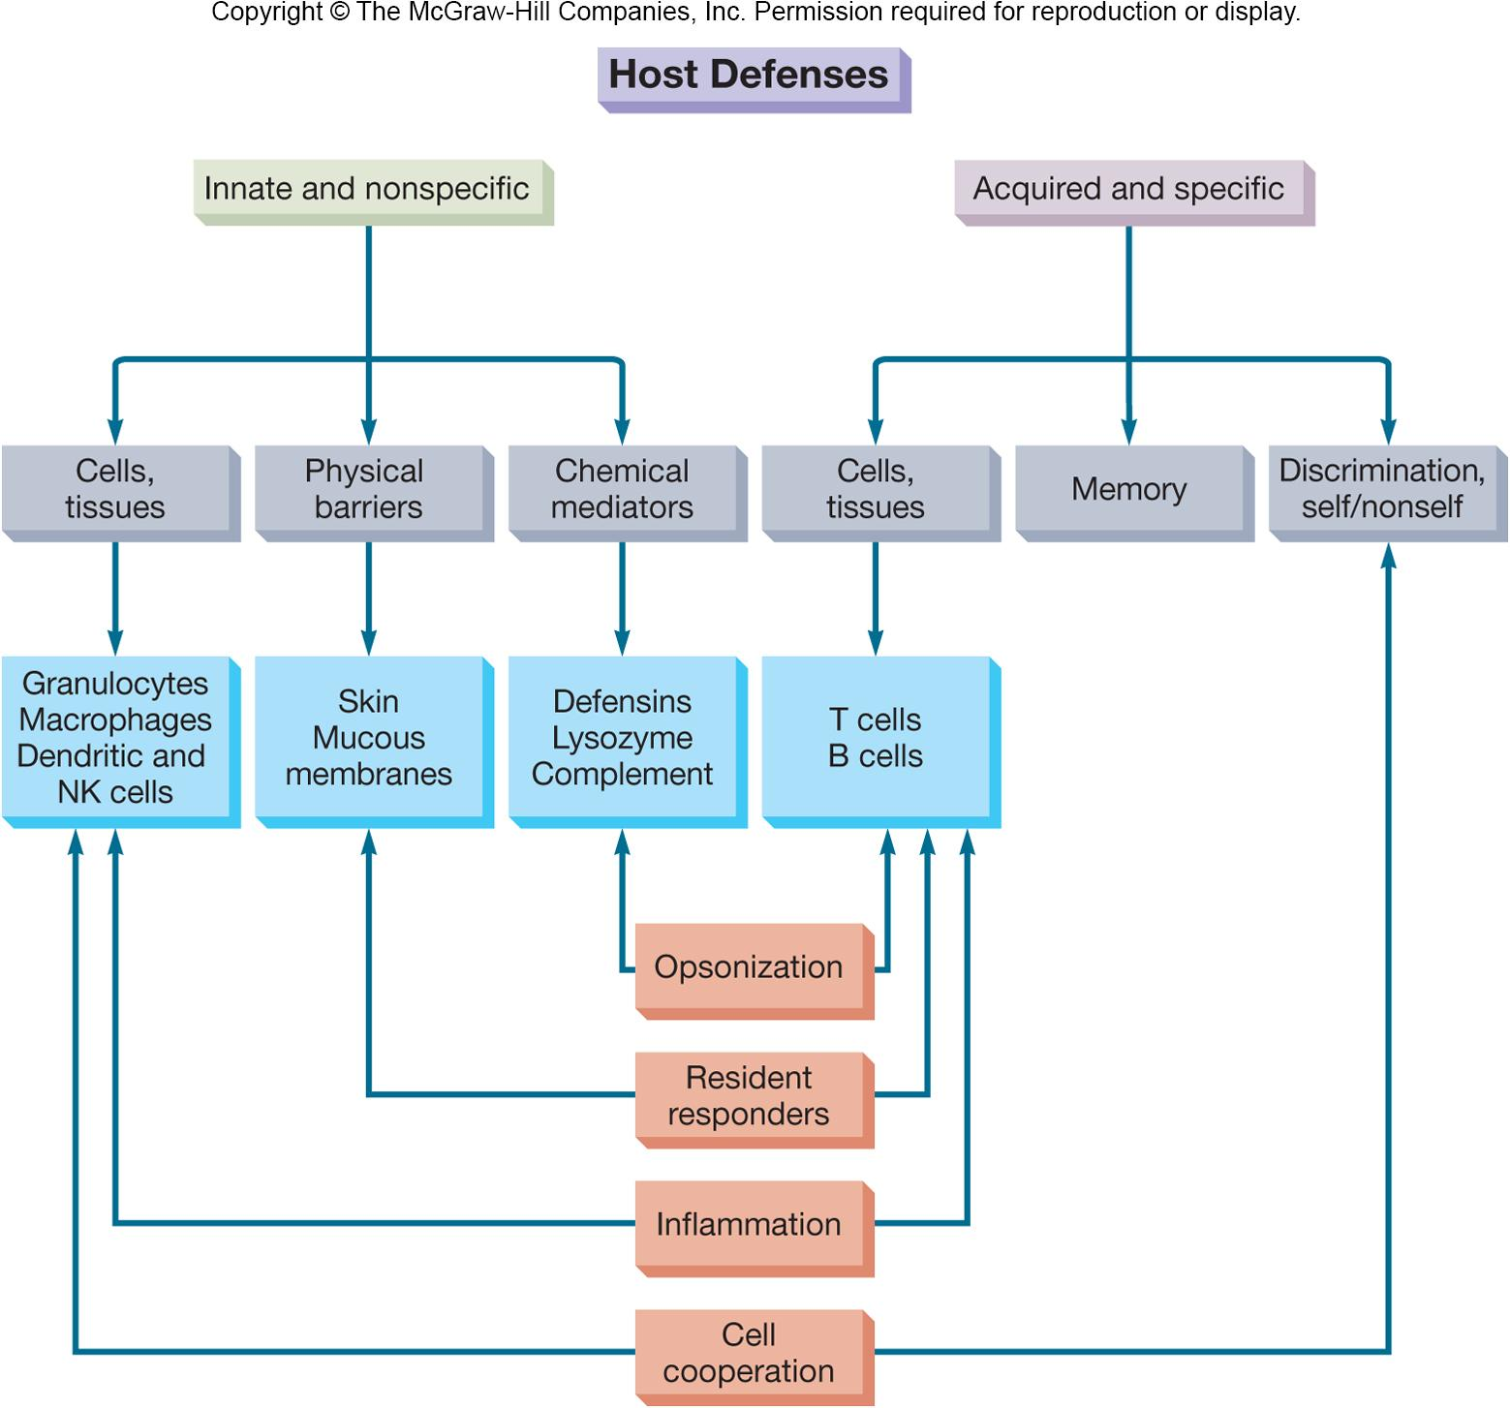
‹#›

Slide 6
Antigens
Recognized as foreign
Invoke immune responses(استدعاء الاستجابات المناعية)
presence of antigen in body ultimately(في النهاية) results in B cell activation 🡪 🡪 production of antibodies
antibodies bind to specific antigens, inactivating or eliminating them
other immune cells also become activated
Name comes from antibody generators(مولدات الاجسام المضادة)
‹#›

Slide 7
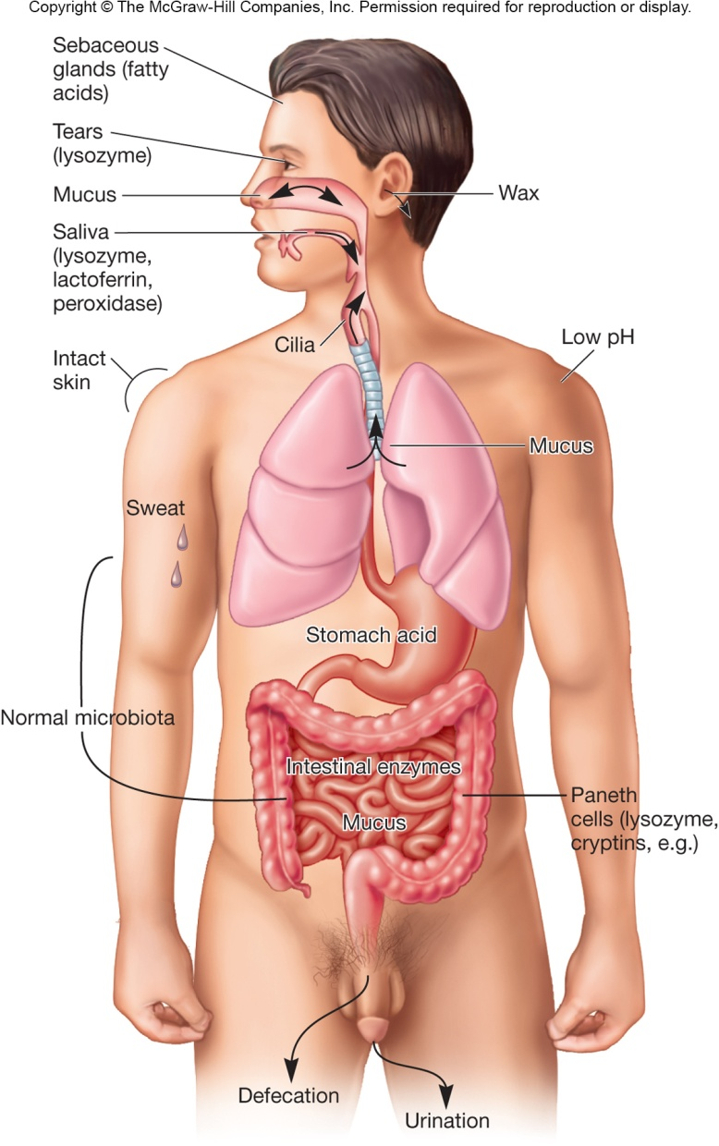
Physical Barriers in Nonspecific (Innate) Resistance
Effectiveness impacted by:
direct factors
nutrition, physiology, fever, age, and genetics
indirect factors
personal hygiene, socioeconomic status, and living conditions
Along with host’s secretions (flushing(تدفق مائي/صرف)), barriers = first line of defense against microbes
‹#›

Slide 8
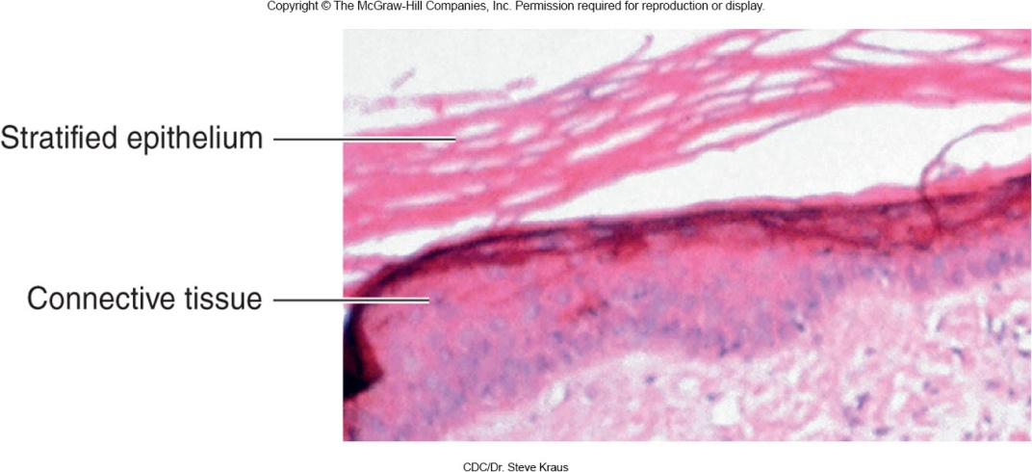
Skin
Strong mechanical barrier to microbial invasion
keratin produced by keratinocytes in outer layer
Inhospitable environment for microbes
attached organisms removed by shedding of outer skin cells
pH is slightly acidic
high NaCl concentration
subject to periodic drying
‹#›

Slide 9
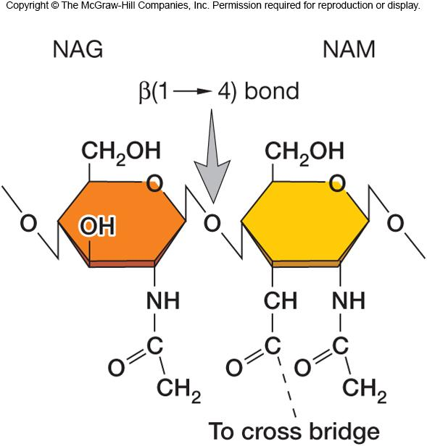
Mucous Membranes
Form protective covering that resists penetration and traps(حصر) many microbes
Are often bathed in antimicrobial secretions which contain a variety of antimicrobial substances
lysozyme
hydrolyzes bond connecting sugars in peptidoglycan
lactoferrin
secreted by activated macro-
phages and PMNs
sequesters(تعزل) iron from plasma
lactoperoxidase
produces superoxide radicals
‹#›

Slide 10
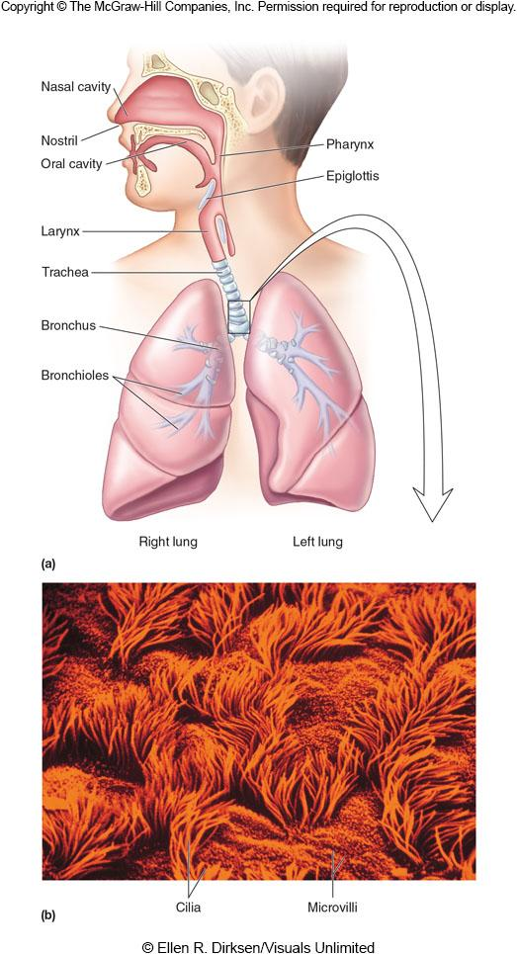
Respiratory System
Turbulent air flow deposits microbes onto mucosal surfaces
Mucociliary blanket
mucous secretions trap microbes
once trapped, microbes transported away from the lungs (mucociliary escalator)
expelled by coughing or sneezing
salivation washes microbes to stomach
Alveolar macrophages
phagocytic cells in alveoli(الحويصلات الهوائية) of lungs
‹#›

Slide 11
Gastrointestinal Tract
Stomach
gastric acid
Intestines
pancreatic enzymes
bile
intestinal enzymes
GALT
Peristalsis(انقباضات)
Intestines
shedding of columnar epithelial cells
secretory IgA
normal microbiota
Paneth cells
produce lysozyme
produce cryptins
‹#›

Slide 12
Genitourinary Tract
Unfavorable environment for foreign microbes
low pH of urine and vagina
vagina has lactobacilli
urea and other toxic metabolic end products in urine
hypertonic nature of kidney medulla
Flushing(تدفق/صرف) with urine and mucus
Distance barrier of male urethra
‹#›

Slide 13
The Eye
Mucus secreting epithelial membrane
Flushing action of tears
Lysozyme, lactoferrin, and secretory IgA in tears
‹#›

Slide 14
Cells of the Immune System
Granulocytes
Mast cells
Monocytes and macrophages
Dendritic cells
Lymphocytes
Each has specialized role in defending host
Leukocytes
white blood cells
involved in both specific and nonspecific immunity
all arise from pluripotent stem cells
‹#›

Slide 15
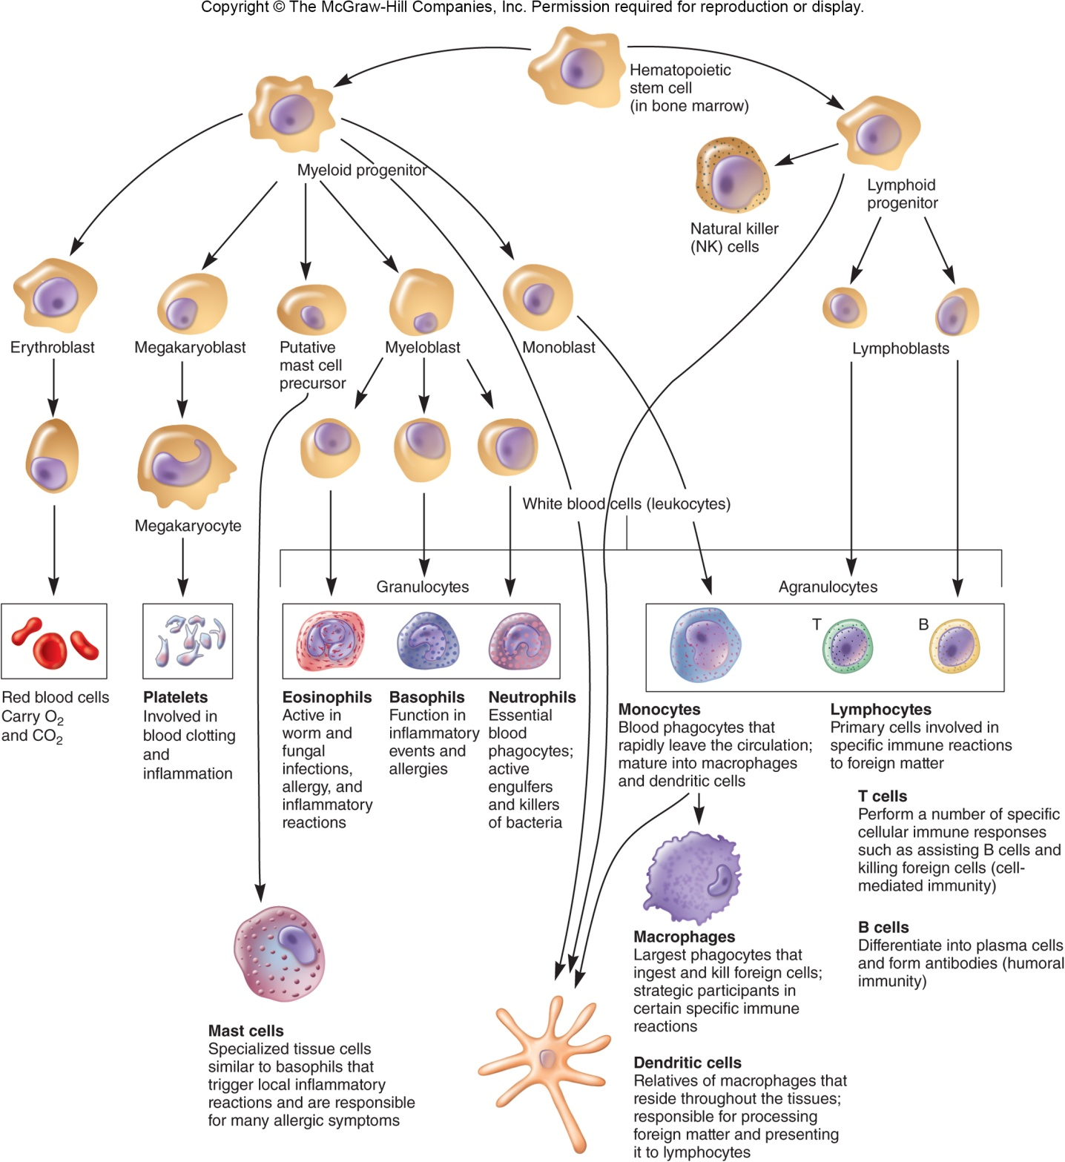
‹#›

Slide 16
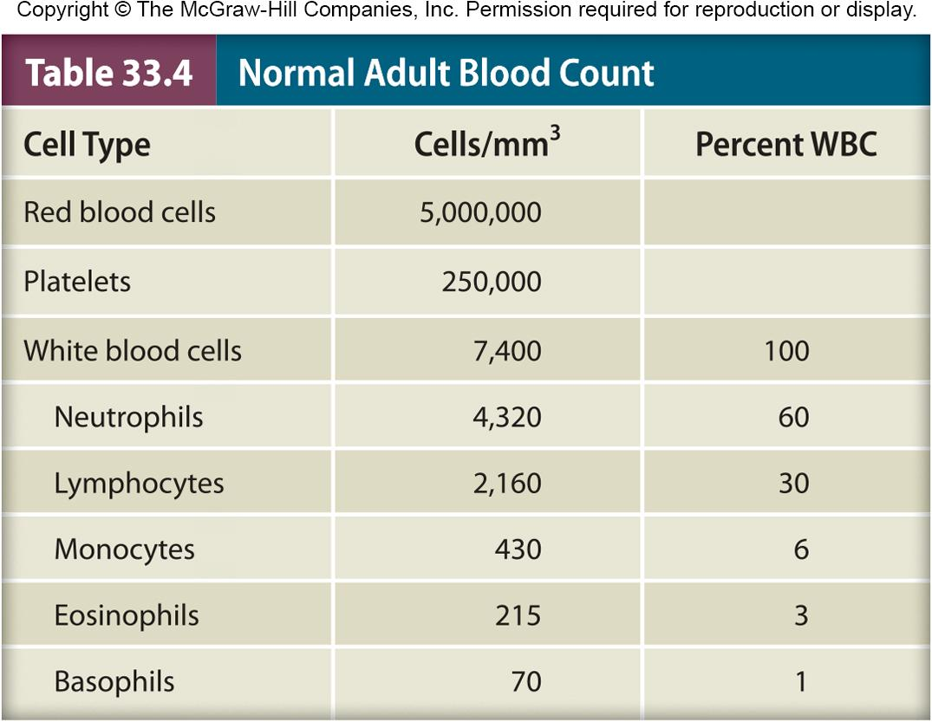
‹#›

Slide 17
Granulocytes
Irregularly-shaped nuclei with two to five lobes
Cytoplasm has granules with reactive substances
kill microbes, enhance inflammation
Three types
basophils, eosinophils, neutrophils (polymorphonuclear neutrophil (PMN))
‹#›

Slide 18
Basophils
Stain bluish-black with basic dyes
Nonphagocytic
Release vasoactive mediators
e.g., histamine, prostaglandins, serotonin, and leukotrienes from granules
Play important role in development of allergies and hypersensitivities
‹#›

Slide 19
Neutrophils
Stain at neutral pH
Highly phagocytic
Circulate in blood then migrate to sites of tissue damage
Kill ingested microbes with lytic enzymes and reactive oxygen metabolites contained in primary and secondary granules
‹#›

Slide 20
Monocytes and Macrophages
Highly phagocytic cells
Monocytes
are mononuclear phagocytic leukocytes
after circulating for ~8 hours, mature into macrophages
Macrophages
larger than monocytes, reside(يقيم) in specific tissues, highly phagocytic
have a variety of surface receptors (including pattern recognition receptors)
bind pathogen associated molecular patterns (PAMPs)
named according to tissue in which they reside
‹#›

Slide 21
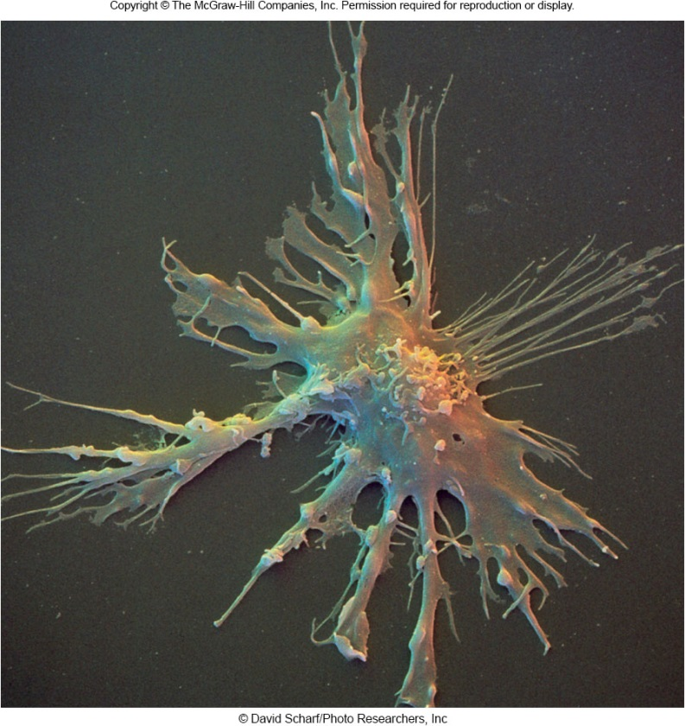
Dendritic Cells
Heterogeneous group of cells with neuron-like appendages(زوائد)
from lymphoid and myeloid lines
Present in small numbers in blood, skin, and mucous membranes of nose, lungs, and intestines
also express pattern recognition receptors
contact, phagocytose, and process antigens 🡪 display foreign antigens on their surfaces (antigen presentation)
‹#›

Slide 22
Lymphocytes
Major cells of the immune system
Major populations include T cells, B cells, and natural killer (NK) cells
B and T lymphocytes differentiate in bone marrow from stem cells
are only activated by binding of specific antigen onto lymphocyte surface receptors
after activation replication continues as lymphocytes circulate and enter lymphoid tissue
memory cells are activated lymphocytes that do not immediately replicate, but will do so later in host’s life when antigen is again present
‹#›

Slide 23
B Lymphocytes
B cells (B lymphocytes)
mature in bone marrow
circulate in blood
can settle in lymphoid organs
after maturation and activation are called plasma cells and produce antibodies
‹#›

Slide 24
T Lymphocytes (T cells)
Mature in thymus
Can remain in thymus, circulate in blood, or reside in lymphoid tissue
Like B cells, require antigen binding to surface receptors for activation and continuation of replication
Activated T cells differentiate into helper T cells (TH) and cytotoxic lymphocytes (CTLs)
Secrete cytokines, chemicals that have effects on other cells, are produced and secreted by activated T cells
‹#›

Slide 25
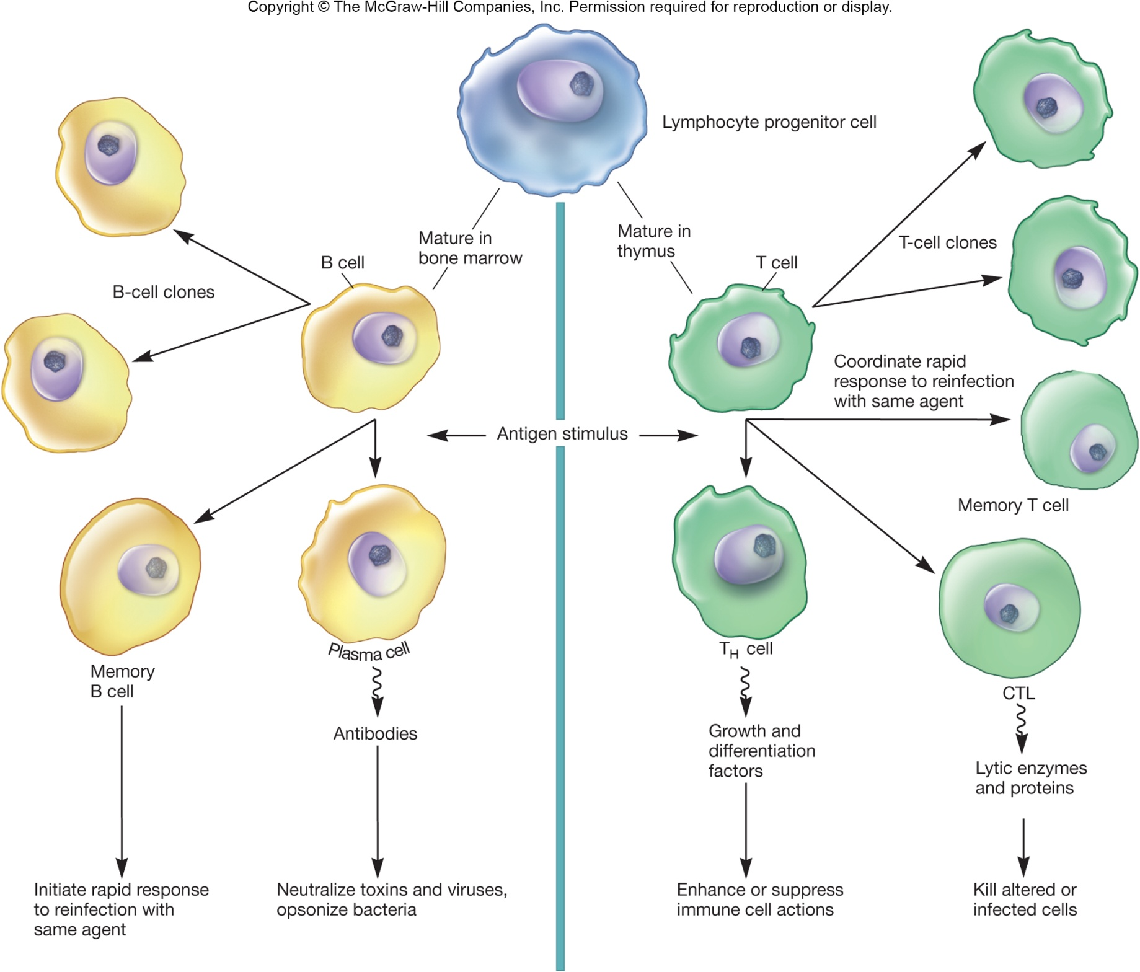
‹#›

Slide 26
Natural Killer (NK) Cells
Small population of large non-phagocytic granular lymphocytes
important role in innate immunity
kill malignant cells(خلايا خبيثة) and cells infected with pathogens by releasing granzymes (cytotoxic enzymes)
Two ways of recognizing target cells
bind to antibodies which coat infected or malignant cells (antibody-dependent cell-mediated cytotoxicity (ADCC)
recognizes cells that have lost their class I major histocompatibility antigen due to presence of virus or cancer
‹#›

Slide 27
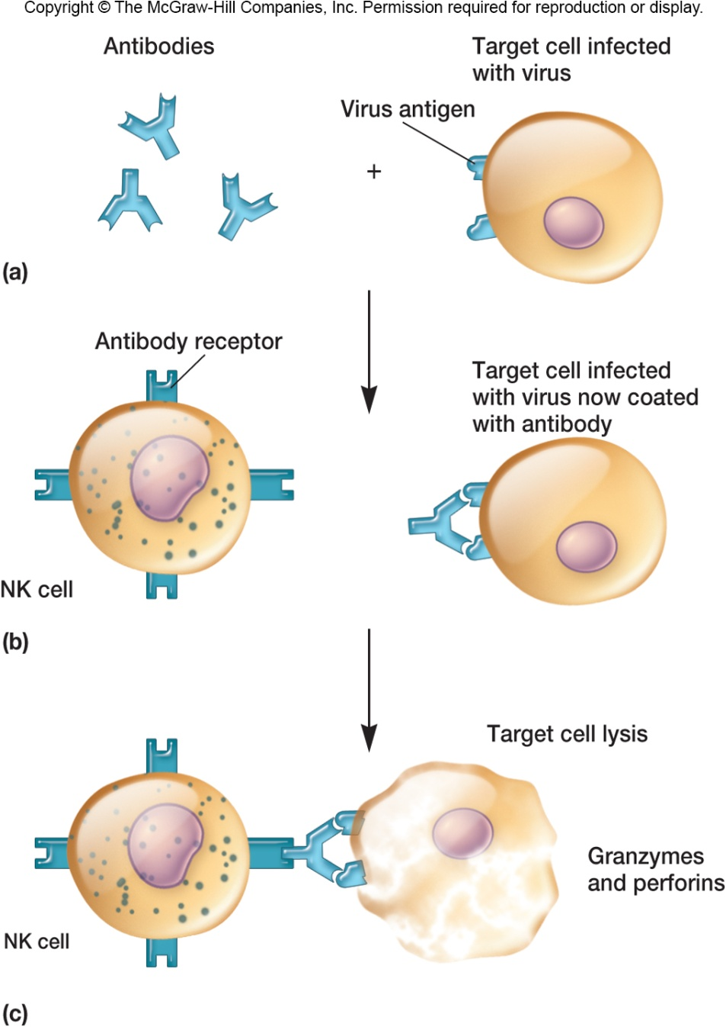
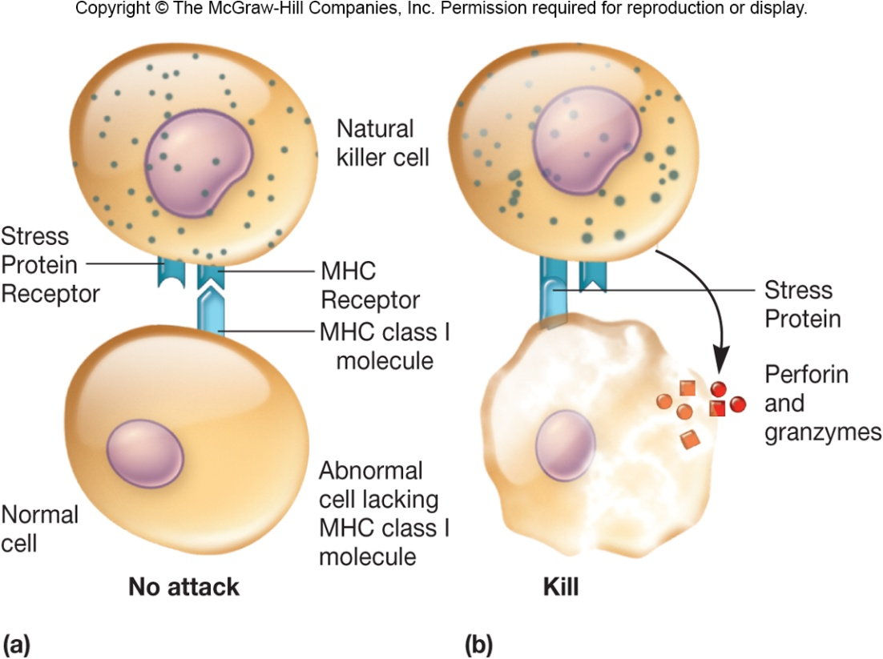
‹#›

Slide 28
Organs and Tissues of the Immune System
Primary organs and tissues
sites where lymphocytes mature and differentiate into antigen-sensitive mature B and T cells
Secondary organs and tissues
areas where lymphocytes may encounter and bind antigen
followed by proliferation and differentiation into fully mature effector cells
‹#›

Slide 29
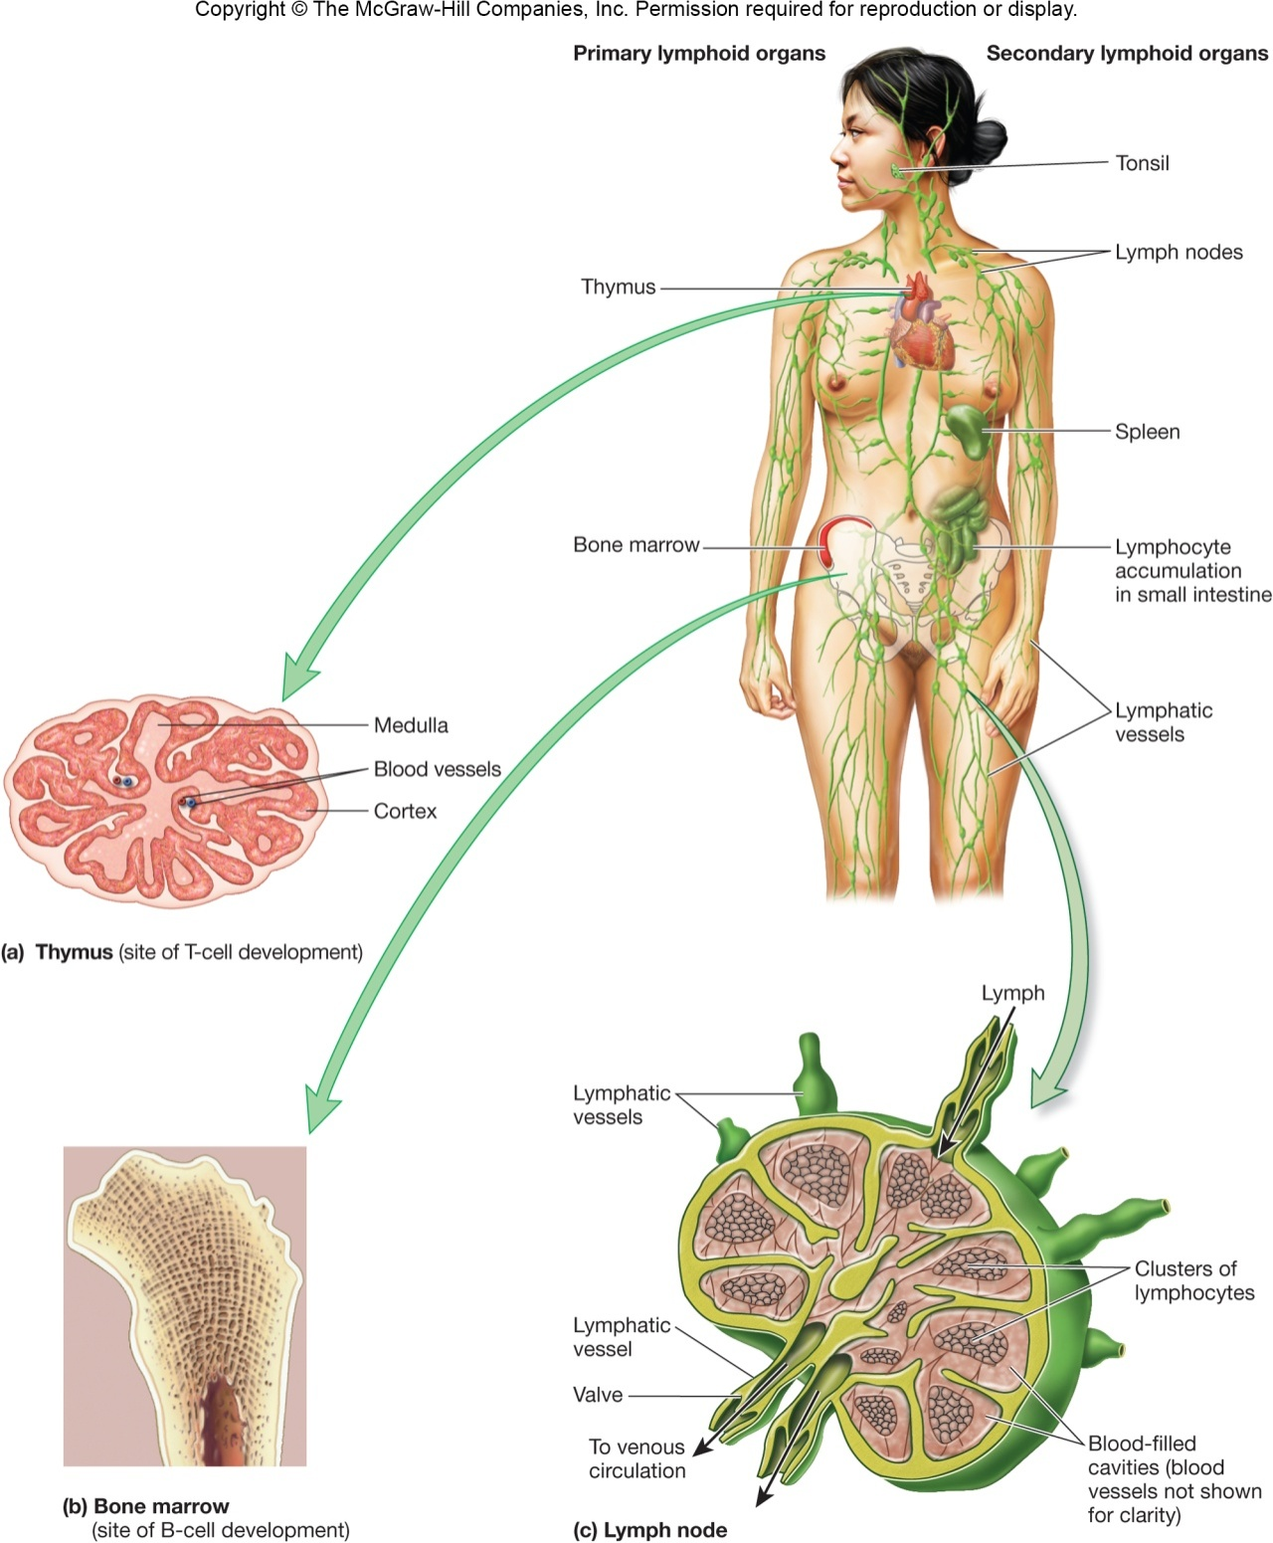
‹#›

Slide 30
Primary Lymphoid Organs and Tissues
Thymus
precursor cells move enter from bone marrow and proliferate(تكاثر)
thymic deletion removes T cells recognizing self antigens
remaining cells become mature T cells
enter bloodstream and recognize nonself antigens
Bone marrow
site of B cell maturation in mammals
maturation involves removal of nonfunctioning and self-reactive cells
‹#›

Slide 31
Secondary Lymphoid Organs and Tissues
Spleen
most highly organized lymphoid organ
filters blood
macrophages and dendritic cells trap(تحاصر) microbes and antigens
present antigens to B and T cells
most common way that lymphocytes become activated to carry out their immune functions
‹#›

Slide 32
Secondary Lymphoid Organs and Tissues
Lymph nodes
most highly organized lymphoid tissue
filter lymph
microbes and antigens trapped and phagocytosed by macrophages and dendritic cells
B cells differentiate into memory and plasma cells within lymph nodes
‹#›

Slide 33
Secondary Lymphoid Organs and Tissues
Lymphoid tissue
located throughout the body
serve as interface between innate and acquired host immunity
act as areas of antigen sampling and processing
some lymphoid cells are found closely associated with specific tissues
e.g., skin-associated lymphoid tissue (SALT)
e.g., mucous-associated lymphoid tissue (MALT)
‹#›

Slide 34
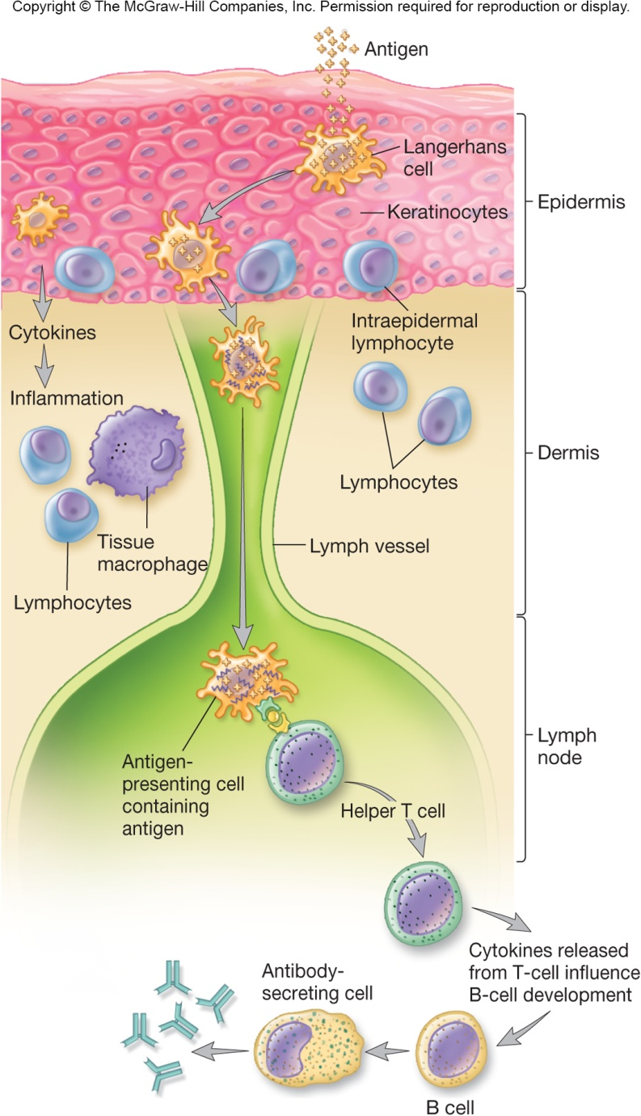
Skin Associated Lymphoid Tissue (SALT)
Contains specialized cells
Langerhans cell
dendritic cell that can phagocytose antigens
differentiates into interdigitating dendritic cell – presents antigen to and activates T cells
intraepidermal lymphocyte
function as T cells
‹#›

Slide 35
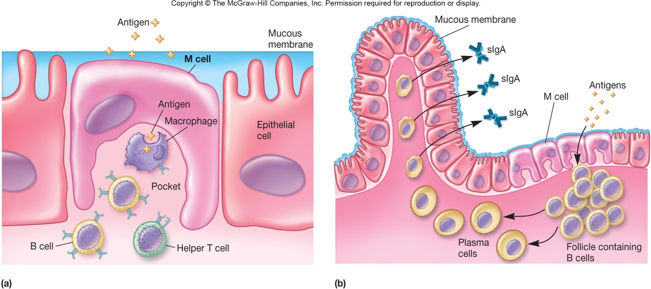
Mucosal-Associated Lymphoid Tissue (MALT)
Specialized immune barrier
gut-associated lymphoid tissue (GALT)
bronchial-associated lymphoid tissue (BALT)
urogenital system(النظام البولي التناسلي ) MALT
‹#›

