Slide 1
6
Viruses and Other Acellular Infectious Agents
Copyright © McGraw-Hill Global Education Holdings, LLC. Permission required for reproduction or display.

Slide 2
Acellular Agents
Viruses – protein and nucleic acid
Viroids – only RNA
Satellites – only nucleic acids
Prions – proteins only

Slide 3
Viruses
Major cause of disease
also importance as a new source of therapy
new viruses are emerging(مستجدة)
Important members of aquatic world
move organic matter from particulate to dissolved
Important in evolution
transfer genes between bacteria, others
Important model systems in molecular biology

Slide 4
General Properties of Viruses
Virion
complete virus particle
consists of ≥1 molecule of DNA or RNA enclosed in coat of protein
may have additional layers
cannot reproduce independent of living cells nor carry out cell division
but can exist extracellularly

Slide 5
Virions Infect All Cell Types
Bacterial viruses called bacteriophages (phages)
Few archaeal viruses
Most are eukaryotic viruses
plants, animals, protists, and fungi
Classified into families based on
genome structure,
life cycle,
morphology,
genetic relatedness

Slide 6
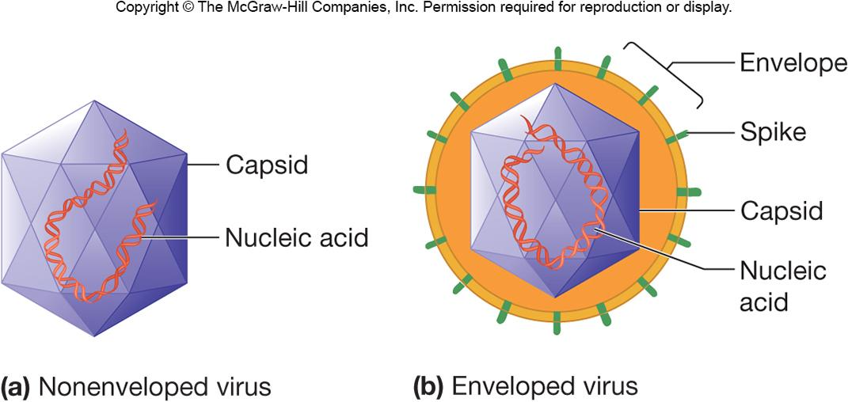
The Structure of Viruses
Virion size range is ~10–400 nm in diameter and most viruses must be viewed with an electron microscope
All virions contain a nucleocapsid which is composed of nucleic acid (DNA or RNA) and a protein coat (capsid)
some viruses consist only of a nucleocapsid, others have additional components
Envelopes

Slide 7
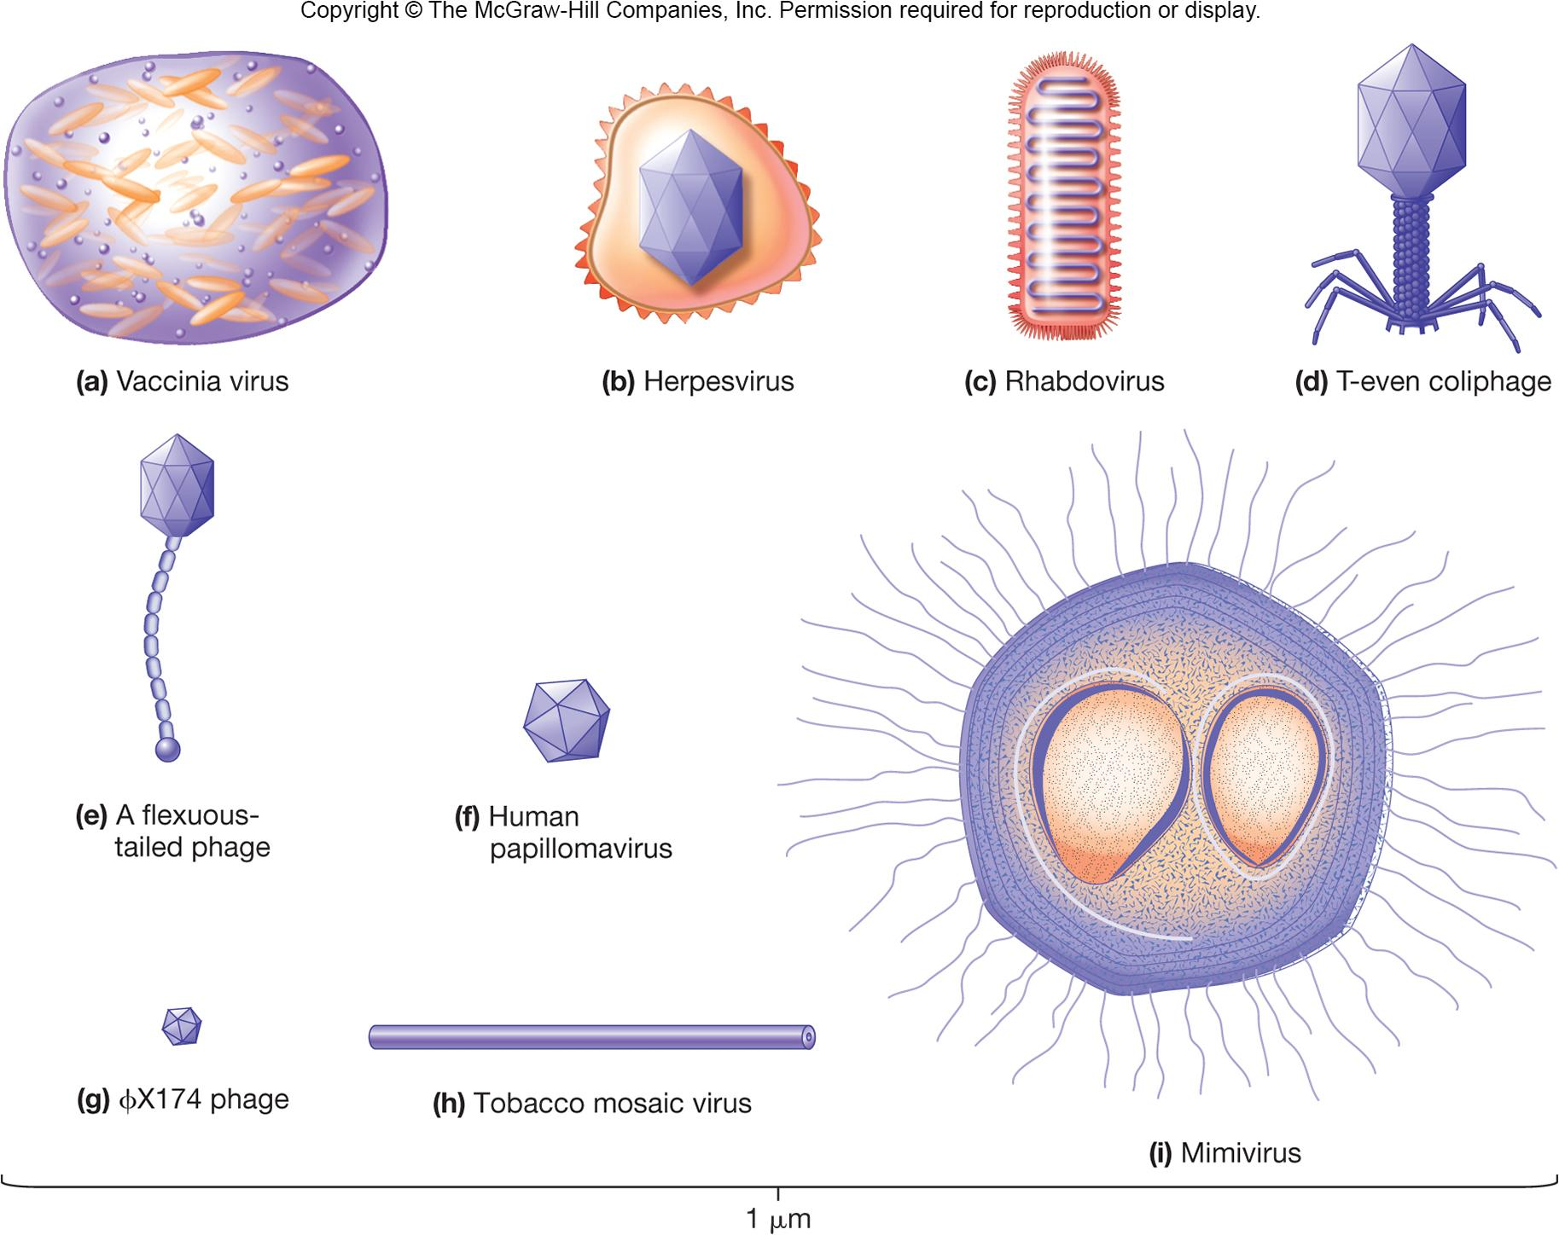

Slide 8
Capsids
Large macromolecular structures which serve as protein coat of virus
Protect viral genetic material and aids in its transfer between host cells
Made of protein subunits called protomers
Capsids are helical,
icosahedral,
or complex

Slide 9
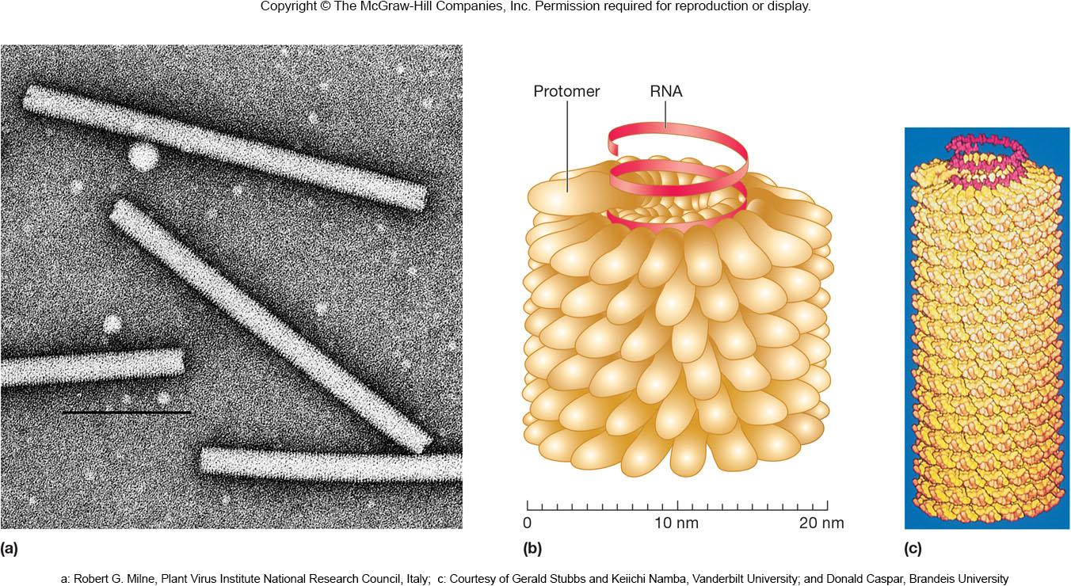
Helical Capsids
Shaped like hollow tubes with protein walls
Protomers self assemble
Size of capsid is a function of nucleic acid

Slide 10
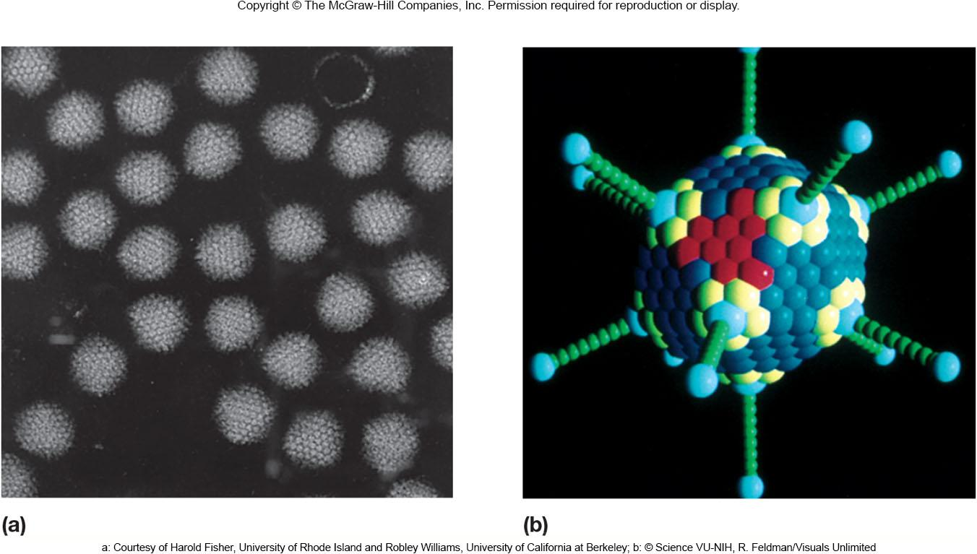
Icosahedral Capsids
An icosahedron is a regular polyhedron with 20 equilateral faces(وجوه متساوية الأضلاع) and 12 vertices(رأس)
Capsomers
ring or knob-shaped units made of 5 or 6 protomers
pentamers (pentons) – 5 subunit capsomers
hexamers (hexons) – 6 subunit capsomers

Slide 11
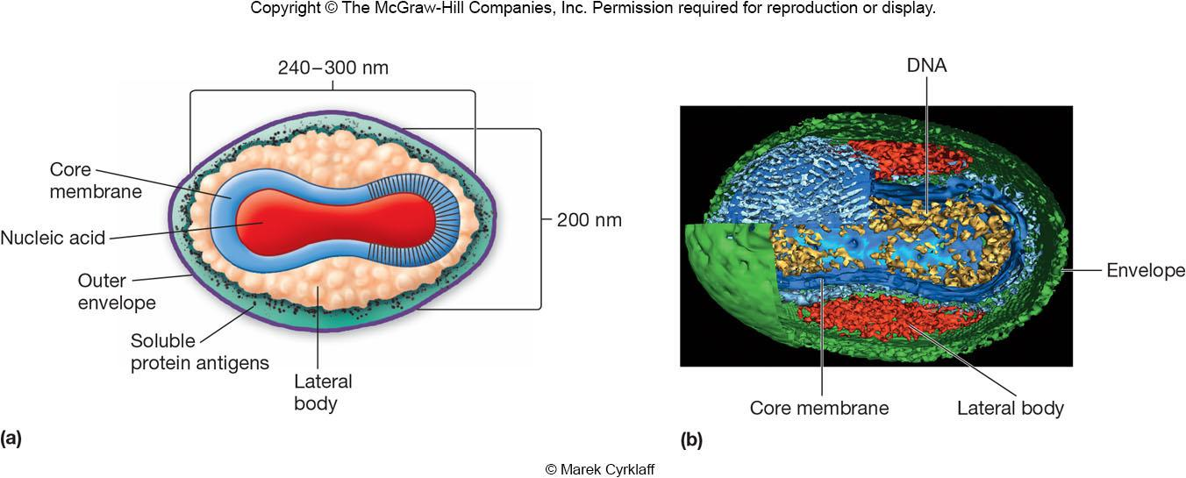
Capsids of Complex Symmetry
Some viruses do not fit into the category of having helical or icosahedral capsids
poxviruses – largest animal virus
large bacteriophages – binal symmetry
head resembles icosahedral, tail is helical

Slide 12
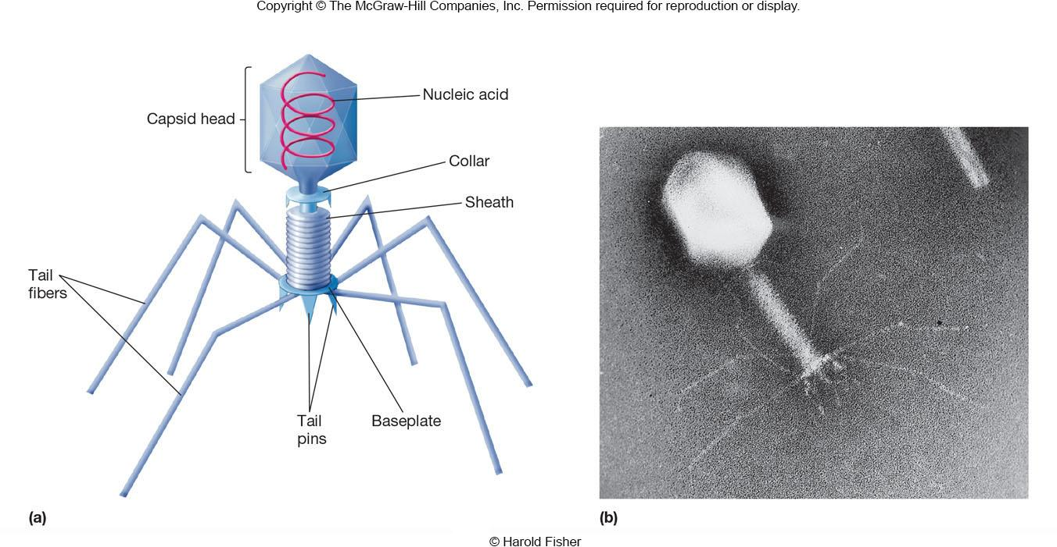

Slide 13
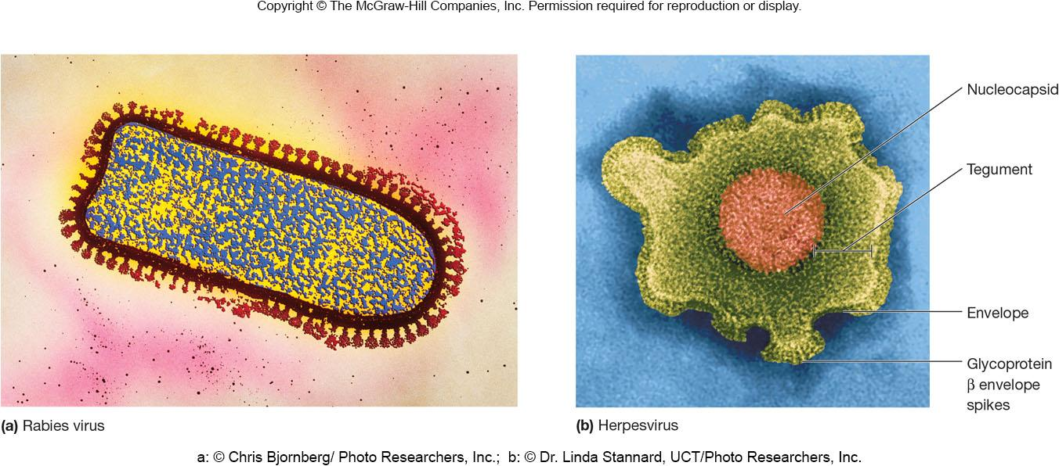
Viral Envelopes and Enzymes
Many viruses are bound by an outer, flexible, membranous layer called the envelope
Animal virus envelopes (lipids and carbohydrates) usually arise from host cell plasma or nuclear membranes

Slide 14
Viral Envelope Proteins
Envelope proteins, which are viral encoded, may project from the envelope surface as spikes or peplomers - glycoprotein spike-
involved in viral attachment to host cell
e.g., hemagglutinin of influenza virus
used for identification of virus
may have enzymatic or other activity
e.g., neuraminidase of influenza virus
may play a role in nucleic acid replication

Slide 15
Virion Enzymes
It was first erroneously thought that all virions lacked enzymes
Now accepted that a variety of virions have enzymes
some are associated with the envelope or capsid but most are within the capsid

Slide 16
Viral Genome
Diverse nature of genomes
A virus may have single or double stranded DNA or RNA
The length of the nucleic acid also varies from virus to virus
Genomes can be segmented or circular

Slide 17
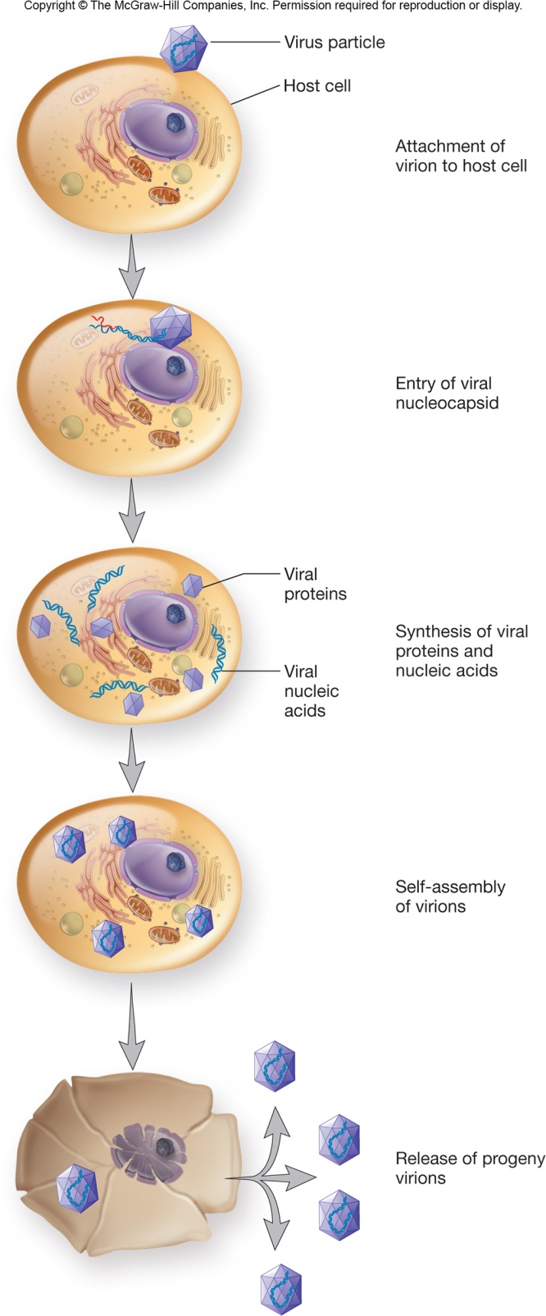
Viral Multiplication
Mechanism used depends on viral structure and genome
Steps are similar
attachment to host cell
entry
uncoating of genome
synthesis
assembly
release

Slide 18
Attachment (Adsorption(امتصاص كيميائي))
Specific receptor attachment
Receptor determines host preference
may be specific tissue (tropism(مع الاجسام))
may be more than one host
may be more than one receptor
may be in lipid rafts providing entry of virus

Slide 19
Viral Entry and Uncoating
Entire genome or nucleocapsid
Varies between naked or enveloped virus
Three methods used
fusion of the viral envelope with host membrane; nucleocapsid enters
Endocytosis(يدخل من الخارج للداخل) in vesicle; endosome(ينقل المواد) aids in viral uncoating
injection of nucleic acid

Slide 20
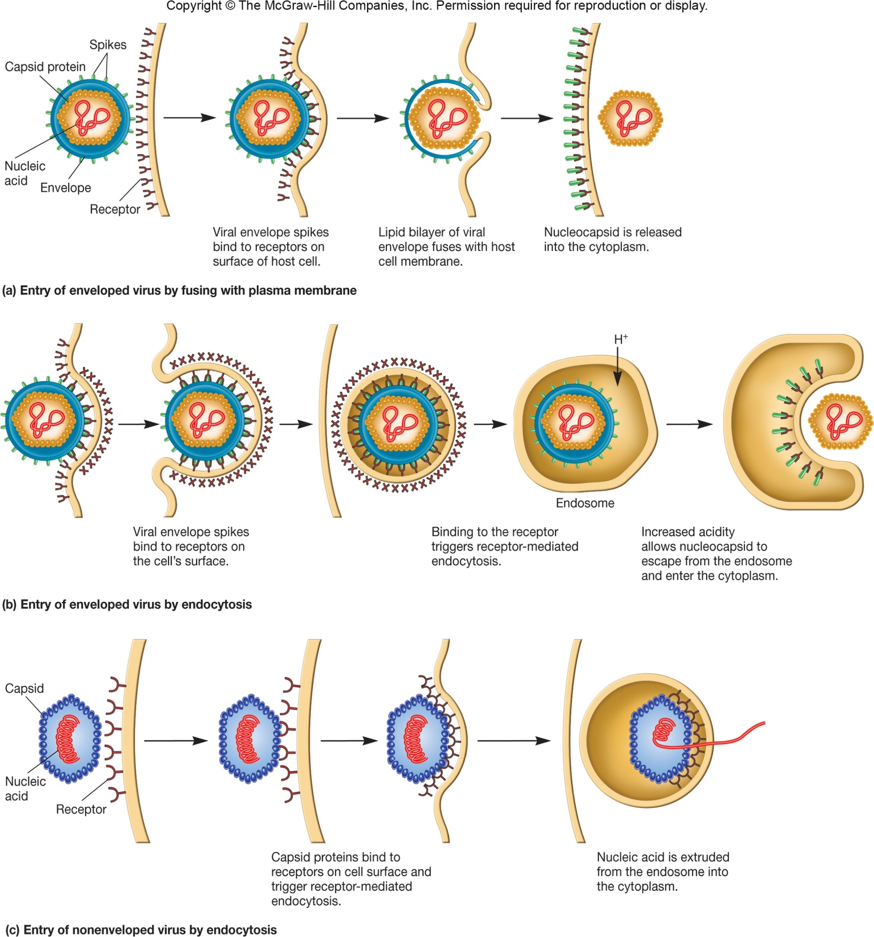

Slide 21
Synthesis Stage
Genome dictates(يأمر/يملي) the events
ds DNA typical flow
RNA viruses
virus must carry in or synthesize the proteins necessary to complete synthesis
Stages may occur, e.g., early and late

Slide 22
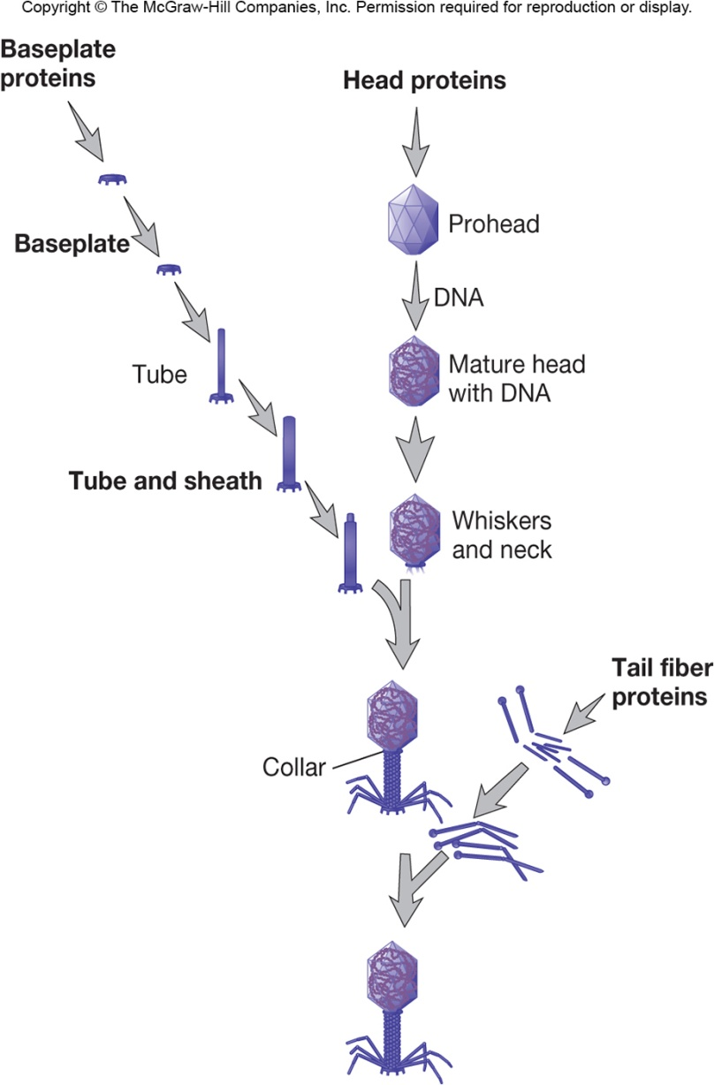
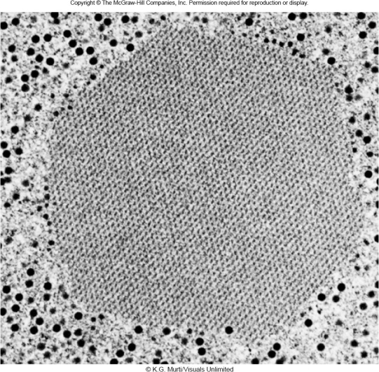
Assembly
Late proteins are important in assembly
Assembly is complicated but varies
bacteriophages – stages
some are assembled in nucleus
some are assembled in cytoplasm
may be seen as paracrystalline structures in cell

Slide 23
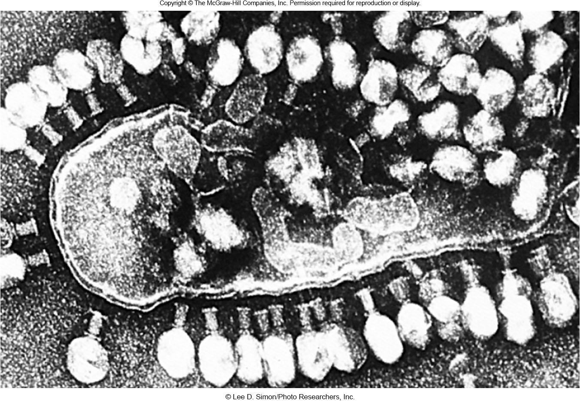
Virion Release
Nonenveloped viruses lyse(تحلل) the host cell
viral proteins may attack peptidoglycan or membrane

Slide 24
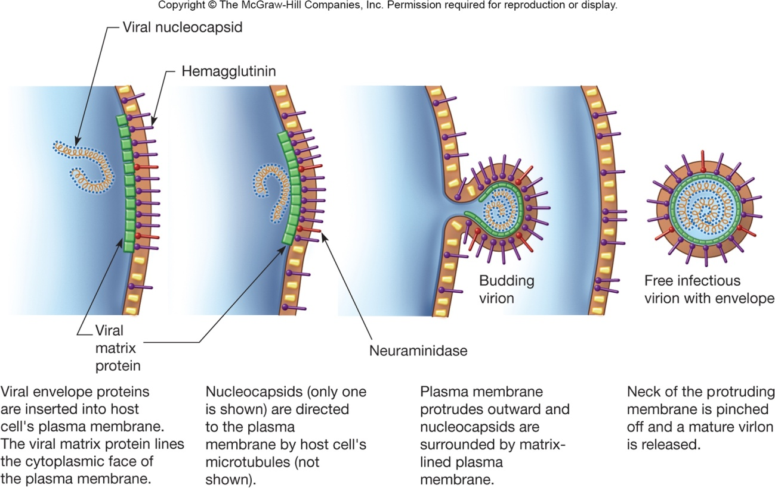
Virion Release
Enveloped viruses use budding
viral proteins are placed into host membrane
nucleocapsid may bind to viral proteins
envelope derived from host cell membrane, but may be Golgi, ER, or other
virus may use host actin tails to propel through host membrane

Slide 25
6.4 Types of viral infections
Compare and contrast the major steps of the life cycles of virulent phages and temperate phages.
List examples of lysogenic conversion.
Differentiate among the types of viral infections of eukaryotic cells.
Summarize the current understanding of how oncoviruses cause cancer.

Slide 26
Types of Viral Infections
Infections in Bacteria and Archaea
Infections in eukaryotic cells
Viruses and cancer

Slide 27
Bacterial and Archaeal Viral Infections
Virulent phage – one reproductive choice
multiplies immediately upon entry
lyses bacterial host cell
Temperate phages have two reproductive options
reproduce lytically as virulent phages do
remain within host cell without destroying it
many temperate phages integrate(تدمج) their genome into host genome (becoming a ‘prophage’ in a ‘lysogenic bacterium’) in a relationship called lysogeny

Slide 28
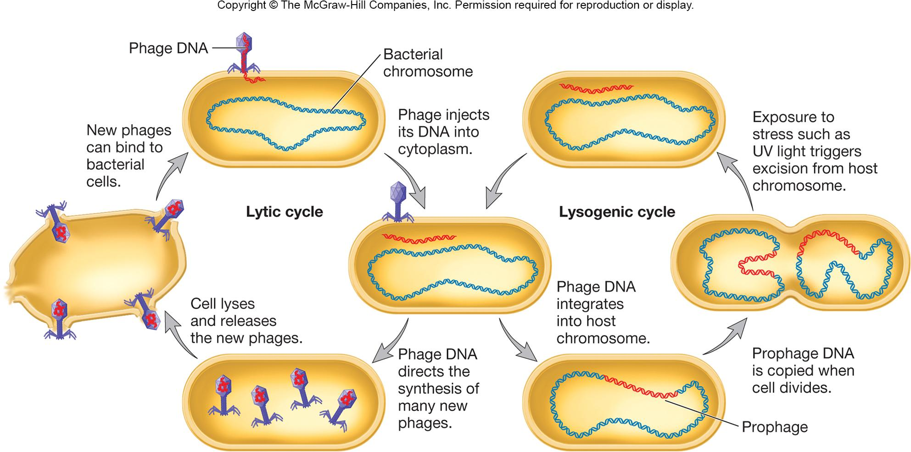

Slide 29
Lysogenic Conversion
Temperate phage changes phenotype of its host
bacteria become immune to superinfection
phage may express pathogenic toxin or enzyme
Two advantages to lysogeny for virus
phage remains viable but may not replicate
multiplicity of infection ensures survival of host cell
Under appropriate conditions infected bacteria will lyse and release phage particles
occurs when conditions in the cell cause the prophage to initiate synthesis of new phage particles, a process called induction(الحث) تتغير الظروف لتكون ملائمة للفايروس ويتكاثر/

Slide 30
Infection in Eukaryotic Cells
Cytocidal infection results in cell death through lysis
Persistent infections(الاصابات المستمرة) may last years
Cytopathic effects (CPEs)
degenerative changes
abnormalities
Transformation to malignant cell(خلية خبيثة)

Slide 31
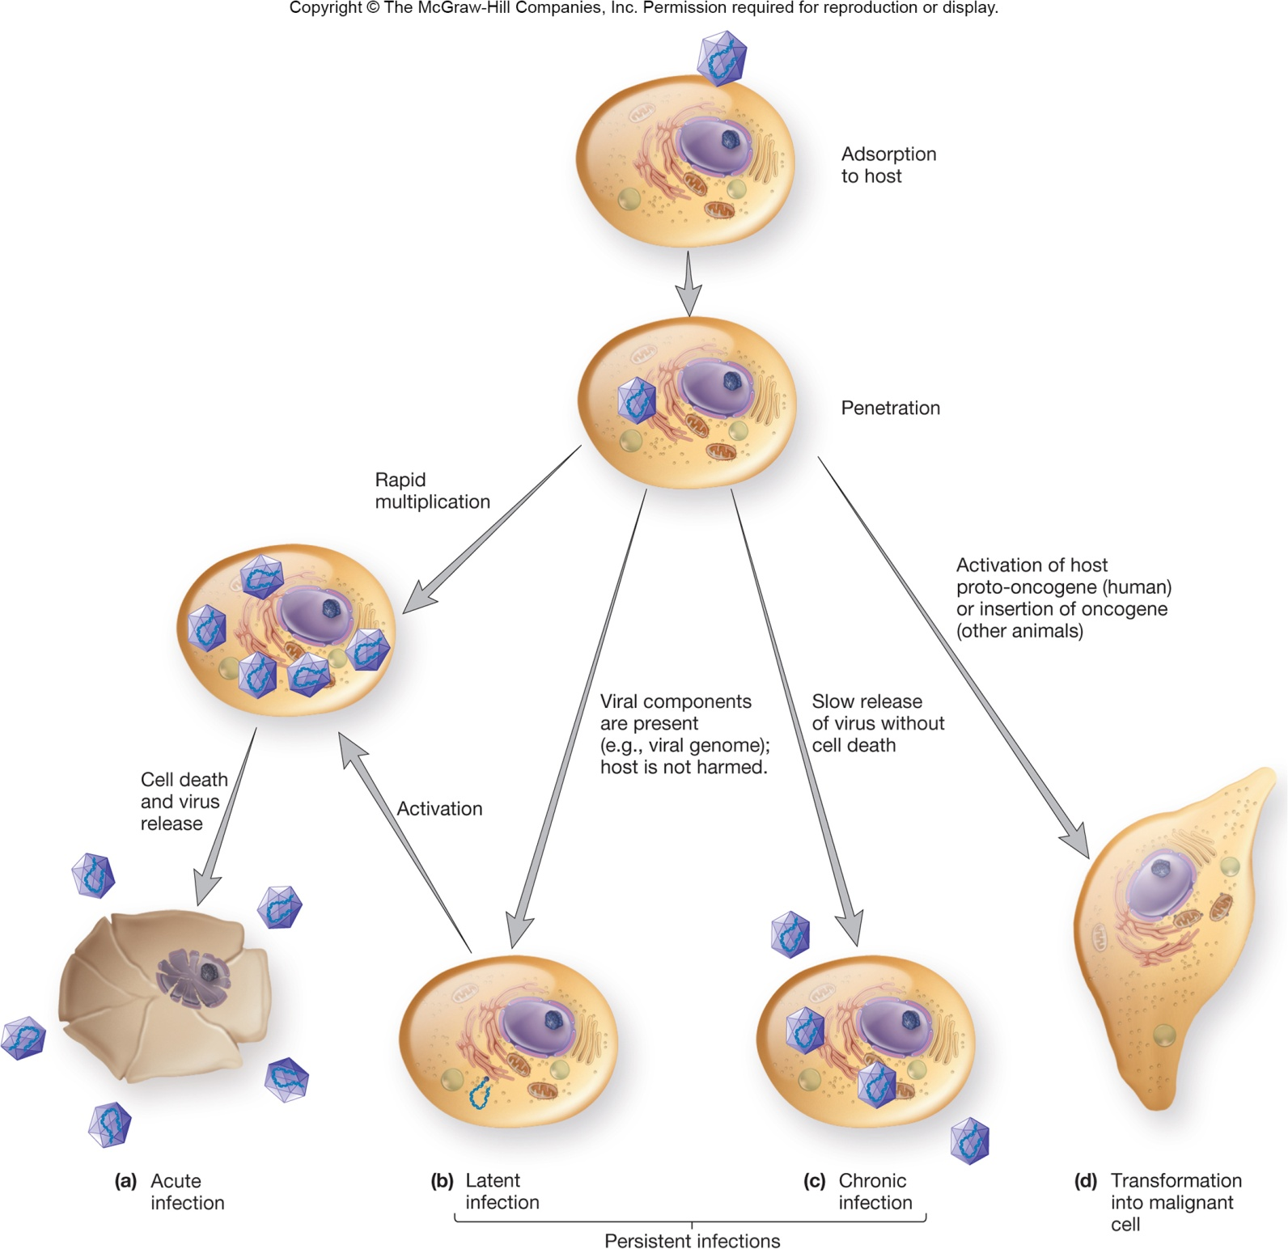

Slide 32
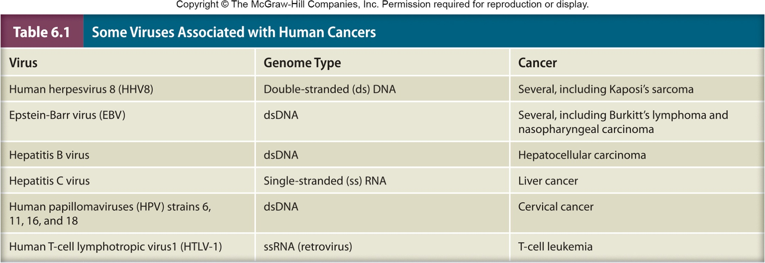
Carcinogenesis
Complex, multistep process
Often involves oncogenes(مسرطنة)
cancer causing genes
may come from the virus OR may be transformed host proto-oncogenes (involved in normal regulation of cell growth/differentiation)

Slide 33
الجين الورمي أو المورثة الورمية Oncogene هو جين يقوم بتشفير صناعة بروتين يعتقد أنه مسبب للسرطان.تنشأ هذه الجينات من جينات تعرف بطلائع الجينات الورمية Proto-Oncogene وظيفتها الأساسية التحكم بدورة حياة الخلية وتمايزها. حدوث طفرات وراثية في هذه الجينات يؤدي إلى خلل في التحكم بنمو الخلية وبالتالي تحولها لخلية سرطانية.

Slide 34
Possible Mechanisms by Which Viruses Cause Cancer
Viral proteins bind host cell tumor suppressor proteins
Carry oncogene into cell and insert it into host genome
Altered cell regulation (تغيير تنظيم الخلية)
Insertion of promoter or enhancer next to cellular oncogene

Slide 35
The Cultivation of Viruses(زراعة الفيروسات)
Requires inoculation of appropriate living host

Slide 36
Hosts for Bacterial and Archael Viruses
Usually cultivated in broth or agar cultures of suitable, young, actively growing bacteria
Broth cultures lose turbidity(اقل عكر/اكثر وضوحاً) as viruses reproduce
Plaques(صفائح) observed on agar cultures

Slide 37
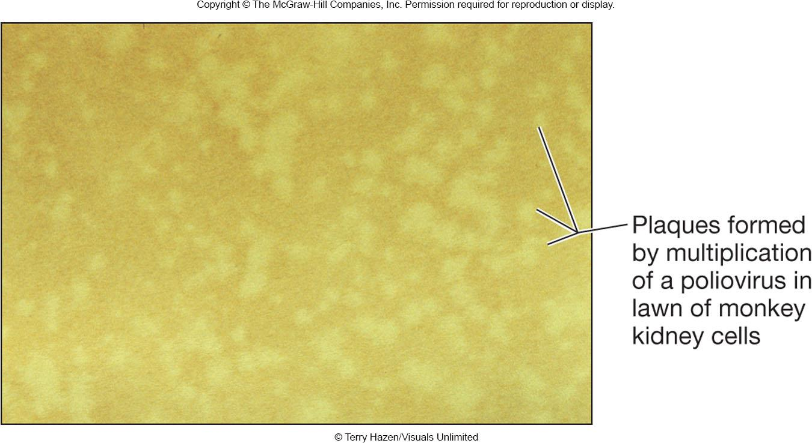
Hosts for Animal Viruses
Tissue (cell) cultures
cells are infected with virus (phage)
viral plaques
localized area of cellular destruction and lysis that enlarge as the virus replicates
Cytopathic effects (CPEs)
microscopic or macroscopic
degenerative changes or
abnormalities in host
cells and tissues
Embryonated eggs

Slide 38
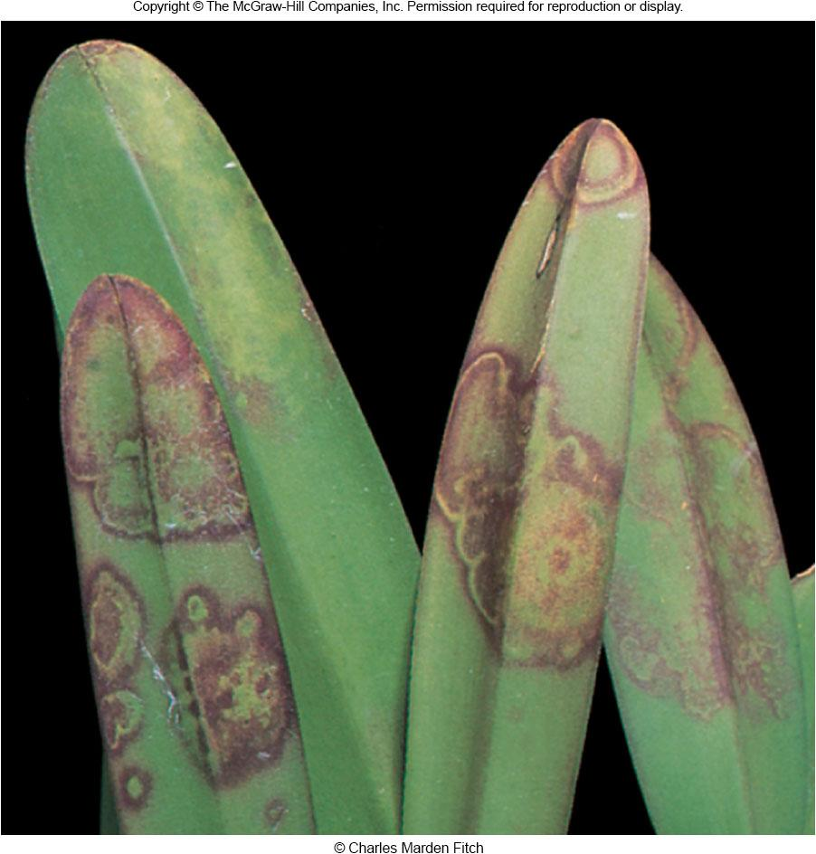
Hosts for Plant Viruses
Plant tissue cultures
Plant protoplast cultures
Suitable whole plants
may cause localized
necrotic lesions or
generalized symptoms
of infection

Slide 39
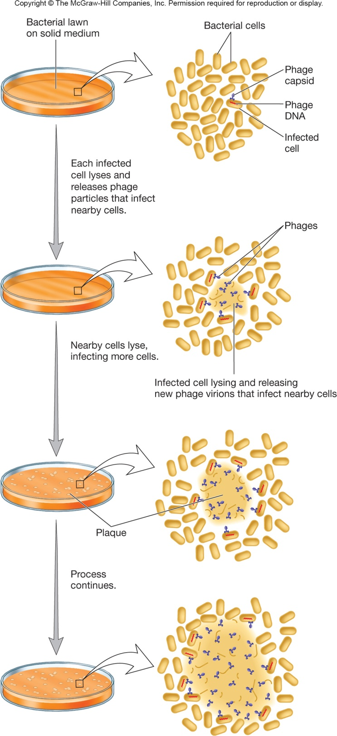
Quantification of Virus(تحديد كمية الفيروسات)
Direct counting – count viral particles
Indirect counting by an observable of the virus
hemagglutination assay(فحص)
plaque assays

Slide 40
Measuring Concentration of Infectious Units
Plaque assays
dilutions of virus preparation made and plated on lawn(العشب) of host cells
number of plaques counted
results expressed as plaque-forming units (PFU) – plaque forming units (PFU)
PFU/ml = number of plaques/sample dilution

Slide 41
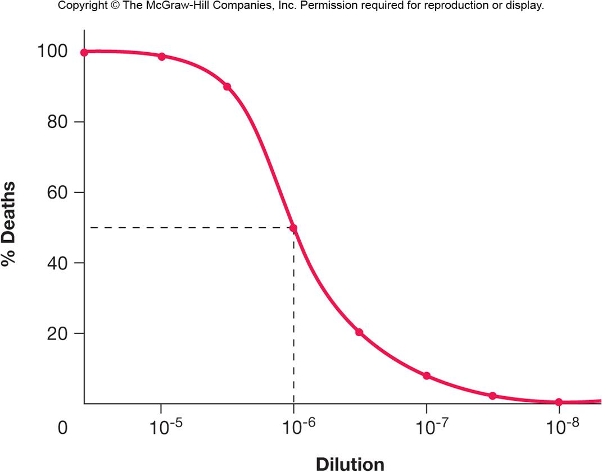
Measuring Biological Effects
Infectious dose and lethal dose assays
determine smallest amount of virus needed to cause infection (ID) or death (LD) of 50% of exposed host cells or organisms (ID₅₀ or LD₅₀)

Slide 42
6.6 Viroids and satellites
Describe the structure of a viroid and discuss the practical importance of viroids.
Distinguish satellite viruses from satellite nucleic acids.

Slide 43
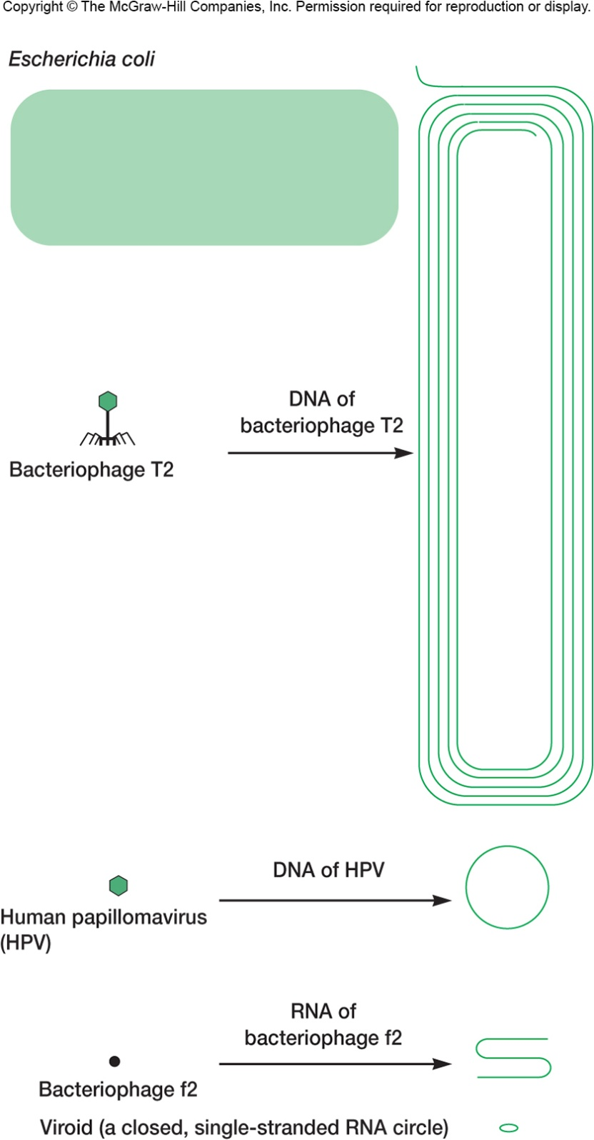
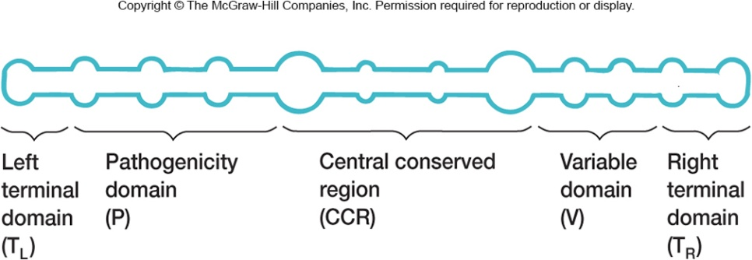
Viroids
infectious agents composed of closed, circular ssRNAs
do not encode gene products
requires host cell DNA-dependent RNA polymerase to replicate
cause plant diseases

Slide 44
Satellites
Infectious nucleic acids (DNA or RNA)
Satellite viruses encode their own capsid proteins when helped by a helper virus
Satellite RNAs/DNAs do NOT encode their own capsid proteins
Encode one or more gene products
Require a helper virus for replication
human hepatitis(التهاب الكبد البشري) D virus is satellite
requires human hepatitis B virus

Slide 45
6.7 Prions
Describe prion structure and how prions are thought to replicate.
List characteristics common to all animal diseases caused by prions.
Name at least two human diseases caused by prions.
Describe the mechanisms by which a prion protein might first appear in a brain cell.

Slide 46
Prions – Proteinaceous Infectious Particle
Cause a variety of degenerative diseases in humans and animals
scrapie in sheep
bovine spongiform encephalopathy (BSE) or mad cow disease(جنون البقر)
Creutzfeldt-Jakob disease (CJD) and variant CJD (vCJD) in humans
kuru in humans

Slide 47
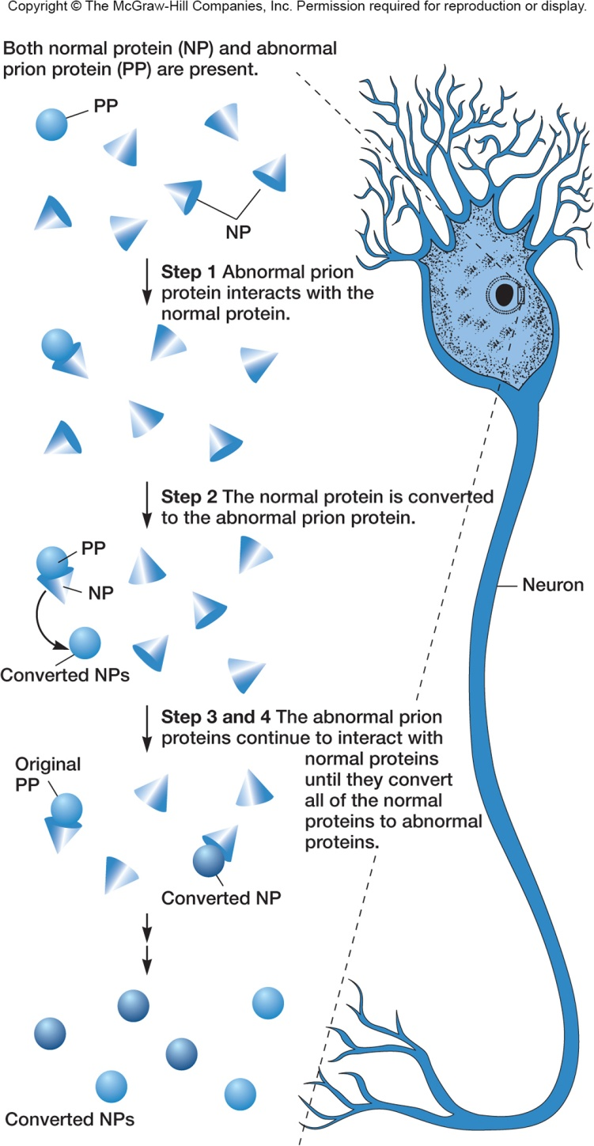
Current Model of Disease Production by Prions
PrP^{C} (prion protein) is present in “normal” form (abnormal form of prion protein is PrP^{Sc})
PrP^{Sc} causes PrP^{C} protein to change its conformation to abnormal form
newly produced PrP^{Sc} molecules convert more normal molecules to the abnormal form through unknown mechanism

Slide 48
Neural Loss(فقدان الخلايا العصبية)
Evidence suggests that PrP^{C} must be present for neural degeneration(انحلال/فساد/انحطاط) to occur
Interaction of PrP^{Sc} with PrP^{C} may cause PrP^{C} to crosslink and trigger apoptosis(تحفيزموت الخلايا المبرمج)
PrP^{C} conversion causes neuron loss, PrP^{Sc} is the infectious agent
All prion caused diseases
have no effective treatment
result in progressive degeneration(انحلال تدريجي/فساد) of the brain and eventual death

