Slide 1
7
Microbial Growth
‹#›
Copyright © McGraw-Hill Global Education Holdings, LLC. Permission required for reproduction or display.
Notes:
‹#›

Slide 2
Reproductive Strategies
The reproductive strategies of eukaryotic microbes
asexual and sexual, haploid or diploid
Bacteria and Archaea
haploid only, asexual - binary fission, budding, filamentous
all must replicate and segregate the genome prior to division
‹#›

Slide 3
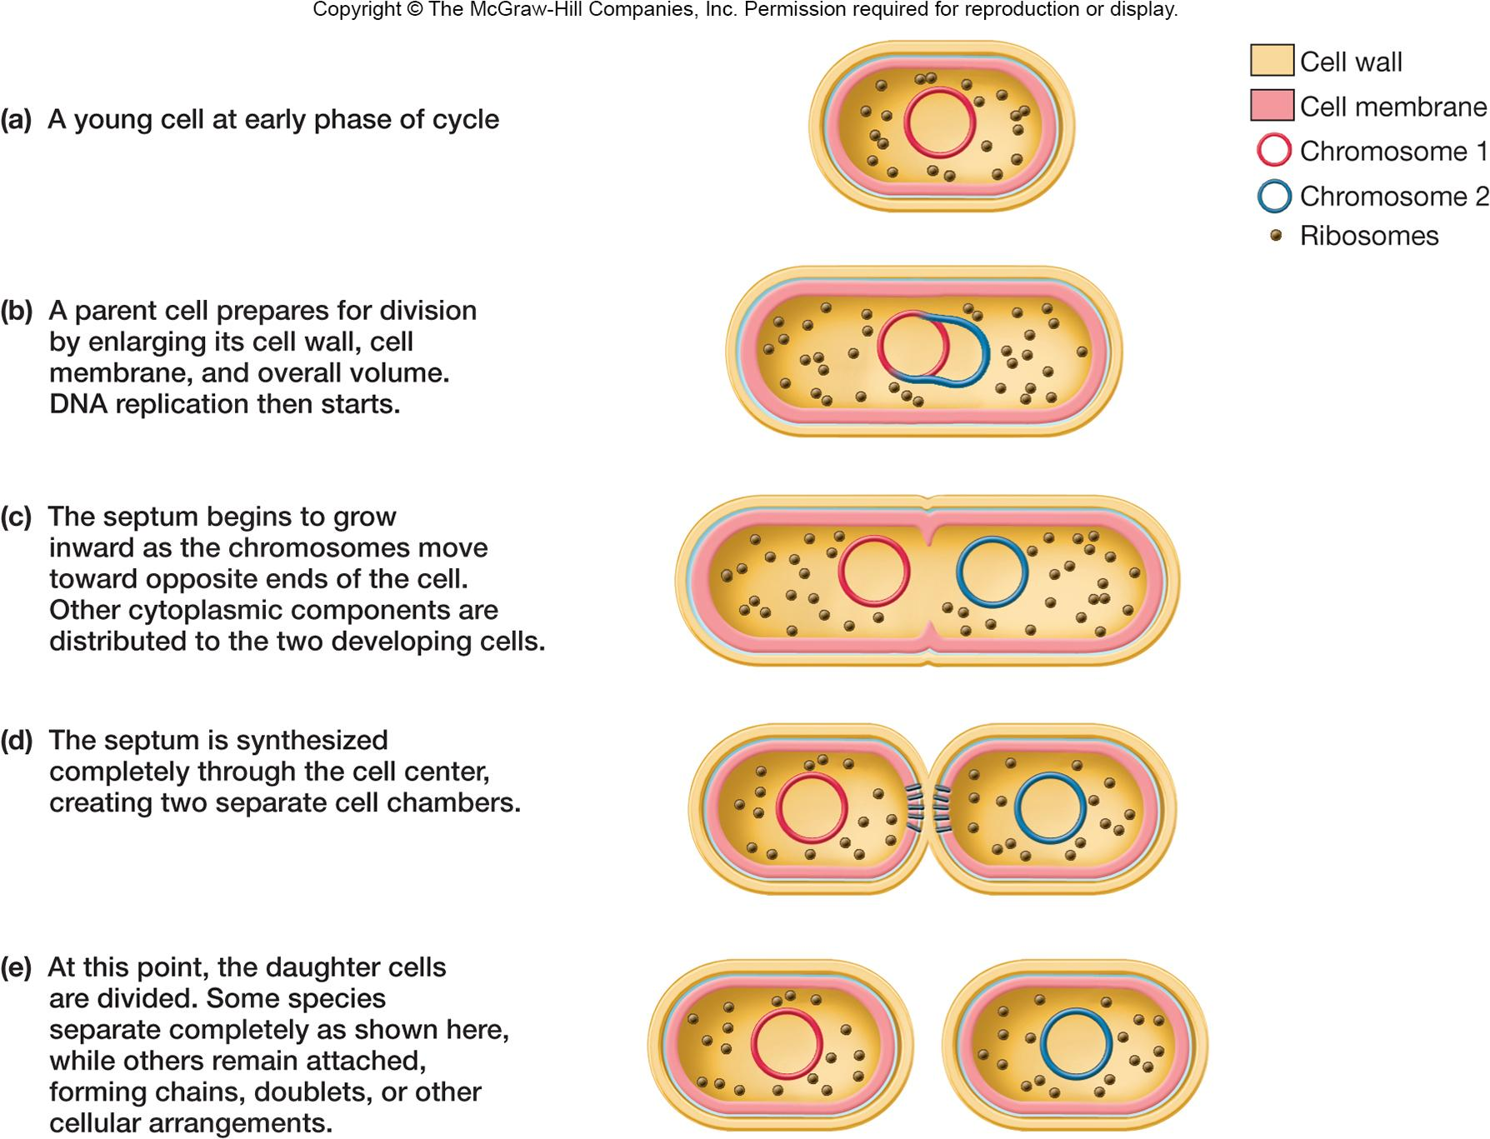
‹#›

Slide 4
Bacterial Cell Cycle
Cell cycle is sequence of events from formation of new cell through the next cell division
most bacteria divide by binary fission
Two pathways function during cycle
DNA replication and partition
cytokinesis
‹#›

Slide 5
Chromosome Replication and Partitioning - 1
Most bacterial chromosomes are circular
Single origin of replication – site at which replication begins
Terminus – site at which replication is terminated, located opposite of the origin
Replisome – group of proteins needed for DNA synthesis
DNA replication proceeds in both directions from the origin
Origins move to opposite ends of the cell
‹#›

Slide 6
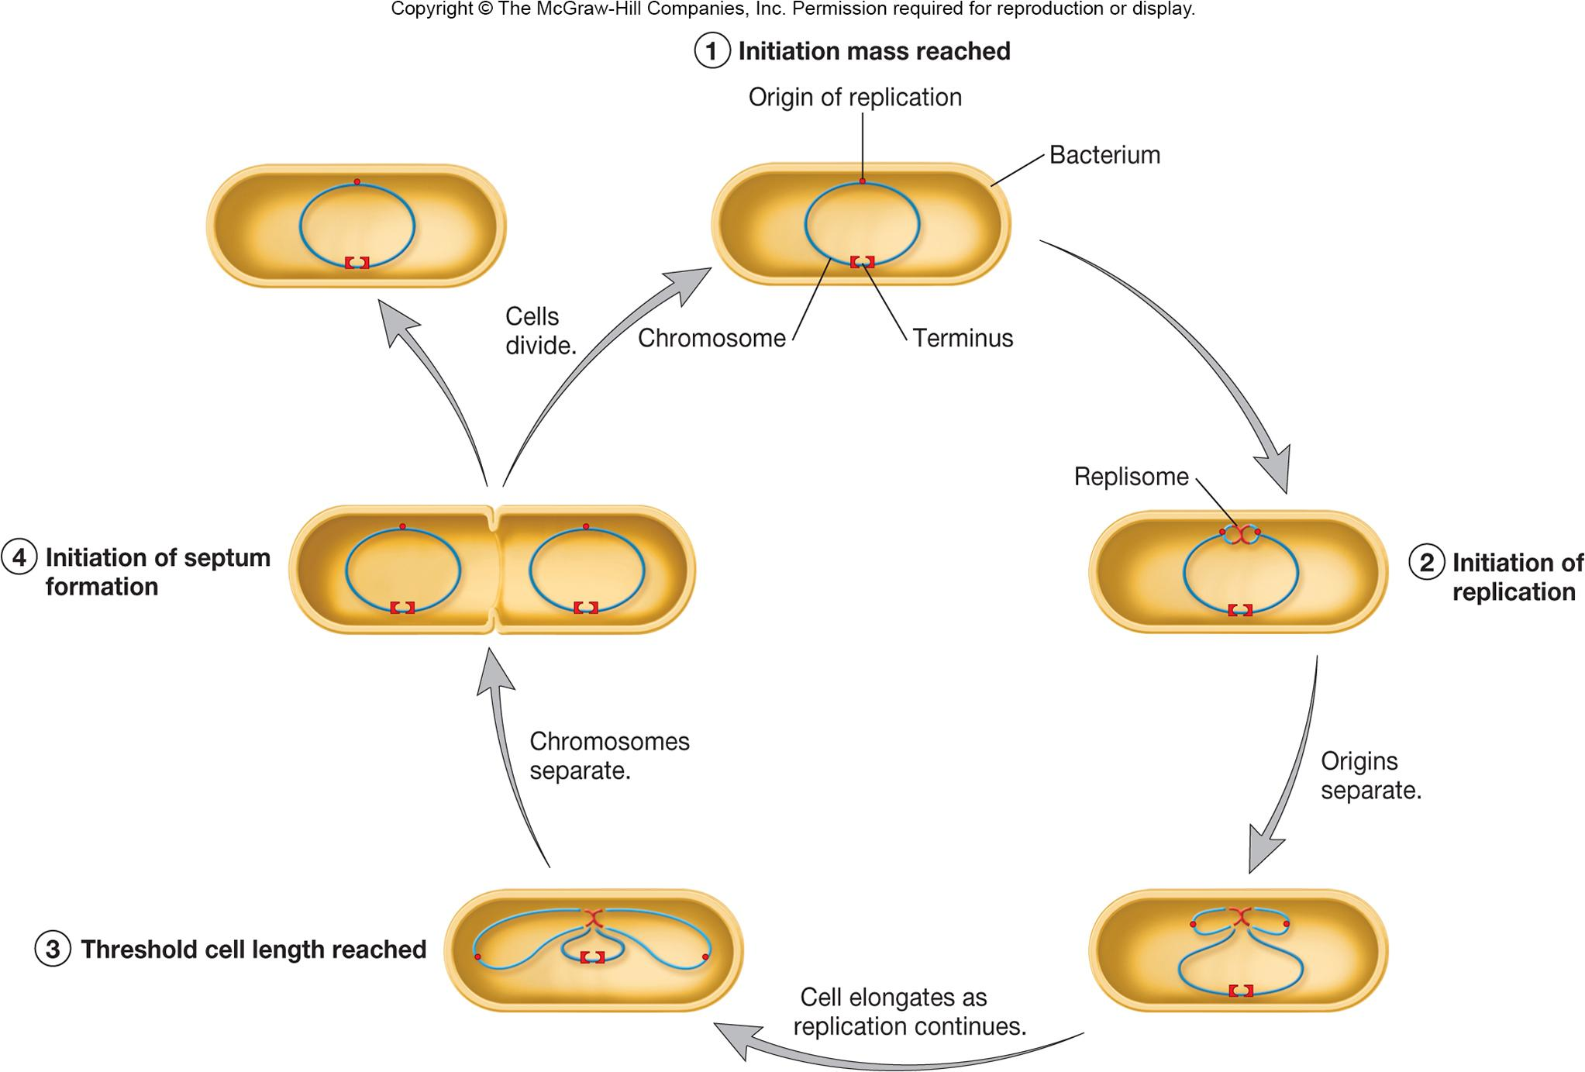
‹#›

Slide 7
Chromosome Partitioning
Replisome pushes, or condensation of, daughter chromosomes to opposite ends
MreB (murein cluster B) – an actin homolog, plays role in determination of cell shape as spiral inside cell periphery, and chromosome segregation
new origins associate with MreB tracks
if MreB is mutated, chromosomes do not segregate
‹#›

Slide 8
Cytokinesis - Septation
Septation – formation of cross walls between daughter cells
Several steps
selection of site for septum formation
assembly of Z ring
linkage of Z ring to plasma membrane (cell wall)
assembly of cell wall synthesizing machinery
constriction of cell and septum formation
‹#›

Slide 9
Z Ring Formation - Role in Septation
Protein FtsZ
tubulin homologue, found in most bacteria and archaea
polymerization forms Z ring, filaments of meshwork
MinCDE system in E. coli limits the Z ring to the center of the cell
MinC, MinD, MinE oscillate from one side of cell to other
link Z ring to cell membrane
Z ring constricts and cell wall synthesis of septal wall
‹#›
Notes:
‹#›

Slide 10
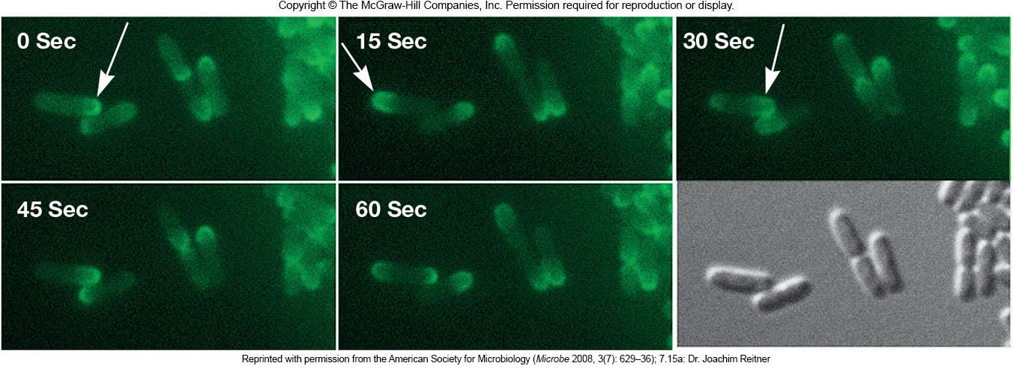
‹#›

Slide 11
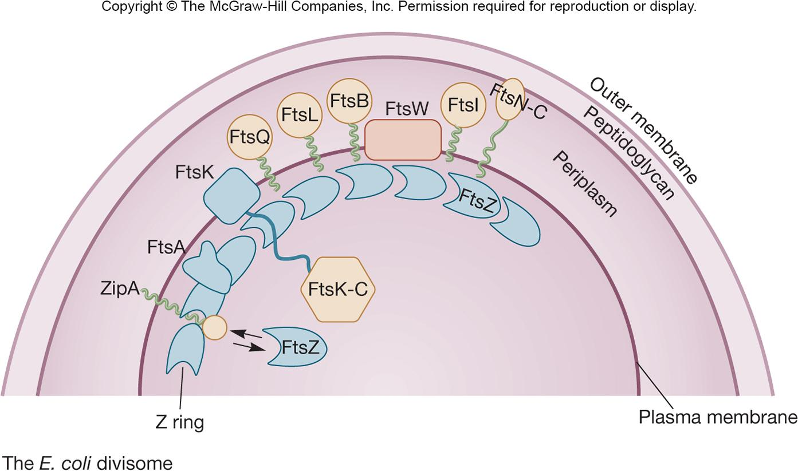
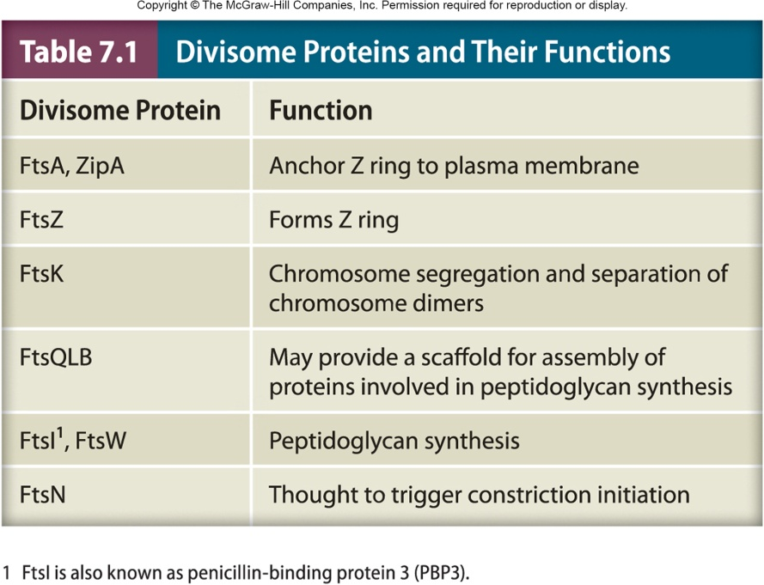
‹#›

Slide 12
Growth
Increase in cellular constituents that may result in:
increase in cell number
increase in cell size
Growth refers to population growth rather than growth of individual cells
‹#›
Notes:
‹#›

Slide 13
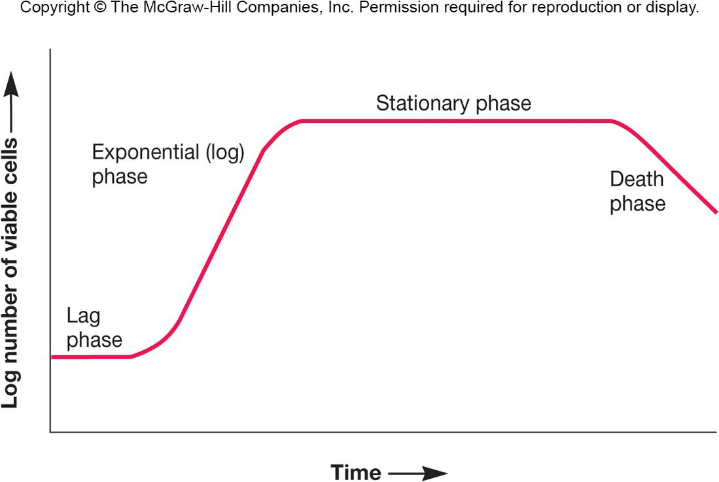
The Growth Curve
Observed when microorganisms are cultivated in batch culture
Usually plotted as logarithm of cell number versus time
Has four distinct phases
‹#›
Notes:
‹#›

Slide 14
Lag Phase
Cell synthesizing new components
e.g., to replenish spent materials(لتجديد المواد المستهلكة)
e.g., to adapt to new medium or other conditions
Varies in length
in some cases can be very short or even absent
‹#›
Notes:
‹#›

Slide 15
Exponential Phase
Also called log phase
Rate of growth and division is constant and maximal
Population is most uniform in terms of chemical and physical properties during this phase
‹#›
Notes:
‹#›

Slide 16
Balanced Growth
During log phase, cells exhibit balanced growth
cellular constituents manufactured at constant rates relative to each other
‹#›
Notes:
‹#›

Slide 17
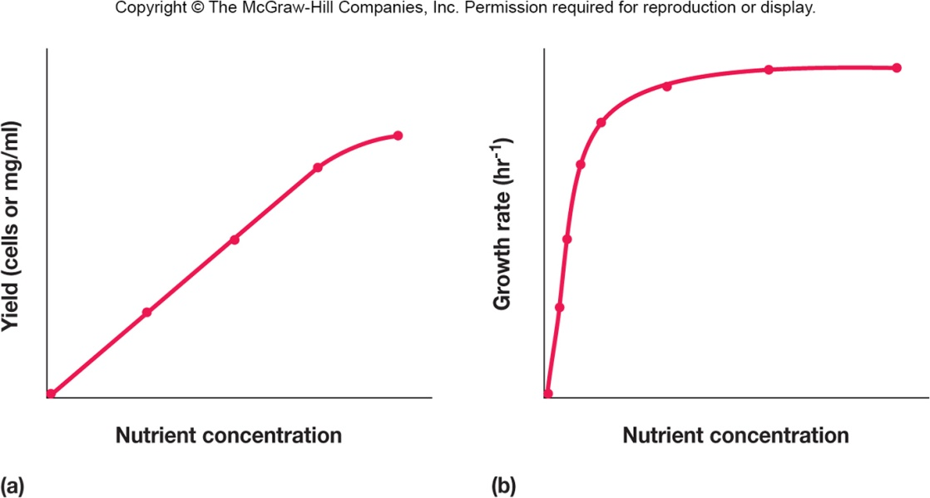
Unbalanced Growth
Rates of synthesis vary relative to each other
Occurs under a variety of conditions
change in nutrient levels
shift-up (poor medium to rich medium)
shift-down (rich medium to poor medium)
change in environmental conditions
‹#›
Notes:
‹#›

Slide 18
Stationary Phase
Closed system population growth eventually ceases, total number of viable cells remains constant
active cells stop reproducing or reproductive rate is balanced by death rate
‹#›
Notes:
‹#›

Slide 19
Possible Reasons for Stationary Phase
Nutrient limitation
Limited oxygen availability
Toxic waste accumulation
Critical population density reached
‹#›

Slide 20
Stationary Phase and Starvation Response
Entry into stationary phase due to starvation and other stressful conditions activates survival strategy
morphological changes
e.g., endospore formation
decrease in size, protoplast shrinkage, and nucleoid condensation
RpoS protein assists RNA polymerase in transcribing genes for starvation proteins
‹#›
Notes:
‹#›

Slide 21
Starvation Responses
Production of starvation proteins
increase cross-linking in cell wall
Dps protein protects DNA
chaperone proteins prevent protein damage
Cells are called persister cells
long-term survival
increased virulence
‹#›
Notes:
‹#›

Slide 22
Senescence and Death Phase
Two alternative hypotheses
cells are Viable But Not Culturable (VBNC)
cells alive, but dormant, capable of new growth when conditions are right
Programmed cell death
fraction of the population genetically programmed to die (commit suicide)
‹#›
Notes:
‹#›

Slide 23
The Influence of Environmental Factors on Growth
Most organisms grow in fairly moderate environmental conditions(ظروف بيئية معتدلة الى حدٍ ما)
Extremophiles
grow under harsh conditions that would kill most other organisms
‹#›
Notes:
‹#›

Slide 24
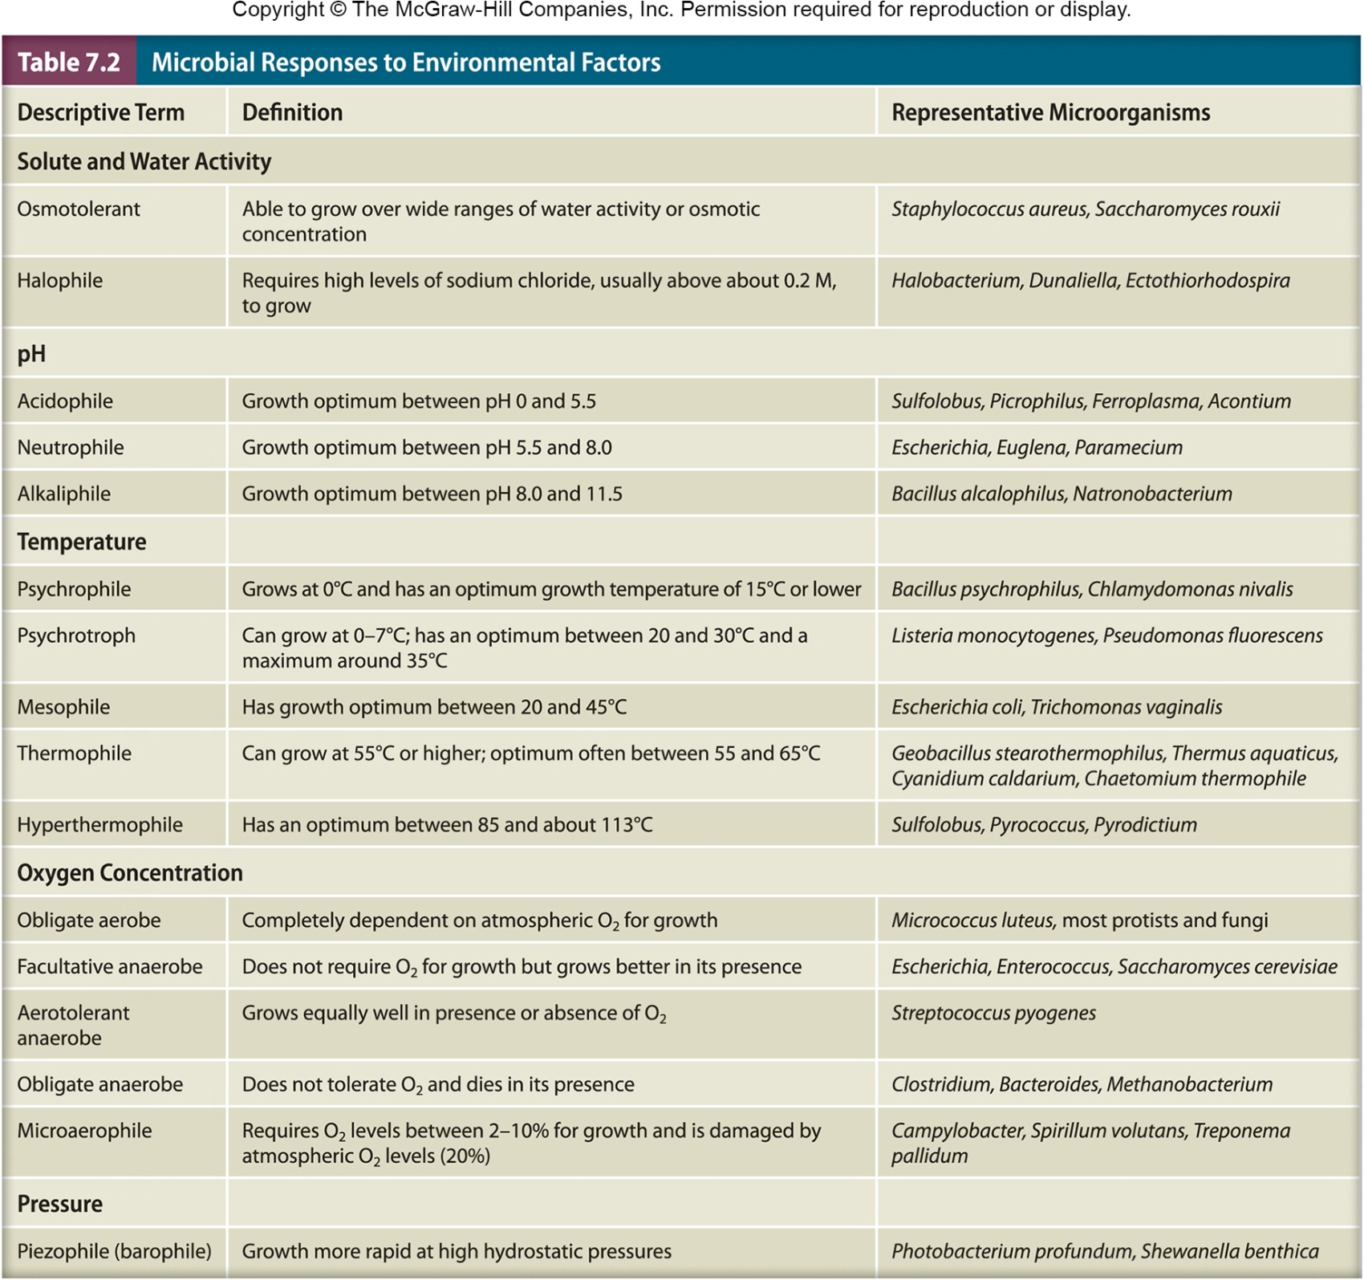
‹#›

Slide 25
Solutes and Water Activity
Changes in osmotic concentrations in the environment may affect microbial cells
hypotonic solution (lower osmotic concentration)
water enters the cell
cell swells may burst
hypertonic (higher osmotic concentration)
water leaves the cell
membrane shrinks from the cell wall (plasmolysis) may occur
‹#›

Slide 26
Water Activity (a_{w})
Water activity of a solution is 1/100 the relative humidity of solution
Also equal to ratio of solution’s vapor pressure (Psoln) to that of pure water (Pwater)
Aw = Psoln/ Pwater
low water activity means most water is bound
Osmotolerant microbes can grow over wide ranges of water activity
‹#›
Notes:
‹#›

Slide 27
Solutes and Water Activity
water activity (a_{w})
amount of water available to organisms
reduced by interaction with solute molecules (osmotic effect)
higher [solute] ⇒ lower a_{w}
reduced by adsorption to surfaces (matric effect)
‹#›
Notes:
‹#›

Slide 28
Microbes Adapt to Changes in Osmotic Concentrations
Reduce osmotic concentration of cytoplasm in hypotonic solutions
mechanosensitive (MS) channels in plasma membrane allow solutes to leave
Increase internal solute concentration with compatible solutes to increase their internal osmotic concentration in hypertonic solutions
solutes compatible with metabolism and growth
‹#›

Slide 29
Extremely Adapted Microbes
Halophiles
grow optimally in the presence of NaCl or other salts at a concentration above about 0.2M
Extreme halophiles
require salt concentrations of 2M and 6.2M
extremely high concentrations of potassium
cell wall, proteins, and plasma membrane require high salt to maintain stability and activity
‹#›
Notes:
‹#›

Slide 30
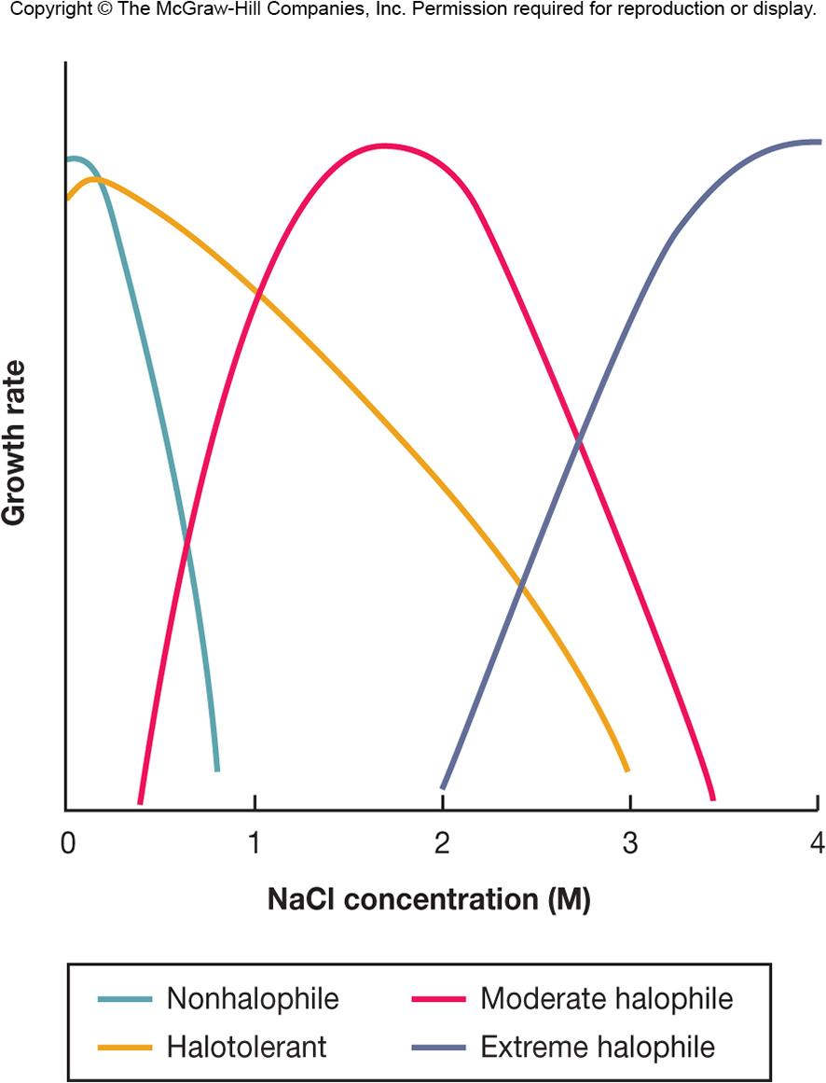
Effects of NaCl on Microbial Growth
Halophiles
grow optimally at >0.2 M
Extreme halophiles
require >2 M
‹#›
Notes:
‹#›

Slide 31
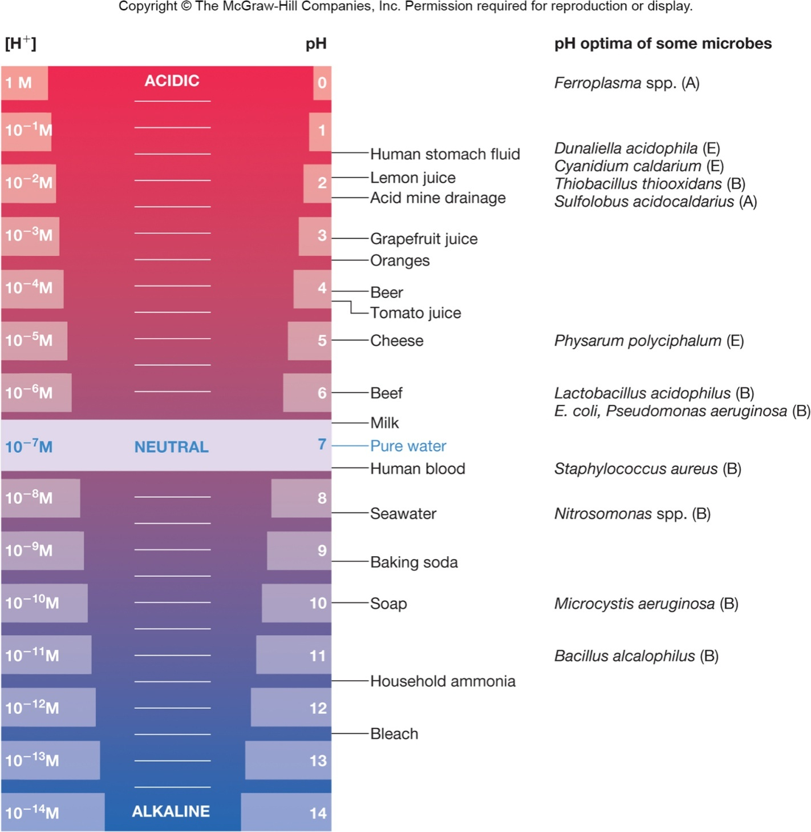
pH
measure of the relative acidity of a solution
negative logarithm of the hydrogen ion concentration
‹#›
Notes:
‹#›

Slide 32
pH
Acidophiles
growth optimum between pH 0 and pH 5.5
Neutrophiles
growth optimum between pH 5.5 and pH 7
Alkaliphiles (alkalophiles)
growth optimum between pH 8.5 and pH 11.5
‹#›
Notes:
‹#›

Slide 33
pH
Most microbes maintain an internal pH near neutrality
the plasma membrane is impermeable(كتيم/غير نافذ) to proton
exchange potassium for protons
Acidic tolerance response
pump protons out of the cell
some synthesize acid and heat shock proteins that protect proteins
Many microorganisms change the pH of their habitat by producing acidic or basic waste products
‹#›
Notes:
‹#›

Slide 34
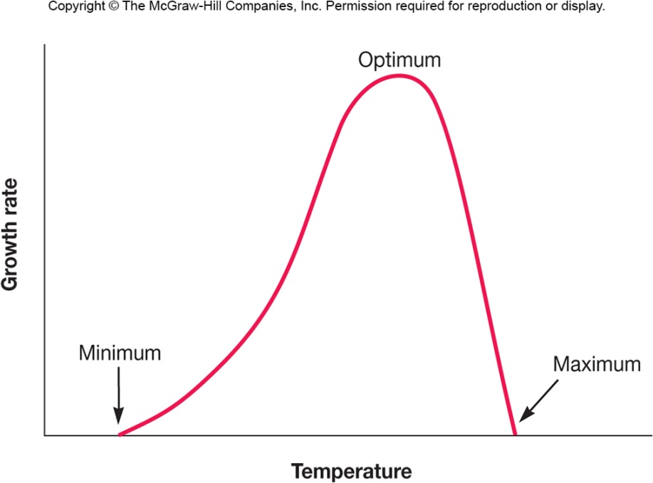
Temperature
Microbes cannot regulate their internal temperature
Enzymes have optimal temperature at which they function optimally
High temperatures may inhibit enzyme functioning and be lethal(قاتل)
Organisms exhibit distinct cardinal growth temperatures
minimal
maximal
optimal
‹#›

Slide 35
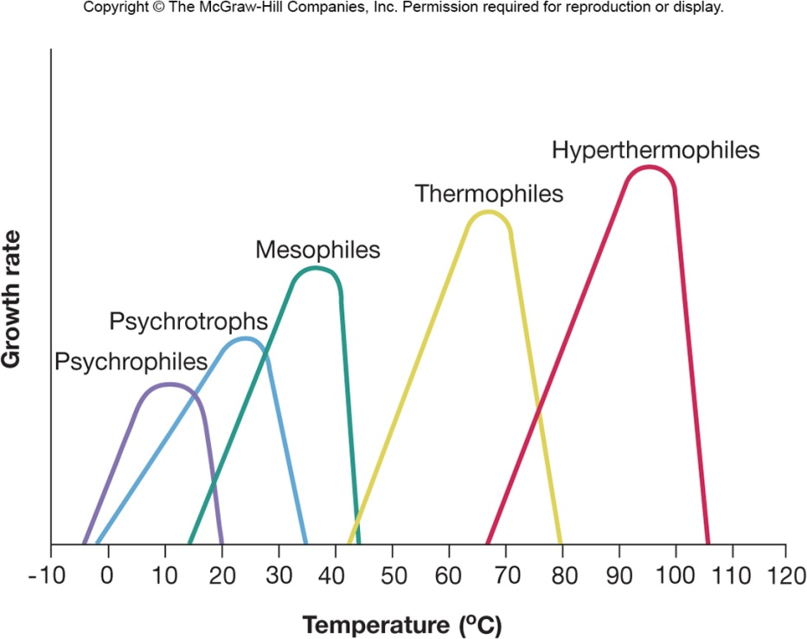
Temperature Ranges for Microbial Growth
psychrophiles – 0º C to 20º C
psychrotrophs – 0º C to 35º C
mesophiles – 20º C to 45º C
thermophiles – 55º C to 85º C
hyperthermophiles – 85º C to 113º C
‹#›

Slide 36
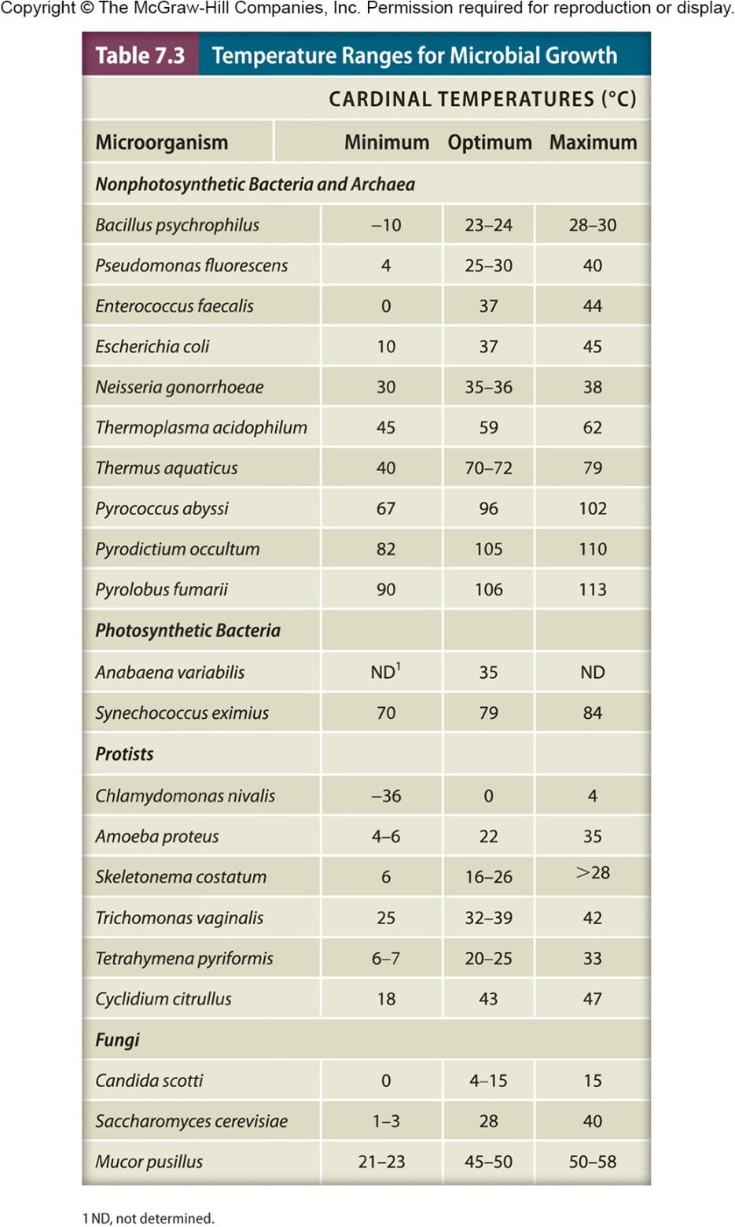
‹#›

Slide 37
Adaptations of Thermophiles
Protein structure stabilized by a variety of means
e.g., more H bonds
e.g., more proline
e.g., chaperones
Histone-like proteins stabilize DNA
Membrane stabilized by variety of means
e.g., more saturated, more branched and higher molecular weight lipids
e.g., ether linkages(روابط) (archaeal membranes)
‹#›
Notes:
‹#›

Slide 38
Oxygen Concentration
growth in oxygen correlates with(يرتبط مع) microbes energy conserving metabolic processes and the electron transport chain (ETC) and nature of terminal electron acceptor
‹#›

Slide 39
Oxygen and Bacterial Growth
Aerobe
grows in presence of atmospheric oxygen (O₂) which is 20% O₂
Obligate aerobe – requires O₂
Anaerobe
grows in the absence of O₂
Obligate anaerobe
usually killed in presence of O₂
‹#›

Slide 40
Oxygen and Bacterial Growth
Microaerophiles
requires 2–10% O₂
Facultative anaerobes
do not require O₂ but grow better in its presence
Aerotolerant anaerobes
grow with or without O₂
‹#›

Slide 41
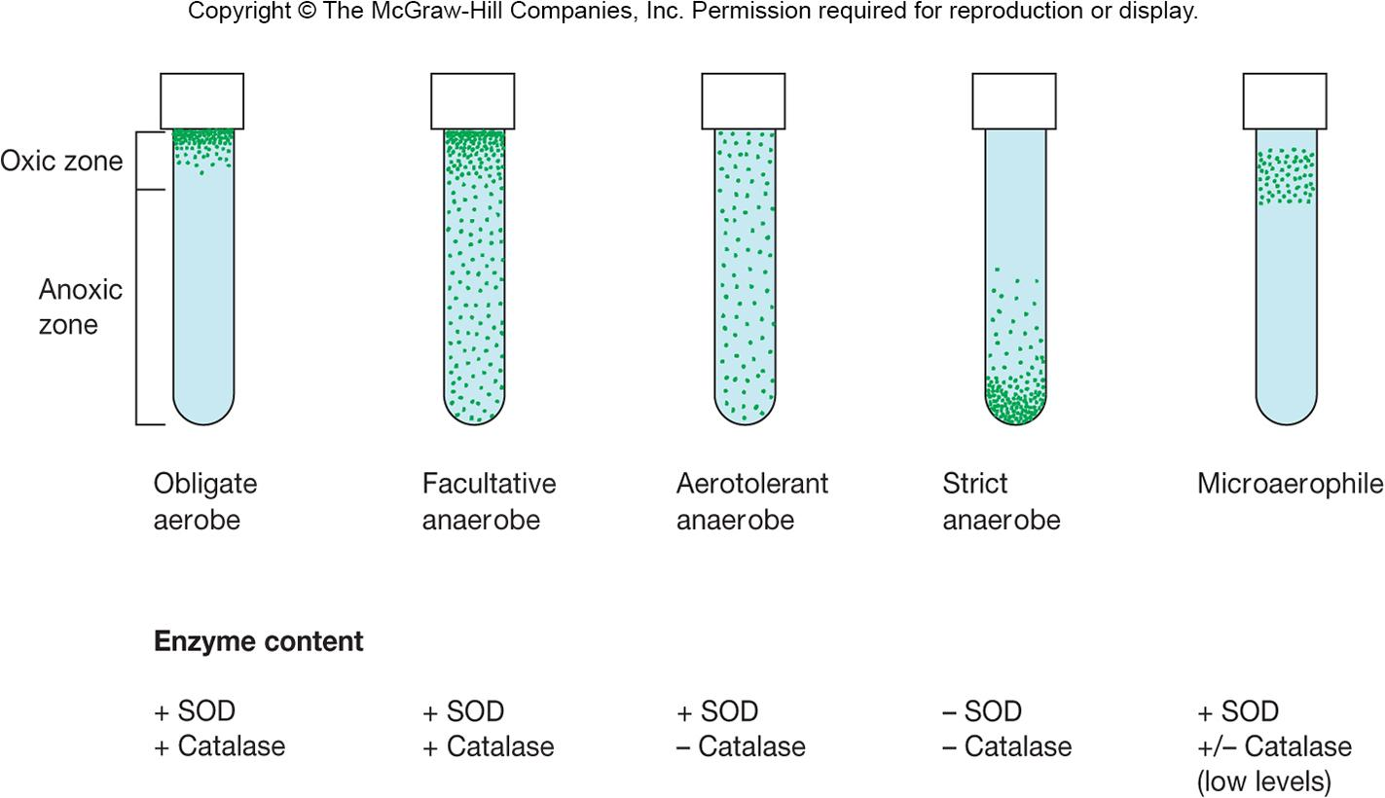
‹#›

Slide 42
Basis of Different Oxygen Sensitivities
Oxygen easily reduced to toxic reactive oxygen species (ROS)
superoxide radical
hydrogen peroxide
hydroxyl radical
Aerobes produce protective enzymes
superoxide dismutase (SOD)
catalase
peroxidase
‹#›
Notes:
‹#›

Slide 43
Strict Anaerobic Microbes
All strict anaerobic microorganisms lack or have very low quantities of
superoxide dismutase
catalase
These microbes cannot tolerate O₂
Anaerobes must be grown without O₂
work station with incubator
gaspak anaerobic system
‹#›

Slide 44
Pressure
Microbes that live on land and water surface live at 1 atmosphere (atm)
Some Bacteria and Archaea live in deep sea with very high hydrostatic pressures
Barotolerant
adversely affected by increased pressure, but not as severely as nontolerant organisms
Barophilic (peizophilic) organisms
require or grow more rapidly in the presence of increased pressure
change membrane fatty acids to adapt to high pressures
‹#›

Slide 45
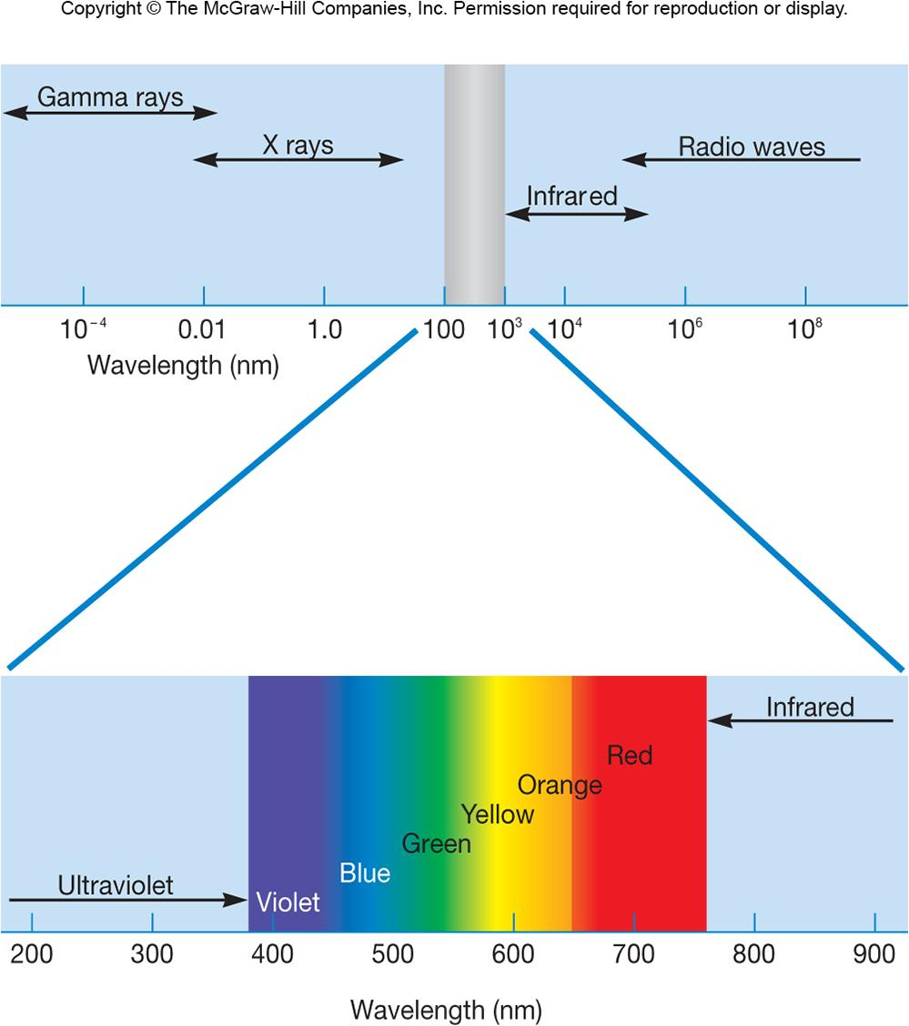
The Electromagnetic Spectrum
‹#›

Slide 46
Radiation Damage
Ionizing radiation
x-rays and gamma rays
mutations → death (sterilization(تعقيم))
Disrupts(تعطيل) chemical structure of many molecules, including DNA
damage may be repaired by DNA repair mechanisms if small dose
Deinococcus radiodurans
extremely resistant to DNA damage
‹#›
Notes:
‹#›

Slide 47
Radiation Damage…
Ultraviolet (UV) radiation
wavelength most effectively absorbed by DNA is 260 nm
mutations → death
causes formation of thymine dimers in DNA
requires direct exposure on microbial surface
DNA damage can be repaired by several repair mechanisms
‹#›
Notes:
‹#›

Slide 48
Radiation Damage…
Visible light
at high intensities generates singlet oxygen (¹O₂)
powerful oxidizing agent
carotenoid pigments
protect many light-exposed microorganisms from photooxidation
‹#›
Notes:
‹#›

Slide 49
Microbial Growth in Natural Environments
Microbial environments are complex, constantly changing, often contain low nutrient concentrations (oligotrophic environment) and may expose a microorganism to overlapping gradients of nutrients and environmental factors
‹#›
Notes:
‹#›

Slide 50
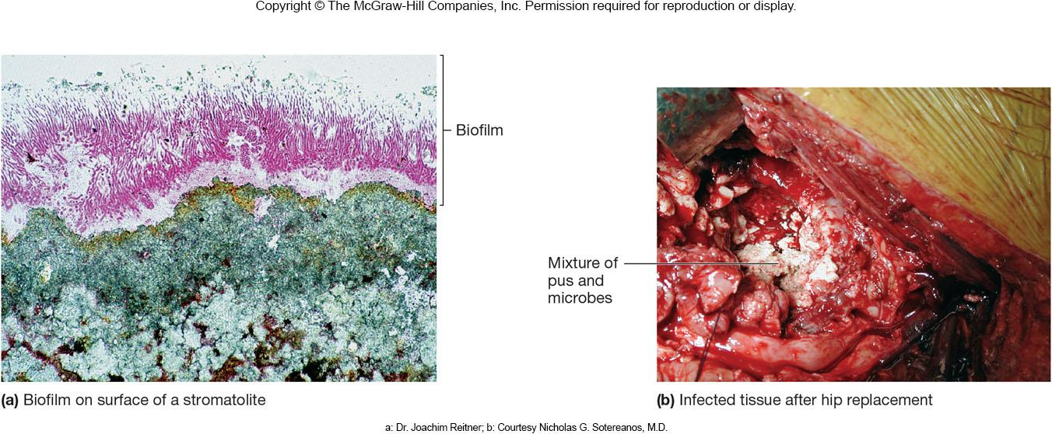
Biofilms
Most microbes grow attached to surfaces (sessile) rather than free floating (planktonic)
These attached microbes are members of complex, slime enclosed communities called a biofilm
Biofilms are ubiquitous in nature in water
Can be formed on any conditioned surface
‹#›
Notes:
‹#›

Slide 51
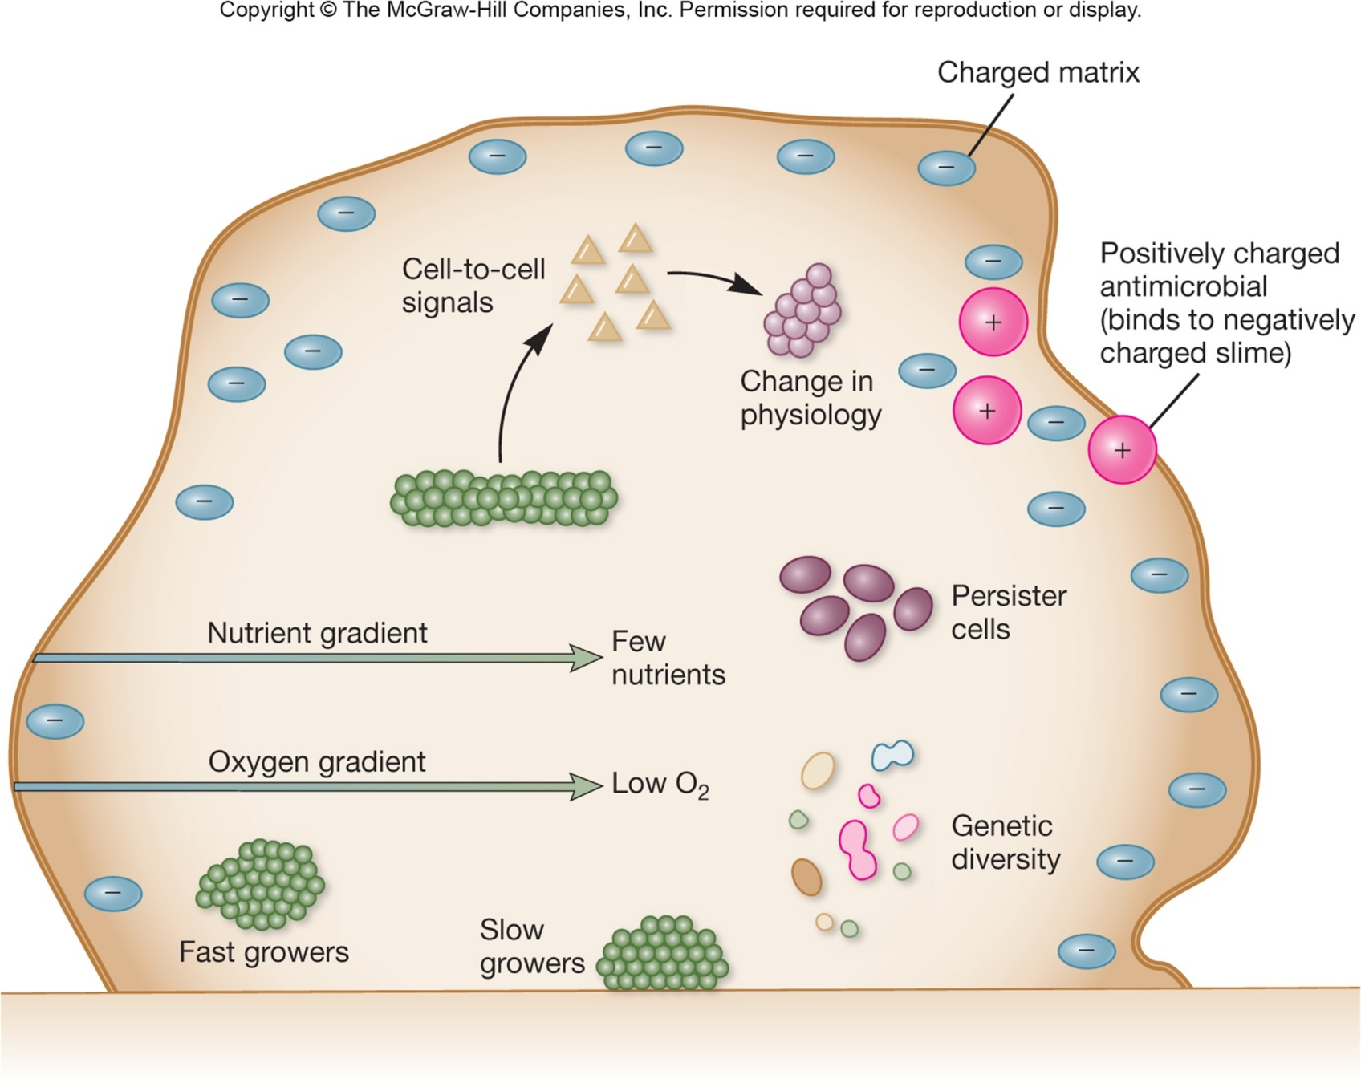
‹#›

Slide 52
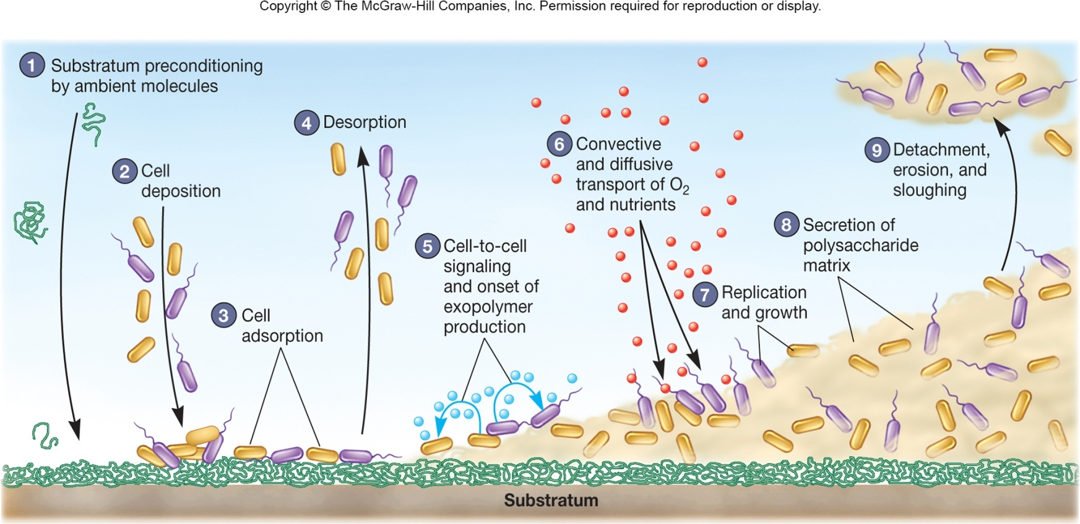
Biofilm Formation
Microbes reversibly attach to conditioned surface and release polysaccharides, proteins, and DNA to form the extracellular polymeric substance (EPS)
Additional polymers are produced as microbes reproduce and biofilm matures
‹#›
Notes:
‹#›

Slide 53
Biofilms
a mature biofilm is a complex, dynamic community of microorganisms
heterogeneity is differences in metabolic activity and locations of microbes
interactions occur among the attached organisms
exchanges take place metabolically, DNA uptake and communication
‹#›

Slide 54
Biofilm Microorganisms
The EPS and change in attached organisms’ physiology protects microbes from harmful agents
UV light, antibiotics, antimicrobials
When formed on medical devices, such as implants, often lead to illness
Sloughing off(تخلي عن/نزع) of organisms can result in contamination of water phase above the biofilm such as in a drinking water system
‹#›
Notes:
‹#›

Slide 55
Cell to Cell Communication Within the Microbial Populations
Bacterial cells in biofilms communicate in a density-dependent manner called quorum sensing
Produce small proteins that increase in concentration as microbes replicate and convert a microbe to a competent state
DNA uptake occurs, bacteriocins are released
‹#›
Notes:
‹#›

Slide 56
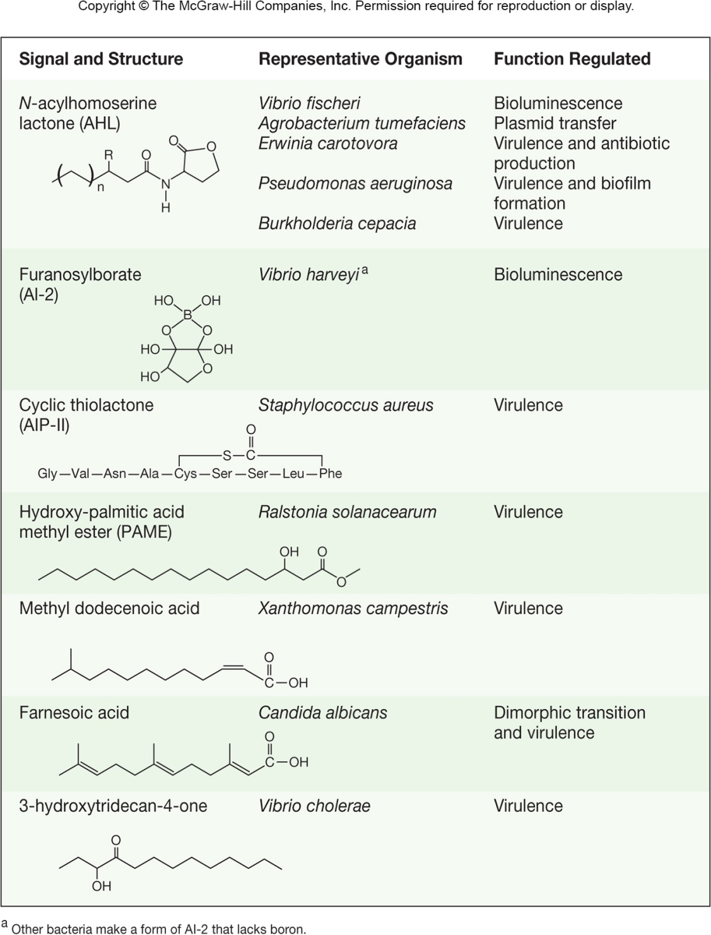
Quorum Sensing
Acylhomoserine lactone (AHL) is an autoinducer molecule produced by many gram-negative organisms
diffuses across plasma membrane
once inside the cell, induces expression of target genes regulating a variety of functions
‹#›

Slide 57
7.8 Continuous culture of microorganisms
Distinguish batch culture and continuous culture
Differentiate chemostats and turbidostats
Discuss the relationship between the dilution rate of a chemostat and population size and growth rate
‹#›

Slide 58
The Continuous Culture of Microorganisms
Growth in an open system
continual provision of nutrients
continual removal of wastes
Maintains cells in log phase at a constant biomass concentration for extended periods
Achieved using a continuous culture system
‹#›
Notes:
‹#›

Slide 59
Importance of Continuous Culture Methods
Constant supply of cells in exponential phase growing at a known rate
Study of microbial growth at very low nutrient concentrations, close to those present in natural environment
Study of interactions of microbes under conditions resembling(تشبه) those in aquatic environments
Food and industrial microbiology
‹#›
Notes:
‹#›

Slide 60
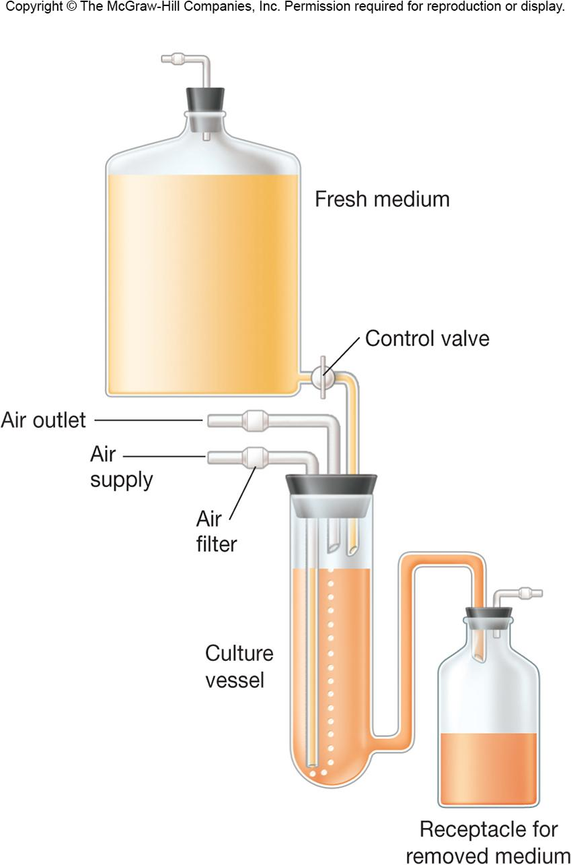
The Chemostat
Rate of incoming medium = rate of removal of medium from vessel
An essential nutrient is in limiting quantities
‹#›
Notes:
‹#›

Slide 61
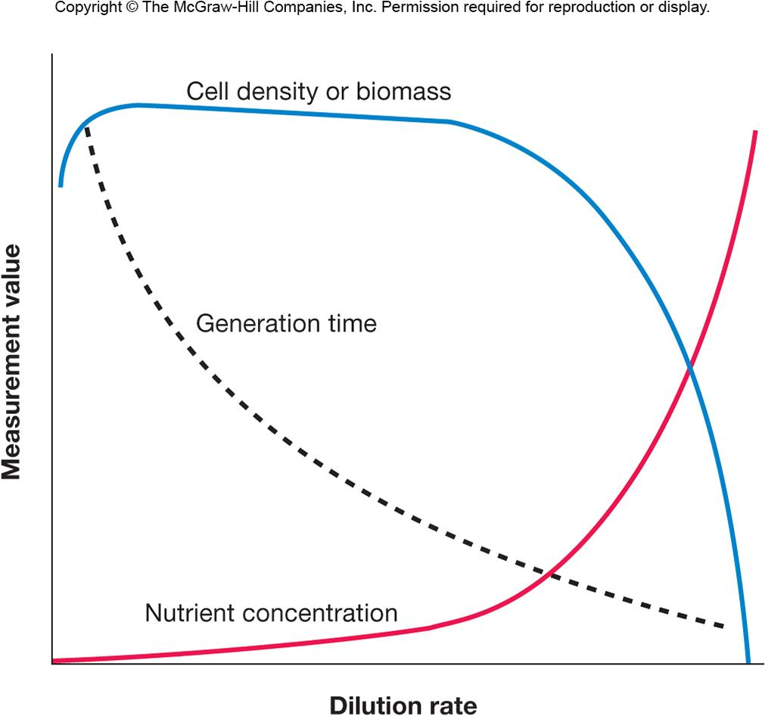
Dilution Rate and Microbial Growth
dilution rate – rate at
which medium flows
through vessel
relative to vessel size
note: cell density
maintained at wide
range of dilution
rates and chemostat operates best at low dilution rate
‹#›
Notes:
‹#›

