Slide 1
9
Antimicrobial Chemotherapy
Copyright © McGraw-Hill Global Education Holdings, LLC. Permission required for reproduction or display.

Slide 2
Chemotherapeutic Agents
Chemical agents used to treat disease
Destroy pathogenic microbes or inhibit their growth within host
Most are antibiotics
microbial products or their derivatives that kill susceptible(سريعة التأثر) microbes or inhibit their growth

Slide 3
Penicillin
First discovered by Ernest Duchesne (1896), but discovery lost
Accidentally discovered by Alexander Fleming (1928)
observed penicillin activity on contaminated plate
did not think could be developed further
Effectiveness demonstrated by Florey, Chain, and Heatley (1939)
Fleming, Florey, and Chain received Nobel Prize in 1945 for discovery and production of penicillin

Slide 4
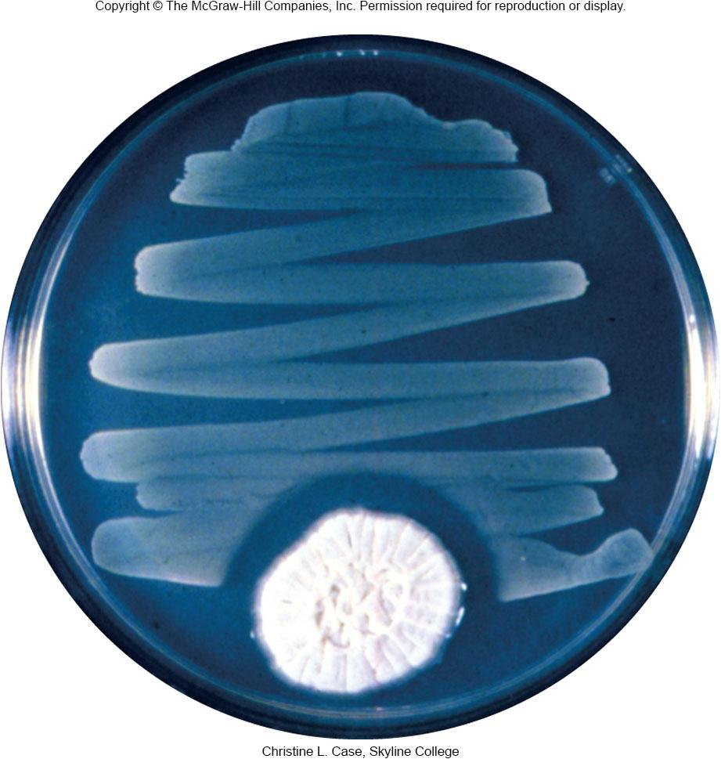

Slide 5
Later Discoveries
Streptomycin, an antibiotic active against tuberculosis(مرض السل), was discovered by Selman Waksman (1944)
Nobel Prize was awarded to Waksman in 1952 for this discovery
By 1953 chloramphenicol, terramycin, neomycin, and tetracycline isolated

Slide 6
General Characteristics of Antimicrobial Drugs
Selective toxicity
ability of drug to kill or inhibit pathogen while damaging host as little as possible
Therapeutic dose
drug level required for clinical treatment
Toxic dose
drug level at which drug becomes too toxic for patient (i.e., produces side effects)
Therapeutic index
ratio of toxic dose to therapeutic dose

Slide 7
General Characteristics of Antimicrobial Drugs…
Side effects – undesirable effects of drugs on host cells
Narrow-spectrum drugs – attack only a few different pathogens
Broad-spectrum drugs – attack many different pathogens
Cidal agent - kills microbes
Static agent - inhibits growth of microbes

Slide 8
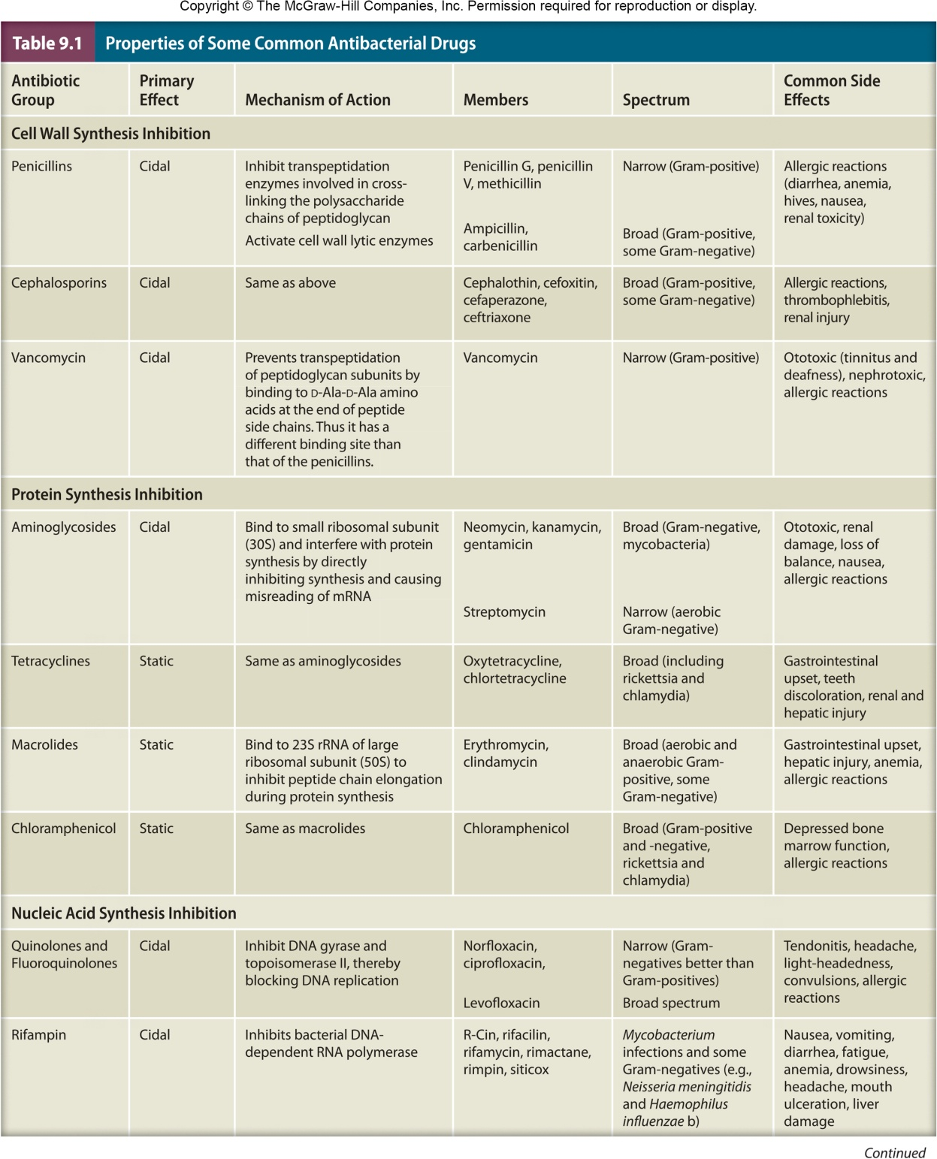

Slide 9
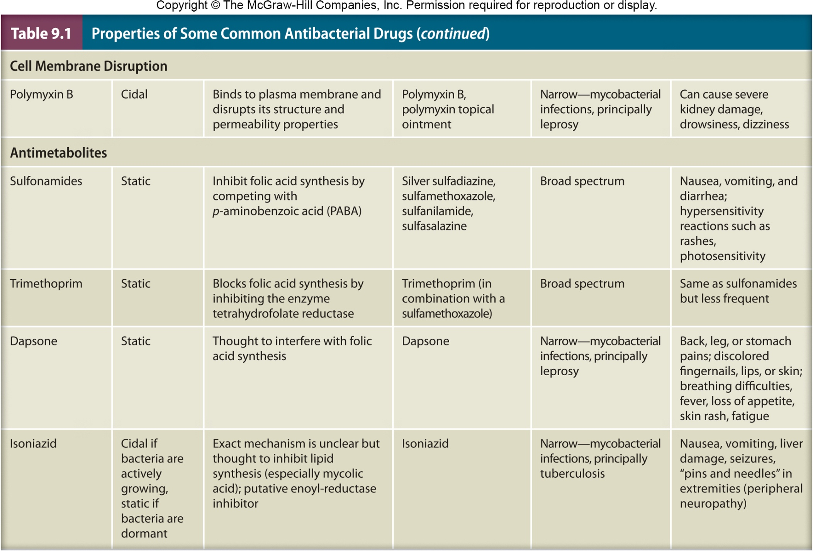

Slide 10
General Characteristics of Antimicrobial Drugs…
Effect of an agent may vary
with concentration, microbe, host
Effectiveness expressed in two ways
minimal inhibitory concentration (MIC)
lowest concentration of drug that inhibits growth of pathogen
minimal lethal concentration (MLC)
lowest concentration of drug that kills pathogen

Slide 11
9.3 Determining the level of antimicrobial activity
Explain how to determine the level of antibacterial drug activity using the dilution susceptibility test, the disk diffusion test, and the Etest
Predict antimicrobial drug levels in vivo from in vitro data

Slide 12
Determining the Level of Antimicrobial Activity
Dilution susceptibility tests for MIC
Disk diffusion tests – Kirby Bauer
The E-test MIC and diffusion

Slide 13
Dilution Susceptibility Tests
Involves inoculating media containing different concentrations of drug
broth or agar with lowest concentration showing no growth is MIC
if broth used, tubes showing no growth can be subcultured into drug-free medium
broth from which microbe can’t be recovered is MLC

Slide 14
Disk Diffusion Tests
Disks impregnated with specific drugs are placed on agar plates inoculated with test microbe
Drug diffuses from disk into agar, establishing concentration gradient
Observe clear zones (no growth) around disks

Slide 15
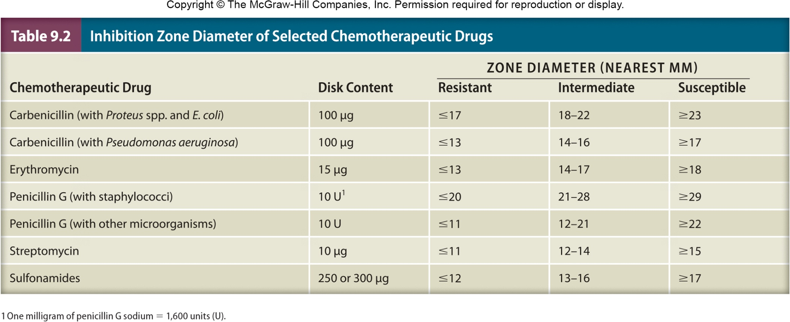

Slide 16
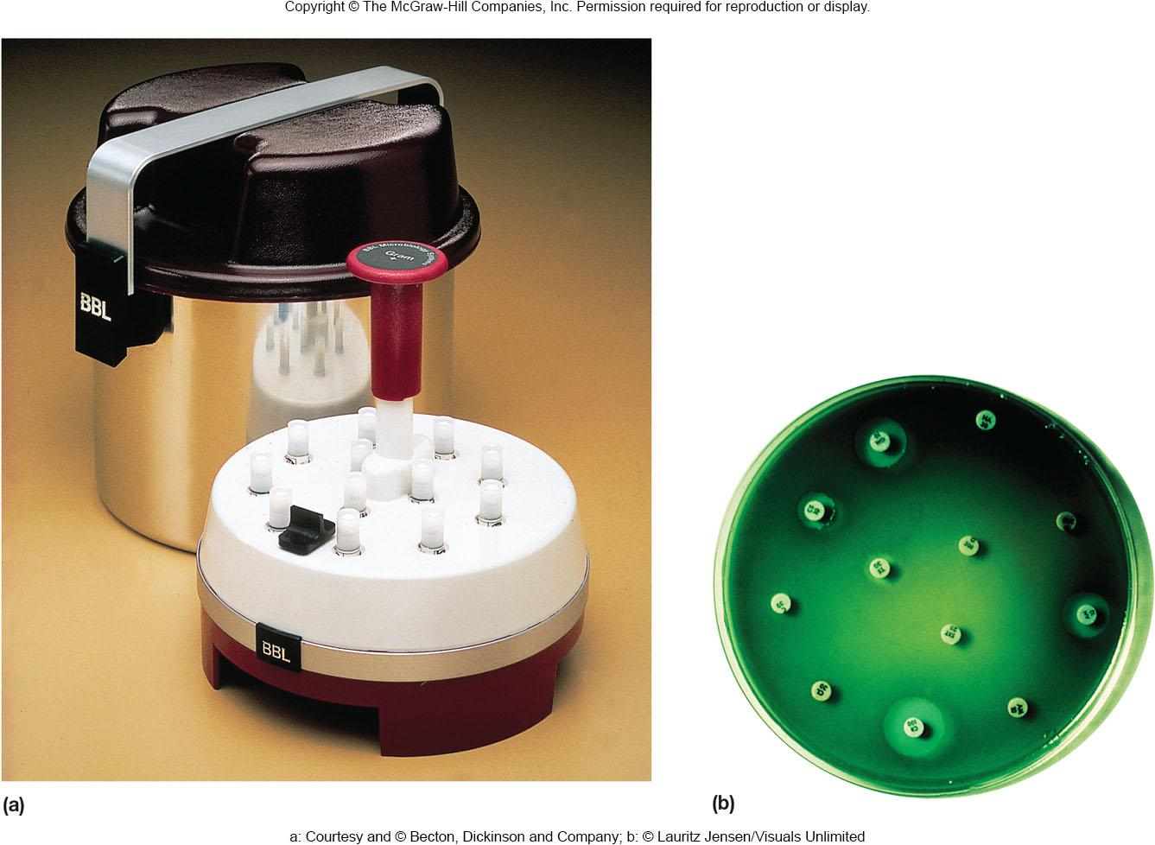
Kirby-Bauer Method
Standardized method for disk diffusion test
Sensitivity/resistance determined using tables relating zone diameter with microbial resistance
Table values plotted, used to determine if effective concentration of drug in body can be reached

Slide 17
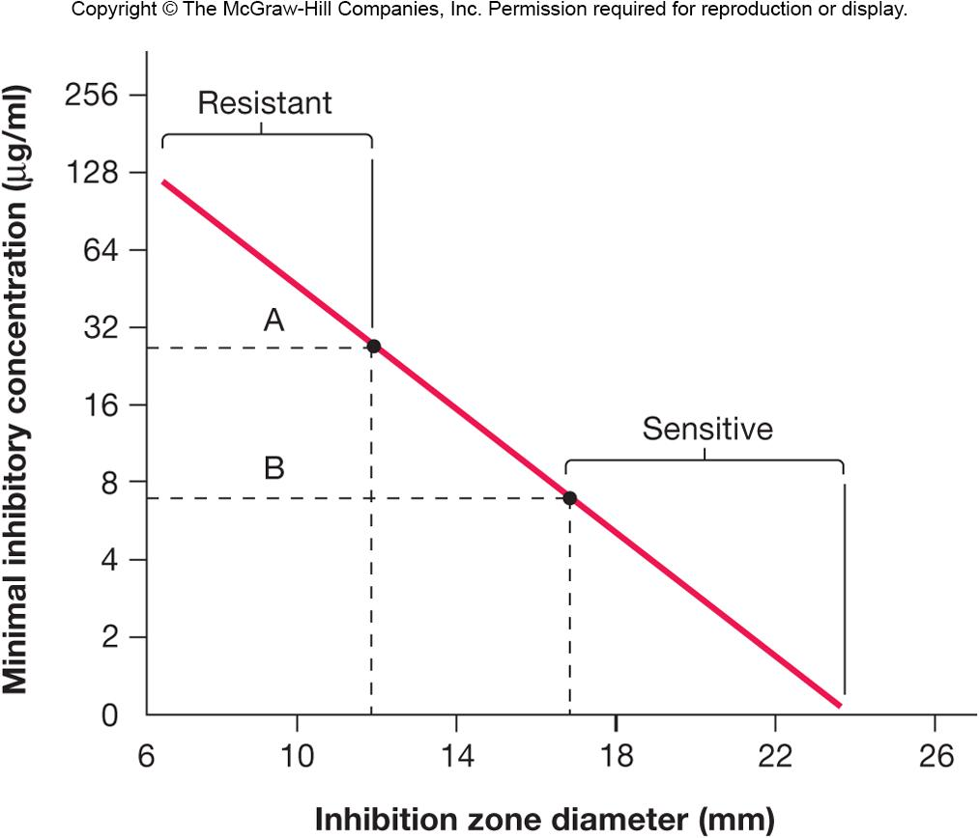

Slide 18
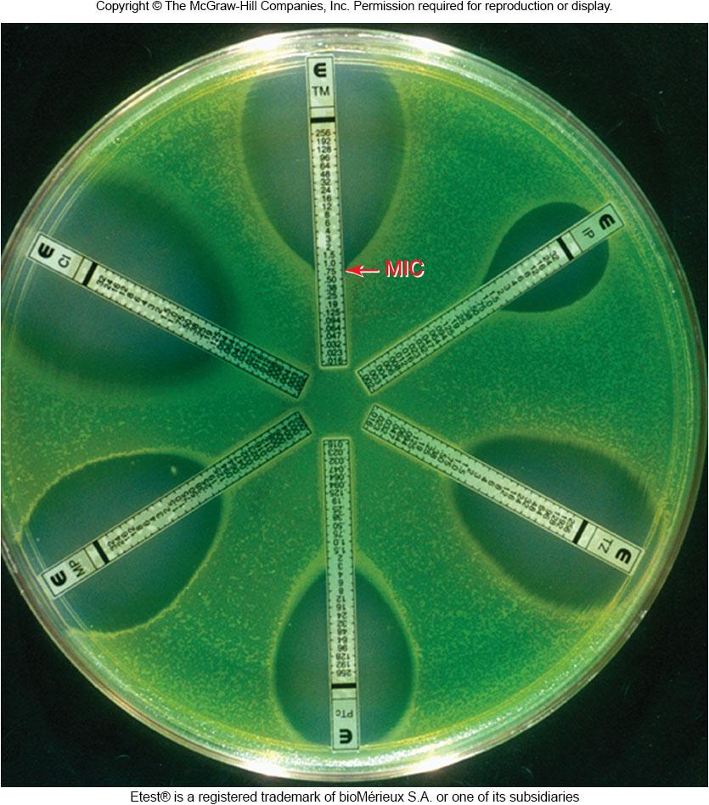
The E Test
Convenient(مناسب) for use with anaerobic pathogens
Similar to disk diffusion method, but uses strip rather than disk
E-test strips contain a gradient of an antibiotic
Intersection(تداخل) of elliptical(بيضاوي الشكل) zone of inhibition with strip indicates MIC

Slide 19
9.4 Antibacterial drugs
Compare antibacterial drug mechanisms of action
Relate side effect toxicity of antibacterial drugs to mechanism of action
Explain the relative effectiveness of various antibacterial agents based on drug target

Slide 20
Antimicrobial Drugs
Inhibitors of cell wall synthesis
Protein synthesis inhibitors
Metabolic antagonists
Nucleic acid synthesis inhibition

Slide 21
Inhibitors of Cell Wall Synthesis
Penicillins
most are 6-aminopenicillanic acid derivatives and differ in side chain attached to amino group
most crucial(مهمة) feature of molecule is the β-lactam ring
essential for bioactivity
many penicillin resistant organisms produce β-lactamase (penicillinase) which hydrolyzes a bond in this ring

Slide 22
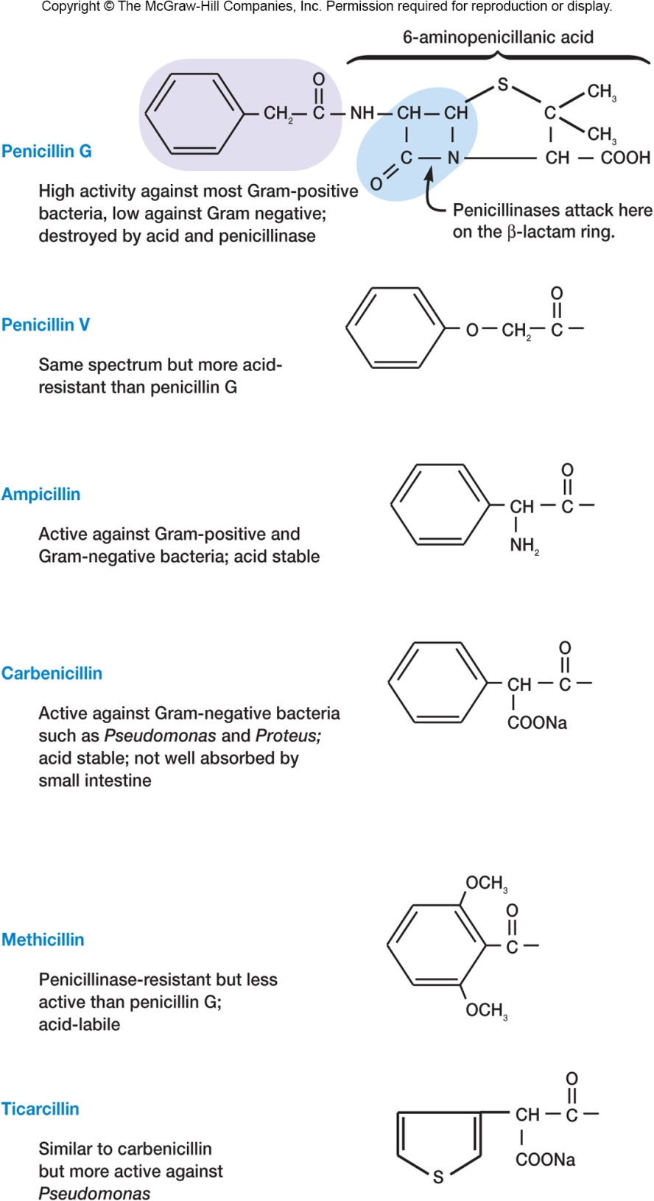
Penicillins…
Mode of action
blocks the enzyme that catalyzes transpeptidation (formation of cross-links in peptidoglycan)
prevents the synthesis of complete cell walls leading to lysis of cell
acts only on growing bacteria that are synthesizing new peptidoglycan

Slide 23
Other Actions of Penicillins
Binds to periplasmic proteins (penicillin-binding proteins, PBPs)
May activate bacterial autolysins and murein hydrolases
Stimulate bacterial holins to form holes or lesions in the plasma membrane

Slide 24
Penicillins…
Naturally occurring penicillins
penicillin V and G are narrow spectrum
Semisynthetic penicillins have a broader spectrum than naturally occurring ones
Resistance to penicillins, including the semisynthetic analogs, continues to be a problem
~1–5% of adults in U.S. are allergic to penicillin
allergy can lead to a violent allergic response and death

Slide 25
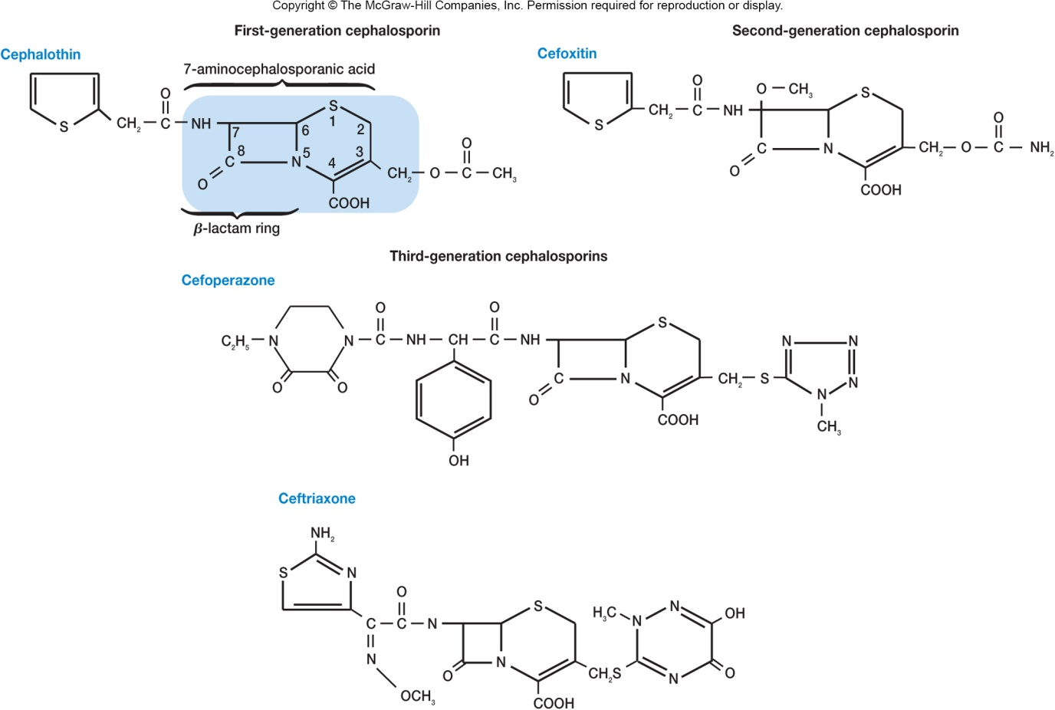
Cephalosporins
Structurally and functionally similar to penicillins
Broad-spectrum antibiotics that can be used by most patients that are allergic to penicillin
Four categories based on their spectrum of activity

Slide 26
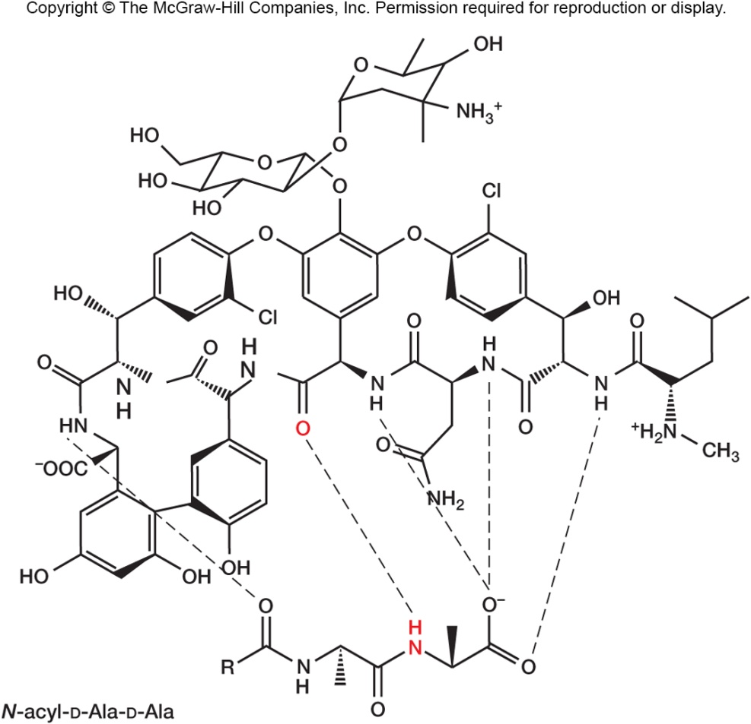
Vancomycin and Teicoplanin
Glycopeptide antibiotics
Inhibit cell wall synthesis
Vancomycin - important for treatment of antibiotic-resistant staphylococcal and enterococcal infections
previously considered “drug of last resort” so rise in resistance to vancomycin is of great concern(قلق عظيم/كبير)

Slide 27
Protein Synthesis Inhibitors
Many antibiotics bind specifically to the bacterial ribosome
binding can be to 30S (small) or 50S (large) ribosomal subunit
Other antibiotics inhibit a step in protein synthesis
aminoacyl-tRNA binding
peptide bond formation
mRNA reading
translocation

Slide 28
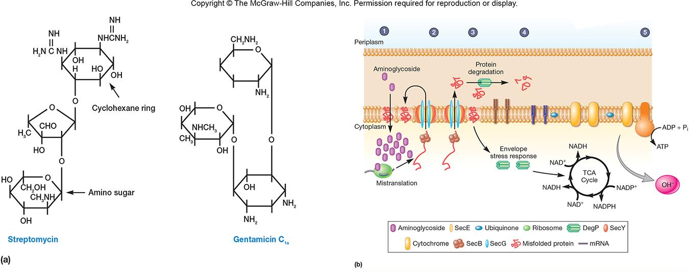
Aminoglycoside Antibiotics
Large group, all with a cyclohexane ring, amino sugars
Bind to 30S ribosomal subunit, interfere with protein synthesis by directly inhibiting the process and by causing misreading of the messenger RNA
Resistance and toxicity

Slide 29
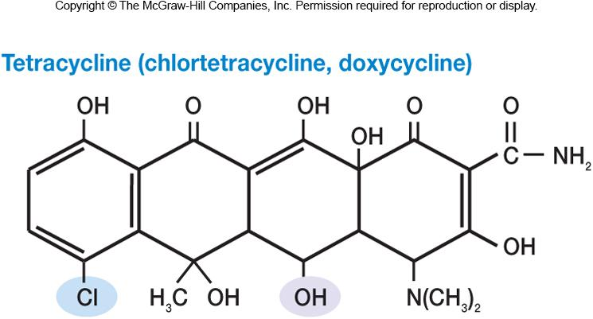
Tetracyclines
All have a four-ring structure to which a variety of side chains are attached
Are broad spectrum, bacteriostatic
Combine with 30S ribosomal subunit
inhibits bind of aminoacyl-tRNA molecules to the A site of the ribosome
Sometimes used to treat acne(حب الشباب)

Slide 30
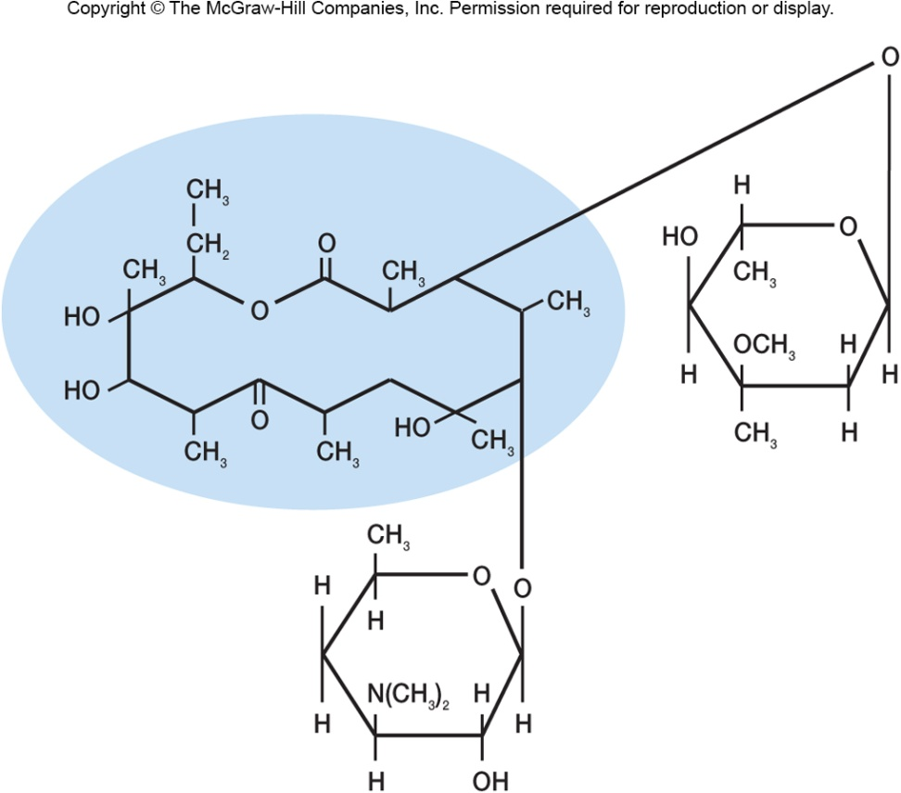
Macrolides
Contain 12- to 22-carbon lactone rings linked to one or more sugars
e.g., erythromycin
broad spectrum, usually bacteriostatic
binds to 23S rRNA of 50S ribosomal subunit
inhibits peptide chain elongation
Used for patients allergic to penicillin

Slide 31
Chloramphenicol
Now is chemically synthesized
Binds to 23s rRNA on 50S ribosomal subunit and inhibits peptidyl transferase reaction
Toxic with numerous side effects so only used in life-threatening situations

Slide 32
Metabolic Antagonists
Act as antimetabolites
antagonize or block functioning of metabolic pathways by competitively inhibiting the use of metabolites by key enzymes
Are structural analogs
molecules that are structurally similar to, and compete with, naturally occurring metabolic intermediates
block normal cellular metabolism

Slide 33
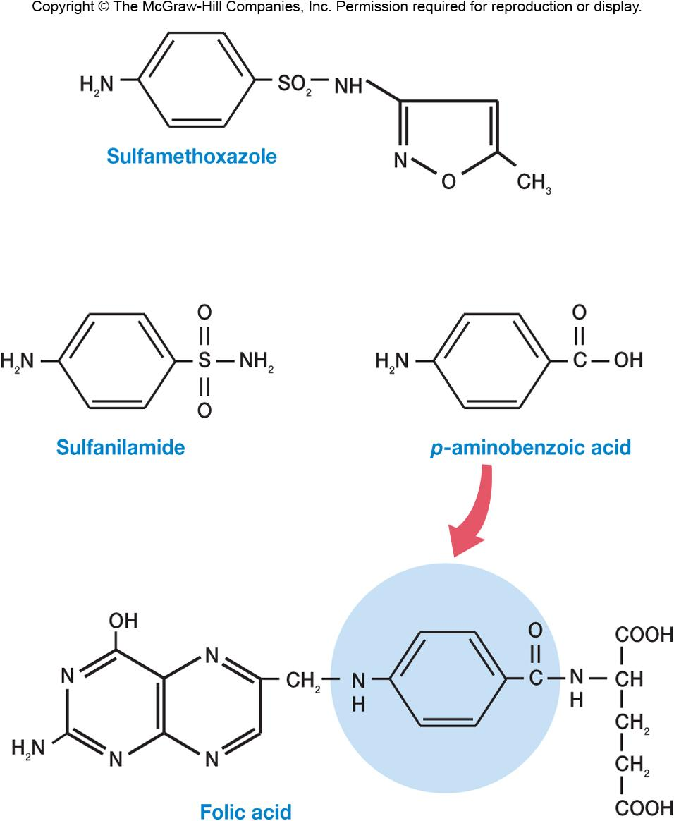
Sulfonamides or Sulfa Drugs
Structurally related to sulfanilamide, a paminobenzoic acid (PABA) analog
PABA used for the synthesis of folic acid and is made by many pathogens
sulfa drugs are selectively toxic due to competitive inhibition of folic acid synthesis enzymes

Slide 34
Trimethoprim
Synthetic antibiotic that also interferes with(يتداخل مع) folic acid production
Broad spectrum
Can be combined with sulfa drugs to increase efficacy of treatment
combination blocks two steps in folic acid pathway
Has a variety of side effects including abdominal pain and photosensitivity reactions (الحساسية للضوء)

Slide 35
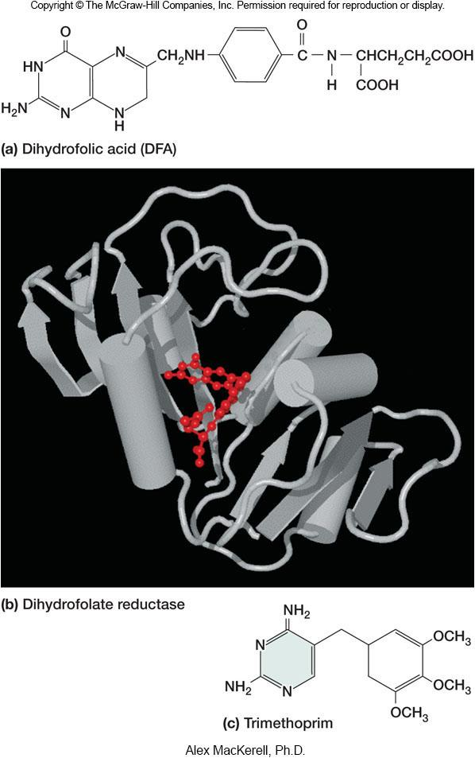

Slide 36
Nucleic Acid Synthesis Inhibition
A variety of mechanisms
block DNA replication
inhibition of DNA polymerase
inhibition of DNA helicase
block transcription
inhibition of RNA polymerase
Drugs not as selectively toxic as other antibiotics because bacteria and eukaryotes do not differ greatly in the way they synthesize nucleic acids

Slide 37
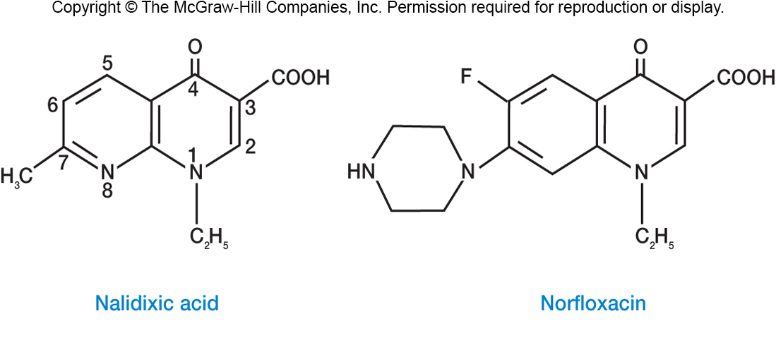
Quinolones
Broad-spectrum, synthetic drugs containing the 4-quinolone ring
Nalidixic acid first synthesized quinolone (1962)
Act by inhibiting bacterial DNA-gyrase and topoisomerase II
Broad spectrum, bactericidal, wide range of infections
Notes:
alidixic

Slide 38
Type II topoisomerases cut both strands of the DNA helix simultaneously in order to manage DNA tangles and supercoils. They use the hydrolysis of ATP, unlike Type I topoisomerase. In this process, these enzymes change the linking number of circular DNA by ±2.
DNA gyrase, or simply gyrase, is an enzyme within the class of topoisomerase (Type II topoisomerase) ^{[1]} that relieves strain(يخفف من الضغط) while double-stranded DNA is being unwound by helicase.^{[2][3]} The enzyme causes negative supercoiling of the DNA or relaxes positive supercoils.

Slide 39
9.8 Factors influencing antimicrobial drug effectiveness
Predict the effects of (1) delivery route, (2) metabolism, and (3) local concentration on the effectiveness of an antimicrobial drug
Correlate the sensitivity of a microorganism to an antimicrobial agent with microbial growth in the presence of that agent
Identify the practices that lead to antimicrobial drug resistance and suggest countermeasures

Slide 40
Factors Influencing Antimicrobial Drugs
Ability of drug to reach site of infection
Susceptibility of pathogen to drug
Ability of drug to reach concentrations in body that exceed(يتجاوز) MIC of pathogen

Slide 41
Ability of Drug to Reach Site of Infection
Depends in part on mode of administration
oral
some drugs destroyed by stomach acid
topical
parenteral routes
nonoral routes of administration
Drug can be excluded by blood clots or necrotic tissue(الأنسجة الميتة)

Slide 42
Factors Influencing Ability of Drug to Reach Concentrations Exceeding MIC
Amount administered
Route of administration
Speed of uptake
Rate of clearance (elimination) from body

Slide 43
Drug Resistance
An increasing problem
once resistance originates(ينشأ) in a population it can be transmitted to other bacteria
a particular type of resistance mechanism is not confirmed to a single class of drugs
Microbes in abscesses or biofilms may be growing slowly and not be susceptible(سريع التأثر)
Resistance mutants arise spontaneously and are then selected

Slide 44
Overcoming Drug Resistance
Give drug in appropriate concentrations to destroy susceptible
Give two or more drugs at same time
Use drugs only when necessary
Possible future solutions
continued development of new drugs
use of bacteriophages to treat bacterial disease

