Slide 1
Chapter 6
Plant Adaptations to the Environment
Lecture prepared by
Aimee C. Wyrick

Slide 2
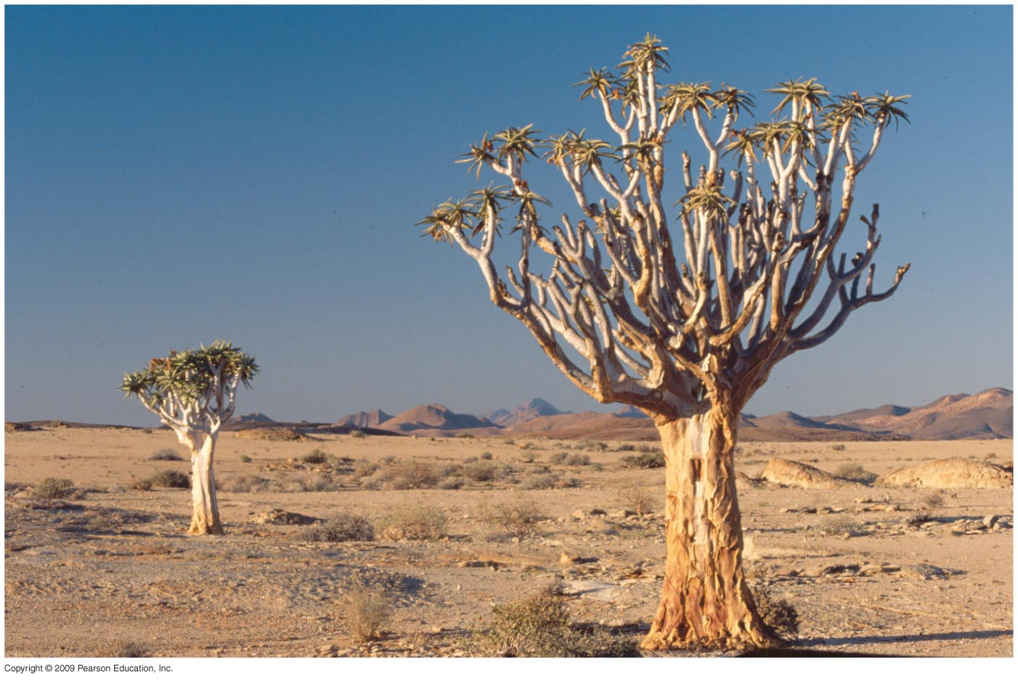
The Kokerboom tree is a desert tree in Namibian desert that uses CAM photosynthetic pathway to conserve water.

Slide 3
6.1 Photosynthesis Is the Conversion of Carbon Dioxide into Simple Sugars
Photosynthesis begins with light reactions:
Absorption of light energy by chlorophyll (a pigment molecule)
Conversion of the light energy into ATP and NADPH
Photosynthesis continues with the dark reactions:
Incorporation of CO₂ into simple (organic) sugars using the energy provided by ATP and NADPH.
Carboxylation is catalyzed by the enzyme rubisco (ribulose biphosphate carboxylase-oxygenase or RuBP)

Slide 4
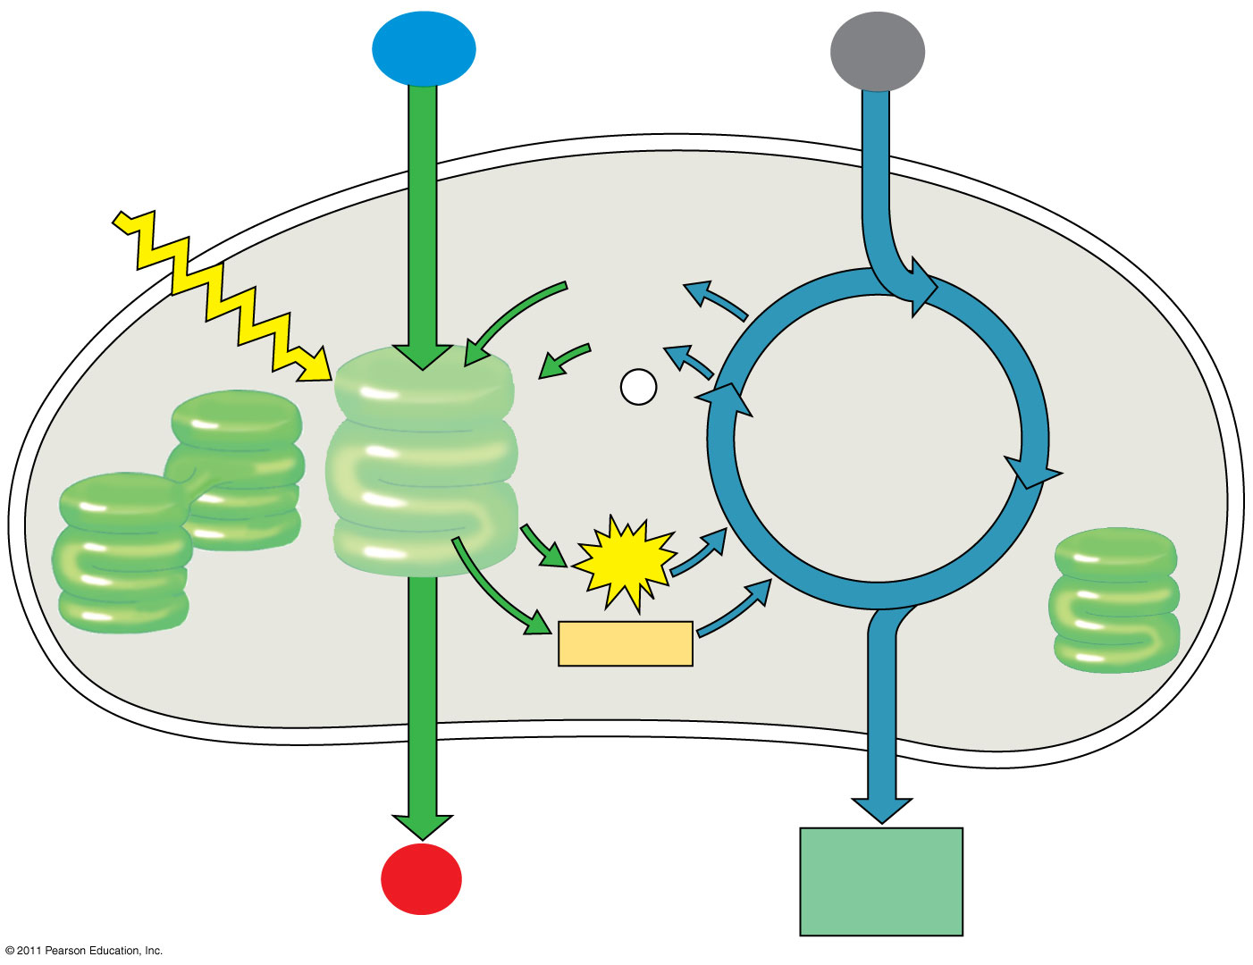
Figure 10.6-4
H₂O
CO₂
Light
NADP⁺
ADP
+ P _{i}
Calvin Cycle
Light Reactions
ATP
NADPH
Chloroplast
O₂
[CH₂O] (sugar)
Notes:
4
An overview of photosynthesis: cooperation of the light reactions and the Calvin cycle.

Slide 5
C₃ Pathway
The Calvin–Benson cycle (C₃ cycle) initially fixes CO₂ into 3-PGA (phosphoglycerate) which is a 3-carbon sugar.
The series of dark reactions of C₃ plants.

Slide 6
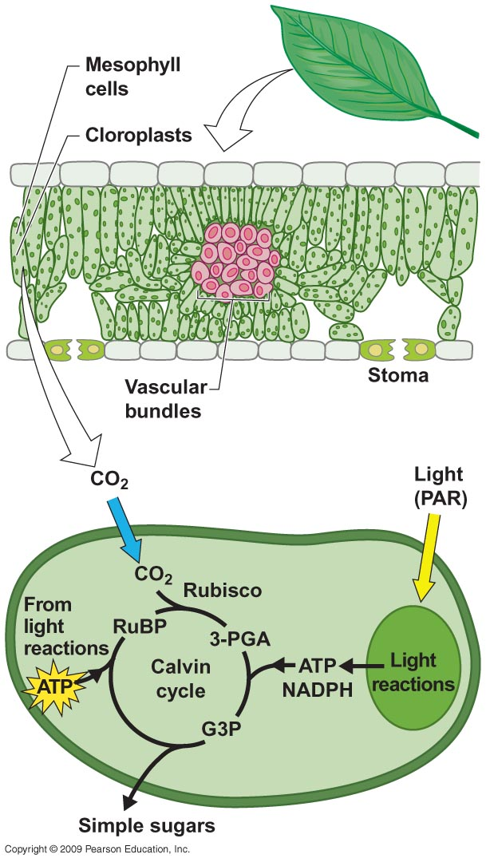
Notes:
Figure 6.1

Slide 7
C₄ & CAM Pathways
Plants adapted to warmer and drier environments have developed alternative photosynthetic pathways that increase water-use efficiency:
Examples: the C₄ & CAM photosynthetic pathways

Slide 8
The C₄ photosynthetic pathway spatially separates CO₂ fixation and assimilation of CO₂ into the Calvin Cycle (dark reactions).
Carbon fixation:
CO₂ is initially fixed into the organic acid oxaloacetate (OAA) in the mesophyll cell.
CO₂ fixation is catalyzed by the enzyme PEP carboxylase.
Carbon assimilation:
Oxaloacetate is broken down and releases CO₂ into the bundle sheath where it is incorporated into the Calvin Cycle.

Slide 9
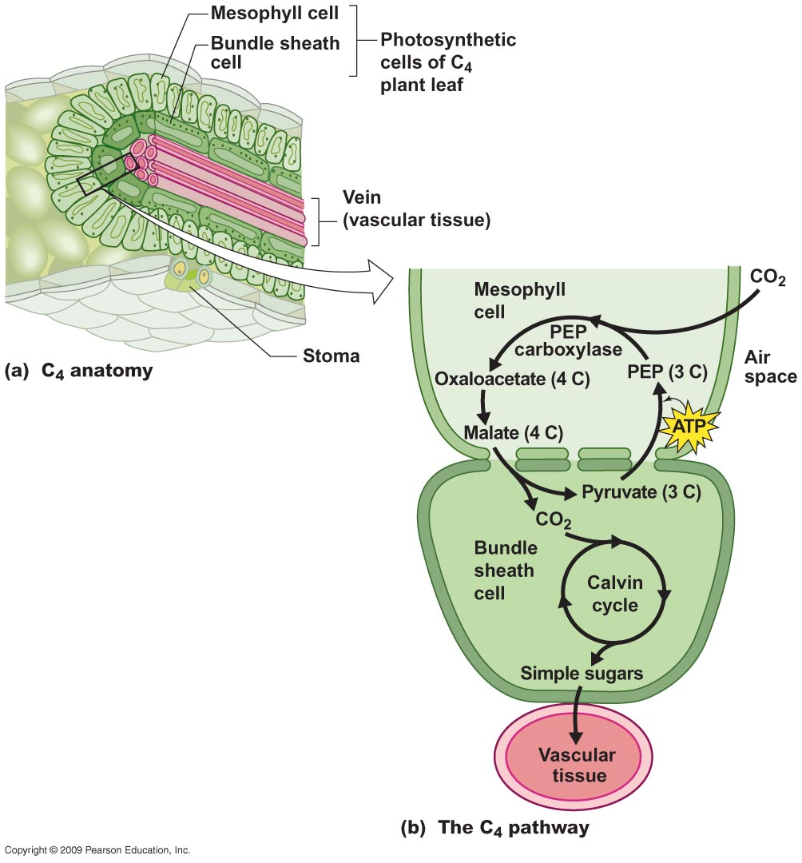
Notes:
Figure 6.15

Slide 10
An increase in photosynthetic efficiency of the C₄ photosynthetic pathway :
PEP carboxylase does not interact with oxygen (as does RuBP)
The conversion of organic acids back into CO₂ acts to concentrate CO₂ (This increases the rate of reaction).
For a given degree of stomatal opening and water loss, C₄ plants typically fix more carbon → greater water-use efficiency.
Most commonly found in grasses native to tropical and subtropical regions.

Slide 11
Plants adapted to warmer and drier environments have developed alternative photosynthetic pathways that increase water-use efficiency:
C₄ photosynthetic pathway
CAM (crassulacean acid metabolism) pathway

Slide 12
The CAM pathway temporally separates CO₂ fixation and assimilation of CO₂ into the Calvin Cycle (dark reactions).
Carbon fixation:
Stomata are open at night.
CO₂ is initially fixed by PEP carboxylase into malic acid at night.
Carbon assimilation:
Stomata are closed during the day.
Malic acid reconverts to CO₂ and is assimilated into the Calvin Cycle.

Slide 13
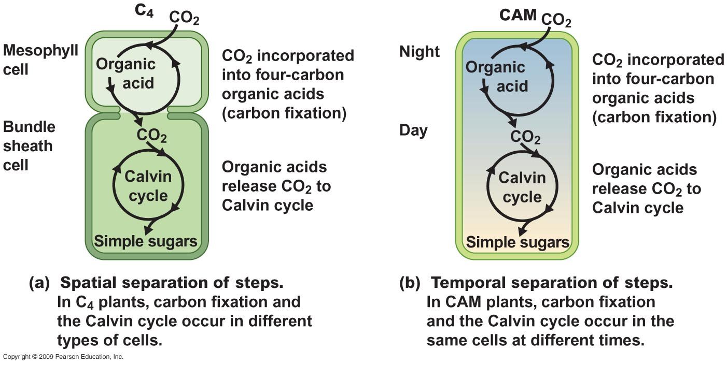
mesophyll cell
bundle sheath
cell
mesophyll cell
Notes:
Figure 6.17

Slide 14
6.2 The Light a Plant Receives Affects Its Photosynthetic Activity
The availability of light, photosynthetically active radiation (PAR), to the leaf directly influences the rate of photosynthesis.
The light compensation point (LCP) is the point at which the rate of net photosynthesis is zero.
The light saturation point is the point above which no further increase in photosynthesis occurs
Photoinhibition is the negative effect of high light levels.

Slide 15
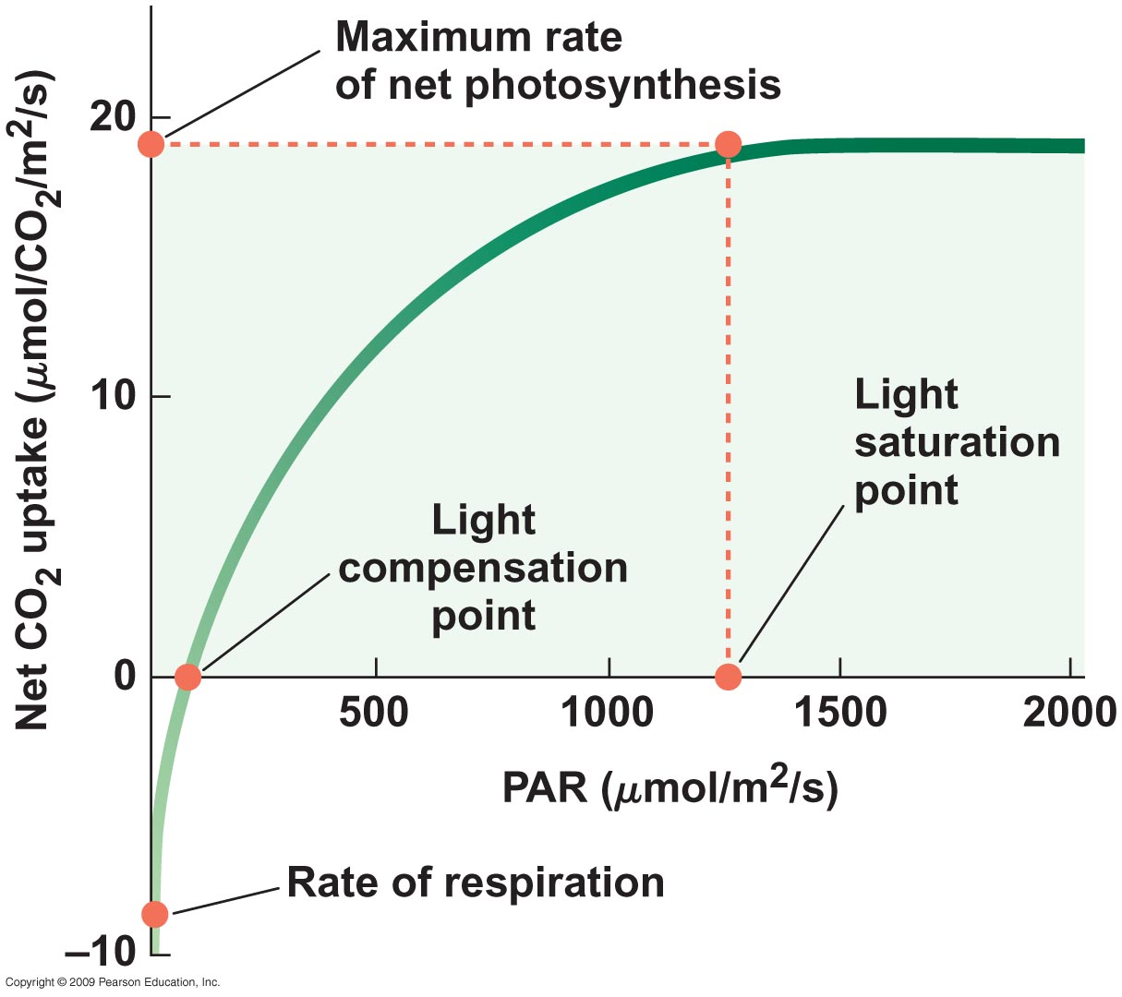
Notes:
Figure 6.2

Slide 16
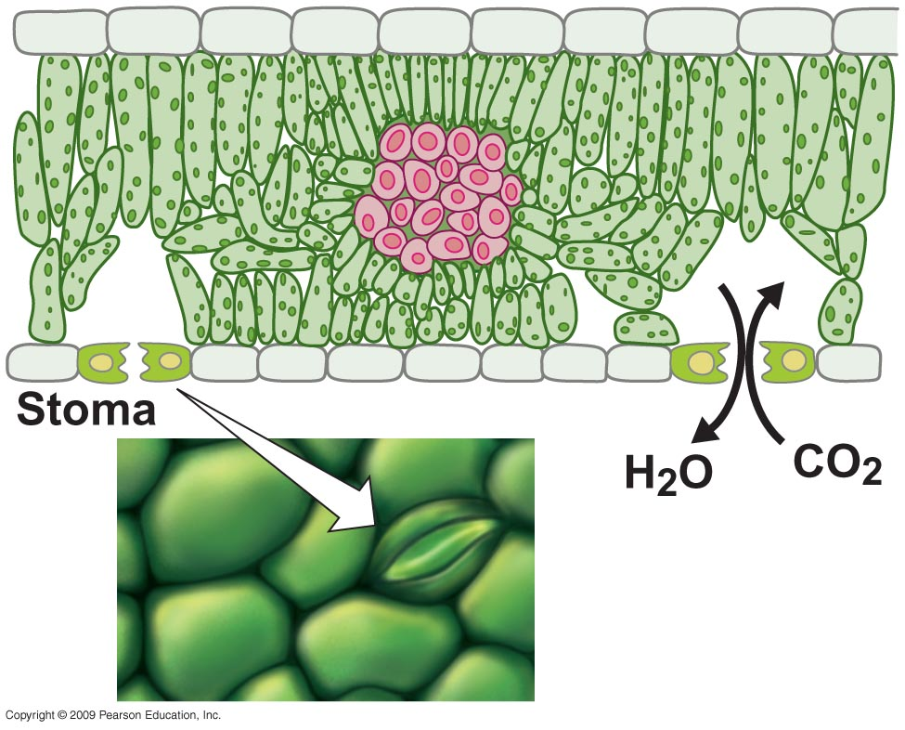
Notes:
Figure 6.3

Slide 17
The rate of water loss from plants varies daily depending on:
Humidity
Temperature
Plant characteristics (stomata opening and closing)
The water-use efficiency is the ratio of carbon fixed (photosynthesis) per unit of water lost (transpiration).
Terrestrial plants must balance intake of CO₂ with the loss of water.

Slide 18
6.9 Species of Plants Are Adapted to Different Light Environments
The presence of other plants greatly influences (by shading) the amount of PAR that each receives.
Sun versus shade plants:
Shade (low-light) plants tend to have a lower light saturation point and a lower maximum rate of photosynthesis.

Slide 19
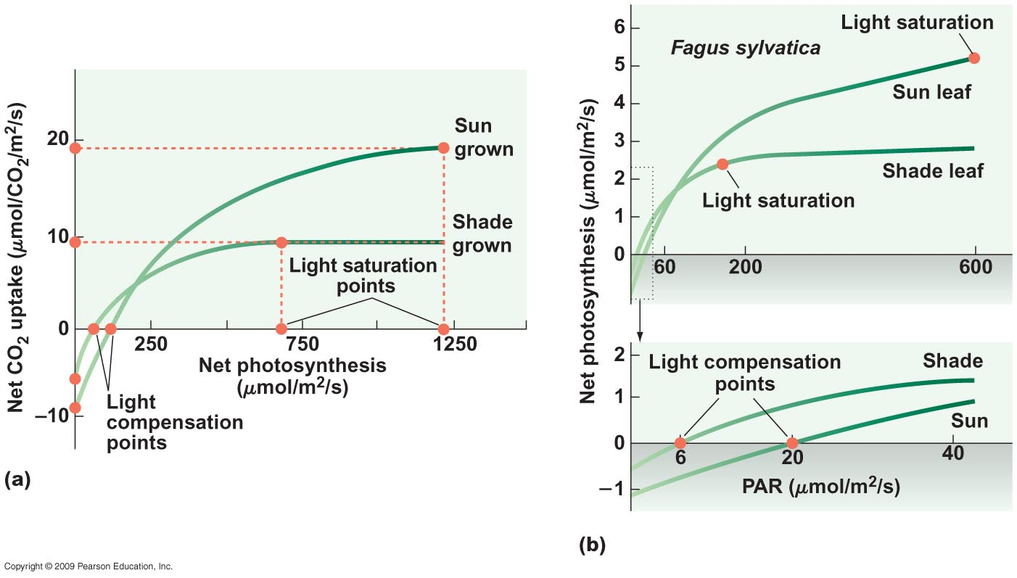
Notes:
Figure 6.9

Slide 20
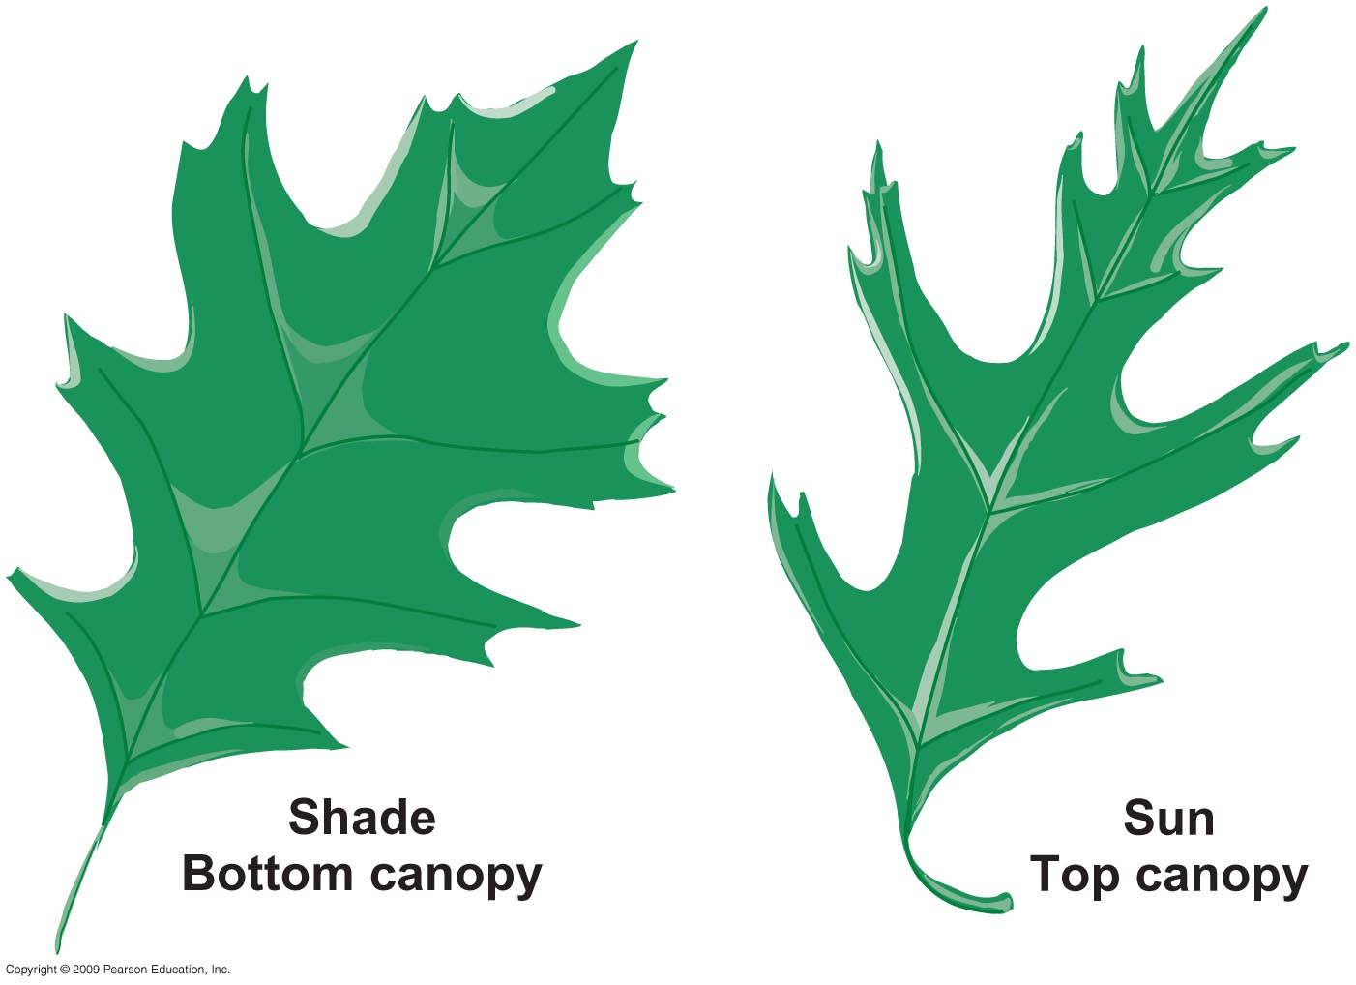
Red oak leaves
Notes:
Figure 6.11

Slide 21
Differences in the performance of sun versus shade plants are related to rubisco:
Rubisco is a costly molecule for a plant to manufacture
Shade plants produce less rubisco which reduces energy cost and leaf respiration rate and produces more chlorophyll:
Lowers photosynthesis rate → Lower light compensation point.
Restricts maximum photosynthetic rate because there is only so much rubisco available to fix CO₂

Slide 22
Phenotypic plasticity is the ability of a plant to change its form under different environmental conditions.
It can be observed:
Among individuals of the same species grown in different light conditions.
Among leaves on the same plant with different light exposures.

Slide 23
Genetic differentiation between plant species in response to light:
Shade-intolerant (sun-adapted) species are those that are adapted to high-light environments.
Shade-tolerant (shade-adapted) species are those adapted to low-light environments.

Slide 24
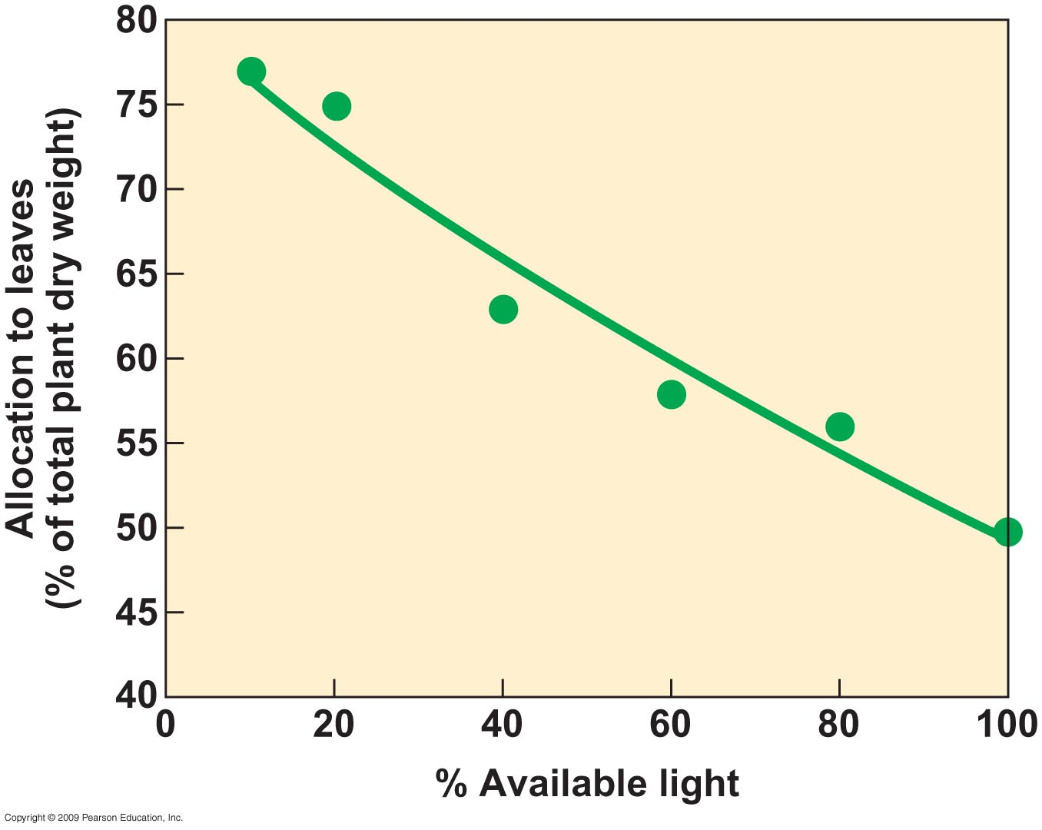
Notes:
Figure 6.12

Slide 25
Plants respond to moisture stress differently:
Leaf curling and wilting.
Inhibition of chlorophyll production → loss of leaves.
Drought deciduous.
Modified photosynthetic pathway.

Slide 26
In response to lower soil water, a plant can increase carbon allocation to roots:
Explore a larger volume and depth of soil
Reduce leaf area exposed to solar radiation and transpiration
Leaf area reduction is a result of reduced allocation of carbon to leaf production and changes in leaf morphology (both size and shape):
Smaller and thicker

Slide 27
Additional leaf modifications to minimize water loss:
Cell wall thickness
Stomatal size (tiny)
Dense vascular system
Leaves covered with hairs, wax, resins: reduce light absorption.

Slide 28
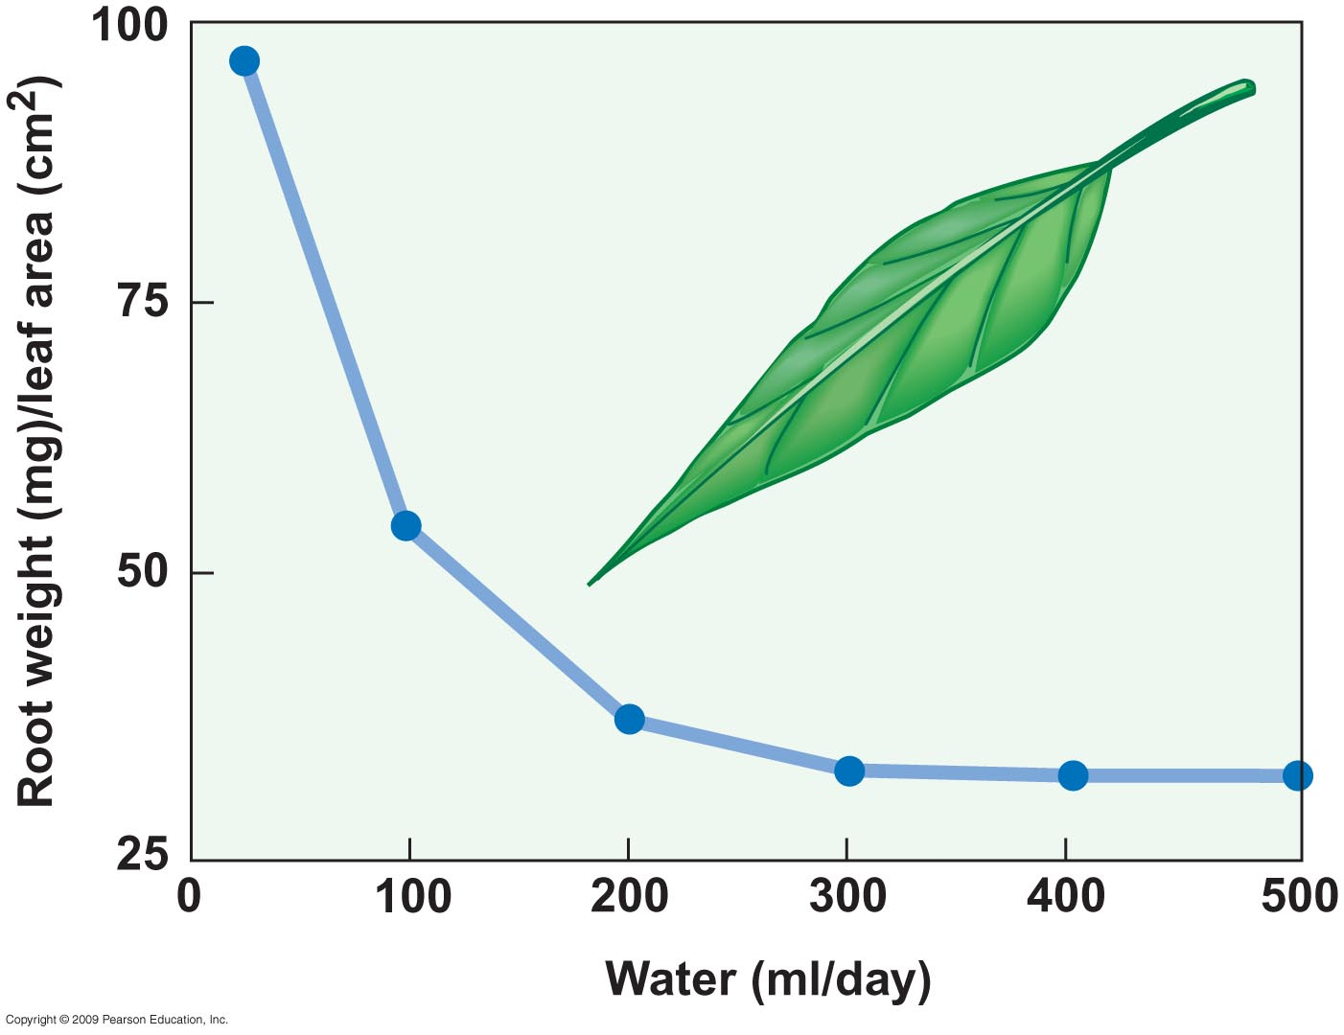
Notes:
Figure 6.18

Slide 29
Differences in plant morphology are most pronounced between species of plants adapted to wet (mesic) and dry (xeric) environments.

Slide 30
6.11 Plants Vary in Their Response to Environmental Temperatures
Species found in cooler environments typically have a lower T_{min}, T_{opt}, and T_{max} than species in warmer climates.
Related to the biochemical and physiological adaptations.
The differences in environmental temperature adaptations are most pronounced between C₃ and C₄ plants.

Slide 31
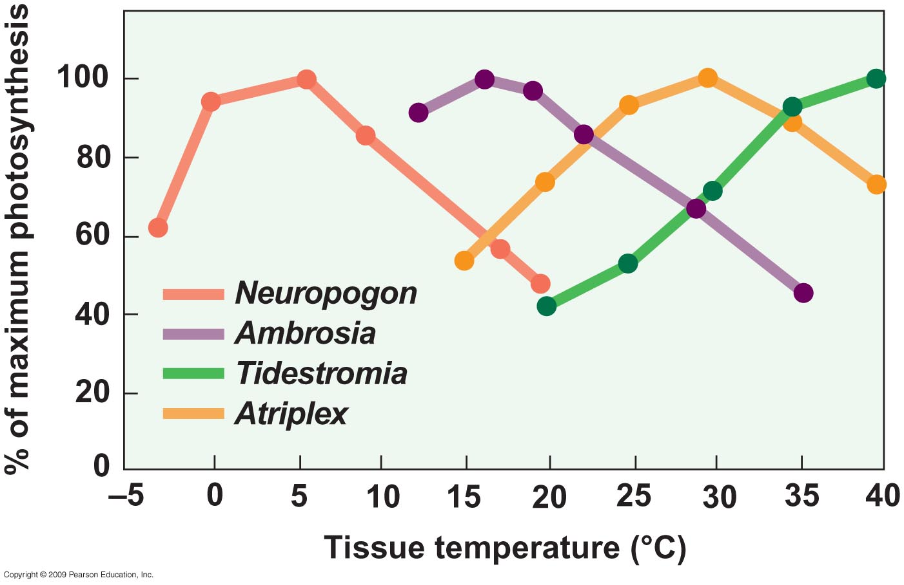
Arctic
Cool coastal
Evergreen desert
Desert perennial
Notes:
Figure 6.20

Slide 32
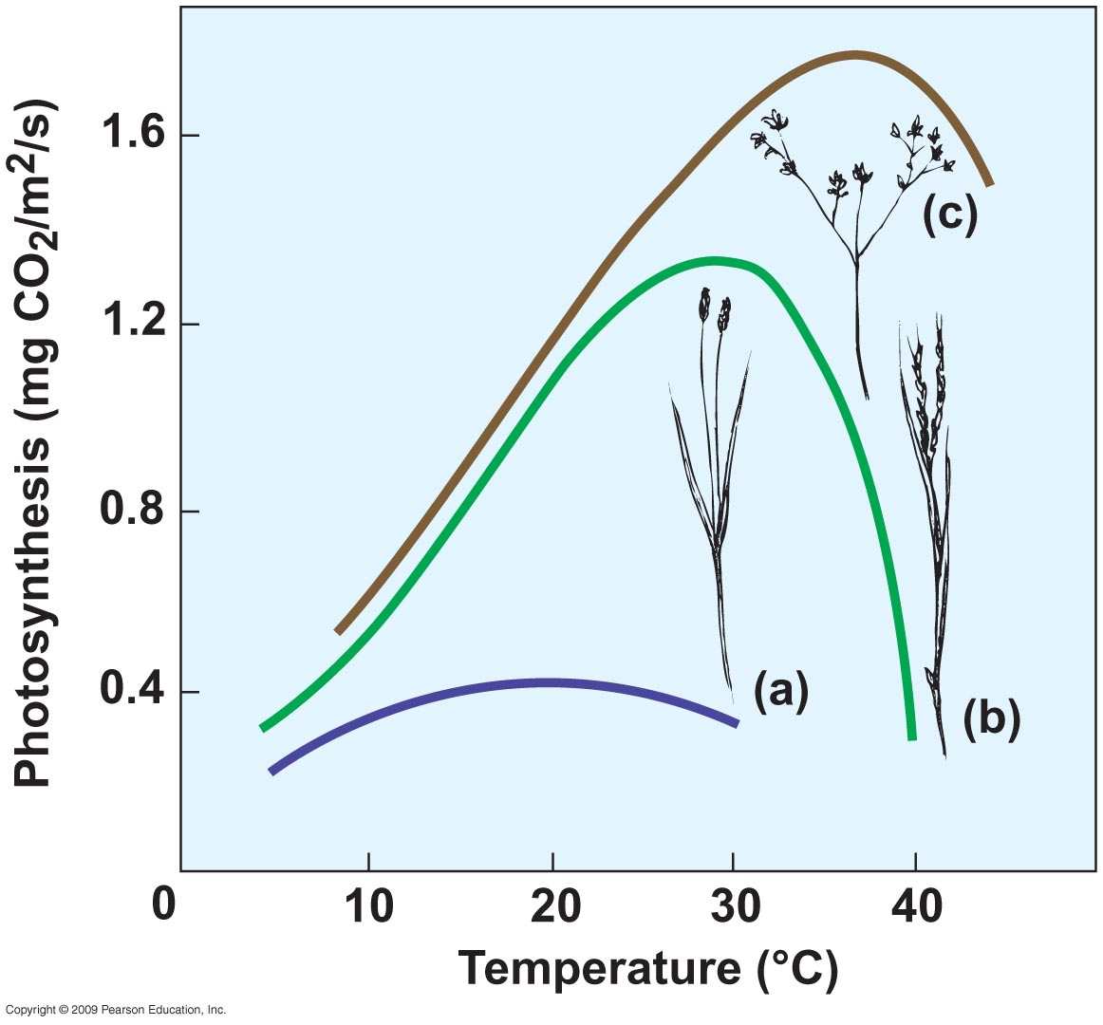
C4 desert
C4 temperate
C3
Notes:
Figure 6.21

Slide 33
Temperature responses are not fixed.
When individuals of the same species are grown under different thermal conditions, a divergence in temperature response of net photosynthesis is often observed:
The T_{opt} shifts in the direction of the thermal conditions under which the plant is grown.
A similar pattern is seen in individual plants in response to seasonal shifts in temperature (acclimation) [this is reversible].

Slide 34
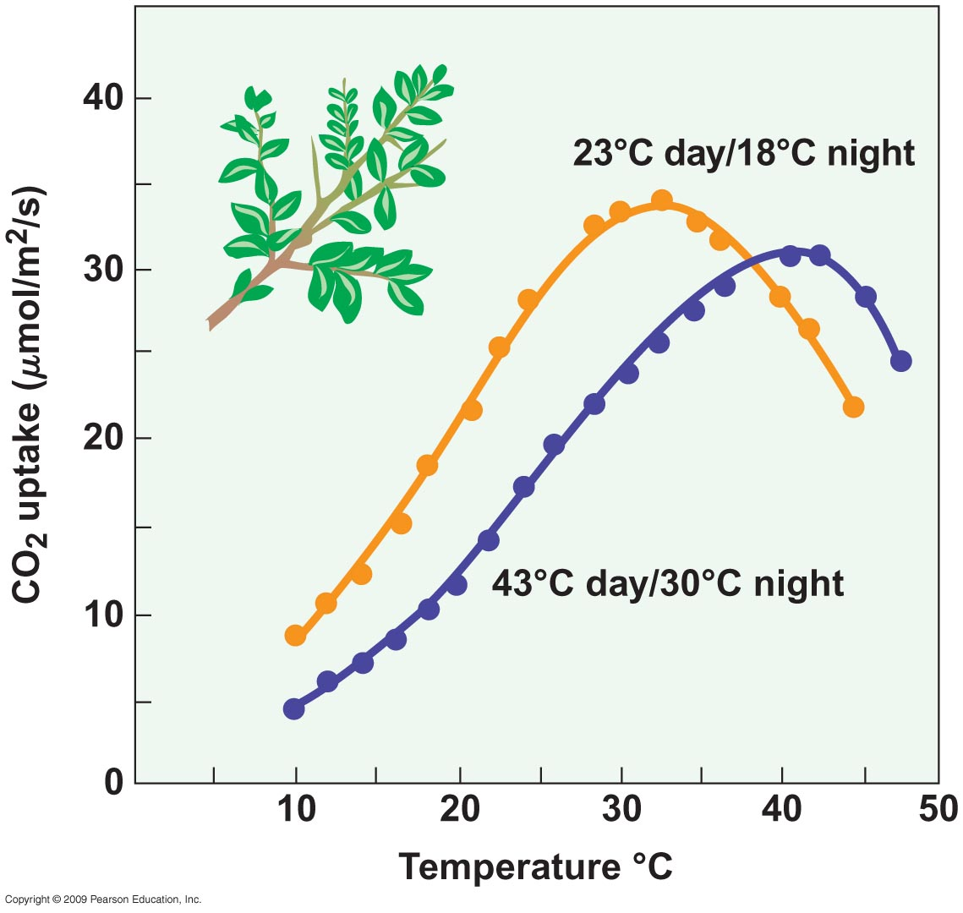
Atriplex plant
Notes:
Figure 6.22

Slide 35
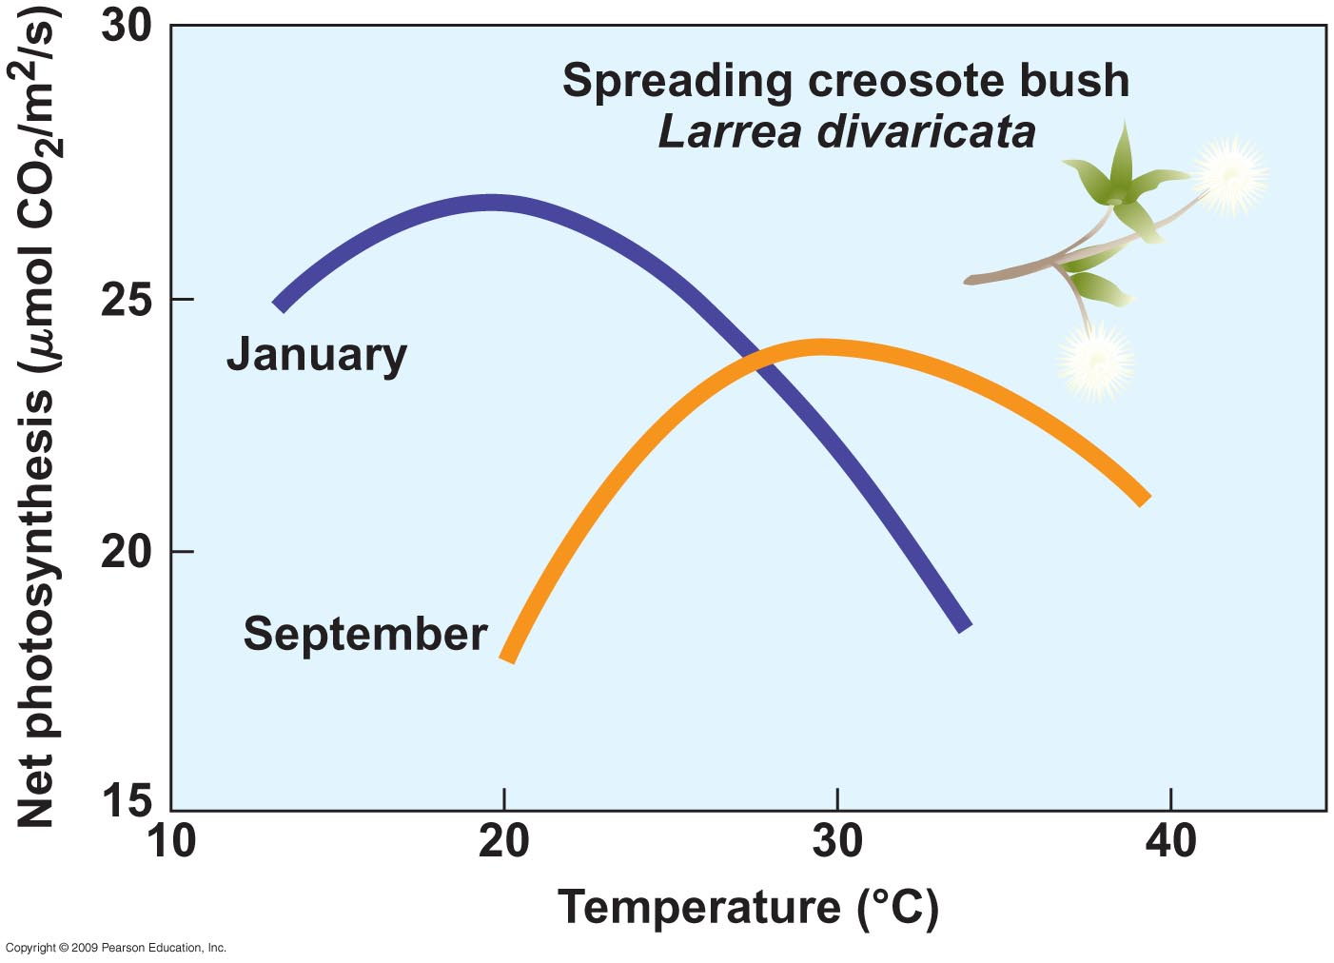
Notes:
Figure 6.23

Slide 36
Plants native to seasonally cold environments have evolved several adaptations for survival:
Frost hardening—the conversion of cold-sensitive cells into hardy ones.
Formation/addition of protective compounds—antifreeze
Winter deciduous.

Slide 37
6.12 Plants Exhibit Adaptations to Variations in Nutrient Availability
Plants require a variety of chemical elements (nutrients) to carry out metabolic processes.
The availability of nutrients has direct effects on plant survival, growth, and reproduction.
Macronutrients are those that are needed in large amounts. (C, H, O, N, Ca, P, Mg, S, K).
Micronutrients (trace elements) are needed in lesser, often minute quantities. (Cl, Fe, Mn, B, Cu, Mo, Zn, Ni).

Slide 38
Nitrogen plays a major role in photosynthesis as it is the major element found in both rubisco and chlorophyll.
The maximum (light saturated) rate of photosynthesis is correlated with the leaf nitrogen content.

Slide 39
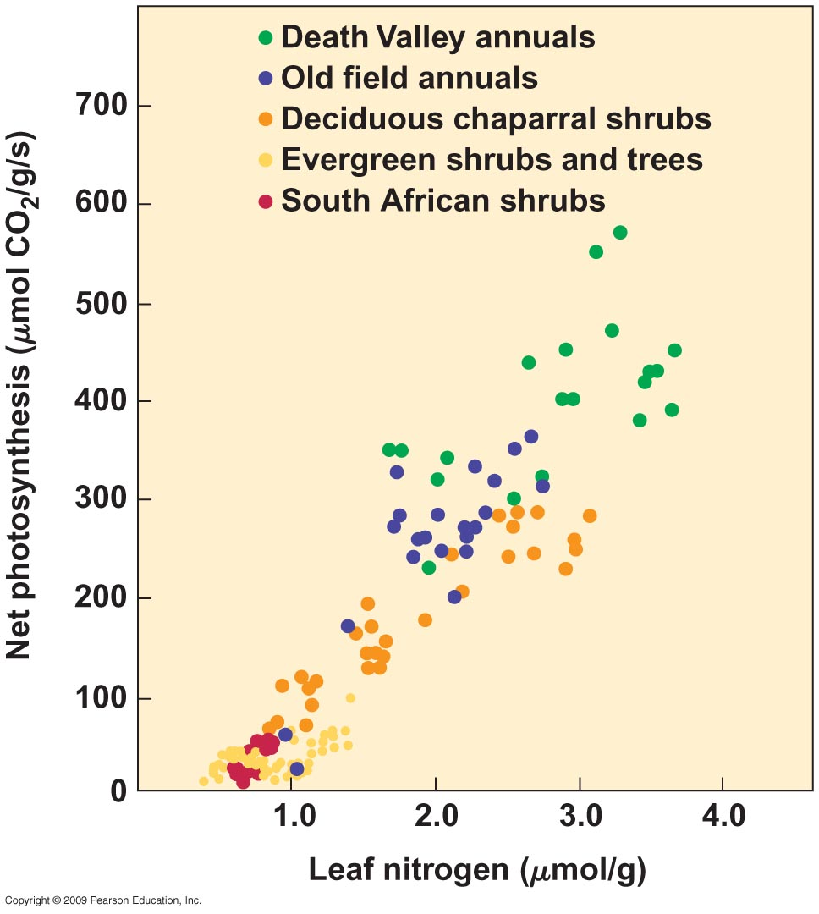
Notes:
Figure 6.24

Slide 40
Nutrient availability is directly related to geology, climate, and biological activity.
A plant’s growth rate influences its demand for a nutrient, and the plant’s uptake rate of the nutrient also influences growth.
Not all plants have the same maximum potential rate of growth.
Generally, there is a reduction in photosynthesis in plants characteristic of low-nutrient environments.

Slide 41
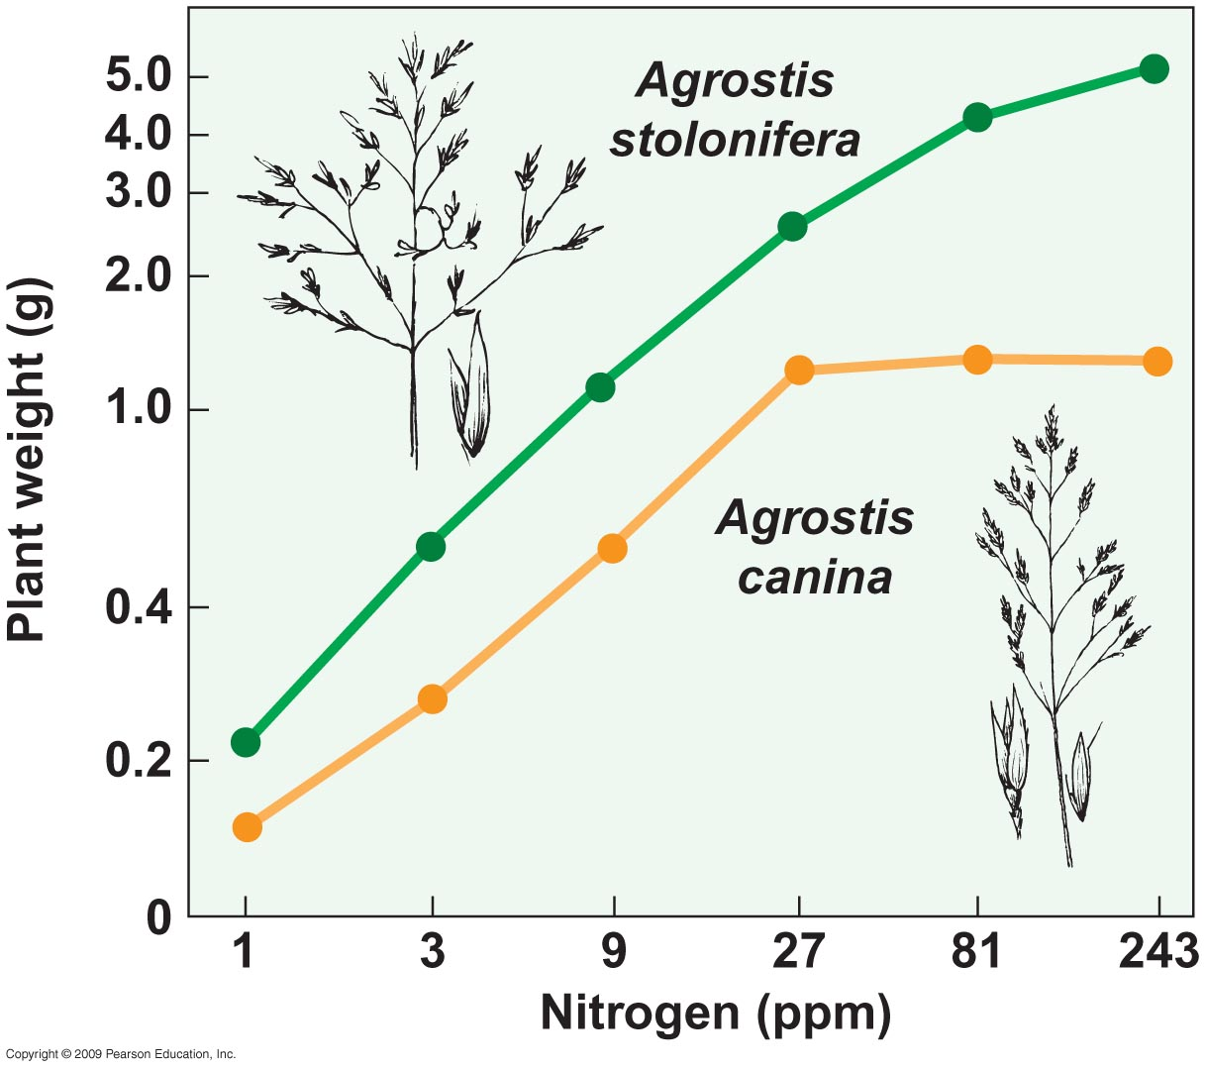
High nutrient ecosystem
Low nutrient ecosystem
Notes:
Figure 6.26

Slide 42
Hypothesized adaptations to low-nutrient environments:
Low maximum growth rate.
Leaf longevity.
Increased root production.
Become carnivorous.

Slide 43
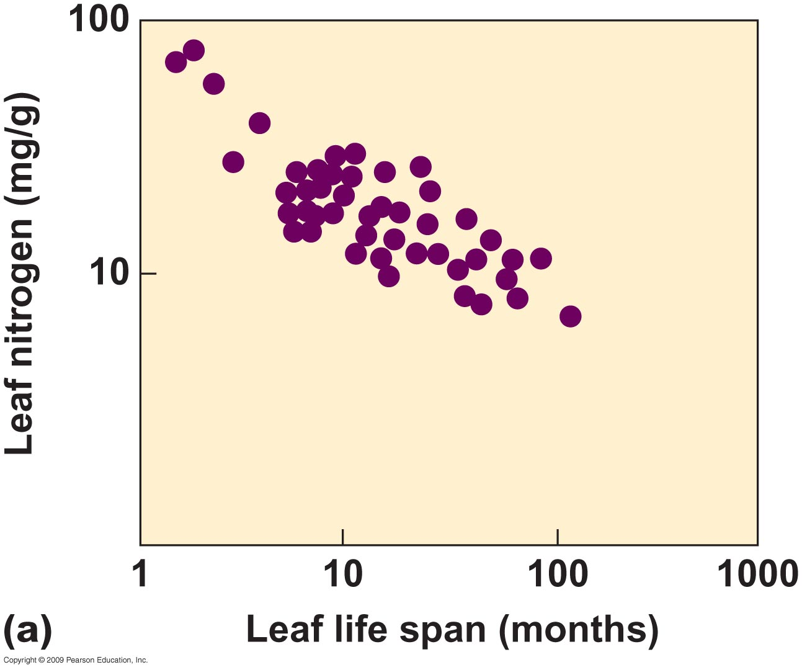
Notes:
Figure 6.27a

Slide 44
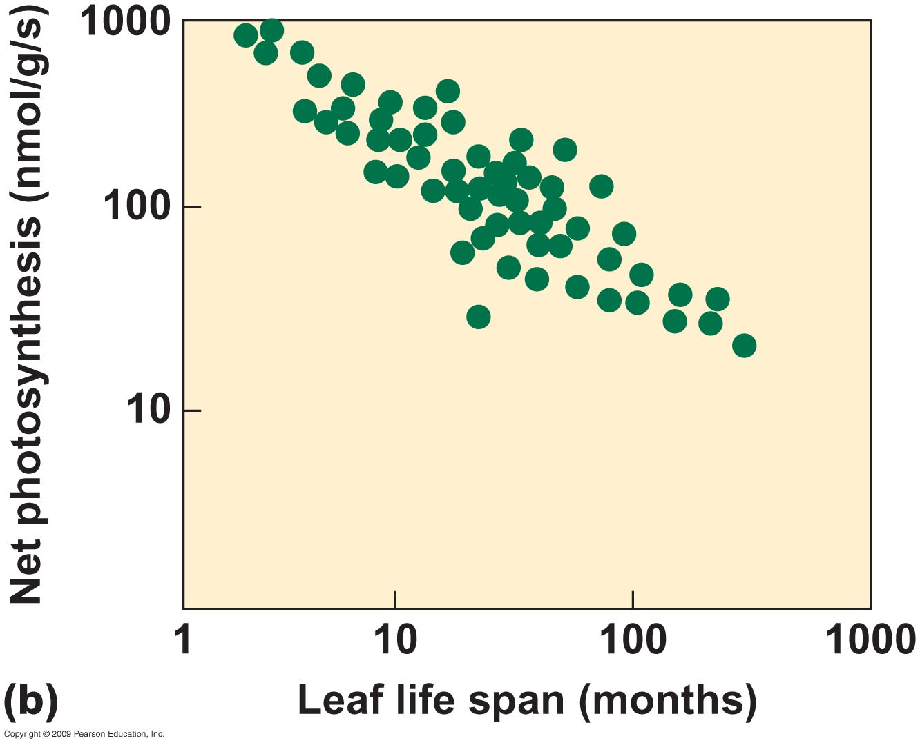
Notes:
Figure 6.27b

Slide 45
Halophytes are plants that take in water containing high levels of solutes.
For a halophyte to maintain a water potential gradient, they:
Accumulate high levels of ions within their cells (especially leaves).
Dilute solutes with stored water.
Secrete salt onto the leaf surface to be washed away by rainwater.
The degree of salt tolerance varies greatly in different halophytes.
End of chapter

