Slide 1
Chapter 7
Animal Adaptations to the Environment
Lecture prepared by
Aimee C. Wyrick

Slide 2
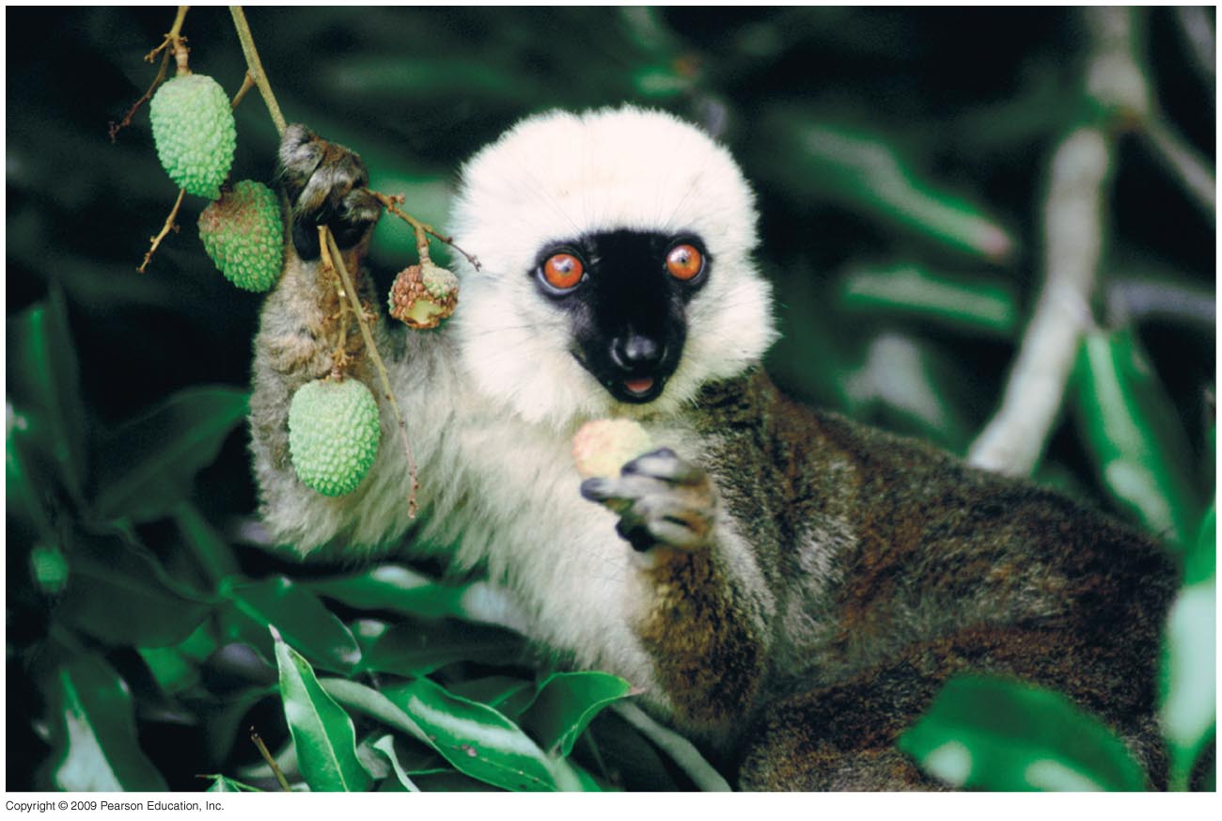

Slide 3
Chapter 7 Animal Adaptations to the Environment
Animals are heterotrophs and derive their energy and most nutrients from consuming organic compounds contained in other plants and animals
Key processes common to all animals:
Acquire and digest food
Absorb oxygen
Maintain body temperature and water balance
Adapt to light and temperature variations
Animals encounter different constraints in aquatic versus terrestrial environments

Slide 4
7.1 Size Imposes a Fundamental Constraint on the Evolution of Organisms
Animals range in body size (2 µg to 100,000 kg)
Morphological and physiological features change as a function of body size, a process known as scaling.
Size has consequences for structure and functional relationships in animals

Slide 5
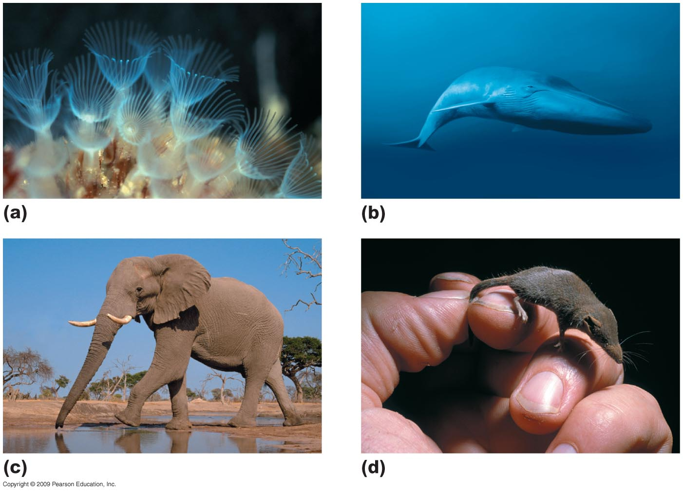
Notes:
Figure 7.1

Slide 6
Smaller bodies have a larger surface area relative to their volume (SA/V) than larger objects (of the same shape)
SA/V sets a basic constraint on animal evolution
Every animal cell is dependent on oxygen—the rate of oxygen delivery is determined by the diffusion gradient and the distance diffused

Slide 7
As the size of an organism increases, the surface area decreases relative to interior body volume
This constraint may be overcome by a body plan that somehow can increase surface area in another way:
Change shape to increase external surface area
Actively transport oxygen into the interior of the body and increase internal surface area
Lungs
Circulatory system

Slide 8
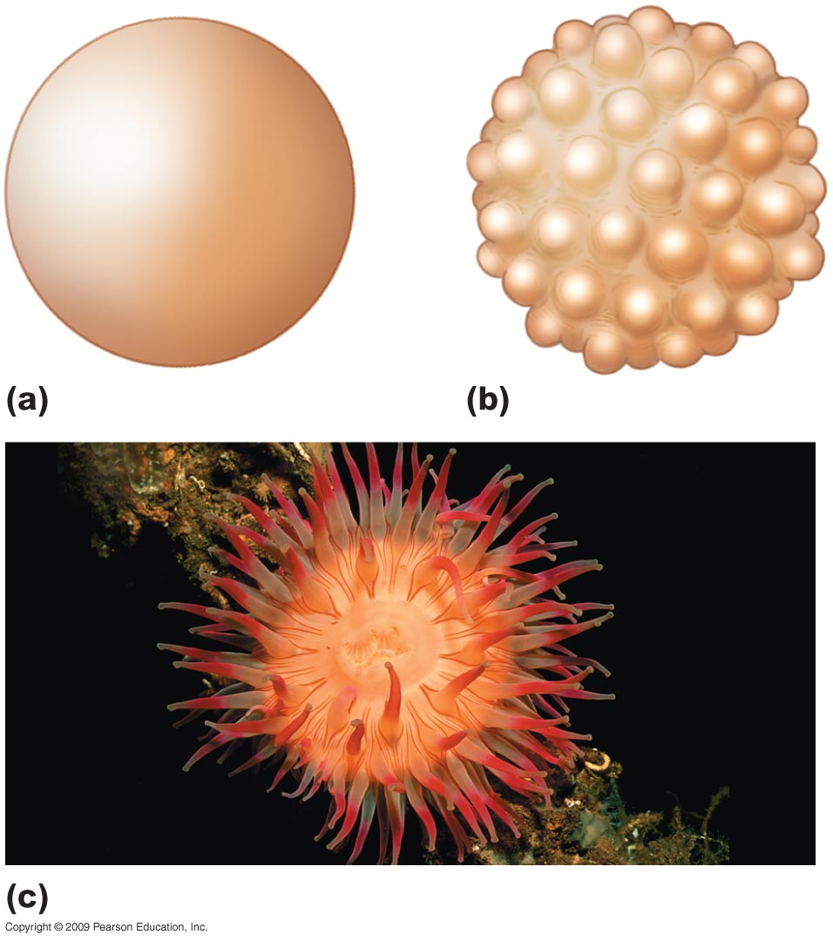
Same size
higher surface area
Notes:
Figure 7.3

Slide 9
7.2 Animals Have Various Ways of Acquiring Energy and Nutrients
Herbivores feed exclusively on plant tissues
Carnivores feed exclusively on the tissues of other animals
Omnivores feed on both plant and animal tissues
Detritivores are those that feed on detritus (dead plant and animal matter)

Slide 10
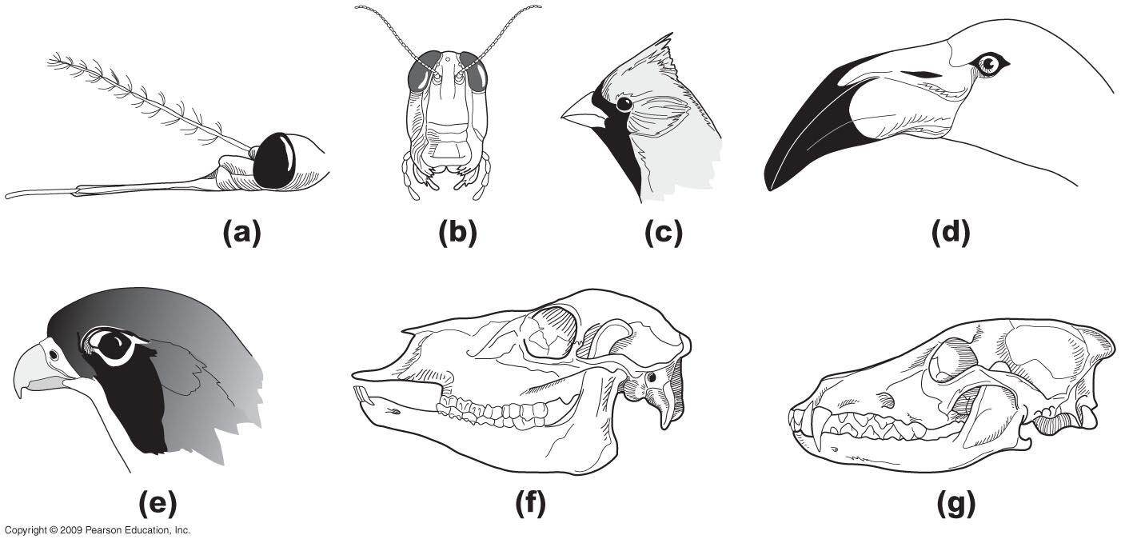
Notes:
Figure 7.5

Slide 11
7.3 Animals Have Various Nutritional Needs
Animals require a variety of mineral elements and amino acids:
Essential amino acids must be supplied by the diet; the animal cannot synthesize these.
Nutritional needs vary little among vertebrates and invertebrates.

Slide 12
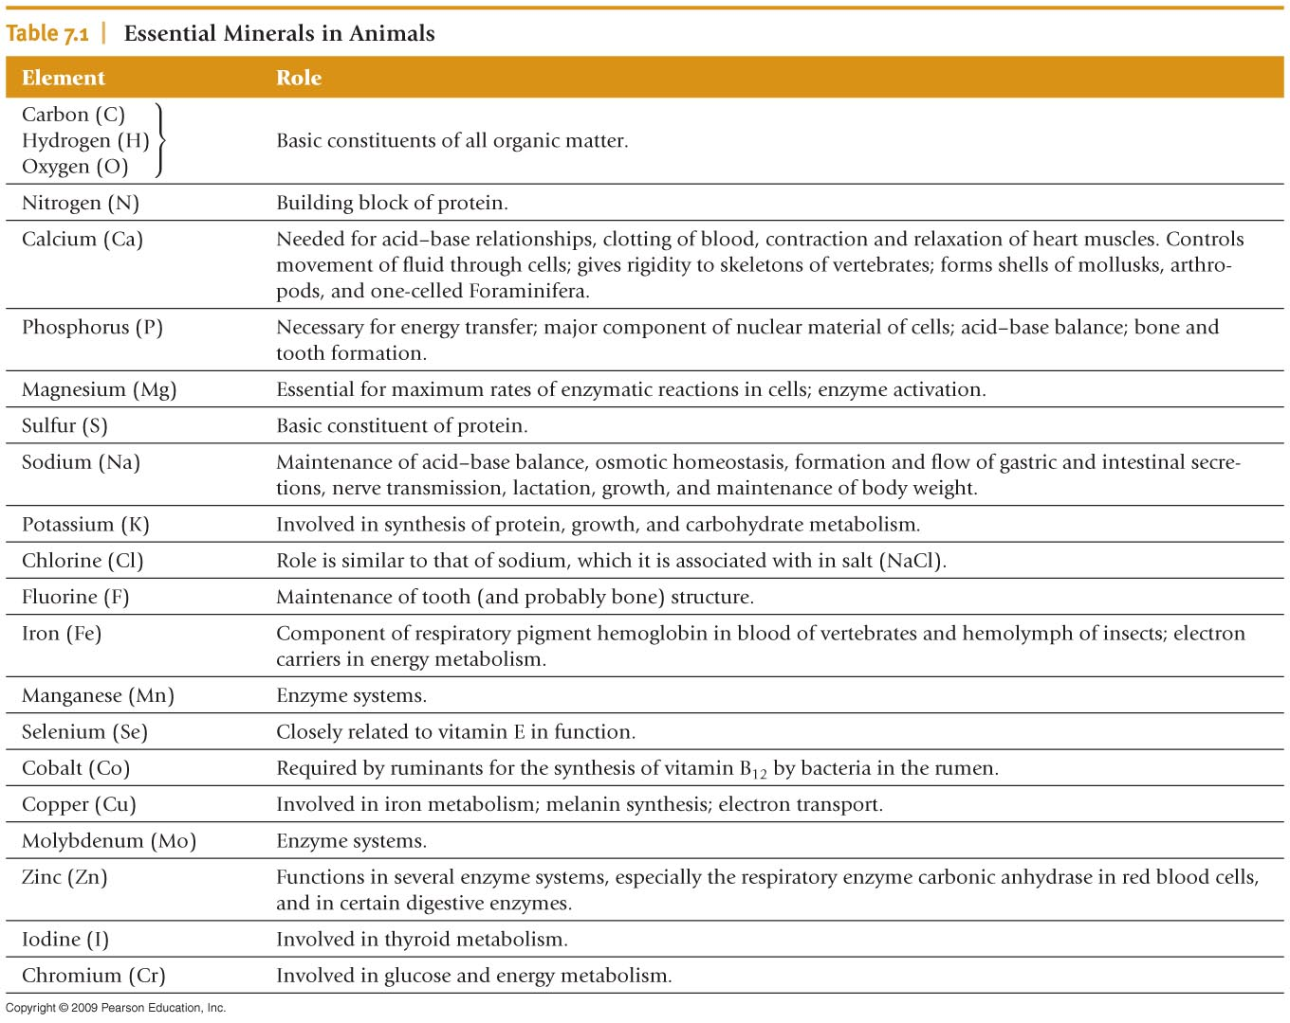
Notes:
Table 7.1

Slide 13
The ultimate source of most nutrients needed by animals is plants
Plant quantity and quality affect herbivorous consumers:
Highest-quality plant food is high in nitrogen (protein)—growing tips, new leaves and buds
Herbivores show some preference for the most nitrogen-rich plants.
For carnivores, quantity is more important than quantity

Slide 14
7.7 Animals Exchange Energy with Their Surrounding Environment
Body structure influences the exchange of heat between animals and external environment
Body surface (boundary surface) temperature differs from both the air (or water) and core body temperatures
This layer of insulation (boundary surface) influences the ability to conduct or transmit heat (conductivity)

Slide 15
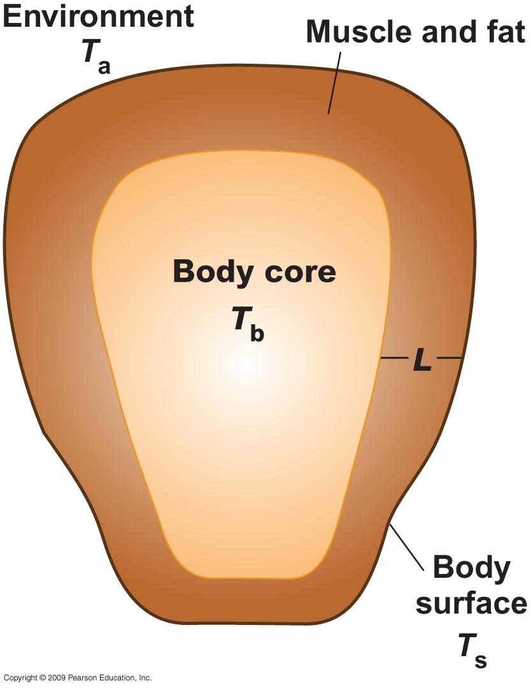
Notes:
Figure 7.10

Slide 16
An animal must balance heat gain and loss to maintain its core body temperature:
The core exchanges heat with the surface area by conduction
Influenced by thickness/conductivity of fat, movement of blood to surface
The surface layer exchanges heat with the environment via convection, conduction, radiation, and evaporation

Slide 17
7.8 Animals Fall into Three Groups Relative to Temperature Regulation
In endothermy, animals generate heat metabolically, and this results in the maintenance of a fairly constant internal temperature independent of external temperatures (homeothermy).
Examples: Birds and mammals.
In ectothermy, animals acquire heat primarily from the external environment (poikilothermy)
Fish, amphibians, reptiles, insects, and other invertebrates.
Heterotherms are animals that regulate body temperature by both endothermy and ectothermy
Bats, bees, and hummingbirds

Slide 18
7.9 Poikilotherms Depend on Environmental Temperatures
Environmental sources of heat control the rates of metabolism and activity among most poikilotherms
For every 10°C rise in temperature, the rate of metabolism in poikilotherms approximately doubles

Slide 19
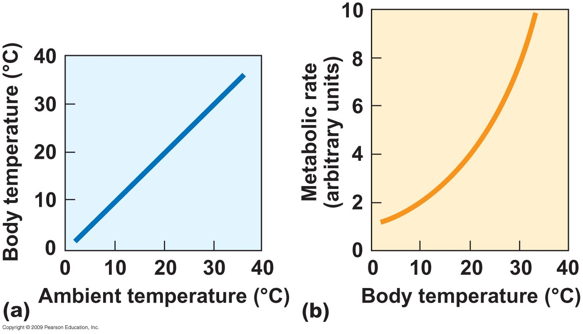
Notes:
Figure 7.11

Slide 20
Poikilotherms have an upper and lower thermal limit that they can tolerate:
Can maintain a relatively constant daytime body temperature by behavioral means.
The operative temperature range is that at which poikilotherms carry out their daily activities.
Poikilotherms have a low metabolic rate and a high ability to exchange heat between body and environment

Slide 21
Terrestrial and amphibious poikilotherms rely on behavioral thermoregulation and seek out appropriate microclimates
Cooling in the shade
Basking in the sun
Seeking a warmer or cooler substrate

Slide 22
7.10 Homeotherms Escape the Thermal Restraints of the Environment
Homeotherms maintain body temperature by oxidizing glucose in cellular respiration.
Oxidation is not completely efficient and some energy is lost as heat
Homeothermic respiration rate is proportional to body mass.

Slide 23
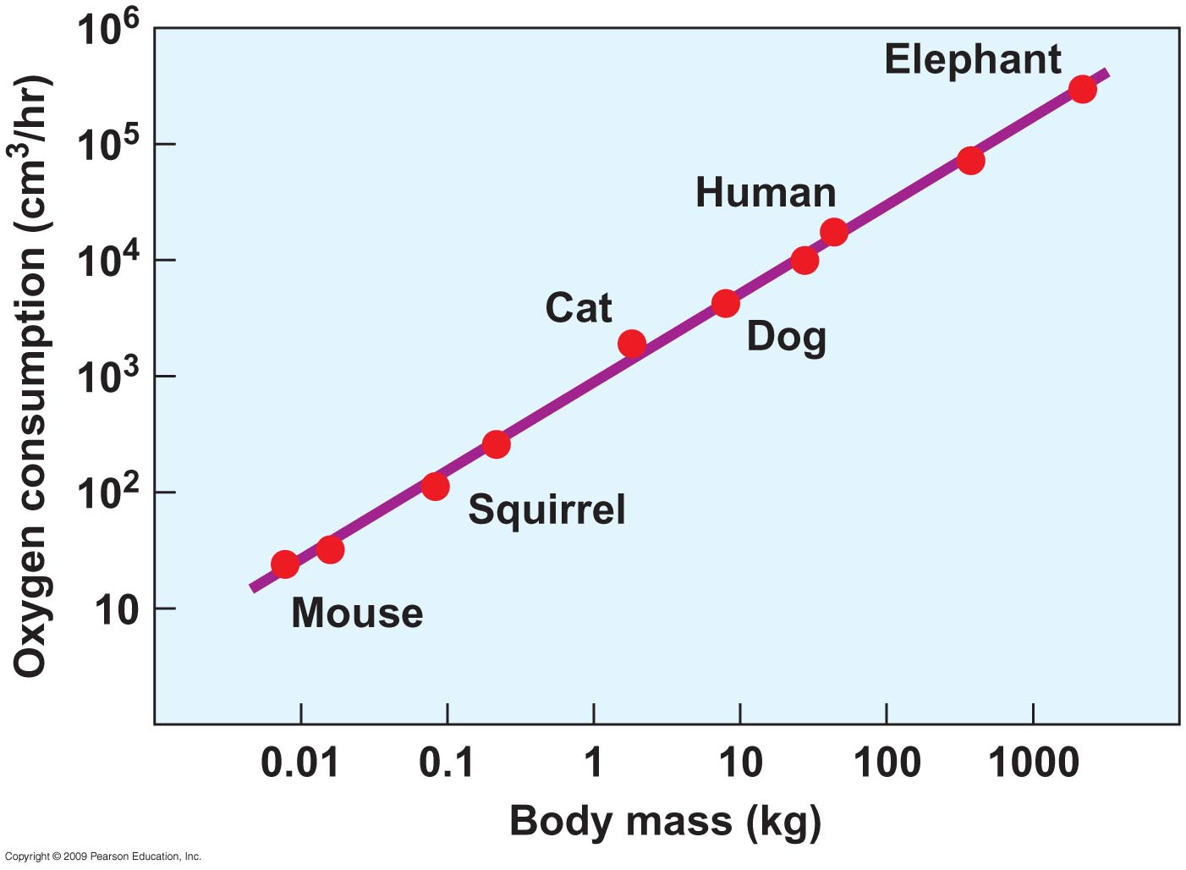
Notes:
Figure 7.14

Slide 24
Homeotherms maintain a high level of energy through aerobic respiration:
They can sustain high levels of physical activity for long periods.
Homeotherms regulate exchange between the body and environment by insulation
Fur: barrier to heat flow, insulation value varies with thickness
Fur thickness changes with the seasons
Feathers
Body fat

Slide 25
Insulation can also keep heat out:
Reflection of solar radiation
Fur coat that heat cannot penetrate (example: camel)
Some insects have a dense, fur-like coat over the thoracic region (where flight muscles are located).
Homeotherms regulate exchange between the body and environment by shivering.
Shivering: is involuntary muscular activity that increases heat production.
Brown fat oxidation (prevalent in hibernators).

Slide 26
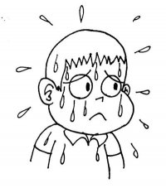
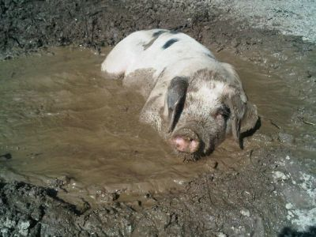
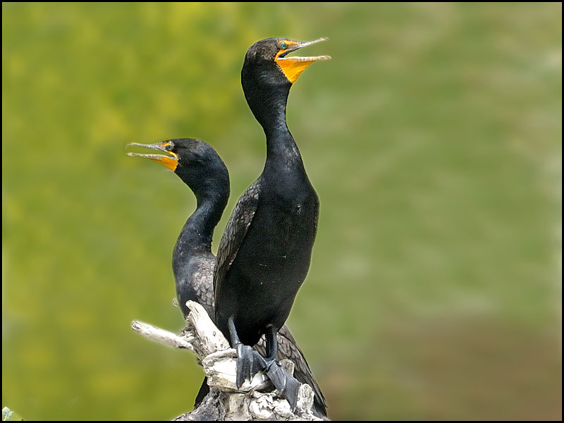
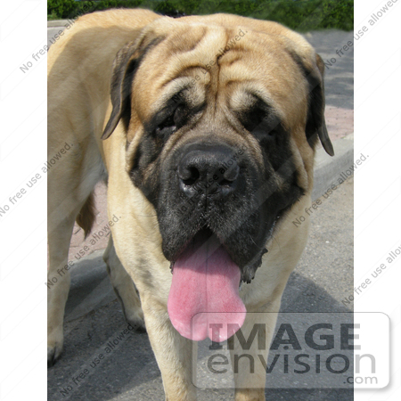
Homeotherms regulate exchange between the body and environment by evaporative cooling:
Sweating
Panting and gular fluttering
Wallow in water and wet mud

Slide 27
7.11 Endothermy and Ectothermy Involve Trade-offs (مقايضات)
Endothermy:
Animals can remain active regardless of environmental temperatures (Advantage)
Animals must consume a lot of food to meet the energy demands of endothermy → a minor amount of energy goes to growth (Disadvantage)
Ectothermy:
Animals can allocate more of their energy to biomass production (Advantage)
Animals require fewer calories per gram of body weight and so can colonize areas of limited food and water (Advantage)
Animals cannot be active under all environmental conditions (disadvantage).

Slide 28
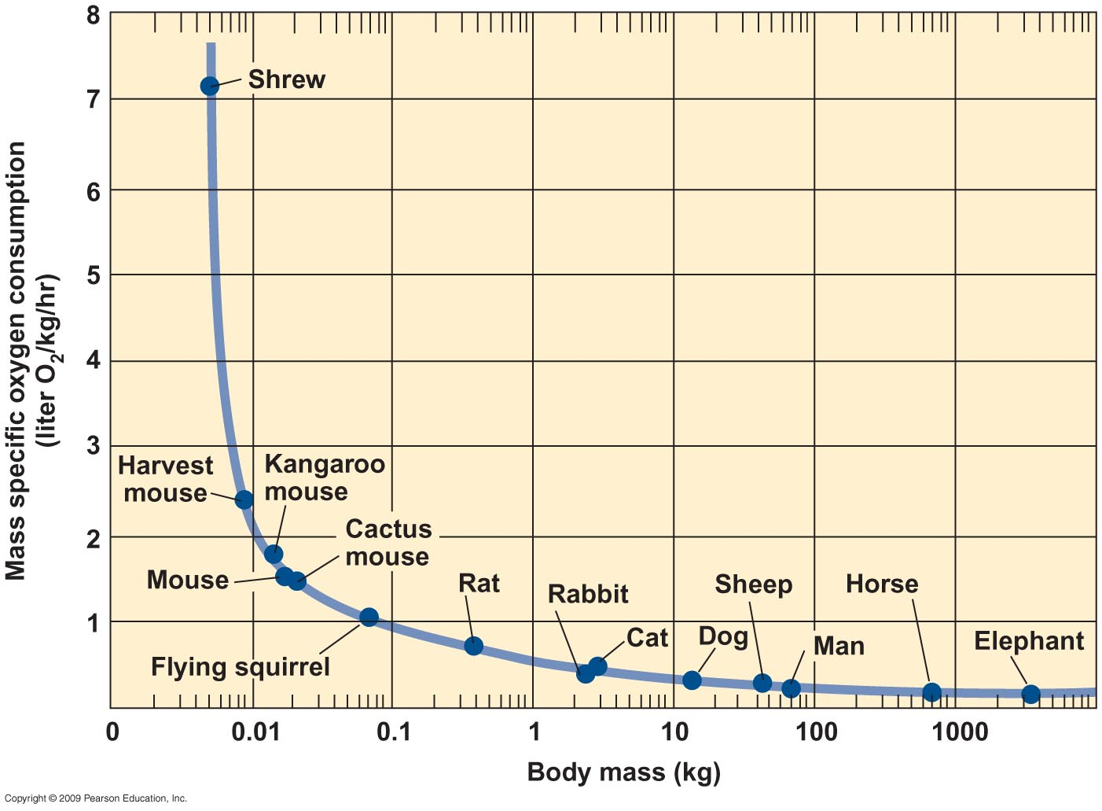
Notes:
Figure 7.16

Slide 29
7.12 Heterotherms Take On Characteristics of Ectotherms and Endotherms
Temporal heterotherms: are those that sometimes regulate their body temperature.
Many species of insect are heterothermic in the adult stage:
Pre-flight warm up of flight muscles → wing beating: moths, butterflies).
Orientation of wings to the sun (butterflies, dragonflies).

Slide 30
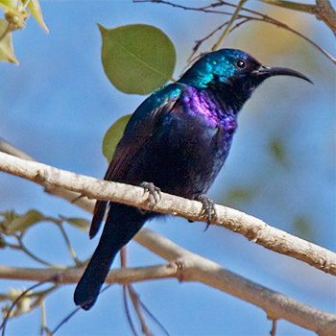
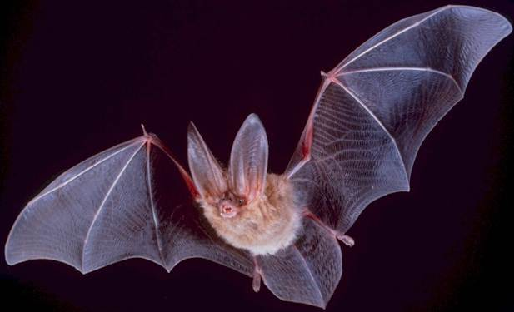
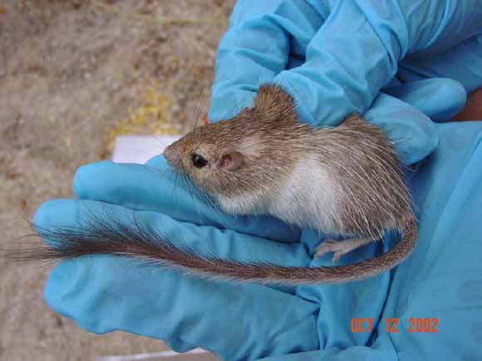
7.13 Torpor Helps Some Animals Conserve Energy
Daily torpor (سبات) is the dropping of body temperature to approximately ambient temperature for a part of each day, regardless of the season:
Temperature drops near to ambient.
Hummingbirds, bats, pocket mice, kangaroo mice … etc.

Slide 31
Hibernation (سبات فصلي) is a long, seasonal torpor characterized by cessation of activity:
Common in terrestrial poikilotherms.
And some heterothermic mammals.
Heart rate, respiration, and total metabolism fall, body temperature sinks below 10°C.

Slide 32
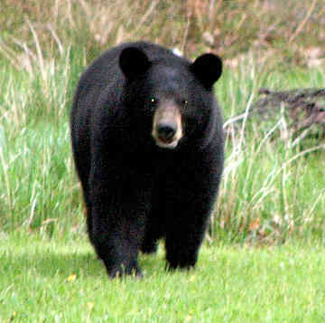
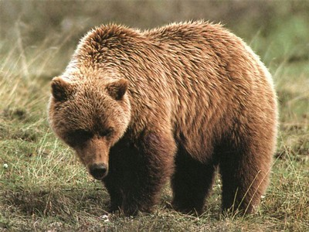
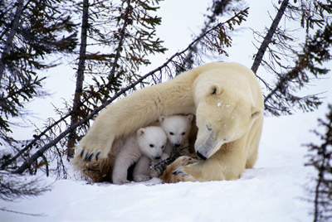
Black bears, grizzly bears, and female polar bears do not hibernate:
A unique winter sleep from which they easily rouse!
Body temperature is only a few degrees below normal
These mammals do not eat, drink, urinate, or defecate.
Females give birth to and nurse young during their sleep.

Slide 33
7.14 Some Animals Use Unique Physiological Means for Thermal Balance
Supercooling of body fluids takes place when the body temperature falls below the freezing point without actually freezing
The presence of solutes (e.g., glycerol) in body fluids functions to lower the freezing point of water.
Characteristic of arctic marine fish, some insects, reptiles, and amphibians.

Slide 34
Countercurrent heat exchange can conserve heat in a cold environment or can cool vital parts of the body under heat stress.

Slide 35
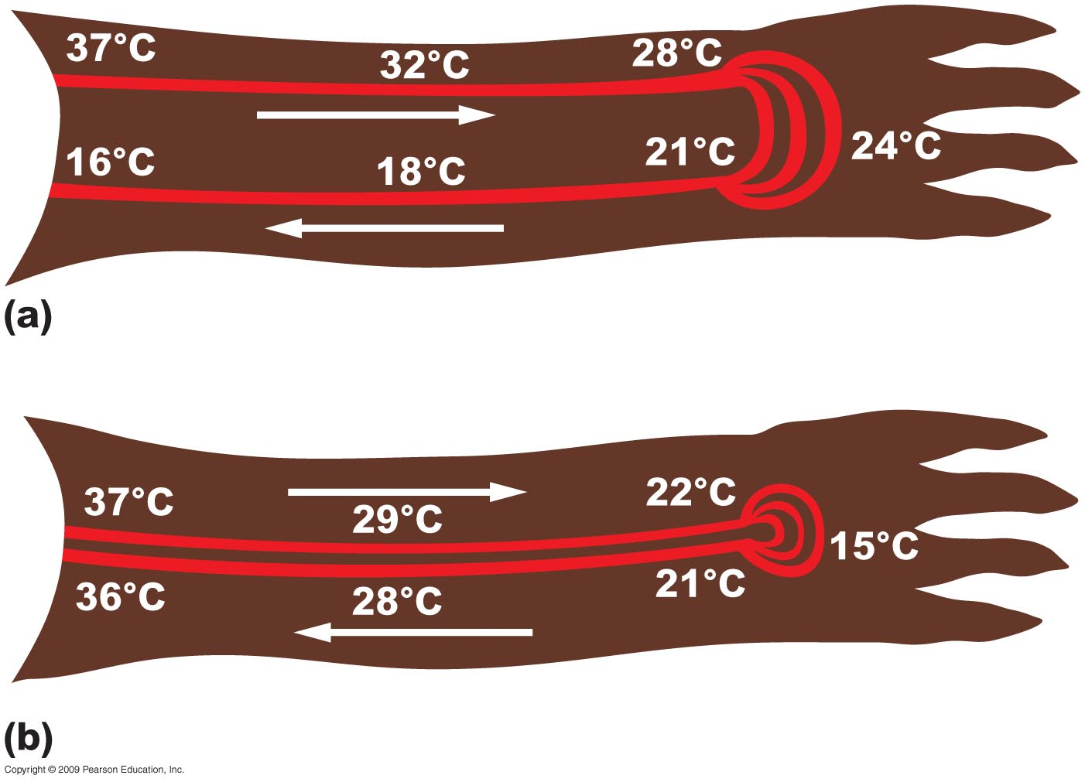
No countercurrent heat exchange
Countercurrent heat exchange
Notes:
Figure 7.17

Slide 36
7.18 Daily and Seasonal Light and Dark Cycles Influence Animal Activity
Biological clocks are the internal mechanisms in organisms that control the periodicity of functions and activities.
Biological processes fluctuate in cycles:
A daily rhythm is a biological process that cycles in 24-hour intervals.
A circadian rhythm is a daily rhythm (cycle) that results from a physiological response to the diurnal environment.
Example: melatonin secretion.

Slide 37
Adaptive value of biological clocks (Advantages):
Time-dependent mechanism that allows an organism to prepare for periodic changes in the environment
Predators can match their feeding activity to the activity rhythm of their prey
Allows for orientation based on the Sun’s position (in birds, reptiles and insects)

Slide 38
7.19 Critical Day Lengths Trigger Seasonal Responses
Critical day length signals certain animal responses (e.g., reproduction)
Usually between 10 and 14 hours
Day neutral organisms are not controlled by day length but by something else.
Short-day organisms are those whose response is stimulated by day lengths shorter than their critical day length.
Long-day organisms are those whose response is stimulated by day lengths longer than their critical day length.

Slide 39
Circannual rhythms are those activities of animals that reflect the seasonal response to changing day length:
Reproductive cycle of white-tailed deer : starts in autumn so that the young are born in spring when food is available.

