Slide 1
Problems Ch 8
Quantum Mechanics in 3D

Slide 2
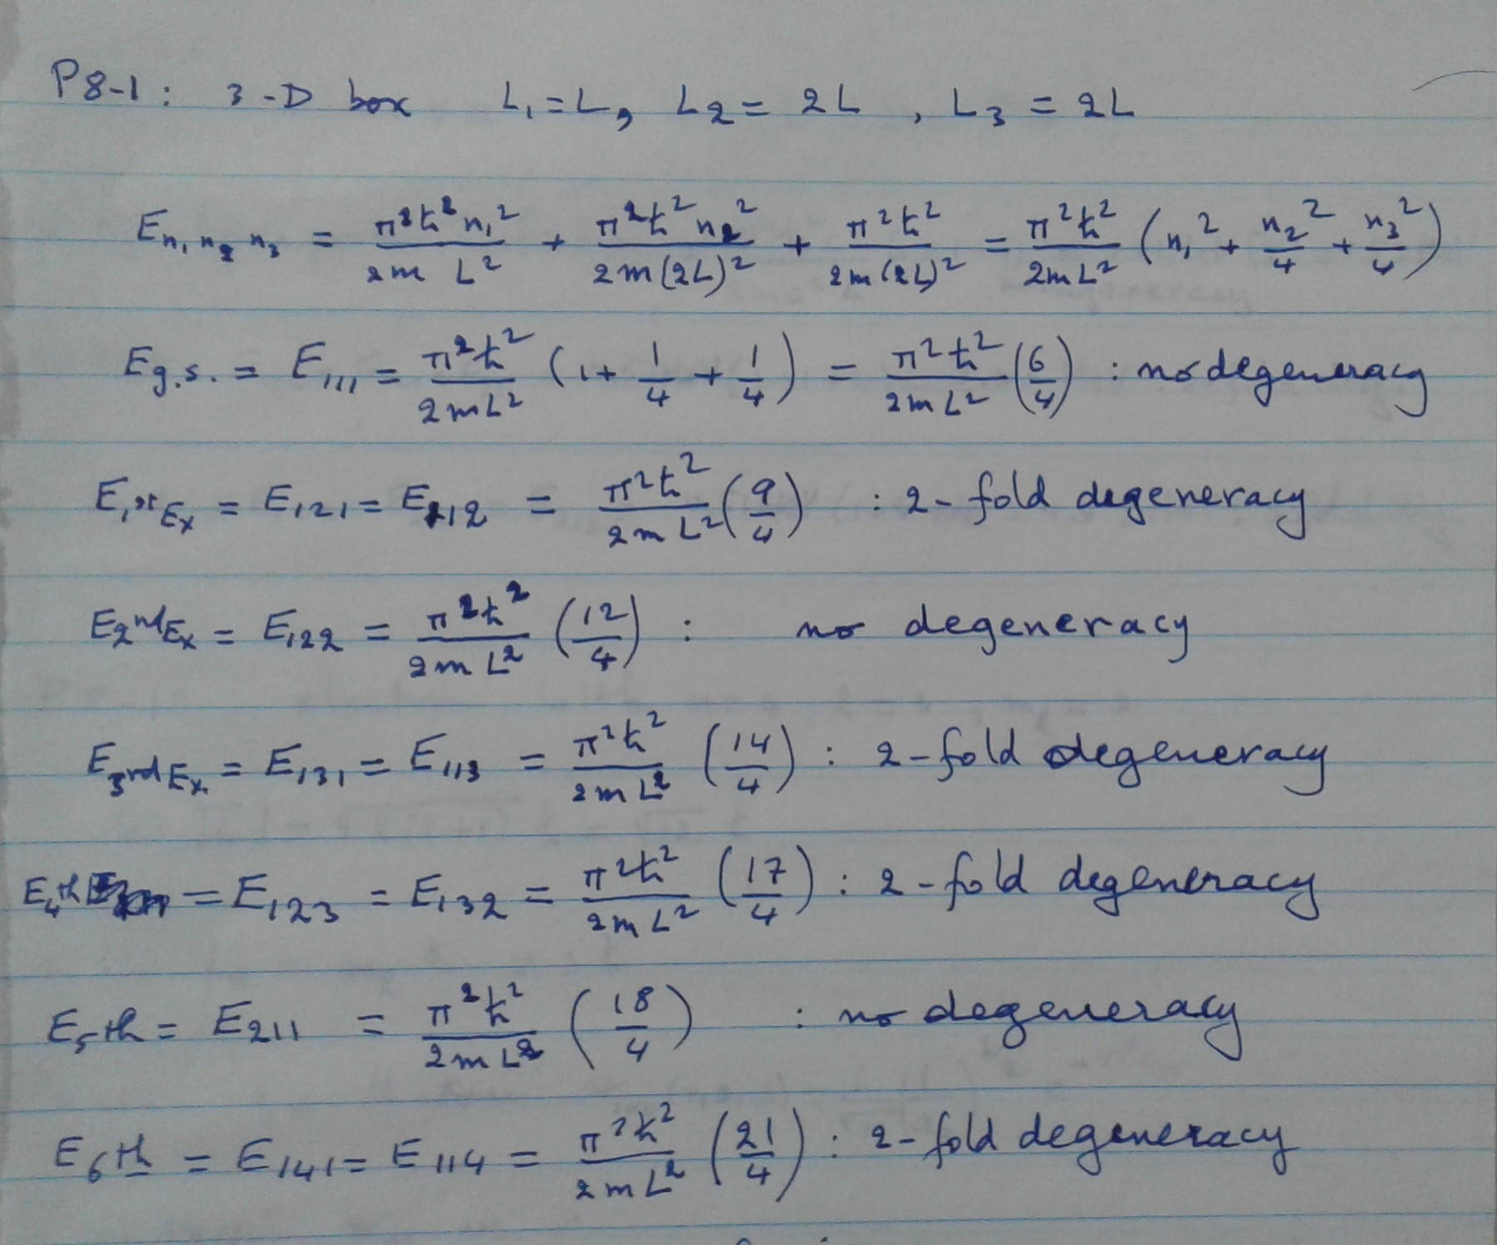
3-D box with unequal sides

Slide 3
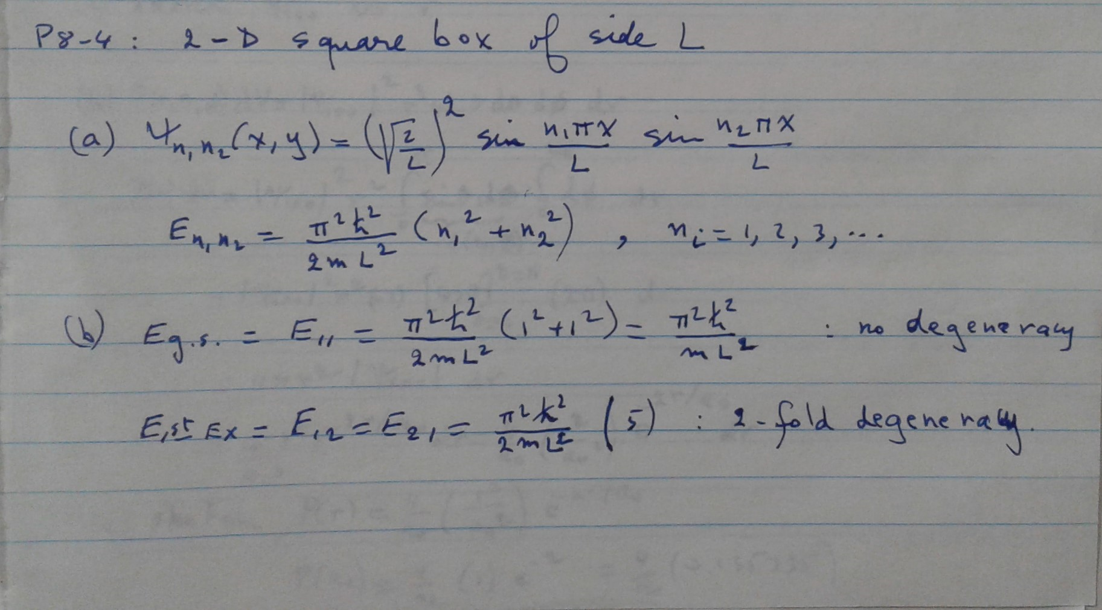
2-D square box

Slide 4
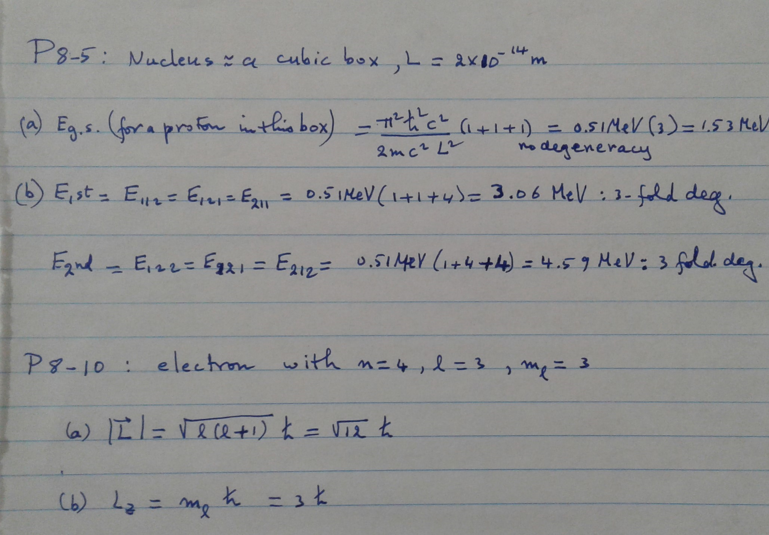
The nucleus modeled as a cubic box
Proton energy: a few MeV

Slide 5
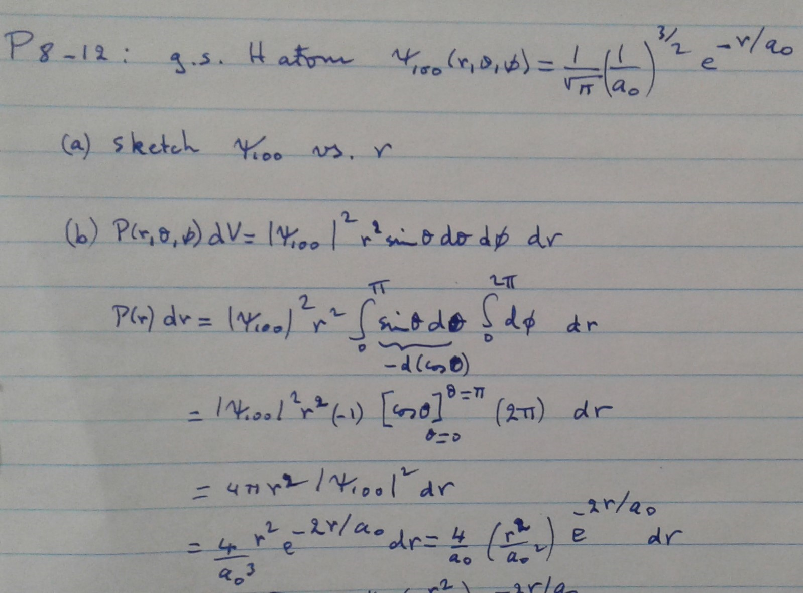
P8-12: Ground State of H atom

Slide 6
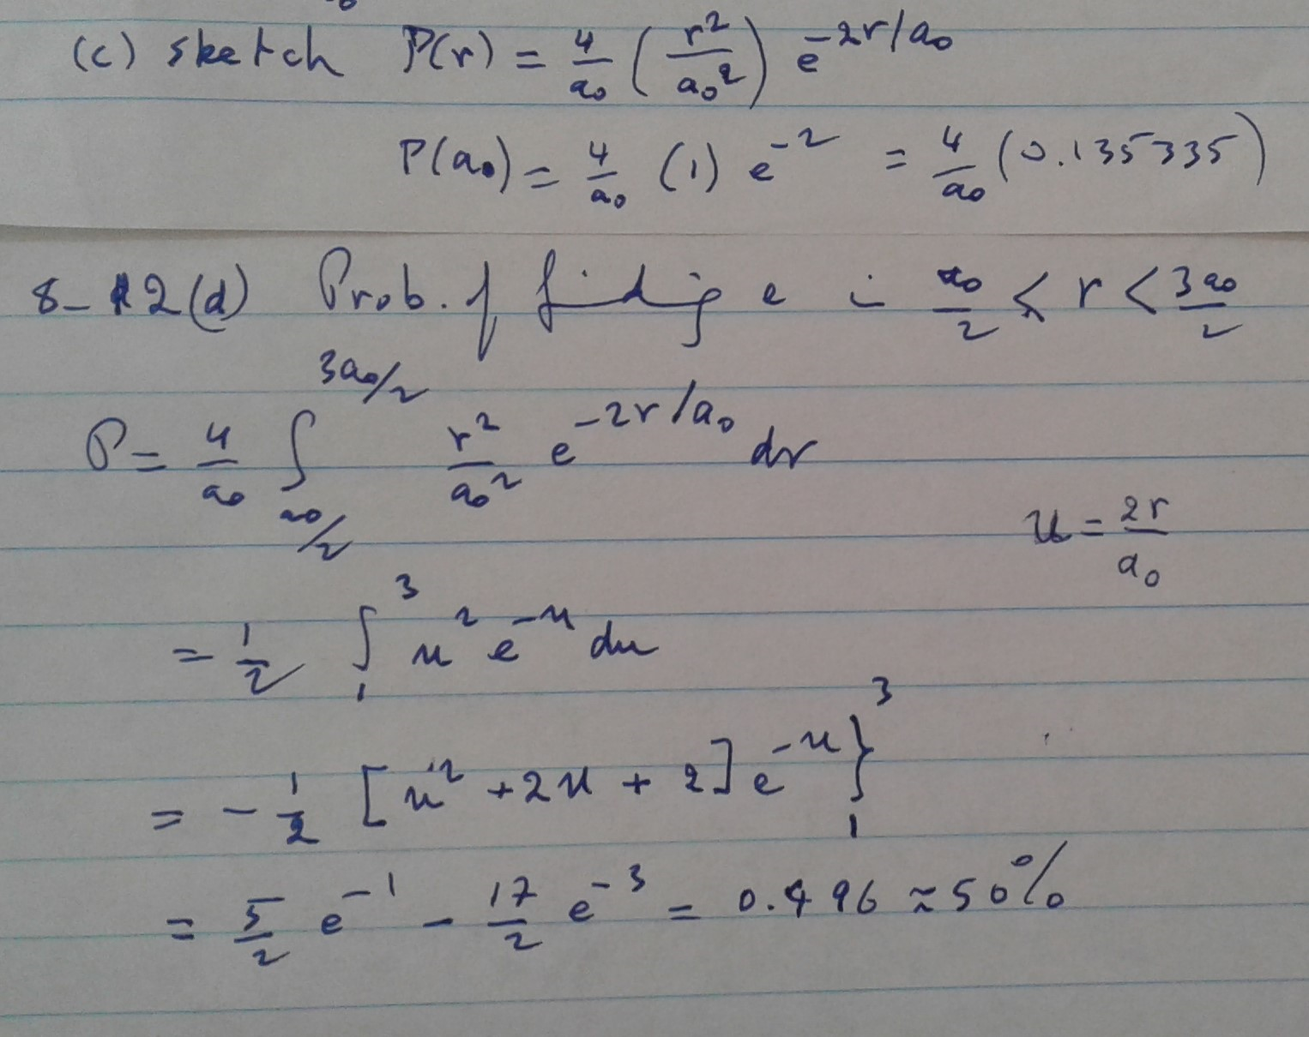
P8-12 continued
0.9 | 0.133892
1 | 0.135335
1.1 | 0.134072

Slide 7
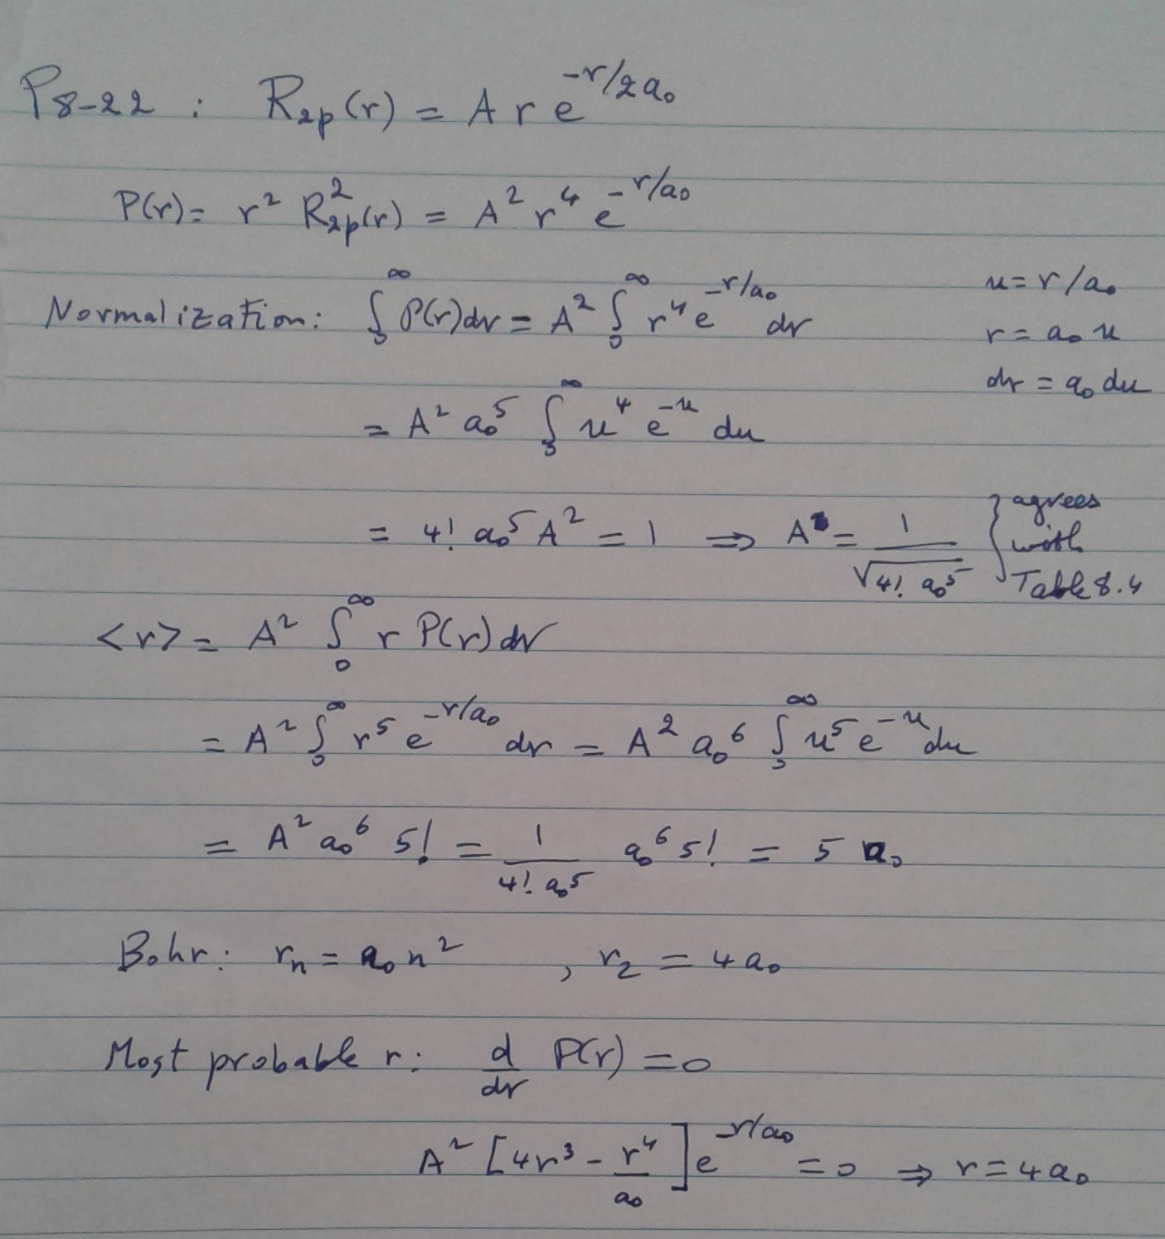
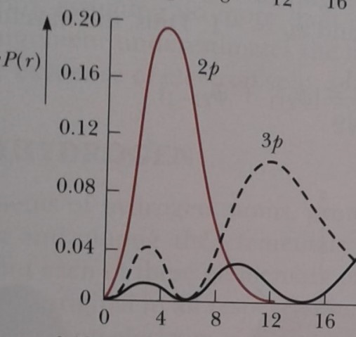
P8-22

Slide 8
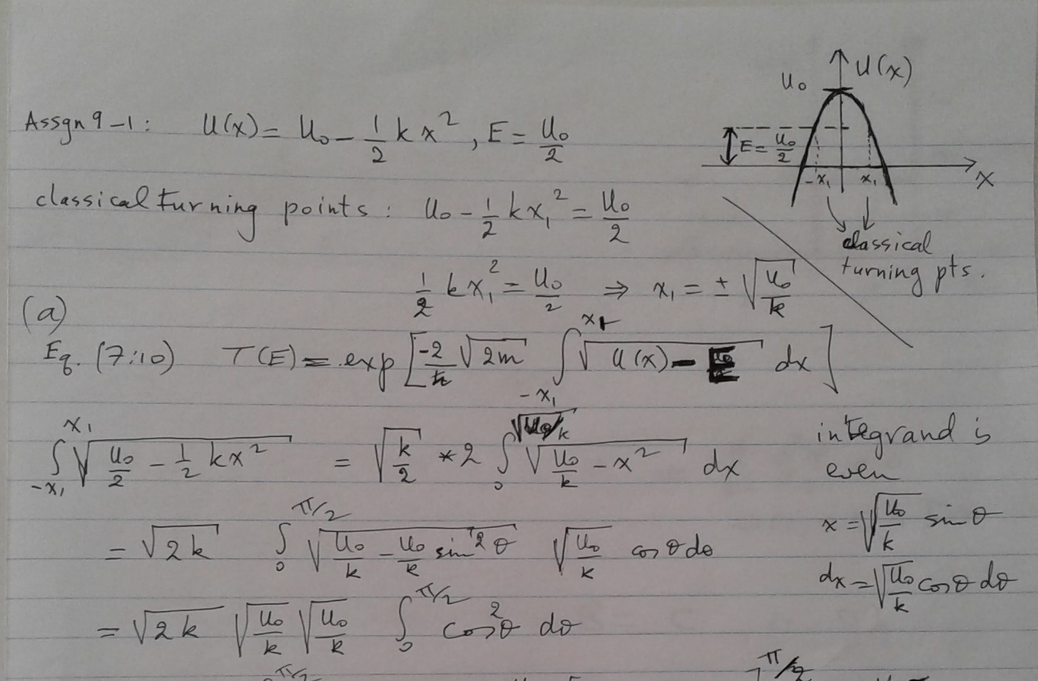
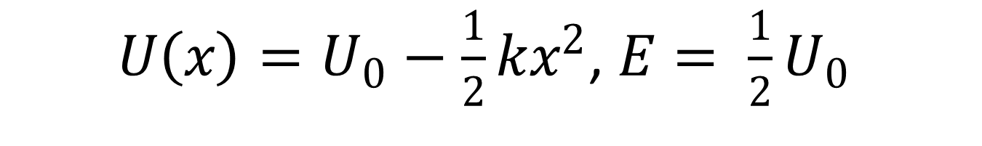
$U\left(x\right)=U_{0}−\frac{1}{2}kx^{2}$, $E= \frac{1}{2}U_{0}$

Slide 9
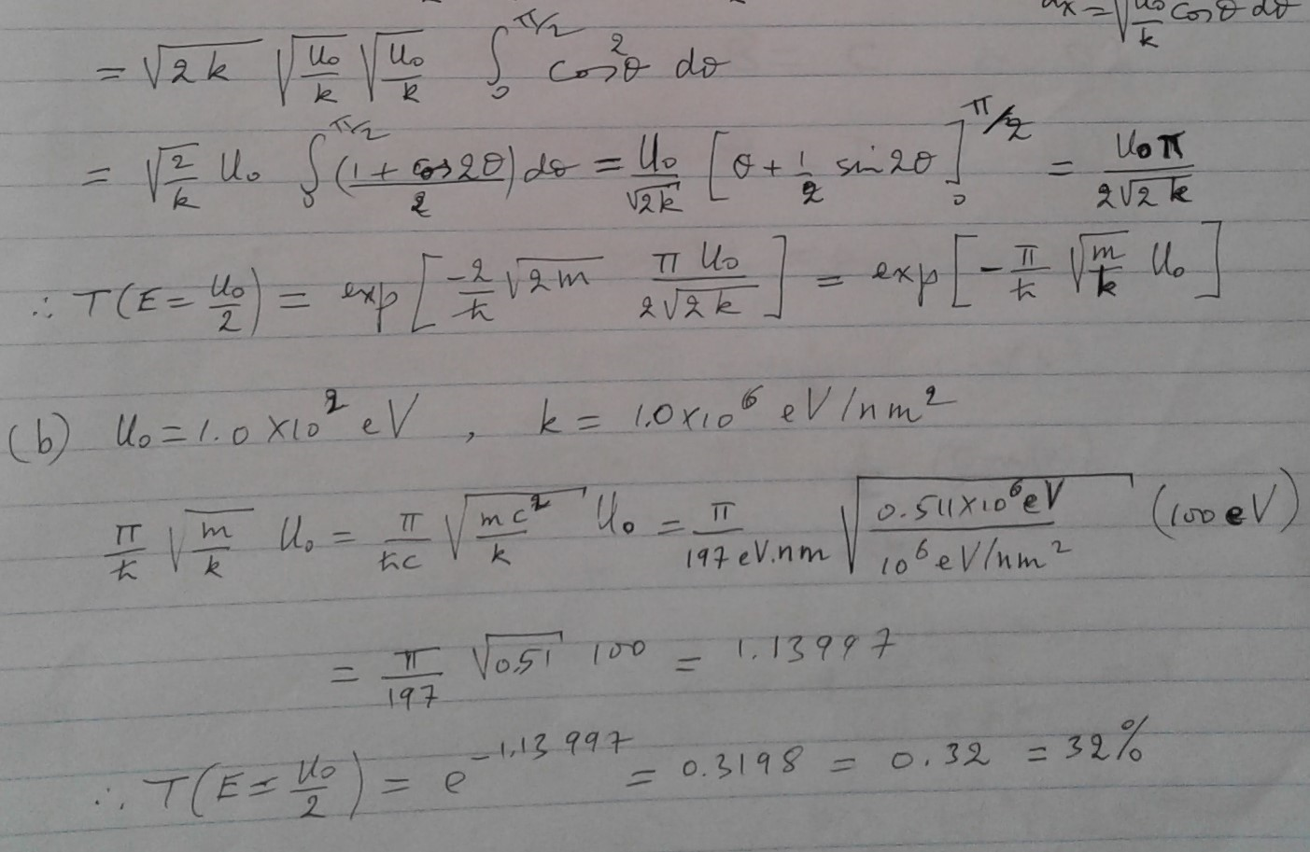
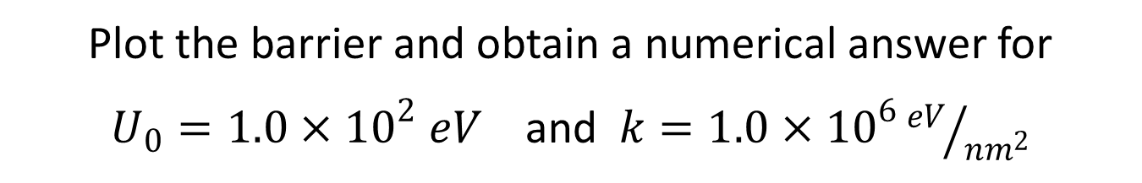
Plot the barrier and obtain a numerical answer for
$U_{0}=1.0×{10}^{2} eV$ and $k=1.0×{10}^{6}{eV}/{{nm}^{2}}$

Slide 10
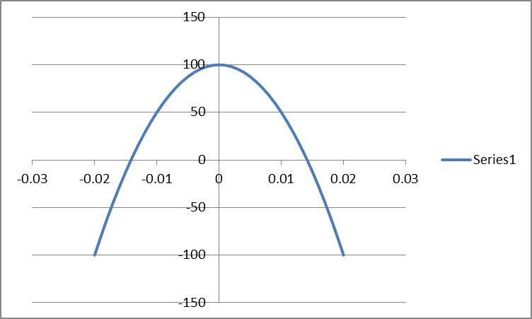
Plot the barrier

Slide 11
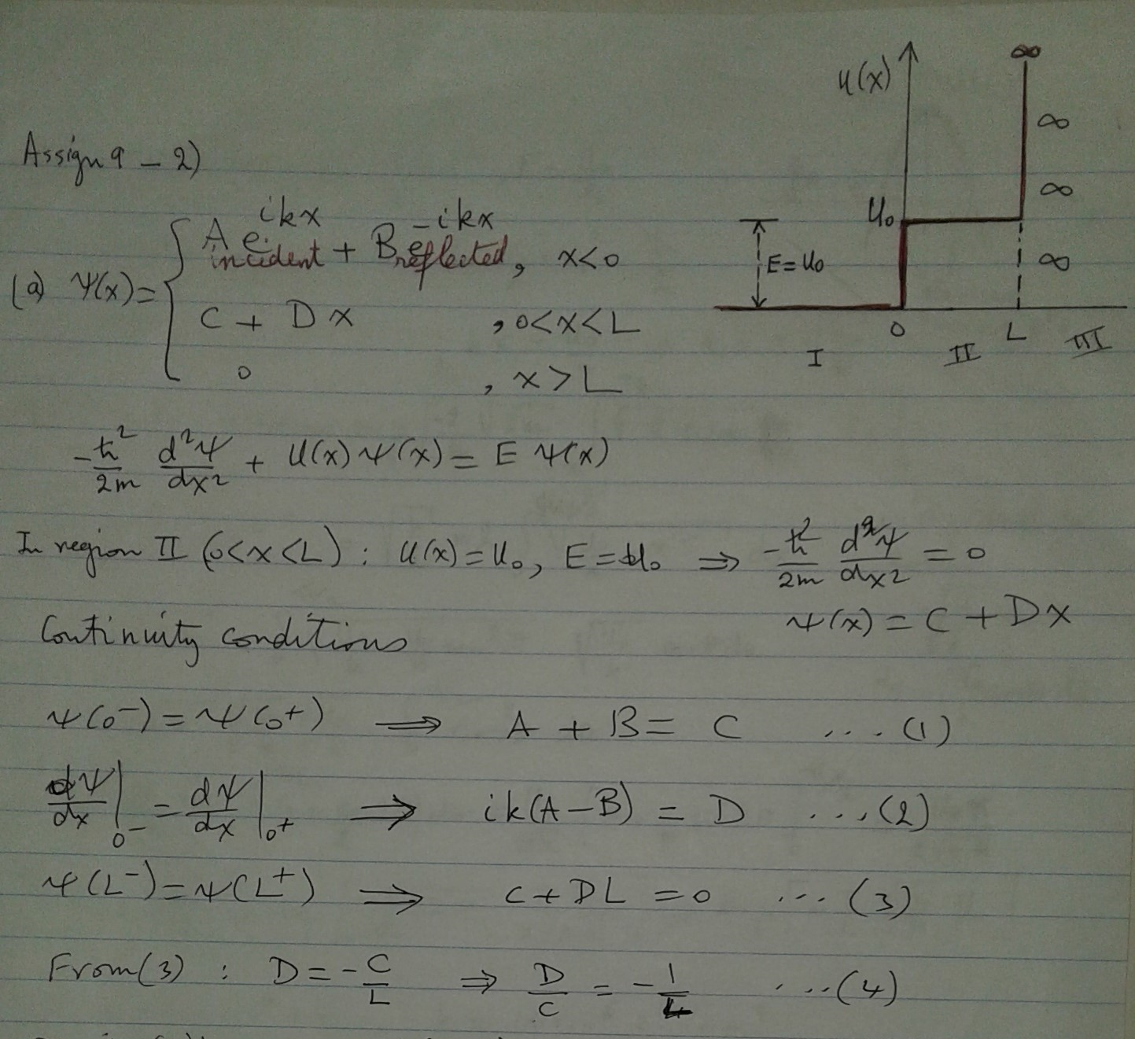

E = U₀ , $U\left(x\right)=\left\{\begin{matrix}0, x<0 \\ U_{0}, 0<x<L \\ ∞, x>L\end{matrix}\right.$

Slide 12
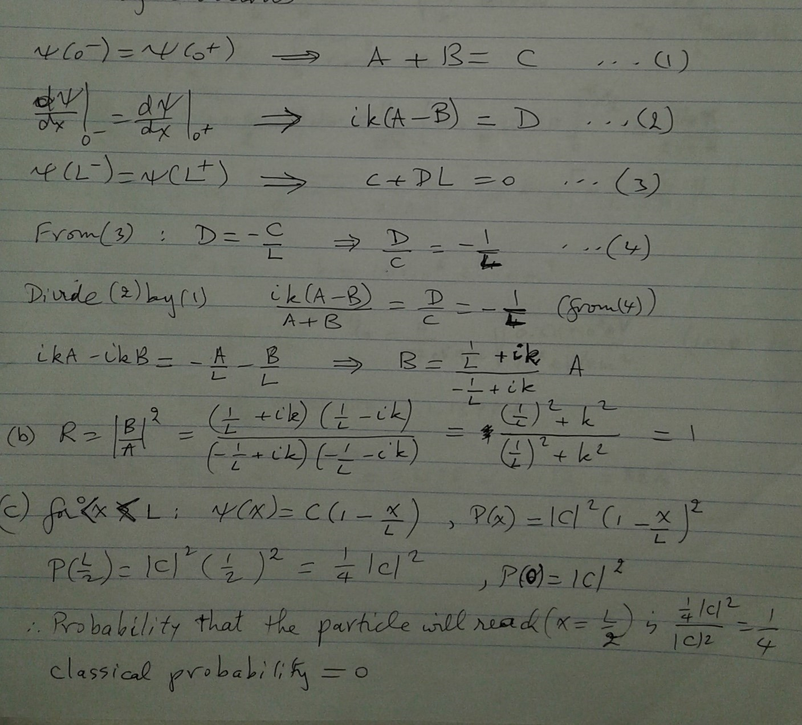
Calculate the probability ratio P(x=L/2)/P(x=0)

Slide 13
كل عام وأنتم بخير

