Slide 1
Quantum Mechanics in 3-D
Chapter 8

Slide 2
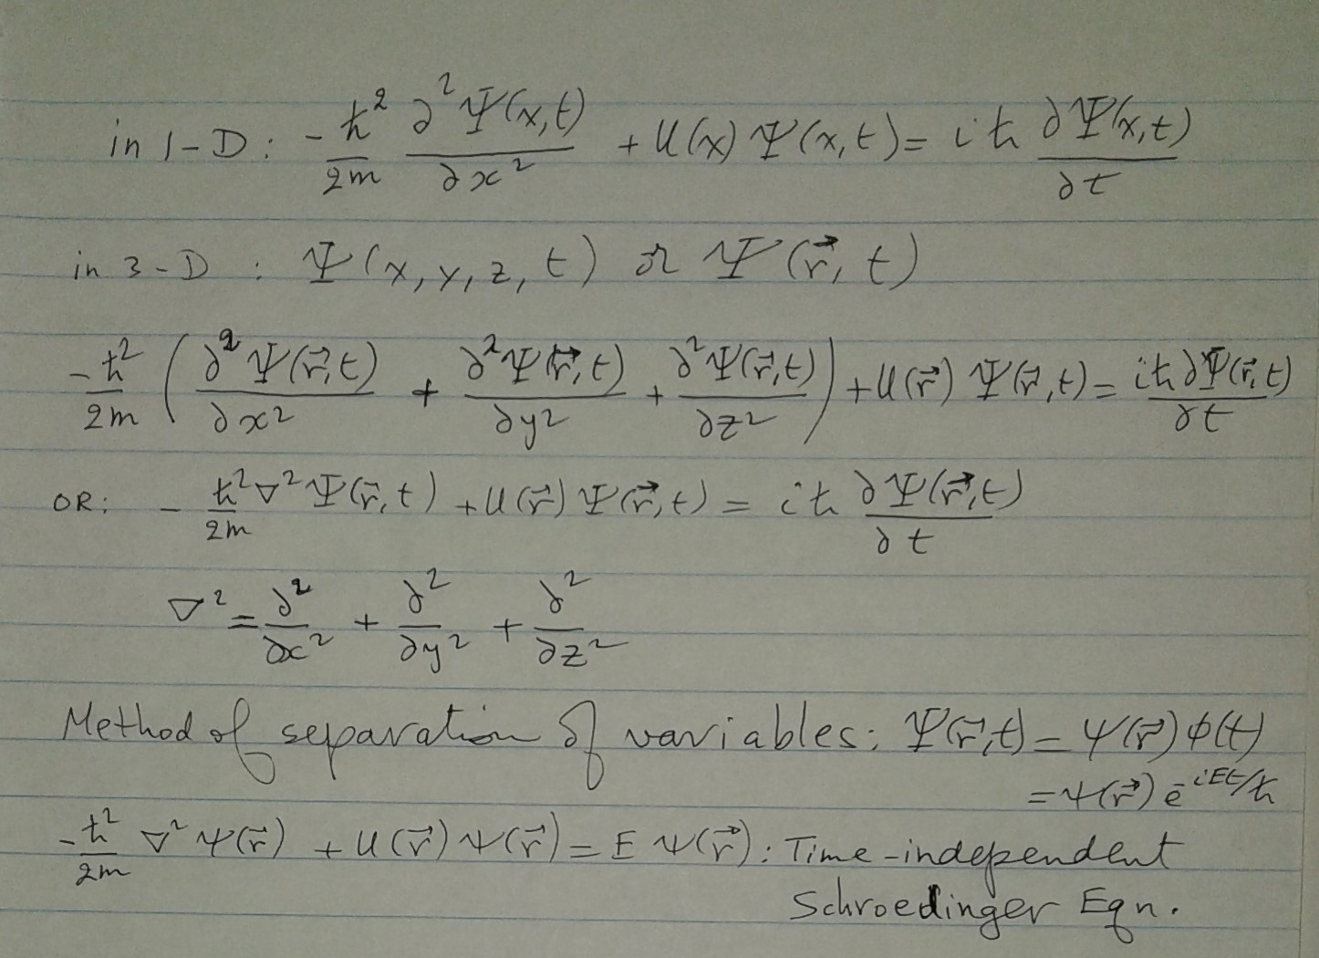
Scroedinger’s Eq. in 3 dimensions

Slide 3
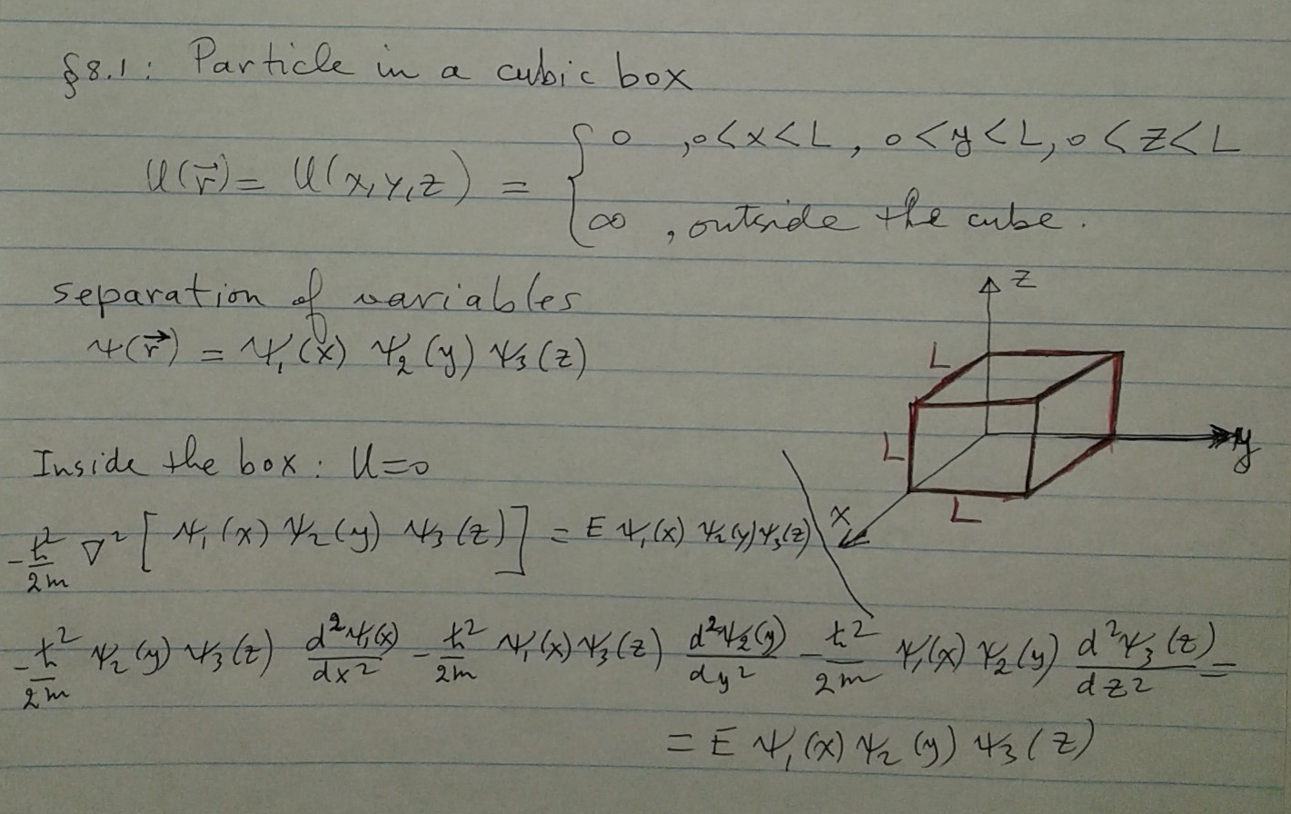
Particle in a Cubic Box

Slide 4
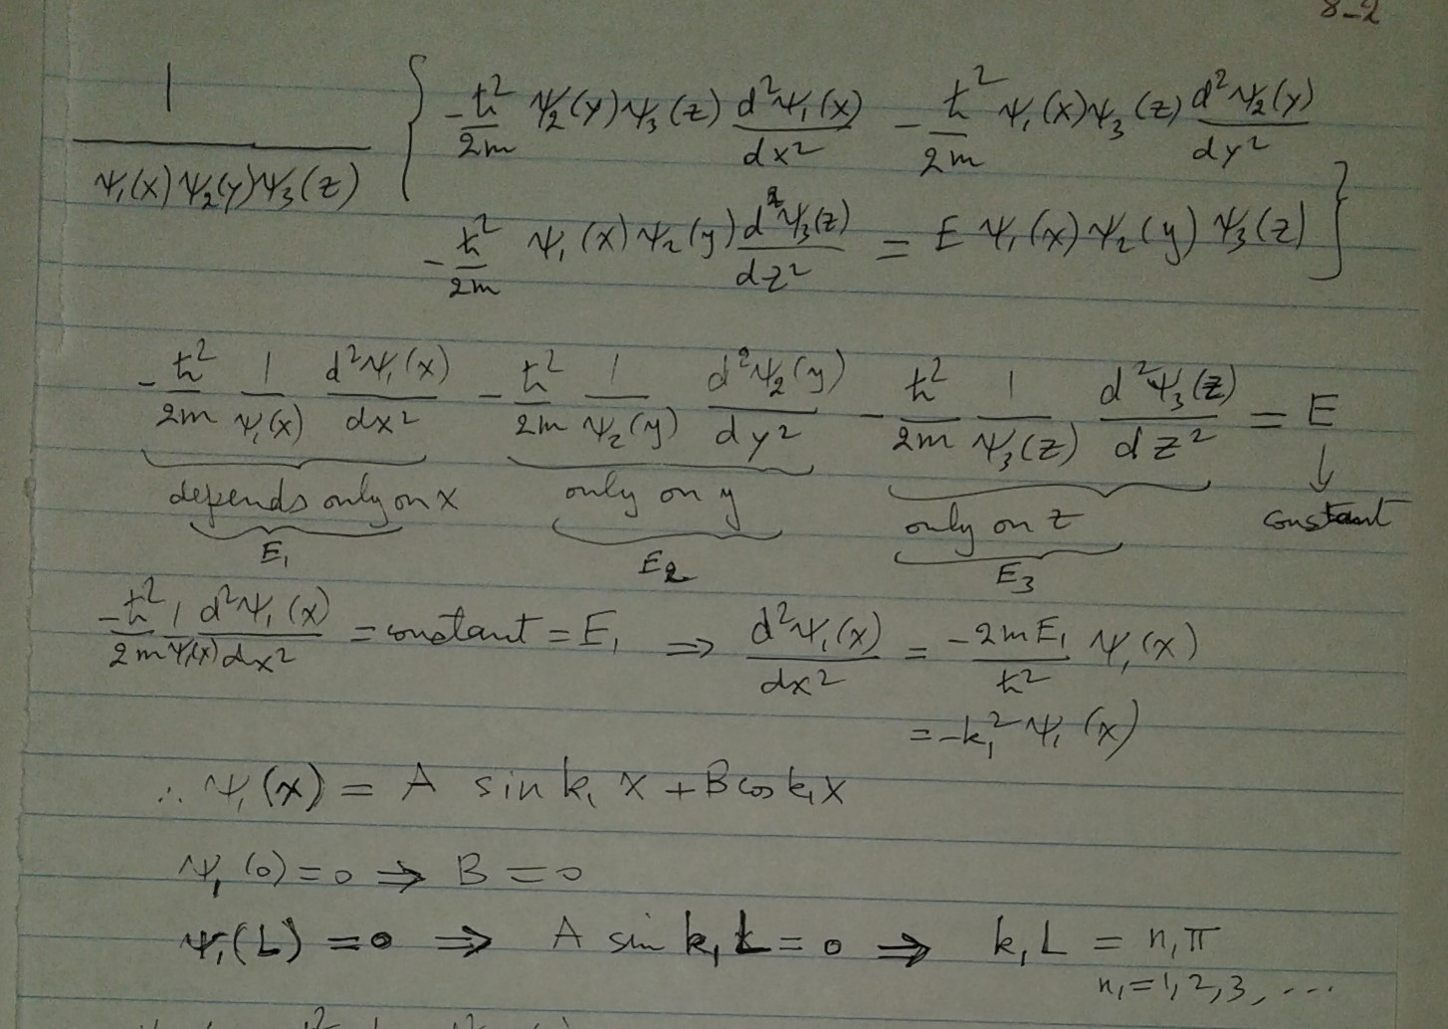
E=E₁+E₂+E₃

Slide 5
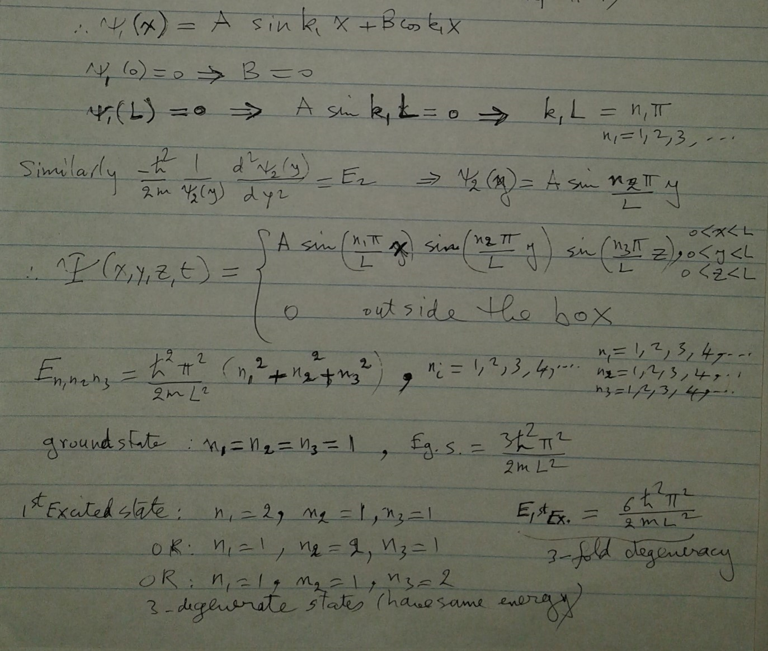

Slide 6
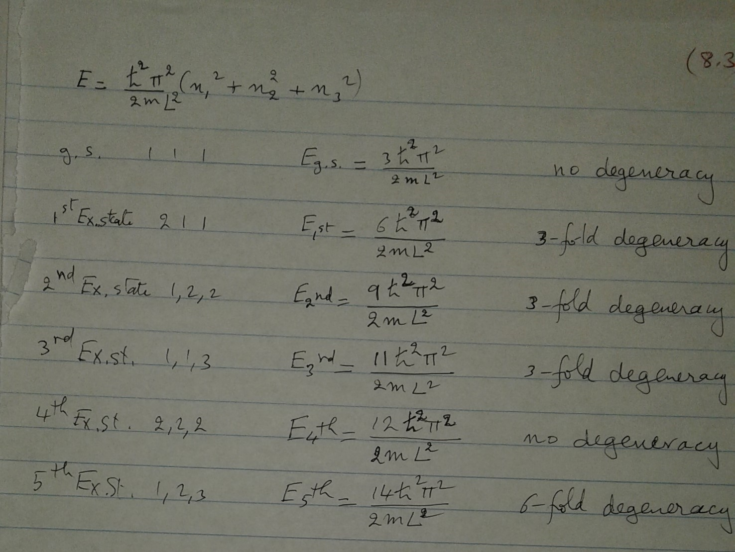
Degeneracy: important in Thermodynamics

Slide 7
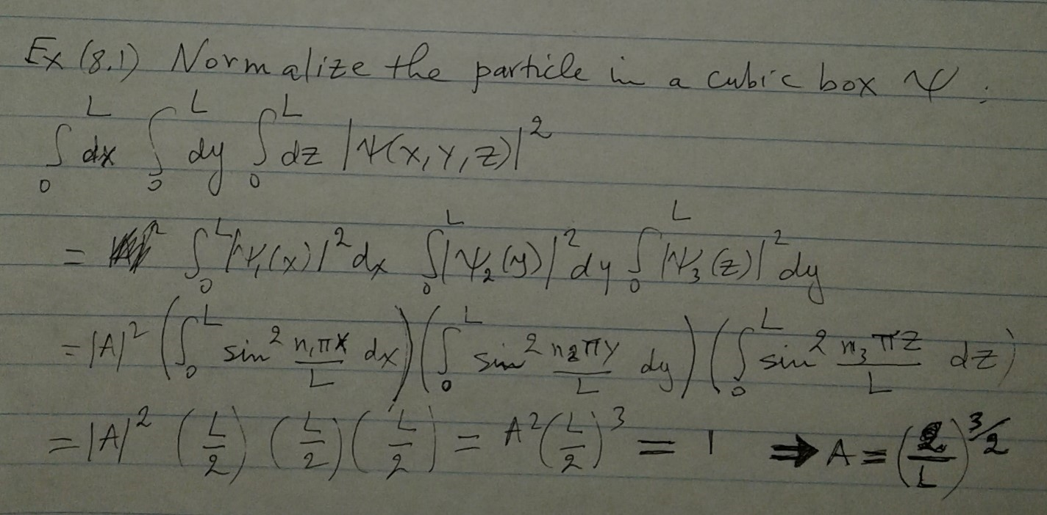
Example 8.1: Normalize ψ

