Slide 1
Metamaterials
Hamza AlHasan
Instructor: Prof Abdallah Sayyed-Ahmad
Department of Physics, Birzeit University
February ${16}^{th}$, 2022

Slide 2
Contents
Classification of Materials
History of Metamaterial
What is Different?
Direction and Propagation
Snell's Law and Negative Refraction
Example of Interesting Effects in DNG Media:
Reverse Cherenkov Radiation
How to Make Metamaterials?
Experimental Verification of a Negative Index of Refraction
Applications:
Metamaterials as a Perfect Lens
Cloaking/Invisibility
Conclusion
References

Slide 3
Classification of Materials
$$\vec{D}=ε \vec{E} → \vec{D}=ε_{0}ε_{r} \vec{E}$$
$$n^{2}=ε_{r}μ_{r}$$
$$\vec{B}=μ \vec{H} → \vec{B}=μ_{0}μ_{r} \vec{H}$$
$ε_{r}=ε/ε_{0}$ = Relative permittivity (dielectric constant)
$μ_{r}=μ/μ_{0}$ = Relative permeability
DPS :
Double Positive Material
$n$ is real and positive
Most known materials have this property
RHM: Right Handed Material
ENG :
Epsilon Negative Material
$n$ is imaginary
Many plasmas exhibit this characteristic
DNG :
Double Negative Material
$n$ is real and negative
Metamaterial
We don’t have METAMATERIALs in nature
LHM: Left Handed Material
MNG :
Mu Negative Material
$n$ is imaginary
Ferromagnetic Materials
So we have MNGs in nature

Slide 4
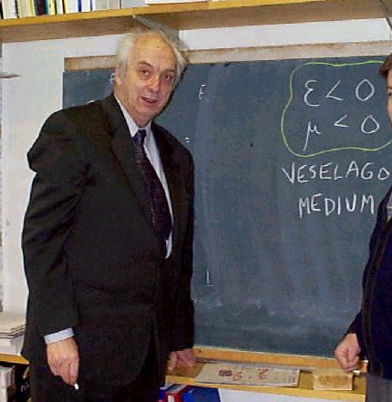
History of Metamaterial
In 1968, Veselago* theoretically investigated the electrodynamic consequences of a medium having both $ε$ and $μ$ negative.
He concluded that such a medium would have dramatically different propagation characteristics stemming from the sign change of the group velocity, including reversal of both the Doppler shift and Cherenkov radiation, anomalous refraction, and even reversal of radiation pressure to radiation tension.
These effects could not be experimentally verified since, as Veselago pointed out, substances with negative $μ$ were not available.
V. G. Veselago
* V. G. Veselago, Sov. Phys. USPEKHI 10, 509 (1968).

Slide 5
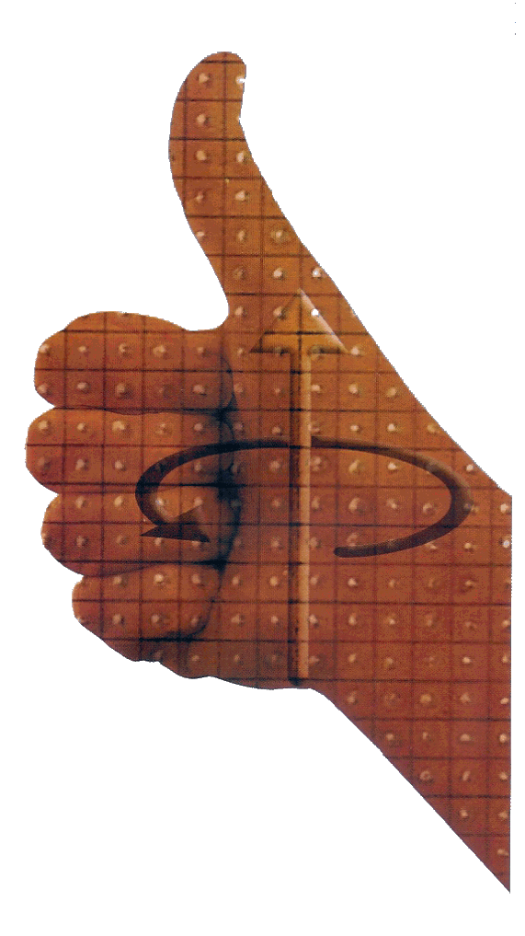
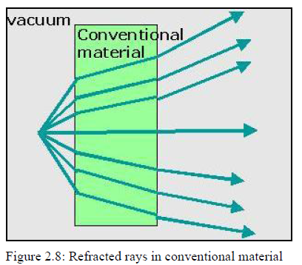
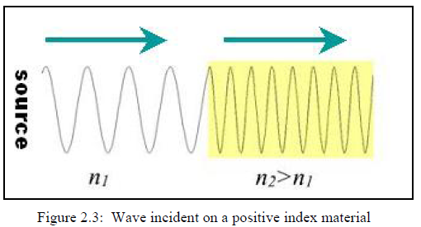
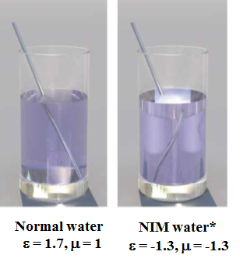
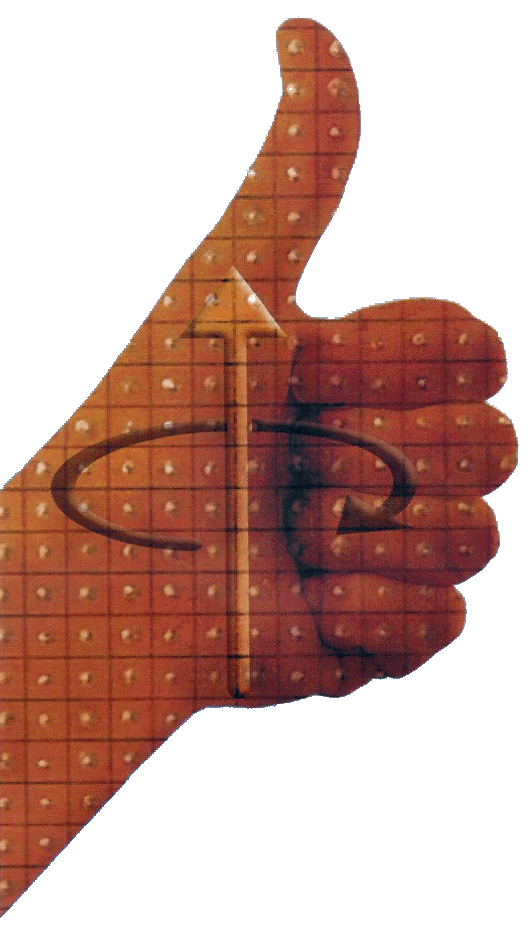
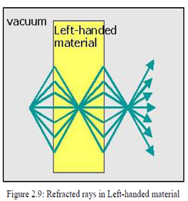
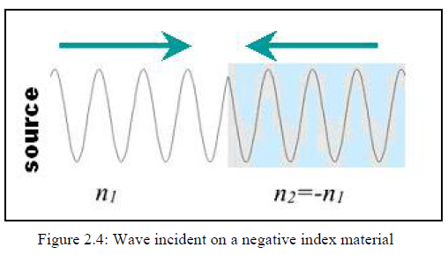
What is Different? 1-Direction
E
$$n^{2}=ε_{r}μ_{r}$$
For conventional material, the refracted waves are spreading away on entering and exiting the medium
RHM: Right Handed Material
In DNG materials (Metamaterials), Veselago showed that if $μ<0 , ε<0 → n<0$
Now, if $n<0 →v=c/n <0$
The speed of the wave is negative, and the wave travels backwards toward the source
k
S
H
E
For Metamaterial, the waves are refracted in such a way as to produce a focus inside the material and then another just outside
LHM: Left Handed Material
k
S
$$\vec{S}=\vec{E}×\vec{H}$$
H

Slide 6
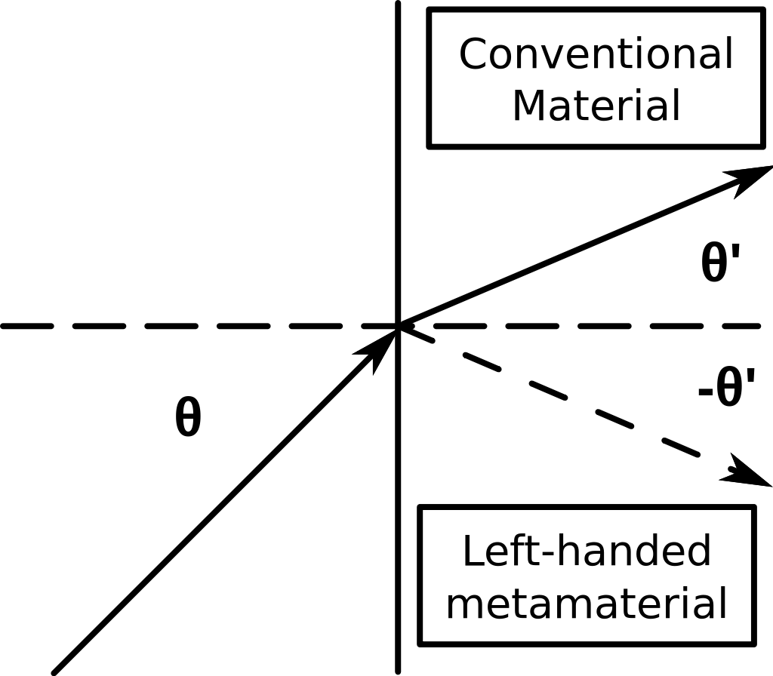
What is Different? 2-Snell’s Law
$$n_{1}\sin{θ_{1}=−\left|n_{2}\right|\sin{θ_{2}}}$$
$$n_{2}<0 \& θ_{2}<0$$

Slide 7
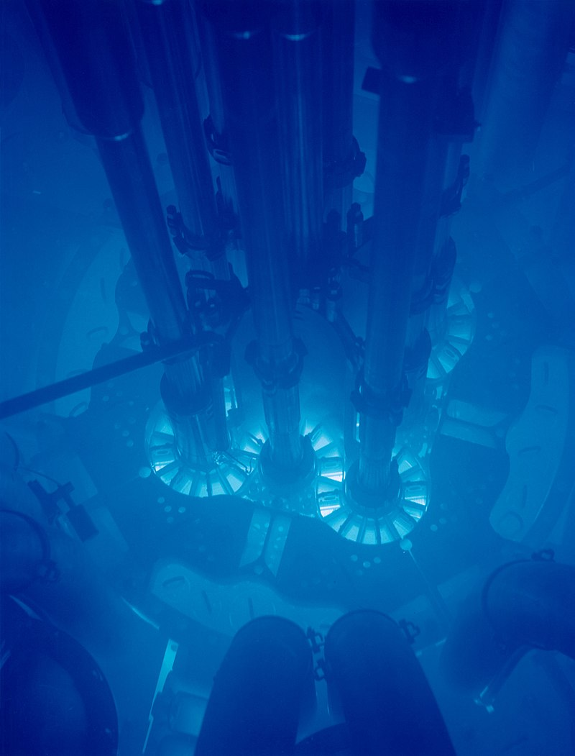
Reverse Cherenkov Radiation
FIRST:
What is Cherenkov Radiation?
The speed of light in vacuum $= c$
The speed of light in water $= 0.75c$
Matter can accelerate beyond this speed during nuclear reactions in particle accelerators:
$$0.75c<v<c$$
Cherenkov radiation glowing in the core of the Advanced Test Reactor.
→ Cherenkov radiation in normal materials is the result of charged particles (mostly electron) traveling faster than the phase velocity of light in that material.

Slide 8
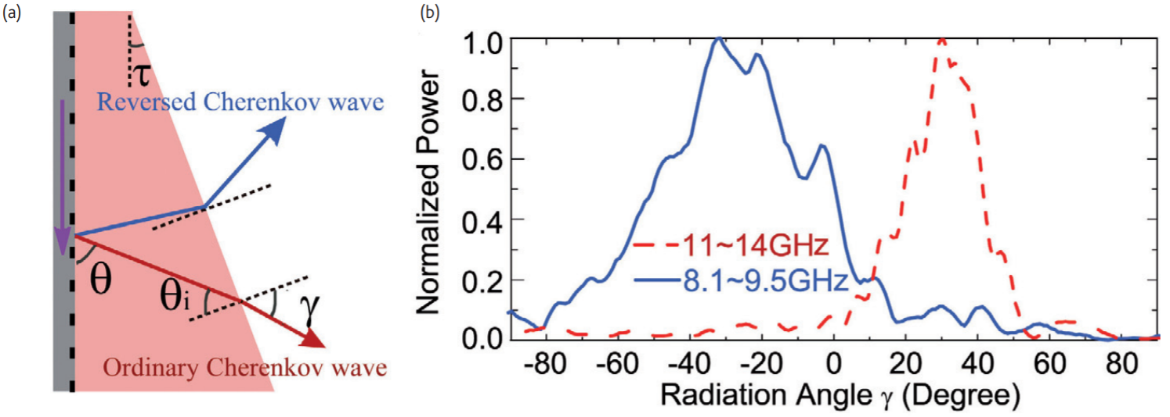
Reverse Cherenkov Radiation
Cherenkov Radiation in Metamaterial → Reverse Cherenkov Radiation
The reversed Cherenkov radiation has many possible applications, such as novel vacuum electronic devices, particle detectors, accelerators and new types of plasmonic couplers.
*The figure shows radiation power in each angle in the negative refraction band (solid line) and positive refraction band (dashed line)
Chen, H. and Chen, M., 2011. Flipping photons backward: reversed Cherenkov radiation. Materials today, 14(1-2), pp.34-41.

Slide 9
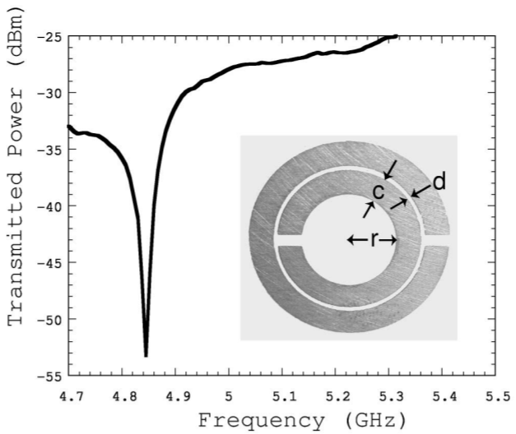
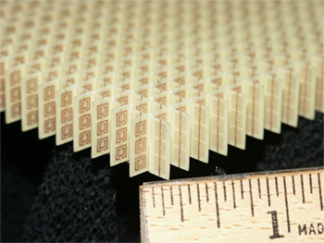
How to Make Metamaterials? Split Ring Resonator (SRR)
The gaps produce a capacitance which produces a resonance that amplifies the magnetic field.
Time varying applied magnetic field → Produced current
Produced magnetic field that may either oppose or enhance the incident field. The magnetic field is dipolar.
→ Charges on the opposite gaps.
→ Capacitance.
→ Lowering the resonant frequency
and concentrating the electric
field.
*Resonance curve of an actual copper split ring resonator (SRR). $c=0.8 mm$, $d=0.2 mm$, and $r=1.5 mm$. The SRR has its resonance at about $4.845 GHz$.
Periodic structures and many cells of SRRs on averaging produce Metamaterial as a macroscopic effect.
*Smith, D., Padilla, W., Vier, D., Nemat-Nasser, S. and Schultz, S., 2000. Composite Medium with Simultaneously Negative Permeability and Permittivity. Physical Review Letters, 84(18), pp.4184-4187.

Slide 10
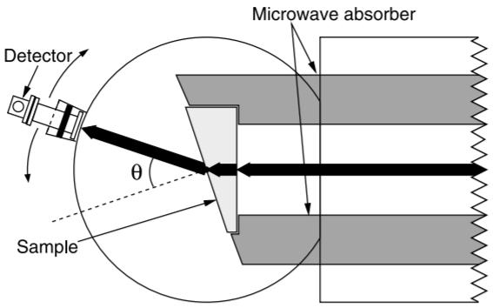
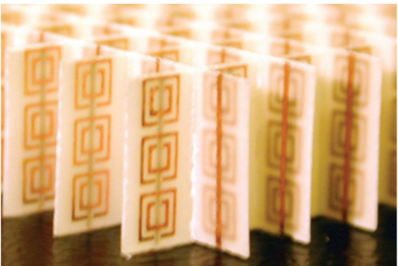
Experimental Verification of a Negative Index of Refraction*
What is the experiment?
It was presented experimental scattering data at microwave frequencies on a structured metamaterial that exhibits a frequency band where the effective index of refraction ($n$) is negative.
What was the material used?
The material consists of a two-dimensional array of repeated unit
cells of copper strips and split ring resonators on interlocking strips
of standard circuit board material.
How the experiment was done?
By measuring the scattering angle of the transmitted beam through
a prism fabricated from this material, the effective $n$ was determined,
appropriate to Snell’s law.
What are the results?
Confirmation the predictions of Maxwell’s equations that $n$ is given by
the negative square root of $ε.μ$ for the frequencies where both the
permittivity ($ε$) and the permeability ($μ$) are negative
Square copper SRR
Fiber glass circuit board
Copper wire strips
*Shelby, R., Smith, D. and Schultz, S., 2001. Experimental Verification of a Negative Index of Refraction. Science, 292(77), pp.77-79.

Slide 11
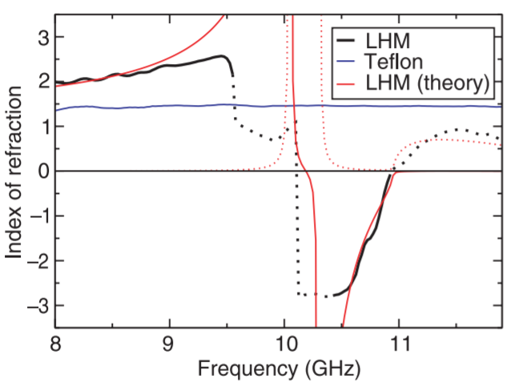
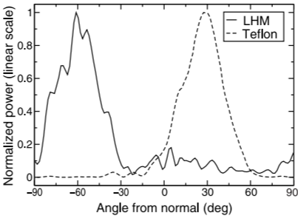
Normalized curves (magnitude of both peaks is unity)
At $θ={−61}^{o}$
$$n=−2.7±0.1$$
At $θ={27}^{o}$
$$n=1.4±0.1$$
Index of refraction versus frequency.
The blue curve: data from the Teflon sample.
Black curve: the LHM data.
The dotted black curve: regions where the index is expected to be either outside the limit of detection ($\left|n\right|>3$) or dominated by the imaginary component and therefore could not be reliably determined experimentally.
The solid red curve: the real component of the theoretical expression .
The dotted red curve: the imaginary component of the theoretical expression .
Transmitted power at 10.5 GHz as a function of refraction angle for both a Teflon sample (dashed curve) and a LHM sample (solid curve).

Slide 12
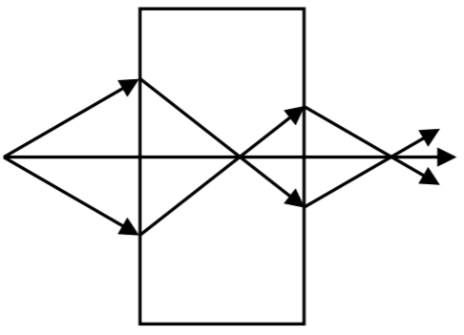
Application 1: Perfect Lens
Many experiments have been motivated by this idea, and several authors have reported observing perfect lens effects in DNM for small frequency intervals. For example:
*Lagarkov, A.; Kissel, V. (2004). Near-Perfect Imaging in a Focusing System Based on a Left-Handed-Material Plate. , 92(7), 77401–0. doi:10.1103/physrevlett.92.077401
**Kissel, Vladimir N.; Lagar’kov, Andrey N. (2005). Superresolution in left-handed composite structures: From homogenization to a detailed electrodynamic description. Physical ReviewB,72(8),085111.doi:10.1103/PhysRevB.72.085111
Allowing subwavelength imaging
$$n=−1$$
Definition: optical microscopy with the ability to see details of an object or organism below the wavelength of visible light.
Using metamaterial → high resolution
In other words, to have the capability to observe, in real time, below 200 nanometers. For example:
Observing a whole living cell.
Observing cellular processes, such as how proteins and fats move in and out of cells.
In the technology domain, manufacturing small computer chips.
Limitations:
The limited frequency range of effect.
The difficulty to construct an ideal perfect lens with isotropic DNM properties.
Attenuation of signals.
Pendry predicted that Double negative metamaterials (DNG) with a refractive index of $n=−1$, can act, at least in principle, as a "perfect lens" allowing imaging resolution which is limited not by the wavelength, but rather by material quality.***
***Pendry, J., 2000. Negative Refraction Makes a Perfect Lens. Physical Review Letters, 85(18), pp.3966-3969.

Slide 13
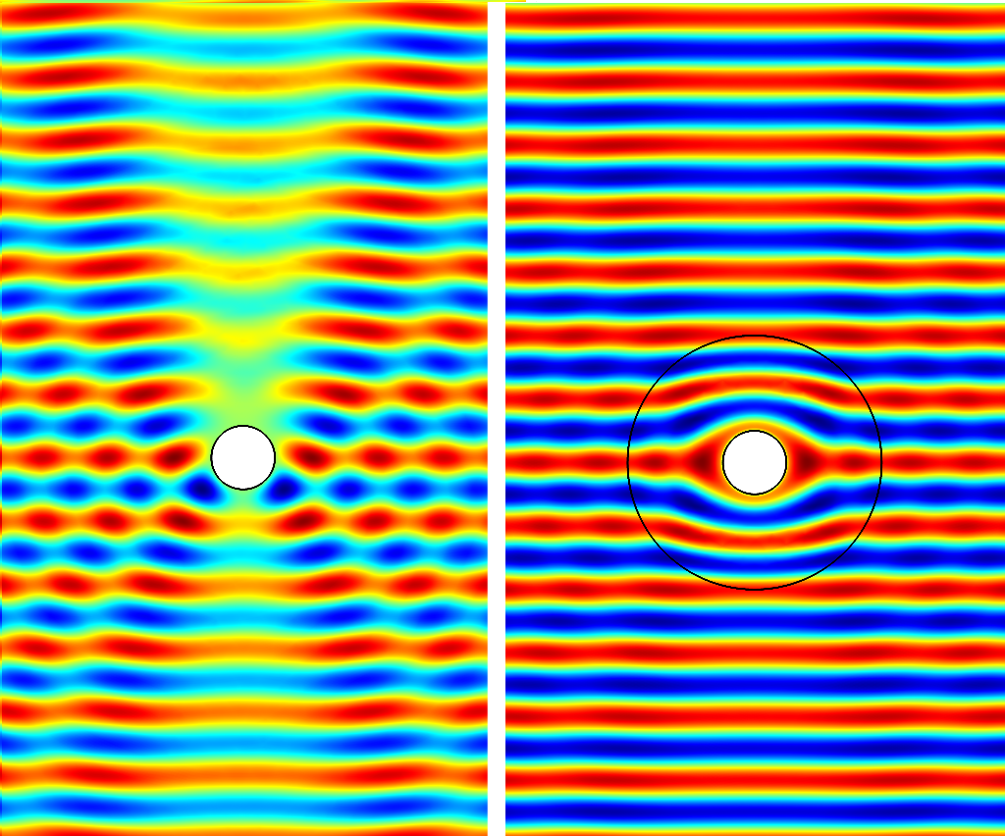
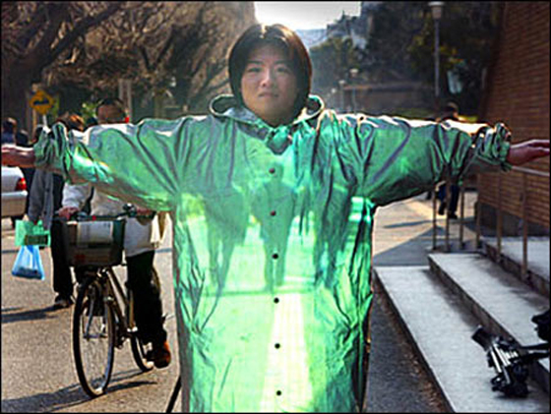
Application 2: Cloaking/Invisibility
Left: The cross section of a PEC cylinder subject to a plane wave (only the electric field component of the wave is shown). The field is scattered.
Metamaterial cloaking:
Based on transformation optics.
Describes the process of shielding something from view by controlling electromagnetic radiation.
Objects in the defined location are still present, but incident waves are guided around them without being affected by the object itself.
Right: a circular cloak, designed using transformation optics methods, is used to cloak the cylinder. In this case the field remains unchanged outside the cloak and the cylinder is invisible electromagnetically. Note the special distortion pattern of the field inside the cloak.

Slide 14
Conclusion
Negative index of refraction (DNG) material was predicted theoretically to exists in 1968 by Veselago and recently experimentally made by researchers.
There are many interesting effects that characterize Metamaterials, such as: Reverse Cherenkov Radiation, Reverse Doppler Effect, Inverse Snell’s Law… etc.
Metamaterial can be made by using (for example) many cells of SRRs.
There are many applications for Metamaterials. It can be used as a perfect lens, or as a cloaking device.

Slide 15
References:
V. G. Veselago, Sov. Phys. USPEKHI 10, 509 (1968).
Chen, H. and Chen, M., 2011. Flipping photons backward: reversed Cherenkov radiation. Materials today, 14(1-2), pp.34-41.
Smith, D., Padilla, W., Vier, D., Nemat-Nasser, S. and Schultz, S., 2000. Composite Medium with Simultaneously Negative Permeability and Permittivity. Physical Review Letters, 84(18), pp.4184-4187.
Shelby, R., Smith, D. and Schultz, S., 2001. Experimental Verification of a Negative Index of Refraction. Science, 292(77), pp.77-79.
Pendry, J., 2000. Negative Refraction Makes a Perfect Lens. Physical Review Letters, 85(18), pp.3966-3969.
Lagarkov, A.; Kissel, V. (2004). Near-Perfect Imaging in a Focusing System Based on a Left-Handed-Material Plate. , 92(7), 77401–0. doi:10.1103/physrevlett.92.077401.
Kissel, Vladimir N.; Lagar’kov, Andrey N. (2005). Superresolution in left-handed composite structures: From homogenization to a detailed electrodynamic description. Physical ReviewB,72(8),085111.doi:10.1103/PhysRevB.72.085111.
Thank You For Listening

