Slide 1
Refraction at a Uniaxial Crystal Surface
Student Name: Hamza AlHasan-1181636
Instructor: Dr. Wael Karin
Date: 1/6/2021

Slide 2
Introduction
Keywords:
Uniaxial Crystal → $n_{x}=n_{y} ≠n_{z}$ and has one optic axis
Optic axis → $n_{1}=n_{2}$
Ordinary ray (o-ray) → corresponds to $n_{o}=n_{z}$
Extraordinary ray (e-ray) → corresponds to ${n_{e}=n}_{x}=n_{y}$

Slide 3
O-ray refraction
Applying Snell’s Law:
$n_{i}\sin{θ_{i}}=n_{o}\sin{θ_{t}}$
$n_{o}$ is the ordinary index inside the crystal
$n_{i}$ is the index outside the crystal
$θ_{i}$ is the incident angle
$θ_{t}$ is the transmitted angle

Slide 4
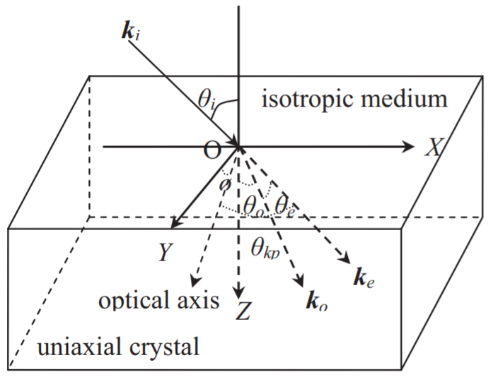
e-ray refraction
For the e-ray, the refractive index $n_{e}$ in the uniaxial crystal is expressed as:
$n_{e}\left(θ^{′}\right)=\frac{n_{0}n_{e}}{√{(n}_{o}^{2}\sin^{2}{θ^{′}+n_{e}^{2}\cos^{2}{θ^{′})}}}$
$θ^{′}$ is the angle between e-ray wave vector and optical axis
$n_{e}=n_{e}\left(θ^{′}=0\right)=constant$
The e-ray obeys the extensive Snell’s law, that is:
$n_{i}\sin{θ_{i}}=n_{e}(θ^{′})\sin{θ_{t}}$
$\cos{θ^{′}=\sin{φ\cos{θ_{t}}}}$
Where $φ$ is the angle between optical axis and y-axis
Using the last two equations:
➔ $θ_{t}=\arcsin{(}n_{i}\sin{θ_{i}\sqrt{\frac{n_{o}\cos^{2}{φ+n_{e}\sin^{2}{φ}}}{n_{o}^{2}n_{e}^{2}−(n_{i}^{2}\sin^{2}{θ_{i})}\left(n_{e}^{2}−n_{o}^{2}\right)\sin^{2}{φ}}}} )$
The influencing factors of e-ray wave vector are:
$θ_{i} , n_{i} , n_{o} , n_{e}$ and the optical axis of uniaxial crystal.
$$θ_{kp}→θ^{′}$$
$$θ_{e}→θ_{t}$$

Slide 5
Why this separation?
Crystal is an anisotropic material → different indices of refraction → polarization.
Uniaxial Crystal → two different indices → two different $θ_{t}$ → two different v and $λ$
For example:
If $n_{e}<n_{o} (Negative Crystal)→θ_{e}>θ_{o}$
If $n_{e}>n_{o} (Positive Crystal)→θ_{e}<θ_{o}$

Slide 6
The End
Thank You
References:
Fang Wu, J. and Tang Zhang, Y., 2012. The relation between the propagation of extraordinary ray and the optical axis in the uniaxial crystal. Optik, 124(17), pp.2667-2669.
Peatross, J. and Ware, M., 2015. Physics of Light and Optics. 1st ed. Provo: Brigham Young University, pp.121-129.
Wang, P., 2018. Ray refraction in uniaxial crystals by Fermat’s principle. Applied Optics, 57(18), pp.4950-4954.
Jia, G., 2011. Evanescent wave of extraordinary beam at uniaxial crystal surfaces. Optoelectronics Letters, 7(3), pp.1673-1905.

