Slide 1
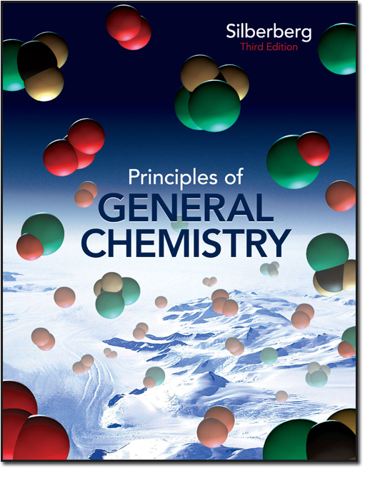
Chapter 12
Lecture Outline
See separate Image PowerPoint slides for all figures and tables pre-inserted into PowerPoint without notes.
Copyright © The McGraw-Hill Companies, Inc. Permission required for reproduction or display.
Notes:
‹#›

Slide 2
Chapter 12
Intermolecular Forces:
Liquids, Solids, and Phase Changes
Notes:
‹#›

Slide 3
Intermolecular Forces:
Liquids, Solids, and Phase Changes
12.1 An Overview of Physical States and Phase Changes
12.2 Quantitative Aspects of Phase Changes
12.3 Types of Intermolecular Forces
12.4 Properties of the Liquid State
12.5 The Uniqueness of Water
12.6 The Solid State: Structure, Properties, and Bonding
Notes:
‹#›

Slide 4
Phases of Matter
Each physical state of matter is a phase, a physically distinct, homogeneous part of a system.
The properties of each phase are determined by the balance between the potential and kinetic energy of the particles.
The potential energy, in the form of attractive forces, tends to draw particles together.
The kinetic energy associated with movement tends to disperse particles.
Notes:
‹#›

Slide 5
Attractive Forces
Intramolecular or bonding forces are found within a molecule. The chemical behavior of each phase of matter is the same because the same basic particle is present in each case.
H₂O molecules are present whether the substance is in the solid, liquid, or gas phase.
Intermolecular or nonbonding forces are found between molecules. The physical behavior of each phase of matter is different because the strength of these forces differs from state to state.
Notes:
‹#›

Slide 6
Table 12.1 A Macroscopic Comparison of Gases, Liquids, and Solids
State
Shape and Volume
Compressibility
Ability to Flow
Gas
Conforms to shape and volume of container
High
High
Liquid
Conforms to shape of container; volume limited by surface
Very low
Moderate
Solid
Maintains its own shape and volume
Almost none
Almost none
Notes:
‹#›

Slide 7
Kinetic Molecular View of the Three States
 | Attractive Forces vs. Kinetic Energy | Properties
Gas | Attractive forces are weak relative to kinetic energy. | Particles are far apart. A gas has no fixed shape or volume.
Liquid | Attractive forces are stronger because particles have less kinetic energy. | A liquid can flow and change shape, but has a fixed volume.
Solid | Attractions dominate motion. Particles are fixed in place relative to each other. | A solid has a fixed shape and volume.
Notes:
‹#›

Slide 8
Phase Changes
sublimation
vaporizing
exothermic
melting
solid
liquid
gas
endothermic
freezing
condensing
deposition
Notes:
‹#›

Slide 9
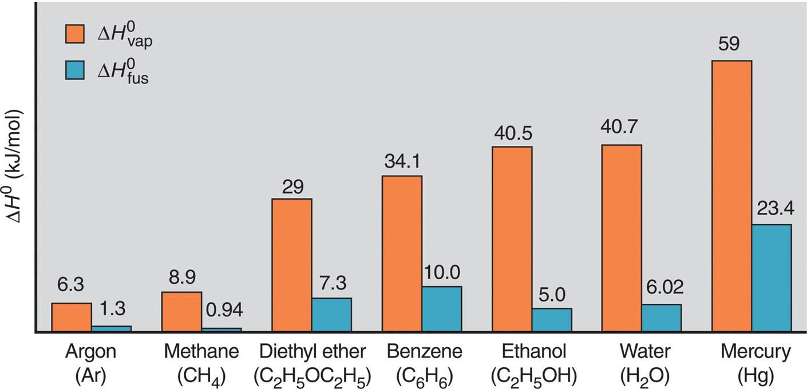
Figure 12.1
Heats of vaporization and fusion for several common substances.
Notes:
‹#›

Slide 10
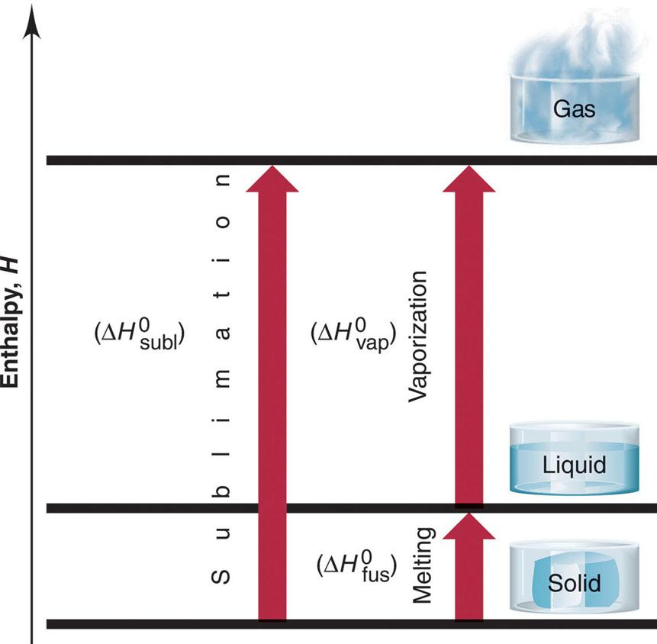
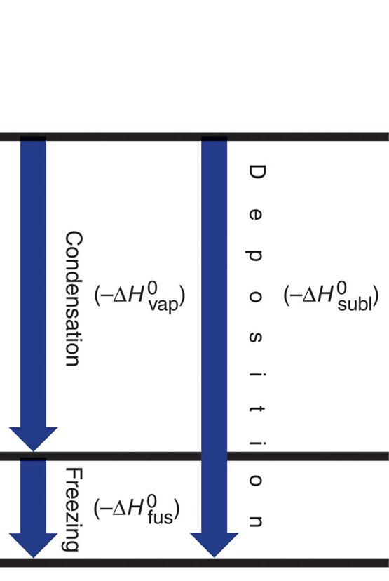
Figure 12.2
Phase changes and their enthalpy changes.
Notes:
‹#›

Slide 11
Quantitative Aspects of Phase Changes
Within a phase, heat flow is accompanied by a change in temperature, since the average E_{k} of the particles changes.
q = (amount) x (heat capacity) x ΔT
During a phase change, heat flow occurs at constant temperature, as the average distance between particles changes.
q = (amount)(ΔH of phase change)
Notes:
‹#›

Slide 12
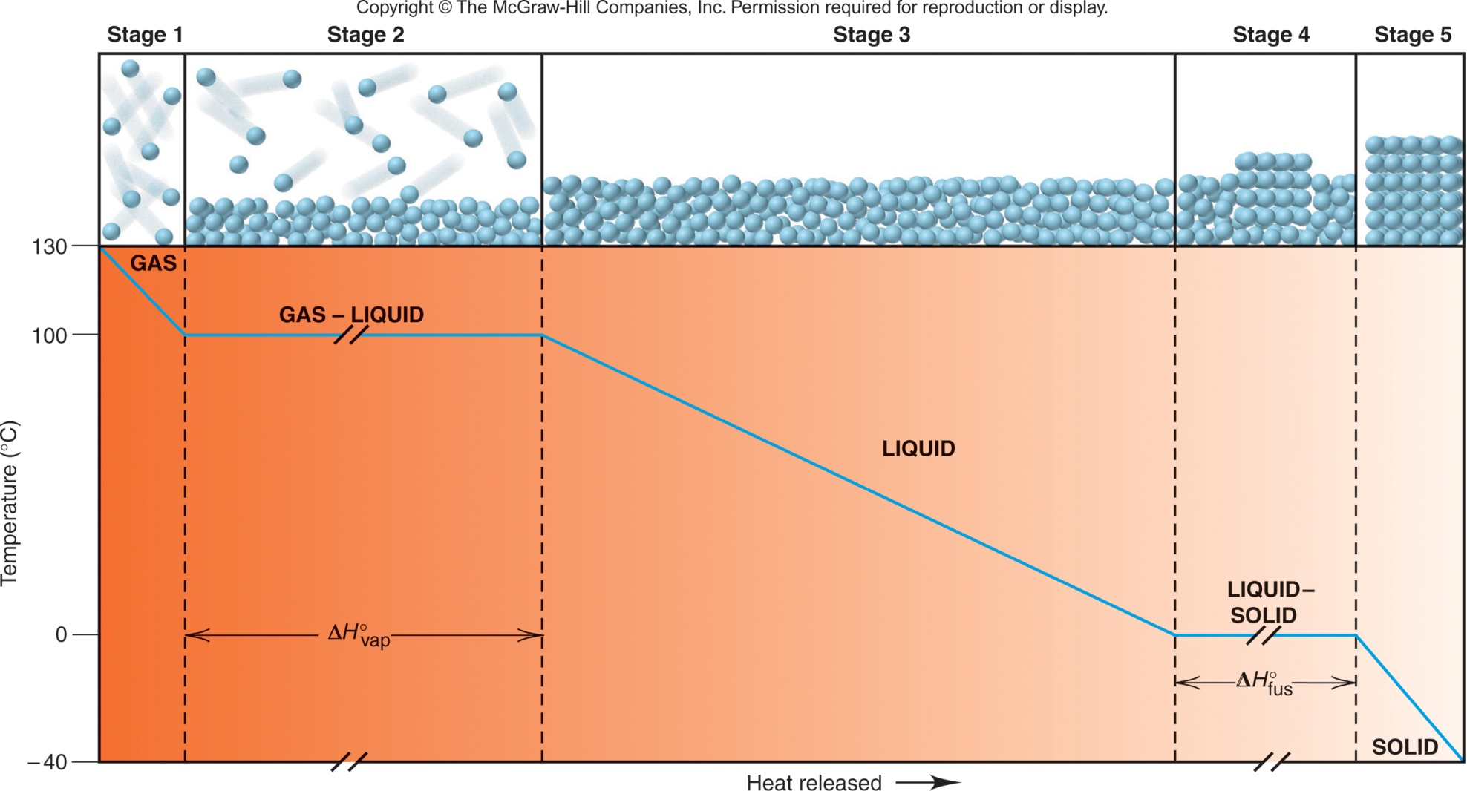
Figure 12.3
A cooling curve for the conversion of gaseous water to ice.
Notes:
‹#›

Slide 13
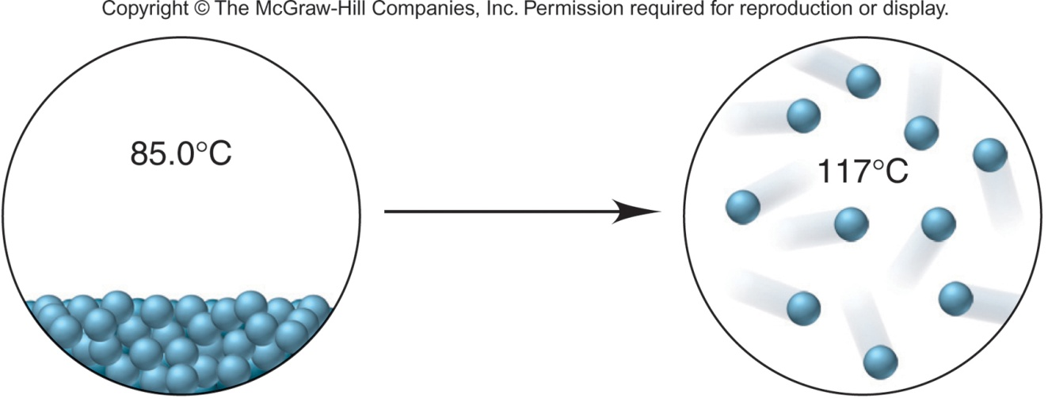
Sample Problem 12.1
Finding the Heat of a Phase Change Depicted by Molecular Scenes
PROBLEM:
The scenes below represent a phase change of water. Select data from the previous text discussion to find the heat (in kJ) released or absorbed when 24.3 g of H₂O undergoes this change.
PLAN:
The scenes show a disorderly, condensed phase at 85.0°C changing to separate particles at 117°C. A liquid is becoming a gas, so the scene shows vaporization. We must identify the number of stages in the process and calculate the heat absorbed in each.
Notes:
‹#›

Slide 14
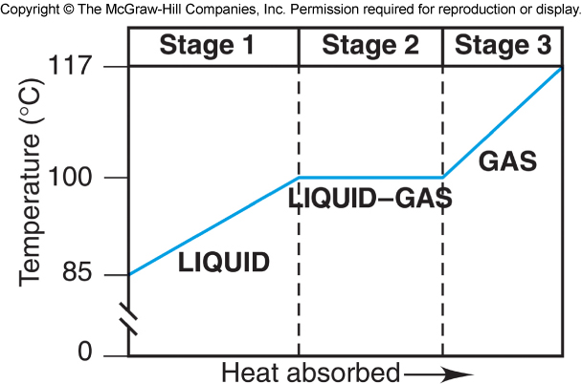
Sample Problem 12.1
SOLUTION:
There are 3 stages involved in this process:
heating of the liquid to its boiling point
the phase change from liquid to gas
heating the gas to the final temperature
1 mol H₂O
mol H₂O = 24.3 g H₂O x
= 1.35 mol H₂O
18.02 g H₂O
For Stage 1:
q = n x C_{water(l)} x ΔT
= (1.35 mol)(75.4 J/mol∙°C)(100. - 85.0°C)
= 1527 J = 1.53 kJ
Notes:
‹#›

Slide 15
Sample Problem 12.1
For Stage 2:
q = n(ΔH°_{vap}) = (1.35 mol)(40.7 kJ/mol) = 54.9 kJ
For Stage 3:
q = n x C_{water(g)} x ΔT
= (1.35 mol)(33.1 J/mol∙°C)(117 – 100.°C)
= 759.6 J = 0.760 kJ
q_{total} = 1.53 + 54.9 + 0.760 kJ = 57.2 kJ
Notes:
‹#›

Slide 16
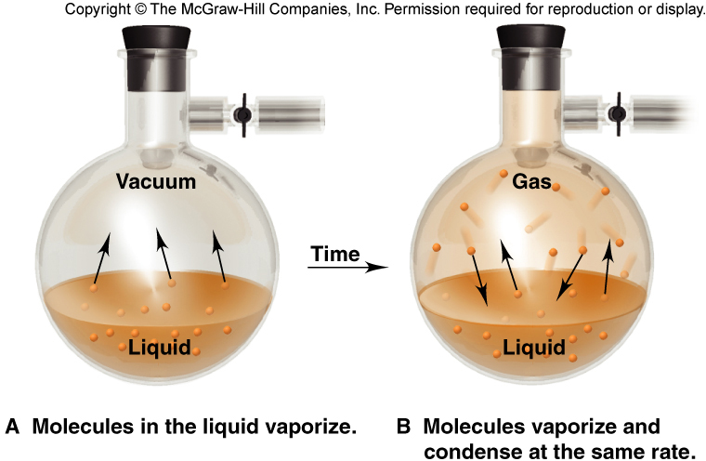
Figure 12.4
Liquid-gas equilibrium.
In a closed flask, the system reaches a state of dynamic equilibrium, where molecules are leaving and entering the liquid at the same rate.
Notes:
‹#›

Slide 17
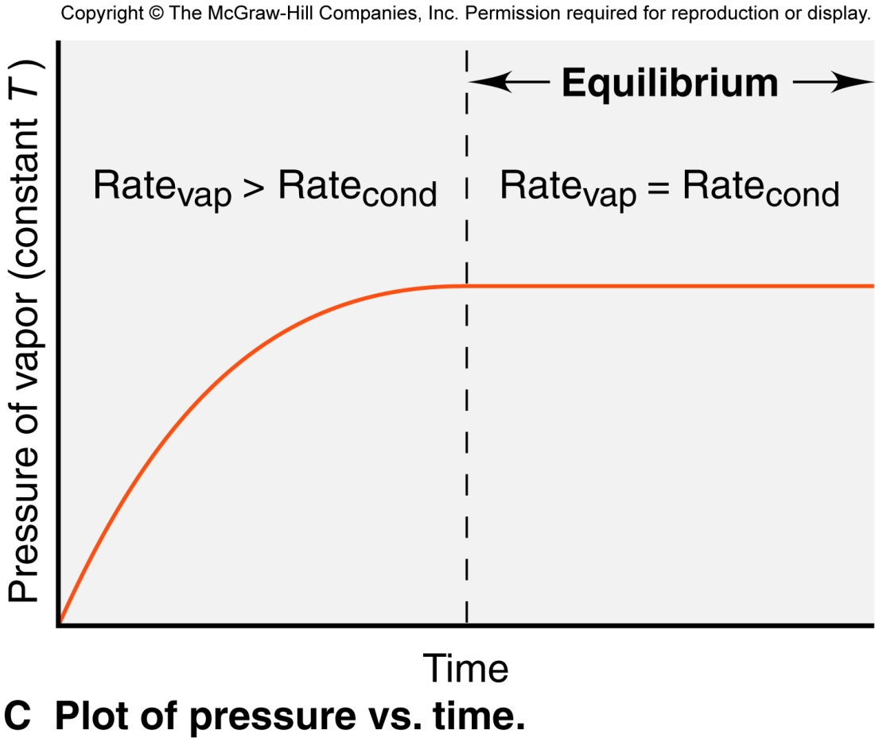
Figure 12.4 continued
The vapor pressure is the pressure exerted by the vapor on the liquid. The pressure increases until equilibrium is reached; at equilibrium the pressure is constant.
Notes:
‹#›

Slide 18
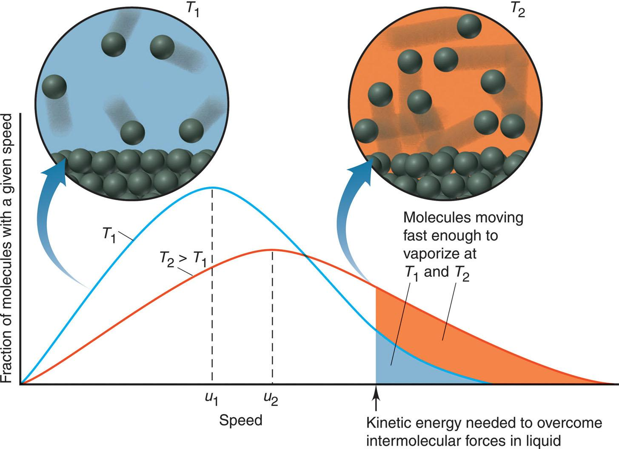
Figure 12.5
The effect of temperature on the distribution of molecular speeds.
Notes:
‹#›

Slide 19
Factors affecting Vapor Pressure
As temperature increases, the fraction of molecules with enough energy to enter the vapor phase increases, and the vapor pressure increases.
higher T higher P
The weaker the intermolecular forces, the more easily particles enter the vapor phase, and the higher the vapor pressure.
weaker forces higher P
Notes:
‹#›

Slide 20
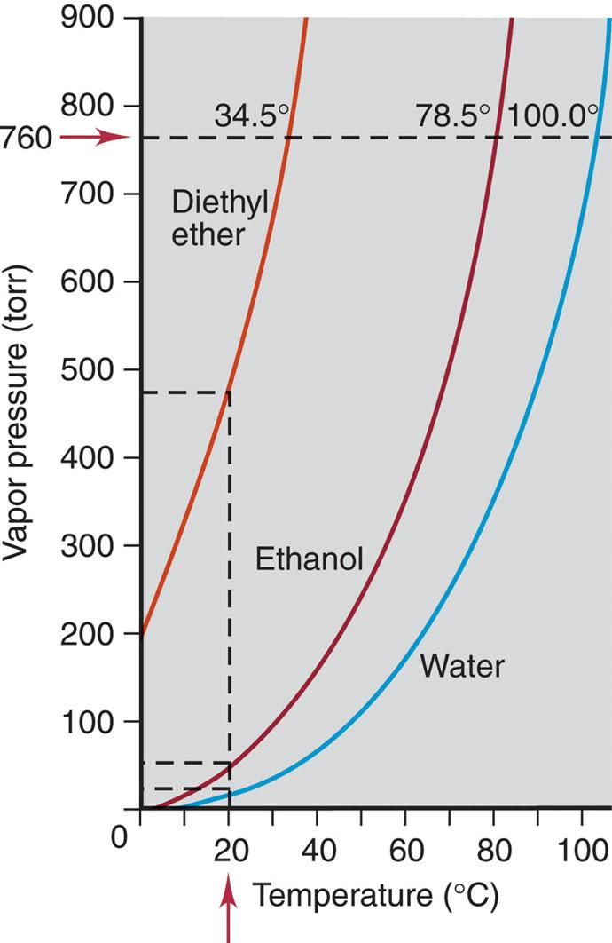
Figure 12.6
Vapor pressure as a function of temperature and intermolecular forces.
Vapor pressure increases as temperature increases.
Vapor pressure decreases as the strength of the intermolecular forces increases.
Notes:
‹#›

Slide 21
The Clausius-Clapeyron Equation
This equation relates vapor pressure to temperature.
The two-point form is used when the vapor pressures at two different temperatures are known.
Notes:
‹#›

Slide 22
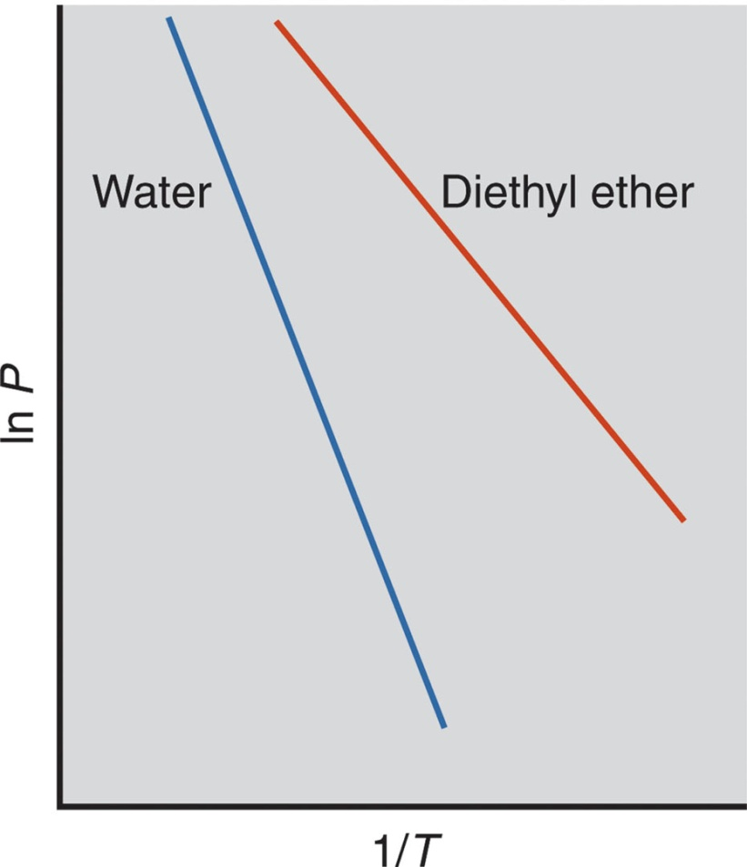
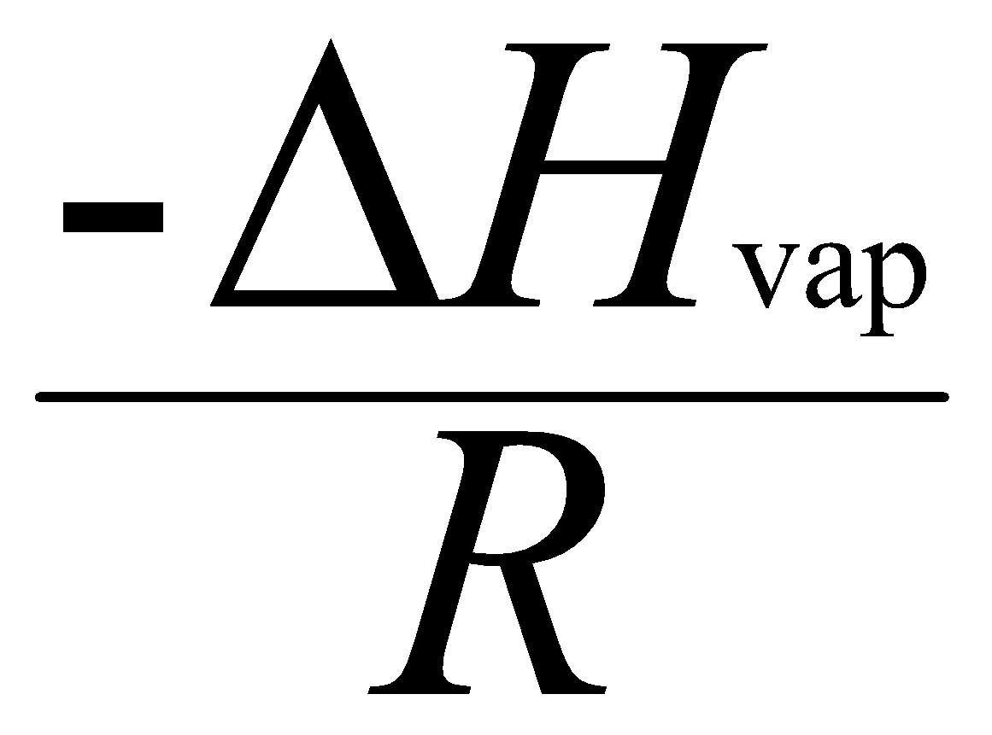
Figure 12.7
Linear plots of the relationship between vapor pressure and temperature .
slope =
Notes:
‹#›

Slide 23
Sample Problem 12.2
Applying the Clausius-Clapeyron Equation
PROBLEM:
The vapor pressure of ethanol is 115 torr at 34.9°C. If ΔH_{vap} of ethanol is 40.5 kJ/mol, calculate the temperature (in °C) when the vapor pressure is 760 torr.
PLAN:
We are given 4 of the 5 variables in the Clausius-Clapeyron equation, so we substitute these into the equation and solve for T₂. T values must be converted to K.
SOLUTION:
P₂
P₁
ΔH_{vap}
R
1
1
T₁ = 34.9°C + 273.15 = 308.0 K
ln
= -
−
T₂
T₁
760 torr
- 40.5 x10³ J/mol
1
1
ln
=
−
115 torr
8.314 J/mol∙K
T₂
308.0 K
T₂ = 350. K – 273.15 = 77°C
Notes:
‹#›

Slide 24
Vapor Pressure and Boiling Point
The boiling point of a liquid is the temperature at which the vapor pressure equals the external pressure.
The normal boiling point of a substance is observed at standard atmospheric pressure or 760 torr.
As the external pressure on a liquid increases, the boiling point increases.
Notes:
‹#›

Slide 25
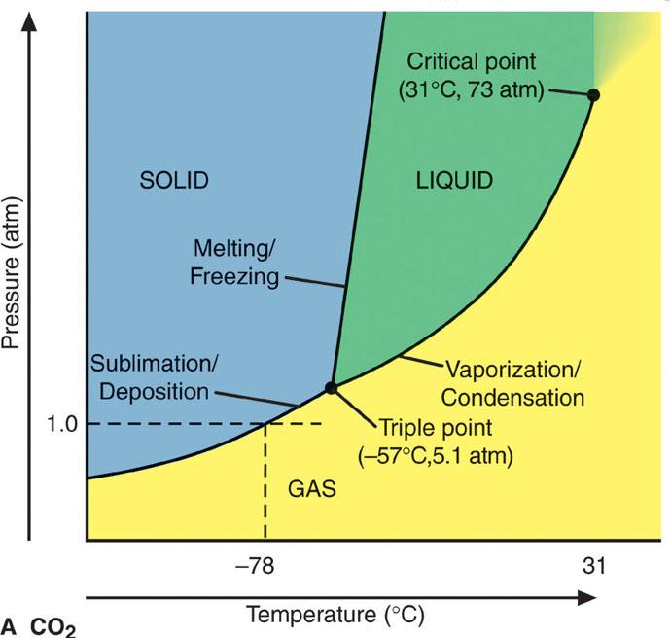
Figure 12.8
Phase diagram for CO₂.
At the critical point, the densities of the liquid and gas phases become equal.
At the triple point, all three phases are in equilibrium.
Notes:
‹#›

Slide 26
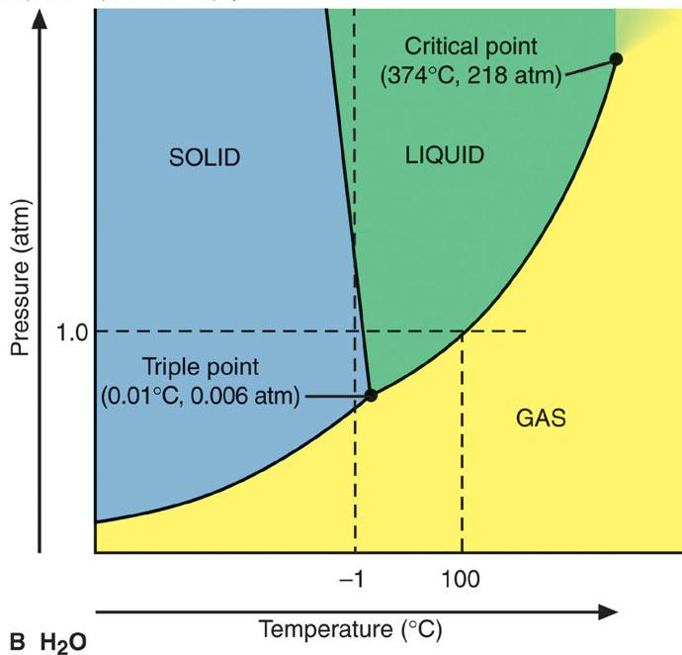
Figure 12.8
Phase diagram for H₂O.
The solid-liquid line slants to the left for H₂O, because the solid is less dense than the liquid. Water expands on freezing.
Notes:
‹#›

Slide 27
The Nature of Intermolecular Forces
Intermolecular forces arise from the attraction between molecules with partial charges, or between ions and molecules.
Intermolecular forces are relatively weak compared to bonding forces because they involve smaller charges that are farther apart.
Notes:
‹#›

Slide 28
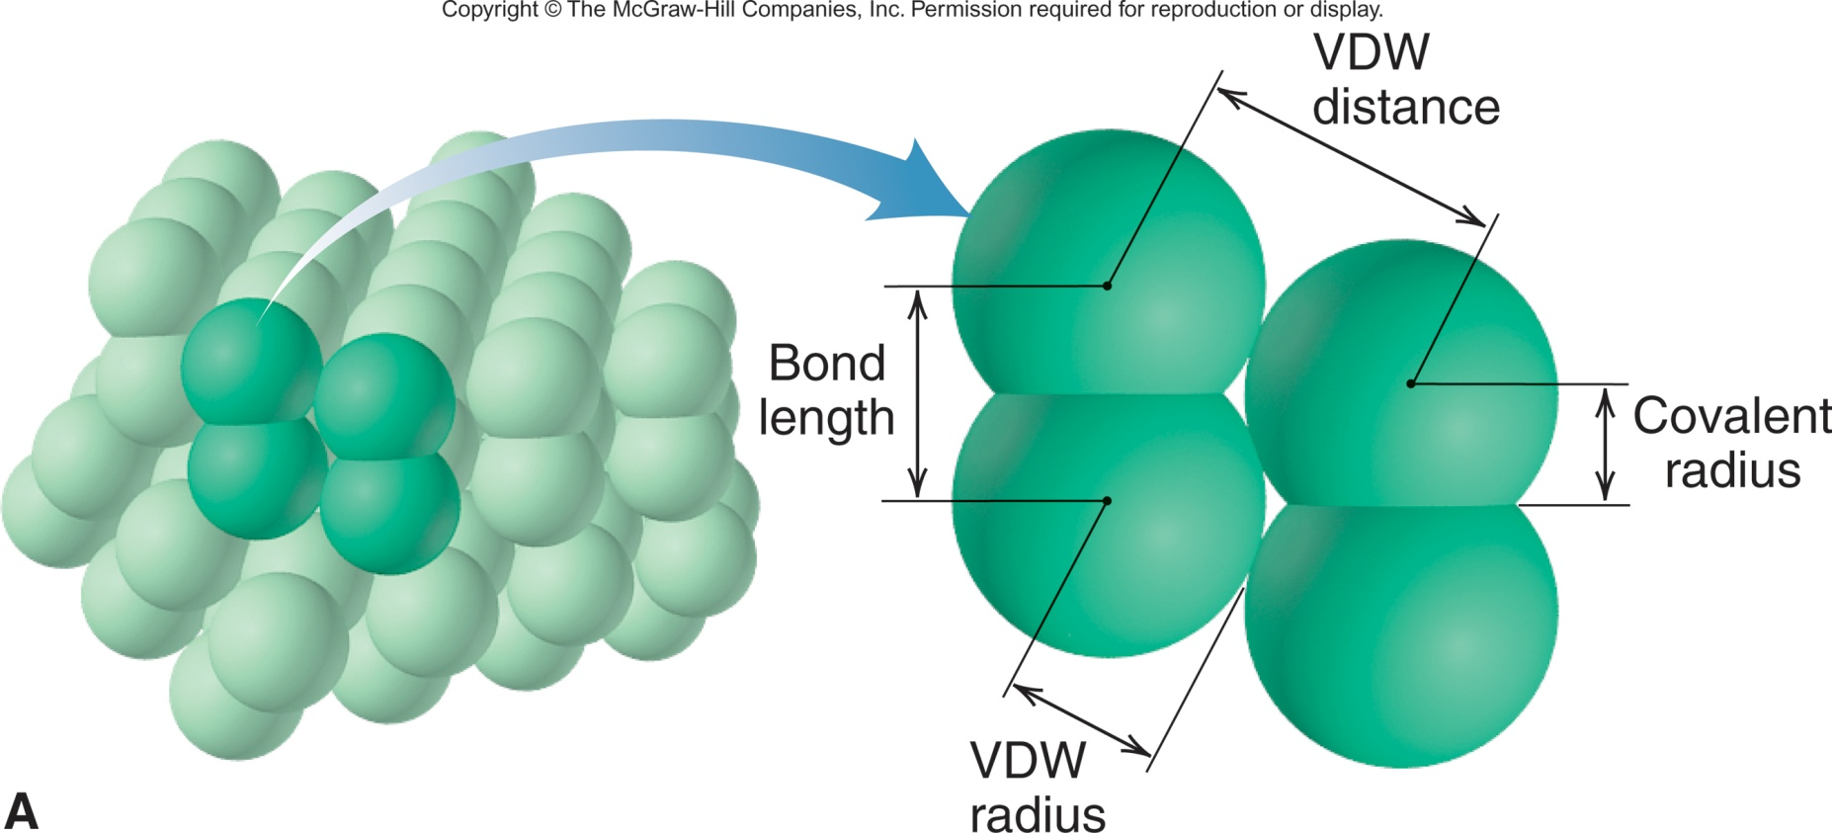
Figure 12.9A
Covalent and van der Waals radii.
The van der Waals distance is the distance between two nonbonded atoms in adjacent molecules.
The van der Waals radius is one-half the closest distance between the nuclei of two nonbonded atoms. The VDW radius is always larger than the covalent radius.
Notes:
‹#›

Slide 29
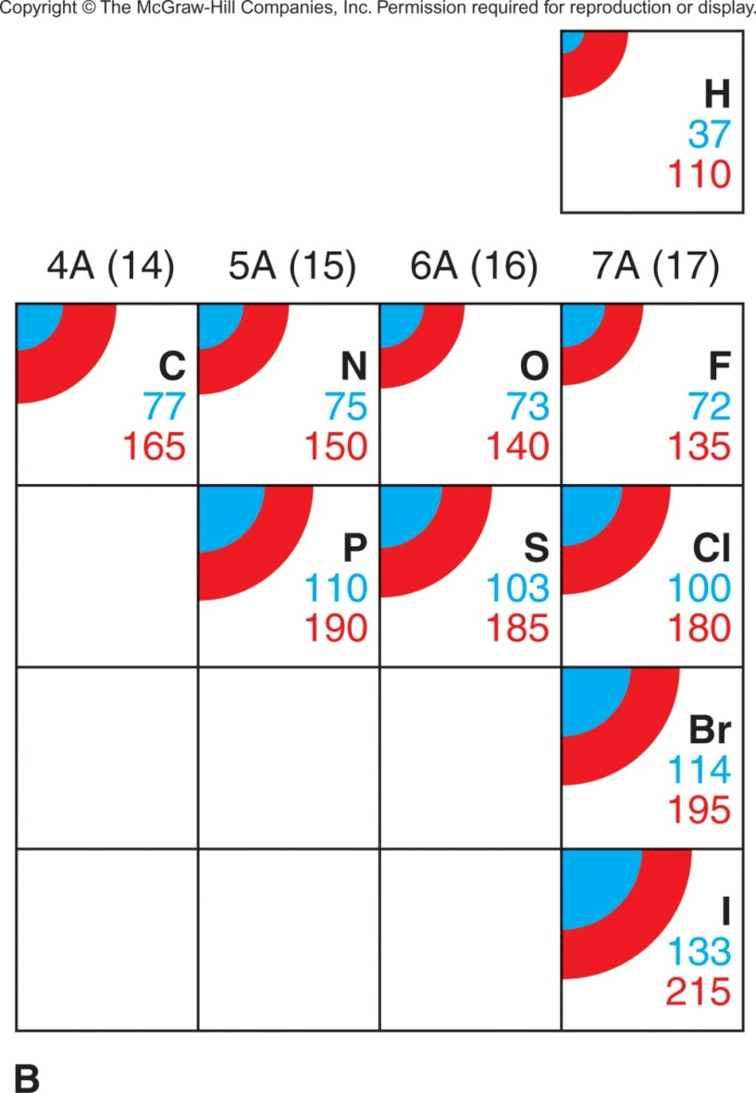
Figure 12.9B
Periodic trends in covalent and van der Waals radii.
Notes:
‹#›

Slide 30
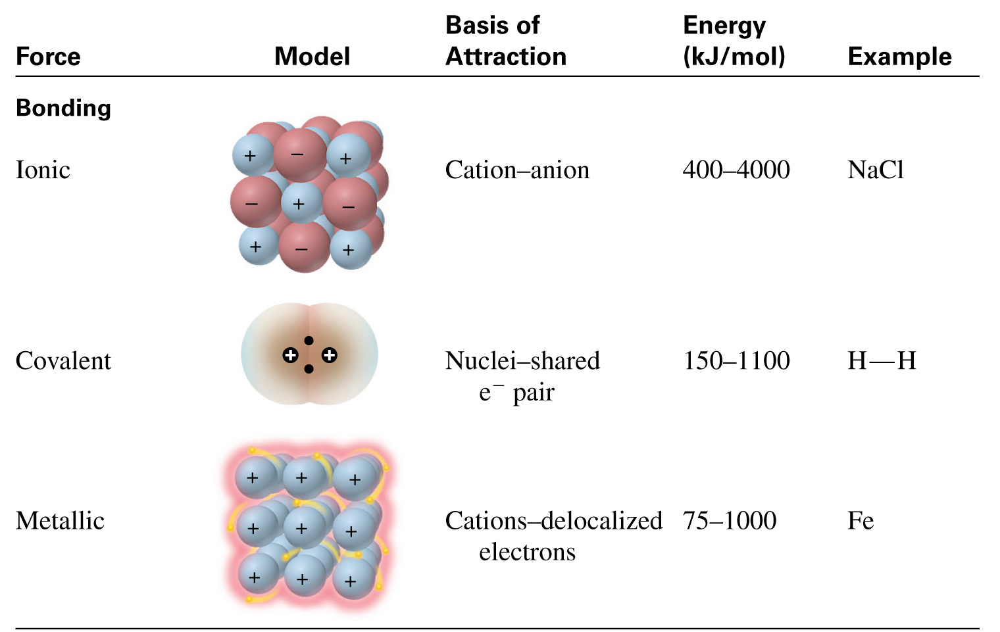
Table 12.2 Comparison of Bonding and Nonbonding (Intermolecular) Forces
Notes:
‹#›

Slide 31
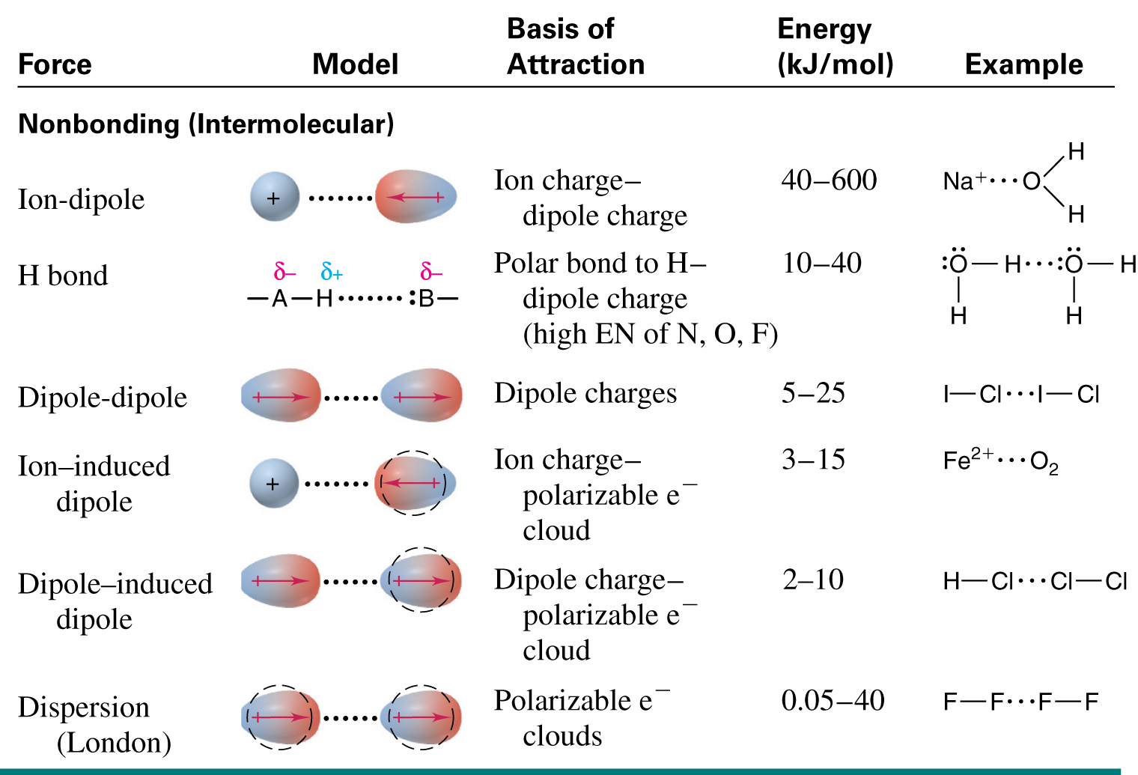
Table 12.2 Comparison of Bonding and Nonbonding (Intermolecular) Forces (continued)
Notes:
‹#›

Slide 32
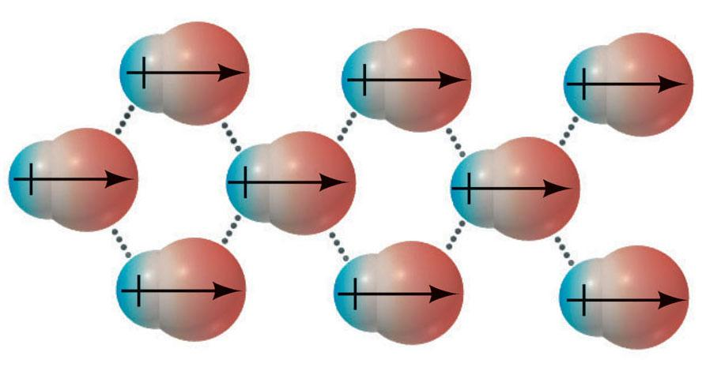
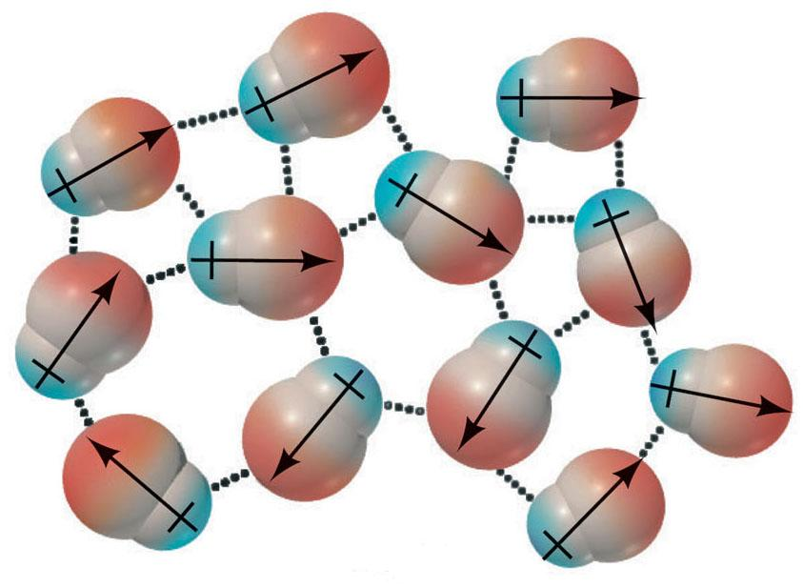
Figure 12.10
Polar molecules and dipole-dipole forces.
solid
liquid
The positive pole of one polar molecule attracts the negative pole of another.
Notes:
‹#›

Slide 33
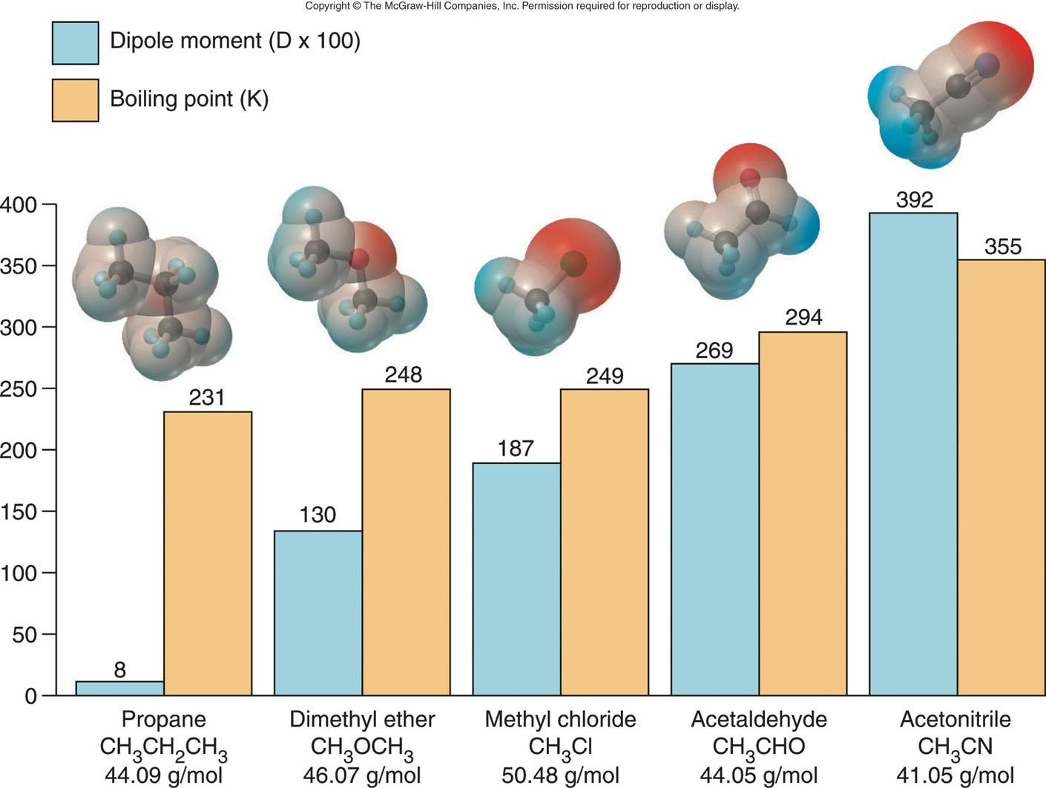
Figure 12.11
Dipole moment and boiling point.
Notes:
‹#›

Slide 34
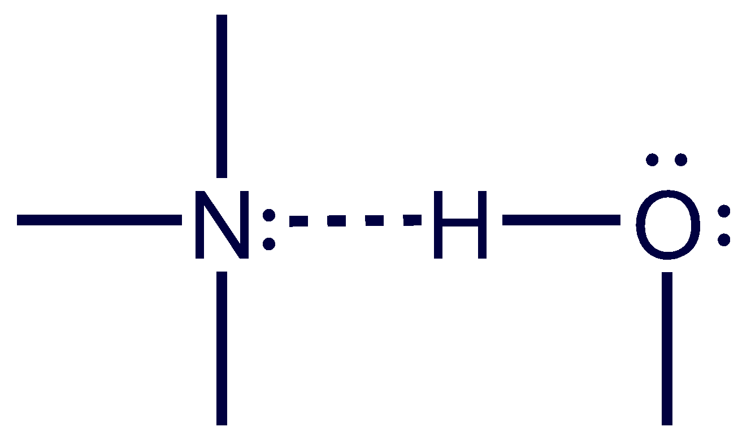
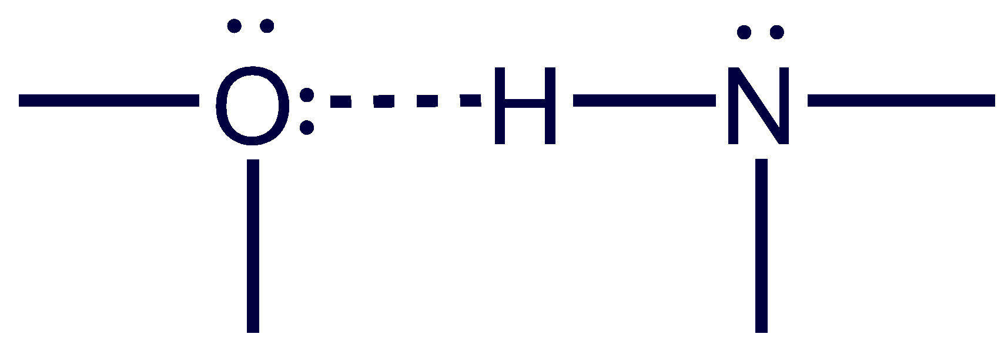
The Hydrogen Bond
Hydrogen bonding is possible for molecules that have a hydrogen atom covalently bonded to a small, highly electronegative atom with lone electron pairs, specifically N, O, or F.
An intermolecular hydrogen bond is the attraction between the H atom of one molecule and a lone pair of the N, O, or F atom of another molecule.
Notes:
‹#›

Slide 35
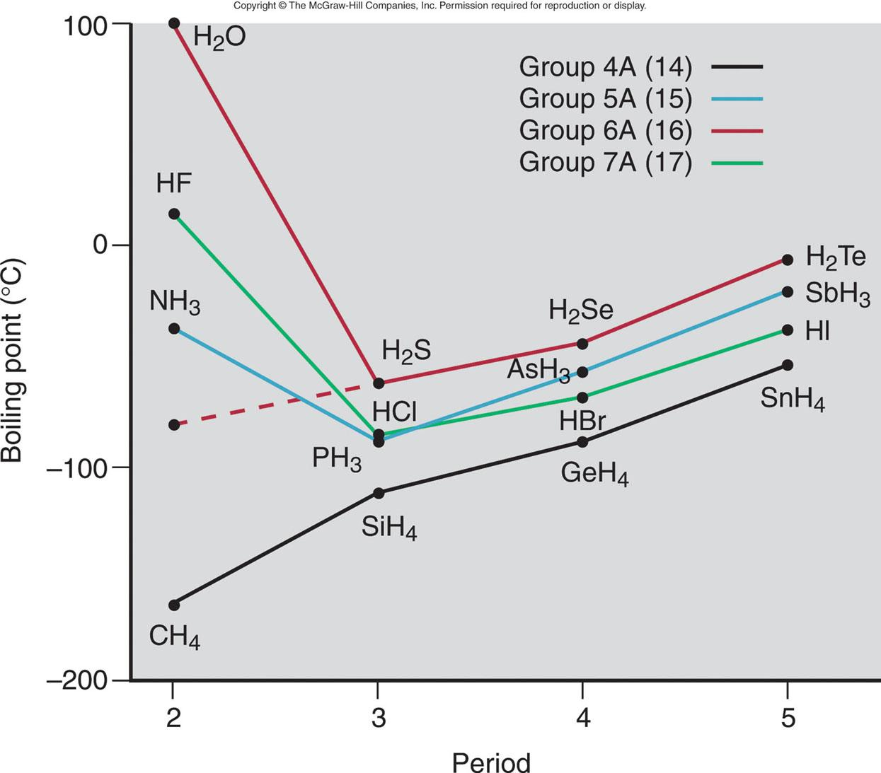
Figure 12.12
Hydrogen bonding and boiling point.
Notes:
‹#›

Slide 36
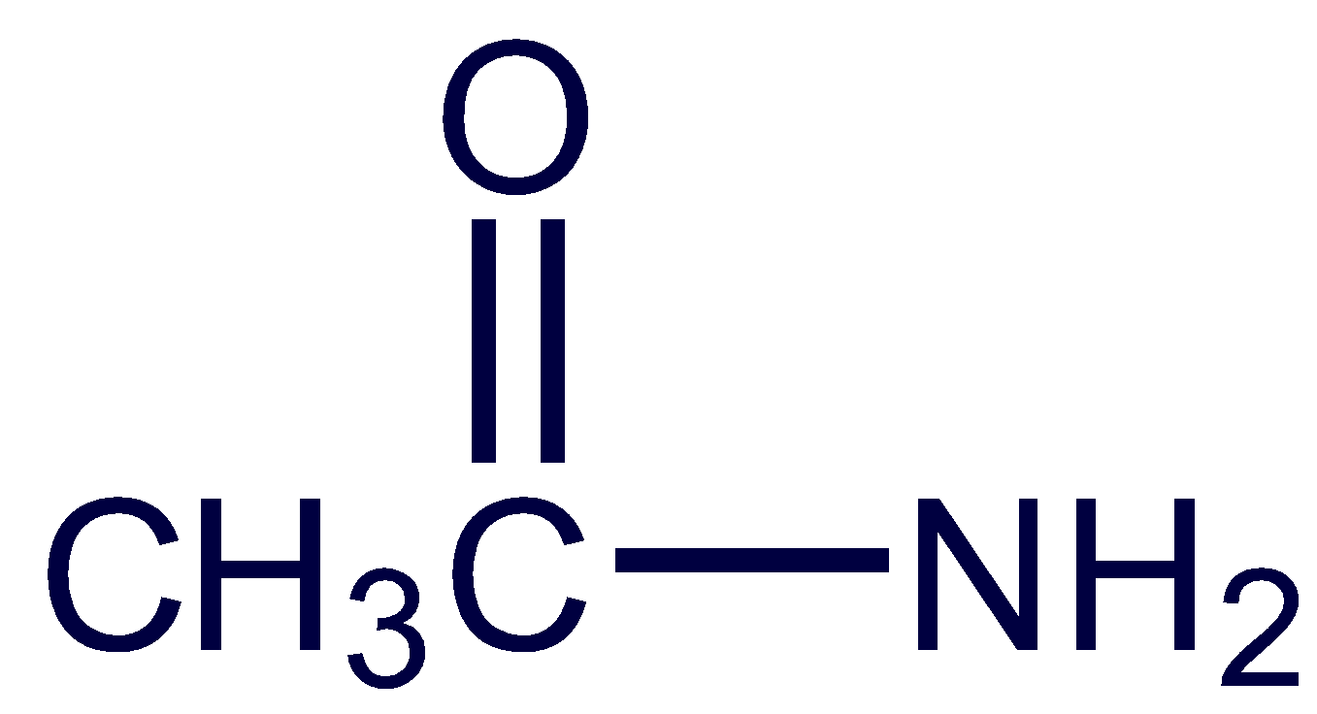
Sample Problem 12.3
Drawing Hydrogen Bonds Between Molecules of a Substance
PROBLEM:
Which of the following substances exhibits H bonding? For any that do, draw the H bonds between two of its molecules.
(a) C₂H₆ (b) CH₃OH (c)
PLAN:
If the molecule does not contain N, O, or F it cannot form H bonds. If it contains any of these atoms covalently bonded to H, we draw two molecules in the pattern –B:----H–A.
SOLUTION:
(a) C₂H₆ has no N, O, or F, so no H-bonds can form.
Notes:
‹#›

Slide 37
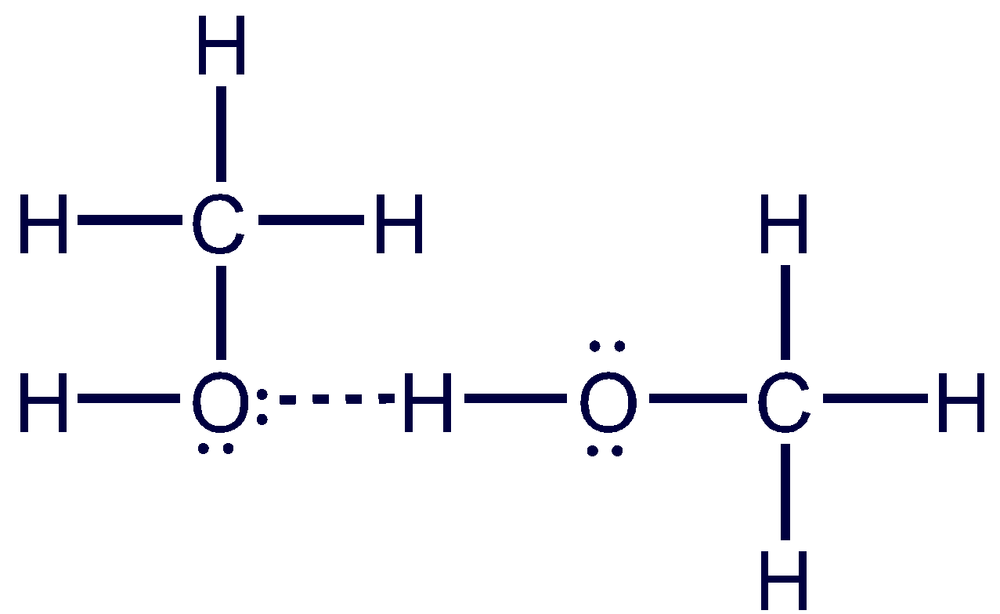
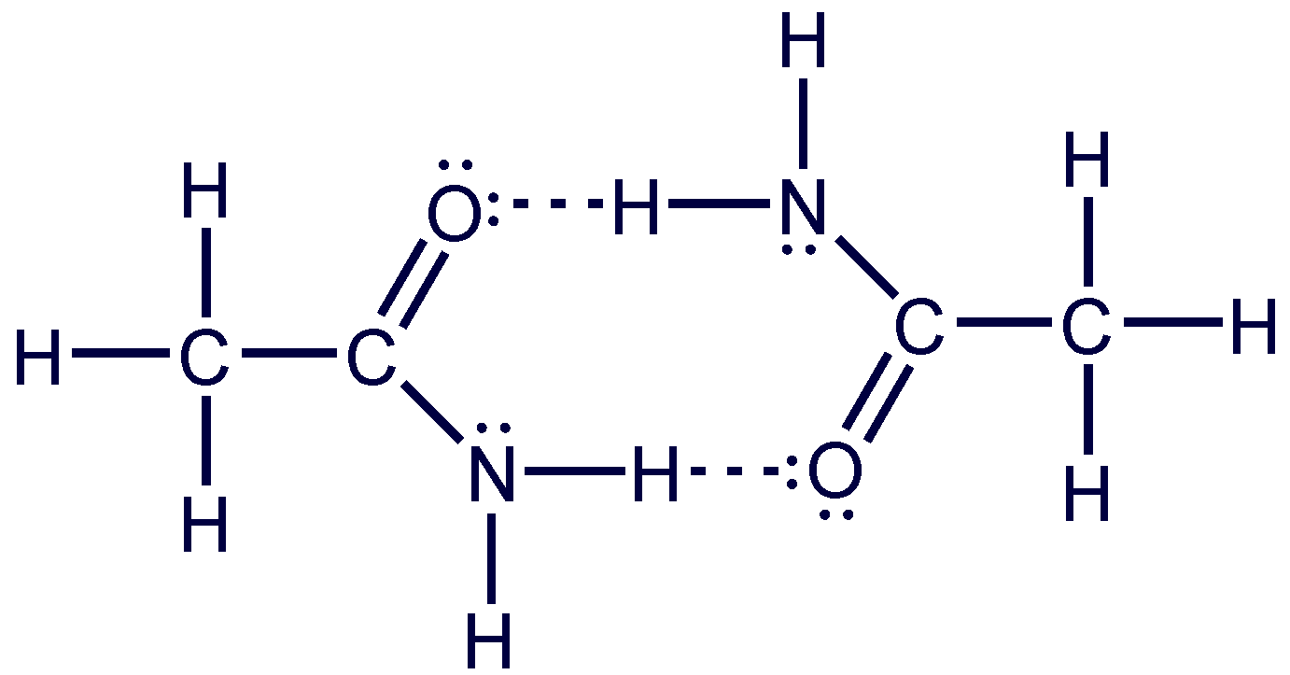
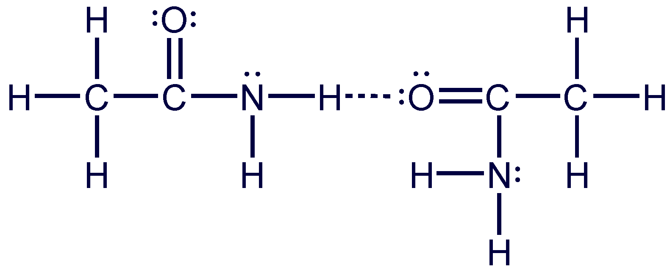
Sample Problem 12.3
(b) CH₃OH contains a covalent bond between O and H. It can form H bonds between its molecules:
(c) can form H bonds at two sites:
Notes:
‹#›

Slide 38
Polarizability and Induced Dipoles
A nearby electric field can induce a distortion in the electron cloud of an atom, ion, or molecule.
- For a nonpolar molecule, this induces a temporary dipole moment.
- For a polar molecule, the field enhances the existing dipole moment.
The polarizability of a particle is the ease with which its electron cloud is distorted.
Notes:
‹#›

Slide 39
Trends in Polarizability
Smaller particles are less polarizable than larger ones because their electrons are held more tightly.
Polarizability increases down a group because atomic size increases and larger electron clouds distort more easily.
Polarizability decreases across a period because of increasing Z_{eff}.
Cations are smaller than their parent atoms and less polarizable; anions show the opposite trend.
Notes:
‹#›

Slide 40
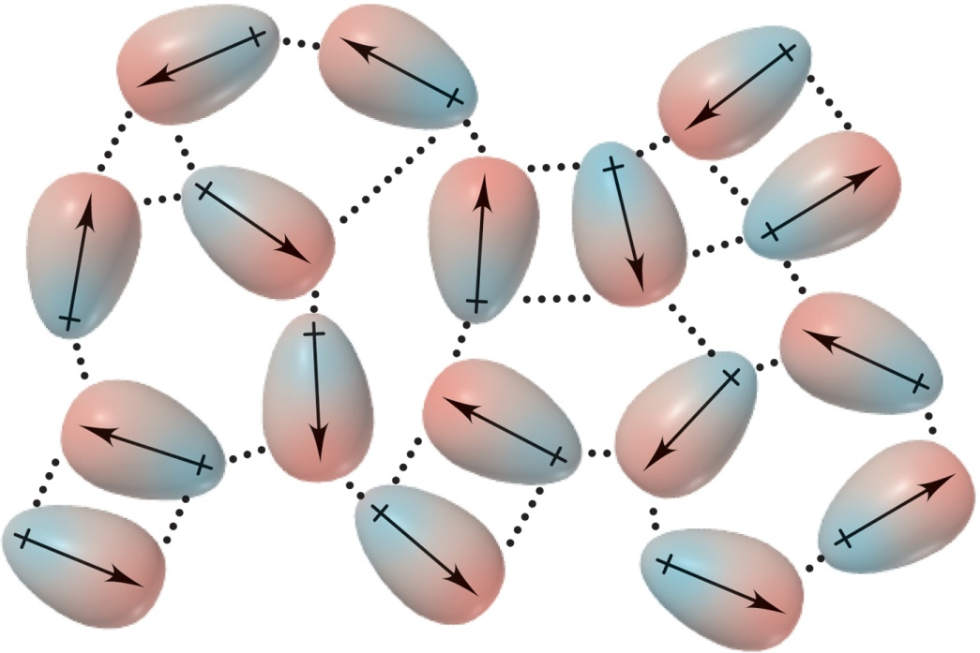
Figure 12.13
Dispersion forces among nonpolar particles.
A. When atoms are far apart they do not influence one other.
B. When atoms are close together, the instantaneous dipole in one atom induces a dipole in the other.
C. The process occurs throughout the sample.
Notes:
‹#›

Slide 41
Dispersion (London) Forces
Dispersion forces or London forces arises when an instantaneous dipole in one particle induces a dipole in another, resulting in an attraction between them.
Dispersion forces exist between all particles, increasing the energy of attraction in all matter.
Dispersion forces are stronger for more polarizable particles.
In general, larger particles experience stronger dispersion forces than smaller ones.
Notes:
‹#›

Slide 42
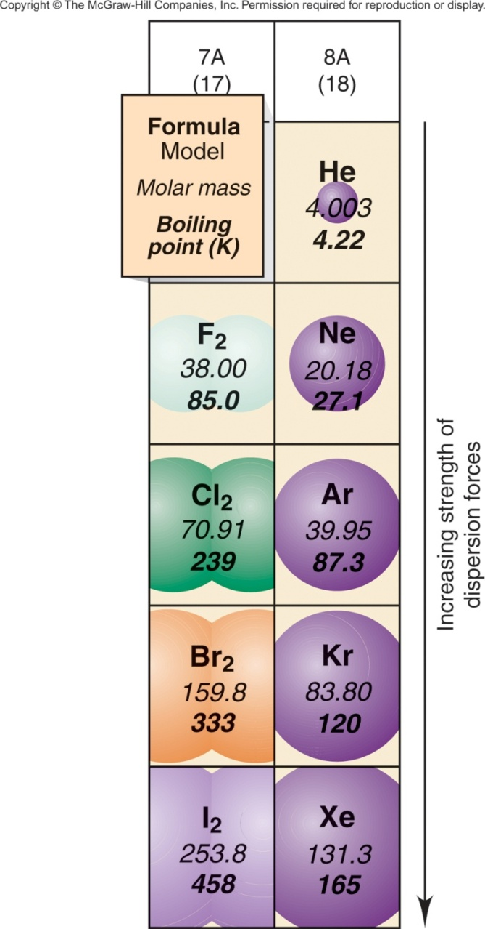
Figure 12.14
Molar mass and trends in boiling point.
Dispersion forces are stronger for larger, more polarizable particles.
Polarizability correlates closely with molar mass for similar particles.
Notes:
‹#›

Slide 43
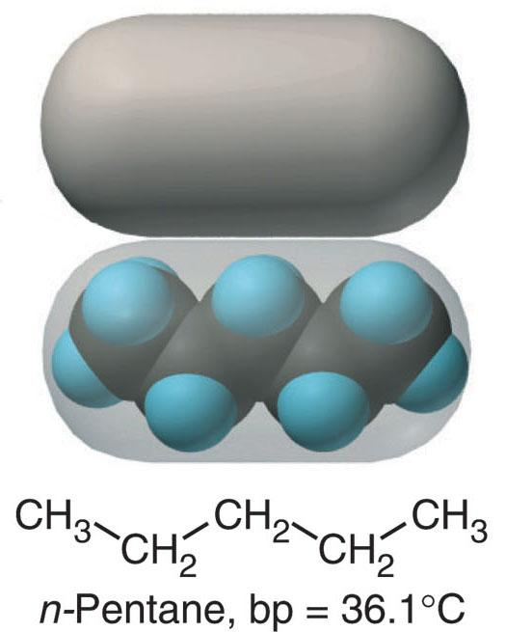
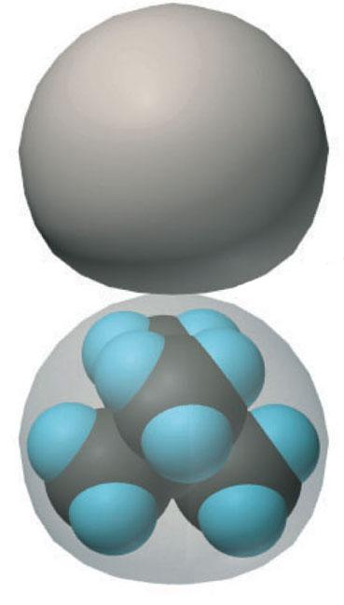
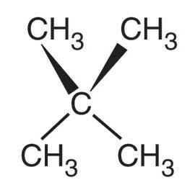
Figure 12.15
Molecular shape, intermolecular contact, and boiling point.
There are more points at which dispersion forces act.
There are fewer points at which dispersion forces act.
Notes:
‹#›

Slide 44
Figure 12.16
Determining the intermolecular forces in a sample.
INTERACTING PARTICLES
(atoms, molecules, ions)
ions present
ions not present
ions only:
IONIC BONDING
(Section 9.2)
polar molecules only:
DIPOLE-DIPOLE
FORCES
nonpolar
molecules only:
DISPERSION
FORCES only
ions + polar molecules:
ION-DIPOLE FORCES
H bonded to
N, O, or F
polar + nonpolar molecules
DIPOLE-INDUCED DIPOLE
FORCES
HYDROGEN
BONDING
DISPERSION FORCES ALSO PRESENT
Notes:
‹#›

Slide 45
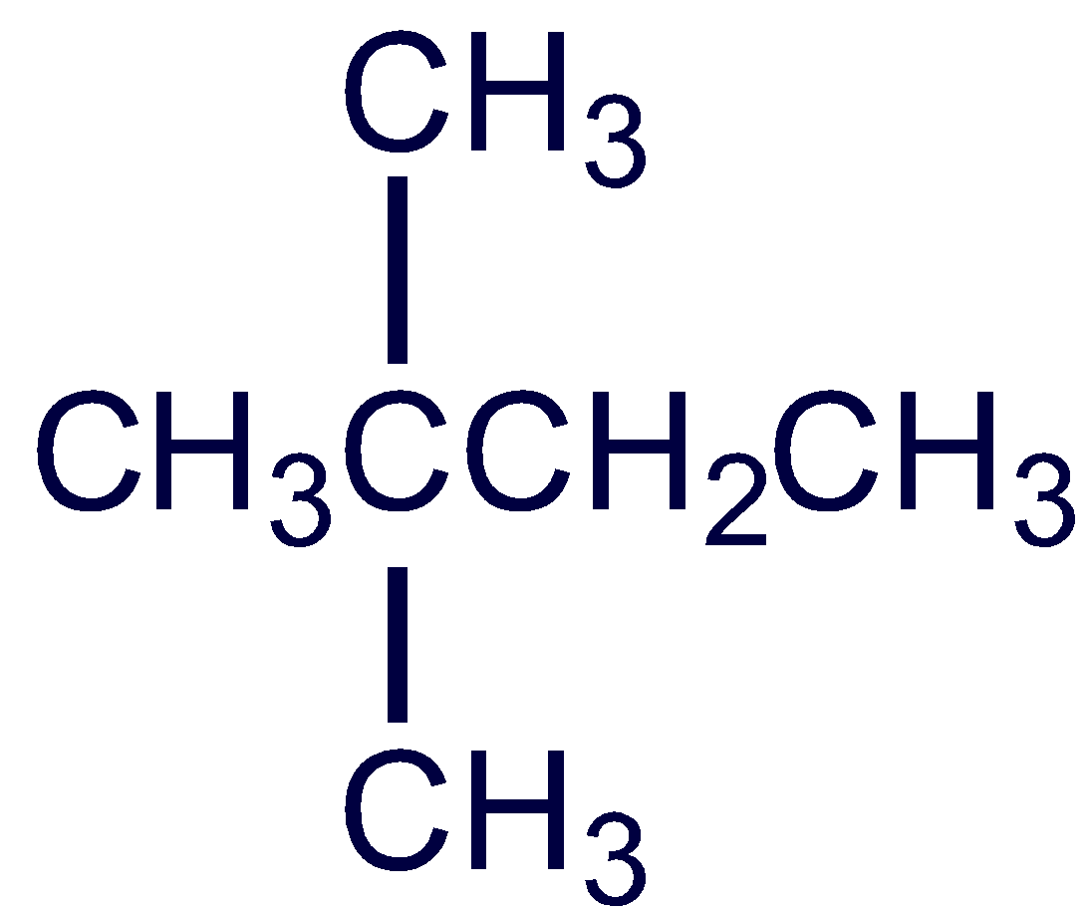
Sample Problem 12.4
Predicting the Types of Intermolecular Forces
PROBLEM:
For each pair of substances, identify the key bonding and/or intermolecular force(s), and predict which one of the pair has the higher boiling point:
(a) MgCl₂ or PCl₃ (b) CH₃NH₂ or CH₃F (c) CH₃OH or CH₃CH₂OH
(d) Hexane (CH₃CH₂CH₂CH₂CH₂CH₃) or 2,2-dimethylbutane
PLAN:
We examine the formulas and structures for key differences between the members of each pair: Are ions present? Are molecules polar or nonpolar? Is N, O, or F bonded to H? Do molecular compounds have different masses or shapes?
Notes:
‹#›

Slide 46
Sample Problem 12.4
Remember that:
Bonding forces are stronger than nonbonding (intermolecular) forces.
Hydrogen bonding is a strong type of dipole-dipole force.
Dispersion forces are decisive when the difference is molar mass or molecular shape.
SOLUTION:
(a) MgCl₂ consists of Mg²⁺ and Cl⁻ ions held together by ionic bonding forces; PCl₃ consists of polar molecules, so intermolecular dipole-dipole forces are present. The ionic bonding forces in MgCl₂ are stronger than the dipole-dipole forces in PCl₃..
MgCl₂ has a higher boiling point than PCl₃.
Notes:
‹#›

Slide 47
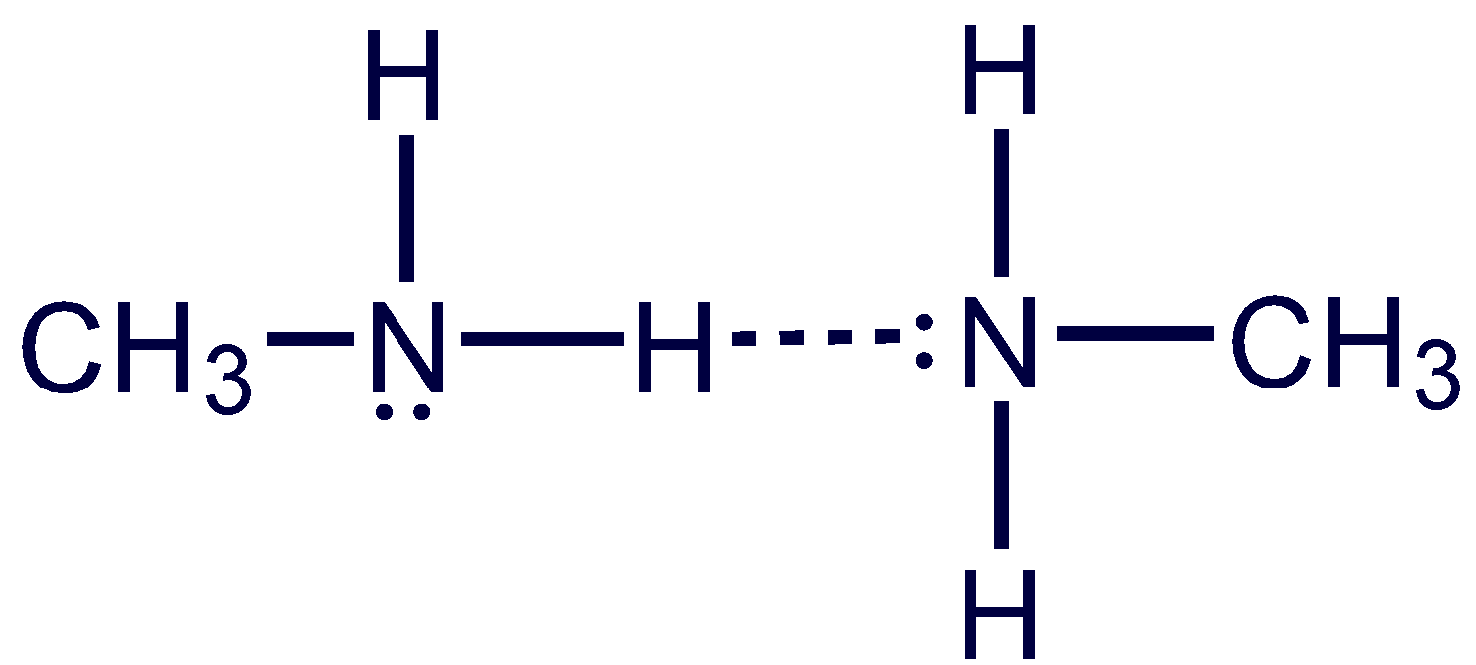
Sample Problem 12.4
(b) CH₃NH₂ and CH₃F both consist of polar molecules of about the same molar mass. CH₃NH₂ has covalent N-H bonds, so it can form H bonds between its molecules. CH₃F contains a C-F bond but no H-F bond, so dipole-dipole forces occur but not H bonds.
CH₃NH₂ has a higher boiling point than CH₃F.
Notes:
‹#›

Slide 48
Sample Problem 12.4
(c) CH₃OH and CH₃CH₂OH are both polar molecules and both contain a covalent O-H bond. Both can therefore form H bonds.
CH₃CH₂OH has a larger molar mass than CH₃OH and its dispersion forces are therefore stronger.
CH₃CH₂OH has a higher boiling point than CH₃OH.
Notes:
‹#›

Slide 49
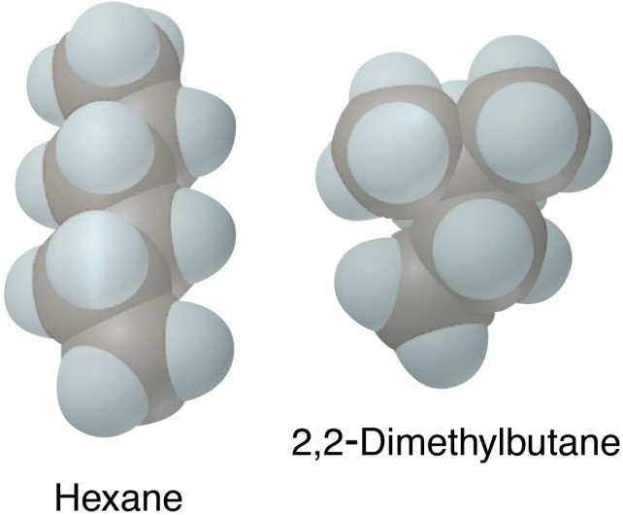
Sample Problem 12.4
(d) Hexane and 2,2-dimethylbutane are both nonpolar molecules and therefore experience dispersion forces as their only intermolecular force. They have equal molar masses but different molecular shapes.
Cylindrical hexane molecules make more intermolecular contact than the more compact 2,2-dimethylbutane molecules.
Hexane has a higher boiling point than 2,2-dimethylbutane.
Notes:
‹#›

Slide 50
Sample Problem 12.4
CHECK:
The actual boiling points show our predictions are correct:
(a) MgCl₂ (1412°C) and PCl₃ (76°C)
CH₃NH₂ (-6.3°C) and CH₃F (-78.4°C)
CH₃OH (64,7°C) and CH₃CH₂OH (78.5°C)
Hexane (69°C) and 2,2-dimethylbutane (49.7°C)
Remember that dispersion forces are always present, but in (a) and (b) they are much less significant than the other forces that occur.
Notes:
‹#›

Slide 51
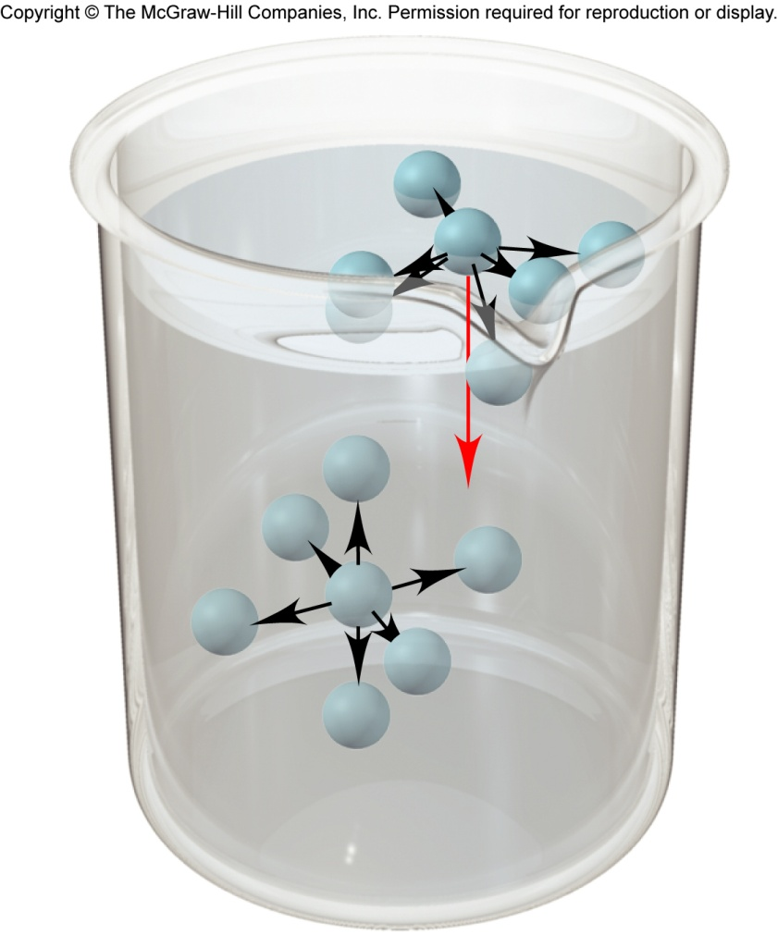
Figure 12.17
The molecular basis of surface tension.
A surface molecule experiences a net attraction downward. This causes a liquid surface to have the smallest area possible.
An interior molecule is attracted by others on all sides.
Surface tension is the energy required to increase the surface area of a liquid. The stronger the forces between the particles the higher the surface tension.
Notes:
‹#›

Slide 52
Surface Tension
(J/m²) at 20⁰C
Substance
Formula
Major Force(s)
Diethyl ether
CH₃CH₂OCH₂CH₃
1.7x10⁻²
Dipole-dipole; dispersion
Ethanol
CH₃CH₂OH
2.3x10⁻²
H bonding
Butanol
CH₃CH₂CH₂CH₂OH
2.5x10⁻²
H bonding; dispersion
Water
H₂O
7.3x10⁻²
H bonding
Mercury
Hg
48x10⁻²
Metallic bonding
Notes:
‹#›

Slide 53
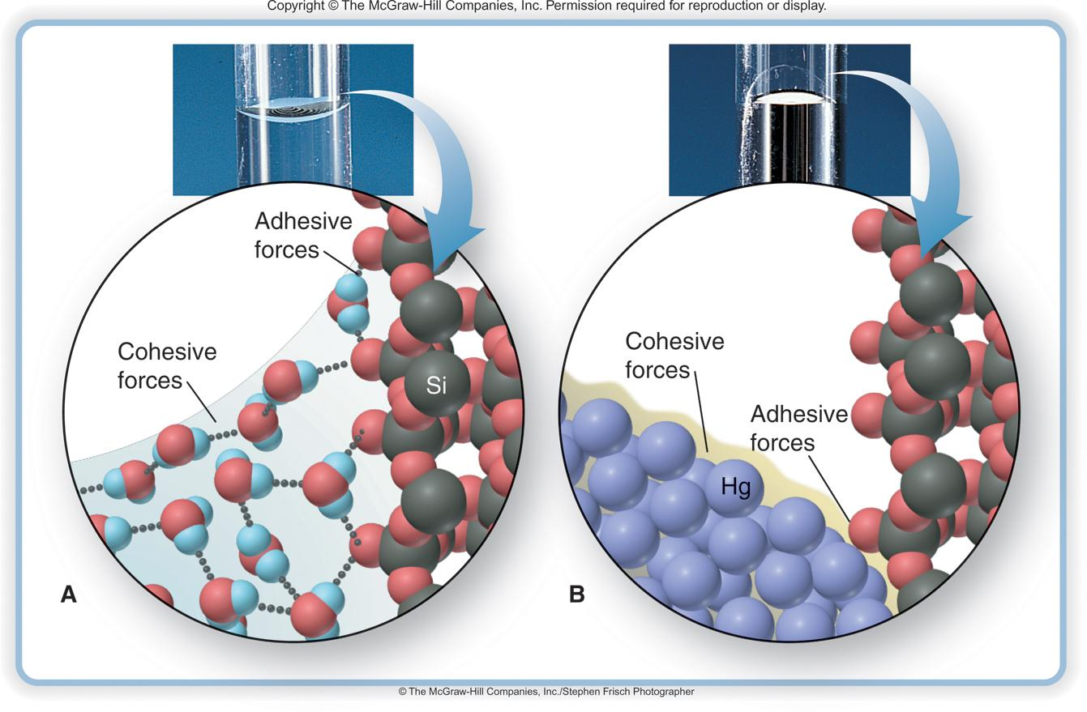
Figure 12.18
Capillary action and the shape of the water or mercury meniscus in glass.
A. Water displays a concave meniscus.
B. Mercury displays a convex meniscus.
Notes:
‹#›

Slide 54
Table 12.4 Viscosity of Water at Several Temperatures
Viscosity is resistance of a fluid to flow.
Viscosity (N∙s/m²)*
Temperature (°C)
20
1.00x10⁻³
40
0.65x10⁻³
60
0.47x10⁻³
80
0.35x10⁻³
*The units of viscosity are Newton-seconds per square meter.
Notes:
‹#›

Slide 55
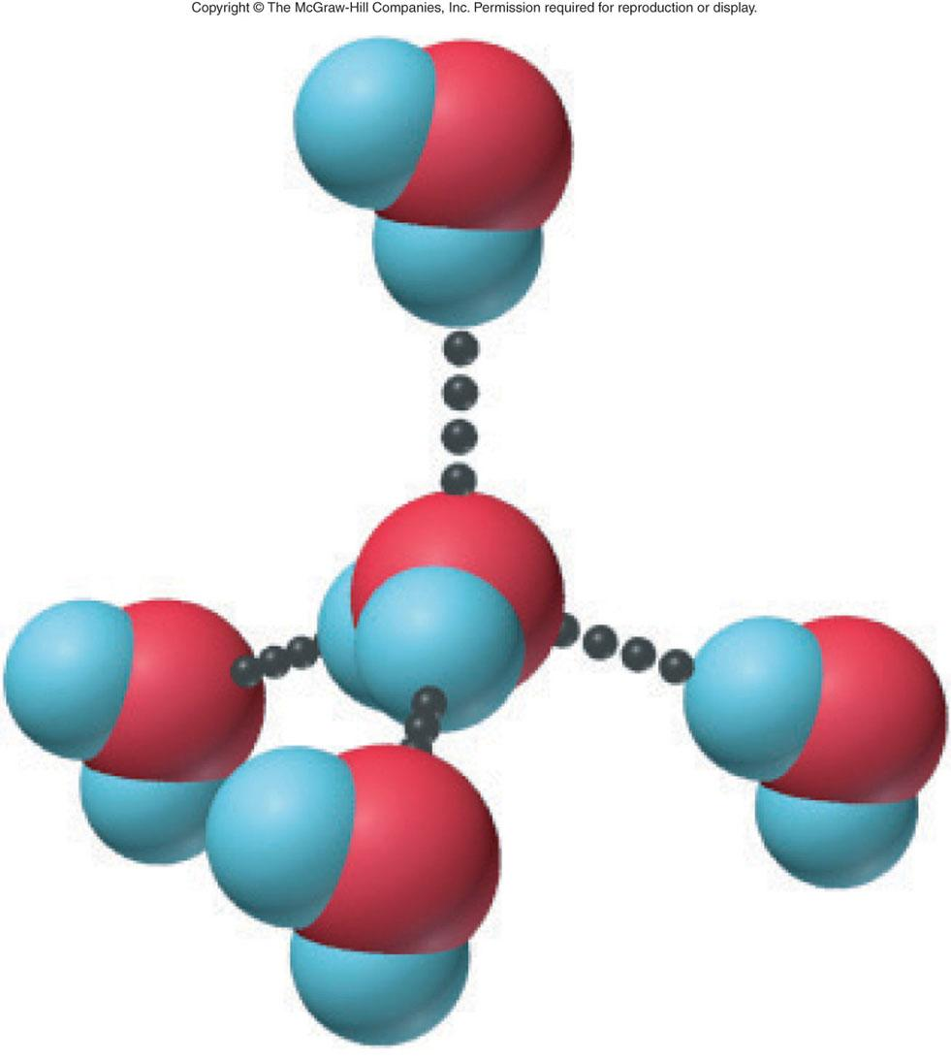
Figure 12.19
H-bonding ability of water.
hydrogen bond donor
hydrogen bond acceptor
Each H₂O molecule can form four H bonds to other molecules, resulting in a tetrahedral arrangement.
Notes:
‹#›

Slide 56
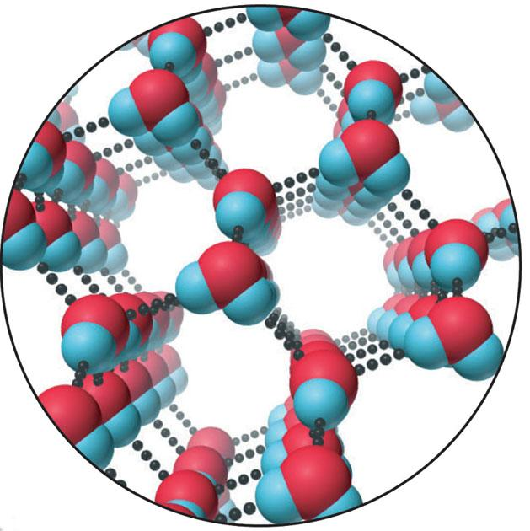
Figure 12.20
The hexagonal structure of ice.
Ice has an open structure due to H bonding. Ice is therefore less dense than liquid water.
Notes:
‹#›

Slide 57
The Solid State
Solids are divided into two categories:
Crystalline solids have well defined shapes due to the orderly arrangement of their particles.
Amorphous solids lack orderly arrangement and have poorly defined shapes.
A crystal is composed of particles packed in an orderly three-dimensional array called the crystal lattice.
Notes:
‹#›

Slide 58
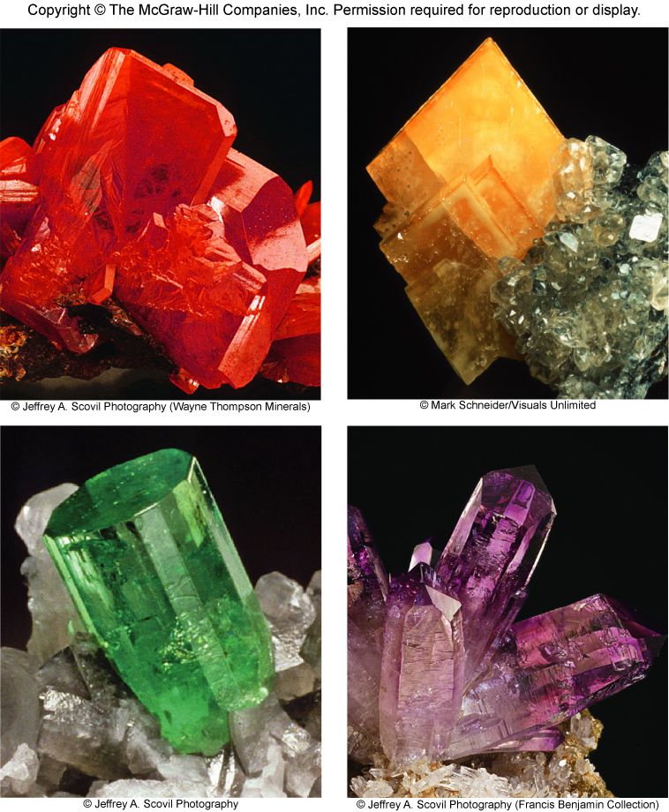
Figure 12.21
The beauty of crystalline solids.
Notes:
‹#›

Slide 59
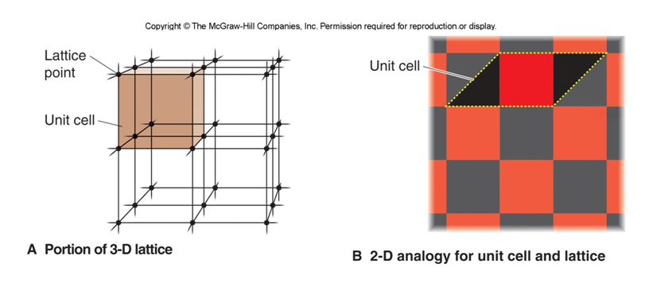
Figure 12.22
The cry stal lattice and the unit cell.
Notes:
‹#›

Slide 60
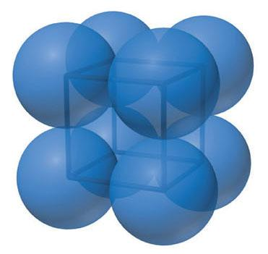
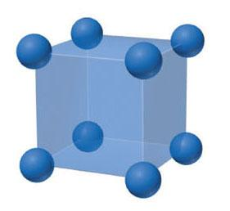
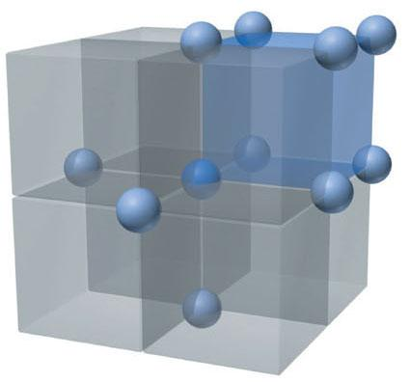
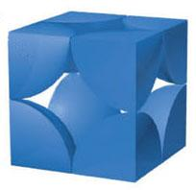
Figure 12.23A
Simple cubic unit cell.
Expanded view.
Space-filling view.
⅛ atom at 8 corners
Coordination number = 6
Atoms/unit cell = (⅛ x 8) = 1
Notes:
‹#›

Slide 61
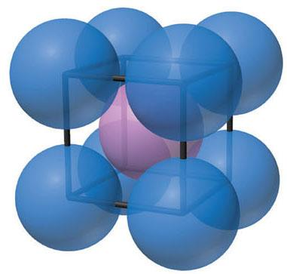
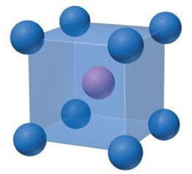
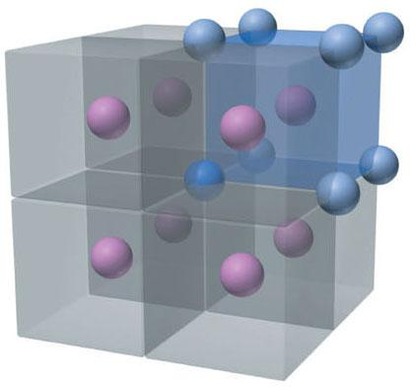
Figure 12.23B
Body-centered cubic unit cell.
⅛ atom at 8 corners
1 atom at center
Atoms/unit cell = (⅛ x 8) + 1 = 2
Coordination number = 8
Notes:
‹#›

Slide 62
Figure 12.23C
The face-centered cubic cell.
⅛ atom at 8 corners
½ atom at 6 faces
Atoms/unit cell = (⅛ x 8) + (½ x 6) = 4
Coordination number = 12
Notes:
‹#›

Slide 63
Figure 12.24
Packing spheres to obtain three cubic and hexagonal cells.
2nd layer directly over 1st
large diamond space
simple cubic
(52% packing efficiency)
2nd layer over diamond spaces in 1st
3rd layer over diamond spaces in 2nd
body-centered cubic
(68% packing efficiency)
Notes:
‹#›

Slide 64
Figure 12.24 continued
Notes:
‹#›

Slide 65
Figure 12.26
Edge length and atomic (ionic) radius in the three cubic unit cells.
Notes:
‹#›

Slide 66
Sample Problem 12.5
Determining Atomic Radius from the Unit Cell
PROBLEM:
Copper adopts cubic closest packing, and the edge length of the unit cell is 361.5 pm. What is the atomic radius of copper?
PLAN:
Cubic closest packing has a face-centered cubic unit cell, and we know the edge length. With Figure 12.26 and A = 361.5 pm, we solve for r.
Notes:
‹#›

Slide 67
Sample Problem 12.5
SOLUTION:
Using the Pythagorean theorem to find C, the diagonal of the cell’s face:
√
C = A² + B²
The unit cell is a cube, so A = B, Therefore
√
√
C = 2A²
=
2(361.5 pm)²
= 511.2 pm
511.2 pm
4
C = 4r, so r =
= 127.8 pm
Notes:
‹#›

Slide 68
Types of Crystalline Solids
Atomic solids consist of individual atoms held together only by dispersion forces.
Molecular solids consist of individual molecules held together by various combinations of intermolecular forces.
Ionic solids consist of a regular array of cations and anions.
Metallic solids exhibit an organized crystal structure.
Network Covalent solids consist of atoms covalently bonded together in a three-dimensional network.
Notes:
‹#›

Slide 69
Figure 12.27
Figure 12.28
Cubic closest packing of frozen argon (face-centered cubic cell).
Cubic closest packing (face-centered unit cell) of frozen CH₄.
Notes:
‹#›

Slide 70
Table 12.5 Characteristics of the Major Types of Crystalline Solids
Type | Particle(s) | Interparticle Forces | Physical Properties | Examples [mp, °C]
Atomic | Atoms | Dispersion | Soft, very low mp, poor thermal and electrical conductors | Group 8A(18) (Ne [-249) to Rn [-71])
Molecular | Molecules | Dispersion, dipole-dipole, H bonds | Fairly soft, low to moderate mp, poor thermal and electrical conductors | Nonpolar* O₂ [-219], C₄H₁₀ [-138] Cl₂ [-101], C₆H₁₄ [-95] P₄ [44.1] Polar SO₂ [-73], CHCl₃ [-64] HNO₃ [-42], H₂O [0.0] CH₃COOH [17]
*Nonpolar molecular solids are arranged in order of increasing molar mass. Note the correlation with increasing melting point (mp).
Notes:
‹#›

Slide 71
Table 12.5 Characteristics of the Major Types of Crystalline Solids (continued)
Type | Particle(s) | Interparticle Forces | Physical Properties | Examples [mp, °C]
Ionic | Positive and negative ions | Ion-ion attraction | Hard and brittle, high mp, good thermal and electrical conductors when molten | NaCl [801] CaF₂ [1423] MgO [2852]
Metallic | Atoms | Metallic bond | Soft to hard, low to very high mp, excellent thermal and electrical conductors, malleable and ductile | Na [97.8] Zn [420] Fe [1535]
Network covalent | Atoms | Covalent bond | Very hard, very high mp, usually poor thermal and electrical conductors | SiO₂ (quartz) [1610] C (diamond) [~4000]
Notes:
‹#›

Slide 72
Figure 12.29
The sodium chloride structure.
Expanded view.
Space-filling model.
Notes:
‹#›

Slide 73
Figure 12.30
Crystal structures of metals.
A. Copper adopts cubic closest packing.
B. Magnesium adopts hexagonal closest packing.
Notes:
‹#›

Slide 74
Table 12.6 Comparison of the Properties of Diamond and Graphite.
Property | Graphite | Diamond
Density (g/cm³) | 2.27 | 3.51
Hardness | < 1 (very soft) | 10 (hardest)
Melting point (K) | 4100 | 4100
Color | Shiny black | Colorless transparent
Electrical Conductivity | High (along sheet) | None
ΔH_{rxn} for combustion (kJ/mol) | -393.5 | -395.4
ΔH°_{f} (kJ/mol) | 0 (standard state) | 1.90
Notes:
‹#›

Slide 75
Figure 12.32
The band of molecular orbitals in lithium metal.
Notes:
‹#›

Slide 76
Figure 12.33
Electrical conductivity in a conductor, semiconductor, and insulator.
conductor
semiconductor
insulator
The conducting properties of a substance are determined by the energy gap between the valence and conduction bands of MOs.
Notes:
‹#›

