Slide 1
Karen Timberlake
CHEMISTRY
Thirteenth Edition, Global Edition
Chapter 1
Chemistry in Our Lives
(Lecture PPTs)
© 2019 Pearson Education Ltd.

Slide 2
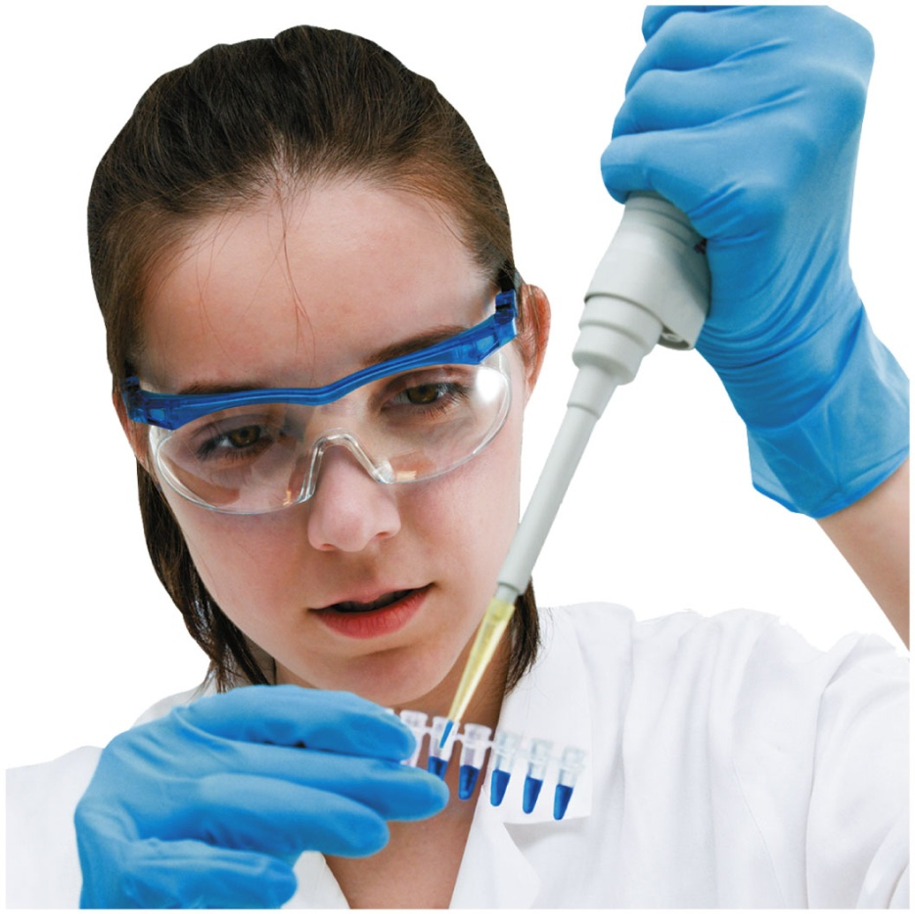
Chapter 1 Chemistry in Our Lives
Forensic scientists work in crime laboratories where they analyze bodily fluids and tissue samples collected by the crime scene investigators.

Slide 3
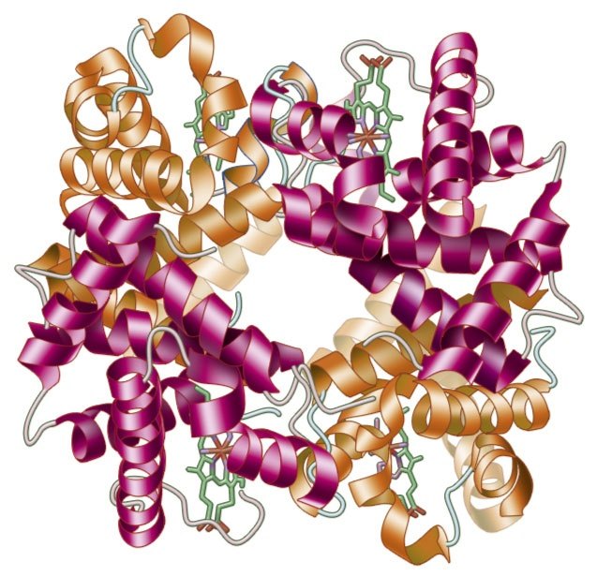
1.1 Chemistry and Chemicals
Learning Goal Define the term chemistry and identify substances as chemicals.
In the blood, hemoglobin transports oxygen to the tissues and carbon dioxide to the lungs.

Slide 4
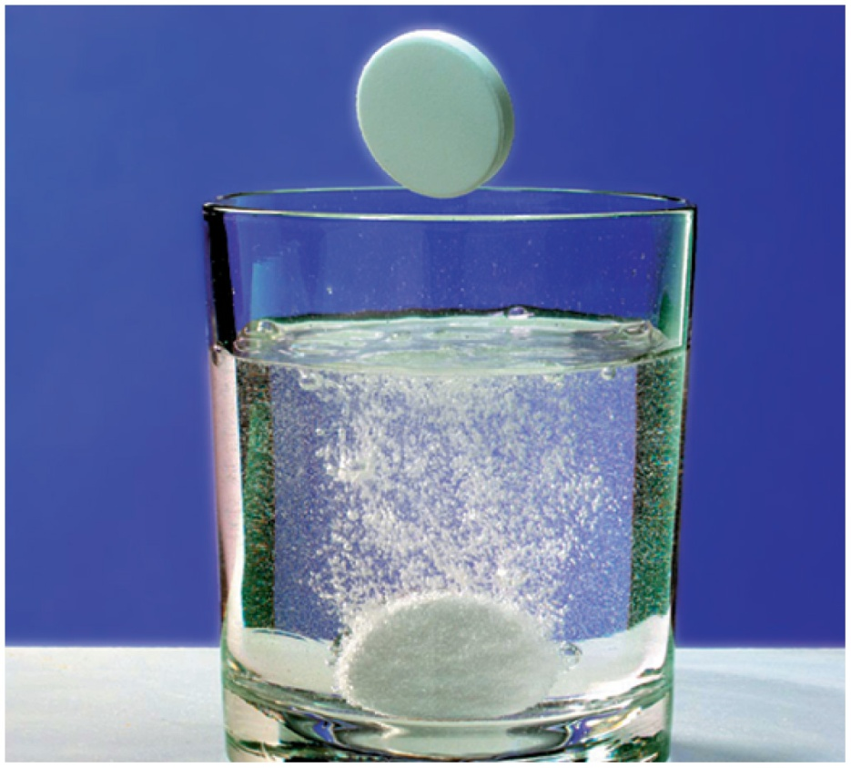
What Is Chemistry?
Chemistry
is the study of composition, structure, properties, and reactions of matter
happens all around you
every day
Antacid tablets undergo a chemical reaction when dropped in water.

Slide 5
What Is Chemistry?
Chemistry is the study of substances in terms of:
Composition What is it made of?
Structure How is it put together?
Properties What characteristics does it have?
Reactions How does it behave with other substances?
Energy How much energy is gained or lost during a reaction or during a physical change?

Slide 6
Chemistry
Matter is another word for all substances that make up our world.
Antacid tablets are matter.
Water is matter.
The oxygen we breathe is matter.
The carbon dioxide we exhale is matter.
We are made of matter.

Slide 7
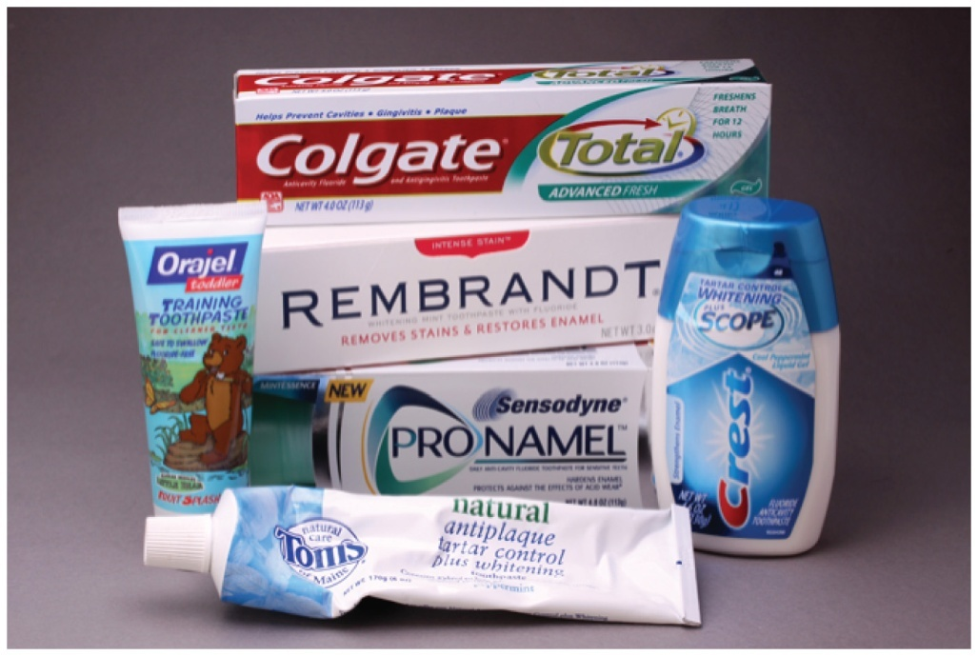
Chemicals
Chemicals are
substances that have the same composition and properties wherever found
often substances made by chemists that you use
every day
Toothpaste is a combination
of many chemicals.

Slide 8
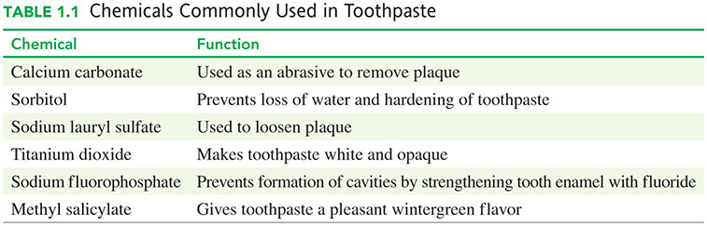
Chemicals Commonly Used in Toothpaste

Slide 9
Learning Check
Which of the following contains chemicals?
A. sunlight
B. fruit
C. milk
D. breakfast cereal

Slide 10
Solution
Which of the following contains chemicals?
A. Sunlight is energy given off by the Sun and therefore does not contain chemicals.
B. Fruit contains chemicals that have the same composition
and properties wherever found.
C. Milk contains chemicals that have the same composition
and properties wherever found.
D. Breakfast cereal contains chemicals that have the same
composition and properties wherever found.
Therefore, only B. Fruit, C. Milk, and D. Breakfast cereal contain chemicals.

Slide 11
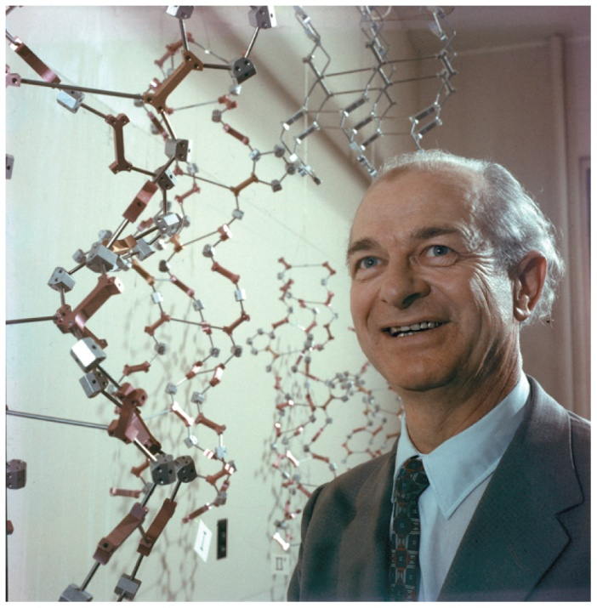
1.2 Scientific Method
Thinking Like a Scientist
Linus Pauling won the Nobel Prize in Chemistry in 1954. was an American chemist, biochemist, peace activist, author, educator, and husband of American human rights activist Ava Helen Pauling.
Learning Goal Describe the activities that are part of the scientific method.

Slide 12
The Scientific Method
The scientific method is a set of general principles that helps to describe how a scientist thinks.
Make observations about nature and ask questions about what you observe.
Propose a hypothesis, which states a possible explanation of the observations.
Several experiments may be done to test the hypothesis.
When results of the experiments are analyzed, a conclusion is made as to whether the hypothesis is true or false.

Slide 13
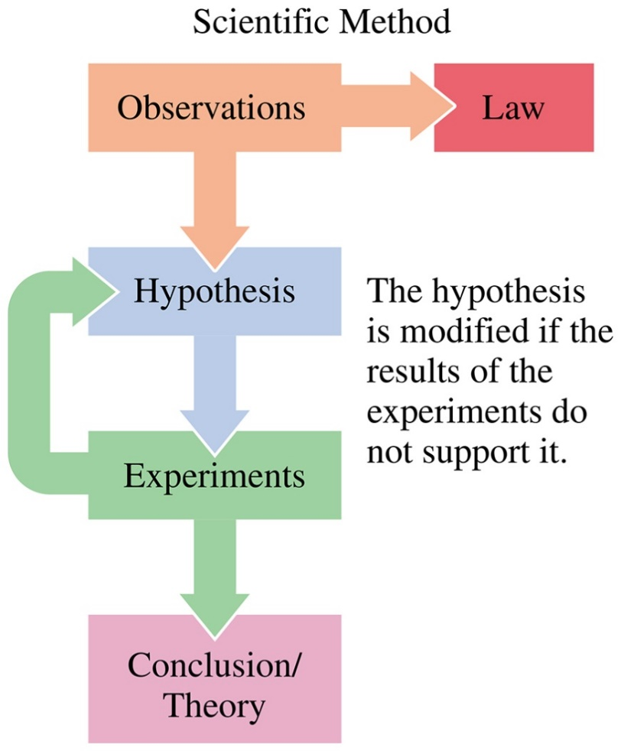
Summary of the Scientific Method
The scientific method develops a conclusion or theory using observations, hypotheses, and experiments.

Slide 14
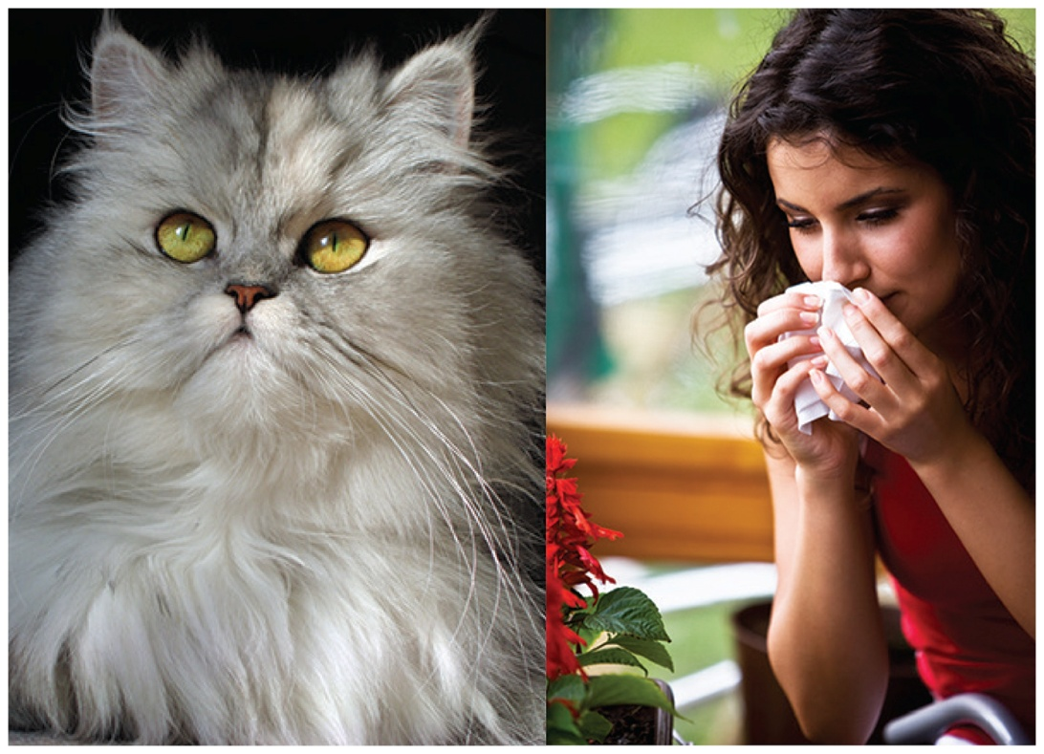
Everyday Scientific Thinking
Observation: Yesterday you went to visit your friend. Soon after you arrived, your eyes began to itch and you started to sneeze. You observed that your friend has a new cat.

Slide 15
Everyday Scientific Thinking
Hypothesis 1: Perhaps you are allergic to cats.
Experiment 1: To test your hypothesis, you leave your friend’s home.
If the itching and sneezing stop, perhaps your hypothesis is correct.
If the itching and sneezing do not stop, perhaps you have a cold.

Slide 16
Everyday Scientific Thinking
Observation: Upon leaving your friend’s home, the itching and sneezing stop.
The observation supports your original hypothesis. To confirm, you visit another friend with a cat.

Slide 17
Everyday Scientific Thinking
Experiment 2: Visiting a second friend with a cat causes your eyes to itch and you begin to sneeze again, further supporting your hypothesis.
Theory: The experimental results indicate that indeed you are allergic to cats.

Slide 18
Learning Check
Identify each of the following as an observation, a hypothesis, an experiment, or a conclusion:
A. During your visit to the gym, your trainer records that you ran for 25 min on the treadmill.
B. Scientific studies show that exercising lowers blood pressure.
C. Your doctor thinks that your weight loss is due to increased exercise.

Slide 19
Solution
Identify each of the following as an observation, a hypothesis, an experiment, or a conclusion:
A. During your visit to the gym, your trainer records that you ran for 25 min on the treadmill. Observation
B. Scientific studies show that exercising lowers blood pressure. Conclusion
C. Your doctor thinks that your weight loss is due to increased exercise. Hypothesis

Slide 20
Learning Check
For each of the following, indicate whether the step of the scientific method being described is
(1) observation, (2) hypothesis, (3) experiment, or (4) theory.
A. A blender does not work when plugged in.
B. The blender motor is broken.
C. The plug has malfunctioned.
D. The blender does not work when plugged into a different outlet.
E. The blender needs repair.

Slide 21
Solution
For each of the following, indicate whether the step of the scientific method being described is
(1) observation, (2) hypothesis, (3) experiment, or (4) theory.
A. A blender does not work when plugged in.
B. The blender motor is broken.
C. The plug has malfunctioned.
D. The blender does not work when plugged into a
different outlet.
E. The blender needs repair.
(1)
(2)
(2)
(3)
(4)

Slide 22

1.3 Studying and Learning Chemistry
Studying in a group can be beneficial to learning.
Learning Goal Identify strategies that are effective for learning. Develop a study plan for learning chemistry.

Slide 23
Strategies to Improve Learning and Understanding
Success in chemistry utilizes good study habits, connecting new information with your knowledge base, rechecking what you have learned and what you have forgotten, and retrieving what you have learned for an exam.
Here are some tips for developing new study habits:
Do not keep rereading the text or notes.
Ask yourself questions as you read.
Self-test by giving yourself quizzes using practice problems in the text.
Study at a regular pace rather than cramming.
Study different topics in a chapter and relate the new concepts to concepts you know.

Slide 24

Text Features for Learning
Using the study features in the text will help you prepare for class and exams.
Looking Ahead outlines the chapter topics.
Glossary and Index list and define key terms in the chapter.
Key Math Skills needed for the chapter are reviewed.

Slide 25


Text Features for Learning
Core Chemistry Skills are indicated by icons in the margin and summarized at the end of each chapter.
Review icon at the start of a chapter Section highlights the Key Math Skills and Core Chemistry Skills needed in the current chapter.

Slide 26


Text Features for Learning
Engage features in the margin remind you to pause your reading and test yourself with a question related to the material.
Try It First feature reminds you to work the Sample Problem before you look at the accompanying Solution.

Slide 27


Text Features for Learning
Test suggestions in the margin remind you to solve the indicated Practice Problems as you study.
Interactive Video suggestions illustrate content as well as problem solving.

Slide 28
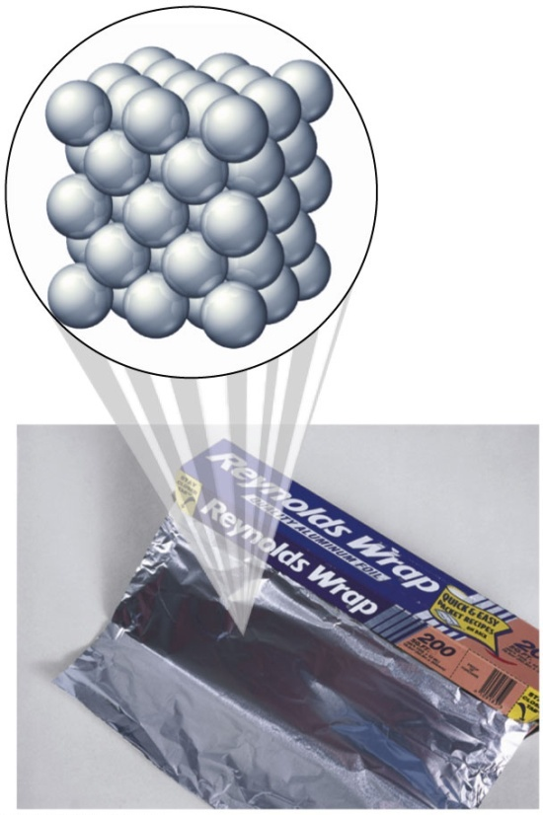
Figures and Diagrams
Many figures and diagrams use macro-to-micro illustrations
to depict atomic level of organization
to illustrate the concepts in the text
to allow you to see the world in a
microscopic way

Slide 29
Features to Help You Study
Before reading the chapter, review the topics in Looking Ahead.
Each Section of the chapter begins with a Learning Goal which states what you need to understand.
Some Sections have a Review box that lists the Key Math Skills and Core Chemistry Skills from previous chapters that relate to the new material in the Section.
Work through each Sample Problem and compare your solution to the one provided.
Chemistry Links to Health and Chemistry Links to the Environment connect the chemical concepts you are learning to real-life situations.

Slide 30
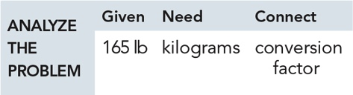
Practice Problems
Practice Problems placed at the end of each Section are written to help you understand the material and give immediate applications of new ideas.
An Analyze the Problem feature shows how to organize the data in the Sample Problems to obtain the solution.

Slide 31
End of Chapter Summaries
At the end of each chapter are study aids, including
Concept Maps
Chapter Reviews
Key Terms
Key Math Skills
Core Chemistry Skills

Slide 32
End of Chapter Problems
At the end of each chapter you can test your knowledge further by using the
Understanding the Concepts problems
Additional Practice Problems
Challenge Problems
Every three chapters, problem sets called Combining Ideas test your ability to solve problems containing material from more than one chapter.
Answers placed at the end of each chapter give feedback to odd-numbered questions.

Slide 33
Make a Study Plan
Consider some of these ideas when making a plan on how to approach your studying and learning in chemistry.
___ reading the chapter before class
___ going to class
___ reviewing the Learning Goals
___ keeping a problem notebook
___ reading the text
___ trying to work the Sample Problem before looking at the Solution
___ answering the Engage questions

Slide 34
Make a Study Plan
___ working the Practice Problems at the end of each Section and checking answers
___ studying different topics at the same time
___ organizing a study group
___ seeing the professor during office hours
___ reviewing Key Math Skills and Core Chemistry Skills
___ attending review sessions
___ studying as often as possible

Slide 35
Learning Check
State whether each of the following activities is part of a successful study plan:
A. staying out late the night before an exam
B. reading the text before class
C. working problems with a study group
D. skipping the lecture one or two times a week
E. discussing a problem with the instructor

Slide 36
Solution
State whether each of the following activities is part of a successful study plan.
A. staying out late the night before an exam
B. reading the text before class
C. working problems with a study group
D. skipping the lecture one or two times a week
E. discussing a problem with the instructor
No
Yes
Yes
No
Yes

Slide 37
1.4 Key Math Skills for Chemistry
Learning Goal Review math concepts used in chemistry: place values, positive and negative numbers, percentages, solving equations, and interpreting graphs.

Slide 38
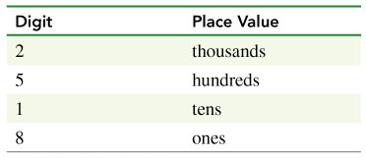
Identifying Place Values
For any number, we can identify a place value for each digit.
2518 g

Slide 39
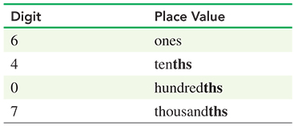
Identifying Place Values
We can identify a place value for each digit in a number with a decimal point.
6.407 g

Slide 40
Learning Check
Identify the place value for each of the digits in the following number:
15.24 g

Slide 41
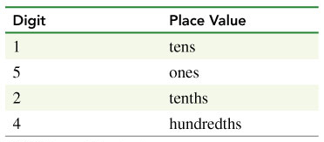
Solution
Identify the place value for each of the digits in the following number:
15.24 g

Slide 42
Positive and Negative
Numbers
A positive number is any number that is greater than zero and has a positive sign (+). Often the positive sign is understood and not written in front of the number.
For example: +8 is also written as 8.
A negative number is any number that is less than zero and is written with a negative sign (−).
For example: −8.

Slide 43
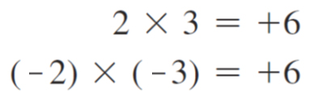
Multiplication with (+) and (–) Numbers
When two positive numbers or two negative numbers are multiplied, the answer is positive.

Slide 44
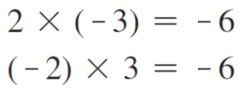
Multiplication with (+) and (–) Numbers
When a positive number and a negative number are multiplied, the answer is negative.

Slide 45
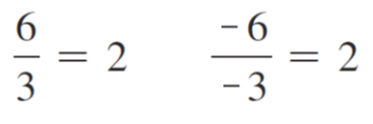
Division with (+) and (–) Numbers
The rules for division of positive and negative numbers are the same as those for multiplication.
When two positive numbers or two negative numbers are divided, the answer is positive (+).

Slide 46
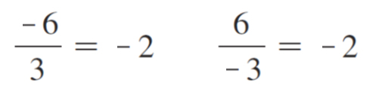
Division with (+) and (–) Numbers
When a positive number and a negative number are divided, the answer is negative (−).

Slide 47
Addition with (+) and (–) Numbers
When positive numbers are added, the sign of the answer is positive (+).
3 + 4 = 7
The (+) sign (+7) is understood.

Slide 48
Addition with (+) and (–) Numbers
When negative numbers are added, the sign of the answer is negative (−).
(−3) + (−4) = −7

Slide 49
Addition with (+) and (–) Numbers
When a positive number and a negative number are added, the smaller number is subtracted from the larger number.
The result has the same sign as the larger number.
12 + (−15) = −3

Slide 50
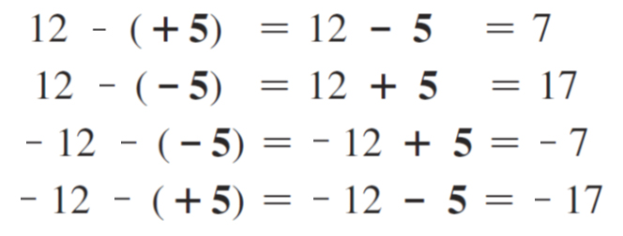
Subtraction with (+) and (–) Numbers
When two numbers are subtracted, change the sign of the number to be subtracted.

Slide 51
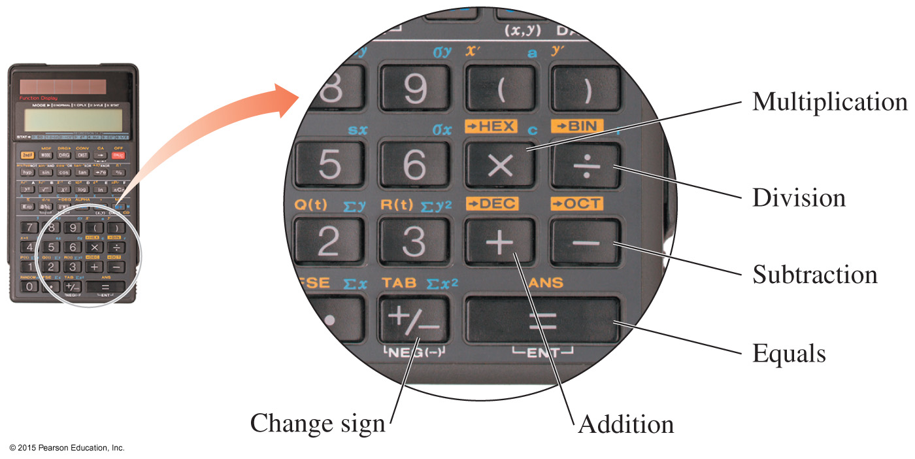
Calculator Operations
On your calculator, there are four keys used for basic mathematical operations.
The change sign key is used to change the sign of a number.

Slide 52
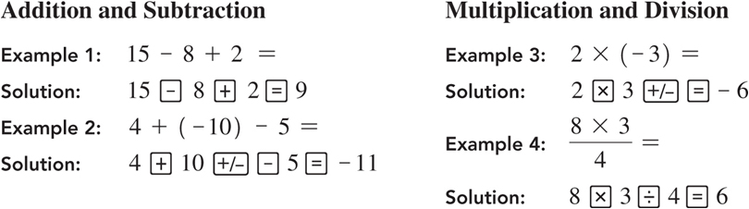
Calculator Operations—Example

Slide 53
Calculating a Percentage
To determine a percent, divide the parts by the total (whole) and multiply by 100%.
An aspirin tablet contains 325 mg of aspirin (active ingredient), and the tablet has a mass of 545 mg. What is the percentage of aspirin in the tablet?

Slide 54
Percentage
A percentage (%) represents the number of parts of an item in 100 of those items.

Slide 55

Solving Equations
Equations can be rearranged to solve for an unknown variable. 2x + 8 = 14
1. Place all like items on one side.
Subtract 8 from each side: 2x + 8 − 8 = 14 − 8
2x = 6
2. Isolate the variable you need to solve for.
Divide both sides by 2:
3. Check your answer.
2(3) + 8 = 14
6 + 8 = 14
14 = 14 Your answer x = 3 is correct

Slide 56
Learning Check
Solve the following equation for P₁:

Slide 57
Solution
Solve the following equation for P₁:
To solve for P₁, divide both sides by V₁.

Slide 58
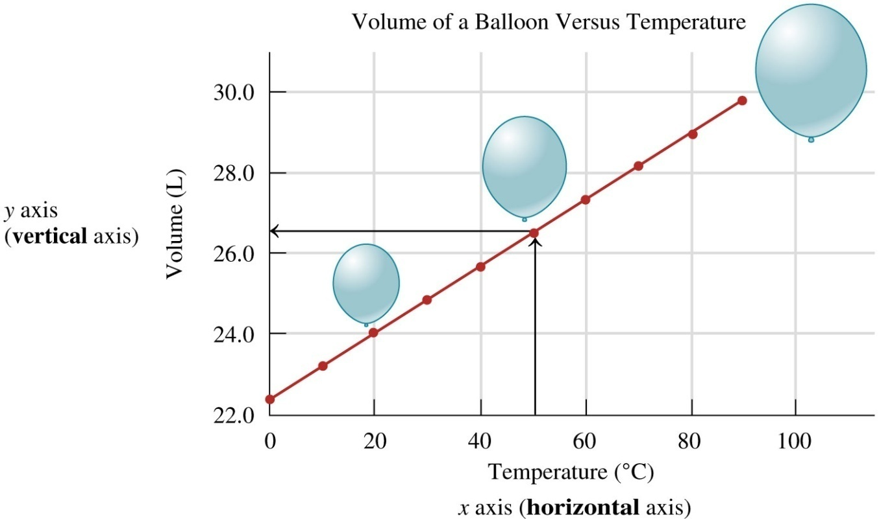
Graphs
A graph represents the relationship between two variables.
The graph below represents the volume of a gas plotted against its temperature.

Slide 59
Interpreting a Graph
The graph title, “Volume of a Balloon versus Temperature,” indicates that the volume of a gas is plotted against its temperature.
The vertical (y) axis label indicates that the volume is measured in liters.
The horizontal (x) axis label indicates that the temperature of the balloon is measured in degrees Celsius.

Slide 60
Interpreting a Graph
Each point on the graph represents a volume in liters that was measured at a specific temperature.
The line on the graph indicates that the volume of the balloon increases as the temperature of the gas increases. This is called a direct relationship.

Slide 61
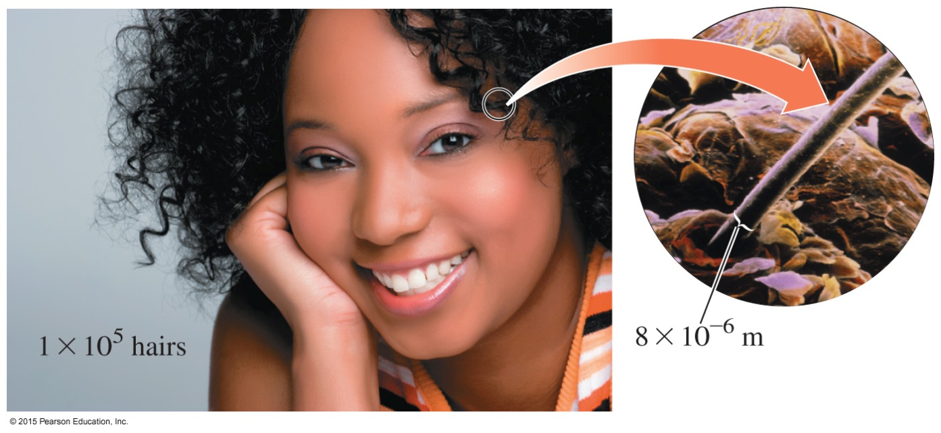
1.5 Writing Numbers in
Scientific Notation
People have an average of
1 × 10⁵ hairs on their scalp.
Each hair is about 8 × 10⁻⁶ m wide.
Learning Goal Write a number in scientific notation.

Slide 62
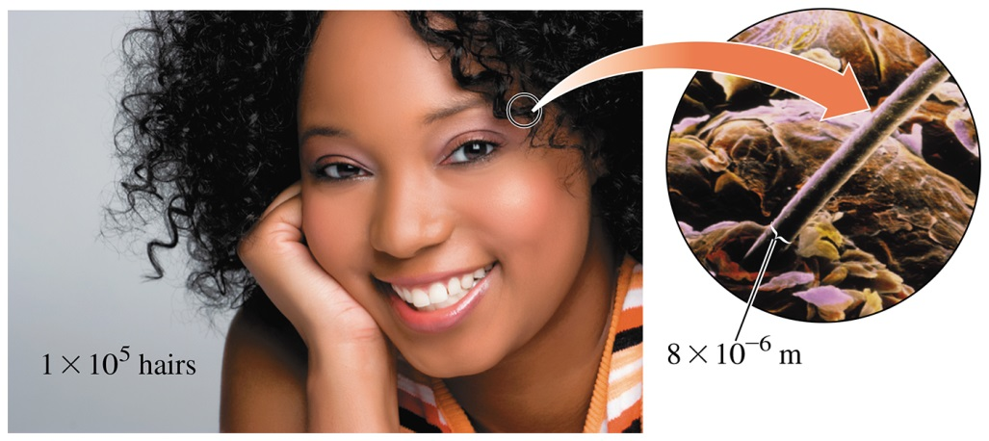
Scientific Notation
Scientific notation is used to write very large or very small numbers, such as
the width of a human hair, 0.000 008 m, which is also written as 8 × 10⁻⁶ m.
the number of hairs on a human scalp, 100 000, which is also written as 1 × 10⁵ hairs.

Slide 63
Scientific Notation
Numbers written in scientific notation have two parts:
1.5 × 10²
Coefficient Power of 10
The coefficient is at least 1 but less than 10.

Slide 64
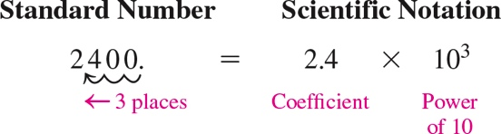
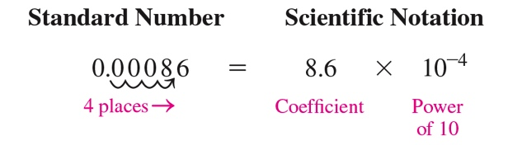
Writing Numbers in Scientific Notation
The coefficient is obtained by moving the decimal point to give a number that is at least 1 but less than 10.

Slide 65
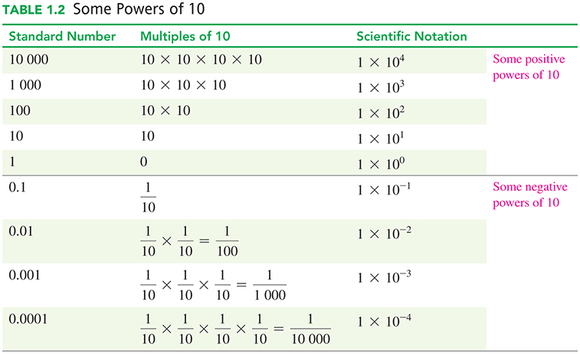
Some Powers of 10

Slide 66
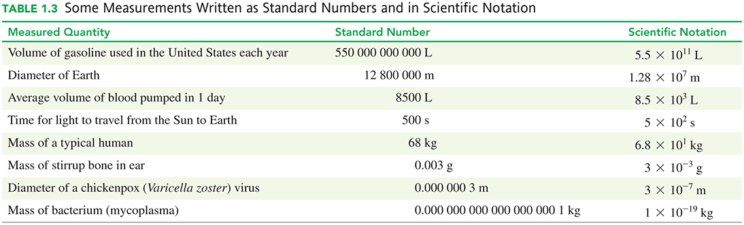
Some Measurements in Scientific Notation

Slide 67
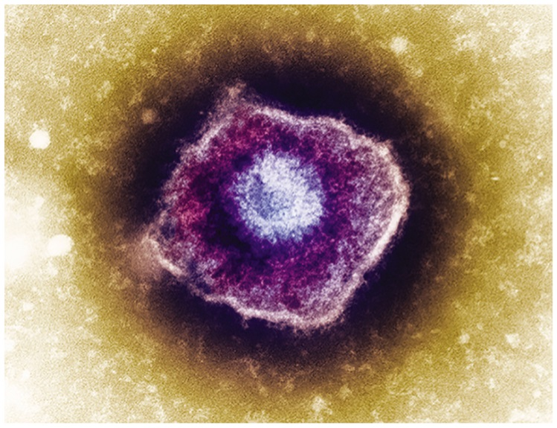
Comparing Numbers in Standard and Scientific Notation
Standard Format Scientific Notation
Diameter of the Earth:
12 800 000 m 1.28 × 10⁷ m
Mass of a human:
68 kg 6.8 × 10¹ kg
Diameter of a chickenpox virus:
0.000 000 3 cm 3 × 10⁻⁷ cm
A chickenpox virus.

Slide 68
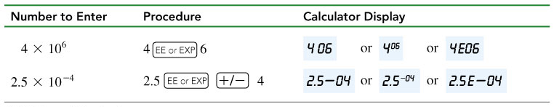
Scientific Notation and Calculators
You can enter a number written in scientific notation on many calculators using the EE or EXP key.

Slide 69
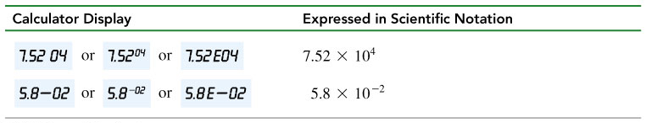
Scientific Notation and Calculators
When a calculator display appears in scientific notation, it is shown as a number between 1 and 10, followed by a space and the power (exponent).

Slide 70
Scientific Notation and Calculators
On many scientific calculators, a number is converted to scientific notation, using the appropriate keys.

Slide 71
Learning Check
Write each of the following in correct scientific notation:
A. 64 000
B. 0.021

Slide 72
Solution
Write each of the following in correct scientific notation:
A. 64 000
Step 1 Move the decimal point to obtain a coefficient that is at least 1 but less than 10.
6.4
Step 2 Express the number of places moved as a power
of 10.
10⁴
Step 3 Write the product of the coefficient multiplied by the power of 10.
6.4 × 10⁴

Slide 73
Solution
Write each of the following in correct scientific notation:
B. 0.021
Step 1 Move the decimal point to obtain a coefficient that is at least 1 but less than 10.
2.1
Step 2 Express the number of places moved as a power
of 10.
10⁻²
Step 3 Write the product of the coefficient multiplied by the power of 10.
2.1 × 10⁻²

Slide 74
Learning Check
Select the correct scientific notation for each.
A. 0.000 008
(1) 8 × 10⁶ (2) 8 × 10⁻⁶ (3) 0.8 × 10⁻⁵
B. 72 000 000
(1) 7.2 × 10⁷ (2) 72 × 10⁶ (3) 7.2 × 10⁻⁷

Slide 75
Solution
Select the correct scientific notation for each.
A. 0.000 008
(Move the decimal point 6 places to the right.)
(2) 8 × 10⁻⁶
B. 72 000 000
(Move the decimal point 7 places to the left.)
(1) 7.2 × 10⁷

Slide 76
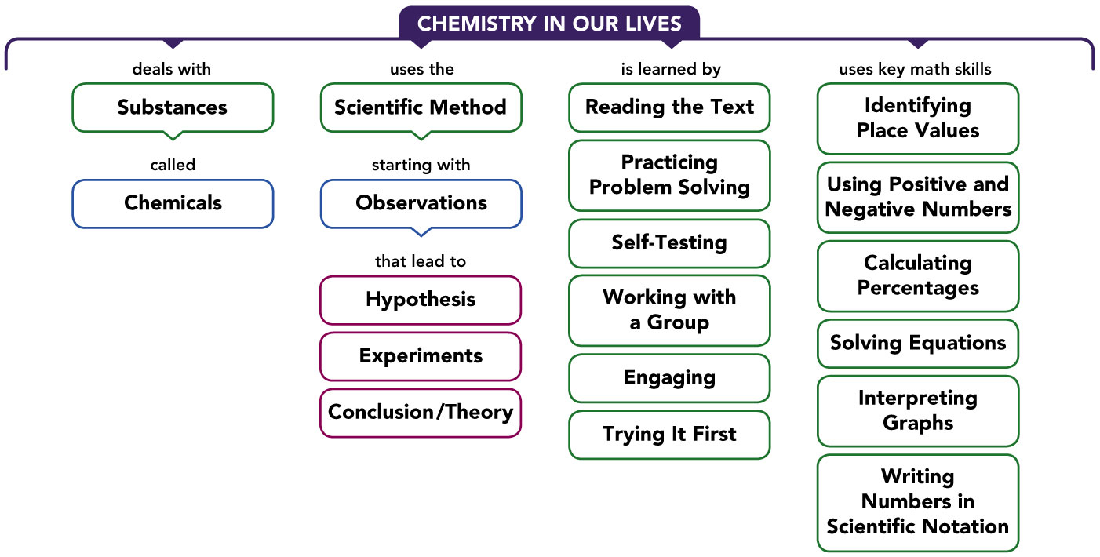
Concept Map

