Slide 1
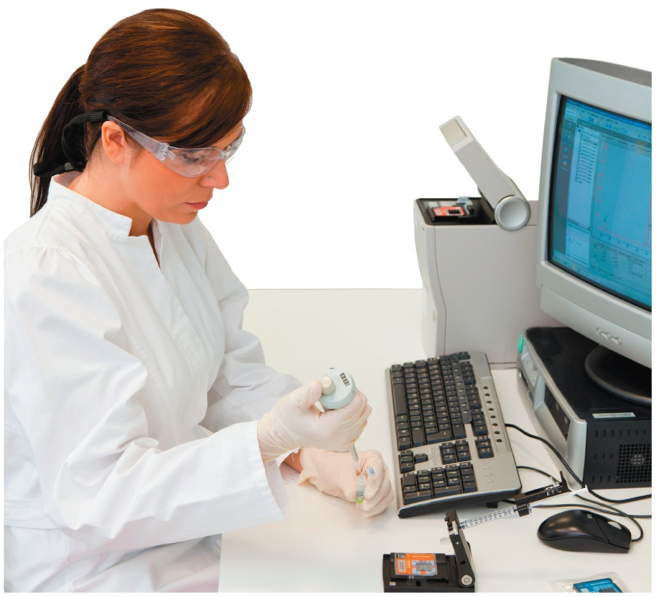
Chapter 10
Acids and Bases and Equilibrium
Clinical laboratory technicians prepare specimens for the detection of cancerous tumors and type blood samples for transfusions. They must also interpret and analyze the test results, which are then passed on to the physician.

Slide 2
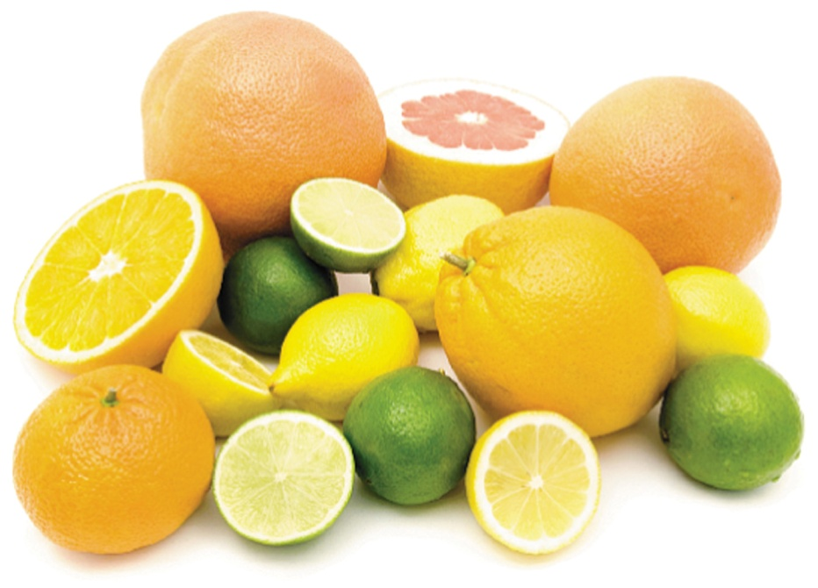
10.1 Acids and Bases
The term acid comes from the Latin word acidus, which means “sour.” We are familiar with the sour taste of vinegar and lemons and other common acids in foods. Citrus fruits are sour because they contain acids.
Learning Goal Describe and name acids and bases.

Slide 3
Acids
Arrhenius acids
produce hydrogen ions (H⁺) ions when they dissolve
in water
HCl(g) H⁺(aq) + Cl⁻(aq)
are also electrolytes because they produce H⁺ in water
have a sour taste
turn blue litmus red
corrode some metals
H₂O

Slide 4
Naming Acids
Acids with a hydrogen ion (H⁺) and a nonmetal (or CN⁻) ion are named with the prefix hydro and end with ic acid.
HCl hydrochloric acid
Acids with a hydrogen ion (H⁺) and a polyatomic ion are named by changing the end of the name of the polyatomic ion from
ate to ic acid or ite to ous acid
ClO₃⁻ chlorate ClO₂⁻ chlorite
HClO₃ chloric acid HClO₂ chlorous acid

Slide 5
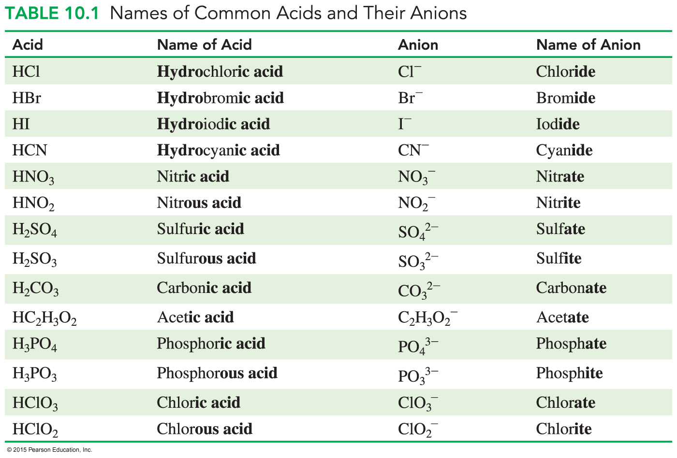
Names of Common Acids

Slide 6
Learning Check
Select the correct name for each of the following acids:
1. HBr A. bromic acid
B. bromous acid
C. hydrobromic acid
2. H₂CO₃ A. carbonic acid
B. hydrocarbonic acid
C. carbonous acid
3. HBrO₂ A. bromic acid
B. hydrobromous acid
C. bromous acid

Slide 7
Solution
1. HBr Br⁻, bromide C. hydrobromic acid
The name of an acid with a hydrogen ion (H⁺) and a nonmetal uses the prefix hydro and ends with ic acid.
2. H₂CO₃ CO₃²⁻, carbonate A. carbonic acid
An acid with a hydrogen ion (H⁺) and a polyatomic ion ending in ate is called an ic acid.
3. HBrO₂ BrO₂⁻, bromite C. bromous acid
An acid with a hydrogen ion (H⁺) and a polyatomic ion ending in ite is called an ous acid.

Slide 8
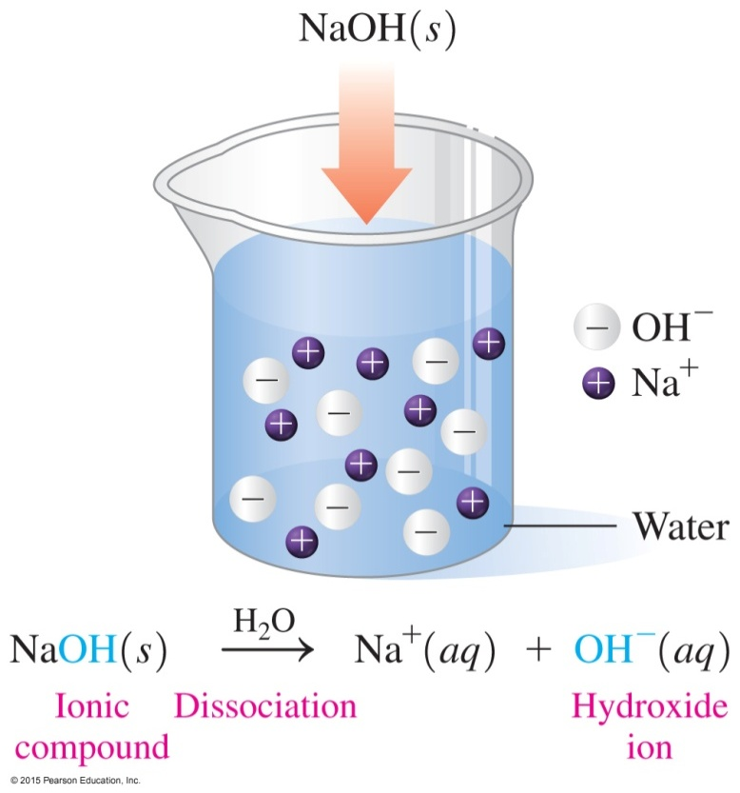
Bases
Arrhenius bases
produce hydroxide ions (OH⁻)
in water
taste bitter or chalky
are also electrolytes because
they produce hydroxide ions
(OH⁻) in water
feel soapy and slippery
turn litmus indicator paper
blue and phenolphthalein
indicator pink

Slide 9
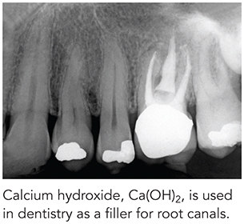
Naming Bases
Typical Arrhenius bases are named as hydroxides.
NaOH sodium hydroxide
KOH potassium hydroxide
Ba(OH)₂ barium hydroxide
Al(OH)₃ aluminum hydroxide

Slide 10
Learning Check
Match the formulas with the names.
1. ___HNO₂ A. iodic acid
2. ___Ca(OH)₂ B. sulfuric acid
3. ___H₂SO₄ C. sodium hydroxide
4. ___HIO₃ D. nitrous acid
5. ___NaOH E. calcium hydroxide

Slide 11
Solution
Match the formulas with the names.
1. _D__HNO₂ D. nitrous acid
2. _E__Ca(OH)₂ E. calcium hydroxide
3. _B__H₂SO₄ B. sulfuric acid
4. _A__HIO₃ A. iodic acid
5. _C__NaOH C. sodium hydroxide

Slide 12
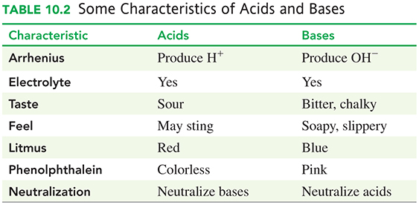
Characteristics of Acids and Bases

Slide 13
Learning Check
Identify each as a characteristic of
A. an acid or B. a base
____1. has a sour taste
____2. produces OH⁻ in aqueous solutions
____3. has a chalky taste
____4. is an electrolyte
____5. produces H⁺ in aqueous solutions

Slide 14
Solution
Identify each as a characteristic of
A. an acid or B. a base
A 1. has a sour taste
B 2. produces OH⁻ in aqueous solutions
B 3. has a chalky taste
A, B 4. is an electrolyte
A 5. produces H⁺ in aqueous solutions

Slide 15
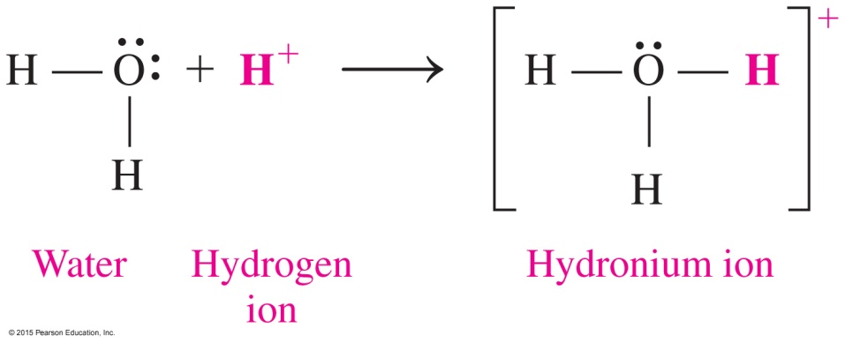
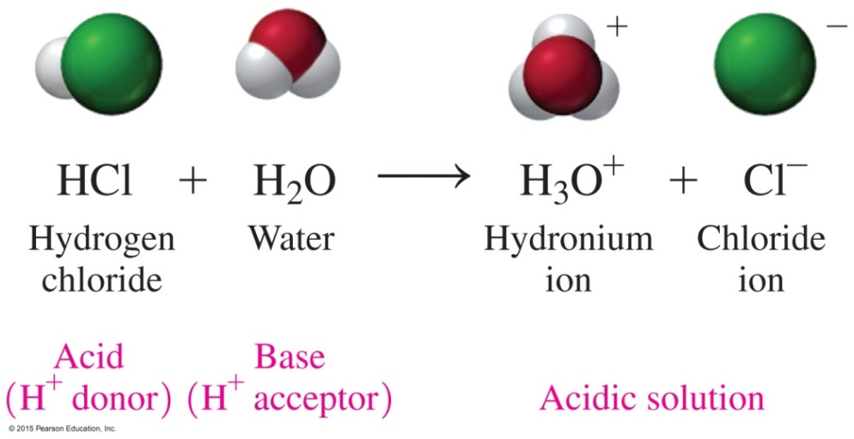
10.2 Brønsted–Lowry Acids and Bases
According to the Brønsted–Lowry theory,
an acid is a substance that donates H⁺
a base is a substance that accepts H⁺
Learning Goal Identify conjugate acid–base pairs for Brønsted–Lowry acids and bases.

Slide 16
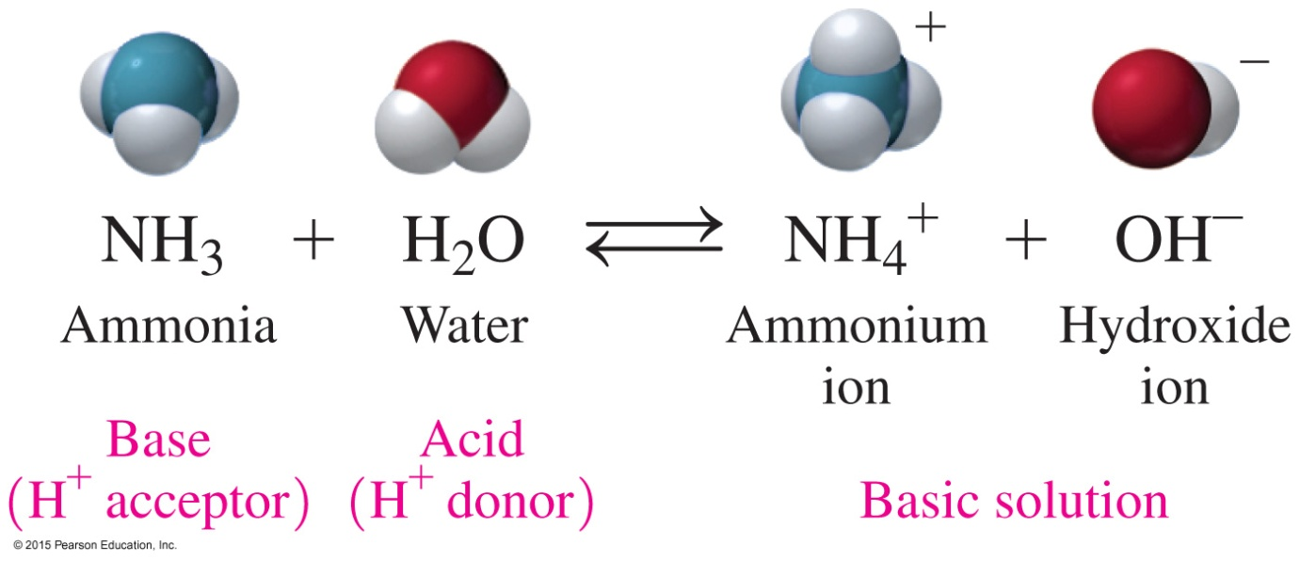
NH₃, a Brønsted–Lowry Base
In the reaction of ammonia and water,
NH₃ acts as the base that accepts H⁺
H₂O acts as the acid that donates H⁺

Slide 17
Learning Check
In each of the following equations, identify the Brønsted–Lowry acid and base in the reactants:
A. HNO₃(aq) + H₂O(l) H₃O⁺(aq) + NO₃⁻(aq)
B. HF(aq) + H₂O(l) H₃O⁺(aq) + F⁻(aq)

Slide 18
Solution
In each of the following equations, identify the Brønsted–Lowry acid and base in the reactants:
A. HNO₃(aq) + H₂O(l) H₃O⁺(aq) + NO₃⁻(aq)
acid base
B. HF(aq) + H₂O(l) H₃O⁺(aq) + F⁻(aq)
acid base

Slide 19
Conjugate Acid–Base Pairs
In any acid–base reaction, there are two conjugate acid–base pairs, and
each pair is related by the loss and gain of H⁺
one pair occurs in the forward direction
one pair occurs in the reverse direction
acid and conjugate base pair 1
HA + B A⁻ + BH⁺
base and conjugate acid pair 2

Slide 20

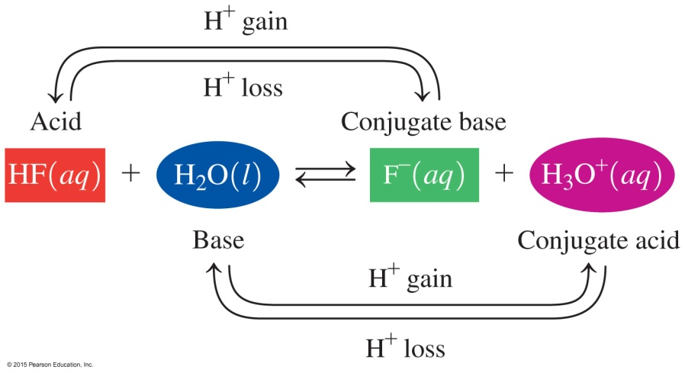
Conjugate
Acid–Base Pairs
In this acid–base reaction,
the first conjugate acid–base pair is HF, which donates H⁺ to
form its conjugate base, F⁻
the other conjugate acid–base pair is H₂O, which accepts
H⁺ to form its conjugate acid, H₃O⁺
each pair is related by a loss and gain of H⁺

Slide 21
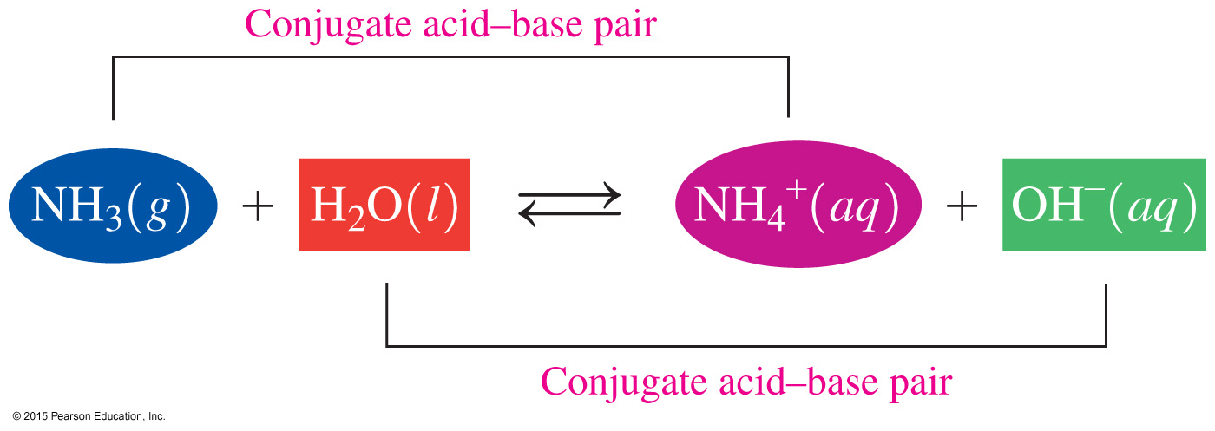
Conjugate Acid–Base Pairs
In the reaction of NH₃ and H₂O,
one conjugate acid–base pair is NH₃/NH₄⁺
the other conjugate acid–base pair is H₂O/OH⁻

Slide 22
Learning Check
1. Write the conjugate base for each of the following acids:
A. HBr
B. H₂S
C. H₂CO₃
2. Write the conjugate acid for each of the following bases:
A. NO₂⁻
B. NH₃
C. OH⁻

Slide 23
Solution
1. Write the conjugate base for each of the following acids:
A. HBr H⁺ + Br⁻
B. H₂S H⁺ + HS⁻
C. H₂CO₃ H⁺ + HCO₃⁻

Slide 24
Solution
2. Write the conjugate acid for each of the following:
Add an H⁺ to each base to get the conjugate acid.
A. NO₂⁻ + H⁺ HNO₂
B. NH₃ + H⁺ NH₄⁺
C. OH⁻ + H⁺ H₂O

Slide 25
Learning Check
Identify the sets that contain acid–base conjugate pairs.
1. HNO₂, NO₂⁻
2. H₂CO₃, CO₃²⁻
3. HCl, ClO₄⁻
4. HS⁻, H₂S
5. NH₃, NH₄⁺

Slide 26
Solution
Identify the sets that contain acid–base conjugate pairs.
1. HNO₂, NO₂⁻ acid, conjugate base
2. H₂CO₃, CO₃²⁻ not acid–base conjugate pair
3. HCl, ClO₄⁻ not acid–base conjugate pair
4. HS⁻, H₂S base, conjugate acid
5. NH₃, NH₄⁺ base, conjugate acid

Slide 27
Learning Check
Identify the conjugate acid–base pairs in the following reaction:
HNO₃(aq) + NH₃(aq) NO₃⁻(aq) + NH₄⁺(aq)

Slide 28
Solution
Identify the conjugate acid–base pairs in the following reaction:
HNO₃(aq) + NH₃(aq) NO₃⁻(aq) + NH₄⁺(aq)
STEP 1 Identify the reactant that loses H⁺ as the acid.
In the reaction, HNO₃ donates H⁺ to NH₃. HNO₃ is the acid and NO₃⁻ is its conjugate base
ANALYZE GIVEN NEED CONNECT
THE HNO₃ NO₃⁻ conjugate lose/gain one H⁺
PROBLEM NH₃ NH₄⁺ acid-base pairs

Slide 29
Solution
Identify the conjugate acid–base pairs in the following reaction:
HNO₃(aq) + NH₃(aq) NO₃⁻(aq) + NH₄⁺(aq)
STEP 2 Identify the reactant that gains H⁺ as the base.
In the reaction, NH₃ gains H⁺ to form NH₄⁺. Thus,
NH₃ is the base and NH₄⁺ is its conjugate acid
STEP 3 Write the conjugate acid–base pairs.
HNO₃/NO₃⁻ is the acid and its conjugate base.
NH₃/NH₄⁺ is the base and its conjugate acid.

Slide 30
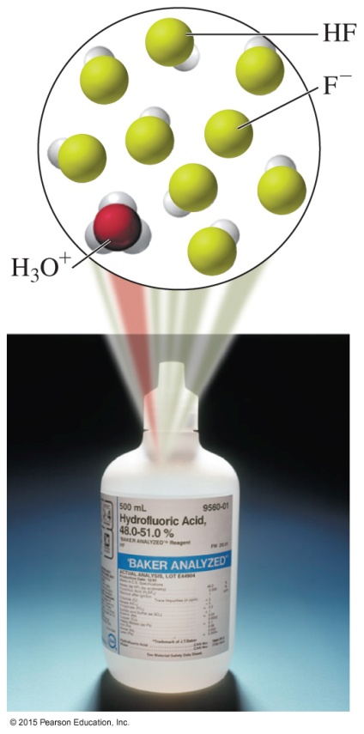
10.3 Strengths of Acids and Bases
Weak acids only partially dissociate in water.
Hydrofluoric acid (HF) is the only halogen acid that is a weak acid.
Learning Goal Write equations for the dissociation of strong and weak acids and bases.

Slide 31
Strong and Weak Acids
A strong acid completely ionizes (100%) in aqueous solutions.
HCl(g) + H₂O(l) H₃O⁺(aq) + Cl⁻(aq)
A weak acid dissociates only slightly in water to form a few ions in aqueous solutions.
H₂CO₃(aq) + H₂O(l) H₃O⁺(aq) + HCO₃⁻ (aq)

Slide 32
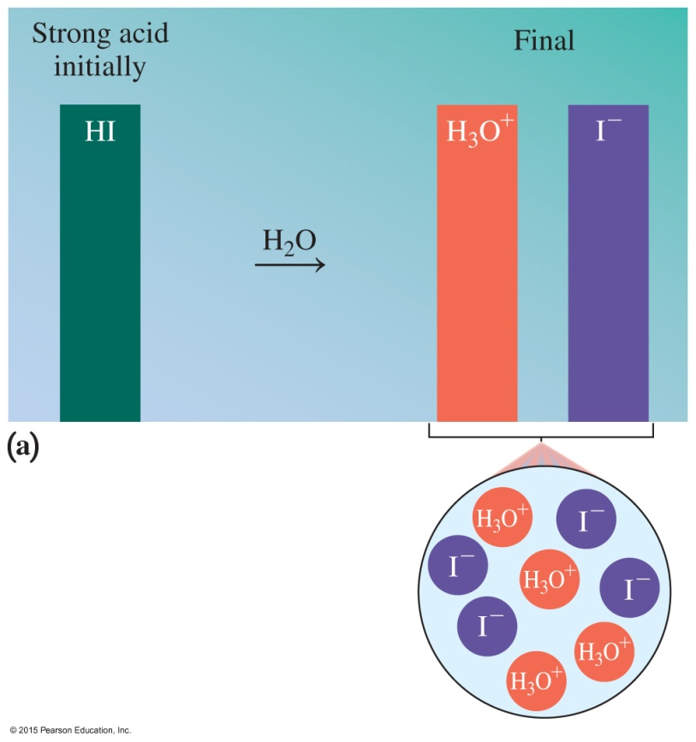
Strong Acids
In water, the dissolved molecules of HA, a strong acid,
dissociate into ions 100%
give large concentrations of H₃O⁺ and the anion A⁻
HI(aq) + H₂O(l)
H₃O⁺(aq) + I⁻(aq)

Slide 33
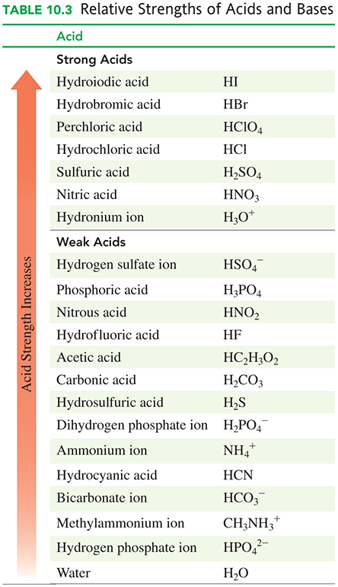
Strong Acids
There are six common
strong acids. They have
weak conjugate bases.

Slide 34
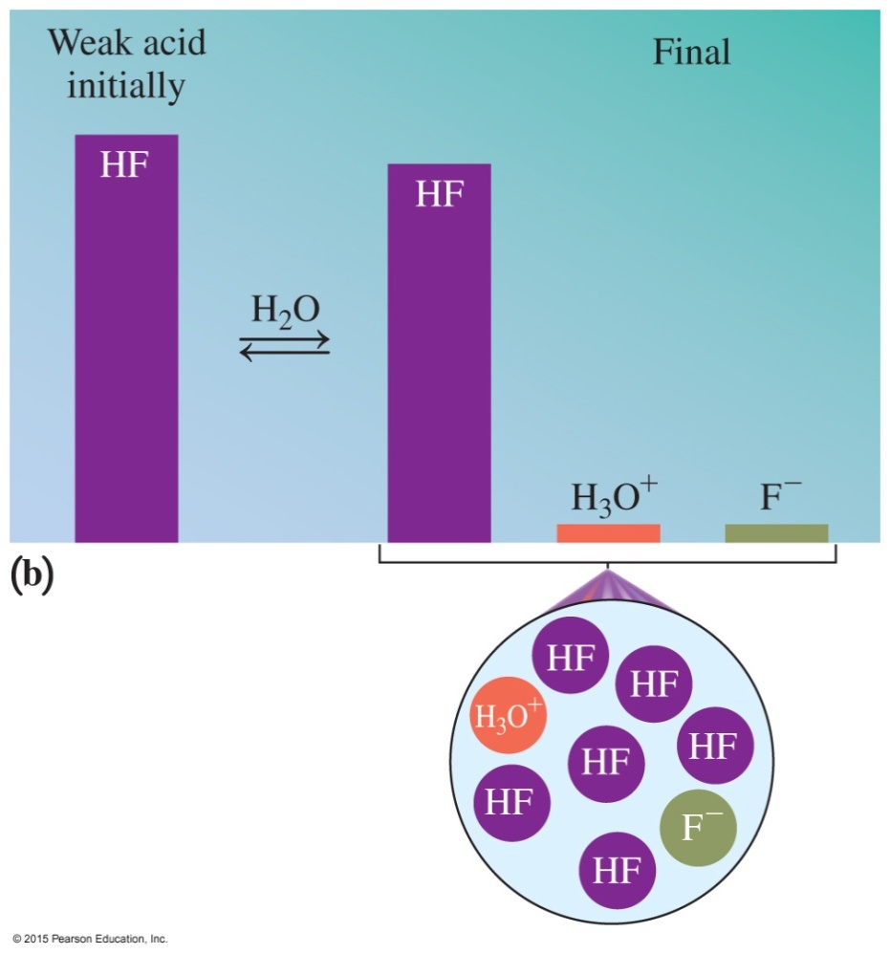
Weak Acids
In weak acids,
only a few molecules dissociate
most of the weak acid remains as the undissociated (molecular) form of the acid
the concentrations of the H₃O⁺ and the anion (A⁻) are small
HF(aq) + H₂O(l)
H₃O⁺(aq) + F⁻(aq)

Slide 35
Weak Acids
Weak acids
make up most of the acids
have strong conjugate bases

Slide 36
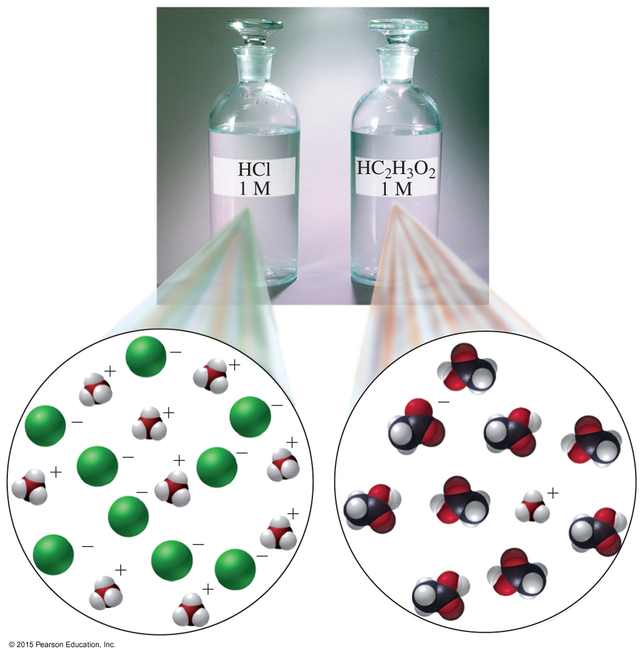
Strong and Weak Acids
In an HCl solution,
the strong acid HCl dissociates 100% to form H⁺ and Cl⁻.
A solution of the weak acid HC₂H₃O₂ contains mostly molecules of HC₂H₃O₂ and a few ions of H⁺ and C₂H₃O₂⁻.

Slide 37
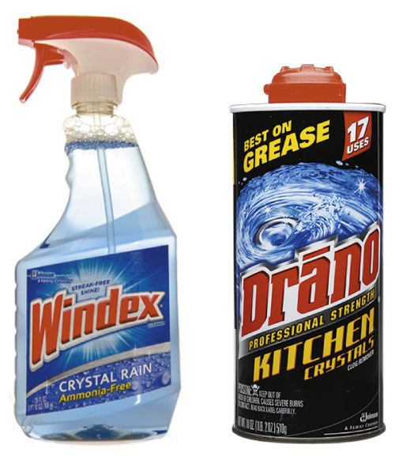
Strong Bases
Strong bases
are formed from metals of
Groups 1A (1) and 2A (2)
include LiOH, NaOH, KOH, Ba(OH)₂, Sr(OH)₂, and Ca(OH)₂
dissociate completely in water
KOH(s) K⁺(aq) + OH⁻(aq)

Slide 38
Weak Bases
Weak bases
Weak electrolytes
include NH₃, Na₂CO₃ and Na₃PO₄
Produce few ions in solution
NH₃(g) + H₂O(l) NH₄⁺(aq) + OH⁻(aq)

Slide 39
Learning Check
Identify each of the following as a strong or weak acid or base:
A. HBr
B. HNO₂
C. NaOH
D. H₂SO₄
E. Cu(OH)₂

Slide 40
Solution
Identify each of the following as a strong or weak acid or base:
A. HBr strong acid
B. HNO₂ weak acid
C. NaOH strong base
D. H₂SO₄ strong acid
E. Cu(OH)₂ weak base

Slide 41
Learning Check
Using Table 10.3, identify the stronger acid in each pair.
A. HNO₂ or H₂S
B. HCO₃⁻ or HBr
C. H₃PO₄ or H₃O⁺

Slide 42
Solution
Using Table 10.3, identify the stronger acid in each pair.
A. HNO₂ or H₂S HNO₂ is the stronger acid.
B. HCO₃⁻ or HBr HBr is the stronger acid.
C. H₃PO₄ or H₃O⁺ H₃O⁺ is the stronger acid.

Slide 43

10.4 Acid–Base Equilibrium
Oxygen transport involves
an equilibrium between
hemoglobin (Hb), oxygen, and
oxyhemoglobin (HbO₂).
Hb(aq) + O₂(g) HbO₂(aq)
Hypoxia may occur at high altitudes
with a lower oxygen concentration.
Learning Goal Use the concept of reversible reactions to explain acid–base equilibrium. Use Le Châtelier’s principle to determine the effect on equilibrium concentrations when reaction conditions change.

Slide 44
Equilibrium
In an equilibrium reaction,
two reactions are taking place
a reversible reaction proceeds in both the forward and reverse directions
Forward reaction:
HF(aq) + H₂O(l) F⁻(aq) + H₃O⁺(aq)
Reverse reaction:
F⁻(aq) + H₃O⁺(aq) HF(aq) + H₂O(l)

Slide 45
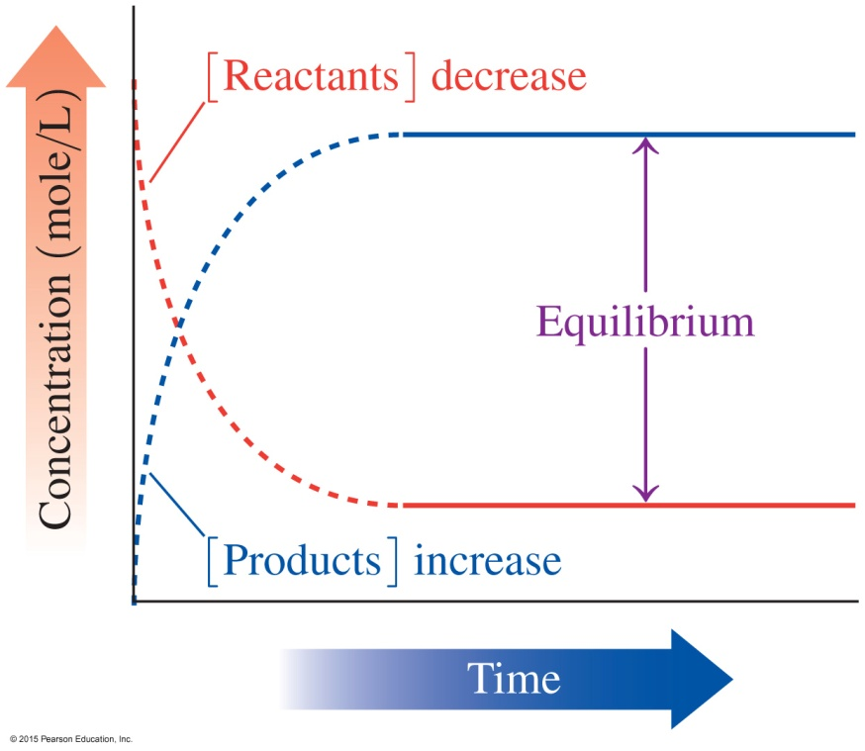
Equilibrium
Equilibrium is reached when
there are no further changes
in the concentrations of
reactants and products
the rate of the forward reaction
is equal to the rate of the
reverse reaction
HF(aq) + H₂O(l) F⁻(aq) + H₃O⁺(aq)
Forward reaction
Reverse reaction

Slide 46
Learning Check
Complete each of the following with equal or not equal, faster or slower, or change or do not change:
A. Before equilibrium is reached, the concentrations of the reactants and products _____________.
B. Initially, reactants have a rate of reaction ______ than the rate of reaction of the products.
C. At equilibrium, the rate of the forward reaction is ______ to the rate of the reverse reaction.
D. At equilibrium, the concentrations of the reactants and products ____________.

Slide 47
Solution
Complete each of the following with equal or not equal, faster or slower, or change or do not change:
Before equilibrium is reached, the concentrations of the reactants and products change.
Initially, reactants have a rate of reaction faster than the rate of reaction of the products.
At equilibrium, the rate of the forward reaction is equal to the rate of the reverse reaction.
At equilibrium, the concentrations of the reactants and products do not change.

Slide 48

Le Châtelier’s
Principle
When we alter the concentration of a reactant or product of a system at equilibrium,
the rates of the forward and reverse reactions will no longer be equal
a stress is placed on the equilibrium
Le Châtelier’s principle states that when equilibrium is disturbed, the rates of the forward and reverse reactions change to relieve that stress and reestablish equilibrium.

Slide 49
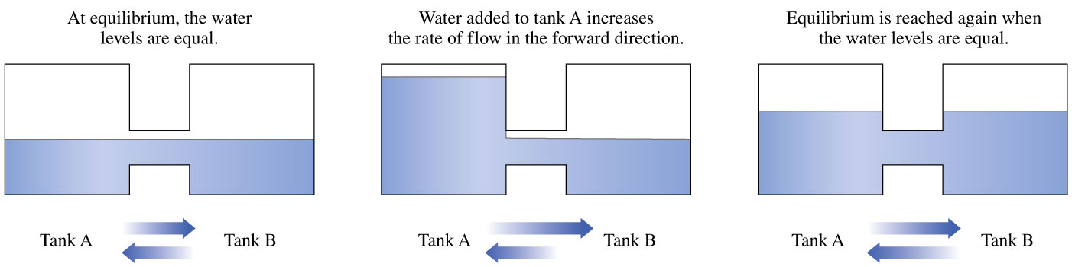
Le Châtelier’s Principle

Slide 50
Concentration Changes, Equilibrium
Given the equilibrium reaction, adding more HF
HF(aq) + H₂O(l) F⁻(aq) + H₃O⁺(aq)
increases the concentration of HF
puts stress on the system that is relieved by increasing the rate of the forward reaction
HF(aq) + H₂O(l) F⁻(aq) + H₃O⁺(aq)
Le Châtelier’s principle states that adding more reactant causes the system to shift the direction of the products until equilibrium is reestablished.
Add HF

Slide 51
Concentration Changes, Equilibrium
Given the equilibrium reaction, removing some of the HF
HF(aq) + H₂O(l) F⁻(aq) + H₃O⁺(aq)
decreases the concentration of HF
puts stress on the system that is relieved by increasing the rate of the reverse reaction
HF(aq) + H₂O(l) F⁻(aq) + H₃O⁺(aq)
Le Châtelier’s principle states that the stress of removing some of the reactant causes the system to shift in the direction of the reactants until equilibrium is reestablished.
Remove HF

Slide 52
Concentration Changes, Equilibrium
Given the equilibrium reaction, adding more F⁻
HF(aq) + H₂O(l) F⁻(aq) + H₃O⁺(aq)
increases the concentration of F⁻
puts stress on the system that is relieved by increasing the rate of the reverse reaction
HF(aq) + H₂O(l) F⁻(aq) + H₃O⁺(aq)
Le Châtelier’s principle states that the addition of more product to the system causes the system to shift in the direction of the reactants.
Add F⁻

Slide 53
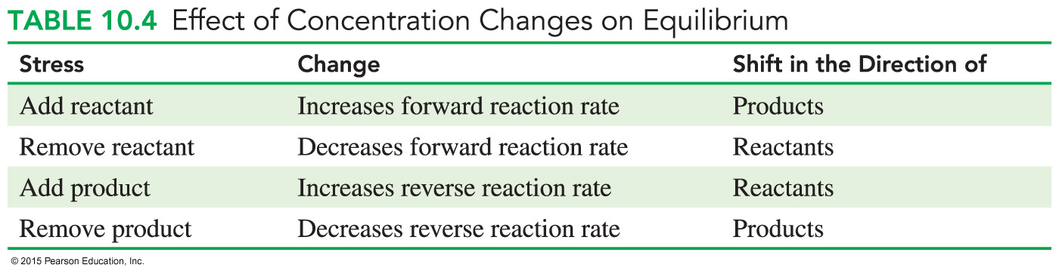
Concentration Changes, Equilibrium
In summary, Le Châtelier’s principle indicates that a stress caused by adding a substance at equilibrium is relieved when the system shifts the reaction away from that substance.

Slide 54
Chemistry Link to Health: Hypoxia
Oxygen transport involves an equilibrium reaction between
hemoglobin (Hb), oxygen, and oxyhemoglobin (HbO₂).
Hb(aq) + O₂(g) HbO₂(aq)
When the O₂ level is high in the alveoli of the lung, the reaction shifts in the direction of the product HbO₂.
In the tissues where O₂ concentration is low, the reverse reaction releases the oxygen from the hemoglobin.

Slide 55
Chemistry Link to Health: Hypoxia
At 18,000 feet, a person receives 29% less O₂ and may experience hypoxia.
Hypoxia is characterized by increased respiratory rate, causing symptoms such as headache, decreased mental acuteness, fatigue, and decreased physical coordination.
According to Le Châtelier’s principle, we see that a decrease in oxygen will shift the system in the direction of the reactants to reestablish equilibrium.
Hb(aq) + O₂(g) HbO₂(aq)
Remove O₂

Slide 56
Learning Check
An important reaction in the body fluids is
H₂CO₃(aq) + H₂O(l) H₃O⁺(aq) + HCO₃⁻(aq)
Use Le Châtelier’s principle to predict whether the system shifts in the direction of products or reactants for each of the following:
A. Adding some H₂CO₃(aq)
B. Removing some HCO₃⁻(aq)
C. Adding some H₃O⁺(aq)

Slide 57
Solution
An important reaction in the body fluids is
H₂CO₃(aq) + H₂O(l) H₃O⁺(aq) + HCO₃⁻(aq)
Use Le Châtelier’s principle to predict whether the system shifts in the direction of products or reactants for each of the following:
A. Adding some H₂CO₃(aq)
The concentration of the reactant H₂CO₃ increases.
The rate of the forward reaction increases to shift the system in the direction of the products until equilibrium is reestablished.

Slide 58
Solution
An important reaction in the body fluids is
H₂CO₃(aq) + H₂O(l) H₃O⁺(aq) + HCO₃⁻(aq)
Use Le Châtelier’s principle to predict whether the system shifts in the direction of products or reactants for each of the following:
B. Removing some HCO₃⁻(aq)
When the concentration of the product HCO₃⁻ decreases, the rate of the reverse reaction decreases.
The system shifts in the direction of the products until equilibrium is reestablished.

Slide 59
Solution
An important reaction in the body fluids is
H₂CO₃(aq) + H₂O(l) H₃O⁺(aq) + HCO₃⁻(aq)
Use Le Châtelier’s principle to predict whether the system shifts in the direction of products or reactants for each of the following:
C. Adding some H₃O⁺(aq)
When the concentration of the product H₃O⁺ increases, the rate of the reverse reaction increases.
The system shifts in the direction of the reactants until equilibrium is reestablished.

Slide 60
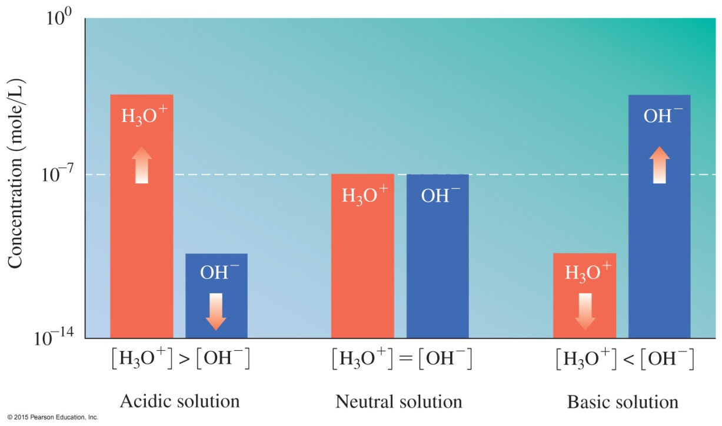
10.5 Dissociation of Water
H₂O(l ) + H₂O(l ) H₃O⁺(aq) + OH⁻(aq)
Learning Goal Use the water dissociation expression to calculate the [H₃O⁺] and [OH⁻] in an aqueous solution.

Slide 61
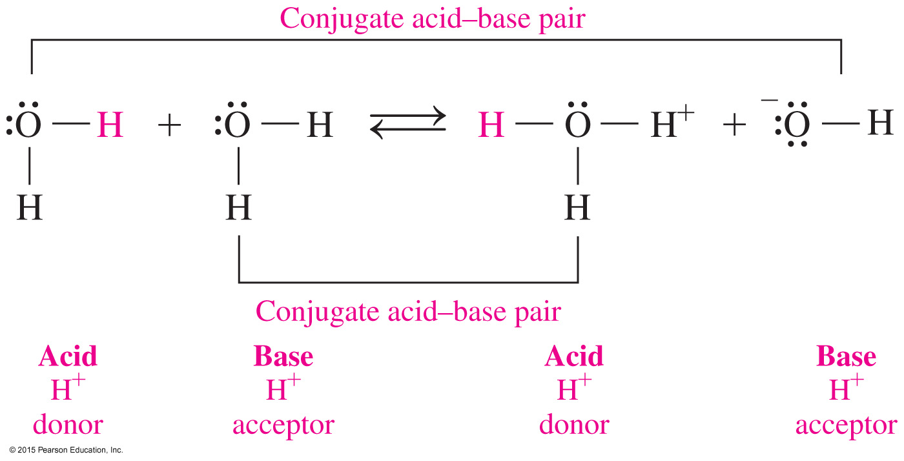
Ionization of Water
Water is amphoteric—it can act as an acid or a base. In water,
H⁺ is transferred from one H₂O molecule to another
one molecule acts as an acid, while another acts as a base
equilibrium is reached between the conjugate acid–base pairs

Slide 62
Writing the Water Dissociation Expression, K_{w}
In the equation for the dissociation of water, there is both a forward and a reverse reaction.
H₂O(l) + H₂O(l) H₃O⁺(aq) + OH⁻(aq)
In pure water, the concentrations of H₃O⁺ and OH⁻ at 25 °C are each 1.0 × 10⁻⁷ M.
[H₃O⁺] = [OH⁻] = 1.0 × 10^{–7} M
K_{w} = [H₃O⁺] [OH⁻]
K_{w} = (1.0 × 10⁻⁷ M) (1.0 × 10⁻⁷ M) = 1.0 × 10^{–14} at 25 °C
Base Acid Conjugate Conjugate
Acid Base

Slide 63
Water Dissociation Expression, K_{w}
The water dissociation expression, K_{w}, is defined
as the product of the concentrations of H₃O⁺ and OH⁻
as equal to 1.0 × 10⁻¹⁴ at 25 °C (the concentration units
are omitted)
When
the [H₃O⁺] and [OH⁻] are equal, the solution is neutral
the [H₃O⁺] is greater than the [OH⁻], the solution is acidic
the [OH⁻] is greater than the [H₃O⁺], the solution is basic

Slide 64
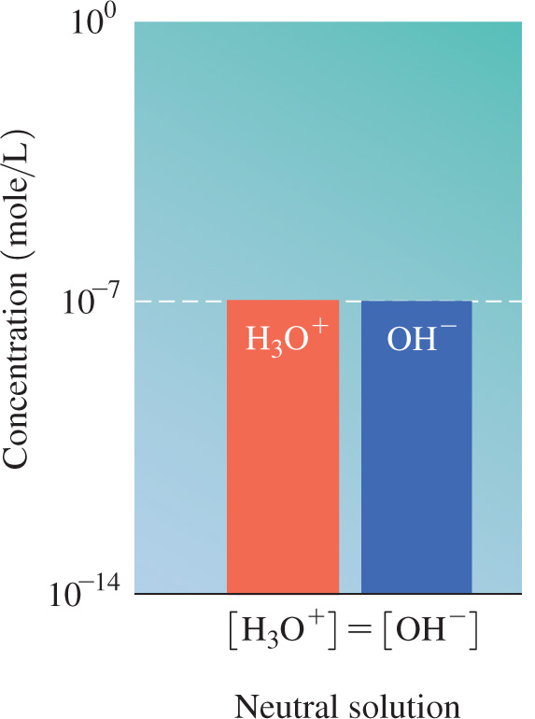
Pure Water Is Neutral
In pure water, the ionization of water molecules produces small but equal quantities of H₃O⁺ and OH⁻ ions.
[H₃O⁺] = 1.0 × 10⁻⁷ M
[OH⁻] = 1.0 × 10⁻⁷ M
[H₃O⁺] = [OH⁻]
Pure water is neutral.

Slide 65
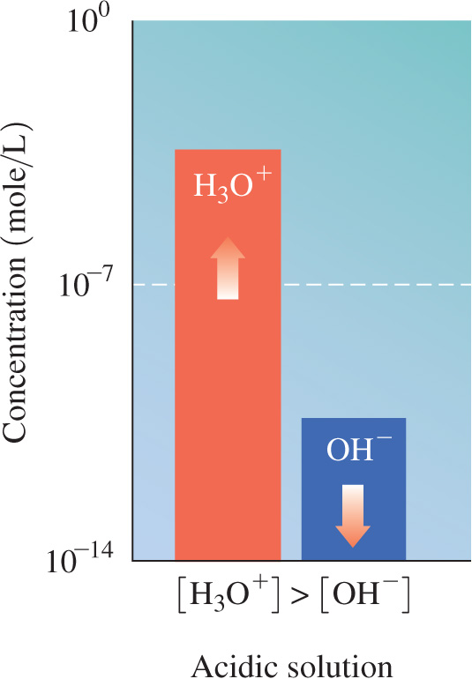
Acidic Solutions
Adding an acid to pure water
increases the [H₃O⁺]
causes the [H₃O⁺] to exceed
1.0 × 10⁻⁷ M
decreases the [OH⁻]
[H₃O⁺] > [OH⁻]
The solution is acidic.

Slide 66
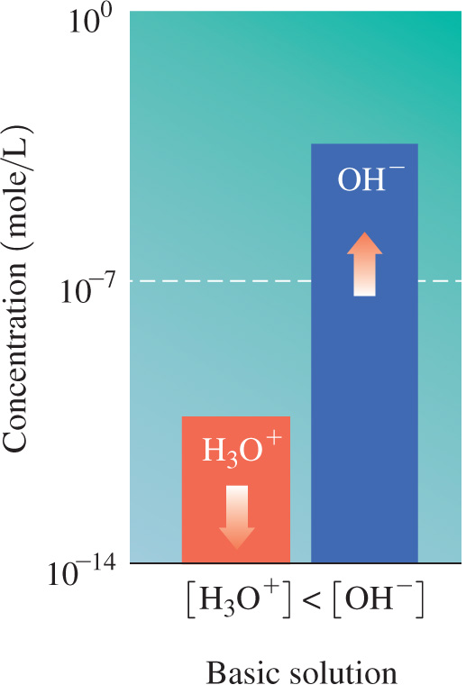
Basic Solutions
Adding a base to pure water
increases the [OH⁻]
causes the [OH⁻] to exceed 1.0 × 10⁻⁷ M
decreases the [H₃O⁺]
[H₃O⁺] < [OH⁻]
The solution is basic.

Slide 67
Comparison of [H₃O⁺] and [OH⁻]

Slide 68
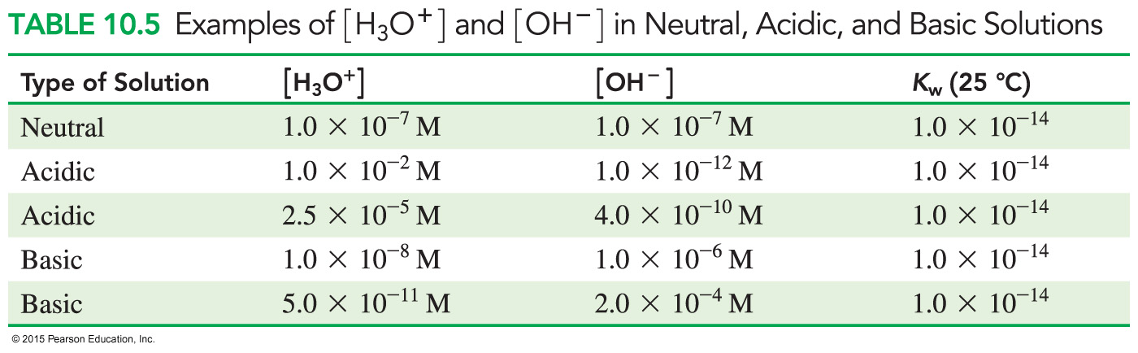
Neutral, Basic, and Acidic Solutions

Slide 69

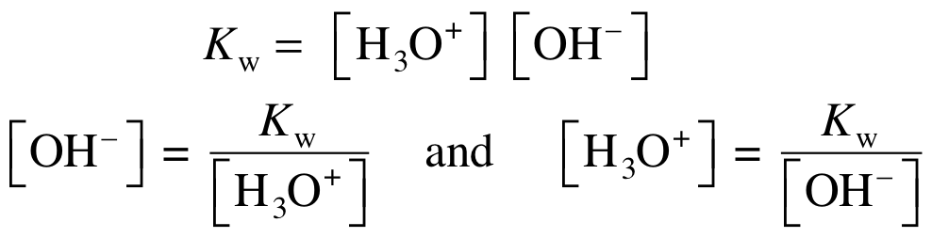
Using K_{w} to Calculate
[H₃O⁺] and [OH⁻]
If we know the [H₃O⁺] of a solution, we can use the K_{w} to calculate the [OH⁻].
If we know the [OH⁻] of a solution, we can use the K_{w} to calculate the [H₃O⁺].

Slide 70
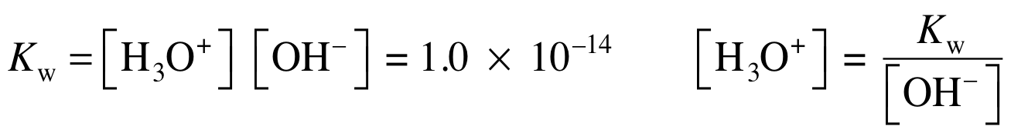
Calculating [H₃O⁺]
What is the [H₃O⁺] of a solution if [OH⁻] is 5.0 × 10⁻⁸ M?
SOLUTION:
STEP 1 State the given and needed quantities.
STEP 2 Write the K_{w} for water and solve for the unknown [H₃O⁺] or [OH⁻].
ANALYZE THE GIVEN NEED CONNECT
PROBLEM [OH⁻] = 5.0 × 10⁻⁸ M [H₃O⁺] K_{w} = [H₃O⁺][OH⁻]

Slide 71
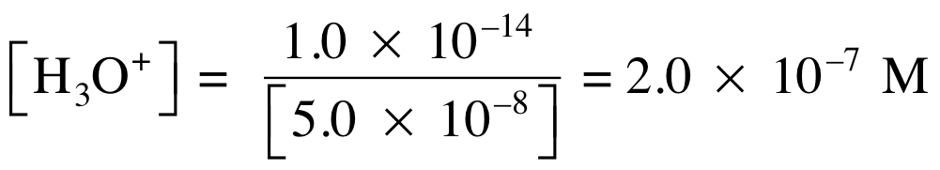
Calculating [H₃O⁺]
What is the [H₃O⁺] of a solution if [OH⁻] is 5.0 × 10⁻⁸ M?
STEP 3 Substitute in the known [H₃O⁺] or [OH⁻] and calculate.
Because the [H₃O⁺] of 2.0 × 10⁻⁷ M is larger than
the [OH⁻] of 5.0 × 10⁻⁸ M, the solution is acidic.

Slide 72
Learning Check
If lemon juice has [H₃O⁺] of 2.0 × 10⁻³ M, what is the [OH⁻] of the solution?
A. 2.0 × 10⁻¹¹ M
B. 5.0 × 10⁻¹¹ M
C. 5.0 × 10⁻¹² M

Slide 73
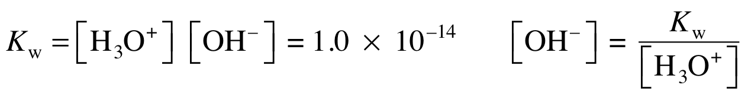
Solution
If lemon juice has [H₃O⁺] of 2.0 × 10⁻³ M, what is the [OH⁻] of the solution?
STEP 1 State the given and needed quantities.
STEP 2 Write the K_{w} for water and solve for the unknown [H₃O⁺] or [OH⁻].
ANALYZE THE GIVEN NEED CONNECT
PROBLEM [H₃O⁺] = 2.0 × 10⁻³ M [OH⁻] K_{w} = [H₃O⁺][OH⁻]

Slide 74
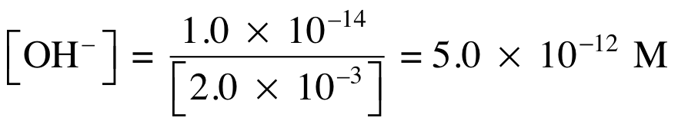
Solution
If lemon juice has [H₃O⁺] of 2.0 × 10⁻³ M, what is the [OH⁻] of the solution?
STEP 3 Substitute in the known [H₃O⁺] or [OH⁻]
and calculate.
Because the [H₃O⁺] concentration of 2.0 × 10⁻³ M is greater than the [OH⁻] of 5.0 × 10⁻¹² M, the solution is acidic.
The answer is C.

Slide 75
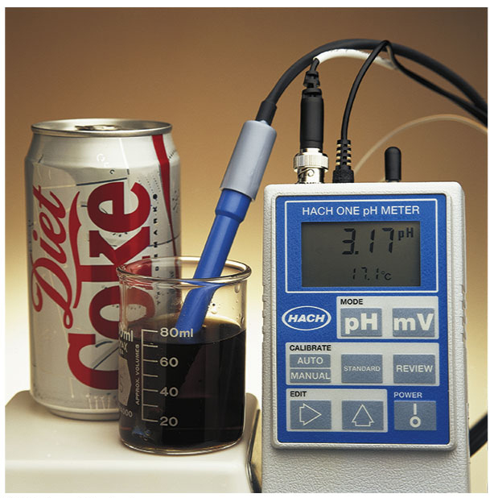
10.6 The pH Scale
The pH scale is used to describe the acidity of solutions.
The pH of Diet Coke is 3.17.
Learning Goal Calculate the pH of a solution from [H₃O⁺]; given the pH, calculate [H₃O⁺].

Slide 76
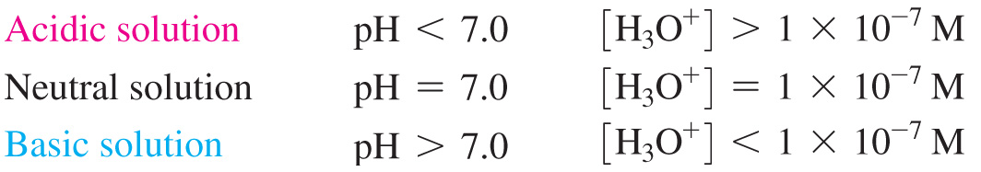
The pH Scale
The pH of a solution
is used to indicate the acidity of a solution
has values that usually range from 0 to 14
is acidic when the values are less than 7
is neutral at a value of 7
is basic when the values are greater than 7

Slide 77
The pH Scale
The pH of a solution is commonly measured using
a pH meter in the laboratory
pH paper, an indicator that turns specific colors at specific pH values
The pH of a solution is found by comparing the colors of indicator paper to a chart.

Slide 78
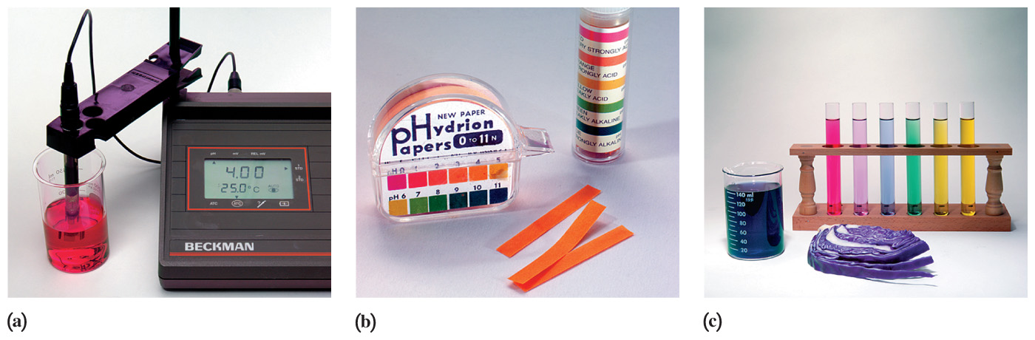
pH Measurement
The pH of a solution can be determined using (a) a pH meter, (b) pH paper, and (c) indicators that turn different colors corresponding to different pH values.

Slide 79
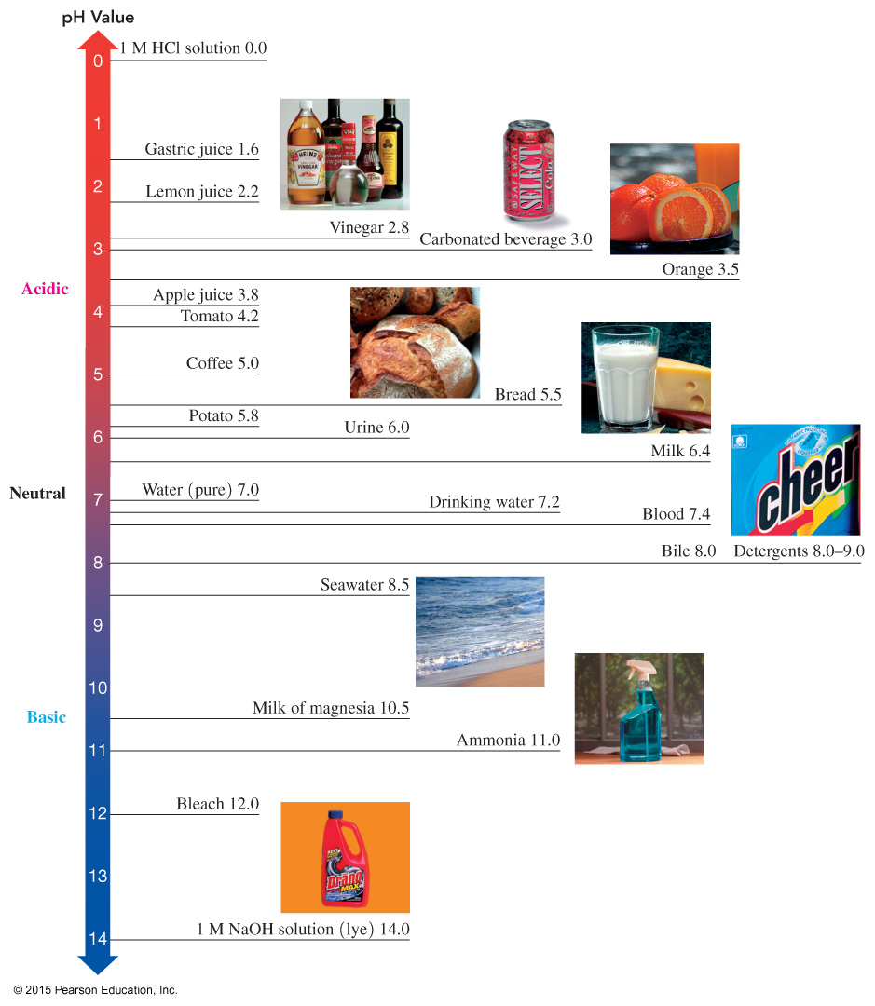
pH of Common Substances
On the pH scale, values below 7.0 are acidic, a value of 7.0 is neutral, and values above 7.0 are basic.

Slide 80
Learning Check
Identify each solution as acidic, basic, or neutral.
A. ___ HCl with a pH = 1.5
B. ___ pancreatic fluid, [H₃O⁺] = 1 × 10⁻⁸ M
C. ___ Sprite soft drink, pH = 3.0
D. ___ pH = 7.0
E. ___ [OH⁻] = 3 × 10⁻¹⁰ M
F. ___ [H₃O⁺ ] = 5 × 10⁻¹²

Slide 81
Solution
Identify each solution as acidic, basic, or neutral.
A. ___ HCl with a pH = 1.5 acidic
B. ___ pancreatic fluid, [H₃O⁺] = 1 × 10⁻⁸ M basic
C. ___ Sprite soft drink, pH = 3.0 acidic
D. ___ pH = 7.0 neutral
E. ___ [OH⁻] = 3 × 10⁻¹⁰ M acidic
F. ___ [H₃O⁺ ] = 5 × 10⁻¹² basic

Slide 82

Calculating the pH of Solutions
The pH scale
is a logarithmic scale that corresponds to the [H₃O⁺] of aqueous solutions.
is the negative logarithm (base 10) of the [H₃O⁺]
pH = −log[H₃O⁺]
To calculate the pH, the negative powers of 10 in the molar concentrations are converted to positive numbers. If [H₃O⁺] is 1.0 × 10⁻² M,
pH = −log[1.0 × 10⁻² ] = −(−2.00) = 2.00

Slide 83
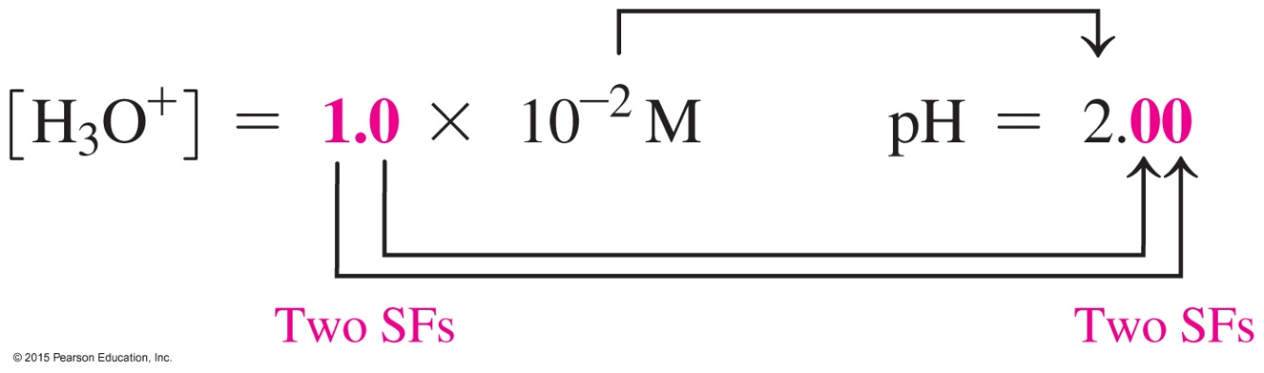
pH, Significant Figures
To determine the number of significant figures in the pH value, consider the following:
The number of decimal places in the pH value is the same as the number of significant figures in the coefficient of [H₃O⁺].
The number to the left of the decimal point in the pH value is the power of 10.

Slide 84
pH Scale and [H₃O⁺]
Because pH is a log scale,
a change of one pH unit corresponds to a tenfold change
in [H₃O⁺]
pH decreases as the [H₃O⁺] increases
pH 2.00 is [H₃O⁺] = 1.0 × 10⁻² M
pH 3.00 is [H₃O⁺] = 1.0 × 10⁻³ M
pH 4.00 is [H₃O⁺] = 1.0 × 10⁻⁴ M

Slide 85
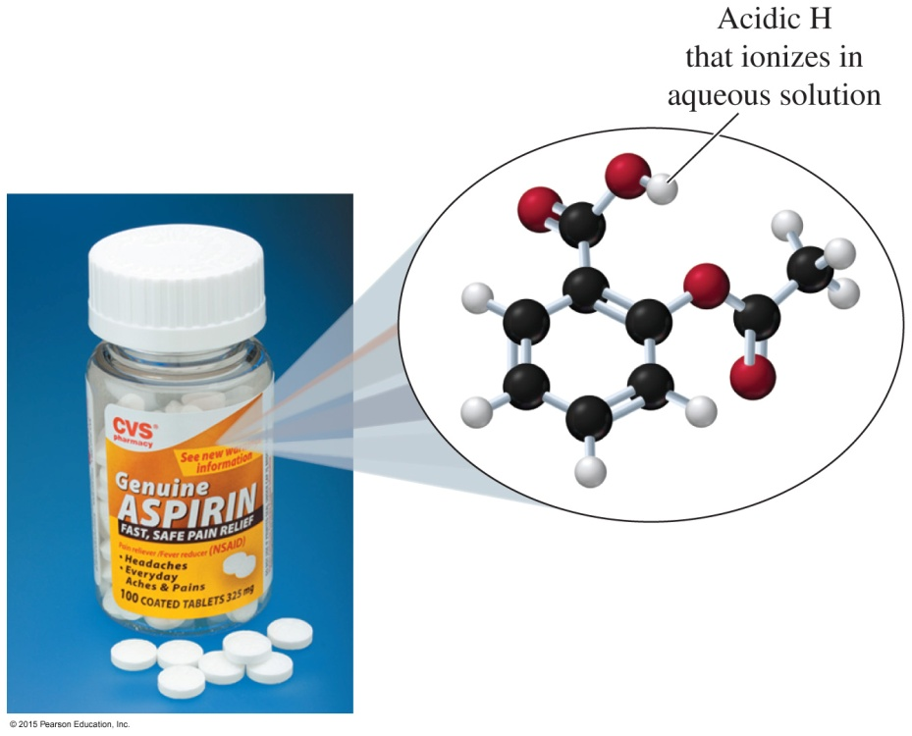
pH Calculation
Aspirin, which is acetylsalicylic acid, was the first nonsteroidal anti-inflammatory drug used to alleviate pain and fever. If a solution of aspirin has a [H₃O⁺] = 1.7 × 10⁻³ M, what is the pH of the solution?

Slide 86
pH Calculation
If a solution of aspirin has a [H₃O⁺] = 1.7 × 10⁻³ M, what is the pH of the solution?
SOLUTION:
STEP 1 State the given and needed quantities.
ANALYZE THE GIVEN NEED CONNECT
PROBLEM [H₃O⁺] = 1.7 × 10⁻³ M pH pH equation

Slide 87
pH Calculation
If a solution of aspirin has a [H₃O⁺] = 1.7 × 10⁻³ M, what is the pH of the solution?
STEP 2 Enter the [H₃O⁺] into the pH equation and calculate.
pH = −log[H₃O⁺] = −log[1.7 × 10⁻³]
Procedure: Enter 1.7 and press .
Calculator Display: 1.7⁰⁰ or 1.700 or 1.7E00
Enter 3 and press to change sign.
Calculator Display: 1.7⁻⁰³ or 1.7−03 or 1.7E−03
EE or Exp
+/−

Slide 88
pH Calculation
If a solution of aspirin has a [H₃O⁺] = 1.7 × 10⁻³ M, what is the pH of the solution?
STEP 2 Enter the [H₃O⁺] into the pH equation and calculate.
Procedure:
Calculator Display: 2.769551079
Combining steps: pH = −log[1.7 × 10⁻³]
= 1.7 3
= 2.769551079
log
+/−
EE or Exp
+/−
log
+/−

Slide 89
pH Calculation
If a solution of aspirin has a [H₃O⁺] = 1.7 × 10⁻³ M, what is the pH of the solution?
STEP 3 Adjust the number of SFs on the right of the decimal point.
Coefficient Power of ten
1.7 × 10⁻³ M H = −log[1.7 × 10⁻³] = 2.77
Two SFs Exact Exact Two SFs

Slide 90
Learning Check
Find the pH of a solution with a [H₃O⁺] of 4.0 × 10⁻⁵.

Slide 91
Solution
Find the pH of a solution with a [H₃O⁺] of 4.0 × 10⁻⁵.
SOLUTION:
STEP 1 State the given and needed quantities.
ANALYZE THE GIVEN NEED CONNECT
PROBLEM [H₃O⁺] = 4.0 × 10⁻⁵ M pH pH equation

Slide 92
Solution
Find the pH of a solution with a [H₃O⁺] of 4.0 × 10⁻⁵.
STEP 2 Enter the [H₃O⁺] into the pH equation and calculate.
pH = −log[H₃O⁺] = −log[4.0 × 10⁻⁵]
Procedure: Enter 4.0 and press .
Calculator Display: 4.0⁰⁰ or 4.000 or 4.0E00 Enter 5 and press to change sign.
Calculator Display: 4.0⁻⁰⁵ or 4.0−05 or 4.0E−05
EE or Exp
+/−

Slide 93
Solution
Find the pH of a solution with a [H₃O⁺] of 4.0 × 10⁻⁵.
STEP 2 Enter the [H₃O⁺] into the pH equation and calculate.
Procedure:
Calculator Display: 4.39794000 Combining steps: pH = −log[4.0 × 10⁻⁵]
= 4.0 5
= 4.397940009
log
+/−
EE or Exp
+/−
log
+/−

Slide 94
Solution
Find the pH of a solution with a [H₃O⁺] of 4.0 × 10⁻⁵.
STEP 3 Adjust the number of SFs on the right of the decimal point.
Coefficient Power of ten
4.0 × 10⁻⁵ M pH = −log[4.0 × 10⁻⁵] = 4.40
Two SFs Exact Exact Two SFs

Slide 95

Calculating [H₃O⁺] from pH
Given the pH of a solution, we can reverse the calculation to obtain the [H₃O⁺].
For whole number pH values, the negative pH value is the power of 10 in the [H₃O⁺] concentration.
[H₃O⁺] = 10^{−pH}
For pH values that are not whole numbers, the calculation requires the use of the 10^{x} key, which is usually a 2nd function key.

Slide 96
Learning Check
Determine the [H₃O⁺] for solutions having each of the following pH values:
A. 3.0
B. 3.42

Slide 97
Solution
Determine the [H₃O⁺] for solutions having each of the following pH values:
A. 3.0 For pH values that are whole numbers, the [H₃O⁺] can be written 1 × 10^{−pH}.
[H₃O⁺] = 1 × 10⁻³ M
pH

Slide 98
Solution
Determine the [H₃O⁺] for solutions having each of the following pH values:
B. 3.42 For pH values that are not whole numbers, do the
following:
STEP 1 State the given and needed quantities.
3.42
Calculator Display: −3.42
ANALYZE THE GIVEN NEED CONNECT
PROBLEM pH = 3.42 [H₃O⁺] [H₃O⁺] = 10^{−pH}
+/−

Slide 99
Solution
Determine the [H₃O⁺] for solutions having each of the following pH values:
B. 3.42 For pH values that are not whole numbers, do the
following:
STEP 2 Enter the pH value into the inverse log equation
and calculate.
Press the 2nd function key and then the 10^{x} key. Or
press the inverse key and then the log key.
or
Calculator Display: 3.801893963⁻⁰⁴ or 3.801893963E⁻⁰⁴
2nd
10^{x}
inv
log

Slide 100
Solution
Determine the [H₃O⁺] for solutions having each of the following pH values:
B. 3.42 For pH values that are not whole numbers, do the
following:
STEP 3 Adjust the SFs for the coefficient.
The pH value of 3.42 has two digits on the right of the decimal point; the [H₃O⁺] is written with two
significant figures in the coefficient.
[H₃O⁺] = 3.8 × 10⁻⁴ M

Slide 101
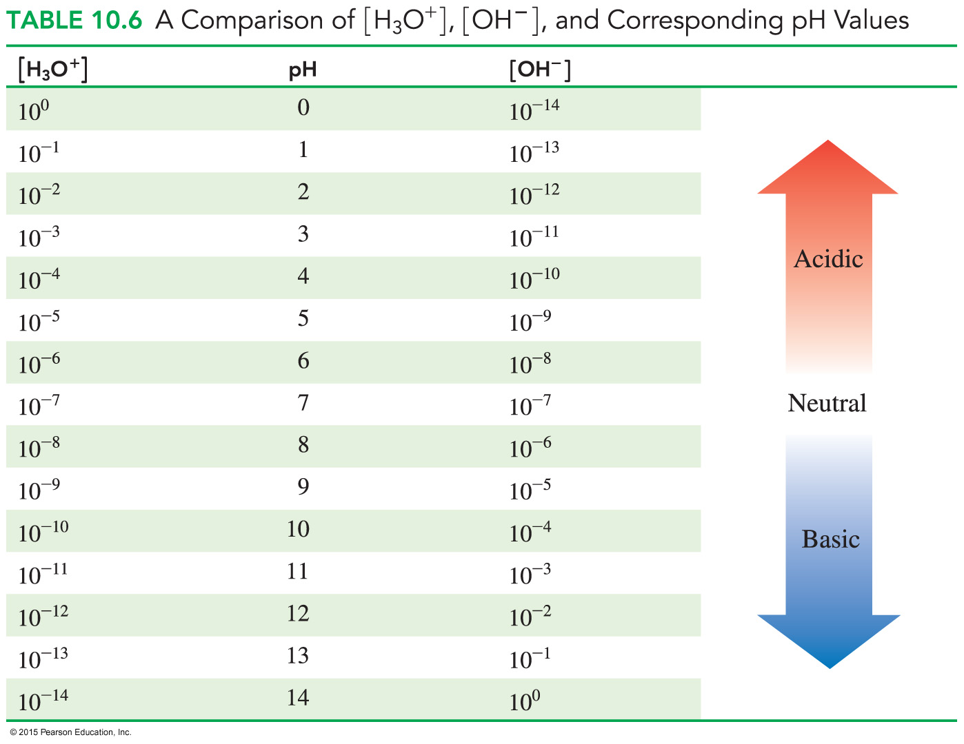
[H₃O⁺], [OH⁻], and pH Comparison

Slide 102
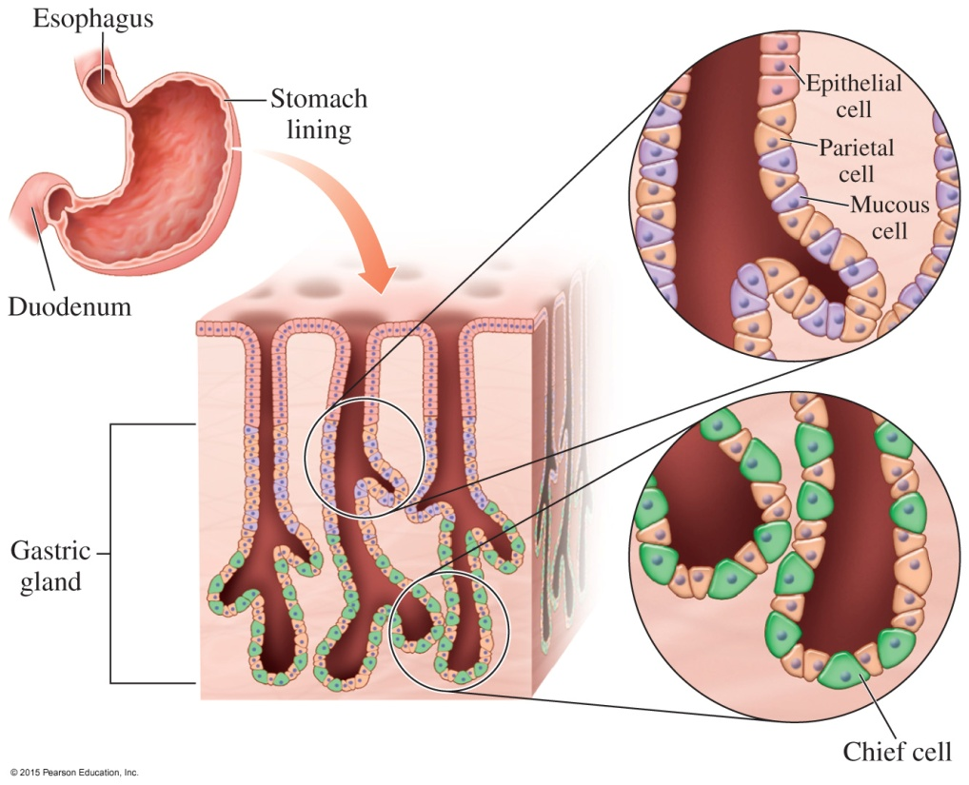
10.7 Reactions of Acids and Bases
Gastric acid contains HCl
and is produced by parietal cells that line the stomach. When protein enters the stomach, HCl is secreted
until the pH reaches 2, optimum for digestion.
Learning Goal Write balanced equations for reactions of acids with metals, carbonates or bicarbonates, and bases; calculate the molarity or volume of an acid from titration information.

Slide 103

Reactions of Acids
Acids react with
certain metals to produce a salt and hydrogen gas
bases to produce a salt and water
bicarbonate and carbonate ions to produce carbon dioxide gas
A salt is an ionic compound that does not have H⁺ as the cation or OH⁻ as the anion.

Slide 104
Acids and Metals
Acids react with metals
such as K, Na, Ca, Mg, Al, Zn, Fe, and Sn
to produce hydrogen gas and the salt of the metal
2K(s) + 2HCl(aq) 2KCl(aq) + H₂(g)
metal acid salt hydrogen
Zn(s) + 2HCl(aq) ZnCl₂(aq) + H₂(g)
metal acid salt hydrogen

Slide 105
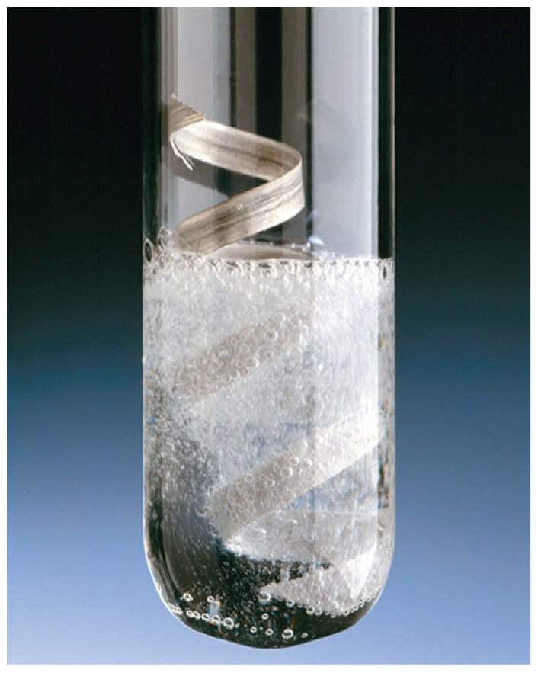
Learning Check
Write balanced equations and label the metal, acid, and salt for the following reactions:
A. Magnesium metal with HCl(aq)
B. Aluminum metal with HNO₃(aq)

Slide 106
Solution
Write balanced equations and label the metal, acid, and salt for the following reactions:
A. Magnesium metal with HCl(aq)
Mg(s) + 2HCl(aq) MgCl₂(aq) + H₂(g)
metal acid salt
B. Aluminum metal with HNO₃(aq)
2Al(s) + 6HNO₃ (aq) 2Al(NO₃)₃(aq) + 3H₂(g)
metal acid salt

Slide 107
Acids, Carbonates, Bicarbonates
Acids react
with carbonates and hydrogen carbonates
to produce carbon dioxide gas, a salt, and water
2HCl(aq) + CaCO₃(s) CO₂(g) + CaCl₂(aq) + H₂O(l)
acid carbonate carbon salt water
dioxide
HCl(aq) + NaHCO₃(s) CO₂(g) + NaCl(aq) + H₂O(l)
acid bicarbonate carbon salt water
dioxide

Slide 108
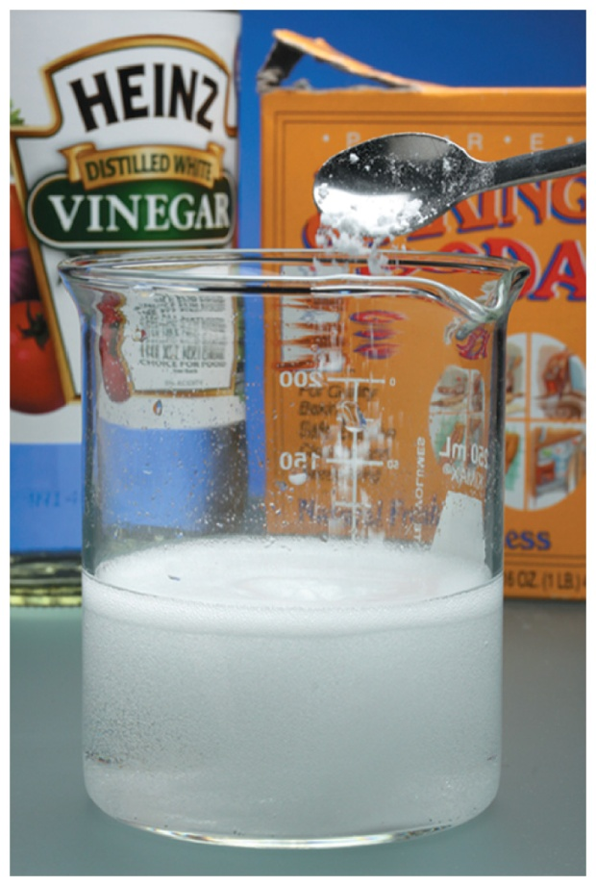
Learning Check
Write balanced equations for the following reactions:
A. MgCO₃(s) + HBr(aq)
B. HCl(aq) + NaHCO₃(aq)

Slide 109
Solution
Write balanced equations for the following reactions:
A. MgCO₃(s) + 2HBr(aq) MgBr₂(aq) + CO₂(g) + H₂O(l)
B. HCl(aq) + NaHCO₃(aq) NaCl(aq) + CO₂(g) + H₂O(l)

Slide 110
Acids and Hydroxides: Neutralization
In a neutralization reaction,
an acid reacts with a base to produce a salt and water
the salt formed is the anion from the acid and the cation from
the base
HCl(aq) + NaOH(aq) NaCl(aq) + H₂O(l)
acid base salt water

Slide 111
Neutralization Reactions
In neutralization reactions, one H⁺ always reacts with one OH⁻.
If we write the strong acid and strong base as ions, we see that H⁺ reacts with OH⁻ to form water, leaving the ions Na⁺ and
Cl⁻ in solution:
H⁺(aq) + Cl⁻(aq) + Na⁺(aq) + OH⁻(aq)
Na⁺(aq) + Cl⁻(aq) + H₂O(l)
The overall reaction occurs as the H⁺ from the acid and OH⁻ from the base form water:
H⁺(aq) + OH⁻(aq) H₂O(l) Net ionic equation

Slide 112
Balancing Neutralization Reactions
Write the balanced equation for the neutralization of solid magnesium hydroxide and nitric acid.
STEP 1 Write the reactants and products.
Mg(OH)₂(s) + HNO₃(aq) salt + H₂O(l)
STEP 2 Balance the H⁺ in the acid with the OH⁻ in the base.
Mg(OH)₂(s) + 2HNO₃(aq) salt + H₂O(l)
ANALYZE THE GIVEN NEED CONNECT
PROBLEM Mg(OH)₂, HNO₃ balanced equation neutralization products

Slide 113
Balancing Neutralization Reactions
Write the balanced equation for the neutralization of solid magnesium hydroxide and nitric acid.
STEP 3 Balance the H₂O with the H⁺ and the OH⁻.
Mg(OH)₂(s) + 2HNO₃(aq) salt + 2H₂O(l)
STEP 4 Write the formula of the salt from the remaining ions.
Mg(OH)₂(s) + 2HNO₃(aq) Mg(NO₃)₂(aq) + 2H₂O(l)

Slide 114
Learning Check
Select the correct group of coefficients for each of the
following neutralization equations.
1. HCl(aq) + Al(OH)₃(aq) AlCl₃(aq) + H₂O(l)
A. 1, 3, 3, 1 B. 3, 1, 1, 1 C. 3, 1, 1, 3
2. Ba(OH)₂(aq) + H₃PO₄(aq) Ba₃(PO₄)₂(s) + H₂O(l)
A. 3, 2, 2, 2 B. 3, 2, 1, 6 C. 2, 3, 1, 6

Slide 115
Solution
Select the correct group of coefficients for each of the
following neutralization equations.
STEP 1 Write the reactants and products.
1. HCl(aq) + Al(OH)₃(aq) salt + H₂O(l)
2. Ba(OH)₂(aq) + H₃PO₄(aq) salt + H₂O(l)

Slide 116
Solution
Select the correct group of coefficients for each of the
following neutralization equations.
STEP 2 Balance the H⁺ in the acid with the OH⁻ in the base.
1. 3HCl(aq) + Al(OH)₃(aq) salt + H₂O(l)
2. 3Ba(OH)₂(aq) + 2H₃PO₄(aq) salt + H₂O(l)

Slide 117
Solution
Select the correct group of coefficients for each of the
following neutralization equations.
STEP 3 Balance the H₂O with the H⁺ and the OH⁻.
1. 3HCl(aq) + Al(OH)₃(aq) salt + 3H₂O(l)
2. 3Ba(OH)₂(aq) + 2H₃PO₄(aq) salt + 6H₂O(l)

Slide 118
Solution
Select the correct group of coefficients for each of the
following neutralization equations.
STEP 4 Write the salt from the remaining ions.
1. 3HCl(aq) + Al(OH)₃(aq) AlCl₃(aq) + 3H₂O(l)
The answer is C, 3, 1, 1, 3.
2. 3Ba(OH)₂(aq) + 2H₃PO₄(aq) Ba₃(PO₄)₂(s) + 6H₂O(l)
The answer is B, 3, 2, 1, 6.

Slide 119

Acid–Base Titration
Titration
is a laboratory procedure used to determine the molarity of an acid
uses a base such as NaOH to neutralize a measured volume of an acid
requires a few drops of an indicator such as phenolphthalein to identify the endpoint

Slide 120
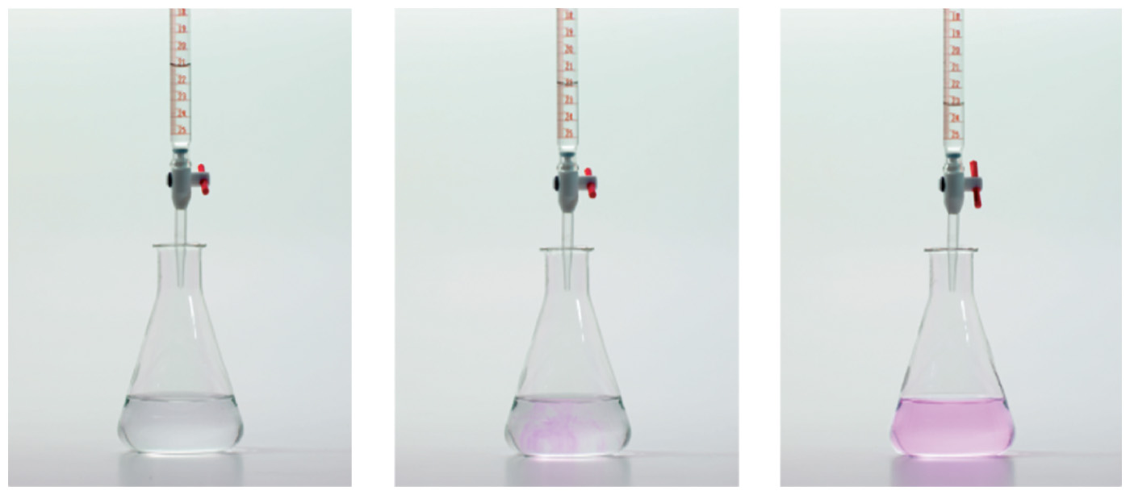
Acid–Base Titration
In the following titration, a specific volume of acidic solution is titrated to the endpoint with a known concentration of NaOH.
Base →
NaOH
Acid →
Solution

Slide 121
Indicator
The indicator phenolphthalein
is added to identify the endpoint
turns pink when the solution is neutralized

Slide 122
Endpoint of Titration
At the endpoint,
the moles of base are equal to the moles of acid in the solution
the concentration of the base
is known
the volume of the base used to reach the endpoint is measured
the molarity of the acid is calculated using the neutralization equation for the reaction

Slide 123
Acid–Base Titration Calculations
What is the molarity of an HCl solution if 18.5 mL of
0.225 M NaOH is required to neutralize 0.0100 L of HCl?
HCl(aq) + NaOH(aq) NaCl(aq) + H₂O(l)
SOLUTION:
STEP 1 State given and needed quantities and
concentrations.
ANALYZE THE GIVEN NEED CONNECT
PROBLEM 18.5 mL of molarity of molarity, mole–mole
0.225 M NaOH HCl solution factor 0.0100 L HCl
HCl(aq) + NaOH(aq) → NaCl(aq) + H₂O(l)

Slide 124
Acid–Base Titration Calculations
What is the molarity of an HCl solution if 18.5 mL of
0.225 M NaOH is required to neutralize 0.0100 L of HCl?
HCl(aq) + NaOH(aq) NaCl(aq) + H₂O(l)
STEP 2 Write a plan to calculate molarity or volume.
mL NaOH
solution
Metric factor
L NaOH
solution
Molarity
moles of
NaOH
moles of
NaOH
Mole–Mole factor
moles of
HCl
Divide by liters
molarity of
HCl solution

Slide 125
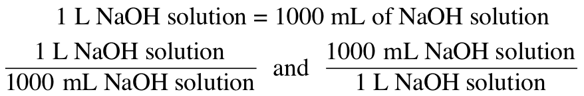
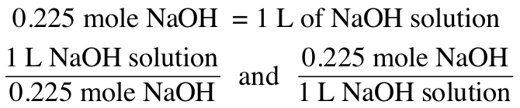
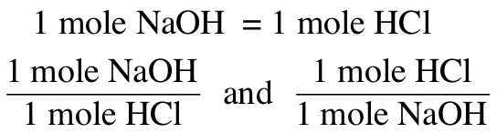
Acid–Base Titration Calculations
What is the molarity of an HCl solution if 18.5 mL of
0.225 M NaOH is required to neutralize 0.0100 L of HCl?
HCl(aq) + NaOH(aq) NaCl(aq) + H₂O(l)
STEP 3 State equalities and conversion factors including concentrations.

Slide 126
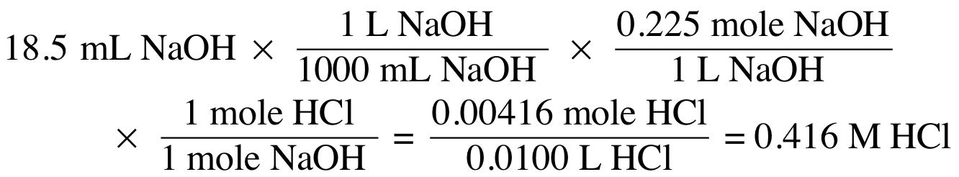
Acid–Base Titration Calculations
What is the molarity of an HCl solution if 18.5 mL of
0.225 M NaOH is required to neutralize 0.0100 L of HCl?
HCl(aq) + NaOH(aq) NaCl(aq) + H₂O(l)
STEP 4 Set up the problem to calculate the needed quantity.

Slide 127
Learning Check
What is the molarity of an HCl solution if 25.5 mL of
0.438 M NaOH is required to neutralize 0.0250 L of HCl?
HCl(aq) + NaOH(aq) NaCl(aq) + H₂O(l)

Slide 128
Solution
What is the molarity of an HCl solution if 25.5 mL of
0.438 M NaOH is required to neutralize 0.0250 L of HCl?
HCl(aq) + NaOH(aq) NaCl(aq) + H₂O(l)
STEP 1 State given and needed quantities and
concentrations.
ANALYZE THE GIVEN NEED CONNECT
PROBLEM 25.5 mL of molarity of molarity, mole-mole
0.438 M NaOH HCl solution factor
0.0250 L HCl
HCl(aq) + NaOH(aq) → NaCl(aq) + H₂O(l)

Slide 129
Solution
What is the molarity of an HCl solution if 25.5 mL of
0.438 M NaOH is required to neutralize 0.0250 L of HCl?
HCl(aq) + NaOH(aq) NaCl(aq) + H₂O(l)
STEP 2 Write a plan to calculate molarity or volume.
mL NaOH
solution
Metric factor
L NaOH
solution
Molarity
moles of
NaOH
Mole–Mole factor
moles of
HCl
Divide by liters
molarity of
HCl solution

Slide 130
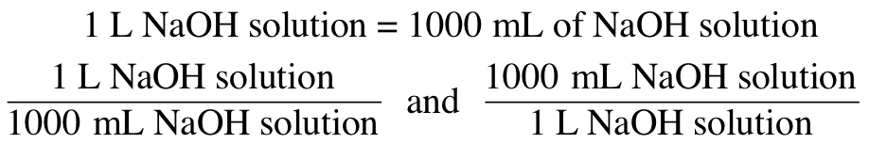
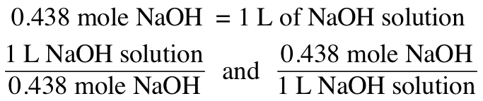
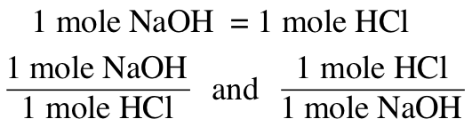
Solution
What is the molarity of an HCl solution if 25.5 mL of
0.438 M NaOH is required to neutralize 0.0250 L of HCl?
HCl(aq) + NaOH(aq) NaCl(aq) + H₂O(l)
STEP 3 State equalities and conversion factors including concentrations.

Slide 131
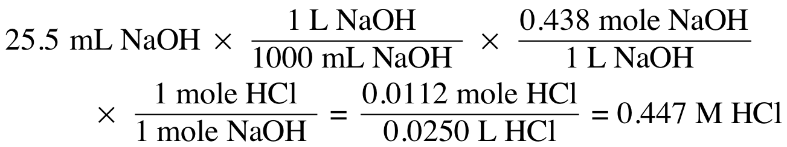
Solution
What is the molarity of an HCl solution if 25.5 mL of
0.438 M NaOH is required to neutralize 0.0250 L of HCl?
HCl(aq) + NaOH(aq) NaCl(aq) + H₂O(l)
STEP 4 Set up the problem to calculate the needed quantity.

Slide 132

Chemistry Link to Health: Antacids
Antacids are substances that
are used to neutralize excess stomach acid
are often made of aluminum hydroxide and magnesium hydroxide mixtures
These hydroxides are not
very soluble in water, so
the levels of available OH⁻
are not damaging to the
intestinal tract.

Slide 133

Chemistry Link to Health: Antacids
Basic Compounds in Antacid Tablets:

Slide 134

10.8 Buffers
A buffer solution maintains
the pH by neutralizing small amounts of added acid or base.
An acid must be present to react with any OH⁻ added, and a base must be present to react with any H₃O⁺ added.
Learning Goal Describe the role of buffers in maintaining
the pH of a solution.

Slide 135

Buffers
When an acid or base is added to water, the pH changes drastically.
In a buffer solution, the
pH is maintained; the pH does not change when acid or base is added.

Slide 136
How Buffers Work
Buffers work because
they resist changes in pH from the addition of acid or base
in the body, they absorb H₃O⁺ or OH⁻ from foods and cellular processes to maintain pH
they are important in the proper functioning of cells and blood
they maintain a pH close to 7.4 in blood
A change in the pH of the blood affects the uptake of oxygen and cellular processes.

Slide 137
Components of a Buffer
A buffer solution
contains a combination of acid–base conjugate pairs, a weak acid and a salt of its conjugate base such as
HC₂H₃O₂(aq) and C₂H₃O₂⁻(aq)
has equal concentrations of a weak acid and its salt
weak acid salt of conjugate base

Slide 138
How Buffers Work
In the buffer with acetic acid (HC₂H₃O₂) and sodium acetate (NaC₂H₃O₂),
the salt produces acetate ions and sodium ions
NaC₂H₃O₂(aq) C₂H₃O₂⁻(aq) + Na⁺(aq)
the salt is added to provide a higher concentration of the conjugate base C₂H₃O₂⁻ than from the weak acid alone
HC₂H₃O₂(aq) + H₂O(l) C₂H₃O₂⁻(aq) + H₃O⁺(aq)
Large amount Large amount

Slide 139

Function of a Weak Acid in a Buffer
The function of the weak acid in a buffer is to neutralize a base.
The acetate ion produced in the neutralization reaction adds to the concentration of acetate already in solution from the salt.
HC₂H₃O₂ + OH⁻ C₂H₃O₂⁻ + H₂O
acetic acid base acetate ion water

Slide 140
Function of Conjugate Base in a Buffer
The function of the acetate ion, C₂H₃O₂⁻, is to neutralize H₃O⁺ from acids.
The acetic acid produced contributes to the available weak acid.
C₂H₃O₂⁻ + H₃O⁺ HC₂H₃O₂ + H₂O
acetate ion acid acetic acid water

Slide 141
Working Buffers
Buffers work because the weak acid in a buffer neutralizes bases and the conjugate base in the buffer neutralizes acids.
The buffer described here consists of about equal concentrations of acetic acid (HC₂H₃O₂) and its conjugate base, acetate ion (C₂H₃O₂⁻).
Adding H₃O⁺ to the buffer reacts with C₂H₃O₂⁻ whereas adding OH⁻ neutralizes HC₂H₃O₂.
The pH of the solution is maintained as long as the added amounts of acid or base are small compared to the concentrations of the buffer components.

Slide 142
Learning Check
Which of the following combinations make a buffer solution?
A. HCl and KCl
B. H₂CO₃ and NaHCO₃
C. H₃PO₄ and NaCl
D. HC₂H₃O₂ and KC₂H₃O₂

Slide 143
Solution
Which of the following combinations make a buffer solution?
A buffer consists of a weak acid and a salt of its conjugate base.
A. HCl and KCl not a buffer
B. H₂CO₃ and NaHCO₃ buffer, a weak acid and its salt
C. H₃PO₄ and NaCl not a buffer
D. HC₂H₃O₂ and KC₂H₃O₂ buffer, a weak acid and its salt

Slide 144

Acids and Bases—Concept Map

