Slide 1
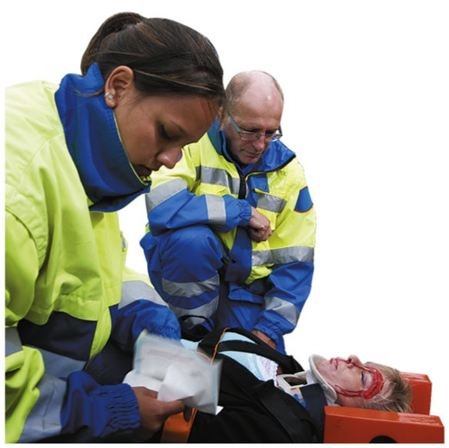
Chapter 11 Introduction to Organic Chemistry: Hydrocarbons
Firefighters/emergency medical technicians must be knowledgeable about fire codes, arson, and the handling and disposal of hazardous materials.
Since firefighters/emergency medical technicians also provide emergency care for sick and injured people, they need to be aware of emergency medical and rescue procedures, as well as the proper methods for controlling the spread of infectious disease.

Slide 2
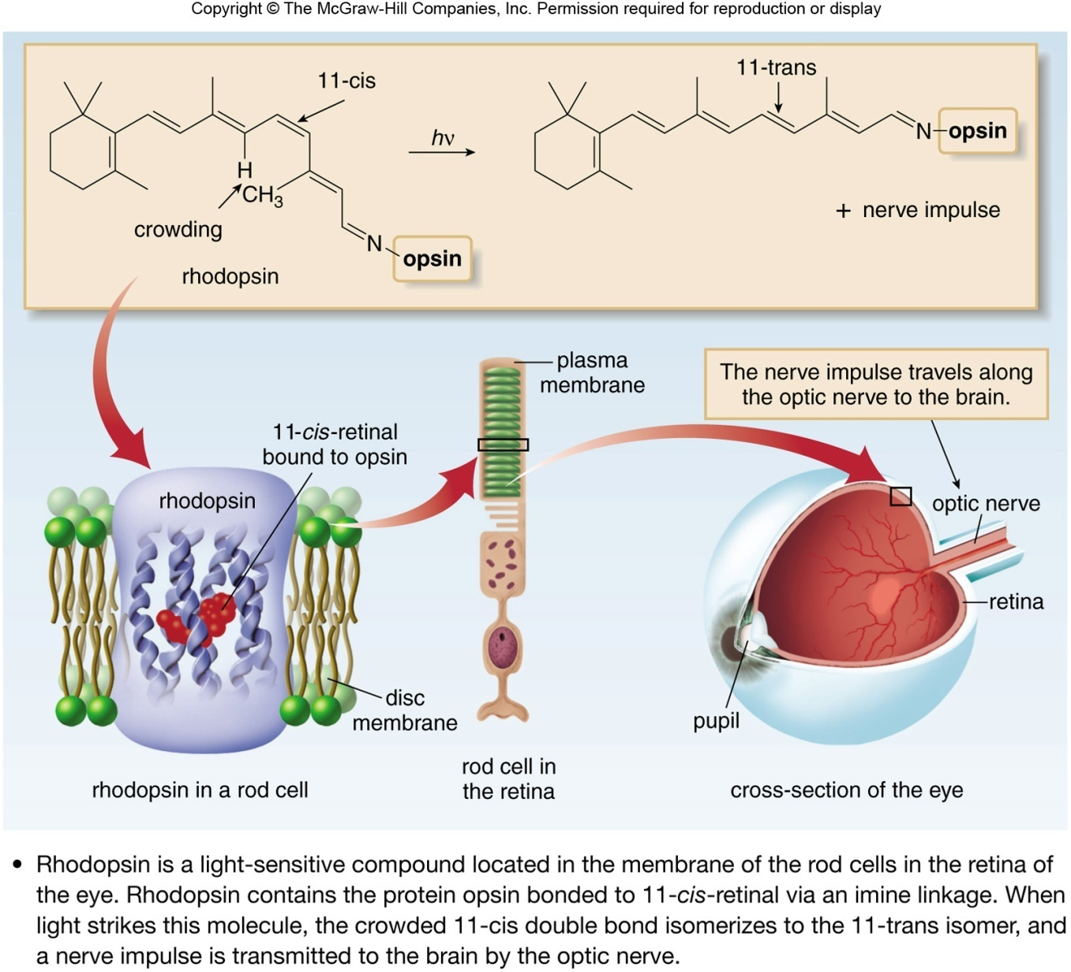
Importance of Organic Chemistry

Slide 3
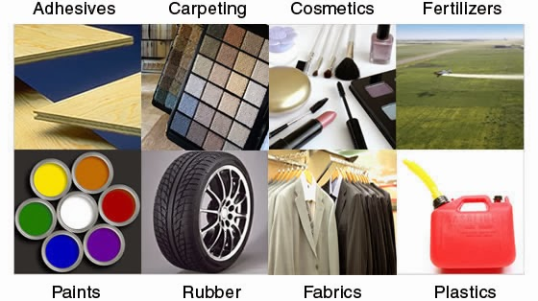
Importance of Organic Chemistry

Slide 4
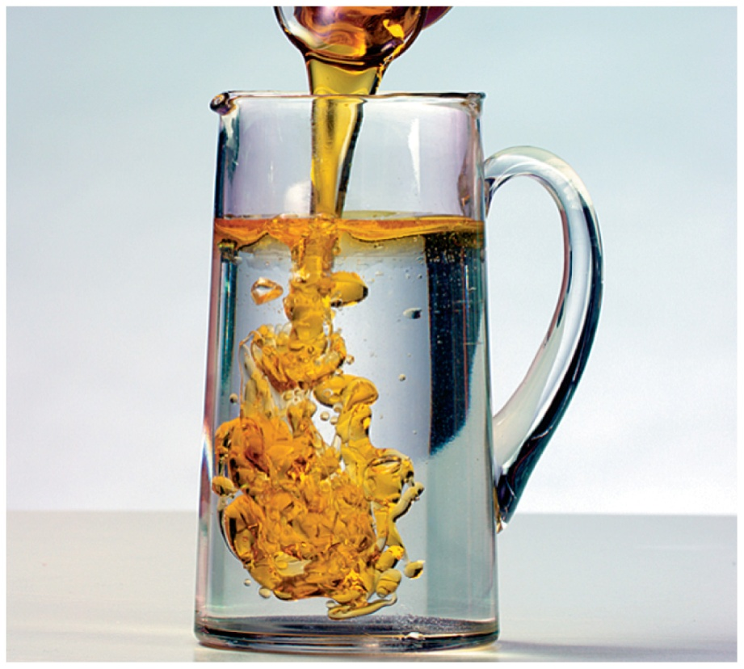
11.1 Organic Compounds
Organic chemistry is the study of carbon compounds.
Organic compounds such as vegetable oil contain carbon and hydrogen.
Learning Goal Identify properties characteristic of organic or inorganic compounds.

Slide 5
Organic Compounds
An organic compound
is a compound made from carbon and hydrogen atoms
may also contain other nonmetals such as oxygen, sulfur, nitrogen, phosphorus, or a halogen
is often found in common products such as gasoline, medicines, shampoos, plastics, and perfumes
The formulas of organic compounds are written with carbon first, followed by hydrogen, and then any other elements.

Slide 6
Properties of Organic Compounds
Organic compounds typically
have covalent bonds
have low melting and
boiling points
are flammable and undergo combustion
are not soluble in water
Vegetable oil is a mixture of
organic compounds and is not
soluble in water.

Slide 7
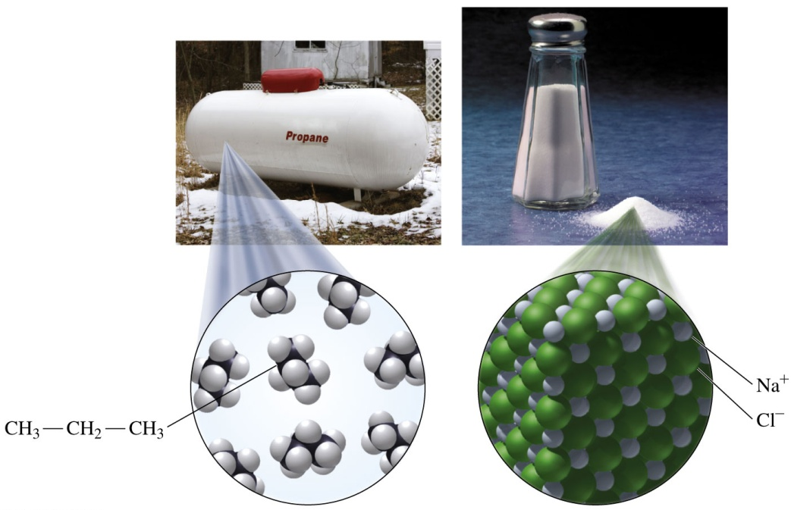
Organic and Inorganic Compounds
Many inorganic compounds have high melting and boiling points.
Inorganic compounds that are ionic are usually soluble in water, and most do not burn in air.
Propane, C₃H₈, is an organic compound used as a fuel. Salt, NaCl, is an inorganic compound composed of Na⁺ and Cl⁻ ions.

Slide 8
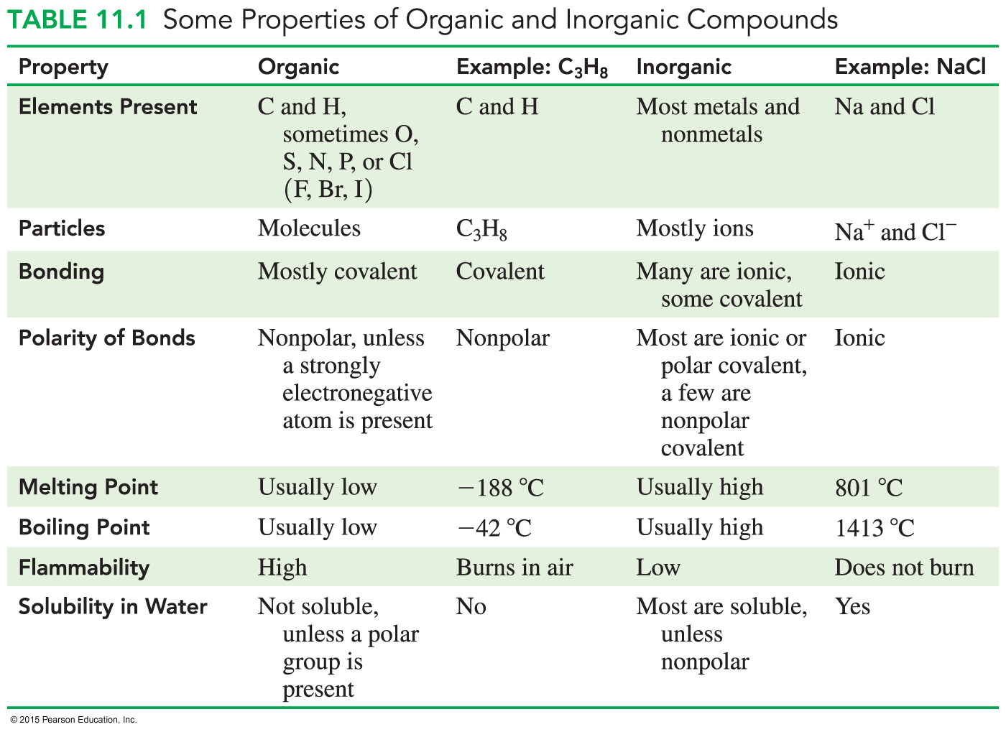
Comparing Organic and Inorganic Compounds

Slide 9
Learning Check
Identify each characteristic as most typical of compounds that are inorganic or organic.
A. It has a high melting point.
B. It is not soluble in water.
C. It has the formula CH₃—CH₂—CH₃.
D. It has the formula MgCl₂.
E. It burns easily in air.
F. It has covalent bonds.

Slide 10
Solution
Identify each characteristic as most typical of compounds that are inorganic or organic.
A. It has a high melting point. inorganic
B. It is not soluble in water. organic
C. It has the formula CH₃—CH₂—CH₃. organic
D. It has the formula MgCl₂. inorganic
E. It burns easily in air. organic
F. It has covalent bonds. organic

Slide 11
Hydrocarbons
Hydrocarbons are organic compounds that contain only carbon and hydrogen.
In organic molecules, every carbon has four bonds.
Saturated hydrocarbons contain only single bonds.

Slide 12
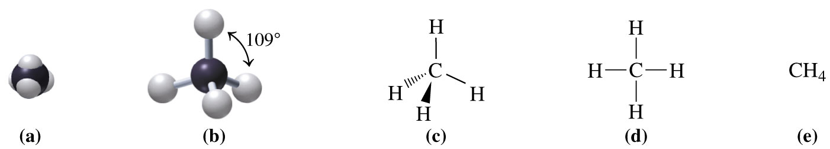
Carbon Compounds: Methane (CH₄)
In methane, CH₄, carbon forms four covalent bonds to hydrogen.
Methane is tetrahedral and has bond angles of 109°.
Two-dimensional and three-dimensional representations of methane, CH₄:
(a) space-filling model (d) expanded structural formula
(b) ball-and-stick model (e) condensed structural formula
(c) wedge-dash model

Slide 13
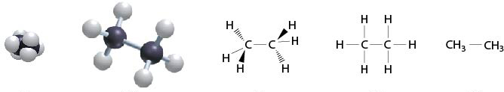
Carbon Compounds: Ethane (C₂H₆)
In ethane, C₂H₆, each tetrahedral carbon forms three covalent bonds to hydrogen and one to the other carbon.
Two-dimensional and three-dimensional representations of methane, C₂H₆:
(a) space-filling model (d) expanded structural formula
(b) ball-and-stick model (e) condensed structural formula
(c) wedge-dash model

Slide 14
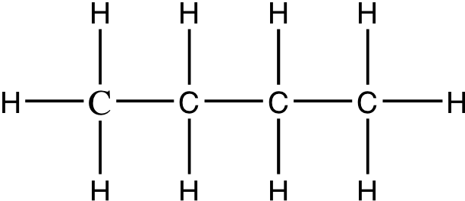
Learning Check
In the butane molecule, C₄H₁₀, predict the shape around each carbon atom.

Slide 15
Solution
In the butane molecule, C₄H₁₀, predict the shape around each carbon atom.
Each carbon atom has four single covalent bonds and, therefore, a tetrahedral shape.

Slide 16
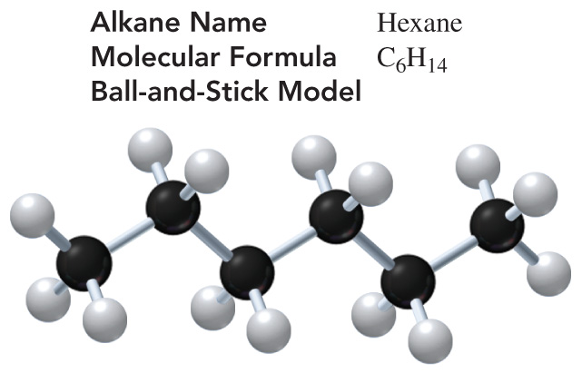
11.2 Alkanes
A large number of carbon compounds are possible because the covalent bond between carbon atoms, such as those in hexane, C₆H₁₄, are very strong.
Learning Goal Write the IUPAC names and draw the condensed structural and line-angle formulas for alkanes and cycloalkanes.

Slide 17

Naming Alkanes
Alkanes
are hydrocarbons that contain only C—C and C—H bonds
are formed by a continuous chain of carbon atoms
are named using the IUPAC (International Union of Pure and Applied Chemistry) system
have names that end in ane
use Greek prefixes to name carbon chains with five or more carbon atoms

Slide 18
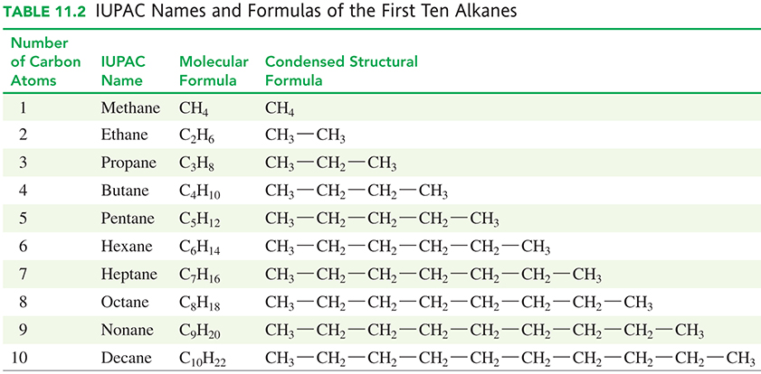
IUPAC Naming of First Ten Alkanes

Slide 19
Condensed Structural Formulas
In a condensed structural formula,
each carbon atom and its attached hydrogen atoms are written
as a group
a subscript indicates the number of hydrogen atoms bonded to each carbon atom
The condensed structural formula of butane has four carbon atoms.
CH₃—CH₂—CH₂—CH₃ butane

Slide 20
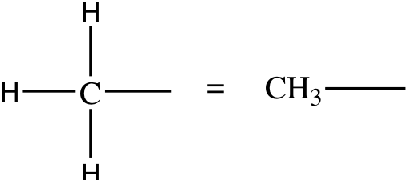
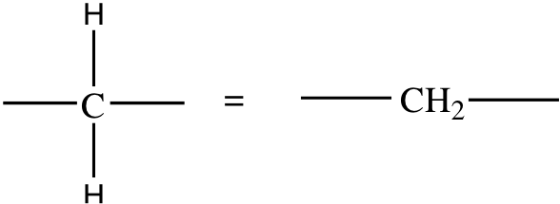
Condensed Structural Formulas
Alkanes are written with structural formulas that are
expanded to show each bond
condensed to show each carbon atom and its attached hydrogen atoms
Expanded Condensed Expanded Condensed

Slide 21
Writing Skeletal Formulas
Alkane compounds can also be represented by their
molecular formulas, which give the total number of carbon and hydrogen atoms
line-angle formulas, which show the carbon skeleton in which carbon atoms are represented at the end of each line or at each corner
CH₂ CH₃
CH₃ CH₂

Slide 22
Alkane Representations
An alkane molecule can be represented in several ways:
as a molecular formula
as a ball-and-stick model
as an expanded structural formula
as a condensed structural formula
as a line-angle formula

Slide 23
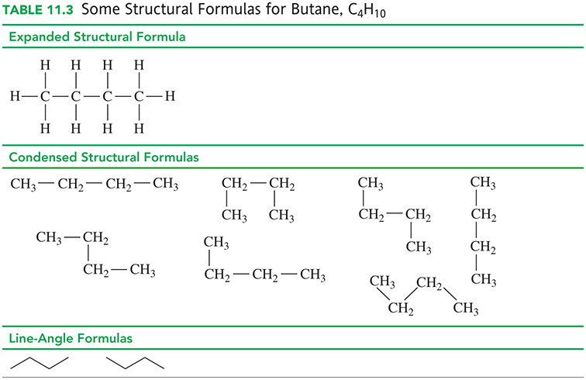
Structural Formulas for Butane, C₄H₁₀

Slide 24
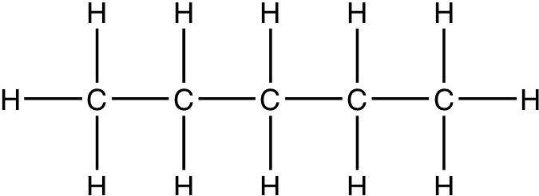
Learning Check
Given the following expanded structural formula, provide the
A. molecular formula
B. condensed structural formula
C. compound name

Slide 25
Solution
Given the following expanded structural formula, provide the
A. molecular formula C₅H₁₂
B. condensed structural formula
CH₃—CH₂—CH₂—CH₂—CH₃
C. compound name pentane

Slide 26
Learning Check
Write the condensed structural formula for
A. ethane
B. heptane

Slide 27
Solution
Write the condensed structural formula for
A. ethane CH₃—CH₃
B. heptane CH₃—CH₂—CH₂—CH₂—CH₂—CH₂—CH₃

Slide 28
Cycloalkanes
Cycloalkanes
are cyclic alkanes
have two fewer hydrogen atoms than the open chain form
are named by using the prefix cyclo before the name of the alkane chain with the same number of carbon atoms
propane, C₃H₈ cyclopropane, C₃H₆

Slide 29
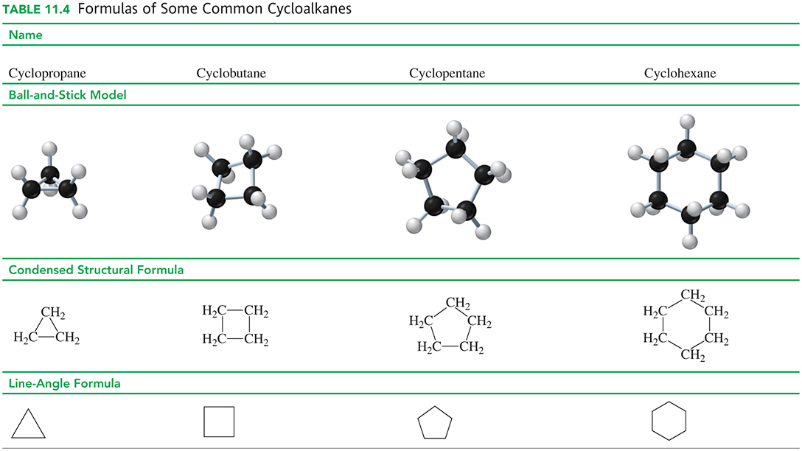
Formulas of Cycloalkanes

Slide 30
Learning Check
Give the IUPAC name for each of the following compounds:
A.
B.

Slide 31
Solution
Give the IUPAC name for each of the following compounds:
A.
An alkane with eight continuous carbon atoms is octane.
B. A cyclic molecule with five carbon atoms is
cyclopentane.

Slide 32
Learning Check
Name the following alkanes:
A. CH₃—CH₂—CH₂—CH₃
B.
C. CH₃—CH₂—CH₂—CH₂—CH₂—CH₂—CH₂—CH₃
D.

Slide 33
Solution
Name the following alkanes:
A. CH₃—CH₂—CH₂—CH₃ butane
B. cyclopropane
C. CH₃—CH₂—CH₂—CH₂—CH₂—CH₂—CH₂—CH₃ octane
D. cyclohexane

Slide 34
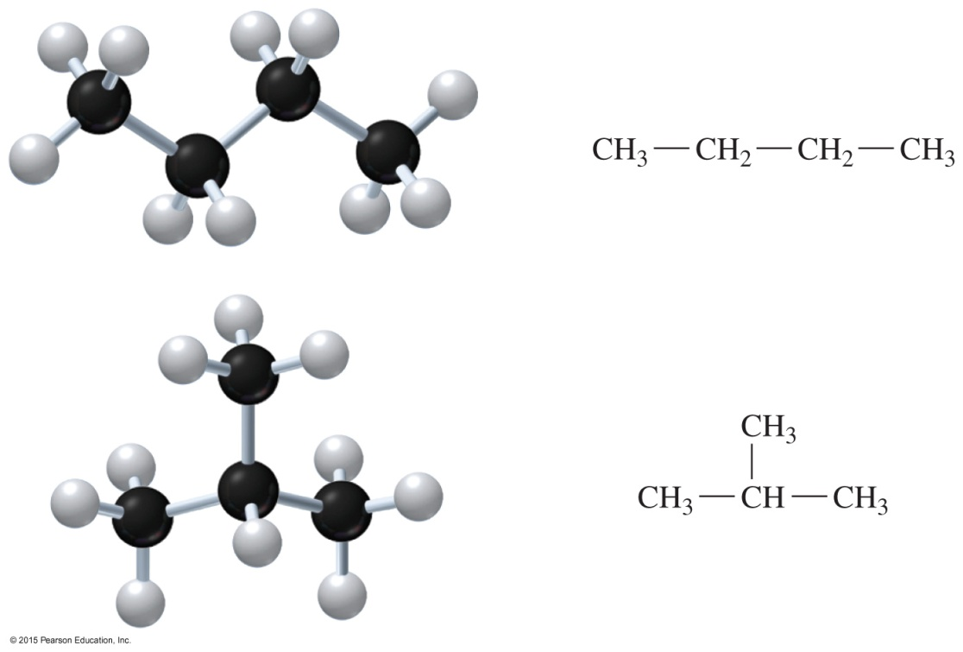
11.3 Alkanes with Substituents
When an alkane has four or more carbon atoms, the atoms can be arranged so that a side group called a branch or substituent is attached to a carbon chain.
Learning Goal Write the IUPAC names for alkanes with substituents and draw their condensed structural or line-angle formulas.

Slide 35

Structural Isomers
Structural isomers
have the same molecular formula with a different arrangement of atoms
have the same number
of atoms bonded in a
different order
Butane, C₄H₁₀, has two
structural isomers: a straight chain and a branched chain.

Slide 36
Learning Check
Draw three possible structural isomers of pentane, C₅H₁₂.

Slide 37
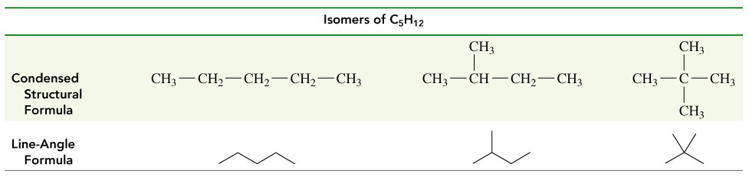
Solution
Draw three possible structural isomers of pentane, C₅H₁₂.

Slide 38
Alkane Substituents
Substituents are atoms or groups of atoms attached to the
carbon chain and include alkyl and halo groups.
Alkyl groups are
groups of carbon atoms attached to carbon chains
named in the IUPAC system with an yl ending
Halo substituents are
halogen atoms attached to the carbon chain
named in the IUPAC system as fluoro, chloro, bromo, or iodo.

Slide 39
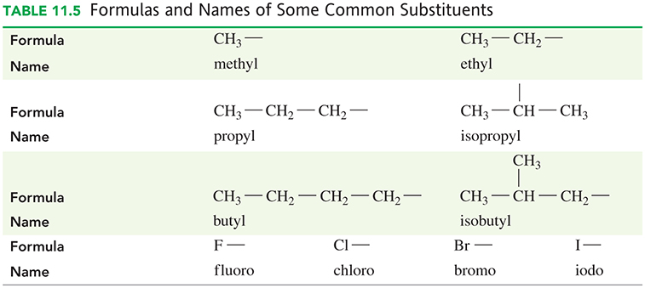
Substituents and Alkyl Groups

Slide 40
Learning Check
Give the IUPAC name for the following compound:

Slide 41
Solution
STEP 1 Write the alkane name for the longest chain of
carbon atoms.
The longest chain has
five carbons—pentane.
ANALYZE Given Need Connect
THE five-carbon chain, IUPAC name position of
PROBLEM one methyl group, substituents on the one chloro group carbon chain

Slide 42
Solution
STEP 2 Number the carbon atoms from the end nearer a substituent.
pentane
STEP 3 Give the location and name for each substituent (alphabetical order) as a prefix to the name of the main chain.
2-chloro-3-methylpentane

Slide 43
Naming Cycloalkanes with Substituents
When one substituent is attached to a carbon atom in a cycloalkane,
the name of the substituent is placed in front of the cycloalkane name
no number is needed for a single alkyl group or halogen atom
The IUPAC name for the following
cycloalkane is ethylcyclohexane.

Slide 44
Drawing Formulas for Alkanes
The IUPAC name gives all the information needed to draw the condensed structural formula for an alkane.
Draw the structure for 1-chloro-2,3-dimethylheptane
heptane: seven-carbon chain
methyl group on carbons 2 and 344
chlorine on carbon 1
di means “two”

Slide 45
Learning Check
Draw the condensed structural and line-angle formula for
3-bromo-1-chlorobutane.

Slide 46
Solution
Draw the condensed structural and line-angle formula for
3-bromo-1-chlorobutane.
STEP 1 Draw the main chain of carbon atoms.
The longest chain
has four carbon atoms—butane. C—C—C—C
ANALYZE Given Need Connect
THE 3-bromo- condensed four carbon chain,
PROBLEM 1-chlorobutane structural and one bromo group, line-angle formula and one chloro group

Slide 47
Solution
Draw the condensed structural and line-angle formula for
3-bromo-1-chlorobutane.
STEP 2 Number the chain and place the substituents on the
carbons indicated by the numbers. 1 2 3 4
3-bromo: — Br goes on carbon 3 C—C—C—C
1-chloro: — Cl goes on carbon 1 Cl Br

Slide 48
Solution
Draw the condensed structural and line-angle formula for
3-bromo-1-chlorobutane.
STEP 3 For the condensed structural formula, add the correct number of hydrogen atoms to give four bonds to each C atom.
CH₂—CH₂—CH—CH₃
⎢ ⎢
Cl Br
3-bromo-1-chlorobutane

Slide 49
Learning Check
Name each of the following alkanes:
A.
B.

Slide 50
Solution
Name each of the following alkanes:
STEP 1 Write the alkane name of the longest chain of carbon atoms.
A. The longest chain in pentane has five carbon atoms.
B. The longest chain in pentane has
five carbon atoms.

Slide 51
Solution
Name each of the following alkanes:
STEP 2 Number the carbon atoms from the end nearer a substituent.
A. 2-chloro: — Cl goes on carbon 2.
B. 2,3-dimethyl: — CH₃ goes on carbons 2 and 3.

Slide 52
Solution
Name each of the following alkanes:
STEP 3 Give the location and name for each substituent
(alphabetical order) as a prefix to the name of the
main chain.
A. 2-chloropentane
B. 2,3-dimethylpentane

Slide 53
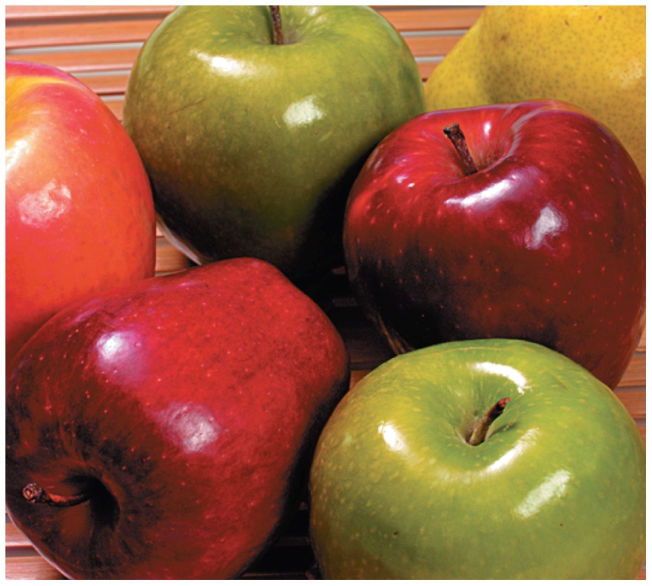
11.4 Properties of Alkanes
The different uses of alkane compounds result from their physical properties, including
their solubility and density.
The solid alkanes that make up waxy coatings on fruits and vegetables help retain moisture, inhibit mold, and enhance appearance.
Learning Goal Identify the properties of alkanes and write a balanced chemical equation for combustion.

Slide 54
Uses of Alkanes
Alkanes with one to four carbons are gases at room temperature and are widely used as heating fuels.
methane, ethane, propane, butane
Butane has four carbons:
Alkanes with five to eight carbons are highly volatile liquids at room temperature, making them useful as fuels.
pentane, hexane, heptane, octane
Octane has eight carbons:

Slide 55
Uses of Alkanes
Alkanes with 9−17 carbons are liquids with higher boiling points and are found in motor oils, mineral oil, kerosene, diesel, and jet fuels.
Decane has 10 carbons:
Alkanes with 18 or more carbon atoms, known as paraffins, are waxy solids at room temperature.
Petroleum jelly, or Vaseline, is a semisolid mixture of hydrocarbons, with more than 25 carbon atoms.

Slide 56
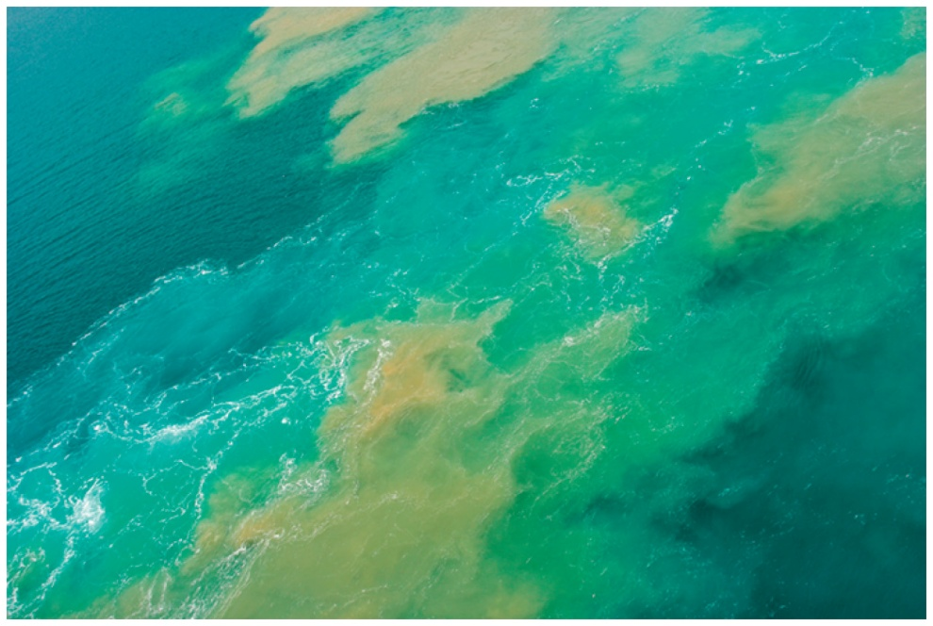
Solubility and Density of Alkanes
Alkanes are
nonpolar
insoluble in water
less dense than water
flammable in air
found in crude oil
If there is an oil spill in the ocean, the alkanes in the crude oil do not mix with the water but float on top, forming a thin layer on the surface.

Slide 57
Combustion of Alkanes
Alkanes with strong C—C bonds
react with oxygen gas to make carbon dioxide and water in combustion reactions
release energy when C—C bonds are broken in combustion reactions
CH₄(g) + 2O₂(g) CO₂(g) + 2H₂O(g) + energy
Methane is the natural gas used to cook our food on gas cooktops and to heat our homes.

Slide 58
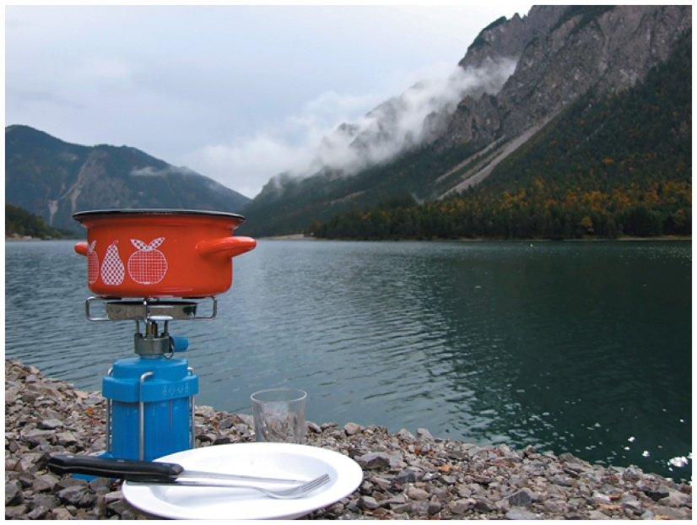
Combustion of Butane
Butane
is used in portable burners
undergoes combustion and
produces enough energy to
cook food
2C₄H₁₀(g) + 13O₂(g) 8CO₂(g) + 10H₂O(g) + energy

Slide 59
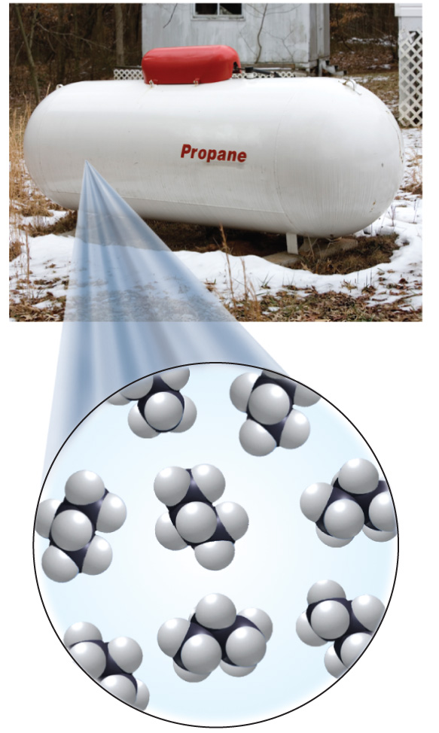
Learning Check
Propane, C₃H₈, is a fuel often used in
barbeques. Write a balanced chemical equation for the complete combustion of propane.

Slide 60
Solution
Unbalanced equation, combustion of propane, C₃H₈:
C₃H₈ + O₂ CO₂ + H₂O + energy
Balance C:
C₃H₈ + O₂ 3CO₂ + H₂O + energy
Balance H: (1/2 of 8 = 4)
C₃H₈ + O₂ 3CO₂ + 4H₂O + energy
Balance O: (1/2 of 10 = 5)
C₃H₈ + 5O₂ 3CO₂ + 4H₂O + energy (balanced)

Slide 61
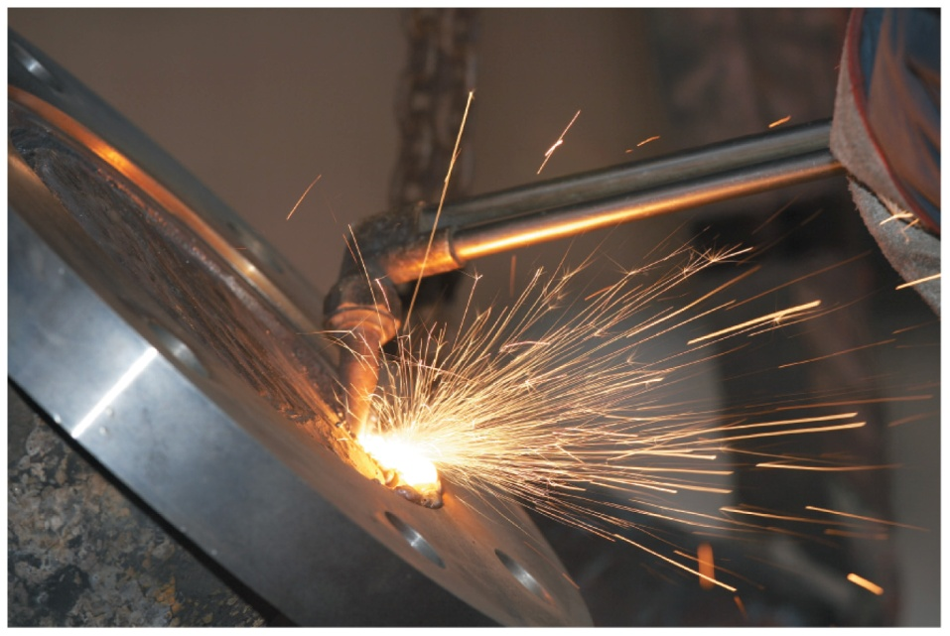
11.5 Alkenes and Alkynes
Ethyne, commonly called acetylene, is used in welding,
where it reacts with oxygen
to produce flames with temperatures above 3300 °C.
Learning Goal Write the IUPAC names or draw the condensed structural or line-angle formulas for alkenes and alkynes.

Slide 62
Alkenes and Alkynes
Alkenes and alkynes are families of hydrocarbons that
contain double and triple bonds, respectively
are called unsaturated hydrocarbons because they do not contain the maximum number of hydrogen atoms
react with hydrogen gas to increase the number of hydrogen atoms and become alkanes

Slide 63
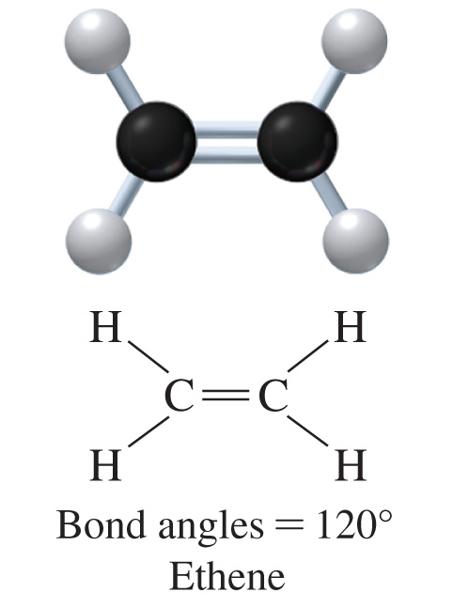
Identifying Alkenes
Alkenes contain one or more carbon–carbon double bonds.
In ethene, C₂H₄, two carbon atoms are connected by a double bond.
Each carbon atom in the double bond is attached to two hydrogen atoms and has a trigonal planar arrangement with bond angles of 120°.

Slide 64
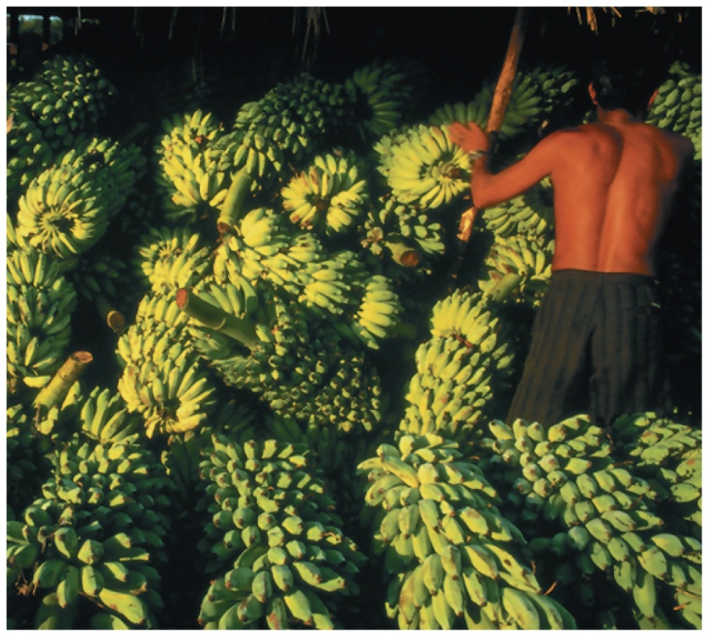
Ethene, C₂H₄
Ethene, C₂H₄, more commonly called ethylene,
is an important plant hormone involved in promoting the ripening of fruit such as bananas
accelerates the breakdown of cellulose in plants, which causes flowers to wilt and leaves to fall from trees

Slide 65
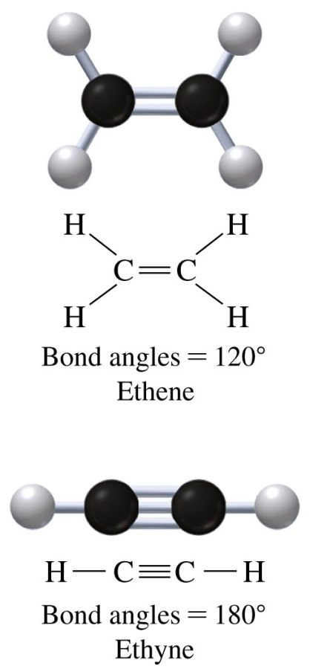
Identifying Alkynes
Alkynes contain one or more
carbon–carbon triple bonds.
In ethyne, C₂H₂,
two carbon atoms are connected
by a triple bond
each carbon is also bonded to
one H atom
Each carbon atom in the triple bond has a linear arrangement with bond angles of 180°.

Slide 66
Learning Check
Identify the following compounds as an alkene or alkyne:
A.
B.

Slide 67
Solution
Identify the following compounds as an alkene or alkyne:
A. alkene
B. alkyne

Slide 68
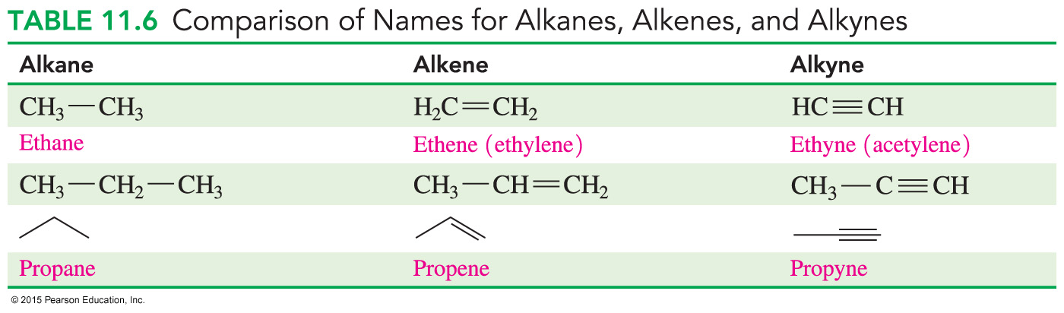
Naming Alkanes, Alkenes, and Alkynes
The IUPAC names for alkenes and alkynes
are similar to those of alkanes
use the alkane name with the same number of carbon atoms, replacing the ane ending with ene
Cyclic alkenes are named as cycloalkenes.

Slide 69
Learning Check
Write IUPAC names for each of the following:
A.
B.

Slide 70
Solution
STEP 1 Name the longest carbon chain that contains the double or triple bond.
A.
five carbon atoms—pentene
B.
six carbon atoms—hexyne
ANALYZE Given Need Connect
THE five carbon chain, IUPAC replace the ane of the
PROBLEM double bond, methyl group name alkane name with ene
ANALYZE Given Need Connect
THE six carbon chain, IUPAC replace the ane of the
PROBLEM triple bond name alkane name with yne

Slide 71
Solution
STEP 2 Number the carbon chain starting from the end nearer the double or triple bond.
A. 2-pentene
B. 2-hexyne

Slide 72
Solution
STEP 3 Give the location and name of each substituent (alphabetical order) as a prefix to the alkene or alkyne name.
A. 4-methyl-2-pentene
B. 2-hexyne; there are no substituents
in this compound.

Slide 73
Naming Cycloalkenes
Cycloalkenes have a double bond within a ring structure and
are named by assigning the double bond to be between carbon 1 and carbon 2 when a substituent is on the ring
do not need to include the numbers for the double bond
The carbon atoms in the ring are numbered to give the double bond numbers 1 and 2, then the lowest possible number to any substituents present.
3-methylcyclopentene (It is understood the double bond is between carbon 1 and carbon 2.)

Slide 74
Learning Check
Name the following alkenes and alkynes:

Slide 75
Solution
Name the following alkenes and alkynes:
cyclohexene 3,3-dimethylcyclopentene

Slide 76
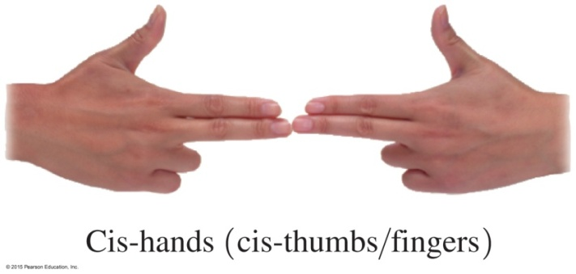
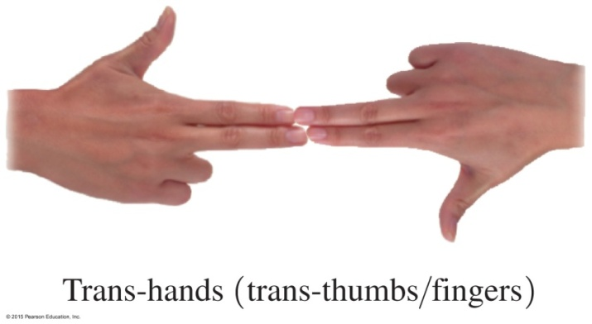
11.6 Cis–Trans Isomers
The atoms or groups of atoms attached to the carbon atoms on the double bond may form two different structures, which are called geometric or cis–trans isomers.
Learning Goal Draw the condensed structural formulas and give the names for the cis–trans isomers of alkenes.

Slide 77
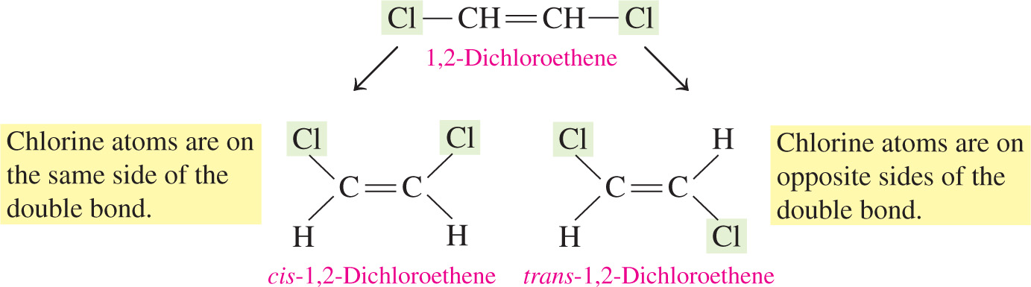
Cis–Trans Isomers
In an alkene, the double bond
is rigid and does not rotate
holds attached groups in fixed positions
makes cis–trans isomers possible when two different groups are attached to the carbon atoms on each side of the double bond

Slide 78


Cis–Trans Isomers
Cis–trans isomers have different physical and chemical properties.
You can make a “double bond” with your fingers with both thumbs on the same side or opposite from each other.

Slide 79
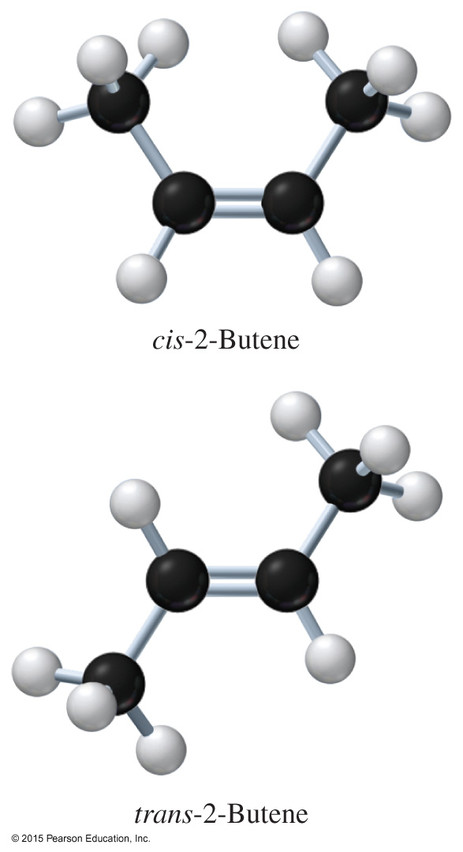
Cis–Trans Isomers of Butene
In a cis isomer, the alkyl groups are attached on the same side of the double bond and H atoms are on
the other side.
In a trans isomer, the alkyl groups and H atoms are attached on opposite sides
of the double bond.

Slide 80
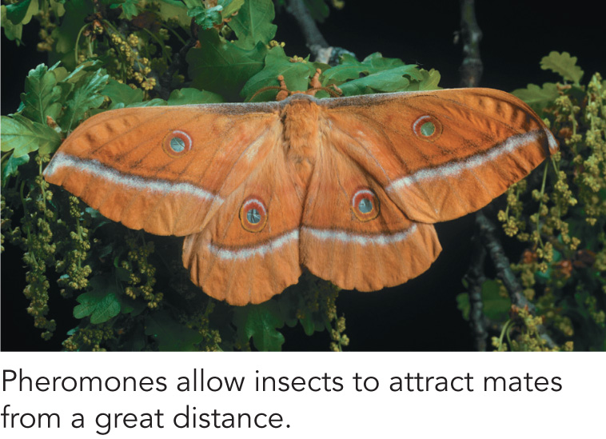
Chemistry Link to the Environment:
Pheromones
Many insects emit minute quantities of chemicals called pheromones to send messages to others of the same species.
Pheromones may
warn an insect of danger
mark a trail
attract the opposite sex

Slide 81
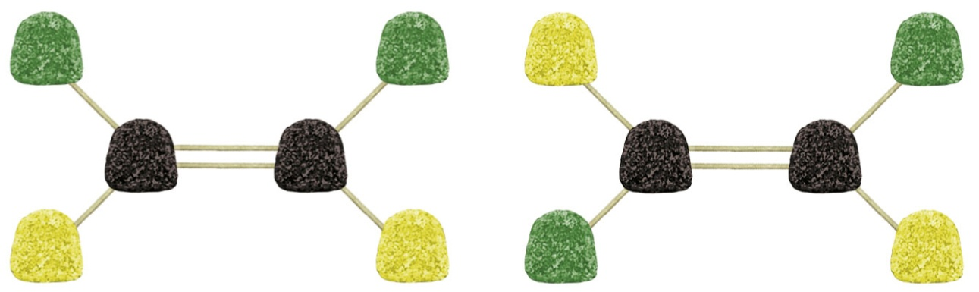
Chemistry Link to the Environment:
Pheromones
The effectiveness of many of these pheromones depends on the cis or trans configuration of the double bonds in the molecules.
One pheromone is bombykol,
the sex pheromone produced by the female silkworm moth
which contains one cis double bond and one trans double bond

Slide 82
Naming Cis–Trans Isomers
The prefix of cis or trans is placed in front of the alkene name when the compound is a cis or trans isomer.
cis trans
cis-1,2-dibromoethene trans-1,2-dibromoethene

Slide 83
Learning Check
Name each, using cis or trans prefixes when needed.
A.
B.
C.

Slide 84
Solution
Name each, using cis or trans prefixes when needed.
A. cis-2,3-dichlorobutene
B. trans-2,3-dibromobutene
C. trans-2-butene

Slide 85
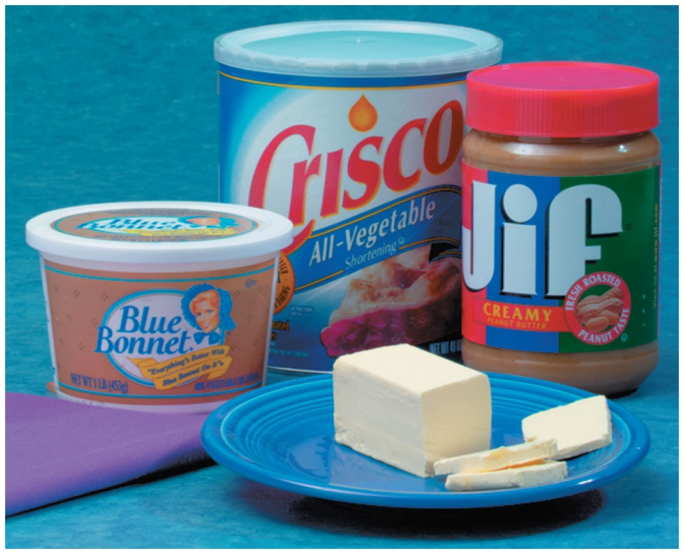
11.7 Addition Reactions
The commercial process of hydrogenation is used to convert the double bonds in vegetable oils to saturated fats to make a more solid product.
Learning Goal Draw the condensed structural and line-angle formulas and give the names for the organic products of addition reactions of alkenes.

Slide 86
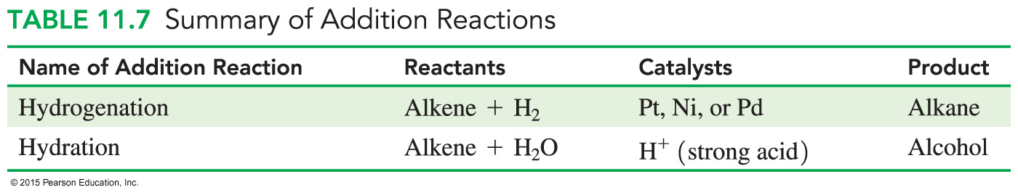
Addition Reactions
In alkenes and alkynes, the double and triple bonds are
very reactive, adding H—H and H—OH to the carbons in the double or triple bond
easily broken, providing electrons to form new bonds

Slide 87

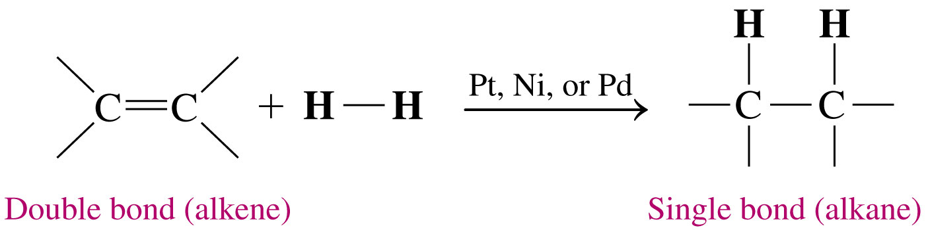
Hydrogenation
In hydrogenation,
hydrogen atoms add to the carbon atoms of a double bond or triple bond
a catalyst such as Pt, Ni, or Pd is used to speed up the reaction

Slide 88
Learning Check
Write an equation for the hydrogenation of 1-butene using a platinum catalyst.

Slide 89
Solution
Write an equation for the hydrogenation of 1-butene using
a platinum catalyst.
Pt
CH₂ CH—CH₂—CH₃ + H₂
CH₃—CH₂—CH₂—CH₃

Slide 90

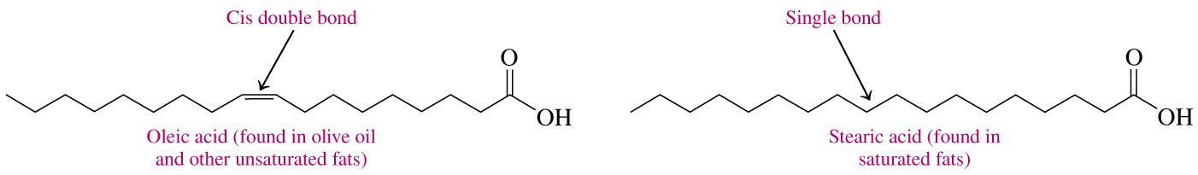
Hydrogenation of Oils
Adding H₂ to double bonds in vegetable oils produces
compounds with higher melting points
solids at room temperature, such as margarine, soft margarine, and shortening

Slide 91
Learning Check
Write the product of each the following:
Pt
CH₃—CH CH—CH₃ + H₂
Pt
+ H₂

Slide 92
Solution
Write the product of each the following:
Pt
CH₃—CH CH—CH₃ + H₂
CH₃—CH₂—CH₂—CH₃
Pt
+ H₂

Slide 93
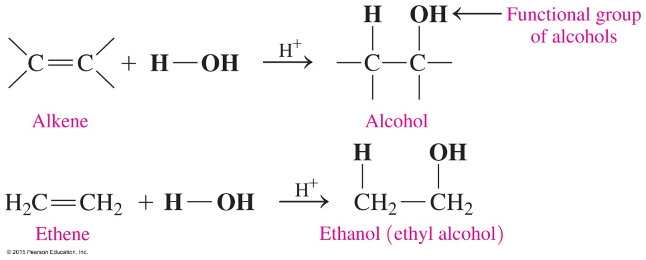
Hydration Reactions
In hydration reactions, an alkene reacts with water, H—OH, to form an alcohol, and
a hydrogen atom (H —) from water forms a bond with the carbon atom in the double bond with more hydrogen atoms
the — OH from water forms a bond with the second carbon atom in the double bond with fewer hydrogen atoms
is catalyzed by a strong acid such as H₂SO₄

Slide 94
Learning Check
Predict the product of the addition of H—OH to the following alkene:

Slide 95
Solution
Predict the product of the addition of H—OH to the following alkene:

Slide 96
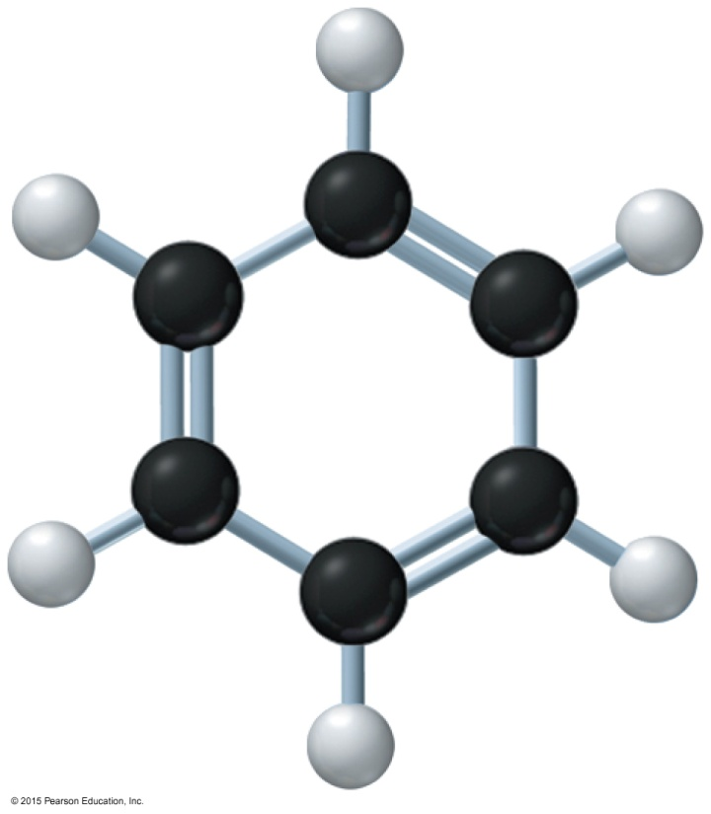
11.8 Aromatic Compounds
In 1825, Michael Faraday isolated a hydrocarbon called benzene, which consists of a six-carbon ring with alternating double bonds and has the molecular formula C₆H₆.
Learning Goal Describe the bonding in benzene; name aromatic compounds and draw their line-angle formulas.

Slide 97
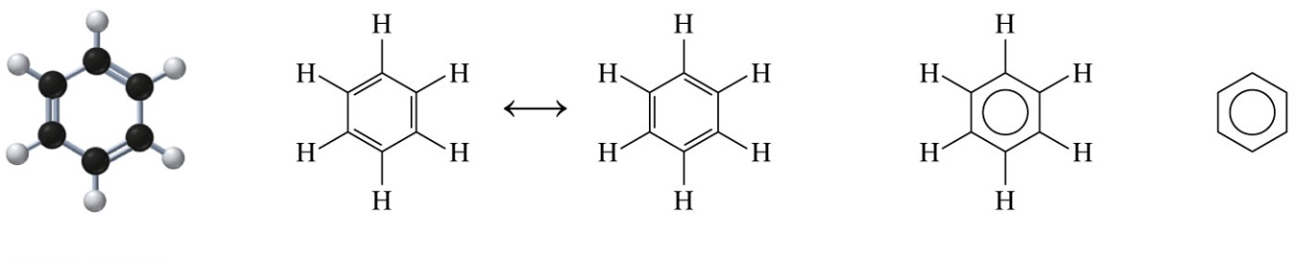
Aromatic Compounds
Benzene is
an aromatic compound
a ring of six C atoms, each bonded to one H atom
a flat ring structure drawn with three alternating double bonds
represented by two structures because the electrons are shared equally among all the C atoms
represented by a skeletal formula using a circle in the center instead of the alternating double bonds

Slide 98
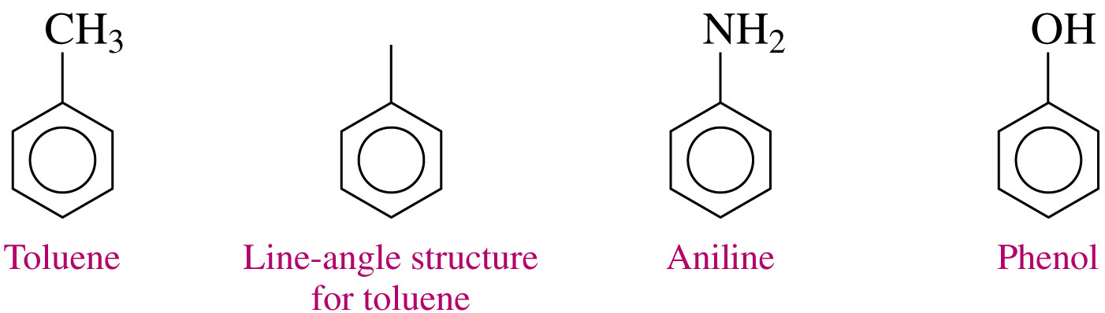
Naming Aromatic Compounds
Aromatic compounds containing a benzene ring and a single substituent are named as benzene derivatives. Since the ring contains only one substituent, the ring is not numbered.
Some common names such as toluene, aniline, and phenol are allowed by IUPAC rules.

Slide 99
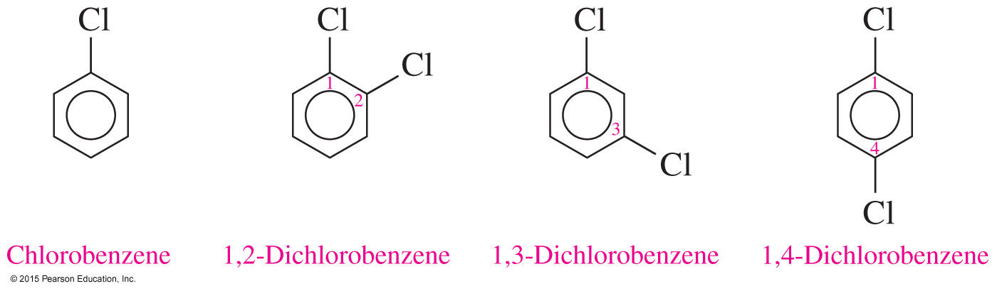
Naming Aromatic Compounds
When there are two or more substituents, the benzene ring is numbered to give the lowest numbers to the substituents.

Slide 100
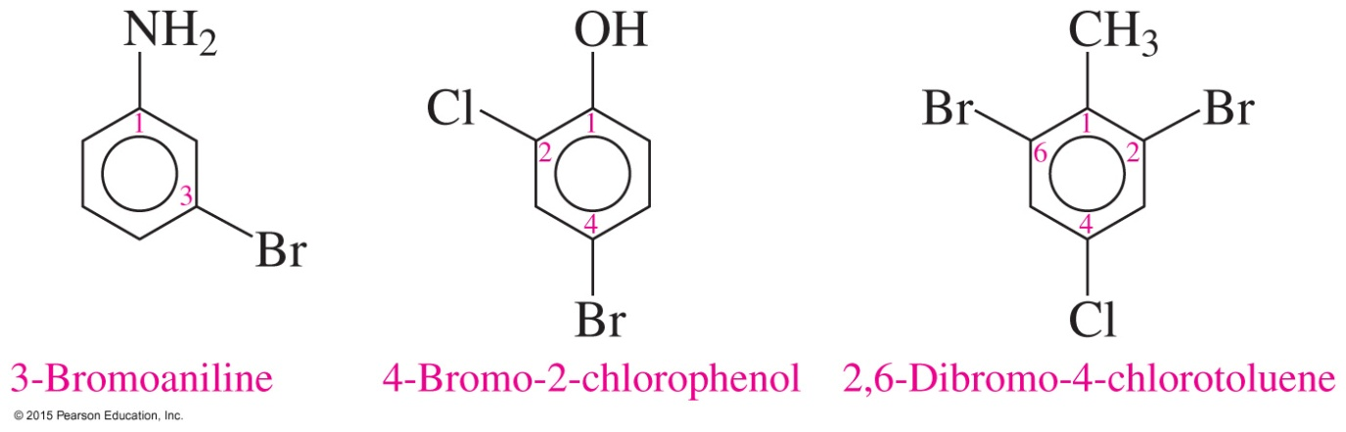
Naming Aromatic Compounds
When toluene, phenol, or aniline has substituents,
the carbon atom attached to the methyl, hydroxyl, or amine group is numbered as carbon 1
the other substituents are named alphabetically

Slide 101
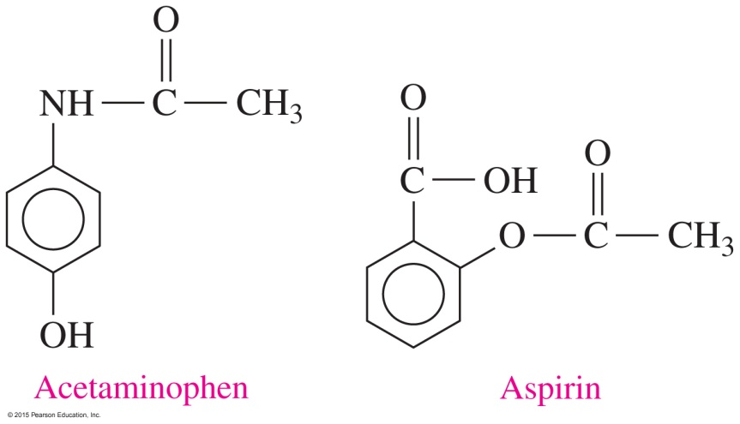
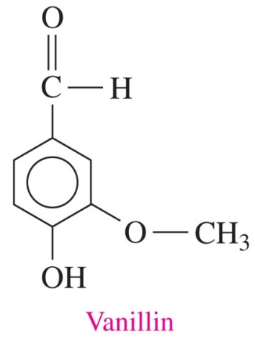
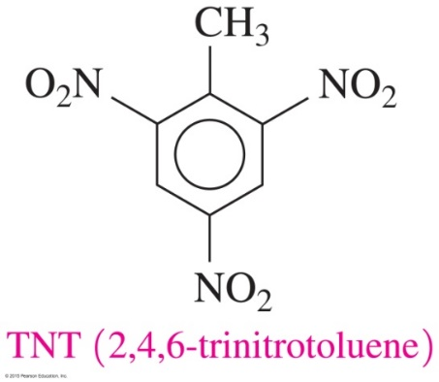
Chemistry Link to Health:
Common Aromatic Compounds
Toluene is used as a reactant to make drugs, dyes, and explosives such as TNT (trinitrotoluene). The benzene ring is found in pain relievers such as aspirin and acetaminophen, and in flavorings such as vanillin.

Slide 102
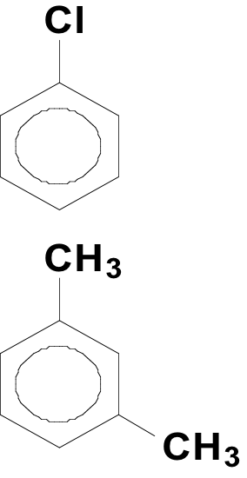
Learning Check
Select the correct name for each compound.
1. A. chlorocyclohexane
B. chlorobenzene
C. 1-chlorobenzene
2. A. 1,2-dimethylbenzene
B. 1,4-dimethylbenzene
C. 1,3-dimethylbenzene

Slide 103
Solution
Select the correct name for each compound.
1.
B. chlorobenzene
2.
C. 1,3-dimethylbenzene

Slide 104
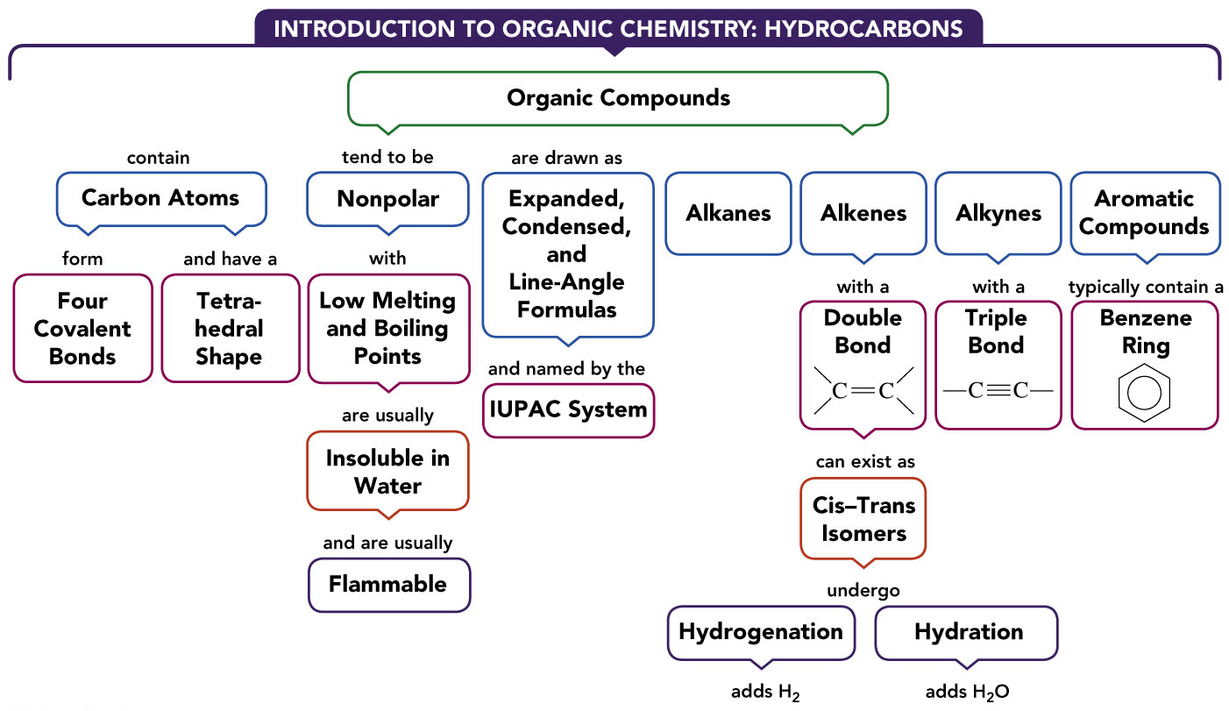
Concept Map—Introduction to Organic Compounds

