Slide 1
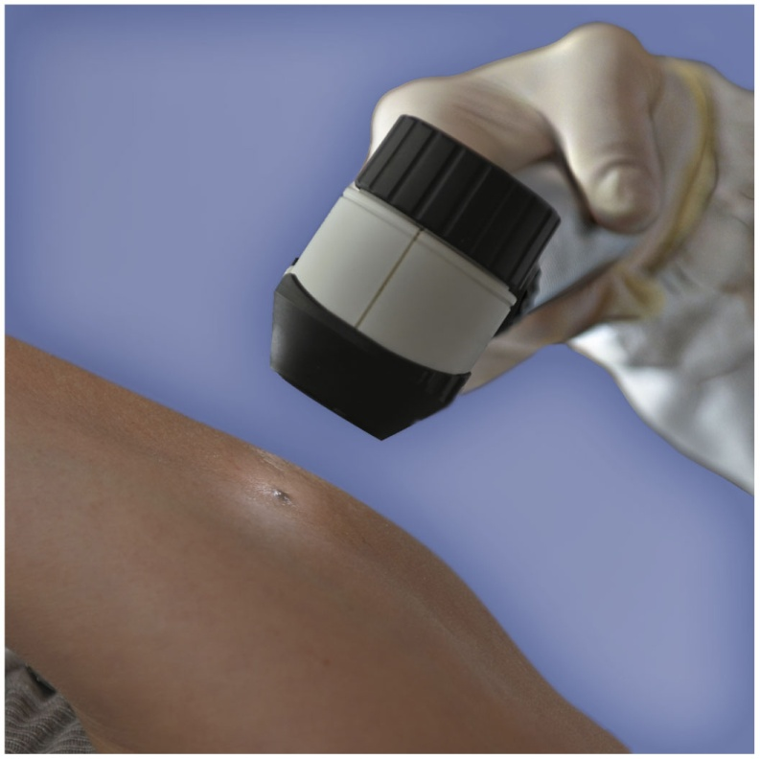
Chapter 12 Alcohols, Thiols, Ethers, Aldehydes, and Ketones
A dermatology nurse performs many of the duties of dermatologists, including treating skin conditions, assisting in surgeries, performing biopsies and excisions, writing prescriptions, freezing skin lesions, and screening patients for skin cancer.

Slide 2
12.1 Alcohols, Phenols, Thiols, and Ethers
2
Functional groups such as
an alcohol contains a hydroxyl group (—OH)
a phenol contains a hydroxyl group (—OH) bonded to a benzene ring
a thiol contains an —SH group
an ether contains a C—O—C group
Learning Goal Write the IUPAC and common names for alcohols, phenols, and thiols and the common names for ethers. Draw their condensed structural formulas or line-angle formulas.

Slide 3

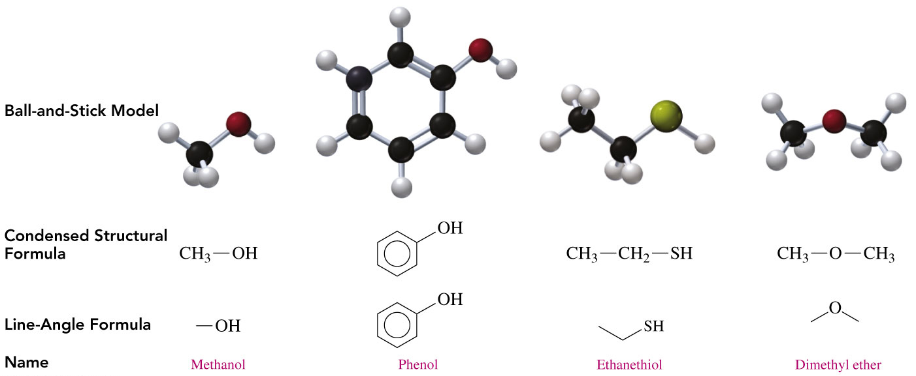
12.1 Functional Groups
3

Slide 4

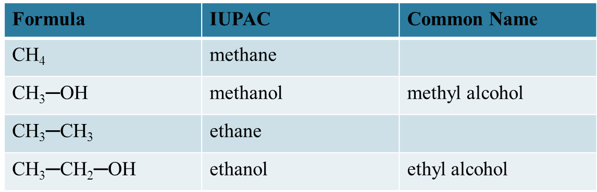
Naming Alcohols
4
The names of alcohols
in the IUPAC system replace the e with ol
with common names use the name of the alkyl group
followed by alcohol

Slide 5
Naming of Alcohols
5
Give the IUPAC name for the following compound:

Slide 6
Naming of Alcohols
6
Give the IUPAC name for the following compound:
SOLUTION:
ANALYZE Given Need Connect
THE six carbon chain, IUPAC position of methyl and
PROBLEM hydroxyl group, name hydroxyl groups, replace
methyl group e in alkane name with ol

Slide 7
Naming of Alcohols
7
Give the IUPAC name for the following compound:
STEP 1 Name the longest carbon chain attached to
the —OH group by replacing the e in the
corresponding alkane name with ol.
hexanol

Slide 8
Naming of Alcohols
8
Give the IUPAC name for the following compound:
STEP 2 Number the chain starting at the end nearer to the
—OH group.
2-hexanol
6 5 4 3 2 1

Slide 9
Naming of Alcohols
9
Give the IUPAC name for the following compound:
STEP 3 Give the location and name for each substituent relative to the —OH group.
5-methyl-2-hexanol
6 5 4 3 2 1

Slide 10
Learning Check
10
Give the IUPAC name for the following compounds:
A.
B.

Slide 11
Solution
11
Give the IUPAC name for the following compounds:
A.
ANALYZE Given Need Connect
THE five carbon chain, IUPAC position of methyl and
PROBLEM hydroxyl group, name hydroxyl groups, replace
methyl group e in alkane name with ol

Slide 12
Solution
12
Give the IUPAC name for the following compounds:
B.
ANALYZE Given Need Connect
THE hydroxyl group IUPAC position of hydroxyl
PROBLEM bonded to benzene name group on carbon 1,
ring, bromo group bromo group

Slide 13
Solution
13
STEP 1 Name the longest carbon chain attached to
the —OH group by replacing the e in the
corresponding alkane name with ol. Name
an aromatic alcohol as a phenol.
A. pentanol
B. phenol

Slide 14
Solution
14
STEP 2 Number the chain starting at the end nearer to the
—OH. The compound is a phenol because it consists
of an —OH group attached to a benzene ring.
A. 2-pentanol
B. phenol
5
4
3
2
1
2
3
1

Slide 15
Solution
15
STEP 3 Give the location and name for each substituent relative to the —OH group.
A. 4-methyl-2-pentanol
B. 3-bromophenol
5
4
3
2
1
2
3
1

Slide 16
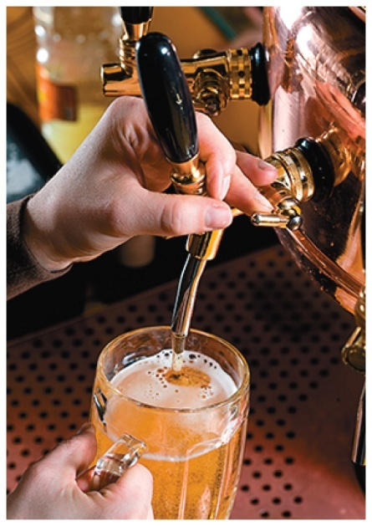
Chemistry Link to Health:
Alcohols and Phenols
16
Ethanol (ethyl alcohol)
has been known since prehistoric times as
an intoxicating product
is formed by the fermentation of grains,
sugars, and starches
C₆H₁₂O₆ 2CH₃—CH₂—OH + 2 CO₂
Fermentation
Glucose
Ethanol

Slide 17
Chemistry Link to Health:
Alcohols and Phenols
17
Ethanol (ethyl alcohol)
is produced by reacting ethene and water at high temperatures and pressures for commercial use
is used as a solvent for perfumes, varnishes, and some medicines, such as tincture of iodine
H₂C CH₂ + H₂O CH₃—CH₂—OH
Ethene Alcohol

Slide 18
Chemistry Link to Health:
Alcohols and Phenols
18
1,2,3-Propanetriol (glycerol)
is a trihydroxy alcohol
is a viscous liquid obtained from
oils and fats during the production
of soaps
has three polar —OH groups that account for its strong attraction to water molecules
is used as a skin softener in products such as skin lotions, cosmetics, shaving creams, and liquid soaps

Slide 19
Chemistry Link to Health:
Alcohols and Phenols
19
Ethylene glycol is used
as an antifreeze in heating and
cooling systems
as a solvent for paints, inks, and plastics
in the production of synthetic fibers such as Dacron
Because its sweet taste is attractive to pets and children, ethylene glycol must be carefully stored. If ingested, it is oxidized to oxalic acid and forms insoluble salts in the kidneys that cause renal damage. It is therefore considered to be extremely toxic.

Slide 20
Chemistry Link to Health:
Alcohols and Phenols
20
Bisphenol A (BPA) is used to make polycarbonate, a clear plastic that is used to manufacture beverage bottles, including baby bottles.
Washing polycarbonate bottles with certain detergents or at high temperatures disrupts the polymer, causing small amounts of BPA to leach from the bottles.

Slide 21
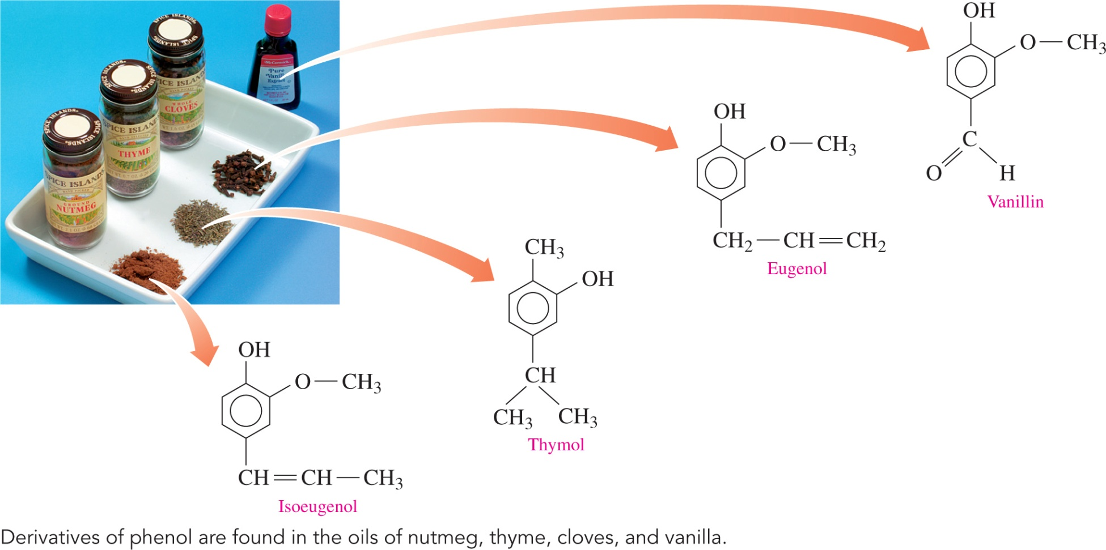
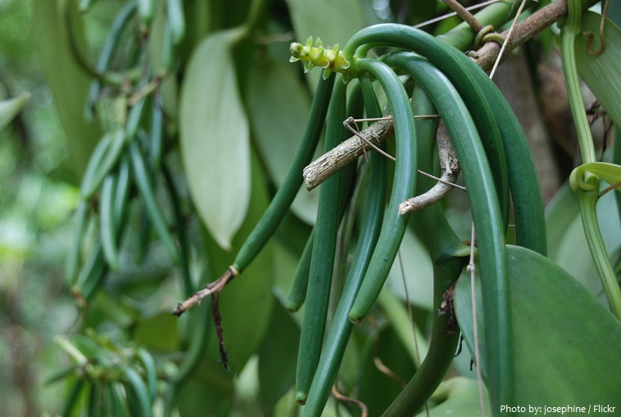
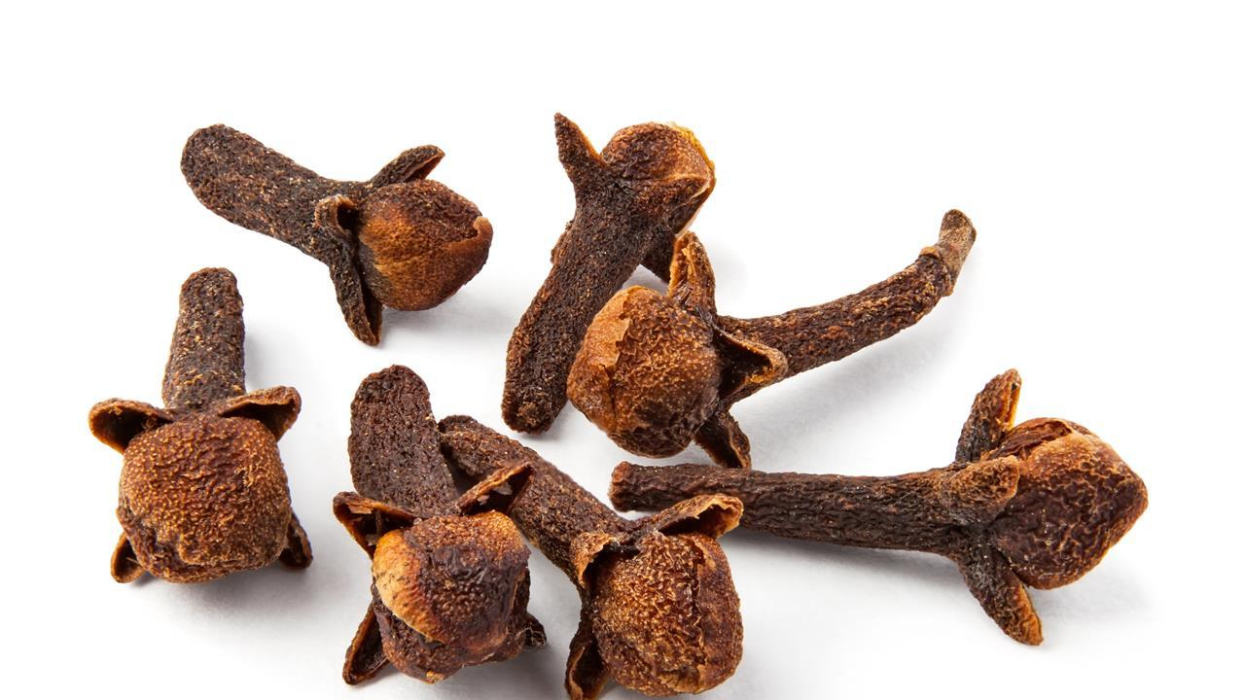
Chemistry Link to Health:
Alcohols and Phenols (continued)
21
Phenols found in essential oils of plants produce the odor or flavor of the plant.

Slide 22
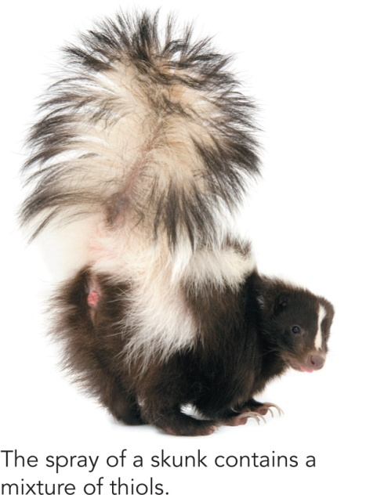
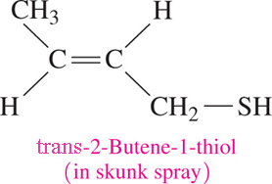
Thiols
22
Thiols
contain sulfur
contain a thiol (—SH) group
often have strong and sometimes disagreeable odors
are found in cheese, onions, garlic, and oysters
are used to detect gas leaks

Slide 23
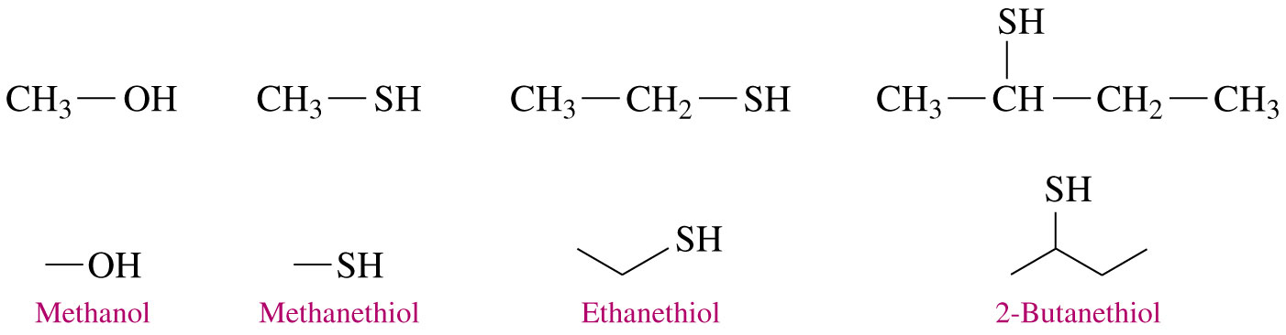
Naming Thiols
23
In the IUPAC system, thiols are named by adding thiol to the alkane name of the longest carbon chain and numbering the carbon chain from the end nearer to the —SH group.

Slide 24
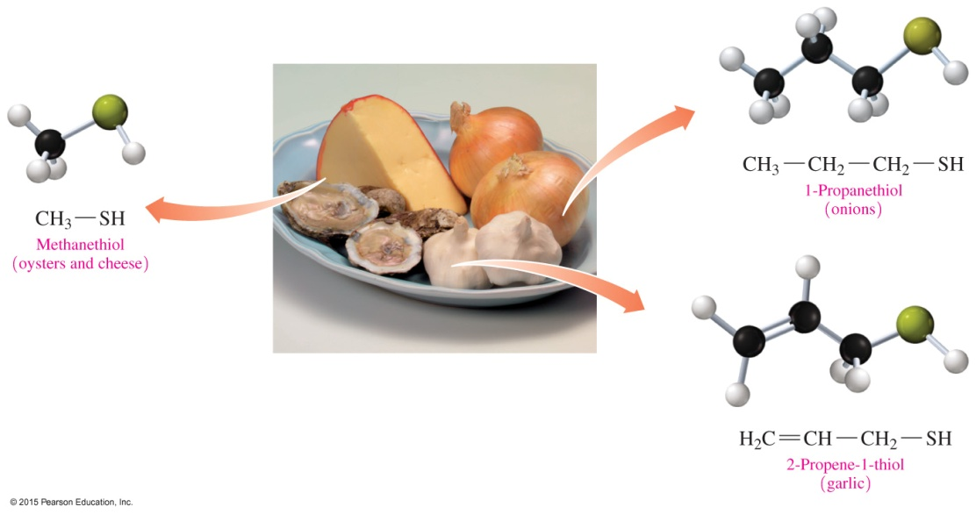
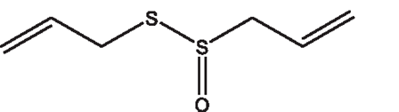
Naming Thiols (continued)
24
Thiols are a family of sulfur-containing organic compounds that have a thiol group (—SH).

Slide 25
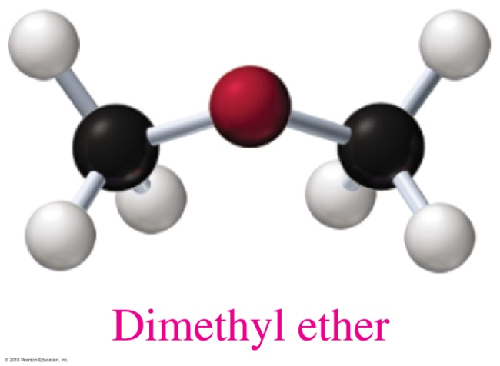
Ethers
25
An ether
contains an —O— between two carbon groups that are alkyls or aromatic rings
has a bent structure, like water and alcohols do
has a common name that gives the alkyl names of the attached groups, followed by ether
CH₃—O—CH₃
Dimethyl ether

Slide 26
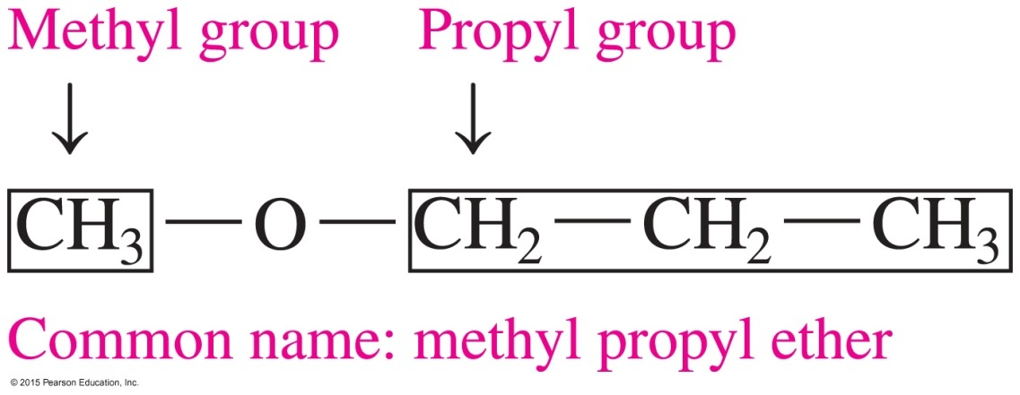
Naming Ethers
26
Most ethers have common names. The names
of each alkyl or aromatic group attached to the oxygen atom are written in alphabetical order
of the alkyl groups are followed by the word ether
In this text, we will use only the common names of ethers.

Slide 27
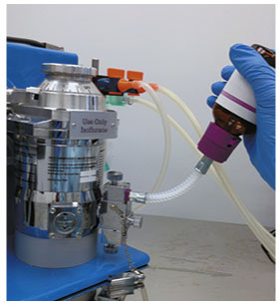
Chemistry Link to Health:
Ethers as Anesthetics
27
Anesthesia is the loss of sensation and consciousness. A general anesthetic is a substance that
blocks signals to the awareness centers in the brain
gives the patient a loss of memory,
a loss of feeling pain, and an
artificial sleep

Slide 28
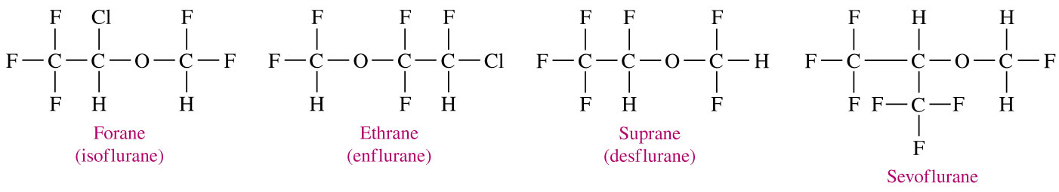
Chemistry Link to Health:
Ethers as Anesthetics
28
Ether was used in anesthetics for hundreds of years until the 1950s, when a new group of anesthetics were developed that
retain the ether group
replace hydrogen atoms on the carbon with halogen atoms to reduce the volatility and flammability of the ethers

Slide 29
Learning Check
29
Write the structures for the following:
A. 3-Pentanol
Ethanol
C. Diethyl ether

Slide 30
Solution
30
Write the structures for the following:
A. 3-Pentanol
B. Ethanol
C. Diethyl ether

Slide 31
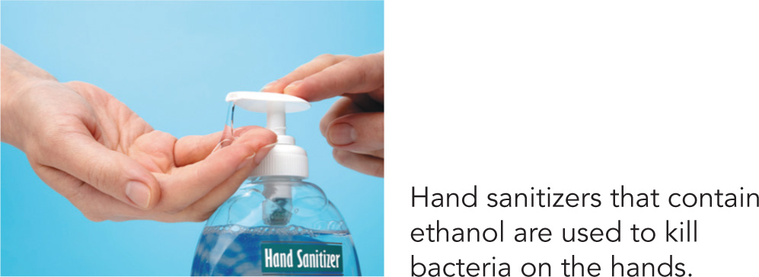
12.2 Properties of Alcohols
31
In an alcohol-containing sanitizer, the amount of ethanol is typically 60% (v/v) but can be as high as 85% (v/v). Because alcohols are flammable, hand sanitizers are a fire hazard in
the home.
Learning Goal Describe the classification of alcohols; describe the solubility of alcohols in water.

Slide 32
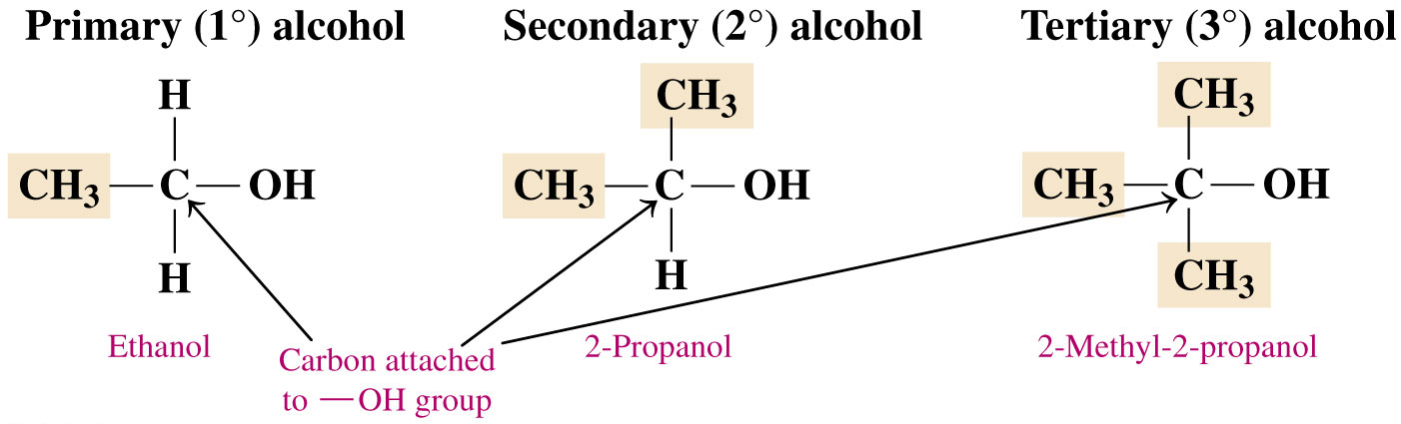
Classification of Alcohols
32
Alcohols are classified
by the number of alkyl groups attached to the carbon bonded to the hydroxyl
as primary (1°), secondary (2°), or tertiary (3°)

Slide 33
Learning Check
33
Classify each alcohol as primary, secondary, or tertiary.
A.
B. CH₃—CH₂—CH₂—OH
C.

Slide 34
Solution
34
Classify each alcohol as primary, secondary, or tertiary.
A. secondary
B. CH₃—CH₂—CH₂—OH primary
C. tertiary

Slide 35
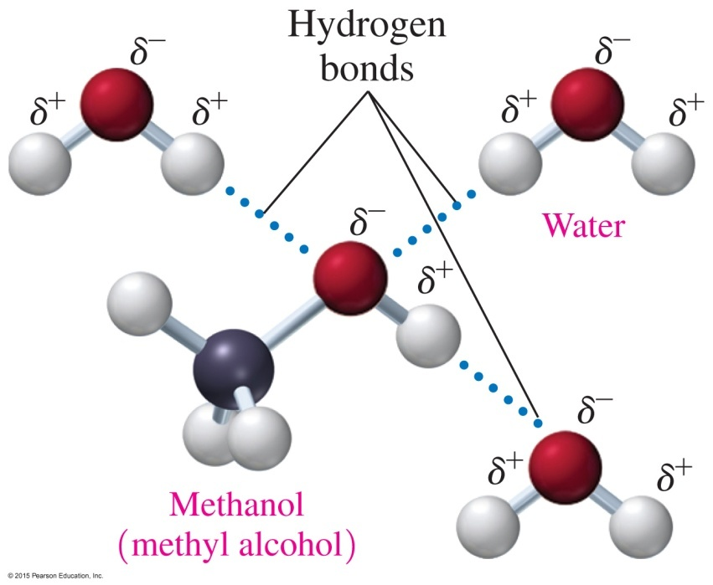
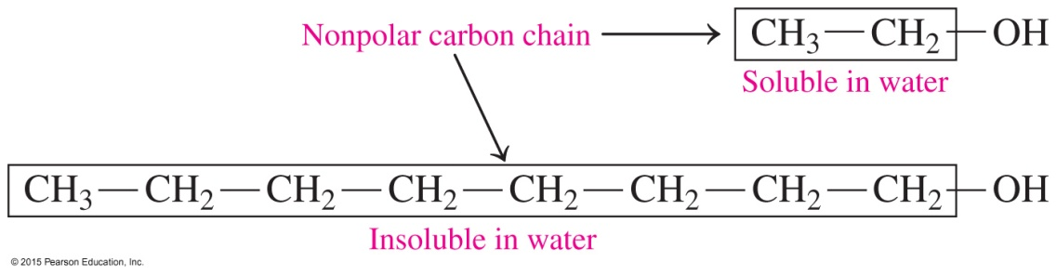
Solubility of Alcohols in Water
35
Alcohols
contain polar —OH groups and form hydrogen bonds with other alcohol molecules and with water
that have one to three carbons are soluble in water; the solubility of alcohols in water decreases with increasing number of carbons

Slide 36
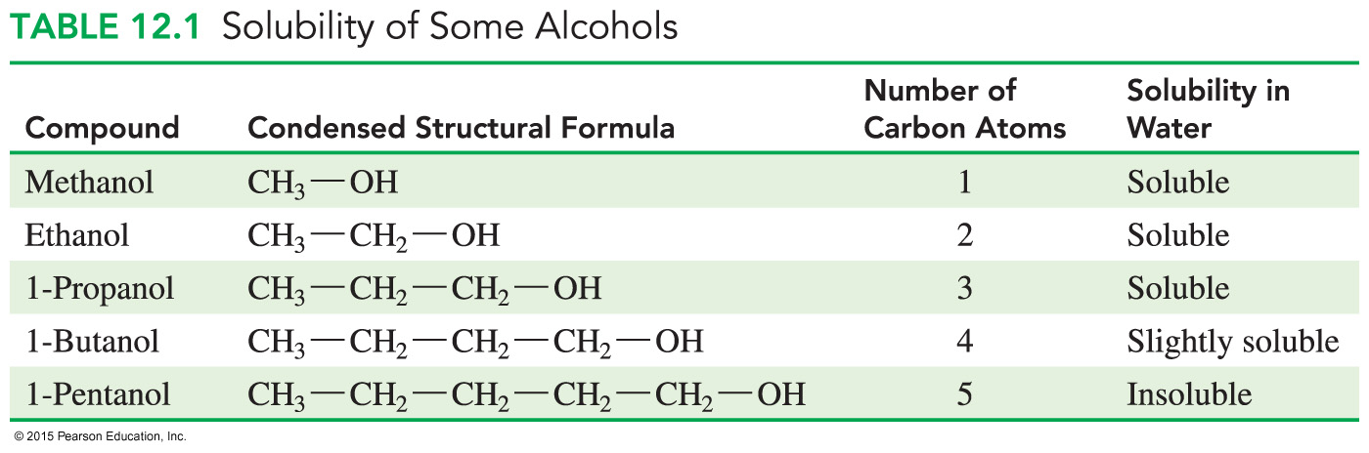
Solubility of Alcohols and Ethers in Water
36

Slide 37
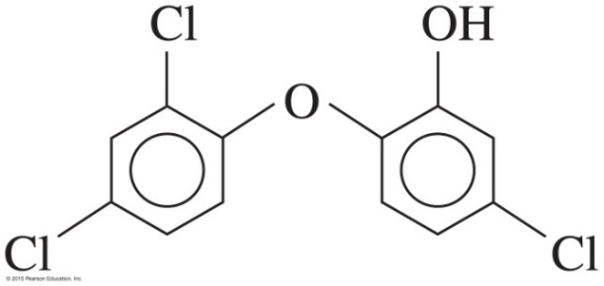
Chemistry Link to Health:
Hand Sanitizers
37
Hand sanitizers containing ethanol or propanol as their active ingredient
are used as an alternative to washing hands
kill most bacteria and viruses that spread cold and flu
are approximately 60% (v/v) but can be as high as 85% (v/v)
are highly flammable and produce a transparent blue flame
may also contain triclosan, which can accumulate in the environment, promoting growth of antibiotic-resistant bacteria

Slide 38
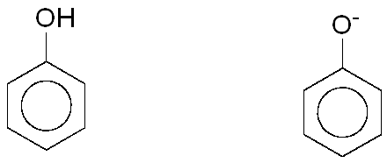
Solubility of Phenols
38
Phenols
are slightly soluble in water
have an —OH group that can form hydrogen bonds with water
can react with water to produce phenoxide ions
were once used as antiseptics
–
+ H₂O + H₃O⁺

Slide 39
Learning Check
39
Indicate whether each of the following is soluble in water
and explain why:
A. CH₃—CH₂—CH₂—CH₂—CH₂—CH₂—OH
B. CH₃—CH₂—OH

Slide 40
Solution
40
Indicate whether each of the following is soluble in water and explain why:
A. CH₃—CH₂—CH₂—CH₂—CH₂—CH₂—OH
not soluble
Alcohols with long carbon chains (nonpolar) are not soluble.
CH₃—CH₂—OH
soluble
Short-chain alcohols form hydrogen bonds with water.

Slide 41
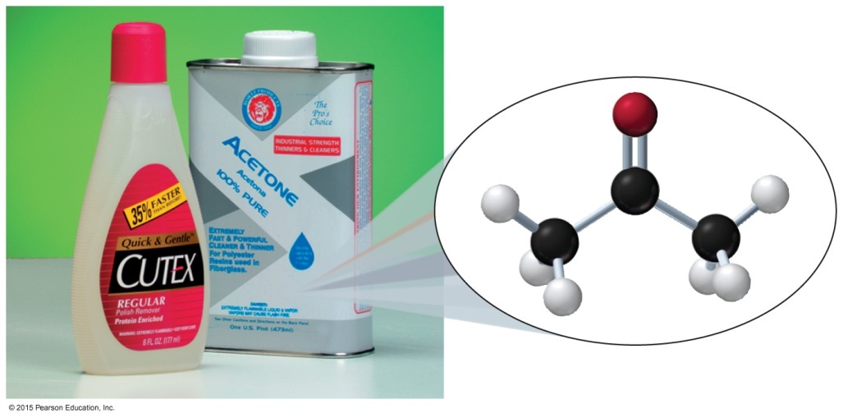
12.3 Aldehydes and Ketones
41
The simplest ketone, known as acetone or propanone (dimethyl ketone), is a colorless liquid with a mild odor that has wide use as a solvent in cleaning fluids, paint and nail polish removers, and rubber cement.
Learning Goal Write the IUPAC and common names for aldehydes and ketones; draw their condensed structural or line-angle formulas. Describe the solubility of aldehydes and ketones in water.

Slide 42

Aldehydes and Ketones:
Carbonyl Group
42
A carbonyl group
consists of a carbon–oxygen polar double bond with two groups of atoms attached to the carbon
has a very electronegative oxygen atom
has two lone pair electrons on the
O atom
has a strong dipole with a partial positive charge on C and a partial negative charge on O

Slide 43
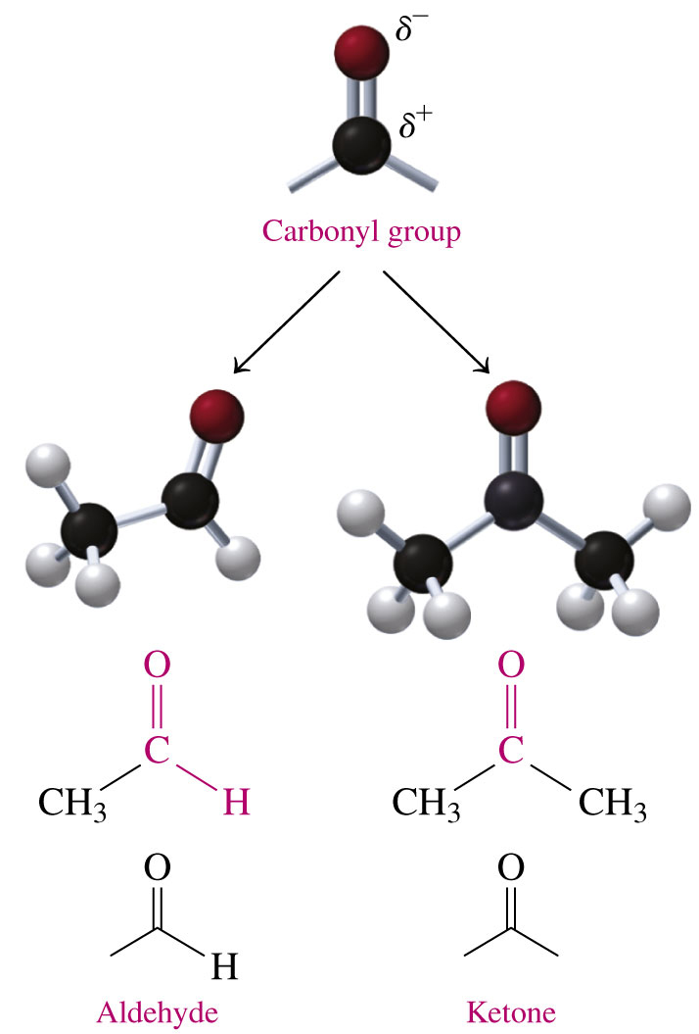
Aldehydes and Ketones:
Carbonyl Group
43
A carbonyl group in
an aldehyde is attached to a carbon atom and at least one H atom
a ketone is attached to two alkyl groups

Slide 44
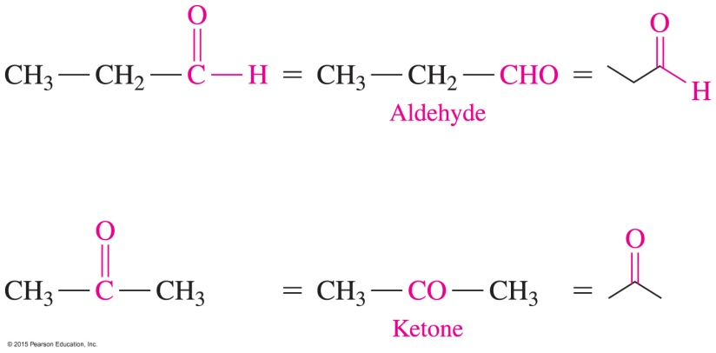
Aldehyde and Ketone Structures
44
An aldehyde group may be written as —CHO, with the double bond understood.
In a ketone, the carbonyl group is bonded to two alkyl groups or aromatic rings. The keto group (C O) can sometimes be written as CO.

Slide 45

Naming Aldehydes
45
An aldehyde
has an IUPAC name in which the e in the alkane name is changed to al
has a common name for the first four aldehydes that use their common names, which end in aldehyde
one carbon, form formaldehyde
two carbons, acet acetaldehyde
three carbons, propion propionaldehyde
four carbons, butyr butyraldehyde
followed by aldehyde

Slide 46
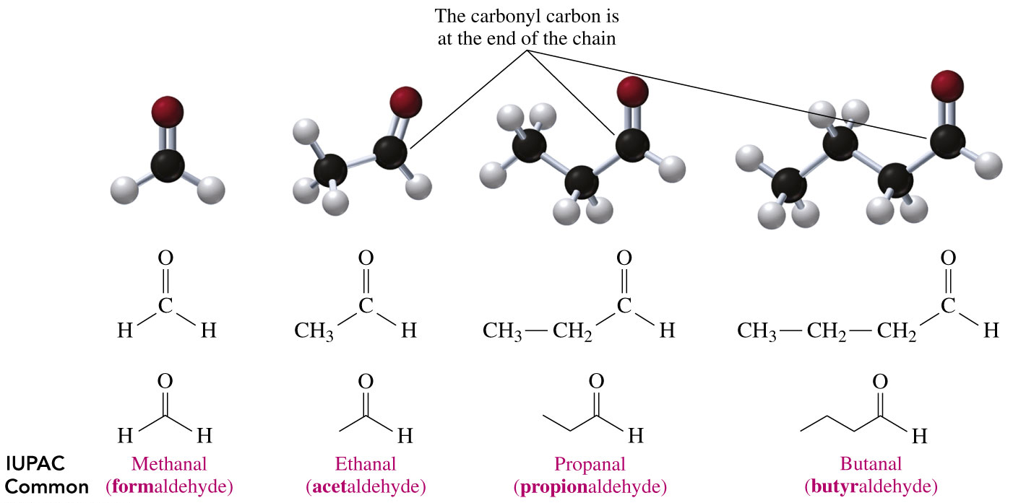
Naming Aldehydes
46

Slide 47
Naming Aldehydes
47
Give the IUPAC name for the following aldehyde:
SOLUTION
ANALYZE Given Need Connect
THE five carbon chain, IUPAC position of methyl
PROBLEM carbonyl group, name group, replace
methyl group e in alkane name with al

Slide 48
Naming Aldehydes
48
Give the IUPAC name for the following aldehyde:
STEP 1 Name the longest carbon chain by replacing
the e in the alkane name with al.
pentanal

Slide 49
Naming Aldehydes
49
Give the IUPAC name for the following aldehyde:
STEP 2 Name and number substituents by counting the carbonyl group as carbon 1.
2-methylpentanal

Slide 50
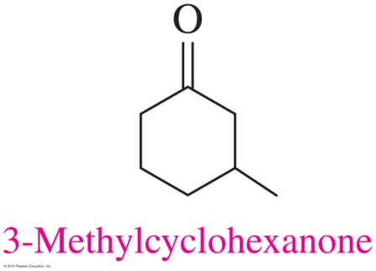
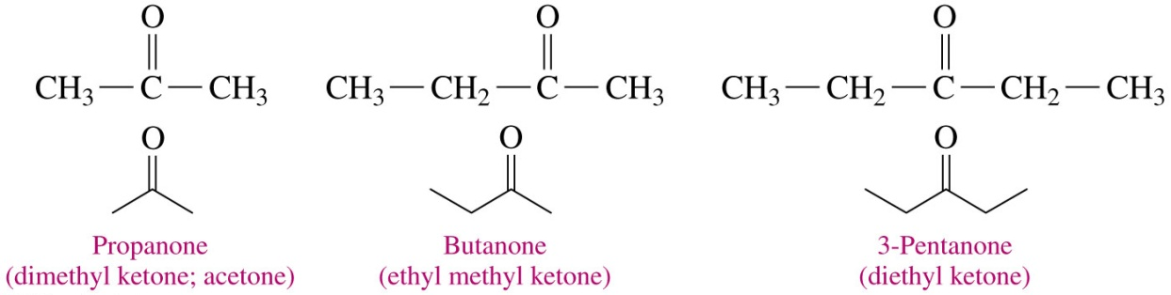
Naming Ketones
50
When naming the following ketones
in the IUPAC system, the e in the alkane name is replaced with one
with a common name, the alkyl groups attached to the carbonyl group are named alphabetically, followed by ketone

Slide 51
Naming Ketones
51
Name the following ketone using the IUPAC system:
SOLUTION
ANALYZE Given Need Connect
THE five carbon chain, IUPAC position of methyl and
PROBLEM carbonyl group, name carbonyl groups, replace
methyl group e in alkane name with one

Slide 52
Naming Ketones
52
Name the following ketone using the IUPAC system:
STEP 1 Name the longest carbon chain by replacing the e in the alkane name with one.
pentanone

Slide 53
Naming Ketones
53
Name the following ketone using the IUPAC system:
STEP 2 Number the carbon chain starting from the end nearer to the carbonyl group and indicate its location.
2-pentanone

Slide 54
Naming Ketones
54
Name the following ketone using the IUPAC system:
STEP 3 Name and number any substituents on the
carbon chain.
4-methyl-2-pentanone

Slide 55
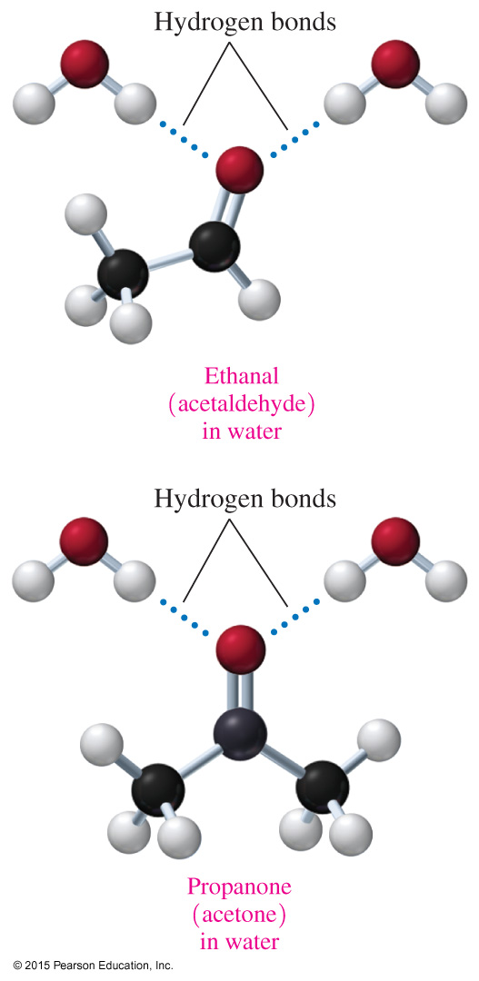
Aldehydes and Ketones in Water
55
Aldehydes and ketones
form hydrogen bonds with water molecules between the carbonyl oxygen and hydrogen atoms on water molecules
are very soluble when they have four or fewer carbons but not soluble when they have longer hydrocarbon chains, which are nonpolar, that diminish the solubility effect of the polar carbonyl group

Slide 56
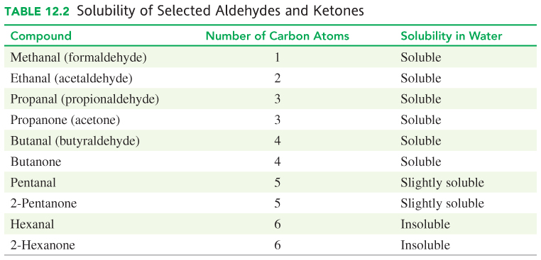
Aldehydes and Ketones in Water
56

Slide 57
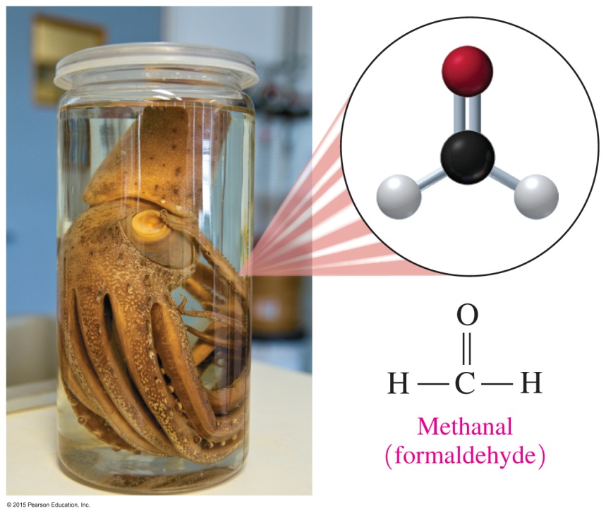
Important Aldehydes and Ketones
57
Acetone (propanone) is a solvent used in nail polish remover, cleaning fluids, and paint.
Formaldehyde, the simplest aldehyde, is a colorless gas with a pungent odor and is used in a solution to preserve biological specimens.

Slide 58
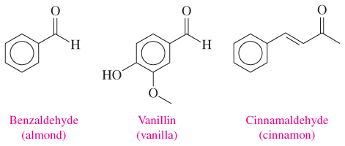
Important Aldehydes and Ketones
58
Several naturally occurring aromatic aldehydes are used to flavor food and as fragrances in perfumes. Benzaldehyde is found in almonds, vanillin in vanilla beans, and cinnamaldehyde in cinnamon.

Slide 59
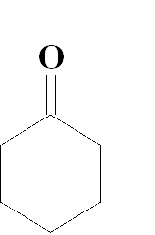
Learning Check
59
Classify each as an aldehyde or a ketone.
O O
|| ||
A. CH₃—CH₂—C—CH₃ B. CH₃—C—H
CH₃ O
| ||
C. CH₃—C—CH₂—C—H D.
|
CH₃

Slide 60
Solution
60
Classify each as an aldehyde or ketone.
O O
|| ||
A. CH₃—CH₂—C—CH₃ B. CH₃—C—H
CH₃ O
| ||
C. CH₃—C—CH₂—C—H D.
|
CH₃
ketone
aldehyde
aldehyde
ketone

Slide 61
Learning Check
61
Give the IUPAC name for each of the following ketones:
A.
B.

Slide 62
Solution
62
Give the IUPAC name for each of the following ketones:
STEP 1 Name the longest carbon chain that contains the
carbonyl group by replacing the e in the alkane name with one.
A. hexanone
B. butanone

Slide 63
Solution
63
Give the IUPAC name for each of the following ketones:
STEP 2 Number the carbon chain starting from the end nearer to the carbonyl group and indicate its location.
A. 2-hexanone
B. 2-butanone

Slide 64
Solution
64
Give the IUPAC name for each of the following ketones:
STEP 3 Name and number any substituents on the
carbon chain.
A. 2-hexanone
B. 4-chloro-2-butanone

Slide 65
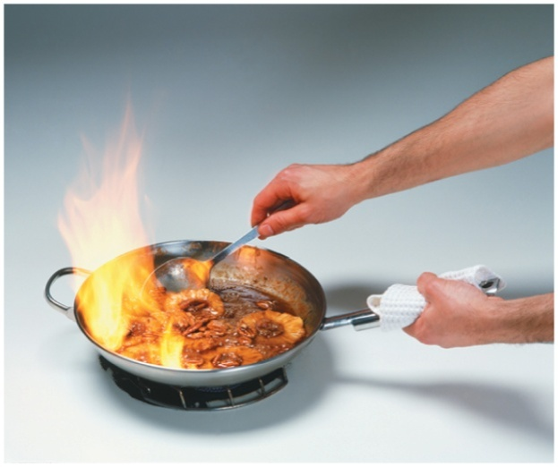
12.4 Reactions of Alcohols, Thiols, Aldehydes, and Ketones
65
A flaming dessert is
prepared using heat
from the combustion
of an alcohol:
Δ
CH₃—CH₂—OH(g) + 3O₂(g) → 2CO₂(g) + 3H₂O(g) + energy
Learning Goal Write balanced chemical equations for the combustion, dehydration, and oxidation of alcohols. Write
balanced chemical equations for the reduction of aldehydes and ketones.

Slide 66
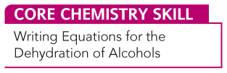
Dehydration of
Alcohols
66
Alcohols undergo
dehydration when heated with an acid catalyst
the loss of —H and —OH from adjacent carbon atoms, producing an alkene and water
H⁺, heat
+ H₂O
alcohol alkene

Slide 67
Oxidation and Reduction
67
In organic chemistry,
oxidation reactions increase the number of carbon–oxygen bonds by the addition of oxygen or a loss of hydrogen atoms
reduction reactions reduce the number of bonds between carbon and oxygen atoms

Slide 68
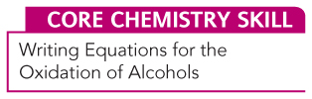
Oxidation of
Primary (1°) Alcohols
68
Alcohols undergo oxidation, which increases the number of carbon and oxygen bonds.
Primary alcohols are oxidized to produce an aldehyde.
1 bond to O 2 bonds to O
oxidation
1° alcohol aldehyde

Slide 69
Oxidation of Primary Alcohols
69
Aldehydes can further oxidize to produce a carboxylic acid.
2 bonds to O 3 bonds to O
oxidation
aldehyde carboxylic acid

Slide 70
Oxidation of Secondary (2°) Alcohols
70
Secondary alcohols are oxidized to produce a ketone.
To indicate the process of oxidation, [O] is placed over the reaction arrow.
1 bond to O 2 bonds to O
[O]
2° alcohol ketone

Slide 71
Oxidation of Tertiary (3°) Alcohols
71
Tertiary alcohols do not readily oxidize because there is no hydrogen atom on the carbon bonded to the —OH group.
[O]
no product
no H to oxidize
3° alcohol

Slide 72
Chemistry Link to Health:
Methanol Poisoning
72
Methanol is
also known as methyl alcohol
highly toxic and found in windshield washer fluid, Sterno, and paint strippers
rapidly absorbed and oxidized to formaldehyde and then formic acid
[O] [O]
Methanol Methanal Methanoic acid
(methyl alcohol) (formaldehyde) (formic acid)

Slide 73
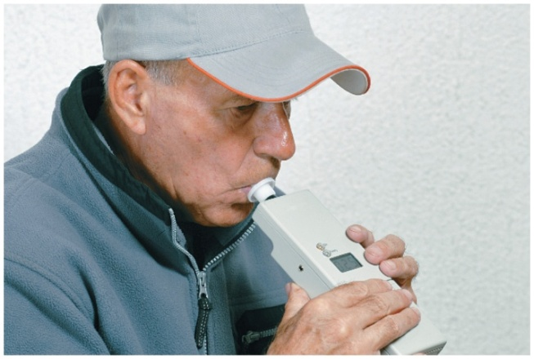
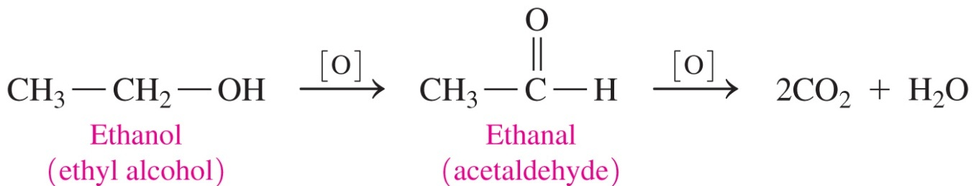
Ethanol, CH₃CH₂OH
73
Ethanol
acts as a depressant and kills or disables more people than any other drug
consumption can be analyzed by
using a breathalyzer
is metabolized by a social drinker at a
rate of 12–15 mg/dL per hour
is metabolized by an alcoholic at a rate of 30 mg/dL per hour

Slide 74
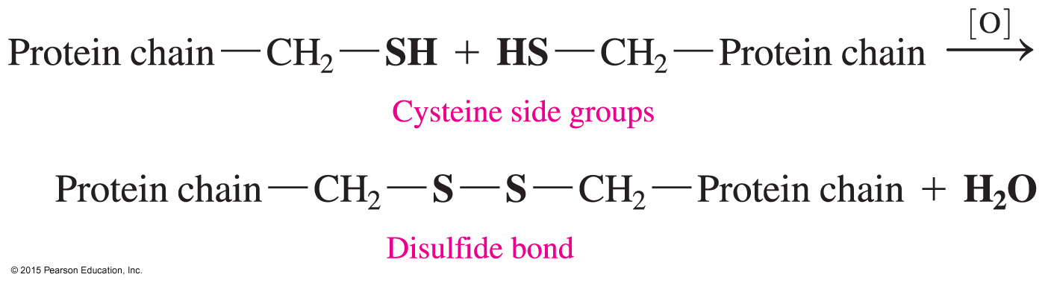
Oxidation of Thiols
74
When thiols undergo oxidation,
an H atom is lost from each of two —SH groups
the product is a disulfide
protein in hair is cross-linked by disulfide bonds found in the amino acid cysteine

Slide 75
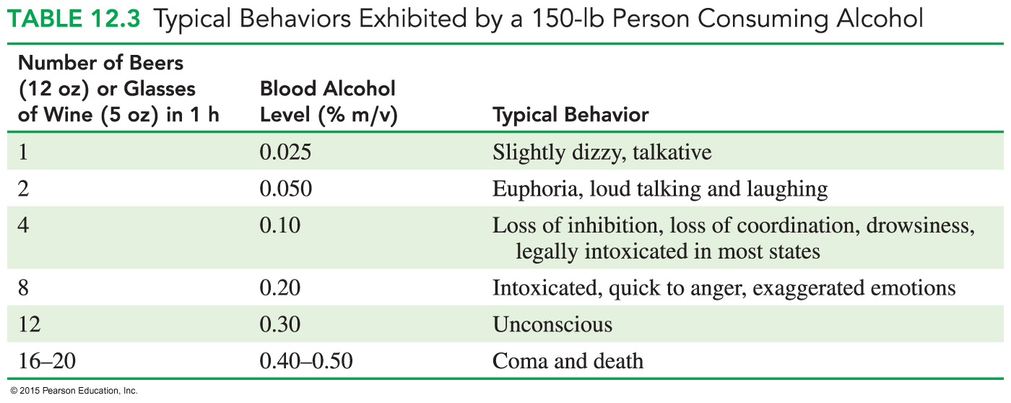
Effect of Alcohol on the Body
75

Slide 76
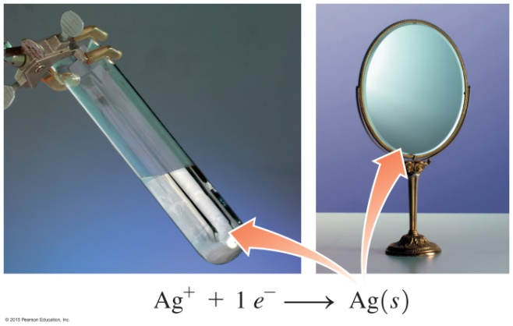
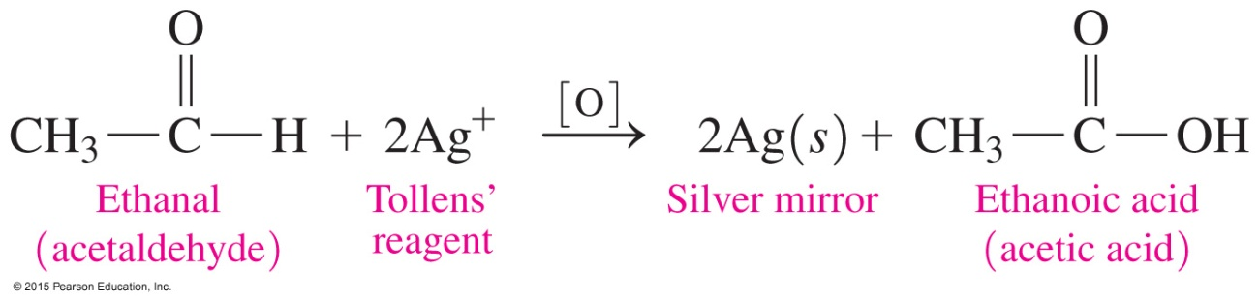
Tollens’ Test
76
In Tollens’ test,
Tollens’ reagent, which contains Ag⁺, oxidizes aldehydes but not ketones.
Ag⁺ is reduced to metallic Ag, which looks like a mirror in
the test tube.

Slide 77
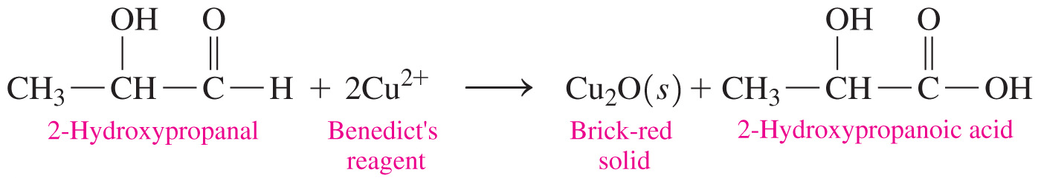
Benedict’s Test
77
In Benedict’s test,
Benedict’s reagent, which contains Cu²⁺, reacts with aldehydes that have an adjacent —OH group.
When Benedict’s solution containing Cu²⁺ (CuSO₄) ions is added to this type of aldehyde and heated, a brick-red solid of Cu₂O forms from the aldehyde.
The test is negative with simple aldehydes and ketones.

Slide 78
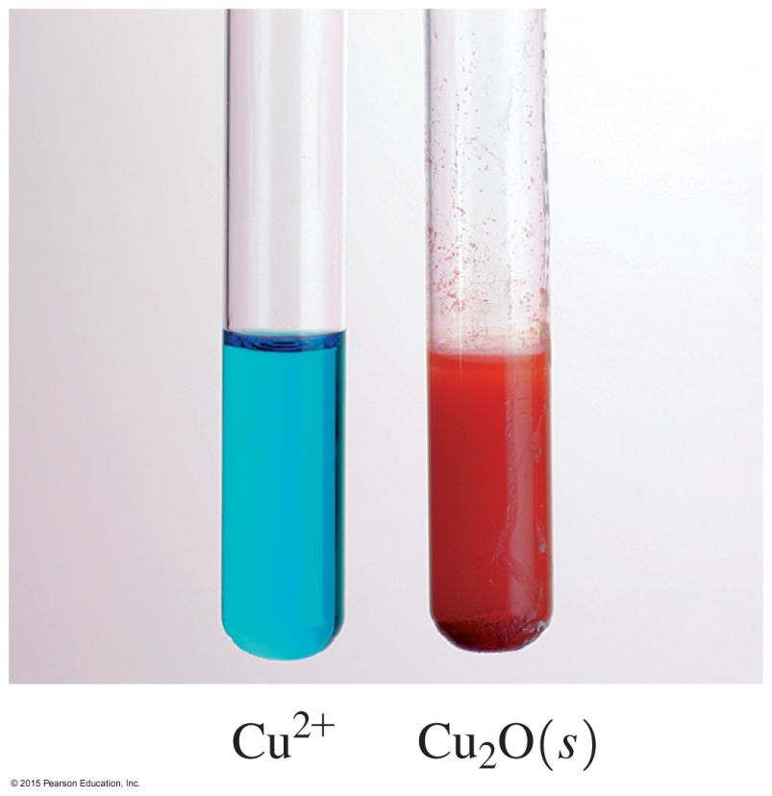
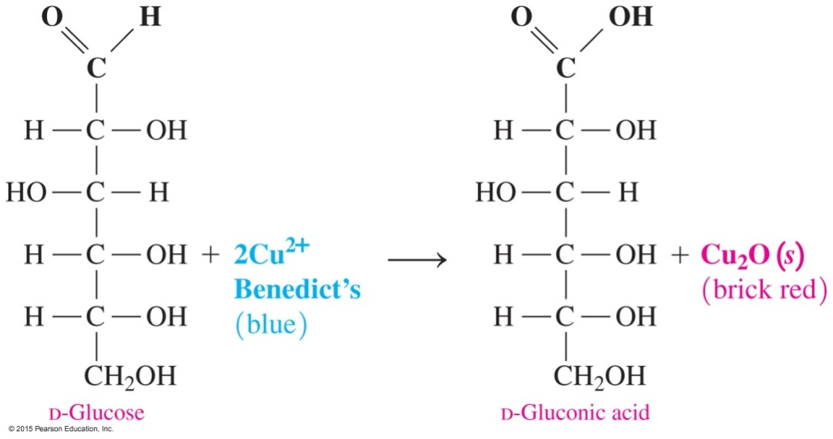
Benedict’s Test
78
In Benedict’s test, the blue Cu²⁺ in Benedict’s solution forms a brick-red solid of Cu₂O in a positive test for many sugars and aldehydes with adjacent hydroxyl groups.

Slide 79
Reduction of Aldehydes and Ketones
79
In the reduction of organic compounds,
aldehydes and ketones are reduced by sodium borohydride (NaBH₄) or hydrogen (H₂)
the number of carbon–oxygen bonds is reduced by the addition of hydrogen or the loss of oxygen
a catalyst such as nickel, platinum, or palladium is needed for the addition of hydrogen to the carbonyl group

Slide 80
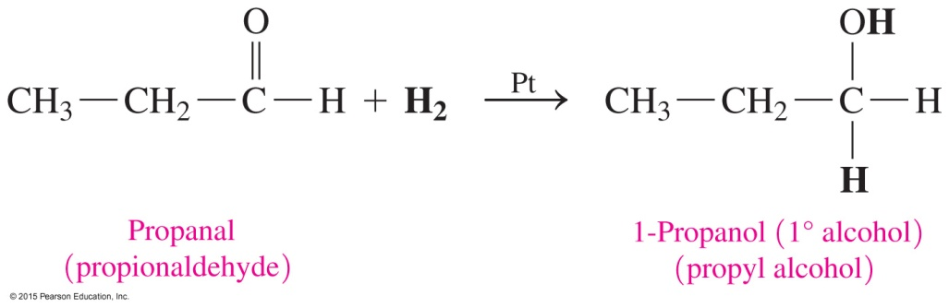
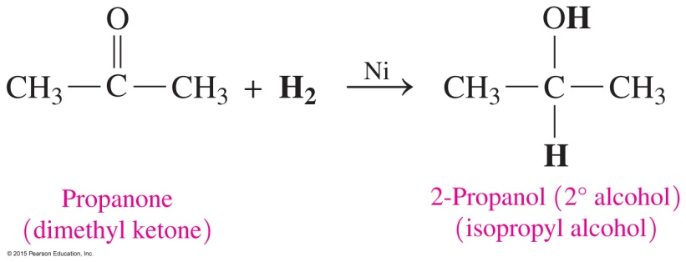
Reduction of Aldehydes and Ketones
80
Aldehydes reduce to form primary alcohols, and ketones reduce to form secondary alcohols.
A catalyst such as nickel, platinum, or palladium is needed for the addition of hydrogen to the carbonyl group.

Slide 81
Learning Check
81
Select the product for the oxidation of the following:
[O]
A. B.
C. CO₂ + H₂O D.

Slide 82
Solution
82
Select the product for the oxidation of the following:
[O]
The correct answer is B.

Slide 83
Learning Check
83
Select the product when CH₃—CH₂—CH₂—OH undergoes each of the following reactions:
[O] [O]
B. C.
1)
2) CO₂ + H₂O
3)
4)

Slide 84
Solution
84
Select the product when CH₃—CH₂—CH₂—OH undergoes each of the following reactions:
[O] [O]
B. C.
B. 3)
C. 4)

Slide 85
Learning Check
85
Give the primary product for the reaction of 2-propanol when it undergoes
A. oxidation
B. dehydration

Slide 86
Solution
86
= 2-propanol = C₃H₈O
A. oxidation
[O]
2
B. dehydration
H⁺, heat
+ H₂O

Slide 87
Learning Check
87
Write the structure and name of the organic product when each is mixed with Tollens’ reagent.
A. butanal
B. acetaldehyde
C. ethyl methyl ketone

Slide 88
Solution
88
A.
Tollens’
butanal butanoic acid
B.
Tollens’
    acetaldehyde acetic acid
ethyl methyl ketone + Tollens’ = no reaction
    Ketones are not oxidized by Tollens’ reagent.

Slide 89
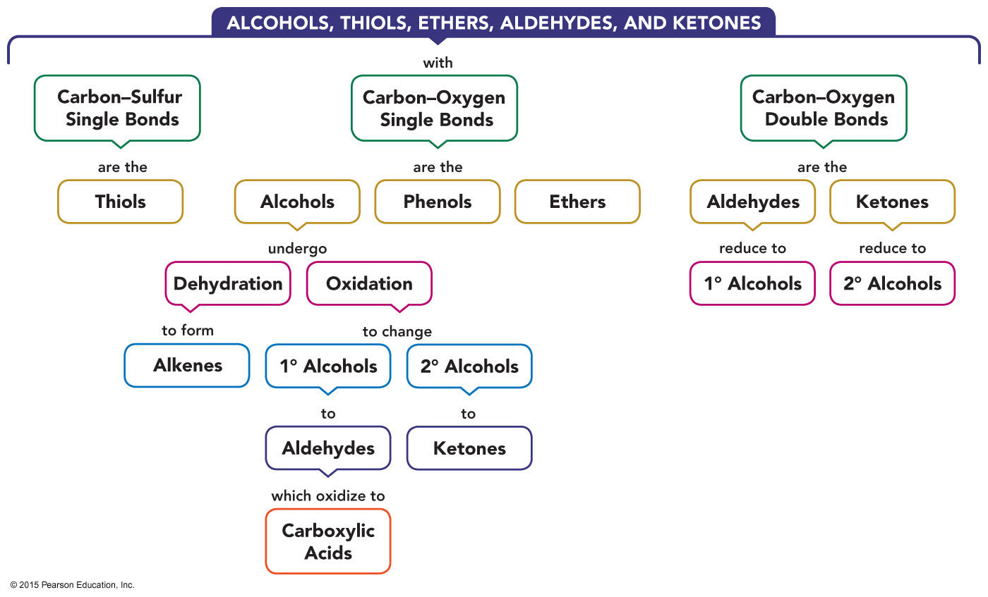
Concept Map
89

