Slide 1

Chapter 14 Carboxylic Acids, Esters, Amines, and Amides
1
Environmental health practitioners (EHPs) monitor environmental pollution to protect the public’s health. By using specialized equipment, EHPs measure pollution levels in soil, air, and water, as well as noise and radiation levels. EHPs can specialize in a specific area, such as air quality or hazardous and solid waste.

Slide 2
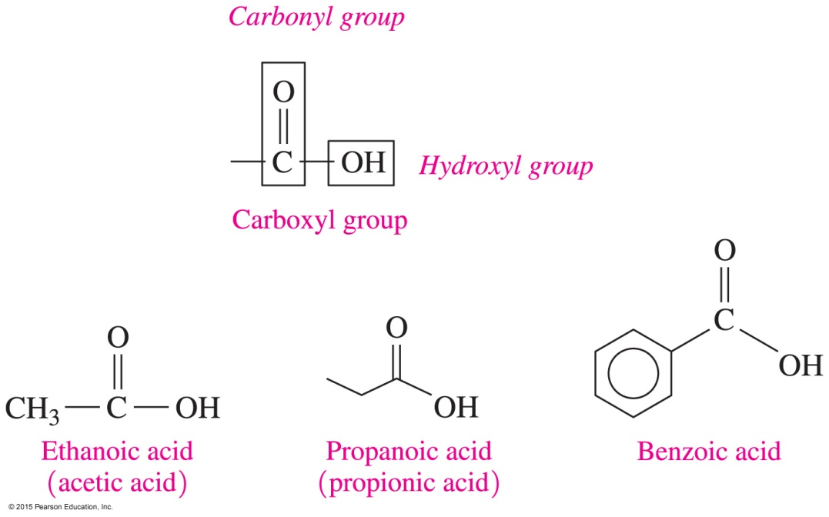
14.1 Carboxylic Acids
2
A carboxylic acid contains a carboxyl group, which consists of a hydroxyl group —OH attached to the carbon in a carbonyl group.
Learning Goal Write the IUPAC and common names for carboxylic acids; draw their condensed structural formulas or line-angle formulas.

Slide 3

IUPAC Names for Carboxylic Acids
3
In the IUPAC names of carboxylic acids,
the -e in the alkane name is replaced with -oic acid
CH₄
Methane Methanoic acid
CH₃—CH₃
Ethane Ethanoic acid

Slide 4
IUPAC Names for Carboxylic Acids
4
In the IUPAC names of carboxylic acids,
substituents are numbered from the carboxyl bonded to carbon 1
4 3 2 1
3-Methylbutanoic acid
2,3-Dichlorobenzoic acid

Slide 5
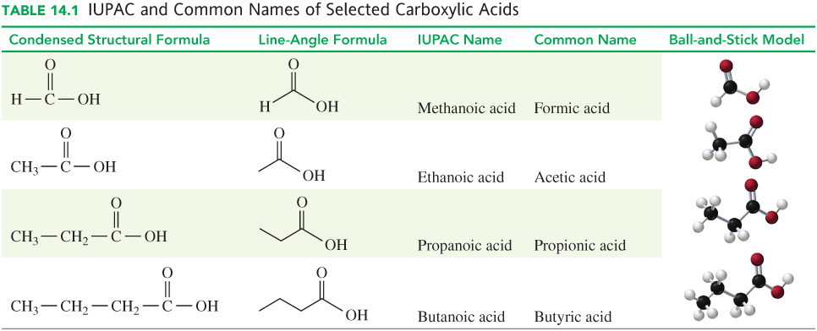
Common Names of Carboxylic Acids
5

Slide 6
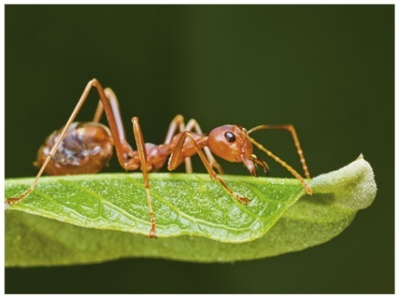
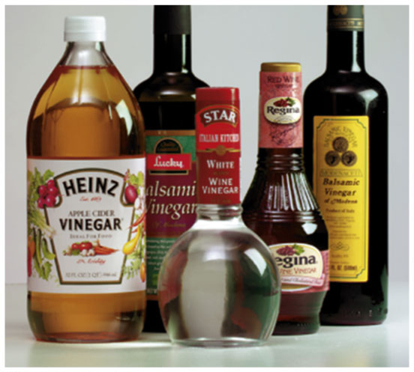
Common Carboxylic Acids
A red ant sting contains formic acid, which irritates the skin.
The sour taste of vinegar is due to ethanoic acid (acetic acid).

Slide 7
Naming Carboxylic Acids
7
Write the IUPAC name for the
following carboxylic acid:
SOLUTION:
ANALYZE Given Need Connect
THE five-carbon chain, IUPAC position of methyl group
PROBLEM methyl group name replace e in alkane name with oic acid

Slide 8
Naming Carboxylic Acids
8
Write the IUPAC name for the
following carboxylic acid:
STEP 1 Identify the longest carbon chain and replace the e in the corresponding alkane name with oic acid.
pentanoic acid

Slide 9
Naming Carboxylic Acids
9
Write the IUPAC name for the
following carboxylic acid:
STEP 2 Name and number any substituents by counting the carboxyl group as carbon 1.
2-methylpentanoic acid

Slide 10
Learning Check
10
Write the IUPAC names of each compound.
A. B.

Slide 11
Solution
11
Write the IUPAC names of each compound.
A. B.
2-methylpropanoic acid
3-bromobenzoic acid

Slide 12
Learning Check
12
Draw the line-angle formula for 4-chlorohexanoic acid.

Slide 13
Solution
13
Draw the line-angle formula for 4-chlorohexanoic acid.

Slide 14

14.2 Properties of Carboxylic Acids
14
Carboxylate salts are often used as preservatives and flavor enhancers in soups and seasonings.
Sodium propionate, a preservative, is added to cheeses, breads, and other bakery items to inhibit the spoilage of the food by microorganisms.
Learning Goal Describe the solubility, dissociation, and neutralization of carboxylic acids.

Slide 15
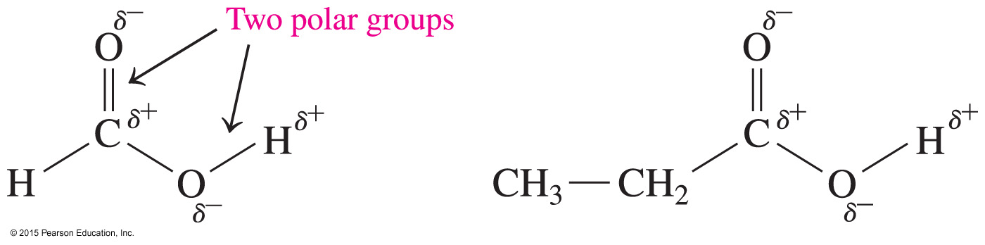
Polarity of Carboxylic Acids
15
Carboxylic acids are strongly polar because they have
two polar groups:
hydroxyl group (—OH)
carbonyl group (C O)

Slide 16
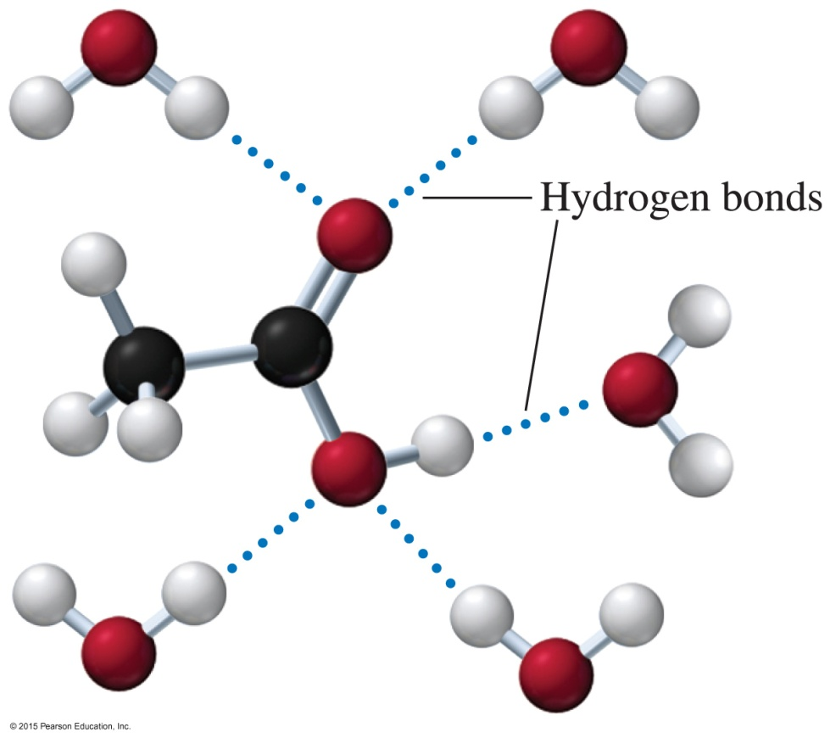
Solubility in Water
16
Carboxylic acids
form hydrogen bonds with many water molecules
with one to five carbon atoms are very soluble in water
As the number of carbons increases, the solubility of
the carboxylic acid in water
is reduced.
Acetic acid forms hydrogen bonds with water molecules.

Slide 17
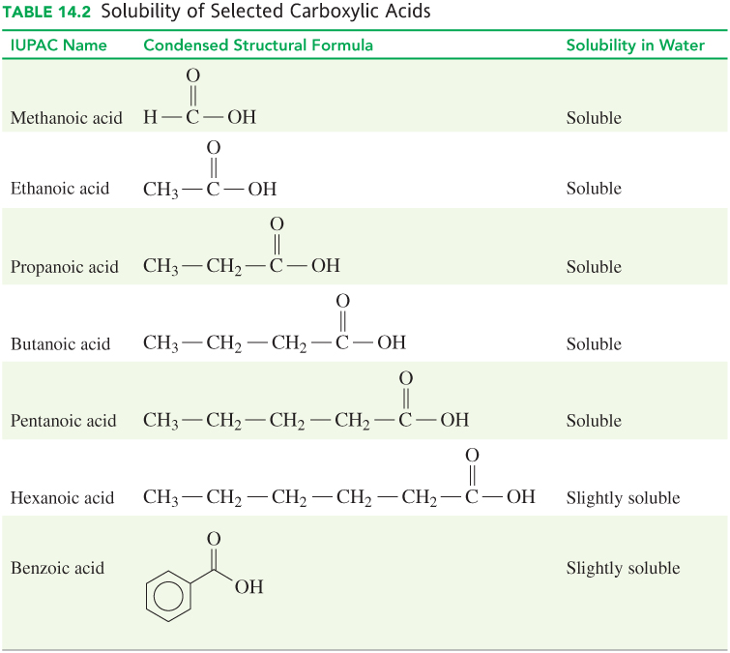
Solubility in Water
17

Slide 18
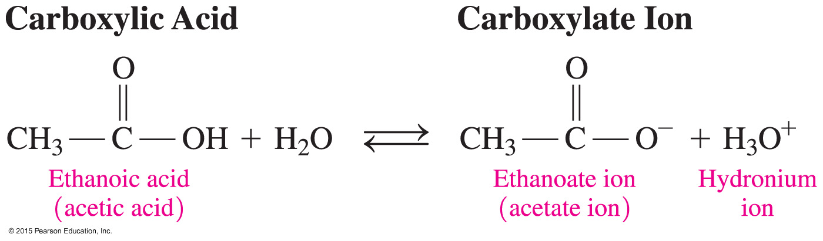
Acidity of Carboxylic Acids
18
Carboxylic acids
are weak acids
ionize in water to produce carboxylate ions
and hydronium ions
can lose a proton because two oxygen atoms in the carboxylate ion stabilize negative charge

Slide 19
Learning Check
19
Write the balanced chemical equation for the dissociation of butanoic acid in water and identify the carboxylate ion.
ANALYZE Given Need Connect
THE butanoic acid, dissociation products: butanoate
PROBLEM H₂O equation ion, H₃O⁺

Slide 20
Solution
20
Write the balanced chemical equation for the dissociation of butanoic acid in water and identify the carboxylate ion.
+ H₂O
– + H₃O⁺
carboxylate ion

Slide 21
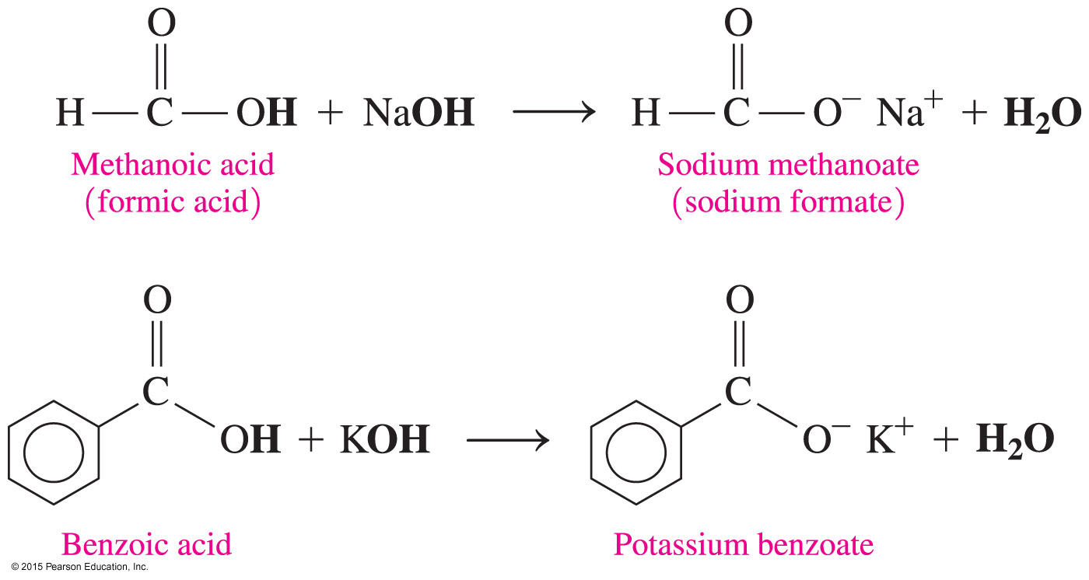

Neutralization of Carboxylic Acids
21
Carboxylic acid salts
are a product of the neutralization of a carboxylic acid with a strong base, such as NaOH or KOH
(carboxylic acid salt)
are used as preservatives and flavor
enhancers

Slide 22
Carboxylic Acid Salts
22
The carboxylate ion is named by replacing the ic acid with ate.

Slide 23
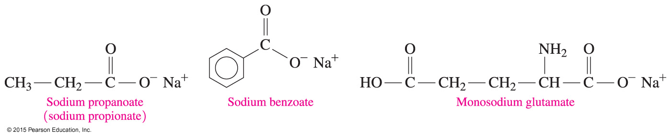
Carboxylic Acid Salts
23
Carboxylic acid salts
are ionic compounds with strong attractive forces between ions
are solids at room temperature
have high melting points
are usually soluble in water

Slide 24
Carboxylic Acid Salts
24
Carboxylic acid salts are used as preservatives and flavor
enhancers such as
sodium propionate, which is used in cheeses and breads
sodium benzoate, which inhibits growth of mold and bacteria and is added to fruit juices, margarine, relishes, salads, and jams
monosodium glutamate, MSG, which is added to meats,
fish, vegetables, and baked goods to enhance flavor

Slide 25
Learning Check
25
Write the balanced chemical equation for the reaction of propanoic acid with NaOH.
ANALYZE Given Need Connect
THE propanoic acid, neutralization products: sodium
PROBLEM NaOH equation propanoate, H₂O

Slide 26
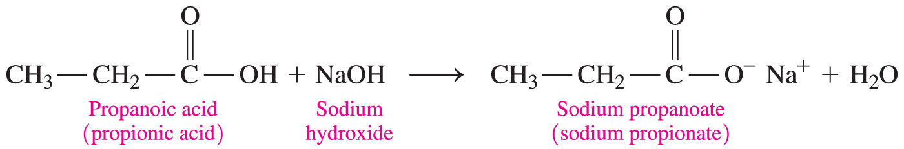
Solution
26
Write the balanced chemical equation for the reaction of propanoic acid with NaOH.

Slide 27
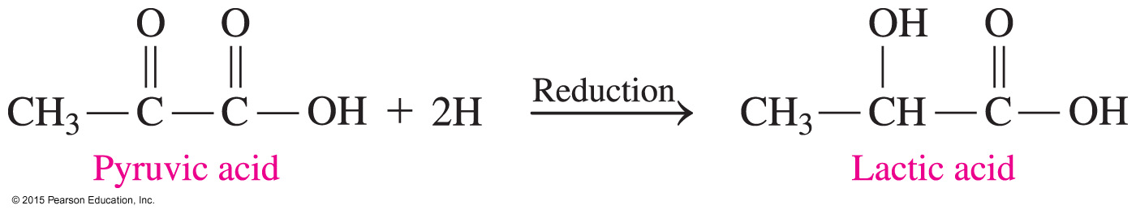
Chemistry Link to Health:
Carboxylic Acids in Metabolism
27
Carboxylic acids are part of the metabolic processes within our cells. For example,
during glycolysis, a molecule of glucose is broken down into two molecules of pyruvate, the carboxylate salt of pyruvic acid
during strenuous exercise, when oxygen levels are low (anaerobic), pyruvic acid is reduced to give lactic acid or the lactate ion

Slide 28

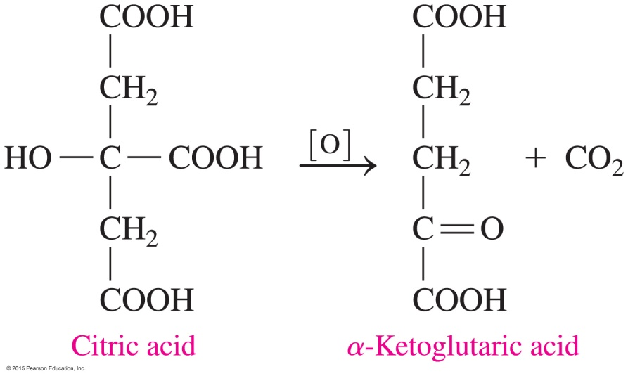
Chemistry Link to Health:
Carboxylic Acids in Metabolism
28
In the critic acid cycle (Krebs cycle), di- and tricarboxylic acids are oxidized and decarboxylated (loss of CO₂) to produce energy for the cells of the body.
At the start of the citric acid cycle, citric acid is oxidized to a five-carbon α-ketoglutaric acid:

Slide 29
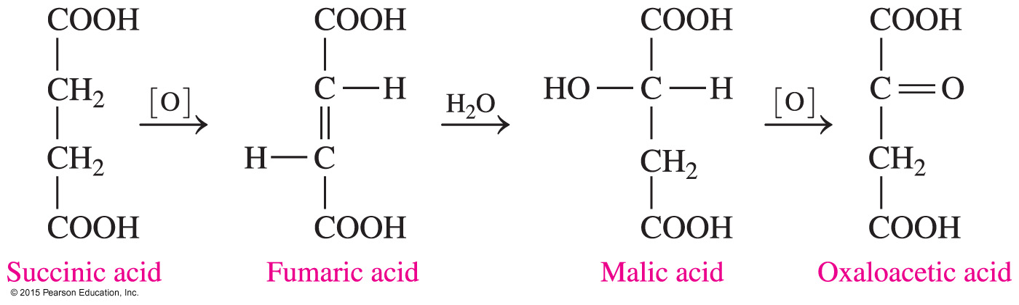
Chemistry Link to Health:
Carboxylic Acids in Metabolism
29
The citric acid cycle continues as α-ketoglutaric acid loses CO₂ to give a four-carbon succinic acid. Then a series of reactions converts succinic acid to oxaloacetic acid.
Some of the functional groups we have studied, along with reactions such as hydration and oxidation, are part of the metabolic processes that take place in our cells.

Slide 30

14.3 Esters
By the 1800s, chemists discovered that
salicin from the willow tree bark and leaves was responsible for pain relief
the body converts salicin to salicylic acid, which irritates the stomach lining
Bayer soon discovered that an ester of salicylic acid, acetylsalicylic acid, is less irritating but still effective in pain relief.
Learning Goal Write the IUPAC and common names for an ester; write the balanced chemical equation for the formation of an ester.

Slide 31
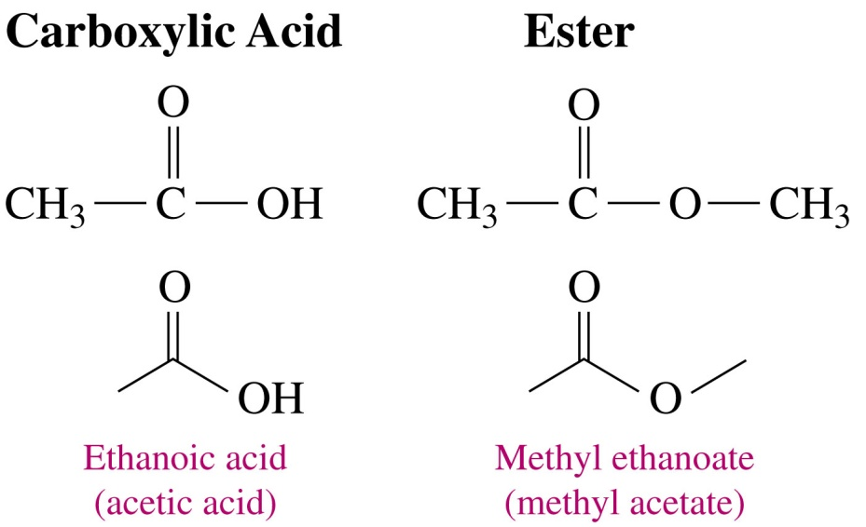
Esters
31
Esters are
synthesized from the reaction of a carboxylic acid and alcohol
found in fats and oils
responsible for the aroma and flavor of bananas, oranges, and strawberries

Slide 32
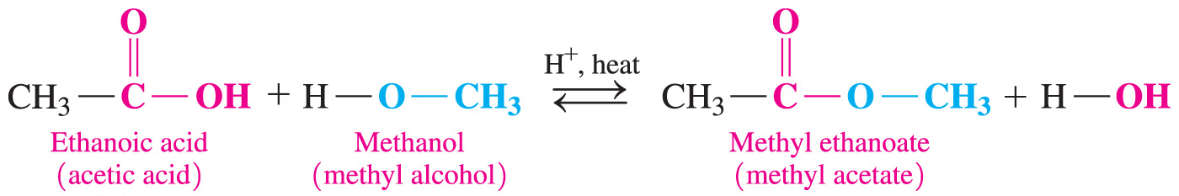
Esterification
32
Esterification is
the reaction of a carboxylic acid and alcohol in the presence of an acid catalyst and heat to produce an ester
the replacement of the hydrogen atom in the carboxylic acid
—OH group with an alkyl group from an alcohol

Slide 33
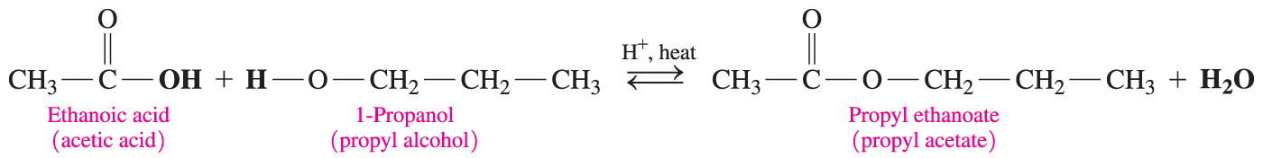
Esterification
33
An example of esterification is the reaction of a ethanoic acid with 1-propanol to produce an ester called propyl ethanoate, responsible for the smell of pears.

Slide 34
Learning Check
34
Write the balanced chemical equation for the reaction of propanoic acid and methanol in the presence of heat and an acid catalyst.
ANALYZE Given Need Connect
THE propanoic acid, esterification products: methyl
PROBLEM methanol equation propanoate, H₂O

Slide 35
Solution
35
Write the balanced chemical equation for the reaction of propanoic acid and methanol in the presence of heat and an acid catalyst.

Slide 36
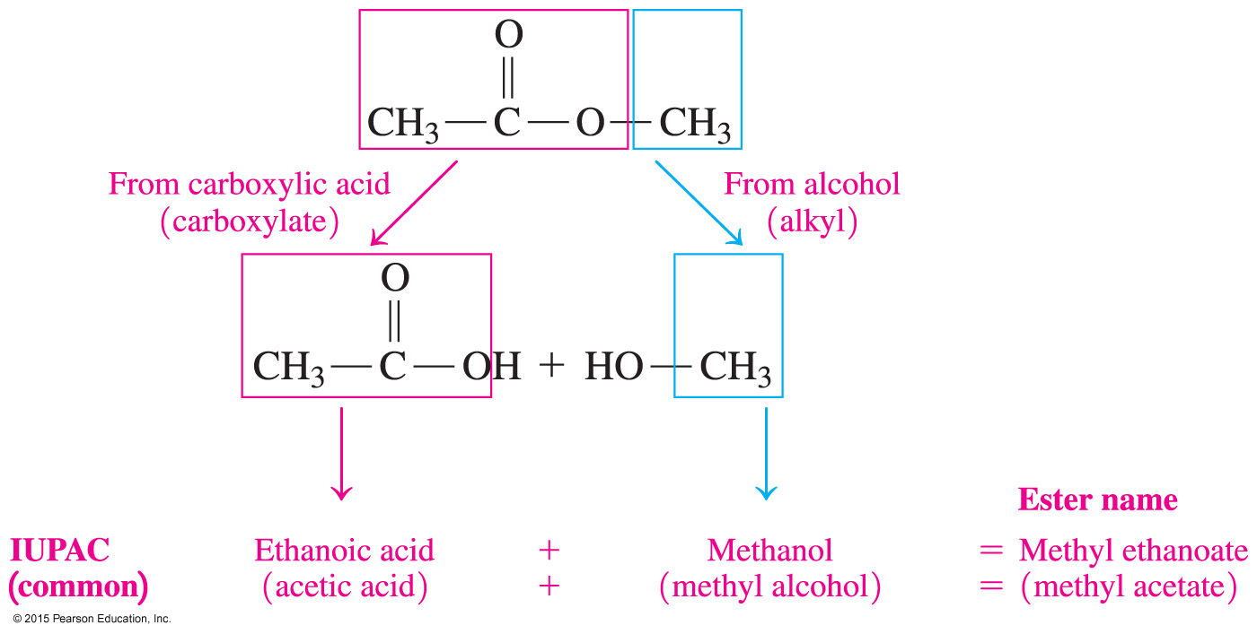
Naming Esters
36
The name of an ester consists of two words:
1. The first word indicates the alkyl part from the alcohol.
2. The second word is the carboxylate name of the
carboxylic acid.

Slide 37
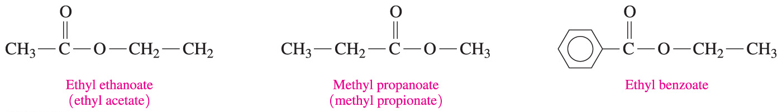
Naming Esters
37
Esters have IUPAC and common names:

Slide 38
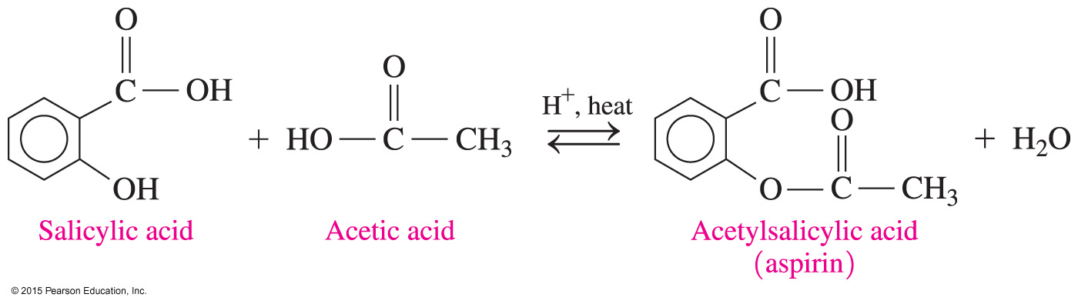
Chemistry Link to Health:
Salicylic Acid from a Willow Tree
38
In 1899, the Bayer chemical company
produced an ester of salicylic acid and acetic acid less irritating to the stomach than salicylic acid
called the ester acetylsalicylic acid (aspirin)
Many people take a daily low-dose aspirin, which has been found to lower the risk of heart attack and stroke.

Slide 39
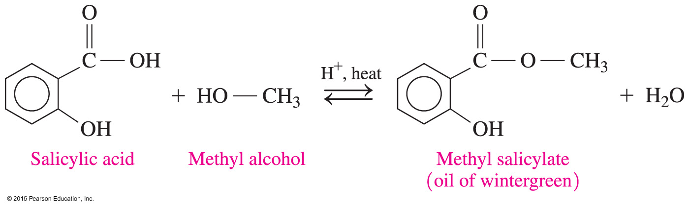
Chemistry Link to Health:
Salicylic Acid from a Willow Tree
39
Oil of wintergreen, or methyl salicylate, has a pungent, minty odor and flavor and
is used in skin ointments
can pass through the skin
acts as a counter-irritant, producing heat to soothe sore muscles

Slide 40
Naming Esters
40
Write the IUPAC name of the following ester.
SOLUTION:
ANALYZE Given Need Connect
THE ester IUPAC name
PROBLEM
Write the alkyl name for
the alcohol, change
ic acid to ate.

Slide 41
Naming Esters
41
Write the IUPAC name of the following ester.
STEP 1 Write the name for the carbon chain from the alcohol as an alkyl group.
ethyl

Slide 42
Guide to Naming Esters
42
Write the IUPAC name of the following ester.
STEP 2 Change the ic acid of the acid name to ate.
ethyl propanoate

Slide 43
Learning Check
43
Write the IUPAC and common names of the following compound, which is responsible for the flavor and odor
of pears.
ANALYZE Given Need Connect
THE ester IUPAC name
PROBLEM common name
Write the alkyl name for
the alcohol, change
ic acid to ate.

Slide 44
Solution
44
Write the IUPAC and common names of the following compound, which is responsible for the flavor and odor
of pears.
STEP 1 Write the name for the carbon chain from the alcohol as an alkyl group.
propyl

Slide 45
Solution
45
Write the IUPAC and common names of the following compound, which is responsible for the flavor and odor
of pears.
STEP 2 Change the ic acid of the acid name to ate.
propyl ethanoate propyl acetate

Slide 46
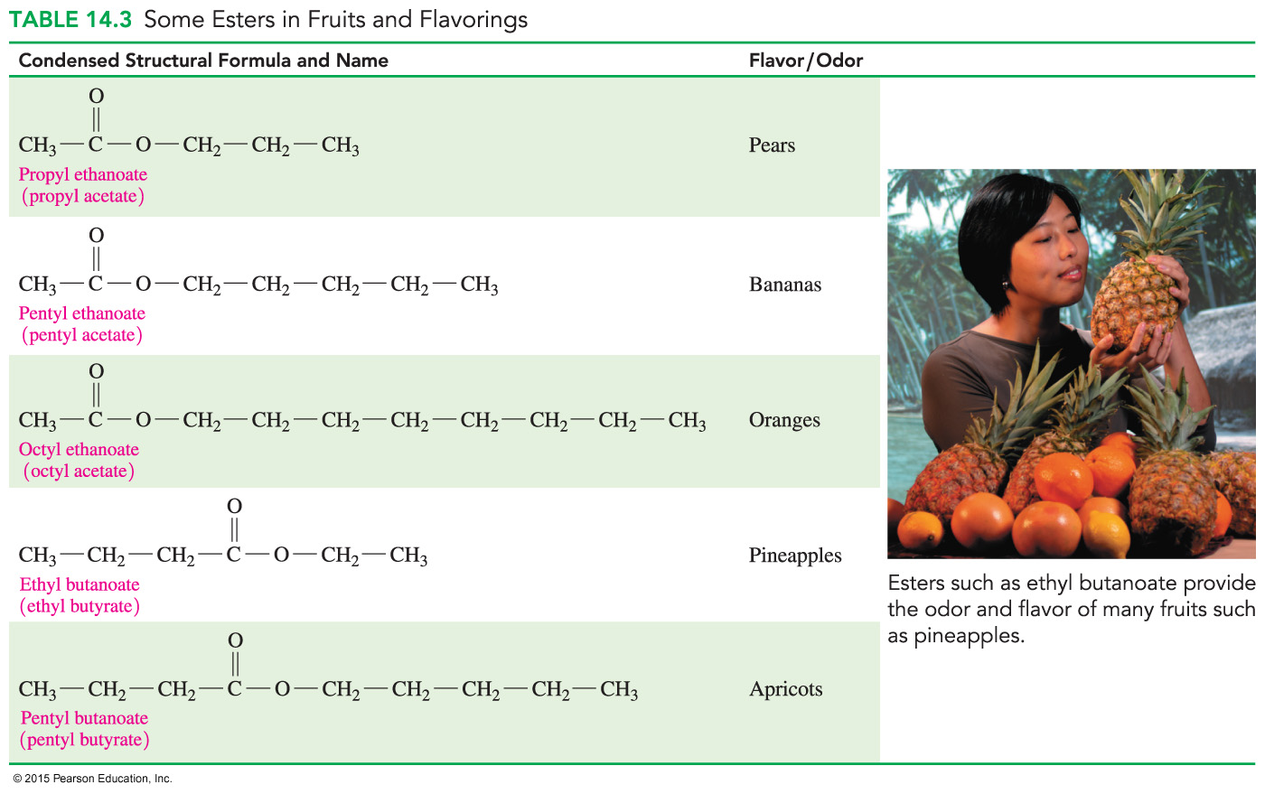
Esters in Fruits
46
Many of the fragrances of perfumes and flowers and the flavors of fruits are due to esters.
Small esters are volatile, so we can smell them, and they are slightly soluble in water, so we can taste them.

Slide 47
Esters in Fruits and Flavoring
47

Slide 48
Learning Check
48
Draw the condensed structural formulas for the following compounds:
A. 3-bromobutanoic acid
B. ethyl propanoate

Slide 49
Solution
49
Draw the condensed structural formulas for the following compounds :
A. 3-bromobutanoic acid
B. ethyl propanoate

Slide 50
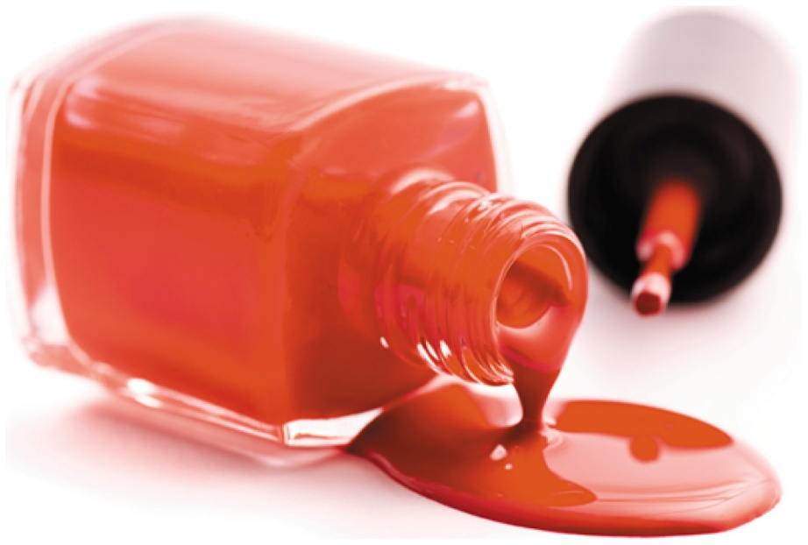
14.4 Hydrolysis of Esters
50
Ethyl acetate is the solvent in fingernail polish, plastics, and lacquers.
Learning Goal Draw the condensed structural or line-angle formulas for the products from acid and base hydrolysis of esters.

Slide 51

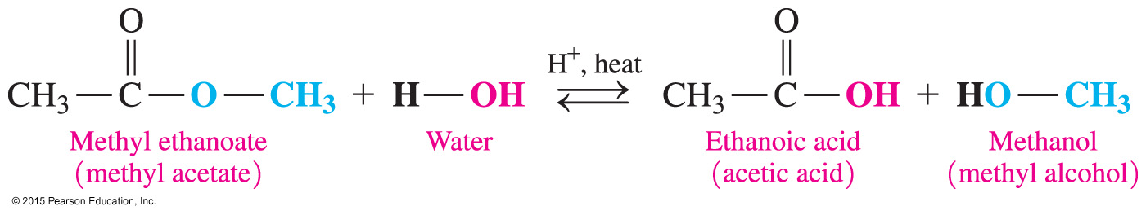
Acid Hydrolysis of Esters
51
In acid hydrolysis,
an ester reacts with water to produce a carboxylic acid
and an alcohol
a water molecule provides the —OH group to convert the carbonyl group of the ester to a carboxyl group
an acid catalyst and heat are required

Slide 52
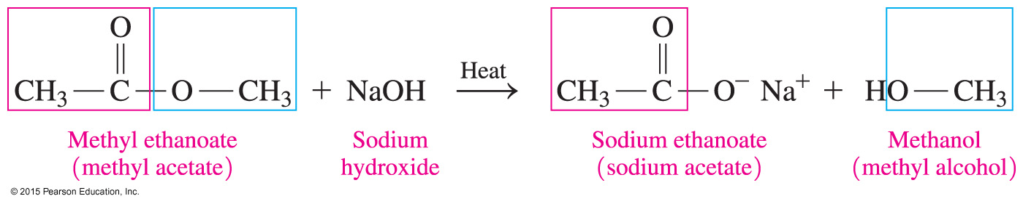
Base Hydrolysis (Saponification)
52
Base hydrolysis, or saponification,
is the reaction of an ester with a strong base in the presence of heat
produces the salt of the carboxylic acid and an alcohol

Slide 53
Learning Check
53
Write the balanced chemical equation when methyl acetate reacts with
A. water, heat, and an acid catalyst
B. KOH, heat

Slide 54
Solution
54
Write the balanced chemical equation when methyl acetate reacts with
A. water, heat, and an acid catalyst
B. KOH, heat
–

Slide 55
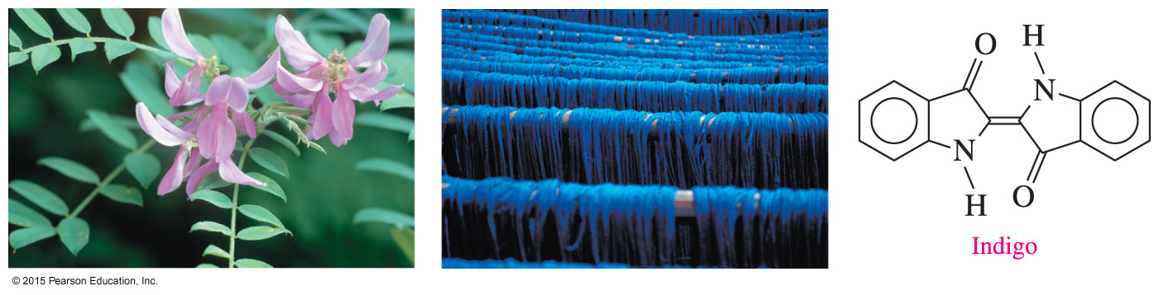
14.5 Amines
55
Indigo used in blue dyes can be obtained from topical plants such as Indigofera tinctoria.
Learning Goal Write the common names for amines; draw the condensed structural or line-angle formulas when given their names. Describe the solubility, dissociation, and neutralization of amines in water.

Slide 56
Amines
56
Amines
are derivatives of ammonia, NH₃, in which one or more hydrogen atoms are replaced with alkyl or aromatic groups
contain N attached to one or more alkyl or aromatic groups

Slide 57
Classification of Amines
57
Amines are classified as primary, secondary, or tertiary:
A primary (1°) amine has one carbon group bonded to the nitrogen atom.
A secondary (2°) amine has two carbon groups bonded to the nitrogen atom.
A tertiary (3°) amine has three carbon groups bonded to the nitrogen atom.
1° 2° 3°

Slide 58
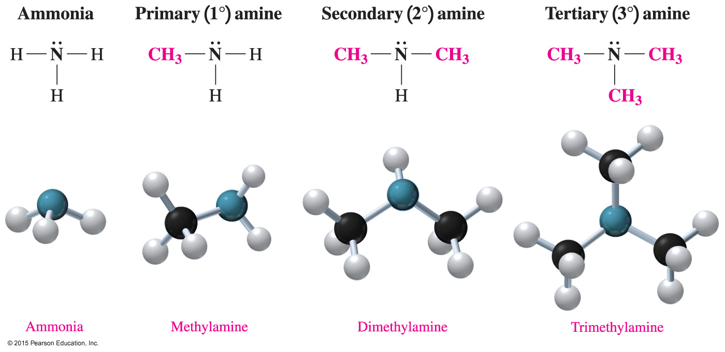
Classification of Amines
58
Amines have one or more carbon atoms bonded to the N atom.

Slide 59
Naming Amines
59
Simple amines
are named as alkylamines
list the names of the alkyl groups bonded to the N atom
in alphabetical order in front of amine
use prefixes to identify duplicate alkyl substituents
Ethylamine
Dimethylamine
Ethyldimethylamine

Slide 60
Learning Check
60
Write the common name for each amine and classify it as primary, secondary, or tertiary.
A. CH₃—CH₂—CH₂—NH₂
B.

Slide 61
Solution
61
Write the common name for each amine and classify it as primary, secondary, or tertiary.
A. CH₃—CH₂—CH₂—NH₂ propylamine, 1°
B. ethyldimethylamine, 3°

Slide 62
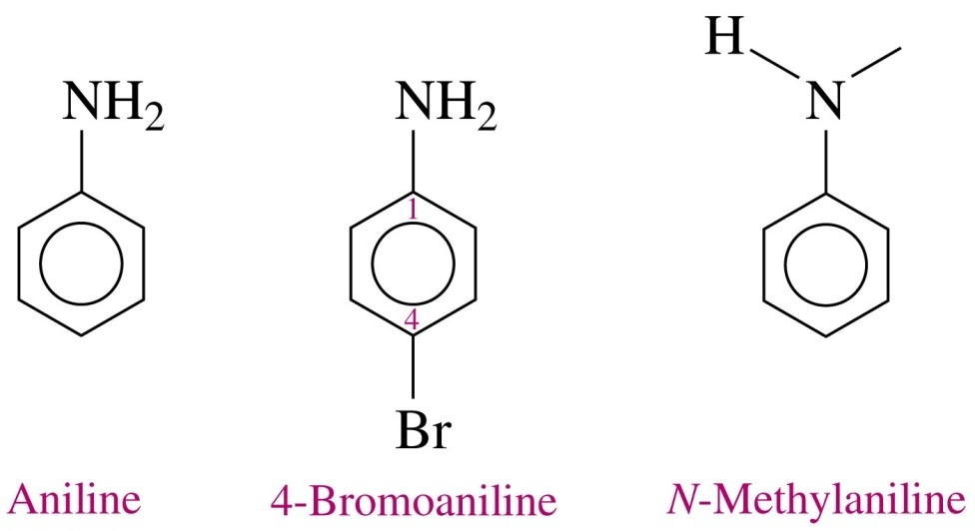
Aromatic Amines
62
The amine of benzene is named aniline.
Alkyl groups on the N use the prefix N- with the alkyl name.
Aniline is used to make many dyes, which give color to wool, cotton, and silk fibers, as well as blue jeans.

Slide 63
Learning Check
63
Write the common name of each amine compound.
A.
B.

Slide 64
Solution
64
Write the common name of each amine compound.
A. diethylmethylamine
B. N-ethylaniline

Slide 65
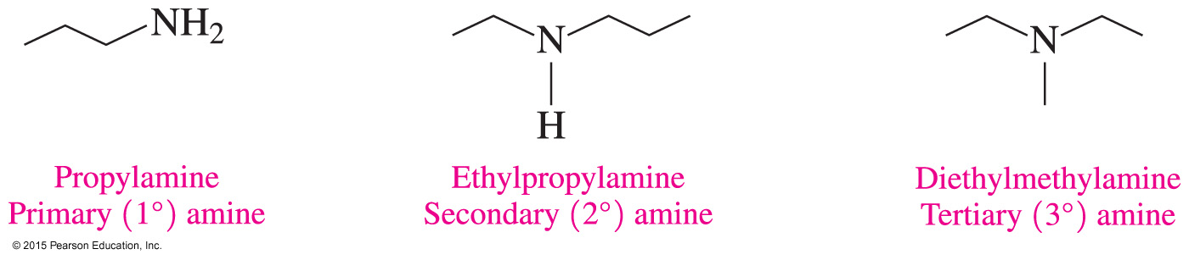
Line-Angle Formulas of Amines
65
The line-angle formulas show the shapes of amine molecules with one or more alkyl groups bonded to the nitrogen atom.

Slide 66
Solubility of Amines: Hydrogen Bonds
66
Primary and secondary amines with fewer than six carbons are soluble in water; thus, they can form hydrogen bonds with water molecules or other compounds having O, N or F.
Tertiary amines can form hydrogen bonds with water molecules or other compounds having H at O, N or F.

Slide 67
Solubility of Amines: Hydrogen Bonds
67
Because amines contain a polar N —H bond, they form hydrogen bonds with water.
Primary (1°) amines, — NH₂, can form more hydrogen bonds than the secondary (2°) amines.
Tertiary (3°) amines have no hydrogen on the nitrogen atom and can form only hydrogen bonds from the N atom.
Like alcohols, the smaller amines, including tertiary ones, are soluble because they form hydrogen bonds with water.

Slide 68
Solubility of Amines in Water
68
In amines with more than six carbon atoms,
the effect of hydrogen bonding is diminished
the nonpolar hydrocarbon chains of the amine decrease its solubility in water

Slide 69
Learning Check
69
Which of the following compounds are soluble in water?
A. CH₃ — CH₂ — CH₂ — NH₂
B. CH₃ — CH₂ — NH — CH₃
C. CH₃ — CH₂ — CH₂ — CH₃

Slide 70
Solution
70
Which of the following compounds are soluble in water?
Both A and B are amines that can form hydrogen bonds with water and are therefore soluble in water. C is an alkane and therefore not soluble in water.
A. CH₃ — CH₂ — CH₂ — NH₂
B. CH₃ — CH₂ — NH — CH₃
C. CH₃ — CH₂ — CH₂ — CH₃

Slide 71
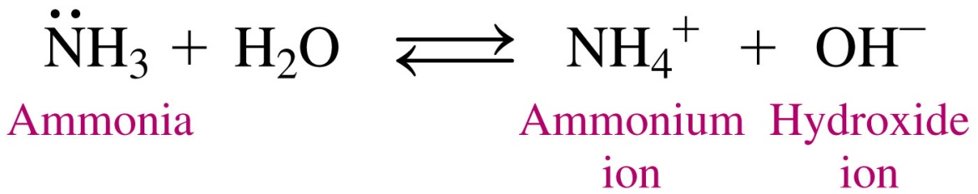
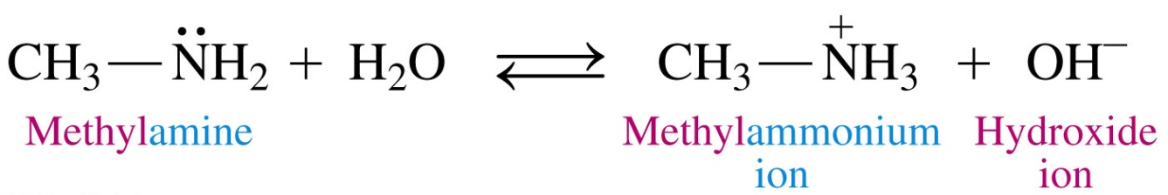
Amines Act as Bases in Water
71
Ammonia (NH₃), as well as 1°, 2° and 3°amines, acts as a Brønsted–Lowry base because the lone electron pair on the nitrogen accepts H⁺ from water to produce an ammonium ion (NH₄⁺) and a hydroxide ion (OH–).

Slide 72
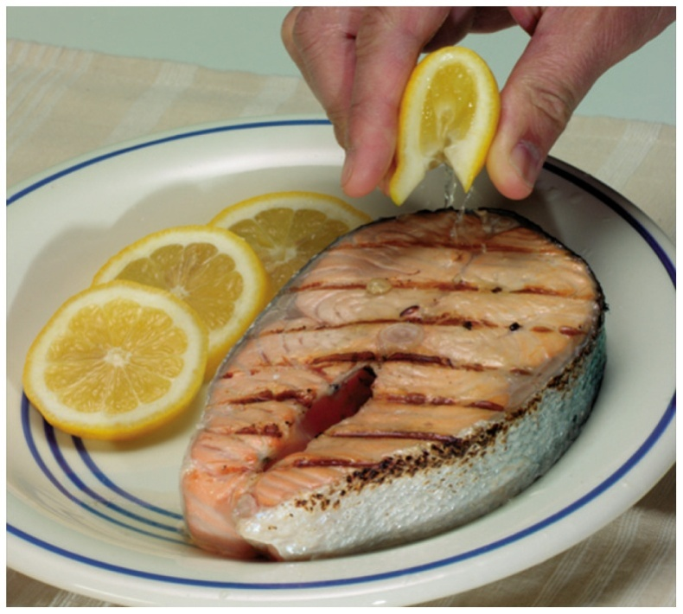
Neutralization Forms Amine Salts
72
An amine salt forms when
amines such as those responsible for the odor in fish are neutralized by an acid
amines react as Brønsted–Lowry bases in a neutralization reaction with citric acid
The amines in fish react with the
acid in lemon juice to neutralize the “fishy” odor.

Slide 73
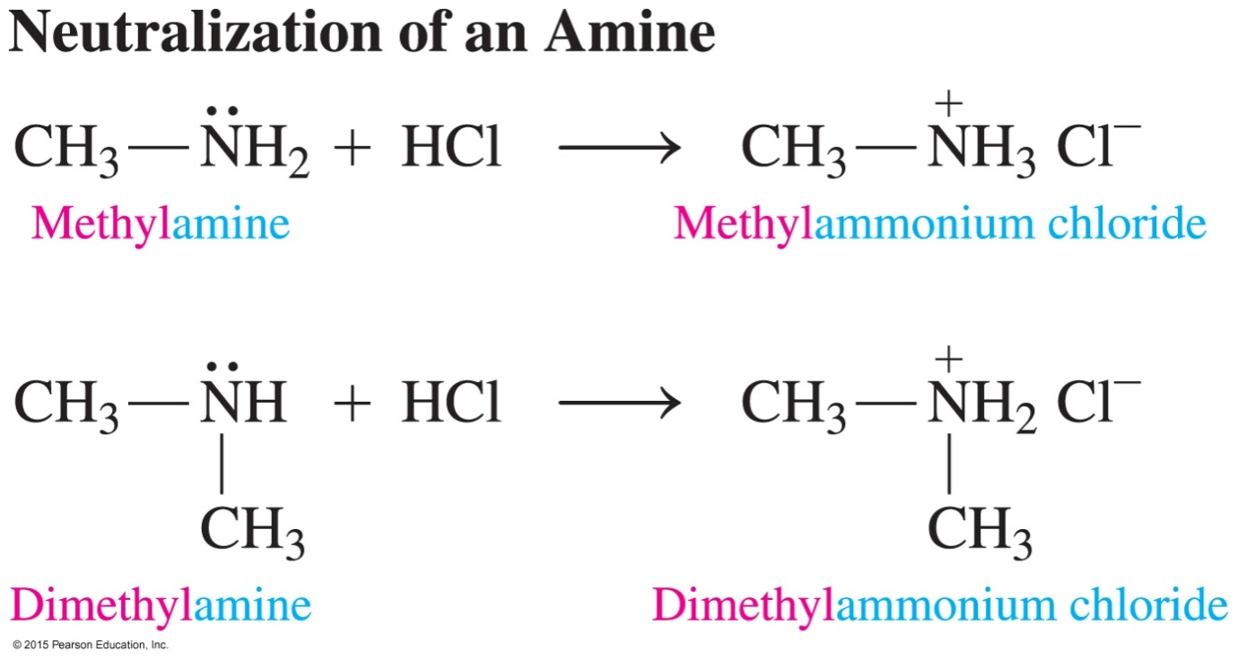
Neutralization Forms Amine Salts
73
An ammonium salt is named by using its alkylammonium ion name, followed by the name of the negative ion.

Slide 74
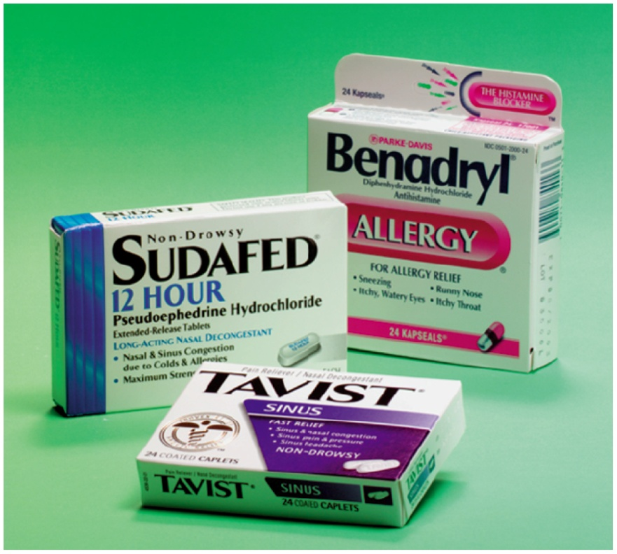
Properties of Ammonium Salts
74
Amines are usually converted
to their ammonium salt before
being used as drugs. The
ammonium salts are solids at
room temperature, odorless and
soluble in water and body fluids.

Slide 75
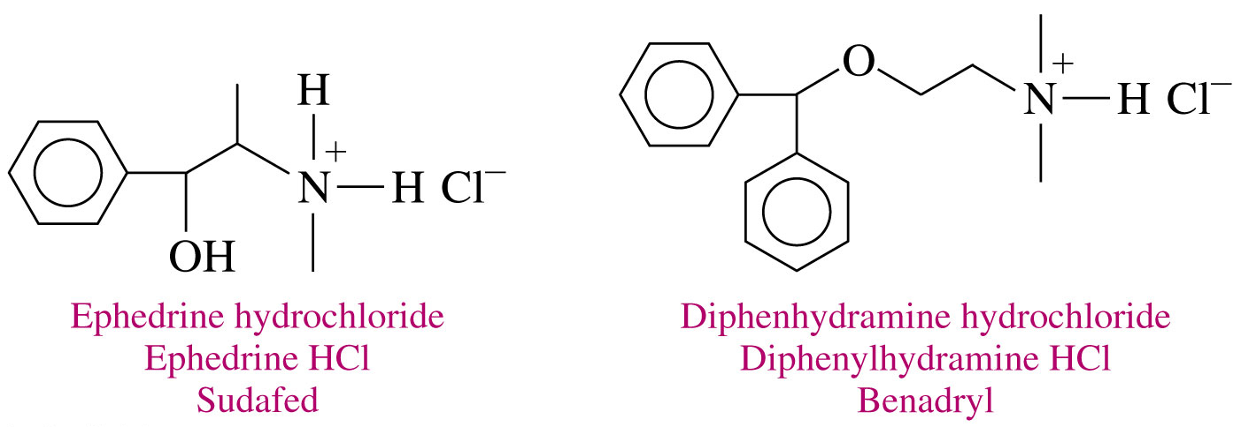
Properties of Ammonium Salts: Medications
75
Ammonium salts are used as the active ingredients in medications:
Ephedrine is used as a bronchodilator in the decongestant Sudafed.
Diphenylhydramine, found in Benadryl, is used for relief of itching and pain from skin irritations and rashes.

Slide 76
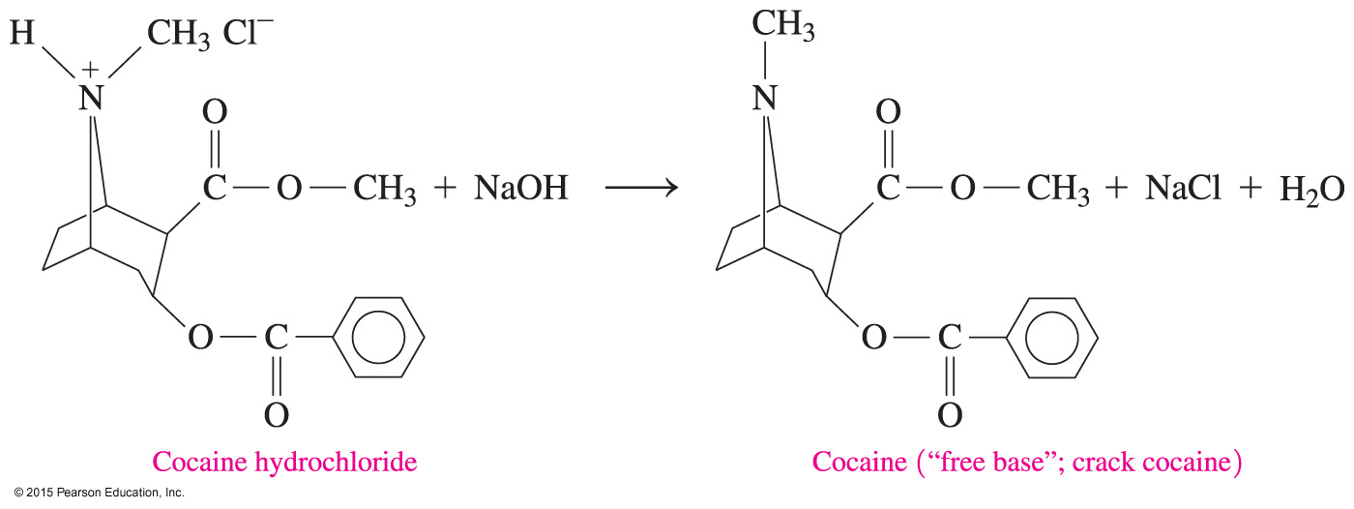
Properties of Ammonium Salts: Cocaine
76
The narcotic cocaine, extracted from coca leaves using an acidic HCl solution, is smuggled and used illegally in the form of cocaine hydrochloride, an ammonium salt.

Slide 77
Properties of Ammonium Salts: Cocaine
77
Cocaine hydrochloride, an ammonium salt, can be converted back to its free amine or free base form, “crack cocaine” by treating it with a strong base.

Slide 78
Chemistry Link to Health: Alkaloids: Amines in Plants
78
Alkaloids are
physiologically active compounds produced by plants that contain nitrogen
used in anesthetics, in antidepressants, and as stimulants, and many are habit forming
Nicotine is a stimulant that increases
the level of adrenaline in the blood
heart rate and blood pressure
Nicotine is addictive because it activates
pleasure centers in the brain.

Slide 79
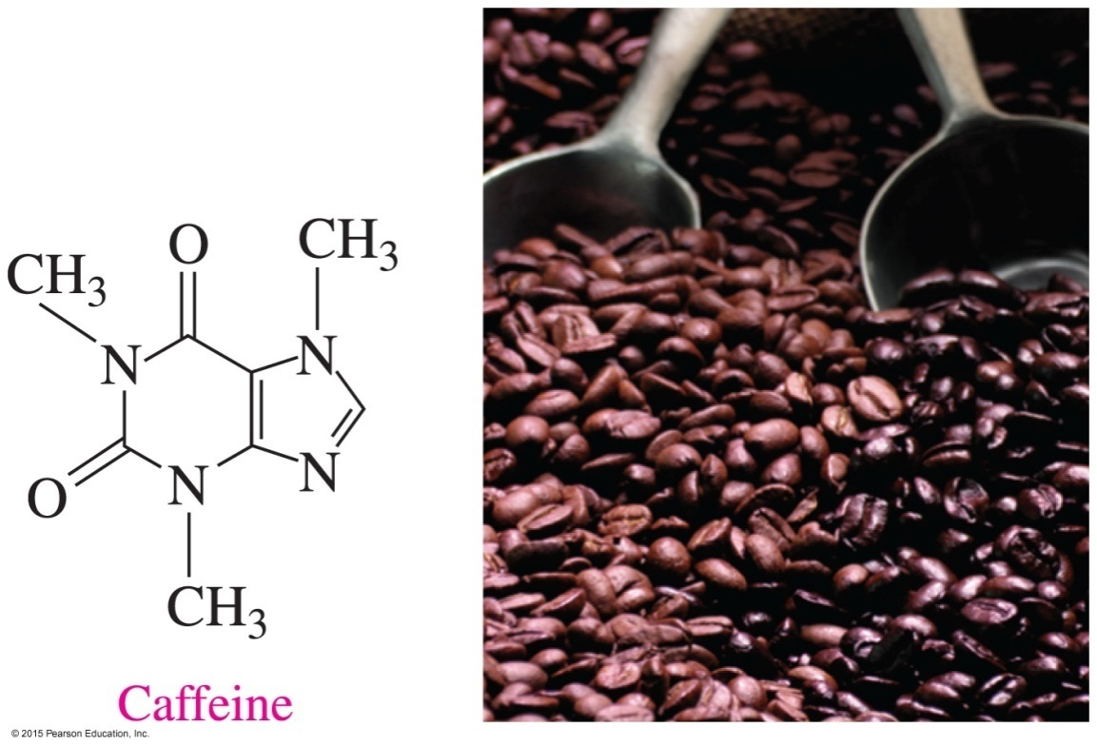
Chemistry Link to Health:
Alkaloids: Amines in Plants
79
Caffeine
is an alkaloid found in coffee beans, tea, chocolate, and soft drinks
is a stimulant of the central nervous system
increases alertness but may cause insomnia أرق

Slide 80
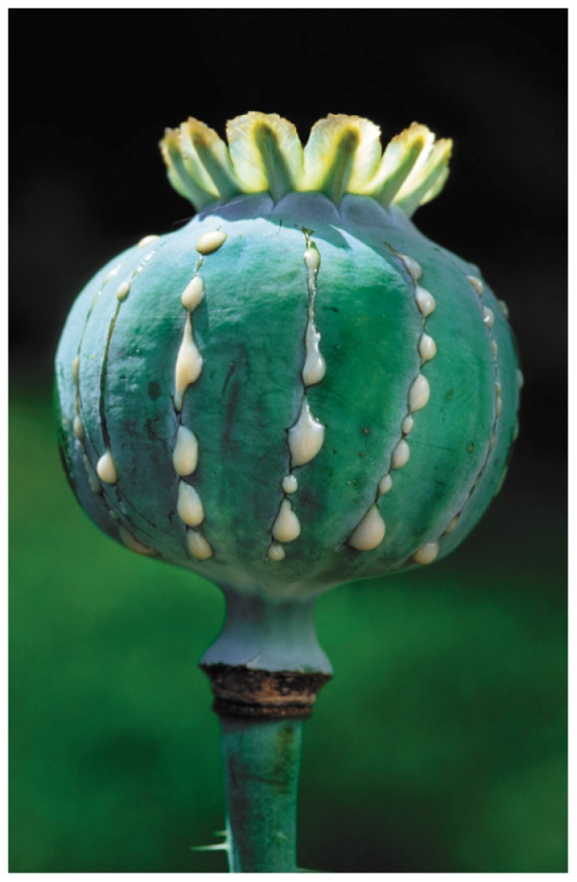
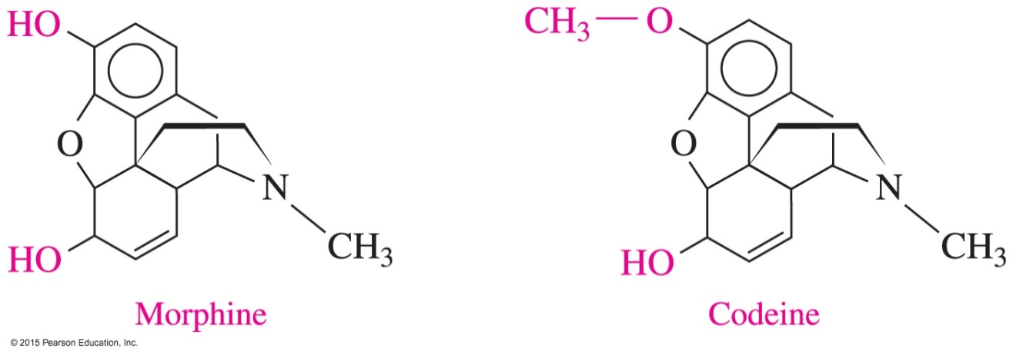
Chemistry Link to Health:
Alkaloids: Amines in Plants
80
Morphine and codeine are
alkaloids, obtained from the oriental poppy plant
used as painkillers

Slide 81
Learning Check
81
Draw the condensed structural formula, or line-angle formula if cyclic, for
A. methylpropylamine
B. 2-chloroaniline

Slide 82
Solution
82
Draw the condensed structural formula, or line-angle formula if cyclic, for
A. methylpropylamine CH₃ — CH₂ — CH₂ — NH — CH₃
B. 2-chloroaniline

Slide 83
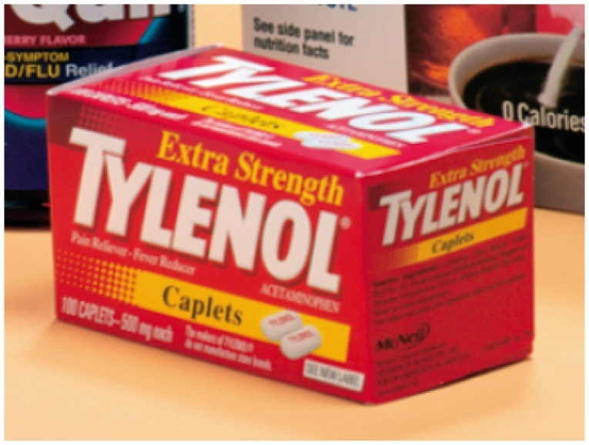
14.6 Amides
83
Tylenol, an aspirin substitute, contains acetaminophen. Acetaminophen is an amide. It acts to reduce fever and pain; however, it has little anti-inflammatory effect.
Learning Goal Write the IUPAC and common names for amides and draw the condensed structural or line-angle formulas for the products of formation and hydrolysis.

Slide 84

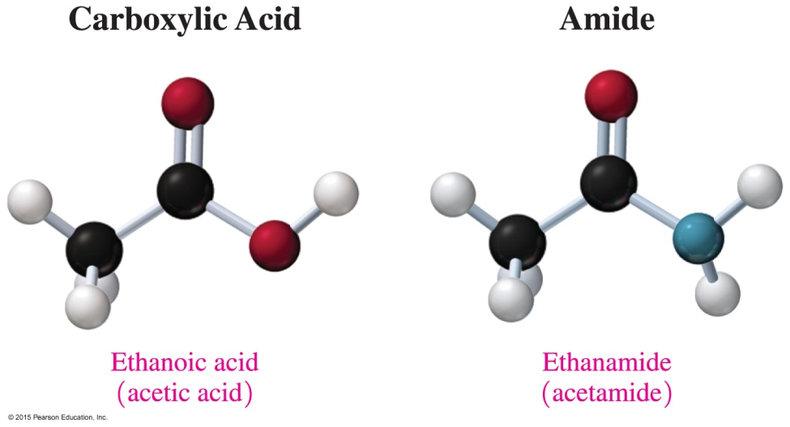
Amides
84
Amides are derivatives of carboxylic acids in which a nitrogen group (—NH₂) replaces the hydroxyl (—OH) group of carboxylic acids.

Slide 85
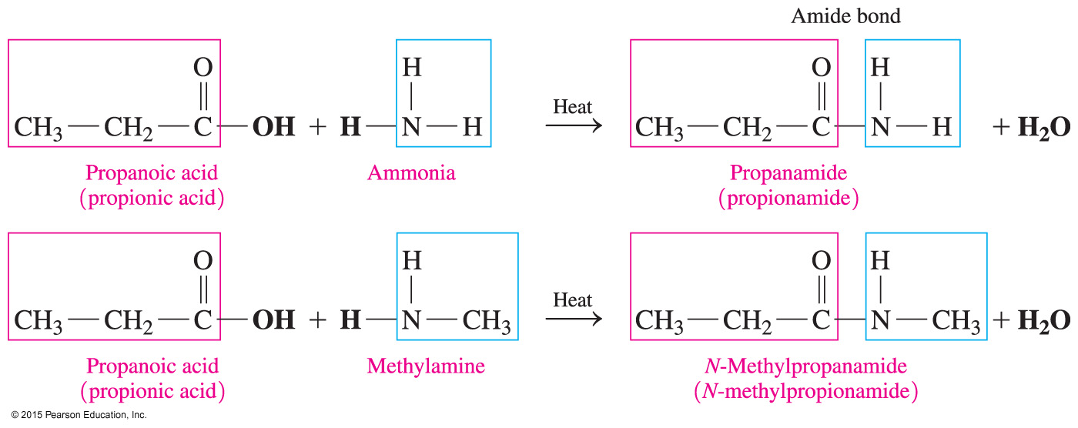
Preparation of Amides: Amidation
85
Amides are produced by reacting a carboxylic acid with ammonia, or a primary or a secondary amine, and heat.

Slide 86
Learning Check
86
Predict the product of the following amidation reaction:

Slide 87
Solution
87
Predict the product of the following amidation reaction:

Slide 88
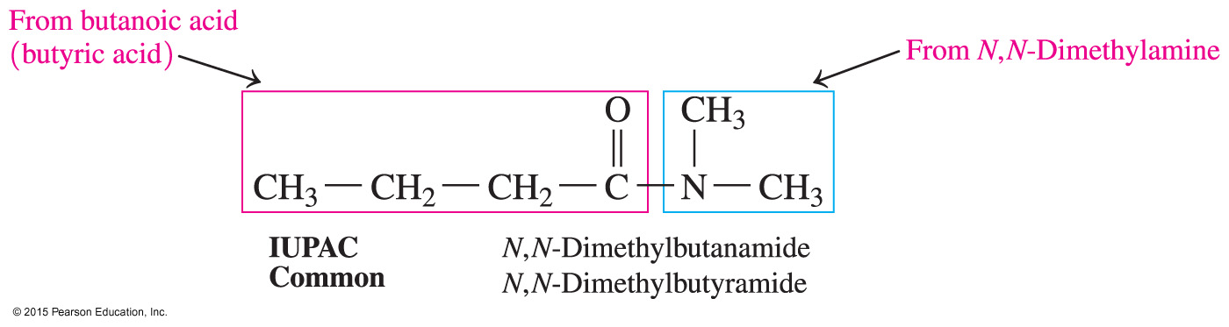
Naming Amides
88
In both the common and IUPAC names, amides are named by dropping the oic acid (IUPAC) or ic acid (common) from the carboxylic acid name and adding the suffix amide.
Alkyl groups attached to the nitrogen of an amide are named with the prefix N-, followed by the alkyl name.

Slide 89
Naming Amides
89
Write the IUPAC and common names for the following amide:
SOLUTION:
ANALYZE Given Need Connect
THE amide IUPAC
PROBLEM name
Replace oic acid or ic acid in acid name with amide, alkyl substituent has prefix N-

Slide 90
Naming Amides
90
Write the IUPAC and common names for the following amide:
STEP 1 Replace oic acid (IUPAC) or ic acid (common) in the carboxylic acid name with amide.
butanamide

Slide 91
Naming Amides
91
Write the IUPAC and common names for the following amide:
STEP 2 Name each substituent on the N atom using the prefix N- and the alkyl name.
N-methylbutanamide

Slide 92
Learning Check
92
Write the IUPAC and common names for the following amides:
A.
B.

Slide 93
Solution
93
Write the IUPAC and common names for the following amides:
A. ethanamide (IUPAC)
acetamide (common)
B.
N-ethylpropanamide (IUPAC)
N-ethylpropionamide (common)

Slide 94
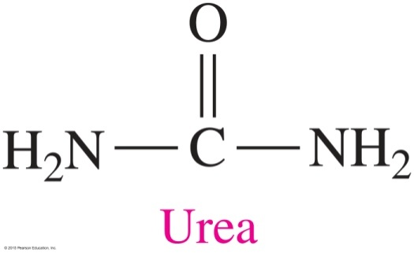
Chemistry Link to Health:
Amides in Health and Medicine
94
Urea is
the end product of protein metabolism
removed from the blood by the kidneys
excreted in the urine
If the kidneys malfunction, urea is not removed and builds to a toxic level, a condition called uremia.

Slide 95
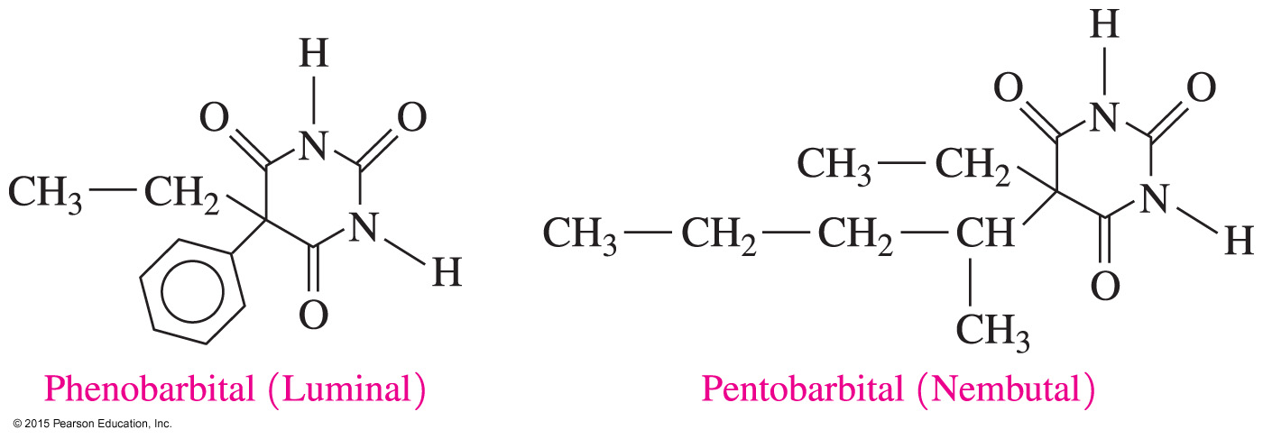
Chemistry Link to Health:
Amides in Health and Medicine
95
Many barbiturates
are cyclic amides of barbituric acid
act as sedatives in small doses or sleep inducers in large doses
are habit forming
Barbiturate drugs include phenobarbital (Luminal) and pentobarbital (Nembutal).

Slide 96
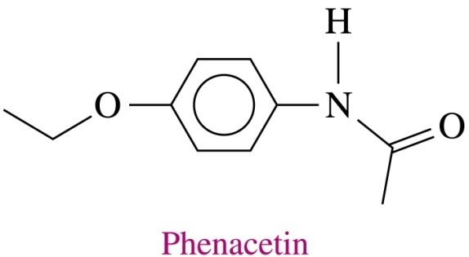
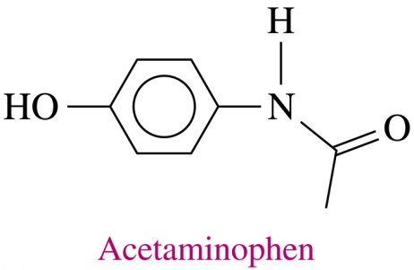
Chemistry Link to Health:
Amides in Health and Medicine
96
Aspirin substitutes
contain phenacetin or acetaminophen
act to reduce fever and pain but have little anti-inflammatory effect

Slide 97
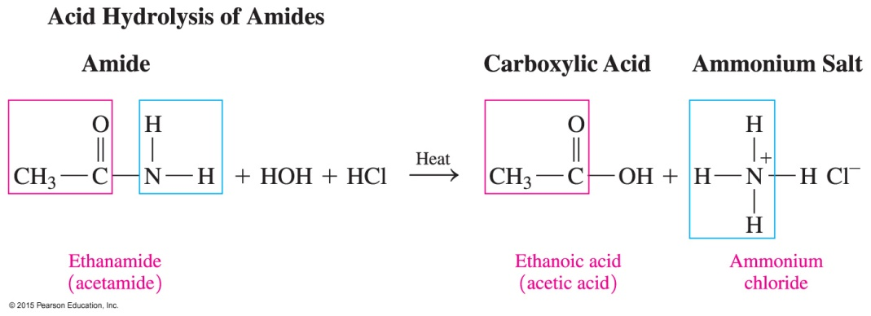
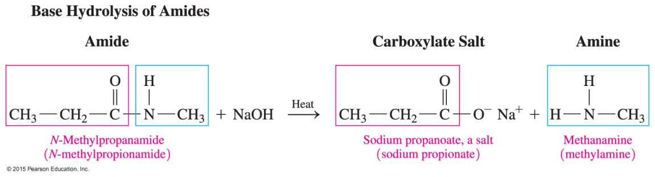
Hydrolysis of Amides
97
Amides undergo
acid hydrolysis to produce a carboxylic acid and an ammonium salt
base hydrolysis with heat to produce the salt of a carboxylic acid and an amine or ammonia

Slide 98
Base Hydrolysis of Amides
98
Draw the condensed structural formulas for the products from the hydrolysis of N-methylpentanamide with NaOH.
SOLUTION:
ANALYZE Given Need Connect
THE N-methylpentanamide products: carboxylate base hydrolysis
PROBLEM NaOH salt, amine of an amide

Slide 99
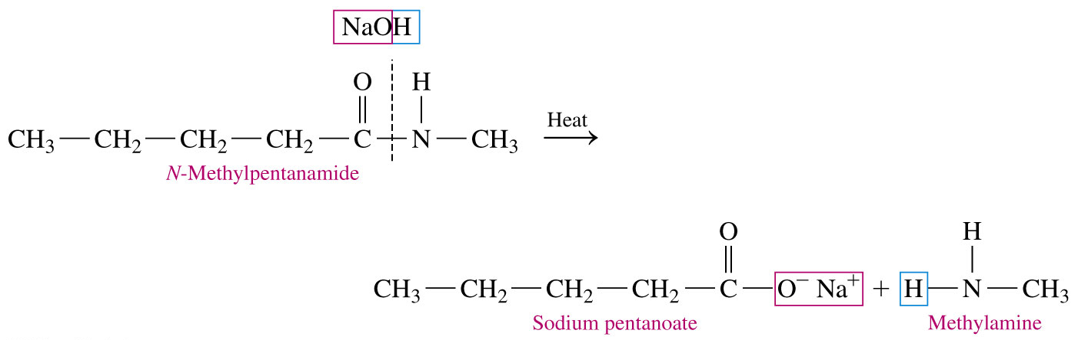
Base Hydrolysis of Amides
99
Draw the condensed structural formulas for the products from the hydrolysis of N-methylpentanamide with NaOH.
In the base hydrolysis of the amide, the amide bond is broken between the carboxyl carbon atom and the nitrogen atom. The products are the carboxylate salt and an amine

Slide 100
Learning Check
100
Draw the condensed structural formulas for the following:
A. pentanamide
B. N-ethylbenzamide

Slide 101
Solution
101
Draw the condensed structural formulas for the following:
A. pentanamide
B. N-ethylbenzamide

Slide 102

Carboxylic Acids, Esters, Amines, and Amides—Concept Map
102

