Slide 1
Karen Timberlake
CHEMISTRY
Thirteenth Edition, Global Edition
Chapter 5
Nuclear Chemistry
(Lecture PPTs)
© 2019 Pearson Education Ltd.

Slide 2
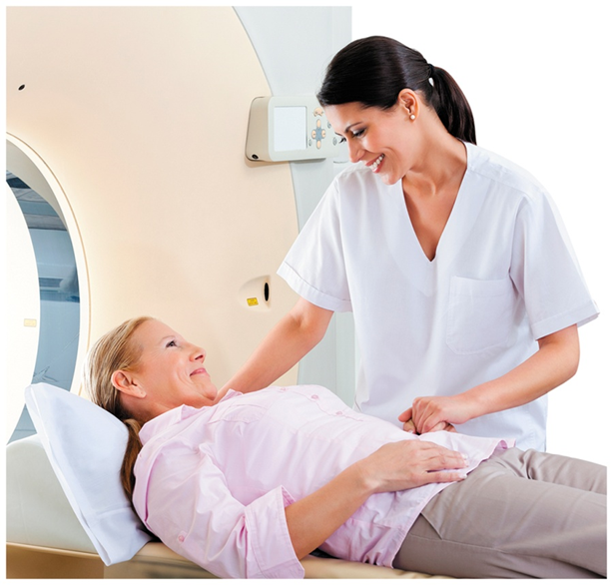
Chapter 5 Nuclear Chemistry
Radiation technologists work in hospitals or imaging centers where nuclear medicine is used to diagnose and treat a variety of medical conditions.

Slide 3
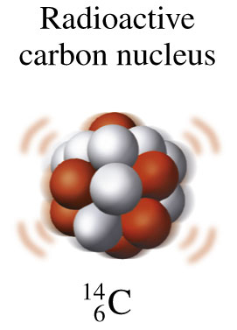
5.1 Natural Radioactivity
Unstable nuclei spontaneously emit small particles of energy called radiation to become more stable.
Learning Goal Describe alpha, beta, positron, and
gamma radiation.

Slide 4
Natural Radioactivity
Most naturally occurring isotopes of elements up to atomic number 19 have stable nuclei.
Elements with atomic numbers 20 and higher usually have one or more isotopes that have unstable nuclei in which the nuclear forces cannot offset the repulsions between the protons.
An unstable nucleus is radioactive, which means that it spontaneously emits small particles of energy called radiation to become more stable.

Slide 5
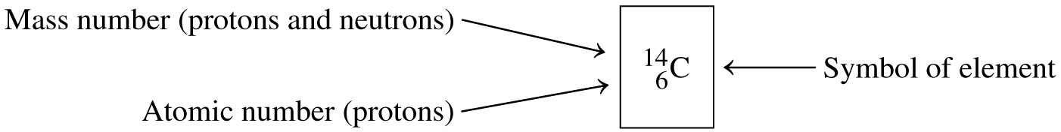
Radioisotopes
A radioisotope
has an unstable nucleus and emits radiation
can be one or more isotopes of an element
includes the mass number in its name
Carbon-14, a radioactive isotope of carbon that is used for archeological dating, has a mass number of 14 and an atomic number of 6.

Slide 6
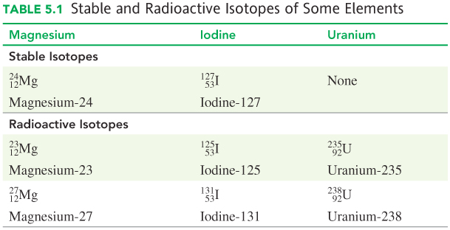
Stable and Radioactive Isotopes

Slide 7




Types of Radiation Emitted
Radioisotopes emit radiation such as
alpha (α) particles, identical to a helium nucleus
beta (β) particles, high-energy electrons
positrons (β⁺)
pure energy called gamma (γ) rays

Slide 8
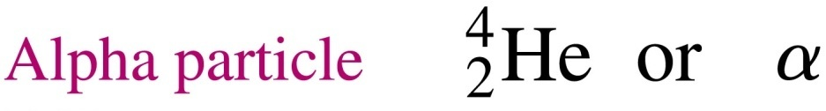
Alpha Particles
8
An alpha (α) particle
is identical to a helium nucleus
has 2 protons and 2 neutrons
has a mass number of 4
has a charge of 2+
has a low energy compared to other radiation particles

Slide 9
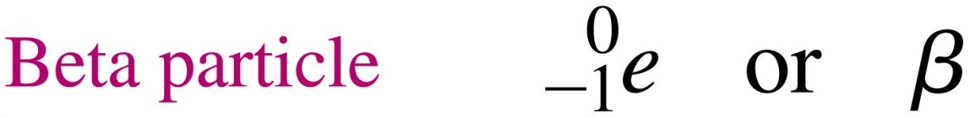
Beta Particles
9
A beta (β) particle
is a high-energy electron
has a mass number of 0
and a charge of 1−
forms in an unstable nucleus when a neutron changes into a proton and an electron

Slide 10

Positrons
A positron (β⁺)
has a mass number of 0
and a charge of 1+
forms in an unstable nucleus when a proton changes into a neutron and a positron

Slide 11

Gamma Rays
A gamma ray
is high-energy radiation
has a mass number of 0
and a charge of 0
is a form of energy emitted from an unstable nucleus to give a more stable, lower-energy nucleus

Slide 12
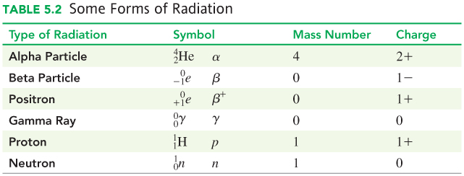
Some Forms of Radiation
12

Slide 13
Learning Check
Give the mass number and charge of each type of radiation.
A. alpha particle
B. positron
C. beta particle
D. neutron
E. gamma ray

Slide 14
Solution
Give the mass number and charge of each type of radiation.
Mass Number Charge
A. alpha particle 4 2+
B. positron 0 1+
C. beta particle 0 1−
D. neutron 1 0
E. gamma ray 0 0

Slide 15
Biological Effects of Radiation
15
Ionizing radiation strikes molecules in its path.
It damages the cells most sensitive to radiation: rapidly dividing cells in bone marrow, skin, and reproductive organs, and cancer cells.
Cancer cells are highly sensitive to radiation; large doses of radiation are used to destroy them.
The normal tissue around cancer cells divides at a slower rate and suffers less damage from radiation.
Radiation may cause malignant tumors, leukemia, anemia, and genetic mutations.

Slide 16
Radiation Protection
16
Radiation protection requires
paper and clothing for alpha particles
a lab coat or gloves for beta particles
a lead shield or thick concrete wall for gamma rays
limiting the amount of time spent near a radioactive source
increasing the distance from the source

Slide 17
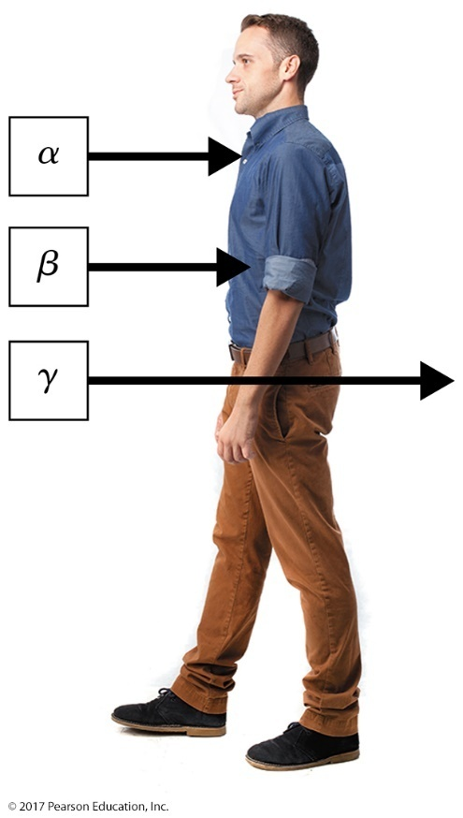
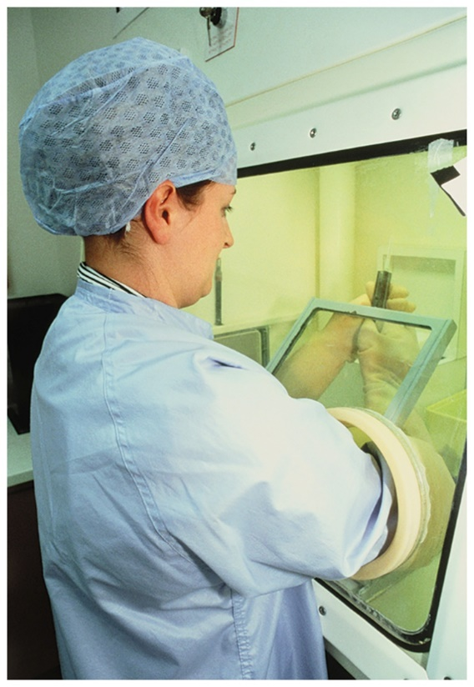
Radiation Protection
Different types of radiation penetrate the body to different depths.
In a nuclear pharmacy, a person working with radioisotopes wears protective clothing and gloves and uses a lead glass shield on a syringe.

Slide 18
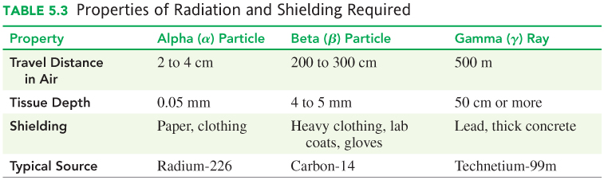
Radiation Protection
18

Slide 19
Learning Check
19
Indicate the type of radiation (alpha, beta, and/or gamma) protection for each type of shielding.
A. heavy clothing
B. paper
C. lead
D. lab coat
E. thick concrete

Slide 20
Solution
20
Indicate the type of radiation (alpha, beta, and/or gamma) protection for each type of shielding.
A. heavy clothing alpha, beta
B. paper alpha
C. lead alpha, beta, gamma
D. lab coat alpha, beta
E. thick concrete alpha, beta, gamma

Slide 21
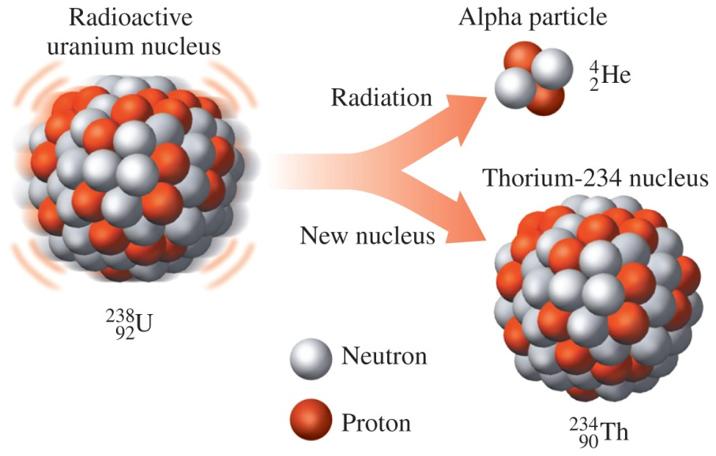
5.2 Nuclear Reactions
Nuclear equations use atomic symbols to show the changes in nuclear reactions.
Learning Goal Write a balanced nuclear equation for radioactive decay, showing mass numbers and atomic numbers.

Slide 22
Radioactive Decay
A process called radioactive decay
an unstable nucleus spontaneously breaks down by emitting radiation
is described by writing a nuclear equation
Radioactive nucleus → new nucleus + radiation
(α, β, β⁺, γ)

Slide 23
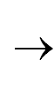
Nuclear Equations
In a balanced nuclear equation
the sum of the mass numbers on each side of the equation must be the same
the sum of the atomic numbers on each side of the equation must be the same
Mass number sum: 251 = 251
²⁵¹Cf ²⁴⁷Cm + ⁴He
98 96 2
Atomic number sum: 98 = 98

Slide 24
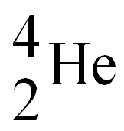
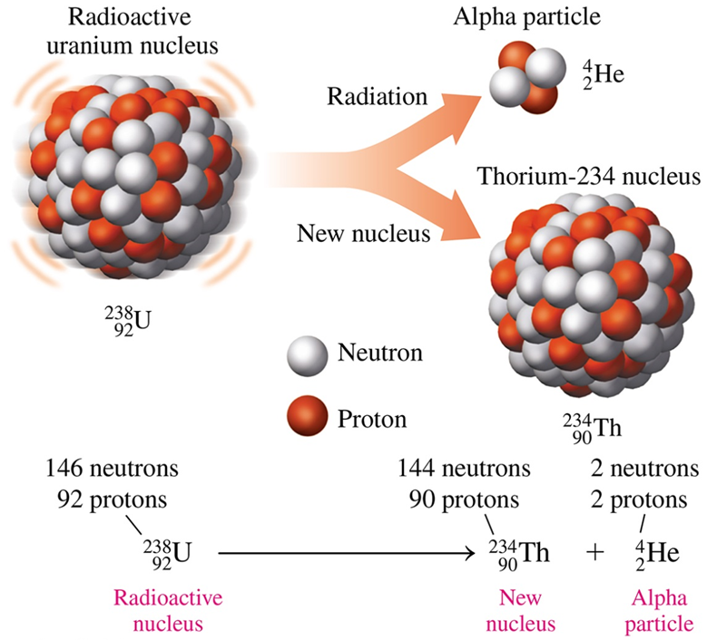
Alpha Decay
When a radioactive nucleus emits an alpha particle, a new nucleus forms with a mass number that is decreased by 4 and an atomic number that is decreased by 2.

Slide 25
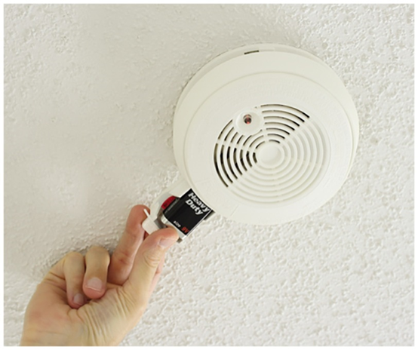
Writing an Equation for Alpha Decay
Example: Write the balanced nuclear equation for the alpha decay of americium-241, used in smoke detectors.

Slide 26


Writing an Equation for Alpha Decay
Example: Write the balanced nuclear equation for the alpha decay of americium-241.
STEP 1 Write the incomplete nuclear equation.

Slide 27
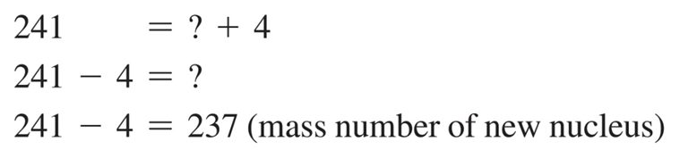
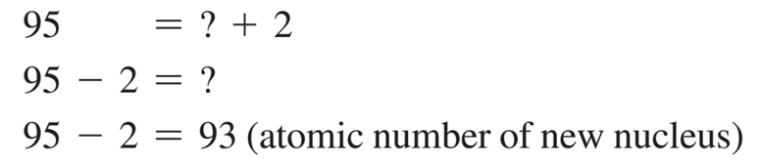
Writing an Equation for Alpha Decay
27
Example: Write the balanced nuclear equation for the alpha decay of americium-241.
STEP 3 Determine the missing atomic number.
STEP 2 Determine the missing mass number.

Slide 28

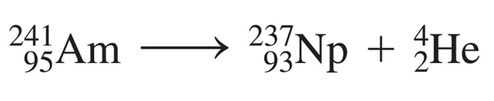
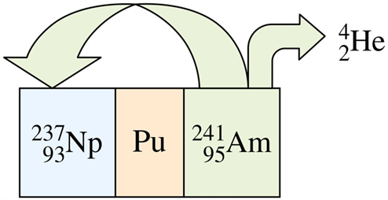
Writing an Equation for Alpha Decay
28
Example: Write the balanced nuclear equation for the alpha decay of americium-241.
STEP 5 Complete the nuclear equation.
STEP 4 Determine the symbol of the new nucleus. On the periodic table, the element that has atomic number 93 is neptunium, Np. The atomic symbol for this isotope of Np is written

Slide 29
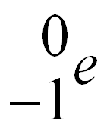
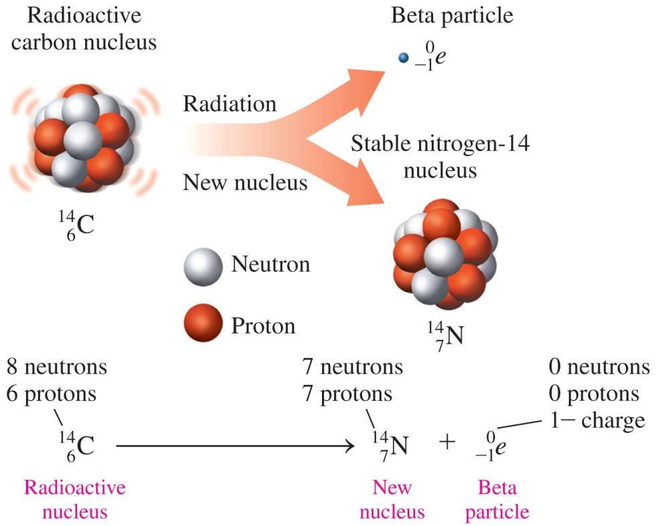
Beta Decay
A beta particle is an electron emitted from the nucleus when a neutron in the nucleus breaks down to form a proton and a beta particle, increasing the atomic number by 1.

Slide 30
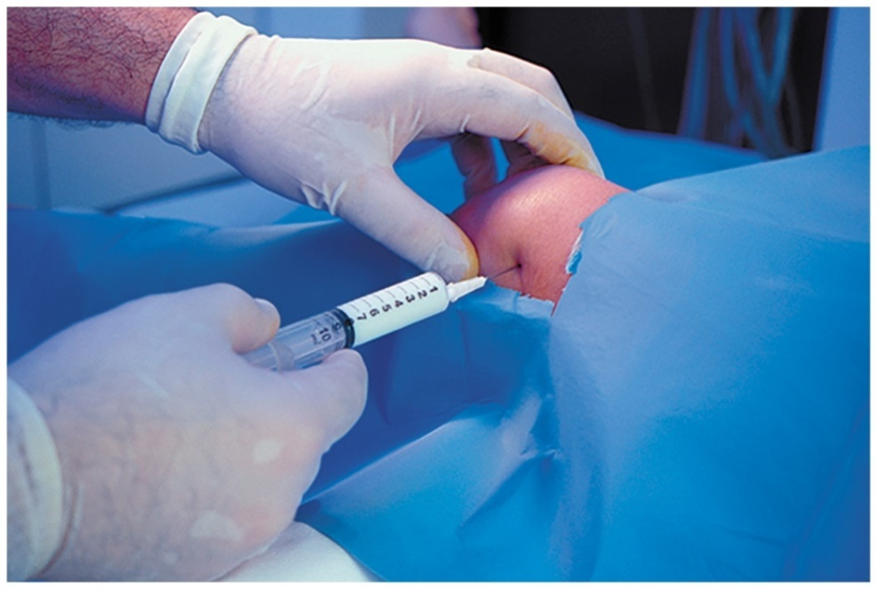
Writing an Equation for Beta Decay
Example: Write the balanced nuclear equation for the beta decay of yttrium-90, used in cancer treatment and as a colloidal injection into large joints to relieve the pain caused by arthritis.

Slide 31

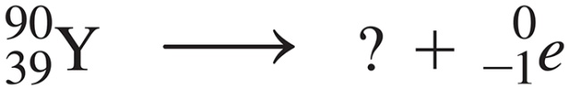
Writing an Equation for Beta Decay
Example: Write the balanced nuclear equation for the beta decay of yttrium-90.
STEP 1 Write the incomplete nuclear equation.

Slide 32
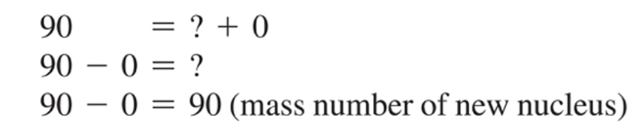
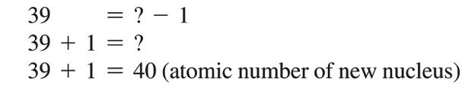
Writing an Equation for Beta Decay
Example: Write the balanced nuclear equation for the beta decay of yttrium-90.
STEP 3 Determine the missing atomic number.
STEP 2 Determine the missing mass number.

Slide 33
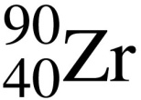
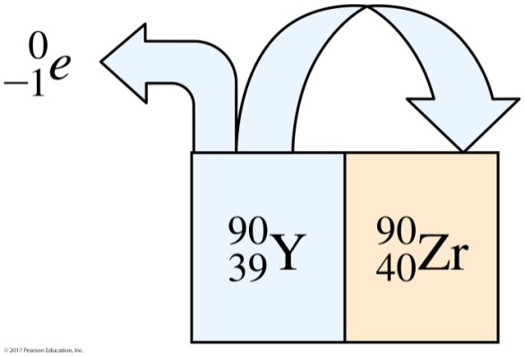
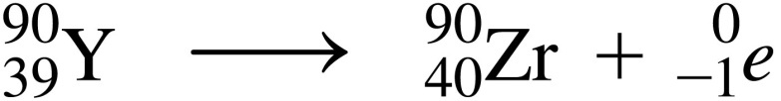
Writing an Equation for Beta Decay
Example: Write the balanced nuclear equation for the beta decay of yttrium-90.
STEP 5 Complete the nuclear equation.
STEP 4 Determine the symbol of the new nucleus. On the periodic table, the element that has atomic number 40 is zirconium (Zr). The atomic symbol for this isotope of Zr is written .

Slide 34
Learning Check
Write the balanced nuclear equation for the beta decay of cobalt-60.

Slide 35
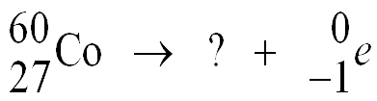
Solution
Write the balanced nuclear equation for the beta decay of cobalt-60.
STEP 1 Write the incomplete nuclear equation.
ANALYZE THE Given Need Connect
PROBLEM Co-60, balanced nuclear mass number, atomic beta decay equation number of new nucleus

Slide 36
Solution
Write the balanced nuclear equation for the beta decay of cobalt-60.
STEP 2 Determine the missing mass number.
60 = ? + 0
60 – 0 = ?
60 − 0 = 60 (mass number of new nucleus)
STEP 3 Determine the missing atomic number.
27 = ? − 1
27 + 1 = ?
27 + 1 = 28 (atomic number of new nucleus)

Slide 37
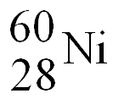
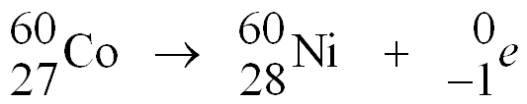
Solution
Write the balanced nuclear equation for the beta decay of cobalt-60.
STEP 4 Determine the symbol of the new nucleus. On the periodic table, the element that has atomic number 28 is nickel (Ni). The atomic symbol for this isotope of Ni is written
STEP 5 Complete the nuclear equation.
.

Slide 38
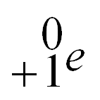
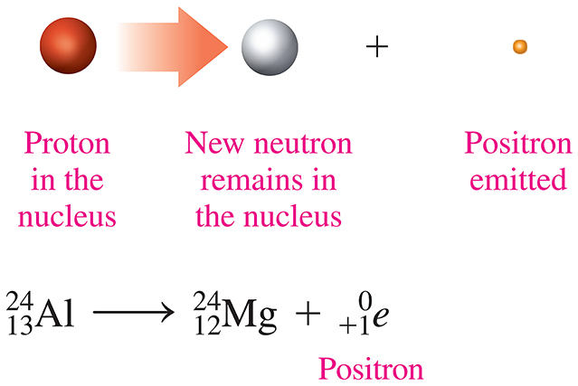
Positron Emission
In positron emission,
a proton is converted to a neutron and a positron
the mass number of the new nucleus is the same, but the atomic number decreases by 1

Slide 39
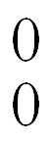
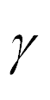

Gamma Emission
In gamma emission,
energy is emitted from an unstable nucleus, indicated by the symbol m following the mass number
the mass number and the atomic number of the new nucleus are the same

Slide 40
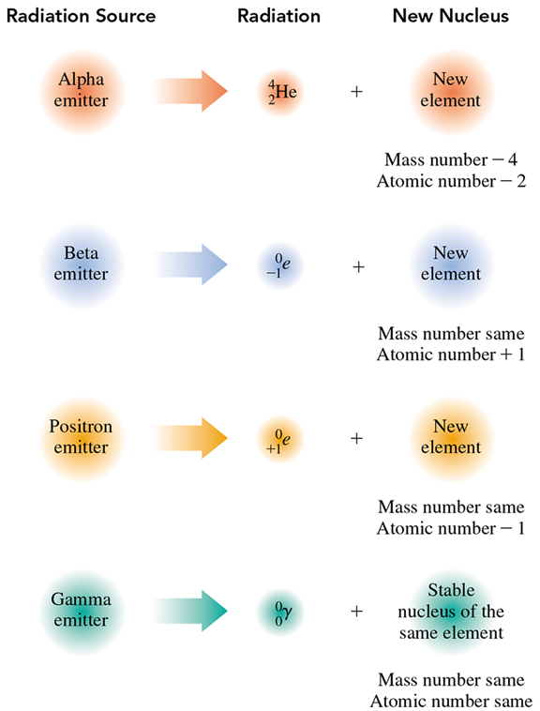
Summary of Radiation Types
When the nuclei of alpha, beta, positron, and gamma emitters emit radiation, new, more stable nuclei are produced.

Slide 41
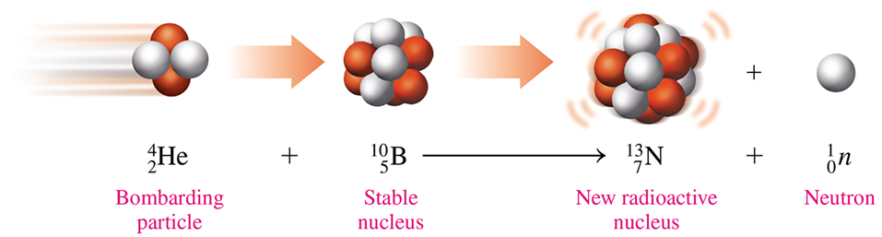
Producing Radioactive Isotopes
Today, many radioisotopes are produced in small amounts by bombarding stable, nonradioactive isotopes with high-speed particles such as alpha particles, protons, neutrons, and small nuclei.
When nonradioactive B-10 is bombarded by an alpha particle, the products are radioactive N-13 and a neutron.

Slide 42
Learning Check
Write the balanced nuclear equation for the bombardment of nickel-58 by a proton, which produces a radioactive isotope and an alpha particle.

Slide 43


Solution
Write the balanced nuclear equation for the bombardment of nickel-58 by a proton, which produces a radioactive isotope and an alpha particle.
STEP 1 Write the incomplete nuclear equation.

Slide 44
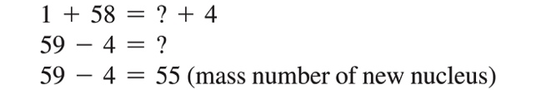
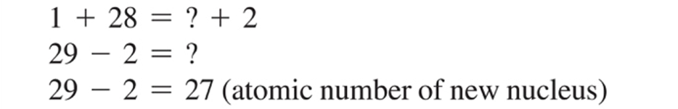
Solution
Write the balanced nuclear equation for the bombardment of nickel-58 by a proton, which produces a radioactive isotope and an alpha particle.
STEP 3 Determine the missing atomic number.
STEP 2 Determine the missing mass number.

Slide 45

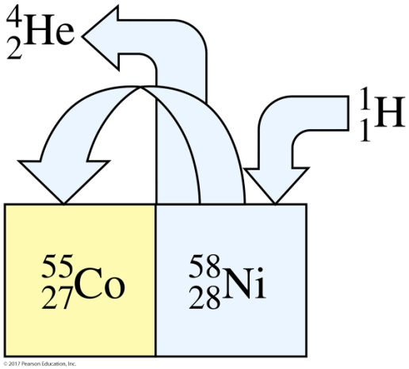
Solution
Write the balanced nuclear equation for the bombardment of nickel-58 by a proton, which produces a radioactive isotope and an alpha particle.
STEP 5 Complete the nuclear equation.
STEP 4 Determine the symbol of the new nucleus. On the periodic table, the element that has atomic number 27 is cobalt, Co. The atomic symbol for this isotope of Co is written

Slide 46
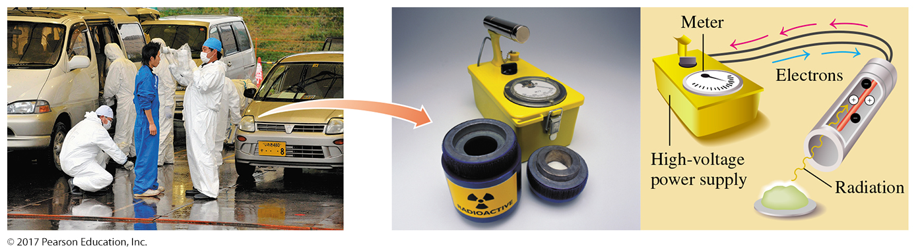
46
5.3 Radiation Measurement
A radiation counter is used to check radiation levels at the Fukushima Daiichi nuclear power plant.
Learning Goal Describe the detection and measurement of radiation.

Slide 47
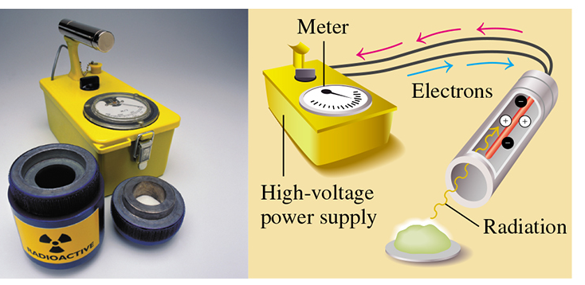
Geiger Counter
A Geiger counter is a common instrument that
detects beta and gamma radiation
uses ions produced by radiation to create an electrical current

Slide 48
Units for Measuring Radiation
Units for measuring radiation activity include the following:
curie (Ci)—the number of disintegrations that occurs in
1 s for 1 g of radium, equal to 3.7 × 10¹⁰ disintegrations/s
becquerel (Bq)—the SI unit of radiation activity, which is 1 disintegration/s
rad (radiation absorbed dose)—measures the amount of radiation absorbed by a gram of material such as body tissues
rem (radiation equivalent in humans)—measures biological effects of different kinds of radiation

Slide 49
Measuring Radiation Damage
The rem (radiation equivalent in humans) measures
alpha particles, which do not penetrate the skin; however, if they enter the body, extensive damage may occur in tissues
high-energy radiation, which causes more damage than alpha particles and includes beta particles, high-energy protons, and neutrons that travel into tissue
gamma rays, which are damaging because they travel a long way through body tissue

Slide 50
Measuring Radiation Damage
To determine the equivalent dose or rem dose,
the absorbed dose (rad) is multiplied by a factor that adjusts for biological damage caused by a particular form of radiation.
Biological damage (rem) = Absorbed dose (rad) × Factor
For beta and gamma radiation, the factor is 1.
For high-energy protons and neutrons, the factor is about 10.
For alpha particles, the factor is 20.

Slide 51
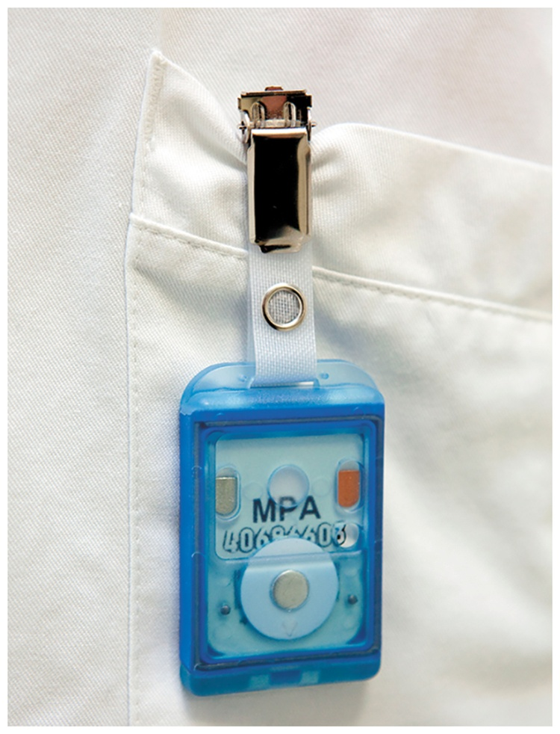
Dosimeters Measure Radiation Exposure
People who work in radiation laboratories wear dosimeters attached to their clothing.
Dosimeters detect the amount of radiation exposure from the following:
X-rays
gamma rays
beta particles

Slide 52
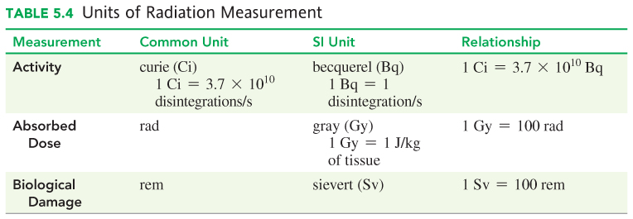
Units of Radiation Measurement
Often the measurement for an equivalent dose will be in millirems (mrem).
1 rem = 1000 mrem
The SI unit is the sievert (Sv).
1 Sv = 100 rem

Slide 53
Radiation Exposure
The average person in the United States is exposed to 3.6 mSv of radiation annually. Exposure to radiation occurs every day from naturally occurring radioisotopes in
buildings where we live and work
food and water
the air we breathe
Sources of naturally occurring isotopes include the following:
potassium-40 in potassium-containing foods
cosmic radiation from the Sun
Medical sources of radiation include X-rays and mammograms.

Slide 54
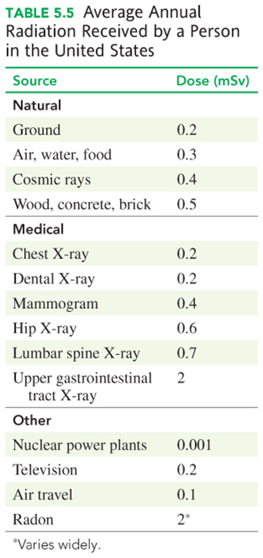
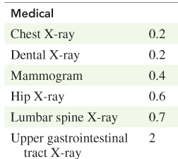
Average Annual Radiation Exposure in the United States

Slide 55
Radiation Sickness
Exposure to radiation
of less than 0.25 Sv usually cannot be detected
whole body exposure of 1 Sv produces a temporary decrease in the number of white cells
of greater than 1 Sv may induce radiation sickness, causing nausea, vomiting, fatigue, and reduced white-cell counts
Exposure to radiation of 5 SV is expected to cause death in 50% of the people receiving that dose.

Slide 56
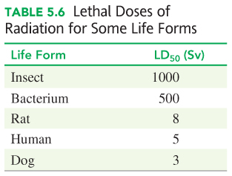
Lethal Doses of Radiation
The larger the dose of radiation received at one time, the greater the effect on the body.
Exposure to radiation of 5 Sv is expected to cause death in 50% of the people receiving the dose.
This amount of radiation to the whole body is called the lethal dose for one-half the population, or LD₅₀.
The LD₅₀ for different life forms

Slide 57
Chemistry Link to Health
Radiation and Food
Foodborne illnesses caused by pathogenic bacteria such as Salmonella, Listeria, and Escherichia coli have become major health concerns in the United States.
The U.S. Food and Drug Administration (FDA) has approved the use of 0.3 to 1 kGy of radiation produced by cobalt-60 or cesium-137 for the treatment of foods.
Cobalt pellets are placed in stainless steel tubes, arranged in racks. When food passes through a series of racks, gamma rays pass through the food and kill the bacteria.

Slide 58

Chemistry Link to Health
Radiation and Food
Currently, tomatoes, blueberries, strawberries, and mushrooms are being irradiated to allow them to be harvested when completely ripe and extend their shelf life.
(a) The FDA requires this symbol to appear on irradiated retail foods.
(b) After two weeks, the irradiated strawberries on the right show no spoilage. Mold is growing on the nonirradiated ones on the left.

Slide 59
Learning Check
Match each property (1 to 3) with its unit of measurement (A to D).
1. activity A. mrad
2. absorbed dose B. mrem
3. biological damage C. becquerel
D. Sv

Slide 60
Solution
Match each property (1 to 3) with its unit of measurement (A to D).
1. activity C. becquerel
2. absorbed dose A. mrad
3. biological damage B. mrem, D. Sv

Slide 61
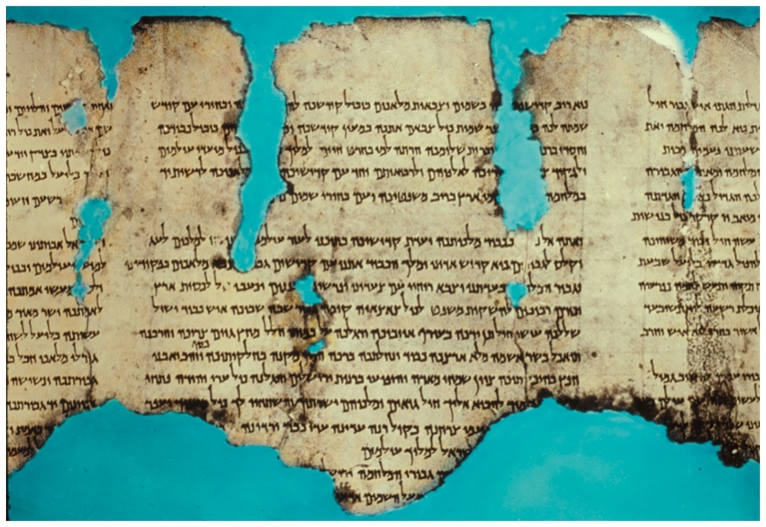
5.4 Half-Life of a Radioisotope
The age of the Dead Sea Scrolls was determined using carbon-14.
Learning Goal Given the half-life of a radioisotope, calculate the amount of radioisotope remaining after one or more half-lives.

Slide 62
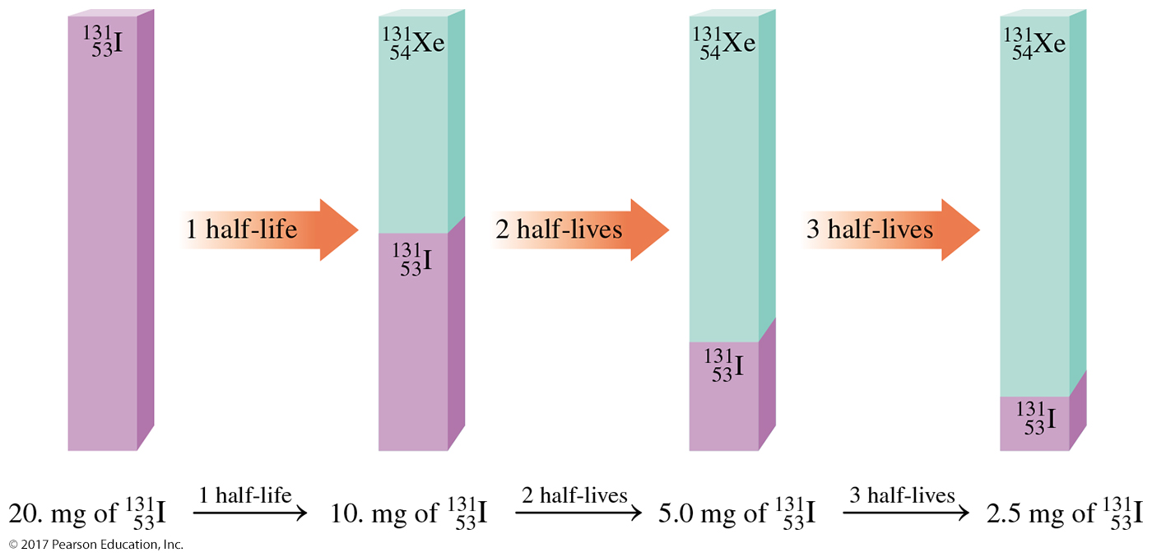
Half-Life of a Radioisotope
The half-life of a radioisotope is the time for the radiation level (activity) to decrease (decay) to one-half of its original value.

Slide 63
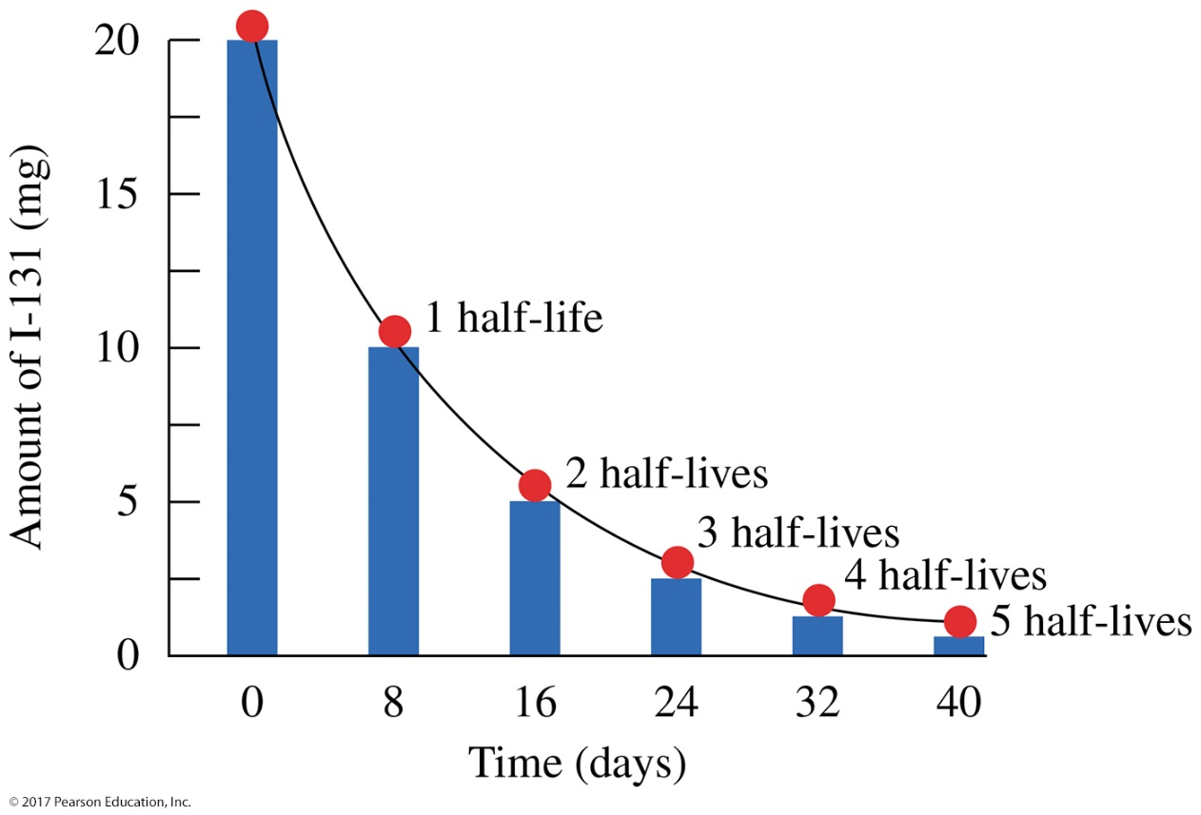
Decay Curve
A decay curve is a diagram illustrating the decay of a radioactive isotope.
The decay curve for iodine-131 shows that one-half of the radioactive sample decays and one-half remains radioactive after each half-life of 8 days.

Slide 64

Half-Lives of Radioisotopes

Slide 65
Using Half-Lives of a Radioisotope
Example: The radioisotope strontium-90 has a half-life of 38.1 yr. If a sample contains 36 mg of Sr-90, how many milligrams will remain after 114.3 yr?

Slide 66
Solution
Example: The radioisotope strontium-90 has a half-life of 38.1 yr. If a sample contains 36 mg of Sr-90, how many milligrams will remain after 114.3 yr?
STEP 1 State the given and needed quantities.
ANALYZE THE Given Need Connect
PROBLEM 36 mg of Sr-90, milligrams of Sr-90 number of
114.3 yr elapsed, remaining half-lives
half-life = 38.1 yr

Slide 67
Solution
Example: The radioisotope strontium-90 has a half-life of 38.1 yr. If a sample contains 36 mg of Sr-90, how many milligrams will remain after 114.3 yr?
STEP 2 Write a plan to calculate the unknown quantity.
years number of half-lives
mg of Sr-90 mg of Sr-90 remaining
Half-life
Number of half-lives

Slide 68
Solution
Example: The radioisotope strontium-90 has a half-life of 38.1 yr. If a sample contains 36 mg of Sr-90, how many milligrams will remain after 114.3 yr?
STEP 3 Write the half-life equality and conversion factors.

Slide 69
Solution
Example: The radioisotope strontium-90 has a half-life of
38.1 yr. If a sample contains 36 mg of Sr-90, how many milligrams will remain after 114.3 yr?
STEP 4 Set up the problem to calculate the needed quantity.

Slide 70
Learning Check
Iodine-123, used in the treatment of thyroid, brain, and prostate cancer, has a half-life of 13.2 h. How much of a 64-mg sample of I-123 is left after 26.4 hours?
A. 32 mg
B. 16 mg
C. 8.0 mg
D. 4.0 mg

Slide 71
Solution
Iodine-123, used in the treatment of thyroid, brain, and prostate cancer, has a half-life of 13.2 h. How much of a 64-mg sample of I-123 is left after 26.4 hours?
STEP 1 State the given and needed quantities.
ANALYZE THE Given Need Connect
PROBLEM 64 mg of I-123, milligrams of I-123 number of
26.4 h elapsed, remaining half-lives
half-life = 13.2 h

Slide 72
Solution
Iodine-123, used in the treatment of thyroid, brain, and prostate cancer, has a half-life of 13.2 h. How much of a 64-mg sample of I-123 is left after 26.4 hours?
STEP 2 Write a plan to calculate the unknown quantity.
years number of half-lives
mg of I-123 mg of I-123 remaining
Half-life
Number of half-lives

Slide 73
Solution
Iodine-123, used in the treatment of thyroid, brain, and prostate cancer, has a half-life of 13.2 h. How much of a 64-mg sample of I-123 is left after 26.4 hours?
STEP 3 Write the half-life equality and conversion factors.

Slide 74
Solution
Iodine-123, used in the treatment of thyroid, brain, and prostate cancer, has a half-life of 13.2 h. How much of a 64-mg sample of I-123 is left after 26.4 hours?
STEP 4 Set up the problem to calculate the needed quantity.
The answer is B.

Slide 75

Chemistry Link to the Environment
Dating Ancient Objects
Radiological dating is a technique used by geologists, archaeologists, and historians to determine the age of ancient objects.
The age of ancient objects is determined by measuring the amount of carbon-14 present.
The age of a bone sample from a skeleton can be determined by carbon dating.

Slide 76

Chemistry Link to the Environment
Dating Ancient Objects
Carbon-14 is produced in the upper atmosphere by the bombardment of nitrogen-14 by high-energy neutrons from cosmic rays.
Carbon-14 reacts with oxygen to form radioactive carbon dioxide which is absorbed by plants.

Slide 77

Chemistry Link to the Environment
Dating Ancient Objects
The uptake of carbon-14 in the CO₂ stops when the plant dies.
As the carbon-14 decays, the amount of radioactive carbon decreases.
In a process called carbon dating, scientists use the half-life of carbon-14 (5730 yr) to calculate the length of time since the plant died.

Slide 78

5.5 Medical Applications Using Radioactivity
78
Chapter 16 Lecture
Different radioisotopes are used to diagnose and treat a number of diseases.
Learning Goal Describe the use of radioisotopes in medicine.

Slide 79
79
Medical Applications of Radioisotopes
Radioisotopes with short half-lives are used in nuclear medicine because
the cells in the body do not differentiate between nonradioactive atoms and radioactive atoms
once incorporated into cells, the radioactive atoms are detected because they emit radiation, giving an image of an organ

Slide 80

Radioisotopes in Medicine
80

Slide 81
Learning Check
Which of the following radioisotopes are most likely to be used in nuclear medicine?
A. K-40 (half-life 1.3 × 10⁹ yr)
B. K-42 (half-life 12 h)
C. I-131 (half-life 8 days)

Slide 82
Solution
Which of the following radioisotopes are most likely to be used in nuclear medicine?
Radioisotopes with short half-lives are used in nuclear medicine.
A. K-40 (half-life 1.3 × 10⁹ yr) Not likely: half-life is too long.
B. K-42 (half-life 12 h) Short half-life, likely used.
C. I-131 (half-life 8 days) Short half-life, likely used.

Slide 83
83
Scans with Radioisotopes
After the patient receives a radioisotope,
the scanner moves slowly across the body above the region where the organ containing the radioisotope is located
the radiation technologist determines the level and location of radioactivity emitted by the radioisotope
the gamma rays emitted from the radioisotope can be used to expose a photographic plate, producing a scan of the organ

Slide 84


Scans with Radioisotopes
A thyroid scan shows the accumulation of radioactive iodine-131 in the thyroid.

Slide 85

Positron Emission Tomography (PET)
In positron emission tomography (PET),
positron emitters with short half-lives are combined with body substances such as glucose
positrons are used to study brain function, metabolism, and blood flow
These PET scans show a normal brain on the left and a brain affected by Alzheimer’s disease on the right.

Slide 86

Positron Emission Tomography (PET)
86
In positron emission tomography (PET),
positrons are emitted from positron emitters such as carbon-11, oxygen-15, nitrogen-13, and fluorine-18
positrons combine with electrons to produce gamma rays are detected by computerized equipment to create a three-dimensional image of the organ

Slide 87

Computed Tomography (CT)
87
In computed tomography (CT),
a computer monitors the absorption of 30 000 X-ray beams directed at successive layers of the target organ
based on the densities of the tissues and fluids in the organ, the differences in absorption of the X-rays provide a series of images of the organ
A CT scan shows a tumor (yellow) in the brain.

Slide 88

Magnetic Resonance Imaging (MRI)
88
Magnetic resonance imaging (MRI)
is an imaging technique that does not involve X-ray radiation
is the least invasive imaging method available
is based on the absorption of energy when protons in hydrogen atoms are excited by a strong magnetic field
works because the energy absorbed is converted to color images of the body
An MRI scan provides images of the heart and lungs.

Slide 89

89
5.6 Nuclear Fission and Fusion
In the 1930s, scientists bombarding U-235 with neutrons discovered that the U-235 nucleus splits into two smaller nuclei and produces a large amount of energy.
Learning Goal Describe the processes of nuclear fission
and fusion.

Slide 90
Nuclear Fission
90
In nuclear fission,
a large nucleus is bombarded with a small particle
the nucleus splits into smaller nuclei and several neutrons, releasing large amounts of energy, called atomic energy
When a neutron bombards U-235,
an unstable nucleus of U-236 undergoes fission (splits)
smaller nuclei are produced such as Kr-91 and Ba-142
the neutrons emitted have high energy and bombard more U-235 nuclei

Slide 91

Nuclear Fission
A typical reaction for nuclear fission is:

Slide 92
Missing Mass: E = mc²
92
If we could determine the mass of the products krypton, barium, and three neutrons, we would find that
their total mass is slightly less than the mass of the starting materials
the missing mass has been converted into an enormous amount of energy consistent with the famous equation derived by Albert Einstein: E = mc²

Slide 93

Chain Reaction
In a nuclear chain reaction, the fission of each uranium-235 atom produces three neutrons that cause the nuclear fission of more and more uranium-235 atoms.

Slide 94
Chain Reaction
94
A chain reaction occurs when
a critical mass of uranium undergoes fission
there is a rapid increase in the number of high-energy neutrons available to react with more uranium
To sustain a nuclear chain reaction, sufficient quantities of U-235 must provide a critical mass in which almost all the neutrons immediately collide with more U-235 nuclei

Slide 95

Nuclear Fusion
95
Nuclear fusion
occurs at extremely high temperatures (100 000 000 °C)
combines small nuclei into larger nuclei
releases large amounts of energy
occurs continuously in the Sun and stars

Slide 96

Nuclear Fusion
In a fusion reaction, large amounts of energy are produced as hydrogen isotopes combine to form helium. Less waste is produced in a fusion reaction than in a fission reaction.

Slide 97

Chemistry Link to Environment
Nuclear Power Plants
97
In nuclear power plants,
fission is used to produce energy
the quantity of U-235 is held below its critical mass
control rods in the reactor absorb neutrons to slow the fission process
the heat produced in the
fission process is used to make steam that drives a generator and produces electricity
Nuclear power plants supply about 20% of electricity in the United States.

Slide 98

Chemistry Link to Environment
Nuclear Power Plants
Heat from nuclear fission is used to generate electricity.

Slide 99
Learning Check
For each of the following, indicate whether it describes nuclear fission or nuclear fusion:
A. A nucleus splits.
B. Large amounts of energy are released.
C. Small nuclei form larger nuclei.
D. Hydrogen nuclei react.
E. Several neutrons are released.

Slide 100
Solution
For each of the following, indicate whether it describes nuclear fission or nuclear fusion:
A. A nucleus splits. fission
B. Large amounts of energy are released. fission and fusion
C. Small nuclei form larger nuclei. fusion
D. Hydrogen nuclei react. fusion
E. Several neutrons are released. fission

Slide 101
Learning Check
101
Supply the missing atomic symbol to complete the equation for the following nuclear fission reaction:

Slide 102
Solution
102
Supply the missing atomic symbol to complete the equation for the following nuclear fission reaction:

Slide 103

Concept Map

