Slide 1

Chapter 6
Ionic and Molecular Compounds
Pharmacy technicians work in hospitals, pharmacies, clinics, and long-term care facilities where they are responsible for the preparation and distribution of pharmaceutical medications based on a doctor’s orders.

Slide 2
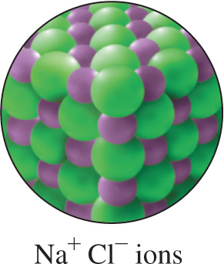
6.1 Ions: Transfer of Electrons
Atoms form positively charged
ions when they lose electrons and
negatively charged ions when
they gain electrons.
Ionic bonds are formed by the strong
attractive forces between positive and
negative ions.
Learning Goal Write the symbols for the simple ions of the representative elements.

Slide 3
Particles and Bonds in Compounds

Slide 4
Ionic and Covalent Bonds
Chemical bonds are formed when atoms lose, gain, or share valence electrons to acquire an octet of eight valence electrons (octet rule).
Ionic bonds occur when the valence electrons of atoms of a metal are transferred to atoms of a nonmetal.
Covalent bonds form when atoms of nonmetals share valence electrons.

Slide 5
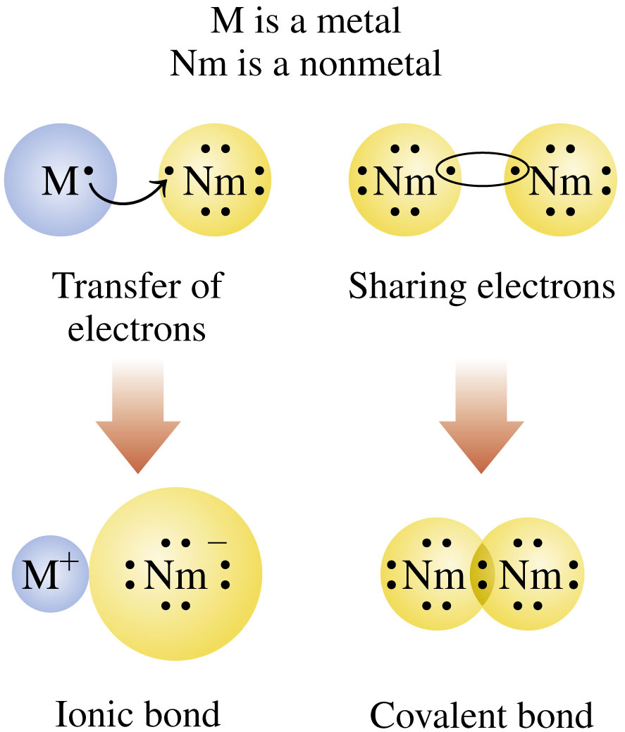
Ionic and Covalent Bonds

Slide 6
Positive Ions
In ionic bonding, ions form when atoms gain or lose their valence electrons to form a stable electron arrangement.
Metals—Group 1A (1), Group 2A (2), and Group 3A (13)—
have low ionization energies
readily lose one or more of their valence electrons to form ions with a positive charge
lose electrons until they have the same number of valence electrons as the nearest noble gas, usually eight valence electrons

Slide 7
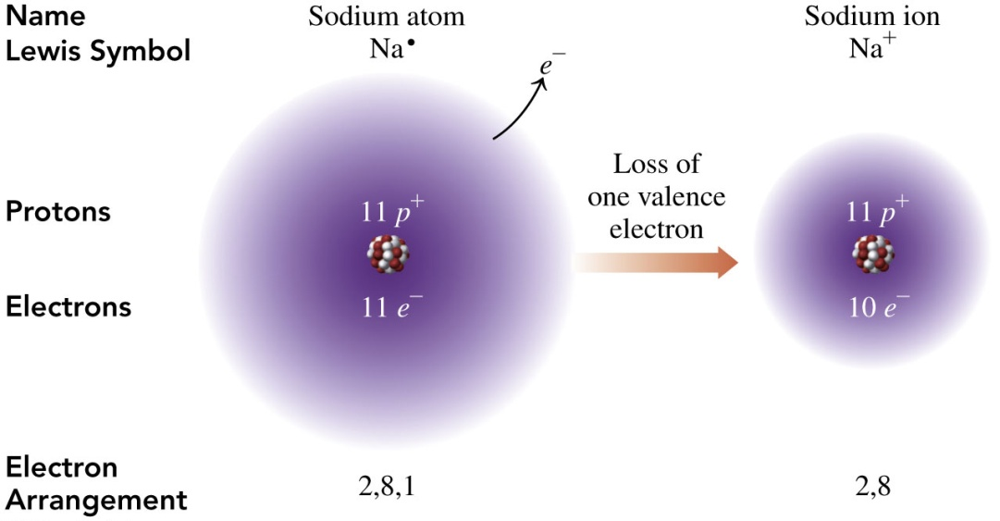
Positive Ions: Metals Lose Electrons
Sodium atoms in Group 1A (1) are neutral, with 11 electrons and 11 protons. They
lose one electron to have the same number of valence electrons as neon and a filled energy level
will form an ion with 10 electrons and 11 protons, and an ionic charge of 1+, Na⁺

Slide 8
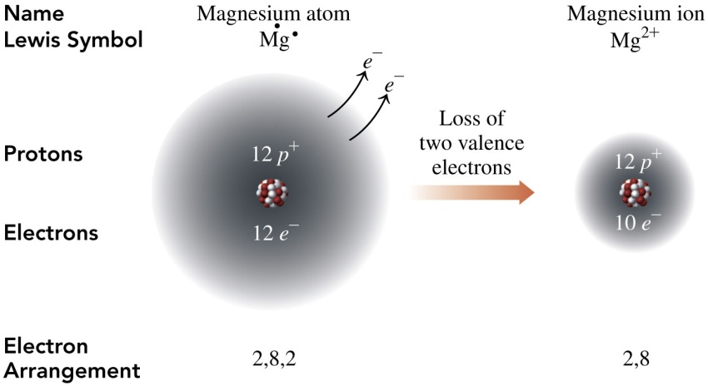
Positive Ions: Metals Lose Electrons
Magnesium atoms in Group 2A (2) are neutral, with 12 electrons and 12 protons. They
will lose two electrons to have the same number of valence electrons as neon and a filled energy level
form an ion with 10 electrons and 12 protons, and an ionic charge of 2+, Mg²⁺

Slide 9
Negative Ions: Nonmetals Gain Electrons
Nonmetals—Group 5A (15), Group 6A (16), and Group 7A (17)—
have high ionization energies
readily gain one or more valence electrons to form ions with a negative charge
gain electrons until they have the same number of valence electrons as the nearest noble gas, usually eight valence electrons

Slide 10
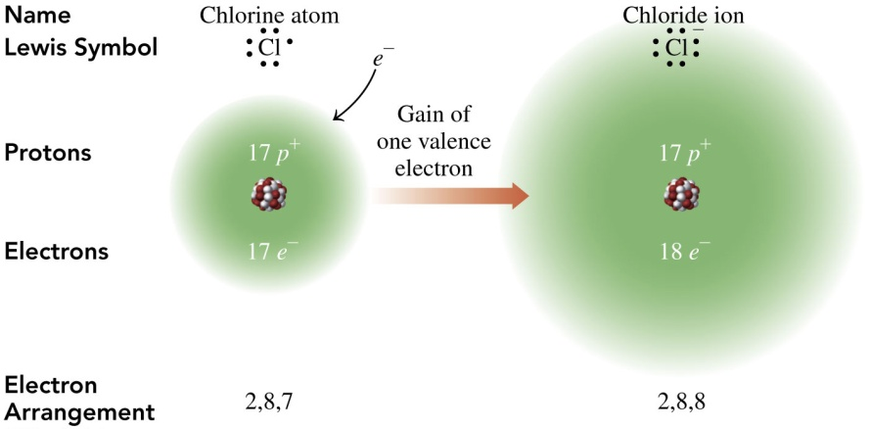
Negative Ions: Gain of Electrons
Chlorine atoms in Group 7A (17) are neutral, with 17 electrons and 17 protons. They
will gain one electron to have the same number of valence electrons as argon and a filled energy level
form an ion with 18 electrons and 17 protons, and an ionic charge of 1−, Cl⁻

Slide 11
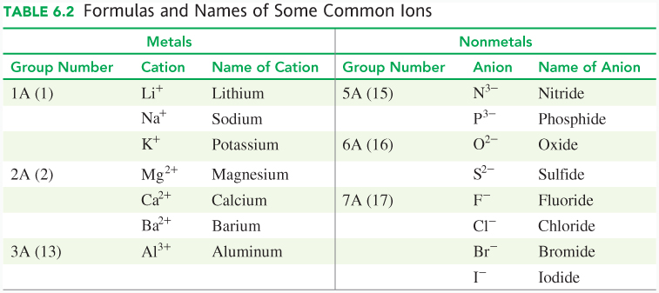
Formulas and Names of Common Ions

Slide 12
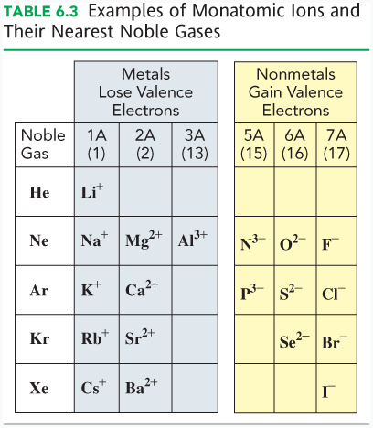
Ionic Charges from Group Numbers
We can use the group numbers in the periodic table to determine
the charges for the ions of the representative elements.

Slide 13
Chemistry Link to Health
Some Important Ions in the Body
Ions are important in regulating body functions.
Ion | Occurrence | Function | Source
Na⁺ | Principal cation outside the cell | Regulation and control of body fluids | Salt, cheese, pickles
K⁺ | Principal cation inside the cell | Regulation of body fluids and cellular functions | Bananas, potatoes, orange juice, milk
Ca²⁺ | Cation outside the cell; found in bones | Major cation of bones, needed for muscle contractions | Milk, yogurt, cheese, greens, spinach
Mg²⁺ | Cation outside the cell; found in bones | Essential for certain enzymes, muscles, nerve control | Chlorophyll, nuts, whole grains

Slide 14
Learning Check
Write the formula and symbol of an ion with 16 protons and
18 electrons.

Slide 15
Solution
Write the formula and symbol of an ion with 16 protons and
18 electrons.
The element with 16 protons is sulfur, with the symbol S.
An ion of sulfur with 18 electrons gives sulfur a charge of 2−.
The sulfide ion is S²⁻.

Slide 16
Learning Check
Consider the elements calcium and chlorine.
A. Identify each as a metal or a nonmetal.
B. State the number of valence electrons for each.
C. State the number of electrons that must be lost or gained for each to acquire an octet.
D. Write the symbol, including its ionic charge, and name of each resulting ion.

Slide 17
Solution
Consider the elements calcium and chlorine.
A. Identify each as a metal or a nonmetal.
calcium = metal chlorine = nonmetal
B. State the number of valence electrons for each.
Calcium in Group 2A (2) has two valence electrons.
Chlorine in Group 7A (17) has seven valence electrons.

Slide 18
Solution
Consider the elements calcium and chlorine.
C. State the number of electrons that must be lost or gained for each to acquire an octet.
Calcium will lose two electrons to acquire an octet.
Chlorine will gain one electron to acquire an octet.
D. Write the symbol, including its ionic charge, and name of each resulting ion.
Ca²⁺ calcium
Cl⁻ chloride

Slide 19
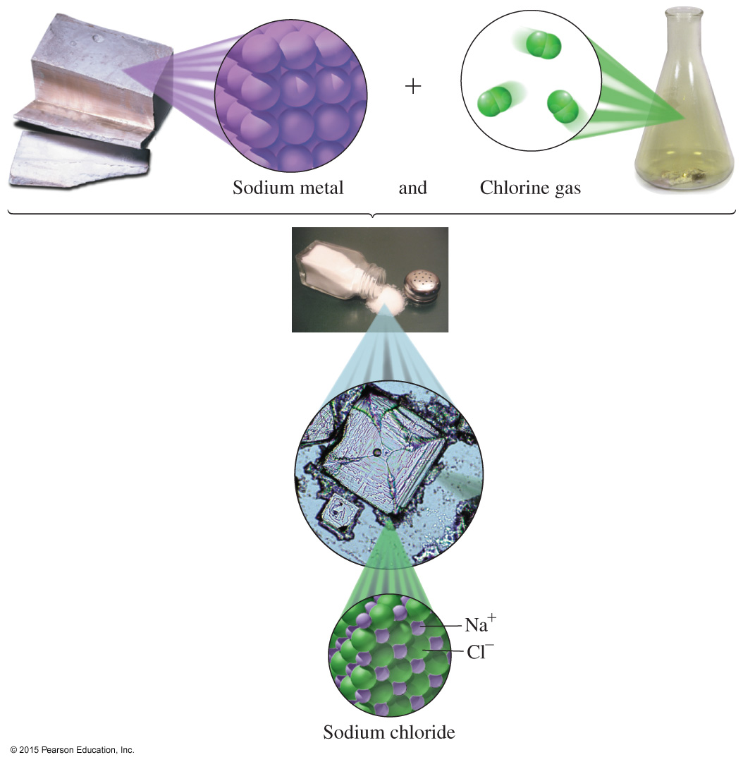
6.2 Ionic Compounds
The elements sodium and chlorine react to form the ionic compound sodium chloride, the compound that makes up table salt.
Learning Goal Using charge balance, write the correct
formula for an ionic compound.

Slide 20
Properties of Ionic Compounds
Ionic compounds
consist of positive and negative ions
have attractions called ionic bonds between positively and negatively charged ions
have high melting points
are solid at room temperature

Slide 21
NaCl, an Ionic Compound
Sodium chloride is more commonly known as table salt. The magnification of
NaCl crystals shows the arrangement of Na⁺ and
Cl⁻ ions in a NaCl crystal.

Slide 22
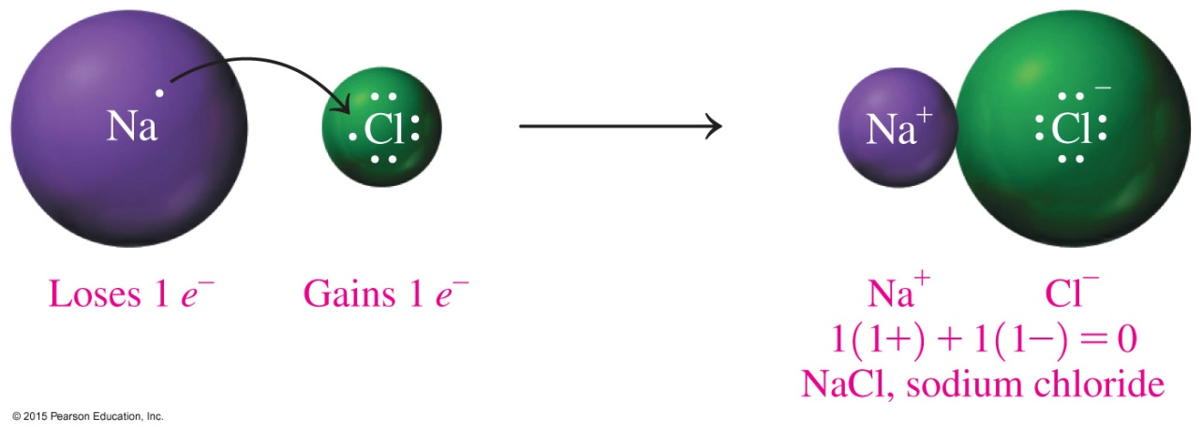
Formulas of Ionic Compounds
In a chemical formula,
the symbols and subscripts are written in the lowest whole-number ratio of the atoms or ions
of ionic compounds, the sum of ion charges equals zero
the total positive charge = total negative charge

Slide 23
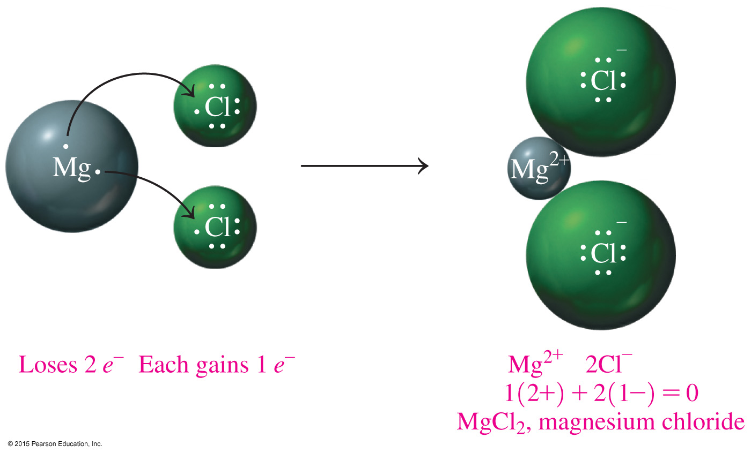
Subscripts in Formulas

Slide 24
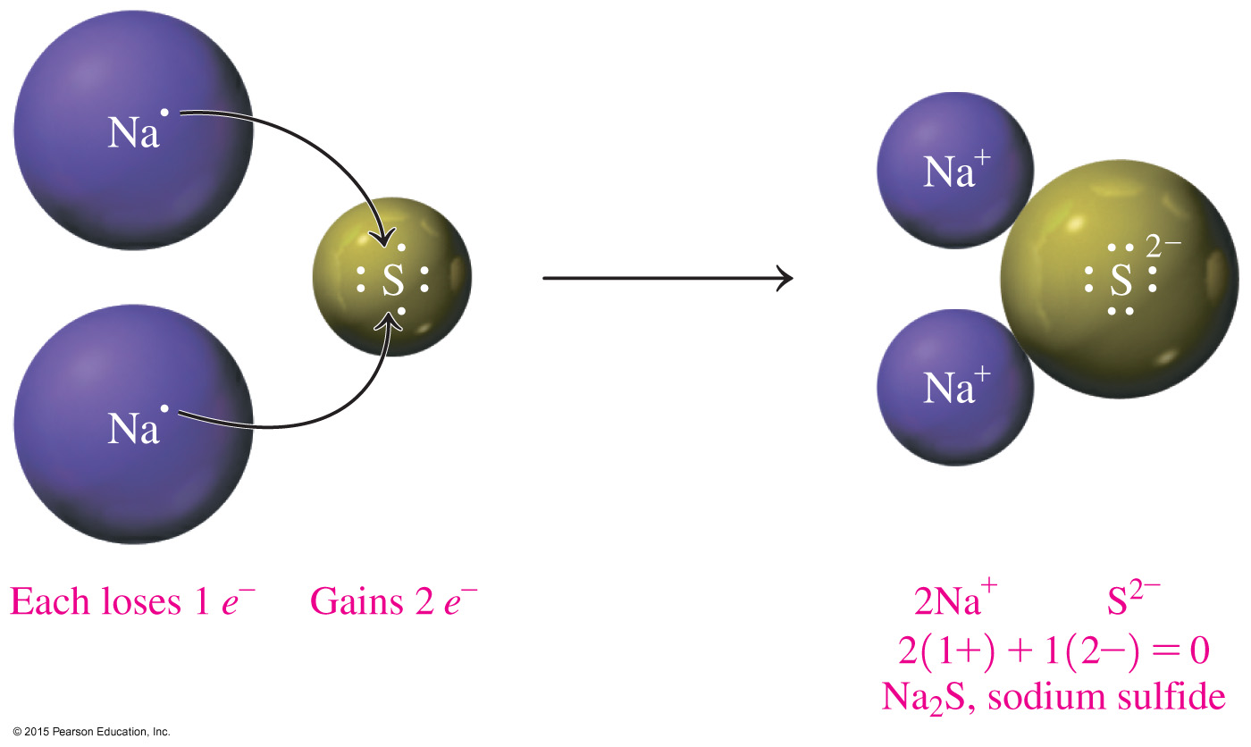
Writing Ionic Formulas from Ion Charges
To balance ionic charge in an ionic compound,
total positive charge = total negative charge

Slide 25
Learning Check
Write the ionic formula for the compound formed with Ba²⁺ and Cl⁻ ions.

Slide 26
Solution
Write the ionic formula for the compound formed with Ba²⁺ and Cl⁻ ions.
Write the symbols of the ions:
  Ba²⁺ Cl⁻
Balance the charges:
1(2+) + 2(1−) = 0
Writing the cation first and the anion second gives the
formula BaCl₂.

Slide 27
Learning Check
Select the correct formula for each of the following ionic compounds:
A. Na⁺ and O²⁻
(1) NaO (2) Na₂O (3) NaO₂
B. Al³⁺ and Cl⁻
(1) AlCl₃ (2) AlCl (3) Al₃Cl
C. Mg²⁺ and N³⁻
(1) MgN (2) Mg₂N₃ (3) Mg₃N₂

Slide 28
Solution
Select the correct formula for each of the following ionic compounds:
A. Na⁺ and O²⁻ (2) Na₂O
Check: 2Na⁺ + O²⁻ = 2(1+) + 1(2−) = 0
B. Al³⁺ and Cl⁻ (1) AlCl₃
Check: Al³⁺ + 3Cl⁻ = 1(3+) + 3(1−) = 0
C. Mg²⁺ and N³⁻ (3) Mg₃N₂
Check: 3Mg²⁺ + 2N³⁻ = 2(3+) + 2(3−) = 0

Slide 29
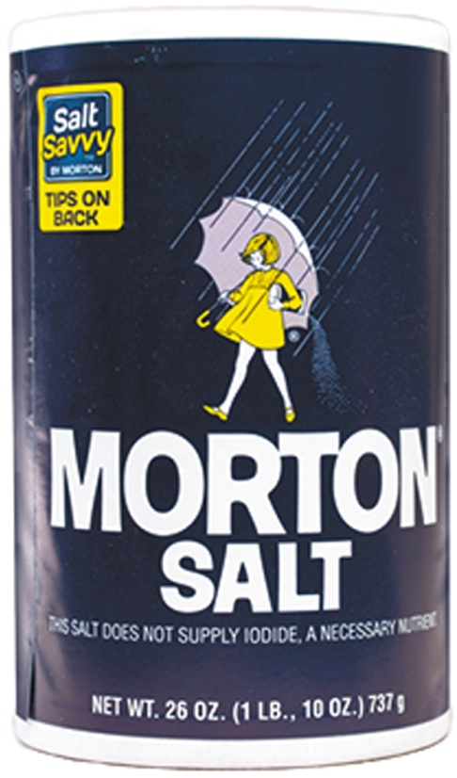
6.3 Naming and Writing Ionic Formulas
Iodized salt contains KI, potassium iodide, to prevent iodine deficiency.
Learning Goal Given the formula of an ionic compound,
write the correct name; given the name of an ionic compound,
write the correct formula.

Slide 30
Naming Ionic Compounds
When naming an ionic compound,
the name of the metal is written first and is the same as the name of the element
the name of the nonmetal is the first syllable of the nonmetal name + ide ending and is written second
a space is placed between the names of the metal and nonmetal ion

Slide 31
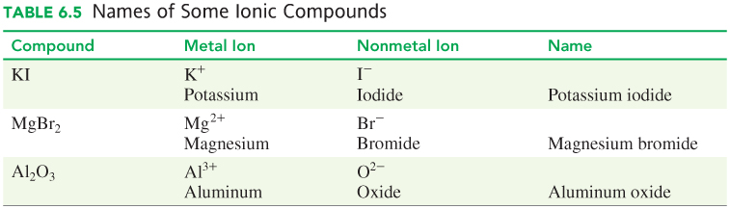
Names of Some Ionic Compounds

Slide 32
Naming Ionic Compounds
Example: Name the ionic compound K₂O.

Slide 33
Solution
Example: Name the ionic compound K₂O.
STEP 1 Identify the cation and anion.
The cation, K⁺, is from Group 1A (1), and the anion,
O²⁻, is from Group 6A (16).
STEP 2 Name the cation by its element name.
The cation, K⁺, is potassium.

Slide 34
Solution
Example: Name the ionic compound K₂O.
STEP 3 Name the anion by using the first syllable of its
element name followed by ide.
The anion, O²⁻, is oxide.
STEP 4 Write the name for the cation first and the
name for the anion second.
K₂O is potassium oxide.

Slide 35
Naming Ionic Compounds
Example: Write the names for the following compounds:
A. CaO ___________
B. Al₂S₃ ___________
C. MgCl₂ ___________

Slide 36
Solution
Example: Write the names for the following compounds:
STEP 1 Identify the cation and anion.
A. CaO: The cation, Ca²⁺, is from Group 2A (2),
and the anion, O²⁻, is from Group 6A (16).
B. Al₂S₃: The cation, Al³⁺, is from Group 3A (13), and the anion, S²⁻, is from Group 6A (16).
C. MgCl₂: The cation, Mg²⁺, is from Group 2A (2),
and the anion, Cl⁻, is from Group 7A (17).

Slide 37
Solution
Example: Write the names for the following compounds:
STEP 2 Name the cation by its element name.
A. CaO The cation, Ca²⁺, is calcium.
B. Al₂S₃ The cation, Al³⁺, is aluminum.
C. MgCl₂ The cation, Mg²⁺, is magnesium.

Slide 38
Solution
Example: Write the names for the following compounds:
STEP 3 Name the anion by using the first syllable of
its element name followed by ide.
A. CaO The anion, O²⁻, is oxide.
B. Al₂S₃ The anion, S²⁻, is sulfide.
C. MgCl₂ The anion, Cl⁻, is chloride.

Slide 39
Solution
Example: Write the names for the following compounds:
STEP 4 Write the name for the cation first and the name
for the anion second.
A. The name of CaO is calcium oxide.
B. The name of Al₂S₃ is aluminum sulfide.
C. The name of MgCl₂ is magnesium chloride.

Slide 40

Learning Check
Write the formulas and names for compounds of the
following ions:
Br⁻ S²⁻ N³⁻
Na⁺
Al³⁺

Slide 41

Solution
Write the formulas and names for compounds of the
following ions:
Br⁻ S²⁻ N³⁻
NaBr Na₂S Na₃N
Na⁺ sodium bromide sodium sulfide sodium nitride
AlBr₃ Al₂S₃ AlN
Al³⁺ aluminum aluminum aluminum
bromide sulfide nitride

Slide 42
Metals with Variable Charges
Transition elements except for Zn²⁺, Cd²⁺, and Ag⁺ form two or more positive ions (cations). We say they have variable charge.
A Roman numeral equal to the ion charge is placed in parentheses immediately after the metal name.
Cu²⁺ copper(II) Pb²⁺ lead(II)
Cu⁺ copper(I) Pb⁴⁺ lead(IV)
Fe²⁺ iron(II) Cr²⁺ chromium(II)
Fe³⁺ iron(III) Cr³⁺ chromium(III)

Slide 43
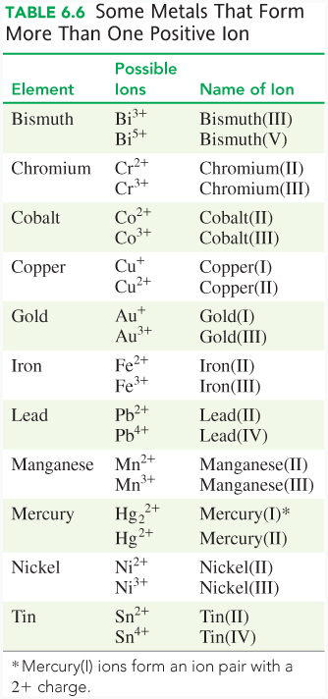
Metals with Variable Charges

Slide 44
Determination of Variable Charge
Use the charge on the anion and charge balance to calculate charge on the metal ion.
MnF₂
Mn charge + 2 F⁻ charge = 0
1(?) + 2(1−) = 0
? = 2+
Therefore, the name of MnF₂ is manganese(II) fluoride.

Slide 45
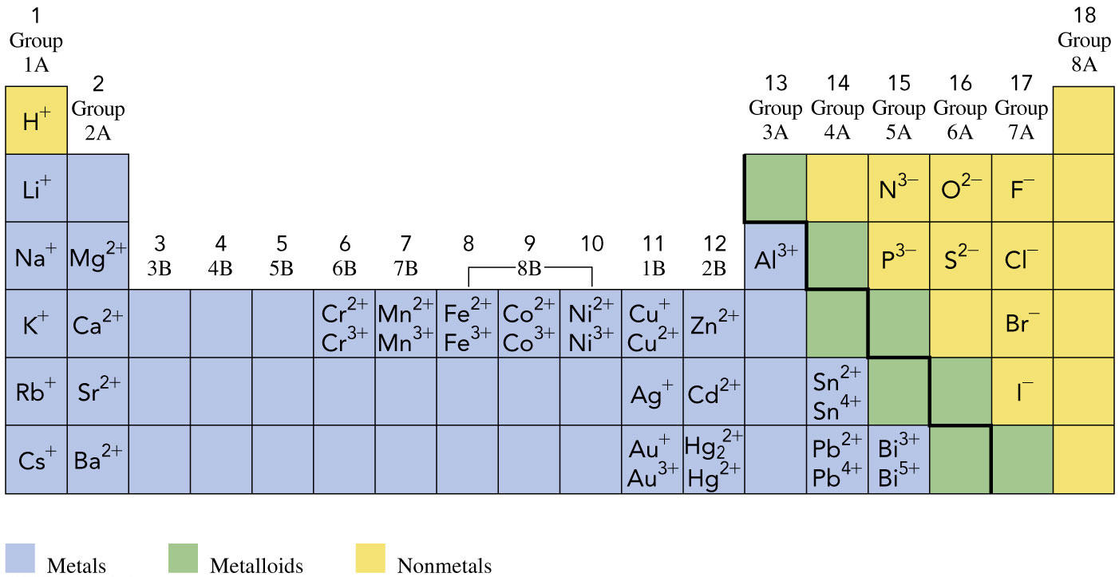
Ion Charges: Periodic Table

Slide 46
Naming Ionic Compounds with Variable Charge Metals
Example: Name the ionic compound FeCl₂.

Slide 47
Solution
Example: Name the ionic compound FeCl₂.
STEP 1 Determine the charge of the cation from the anion.
Metal Nonmetal
ANALYZE THE Element iron (Fe) chlorine (Cl) PROBLEM Group transition element Group 7A (17) Ion Fe? Cl⁻
Charge Balance 1Fe? + 2(1−) = 0
? = 2+
Ion Fe²⁺ Cl⁻

Slide 48
Solution
Example: Name the ionic compound FeCl₂.
STEP 2 Name the cation by its element name and use a Roman numeral in parentheses for the charge.
iron(II)
STEP 3 Name the anion by using the first syllable of its element name followed by ide. chloride
STEP 4 Write the name for the cation first and the name for the anion second. iron(II) chloride

Slide 49
Learning Check
Name the following ionic compound containing a variable charge metal: MnO₂

Slide 50
Solution
Name the following ionic compound containing a variable charge metal: MnO₂
STEP 1 Determine the charge of the cation from the anion.
Metal Nonmetal
ANALYZE THE Element manganese (Mn) oxygen (O) PROBLEM Group transition element Group 6A (16) Ion Mn? O²⁻
Charge Balance 1Mn? + 2(2−) = 0
? = 4+
Ion Mn⁴⁺ O²⁻

Slide 51
Solution
Name the following ionic compound containing a variable charge metal: MnO₂
STEP 2 Name the cation by its element name and use a
Roman numeral in parentheses for the charge.
manganese(IV)
STEP 3 Name the anion by using the first syllable of its element name followed by ide. oxide
STEP 4 Write the name for the cation first and the name for the anion second. manganese(IV) oxide

Slide 52
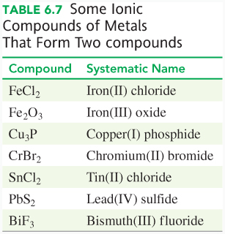
Writing Formulas from the Name of an Ionic Compound
The formula for an ionic
compound is written from
the first part of the
name that describes the metal ion
the second part of the
name that specifies the nonmetal ion
Subscripts are added, to
balance the charge.

Slide 53
Writing Formulas from the Name of an Ionic Compound
Example: Write the formula for tin(II) chloride.

Slide 54
Solution
Example: Write the formula for tin(II) chloride.
STEP 1 Identify the cation and anion.
Type of Ion Cation Anion
ANALYZE THE Name tin(II) chloride
PROBLEM Group transition element Group 7A (17)
Symbol of Ion Sn²⁺ Cl⁻

Slide 55
Solution
Example: Write the formula for tin(II) chloride.
STEP 2 Balance the charges.
Sn²⁺ Cl⁻
Cl⁻
1(2+) + 2(1−) = 0
STEP 3 Write the formula, cation first, using subscripts from the charge balance. SnCl₂
Becomes the subscript in the chemical formula.

Slide 56
Learning Check
Write chemical formulas for the following compounds:
A. nickel(II) sulfide
B. zinc chloride
C. iron(III) oxide

Slide 57
Solution
Write chemical formulas for the following compounds:
STEP 1 Identify the cation and anion.
A. nickel(II) sulfide
The Roman numeral (II) indicates that the charge
on the nickel ion is 2+, Ni²⁺.
B. zinc chloride
Zinc is one of the transition elements with a fixed
charge of 2+, Zn²⁺.
C. iron(III) oxide
The Roman numeral (III) indicates that the charge
on the iron ion is 3+, Fe³⁺.

Slide 58
Solution
Write chemical formulas for the following compounds:
STEP 2 Balance the charges.
A. nickel(II) sulfide C. iron(III) oxide
Ni²⁺ S²⁻ Fe³⁺ O²⁻ 1(2+) + 1(2−) = 0 Fe³⁺ O²⁻
O²⁻
B. zinc chloride 2(3+) + 3(2−) = 0
Zn²⁺ Cl⁻
Cl⁻
1(2+) + 2(1−) = 0

Slide 59
Solution
Write chemical formulas for the following compounds:
STEP 3 Write the formula, cation first, using subscripts from the charge balance.
A. nickel(II) sulfide, NiS
B. zinc chloride, ZnCl₂
C. iron(III) oxide, Fe₂O₃

Slide 60
6.4 Polyatomic Ions
Aluminum hydroxide, Al(OH)₃, is an antacid used to treat acid indigestion.
Learning Goal Write the name and formula for an ionic compound containing a polyatomic ion.

Slide 61
Polyatomic Ions
Polyatomic ions
are a group of atoms with an overall charge
often consist of a nonmetal such as phosphorus, sulfur,
carbon, or nitrogen covalently bonded to oxygen atoms
usually have a 1−, 2−, or 3− charge
have a negative charge except for NH₄⁺, ammonium, which has a positive charge

Slide 62
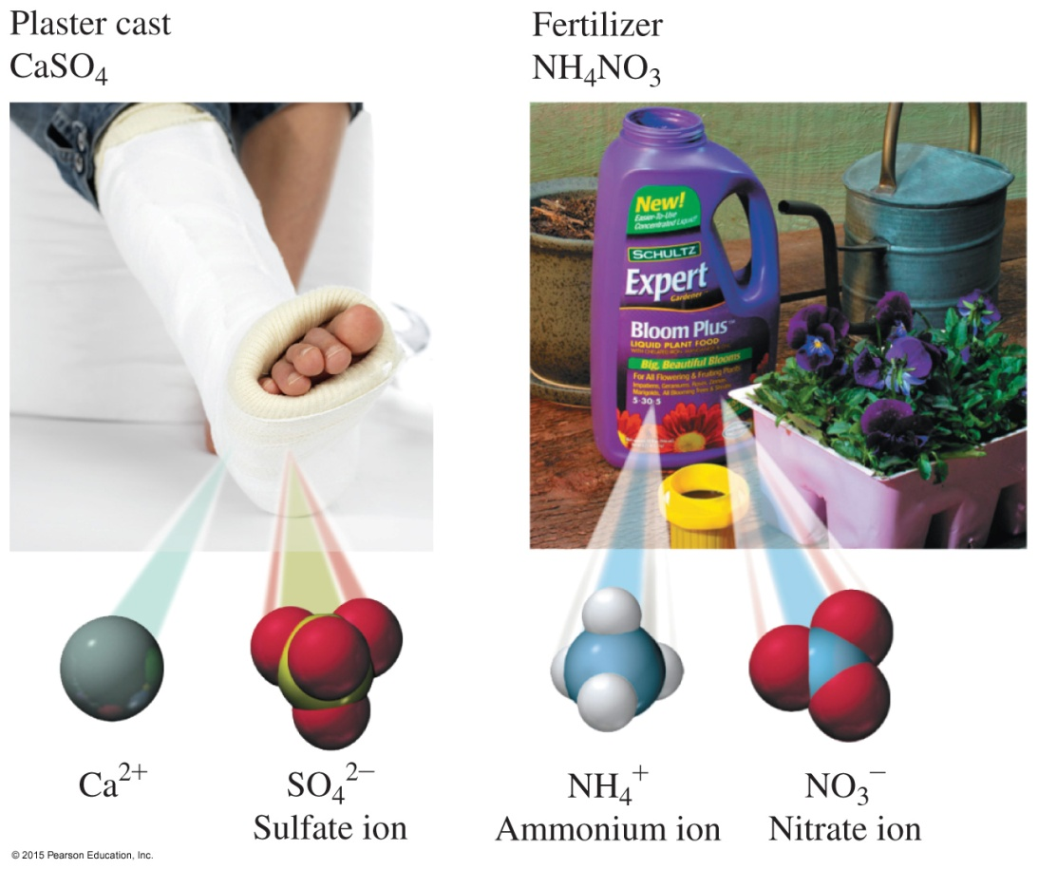
Polyatomic Ions
Many products contain polyatomic ions, which are groups of ions that have an ionic charge.

Slide 63
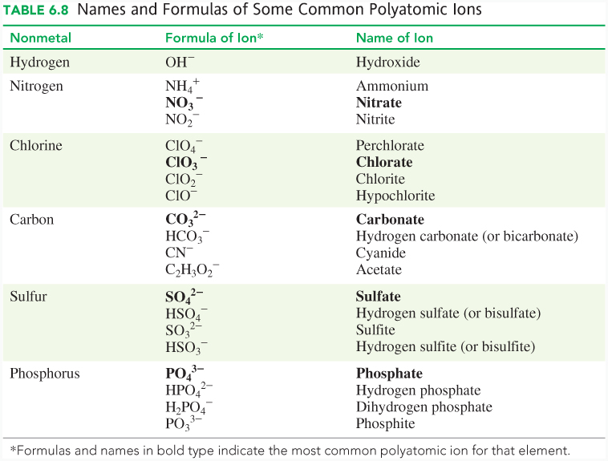
Polyatomic Ions: Names and Formulas

Slide 64
Names of Polyatomic Ions
1. The names of most common polyatomic ions end in ate:
SO₄²⁻ sulfate
PO₄³⁻ phosphate
NO₃⁻ nitrate
2. When a related ion has one less O atom, its name ends in ite:
SO₃²⁻ sulfite
PO₃³⁻ phosphite
NO₂⁻ nitrite

Slide 65
Names of Polyatomic Ions
3. Exceptions to these rules are the following:
CN⁻ cyanide
OH⁻ hydroxide
4. Add an H⁺ to the polyatomic ion; add 1+ to its charge:
CO₃²⁻ + H⁺ = HCO₃⁻
carbonate + H⁺ = bicarbonate or hydrogen carbonate
SO₄²⁻ + H⁺ = HSO₄⁻
sulfate + H⁺ = bisulfate or hydrogen sulfate

Slide 66
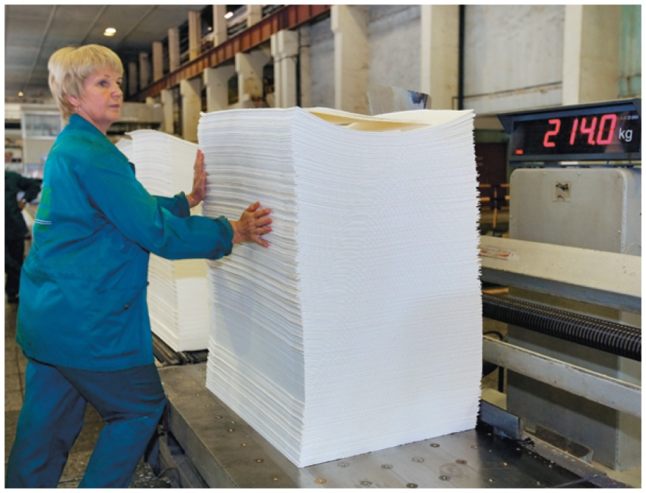
Names of Polyatomic Ions
5. Halogens form four polyatomic ions with oxygen,
each with a 1− charge:
ClO₄⁻ perchlorate
ClO₃⁻ chlorate
ClO₂⁻ chlorite
ClO⁻ hypochlorite
Sodium chlorite is used in the processing and bleaching of pulp from wood fibers and recycled cardboard.

Slide 67
Writing Formulas for Compounds Containing Polyatomic Ions
When writing formulas for ionic compounds containing
polyatomic ions, we use the same rules of charge balance as those for simple ionic compounds.
Consider the formula for magnesium nitrate:
Magnesium ion Nitrate ion
Mg²⁺ + NO₃⁻
NO₃⁻
1(2+) + 2(1−) = 0
Mg²⁺ + 2 NO₃⁻ = Mg(NO₃)₂
Parentheses are placed around the
polyatomic ion. The subscript is
placed just outside the parentheses.

Slide 68
Writing Formulas with Polyatomic Ions
Example: Write the formula for aluminum bicarbonate.

Slide 69
Solution
Example: Write the formula for aluminum bicarbonate.
STEP 1 Identify the cation and polyatomic ion (anion).
Cation Polyatomic ion
Al³⁺ HCO₃⁻
STEP 2 Balance the charges.
Al³⁺ HCO₃⁻
HCO₃⁻
HCO₃⁻
1(3+) + 3(1−) = 0

Slide 70
Solution
Example: Write the formula for aluminum bicarbonate.
STEP 3 Write the formula, cation first, using the subscripts from charge balance. Al(HCO₃)₃

Slide 71
Learning Check
Write the formula for sodium phosphate.

Slide 72
Solution
Write the formula for sodium phosphate.
STEP 1 Identify the cation and polyatomic ion (anion).
Cation Polyatomic ion
Na⁺ PO₄³⁻
STEP 2 Balance the charges.
Na⁺ PO₄³⁻
Na⁺
Na⁺
3(1+) + 1(3−) = 0

Slide 73
Solution
Write the formula for sodium phosphate.
STEP 3 Write the formula, cation first, using the subscripts from charge balance. Na₃PO₄

Slide 74
Naming Compounds with
Polyatomic Ions
When naming ionic compounds containing polyatomic ions,
first, write the positive ion, usually a metal
second, write the name of the polyatomic ion
Recognizing polyatomic ions in a chemical formula helps to name the compound correctly. As with other ionic compounds, no prefixes are used.

Slide 75
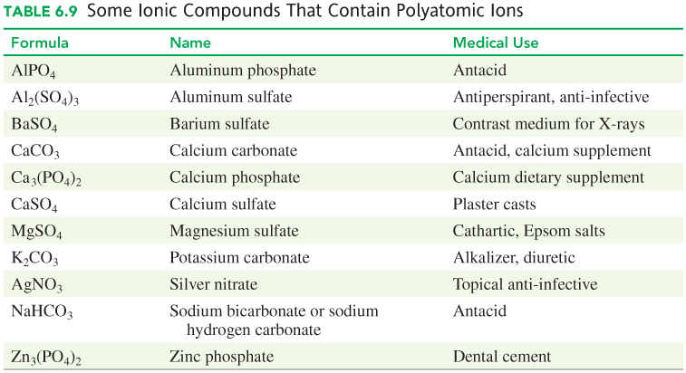
Compounds with Polyatomic Ions

Slide 76
Learning Check
Select the correct formula for each compound.
A. aluminum nitrate
(1) AlNO₃ (2) Al(NO)₃ (3) Al(NO₃)₃
B. copper(II) nitrate
(1) CuNO₃ (2) Cu(NO₃)₂ (3) Cu₂(NO₃)
C. iron(III) hydroxide
(1) FeOH (2) Fe₃OH (3) Fe(OH)₃
D. tin(IV) hydroxide
(1) Sn(OH)₄ (2) Sn(OH)₂ (3) Sn₄(OH)

Slide 77
Solution
Select the correct formula for each compound.
A. aluminum nitrate (3) Al(NO₃)₃
B. copper(II) nitrate (2) Cu(NO₃)₂
C. iron(III) hydroxide (3) Fe(OH)₃
D. tin(IV) hydroxide (1) Sn(OH)₄

Slide 78
Learning Check
Name the following ionic compounds:
A. Ca(NO₃)₂
B. SnSO₄

Slide 79
Solution
Name the following ionic compounds:
STEP 1 STEP 2 STEP 3 STEP 4
Identify Name of Name of Name of
cation/anion cation anion compound
A. Ca(NO₃)₂ Ca²⁺ NO₃⁻ calcium nitrate calcium
nitrate
B. SnSO₄ Sn²⁺ SO₄²⁻ tin(II) sulfate tin(II)
sulfate

Slide 80
Learning Check
Name the following ionic compounds:
A. MgSO₃
B. MgSO₄
C. Pb₃(PO₃)₂

Slide 81
Solution
Name the following ionic compounds:
STEP 1 STEP 2 STEP 3 STEP 4
Identify Name of Name of Name of
cation/anion cation anion compound
A. MgSO₃ Mg²⁺ SO₃²⁻ magnesium sulfite magnesium
sulfite
B. MgSO₄ Mg²⁺ SO₄²⁻ magnesium sulfate magnesium
sulfate
C. Pb₃(PO₃)₂ Pb²⁺ PO₃³⁻ lead(II) phosphite lead(II)
phosphite

Slide 82
Learning Check
Name each of the following compounds:
A. Fe₂(SO₄)₃
B. Ba₃(PO₃)₂
C. NiCO₃

Slide 83
Solution
Name each of the following compounds:
STEP 1 STEP 2 STEP 3 STEP 4
Identify Name of Name of Name of
cation/anion cation anion compound
A. Fe₂(SO₄)₃ Fe³⁺ SO₄²⁻ iron(III) sulfate iron(III)
sulfate
B. Ba₃(PO₃)₂ Ba²⁺ PO₃³⁻ barium phosphite barium phosphite
C. NiCO₃ Ni²⁺ CO₃²⁻ nickel(II) carbonate nickel(II) carbonate

Slide 84
6.5 Molecular Compounds: Sharing Electrons
The names of molecular compounds need prefixes because several different compounds can be formed from the same two nonmetals.
Learning Goal Given the formula of a molecular compound, write its correct name; given the name of a molecular compound, write its formula.

Slide 85
Covalent Bonds
Molecular compounds form when
atoms of two or more nonmetals share electrons and form
a covalent bond
valence electrons are shared by nonmetal atoms to achieve stability
A molecule forms when two or more atoms share electrons.

Slide 86
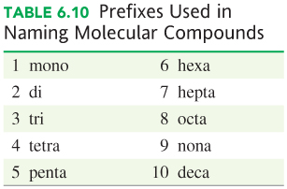
Names and Formulas of Molecular Compounds
When naming a molecular compound:
the first nonmetal in the formula is named by its element name
the second nonmetal is named by using the first syllable of its name followed by ide
When a subscript indicates two or more atoms of an element, a prefix is used in front of its name.

Slide 87
Names and Formulas of Molecular Compounds
Several compounds may be formed from the same two nonmetals:
NO₂ = nitrogen dioxide
NO₃ = nitrogen trioxide
The number of oxygen atoms present is indicated by the prefix.
When the vowels o and o or a and o appear together, the first vowel is omitted.
In the name of a molecular compound, the prefix mono is usually omitted, as in NO, nitrogen oxide. The exception is CO, carbon monoxide.

Slide 88
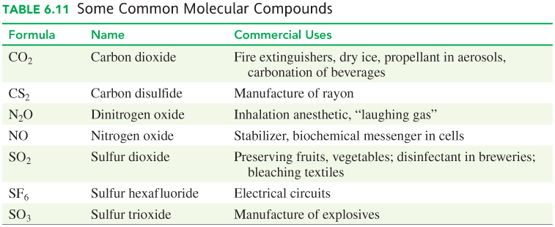
Some Common Molecular Compounds

Slide 89
Naming Molecular Compounds
Example: Name the molecular compound NBr₃.

Slide 90
Solution
Example: Name the molecular compound NBr₃.
STEP 1 Name the first nonmetal by its element name.
In NBr₃, the first nonmetal (N) is nitrogen.
Symbol of the Element N Br
ANALYZE THE Name nitrogen bromide PROBLEM Subscript 1 3
Prefix none tri

Slide 91
Solution
Example: Name the molecular compound NBr₃.
STEP 2 Name the second element by using the first
syllable of its name followed by ide.
The second nonmetal (Br) is bromide.
STEP 3 Add prefixes to indicate number of atoms (subscripts).
Because there is one nitrogen atom, no prefix is needed. The subscript 3 for the Br atoms is shown as the prefix tri.
NBr₃, nitrogen tribromide

Slide 92
Learning Check
Select the correct name for each molecular compound.
A. SiCl₄ (1) tetrasilicon chloride
  (2) silicon tetrachloride
  (3) silicon chloride
B. P₂O₅ (1) phosphorus oxide
(2) phosphorus pentoxide
(3) diphosphorus pentoxide
C. Cl₂O₇ (1) dichlorine heptoxide
(2) dichlorine oxide
(3) chlorine heptoxide

Slide 93
Solution
Select the correct name for each molecular compound.
A. SiCl₄ (2) silicon tetrachloride
B. P₂O₅ (3) diphosphorus pentoxide
C. Cl₂O₇ (1) dichlorine heptoxide

Slide 94
Learning Check
Write the name for each molecular compound.
A. CO
B. N₂O
C. PF₃
D. CCl₄

Slide 95
Solution
Write the name for each molecular compound.
STEP 1 Name the first nonmetal by its element name.
A. CO The first nonmetal (C) is carbon.
B. N₂O The first nonmetal (N) is nitrogen.
C. PF₃ The first nonmetal (P) is phosphorus.
D. CCl₄ The first nonmetal (C) is carbon.

Slide 96
Solution
Write the name for each molecular compound.
STEP 2 Name the second element by using the first syllable of its name followed by ide.
A. CO The second nonmetal (O) is oxide.
B. N₂O The second nonmetal (O) is oxide.
C. PF₃ The second nonmetal (F) is fluoride.
D. CCl₄ The second nonmetal (Cl) is chloride.

Slide 97
Solution
Write the name for each molecular compound.
STEP 3 Add prefixes to indicate number of atoms (subscripts).
A. CO: Because there is one carbon atom, no prefix is
needed. The subscript 1 for the O atom is shown using the prefix mono.
CO is carbon monoxide.
B. N₂O: The subscript 2 for the nitrogen atoms is shown using the prefix di. Because there is only one O atom, no prefix is needed.
N₂O is dinitrogen oxide.

Slide 98
Solution
Write the name for each molecular compound.
STEP 3 Add prefixes to indicate number of atoms (subscripts).
C. PF₃: Because there is one phosphorus atom, no
prefix is needed. The subscript 3 for F atoms is shown using the prefix tri.
PF₃ is phosphorus trifluoride.
D. CCl₄: Because there is one carbon atom, no prefix
is needed. The subscript 4 for the Cl atoms is
shown using the prefix tetra.
CCl₄ is carbon tetrachloride.

Slide 99
Writing Formulas for Molecular Compounds
Example: Write the formula for the molecular compound diphosphorus pentoxide.

Slide 100
Solution
Example: Write the formula for the molecular compound diphosphorus pentoxide.
STEP 1 Write the symbols in order of the elements in the name. The first nonmetal is phosphorus (P) and the second nonmetal is oxygen (O). P O
STEP 2 Write any prefixes as subscripts.
The prefix di in diphosphorus indicates there are two atoms of phosphorus and is shown as a subscript 2 in the formula. The prefix pent in pentoxide indicates there are five atoms of oxygen, shown as a subscript 5 in the formula. P₂O₅

Slide 101
Learning Check
Write the correct formula for each of the following:
A. phosphorus pentachloride
B. dinitrogen trioxide
C. sulfur hexafluoride

Slide 102
Solution
Write the correct formula for each of the following:
STEP 1 Write the symbols in the order of the elements in the name.
A. phosphorus pentachloride
The first nonmetal is phosphorus (P) and the second nonmetal is chlorine (Cl). P Cl
B. dinitrogen trioxide
The first nonmetal is nitrogen (N) and the second nonmetal is oxygen (O). N O
C. sulfur hexafluoride
The first nonmetal is sulfur (S) and the second
nonmetal is fluorine (F). S F

Slide 103
Solution
Write the correct formula for each of the following:
STEP 2 Write any prefixes as subscripts.
A. phosphorus pentachloride: No prefix for
phosphorus indicates there is one phosphorus
atom. The prefix penta in pentachloride
indicates there are five chlorine atoms and is
shown as a subscript after Cl. PCl₅
B. dinitrogen trioxide: The prefix di in dinitrogen
indicates there are two nitrogen atoms and is
shown as a subscript after N. The prefix tri in
trioxide indicates there are three oxygen atoms and is shown as a subscript after O. N₂O₃

Slide 104
Solution
Write the correct formula for each of the following:
STEP 2 Write any prefixes as subscripts.
C. sulfur hexafluoride: No prefix for sulfur
indicates there is one sulfur atom. The prefix
hexa in hexafluoride indicates there are six fluorine atoms and is shown as a subscript after F. SF₆

Slide 105
Compounds: Ionic or Molecular?
A compound is usually
ionic if the first element in the formula or the name is a metal or the polyatomic ion NH₄⁺
In K₂O, K is a metal.
The compound is ionic, named potassium oxide.
molecular if the first element in the formula is a nonmetal
In N₂O, N is a nonmetal.
The compound is molecular, named dinitrogen oxide.

Slide 106
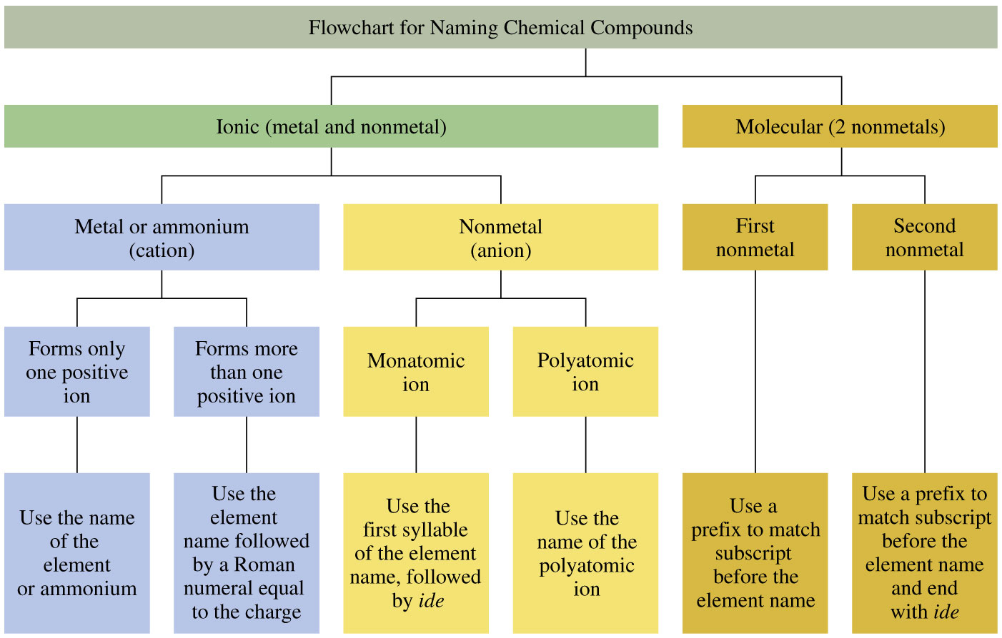
Naming Ionic/Molecular Compounds

Slide 107
Learning Check
Identify each compound as ionic or molecular, and give its correct name.
A. SO₃
B. BaCl₂
C. (NH₄)₃PO₃
D. Cu₂CO₃
E. N₂O₄

Slide 108
Solution
Identify each compound as ionic or molecular, and give its correct name.
A. SO₃ molecular, sulfur trioxide
B. BaCl₂ ionic, barium chloride
C. (NH₄)₃PO₃ ionic, ammonium phosphite
D. Cu₂CO₃ ionic, copper(I) carbonate
E. N₂O₄ molecular, dinitrogen tetroxide

Slide 109
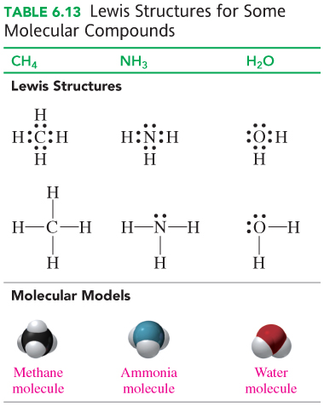
6.6 Lewis Structures for Molecules
Lewis structures use Lewis symbols to diagram the sharing of valence electrons for single and multiple bonds in molecules.
Learning Goal Draw the Lewis structures for molecular compounds with single and multiple bonds.

Slide 110
Covalent Bonds
Molecular compounds form when
atoms of two or more nonmetals share electrons and form
a covalent bond
valence electrons are shared by nonmetal atoms to achieve stability
A molecule forms when two or more atoms share electrons.

Slide 111
Formation of a Hydrogen Molecule
A hydrogen molecule, H₂,
forms as the atoms move closer and the positive charge of the nucleus attracts the electron of the other atom
has a shared pair of electrons that form a covalent bond to give each atom a noble gas arrangement of He to each H atom
is more stable than individual H atoms

Slide 112
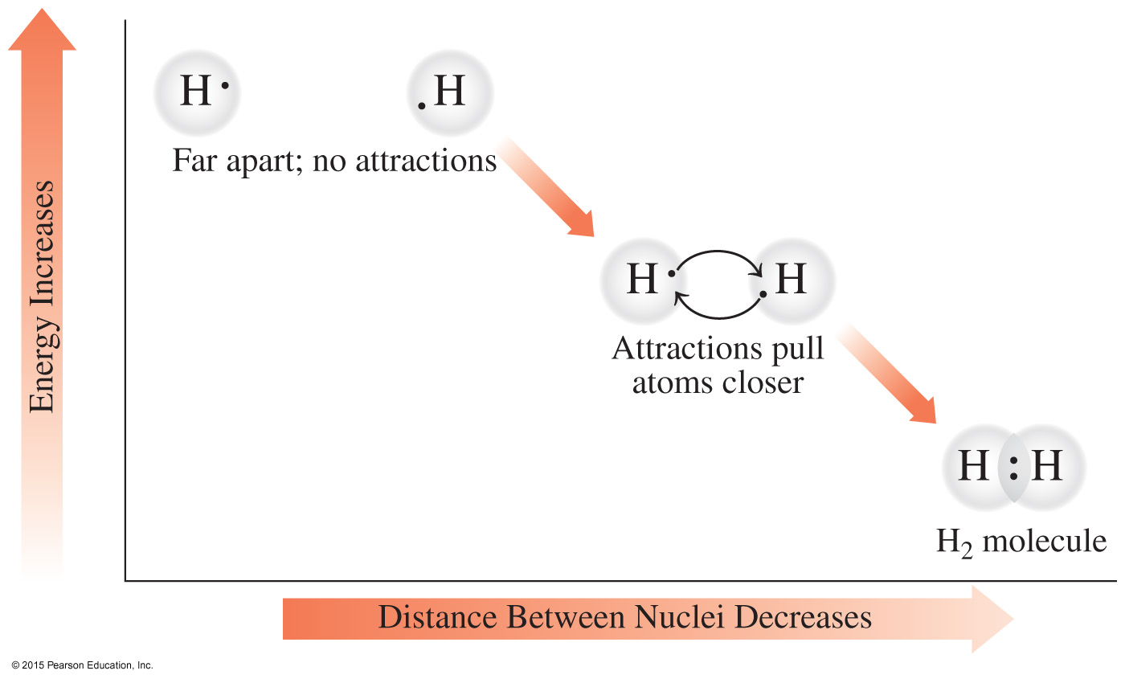
Lewis Structure for the Hydrogen Molecule, H₂
A covalent bond forms
as H atoms move close together to share electrons.

Slide 113

Lewis structures
A molecule is represented by a Lewis structure in which the valence electrons of all the atoms are arranged to give octets, except for hydrogen, which has two electrons.
The number of electrons a nonmetal atom shares and the number of covalent bonds it forms are usually equal to the number of electrons it needs to achieve a noble gas arrangement.
The shared electrons, or bonding pairs, are shown as two dots or a single line between atoms.
The nonbonding pairs of electrons, or lone pairs, are placed on the outside.

Slide 114
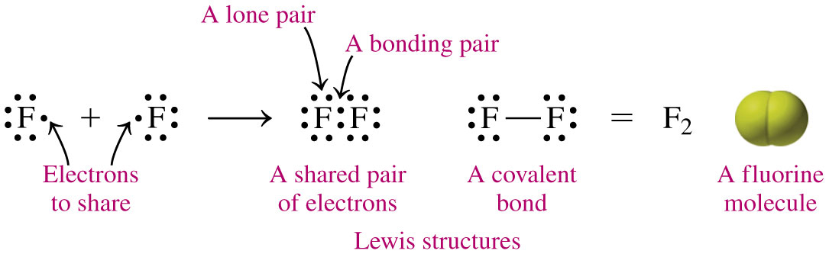
Lewis Structures for Molecular Compounds
To draw the Lewis structure for a fluorine molecule, F₂,
we start with two fluorine atoms each with seven valence electrons
each fluorine atom shares one electron to form a covalent bond, giving each fluorine an octet

Slide 115
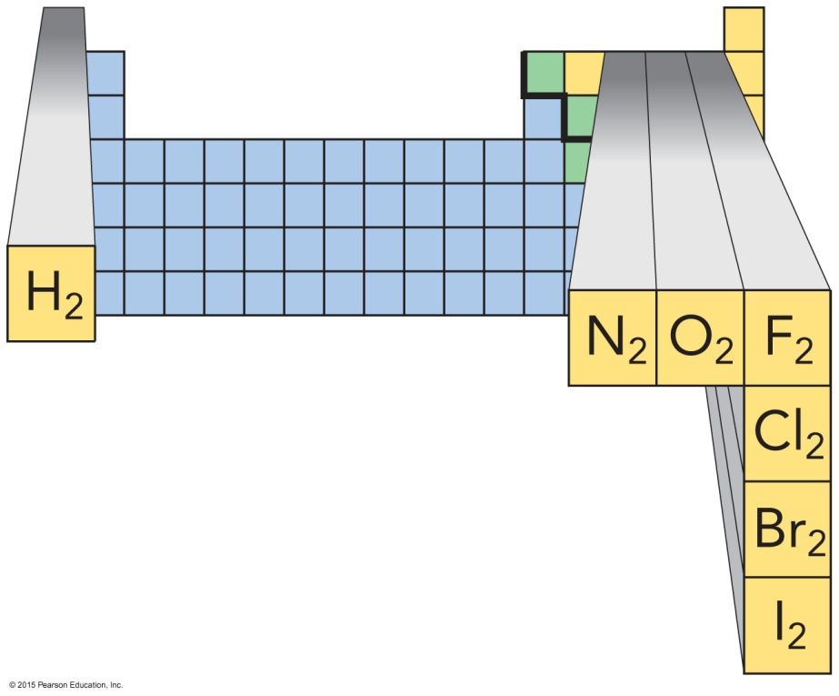
Diatomic Molecules
The elements hydrogen, nitrogen, oxygen, fluorine, chlorine, bromine, and iodine exist as diatomic molecules.
There are seven diatomic molecules: H₂, N₂, O₂, F₂, Cl₂, Br₂, and I₂.

Slide 116

Drawing Lewis structures
To draw the Lewis structure for methane, CH₄, we start by drawing the Lewis symbols for carbon and hydrogen.
Carbon needs four hydrogen atoms to complete the noble gas configurations for carbon and hydrogen.

Slide 117
Molecules: Lewis structures
Lewis structures for common molecules such
as methane, ammonia,
and water are shown in Table 6.13.

Slide 118
Double and Triple Covalent Bonds
A double bond
occurs when atoms share two pairs of electrons
forms when there are not enough electrons to complete octets
A triple bond
occurs when atoms share three pairs of electrons
forms when there are not enough electrons to complete octets

Slide 119
Lewis structures with Multiple Bonds: CO₂
Draw the Lewis structure for carbon dioxide, CO₂, in which the central atom is C.
SOLUTION:
STEP 1 Determine the arrangement of atoms. O C O
ANALYZE Given Need Connect
THE CO₂ Lewis structure total valence PROBLEM electrons

Slide 120
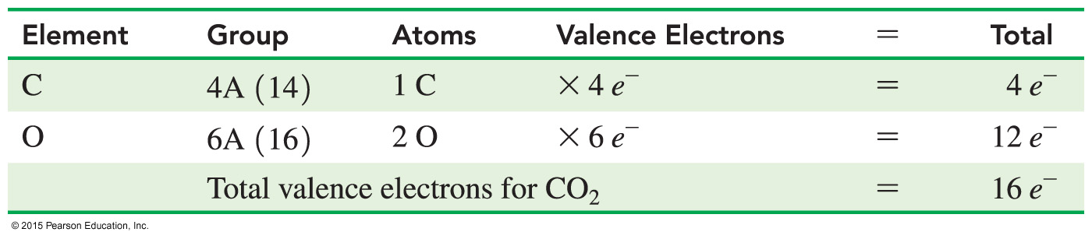
Lewis structures with Multiple Bonds: CO₂
Draw the Lewis structure for carbon dioxide, CO₂, in which the central atom is C.
SOLUTION:
STEP 2 Determine the total number of valence electrons.

Slide 121

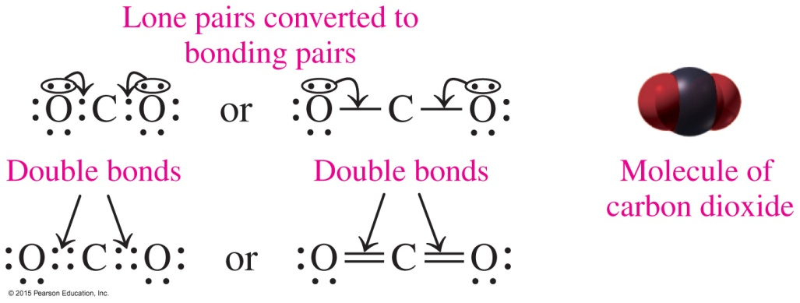
Lewis structures with Multiple Bonds: CO₂
Draw the Lewis structure for carbon dioxide, CO₂, in which the central atom is C.
STEP 3 Attach each bonded atom to the central atom
with a pair of electrons.
STEP 4 Use the remaining
electrons to
complete octets,
using multiple
bonds if needed.

Slide 122
Exceptions to the Octet Rule
While the octet rule is useful, there are exceptions:
Hydrogen requires just two electrons to form a noble gas arrangement.
Nonmetals P, S, Cl, Br, and I can form compounds with
10 or 12 valence electrons.
The S atom has an octet in many compounds, but in SF₆, there are 12 valence electrons or six bonds to the sulfur atom.

Slide 123
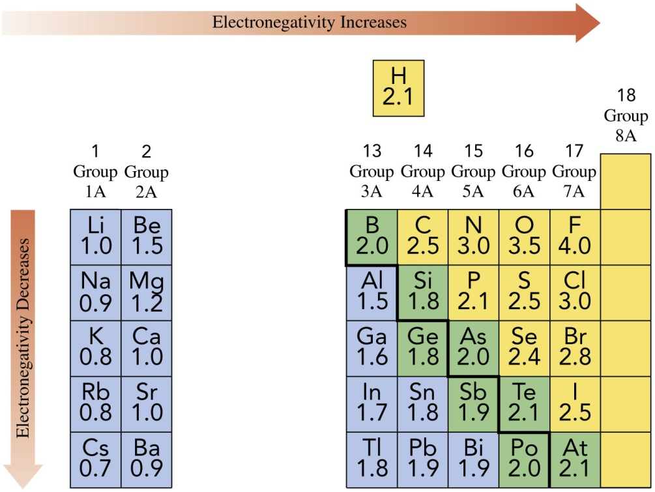
6.7 Electronegativity and Bond Polarity
The electronegativity
values of representative elements in Group 1A (1) to Group 7A (17).
Learning Goal Use electronegativity to determine the polarity of a bond.

Slide 124

Electronegativity
The electronegativity value of an element indicates the attraction of an atom for the shared electrons in a bond.
Electronegativity
increases from left to right going across a period on the periodic table
increases from the bottom to the top of the periodic table
is high for the nonmetals, with fluorine as the highest
is low for the metals

Slide 125
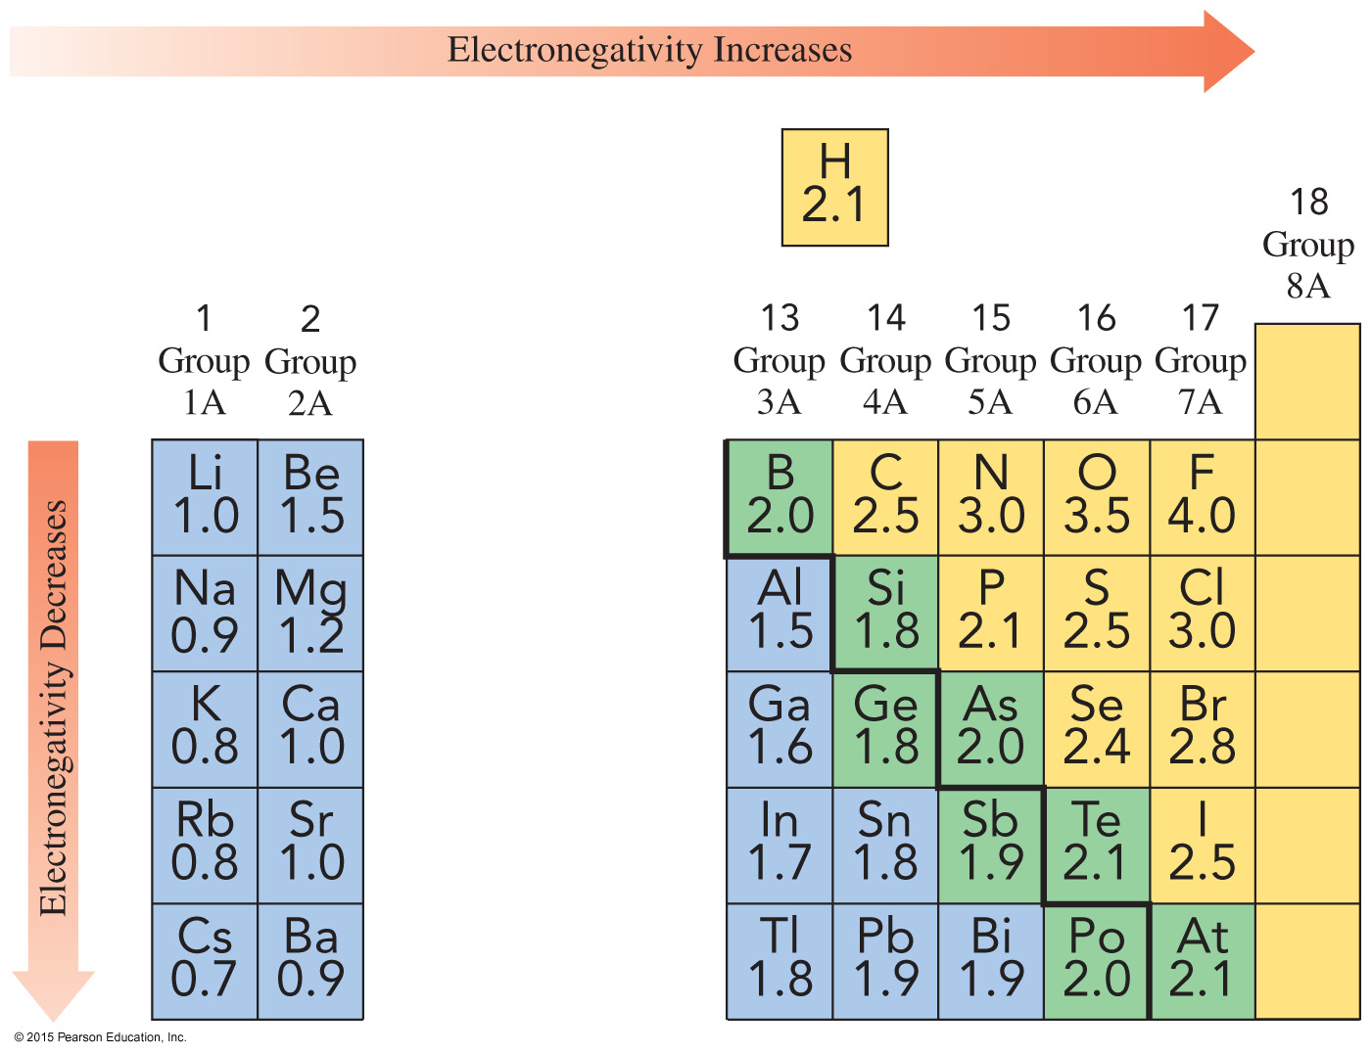
Electronegativity and the
Periodic Table

Slide 126
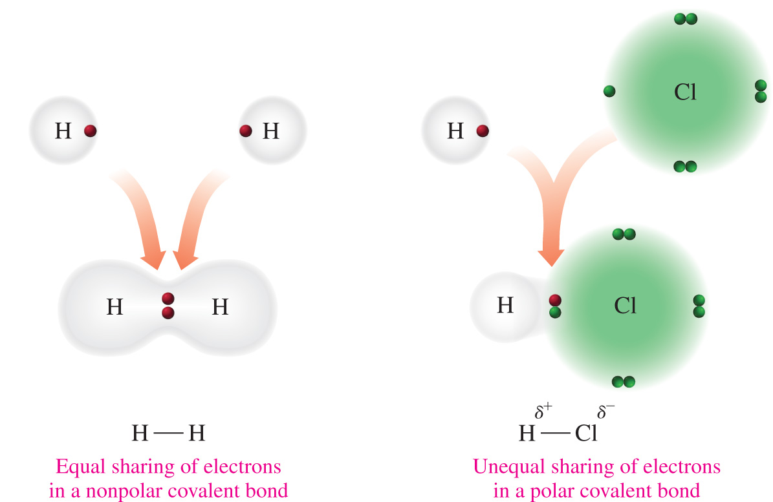
Polarity of Bonds
In the nonpolar covalent bond of H₂, electrons are shared equally. In the polar covalent bond of HCl, electrons are shared unequally.

Slide 127
Nonpolar Covalent Bonds
A nonpolar covalent bond
occurs between nonmetals
is an equal or almost equal sharing of electrons by two bonding atoms
has a very small electronegativity difference
Examples:
Electronegativity
Atoms Difference Type of Bond
N—N 3.0 − 3.0 = 0.0 Nonpolar covalent
Cl—Br 3.0 − 2.8 = 0.2 Nonpolar covalent
H—Si 2.1 − 1.8 = 0.3 Nonpolar covalent

Slide 128
Polar Covalent Bonds
A polar covalent bond
occurs between nonmetal atoms
is an unequal sharing of electrons
has a moderate electronegativity difference
Examples:
Electronegativity
Atoms Difference Type of Bond
O—Cl 3.5 − 3.0 = 0.5 Polar covalent
Cl—C 3.0 − 2.5 = 0.5 Polar covalent
O—S 3.5 − 2.5 = 1.0 Polar covalent

Slide 129
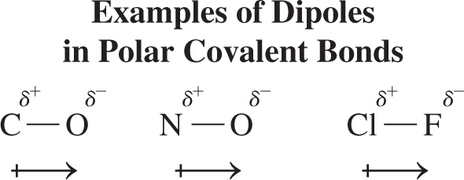
Dipoles and Bond Polarity
A polar covalent bond becomes more polar as the difference in electronegativity increases. The separation of charges in a polar bond is called a dipole.
The positive and negative ends of the dipole are located by using:
the lowercase Greek letter delta with a positive or negative charge
an arrow that points from the positive to the negative end of the dipole

Slide 130
Ionic Bonds
An ionic bond
occurs between metal and nonmetal ions
is a result of electron transfer
has a large electronegativity difference (greater than 1.8)
Examples:
Electronegativity
Atoms Difference Type of Bond
Cl—K 3.0 – 0.8 = 2.2 Ionic
N—Na 3.0 – 0.9 = 2.1 Ionic

Slide 131
Variations in Bonding
The difference in electronegativity values for two atoms can be used to predict the type of chemical bond.
If the electronegativity difference is between 0 and 0.4, the bond is nonpolar covalent.
If the electronegativity difference is between 0.5 and 1.8, the bond is polar covalent.
If the electronegativity difference is between 1.9 and 3.3, the bond is ionic.

Slide 132
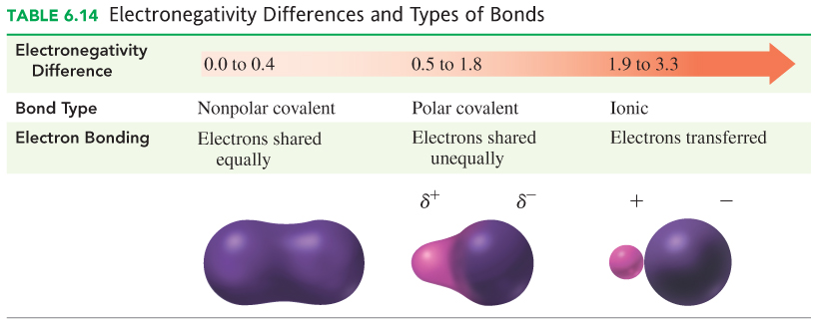
Electronegativity and Bond Types

Slide 133
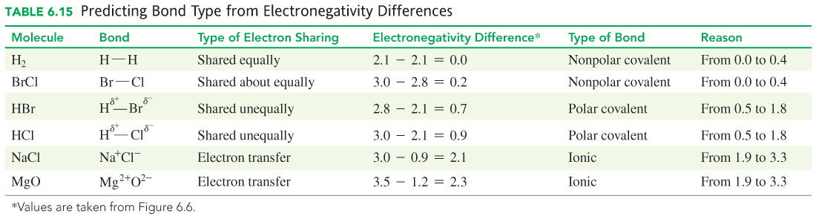
Electronegativity and Predicting Bond Type

Slide 134
Learning Check
Use the electronegativity difference to identify the type of bond—nonpolar covalent, polar covalent, or ionic—between the following:
A. K—N
B. N—O
C. Cl—Cl
D. H—Cl

Slide 135
Solution
Use the electronegativity difference to identify the type of bond—nonpolar covalent, polar covalent, or ionic—between the following:
Difference Type of bond
A. K—N 2.2 ionic
B. N—O 0.5 polar covalent
C. Cl—Cl 0.0 nonpolar covalent
D. H—Cl 0.9 polar covalent

Slide 136
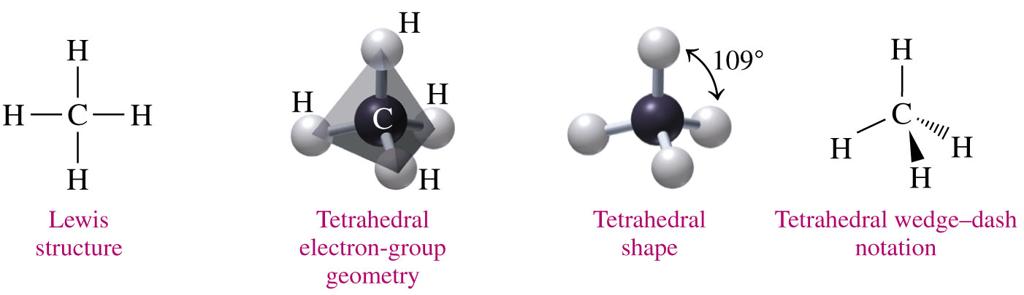
6.8 Shapes of Molecules
In a molecule of methane, CH₄, the central C atom is bonded to four H atoms. The best geometry for minimal repulsion is tetrahedral, with bond angles of 109°.
Learning Goal Predict the three-dimensional structure of a molecule.

Slide 137

VSEPR Theory
The valence shell electron-pair repulsion (VSEPR) theory
describes the orientation of electron groups around the central atom
states that electron groups are arranged as far apart as possible around the central atom
states that the specific shape of a molecule is determined by the number of atoms attached to the central atom

Slide 138
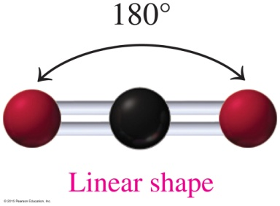
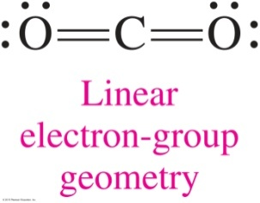
Central Atoms with Two Electron Groups
In a molecule of CO₂,
two electron groups are placed around the central atom, carbon
the repulsion is minimized by placing the two groups on opposite sides of the carbon atom, giving the molecule a linear arrangement with bond angles of 180°
the shape with two electron groups around the central atom is called linear

Slide 139
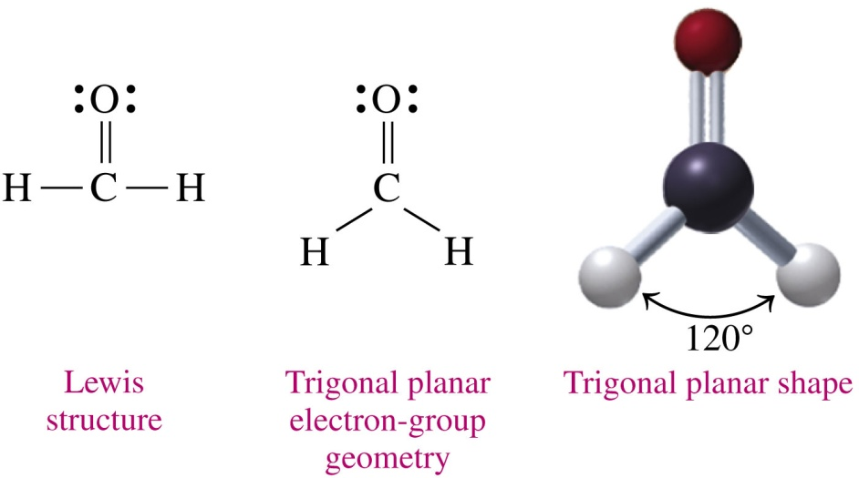
Central Atoms with Three Electron Groups
In a molecule of formaldehyde, H₂CO,
three electron groups are placed around the central atom, carbon
the repulsion is minimized by placing the three groups as far apart as possible, at bond angles of 120°
the shape with three electron groups around the central atom is called trigonal planar

Slide 140
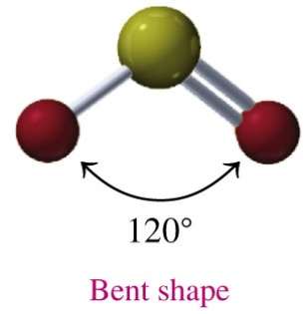
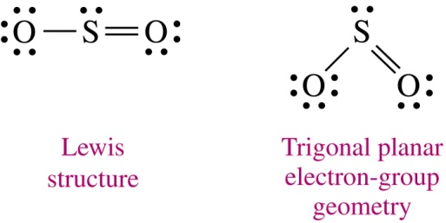
Central Atoms with Three Electron Groups
In a molecule of SO₂,
three electron groups are placed around the central atom, S:
1. a single-bonded O atom
2. a double-bonded O atom
3. a lone pair of electrons
the repulsion is minimized by placing the three groups as far apart as possible
the shape with two bonds and a lone pair on the central atom
is called bent

Slide 141
Central Atoms with Four Electron Groups
In a molecule of CH₄,
four electron groups are attached to H atoms around the central atom, carbon
the repulsion is minimized by placing the four groups at corners of a tetrahedron with bond angles of 109°
the shape with four bonds on the central atom is called tetrahedral

Slide 142
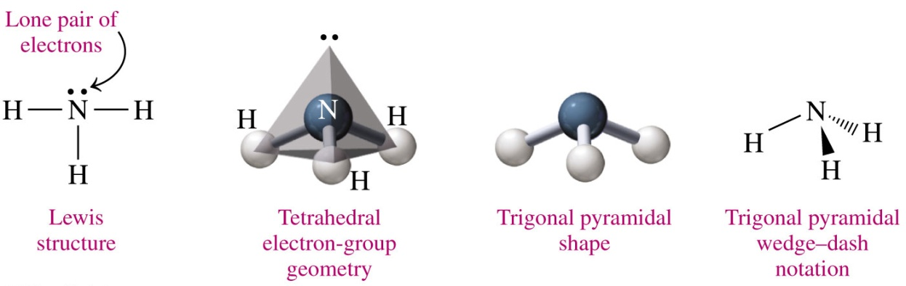
Central Atoms with Four Electron Groups
In a molecule of NH₃,
three electron groups include three bonds to H atoms and one is a lone pair around the central atom, N
the repulsion is minimized by placing the four groups at corners of a tetrahedron with bond angles of 109°
the shape with three bonds and a lone pair on the central atom is called trigonal pyrimidal

Slide 143
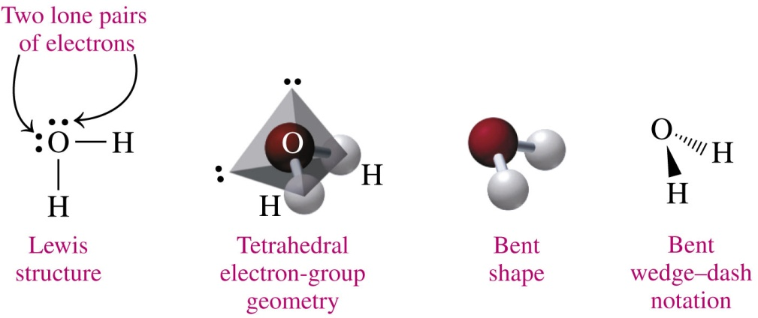
Central Atoms with Four Electron Groups
In a molecule of H₂O,
two electron groups are attached to H atoms and two lone pairs are around the central atom, O
the repulsion is minimized by placing the four groups at corners of a tetrahedron with bond angles of 109°
the shape with two bonds and two lone pairs on the central atom is called bent

Slide 144
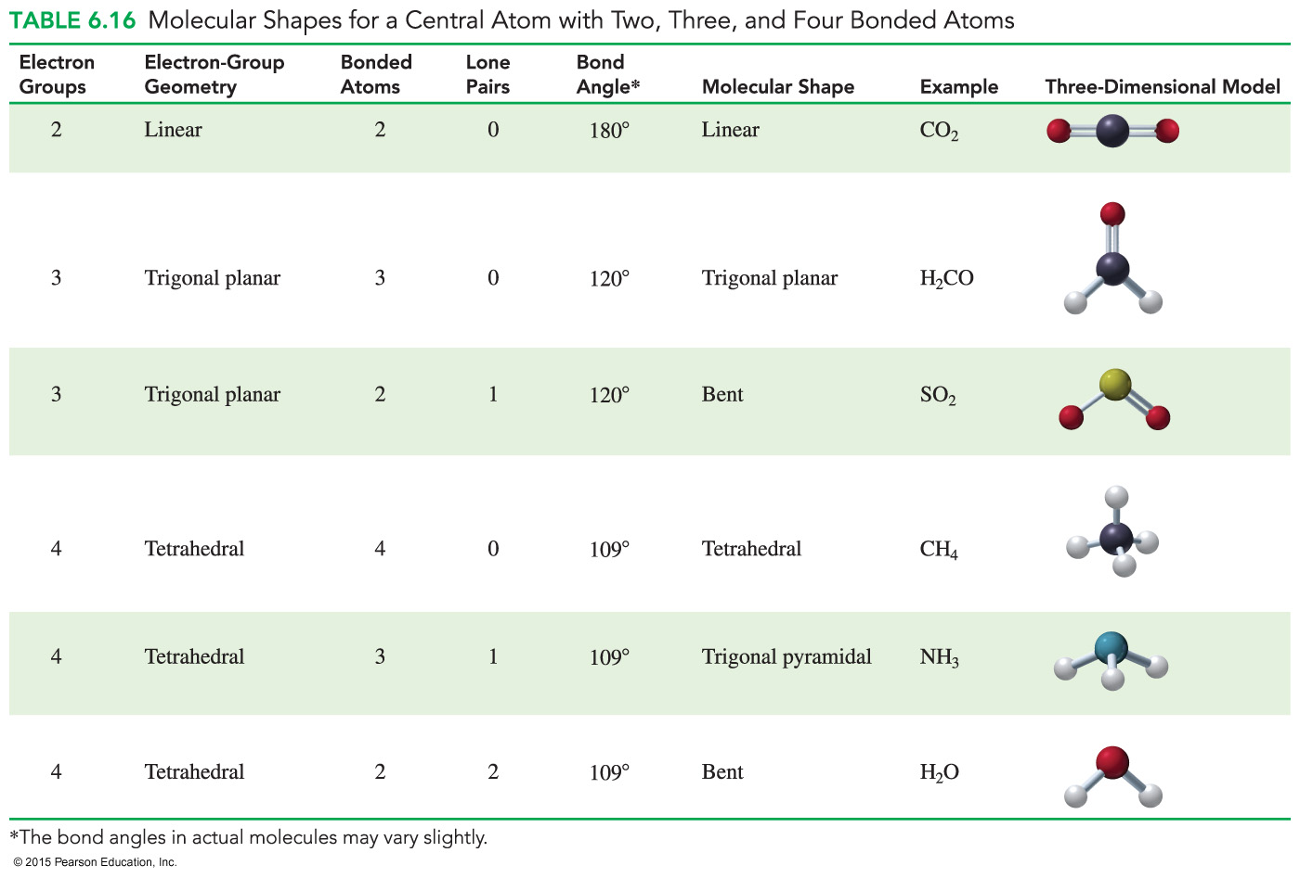
Molecular Shapes: Electron Groups

Slide 145

Predict the Molecular Shape of H₂S
Use VSEPR theory to predict the shape of H₂S.
SOLUTION:
STEP 1 Draw the Lewis structure.
ANALYZE Given Need Connect
THE H₂S shape Lewis structure, electron PROBLEM groups, bonded atoms

Slide 146
Predict the Molecular Shape of H₂S
Use VSEPR theory to predict the shape of H₂S.
SOLUTION:
STEP 2 Arrange electron groups around the central atom to
minimize repulsion.
To minimize repulsion, electron groups have a
tetrahedral arrangement.
STEP 3 Use the atoms bonded to the central atom to
determine the shape.
With two bonds and two lone pairs, the shape is bent.

Slide 147
Learning Check
State the number of electron groups and lone pairs and use the VSEPR theory to determine the shape of the following molecules or ions as tetrahedral, trigonal pyramidal, or bent:
A. PF₃
B. H₂S
C. CCl₄

Slide 148
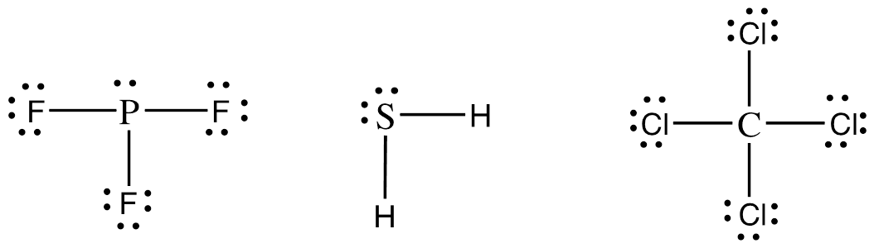
Solution
State the number of electron groups and lone pairs and use the VSEPR theory to determine the shape of the following molecules or ions as tetrahedral, trigonal pyramidal, or bent:
STEP 1 Draw the Lewis structure.
A. PF₃ B. H₂S C. CCl₄

Slide 149
Solution
State the number of electron groups and lone pairs and use the VSEPR theory to determine the shape of the following molecules or ions as tetrahedral, trigonal pyramidal, or bent:
STEP 2 Arrange electron groups around the central atom to minimize repulsion.
A. PF₃: To minimize repulsion, electron groups have
a tetrahedral arrangement.
B. H₂S: To minimize repulsion, electron groups have
a tetrahedral arrangement.
C. CCl₄: To minimize repulsion, electron groups have
a tetrahedral arrangement.

Slide 150
Solution
State the number of electron groups and lone pairs and use the VSEPR theory to determine the shape of the following molecules or ions as tetrahedral, trigonal pyramidal, or bent:
STEP 3 Use the atoms bonded to the central atom to
determine the molecular shape.
A. PF₃: With three bonds and one lone pair, on the
central atom, the shape is trigonal pyrimidal.
B. H₂S: With two bonds and two lone pairs, on the
central atom, the shape is bent.
C. CCl₄: With four bonds on the central atom, the
shape is tetrahedral.

Slide 151
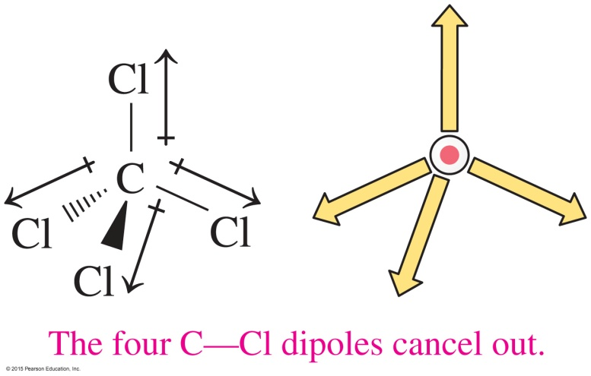
6.9 Polarity of Molecules and Intermolecular Forces
Covalent bonds in molecules can be polar or nonpolar. The bonds in a molecule and its shape determine whether that molecule is classified as polar or nonpolar.
Learning Goal Use the three-dimensional structure of a molecule to classify it as polar or nonpolar. Describe the intermolecular forces between ions, polar covalent molecules, and nonpolar covalent molecules.

Slide 152

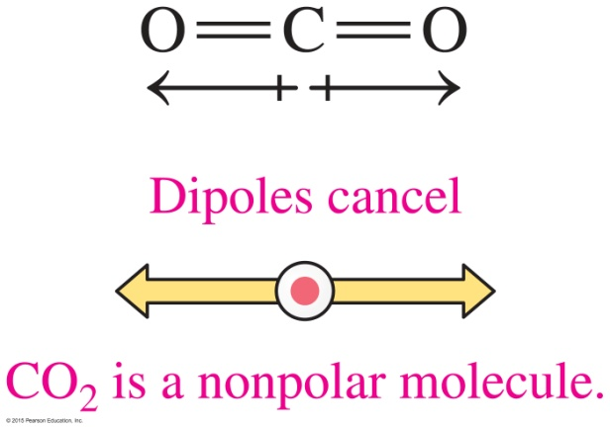
Dipoles:
Nonpolar Molecules
Nonpolar molecules
such as H₂, Cl₂, and O₂ are nonpolar because they contain nonpolar covalent bonds
with polar bonds can be nonpolar if the dipoles in the polar bonds cancel each other in a symmetrical arrangement such as in CO₂ and CCl₄

Slide 153

Dipoles: Polar Molecules
Polar molecules such as HCl are polar because
one end of the molecule is more negatively charged than
the other
the polar bonds in the molecule do not cancel each other
the electrons are shared unequally in the polar covalent bond

Slide 154
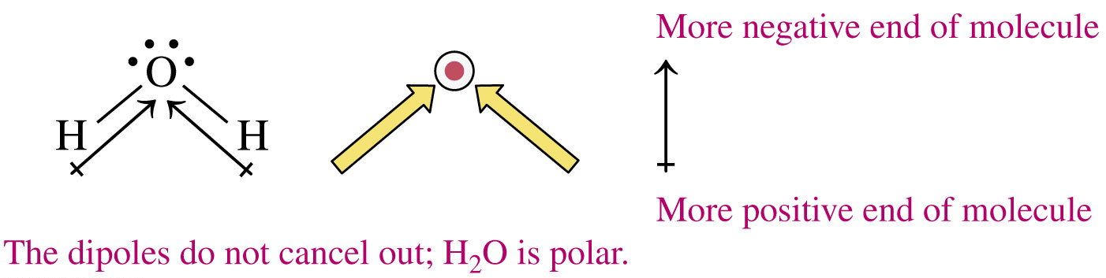
Dipoles: Polar Molecules
In polar molecules such as H₂O,
there are two lone pairs and two bonds around the central atom
there are dipoles that do not cancel, making the molecule positive at one end and negative at the other end
there is a partial negative charge on the central atom

Slide 155
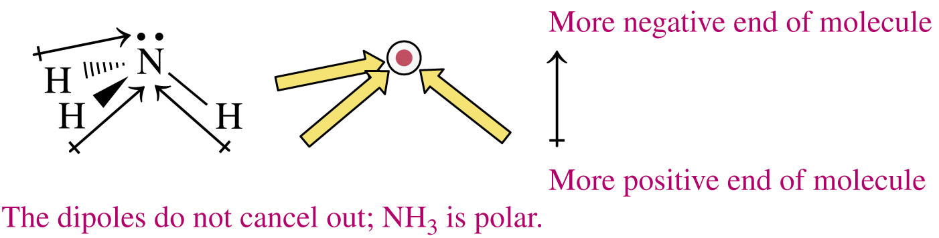
Dipoles: Polar Molecules
In polar molecules such as NH₃,
there is one lone pair and three bonds around the central atom
there are dipoles that do not cancel, making the molecule positive at one end and negative at the other end
there is a partial negative charge on the central atom

Slide 156
Determination of Polarity
Determine whether a molecule OF₂ is polar or nonpolar.
SOLUTION:
STEP 1 Determine if the bonds are polar covalent or nonpolar covalent.
O—F: Oxygen is 3.5 and fluorine is 4.0, so the difference in electronegativity is 0.5, and the bonds are polar covalent.
ANALYZE Given Need Connect
THE OF₂ polarity Lewis structure, bond PROBLEM polarity

Slide 157
Determination of Polarity
Determine whether a molecule OF₂ is polar or nonpolar.
SOLUTION:
STEP 2 If the bonds are polar covalent, draw the Lewis structure and determine if the dipoles cancel.
OF₂ is a polar molecule.

Slide 158
Learning Check
Identify each of the following molecules as polar or nonpolar:
A. PBr₃
B. HBr
C. CF₄

Slide 159
Solution
Identify each of the following molecules as polar or nonpolar:
STEP 1 STEP 2
Bonds, polar or Draw molecule to see if
nonpolar covalent any polar bonds cancel
A. PBr₃ P = 2.1
Br = 2.8, polar polar
covalent
B. HBr H = 2.1
Br = 2.8, polar polar
covalent
C. CF₄ C = 2.5
H = 2.1, nonpolar nonpolar
covalent

Slide 160
Ionic Bonds
Ionic bonds are the strongest of the attractive forces found in compounds. Thus, most ionic compounds are solids at room temperature. The ionic compound sodium chloride, NaCl, melts at 801°C.

Slide 161
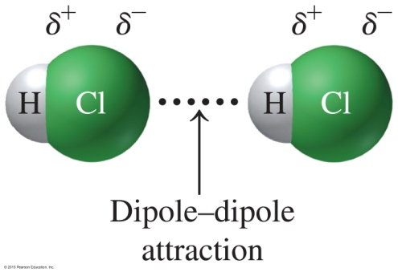
Dipole–Dipole Attractions
In covalent compounds, polar molecules
exert attractive forces called dipole–dipole attractions
have dipoles where the positively charged end of the dipole in one molecule is attracted to the negatively charged end of the dipole in another molecule

Slide 162


Hydrogen Bonds
In covalent compounds, polar molecules form strong dipole attractions called hydrogen bonds between hydrogen atoms bonded to F, O, or N and a lone pair on F, O, or N.
Hydrogen bonds are the strongest force between molecules and play a major role in the shape of DNA.

Slide 163

Dispersion Forces
Dispersion forces are
weak attractions between nonpolar molecules
caused by temporary dipoles that develop when molecules bump into each other
weak but make it possible for nonpolar molecules to form liquids and solids

Slide 164
Melting Points and Attractive Forces
Melting points of compounds
are related to the strength of attractive forces between molecules or compounds
are lower as a result of weak forces such as dispersion forces
are higher as a result of stronger attractive forces such as hydrogen bonding
are highest in ionic compounds as a result of the strong attractive forces between ions in the compound

Slide 165

Melting Points of Selected Substances

Slide 166

Comparison of Bonding and Attractive Forces

Slide 167
Learning Check
Identify the main type of attractive forces that are present in liquids of the following compounds: ionic bonds, dipole–dipole, hydrogen bonds, or dispersion forces.
A. NCl₃
B. H₂O
C. Br—Br
D. KCl
E. NH₃

Slide 168
Solution
Identify the main type of attractive forces that are present in liquids of the following compounds: ionic bonds, dipole–dipole, hydrogen bonds, or dispersion forces.
A. NCl₃ dipole–dipole forces
B. H₂O hydrogen bonds
C. Br—Br dispersion forces
D. KCl ionic bonds
E. NH₃ hydrogen bonds

Slide 169

Concept Map

