Slide 1
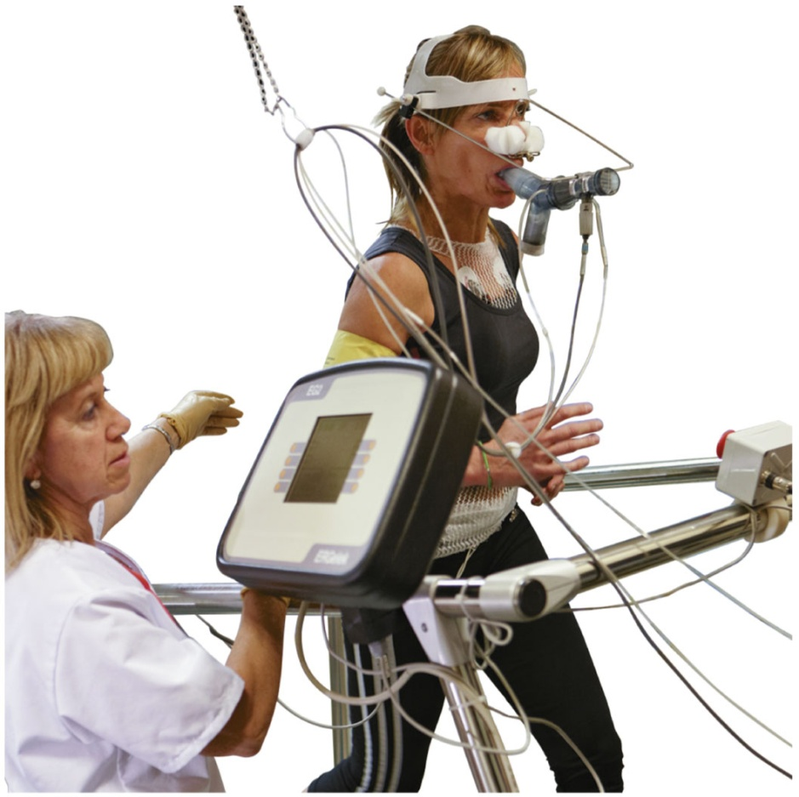
Chapter 7 Chemical Quantities and Reactions
1
Exercise physiologists work with athletes as well as patients who have been diagnosed with diabetes, heart disease, pulmonary
disease, or other chronic disabilities or diseases.

Slide 2
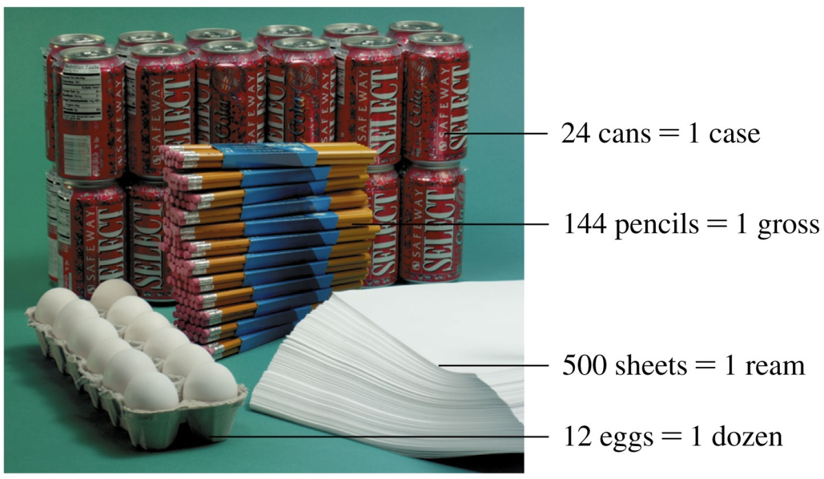
7.1 The Mole
2
A counting term states a specific number of items. The terms dozen, case, gross, and ream are used to count the number of items present.
Learning Goal Use Avogadro’s number to determine the number of particles in a given number of moles.

Slide 3
Avogadro’s Number
Small particles such as atoms, molecules, and ions are
counted using the mole, a unit called Avogadro’s number which
contains 6.02 × 10²³ items.
1 mole = 6.02 × 10²³ items
Avogadro’s number
6.02 × 10²³ = 602 000 000 000 000 000 000 000
Avogadro’s number is named for Amedeo Avogadro
(1776–1856), an Italian physicist.

Slide 4
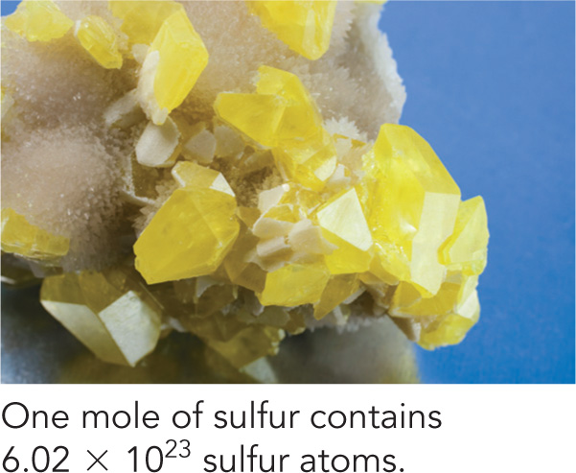
Mole of Atoms
1 mole of an element = 6.02 × 10²³ atoms of that element
1 mole of carbon = 6.02 × 10²³ atoms of carbon
1 mole of sodium = 6.02 × 10²³ atoms of sodium

Slide 5
Particles in 1-Mole Quantities

Slide 6
Avogadro’s Number
Avogadro’s number, 6.02 × 10²³, can be written as an equality and as two conversion factors.
Equality:
1 mole = 6.02 × 10²³ particles
Conversion Factors:

Slide 7
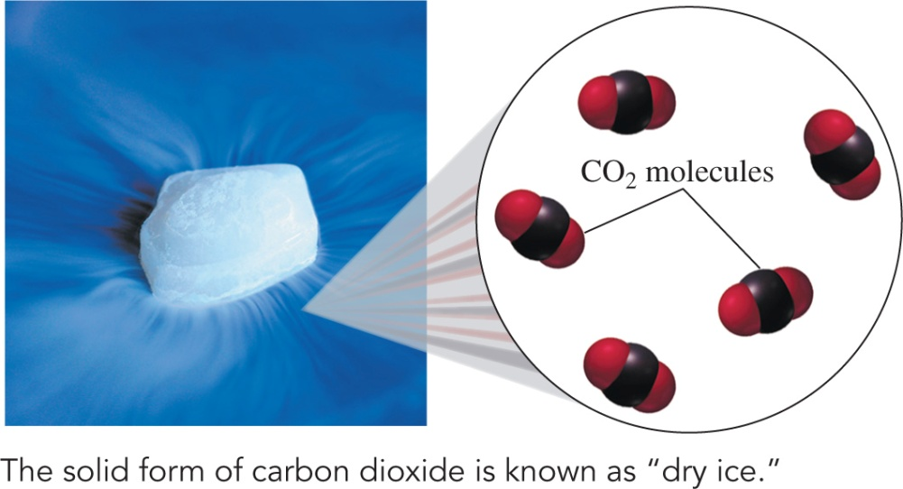
Converting Moles to Molecules
Avogadro’s number is used to
convert moles of a substance
to particles. How many CO₂
molecules are in 0.50 mole of CO₂?
SOLUTION:
STEP 1 State the given and needed quantities.
ANALYZE GIVEN NEED CONNECT
THE PROBLEM 0.50 mole molecules Avogadro’s of CO₂ of CO₂ number

Slide 8
Converting Moles to Molecules
STEP 2 Write a plan to convert moles to atoms or molecules.
moles of CO₂ molecules of CO₂
STEP 3 Use Avogadro’s number to write conversion factors.
1 mole of CO₂ = 6.02 × 10²³ molecules of CO₂
Avogadro’s number

Slide 9
Converting Moles to Molecules
STEP 4 Set up the problem to calculate the number of particles.

Slide 10
Learning Check
What is the number of atoms in 2.0 moles of Al?
A. 2.0 atoms of Al
B. 3.0 × 10²³ atoms of Al
C. 1.2 × 10²⁴ atoms of Al

Slide 11
Solution
What is the number of atoms in 2.0 moles of Al?
STEP 1 State the given and needed quantities.
STEP 2 Write a plan to convert moles to atoms or molecules.
moles of Al atoms of Al
ANALYZE GIVEN NEED CONNECT
THE PROBLEM 2.0 mole of Al atoms of Al Avogadro’s number
Avogadro’s number

Slide 12
Solution
What is the number of atoms in 2.0 moles of Al?
STEP 3 Use Avogadro’s number to write conversion factors.
1 mole of Al = 6.02 × 10²³ atoms of Al

Slide 13
Solution
What is the number of atoms in 2.0 moles of Al?
STEP 4 Set up the problem to calculate the number
of particles.
Answer is C.

Slide 14
Learning Check
What is the number of moles of S in 1.8 × 10²⁴ atoms of S?
A. 1.0 mole of S atoms
B. 3.0 moles of S atoms
C. 1.1 × 10⁴⁸ moles of S atoms

Slide 15
Solution
What is the number of moles of S in 1.8 × 10²⁴ atoms of S?
STEP 1 State the given and needed quantities.
STEP 2 Write a plan to convert moles to atoms or molecules.
atoms of S moles of S
ANALYZE GIVEN NEED Connect
THE PROBLEM l.8 × 10²⁴ atoms of S moles of S Avogadro’s
number
Avogadro’s number

Slide 16
Solution
What is the number of moles of S in 1.8 × 10²⁴ atoms of S?
STEP 3 Use Avogadro’s number to write conversion factors.
1 mole of S = 6.02 × 10²³ atoms of S

Slide 17
Solution
What is the number of moles of S in 1.8 × 10²⁴ atoms of S?
STEP 4 Set up the problem to calculate the number of particles.
Answer is B.

Slide 18
Moles of Elements in a Formula

Slide 19
Moles of Elements in a Formula
The subscripts in a chemical formula show
the relationship of atoms in the formula
the moles of each element in 1 mole of compound
Aspirin
C₉H₈O₄
1 molecule: 9 atoms of C 8 atoms of H 4 atoms of O
1 mole: 9 moles of C 8 moles of H 4 moles of O

Slide 20
Moles of Elements in a Formula
Subscripts are used to write conversion factors for moles of each element in 1 mole of a compound.
For 1 mole of aspirin, C₉H₈O₄, the possible conversion factors are as follows:

Slide 21
Learning Check
How many atoms of O are in 0.150 mole of aspirin, C₉H₈O₄?

Slide 22
Solution
How many atoms of O are in 0.150 mole of aspirin, C₉H₈O₄?
STEP 1 State the given and needed quantities.
STEP 2 Write a plan to convert moles to atoms.
moles of moles atoms
C₉H₈O₄ of O of O
ANALYZE GIVEN NEED CONNECT
THE PROBLEM l.50 mole atoms of O subscripts in formula of C₉H₈O₄ & Avogadro’s number
Subscript
Avogadro’s number

Slide 23
Solution
How many atoms of O are in 0.150 mole of aspirin, C₉H₈O₄?
STEP 3 Use subscripts in formulas and Avogadro’s number to write conversion factors.
Subscript factor: 1 mole of C₉H₈O₄ = 4 moles of O
Avogadro’s number: 1 mole of O = 6.02 × 10²³ atoms of O

Slide 24
Solution
How many atoms of O are in 0.150 mole of aspirin, C₉H₈O₄?
STEP 4 Set up the problem to calculate the number of particles.
= 3.61 × 10²³ atoms of O

Slide 25
7.2 Molar Mass
25
The molar mass of an element is the quantity in grams that equals the atomic mass of that element.
For example, 1 mole
of sodium has a mass
of 22.99 grams.
Na
11
22.99
Learning Goal Given the chemical formula of a substance, calculate its molar mass.

Slide 26
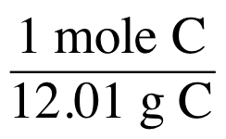
Molar Mass
The molar mass is
the mass of 1 mole of an element
the atomic mass expressed in grams
1 mole of C atoms = 12.01 g of C atoms
6
C
12.01

Slide 27
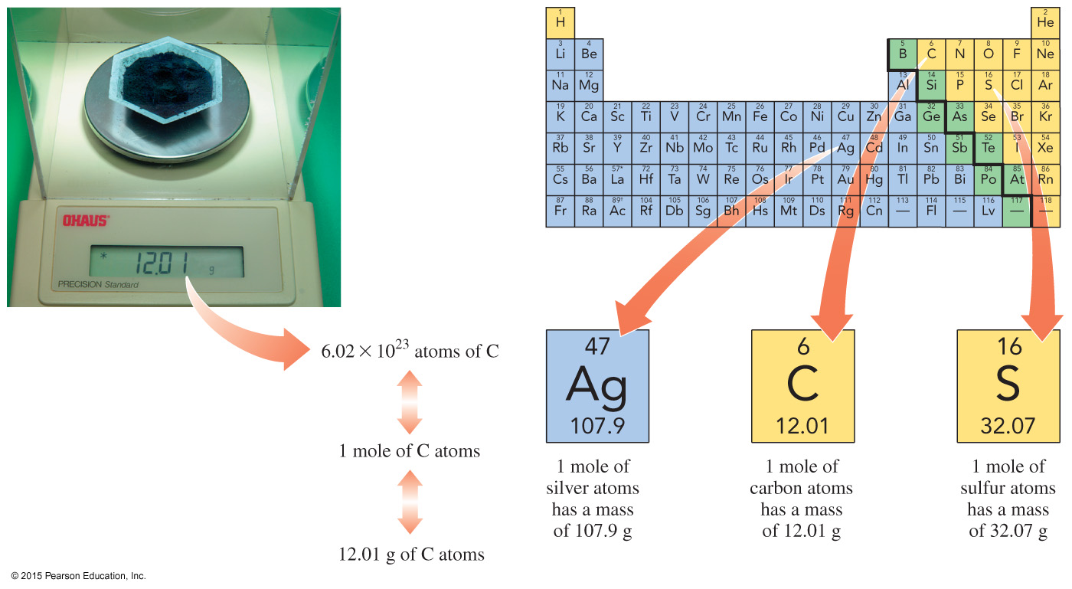
Molar Mass from Periodic Table
In this text, we round molar mass to the hundredths place (0.01) or use at least four significant figures for calculations.

Slide 28
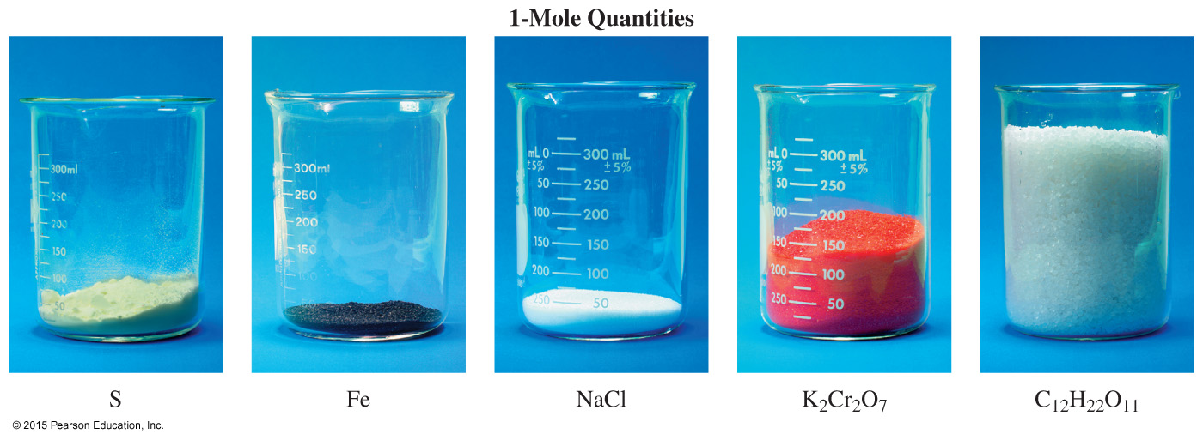
1-Mole Quantities

Slide 29
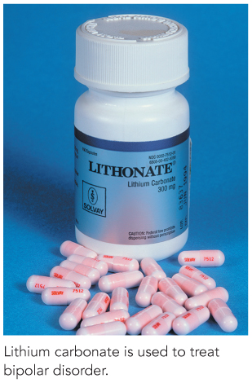
Calculating Molar Mass: Li₂CO₃
Calculate the molar mass for lithium
carbonate, Li₂CO₃, used to treat bipolar
disorder.
SOLUTION:
STEP 1 Obtain the molar mass of each element.
ANALYZE GIVEN NEED CONNECT
THE PROBLEM formula, molar mass, periodic
Li₂CO₃ Li₂CO₃ table

Slide 30
Calculating Molar Mass: Li₂CO₃
STEP 2 Multiply each molar mass by the number of moles (subscript) in the formula.

Slide 31
Calculating Molar Mass: Li₂CO₃
STEP 3 Calculate the molar mass by adding the masses of the elements.
2 moles Li = 13.88 g Li
1 mole C = 12.01 g C
3 moles O = 48.00 g O
1 mole Li₂CO₃ = 73.89 g

Slide 32
Learning Check
Calculate the molar mass of C₂H₆O.

Slide 33
Solution
Calculate the molar mass of C₂H₆O.
STEP 1 Obtain the molar mass of each element.
ANALYZE GIVEN NEED CONNECT
THE PROBLEM formula, molar mass, periodic
C₂H₆O C₂H₆O table

Slide 34
Solution
Calculate the molar mass of C₂H₆O.
STEP 2 Multiply each molar mass by the number of moles (subscripts) in the formula.

Slide 35
Solution
Calculate the molar mass of C₂H₆O.
STEP 3 Calculate the molar mass by adding the masses of the elements.
2 moles C = 24.02 g C
6 moles H = 6.06 g H
1 mole O = 16.00 g O
1 mole C₂H₆O = 46.08 g

Slide 36
7.3 Calculations Using Molar Mass
36
The molar mass of an element is useful to convert moles of an element to grams, or grams of an element to moles. For example, 1 mole of silver has a mass of 107.9 g.
Learning Goal Use molar mass to convert between grams and moles.

Slide 37
Conversion Factors
Molar mass conversion factors
are fractions (ratios) written from the molar mass
relate grams and moles of an element or compound
For methane, CH₄, used in gas stoves and gas heaters,
1 mole of CH₄ = 16.05 g of CH₄ (molar mass equality)
Conversion factors:

Slide 38
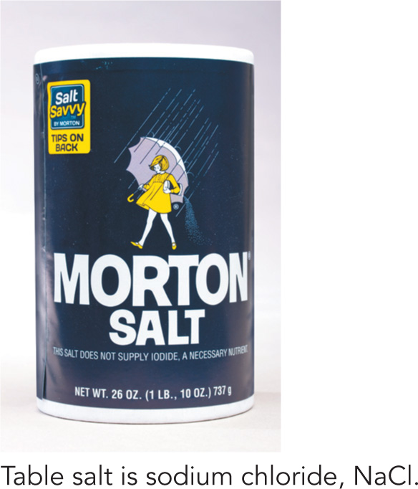
Converting Mass to Moles of NaCl
A box of table salt contains 737 g of NaCl. How many
moles of NaCl are present in the box?

Slide 39
Converting Mass to Moles of NaCl
A box of table salt contains 737 g of NaCl. How many
moles of NaCl are in the box?
STEP 1 State the given and needed quantities.
STEP 2 Write a plan to convert grams to moles.
grams of NaCl moles of NaCl
ANALYZE GIVEN NEED CONNECT
THE PROBLEM 737 g NaCl moles NaCl molar mass
Molar Mass

Slide 40
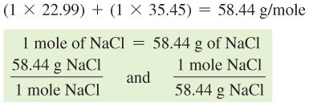
Converting Mass to Moles of NaCl
A box of table salt contains 737 g of NaCl. How many moles of NaCl are in the box?
STEP 3 Determine the molar mass and write conversion factors.

Slide 41
Converting Mass to Moles of NaCl
A box of table salt contains 737 g of NaCl. How many moles of NaCl are in the box?
STEP 4 Set up the problem to convert grams to moles.

Slide 42
Learning Check
A sample of water has a mass of 59.8 grams. How many moles
of water are in the sample?

Slide 43
Solution
A sample of water has a mass of 59.8 grams. How many moles
of water are in the sample?
STEP 1 State the given and needed quantities.
STEP 2 Write a plan to convert grams to moles.
grams of H₂O moles of H₂O
ANALYZE GIVEN NEED CONNECT
THE PROBLEM 59.8 g H₂O moles H₂O molar mass
Molar Mass

Slide 44
Solution
A sample of water has a mass of 59.8 grams. How many moles
of water are in the sample?
STEP 3 Determine the molar mass and write conversion factors.

Slide 45
Solution
A sample of water has a mass of 59.8 grams. How many moles
of water are in the sample?
STEP 4 Set up the problem to convert grams to moles.

Slide 46
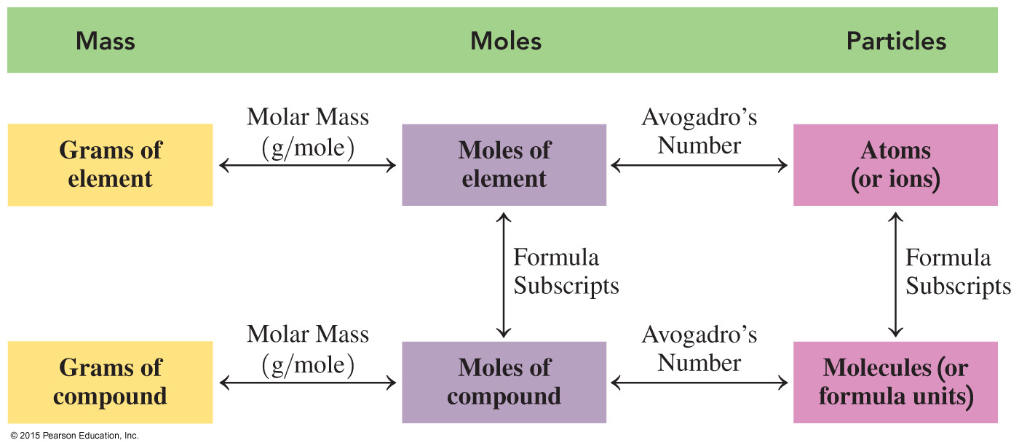
Map: Mass, Moles, and Particles

Slide 47
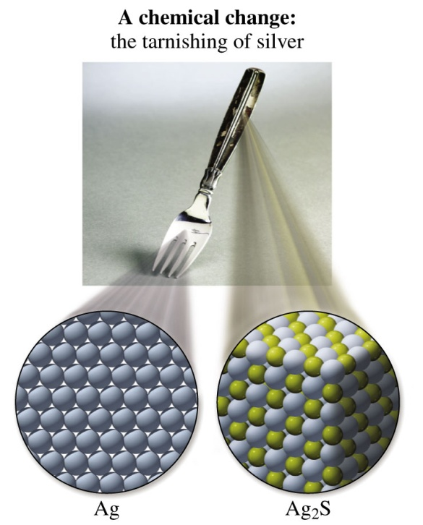
7.4 Equations for Chemical Reactions
47
A chemical change occurs when a substance is converted into one or more new substances that have different formulas and different properties.
Learning Goal Write a balanced chemical equation from the formulas of the reactants and products for a reaction; determine the number of atoms in the reactants and products.

Slide 48
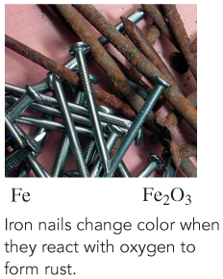
Evidence of a Chemical Reaction

Slide 49
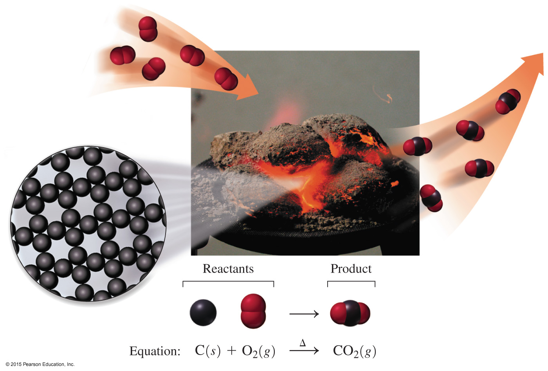
Writing a Chemical Equation

Slide 50
Symbols Used in Chemical Equations
To write a chemical equation,
an arrow separates reactants from the products
reactants are written on the left side of the arrow, products on the right side of the arrow
multiple reactants or products are separated by a plus (+) sign
the delta (Δ) sign indicates heat is used to start the reaction
reactant + reactant product + product
physical states of compounds are denoted in parentheses following the compound: solid (s), liquid (l), gas (g), and aqueous (aq) or dissolved in water
Δ

Slide 51
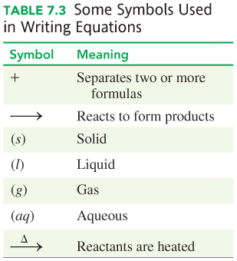
Symbols Used in Chemical Equations

Slide 52
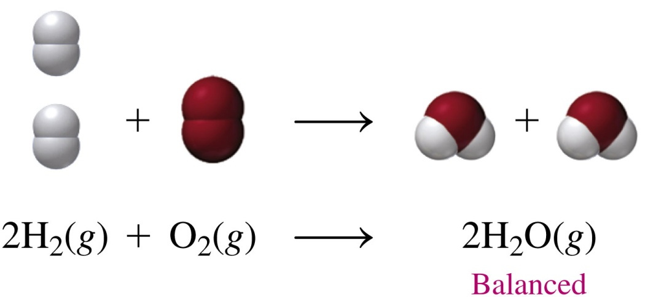
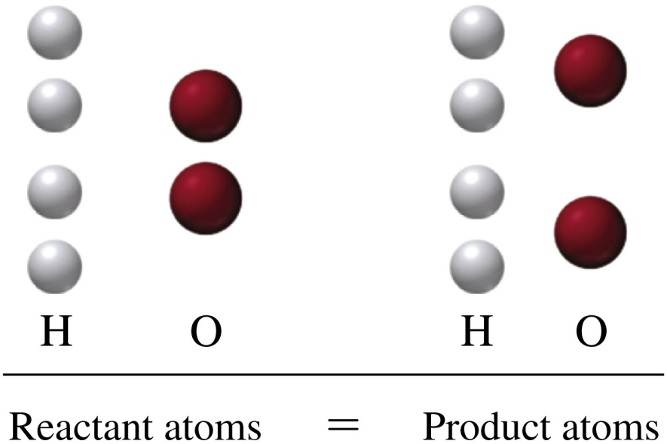
Identifying a Balanced Equation
In a balanced chemical equation,
no atoms are lost or gained
the number of atoms on the reactant side is equal to the number of atoms on the product side for each element

Slide 53
Balancing a Chemical Equation: Formation of Al₂S₃
STEP 1 Write an equation using the correct formulas for the
reactants and products.
Al(s) + S(s) Al₂S₃(s)
ANALYZE GIVEN NEED CONNECT
THE PROBLEM reactants, balanced equal numbers of atoms in products equation reactants and products

Slide 54
Balancing a Chemical Equation: Formation of Al₂S₃
STEP 2 Count the atoms of each element in the reactants
and products.

Slide 55
Balancing a Chemical Equation: Formation of Al₂S₃
STEP 3 Use coefficients to balance each element. Starting with the most complex formula, change coefficients to balance the equation.
2Al(s) + 3S(s) Al₂S₃(s)
STEP 4 Check the final equation to confirm it is balanced. Make sure coefficients are the lowest ratio.

Slide 56
Learning Check
State the number of atoms of each element on the reactant
side and the product side for each of the following balanced equations.
A. P₄(s) + 6Br₂(l) 4PBr₃(g)
B. 2Al(s) + Fe₂O₃(s) 2Fe(s) + Al₂O₃(s)

Slide 57
Solution
State the number of atoms of each element on the reactant
side and the product side for each of the following balanced
equations.
A. P₄(s) + 6Br₂(l) 4PBr₃(g)

Slide 58
Solution
State the number of atoms of each element on the reactant
side and the product side for each of the following balanced
equations.
B. 2Al(s) + Fe₂O₃(s) 2Fe(s) + Al₂O₃(s)

Slide 59
Learning Check
Balance the chemical equation when solid Fe₃O₄ reacts with hydrogen gas to produce solid iron and water.

Slide 60
Solution
Balance the chemical equation when solid Fe₃O₄ reacts with hydrogen gas to produce solid iron and water.
STEP 1 Write an equation using the correct formulas of the reactants and products.
Fe₃O₄(s) + H₂(g) Fe(s) + H₂O(l)
ANALYZE GIVEN NEED CONNECT
THE PROBLEM reactants, balanced equal numbers of atoms in products equation reactants and products

Slide 61
Solution
Balance the chemical equation when solid Fe₃O₄ reacts with hydrogen gas to produce solid iron and water.
Fe₃O₄(s) + H₂(g) Fe(s) + H₂O(l)
STEP 2 Count the number of atoms of each element in the reactants and products.
Unbalanced
Unbalanced
Balanced

Slide 62
Solution
Balance the chemical equation when solid Fe₃O₄ reacts with hydrogen gas to produce solid iron and water.
Fe₃O₄(s) + 4H₂(g) 3Fe(s) + 4H₂O(l)
STEP 3 Use coefficients to balance each element.

Slide 63
Solution
Balance the chemical equation when solid Fe₃O₄ reacts with hydrogen gas to produce solid iron and water.
Fe₃O₄(s) + 4H₂(g) 3Fe(s) + 4H₂O(l)
STEP 4 Check the final equation to confirm it is balanced.

Slide 64
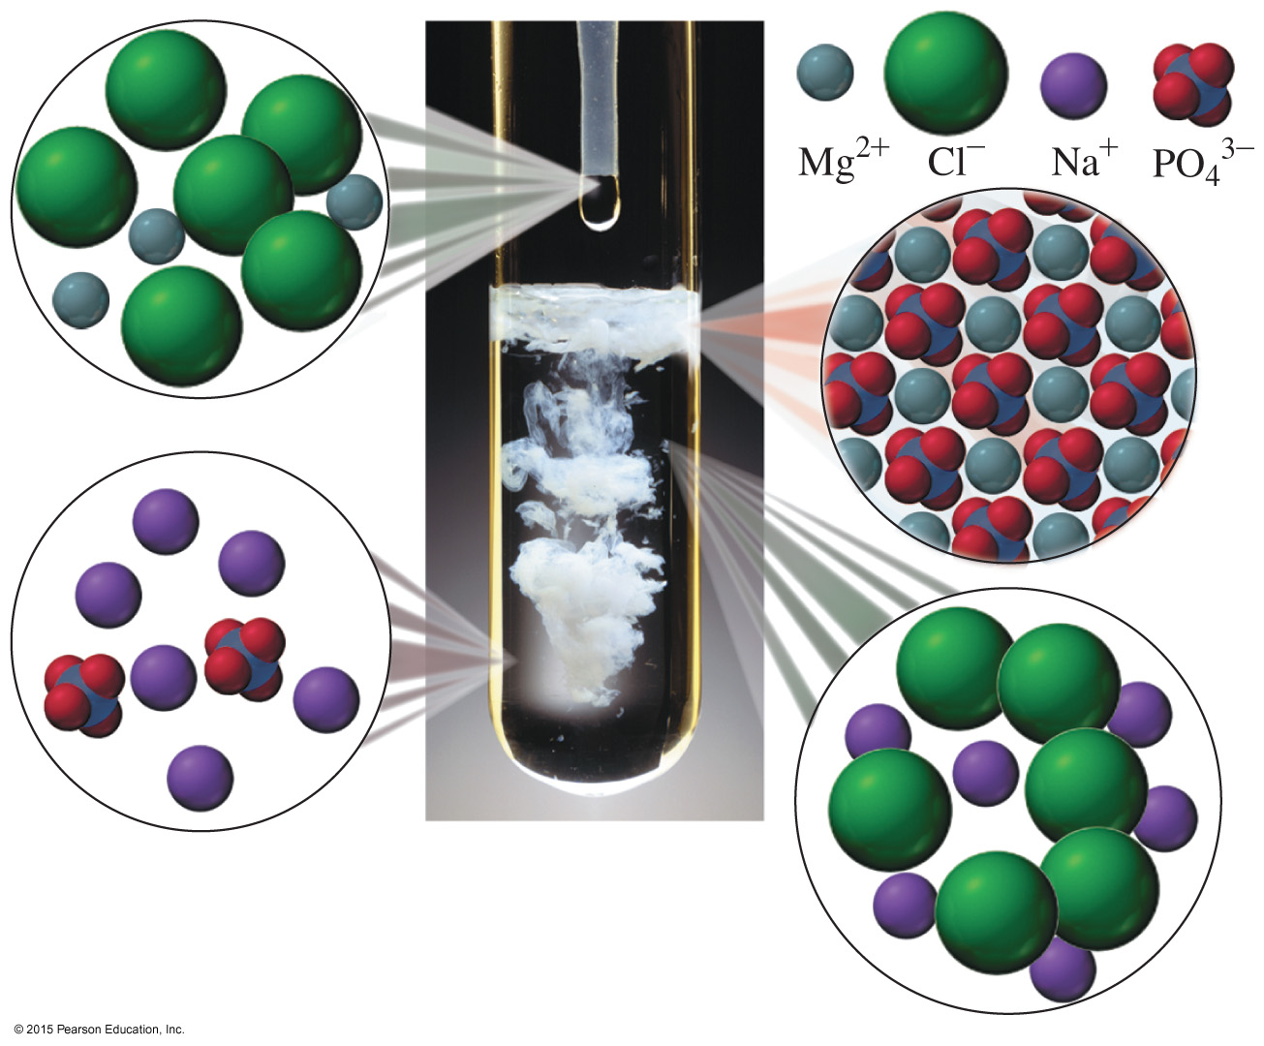
Balancing with Polyatomic Ions

Slide 65
Balancing with Polyatomic Ions
Balance the following chemical equation:
Na₃PO₄(aq) + MgCl₂(aq) Mg₃(PO₄)₂(s) + NaCl(aq)
STEP 1 Write an equation using the correct formulas of the reactants and products.
Na₃PO₄(aq) + MgCl₂(aq) Mg₃(PO₄)₂(s) + NaCl(aq)
Unbalanced
ANALYZE GIVEN NEED CONNECT
THE PROBLEM reactants, balanced equal numbers of atoms in products equation reactants and products

Slide 66
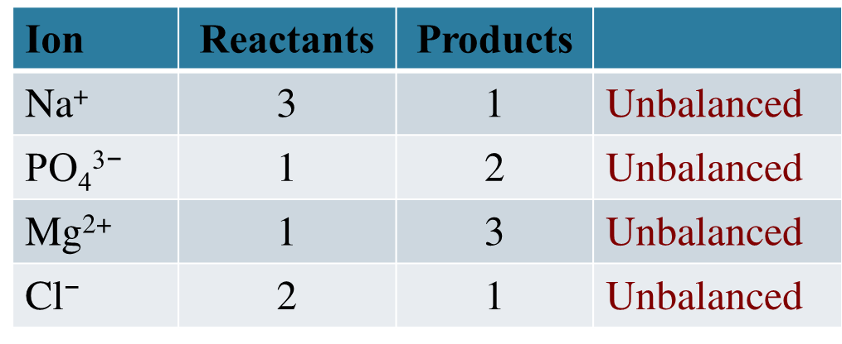
Balancing with Polyatomic Ions
STEP 2 Count the atoms of each element in the reactants and products. Balance the phosphate ion as a unit.
Na₃PO₄(aq) + MgCl₂(aq) Mg₃(PO₄)₂(s) + NaCl(aq)

Slide 67
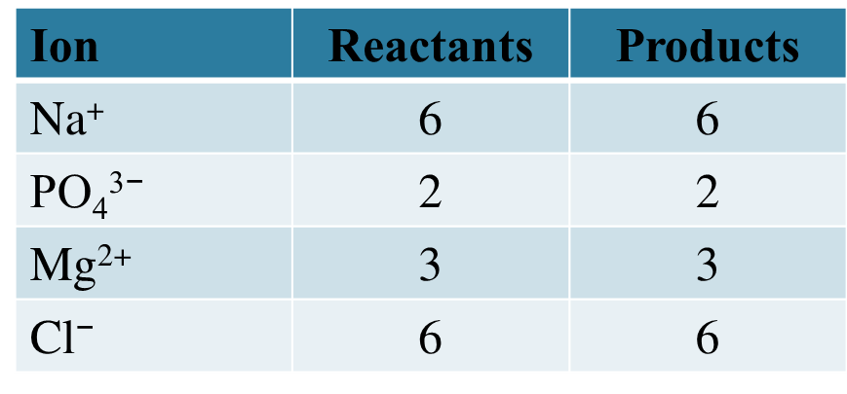
Balancing with Polyatomic Ions
STEP 3 Use coefficients to balance each element.
2Na₃PO₄(aq) + 3MgCl₂(aq) Mg₃(PO₄)₂(s) + 6NaCl(aq)

Slide 68
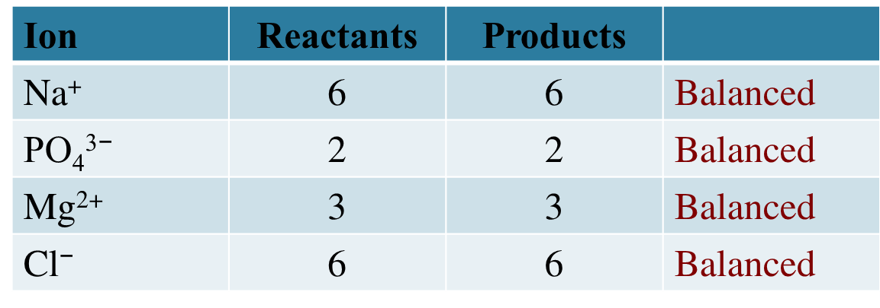
Balancing with Polyatomic Ions
STEP 4 Check the final equation to confirm it is balanced.
2Na₃PO₄(aq) + 3MgCl₂(aq) Mg₃(PO₄)₂(s) + 6NaCl(aq)

Slide 69
Learning Check
Balance and list the coefficients from reactants to products.
A. __Fe₂O₃(s) + __C(s) __Fe(s) + __CO₂(g)
1) 2, 3, 2, 3 2) 2, 3, 4, 3 3) 1, 1, 2, 3
B. __Al(s) + __FeO(s) __Fe(s) + __Al₂O₃(s)
1) 2, 3, 3, 1 2) 2, 1, 1, 1 3) 3, 3, 3, 1
C. __Al(s) + __H₂SO₄(aq) __Al₂(SO₄)₃(aq) + __H₂(g)
1) 3, 2, 1, 2 2) 2, 3, 1, 3 3) 2, 3, 2, 3

Slide 70
Solution
A. 2) 2, 3, 4, 3
2Fe₂O₃(s) + 3C(s) 4Fe(s) + 3CO₂(g)
B. 1) 2, 3, 3, 1
2Al(s) + 3FeO(s) 3Fe(s) + 1Al₂O₃(s)
C. 2) 2, 3, 1, 3
2Al(s) + 3H₂SO₄(aq) 1Al₂(SO₄)₃(aq) + 3H₂(g)

Slide 71
7.5 Types of Chemical Reactions
In a combustion reaction, a candle burns using the oxygen in the air.
Learning Goal Identify a reaction as a combination,
decomposition, single replacement, double replacement,
or combustion.

Slide 72
Types of Reactions
Chemical reactions can be classified as
combination reactions
decomposition reactions
single replacement reactions
double replacement reactions
combustion reactions

Slide 73
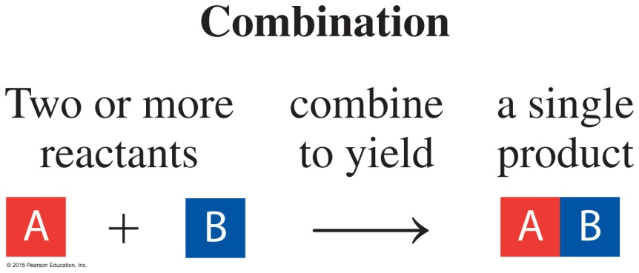
Combination Reactions
In a combination reaction,
two or more elements form one product
simple compounds combine to form one product
2Mg(s) + O₂(g) 2MgO(s)
2Na(s) + Cl₂(g) 2NaCl(s)
SO₃(g) + H₂O(l) H₂SO₄(aq)

Slide 74
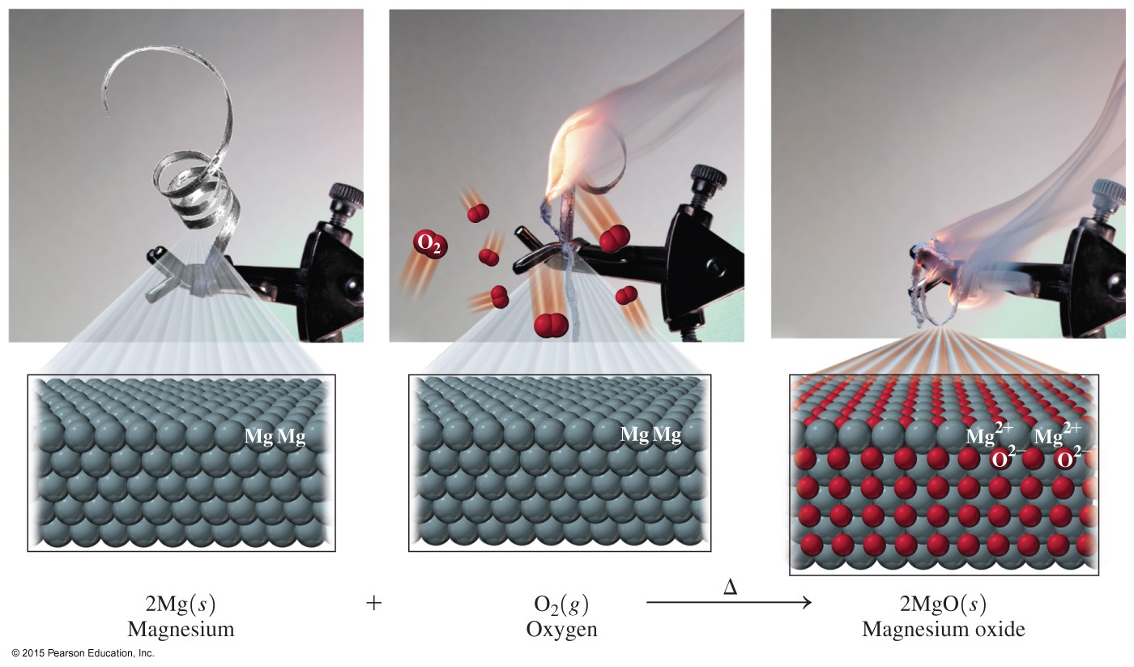
Combination Reaction: MgO

Slide 75
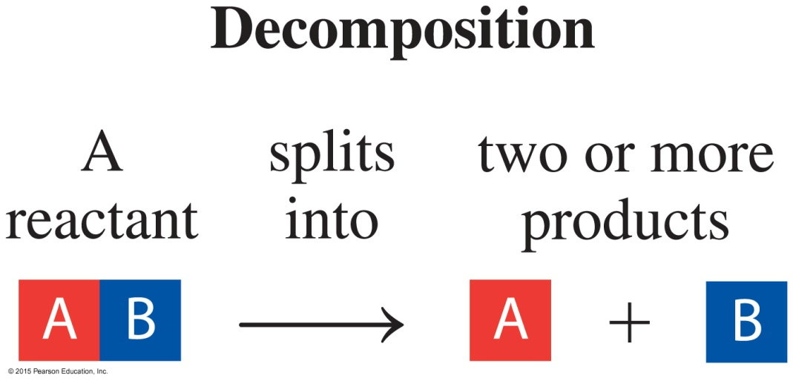
Decomposition Reaction
In a decomposition reaction, one substance splits into
two or more simpler substances.
2HgO(s) 2Hg(l) + O₂(g)
2KClO₃(s) 2KCl(s) + 3O₂(g)

Slide 76
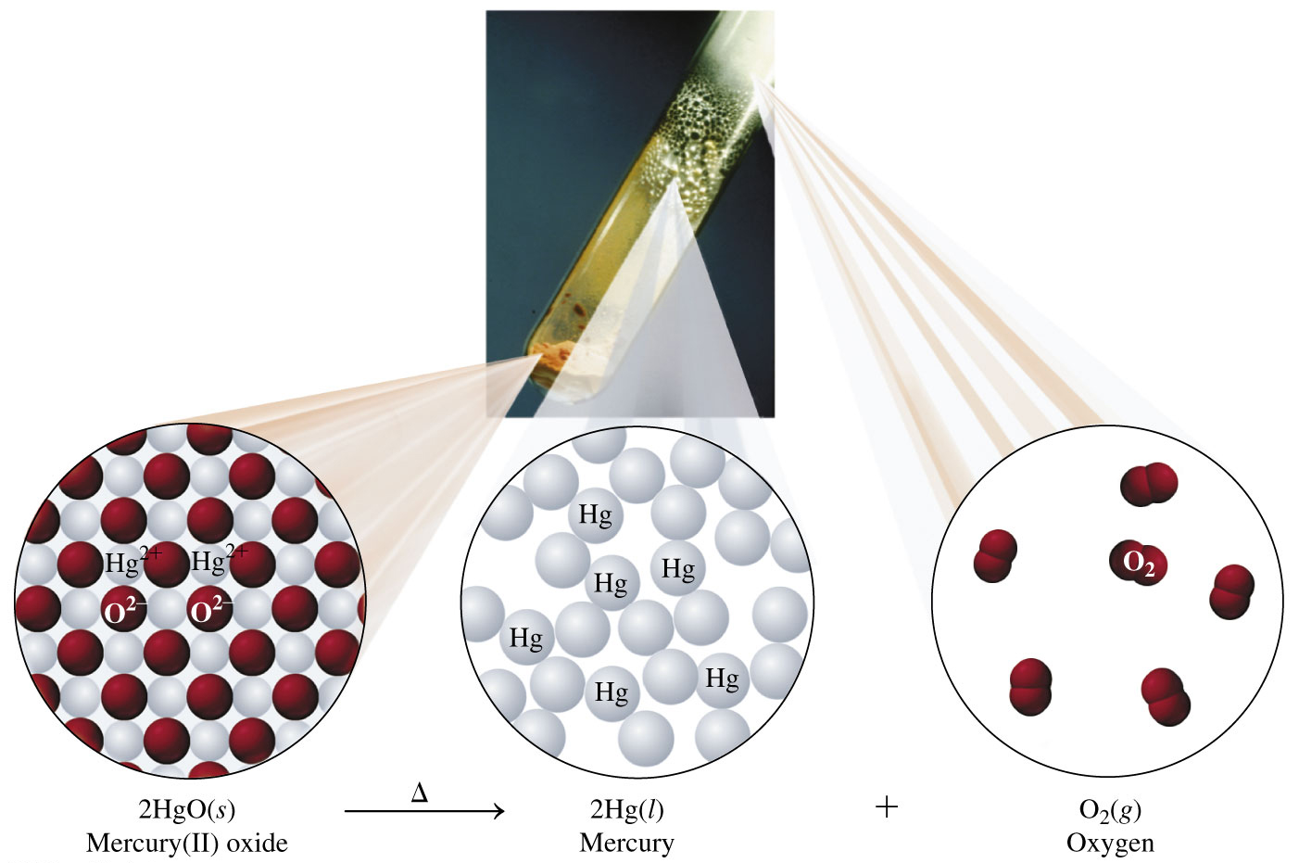
Decomposition Reaction: HgO

Slide 77
Single Replacement Reaction
In a single replacement reaction, one element takes the
place of a different element in another reacting compound.
Zn(s) + 2HCl(aq) ZnCl₂(aq) + H₂(g)
Fe(s) + CuSO₄(aq) FeSO₄(aq) + Cu(s)

Slide 78
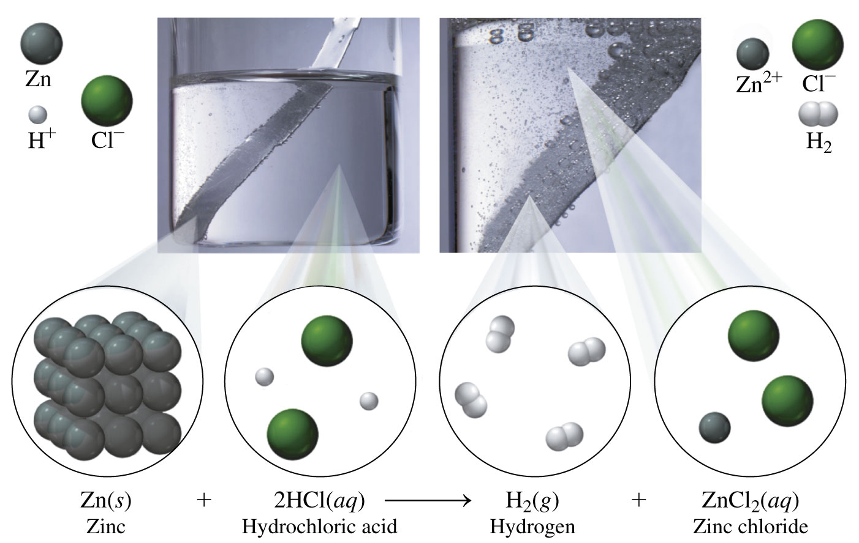
Single Replacement Reaction: ZnCl₂

Slide 79
Double Replacement Reaction
In a double replacement, the positive ions in the reactant compounds switch places.
AgNO₃(aq) + NaCl(aq) AgCl(s) + NaNO₃(aq)
ZnS(s) + 2HCl(aq) ZnCl₂(aq) + H₂S(g)

Slide 80
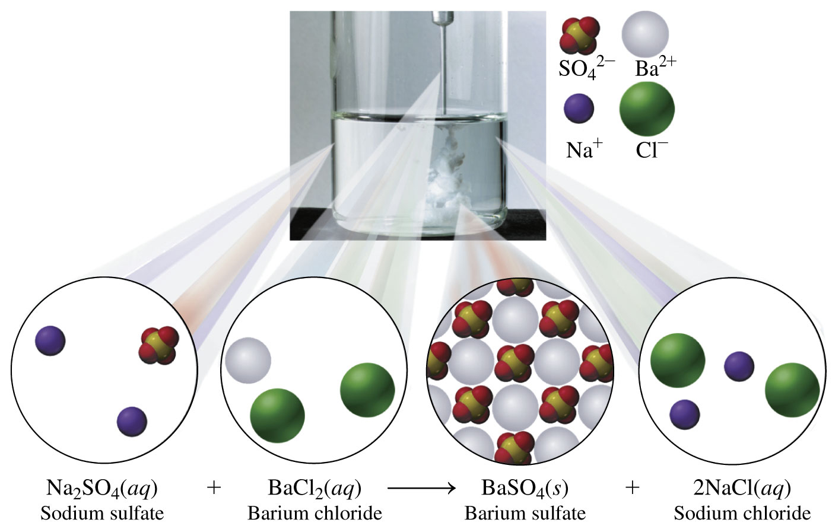
Double Replacement Reaction: BaSO₄

Slide 81
Combustion Reaction
In a combustion reaction,
a carbon-containing compound burns in oxygen gas to form carbon dioxide (CO₂) and water (H₂O)
energy is released as a product in the form of heat
CH₄(g) + 2O₂(g) CO₂(g) + 2H₂O(g) + energy
C₃H₈(g) + 5O₂(g) 3CO₂(g) + 4H₂O(g) + energy
∆
∆

Slide 82
Chemistry Link to Health: Incomplete Combustion
When a propane heater, fireplace, or woodstove is used to burn fuel, adequate ventilation is needed.
When the oxygen supply is limited, incomplete combustion occurs
from burning gas, oil, or wood and produces CO, carbon monoxide
according to the following reaction:
2CH₄(g) + 3O₂(g) 2CO(g) + 4H₂O(g) + heat
∆

Slide 83
Chemistry Link to Health: Incomplete Combustion
Carbon monoxide (CO)
is a colorless, odorless, poisonous gas
attaches to hemoglobin molecules when inhaled
reduces the amount of oxygen gas (O₂) that can reach cells
causes a person to experience a reduction in exercise capability, visual perception, and manual dexterity

Slide 84
Chemistry Link to Health: Incomplete Combustion
Hemoglobin is the protein in the blood that transports O₂ to cells.
When hemoglobin bound to CO (COHb) reaches
10%, a person may experience shortness of breath, mild headache, and drowsiness
30%, a person may experience more severe symptoms, including dizziness, mental confusion, severe headache, and nausea
50%, a person could become unconscious and die if not treated immediately with oxygen

Slide 85
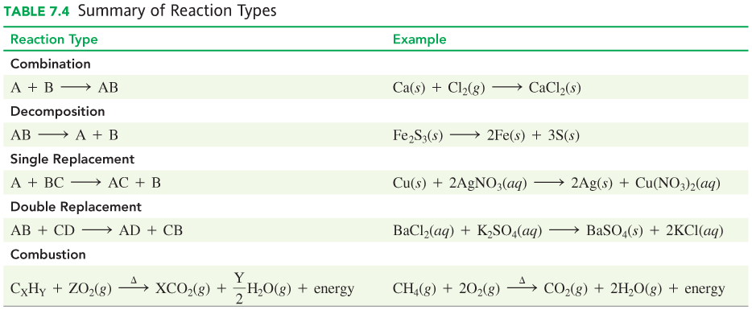
Summary of Reaction Types

Slide 86
Learning Check
Identify each reaction as combination, decomposition,
combustion, single replacement, or double replacement.
A. 2Al(s) + 3H₂SO₄(aq) Al₂(SO₄)₃(s) + 3H₂(g)
B. Na₂SO₄(aq) + 2AgNO₃(aq) Ag₂SO₄(s) + 2NaNO₃(aq)
C. 3C(s) + Fe₂O₃(s) 2Fe(s) + 3CO(g)
D. C₂H₄(g) + 3O₂(g) 2CO₂(g) + 2H₂O(g)

Slide 87
Solution
Identify each reaction as combination, decomposition,
combustion, single replacement, or double replacement.
A. 2Al(s) + 3H₂SO₄(aq) Al₂(SO₄)₃(s) + 3H₂(g)
Single Replacement
B. Na₂SO₄(aq) + 2AgNO₃(aq) Ag₂SO₄(s) + 2NaNO₃(aq)
Double Replacement

Slide 88
Solution
Identify each reaction as combination, decomposition,
combustion, single replacement, or double replacement.
C. 3C(s) + Fe2O3(s) 2Fe(s) + 3CO(g)
Single replacement
C. N₂(g) + O₂(g) 2NO(g) Combination
D. C₂H₄(g) + 3O₂(g) 2CO₂(g) + 2H₂O(g)
Combustion

Slide 89
Learning Check
Identify each reaction as combination, decomposition,
combustion, single replacement, or double replacement.
A. 3Ba(s) + N₂(g) Ba₃N₂(s)
B. 2Ag(s) + H₂S(aq) Ag₂S(s) + H₂(g)
C. 2C₂H₆(g) + 7O₂(g) 4CO₂(g) + 6H₂O(g)
D. PbCl₂(aq) + K₂SO₄(aq) 2KCl(aq) + PbSO₄(s)
E. K₂CO₃(s) K₂O(aq) + CO₂(g)

Slide 90
Solution
Identify each reaction as combination, decomposition,
combustion, single replacement, or double replacement.
A. 3Ba(s) + N₂(g) Ba₃N₂(s) Combination
B. 2Ag(s) + H₂S(aq) Ag₂S(s) + H₂(g)
Single Replacement
C. 2C₂H₆(g) + 7O₂(g) 4CO₂(g) + 6H₂O(g)
Combustion

Slide 91
Solution
Identify each reaction as combination, decomposition,
combustion, single replacement, or double replacement.
D. PbCl₂(aq) + K₂SO₄(aq) 2KCl(aq) + PbSO₄(s)
Double Replacement
E. K₂CO₃(s) K₂O(aq) + CO₂(g)
Decomposition

Slide 92
7.6 Oxidation−Reduction Reactions
© 2018 Pearson Education Ltd.
Rust forms when the oxygen in the air reacts with iron. In this process, electrons are transferred from one substance to another.
Learning Goal Define the terms oxidation and reduction; identify the reactants oxidized and reduced.

Slide 93
Oxidation−Reduction Reactions
An oxidation–reduction reaction
provides us with energy from food
provides electrical energy in batteries
occurs when iron rusts:
4Fe(s) + 3O₂(g) 2Fe₂O₃(s)

Slide 94
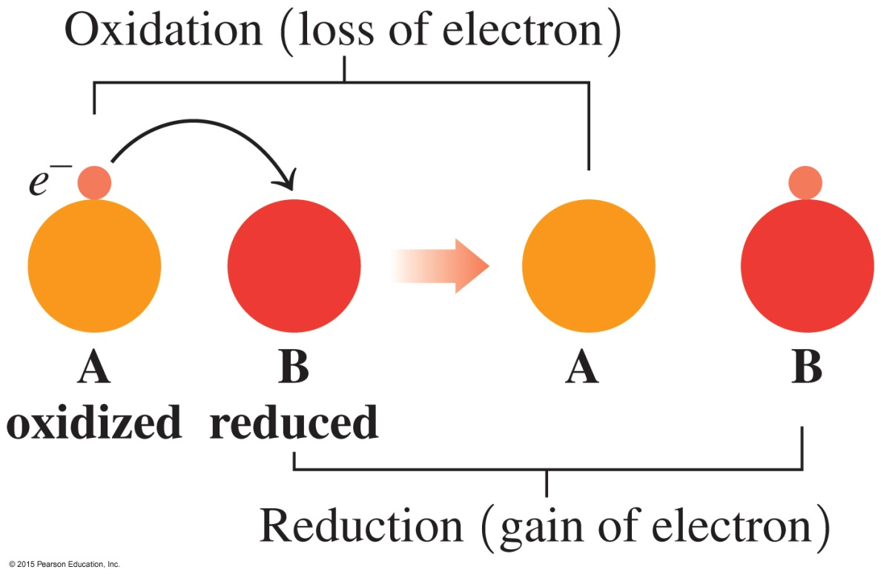
Oxidation−Reduction Reactions
In an oxidation–reduction reaction, electrons are transferred from one substance to another.
OIL RIG
Oxidation Is Loss of electrons
Reduction Is Gain of electrons

Slide 95
Oxidation and Reduction
The green patina on the Statue of Liberty is due to the oxidation of copper metal as it forms a green solid, CuO.
2Cu(s) 2Cu²⁺(s) + 4e⁻oxidation
O₂(g) + 4e⁻ 2O²⁻ (s) reduction
2Cu(s) + O₂(g) 2CuO(s)

Slide 96
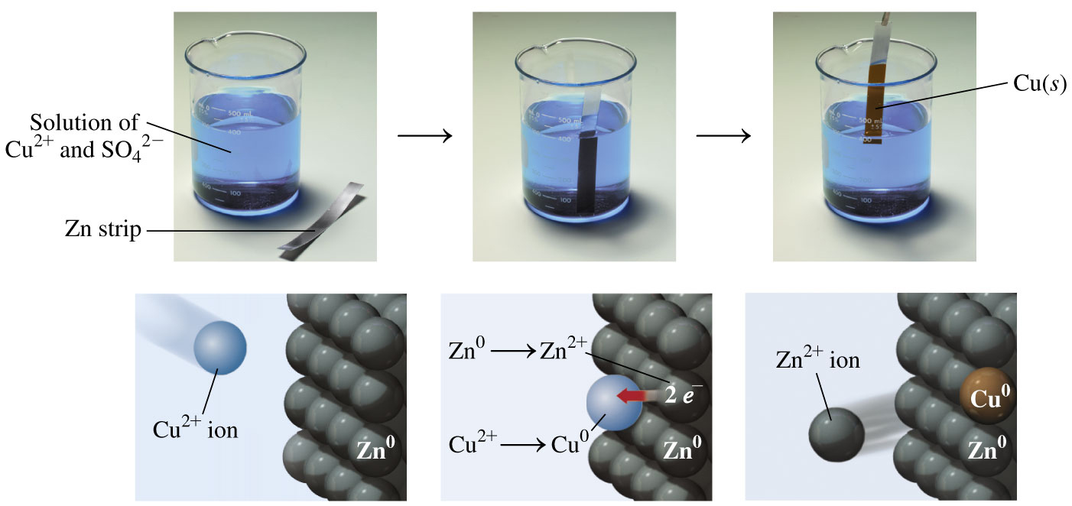
Zn Transfers Electrons to Cu²⁺

Slide 97
Learning Check
Identify each of the following as oxidation or reduction:
____ A. Sn(s) Sn⁴⁺(aq) + 4e⁻
____ B. Fe³⁺(aq) + 1e⁻ Fe²⁺(aq)
____ C. Cl₂(g) + 2e⁻ 2Cl⁻ (aq)

Slide 98
Solution
Identify each of the following as oxidation or reduction:
Oxidation A. Sn(s) Sn⁴⁺(aq) + 4e⁻
Reduction B. Fe³⁺(aq) + 1e⁻ Fe²⁺(aq)
Reduction C. Cl₂(g) + 2e⁻ 2Cl⁻ (aq)

Slide 99
Learning Check
In light-sensitive sunglasses, UV light initiates an
oxidation–reduction reaction.
2Ag⁺ + 2Cl⁻ 2Ag + Cl₂
A. Which reactant is oxidized?
B. Which reactant is reduced?
uv light

Slide 100
Solution
In light-sensitive sunglasses, UV light initiates an
oxidation-reduction reaction.
2Ag⁺ + 2Cl⁻ 2Ag + Cl₂
A. Which reactant is oxidized? 2Cl⁻ Cl₂ + 2e⁻
B. Which reactant is reduced? 2Ag⁺ + 2e⁻ 2Ag
uv light

Slide 101
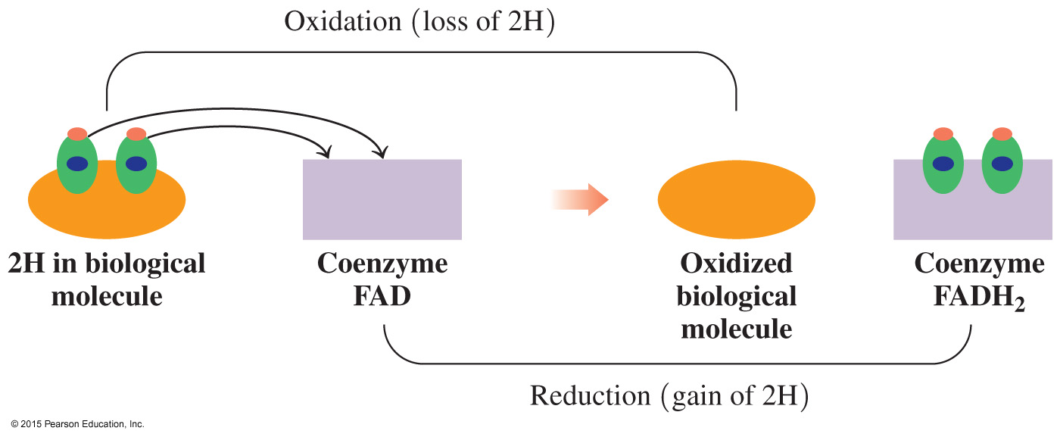
Oxidation–Reduction in Biological Systems
The biochemical molecule coenzyme FAD (flavin adenine dinucleotide) can be reduced to the coenzyme FADH₂ by the transfer of two hydrogen atoms (2H⁺ and 2e⁻).

Slide 102
Oxidation–Reduction of CH₃OH
In many biochemical oxidation–reduction reactions, the transfer of hydrogen atoms is necessary for the production of energy.
The body metabolizes methyl alcohol, a poisonous substance, by the following reactions:
CH₃OH H₂CO + 2H Oxidation: loss of H atoms
methyl alcohol formaldehyde
2H₂CO + O₂ 2H₂CO₂ Oxidation: addition of O atoms
formaldehyde formic acid
2H₂CO₂ + O₂ 2CO₂ + 2 H₂O Oxidation: addition of O atoms
formic acid
The intermediate products are toxic, causing headaches and possible death because they interfere with key reactions in cells.

Slide 103
Characteristics of Oxidation−Reduction
The particular definition of oxidation and reduction depends on the process that occurs in the reaction. Oxidation
always involves a loss of electrons,
may also be seen as an addition of oxygen
may also be seen as the loss of hydrogen atoms
The definition of reduction
always involves a gain of electrons
may also be seen as the loss of oxygen
may also be seen as the gain of hydrogen

Slide 104
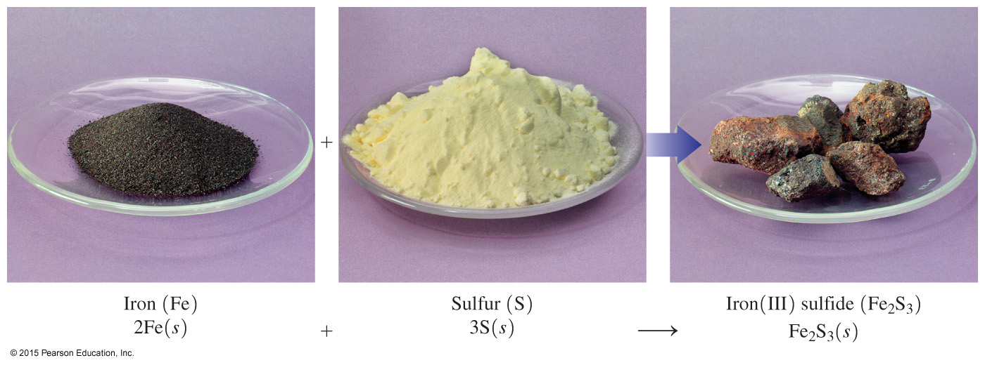
7.7 Mole Relationships in Chemical Equations
In the chemical reaction of Fe and S, the mass of the reactants is the same as the mass of the product, Fe₂S₃.
Learning Goal Use a mole–mole factor from a balanced chemical equation to calculate the number of moles of another substance in the reaction.

Slide 105
Law of Conservation of Mass
The law of conservation of mass indicates that in an ordinary chemical reaction,
matter cannot be created or destroyed
no change in total mass occurs
the mass of products is equal to the mass of reactants

Slide 106
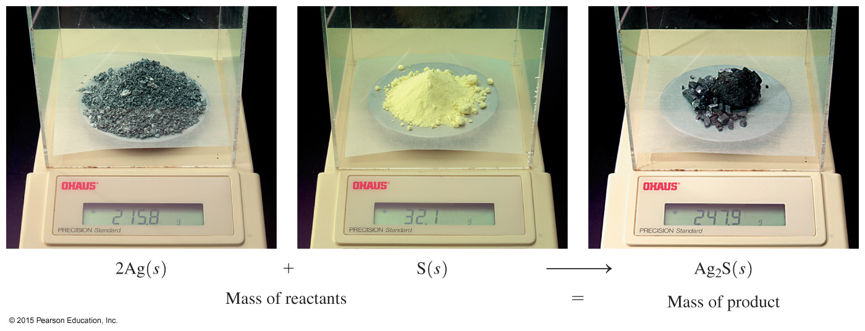
Conservation of Mass
Tarnish (Ag₂S) forms when silver reacts with sulfur to form silver sulfide.
2Ag(s) + S(s) Ag₂S(s)
Twice the number of silver atoms react as sulfur atoms.

Slide 107
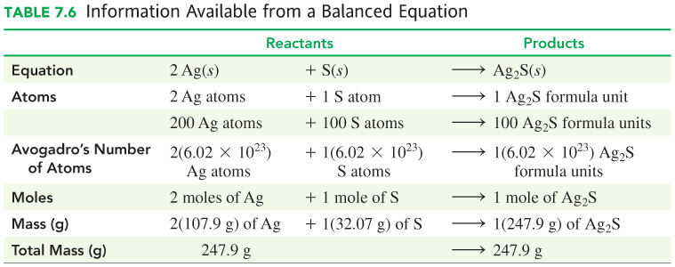
Information from a Balanced Equation

Slide 108
Reading Equations in Moles
Consider the following equation:
2Fe(s) + 3S(s) Fe₂S₃(s)
We can read this as:
2 moles of Fe + 3 moles of S 1 mole of Fe₂S₃

Slide 109
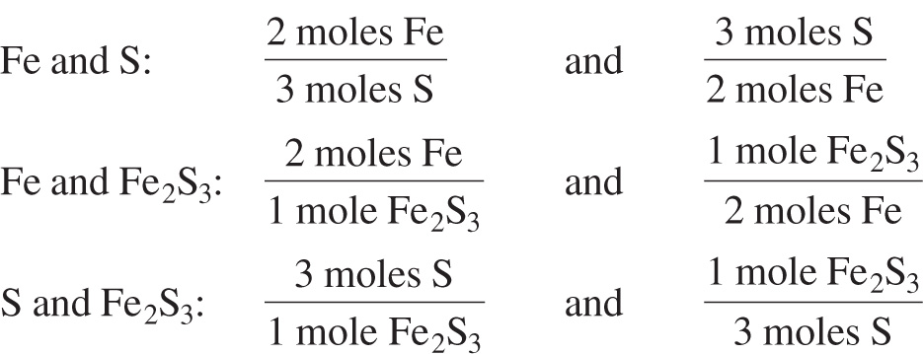
Writing Conversion Factors from Equations
A mole–mole factor is a ratio of the moles for any two substances in an equation.
2Fe(s) + 3S(s) Fe₂S₃(s)

Slide 110
Learning Check
Consider the following equation:
3H₂(g) + N₂(g) 2NH₃(g)
A mole–mole factor for H₂ and N₂ is
A mole–mole factor for NH₃ and H₂ is

Slide 111
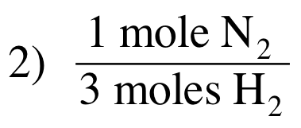
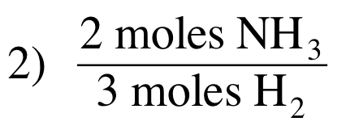
Solution
Consider the following equation:
3H₂(g) + N₂(g) 2NH₃(g)
A mole–mole factor for H₂ and N₂ is
A mole–mole factor for NH₃ and H₂ is

Slide 112
Calculations with Mole Factors
How many moles of Fe₂O₃ can form from 6.0 moles of O₂?
4Fe(s) + 3O₂(g) 2Fe₂O₃(s)
Relationship: 3 moles of O₂ = 2 moles of Fe₂O₃
Use a mole–mole factor to determine the moles of Fe₂O₃.

Slide 113
Learning Check
How many moles of Fe are needed for the reaction of
12.0 moles of O₂?
4Fe(s) + 3O₂(g) 2Fe₂O₃(s)
A. 3.00 moles of Fe
B. 9.00 moles of Fe
C. 16.0 moles of Fe

Slide 114
Solution
How many moles of Fe are needed for the reaction of
12.0 moles of O₂?
4Fe(s) + 3O₂(g) 2Fe₂O₃(s)
STEP 1 State the given and needed quantities.
ANALYZE GIVEN NEED CONNECT
THE PROBLEM 12.0 moles O₂ moles Fe mole-mole factor
4Fe(s) + 3O₂(g) 2 Fe₂O₃(s)

Slide 115
Solution
How many moles of Fe are needed for the reaction of
12.0 moles of O₂?
4Fe(s) + 3O₂(g) 2Fe₂O₃(s)
STEP 2 Write a plan to convert the given to the needed quantity (moles).
moles of O₂ moles of Fe
Mole–mole
factor

Slide 116
Solution
How many moles of Fe are needed for the reaction of
12.0 moles of O₂?
4Fe(s) + 3O₂(g) 2Fe₂O₃(s)
STEP 3 Use coefficients to write mole–mole factors.
3 moles of O₂ = 4 moles of Fe

Slide 117
Solution
How many moles of Fe are needed for the reaction of
12.0 moles of O₂?
4Fe(s) + 3O₂(g) 2Fe₂O₃(s)
STEP 4 Set up the problem to give the needed quantity (moles).
The answer is C.
exact
Three SFs
exact
Three SFs

Slide 118
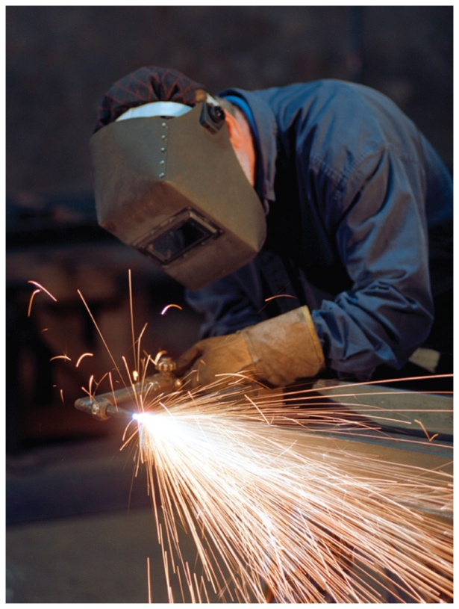
7.8 Mass Calculations for Chemical Reactions
A mixture of acetylene and oxygen undergoes combustion during the welding of metals. We can calculate the mass of acetylene used to weld a specific mass of metal.
Learning Goal Given the mass in grams of a substance in a
reaction, calculate the mass in grams of another substance in the reaction.

Slide 119
Mass Calculations
Given a balanced chemical equation, we can convert
the mass of one substance A to another substance B by
first, converting the mass of substance A to moles using the molar mass of A
second, converting moles of substance A to moles of substance B using the mole ratio of B to A in the balanced equation
third, converting moles of substance B to grams using the molar mass of B

Slide 120
Mass N₂ − Mass NH₃
Suppose we want to determine the mass (grams) of NH₃ that can be produced from 32 grams of N₂ in the following equation:
N₂(g) + 3H₂(g) 2NH₃(g)
SOLUTION:
STEP 1 State the given and needed quantities (grams).
ANALYZE GIVEN NEED CONNECT
THE PROBLEM 32 g of N₂ grams of NH₃ molar masses,
mole-mole factor
N₂(g) + 3H₂(g) 2NH₃(g)

Slide 121
Mass N₂ − Mass NH₃
Suppose we want to determine the mass (grams) of NH₃ that can be produced from 32 grams of N₂ in the following equation:
N₂(g) + 3H₂(g) 2NH₃(g)
STEP 2 Write a plan to convert the given to the needed quantity (grams).
grams moles moles grams
N₂ N₂ NH₃ NH₃
Molar mass
Mole–mole factor
Molar mass

Slide 122
Mass N₂ − Mass NH₃
Suppose we want to determine the mass (grams) of NH₃ that can be produced from 32 grams of N₂ in the following equation.
N₂(g) + 3H₂(g) 2NH₃(g)
STEP 3 Use coefficients to write mole–mole factors; write molar mass factors if needed.

Slide 123
Mass N₂ − Mass NH₃
Suppose we want to determine the mass (grams) of NH₃ that can be produced from 32 grams of N₂ in the following equation.
N₂(g) + 3H₂(g) 2NH₃(g)
STEP 4 Set up the problem to give the needed quantity (grams).
exact
exact
Four SFs
Two SFs
Four SFs
exact
exact
Two SFs

Slide 124
Learning Check
How many grams of O₂ are needed to produce 45.8 grams of
Fe₂O₃ in the following reaction?
4Fe(s) + 3O₂(g) 2Fe₂O₃(s)
A. 38.4 g of O₂
B. 13.8 g of O₂
C. 1.38 g of O₂

Slide 125
Solution
How many grams of O₂ are needed to produce 45.8 grams of
Fe₂O₃ in the following reaction?
4Fe(s) + 3O₂(g) 2Fe₂O₃(s)
STEP 1 State the given and needed quantities.
ANALYZE GIVEN NEED CONNECT
THE PROBLEM 45.8 g of Fe₂O₃ grams of O₂ molar masses,
mole-mole factor
4Fe(s) + 3O₂(g) 2Fe₂O₃(s)

Slide 126
Solution
How many grams of O₂ are needed to produce 45.8 grams of
Fe₂O₃ in the following reaction?
4Fe(s) + 3O₂(g) 2Fe₂O₃(s)
STEP 2 Write a plan to convert the given to the needed quantity (grams).
grams moles moles grams
Fe₂O₃ Fe₂O₃ O₂ O₂
Molar mass
Mole–mole factor
Molar mass

Slide 127
Solution
How many grams of O₂ are needed to produce 45.8 grams of
Fe₂O₃ in the following reaction?
4Fe(s) + 3O₂(g) 2Fe₂O₃(s)
STEP 3 Use coefficients to write mole–mole factors; write molar mass factors if needed.

Slide 128
Solution
How many grams of O₂ are needed to produce 45.8 grams of
Fe₂O₃ in the following reaction?
4Fe(s) + 3O₂(g) 2Fe₂O₃(s)
STEP 4 Set up the problem to give the needed quantity (grams).
Answer is B.
exact
exact
Four SFs
Three SFs
Five SFs
exact
exact
Three SFs

Slide 129
Learning Check
The reaction between H₂ and O₂ produces 13.1 g of water. How many grams of O₂ reacted?
2H₂(g) + O₂(g) 2H₂O(g)

Slide 130
Solution
The reaction between H₂ and O₂ produces 13.1 g of water. How many grams of O₂ reacted?
2H₂(g) + O₂(g) 2H₂O(g)
STEP 1 State the given and needed quantities.
ANALYZE GIVEN NEED CONNECT
THE PROBLEM 13.1 g of H₂O grams of O₂ molar masses,
mole-mole factor
2H₂(g) + O₂(g) 2H₂O(g)

Slide 131
Solution
The reaction between H₂ and O₂ produces 13.1 g of water. How many grams of O₂ reacted?
2H₂(g) + O₂(g) 2H₂O(g)
STEP 2 Write a plan to convert the given to the needed quantity (grams).
grams moles moles grams
H₂O H₂O O₂ O₂
Molar mass
Mole–mole factor
Molar mass

Slide 132
Solution
The reaction between H₂ and O₂ produces 13.1 g of water. How many grams of O₂ reacted?
2H₂(g) + O₂(g) 2H₂O(g)
STEP 3 Use coefficients to write mole–mole factors; write molar mass factors if needed.

Slide 133
Solution
The reaction between H₂ and O₂ produces 13.1 g of water. How many grams of O₂ reacted?
2H₂(g) + O₂(g) 2H₂O(g)
STEP 4 Set up the problem to give the needed quantity (grams).
exact
exact
Four SFs
Three SFs
Four SFs
exact
exact
Three SFs

Slide 134
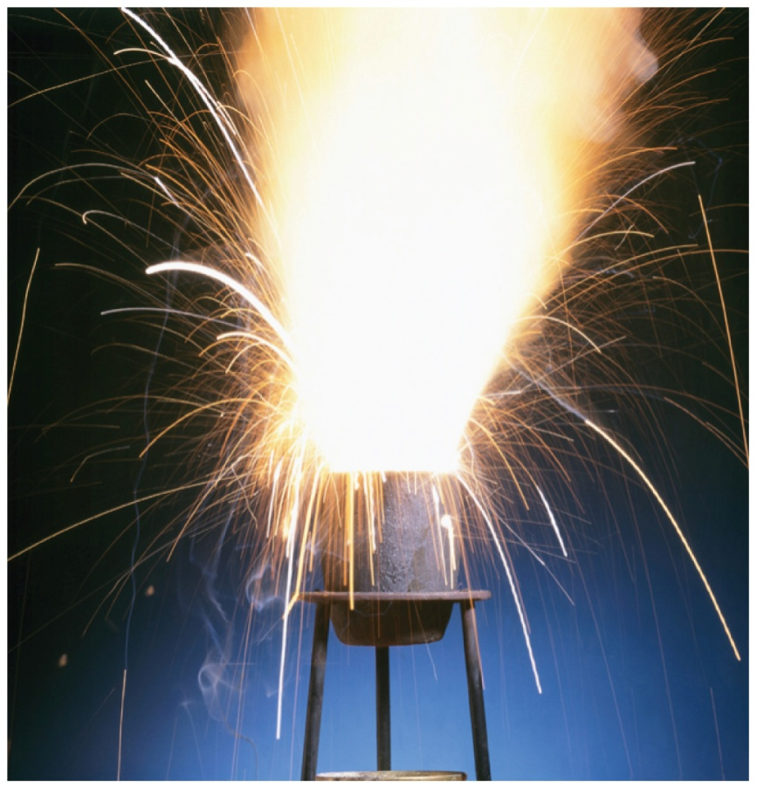
7.9 Energy in Chemical Reactions
The high temperature of the thermite reaction has been used to cut or weld railroad tracks.
Learning Goal Describe exothermic and endothermic
reactions and factors that affect the rate of a reaction.

Slide 135
Molecules Must Collide for Reaction
Three conditions for a reaction to occur are the following:
1. collision The reactants must collide.
2. orientation The reactants must align properly to
break and form bonds.
3. energy The collision must provide the energy of
activation.

Slide 136
Exothermic Reaction, Heat Released
In an exothermic reaction,
heat is released
the energy of the products is less than the energy of the reactants
heat is a product
C(s) + 2H₂(g) CH₄(g) + 18 kcal

Slide 137
Endothermic Reaction, Heat Absorbed
In an endothermic reaction,
heat is absorbed
the energy of the products is greater than the energy of the reactants
heat is a reactant (added)
N₂(g) + O₂(g) + 43.3 kcal 2NO(g)

Slide 138
Learning Check
Identify each reaction as exothermic or endothermic.
A. N₂(g) + 3H₂(g) 2NH₃(g) + 22 kcal
B. CaCO₃(s) + 133 kcal CaO(s) + CO₂(g)
C. 2SO₂(g) + O₂(g) 2SO₃(g) + heat

Slide 139
Solution
Identify each reaction as exothermic or endothermic.
A. N₂(g) + 3H₂(g) 2NH₃(g) + 22 kcal
Exothermic
B. CaCO₃(s) + 133 kcal CaO(s) + CO₂(g)
Endothermic
C. 2SO₂(g) + O₂(g) 2SO₃(g) + heat
Exothermic

Slide 140
Reaction Rate
The reaction rate
is the speed at which reactant is used up
is the speed at which product forms
increases when temperature rises because the reacting molecules move faster, providing more collisions between molecules with energy of activation
increases with increase in concentration of reactants

Slide 141
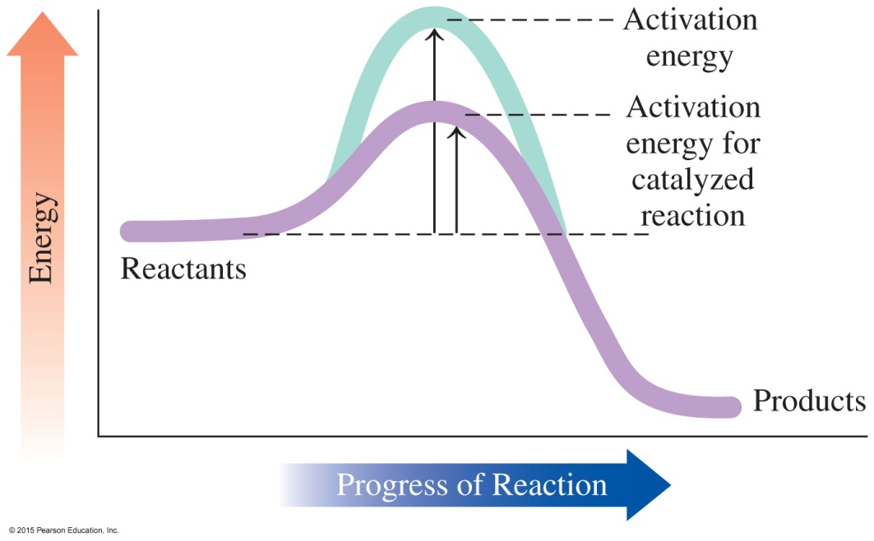
Catalyst
A catalyst
increases the rate of a reaction
lowers the energy of activation
is not used up during the reaction

Slide 142
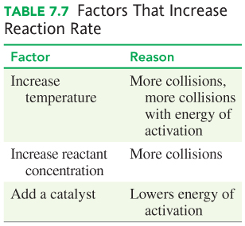
Factors That Increase Reaction Rate

Slide 143
Learning Check
State the effect of each on the rate of reaction as increases, decreases, or has no effect.
A. increasing the temperature
B. removing some of the reactants
C. adding a catalyst
D. placing the reaction flask in ice
E. increasing the concentration of one of the reactants

Slide 144
Solution
State the effect of each on the rate of reaction as increases, decreases, or has no effect.
A. increasing the temperature increases
B. removing some of the reactants decreases
C. adding a catalyst increases
D. placing the reaction flask in ice decreases
E. increasing the concentration of one of the reactants increases

Slide 145
Learning Check
Indicate the effect of each factor listed on the rate of the
following reaction as increases, decreases, or no change.
2CO(g) + O₂(g) 2CO₂(g)
A. raising the temperature
B. adding O₂
C. adding a catalyst
D. lowering the temperature

Slide 146
Solution
Indicate the effect of each factor listed on the rate of the
following reaction as increases, decreases, or no change.
2CO(g) + O₂(g) 2CO₂(g)
A. raising the temperature increases
B. adding O₂ increases
C. adding a catalyst increases
D. lowering the temperature decreases

Slide 147
Concept Map

