Slide 1
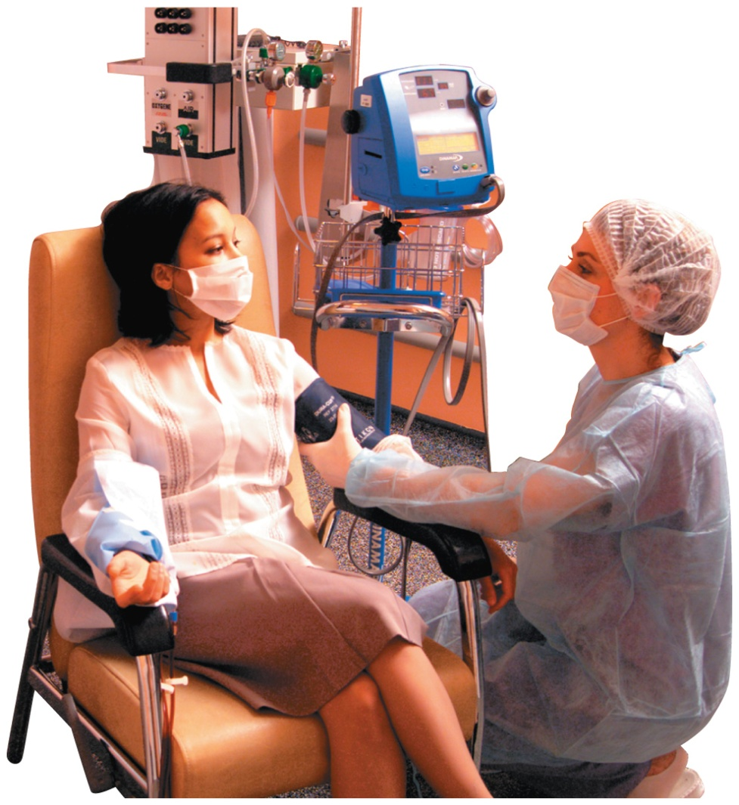
Chapter 9 Solutions
7.1
Solutions
A dialysis nurse informs Michelle that
her side effects are due to her body’s inability to regulate the amount of water in her cells
the amount of water in her body fluids is regulated by the concentration of electrolytes and the rate at which waste products are removed from her body

Slide 2
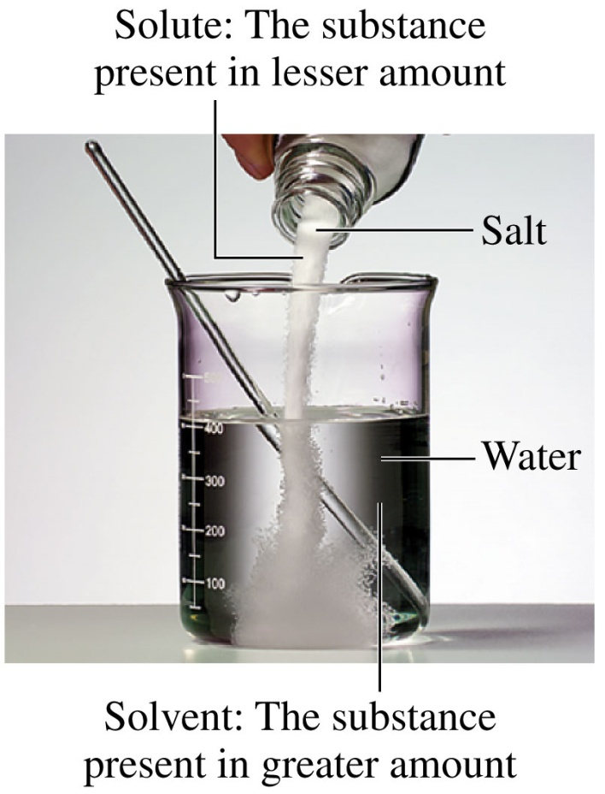
9.1 Solutions
Solutions
are homogeneous mixtures of two or more substances
form when there is sufficient attraction between the solute and solvent molecules
have two components: the solvent, present in a much larger amount, and the solute, present in a smaller amount
Learning Goal: Identify the solute and solvent in a solution; describe the formation of a solution.

Slide 3
Solutes
Solutes
may be liquids, gases, or solids
are spread evenly throughout the solution
mix with solvents, so the solute and solvent have the same physical state
cannot be separated by filtration but can be separated by evaporation
are not visible but can give a color to the solution

Slide 4
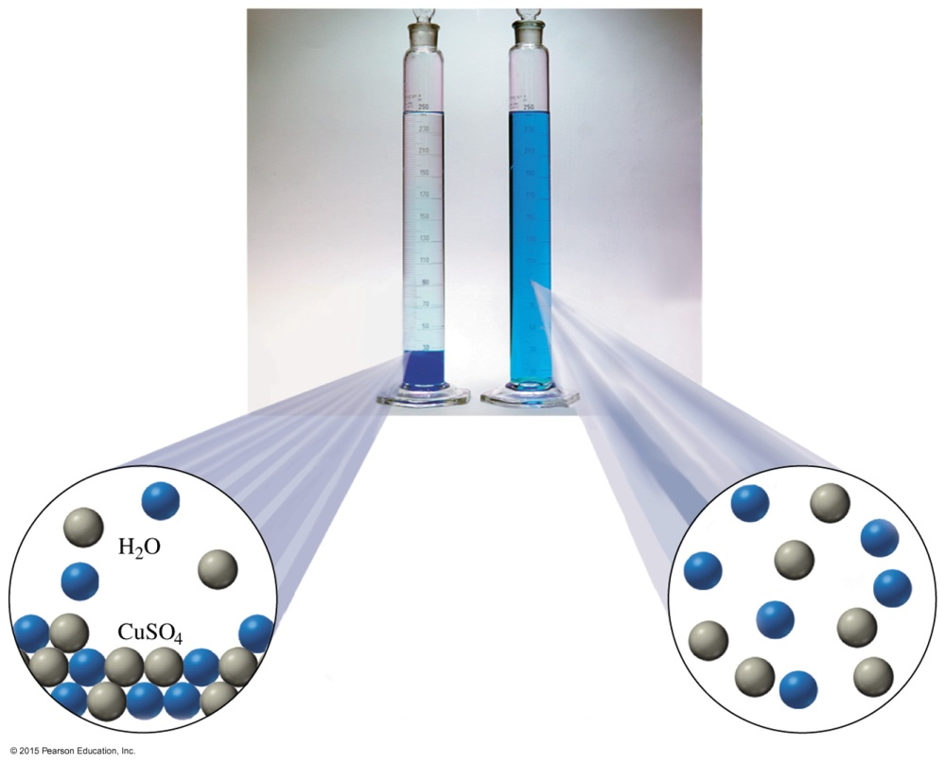
Solutes
A solution of copper(II) sulfate (CuSO₄) forms as particles of solute dissolve and become evenly dispersed among the solvent (water) molecules.

Slide 5
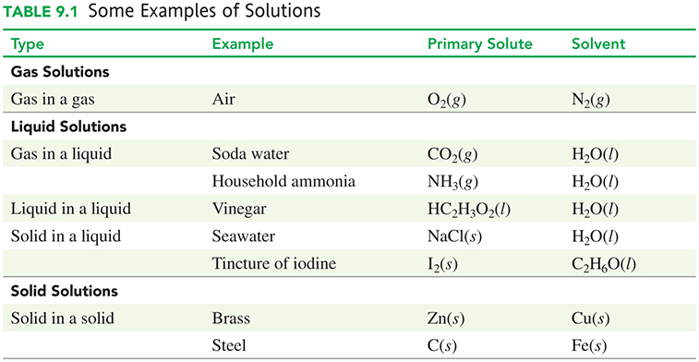
Types of Solutes and Solvents
Solutes and solvents may be solids, liquids, or gases.

Slide 6
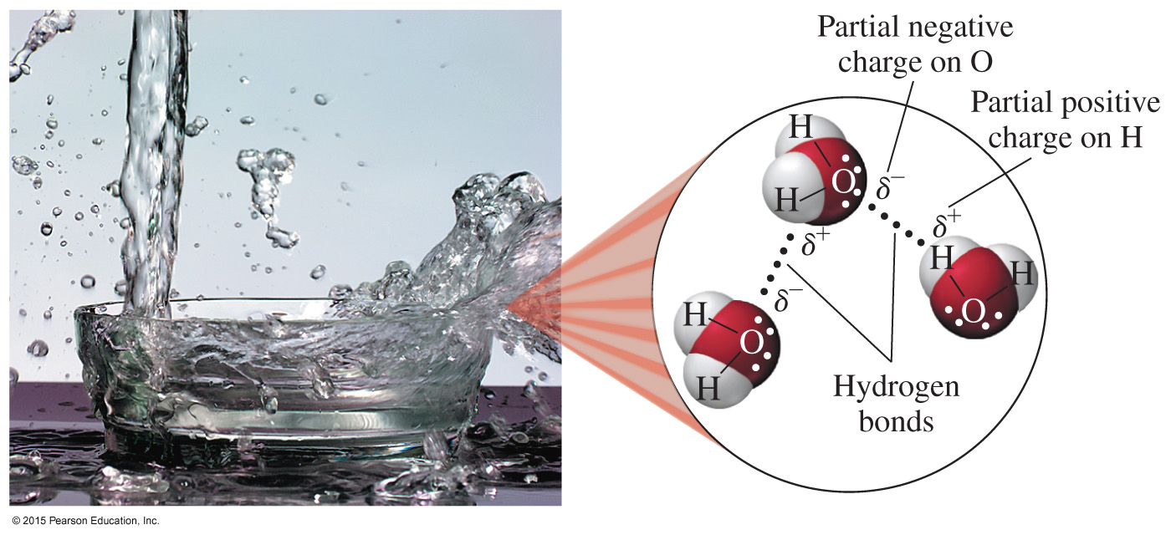
Water as a Solvent
Water
is one of the most common solvents in nature
is a polar molecule because of polar O—H bonds
molecules form hydrogen bonds important in many biological compounds

Slide 7
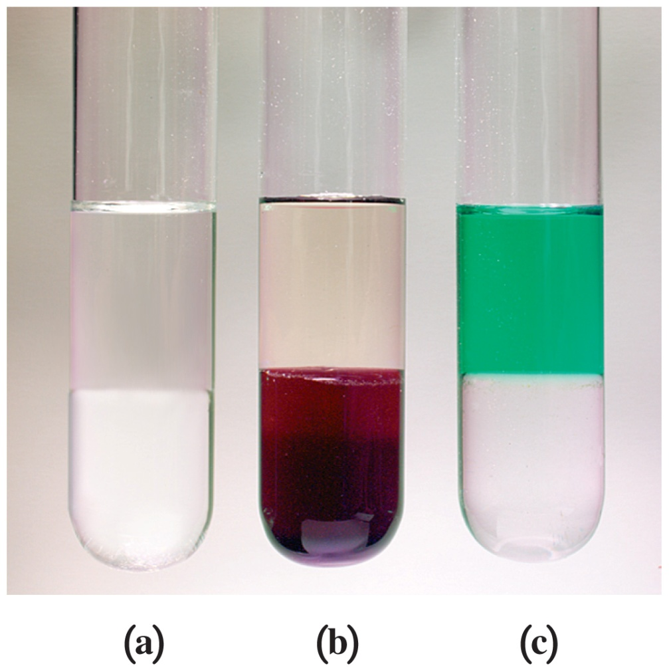
Formation of Solutions
Solutions form when the solute–solvent interactions are large enough to overcome the solute–solute interactions and the solvent–solvent interactions.

Slide 8
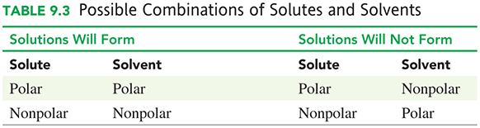
Solutions: Like Dissolves Like
Solutions will form when the solute and solvent have similar polarities: “like dissolves like.”

Slide 9
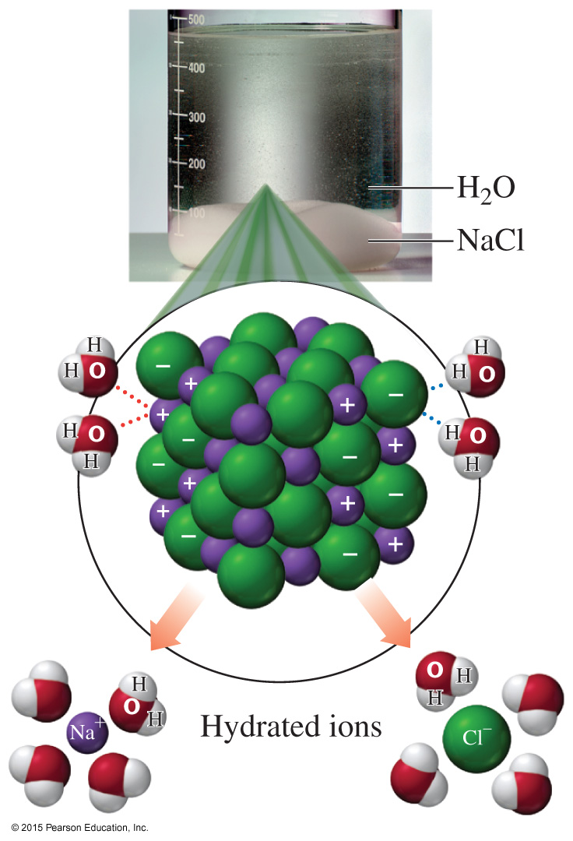

Solutions with Ionic Solutes
NaCl crystals undergo hydration as water molecules surround each ion and pull it into solution.
solid separate ions

Slide 10
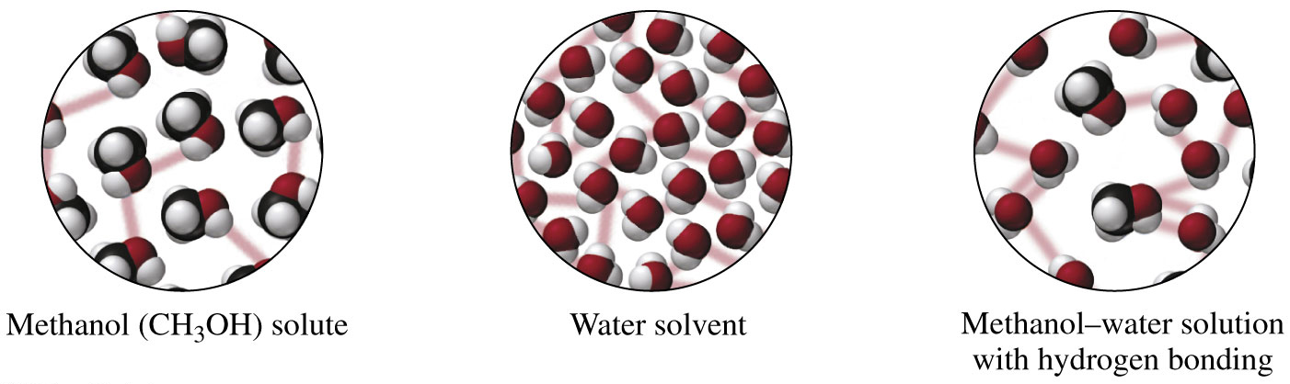
Solutions with Polar Solutes
A polar molecular compound such as methanol, CH₃—OH, is soluble in water because methanol has a polar —OH group to form hydrogen bonds with water.
Polar solutes require polar solvents for a solution to form.

Slide 11
Learning Check
Identify the solute in each of the following solutions:
A. 2 g of sugar and 100 mL of water
B. 60.0 mL of ethyl alcohol and 30.0 mL of methyl alcohol
C. 55.0 mL of water and 1.50 g of NaCl
D. air: 200 mL of O₂ and 800 mL of N₂

Slide 12
Solution
Identify the solute in each of the following solutions:
A. 2 g of sugar and 100 mL of water
The solute is sugar.
B. 60.0 mL of ethyl alcohol and 30.0 mL of methyl alcohol
The solute is methyl alcohol.
C. 55.0 mL of water and 1.50 g of NaCl
The solute is NaCl.
D. air: 200 mL of O₂ and 800 mL of N₂
The solute is O₂.

Slide 13
Learning Check
When solid LiCl is added to water, it dissolves because
A. the Li⁺ ions are attracted to the
1) oxygen atom (δ ⁻) of water
2) hydrogen atom (δ ⁺) of water
B. the Cl⁻ ions are attracted to the
1) oxygen atom (δ ⁻) of water
2) hydrogen atom (δ ⁺) of water

Slide 14
Solution
When solid LiCl is added to water, it dissolves because
A. the Li⁺ ions are attracted to the
1) oxygen atom (δ ⁻) of water
B. the Cl⁻ ions are attracted to the
2) hydrogen atom (δ ⁺) of water

Slide 15
Learning Check
Which of the following solutes will dissolve in water? Why?
A. Na₂SO₄
B. gasoline (nonpolar)
C. I₂
D. HCl

Slide 16
Solution
Which of the following solutes will dissolve in water? Why?
Water is a polar solvent that can dissolve ionic and polar substances but not nonpolar solutes.
A. Na₂SO₄ will dissolve, ionic
B. gasoline (nonpolar) will not dissolve, nonpolar
C. I₂ will not dissolve, nonpolar
D. HCl will dissolve, polar

Slide 17
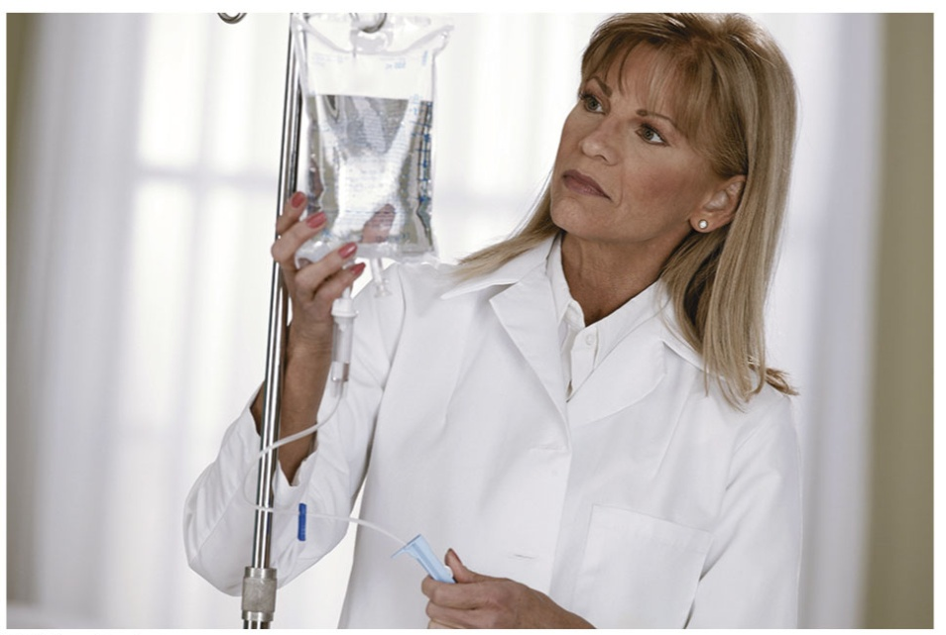
9.2 Electrolytes and Nonelectrolytes
Electrolytes in the body play an important role in maintaining the proper function of the cells and organs.
Electrolytes such as sodium, potassium, chloride, and bicarbonate can be measured in a blood test.
Learning Goal: Identify solutes as electrolytes or nonelectrolytes.

Slide 18
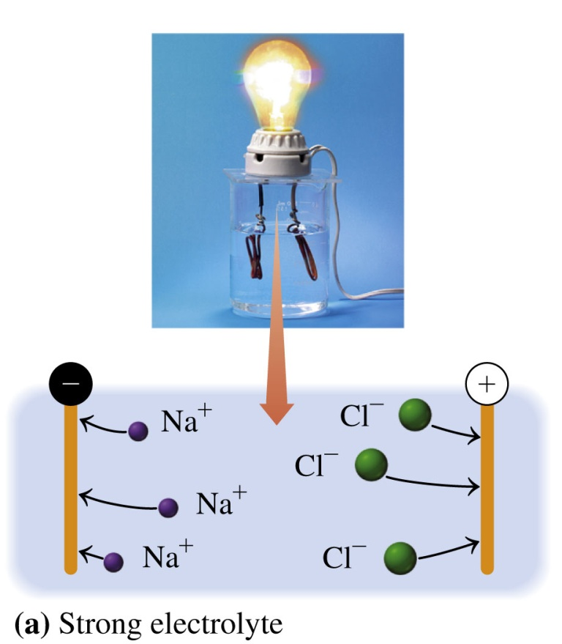
Strong Electrolytes
Strong electrolytes
dissociate 100% in water, producing positive and negative ions
form solutions that conduct an electric current strong enough to light a bulb
dissociation
H₂O

Slide 19
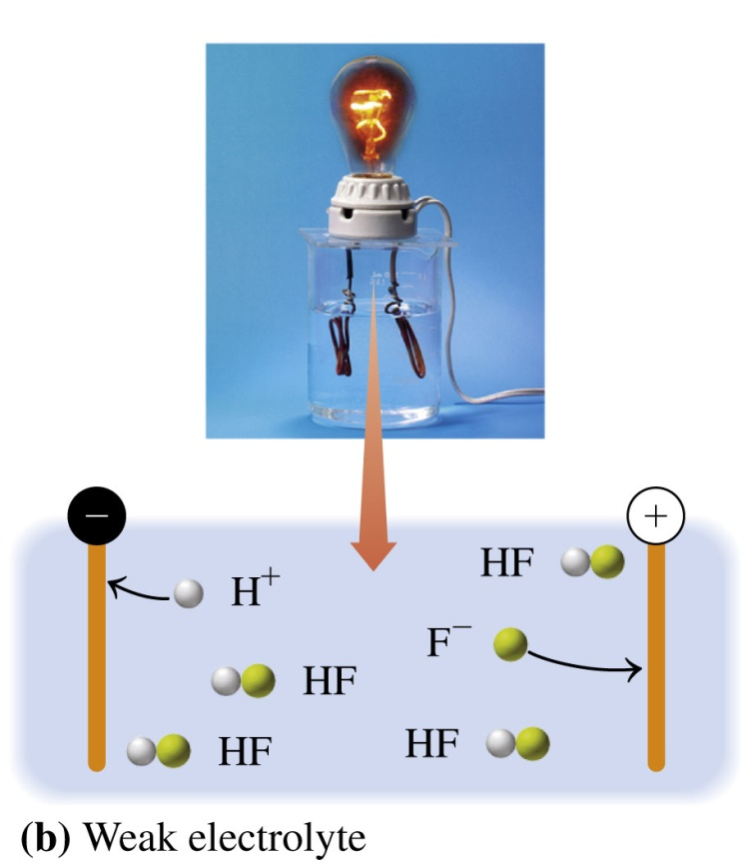

Weak Electrolytes
A weak electrolyte
dissociates only slightly in water
forms a solution with a few ions and mostly ions from undissociated molecules
dissociation
H₂O
recombination

Slide 20
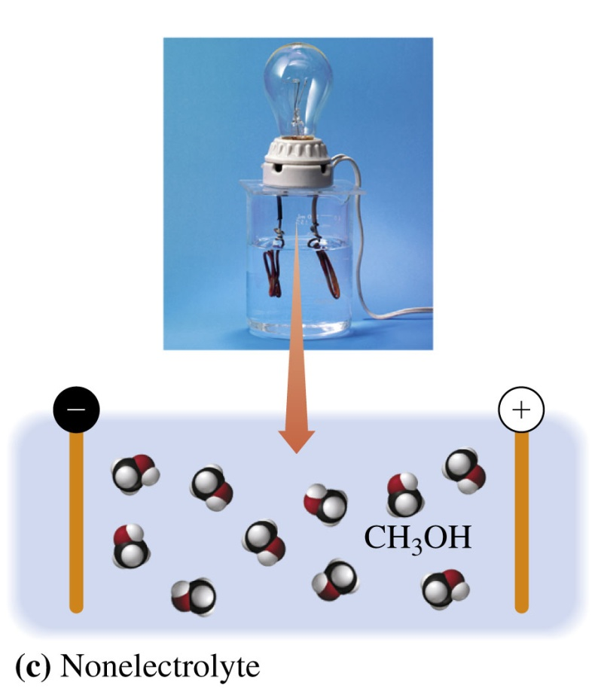
Nonelectrolytes
Nonelectrolytes
dissolve as molecules in water
do not produce ions in water
do not conduct an electric current
CH₄O(l) CH₄O(aq) methanol solution of methanol
H₂O
CH₃OH(l) CH₃OH(aq) methanol solution of methanol

Slide 21
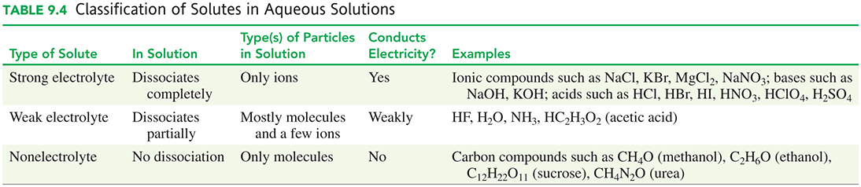
Solutes in Aqueous Solutions

Slide 22
Learning Check
Complete each reaction for strong electrolytes in water.
1. CaCl₂(s) ___________
    A. CaCl₂(s)
    B. Ca²⁺(aq) + Cl₂⁻(aq)
    C. Ca²⁺(aq) + 2Cl⁻(aq)
  2. K₃PO₄(s) ___________
    A. 3K⁺(aq) + PO₄³⁻(aq)
    B. K₃PO₄(s)
    C. K₃⁺(aq) + P³⁻(aq) + O₄⁻(aq)
H₂O
H₂O

Slide 23
Solution
Complete each reaction for strong electrolytes in water.
1. CaCl₂(s)
    C. Ca²⁺(aq) + 2Cl⁻(aq)
  2. K₃PO₄(s)
  A. 3K⁺(aq) + PO₄³⁻(aq)
H₂O
H₂O

Slide 24
Learning Check
Which of the following reactions represent the dissociation of a strong electrolyte in water?
A. NH₃(g) + H₂O(l) NH₄OH(aq)
B. CH₃OH(l) CH₃OH(aq)
Na₂SO₄(s) 2Na⁺(aq) + SO₄²⁻(aq)
D. C₂H₅OH(l) C₂H₅OH (aq)
H₂O
H₂O
H₂O

Slide 25
Solution
Which of the following reactions represent the dissociation of a strong electrolyte in water?
Na₂SO₄(s) 2Na⁺(aq) + SO₄²⁻(aq)
H₂O

Slide 26
Learning Check
Write the equation for the formation of a solution for each of the following:
dissociation of K₂CrO₄(s), a strong electrolyte, in water
the partial dissociation of the weak electrolyte H₃PO₄(aq) in water
solid sugar, C₁₂H₂₂O₁₁(s), dissolves in water

Slide 27
Solution
Write the equation for the formation of a solution for each of the following:
dissociation of K₂CrO₄(s), a strong electrolyte, in water
K₂CrO₄(s) 2K⁺(aq) + CrO₄²⁻(aq)
the partial dissociation of the weak electrolyte H₃PO₄(aq) in water
H₃PO₄(s) H⁺(aq) + H₂PO₄⁻(aq)
solid sugar, C₁₂H₂₂O₁₁(s), dissolves in water
C₁₂H₂₂O₁₁(s) C₁₂H₂₂O₁₁(aq)
H₂O
H₂O
H₂O

Slide 28
Equivalents
An equivalent (Eq) is the amount of an electrolyte or an ion that provides 1 mole of electrical charge (+ or −). In solution,
the charge of the positive ions is always balanced by the charge of the negative ions
the concentrations of electrolytes in intravenous fluids are expressed in milliequivalents per liter (mEq/L):
1 Eq = 1000 mEq

Slide 29
Equivalents, Milliequivalenets
For example, a solution containing
25 mEq/L of Na⁺ and 4 mEq/L of K⁺ has a total positive charge of 29 mEq/L
Cl⁻ as the only anion must also have a concentration of 29 mEq/L

Slide 30
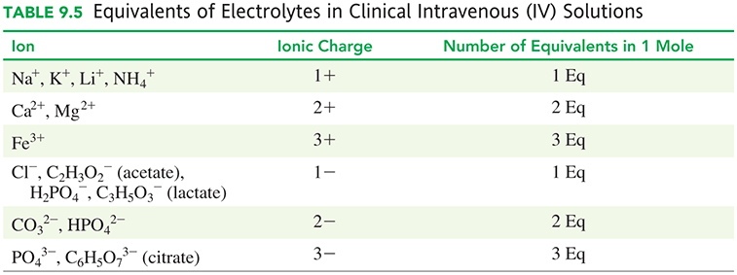
Equivalents, Milliequivalenets

Slide 31
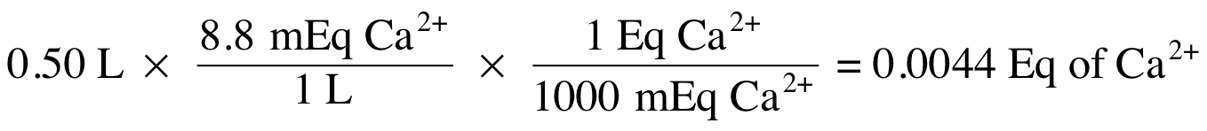
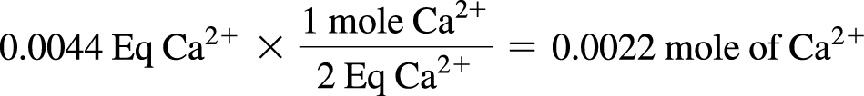
Calculating Equivalents
The laboratory tests for a patient indicate a blood calcium level of 8.8 mEq/L.
How many moles of calcium ion are in 0.50 L of blood?
We can then convert equivalents to moles (for Ca²⁺). There are 2 Eq per mole).

Slide 32
Calculating Equivalents
The laboratory tests for a patient indicate a blood calcium level of 8.8 mEq/L.
B. If chloride ion is the only other ion present, what is its concentration in mEq/L?
If the concentration of Ca²⁺ is 8.8 mEq/L, then the concentration of Cl⁻ must be 8.8 mEq/L to balance the charge.

Slide 33
Chemistry Link to Health:
Electrolytes in Body Fluids
Typical concentrations of electrolytes in blood plasma
have a charge balance; the total number of positive charges is equal to the total number of negative charges
varies as a result of the nutritional, electrolyte, and fluid needs of the patient

Slide 34
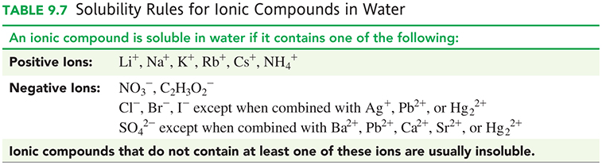
Electrolytes in IV Solutions

Slide 35
Learning Check
1. In 1 mole of Fe³⁺, there are
A. 1 Eq B. 2 Eq C. 3 Eq
2. In 2.5 moles of SO₄²⁻, there are
A. 2.5 Eq B. 5.0 Eq C. 1.0 Eq
3. An IV bottle contains NaCl. If the Na⁺ is 34 mEq/L, the Cl⁻ is
A. 34 mEq/L B. 0 mEq/L C. 68 mEq/L

Slide 36
Solution
1. In 1 mole of Fe³⁺, there are C. 3 Eq
2. In 2.5 moles of SO₄²⁻, there are B. 5.0 Eq
2.5 mole SO₄²⁻ × 2 Eq = 5.0 Eq
1 mole SO₄²⁻
3. An IV bottle contains NaCl. If the Na⁺ is 34 mEq/L, the Cl⁻ is A. 34 mEq/L

Slide 37
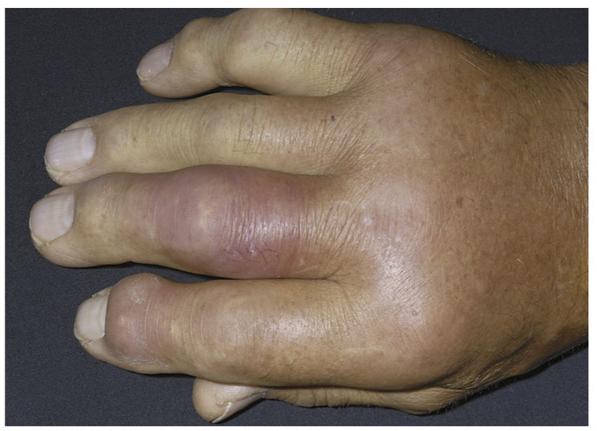
9.3 Solubility
Gout affects primarily adult men over the age of 40.
Attacks of gout may occur
when the concentration of uric acid in blood plasma exceeds its solubility of 7 mg/100 mL of plasma at 37 °C.
Learning Goal Define solubility; distinguish between an unsaturated and a saturated solution. Identify an ionic compound as soluble or insoluble.

Slide 38
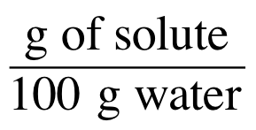
Solubility
Solubility is
the maximum amount of solute that dissolves in a specific amount of solvent at specific temperature.
temperature sensitive for solutes
expressed as grams of solute in 100 grams of solvent, usually water

Slide 39
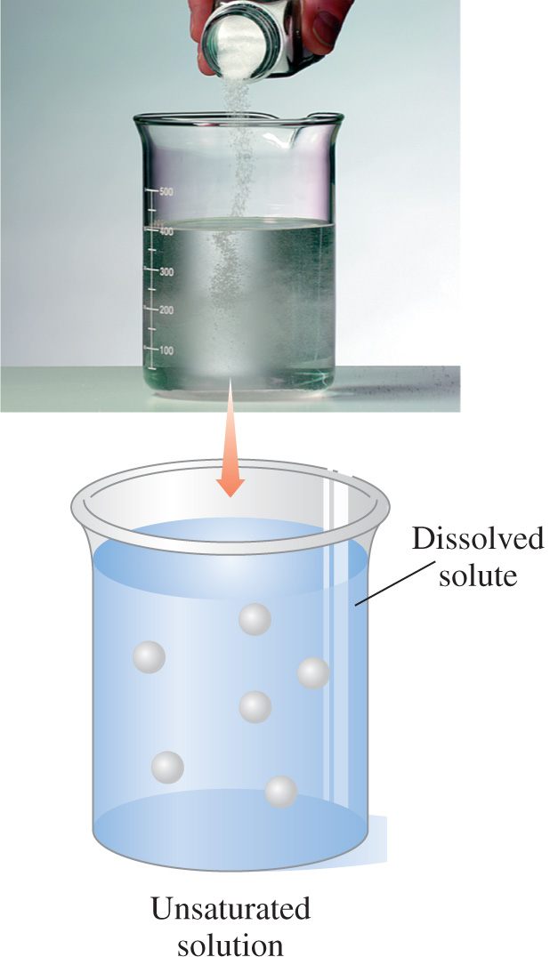
Unsaturated Solution
Unsaturated solutions
contain less than the maximum amount of solute
can dissolve more solute

Slide 40
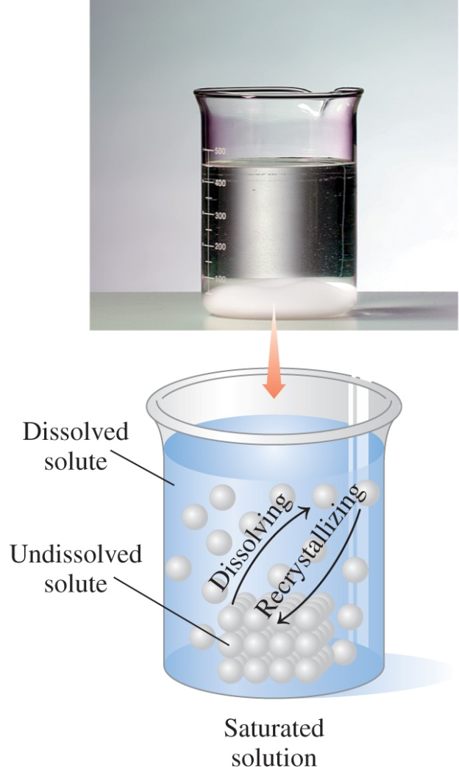
Saturated Solution
Saturated solutions
contain the maximum amount of solute that can dissolve
have undissolved solute at the bottom of the container
contain solute that dissolves as well as solute that recrystallizes in an equilibrium process

Slide 41
Learning Check
Label each of the following solutions as saturated or unsaturated:
A. Salt disappears when placed in water.
B. Sugar added to a cup of water does not disappear but sits at the bottom of the cup.

Slide 42
Solution
Label each of the following solutions as saturated or unsaturated.
A. Unsaturated: Salt disappears when placed in water.
B. Saturated: Sugar added to a cup of water does not disappear but sits at the bottom of the cup.

Slide 43
Learning Check
At 40 °C, the solubility of KBr is 80 g/100 g of H₂O. Identify the following solutions as either saturated or unsaturated. Explain.
A. 60 g KBr added to 100 g of water at 40 °C
B. 200 g KBr added to 200 g of water at 40 °C
C. 25 g KBr added to 50 g of water at 40 °C

Slide 44
Solution
At 40 °C, the solubility of KBr is 80 g/100 g of H₂O. Identify the following solutions as either saturated or unsaturated. Explain.
A. Unsaturated: 60 g KBr/100 g of water at 40 °C is less than
the solubility of KBr in water (80 g KBr/100 g water)
B. Saturated: 200 g KBr/200 g of water at 40 °C is greater than the solubility of KBr in water (80 g KBr/100 g water)
C. Unsaturated: 25 g KBr/50 g of water at 40 °C is less than the solubility of KBr in water (80 g KBr/100 g water)

Slide 45
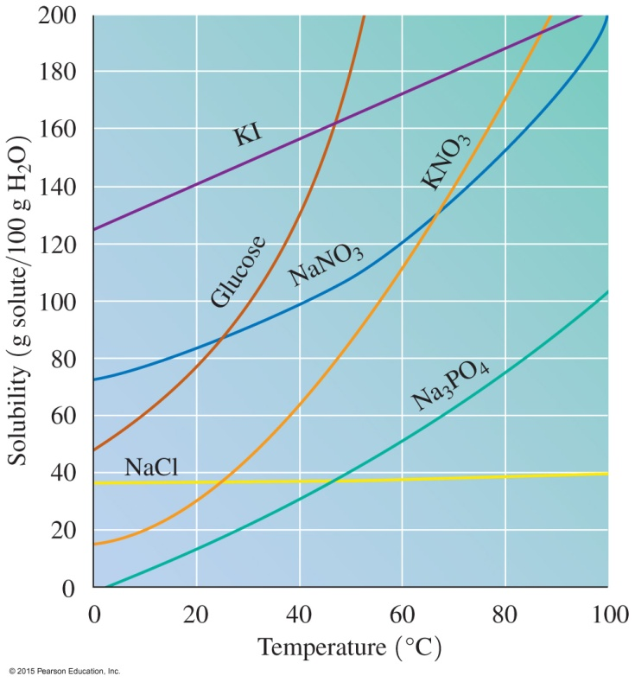
Effect of Temperature on Solubility
Solubility
depends on temperature
of most solids increases as
temperature increases
of gases decreases as
temperature increases
In water, most common solids are more soluble as the temperature increases.

Slide 46
Learning Check
1. Why could a bottle of carbonated drink possibly burst (explode) when it is left out in the hot sun?
2. Why do fish die in water that is too warm?

Slide 47
Solution
1. The pressure in a bottle increases as the gas leaves solution when it becomes less soluble at higher temperatures. As pressure increases, the bottle could burst.
2. Because O₂ gas is less soluble in warm water, fish cannot obtain the amount of O₂ required for their survival.

Slide 48
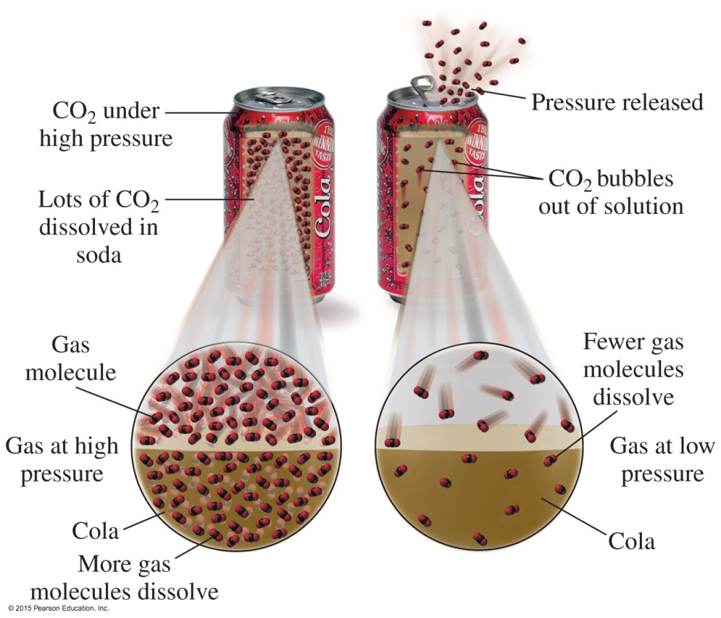
Solubility and Pressure
Henry’s law states that
the solubility of a gas in a liquid is directly related to the pressure of that gas above the liquid
at higher pressures, more gas molecules dissolve in the liquid

Slide 49
Soluble and Insoluble Ionic Compounds
Not all ionic compounds are soluble in water.

Slide 50

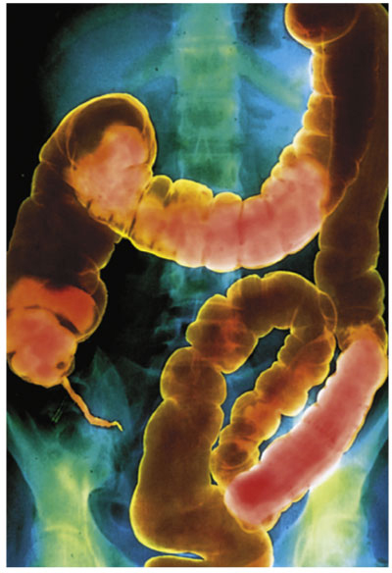
Soluble and Insoluble
Ionic Compounds
Mixing certain aqueous
solutions produces insoluble
ionic compounds.
Barium sulfate (BaSO₄),
an insoluble ionic compound, is
used to enhance X-rays.

Slide 51
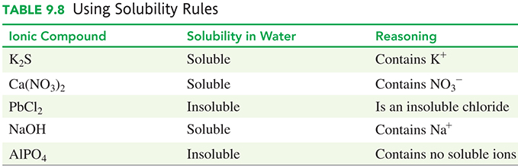
Using Solubility Rules

Slide 52
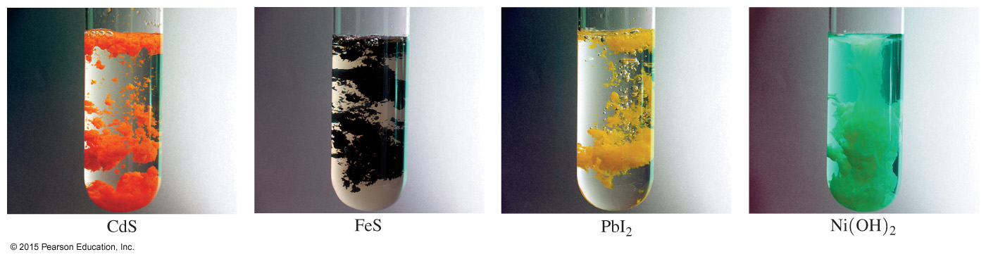
Learning Check
Why are each of these ionic compounds insoluble in water?

Slide 53
Solution
Why are each of these ionic compounds insoluble in water?
A. CdS(s) contains no soluble ions.
B. FeS(s) contains no soluble ions.
C. PbI₂(s) I⁻ is soluble unless combined with Pb²⁺.
D. Ni(OH)₂(s) contains no soluble ions.

Slide 54
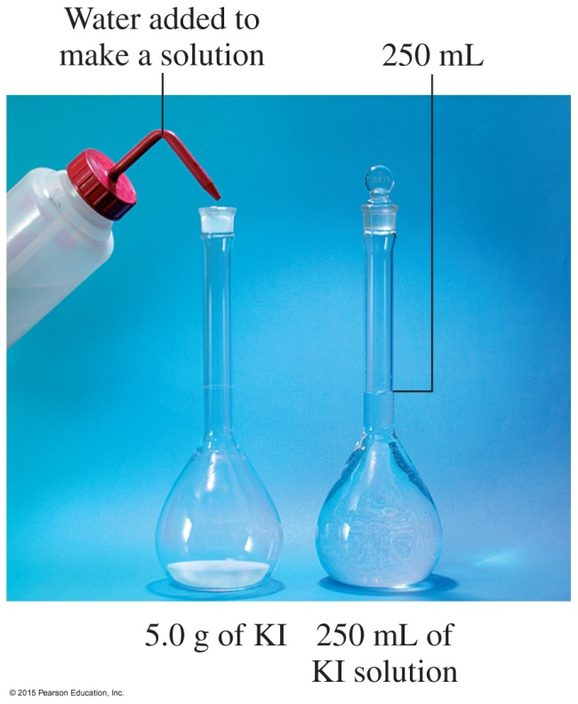
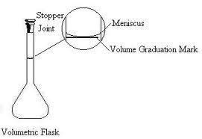
9.4 Solution Concentrations
5.0 g of KI is added to a 1-L volumetric flask. Enough water is added to the volumetric flask to make exactly 1 L of the KI solution.
Learning Goal Calculate the concentration of a solute in a solution; use concentration as a conversion factor to calculate the amount of solute or solution.

Slide 55

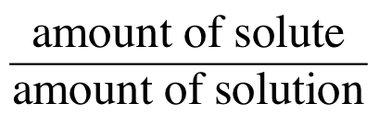
Solution
Concentration
The concentration of a solution is expressed as
Units of concentration include the following:
Mass percent (m/m)
Volume percent (v/v)
Mass/volume percent (m/v)
Molarity (moles solute/liters solution)

Slide 56
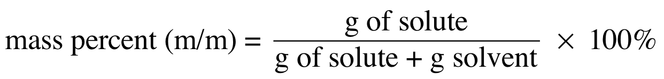
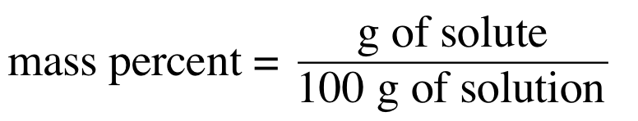
Mass Percent
Mass percent (m/m) is the
concentration by mass of solute in a solution
grams of solute in 100 g of solution (conversion factor for mass percent)

Slide 57
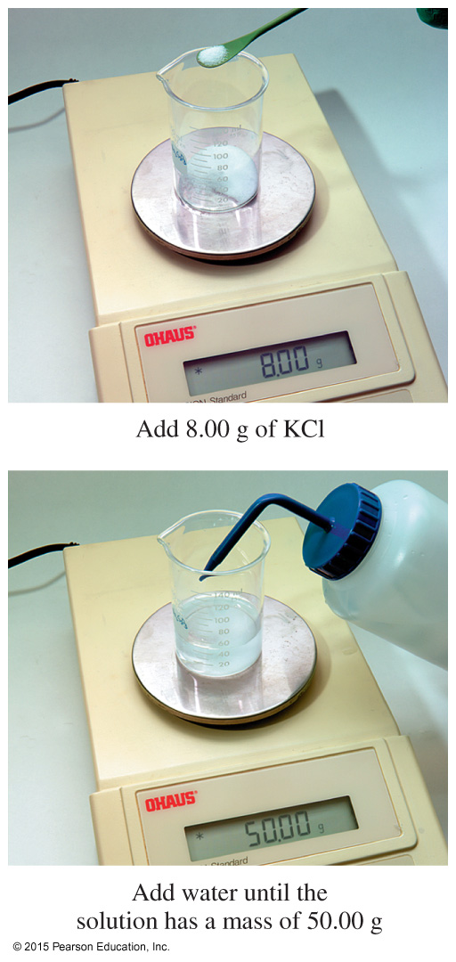
Mass Percent
When water is added to 8.00 g of KCl to form 50.00 g of a KCl solution, the mass percent concentration is 16.0% (m/m).

Slide 58
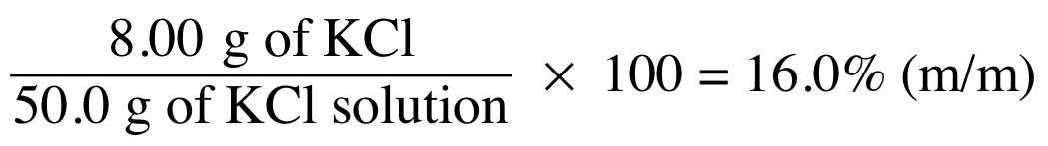
Calculating Mass Percent
The calculation of mass percent (m/m) of KCl in a solution requires the
grams of solute (KCl) and
grams of solution (KCl + water) or
  g of KCl 8.00 g
  g of solvent (water) 42.00 g
  g of KCl solution = 50.00 g

Slide 59
Learning Check
A solution is prepared by mixing 15.0 g of Na₂CO₃ and 235 g of H₂O. Calculate the mass percent (m/m) of the solution.
A. 15.0% (m/m) Na₂CO₃
B. 6.38% (m/m) Na₂CO₃
C. 6.00% (m/m) Na₂CO₃

Slide 60

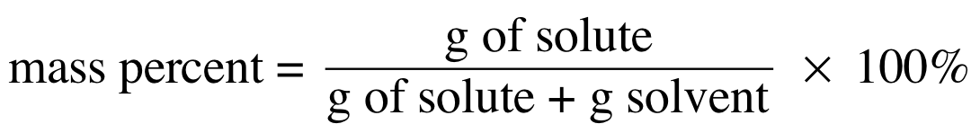
Solution
A solution is prepared by mixing 15.0 g of Na₂CO₃ and 235 g of H₂O. Calculate the mass percent (m/m) of the solution.
STEP 1 State the given and needed quantities.
STEP 2 Write the concentration expression.
ANALYZE GIVEN NEED CONNECT
THE 15.0 g of Na₂CO₃ mass percent
PROBLEM 235 g of H₂O (m/m)

Slide 61
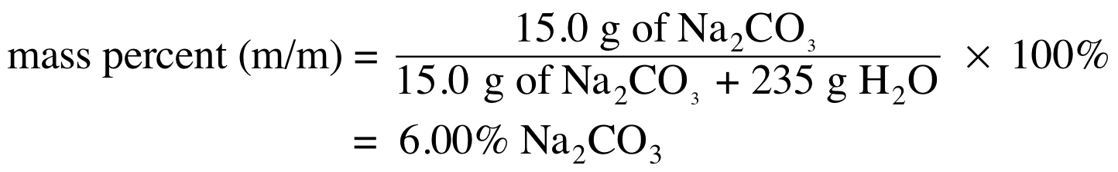
Solution
A solution is prepared by mixing 15.0 g of Na₂CO₃ and 235 g of H₂O. Calculate the mass percent (m/m) of the solution.
STEP 3 Substitute solute and solution quantities into the expression and calculate.
The answer is C, 6.00% Na₂CO₃.

Slide 62
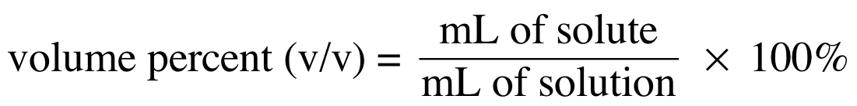
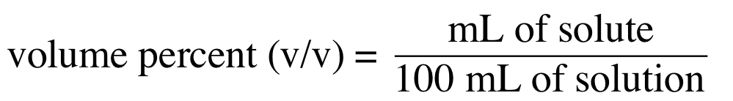
Volume Percent
The volume percent (v/v) is the
percent volume (mL) of solute (liquid) to volume (mL)
of solution
volume of solute (mL) in 100 mL of solution (conversion factor for volume percent)

Slide 63
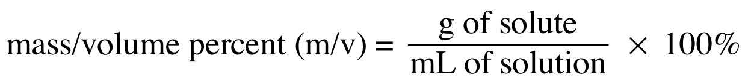
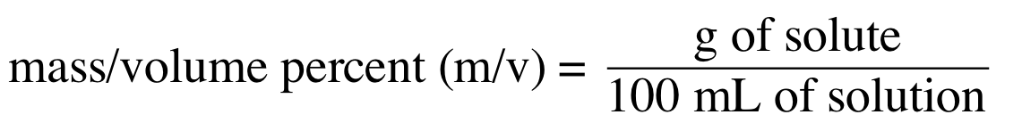
Mass/Volume Percent
The mass/volume percent (m/v) is the
percent mass (g) of solute to volume (mL) of solution
mass of solute (g) in 100 mL of solution (conversion factor for mass/volume percent)

Slide 64
Learning Check
Write two conversion factors for each solution.
A. 8.50% (m/m) NaOH
B. 5.75% (v/v) ethanol
C. 4.8% (m/v) HCl

Slide 65
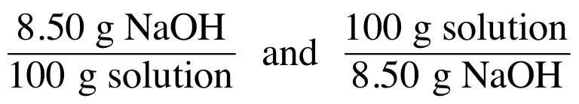
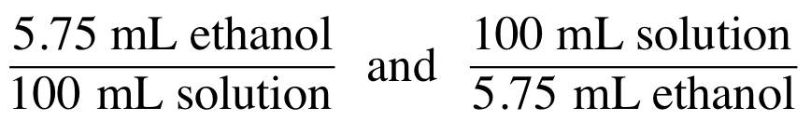
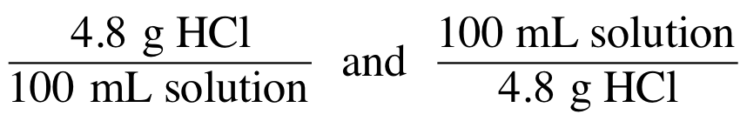
Solution
A. 8.50% (m/m) NaOH
B. 5.75% (v/v) ethanol
C. 4.8% (m/v) HCl

Slide 66
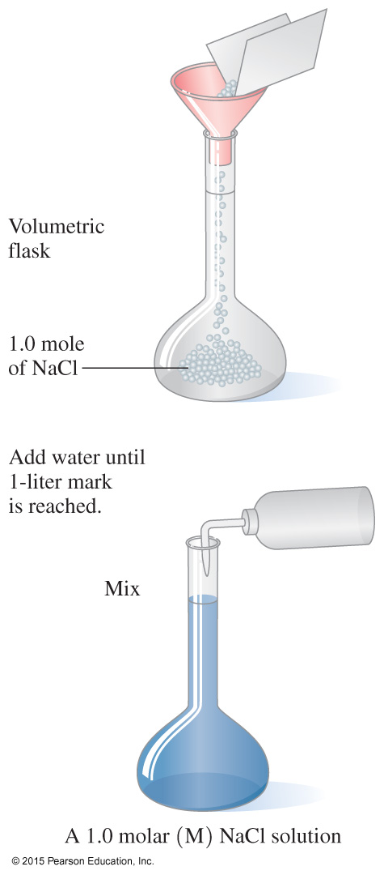
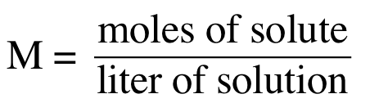
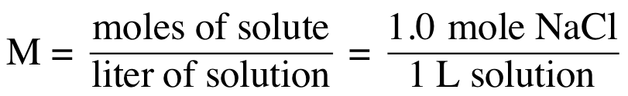
Molarity
Molarity (moles of solute/liter of solution)
is defined as the moles of solute per
volume (L) of solution.
A 1.0 M solution of NaCl is defined as

Slide 67
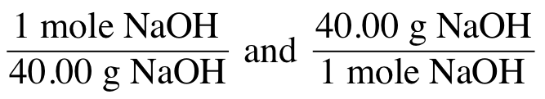
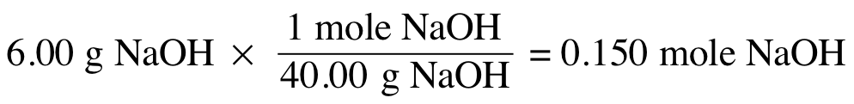

Molarity Calculations
What is the molarity of 0.500 L of NaOH solution if it contains 6.00 g of NaOH?
SOLUTION:
STEP 1 State the given and needed quantities.
1 mole NaOH = 40.00 g NaOH
ANALYZE GIVEN NEED CONNECT
THE 6.00 g of NaOH molarity (mole/L) molar mass of NaOH,
PROBLEM 0.500 L of NaOH solution
$$\frac{moles of solute}{liters of solution}$$

Slide 68
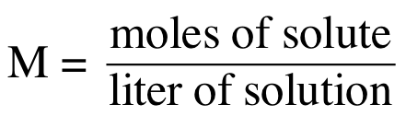
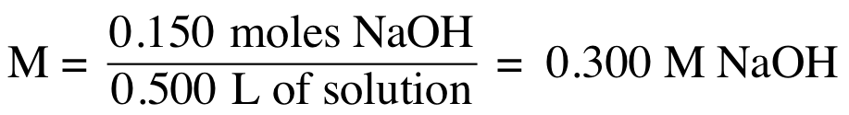
Molarity Calculations
What is the molarity of 0.500 L of NaOH solution if it contains 6.00 g of NaOH?
STEP 2 Write the concentration expression.
STEP 3 Substitute solute and solution quantities into
the expression and calculate.

Slide 69
Learning Check
What is the molarity of 0.225 L of a KNO₃ solution containing 34.8 g of KNO₃?
A. 0.344 M
B. 1.53 M
C. 15.5 M

Slide 70



Solution
What is the molarity of 0.225 L of a KNO₃ solution containing 34.8 g of KNO₃?
STEP 1 State the given and needed quantities.
1 mole of KNO₃ = 101.11 g KNO₃
ANALYZE GIVEN NEED CONNECT
THE 34.8 g of KNO₃ molarity (mole/L) molar mass of KNO₃,
PROBLEM 0.225 L of KNO₃ solution
$$\frac{moles of solute}{liters of solution}$$

Slide 71

Solution
What is the molarity of 0.225 L of a KNO₃ solution containing 34.8 g of KNO₃?
STEP 2 Write the concentration expression.
STEP 3 Substitute solute and solution quantities into the expression and calculate.
The answer is B, 1.53 M KNO₃.

Slide 72

Molarity as a Conversion Factor
The units of molarity are used as conversion factors in calculations with solutions.
Molarity Equality
3.5 M HCl 1 L = 3.5 moles of HCl
Written as conversion factors,

Slide 73


Conversion Factors,
Concentrations

Slide 74
Learning Check
How many grams of NaOH are needed to prepare 75.0 g of 14.0% (m/m) NaOH solution?
A. 10.5 g of NaOH
B. 75.0 g of NaOH
C. 536 g of NaOH

Slide 75
Solution
How many grams of NaOH are needed to prepare 75.0 g of 14.0% (m/m) NaOH solution?
STEP 1 State the given and needed quantities.
STEP 2 Write a plan to calculate mass.
grams of grams of
solution solute
ANALYZE GIVEN NEED CONNECT
THE 75.0 grams of 14.0% grams of NaOH % (m/m) factor
PROBLEM (m/m) NaOH solution
Percent (m/m)

Slide 76


Solution
How many grams of NaOH are needed to prepare 75.0 g of 14.0% (m/m) NaOH solution?
STEP 3 Write equalities and conversion factors.
14.0 g NaOH = 100 g of solution
STEP 4 Set up the problem to calculate the mass.
Answer is A, 10.5 g NaOH.

Slide 77
Learning Check
How many milliliters of a 5.75% (v/v) ethanol solution can be prepared from 2.25 mL of ethanol?
A. 2.56 mL
B. 12.9 mL
C. 39.1 mL

Slide 78
Solution
How many milliliters of a 5.75% (v/v) ethanol solution can be prepared from 2.25 mL of ethanol?
STEP 1 State the given and needed quantities.
STEP 2 Write a plan to calculate volume.
mL of mL of
solute solution
ANALYZE GIVEN NEED CONNECT
THE 2.25 mL of ethanol milliliters % (v/v) factor
PROBLEM 5.75% (v/v) ethanol solution ethanol solution
Percent (v/v)

Slide 79


Solution
How many milliliters of a 5.75% (v/v) ethanol solution can be prepared from 2.25 mL of ethanol?
STEP 3 Write equalities and conversion factors.
5.75 mL ethanol = 100 mL of solution
STEP 4 Set up the problem to calculate mass or volume.
Answer is C, 39.1 mL of solution.

Slide 80
Learning Check
How many grams of AlCl₃ are needed to prepare 125 mL of a 0.150 M solution?
A. 20.0 g of AlCl₃
B. 16.7 g of AlCl₃
C. 2.50 g of AlCl₃

Slide 81
Solution
How many grams of AlCl₃ are needed to prepare 125 mL of a 0.150 M solution?
STEP 1 State the given and needed quantities.
STEP 2 Write a plan to calculate mass or volume.
liters of moles of grams of
solution solute solute
ANALYZE GIVEN NEED CONNECT
THE 125 mL (0.125 L) solution grams AlCl₃ molar mass of AlCl₃,
PROBLEM 0.150 M solution molarity
molarity
molar mass

Slide 82


Solution
How many grams of AlCl₃ are needed to prepare 125 mL of a 0.150 M solution?
STEP 3 Write equalities and conversion factors.
0.150 moles AlCl₃ = 1 L of solution
1 mole AlCl₃ = 133.33 g AlCl₃

Slide 83
Solution
How many grams of AlCl₃ are needed to prepare 125 mL of a 0.150 M solution?
STEP 4 Set up the problem to calculate mass or volume.
Answer is C, 2.50 g AlCl₃.
=

Slide 84

9.5 Dilution of Solutions
In a dilution, a solvent, usually water, is added to a solution, which increases its volume and decreases the concentration of the solution. Making orange juice from concentrate is an example of a dilution.
Learning Goal Describe the dilution of a solution; calculate the unknown concentration or volume when a solution is diluted.

Slide 85

Dilution
In a dilution,
water is added
the volume of the solution increases
concentration decreases
mass of solute in the solution remains the same

Slide 86
Solute Concentrations
In the initial and diluted solutions,
the moles of solute are the same
the concentrations and volumes are related by the following equation:
C₁V₁ = C₂V₂
Concentrated Diluted
solution solution

Slide 87
Dilution: Molarity
What is the final concentration when 0.50 L of 6.0 M HCl solution is diluted to a final volume of 1.0 L?
SOLUTION:
STEP 1 Prepare a table of the concentrations and volumes of the solutions.
ANALYZE GIVEN NEED CONNECT
THE C₁ = 6.0 M C₂ C₁V₁ = C₂V₂
PROBLEM V₁ = 0.50 L V₂ increases,
V₂ = 1.0 L C₂ decreases

Slide 88


Dilution: Molarity
What is the final concentration when 0.50 L of 6.0 M HCl solution is diluted to a final volume of 1.0 L?
STEP 2 Rearrange the dilution expression to solve for the unknown quantity.
${ C}_{1}V_{1}=C_{2}V_{2}$ C₂ = C₁ $×\frac{V_{1}}{V_{2}}$
STEP 3 Substitute the known quantities into the dilution expression and solve.
C₂

Slide 89
Learning Check
What volume of a 2.00% (m/v) HCl solution can be prepared by diluting 25.0 mL of 14.0% (m/v) HCl solution?

Slide 90
Solution
What volume of a 2.00% (m/v) HCl solution can be prepared by diluting 25.0 mL of 14.0% (m/v) HCl solution?
STEP 1 Prepare a table of the concentrations and volumes of the solutions.
ANALYZE GIVEN NEED CONNECT
THE C₁ = 14.0% (m/v) V₂ C₁V₁ = C₂V₂
PROBLEM V₁ = 25.0 mL C₂ decreases,
C₂ = 2.00% (m/v) V₂ increases

Slide 91


Solution
What volume of a 2.00% (m/v) HCl solution can be prepared by diluting 25.0 mL of 14.0% (m/v) HCl solution?
STEP 2 Rearrange the dilution expression to solve for the unknown quantity.
STEP 3 Substitute the known quantities into the dilution expression and solve.

Slide 92
Learning Check
What is the percent (m/v) of a solution prepared by diluting 10.0 mL of 9.00% NaOH to 60.0 mL?

Slide 93
Solution
What is the percent (m/v) of a solution prepared by diluting 10.0 mL of 9.00% NaOH to 60.0 mL?
STEP 1 Prepare a table of the concentrations and volumes of the solutions.
ANALYZE GIVEN NEED CONNECT
THE C₁ = 9.00% (m/v) C₂ C₁V₁ = C₂V₂
PROBLEM V₁ = 10.0 mL V₂ increases,
V₂ = 60.0 mL C₂ decreases

Slide 94


Solution
What is the percent (m/v) of a solution prepared by diluting 10.0 mL of 9.00% NaOH to 60.0 mL?
STEP 2 Rearrange the dilution expression to solve for
the unknown quantity.
STEP 3 Substitute the known quantities into the dilution
expression and solve.

Slide 95
Learning Check
What is the molarity (M) of a solution prepared by diluting 0.180 L of 0.600 M HNO₃ to 0.540 L?

Slide 96
Solution
What is the molarity (M) of a solution prepared by diluting 0.180 L of 0.600 M HNO₃ to 0.540 L?
STEP 1 Prepare a table of the concentrations and volumes of the solutions.
ANALYZE GIVEN NEED CONNECT
THE C₁ = 0.600 M C₂ C₁V₁ = C₂V₂
PROBLEM V₁ = 0.180 L V₂ increases,
V₂ = 0.540 L C₂ decreases

Slide 97

Solution
What is the molarity (M) of a solution prepared by diluting 0.180 L of 0.600 M HNO₃ to 0.540 L?
STEP 2 Rearrange the dilution expression to solve for
the unknown quantity.
STEP 3 Substitute the known quantities into the dilution
expression and solve.
C₂

Slide 98

9.6 Properties of Solutions
A 0.9% NaCl solution is isotonic with the solute concentration of the blood cells of the body.
Learning Goal Identify a mixture as a solution, a colloid, or a suspension. Describe how the number of particles in a solution affects the osmotic pressure.

Slide 99
Solutions
Solutions
are transparent
do not separate
contain small particles, ions, or molecules that cannot be filtered and pass through semipermeable membranes

Slide 100
Colloids
Colloids
have medium-size particles
cannot be filtered
can be separated by semipermeable membranes

Slide 101

Examples of Colloids

Slide 102
Suspensions
Suspensions
are heterogeneous, nonuniform mixtures
have very large particles that settle out of solution
can be filtered
must be stirred to stay suspended
Examples include blood platelets, muddy water, and
calamine lotion.

Slide 103

Solutions, Colloids, and Suspensions

Slide 104

Solutions, Colloids, and Suspensions

Slide 105
Learning Check
A mixture that has solute particles that do not settle out but are too large to pass through a semipermeable membrane is called a _______.
A. solution
B. colloid
C. suspension

Slide 106
Solution
A mixture that has solute particles that do not settle out but are too large to pass through a semipermeable membrane is called a ______.
B. colloid

Slide 107

Osmosis
In osmosis,
water (solvent) flows from a lower to a higher solute concentration
the level of the solution
with the higher solute concentration rises
the concentrations of the
two solutions become equal with time
Water flows into the solution with a higher solute concentration until the flow of water becomes equal in both directions.

Slide 108
Osmotic Pressure
Osmotic pressure is
equal to the pressure that would prevent the flow of additional water into the more concentrated solution
greater as the number of dissolved particles in the
solution increases

Slide 109
Reverse Osmosis
In a process called reverse osmosis,
a pressure greater than the osmotic pressure is applied to a solution forcing it through a purification membrane
the flow of water is reversed because water flows from
an area of lower water concentration to an area of higher
water concentration, leaving behind the molecules and ions
in solution
Reverse osmosis, used in a few desalination plants to obtain pure water from sea (salt) water, requires a large amount of energy.

Slide 110

Isotonic Solutions
An isotonic solution
exerts the same osmotic pressure as body fluids such as red blood cells (RBCs)
of 5.0% (m/v) glucose or 0.90% (m/v) NaCl is a typical isotonic solution
(a) In an isotonic solution, a red blood cell retains its normal volume.

Slide 111

Hypotonic Solution
A hypotonic solution
has a lower solute concentration than RBCs
means water flows into
cells by osmosis
The increase in fluid causes the
cells to swell and burst, a
condition called hemolysis.
(b) Hemolysis: In a hypotonic solution, water flows into a red blood cell, causing it to swell and burst.

Slide 112

Hypertonic Solution
A hypertonic solution
has a higher solute concentration than RBCs
causes crenation: RBCs shrink in size
In a hypertonic solution, water goes out of the cells
by osmosis.
(c) Crenation: In a hypertonic solution, water leaves the red blood cell, causing it to shrink.

Slide 113

Dialysis
In dialysis,
solvent and small solute particles pass through an artificial membrane
large particles are retained inside
waste particles such as urea from blood are removed using hemodialysis (artificial kidney)

Slide 114
Learning Check
Indicate whether each of the following solutions is
A. isotonic B. hypotonic C. hypertonic
1. ____ 2% NaCl solution
2. ____ 1% glucose solution
3. ____ 0.5% NaCl solution
4. ____ 5% glucose solution

Slide 115
Solution
Indicate whether each of the following solutions is
A. isotonic B. hypotonic C. hypertonic
1. _C__ 2% NaCl solution
2. _B__ 1% glucose solution
3. _B__ 0.5% NaCl solution
4. _A__ 5% glucose solution

Slide 116
Learning Check
When placed in each of the following, indicate whether a red
blood cell will
A. not change B. undergo hemolysis C. undergo crenation
1. ____ 5% glucose solution
2. ____ 1% glucose solution
3. ____ 0.5% NaCl solution
4. ____ 2% NaCl solution

Slide 117
Solution
When placed in each of the following, indicate whether a red
blood cell will
not change B. undergo hemolysis C. undergo crenation
1. _A__ 5% glucose solution
2. _B__ 1% glucose solution
3. _B__ 0.5% NaCl solution
4. _C__ 2% NaCl solution

Slide 118

Concept Map
Insert concept map page 310

