Slide 1
Experiment 11
Biodiesel

Slide 2
Biodiesel
The amount of usable fossil fuels is steadily decreasing as the world population increases.
This has driven scientists to find alternative resources for fossil fuels.
One alternative is converting vegetable oil to biodiesel by means of
trans-esterification.
This reaction is commonly catalyzed by a base; however, with used vegetable oil, the product has a lower yield due to soap production.
Used oil contains certain amounts of free fatty acids that would quickly react with the base to form soap.
Acid catalysis, while slower, shows the promise of a much higher yield of biodiesel from used vegetable oil.
Acid catalysts such as sulfuric acid and aluminum trichloride produced biodiesel in good yield, in a reasonable time.

Slide 3
Biodiesel
Advantages of biodiesel fuel
• Biodiesel fuel is a renewable energy source unlike petroleum-based diesel.
• An excessive production of soybeans in the world makes it an economic way to utilize this surplus for manufacturing the Biodiesel fuel.
• One of the main biodiesel fuel advantages is that it is less polluting than petroleum diesel (Biodiesel provides significantly reduced emissions of carbon monoxide, particulate matter, unburned hydrocarbons, and sulfates compared to petroleum diesel fuel).
• The lack of sulfur in 100% biodiesel extends the life of catalytic converters. • Another advantages of biodiesel fuel is that it can also be blended with other energy resources and oil.

Slide 4
Biodiesel
Disadvantages of biodiesel fuel
• At present, biodiesel fuel is about one and a half times more expensive than petroleum diesel fuel.
• It requires energy to produce biodiesel fuel from sources (energy of sowing, fertilizing and harvesting.
• it can harm rubber hoses in some engines.
• As Biodiesel cleans the dirt from the engine, this dirt can then get collected in the fuel filter, thus clogging it. So, filters have to be changed after the first several hours of biodiesel use.

Slide 5
Biodiesel
Although vegetable oil is a good source of energy, yet, it is too viscous to work effectively as a fuel.
Once the oil is broken down through transesterfication, it produces an effective biodiesel. A series of simple tests can be employed to analyze the biodiesel such as density, pH, combustion, TLC and IR

Slide 6
Biodiesel: Mechanism (Base catalyzed)

Slide 7
Procedure
1. Measure 15 mL of pure methanol into a 250ml Erlenmeyer flask. (This is your reaction flask)
2. Measure 0.5 g of finely ground anhydrous NaOH and transfer it into the 250ml flask.
3. Cover the flask containing methanol and NaOH with aluminum foil.
4. Use a magnetic stirring bar to stir the solution until all NaOH dissolves.
( Alternatively, you may shake the flask carefully-this may take 10-15 minutes)
5. Measure 50 ml of vegetable oil, determine its mass and add it to the reaction flask.
6. Heat the reaction flask and its contents in a water bath to a temperature of 45-50ºC for 30 minutes. The mixture should be stirred (or shaken) continuously.
7- The mixture becomes cloudy at first, but it soon separates into two layers.

Slide 8
Procedure:Continued
8- While still warm, pour the mixture into a separatory funnel and allow to cool until two layers are distinctly observed.
9-Drain the lower layer into a 100 ml beaker and discard it in. This layer contains glycerin, un-reacted methanol, un-reacted sodium hydroxide, a trace of water and salts.
10-Add 10 ml. of water to the remaining layer ( the biodiesel). Swirl the separatory funnel gently for a couple of minutes. This wash should remove methanol, glycerin, sodium hydroxide, and any soap.
11-Drain the lower layer and discard it. Transfer the biodiesel into a small beaker and place it on a hot plate ( in the hood) to evaporate any methanol left.
12- Add 0.5 g of anhydrous sodium sulfate to remove any traces of water.
13- Pour the dried biodiesel into a clean, dry, weighed 50 mL flask. Determine the mass and the volume of the biodiesel.

Slide 9
Tests on Biodiesel:
Determination of pH: Add 5 drops of your biodiesel to 1 ml of distilled water and mix thoroughly. Using pH paper, estimate the aqueous pH of your biodiesel.
Density: Determine the density of the biodiesel, compare it to the density of the oil.
Combustion: A combustion test can be conducted using porcelain crucibles containing cotton wool soaked with oil, biodiesel, methanol and glycerin. Carry out the combustion in the hood. Light the soaked cotton wool and record your notes on the combustion of each compound.
IR (optional): determine the IR spectrum of diesel and vegetable oil. Compare.
TLC ( optional) :Dissolve the biodiesel and the starting material in petroleum ether and apply to TLC plate. The mobile phase is a mixture of petroleum ether: ethyl ether: acetic acid (80:19:1). After elution, the TLC plate can be developed with iodine vapor. Spot oleic acid and methyl oleate next to the biodiesel .

Slide 10
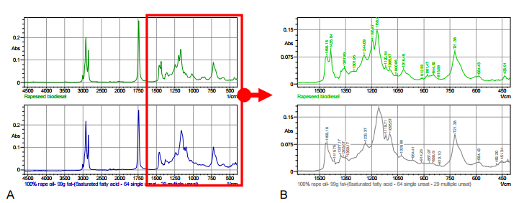
Methyl ester peak
pure biodiesel
Pure oil

