Slide 1

Chapter 2
Acids and Bases:
Central to Understanding Organic Chemistry
Paula Yurkanis Bruice
University of California,
Santa Barbara

Slide 2
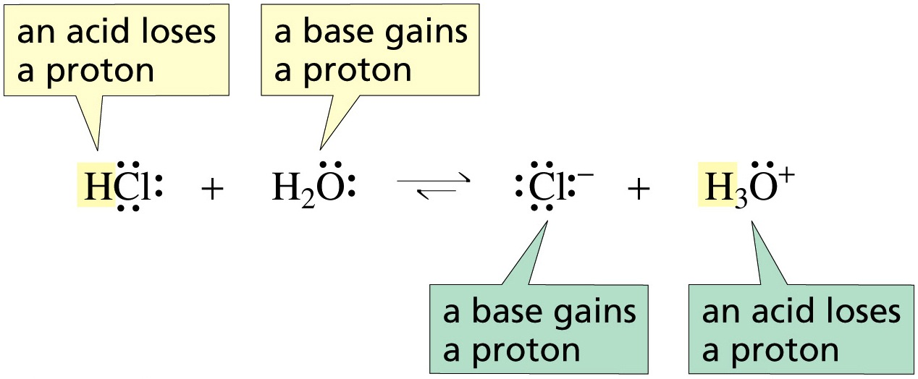
An Acid Loses a Proton
A Base Gains a Proton

Slide 3
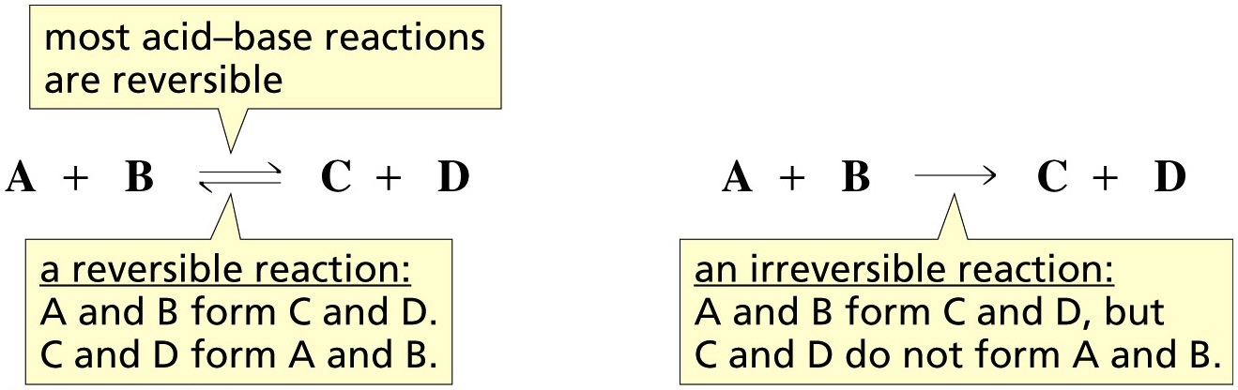
Most Acid–Base Reactions are Reversible

Slide 4
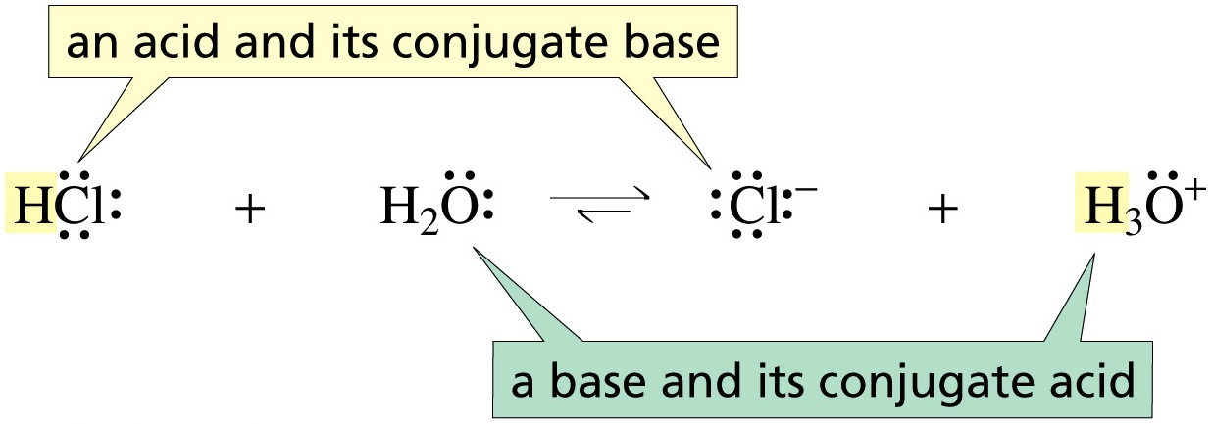
An Acid and its Conjugate Base
A Base and its Conjugate Acid
When an acid loses a proton, its conjugate base is formed
When a base gains a proton, its conjugate acid is formed

Slide 5
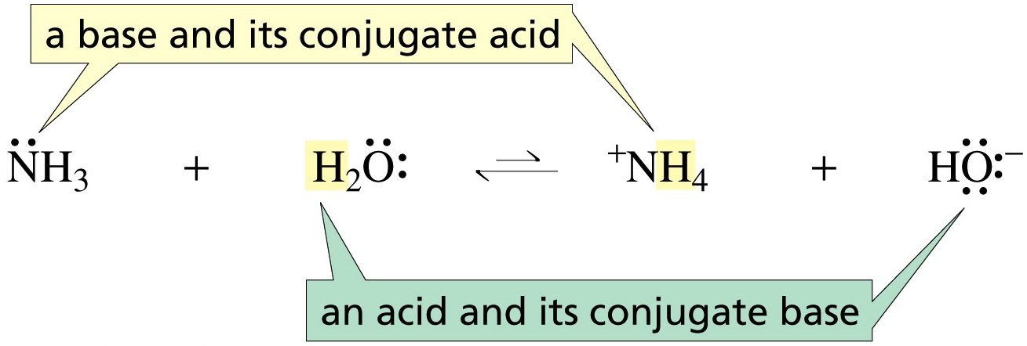
An Acid and its Conjugate Base
A Base and its Conjugate Acid
When an acid loses a proton, its conjugate base is formed
When a base gains a proton, its conjugate acid is formed
The stronger the acid, the weaker is its conjugate base

Slide 6
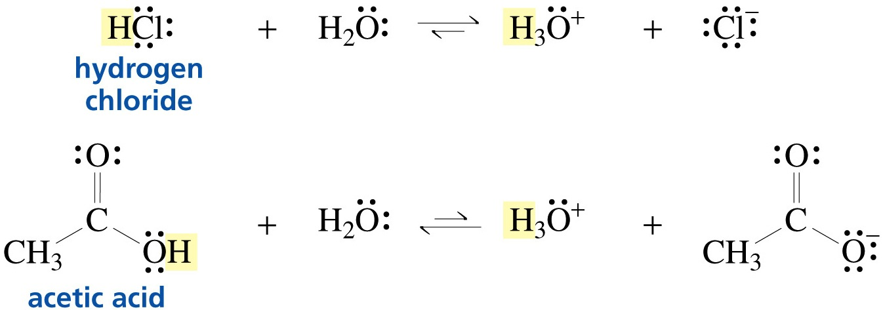
Acids Have Different Strengths
stronger acid
weaker acid

Slide 7
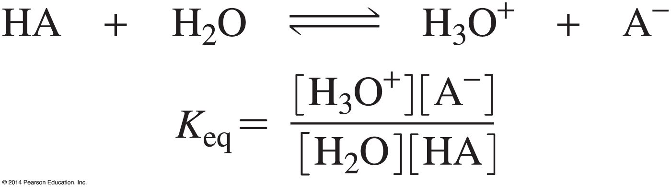
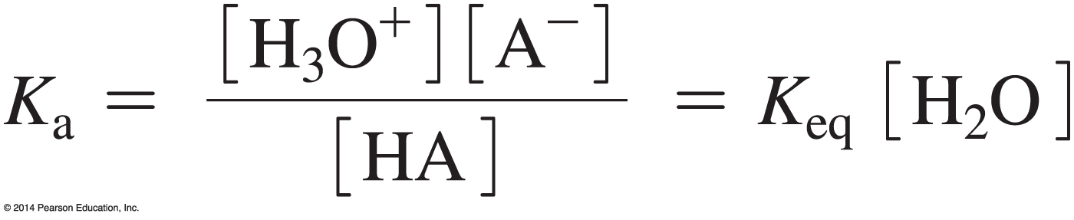
The Acid Dissociation Constant (K_{a}) is a
Measure of the Extent of Dissociation of an Acid
Put the constants on the same side of the equation.

Slide 8
pK_{a} = – log K_{a}
for K_{a} = 10^{–20}, pK_{a} = 20
for K_{a} = 10^{–5}, pK_{a} = 5
for K_{a} = 10⁷, pK_{a} = –7

Slide 9
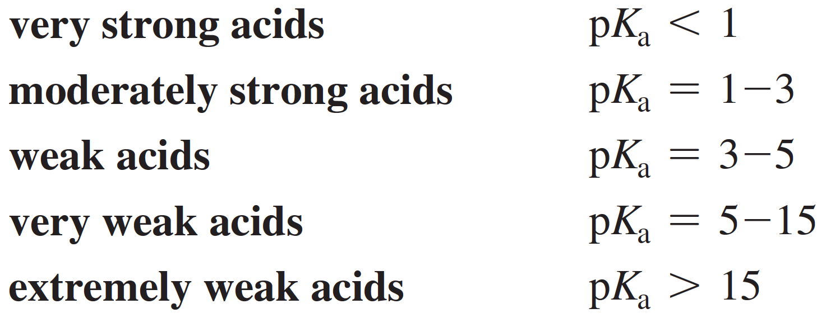
pK_{a} is a Covenient Scale for
Acid Strength
The stronger the acid, the larger the K_{a} value
The stronger the acid, the smaller the pK_{a} value

Slide 10
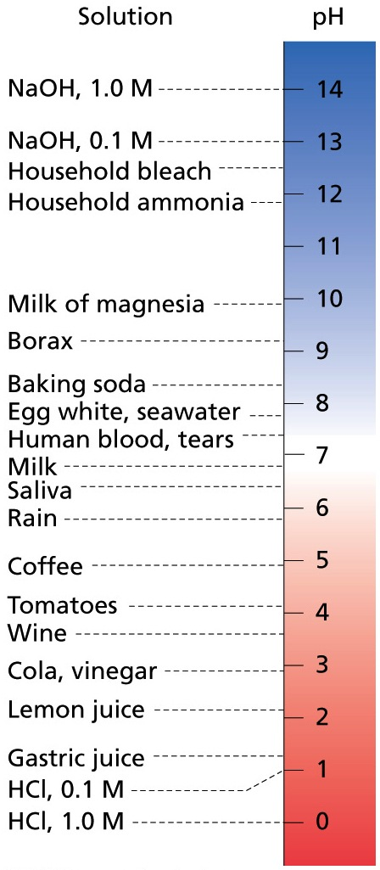
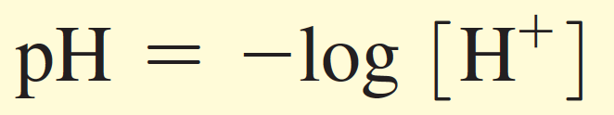
pH Indicates the Acidity of a Solution
The pH indicates the concentration
of protons in a solution.

Slide 11
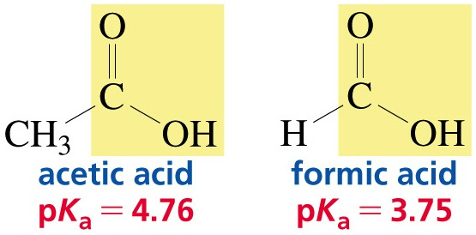
Carboxylic Acids are the Most
Common Organic Acids

Slide 12
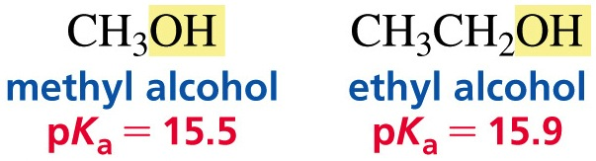
Alcohols

Slide 13
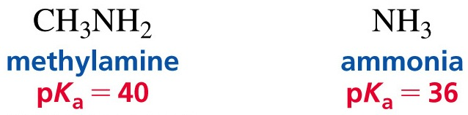
Amines

Slide 14
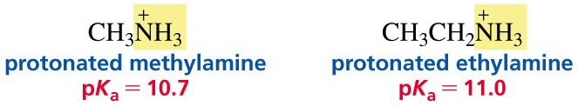
Protonated Amines

Slide 15
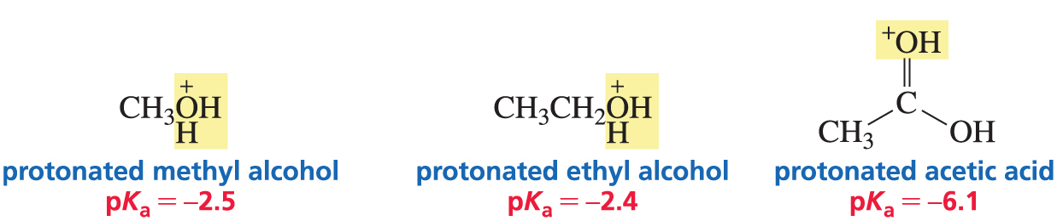
Protonated Alcohols and
Protonated Carboxylic Acids

Slide 16
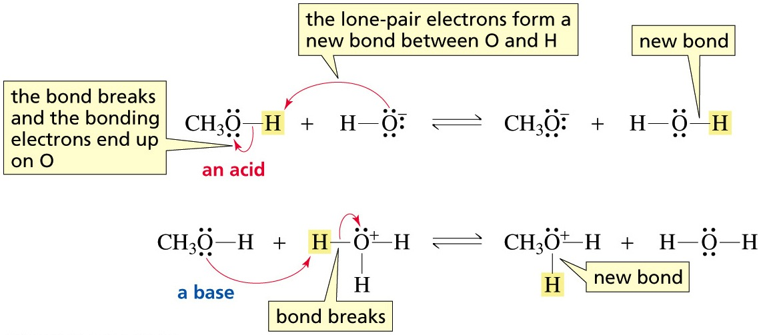
An Alcohol Can Behave as
an Acid and as a Base
A curved arrow points from the electron donor to the electron acceptor

Slide 17
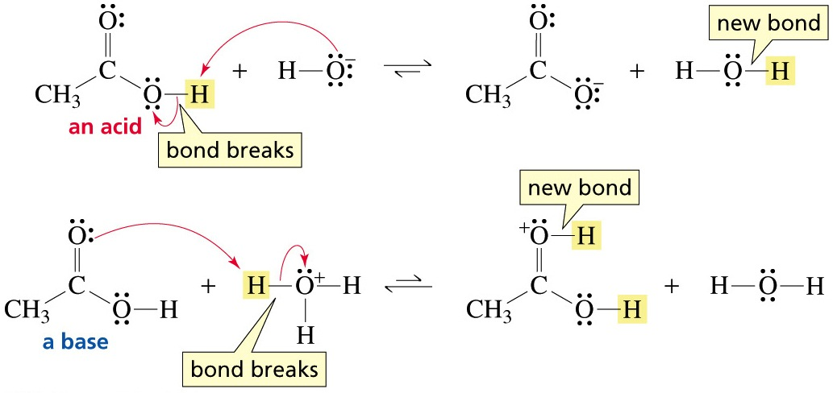
A Carboxylic Acid Can Behave
as an Acid and as a Base
A curved arrow points from the electron donor to the electron acceptor

Slide 18
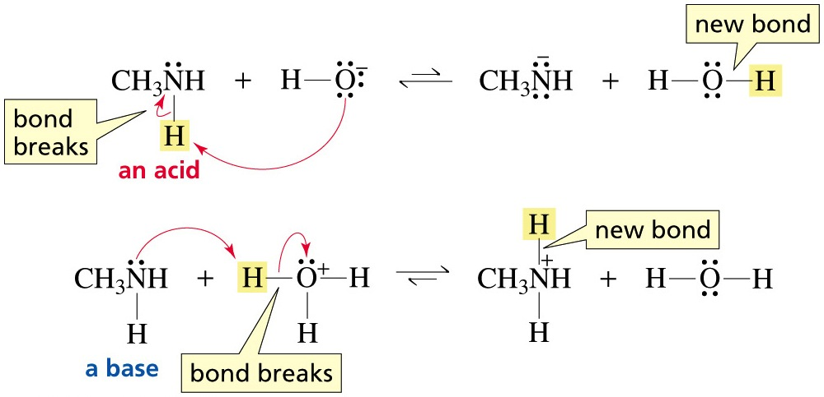
An Amine Can Behave
as an Acid and as a Base
A curved arrow points from the electron donor to the electron acceptor

Slide 19
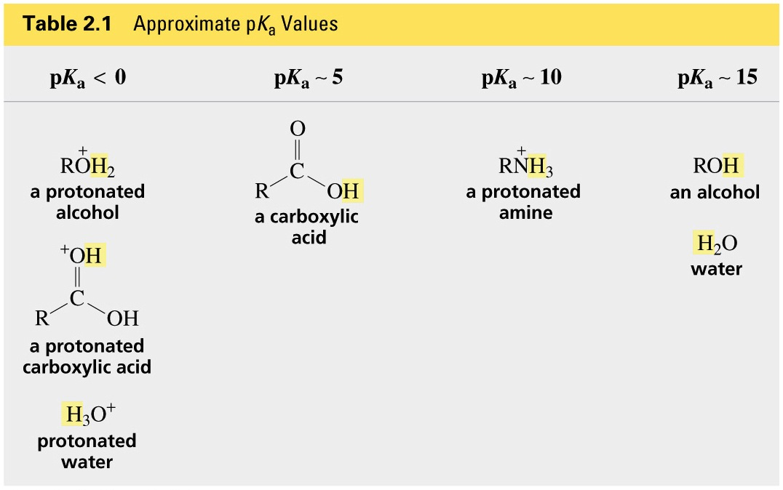

Slide 20
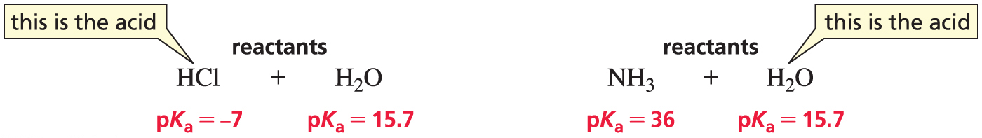
Which Reactant is the Acid?
The stronger acid (the one with the lower pK_{a}) behaves as the acid:
Here water is behaving as a base. Here water is behaving as an acid.

Slide 21
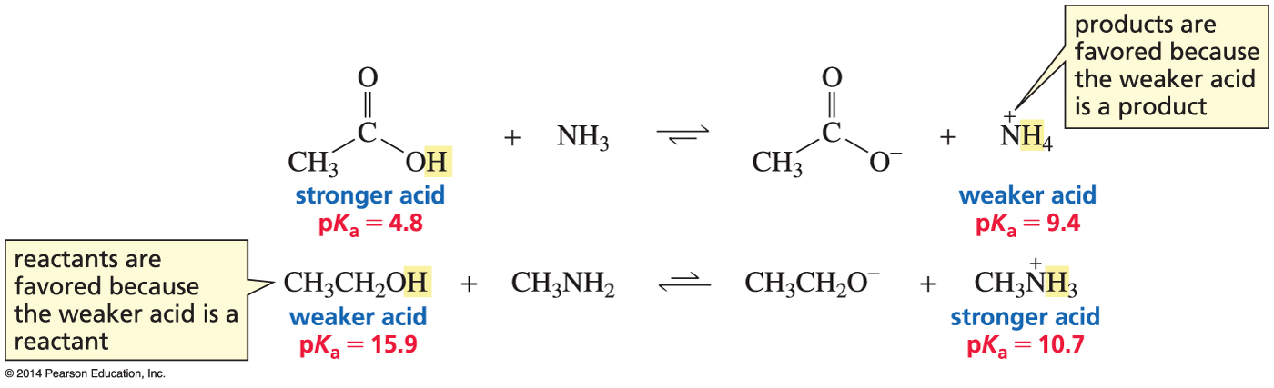
The Position of Equilibrium
The equilibrium favors formation of the weaker acid.

Slide 22
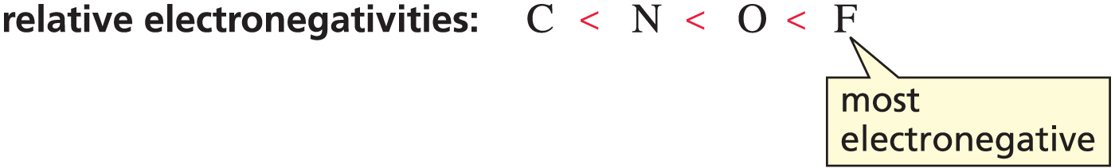
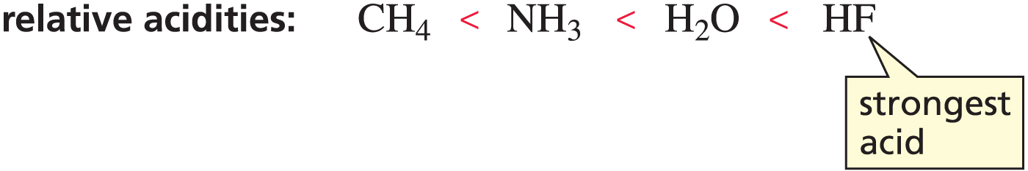
Electronegativity Affects pK_{a} Values
When atoms are the same size, the strongest acid has
its hydrogen attached to the most electronegative atom.

Slide 23
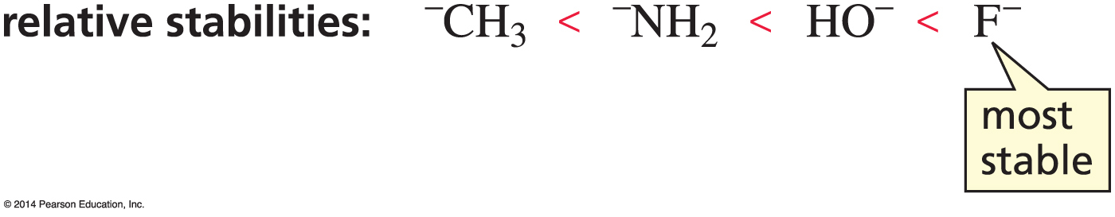
The Stronger the Acid,
the Weaker Its Conjugate Base
stable bases are weak bases

Slide 24
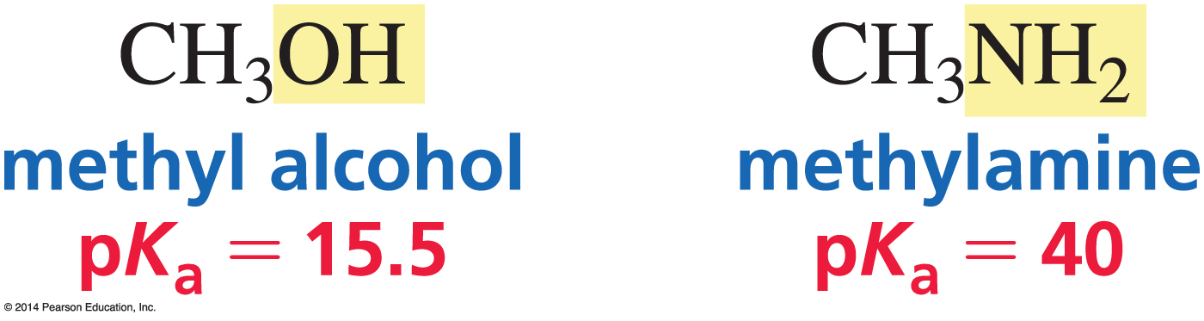
Why are Alcohols Stronger Acids Than Amines?
Oxygen is more electronegative than nitrogen.

Slide 25
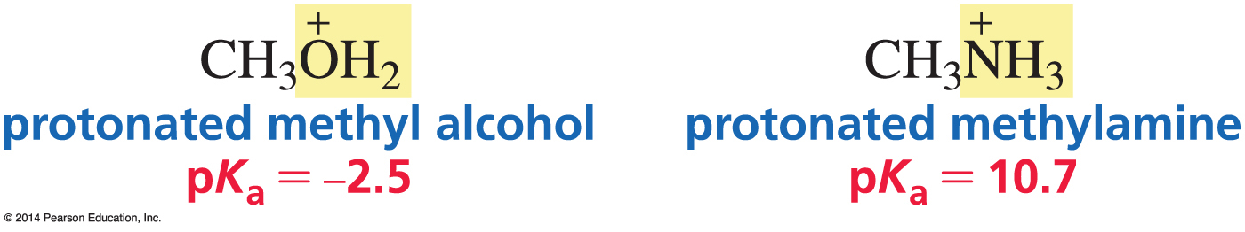
Why are Protonated Alcohols Stronger Acids Than Protonated Amines?
Oxygen is more electronegative than nitrogen.

Slide 26
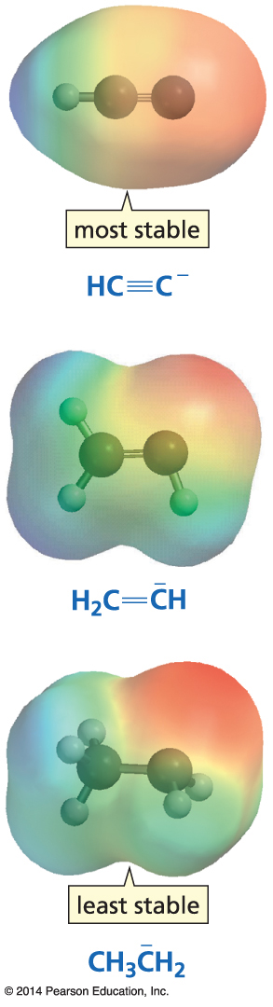
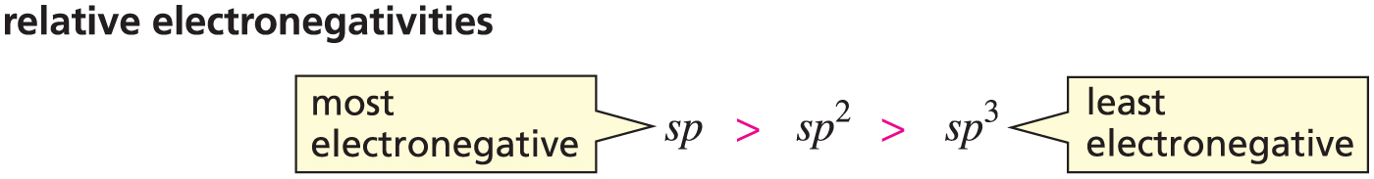
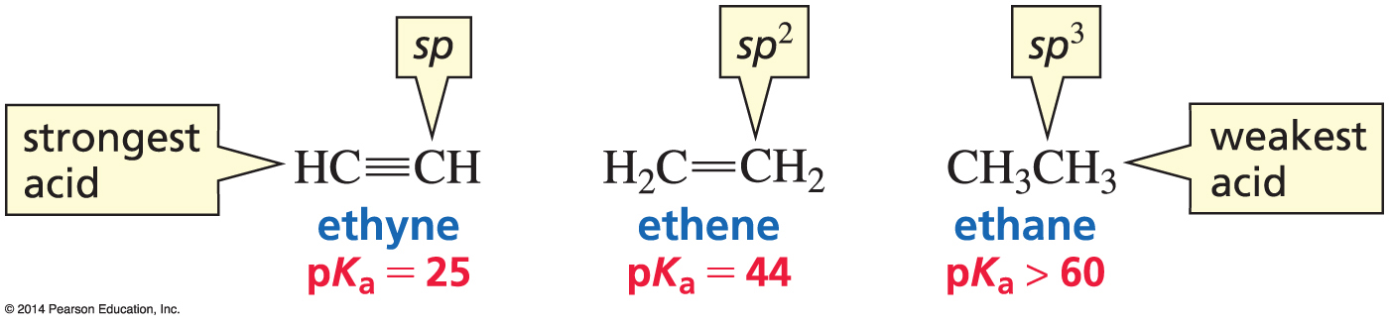
Hybridization Affects Electronegativity
The weakest acid has the
strongest conjugate base.
Notes:
I would make the blue structural formulas on the right much larger.

Slide 27
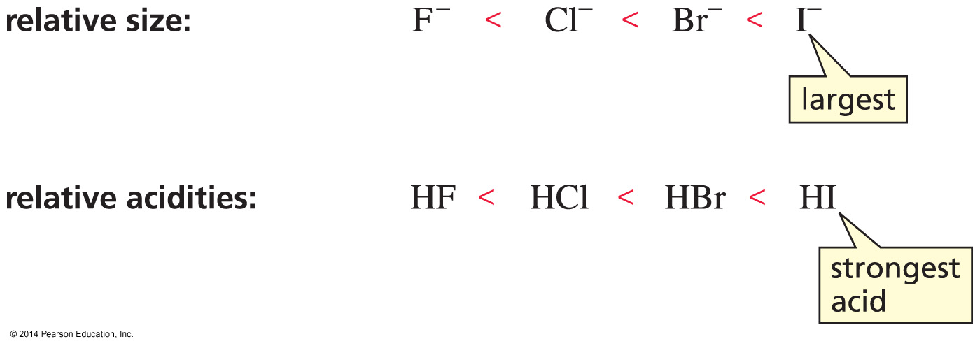
Size Affects pK_{a} Values
When atoms differ in size, the strongest acid has its hydrogen bonded to the largest atom.

Slide 28
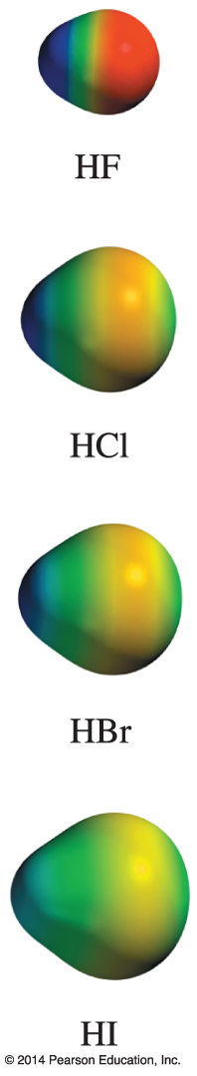
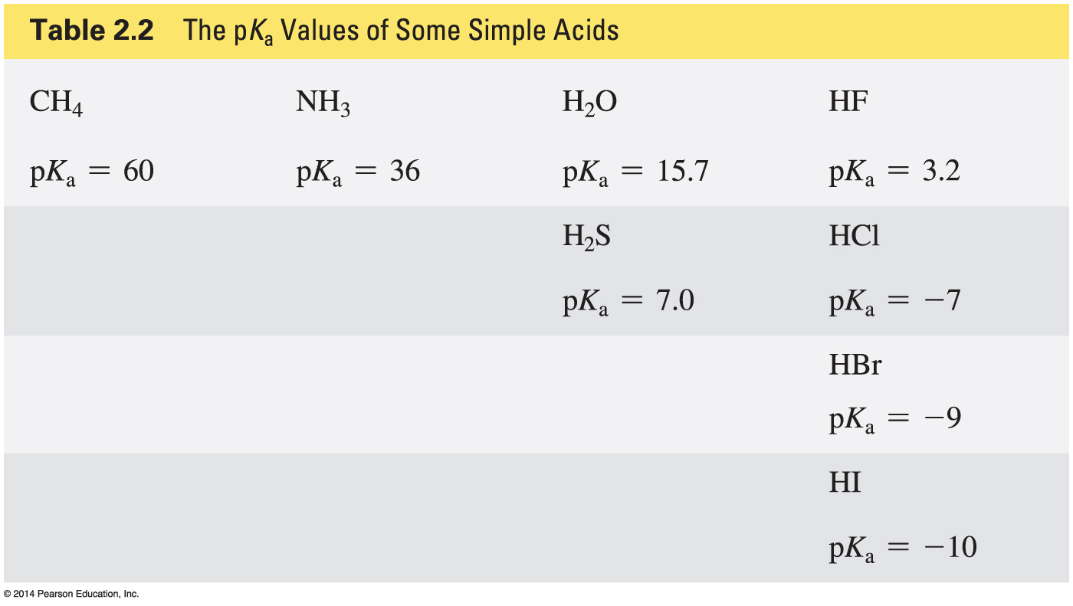
Some pK_{a} Values

Slide 29
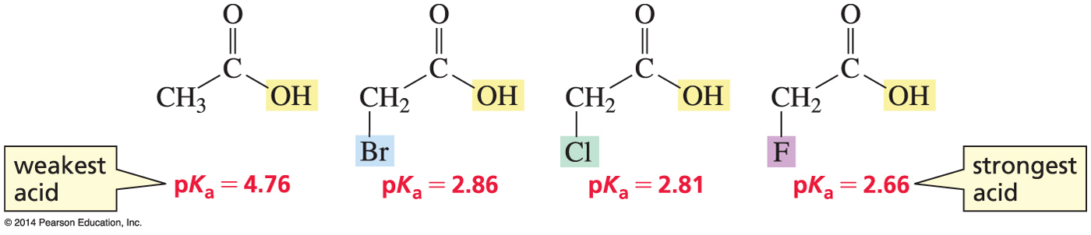
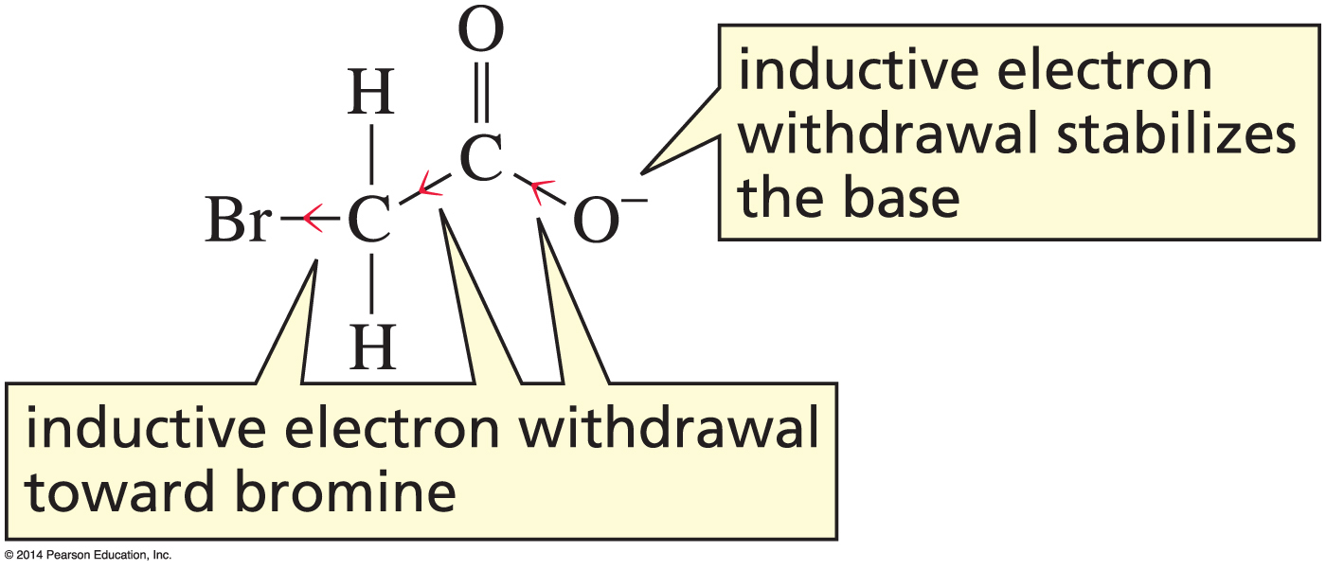
A Substituent’s Effect on Acidity
inductive electron withdrawal

Slide 30
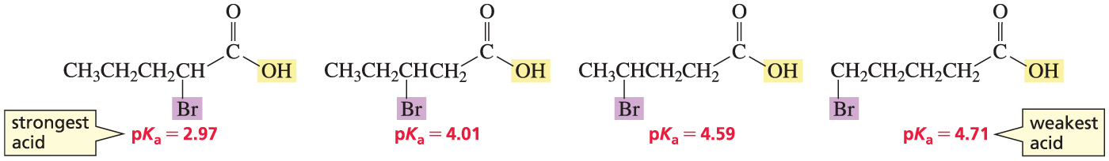
A Substituent’s Effect on pK_{a}
Depends on Distance

Slide 31
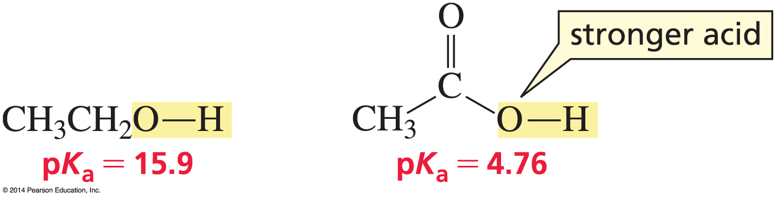
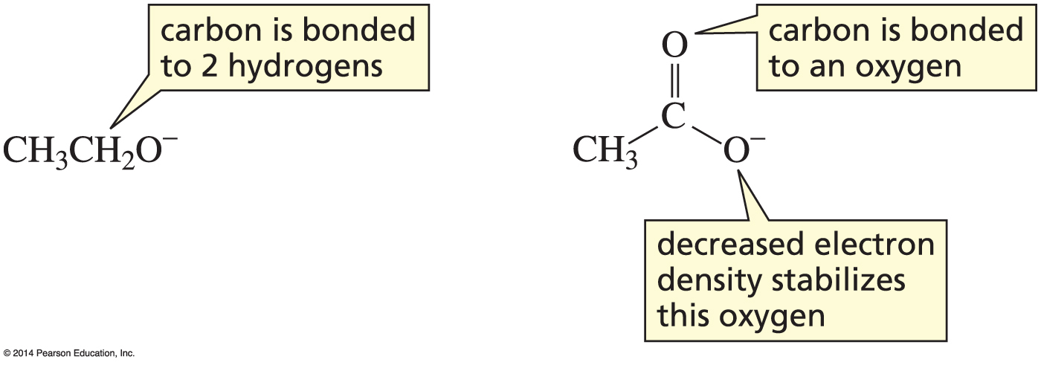
Why is a Carboxylic Acid a Stronger Acid
Than an Alcohol?
1. inductive electron withdrawal

Slide 32
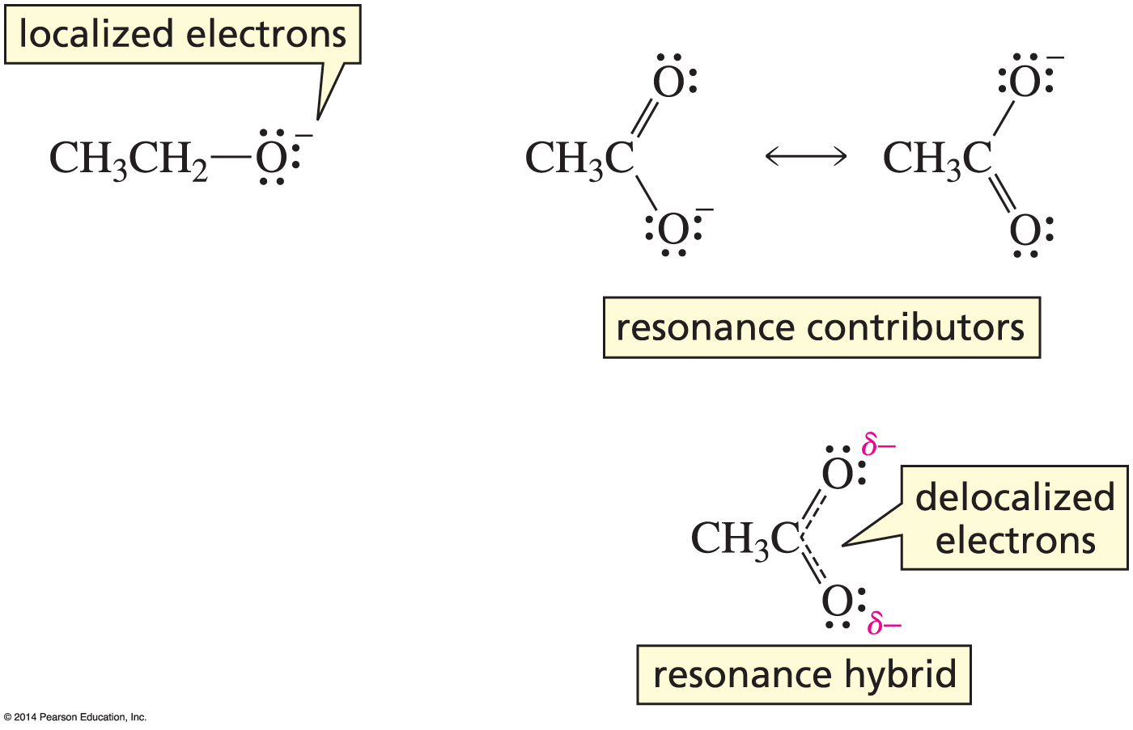
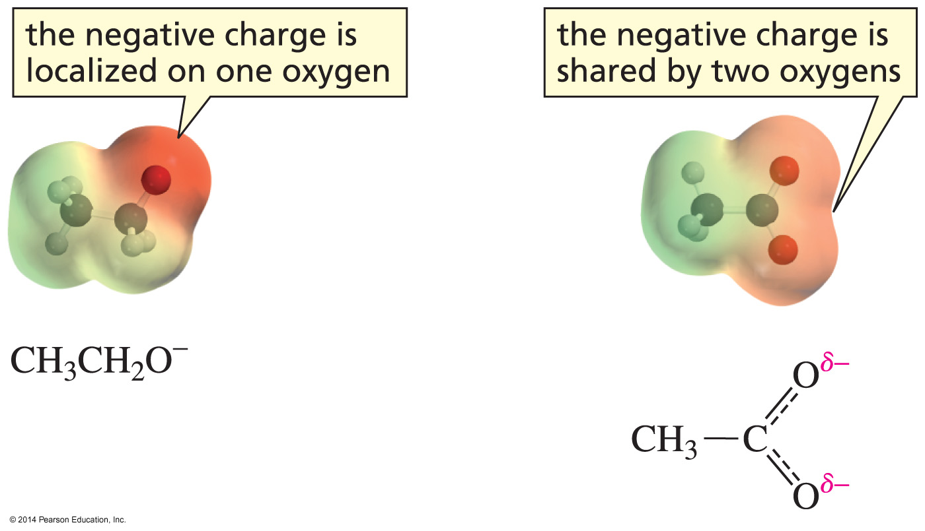
Why is a Carboxylic Acid a Stronger Acid
Than an Alcohol?
2. delocalized electrons (resonance)

Slide 33
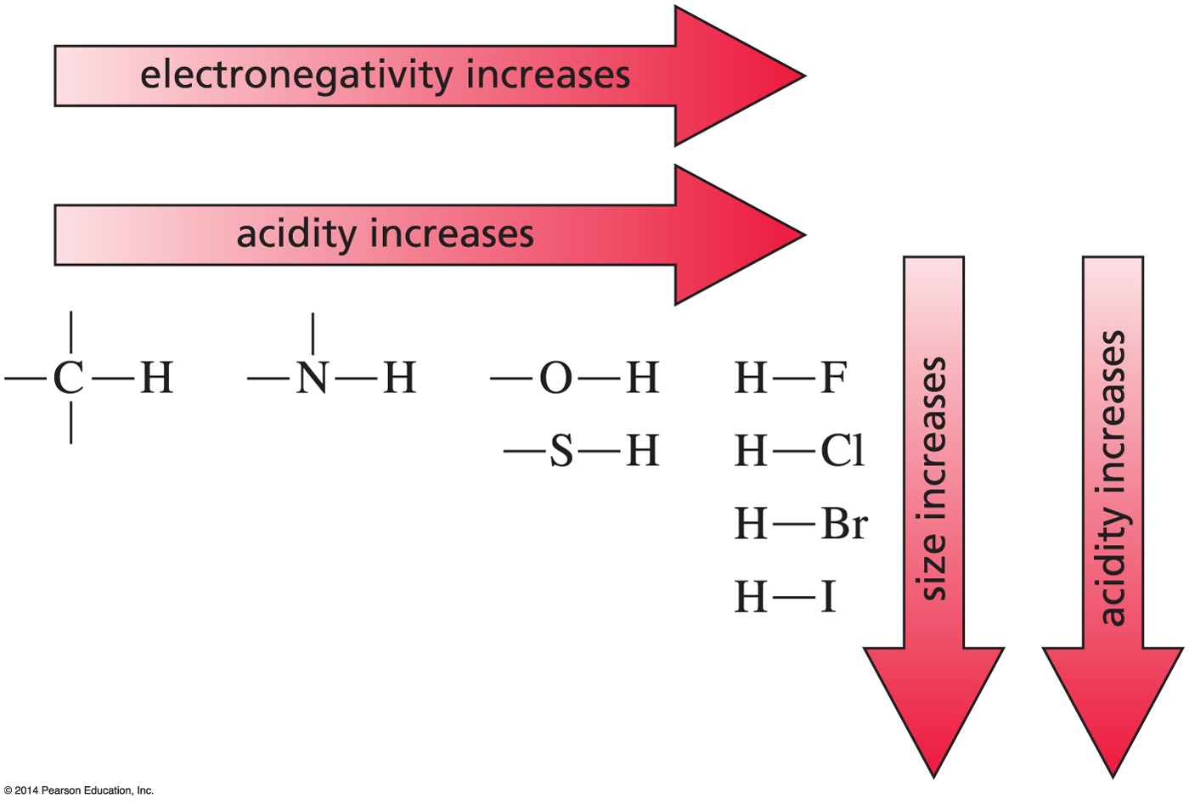
Summary of Factors
That Affect Acid Strength
electronegativity and size

Slide 34
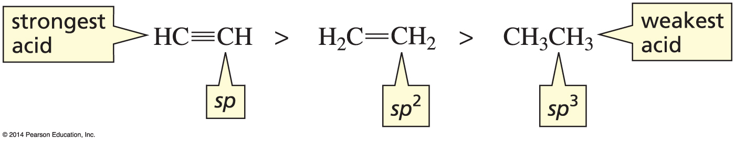
Summary of Factors
That Affect Acid Strength
hybridization

Slide 35
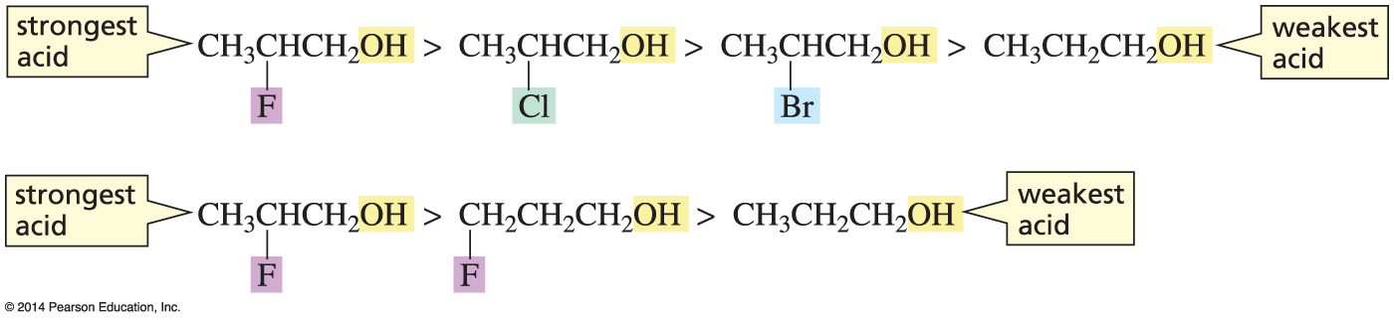
Summary of Factors
That Affect Acid Strength
inductive electron withdrawal

Slide 36
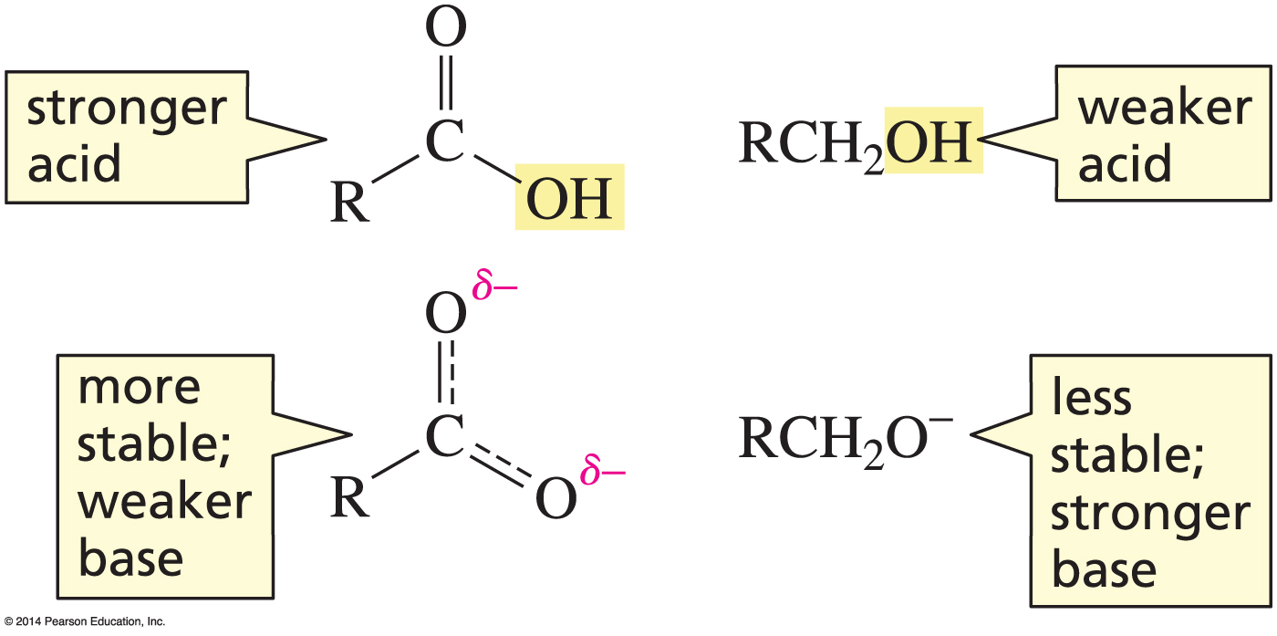
Summary of Factors
That Affect Acid Strength
electron delocalization

Slide 37
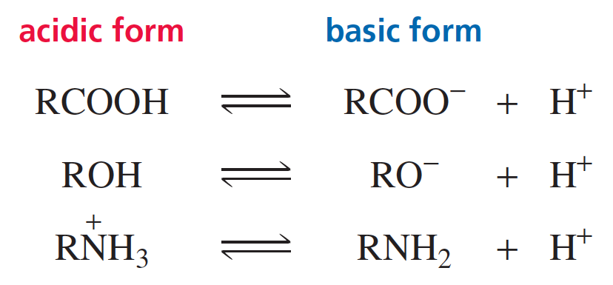
Is a Compound Charged or Neutral?
A carboxylic acid is neutral in its acidic form and charged in its basic form.
An alcohol is neutral in its acidic form and charged in its basic form.
An amine is charged in its acidic form and neutral in its basic form.

Slide 38
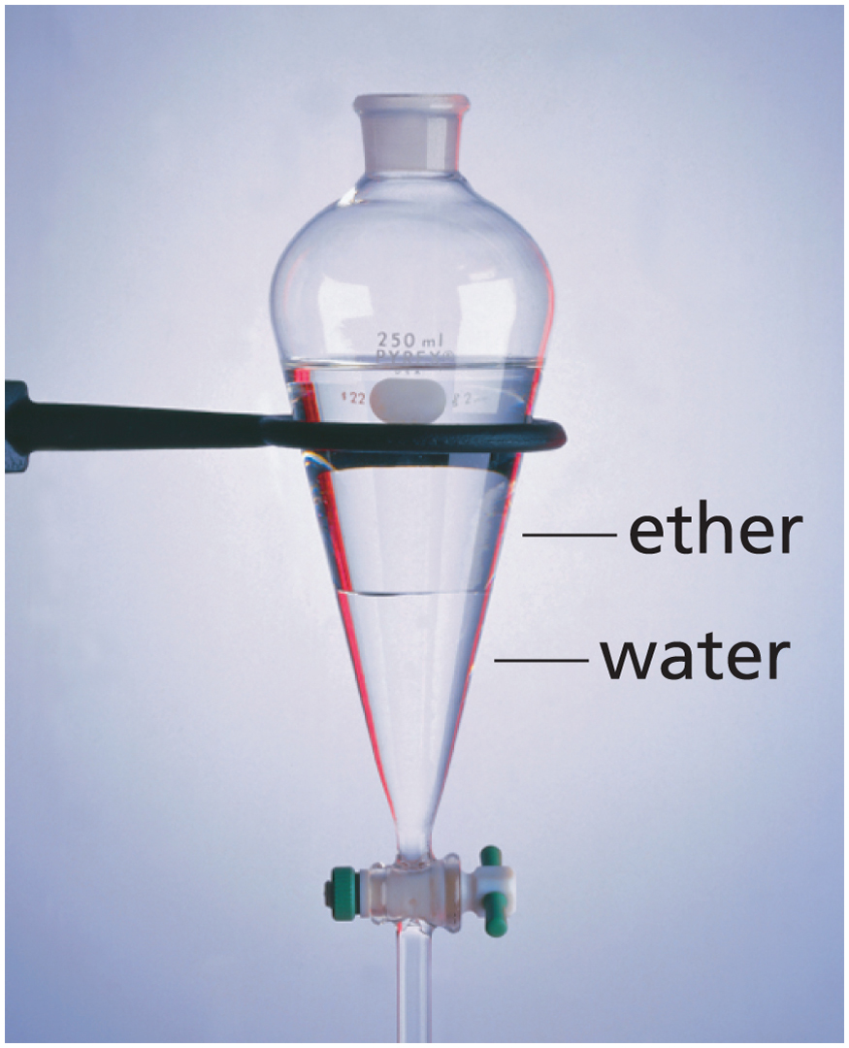
Water and Diethyl Ether are Immiscible –
They Form Two Layers
Diethyl ether is less dense than water,
so diethyl ether is on top. Diethyl ether is less polar than water, and carries the neutral form of an acid or base.
The lower aqueous layer (an acidic or basic solution, depending on the pH) carries the charged form.
In this way, separation of an acid or base can be accomplished.

Slide 39
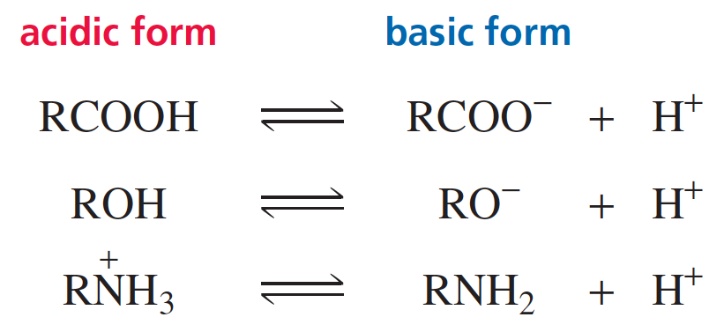
Buffer Solutions

Slide 40
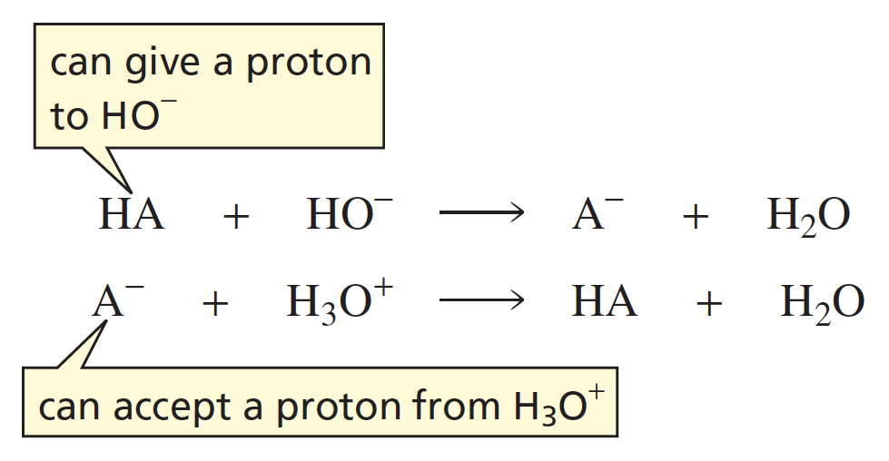
How a Buffer Solution Maintains
Nearly Constant pH
A buffer solution contains an acid and its conjugate base.
A buffer solution can maintain nearly constant pH when small amounts of acid or base are added to it.

