Slide 1
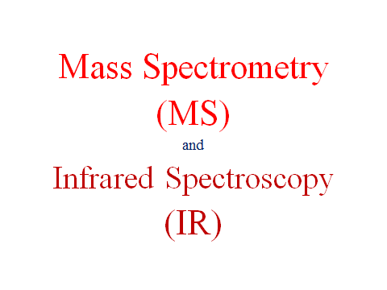
CHE 232
MtWTF 8-8:50pm
*
‹#›
Notes:
‹#›

Slide 2
Mass Spectrometry
Used in determining the molecular weight and formula of a compound.
A compound is vaporized and ionized by bombardment with a
beam of high-energy electrons.
When the electron bean ionizes the molecule, the species formed
is called a radical cation, and symbolized as M^{+•}.
The radical cation M^{+•} is called the molecular ion or parent ion.
The mass of M^{+•} represents the molecular weight of M.
*
‹#›
Notes:
‹#›

Slide 3
Because M^{+•} is unstable, it decomposes to form fragments of radicals and cations that have a lower molecular weight than M^{+•}.
The mass spectrometer measures the mass of these cations.
The mass spectrum is a plot of the amount of each cation (relative abundance) versus its mass to charge ratio (m/z, where m is mass and z is charge)
Since z is almost always +1, m/z actually measures the mass (m) of the individual ions
*
‹#›
Notes:
‹#›

Slide 4
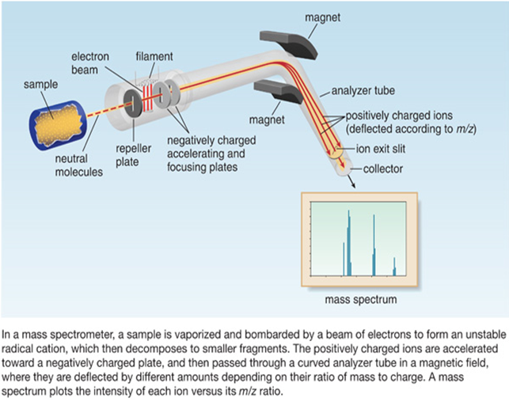
*
‹#›
Notes:
‹#›

Slide 5
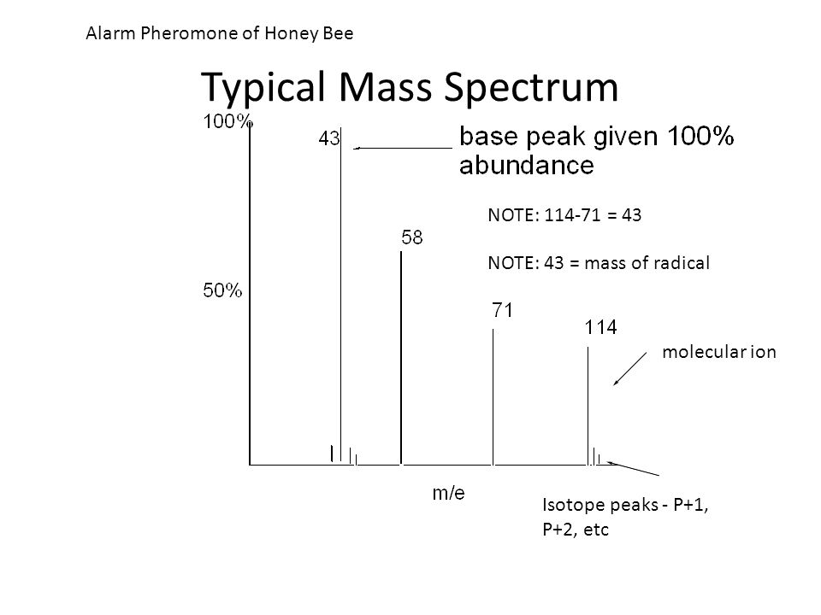
*
‹#›

Slide 6
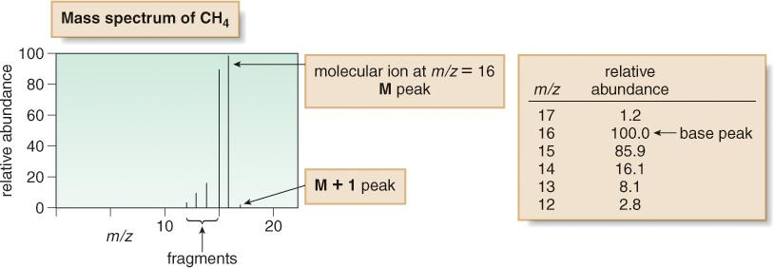
Methane CH₄
Though most C atoms have an atomic mass of 12, 1.1% have a mass of 13. Thus, ¹³CH₄ is responsible for the peak at m/z = 17. This is called the M + 1 peak.
*
‹#›
Notes:
‹#›

Slide 7
What is an M+1 peak?
If you had a complete (rather than a simplified) mass spectrum, you will find a small line 1 m/z unit to the right of the main molecular ion peak. This small peak is called the M+1 peak.
The carbon-13 isotope
The M+1 peak is caused by the presence of the ¹³C isotope in the molecule. ¹³C is a stable isotope of carbon. Carbon-13 makes up 1.11% of all carbon atoms.
*
‹#›

Slide 8
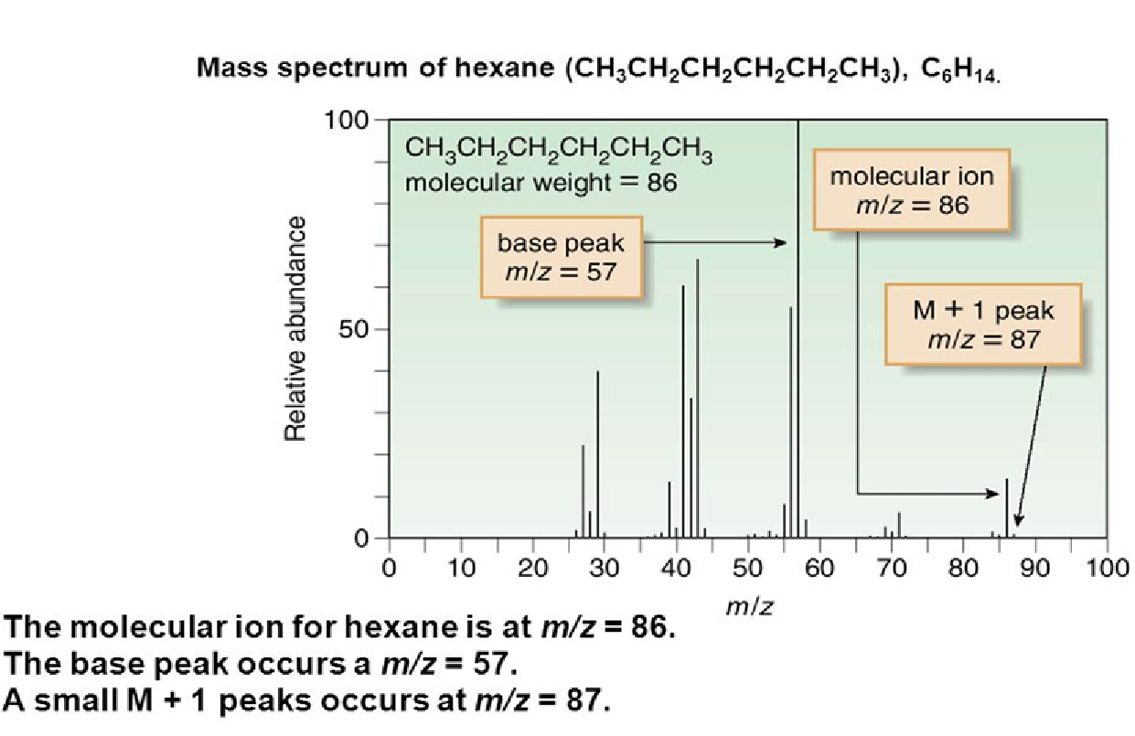
*
‹#›

Slide 9
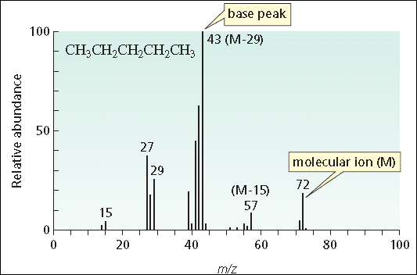
*
‹#›

Slide 10
Alkyl Halides and the M+2 peak
Most elements have one major isotope.
However some halogens have more than one. Iodine and Fluorine are isotopically pure but….
Chlorine has two common isotopes, ³⁵Cl and ³⁷Cl, which occur naturally in a 3:1 ratio.
Bromine also has 2 isotopes, ⁷⁹Br and ⁸¹Br in a 1:1 ratio.
*
‹#›
Notes:
‹#›

Slide 11
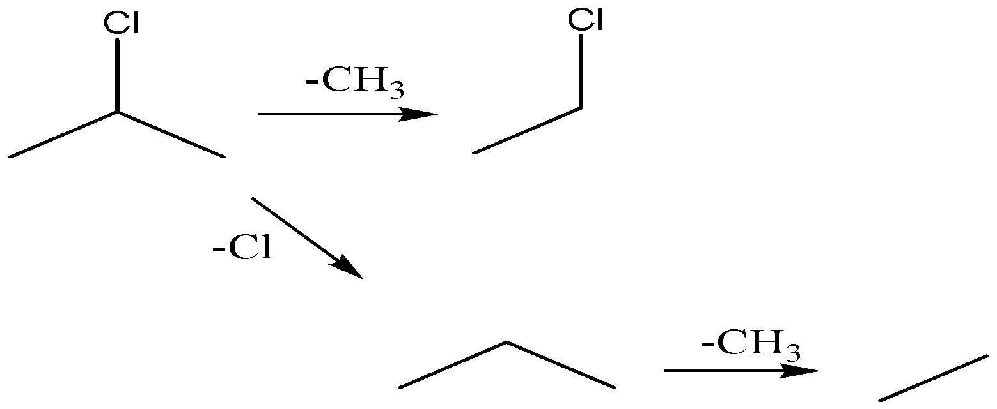
*
‹#›
Notes:
‹#›

Slide 12
*
‹#›
Notes:
‹#›

Slide 13
Mass spectrometry spectra interpretation
(Practice examples)
*
‹#›

Slide 14
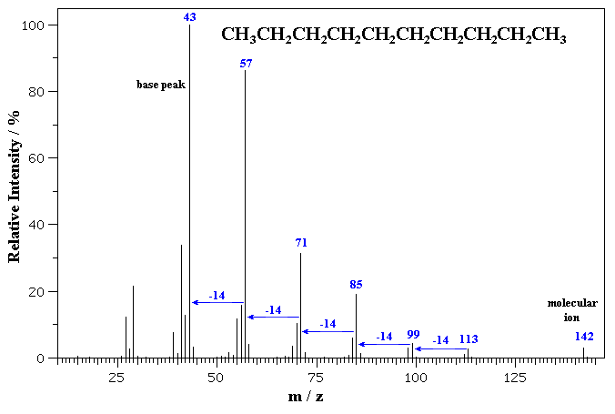
*
‹#›
Notes:
‹#›

Slide 15
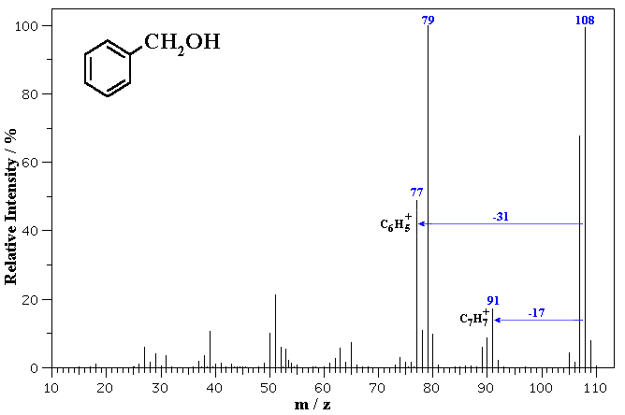
*
‹#›
Notes:
‹#›

Slide 16
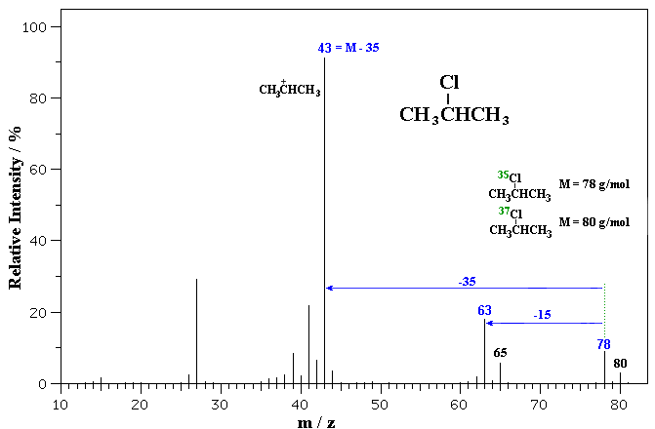
*
‹#›
Notes:
‹#›

Slide 17
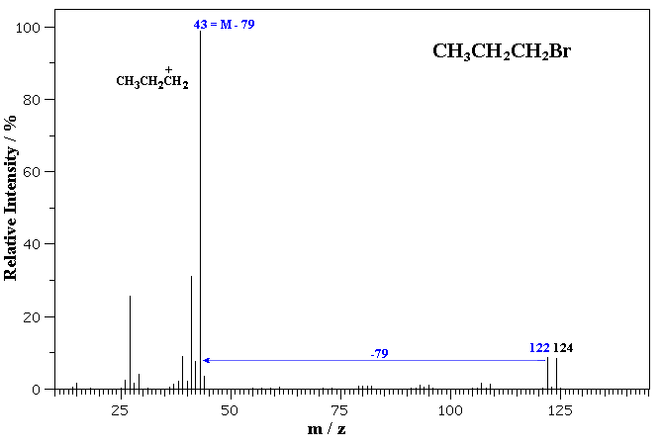
*
‹#›

Slide 18
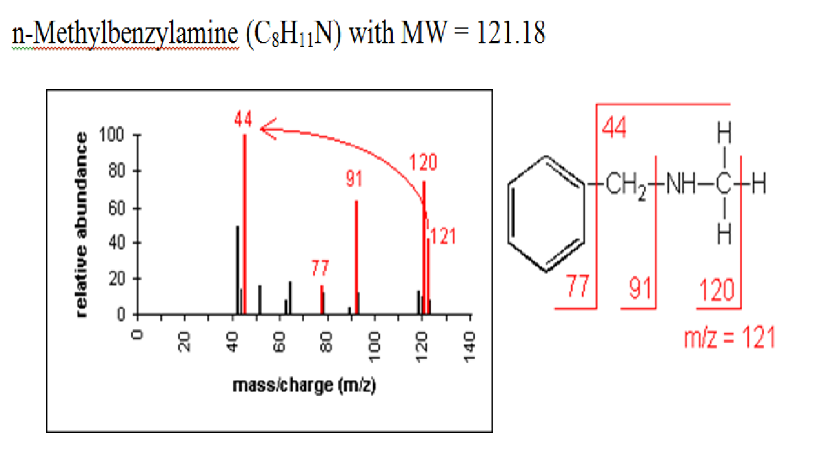
*
‹#›

Slide 19
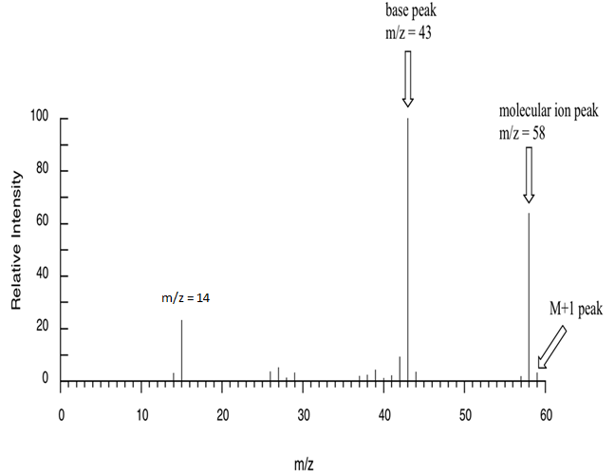
Suggest a structure for a molecular ion C₃H₆O?
3 C’s 3 x 12 = 36
6 H’s 6 x 1 = 6
1 O 1 x 16 = 16
36 + 6 + 16 = 58
M = M^{+•}(m/z) = 58
Degree of Unsaturation expected structures
(2(3) + 2 – 6)/2 = 1
*
‹#›
Notes:
‹#›

Slide 20
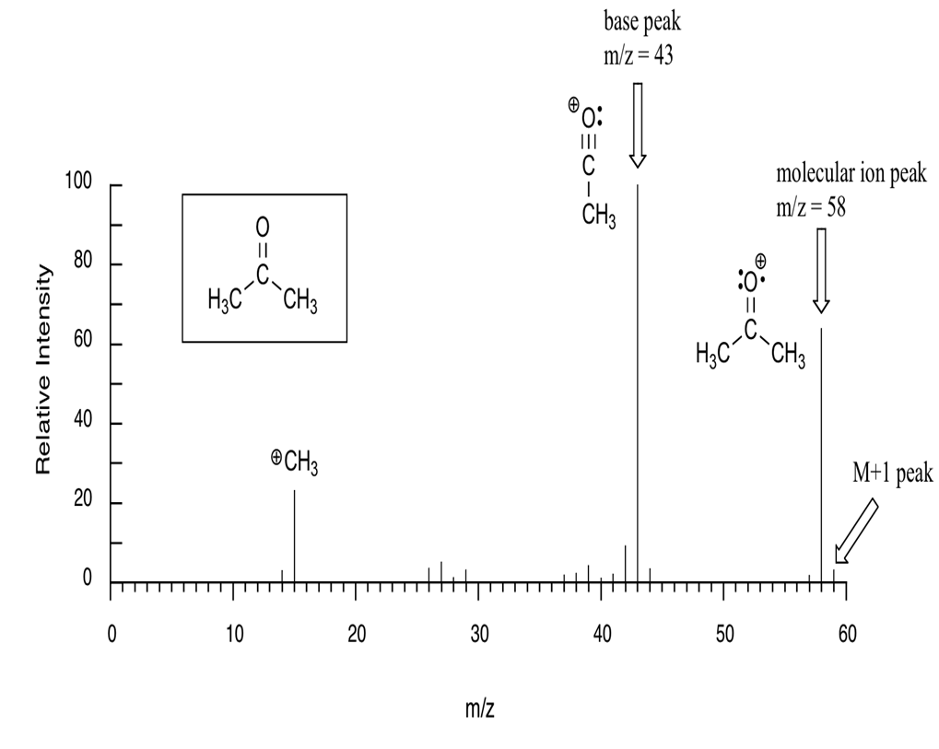
*
‹#›

Slide 21
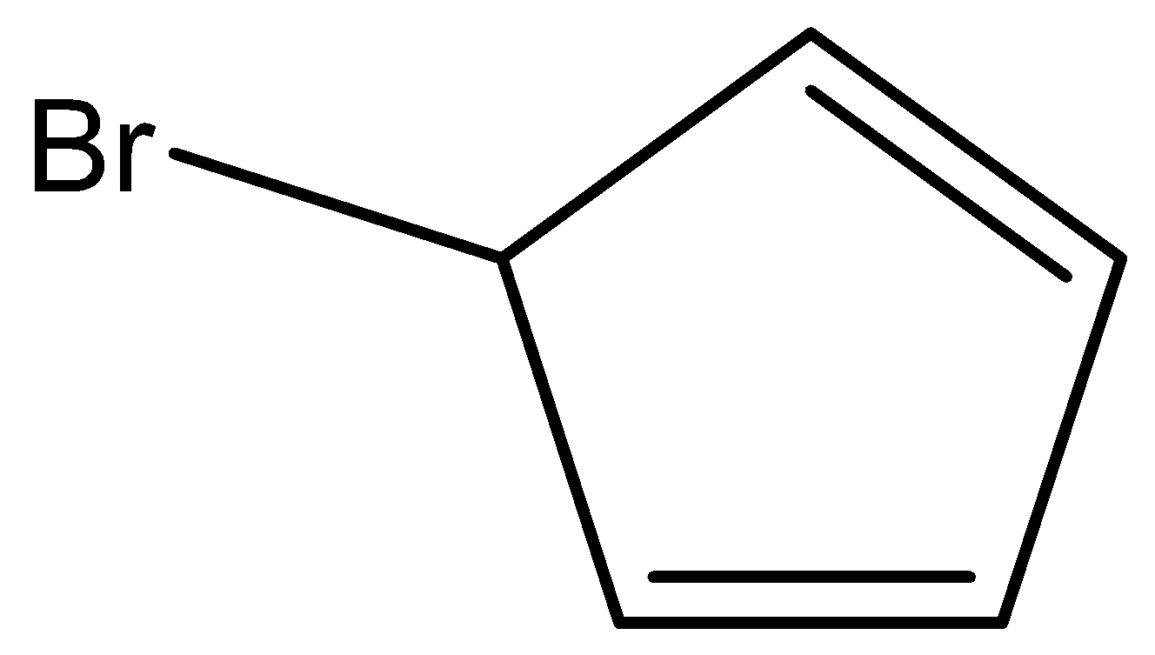
Suggest a structure for a molecular ion peak that has 2 peaks 144 and 146 in a 1:1 ratio.
Step 1 – Since we have an M and M + 2 peak as the molecular ion, we know that there is a halogen.
Also since they occur in a 1: 1 ration we know it’s Br.
144 – 79 = 65
146 – 81 = 65
Step 2 – Determine max # C’s
65/12 = 5 Carbons
Step 3 – Add enough H’s to make up the rest of the mass.
5 x 12 = 60
C₅BrH₅
144 – (60 + 79) = 5 H’s
(2(5) + 2 – 6)/2 = 3
*
‹#›
Notes:
‹#›

Slide 22
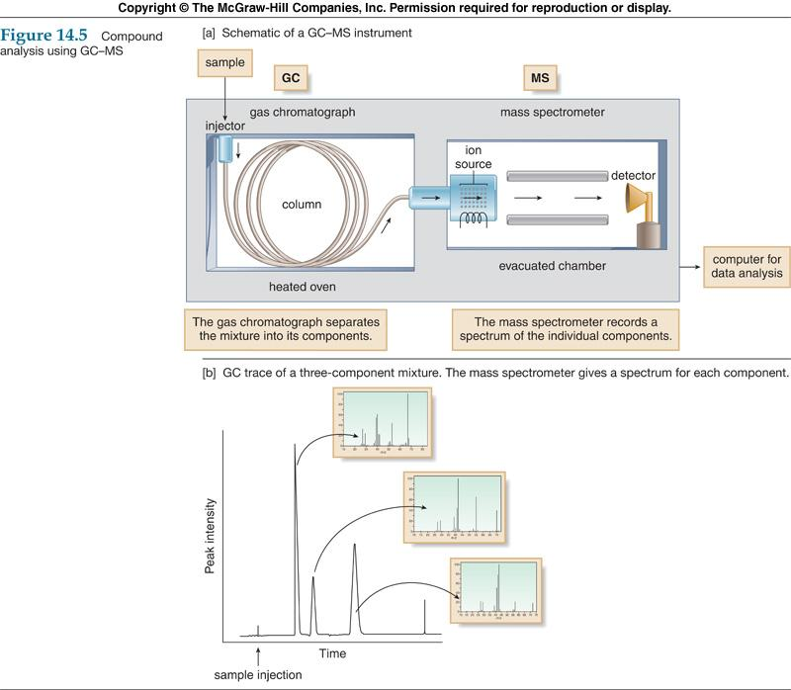
Gas Chromatography/Mass Spectrometry (GC/MS)
Sample introduced into GC inlet vaporized at 250 °C , swept onto the column by He carrier gas & separated on column. Sample components emerge from column, flowing into the capillary column interface connecting the GC col-umn and the MS (He removed).
*
‹#›
Notes:
‹#›

Slide 23
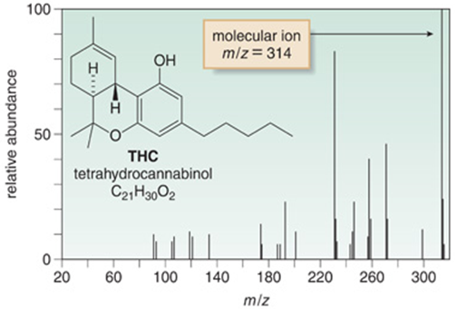
Gas Chromatography-Mass Spectrometry (GC-MS)
To analyze a urine sample for tetrahydrocannabinol, (THC) the principle psychoactive component of marijuana, the organic compounds are extracted from urine, purified, concentrated and injected into the GC-MS.
THC appears as a GC peak, and gives a molecular ion at 314, its molecular weight.
*
‹#›
Notes:
‹#›

Slide 24
Electromagnetic spectrum
*
‹#›
Notes:
‹#›

Slide 25
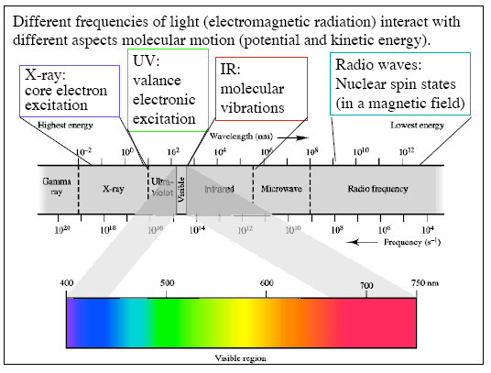
Electromagnetic spectrum
*
‹#›
Notes:
‹#›

Slide 26
Infrared Spectroscopy
* Absorption of infrared light (heat) by a compound.
* IR spectroscopy distinguishes between the different types of bonds,
thus allowing the identification of the functional groups present.
* Different kinds of bonds vibrate at different frequencies, therefore they absorb different wavelengths of radiation.
* Absorptions are recorded in wave number = 1/λ. Using this scale,
the IR region is 4000-400 cm⁻¹.
* The stronger the bond the higher the wavenumber of absorption
.
*
‹#›
Notes:
‹#›

Slide 27
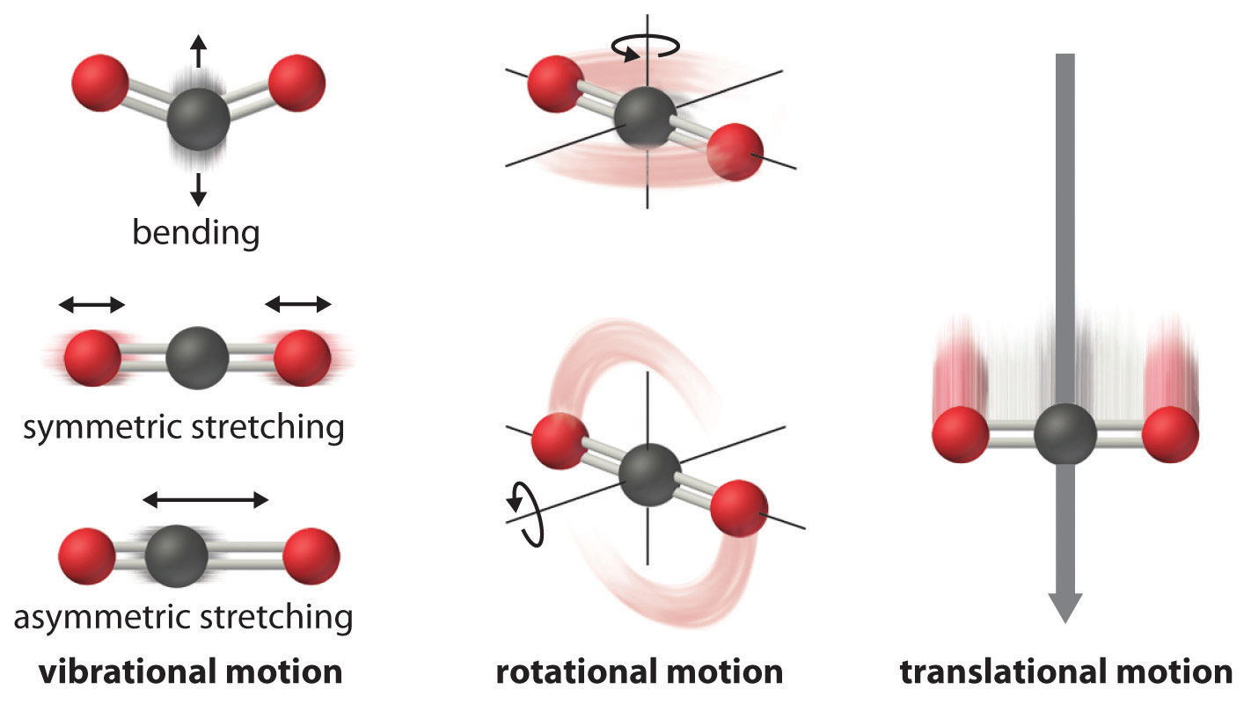
* Chemical bonds are not static, they have different vibrational
modes, such as bending and stretching.
*
‹#›

Slide 28
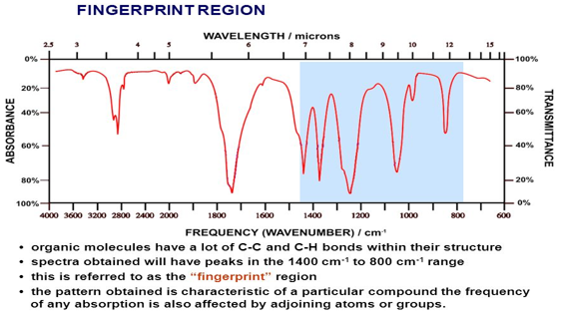
There are two sections of the IR spectra:
1. The fingerprint region (less than 1500 cm⁻¹).
2. The functional group region (greater than 1500 cm⁻¹)
*
‹#›
Notes:
‹#›

Slide 29
Frequency (wave number) scale and chemical bonds
4000-2500 cm⁻ ¹
2500-2000 cm⁻ ¹
2000-1500 cm⁻ ¹
1500-400 cm⁻ ¹
Bonds to H
C-H, N-H, O-H
Triple Bonds
C≡C, C≡N
Double Bonds
C=C, C=O, C=N
Single Bonds
C−C, C−O, C−N, C−X
*
‹#›
Notes:
‹#›

Slide 30
*
‹#›

Slide 31
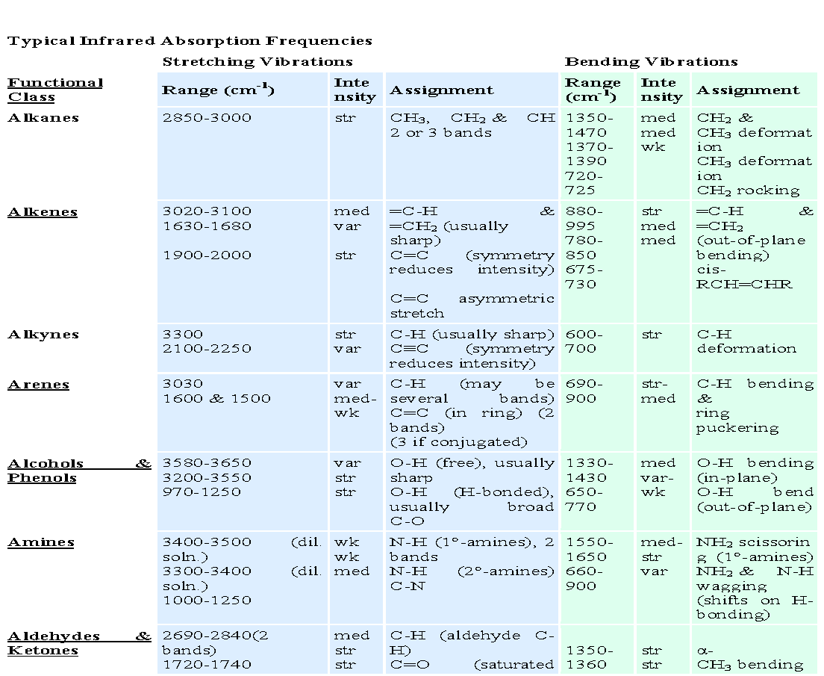
*
‹#›

Slide 32
Interpretation of Infrared Spectra
(Practice examples)
*
‹#›

Slide 33
*
‹#›

Slide 34
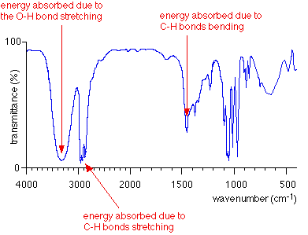
*
‹#›

Slide 35
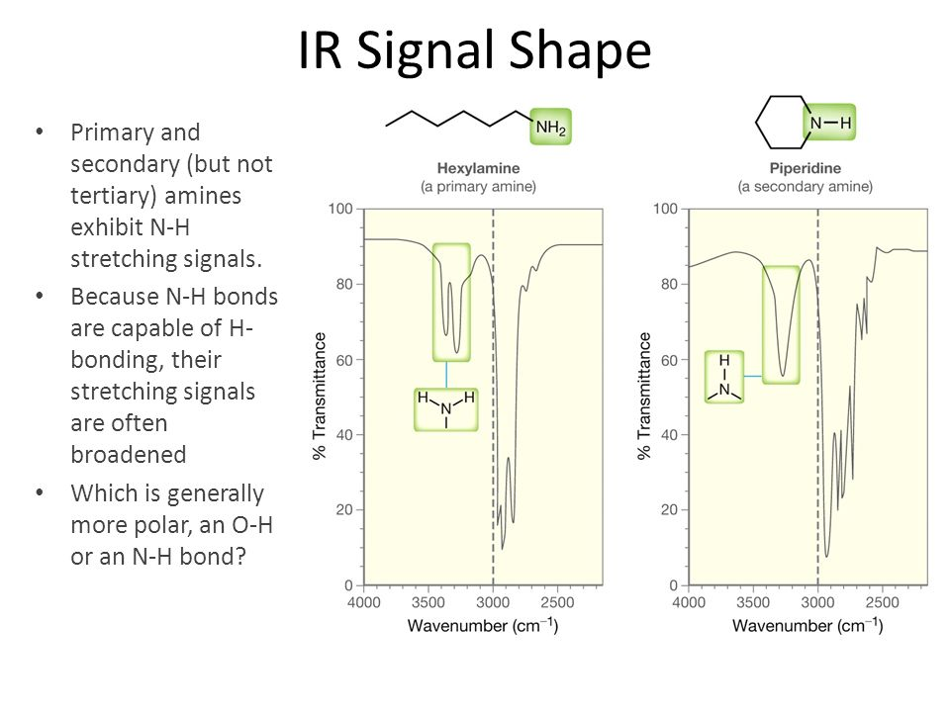
*
‹#›

Slide 36
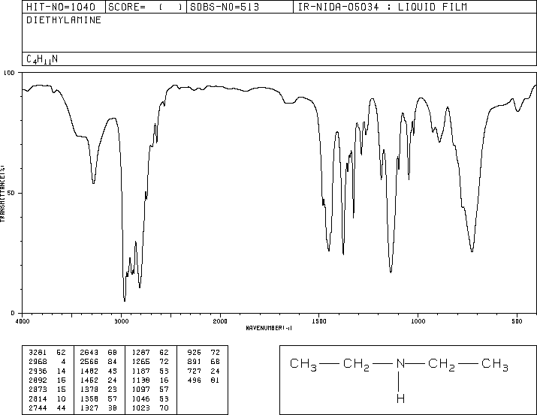
N-H stretch appears at 3200-3500, C-H at 3000.
-NH⇒
⇐ -CH
*
‹#›
Notes:
‹#›

Slide 37
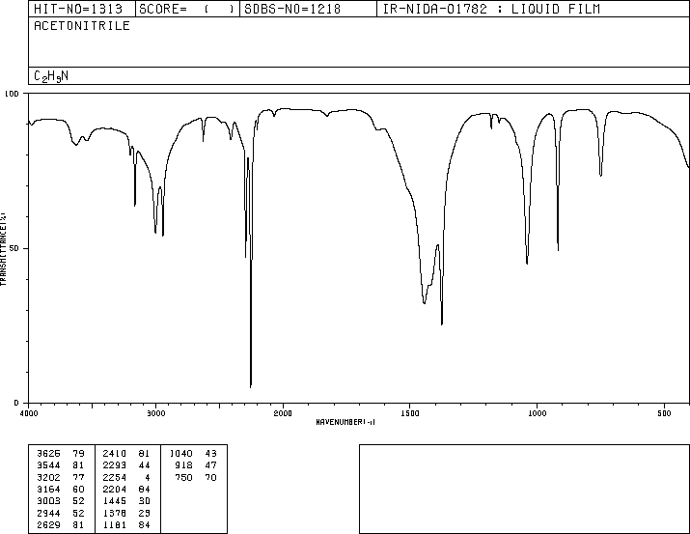
C≡N stretch appears at 2250, C-H at 3000.
⇐ -CH
- C≡N ⇒
*
‹#›
Notes:
‹#›

Slide 38
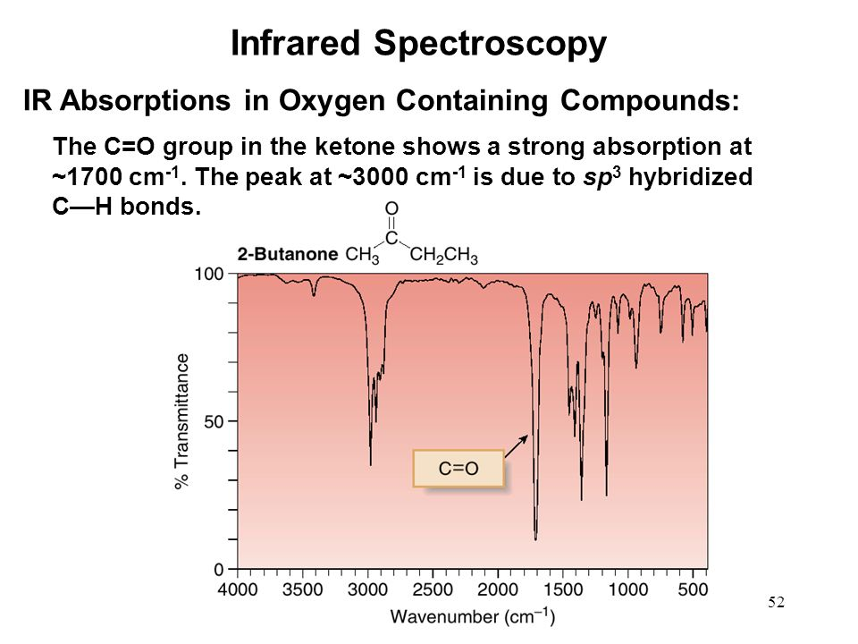
*
‹#›

Slide 39
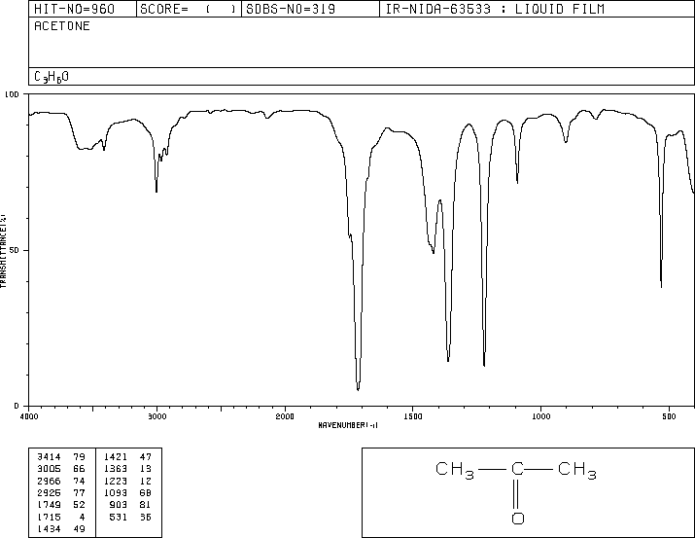
C=O stretch appears at 1650-1800, C-H at 3000.
⇐ -CH
- C=O ⇒
*
‹#›
Notes:
‹#›

Slide 40
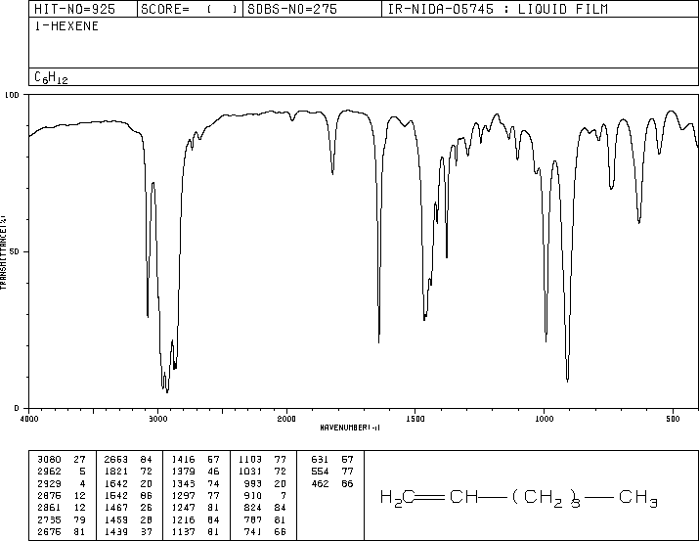
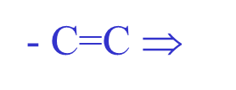
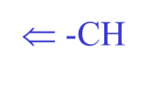
*
‹#›

Slide 41
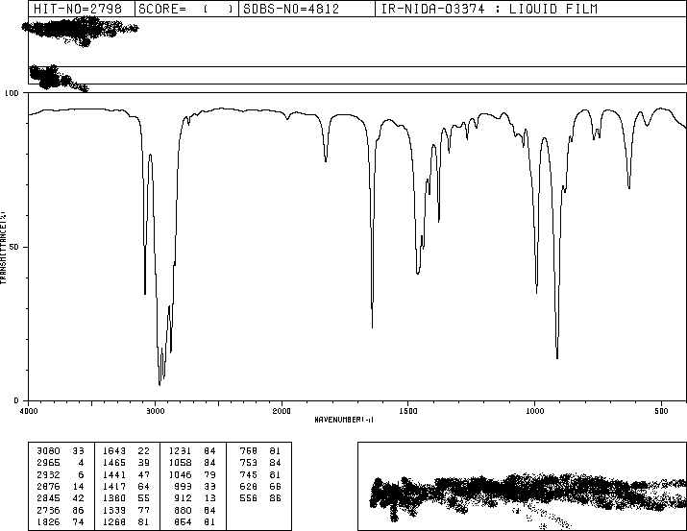
Which of these two isomers, cyclopentane or 1-pentene, is this the IR spectra of?
1650 cm⁻¹
3000 cm⁻¹
*
‹#›
Notes:
‹#›

Slide 42
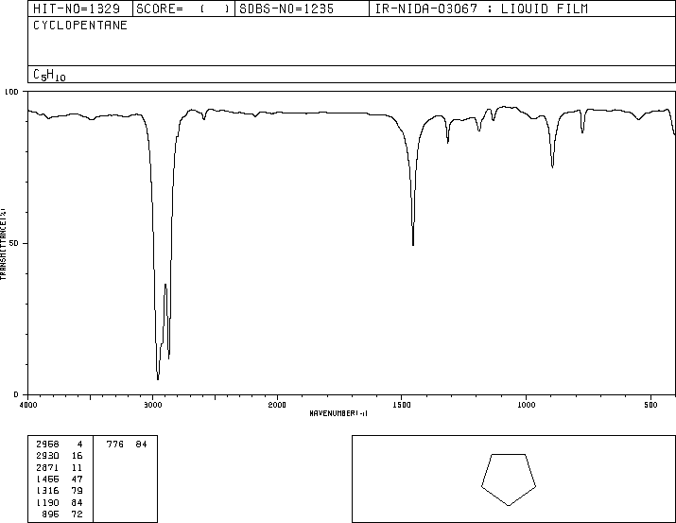
*
‹#›
Notes:
‹#›

Slide 43
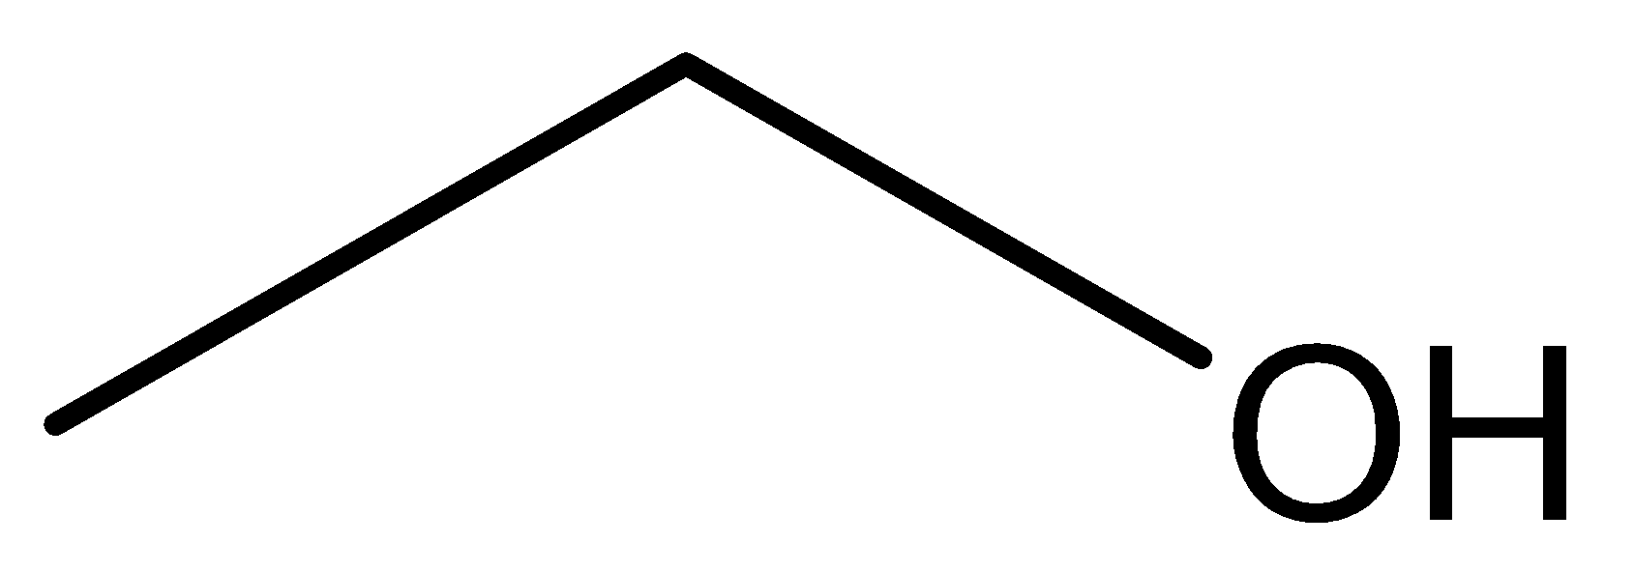
What IR peaks would you expect for the two molecules with the formula C₂H₆O?
Ethanol
Dimethyl ether
-OH 3200 - 3600 cm⁻¹
-CH 3000 cm⁻¹
-CH 3000 cm⁻¹
*
‹#›
Notes:
‹#›

Slide 44
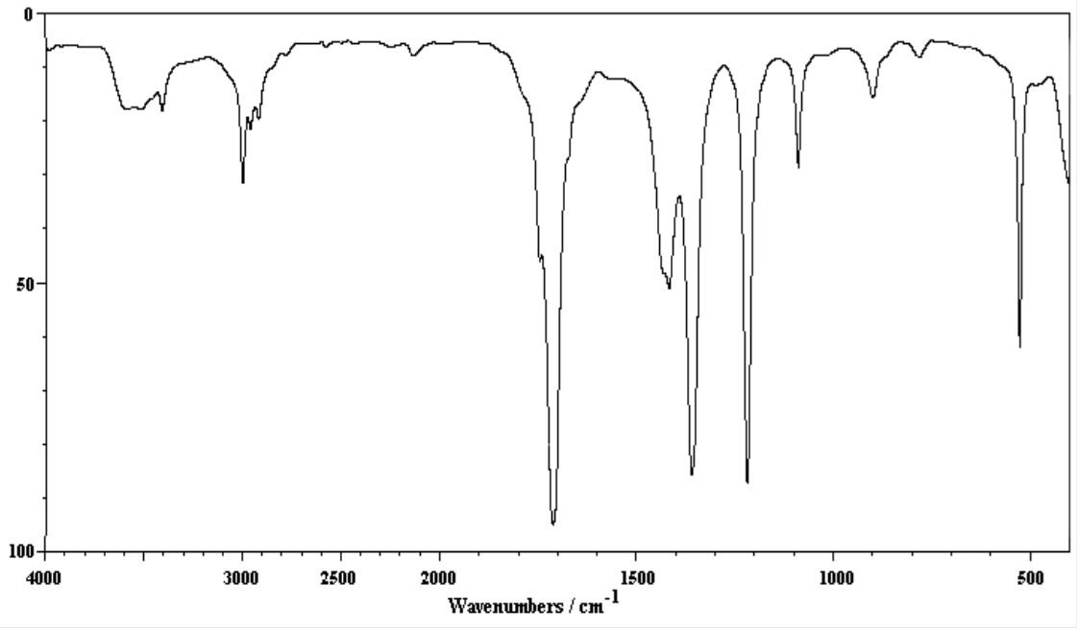
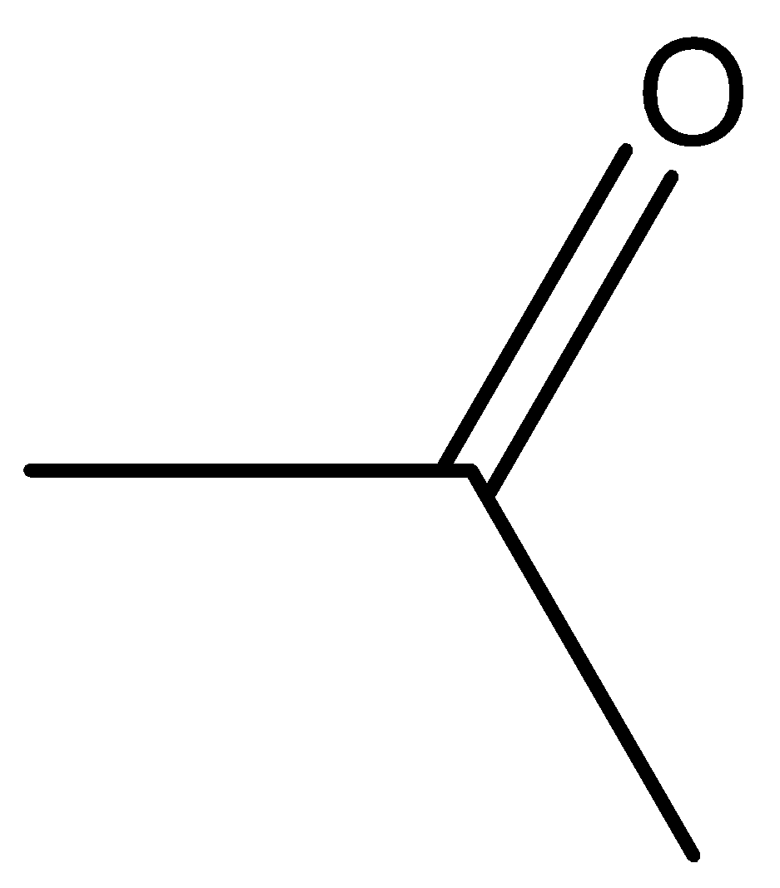
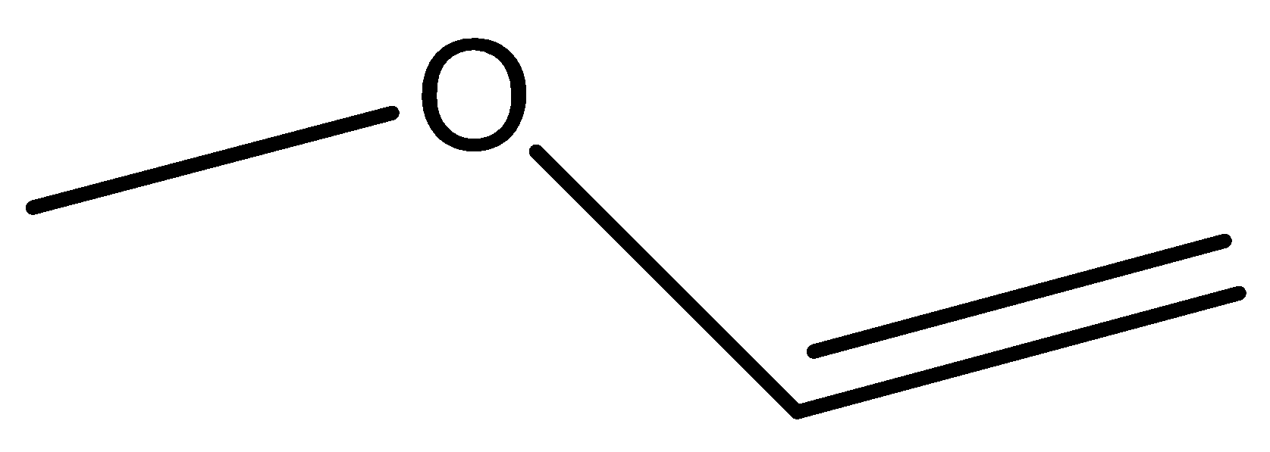
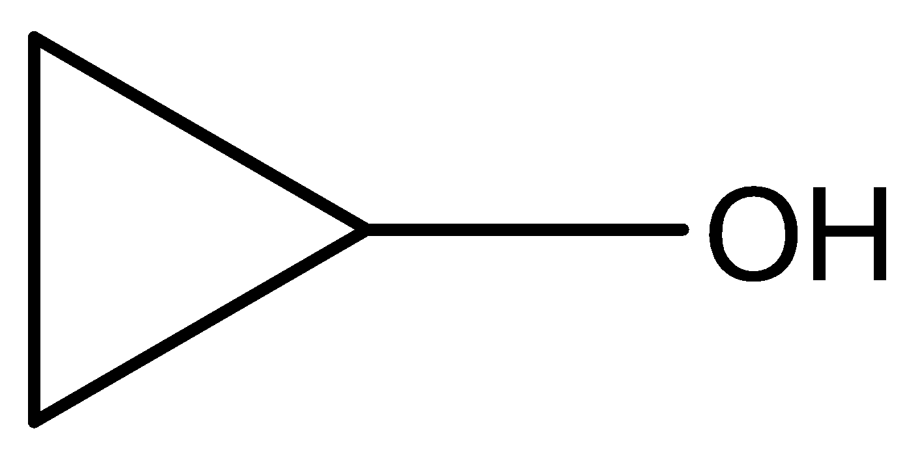
Which of the three compounds below matches the IR spectra?
*
‹#›
Notes:
‹#›

Slide 45
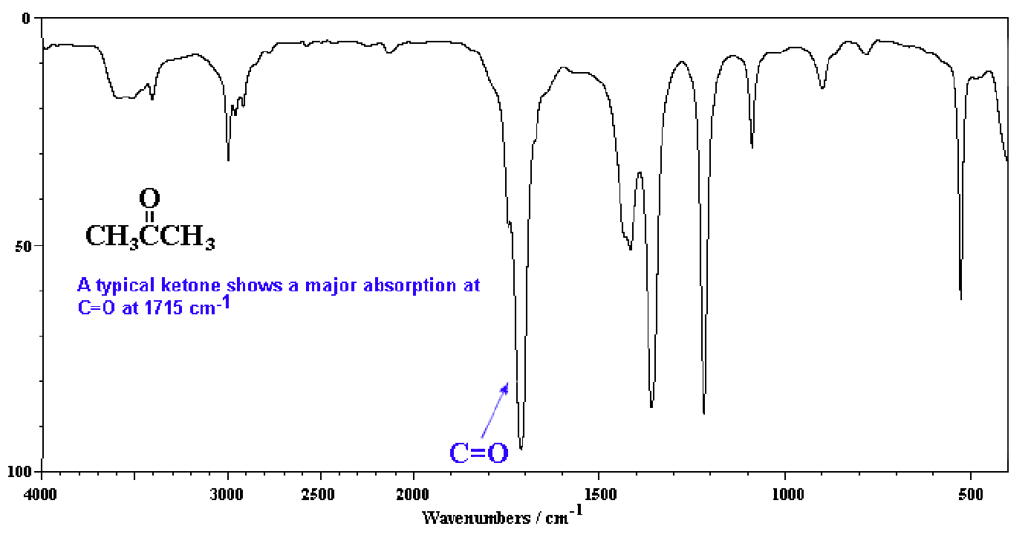
Answer
*
‹#›

