Slide 1
MEGA-ENTERTAINMENTS AND PHILOSOPHY (1979–90)
The extremes of world cinema

Slide 2
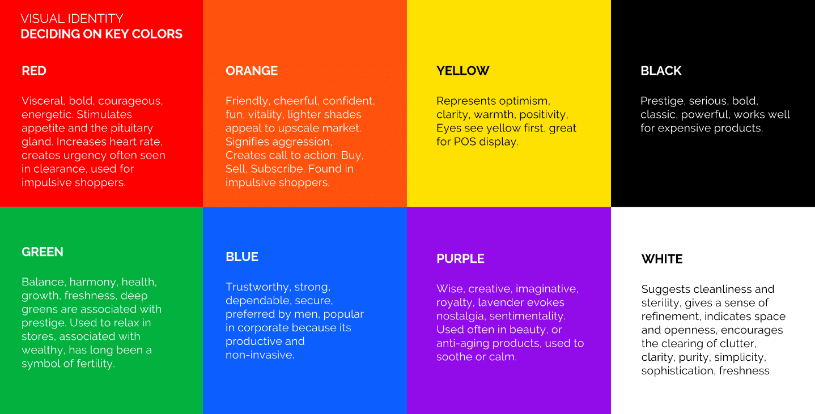

Slide 3
Color in Film
GREEN – healing, soothing, perseverance, tenacity, self-awareness, proud, unchanging nature, environment, healthy, good luck, renewal, youth, vigour, spring, generosity, fertility, jealousy, inexperience, envy

Slide 4
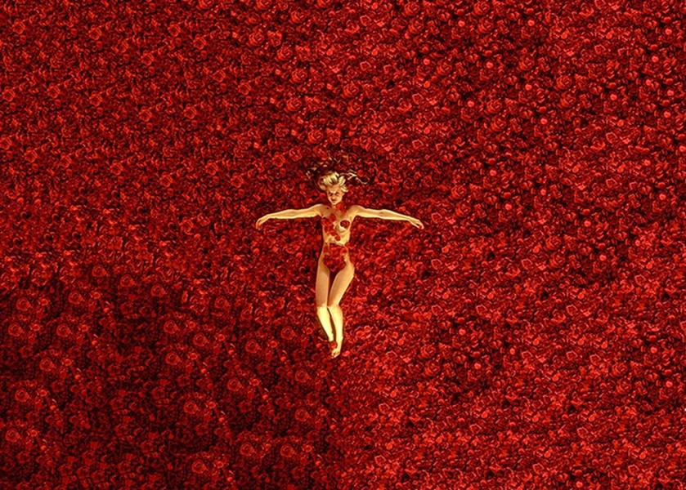
RED – anger, passion, rage, desire, excitement, energy, speed, strength, power, heat, love, aggression, danger, fire, blood, war, violence

Slide 5
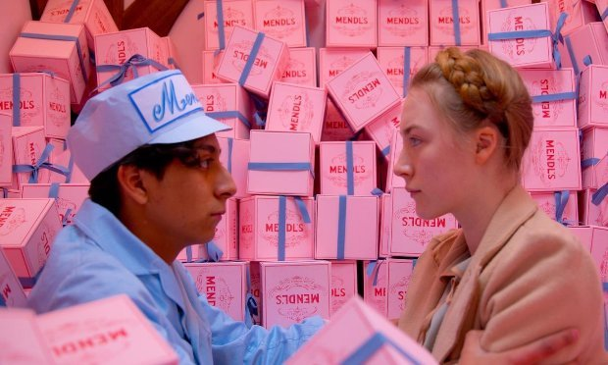
PINK – love, innocence, healthy, happy, content, romantic, charming, playfulness, soft, delicate, feminine

Slide 6
YELLOW – wisdom, knowledge, relaxation, joy, happiness, optimism, idealism, imagination, hope, sunshine, summer, dishonesty, cowardice, betrayal, jealousy, covetousness, deceit, illness, hazard

Slide 7
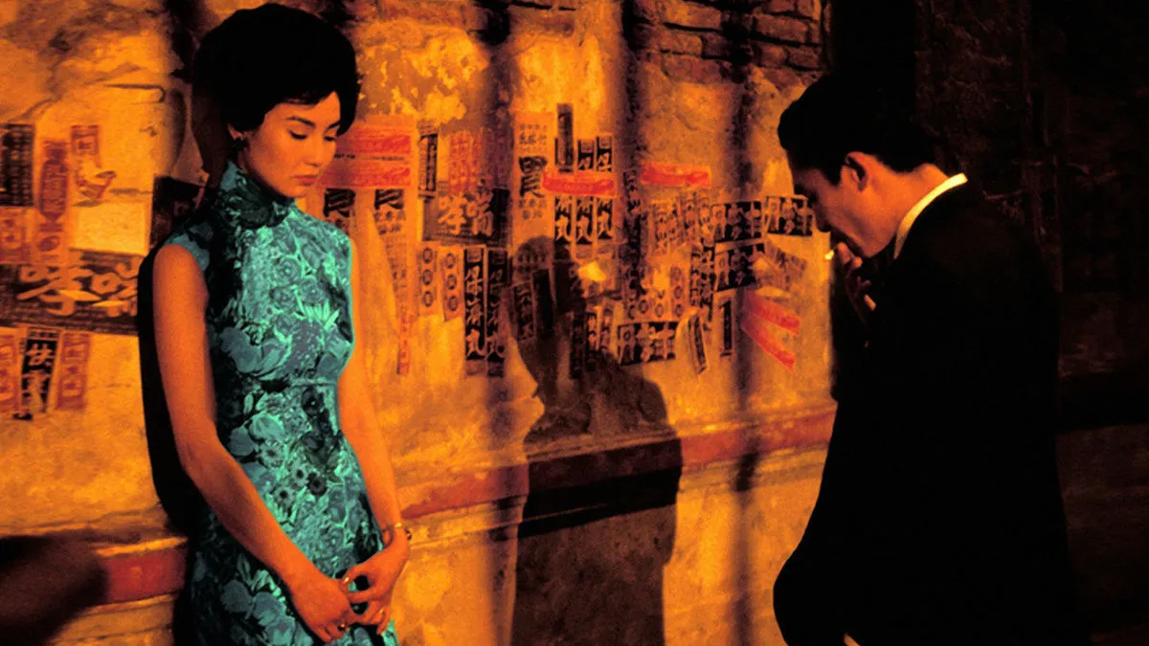
ORANGE – humor, energy, balance, warmth, enthusiasm, vibrant, expansive, flamboyant

Slide 8
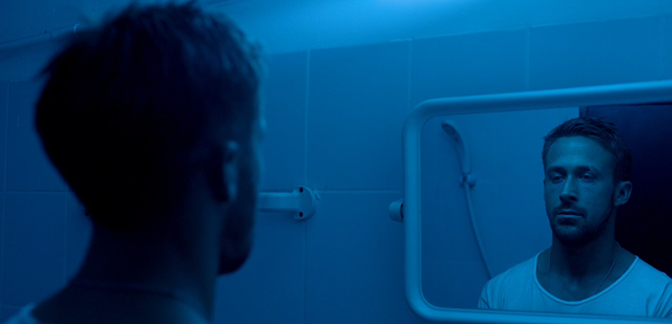
BLUE – faith, spirituality, contentment, loyalty, fulfillment peace, tranquility, calm, stability, harmony, unity, trust, truth, confidence, conservatism, security, cleanliness, order, sky, water, cold, technology, depression

Slide 9
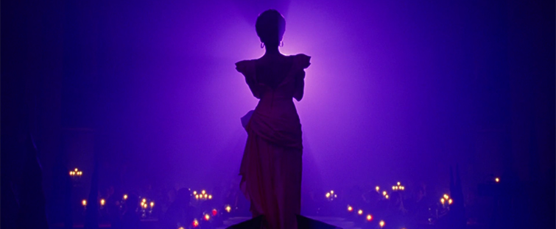
PURPLE/VIOLET – erotic, royalty, nobility, spirituality, ceremony, mysterious, transformation, wisdom, enlightenment, cruelty, arrogance, mourning, power, sensitive, intimacy

Slide 10
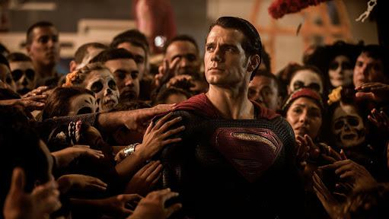
BROWN – materialistic, sensation, earth, home, outdoors, reliability, comfort, endurance, stability, simplicity

Slide 11
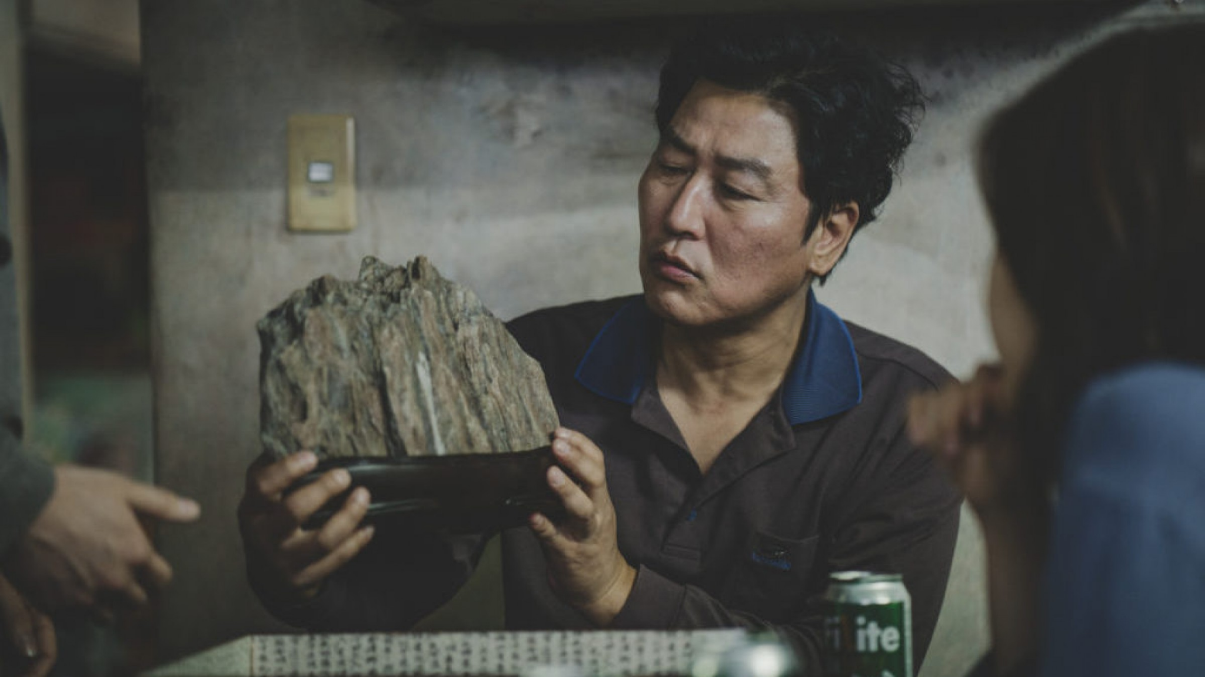
BLACK – No, power, sexuality, sophistication, formality, elegance, wealth, mystery, fear, anonymity, unhappiness, depth, style, evil, sadness, remorse, anger

Slide 12
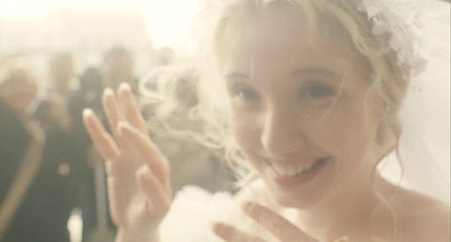
WHITE – Yes, protection, love, reverence, purity, simplicity, cleanliness, peace, humility, precision, innocence, youth, birth, winter, snow, good, sterility, marriage (Western cultures), death (Eastern cultures), cold, clinical, sterile

Slide 13
Color in Film

