Slide 1
Symbolism
Most Eastern European directors discussed previously used symbols in their films to get round political restrictions, just as their Western forebears, Lubitsch and Hitchcock, had to counteract sexual restrictions. Other 1950s filmmakers followed D.W. Griffith, Von Stroheim, Ozu, Ford, Welles and Kurosawa by using metaphor not necessarily because of political or censorship restrictions, but simply to enrich their work. The Scandinavians Carl Theodor Dreyer and Ingmar Bergman were pre-eminent among these.

Slide 2
Ingmar Bergman (00:03:23 - 00:09:00)
“The Swedish filmmaker, Ingmar Bergman, hit his stride in the mid-1950s. He was born in 1918 into a strict, Lutheran family and his father was pastor to Sweden’s Royal Family. Like other masters of cinematic claustrophobia, such as Hitchcock and Polanski, the young Bergman was sometimes punished by being locked in a closet. Just as Orson Welles had been, he became entranced by theatre aged five, writing plays and mounting puppet shows. He doctored and wrote screenplays in the early 1940s, started directing in 1944, exploring themes of Sweden’s post-war generation gap. Det Sjunde Inseglet/The Seventh Seal (1957) has a place in the emergence of symbolism in 1950s cinema. The film’s origins were unusual and stemmed from Bergman’s boyhood memories of being taken by his father to small countryside churches. Left to explore, he would look at the churches’ medieval paintings, saying later of The Seventh Seal, “My intention has been to portray in the manner of these frescoes. My characters laugh, weep, mourn, are afraid, speak, reply, question. They dread the Plague and Last Judgment. Our anguish is of a different kind, but the words remain the same.”

Slide 3
Ingmar Bergman
The director conjured up this fearful mediaeval world by telling a story of a Swedish knight who returns from the crusades at the time of the Black Death, meets Death, plays chess with him and eventually succumbs (184). The film starts with shots of a cloudy sky and a quotation from the Book of Revelations, which talks of a time when God was silent for half an hour and when an angel “took the censer, filled it with fire from the altar and cast it into the Earth. And there were voices and thunderings and lightnings and an earthquake.“These images symbolized the threat of nuclear war for Bergman and, like many intellectuals of the period, he had been influenced by the French existential writers of the late 1940s and early 1950s, who had argued that it was no longer possible to believe in God after the Nazi death camps and the bombs in Hiroshima and Nagasaki. What, The Seventh Seal argued, if God did not exist? Or what if he was “silent for half an hour”? What apocalypse would ensue? Neo-realism was cinema’s sober moral response to the calamities of the Second World War, but a film had never before used extended metaphors to debate the philosophical implications of those calamities. Consequently Bergman, more than any other director since the 1920s, convinced intellectuals around the world that cinema was the equal of literature or theatre.

Slide 4
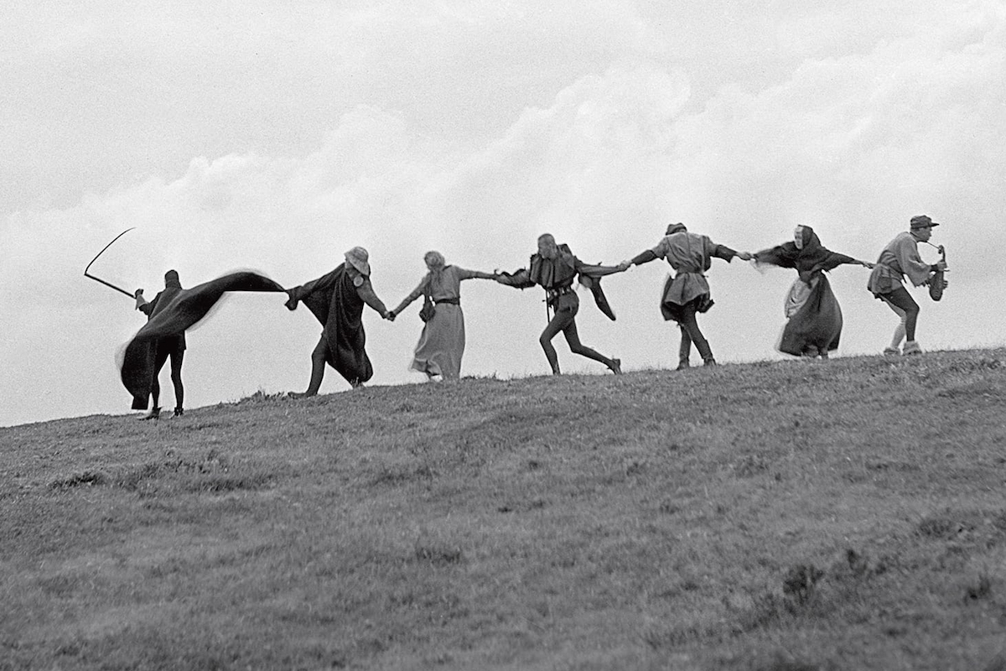
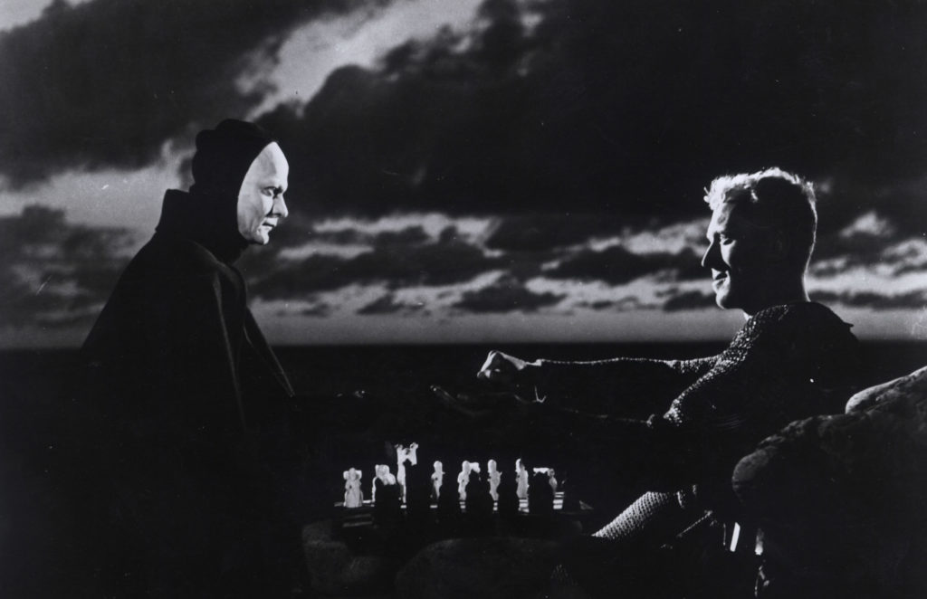
Stills from The Seventh Seal (1957) by Ingmar Bergman

Slide 5
Federico Fellini (00:18:42 - 00:25:00)
Federico Fellini, was an Italian film director and screenwriter known for his distinctive style, which blends fantasy and baroque images with earthiness.
Federico Fellini was born in north-east Italy in 1920 and whereas Bergman’s first symbolic world was the theatre, Fellini’s inspiration was the circus, running away to one around the age of seven. Where Bergman found in puppetry his core thematic idea that human beings are worked by greater forces, Fellini found in the circus something more aesthetic – visual extravagance, display and larger-than-lifeness. He became a cartoonist and opened a shop in Rome, which was visited by Roberto Rossellini, who was planning a realist film about the city, Roma città aperta/Rome, Open City (Italy, 1945). Fellini collaborated somewhat on this film’s script – as he had done on others in the previous five years – and his first successful work as director, the delightful I Vitelloni/The Loafers (Italy, 1953) is marked by Rossellini’s sense of detail. Based on his early years in Rimini, he followed it with another autobiographical work, La Strada/Road (Italy 1954), which concerned the relationship between a circus strong man and a shy young woman. La Strada shared Bicycle Thieves’ (Italy, 1948) delicate and mythic qualities and was a huge international success.

Slide 6
Federico Fellini
La Strada and Nights of Cabiria were not as theoretical as Bergman’s films, but they also explored the human condition and for the time being, used the language of cinema more joyously than his Swedish counterpart. His later work would become intensely personal, extravagant representations of his erotic and dream life. So great was his influence on directors as diverse as Martin Scorsese and Woody Allen, that the term “Fellini-esque” became a staple of film criticism.

Slide 7
Robert Bresson (00:09:07 - 00:14:18)
Bresson was perhaps the most artistically ambitious of any of the international directors who hit their stride in the mid-1950s. His 1959 film, Pickpocket, contains a sequence where the actor, Martin Lassalle, is filmed in a plain, unadorned manner. The lens used to film the sequence was 50mm (2in), which approximates human vision and its lighting corresponds to flat daylight. The costume is contemporary, exactly what this character might wear on the street. Lassalle’s looks are not those of a matinée idol and there is no expression on his face. The composition is not de-centred, nor does it make use of any emphatic geometry. If Bergman and Fellini filmed life as if it was a theatre and circus respectively, Bresson’s microcosm was that of a prison. Born in France in 1907, he studied Greek, Latin, painting and philosophy, getting his first job in cinema in 1933 and working with Clair in 1939. Between 1950 and 1961, he made four films, each about imprisonment. A young curate reflects on his life, grows ill and dies in Le Journal d’un curé de campagne/Diary of a Country Priest (1950); a Resistance worker escapes a German prison in Un Condamné à mort s’est échappé/A Man Escaped (1956); an unemployed man starts stealing, becomes addicted to it and is imprisoned in Pickpocket; in Le Procès de Jeanne d’Arc/The Trial of Joan of Arc (1961), he films the martyr’s captivity, thirty-three years after Dreyer’s adaptation.

Slide 8
Robert Bresson (00:09:07 - 00:14:18)
As this quartet of prison films is so central to Bresson’s whole career, it is tempting to highlight Bresson’s imprisonment by the Germans during the Second World War. It would, however, be wrong to do so as his work is not driven by the claustrophobia or mental scarring that could result from such an experience. Like Ozu, his films are expressive of no inner chaos or fire. They are the opposite of Fellini, being autobiographically detached and his methods, which result in images like the one in Pickpocket can be explained by this very idea of detachment. Directly echoing Ozu’s sentiments from the early 1930s he said, “I try more and more in my films to suppress what people call plot. Plot is a novelist’s idea.” The first sentence in his short book of cinematic commandments, Notes Sur le cinématographe/Notes on Cinematography reads, “Rid myself of the accumulated errors.”8 At the bottom of the same first page, he added, “No actors. No parts. No Staging.” “He rejected all the glossy razzmatazz of the Hollywood studios, the sensation and technical thrill of the early years and the subsequent move towards narrative. He rejected cinema’s accumulated achievements and refused all its schemas, except perhaps those of the documentary.

Slide 9
Robert Bresson (00:09:07 - 00:14:18)
What appalled Bresson so much about cinema’s advances that made him want to burn them off with acid? He hated its attempt to photograph actor’s thoughts and believed that it was wrong to imply that it could capture them on camera. This is plain everywhere in his films. The character’s lack of facial expression and blankness in Pickpocket was achieved by repetition. Bresson made Lassalle do a scene again and again, until he would reach such a “level of boredom that he would perform like a robot. The director also saw this as a process of detachment. “Your models”, he wrote, referring to his actors, “will get used to gestures they have repeated twenty times. The words they have learned with their lips will find, without their minds taking part in this, the inflections and the lilt proper to their true natures.” “He not only avoided Hollywood’s heightened emotions and its closed romantic realism, but also distanced himself from them even more than Ozu. The latter had found a classical balance between his characters’ inner lives and a world-view not centred on humans. Bresson stripped away Ozu’s intimate human details, but in so doing, wanted to avoid a technically austere cinema, peopled by unfeeling robots. He aimed to portray the “invisible hand … directing what happens” as Dreyer had done in Ordet. This is where the prison metaphor in Bresson reveals its full richness.

Slide 10
Robert Bresson (00:09:07 - 00:14:18)
According to Bresson, human beings were locked in their own bodies and cinema was the best art form to capture this outward fact. Its very outwardness captured this imprisonment magnificently. Some Christian critics have argued that it is only at Pickpocket’s end and at the imprisonment of Lassalle for his crimes, that he breaks out into “a state of grace” and a full acceptance of the power of God. Imprisoned for his serial thieving, he finally has a moment of insight. He looks at his girlfriend, Jeanne, touches her face with his and then says, “What a strange road I had to take to reach you.” At the time of Pickpocket’s release Bresson explained this: “There must, at a certain point, be a transformation. If not, there is no art.”

Slide 11
“One does not create by adding but by taking away.” Robert Bresson

Slide 12
THE EXPLODED STORY (1959–69)
The breakdown of romantic cinema and the coming of modernism

Slide 13
François Truffaut
“Truffaut (187) was born in Paris, had inattentive parents, left school at fifteen and became obsessed by cinema. He inherited some of the moral force of Bazin’s criticism, but added a new 1950s anger to it. In the same year that France suffered defeat in Indochina, Truffaut wrote a now-famous article, “A Certain tendency in French Cinema” in Cahiers. A series of notes, the piece touched a nerve by denouncing the literary and script-driven prestige films made in his country at that time. Although it mostly focused on the adaptation of French novels to the screen, it pointed an accusing finger at the work of writers Jean Aurenche, Pierre Bost and directors Claude Autant-Lara and Jean Delannoy, whose impersonal films were technically glossy, lit in a cold, studio style and represented the cinematic equivalent of the perfectly ironed shirt. These films flew the French flag internationally, won awards, were popular with the middle-classes, but, failed to capture contemporary tension. Unlike Bergman, Fellini or Bresson, they did not ask questions about the nature of human life or cinematic symbolism. Truffaut argued that they had no reason to exist; they were dead.”

Slide 14
If film producers around the world found the 1950s a difficult decade, they had a shock coming to them in the 1960s, when the apparent cracks in Western social consensus turned into chasms, the sexualization of culture gathered pace, and a decade of consumerism and affluence engendered, strong distaste. Alienated youth, as portrayed in the 1950s by James Dean in America and Zbigniew Cybulski in Poland, was radicalized in colleges and universities with students demonstrating against government policy, war and conformism.

Slide 15
France
In France during the late 1950s, the idealism and politi­cal movements of the immediate postwar years gave way to a more apolitical culture of consumption and leisure. The rising generation was dubbed the Nouvelle Vague, the "New Wave" that would soon govern France. Many of these young people read cinema journals and attended screenings at cine-clubs and art et essai ("art and experiment") cinemas. They were ready for more offbeat cinema than those of the Cinema of Quality.
The French New Wave (Nouvelle Vague) is largely re­sponsible for the romantic image of the young director fighting to make personal films that defy the conven­tional industry. Ironically, most directors associated with the New Wave quickly became mainstream, even ordi­nary, filmmakers. But certain members of the group not only popularized a new conception of personal cinema but also provided innovations in film form and style.
The principal Nouvelle Vague directors had been film critics for the magazine Cahiers du cinema (p. 374). Strong adherents of the auteur policy, these men be­lieved that the director should express a personal vision of the world. This vision would appear not only in the film's script but also in its style. Most of the Cahiers group started by directing short films but, by the end of the decade, most turned to features. They helped each other by financing projects and sharing the services of two outstanding cinematographers, Henri Decae and Raoul Coutard.

Slide 16
Audiences too continued to change. Older people were going to the cinema proportionally much less in 1959 than at any period since the earliest days of the movies. The “tradition of quality” films aimed at them were still produced using the large, slow, heavy filming and lighting kits evolved by studio systems around the world. Hundreds of technicians and craftspeople were needed to use this equipment and the division of labour was long established.
Filming on the streets, which had been undertaken sporadically in the 1920s and 1940s, was challenging this cumbersome studio aesthetic. New lenses, film stocks and lighting equipment had gradually freed up crews and allowed them more mobility. The best of them did not even wait for the technological changes to work their way through the system.

Slide 17
Thirteen new film movements were born, in France, America, Italy, Japan, Britain, Eastern Europe, the Soviet Union, Cuba, Brazil, India, Czechoslovakia, Iran and Algeria. These movements became known as the New Wave, though their approaches were far from unified. In Western Europe and the US, for example, directors concentrated on challenging old stylistic norms, while in totalitarian countries and those emerging from colonialism, questions of content, such as political freedom, were more pressing.

Slide 18
French New Wave
The French New Wave was a film movement from the 1950s and 60s and one of the most influential in cinema history. Also known as “Nouvelle Vague," it gave birth to a new kind of cinema that was highly self-aware and revolutionary to mainstream filmmaking. A group of French critics, who wrote for the journal, Cahiers du Cinema, believed films had lost their ability to capture true human emotion and "lacked sincerity." They felt the films were out of step with how people actually live.
There were quite a few notable French film directors who were part of the movement, including Francois Truffaut, Jean-Luc Godard, Claude Chabrol, Eric Rohmer, Jacques Rivette, Louis Malle, Alain Resnais, Agnes Varda, and Jacques Demy. Their films were characterized by rejecting film traditions but how did they do that?

Slide 19
FRENCH NEW WAVE CHARACTERISTICS
Deemphasized plot & dialogue was often improvised
Jump cuts rather than continuity editing
Location shooting
Handheld cameras
Long takes
Direct sound & available light (live recordings, often didn’t adjust light)
No hero’s journey
No distinction between good and bad characters

Slide 20
The French New Wave (00:29:29 - 00:35:00)
Perhaps it is no surprise that fractured times led to fractured imagery.
Breathless (1960):
An American actress, Jean Seberg, who had fashionably cropped hair and sunglasses, was in the passenger seat. A French cameraman, Raoul Coutard, filmed the back of her head with a new, smaller 35mm camera. He had made his own rolls of film out of 18m lengths sold for stills cameras and had it developed in a way that gave it a speed of 800ASA, ten to twenty times faster than studio colour film.
His director, Jean-Luc Godard, did not want to use artificial lights during the whole film, so the effects of sunlight registered on Seberg’s head more naturally than ever before in cinema. Even in interiors, thanks to the new super-fast film, Godard used only natural light, bouncing it off ceilings to create soft shadows. In the car, as a voice-over said, “I love a girl with a lovely neck”, the shot cut to a moment later – same angle, same girl, same hair, same speed. Then it cut again, and again. Nine times in total.

Slide 21
The French New Wave
From Porter’s The Life of an American Fireman (USA, 1903) onwards, when a cut happened in a film it was almost always to show something else – that was the language of film – but in this one, the cuts were there to show the same thing but with the sunlight from a slightly different direction, the background moving in a slightly different way.
This ground-breaking film was A bout de souffle/Breathless (1959), about a car thief who has an American girlfriend and kills a policeman. It was derived from American gangster pictures and was more influenced by Nicholas Ray’s Rebel without a Cause (USA, 1955) than by anything in French cinema. The director, Jean-Luc Godard, would become one of the most significant in world cinema and this was his first feature. The critic François Truffaut said “there is cinema before Godard and after Godard”
“There had been jump cuts in movies before. Still, they were very rare because filmmakers felt that they disrupted the flow of their films, broke the atmosphere.

Slide 22
The French New Wave
The shock attached to seeing jump cuts in A bout de souffle arose because they were not there for any special psychological purpose, as they had been in Arsenal, nor were they wedded to quite traditional stories, as in the Spanish films. The reason for cutting the sequence in this way was because the cuts were beautiful in themselves, because they emphasized that what we were watching was cinema, just as painters had turned to cubism many years earlier because it emphasized the flatness of the canvas. Godard had been part of the magazine Cahiers du Cinéma’s “think tank”. So immersed in cinema were he, Truffaut and others that they saw it not as something that captures real life, a mere medium, but as a part of life, like money or unemployment.
So, when they became filmmakers themselves, movies were not just vehicles to carry stories and information or to portray feeling; they were also what those stories carried, part of the sensory experience of, say, sitting in a café watching the world go by. In the twentieth century, all the great art forms became self-aware in the same way. Truffaut once asked “Is life as important as the movies?”and while the obvious answer is “no”, the question clearly shows how passionate these young men were.

Slide 23
The French New Wave
Looking back it is clear that while Godard’s explosive sequence was a revelation, it did not begin to explore the full implications of the new language of film. If a shot no longer had to be about getting a fireman into a burning building or getting a woman into or out of a car, then what was it? An expression of the filmmaker’s attraction to his actress? Well, in part, yes. Indeed, most of the so-called “New Wave” films that followed on the heels of Godard’s were in some way about men looking at women’s faces. These younger filmmakers were bored with the high moral stance of neo-realism and the endless raking over the ashes of the Second World War. By taking their new lighter cameras loaded with faster film on to the streets, they could photograph everyday life, women of their own age, without make-up or fussy studio lighting. The subjects of their films were themselves, their erotic imagination, their fragility and alienation.”
Godard and other New Wave directors began to explore further. If a shot is not just a slave to action, if once someone leaves the frame you do not have to cut, then a shot is a unit of time as much as action. It no longer said, “Here is a scene of a woman sitting in a car which is relevant to the chain of events which make up our story”, but “I think this moment in time in the back of this car is beautiful in and of itself.” In other words the shot said, “I think”. The fact that a shot is a thought was buried in Godard’s innovation.

Slide 24
Truffaut
Truffaut himself made his first feature film in 1959. Les Quatres cents coups/The 400 Blows did not use jump cuts like Godard’s A bout de souffle but was startlingly fresh and worshipped cinema just as much. The story of a twelve-year-old boy who escapes from a children’s home, falls in love with film and goes on the run, was based on elements of the director’s own life. Like Godard, Truffaut had his film shot with only natural light on real Parisian streets. His story was loosely constructed, in a similar way to the work of neo-realists. However, unlike them, he was not using these techniques to describe post-war problems or sociological trends. The 400 Blows was a success internationally and encouraged the French film industry to take risks with many other new directors. Louis Malle, Jacques Rivette, Eric Rohmer, Claude Chabrol and many more started directing in the late 1950s or early 1960s and, although their work diverged substantially in style, the contemporary search for meaning was central to them all. ”

Slide 25
Vivre sa Vie (Godard)
“In the opening sequence in Godard’s fourth feature Vivre sa Vie/My Life to Live (1964), a conversation takes place between a woman and a man in a bar. They talk about love, and the camera takes close-ups of each character. So far everything is normal, except for one crucial detail: the camera is behind their heads throughout, as it was with Seberg in the car in A bout de souffle. The actors are never shot from the front, so the audience never sees their faces. This is as radical a refusal of the most basic, apparently common-sense aspects of cinema and photography as Bresson’s work had been. In Vivre sa Vie the woman, a prostitute played by Anna Karina, goes to the cinema. She watches Dreyer’s The Passion of Joan of Arc (France, 1928). Alone in the dark she looks up at the huge silent close-ups of Falconetti as Joan, and cries. Godard reveals to us how human this woman is, not through showing her reaction to a real-life event, but by showing how moved she is by “one of the most delicate moments in the art of silent cinema

Slide 26
This extraordinary passion for cinema felt by French filmmakers was not matched by the general public. Attendances dropped thirty-six percent from 420 million in 1957 to 270 million just six years later. Principally it was middle-aged and older people who stopped buying tickets, in part because of television.

Slide 27
Psycho (1960)
At the beginning of the 1960s Hitchcock abandoned his Freudian quest and colour films, for a black-and-white gothic study in loneliness and serial killing. In Psycho (1960) he did nothing less than reinvent his already complex career. The veteran director had, perhaps surprisingly, taken to television in 1955, producing, presenting and sometimes directing short macabre dramas. “He liked the intimacy and faster working methods of the smaller TV crews, so decided to shoot Psycho in a similar manner. As he said to François Truffaut, “It was an experiment in this sense: Could I make a feature film under the same conditions as a television show?”5 Where conventional Hollywood was aggrandizing, he stripped his work of its gloss, had his lead actress wear ordinary clothes and little make-up and pared down dialogue so that whole sequences had no talking.

Slide 28
Psycho (1960)
Hitchcock correctly judged the public taste by shifting to more violent subject matter. A third of the way into Pyscho, Crane, who has stolen money to try to start a new life with her lover, stops at an isolated hotel, is checked in by a nervous young man and, having undergone a crisis of conscience and decided to return the stolen money, is brutally stabbed to death in the shower by what appears to be the young man’s mother (204). In this infamous sequence, a spare and leisurely film suddenly splinters into Eisenstein-ian fragments. Instead of running long lengths of film through the camera, Hitchcock shot short strips, over seven days, from seventy different angles, resulting in just forty-five seconds of footage. Back in 1922, in La Roue (France), Abel Gance had edited film faster than the human eye could perceive it and everyone from Griffith onward had understood that increasing the rate of cutting in a chase sequence or high-drama scene quickens the pulse of the audience. No one before, however, except perhaps Eisenstein himself, had so completely structured a film with this in mind. The film terrified audiences, took twenty times its cost at the box office and established the schema for violent cinema thereafter.

