Slide 1
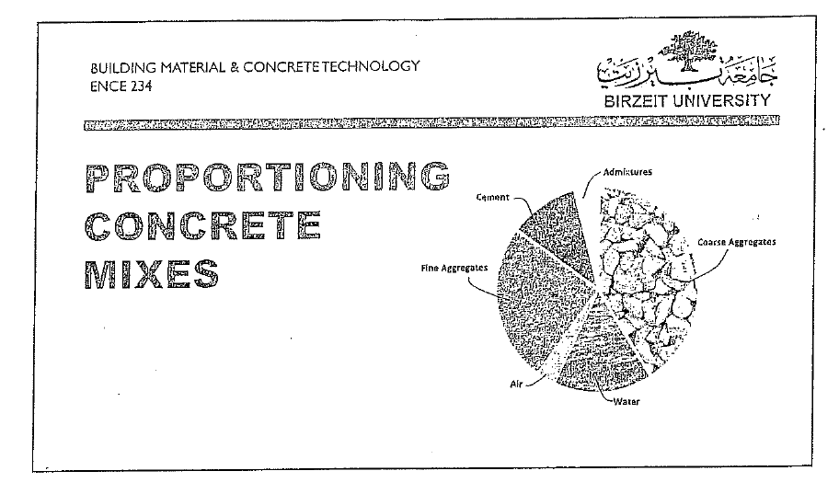

Slide 2
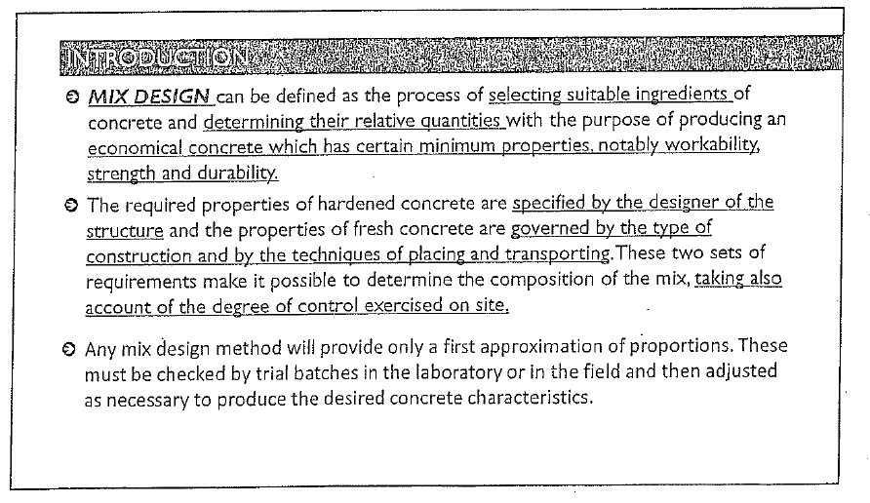

Slide 5
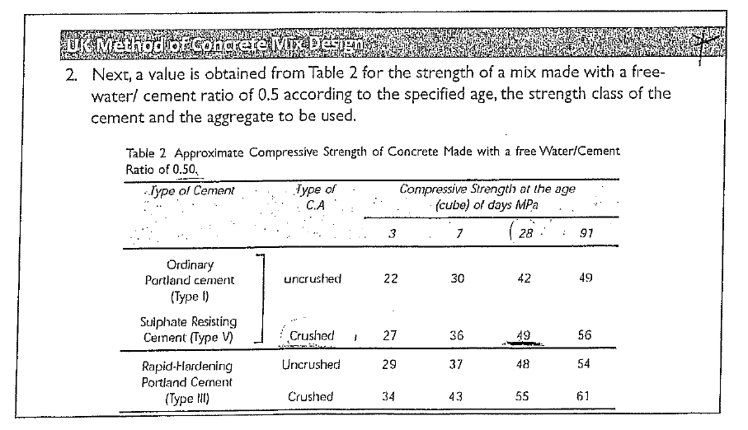

Slide 6
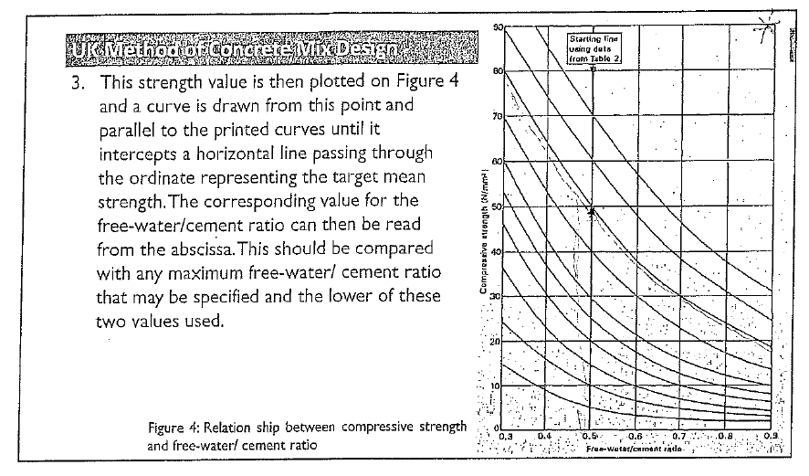

Slide 7
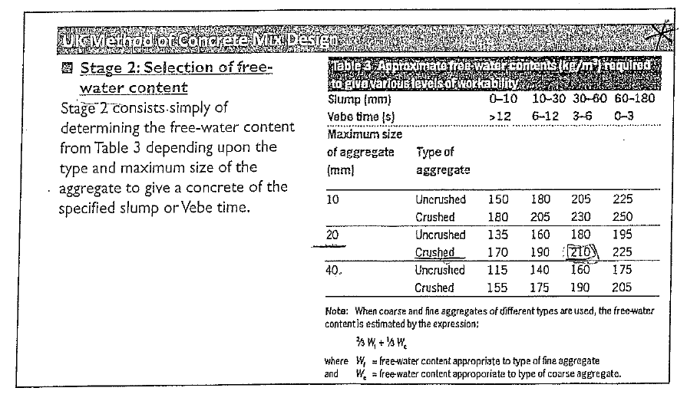

Slide 8
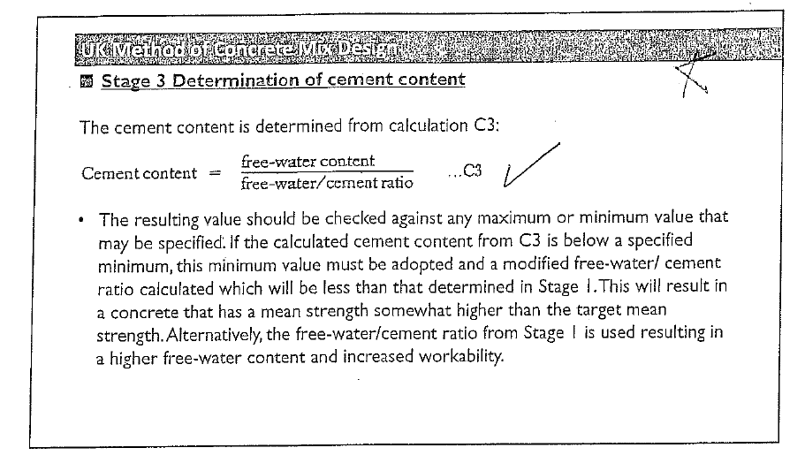

Slide 9
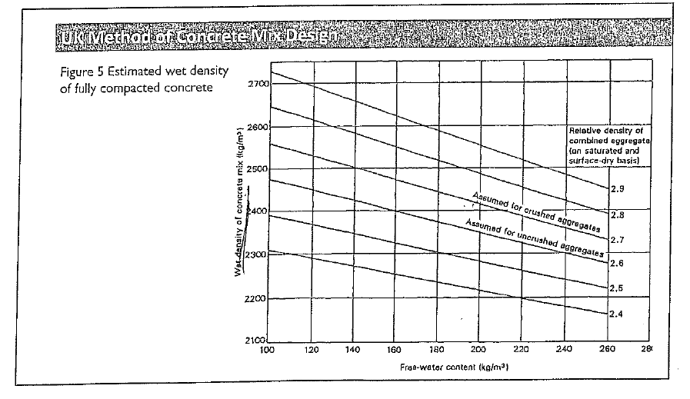

Slide 10
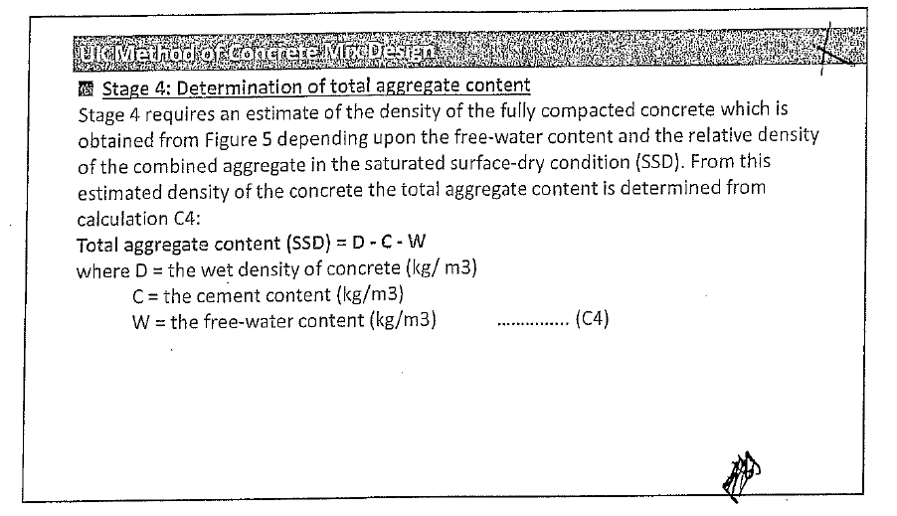

Slide 11
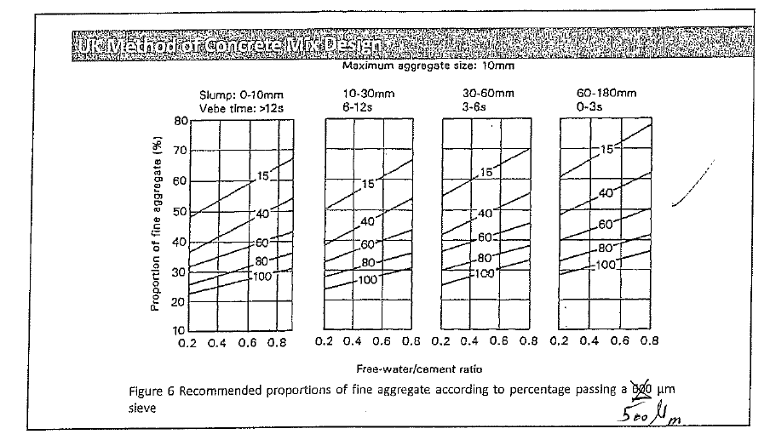

Slide 12
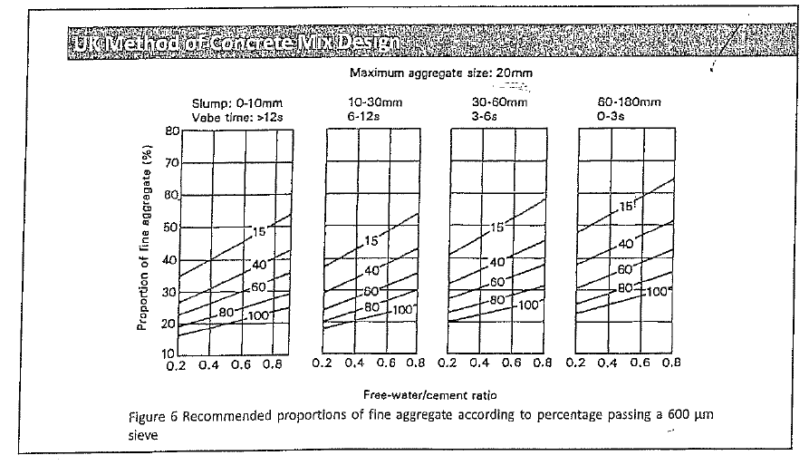

Slide 13
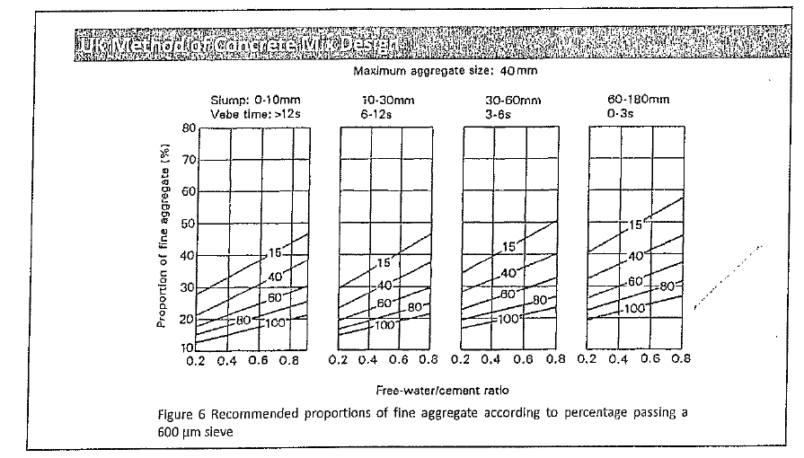

Slide 14
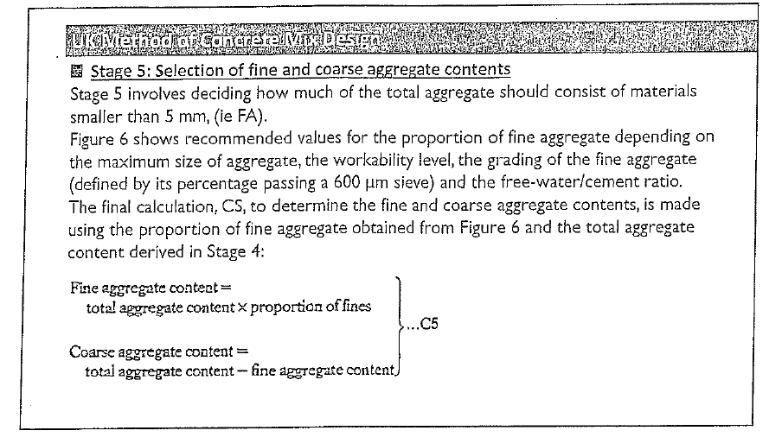

Slide 15
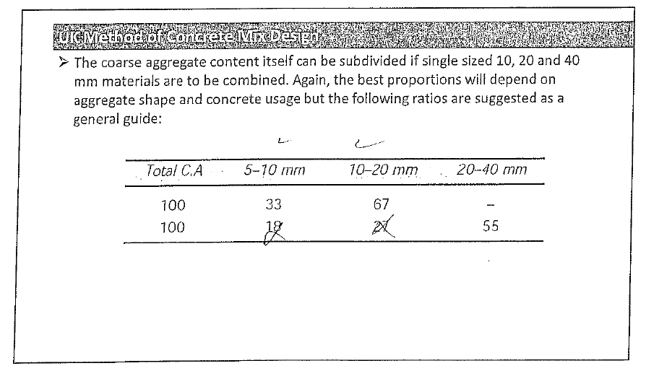

Slide 16
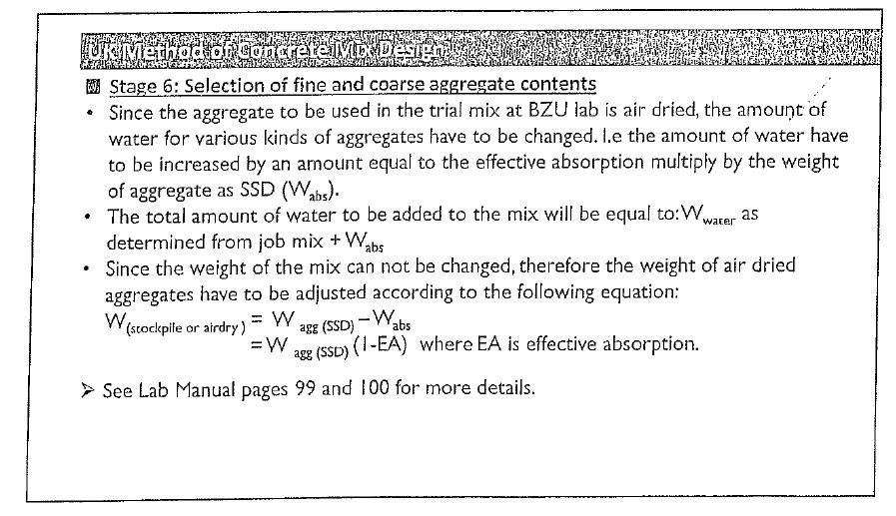
Water added or subtracted= Wagg*EA

Slide 17
Adjusting ingredients weights for the required batch weight
Ingredient | Weight for 1 m3 | Weight for 90 kg
Water
Cement
F.A
C.A

Slide 18
Required parameters for each group
Group | Fc’ | Max. aggregate size (mm) | Min. cement content (kg) | Slump (mm)
A | B400 | 20 | 350 | 0-10
B | B350 | 20 | 350 | 10-30
C | B300 | 20 | 300 | 30-60
D | B250 | 20 | 300 | 60-90
Specific Gravity | 2.7
Aggregate state | Dry
EA for coarse aggregate | 3.5%
EA for fine aggregate | 0%

