Slide 1
Glaciers & Glaciation
A glacier: Is a thick ice mass that forms over hundreds or thousands of years; it originates on land from the accumulation, compaction and re-crystallization of snow.
Glaciers are dynamic erosional agents that erode (accumulate), transport and deposit sediments.
Seen stationary but move at slow motion.

Slide 2
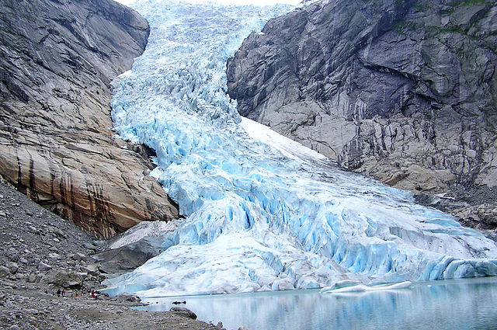
Glaciers Types:
1- Valley or Alpine glaciers: A stream of Ice bounded by steep rock walls with small width.

Slide 3
2) Ice Sheets (also called continental ice sheets): Exist in large scale; examples: Antarctica & Greenland

Slide 4
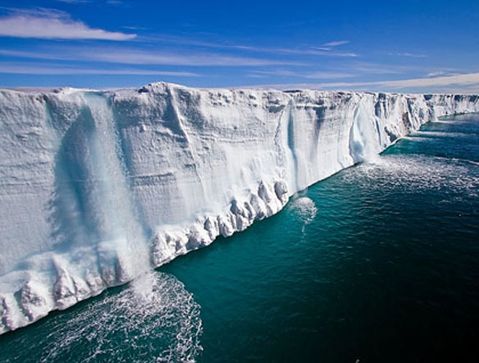

Slide 5
Antarctica: 80% of all glaciers, height/thickness= 4300m, area covered 13.6 million km². Greenland: 1.7 million km² ,covers 80% of Greenland, thickness of ice= 1500m.

Slide 6
….Ice sheets↓ -Flow in all directions. - Thinning seawards and thickening landwards. - Movement affected by the beneath land topography. -Die out in oceans.

Slide 7
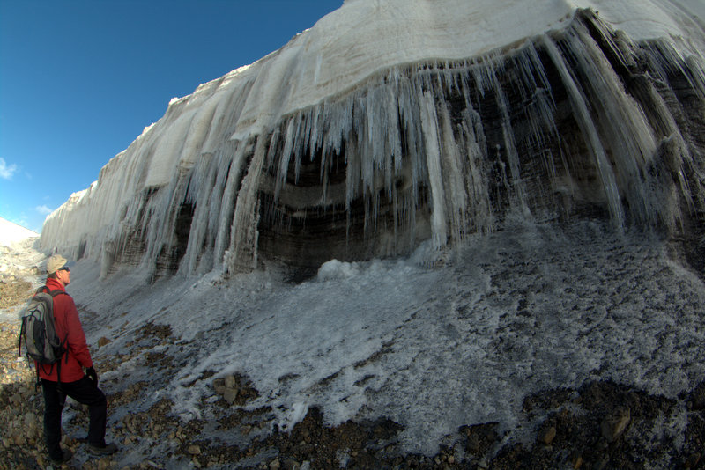
3) Ice caps: Cover uplands; similar to ice sheets but smaller.

Slide 8
4) Piedmont Glaciers: They cover broad low lands at the base of steep mountains when valley glaciers spread

Slide 9
DATA - In the world nowadays there are more than 160,000 glacier of all types.

Slide 10
Movement of Glaciers:
- Movement of glaciers is referred as “FLOW”; the movement is of 2 ways:
1) Movement within the ice; ice behaves as brittle solid until the pressure upon it reaches (50-60)m of ice, then the ice will behave as a plastic and flows continuously ; this flow is called a PLASTIC FLOW

Slide 11
2) Slipping along the ground
- Slow → few centimeters a day.
- Variable rates.
In Ice sheets in all directions: radial to semi-radial from the center.
The beneath land topography is reflected at the surface of a moving flow.
Some glaciers move rapidly; we call this movement a “SURGE”.

Slide 12
GLACIERS FORMATION
1) Snow is the raw material.
2) Glaciers constantly gaining and loosing ice.
3) Snow accumulates in the zone of ACCUMULATION; its outer limit is called the SNOW LINE. Snow line elevation differs from area to area tropical 4500m , polar areas below 0m.

Slide 13
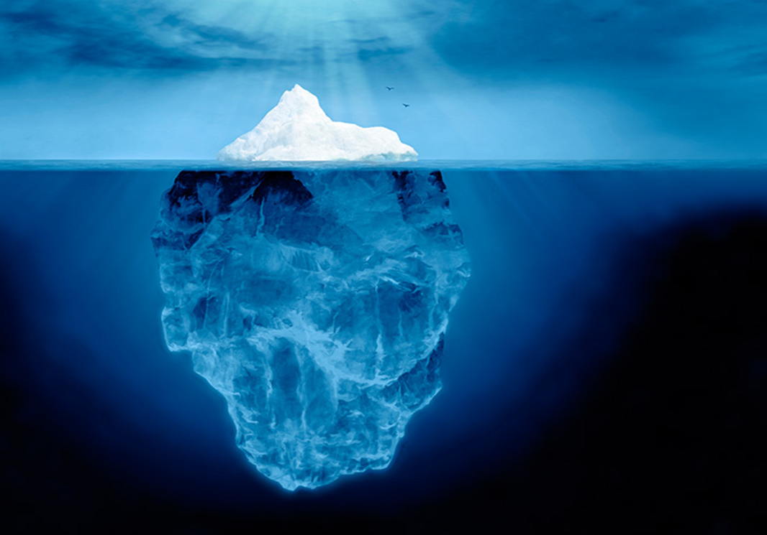
4) Below the snow line is the ZONE OF WASTAGE. 5) CALVING: The breaking of the ice at the front of the glacier forming Ice bergs

Slide 14
- Icebergs range from the size of a car to thousands of square kms. -they are composed of freshwater, not saltwater because they are formed from frozen rain or snow over thousands of years.
- Only 10% of the Iceberg appears above the water.

Slide 15
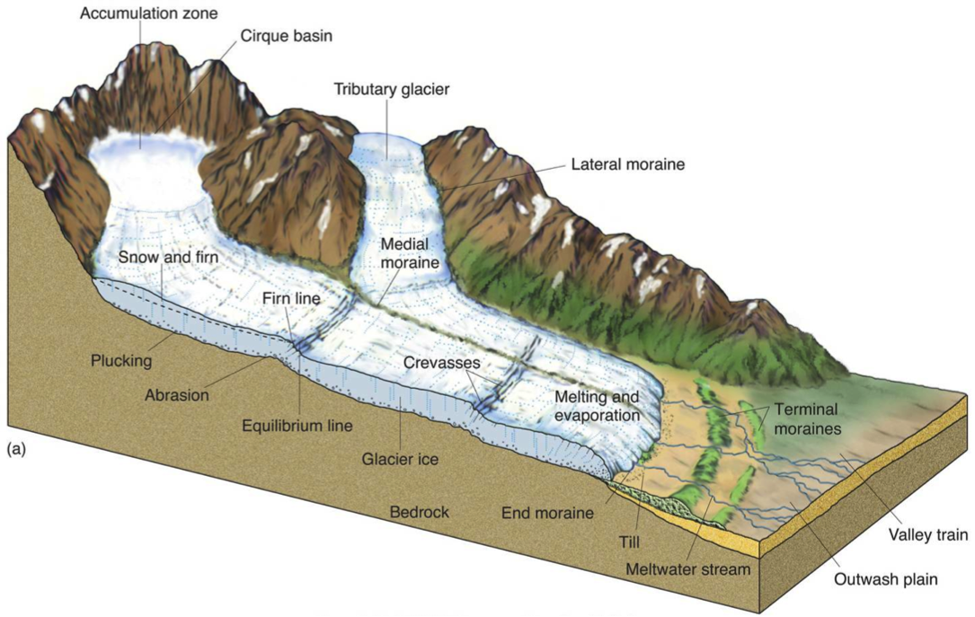
PARTS OF A GLACIER

Slide 17
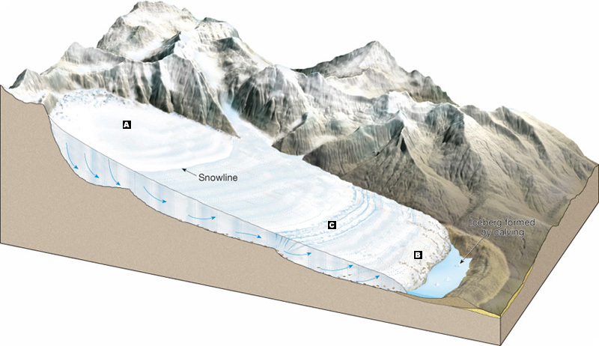

Slide 18
1) Zone of Accumulation: Where snow falls and accumulates. Bounded by snow line downwards. 2) Crevases zone: Where snow starts to melt; bounded by the snow line in the upstream. 3)Zone of wastage: Where snow melts and produces water.

Slide 19
Crossing a Crevase

Slide 20
GLACIAL EROSION
Glaciers are capable of great erosion; they can carry all sizes of rocks together. Glaciers erode land in 2 ways:-
1- As the glacier flows it covers a fractured bedrock surface, loosen it and lifts blocks of rocks and carries them by a process called “PLUCKING”- قلع – water can inter the fissures, joints and cracks , freezes and breaks the rocks.

Slide 21
2) Abrasion process: When the ice moves with its carried load (sediments of different sizes and shapes), the rock fragments grind the floor below and pulverizes the rock. This powder is called “ROCK FLOUR” and gives the melted water its milky color. This process leaves grooves and scratches on the surface of the affected rocks called “GLACIAL STRIATIONS”.

Slide 22
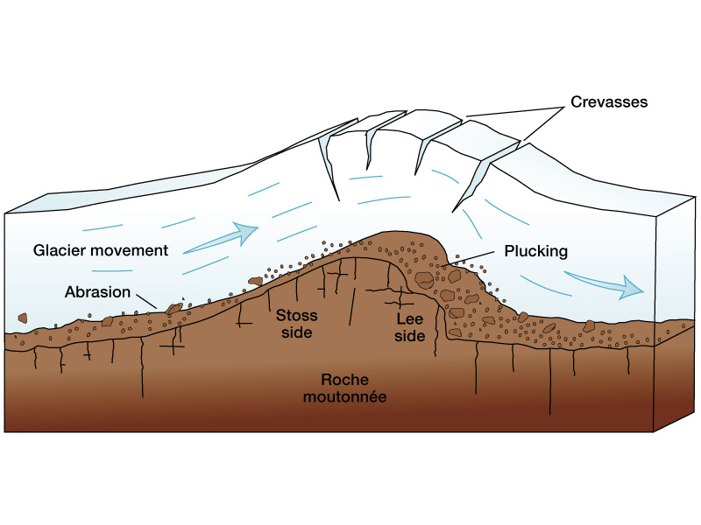

Slide 23
Glacial Striations↓

Slide 24
The erosional effect of valley glaciers is characterized by sharp and angular topography, while that of ice sheets is less angular

Slide 25
FACTORS AFFECTING GLACIAL MOVEMENT
1- Rate of glacial movement.
2- Thickness of the ice.
3- Shape, abundance and hardness of the rock fragments contained within the moving ice at the base of the glacier; and
4- The erodability of the surface beneath the glacier.
These factors vary in magnitude and time from place to place.

Slide 26
LANDFORMS CREATED BY GLACIAL EROSION
There are big differences between effects (features) created by valley glaciers & sheet glaciers. Example: Alpine (or mountain) glaciers are likely to see a sharp & angular topography in spite of that the continental sheet glaciers do enormous work.

Slide 27
The major difference between glaciers (as erosional agent) and other erosional agents (especially the water) is that most sediments drifted by glaciers consist primarily of mechanically weathered rock debris (approx. no chemicals).

Slide 28
Therefore most of the minerals that dissolve by chemical weathering can be found within the glaciers

Slide 29
Glacial valleys: The V-shape by time transfers to a U-shape called a “GLACIAL TROUPH”.

Slide 30
Also the glacier tends to straighten the valley by removing the spurs along and around the glacial channel.

Slide 31
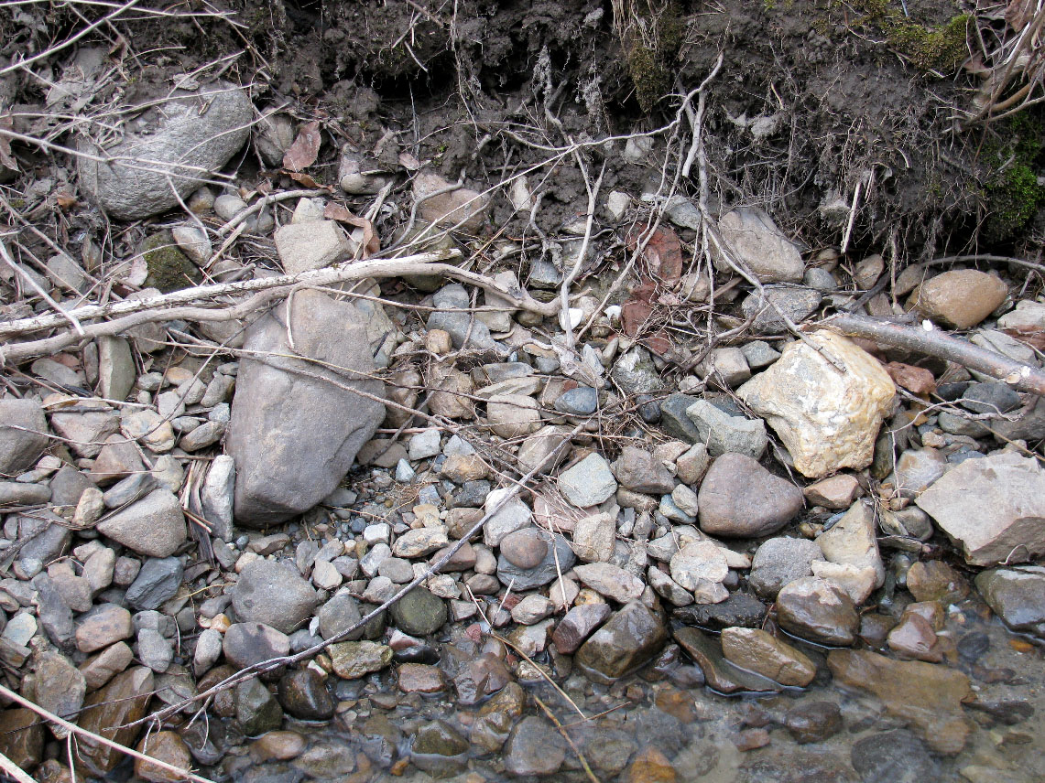
Glacial Drifts: Are divided into 2 types:
1- Till: Materials deposited by the lacier when the glacier melts. A mixture of all grain sized-sediments [THE DRIFT] are accumulated.

Slide 32
2- Stratified sediments or drifts: These are sediments laid down by glacial melt water.

Slide 33
3- Glacial erratics: Large boulders found in the till or lying free on the till surface

Slide 34
4- Moraines: Layers of ridges of till accumulation. They can form lakes.

Slide 35
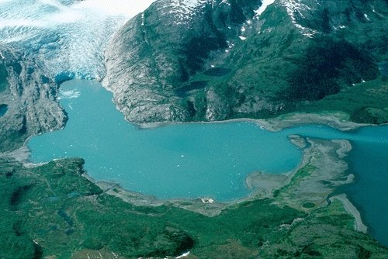
Moraine Lake

Slide 36
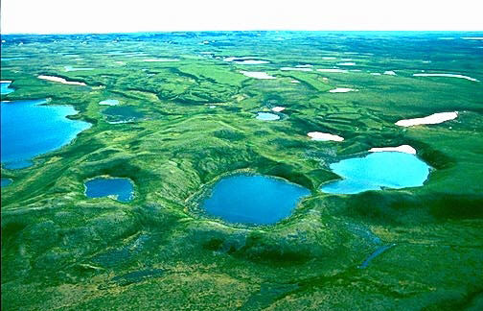
5- Kettle holes: When ice is buried within the drift, then melts leaving pits( some of 2 – 50 kms long).

Slide 37
6- Outwash Plains: when the ice sheet melts, the water leaves the glacier and moves into relatively wider area; this water looses momentum and its velocity decreases dropping much of the bed load forming those outwash plains ↓

Slide 38
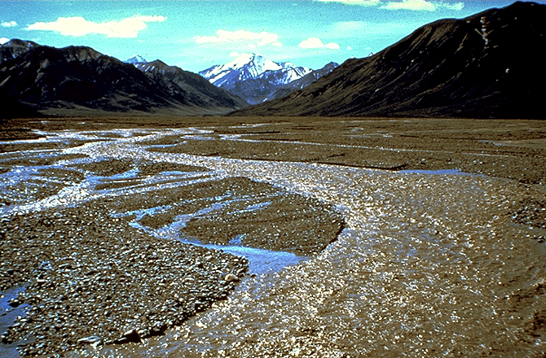

Slide 39
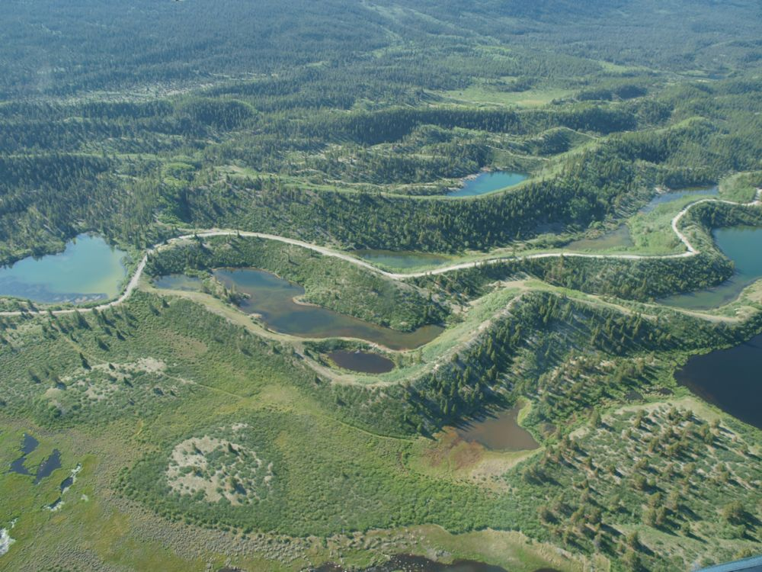
7- Eskers: Are longitudinal ridges composed largely of sand- and gravel-sized particles. Eskers’ size may reach 100m or even 100km in length.

Slide 40
8- There are many other conspicuous features formed by glaciers and glacial melting (uncountable); e.g. kames, drumlins, valley terrains, end mor, ground morains, fyords …..ains

Slide 41
8- There are many other conspicuous features formed by glaciers and glacial melting (uncountable); e.g. kames, drumlins, valley terrains, end mor, ground morains, fyords …..ains

Slide 42
8- There are many other conspicuous features formed by glaciers and glacial melting (uncountable); e.g. kames, drumlins, valley terrains, end moraines, ground moraines, fjords ….. etc

Slide 43
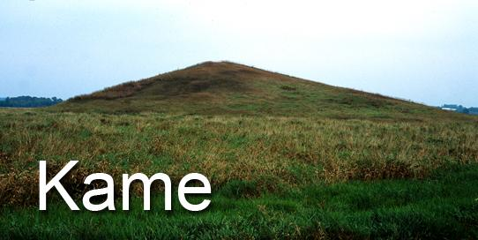
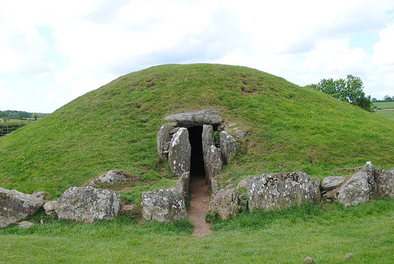
Kames↓

Slide 44
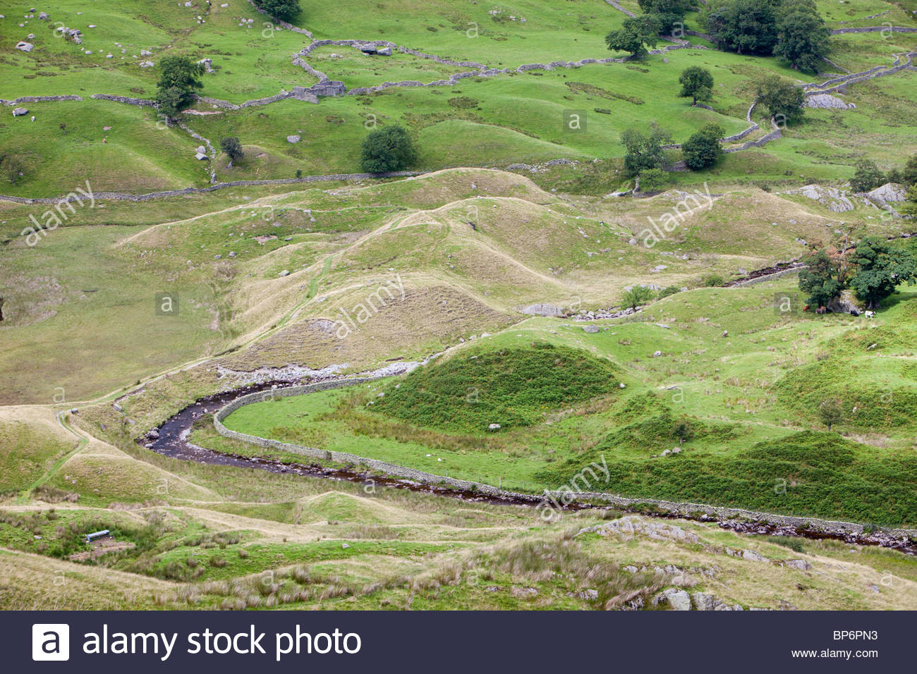
Drumlins↓

Slide 45
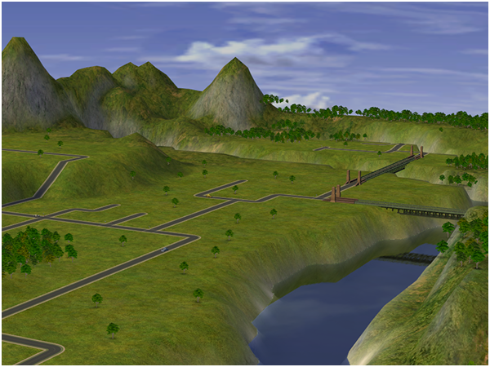
Valley Terrains↓

Slide 46
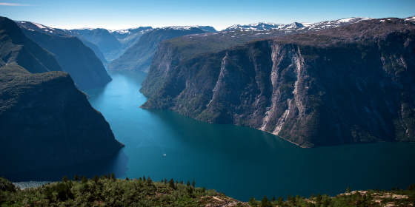
Fjords↓

Slide 47
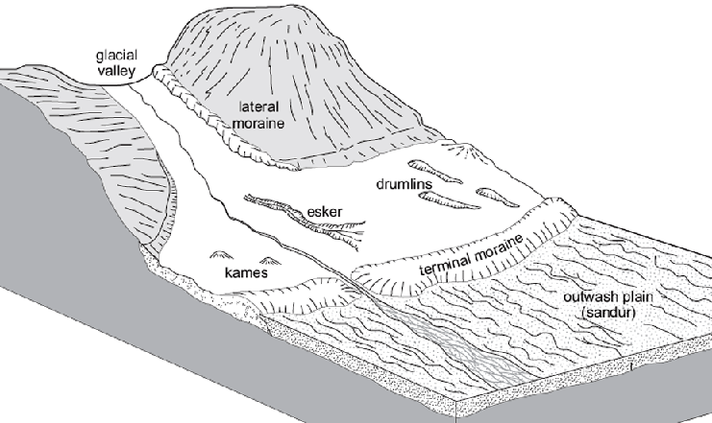

Slide 48
More Information about Glaciers
1) Glaciers nowadays are found in all continents except Australia.
2) North pole ice is not a glacier as glaciers found on land. Ice there is accumulation over seawater.
3) Melting glaciers may disturb the Earth balance and enhance Earthquakes.
4) Earth experienced many ice ages in its life >32 ICE AGES recorded.
5) Plate tectonics & Glaciations: Mountain building & then melting ….

