Slide 1
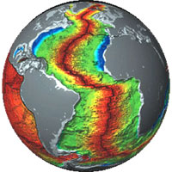
PLATE TECTONICS THEORY
It becomes really a THEORY that answers fully a lot of geological questions

Slide 2
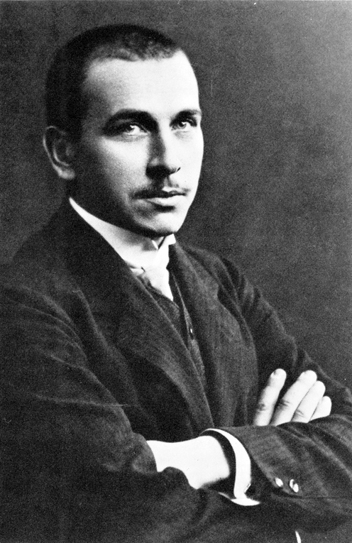
Continental Drift Hypothesis
WEGENER: A German geologist put
this hypothesis in 1912 which says:
1- All continents of today were not in
their nowadays places.
2- Continents have been subjecting to steady movement away from each other.
3- According to Wegener: The driving force beyond this continental drift is the Tidal force (Alternate cycling of Low & High tide).
4- Wegener said only the Earth crust that moves.

Slide 3
PLATE TECTONICS THEORY
Later on many geologists (among them Wegener himself) realized that:
1) Not only the upper thin Earth crust that moves but the whole rigid outer layer of the Earth (both the Lithosphere and what above it “the Earth crust”) moves (= slides over the underlying viscous Asthenosphere).
2) This rigid layer is not fully interconnected but divided into slabs, they named them PLATES.
3) A plate (or a slab) may be totally composed of a continent, ocean or both. ……cont.

Slide 4
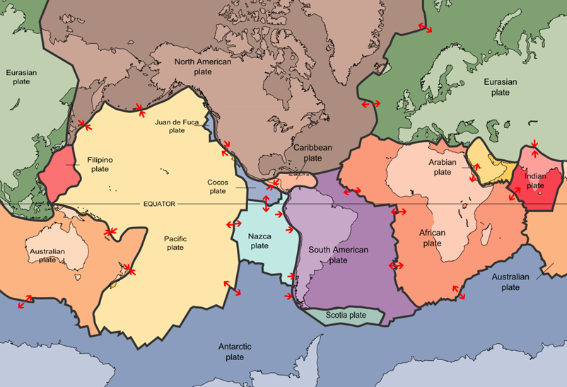

Slide 5
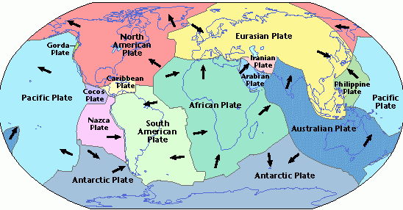

Slide 6
4) The sizes/areas of these plates are not equal, some are very large but many are small. 5) The boundaries between the plates are never linear or regular. 6) When a plate moves apart from the other then at its other end it collides with another one. …..cont.

Slide 7
7) Some of these plates do move apart (Divergent Movement), some do collide with each other (Convergent Movement). Another shorter and less significant movement, which is neither divergent nor convergent, but it shows that one plate is cut into two plates moving parallel to each other but in different directions is called a Transverse Movement. The types of stresses exerted can be classified as follows: a. Divergent= Tensile Stress. b. Convergent= Compressional stress. c. Transverse= Shear stress. Each plate is bounded by these 3 forms

Slide 9
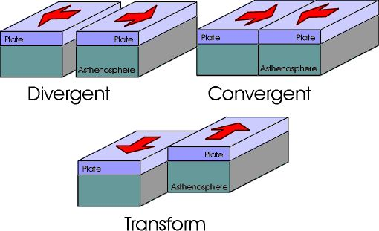

Slide 10
8) When moving apart, basaltic lava erupts out from the Asthenosphere creating new land. 9) When colliding each other, the heavier plate slides beneath the lighter one and by time it melts (= is consumed) in the Asthenosphere at a depth of approx. 700km. ……cont.

Slide 11
The oceanic crust is denser (=heavier) than the continental crust hence it is the one that sinks. The Earths’ upper solid sphere is composed of 3 layers: The lower one rich in Mg+Fe silicates called SIMA, then the middle one rich in Al silicates called SIAL and the most upper of sedimentary rocks called the EARTHS’CRUST

Slide 12
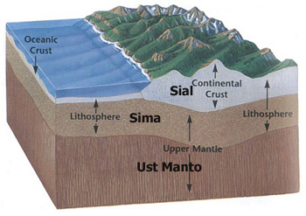

Slide 13
10) The driving force beyond the whole movements is the Convectional Currents which are created in the Asthenosphere due to atomic reactions occurring there. 11) On the boundaries of both the diverging as well as the converging plates, many and complicated geological processes and events are happening (e.g. Earthquakes, volcanism, mountain building, metamorphism, melting & partial melting, rocks’ deformation/folding/faulting/doming ...) …cont.

Slide 14
The Convectional Currents

Slide 15
Convectional Currents

Slide 16
The heavier one that sinks is called the SINKING PLATE and the lighter one is called the HANGING PLATE. The zone where the two plate meet is called the SUBDUCTION ZONE.

Slide 17
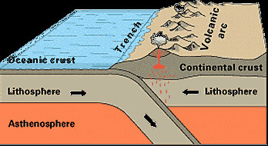
A. ON THE CONVERGENT BOUNDARIES:
The heavier plate slides below the lighter one with inclination of approx. 45ºand sinks in the Asthenoshere to melt completely below approx. 700 km. Results:
At the meeting
boundary a deep
trench is formed.
……cont.

Slide 18
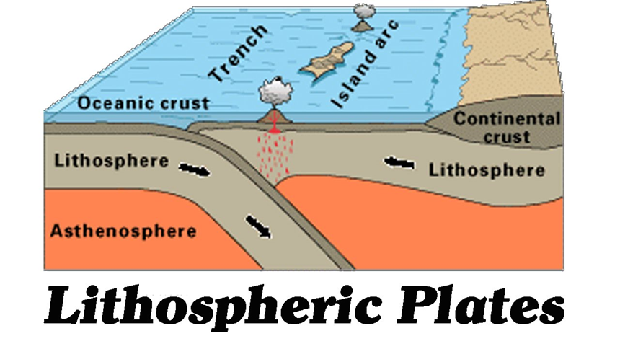

Slide 19
b) The minerals’ components of the sinking plate, and in its way to melt in the Asthenosphere, melt in a gradual rhythmus called “PARTIAL MELTING” [that means minerals with lower melting points melt first & so on…]. This produces magma of lighter composition in weight [= granitic magma]. And due to the high pressure exerted by the collision, this magma intrudes the hanging plate to form a series of a rather rhyolitic volcanoes nearer to the convergent boundary.

Slide 20
c) As the sinking plate goes deeper, minerals of higher melting points (e.g. ferro-magnesian minerals) start to melt and the magma starts to be more heavier (andesitic first then basaltic). The intruding magma in form of lava over the hanging plate forms series of volcanoes called “VOLCANIC ARCS”. They get to be basaltic (richer in Fe-Mg Minerals) in composition away from the boundary.

Slide 21
….. Also on the hanging plate: The components forming the hanging plate [which in their upper part are mainly composed of layers of sedimentary rocks], and due to the pushing force exerted, start to fault and fold to form higher areas [THE MOUNTAINS] as Hemalaya, Alps, Andes, Anatolia, Oral …. etc.

Slide 22
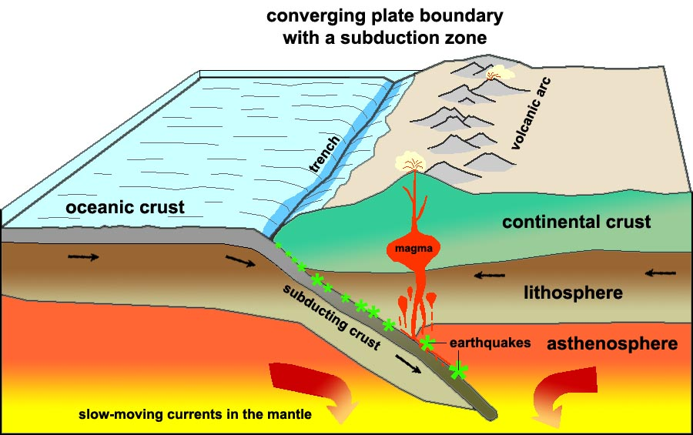

Slide 23
Worth to mention is that the sliding of the sinking plate does not happen in a gradual manner but in abrupt way leading to release of immense energy in form of EARTHQUACKES. The nearer the release of this energy to the boundary of convergence the more intensive is the Earthquake.

Slide 24
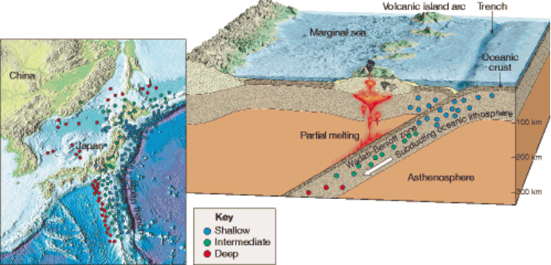

Slide 25
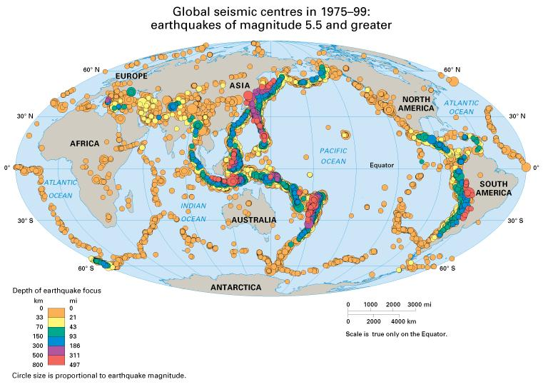

Slide 26
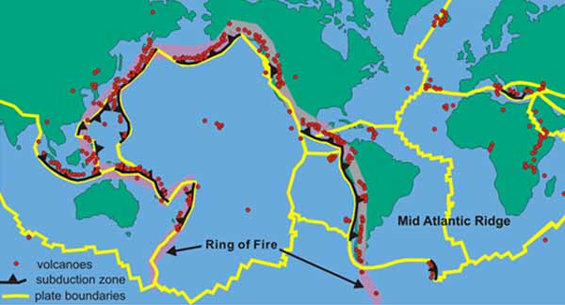

Slide 27
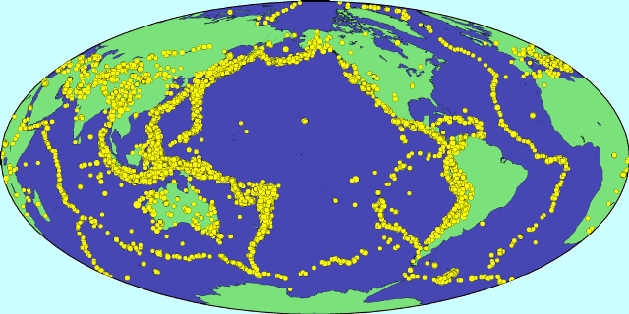

Slide 28
2. On the Divergent Boundaries:
At first, and due to the convectional currents power, immense tensile stress leads to the breaking of one plate into two plates.
This breaking resembles an injury in mans’ skin in that the injury itself is deeper than the areas around on both sides & is called a RIFT. The areas around are subjected to inflation and rise above the areas far around. This inflated area on both sides of the rift is called a RIDGE.

Slide 29
3- The rift, as well as its ridge are running nonlinear and irregular. 4) Along the rift, basaltic magma intrudes out in form of lava pushing the two plates apart forming a new crust [this extruded lava resembles the blood that flows out of the injury].

Slide 30
5- The divergence of the two plates is a continuous action but the extrusion of lava happens sometimes in pulses creating Earthquakes of medium scale. 6- By time the rift deepens more and more and sea water intrudes the area forming a longitudinal sea that with time becomes an ocean; examples: the Atlantic Ocean & the Red Sea….

Slide 31
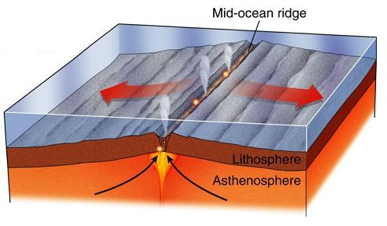

Slide 32
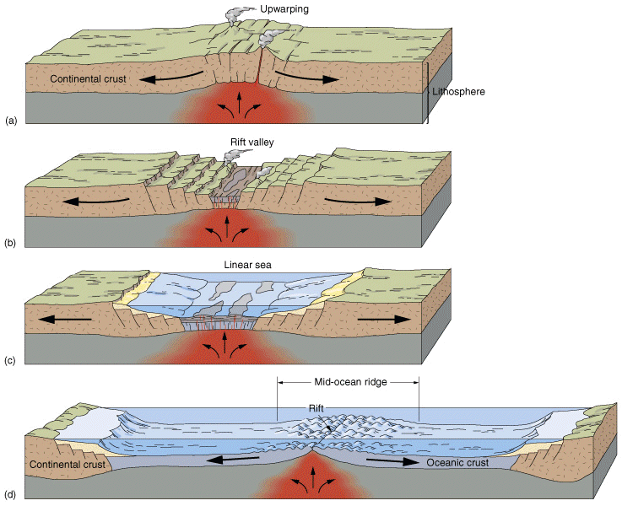

Slide 33
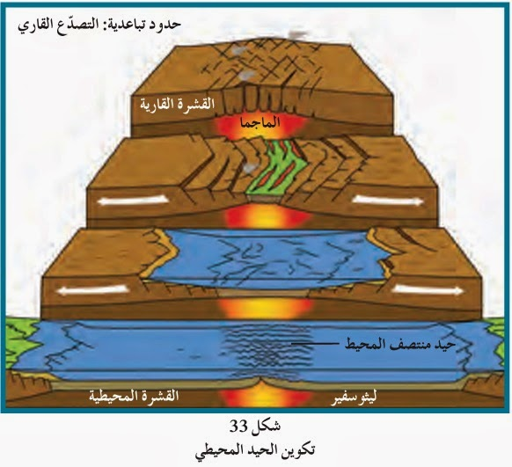

Slide 34
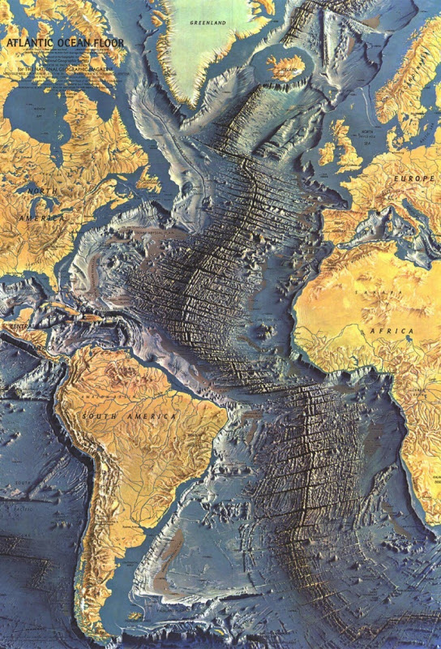

Slide 35
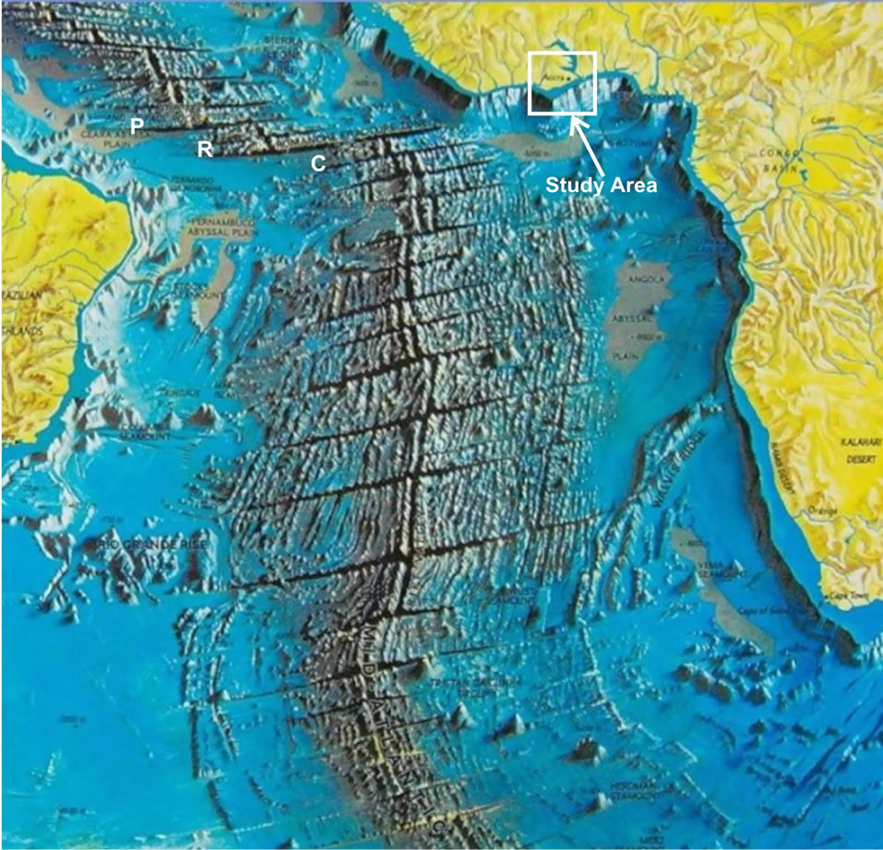

Slide 36
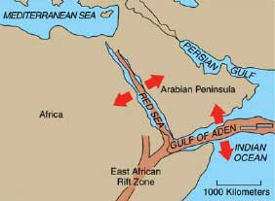
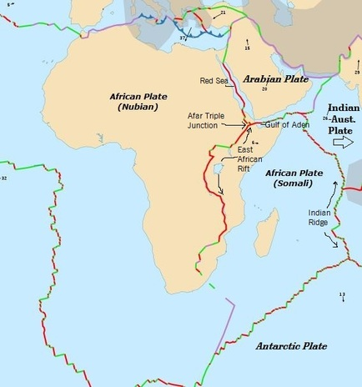
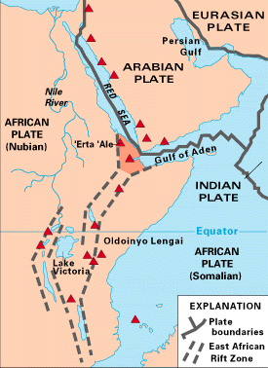

Slide 37
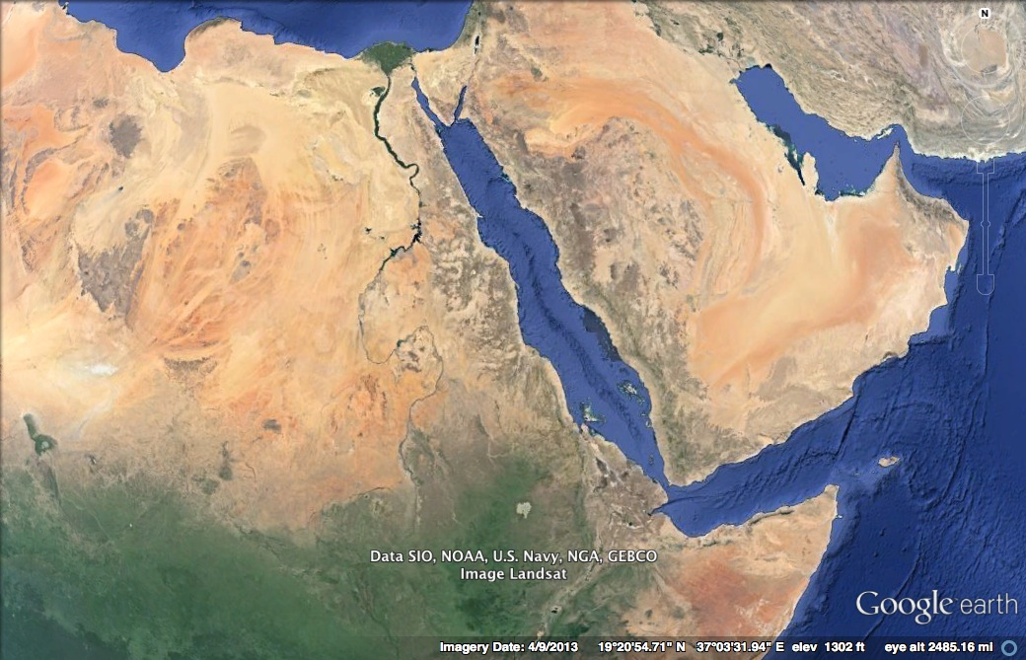

Slide 38
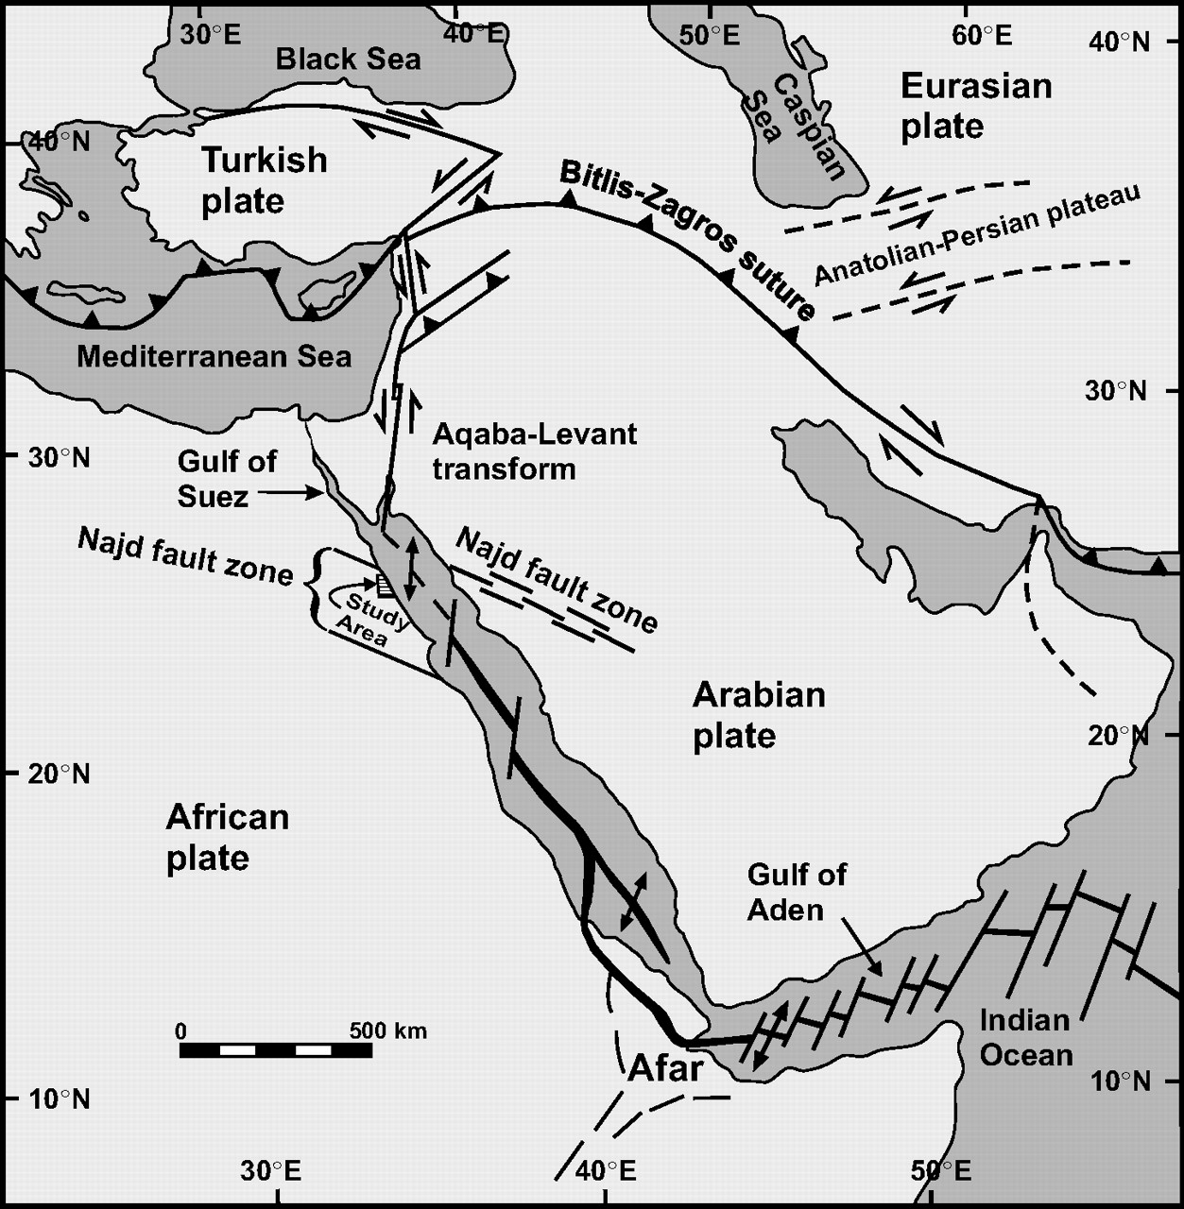

Slide 39
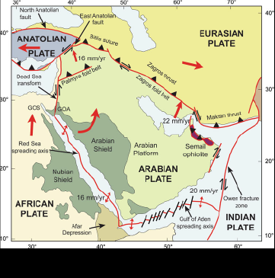

Slide 40
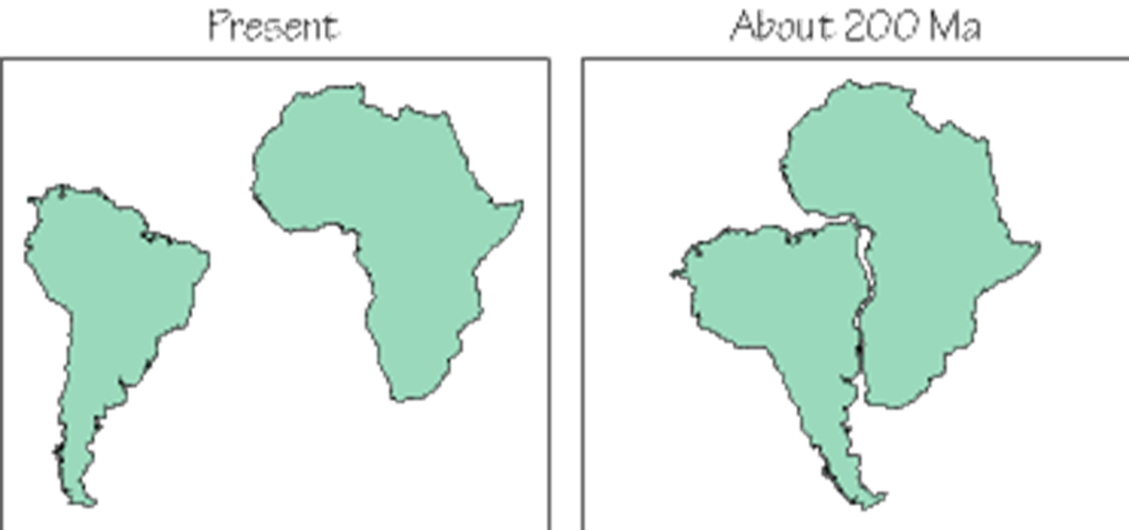
EVIDENCES PRO PLATE TECTONIC THEORY
1) The fitting between the eastern coast line of South America/North America and the western coast line of Africa/ Europe. Max. fitting at -800m below
Sea level.

Slide 41
Earth before 300 Million Years ago

Slide 42
Prior to this splitting [before 250 Million years ago], scientists say: The whole land was one continent called “PANGEA” surrounded by water of the super ocean named “TETHYS”

Slide 43
180 Million years ago: The splitting and drifting away from each other continued with time

Slide 44
135 Million years ago

Slide 45
Nowadays Earth: Land & Sea

Slide 46
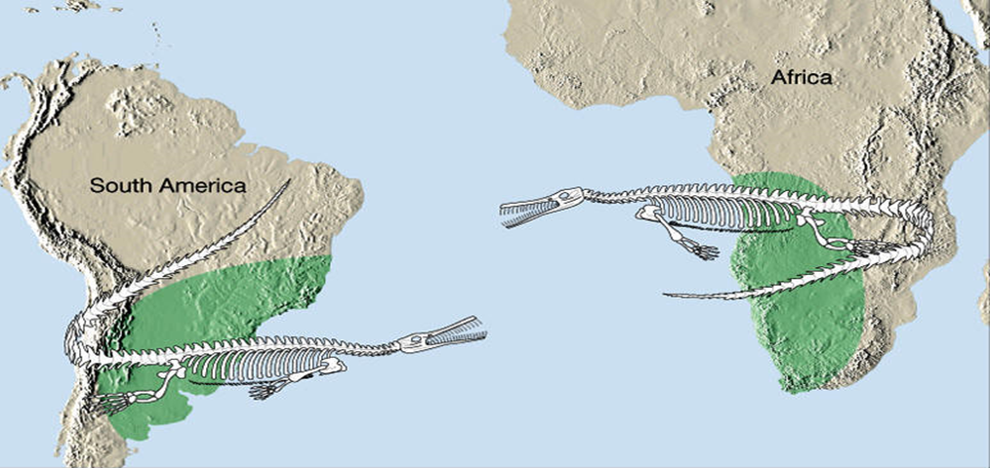
2- Fossil Evidence:
Remains of many similar terrestrial fossil species were found in old rocks on eastern coast of South America & western coast of Africa; especially that of the in fresh water lived Mesosaurus sp.

Slide 47
3- Rock types and successions evidence
On both sides of the Atlantic Ocean, similar rock types with their detailed components and approx. similar thicknesses were found:

Slide 48
4. Environmental evidence: Rock types indicate certain environmental conditions under which they were deposited or formed; these paleo-environments were found similar in southern parts of many continents. One significant rock type is the rock “TILL” which indicates glaciation climate.

Slide 49
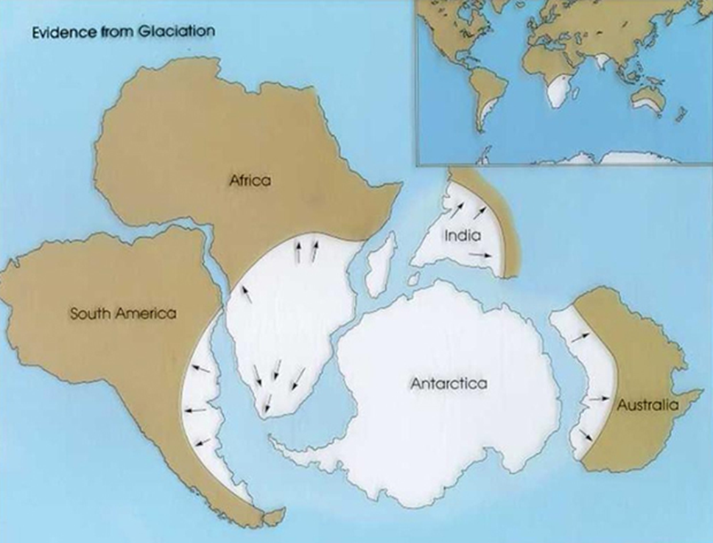

Slide 50
5- Paleomagnetism Evidence: As a scientific fact; our Earth nowadays has a + North magnetic pole and a – South magnetic pole with certain intensity. This was not the case always. Scientists detected that our Earths’ magnetic intensity had lost > 5% of its intensity in the last century and the loss is going on until the intensity will reach a zero Gauss.

Slide 51
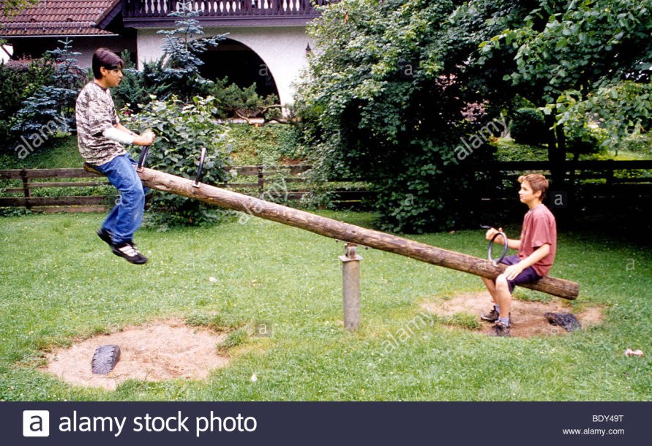
Then the intensity of both poles will start to grow up but with changing sign; the – will regrow as + and the + will regrow as – like a balance game. This phenomenon is called Magnetic Reversals

Slide 52
What has this to do with Plate Tectonics? Answer: Nowadays we have many active volcanoes that extrude basaltic magma rich in ferrous minerals. These minerals once start to quench on Earth surface and below 770 Cº? [The degree above which magnet looses its magnetism], they arrange themselves parallel to the recent magnetic field [+ North & - South].

Slide 53
As we know, the most areas that extrude basaltic lava are the rift areas. So going apart from any rift on both sides, we meet basaltic flows symmetrical in their polarity, arrangement and age on both sides.

Slide 54
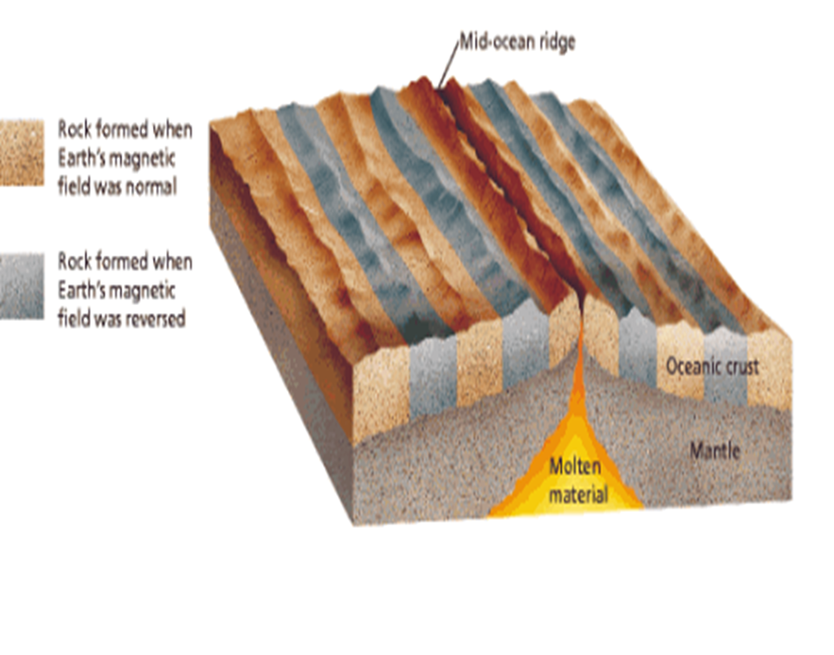

Slide 55
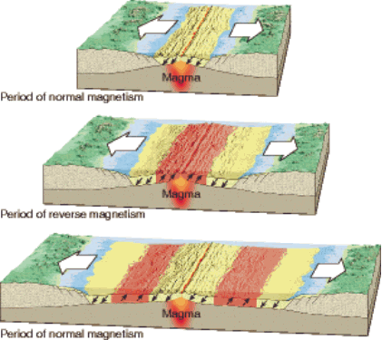

Slide 56
Polar Wandering Phenomenon:
Magnetic poles are stationary always. When ferrous minerals in basalts were extruded in old times, these minerals arranged themselves in accordance with the Earths’ polarity at that time. Observing many extrusions on Earth surface of same age but with different directions’ orientations means only one thing:
“The poles were not wandering but the plates did”.

Slide 57
Also studying the directions’ orientation of ferrous minerals in basaltic extrusions of different ages over one plate; scientists found that each extrusion shows certain direction different from the other. This observation also means that this plate on which all these basaltic extrusions occurred itself has been moving thru time not the Earths’ poles.

Slide 58
POLAR WANDERING↓

Slide 59
6- Evidences from Deep Sea Drilling Project (Glomar Challenger Driller):
On both sides of the Mid-Atlantic Ridge, Geologists dug many deep boreholes and picked rock cores out of them. On both sides of the rift they found there is symmetry in rock successions, ages and features (e.g. microfossil content, rock types, thicknesses…)

Slide 60
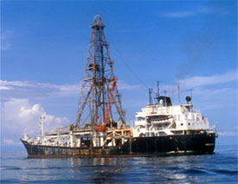
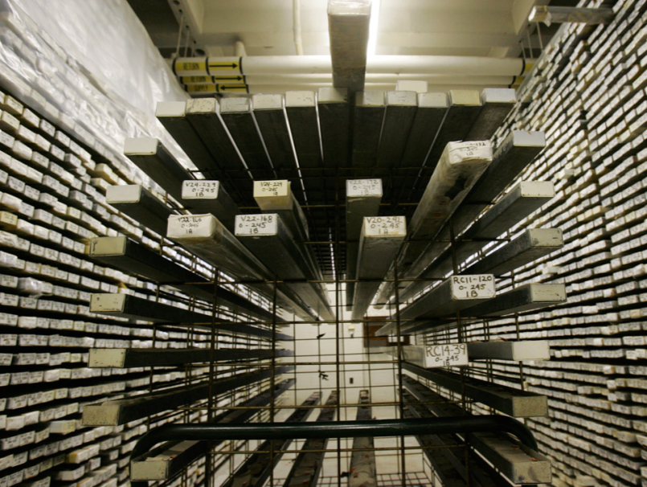
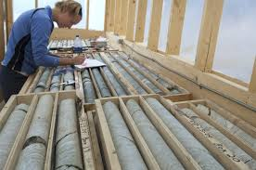
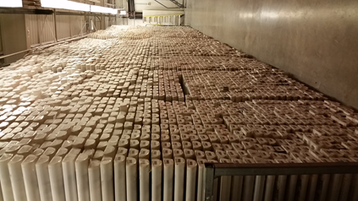

Slide 61
7. Evidence from Hot Spots: What is a HS?. It is a stationary “zone” within the Asthenosphere that extrudes basalt in pulses on the moving Lithosphere every certain period of time. Example: Hawaii Archipelago.

Slide 62
