Slide 1
ENCE 231: Engineering Geology Fall Semester 2017/2018 Department of Civil Engineering- Birzeit University, Palestine Chapter 8: Mass Wasting
Instructor : Saheem Murshid
*Material Source: Essentials of Geology (Lutgens et al., 2006)

Slide 2
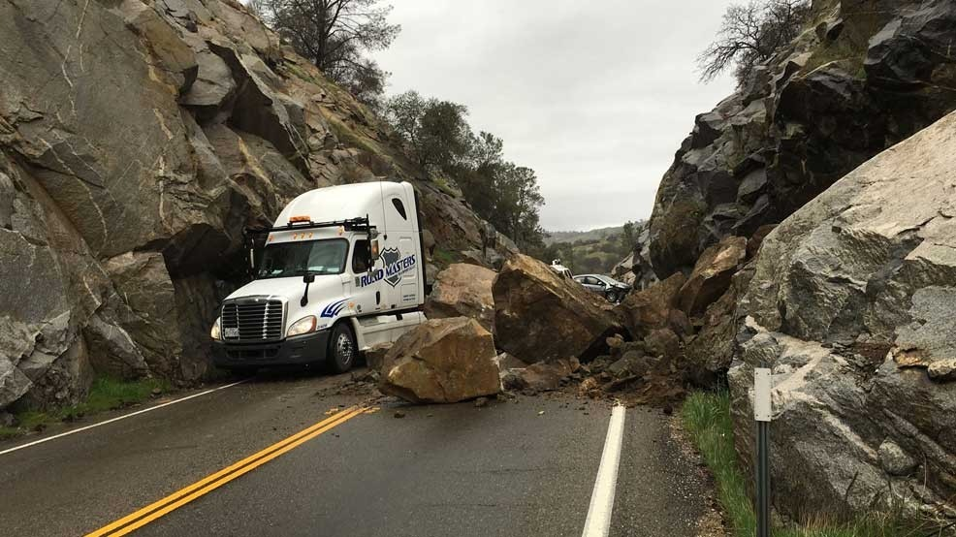
Mass Wasting: Definition
Mass Wasting: The downslope movement of rock, regolith and soil under the direct influence of gravity. It is distinct from erosional forces in that it does not require a transporting medium such water & wind.
The movement may be gradual or sudden & violent.
Landslides are a worldwide natural hazard when they cause damage to property & loss of life.

Slide 3
Mass Wasting
Weathering & Mass Wasting: Once weathering breaks weakens & breaks rock apart, mass wasting transfers the debris downslope.
As mentioned in earlier chapters, Mass wasting (an external dynamic process) opposes the internal processes of mountain building and volcanic eruptions. If the latter did not exist, earth would be flatter and mass wasting would slow or stop
Mass wasting supplies materials to streams, which then carries it away (eventually to the sea).
Mass wasting explains why river valleys are much wider than the channel filled with water.

Slide 4
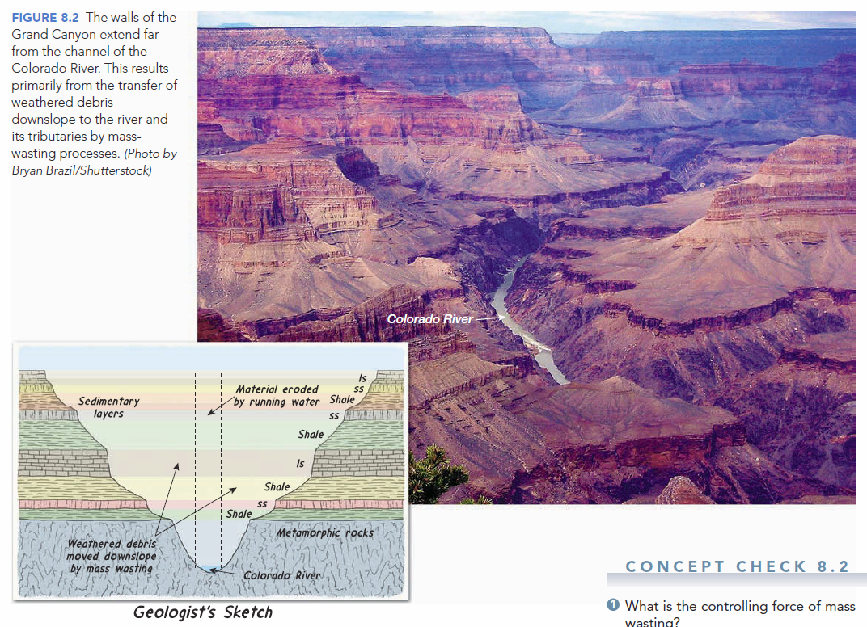
In the Grand Canyon, mass wasting makes the valleys much wider than the channel of the river.

Slide 5
Controls & Triggers of Mass Wasting
Gravity is the controlling force, but other factors may play an important role in reaching instability in a slope. These factors are called “triggers” (محفزات). Some of the most common natural triggers are as follows:
Saturation of Materials from Water.
Oversteepening of Slopes.
Ground Vibrations from Earthquakes.
Geologic structure / Bedding.
Removal of anchoring Vegetation.

Slide 6
The Role of Water
Heavy rain or snowmelt may trigger mass wasting.
In rock masses, we mentioned how water causes frost wedging through freeze-thaw cycles.
Water may fill the pores of a sediment with water causing the particles’ cohesion (التصاق او التحام) to be reduced or destroyed, allowing them to slide past one another (reducing shear strength).
In the same way, saturation reduces internal friction between particles, allowing it to move by gravity.
Water also adds considerable weight to a mass of material, which may cause it to slide or flow downslope.

Slide 7
The Role of Water
Reduction of internal friction

Slide 8
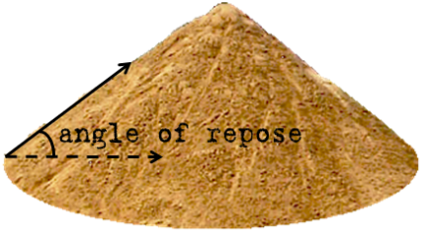
Oversteepening of Slopes
It is simply when slopes become steeper(شديدة الانحدار). May be caused by a stream undercutting a valley wall via human activity.
The Angle of Repose is the steepest angle at which a slope is considered stable (on the verge of collapse) and it depends on the size & shape of the particles.
In an unconsolidated mass of granular particles (sand-sized or larger) the angle of repose ranges from 25-40°.

Slide 9
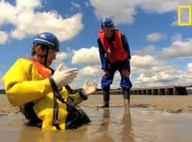
Earthquakes
Mass movement conditions may exist for a long time without movement. An earthquake can be a dramatic trigger.
Earthquakes may trigger tens, hundreds or thousands of landslides in a susceptible area.
LIQUEFACTION. Intense ground shaking during earthquakes can cause water saturated surface materials to lose their strength and behave as a liquid.
Quick Sand

Slide 10
A combination of Triggers is also common
Class Question:
Can a landslide occur without a trigger?

Slide 11
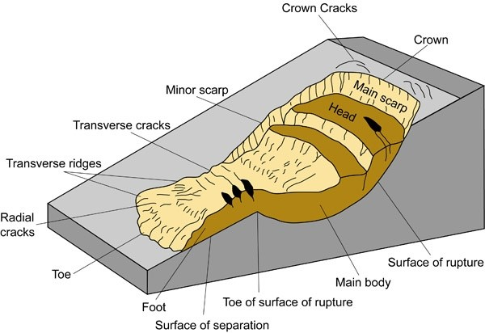
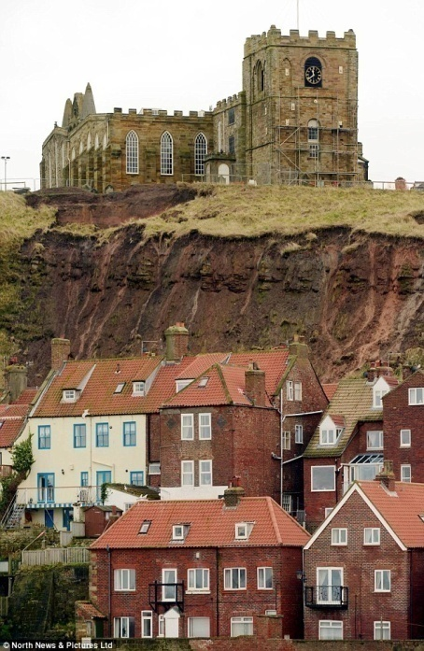
Other Factors (Mainly From Human Activity)
Removal of Vegetation.
Removal of the foot of a slope (considered the support of a slope).
Vibrations (Ex: quarrying, construction, etc.)
Loading at the top of a slope.
Etc….

Slide 12
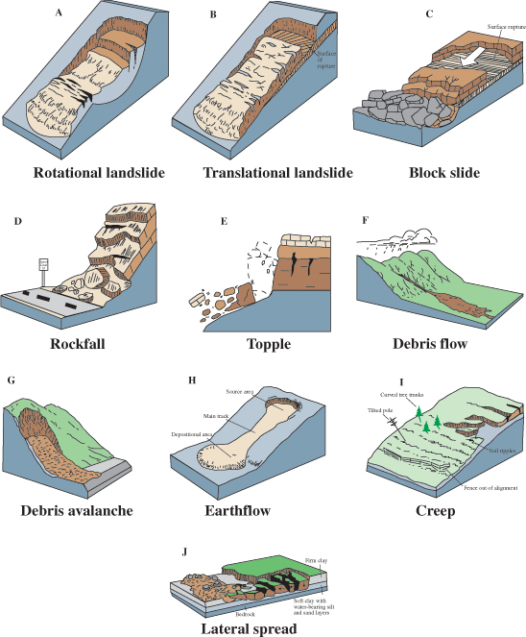
Classification of Mass Wasting Processes
Classification of Mass Wasting events are generally classified based on the type of material involved, the kind of motion displayed, and the velocity of the movement.

Slide 13
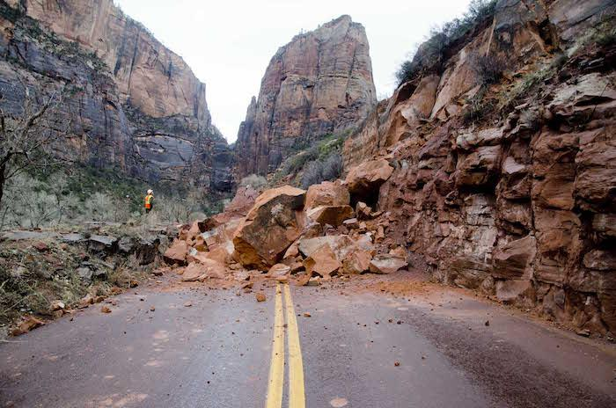
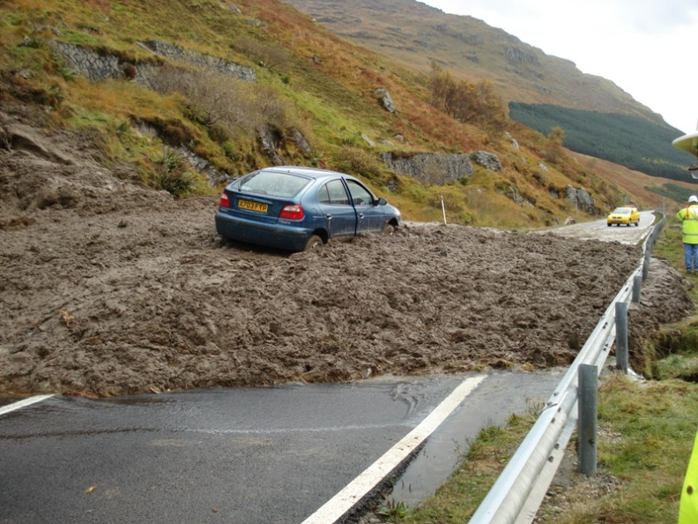
Classification of Mass Wasting Processes: 1) Type of Material
It depends on the type of material that the mass movement began from;
Is soil and regolith dominate→ terms such as “mud”, “debris”, or “earth” are used.
If mass of bedrock breaks loose → terms such as “rock” and “block” are used in the description.

Slide 14
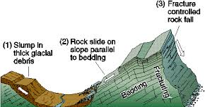
Classification of Mass Wasting Processes: 2) Type of Motion
The types of motion or how the mass moves are highly variable, but generally it is either described as fall, slide, or flow.
Fall: describes a motion of freefall of detached pieces of any size. It is common in steep slopes when material cannot remain on the surface. This type of motion may cause other types.
Slide: Occur when material remains fairly coherent until it moves along a well-defined surface.
This surface may be a joint, fault or even a bedding plane nearly parallel to slope.
When movement occurs along a curved surface, it is called slump (rotational).

Slide 15
Classification of Mass Wasting Processes: 2) Type of Motion
Flow: Occurs when material moves downslope as a viscous fluid. Most flows are saturated with water.
Other possible types of motion:
Spreads
Topples
And Complex

Slide 16
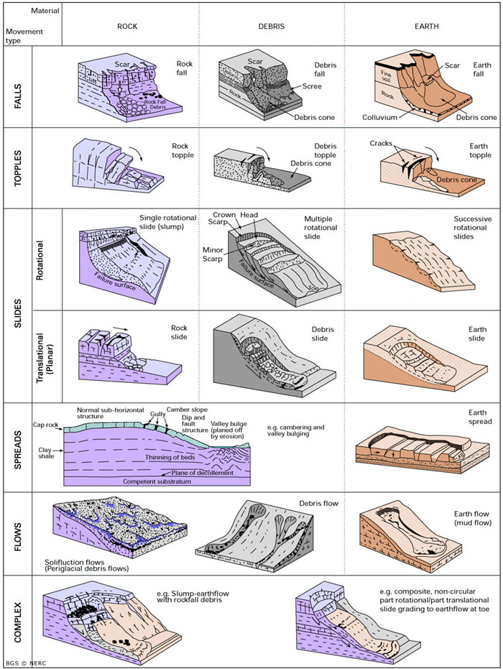

Slide 17
Classification of Mass Wasting Processes: 3) Rate of Movement
Rates of movement can be very sudden or exceptionally gradual.
When mass-wasting events make the news, it is most likely because a large quantity of material has moved rapidly down a steep slope and has had a disastrous effect upon people and property.
For instance, rock avalanches, rock and debris can hurtle downslope at speeds exceeding 200 kilometers per hour.
In this case, high velocities result when air becomes trapped and compressed beneath the falling mass of debris, allowing it to move as a buoyant, flexible sheet across the surface.
However most mass movements is slow. One process that is extremely slow is Creep, in which movement is usually measured in millimeters or centimeters per year.

Slide 18
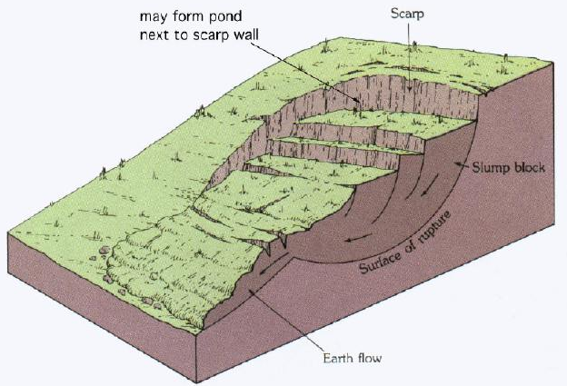
Slump (slow)
Slump is a common type of mass movement and refers to the downward sliding of a mass of rock or unconsolidated material moving as a unit along a curved surface.
Usually slumped material does not travel fast or to long distances.
It is common in thick accumulations of cohesive material such as clay and the surface of rupture forms crescent-shaped (spoon).
Commonly occurs due to oversteepened slopes by removing slope foot or overloading at the top. Water may also play a role when weak rock layer (clay-rich) underlies a more resistant rock (ex: sandstone).

Slide 19
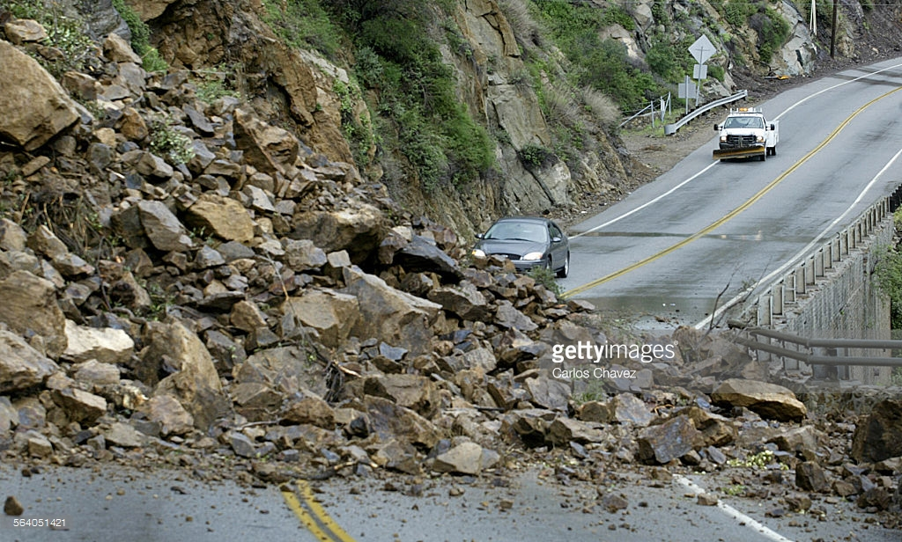
Rockslide (fast)
Occurs when blocks of bedrock break loose and slide downslope.
If the material is largely unconsolidated the term debris slide is used.
It occurs where either rock strata (bedding/ dip) or joints and fractures are inclined parallel the slope.

Slide 20
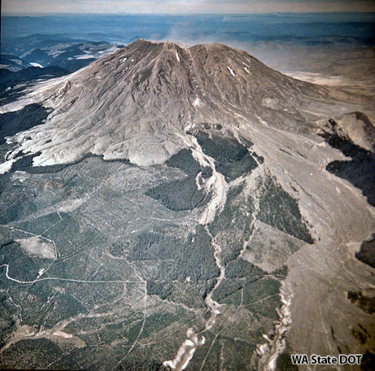
Debris Flow or Mudflow (fast)
It is a relatively rapid type of mass wasting that involves a flow of debris containing a large amount of water.
It is characteristic of semiarid mountain regions with infrequent but heavy rainfall.
Mudflows occurring on slopes of volcanoes are termed “Lahars”. They occur when a highly unstable layer of ash and debris become saturated with water and flow downslope.

Slide 21
Earthflow (slow-med.)
Most often forms in hillsides in humid areas during heavy precipitation or snowmelt. Water saturates the soil and regolith, which then moves downslope in the shape of a teardrop.
It varies in size; from a few meters in width, length & depth to over a kilometer long, several hundred meters wide & more than 10 meters deep.
The material involved is commonly rich in clay & silt, with small portion of sand & coarse particles.
The material is more viscous than in mudflows, so it is typically slower and more consistent. It may move over a period of days to years depending on slope steepness, amount of rain, and consistency of material.

Slide 22
Earthflow

Slide 23
Creep (very slow)
Very wide-spread as it occurs on both steep & gentle slopes. Despite this fact, it is characterized by very slow movement.
By definition, Creep is the type of mass wasting that involves the gradual downhill movement of soil & regolith.
One of the factors controlling creep is freezing & thawing cycles or wetting & drying cycles.
Freezing or wetting lifts particles at right angles to the slope

Slide 24
Creep: Movement due to Freezing-Thawing or Wetting-Drying Cycles

Slide 25
Solifluction
When soil is saturated with water, the soggy mass may flow downslope at a rate of a few millimeters or a few centimeters per day or per year. Such a process is called solifluction (literally, “soil flow”).
It is a type of mass wasting that is common wherever water cannot escape from the saturated surface layer by infiltrating to deeper levels. A dense clay hardpan in soil or an impermeable bedrock layer can promote solifluction.
It is common in regions underlain by permafrost. Permafrost refers to the permanently frozen ground.
Solifluction occurs in a zone above the permafrost called the active layer, which thaws to a depth of about a meter during the brief high-latitude summer and then refreezes in winter. During the summer season, water is unable to percolate into the impervious permafrost layer below. As a result, the active layer becomes saturated and slowly flows. The process can occur on slopes as gentle as 2 or 3 degrees.

Slide 26
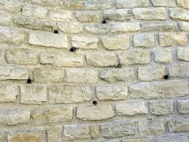
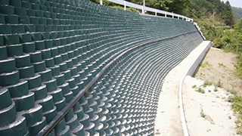
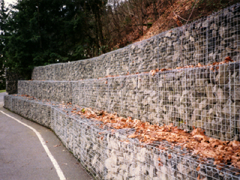
Landslide Mitigation Techniques “Slope Protection”
1) Drainage: Both at surface & subsurface (ex: drainage pipes, drainage tunnels, soil filters or geotextile filters, and ditches & trenches also serve for drainage).
2) Retaining Structures: most common is retaining walls (typically concrete, but may also be pile wall, geotextile or other materials). Regardless of material, retaining structures need to have drainage to avoid water build-up “weepholes”.
- Gabions & Rip Rap serve as both retaining structures (limited) and for drainage due to large gaps between rocks)

Slide 27
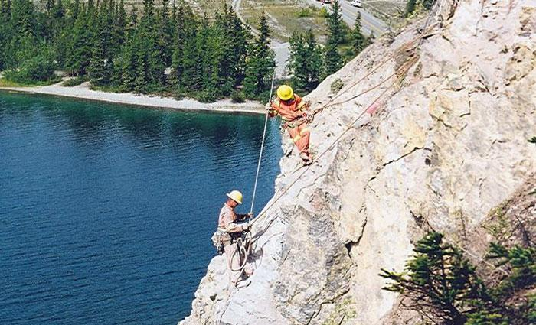
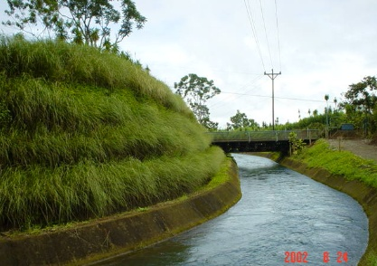
Landslide Mitigation Techniques “Slope Protection”
3) Slope Treatment:
Changing the risk factor in slopes with methods such as:
Slope Flattening (making it gentler)
Benching or Terracing
Scaling (removing unstable rocks)
Increasing Vegitation
Decreasing load on slope

Slide 28
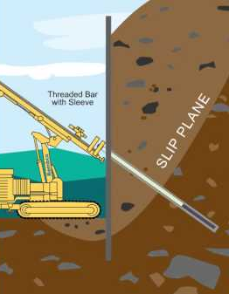
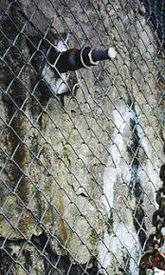
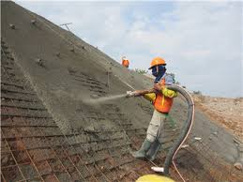
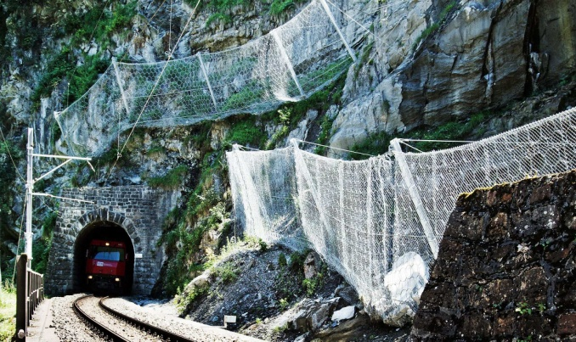
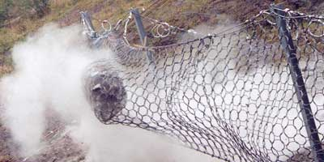
Landslide Mitigation Techniques “Slope Protection”
4) Other Techniques:
Safety Nets
Rock Anchoring
Ditches & Trenches
Shotcrete
Piles

