Slide 1
ENCE 231: Engineering Geology
Fall Semester 2017/2018
Department of Civil Engineering- Birzeit University, Palestine
Chapter 5: Weathering & Soils
Instructor: Saheem Murshid
*Material Source: Essentials of Geology (Lutgens et al., 2006)

Slide 2
Earth’s External & Internal Processes
Earth is a dynamic body (constantly changing):
Internal Processes (derive energy from the interior of the Earth): Elevate the earth’s surface through mountain building & volcanoes
External Processes (derive energy from the Sun): Oppose internal processes; breaking rocks apart transforming it into sediments, and lowering mountains by moving debris to lower elevations.
They take place at or near the earth’s surface (hence called external) & and we discussed in chapter 1 are an integral part of the rock cycle.

Slide 3
Internal Processes
Internal Processes include the following:
Weathering: The physical breakdown (disintegration) and chemical alteration (decomposition) of rocks at or near the surface.
Mass Wasting: The transfer of rock and soil down slope by gravity.
Erosion: The physical removal of material by mobile agents such as water, wind, or ice.

Slide 4
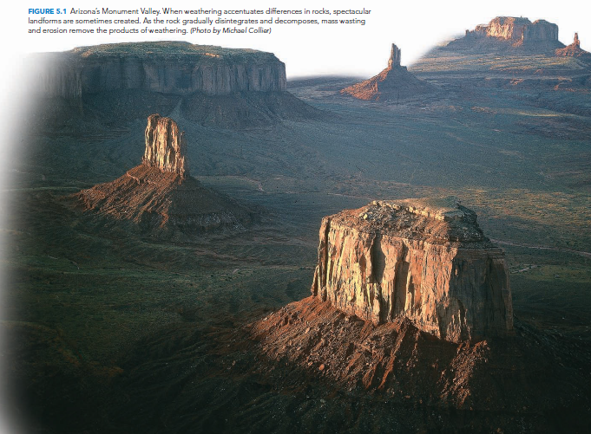

Slide 5
Weathering
Weathering takes place all around us. It may seem like a slow insignificant process, however it is an integral part of the Rock Cycle, so it is a important process in the Earth System…
Example: weathering even affects concrete structures.
Weathering is the response of Earth’s materials to a change in environment.
Example: Intrusive/Plutonic rock uplifted & exposed.
Weathering occurs both when rock is mechanically fragmented (disintegrated)→ Mechanical Weathering; and when chemically altered (decomposed)→ Chemical Weathering
Example: piece of paper ripped into pieces (mechanical) or burned (chemical)

Slide 6
Weathering
So…
Mechanical Weathering: accomplished by physical forces that break rock into smaller and smaller pieces without changing the rock’s mineral composition.
Chemical Weathering: involves a chemical transformation of rock into one or more new compounds.
*Note: The two types of weathering do not necessarily occur separately. They may both take place simultaneously (at the same time) or affect the rate of each other.

Slide 7
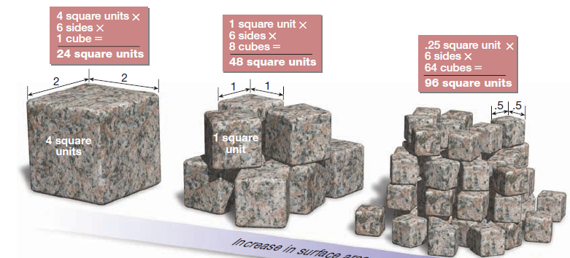
1) Mechanical Weathering
When rock undergoes mechanical weathering it is broken into smaller and smaller pieces, each retaining the characteristics of the original material, so the result is many small pieces from a single large one.
This also results in a larger surface area exposed to chemical weathering.

Slide 8
1) Mechanical Weathering: a. Frost Wedging
Frost Wedging is an important process of mechanical weathering.
It occurs with repeated freeze-thaw cycles.
How? Well, consider that liquid water has a unique property of expanding about 9% upon freezing, which exerts a tremendous outward force.
Ex: putting a full bottle of water in the freezer.
Similarly, in nature water penetrates cracks in rock masses, upon freezing it expands & enlarges the openings by exerting a strong outward force. After many freeze-thaw cycles, it causes the rock to break into angular fragments.

Slide 9
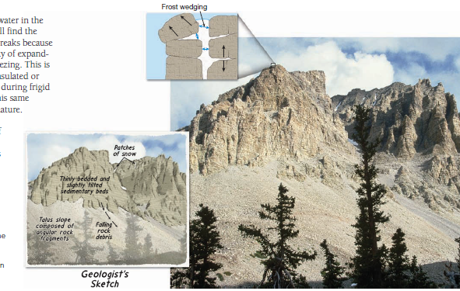
Frost wedging is most common & effective in mountainous areas as a daily freeze-thaw cycle often exists.
Sections of the rock that fall to the base of steep mountains, forming cone-shaped debris piles called TALUS.

Slide 10
1) Mechanical Weathering: b. Unloading
Unloading occurs when large masses of igneous rock (particularly granites) are exposed to erosion. Large slabs begin to break loose generating an onion-like layering called sheeting.
The main reason this occurs is because of unloading or a great reduction in pressure when overlaying rock is eroded away, so the lower rock starts expanding or moving outward, then collapsing. Also may occur in underground mines where the confining pressure is removed.
Continued weathering eventually creates structures called exfoliation domes.

Slide 11
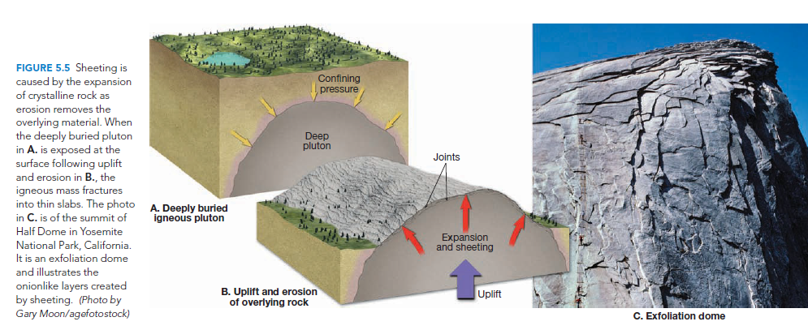
1) Mechanical Weathering: b. Unloading

Slide 12
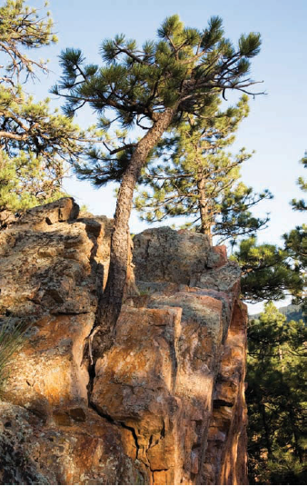
1) Mechanical Weathering: c. Biological Activity
Biological or Organic Activity is the activity of organisms that can cause rocks to break. It contributes to both mechanical & chemical weathering.
Examples include the tree roots wedging rocks apart by growing through fractures in search for water & minerals, burrowing animals move fresh material onto the surface to be weathered, or even humans when blasting is done for mining.
Other organisms such as fungi & lichens may produce acids that cause decomposition to certain rocks (chemical weathering).
Some mineral-eating bacteria may break chemical bonds of minerals to feed on certain compounds.

Slide 13
2) Chemical Weathering:
Chemical weathering involves complex processes that break down rock components as well as the internal structures of minerals (even turning them into new minerals through breaking of chemical bonds & internal structures…may add and remove elements).
During this transformation, the original rock decomposes into substances that are stable at the surface environment.

Slide 14
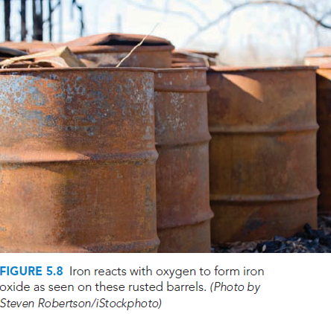
2) Chemical Weathering: a. H2O & Carbonic Acid
Water is the most important agent of chemical weathering.
Pure water is nonreactive, but it is activated with a small amount of dissolved material.
Oxygen dissolved in water will oxidize material it comes in contact with.
Ex: Rusting of nail or iron barrel. Similarly, rock containing iron-rich minerals also oxidize.

Slide 15
2) Chemical Weathering: a. H2O & Carbonic Acid: Limestone Weathering
Carbon dioxide (CO2) [from the atmosphere & decaying organisms in soil] dissolves in water (H2O) forming carbonic acid (H2CO3), the same acid in soft drinks.
H2O+CO2→H2CO3 (Carbonic acid)
Carbonic acid ionizes to form the very reactive hydrogen ion (H+) and the bicarbonate ion (HCO3), which chemically attack or dissolve certain rocks such as limestone.
Limestone caves form through this process.
Limestone

Slide 16
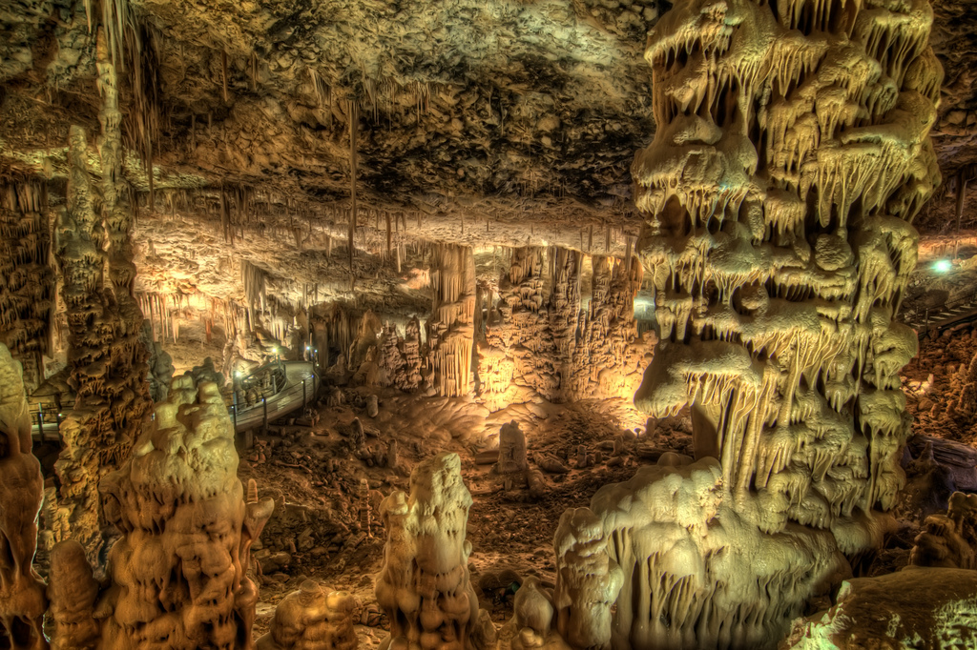
Soreq Cave, West of Jerusalem, Palestine

Slide 17
2) Chemical Weathering: a. H2O & Carbonic Acid: Granite Weathering
Granite also weathers chemically via carbonic acid (H2CO3)…
Remember that granite is mainly composed of Quartz & K-feldspar. The weathering of k-feldspar takes place as follows:
In this reaction, the hydrogen ions (H+) attack and replace potassium ions (K+) in the feldspar structure, thereby disrupting the crystalline network. Once removed, the potassium is available as a nutrient for plants or becomes the soluble salt potassium bicarbonate (KHCO3) which may be incorporated into other minerals or carried to the ocean in dissolved form by streams.
The most abundant end products of the chemical breakdown of feldspar are residual clay minerals (such as kaolinite, illite, montmorillonite). Clay minerals are very stable under surface conditions, so they make up a high percentage of the inorganic material in soils. Moreover, the most abundant sedimentary rock, shale, contains a high proportion of clay minerals.

Slide 18
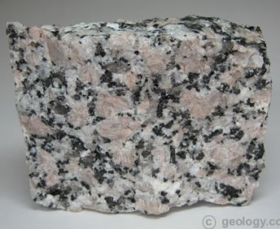
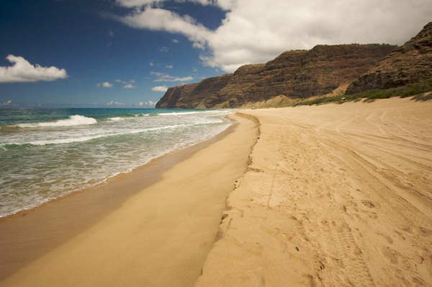
Chemical Weathering:
- H2O & Carbonic Acid: Granite Weathering
Another product of the weathering of granite may be dissolved silica eventually precipitates as chert or flint or is carried to the ocean to be used by organisms to build hard shells.
On the other hand, Quartz, the other main component of granite, is very resistant to chemical weathering; it remains substantially unchanged when attacked by weak acidic solutions. As a result, when granite weathers, the feldspar crystals dull and slowly turn to clay, releasing the once-interlocked quartz grains, which still retain their fresh, glassy appearance. Although some quartz remains in the soil, much is eventually transported to the sea or to other sites of deposition, where it becomes the main constituent of such features as sandy beaches and sand dunes. In time these quartz grains may become lithified to form the sedimentary rock Sandstone.
Quartz in Granite
Sandy Beach

Slide 19
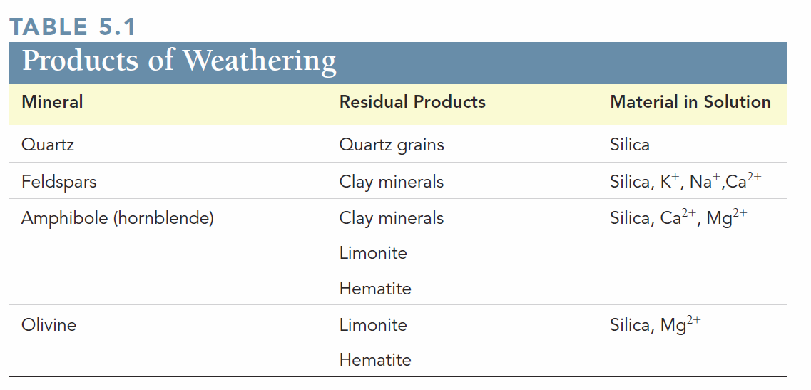
Chemical Weathering: Weathering of Silicate Minerals

Slide 20
Chemical Weathering:
- Spheroidal Weathering
Other than altering the internal structure of minerals, chemical weathering also causes physical changes.
Spherical Weathering occurs when angular rock masses weather chemically (i.e. water enters along joints), the corners and edges of the angular blocks gradually become more rounded and tend to take on a spherical shape.
The corners are attacked most readily because of their greater surface area, as compared to the edges and faces.

Slide 21
Chemical Weathering:
- Spheroidal Weathering
Sometimes during the formation of spheroidal boulders, successive shells separate from the rock’s main body. Eventually the outer shells break off, allowing the chemical-weathering activity to penetrate deeper into the boulder.
This spherical scaling results because the minerals in the rock increase in size through the addition of water to their structure as they weather to clay. This increased bulk exerts an outward force that causes concentric layers of rock to break loose and fall off.
This type of spheroidal weathering, in which shells spall off, should not be confused with the phenomenon of sheeting discussed earlier.

Slide 22
Rates of Weathering
Rocks may weather at different rates (just like earth processes at large).
We already saw how mechanical weathering increases the rate of chemical weathering by exposing more surface area of a rock it breaks.
Other Factors affecting the rate of weathering:
Rock Characteristics
Climate

Slide 23
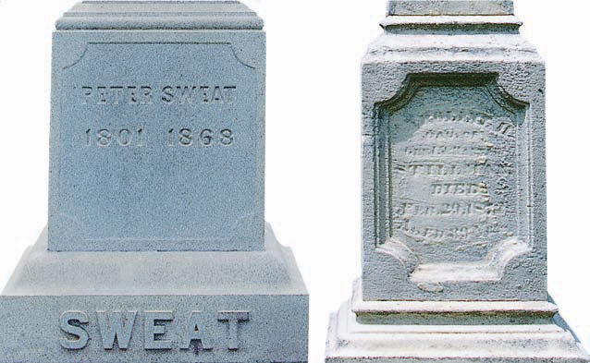
Rates of Weathering:
1) Rock Characteristics
Rock characteristics includes all the chemical traits of a rock, including its mineral composition and solubility.
In rock masses joints (cracks) have an influence.
Variation in weathering due to mineral composition is clear. For instance granite (composed of silicate minerals) is far more resistant to weathering than marble (composed of calcium carbonate). Example: the tombstone in the picture.
In silicates, weathering rates are in the same order as that for crystallization according to Bowen’s reaction series. Olivine ( the first to crystallize) is the least resistant to chemical weathering, while quartz (the last to crystallize) is the most resistant.
Granite
Marble

Slide 24
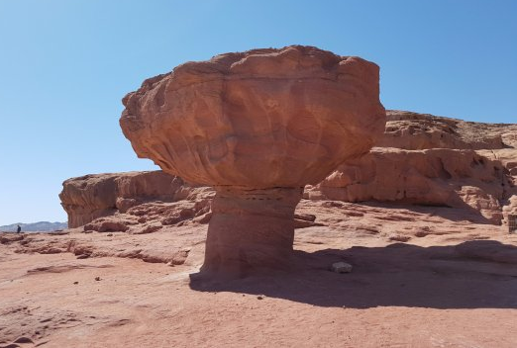
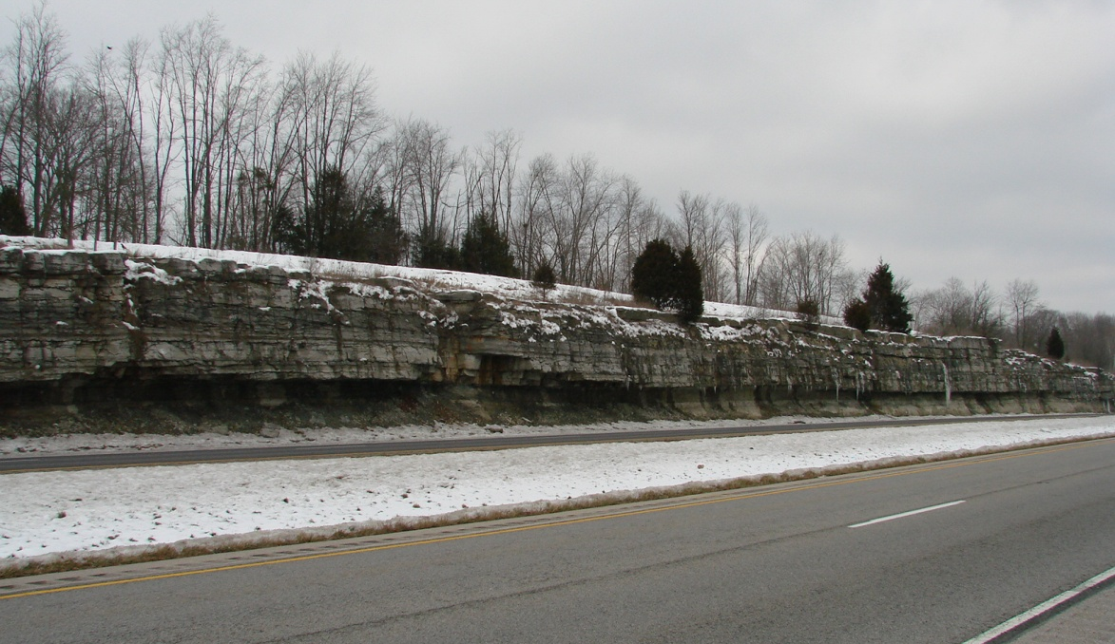
Rates of Weathering:
1) Rock Characteristics→ Differential Weathering
Different Rock Characteristics (among other factors such as joints) cause rocks not to weather uniformly. When different rock type weather differently in a certain, we call the process Differential Weathering.
Resistant layer
Weaker Layer
Weaker Layer
“Mushroom”, Timna Park, South Palestine

Slide 25
Rates of Weathering:
2) Climate
Climate affects the rates of weathering.
As discussed earlier, frost wedging is most effective in cold regions with many freeze-thaw cycle.
Temperature & Moisture also have an influence; regions with warm temperature & abundant moisture encourage chemical weathering, partly because they typically have a lot of vegetation, which feed nearby soils with decaying organic matter, from which chemically active fluids such as carbonic & humic acids are derived an cause weathering.
Chemical weathering is not as effective in polar regions because fluids are locked up in ice. In deserts there isn’t enough moisture for chemical weathering.
Human activity may have an impact: CO2 emissions into the atmosphere cause acid rain, which is carries out chemical weathering.

Slide 26
Soil
Soil extremely important for life & in a way is an interface (boundary) between all of earth’s spheres
Soil covers most of land surfaces and is composed of inorganic (regolith)& organic matter, water, and air.
Regolith: the layer of rock & mineral fragments produced by weathering.
In relation to regolith, Soil can be perceived as the portion of regolith that supports plant growth after maturing & acquiring organic matter.

Slide 27
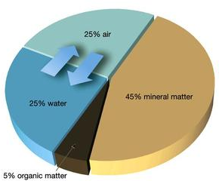
Soil Components
Although variable from place to place, a good-quality soil’s composition (by volume) is as follows:
45%: Disintegrated & decomposed rock (mineral matter or regolith).
5%: Organic matter or humus, the decayed remains of animal & plant life.
25%: Water
25%: Air
50%: Pore space

Slide 28
Soil Components
Organic/ humus Portion: Important as it is the source of nutrients for plants & for the soil’s ability to retain water.
Pores: provide the space for water & air to circulate & feed plants.
Soil water is far from being “pure” as it is a complex solution containing many soluble nutrients supplied to plants in a form they can use. It also provides necessary moisture for chemical reactions that sustain life.
Soil Air in the pores is the source of necessary oxygen & carbon dioxide for microorganisms and plants.

Slide 29
Controls of Soil Formation
Soil is the product of complex and interrelated factors & processes. The most important are:
Parent Material
Time
Climate
Plants & Animals
Topography (التضاريس)

Slide 30
Controls of Soil Formation:
1) Parent Material
Parent Material: It is the source of mineral matter, from which soils develop. It gets weathered/eroded through physical & chemical changes as the processes of soil formation progress.
The source of parent material may be:
Underlying Bedrock→ Produce “Residual Soils”
Unconsolidated Sediment/deposits→ Produce “Transported Soils”
The nature of parent material influences soil as follows:
1) Rate of weathering: Consequently, rate of soil formation. Recall how different rocks have diff. resistances to weathering (Granite vs. Marble). Also note that unconsolidated deposits weather much more easily.
2) The Chemical Makeup: affects the fertility of soils & the plants it can support.

Slide 31
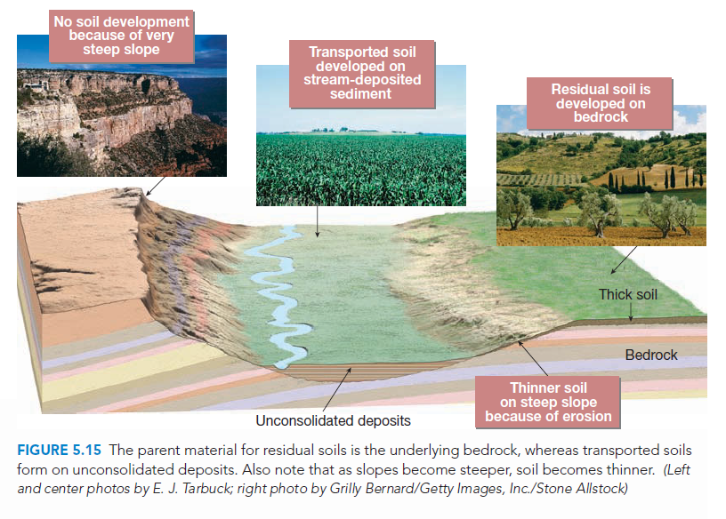

Slide 32
Controls of Soil Formation:
2) Time
The amount of time required for various soils to evolve cannot be specified, because the soil-forming processes act at varying rates under different circumstances.
However, as a rule, the length of time these processes have been operating determines the nature of the soil:
The shorter the time of weathering→ the more the soil resembles the parent material (i.e. the parent material determines to a large extent the characteristics of the soil).
The longer the time of weathering→ the thicker the soil becomes and the less it resembles the parent material.

Slide 33
Controls of Soil Formation:
3) Climate
The most influential control of soil formation.
Variations in temperature & precipitation (rain) determine whether chemical or mechanical weathering will dominate. Additionally, they influence the rate & depth of weathering.
Hot & Wet Climate→ Produces a thick layer of chemically weathered soil
Cold & Dry Climate → Produces a thin layer of mechanically weathered soil
Furthermore, the amount of precipitation influences the amount of materials removed (leached) from the soil, which determines the fertility of the soil, and ultimately the nature of vegetation & animal life.

Slide 34
Controls of Soil Formation:
4) Plants & Animals
The biosphere plays an important role; the types & abundance or organisms influences the physical & chemical properties of the soil, primarily the organic content of the soil.
Soils can be described by the environment & the vegetation it generates. Examples include Forrest Soil, Desert Soil, Prairie Soil (مرج), & Tundra Soil(سهل اجرد).
Organic Content: Plants are the primary source of organic material (animals & microorganisms to a lesser extent). When organic material decomposes (تتحلل), important nutrients are supplied to other plants, animals & microorganisms (i.e. soil becomes more fertile).

Slide 35
Controls of Soil Formation:
4) Plants & Animals
The decay of plant & animal remains forms various complex organic acids, that contribute to weathering processes & make it faster.
Organic matter also helps the soil retain water.
Microorganisms (like bacteria & fungi) play an active role in the decay of organic remains→ converting them into a new material “Humus”. Certain microorganism even increase the fertility of soil by converting atmospheric nitrogen into soil nitrogen.
Earthworms on the other hand feed on organic matter and certain minerals, mix the soil, and burrowing holes that help water & air penetrate the soil.

Slide 36
Controls of Soil Formation:
4) Topography
Change in topography affects soils even in a small area. The length, orientation and steepness of a slopes, water drainage conditions & amount of sunlight all have consequence:
Steep slopes encounter significant erosion & mass wasting, so they do not support the accumulation of soil or water on them. The result is a thin layer of soil or non & little to no vegetation.
On the contrary, waterlogged (poor drainage) bottomlands form soils that are thick (due to accumulation of sediments) & dark (due to high content of organic matter that is not allowed to decay from saturated conditions).
The ideal terrain for soil development is a flat-to-undulating upland surface where there is good drainage, minimum erosion, and sufficient infiltration of water into the soil.

Slide 38
The Soil Profile
Because soil processes take place at the surface downwards, there are variations in composition, texture, structure, & color that develop with depth.
With time, these differences become more pronounced & divide the soil into layers or zones known as horizons.
When digging into soil, the vertical section through the horizons constitutes the Soil Profile.
The profile of an idealized well-developed soil is divided into 5 major horizons O, A, E, B & C.

Slide 39
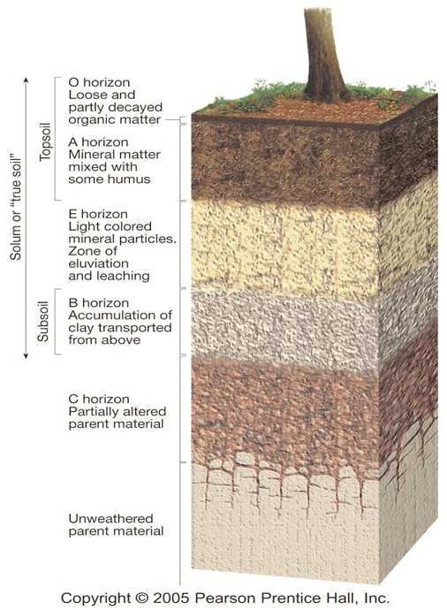
The Soil Profile
O Horizon: consists largely of organic matter & filled with microorganisms. Its upper section is mainly tree leaves & other identifiable plant litter, while the its lower portion is mainly made up of decomposed organic material (humus).
A Horizon: A zone largely composed of mineral matter, yet has high biological activity as humus constitutes up to 30% of its content.
Both O & A Horizons make up what is commonly referred to as “top soil”.

Slide 40
The Soil Profile
E Horizon: Light- colored layer, little organic material, & is depleted by percolating water transporting fine soil particles (Eluviation) & dissolving inorganic soil components (leaching).
B Horizon (Subsoil): referred to as the “zone of accumulation” because it accumulates/ receives the fine material removed from the overlying horizon E through eluviation. If fine clay accumulates, it enhances water retention & in some extreme cases can form a compact impermeable layer called “hardpan”.
Horizons O, A, E, & B together constitute the Solum or True Soil. It is the area where soil-forming processes take place & most roots, plants and animals reside.

Slide 41
The Soil Profile
Finally, Horizon C is a layer of partially altered parent material (i.e. the bedrock below it). It hasn’t yet transformed from Regolith to Soil, but will eventually become soil.
Some soils have clear horizons as a result of a stable environment & a long time-span that allowed it to mature (أن تنضج). The opposite conditions result in immature soils (ex: steep slopes).

Slide 42
Soil Classification
Soils have a vast and variable range types & compositions in different areas and time of processing. Hence, putting these types in groups or categories is necessary to better understand and simplify.
Many classification systems exist depending on the application.
For instance, The Soil Taxonomy System is suitable for agricultural & land-use purposes. It emphasizes the physical & chemical properties of a soil profile and on the basis of observable characteristics. In this system, soils are placed in 6 major categories from order (Qty. 12) [ the broadest category] to series (Qty. 19,000).

Slide 43
Soil Erosion
However, for engineering applications, this system is useless.
Some of the most commonly used Classification Systems used by Engineering Geologists & Engineers are as follows:
Unified Soil Classification System (USCS)
American Association of State Highway and Transportation Officials (AASHTO)
The Basis of these two classification systems is Soil Particle Size.
- Gravel (G), Sand (S), Silt (M), & Clay (C).

Slide 44
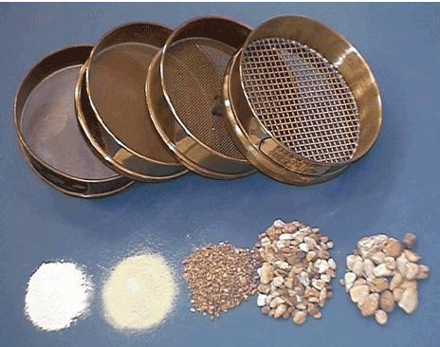
Soil Classification Systems
Soil Type | USCS | AASHTO
Boulders | > 12” (300 mm) | > 3” (75 mm)
Cobbles | 3” (75mm)- 12” (300mm)
Gravel | No.4 Sieve (4.75mm)- 3” | 2 .0- 75 mm (3”)
Sand | No. 200- No. 4 Coarse: 2.0-4.76 mm Med.: 0.42 – 2.0 mm Fine: 0.42- 0.074 mm | 0.074- 2 mm
Silt | Fines < No.200 If plastic→ Clay If non-plastic→ Silt | 0.005-0.074 mm
Clay |  | <0.005
Sieve Analysis is used.
Examples: Sieve No. 4 (4.75mm), Sieve No. 10 (2.0mm), No. 200 (0.074mm), etc.

Slide 45
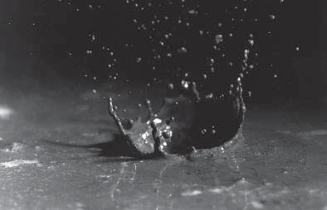
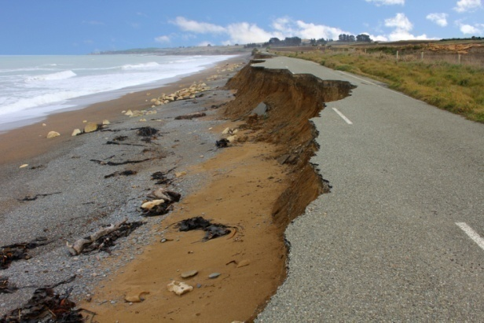
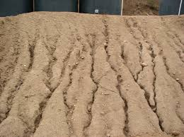
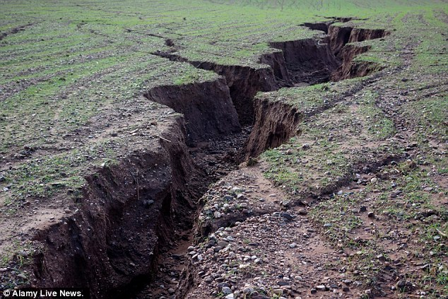
Soil Erosion
Soil erosion is part of the Rock Cycle (i.e. the natural process of the recycling of earth materials).
Once soil forms, erosional forces, especially water & wind, attach the soil & move it from one place to another.
water flowing across the surface carries the soil particles in thin sheets in a process termed sheet erosion.
This process also forms tiny channels called rills and if they become larger they are called gullies.
Once soil is eroded in a channel, the soil particles can then be called sediment.

Slide 46
Rates of Erosion
Soil erosion is expected to occur to soil particles.
However, it varies from place to place and to factors such as soil characteristics, climate, topography, and amount & type of vegetation.
On a broad area, erosion caused by surface runoff can be estimated by determining the amount of sediment carried & deposited by a stream.
Studies show that prior to (before) intense human activity, soil erosion was less:
Past→ sediment transported by rivers to oceans, just over 9 billion tons/year.
Present→ 24 billion tons/year.

Slide 47
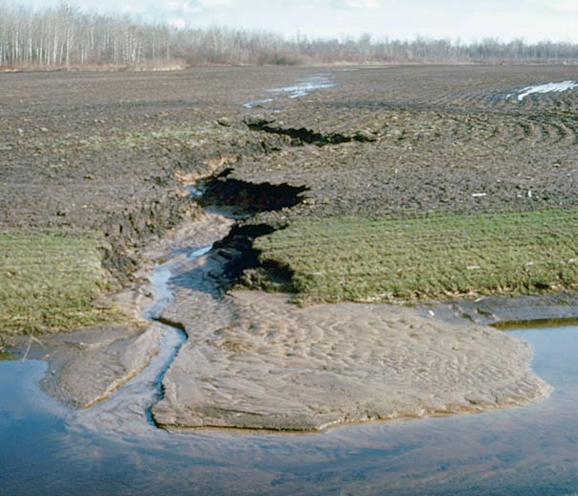
Channel or stream carrying soil particles
Deposited Sediment

Slide 48
Affects of Excessive Soil Erosion
Affects:
In many areas, soil erosion is faster than its formation. At present, more than 1/3 of the world’s croplands affecting agricultural productivity and quality of crops.
Excessive erosion & deposition of too many sediments, will reduce the capacity of reservoirs (affecting hydroelectric generation & flood control, etc.).
Soils containing Fertilizers & chemicals may also affect the water quality of lakes, reservoirs, etc.
Hence, soil preservation is necessary.

Slide 49
Weathering of Ore Deposits
Weathering can also produce economically valuable deposits by depositing small scattered (مبعثر أو منتشر) metals into concentrated areas.
This process is termed “Secondary Enrichment”.
This may occur either through 1) chemical weathering of undesirable material and percolating water moving it downwards, concentrating desired elements in the upper zone or 2) the reverse, the desirable material (in low concentrations) moved downward to lower zones where they are highly concentrated.
Example: Bauxite, an aluminum ore that forms when

Slide 50
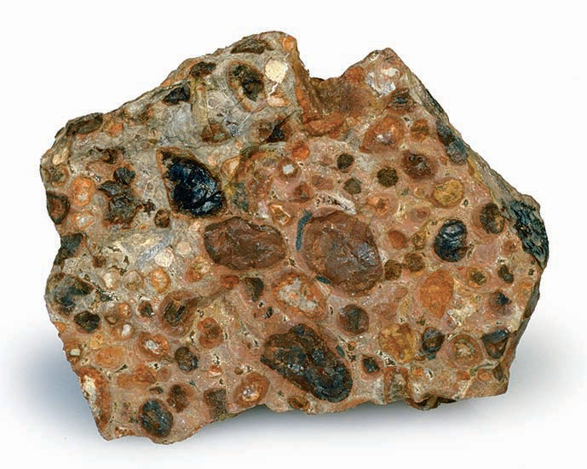
Weathering of Ore Deposits
Example: Bauxite, an aluminum ore that forms (predominantly in rainy tropical climates) when intense & prolonged chemical weathering leaches elements such as Ca, K, & Na leaving concentrations of Bauxite (a hydrated aluminum oxide) on the top due to its insolubility.

