Slide 1
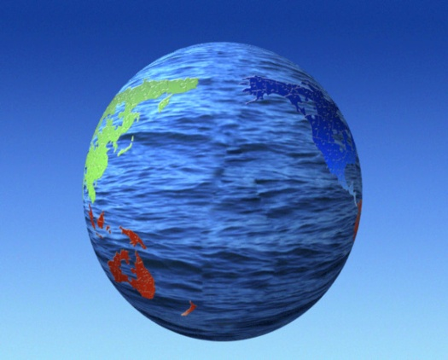
RUNNING & GROUNDWATERWATER 1- Running Water↓
General: Earth = The Blue Planet
Amount of water on Earth approx. 1.3 Billion Kilometer Cubic meters, spread as follows:
97.2% Oceans & Seas.
2.15% Ice Sheets & Glaciers.
0.65% Lakes, Rivers,
Atmosphere & Groundwater.

Slide 2
2) Hydrological Cycle:

Slide 3
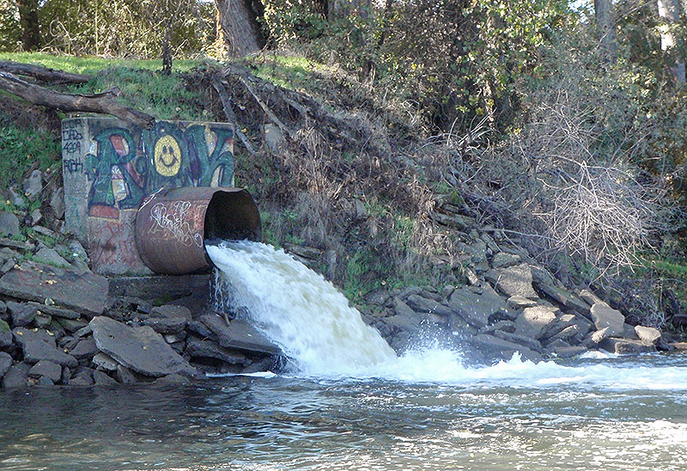
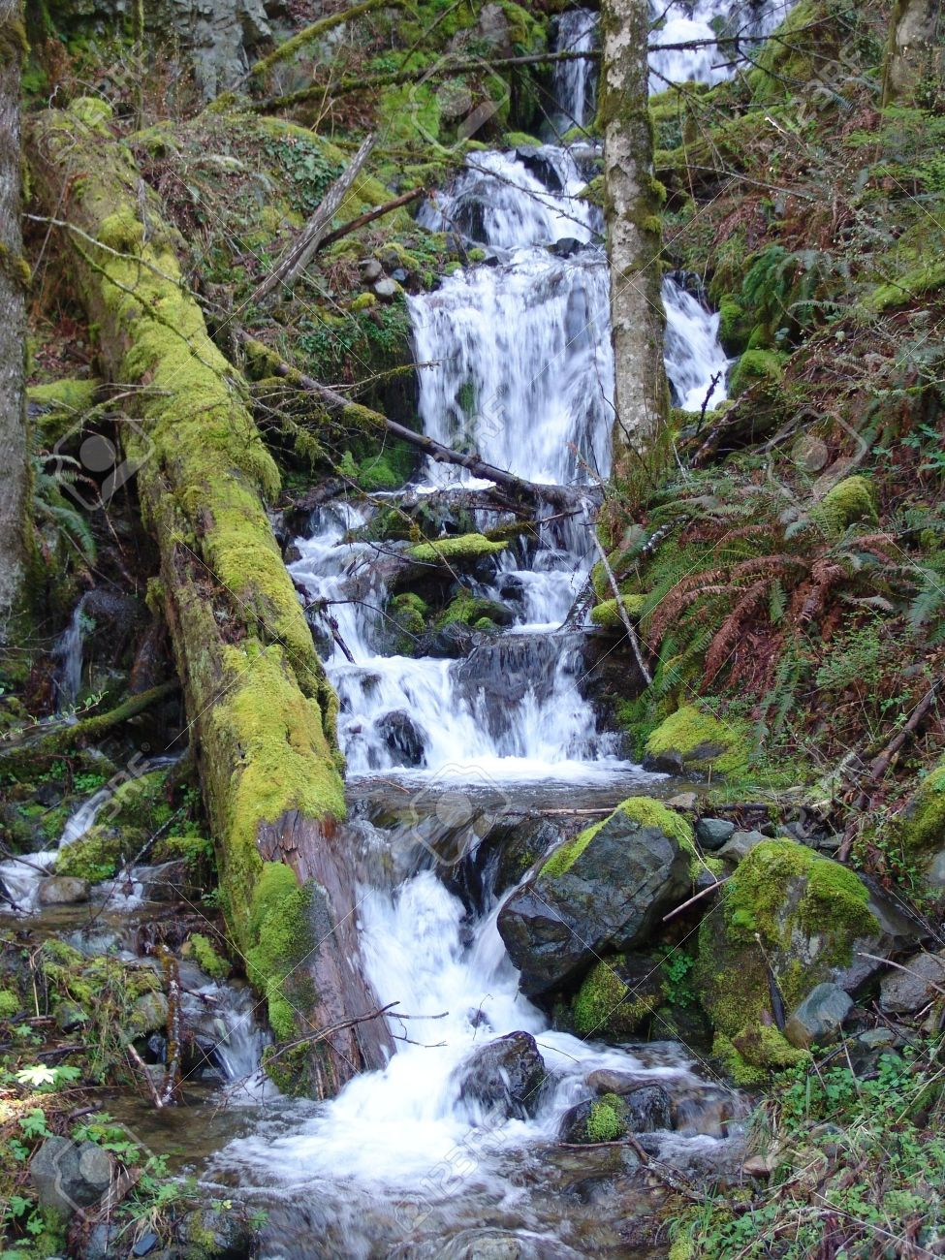
1:1) Runoff: Is that amount of water which exceeds the soaking (absorption) capacity of the land. It flows to the lower areas (Oceans, Lakes, Seas, Dams, …). It is the most important agent of Earths’ Wearing.

Slide 4
Importance to people:
1- Energy source. 2- Transportation. 3- Sport. 4- Tourism. 5- Fishing.
6- Irrigation. 7- Source of fertile soils.

Slide 5
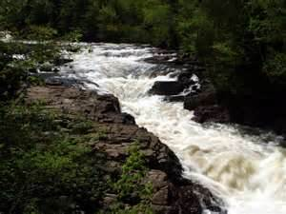
….Stream →
Channelized flow path of any size. Supplied by the runoff & underground water.
River is used to describe main stream into which all tributaries flow. Water flows under the influence of gravity.

Slide 6
…Velocity of water in a stream differs and so its erodability.
Velocity depends on:
1- Gradient (slope) of the stream channel.
> steep > velocity.
2- Shape, size and roughness of the channel. The channel cross-section determines the amount of water in contact with the channel and hence affects the frictional drag; the most efficient channel is the one with the least perimeter for its cross section.

Slide 7
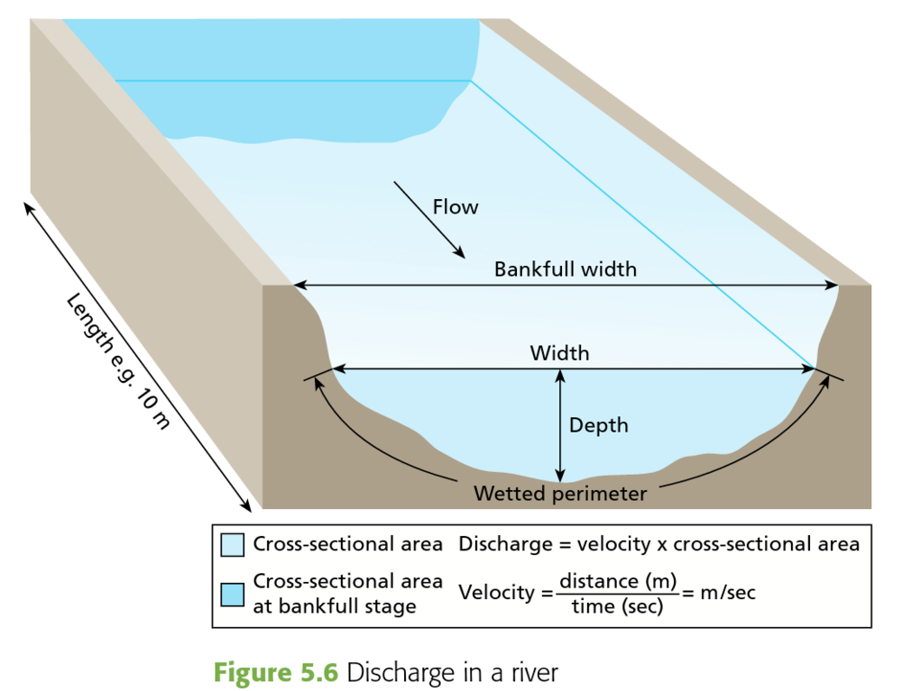
The wide shallow perimeter means decrease in current velocity and visa versa

Slide 8
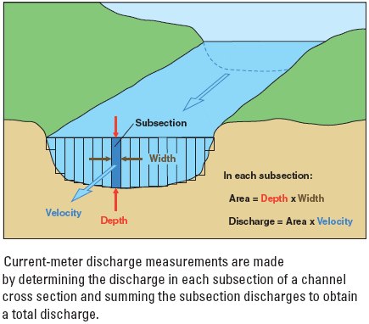
3- Discharge: Amount of water in M³ passing the wetted cross section in a given unit of time.
Example:
D= Cross Section(m2) X
Velocity (m/Sec)
=M³/Sec
e.g. - Amazon discharges 15% of world
Fresh water in the ocean.
- Missisippi 17300 M3/sec.

Slide 9
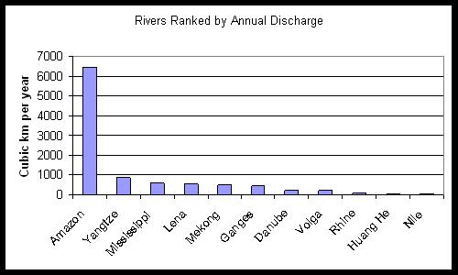

Slide 10
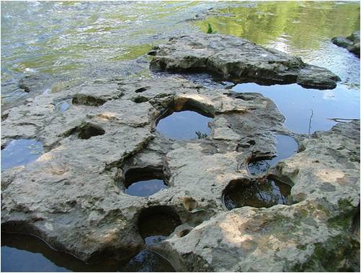
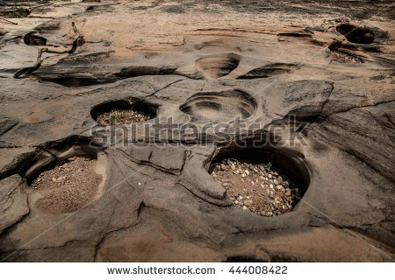
Work of Streams:
1) Erosion: Carrying sediments works as abrasive agent on the floor and sides of the river. Angular pebbles will get circular shape and Potholes↓ will form.

Slide 11
2) Transportation: Streams are the most important erosional agent because they carry large quantities of materials produced by weathering.

Slide 12
How material is transported by stream water? Answer: In 3 ways:
1- In solution (dissolved load): Brought to the stream by groundwater or the running water.
Solvents are measured in ppm (=parts per million). Type and quantity of solvents depends on the climatic conditions and the geological setting (mineralogical composition of the rocks, the geothermal gradient, the geo-structures, ….)

Slide 13
2- In suspension (=suspended load): As fine sands, clays, silts, even pebbles in floods’ time. Water with suspensions is denser than plain water and can carry heavier particles as suspended.

Slide 14
3- Along the bottom (bed load): Larger particles are transported along the river bottom leading to the grinding action. Particles move along the bottom by rolling, sliding, traction or saltation. Bed load counts approx. for 10% of total stream load; max. during flooding.

Slide 15
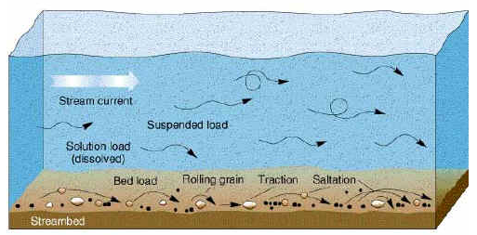

Slide 16
STREAM ABILITY TO CARRY LOADS IS MEASURED BY 2 CRITERIA:
1- Stream competence: Is a measure of the max. size the stream can carry; a function of velocity→ Q is proportional with V² this means if velocity doubles the force of water increases 4 times.
2- Stream capacity: The max. load (quantity) a stream can carry; it is a function of discharge and this means the more the water discharge the more the quantity a stream can carry.

Slide 17
3- Deposition:
* When stream velocity decreases its competence decreases. A particle starts to settle out from the water when the stream velocity drops below the critical settling velocity of that particle.
.The gradual drop in
the velocity leads to
what we say
“SORTING” of the
deposited sediments.

Slide 18
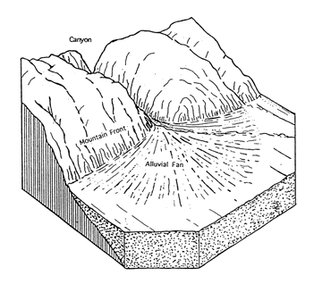
The well-sorted material deposited by a stream is called ALLUVIUM. Alluvial Fans form when stream leaves narrow area to open area so a sudden drop of sediments occur in open area due to reduce in gradient

Slide 19
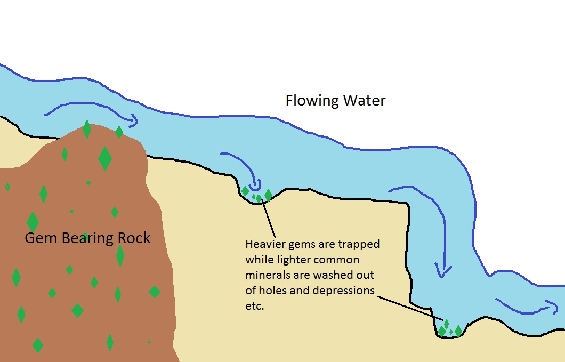
PLACER DEPOSITS: It is a way in which valuable minerals (Gold, Diamond, Platinum) are concentrated into economically significant accumulations. Placers are a sorting type according to specific gravity (heavy minerals settle quickly).

Slide 20
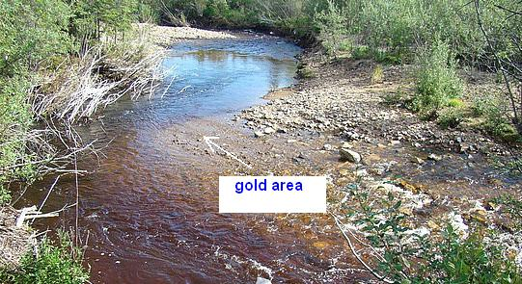
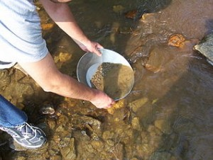
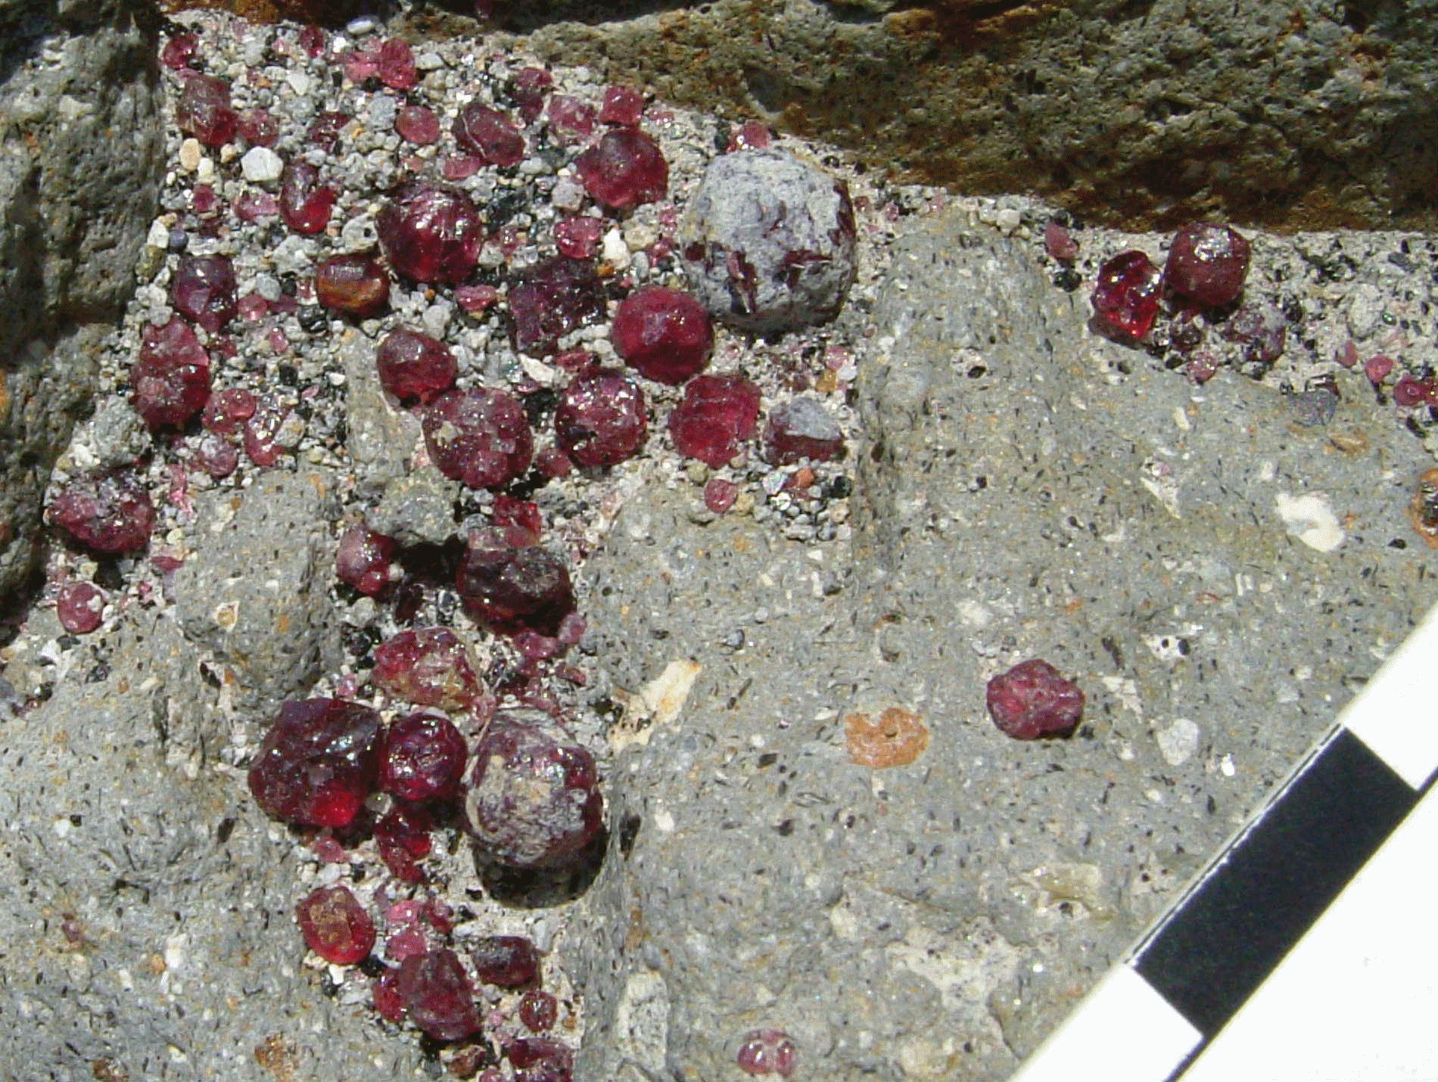

Slide 21
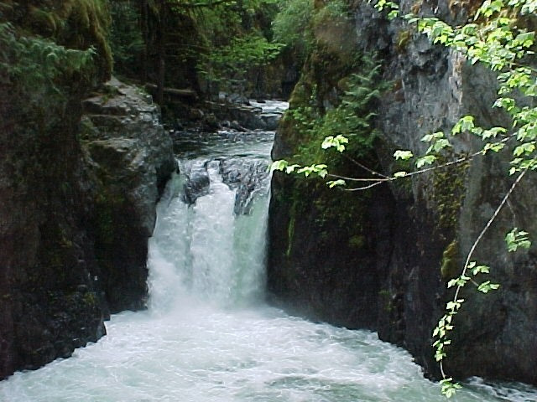
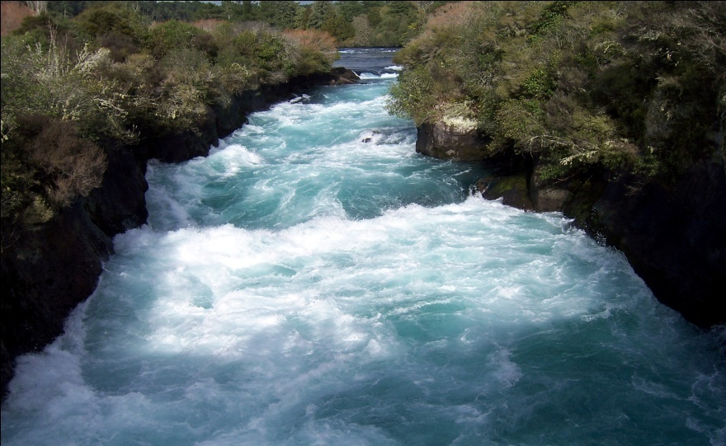
Stream Valleys:
Narrow V-shaped: Indicate immaturity of the river channel and that the primary work of the stream is down-cutting towards base level. Features of V-shaped valleys are the “Rapids” & “Falls”.

Slide 22
2- Wide valley with flat floor: Indicates maturity; sides of these valleys are shaped by a combination of weathering, sheet flow and mass wasting.

Slide 23
Stream Evolution with time

