Slide 1
ENCE 231: Engineering Geology Fall Semester 2018/2019 Department of Civil Engineering- Birzeit University, Palestine Chapter 10: Groundwater
Course Instructors: Saheem Murshid & Nidal Atallah
Information Source: Essentials of Geology (Lutgens et al., Eds. 9 & 11)

Slide 2
Groundwater المياه الجوفية
What is Groundwater?
Groundwater is the water from rainfall & surface water that infiltrates the ground and is stored inside the ground.
The study of groundwater is called “Hydrogeology”.
Many people think that groundwater occurs in the form of underground rivers. In reality, it is the water stored in the pore spaces of soil & rock and in joints & fractures in bedrock.

Slide 3
The Importance of Groundwater
Groundwater provides close to 50% of drinking water worldwide.
1) While it account for less than 1% of all water in the hydrosphere, it accounts for 14% of all freshwater (after glaciers) and if we exclude glaciers it accounts for 94% of freshwater (“the largest reservoir of fresh water readily available to humans”)

Slide 4
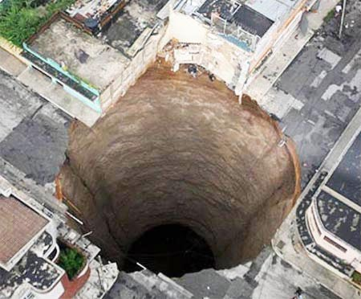
The Importance of Groundwater
2) Geologically groundwater is an important erosional agent.
Groundwater dissolves rock and creates caves & on the surface sinkholes.
3) It also provide streams with water.
Caverns or Caves
A sinkhole

Slide 5
Distribution of Water
As rain falls some of the water runs off, some evaporates, and the rest soaks into the ground (groundwater).
Each of these three paths depends on:
a) slope steepness, b) the nature of surface material, c) intensity of rainfall, and d) the type & amount of vegetation.
Example: Steep slope underlain by impermeable material vs. gentle slope with permeable material….

Slide 6
Distribution of Groundwater
As water percolates into the ground, some is held near the surface (between particles) in the zone of soil moisture and is used by plants.
The rest will continue to infiltrate/ percolate the ground under it reaches a zone where pores are completely filled with water, referred to as the Zone of Saturation. Water here is considered Groundwater. The upper limit of this zone is known as the Water Table.
The area above this zone that is not saturated is called the Zone of Aeration. Pores here are filled with air.

Slide 7
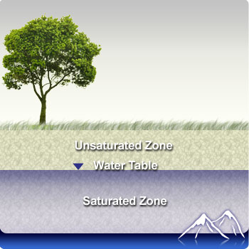

Slide 8
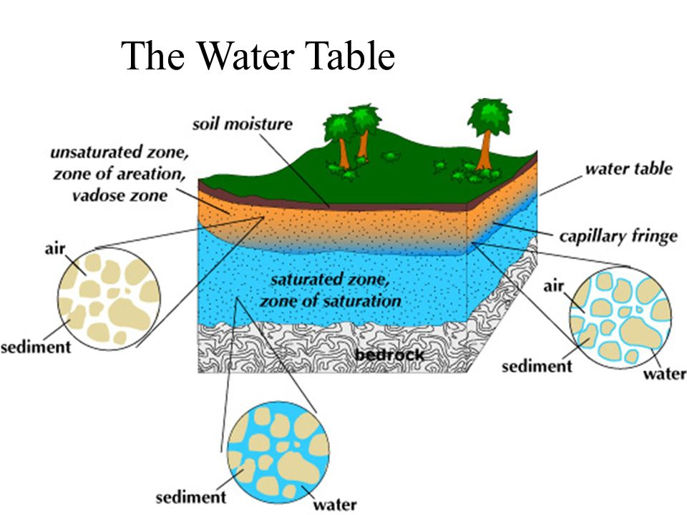

Slide 9
Groundwater Distribution

Slide 10
Water Table
The depth of the water table varies greatly; from zero (when at the surface) to hundreds of meters below the surface.
Seasonal variations occur depending on the amount of water added (related to quantity, distribution, & timing of rain).
The water table is typically a subdued replica (نسخة) of the surface topography (التضاريس).
The water table may drop dramatically if groundwater is overused (pumped) and in extended periods of drought (مواسم جفاف طويلة).

Slide 11
We can use maps to show the depth of the water table and the flow of groundwater.
These flow nets show us the direction of groundwater movement (from high elevation to lower elevation).
Gravity is the single most important force driving GW movement.

Slide 12
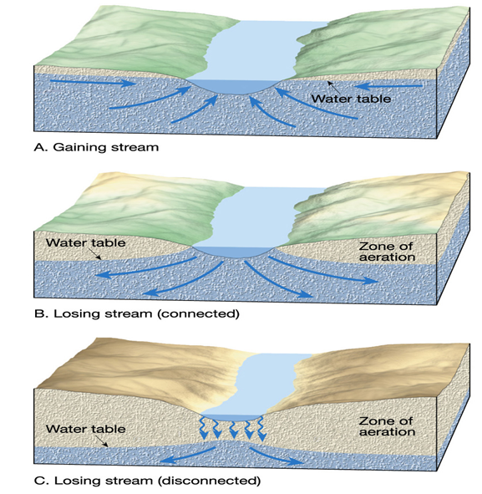
Interaction Between Groundwater & Streams
Gaining Stream:
Streams that gain water from the inflow of groundwater.
Occurs in humid areas.
Loosing Stream:
Streams that loose water to groundwater through outflow from streambed.
Types: connected & disconnected (arid region) from the WT.
* Note: in some cases a stream might be both gaining & loosing in different sections or depending on the supply of GW.

Slide 13
Storage & Movement of Groundwater
The rate of groundwater movement is strongly influenced by the subsurface material, especially Porosity (المسامية) & Permeability (النفاذية).
Porosity: (the voids or opennings)
It is the percentage of the total volume of rock or sediment that consists of pore space.
It amount of pore space depends on the size & shape of grains, how they are packed together, the degree of sorting, and (in some sed. rocks) the amount of cementing material.
Porosity influences the quantity of groundwater that can be stored and it can vary greatly from 10-50% of the total volume.

Slide 14
Storage & Movement of Groundwater
2) Permeability (k): (also referred to as Hydraulic Conductivity)
It the ease with which a fluid can pass through a certain material.
- Porosity is not a good indicator of how much fluid a material is able to transfer/move. The pores must be connected & large enough to allow flow.
Example: Clay has a high porosity (50%), so it’s able to store a lot of water, but the pores are too small to allow water to flow through it, so it has a low permeability. (Permeability= Gravel > Sand > Silt > Clay)
Permeability & groundwater flow are also influenced by joints, faults, & cavities (الفجوات والتشققات).

Slide 15
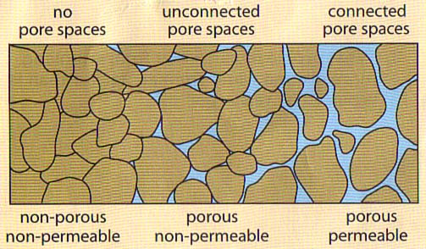
Porosity & Permeability

Slide 17
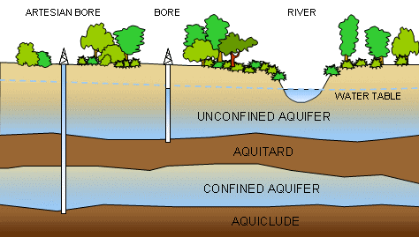
Storage & Movement of Groundwater
Aquifer:
Permeable rock strata or sedimens that transmit groundwater freely (ex: gravel & sand).
Aquiclude:
Impereable layers that hinder or prevent water movement. (ex: clay)

Slide 18
Storage & Movement of Groundwater
The movement of groundwater is exceedingly slow, from pore to pore. The rate of movement may vary from millimeters per year to a kilometer per year.
The energy that makes groundwater flow is provided by the force of gravity; in response to gravity GW moves from areas where the water table is high to areas where it is low.

Slide 19
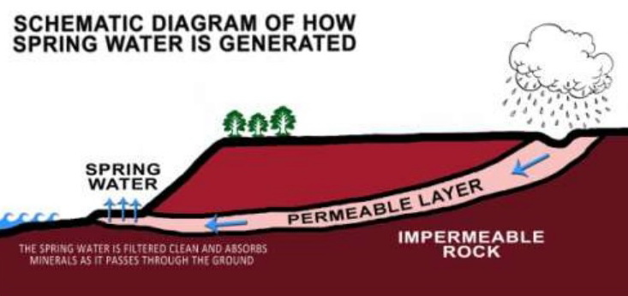
Springs
The source for springs is water from the zone of saturation and the ultimate from precipitation.
Whenever the water table intersects Earth’s surface, a natural outflow of water of groundwater occurs, resulting in a spring.
Formation of Springs:
Sratum Spring: When an aquitard blocks the downward movement of groundwater and forces it to move horizontally.

Slide 20
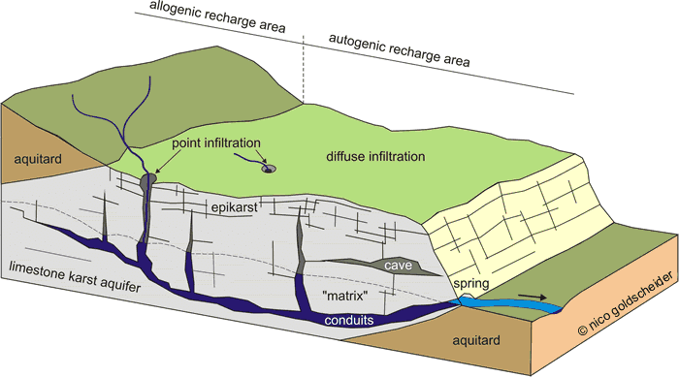
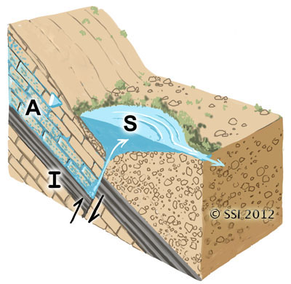
Formation of Springs:
2) When an aquitard is situated above the main water table, some of the water percolating downward is held by the quitard creating a “perched water table”.
3) Through fractures or solution channels (dissolved rock) in impermeable rock.
4) Fault Spring.

Slide 21
Wells (الآبار)
It is a hole bored into the ground to the zone of saturation, where groundwater can be pumped to the surface.
After pumping the water table is lowered near the well (“drawdown”) and with increased pumping create a “Cone of Depression”.
If overpumped, it may result in a large cone of depression and cause the Water Table to be lowered substantially affecting nearby wells.

Slide 22
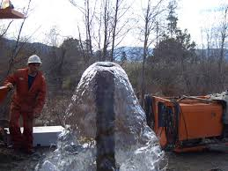
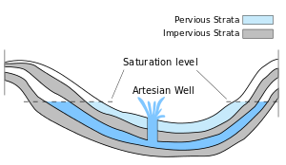
Artesian Wells
When groundwater is under pressure and rises well above the level of the aquifer or where the water was first encountered.
Conditions needed:
Water must be confined to an aquifer the is inclined so that one end is exposed at the surface, where it can receive water.
Impermeable layers (Aquitards), both above and below the aquifer, preventing it from escaping.

Slide 23
Flowing vs. Non-flowing Artesian Wells

Slide 24
Environmental & Eng. Problems Associated with Groundwater
Some of the main issues:
Overexploitation/ overuse
Groundwater withdrawal & sinking
Groundwater contamination.
All this has led some to consider groundwater as “a non-renewable resource”

Slide 25
1) Over-Use of Groundwater
Caused by over-pumping or over-use/ over-exploitation: The discharge exceeds the recharge in the groundwater budget (like a person in dept).
The GW can be described as being “mined”!
This cases the depletion (استنفاذ) of GW resources.
If the problem is prolonged, even if pumping were to stop, it could potentially take hundreds or even thousands of years for the groundwater resource to be replenished (إعادة تعبئتها) or recovered (تعافيها).

Slide 26
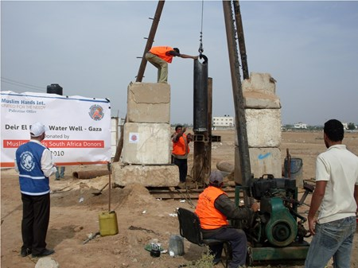
1) Over-Use of Groundwater: Gaza Strip & the Coastal Aquifer
In Gaza, over 4,000 private agricultural and domestic wells.
The aquifer is replenished with an annual 85 Mcm while abstracted with over 165 Mcm/Year. (95% over-abstraction).
This is causing a drop in the water table of about 1.6 Meters per year. It is damaging the already depleted coastal aquifer and posing a the threat of irreversible environmental damage.
Salt-water Intrusion.

Slide 27
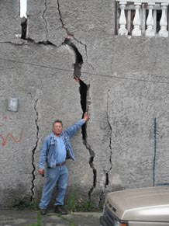
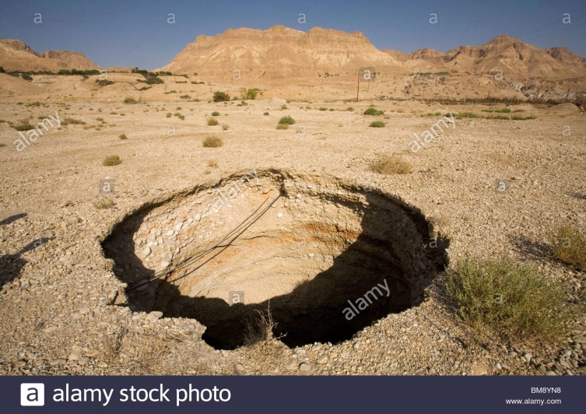
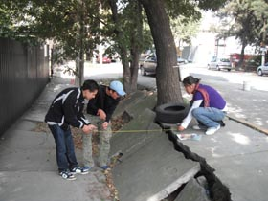
2) Land Subsidence
Over-pumping of a GW resources→ a drop in the water table →may cause land subsidence.
Especially in areas underlain by thick layer of loose soil, which is compacted by overburden, causing the land to subside.
Example: Mexico City; 7 Meter drop.

Slide 28
Groundwater Pollution/ Contamination
A serious issues especially in areas that depend on GW as the main source of water.
Contamination from Sewage:
From a septic tank, or leakage from sewage pipeline, or farm wastes (fertilizers), or chemical contaminants.
If sewage water contaminated with bacteria enters the ground, it may be purified through natural processes ( the bacteria mechanically filtered by sediment on its way down or destroyed through oxidation or/and consumed by other organisms).
However, for this to occur, the aquifer must be the correct composition. For example: if aquifer extremely permeable (coarse gravel, or fractured rock, or cavernous limestone)→ water travels quickly→ not enough contact with surrounding material to be cleansed/ purified.

Slide 30
Groundwater Pollution/ Contamination
Some Solutions…
Its not an easy process but remediation (المعالجة) must be done.
Stopping the source of pollution.
Pumping the polluted water, treating it, and re-ejecting it into the ground.
Injection of cleansing chemicals.
Leaving a resource without usage for a long time.

Slide 31
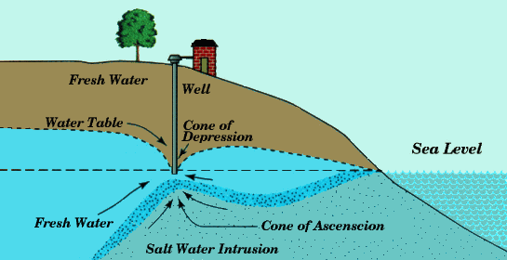
Groundwater Contamination: Salt Water Intrusion/ Contamination
Salt Water Intrusion is a phenomenon that occurs in over-used coastal aquifers, when sea water intrudes or enters the fresh water aquifer.
Fresh water is less dense & will float on top of salty water forming a lense-shaped body.

Slide 32
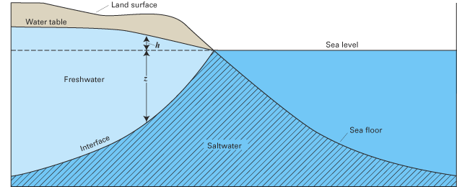
Groundwater Contamination
the Ghyben–Herzberg ratio: h=40 z
For every foot drop in the water table above sea level (h), there will be 40 feet of freshwater below sea level (z). This means that saltwater will intrude to compensate the rise of the freshwater boundary (z).
Note: Today this ratio is considered outdated because it makes many theoretical assumptions & we have better computational techniques to account for variables.

Slide 33
Groundwater Contamination
Some General Solutions….
Management of Abstraction.
Recharge Wells.
Building a large basin to collect surface drainage and allow it to seep in the ground.

Slide 34
The Geologic Work of Groundwater
The primary erosion is carried out by groundwater that is dissolving rock (mainly limestone).
Water+ carbonic acid→ reaction with limestone→ calcium by carbonate
Creation of limestone caverns just below the water table in the saturated zone as GW follows lines of weakness and joints in rock, with time dissolving rock & creating caves.

Slide 35
Hot Springs & Geysers
Hot Springs have water 6-9 degrees warmer than mean air temp. Water is heated at depth & if it rises, it emerges as a hot spring.
Geysers are intermittent hot springs or fountains where water & steam are ejected with great force into the air (30-60 meters).
0

Slide 36
The Geologic Work of Groundwater
Formation of drip stone (or Travertine):
After caves are formed/ carved & become in the aeration zone, dripping of water containing calcium bicarbonate for extended periods will form leave calcite behind it to produce limestone (travertine).
The following feastures are referred to as “Speleothems”:
Stalactites هوابط
Stalagmites صواعد
Columns عواميد (when a stalactite & stalagmite meet).

Slide 37
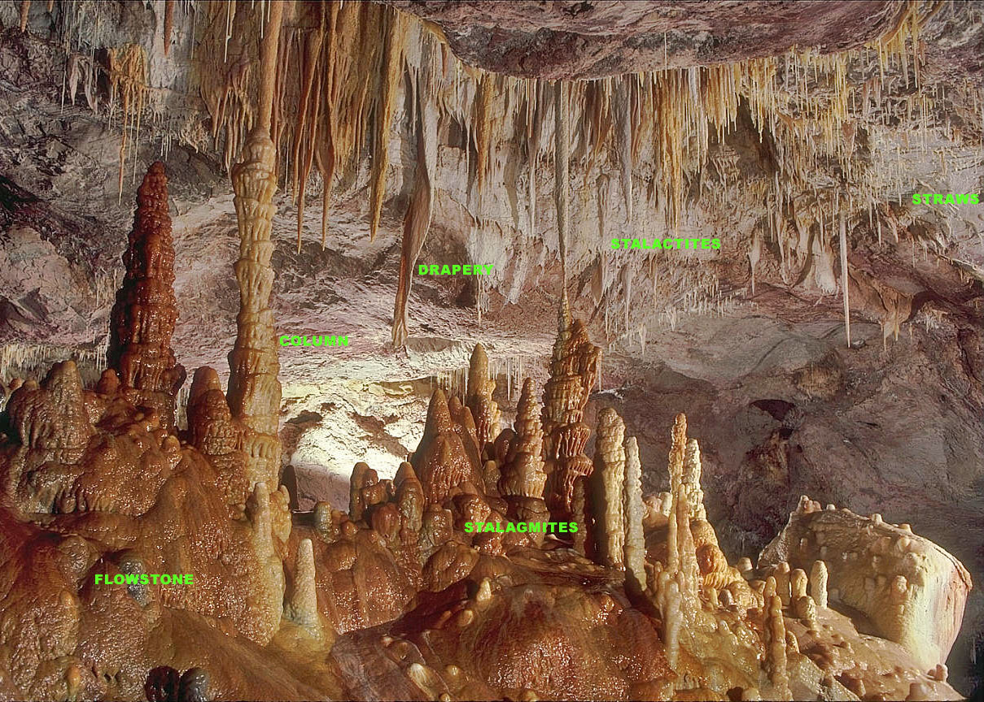
Stalactites & Stalagmites

Slide 38
The Geologic Work of Groundwater
Karst Topography:
When the landscape reflects the erosional work of groundwater; exhibiting irregular terrain punctuates with many depressions called sinkholes (1-50 meters) and lack of surface drainage.
2 Types of Sinkhole Formation:
1) gradual dissolution of limestone beneath the soil (as water picks up carbon dioxide forming carbonic acid). It is gradual & Produces gentle slopes.
2) Sudden formation due to the collapse of cavern roof under weight. Produces steep slopes.

