Slide 1
Subdivision project
Introduction :
What is the project ?
the objective of the project
What we do in the project ?

Slide 2
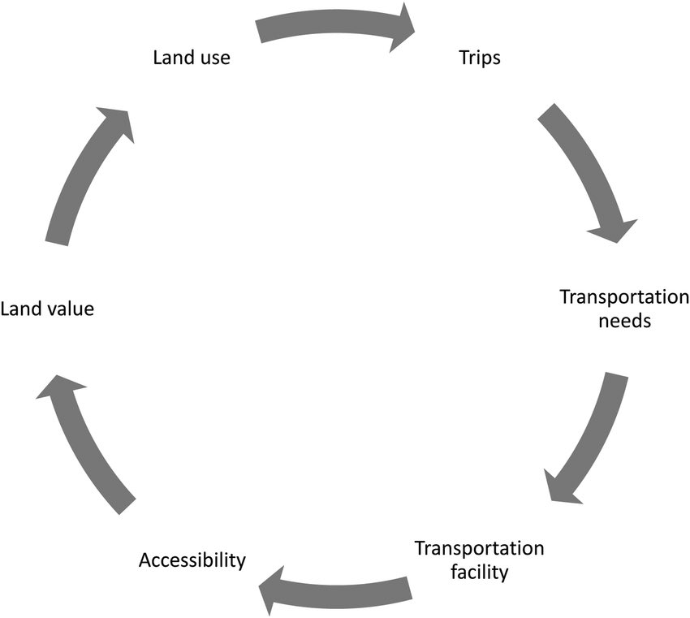

Slide 3
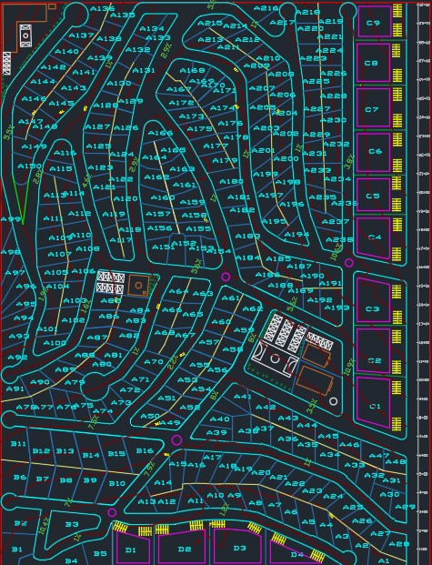
Roads
Main road 25 m
Road 12 m
Road 14 m

Slide 4
Slope for Roads
Slopes 6% or less are recommended on most roads but exceptions of up to 12%
Maximum slope 10.6%

Slide 5
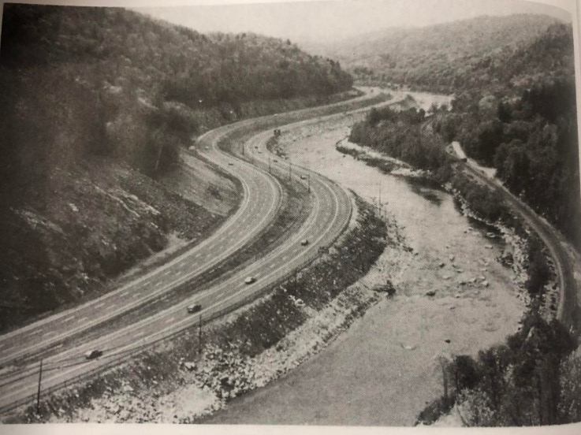

Slide 6
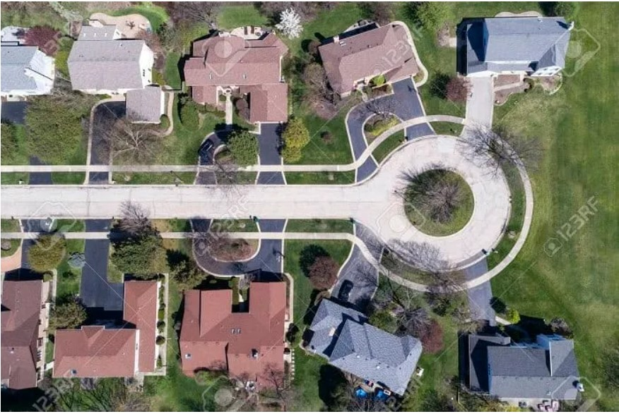
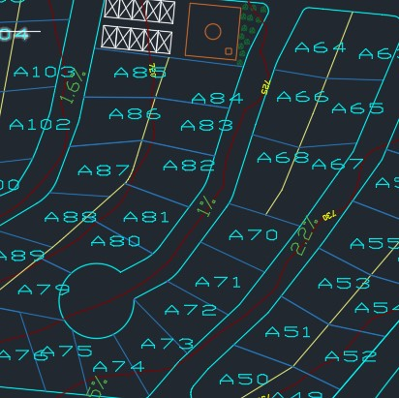
Cul-de-sac

Slide 7
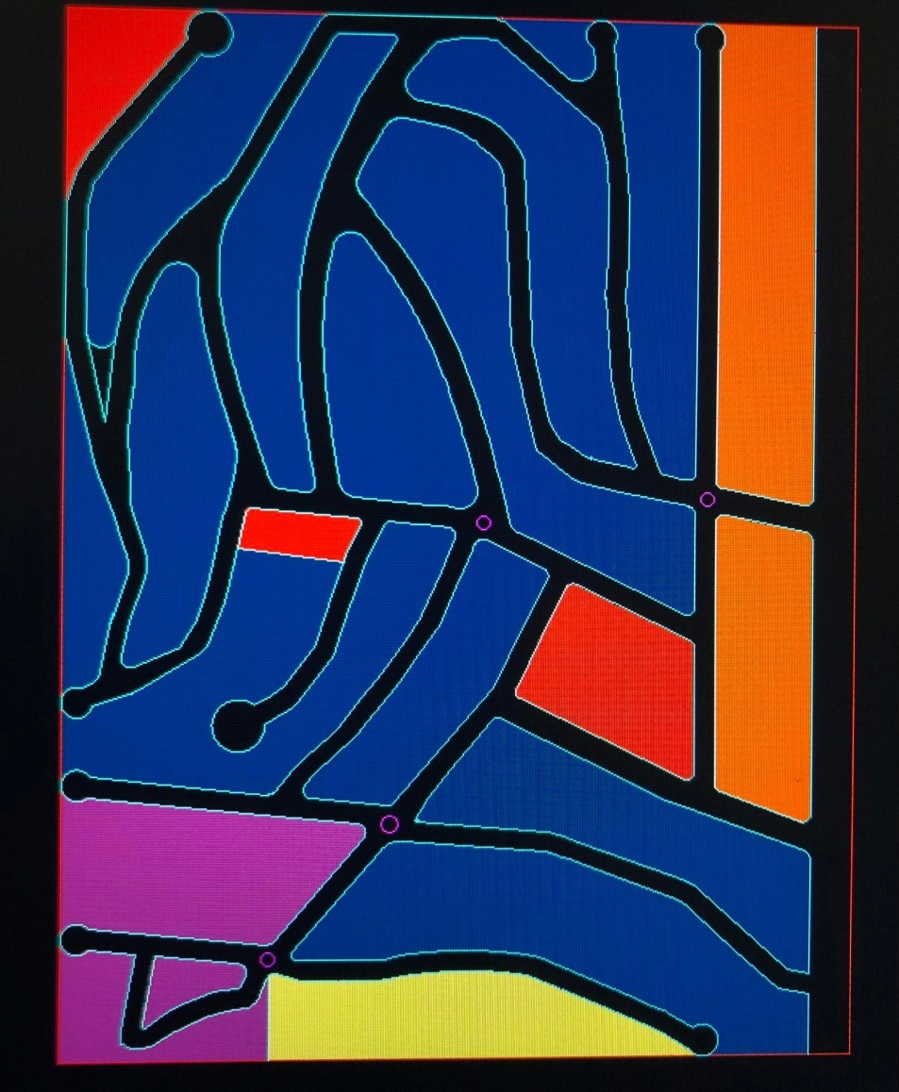
Zoning :

Slide 8
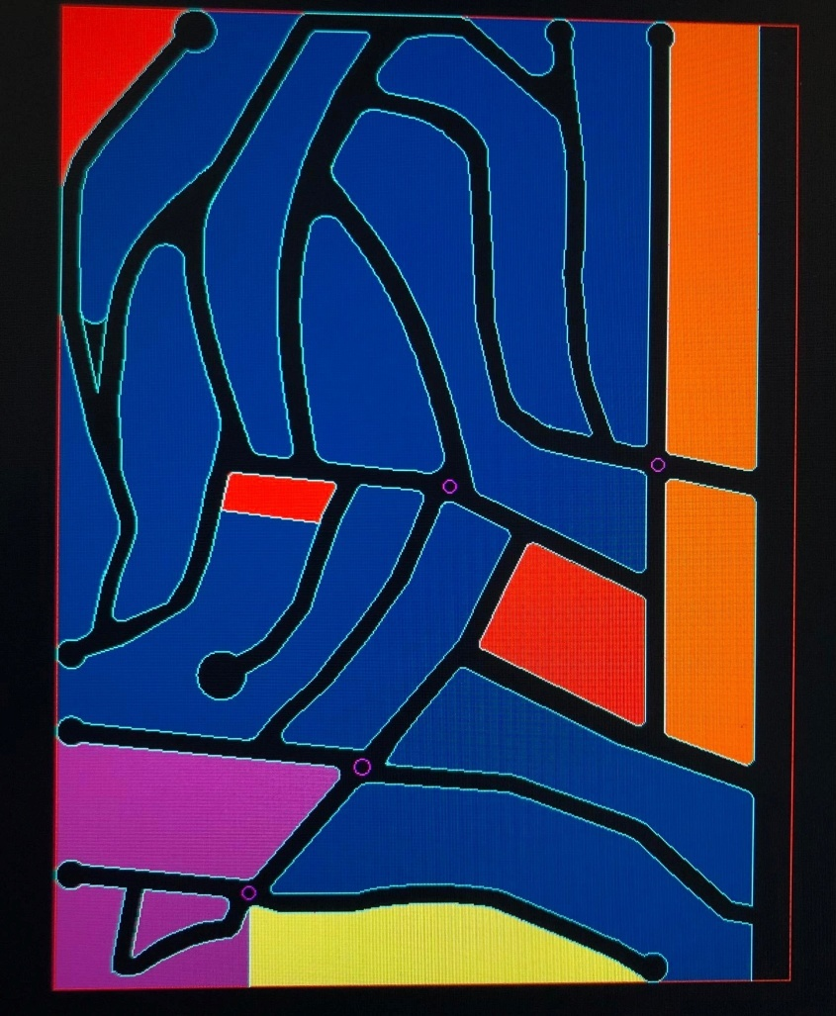
Zones :
We have many zones:
Zone A
Zone B
Zone C
Zone D
Public zones

Slide 9
Parcels:
We have 4 types of parcels:
Parcel A
Parcel B
Parcel C
Parcel D

Slide 10
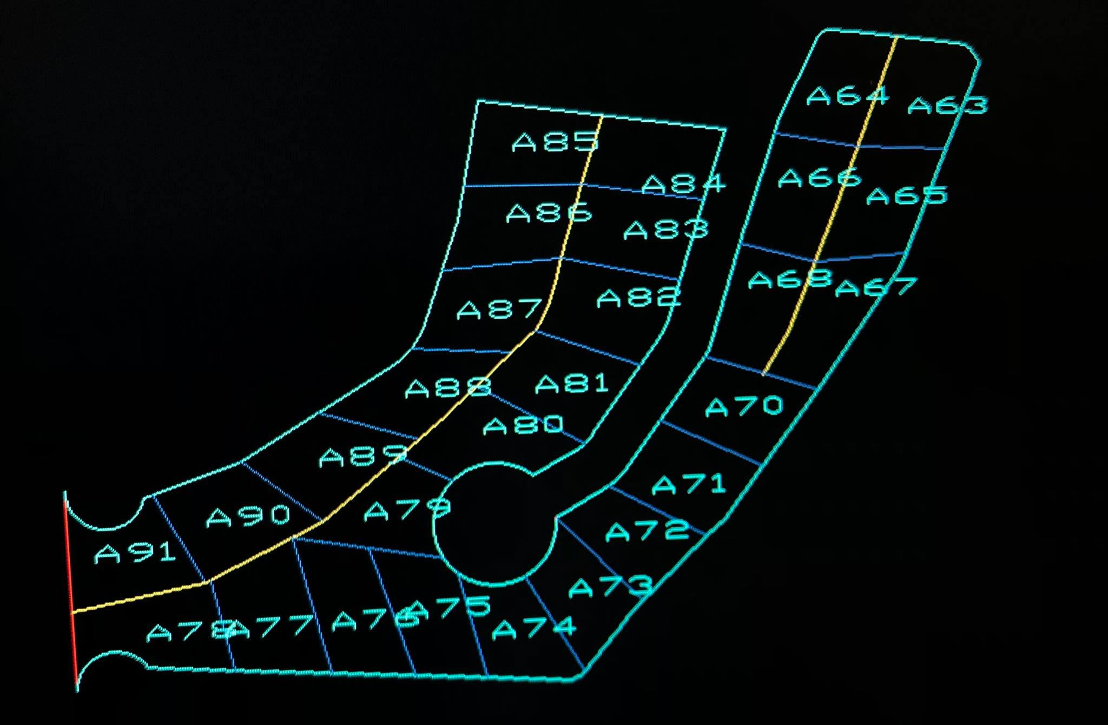
Parcels A :
500 – 600 sq. meters .
Minimum frontage distance 20m.
no limitations on number of parcels. (238)

Slide 11
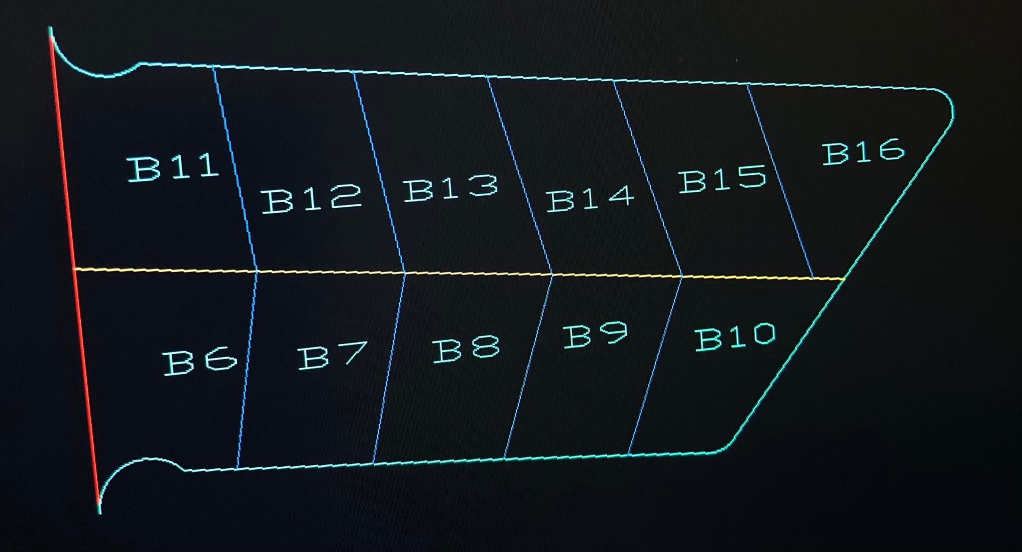
Parcels B (villas) :
900 – 1100 sq. meters residential.
Minimum frottage distance 25 m.
the number of parcels should be (10% - 20%) of the number of parcels A area . (12.5)

Slide 12
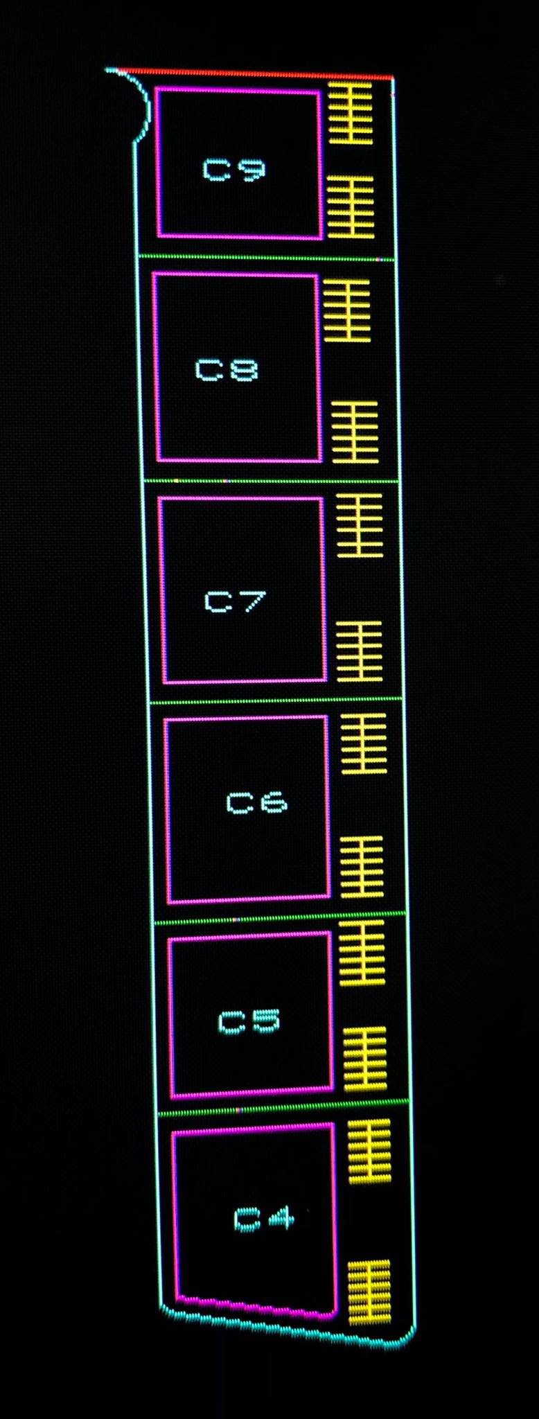
Parcels C (commercial) :
2000 – 3000 sq. meters.
Minimum frontage distance 25 meters.
Number of parcels must be in the range of 3-10. (9) .
Minimum setbacks are front: 18 meters, back and sides 4 meters.
Parking (20).

Slide 13
Parcels D :
1500-3000 sq. meters.
Number of parcels must be in the range of 2-4.
Minimum frontage distance 15 meters.
minimum setbacks: front 10 meters, sides and back 5 meters.
apartments with 6-8 floors .

Slide 14
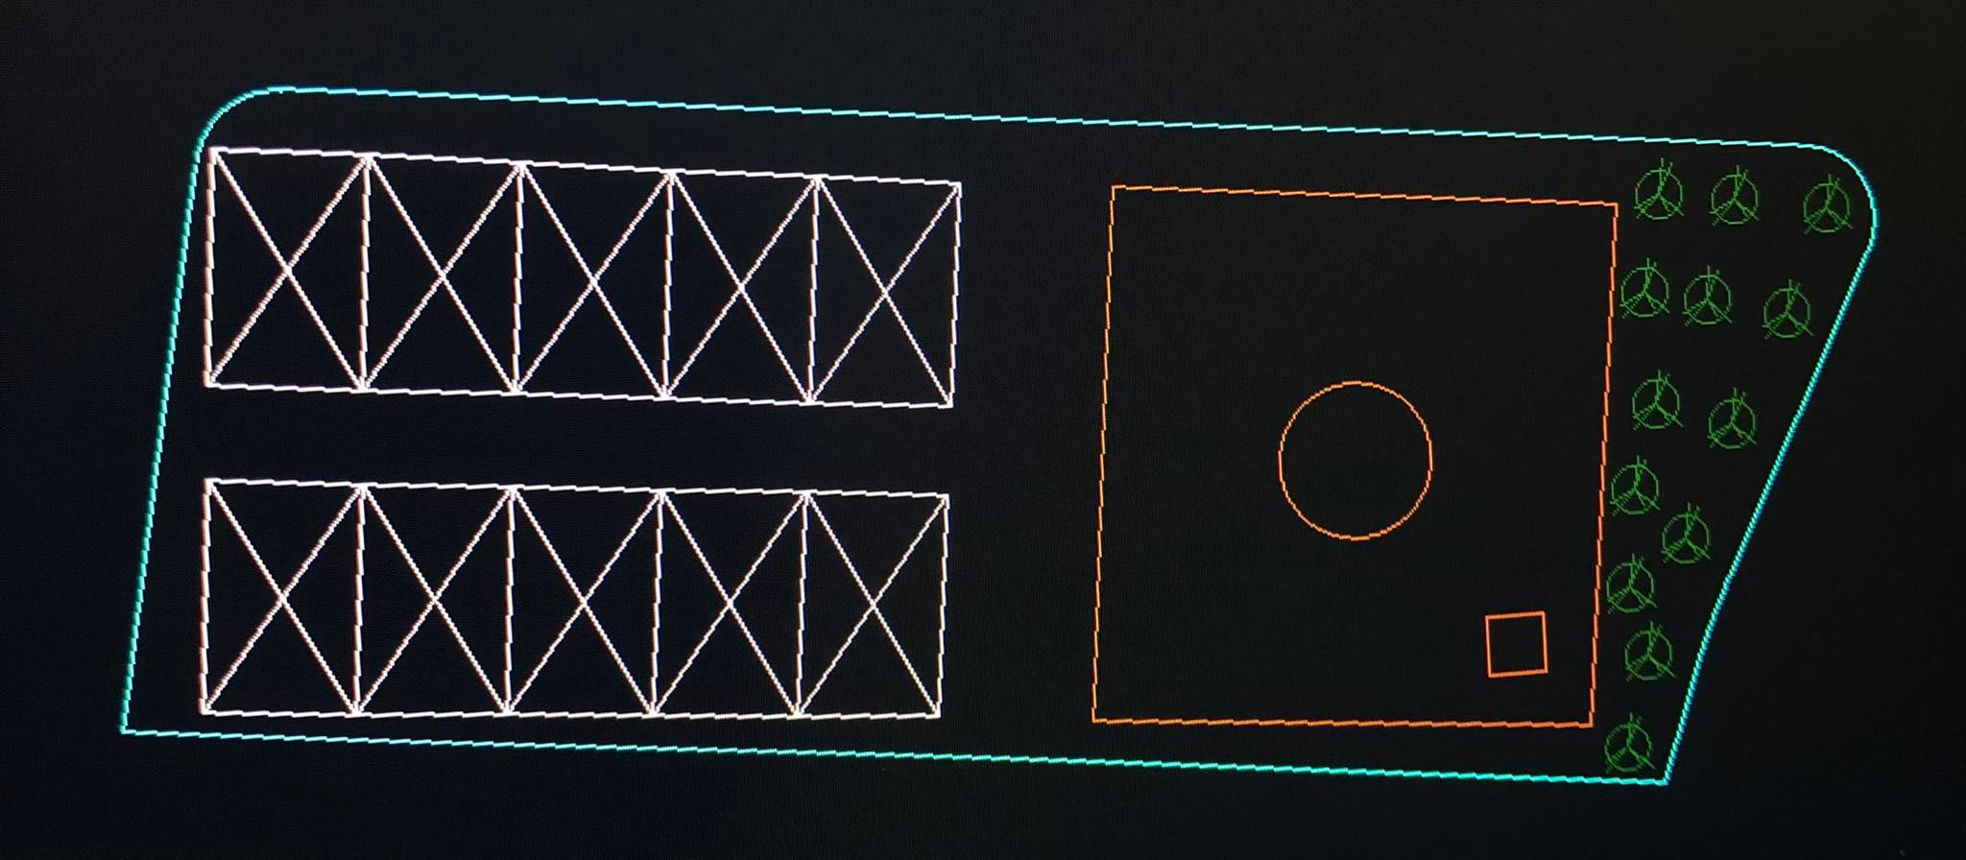
Public zones :
We have 5 public area:
Playground and garden
clinic
mosque
school

Slide 15
Cross sections

Slide 16
Road cross section elements
Road width
Roadway width
Median
Shoulder
Parking lanes
sidewalks

Slide 17
Main Road
Two way, two lanes in each direction Roadway width: 3.7m
Parking: 2m
Shoulder:1.6m
Median: 3m (U-turn, Left turn, safety)

Slide 18
Other roads: (12m, 14m)
Two way, one lane in each direction
Roadway width ( 2.75-3 m)
2m lane in each direction ( parking)
1.25m lane in each direction (sidewalk)
2m median

Slide 19
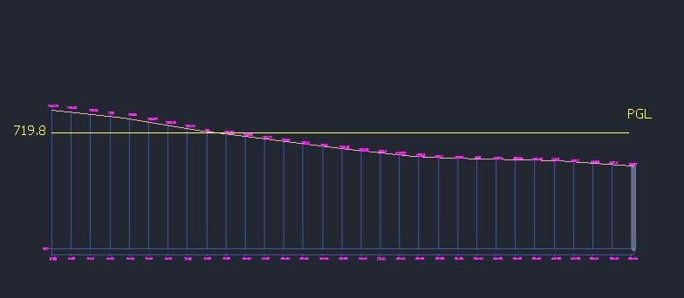
Vertical Alignment for main road 20m stations
Total cut volume | Total fill volume
102.16 m^3 | 468.01 m^3

Slide 20
Re parceling of area

Slide 21
parcels before planning

Slide 23
Agriculture road

Slide 24
After planning

Slide 25
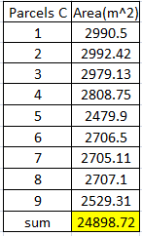

Slide 29
Parcels before planning parcels after planning

