Slide 1
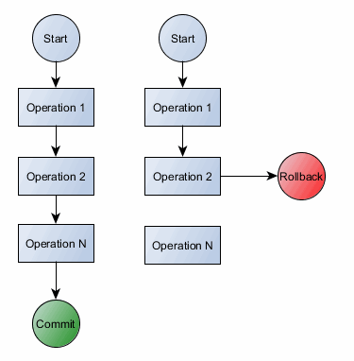
Chapter 16: Transaction Management
Looking at the execution of user programs on the database
Interleaving transactions are the foundation
Concurrent execution
Interleaving must be done with care
Should be equivalent to some serial
order of transaction execution
(Concurrency control)

Slide 2
Transactions
A single execution of a user program on the database.
A single transaction might require many queries, each reading and/or writing information to the database.
A transaction is an isolated sequence of operations that can either all be saved to the database or all cancelled and ignored .

Slide 3
Main Properties of Transactions
To resolve issues relating to concurrency, crash recovery, reliability, and consistency,
A transaction in a database management system must maintain 4 properties:

Slide 4
[1] Atomic
A transaction is an atomic unit of processing
Either all operations of a transaction are executed or none of them are. (All or nothing)
Either all actions are carried out or none.
Incomplete transactions are aborted (rolled back)
The user should not worry about the effect of incomplete transactions.
[1] DBMS abort the transaction
[2] System may crash
[3] Transaction may encounter
a problem by itself
Example ATM Machine:

Slide 5
[2] Consistency
Every transaction running by itself must preserve the consistency of the database.
A requested action must be reflected correctly and accurately on the database.
In other words, a transaction must leave the database in consistent state.
This is the responsibility of database developers.

Slide 6
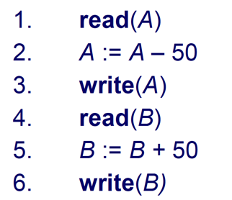
Example (Consistency)
Transaction to transfer $50 from account A to account B
Consistency requirement:
The sum of A and B is unchanged by the execution of the transaction

Slide 7
[3] Isolation
Even though transactions maybe interleaved, the net effect is identical to executing all transactions one after another in some serial order
Transactions are isolated or protected from the effects of concurrently scheduling other transactions.
Every transaction is an independent entity.
One transaction should not affect any other transaction running at the same time.
Example: T1 and T2 may be interleaved, but the net effect should be same as running T1 and then running T2.

Slide 8
[4] Durability
Once the DBMS informs the user that the transaction has been successfully completed:
Its effects should persist.
Even if the system crashes before changes are reflected to disk
How?!
A separate log is maintained for every action in the database.
The log entry is written to stable storage before any action is taken.
This is the work of the Recovery Manager module.

Slide 9
Transactions and Schedules
A transaction is seen by DBMS as a series of actions…..read and write
RT(O) : transaction reading an object from DB
WT(O) : transaction writing an object to DB
Abort T : action of a transaction aborting
CommitT : action of transaction committing

Slide 10
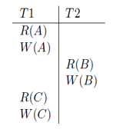
Transactions and Schedules (2)
A schedule: is a chronological ordering of actions (read/write/abort/commit) from a set of transactions.
The order in which two actions of a transaction T appears in a schedule must be the same as the order as they would appear in T.
Realistically: A schedule is an actual execution sequence!
A complete schedule must include all actions of all transactions appearing in it
Serial schedule is the one that transactions in it are not interleaved

Slide 11
Concurrent Execution Of Transactions
The DBMS interleaves the actions of different transactions to improve performance
Must ensure Transaction Isolation
not all interleaves should be allowed
Concurrency necessary for:
Overlapping I/O and CPU operations reduces amount of time disks and processors are idle. This increases system throughput
Throughput: Average number of transactions completed in a unit time.
Interleaved execution of a short transaction with a long transaction allows the short transaction to complete quickly.
In serial execution of transactions, a short transaction might get stuck behind a long transaction leading to unacceptable delays in response time.
Response time: Average time take to complete a transaction.

Slide 12
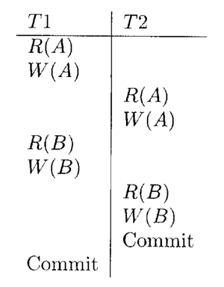
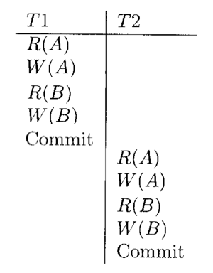
Serializability
A serializable schedule: over a set of a committed transactions is a schedule that is guaranteed to be identical to that of some complete serial schedule.

Slide 13
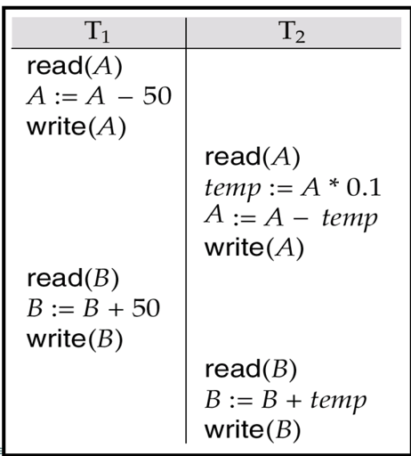
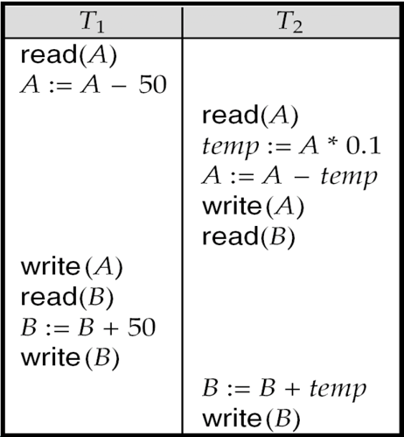
Serializability (2)

Slide 14
Serializability (3)
DBMS might sometimes execute transactions in a way that is not equivalent to any serial execution;
i.e., using a schedule that is not serializable.
How could this happen?!
First, the DBMS might use a concurrency control method that ensures the executed schedule, though not itself serializable, is equivalent to some serializable schedule.
Second, SQL gives application programmers the ability to instruct the DBMS to choose non-serializable schedulers.

Slide 15
The root of all problems
Writing is the main problem
A conflict occurs
Two actions
On the same data object
At least one of them is a write
WR
RW
WW

Slide 16
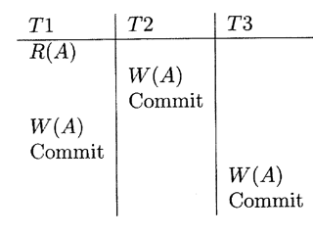
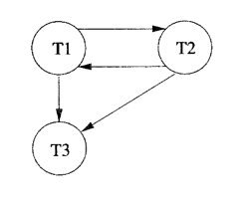
Serializability Graph
A node is drawn for each Transaction
An arc from Ti to Tj if an action of Ti precedes and CONFLICTS with one of Tj’s actions

Slide 17
Concurrent Execution Of Transactions
The DBMS interleaves the actions of different transactions to improve performance
Must ensure Transaction Isolation
not all interleaves should be allowed
Must ensure schedule remains serializable
Or the serializability graph contains no cycles!

Slide 18
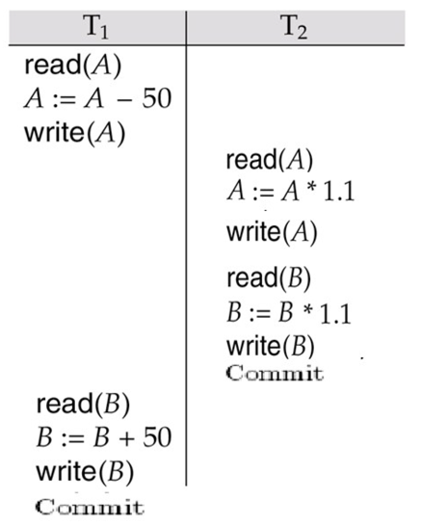
Reading Uncommitted Data (WR)

Slide 19
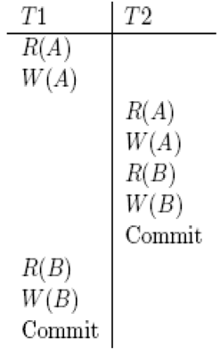
Reading Uncommitted Data (2)
The result of this schedule is different from any result that we would get by running one of the two transactions first and then the other.
The problem can be traced to the fact that the value of A written by T1 is read by T2 before T1 has completed all its changes.
T1
T2

Slide 20
Unrepeatable Reads (RW)
where a transaction T reads the same item twice and the item is changed by another transaction T′ between the two reads.
A transaction T2 could change the value of an object A that has been read by a transaction T1, while T1 is still in progress.
If T1 tries to read the value of A again, it will get a different result, even though it has not modified A in the meantime.

Slide 21
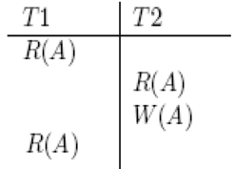
Unrepeatable Reads (RW) (2)
Suppose A is available number of copies of a book in a library.
A transaction that places an order first reads the A, checks that it is greater than 0 and decrements it.
Transaction T1 reads A and finds 1,
Transaction T2 also reads A, finds 1 and decrements A to 0
Transaction T1 reads A and gets a different value!
T1
T2

Slide 22
Overwriting Uncommitted Data
A transaction T2 could overwrite the value of an object A, which has already been modified by a transaction T1, while T1 is still in progress.
This is also known as Lost Update Problem
Reception 1
Reception 2
R(A)
Flight example
Two users
One Ticket left!
R(A)
W(A)
W(A)
T1
T2

Slide 23
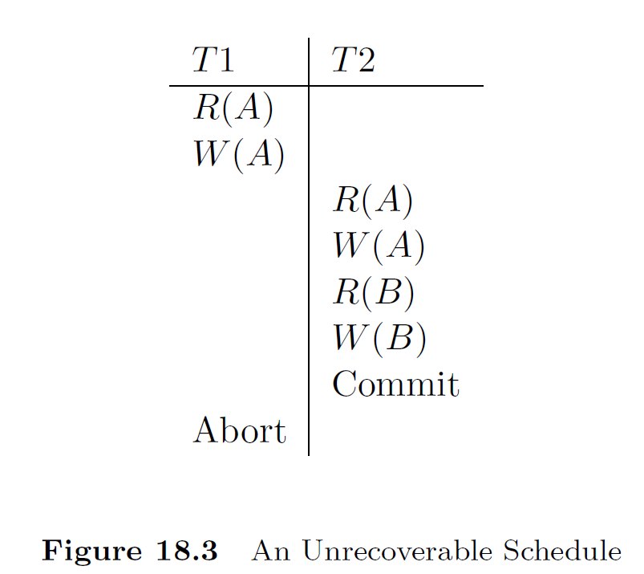
Unrecoverable schedule
Committing uncommitted data
How to make it recoverable?
Can we avoid cascading aborts?

Slide 24
Lock-Based Concurrency Control
A DBMS must be able to ensure that:
only serializable, recoverable schedules are allowed,
and that no actions of committed transactions are lost while undoing aborted transactions.
A DBMS typically uses a locking protocol to achieve this.
A locking protocol is a set of rules to be followed by each transaction in order to ensure that even though actions of several transactions might be interleaved, the net efect is identical to executing all transactions in some serial order

Slide 25
Strict Two Phase Locking (S2PL)
It is the most widely used locking protocol.
It has two rules:
A) If a transaction T wants to read (respectively, modify) an object, it first requests a shared (respectively, exclusive) lock on the object
B) All locks held by a transaction are released when the transaction is completed.

Slide 26
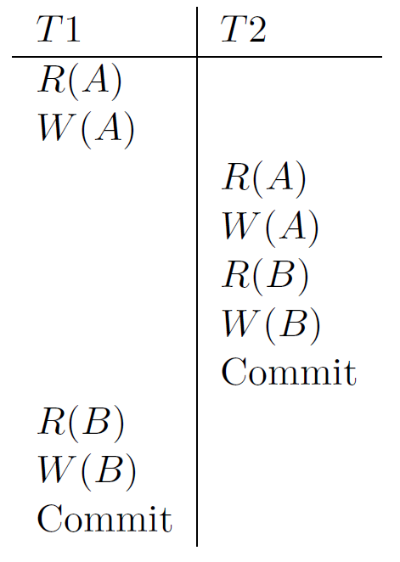
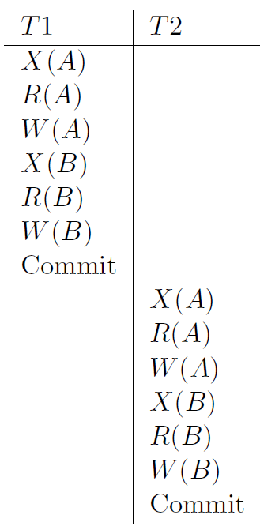
Example S2PL:

Slide 27
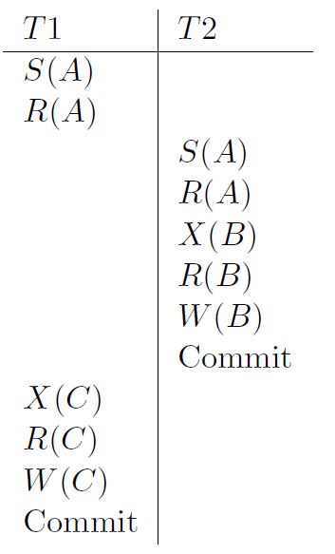
Example S2PL (2):

Slide 28
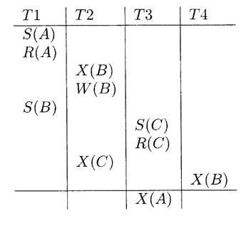
Deadlocks, Thrashing
What is a deadlock?
How do we detect a deadlock?
Construct a wait-for graph
For each Transaction a node is drawn
An arch from Ti to Tj is drawn if and only if Ti is waiting for a lock to be released by Tj

Slide 29
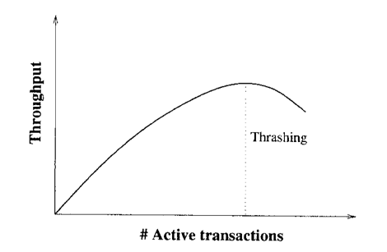
Thrashing
Seen when around 30% of active transactions are blocked
At this point adding any new transaction actually reduces throughput.

