Slide 2
Welcome Note
COMP333: Database Management Systems
Instructor: Bassem Sayrafi
Office: Masri 316
Communication
Email: bsayrafi@Birzeit.edu
Facebook Group: https://www.facebook.com/groups/BZUCOMP333/
Office
One of the most important courses of your careers.
Most students can work after this course.

Slide 3
What is Data
Attributes
Collection of data objects and their attributes
An attribute is a property or characteristic of an object
Examples: eye color of a person, temperature, etc.
Attribute is also known as variable, field, characteristic, or feature
A collection of attributes describe a tuple
tuple is also known as record, row,entity, or an object
Tuples

Slide 4
Where do we find Data?!
Lots of data is being collected and warehoused
Web data, e-commerce
Financial transactions, bank/credit transactions
Online trading and purchasing
Social Network
Government
Scientific data
Historical
Measurements

Slide 5
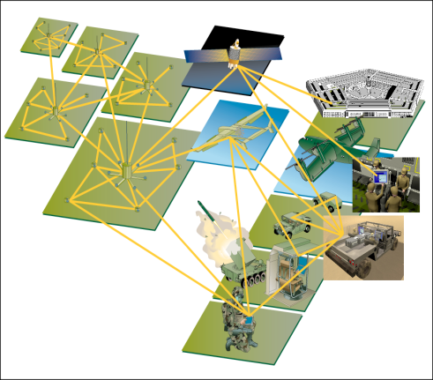
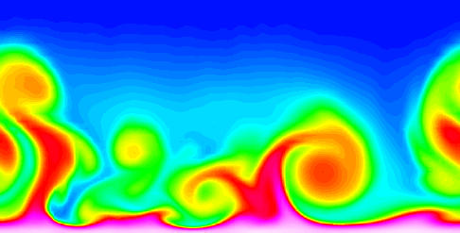
How much Data?
Data collected and stored at enormous speeds (GB/hour)
remote sensors on a satellite
telescopes scanning the skies
microarrays generating gene expression data
scientific simulations generating terabytes of data
Traditional techniques infeasible for raw data

Slide 6
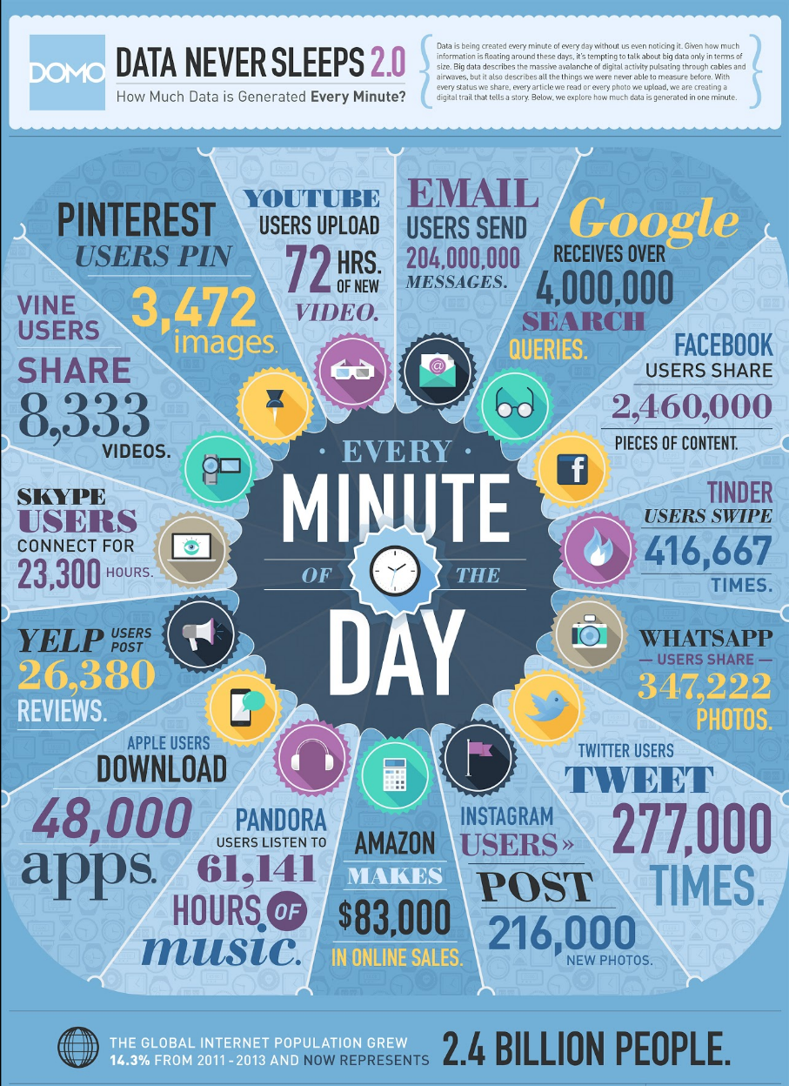

Slide 7
How Much Social Data?
People send more than 144.8 billion Email messages sent a day.
People and brands on Twitter send more than 340 million tweets a day (revised to 500m).
2.7 Billion likes a day on FB.
300 Million photos daily on FB.
70,000 queries daily on FB alone.
950 Million FB user with average 6 hours per day.
People upload 100 hours of new video to YouTube a minute.

Slide 8
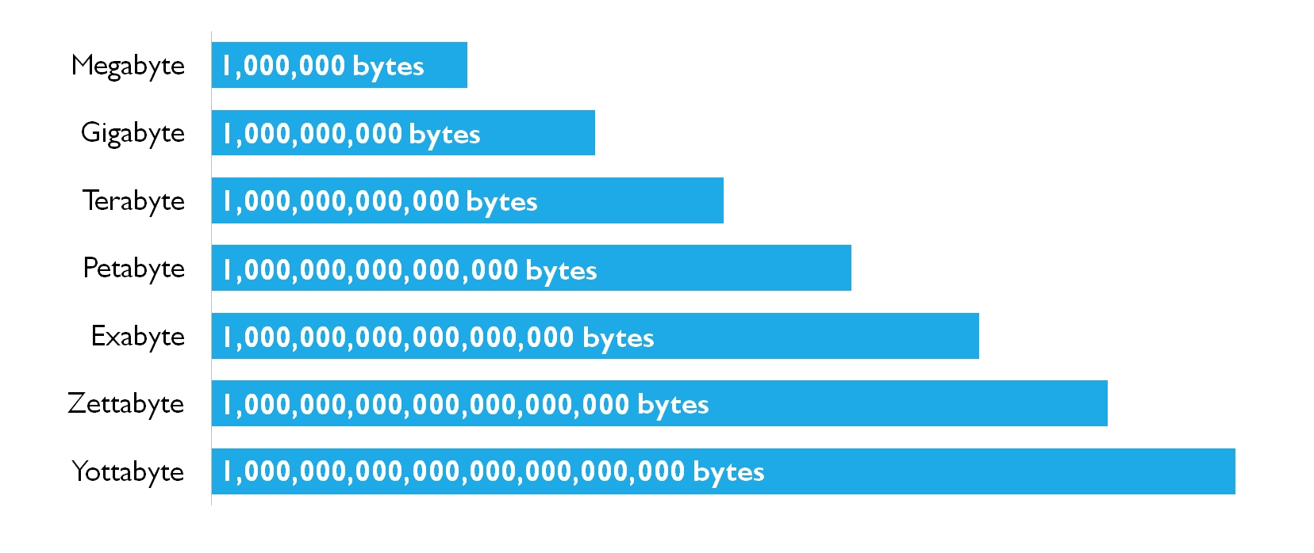
YouTube
Storage per minute: 40MB
100 hours per minute
Total storage of 100 hour per minute: 240GB
Total storage per day: 345 TB
Total storage per year: 126 PT
1 PB = 1000 TB
1 EB = 1000 PT
1 ZB = 1000 EB
Or
1 ZB = 1000 million TB

Slide 9
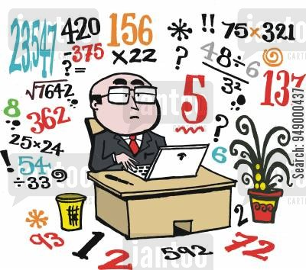
Crunch the Numbers
2008 3.6 ZB
2020 44 ZB
2025 175 ZB (estimate)
https://seedscientific.com/how-much-data-is-created-every-day/
90% of the world’s data created in the last two years alone
What does that mean?!
If each Terabyte in a Zettabyte were a kilometer, it would be equivalent to 1,300 round trips to the moon and back (768,800 kilometers).

Slide 10
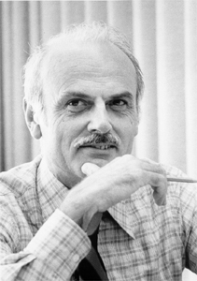
Back to the basics (1970)
Student ID | Name | Major
1161234 | Ahmad | ENCS
1161455 | Noor | COMP
Need to record banking transactions
Withdrawal
Deposit
Transactions
Fail-Safe
Edgar Codd at IBM 1970 Seminal paper
Proposed the relational model
Main idea was to organize data as groups of relations
Each relation describes a group of objects with similar attributes
ACM Turing Award
Course ID | CODE | Name
56478 | COMP333 | Database management Systems
56479 | COMP232 | Data Structures

Slide 11
DBMS
A Database Management System (DBMS) is an integrated set of programs used to create and maintain a database.
They are very complex systems
Examples:
Oracle
DB2
MySql
MariaDB
SQL SERVER
Informix
Both MySQL and MariaDB created by Michael Widenius (Monty)

Slide 12
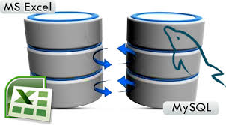
Files vs. DB
Would an Excel file suffice?!
Suppose a population of china File!
Problems
Memory
Questions on the data
Concurrent Data Access
Consistency
Security
Privacy
Recovery
Data depending on software!

Slide 13
Advantages of DBMS
Data independence
Generated and stored data should be kept separate from applications
The role of a database is to hold data for use by various applications. Data independence allows for the same data to be used in many different ways.
Efficient Data Access
DBMS utilizes a mixture of sophisticated concepts and techniques for storing and retrieving data competently, and this feature becomes important in cases where the data is stored on external storage devices
Data integrity and security
If data is accessed through the DBMS, the DBMS can enforce integrity constraints on the data.

Slide 14
Advantages of DBMS
Data Administration
Data sharing among multiusers.
Integrating the administration of data can offer major improvements.
Experienced professionals understand the nature of the data being managed and can be responsible for organizing the data representation to reduce redundancy and make the data to retrieve efficiently.
Concurrent Access
Allows for multiusers to access to the database at the same time without any problems in consistency or integrity.
Crash Recovery
Protect data from system failures.
Reduced Application Development time
DBMS supports many important functions that are common to many applications accessing data stored in the DBMS. This, in conjunction with the high-level interface to the data, facilitates quick development of application

Slide 15
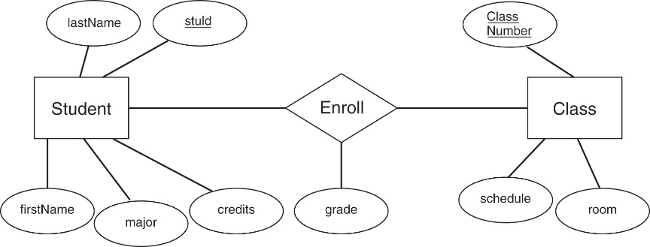
Data Model: Describing Data in DBMS
Users ultimately concerned with model data for real-world applications.
Data Model: collection of concepts for describing the data.
Semantic Data Model
Abstract data model easier for user to describe the data of real application scenario.
E.g. ER Diagram
Relational Data Model
Relations
Set of records
Attributes
Schema: Description of data using a particular data model

Slide 16
Database Example
A University database.
What entities do we have?
Entities such as
Students
Teachers
Courses
Rooms
Departments
Faculties
Relationships between entities:
Students enroll in classes
Teachers teach courses

Slide 17
Relational data model example

Slide 18
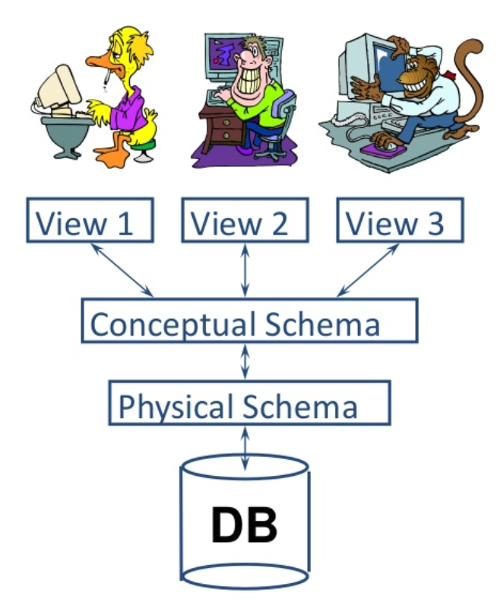
Levels of abstraction in a DBMS
The data in a DBMS is described in 3 levels of abstraction
There is a schema at each level
External schema
Conceptual schema
Physical schema
Information about the above schemas are found in the system catalog

Slide 19
St_id | fName | lName | DOB | Major
Conceptual Level (logical level)
Student(student id int, fName: String, lName: String, DOB: Date, major: String)
Describes the stored data in terms of data model (relational)
Relational data model
Describes all objects in terms of Entities and relationships between them.
Quiz: Why do we store DOB rather than age?!

Slide 20
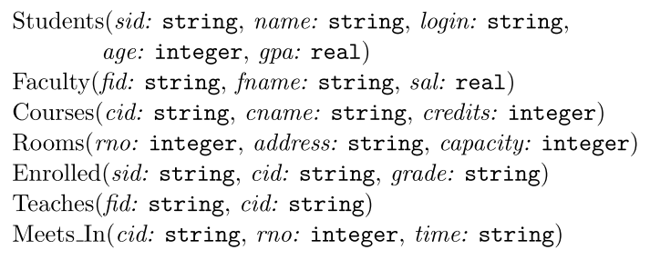
Example Conceptual Schema

Slide 21
Other levels
External level:
Based on view from conceptual model
E.g. Ritaj
Physical level
Concerned with how exactly the data is stored in files on storage medium

Slide 22
Data Independence
Ability to modify a schema in one level without affecting the next level.
Logical data independence
Users are shielded from changes in the logical structure of the data (changes in relations).
Physical data independence
Conceptual schema insulates users from changes in the physical storage details.

Slide 23
Queries in DBMS

Slide 24
SQL
DBMS Supports Structured Query Language.
Based on Relational Algebra
Composed of
DDL
DML

Slide 25
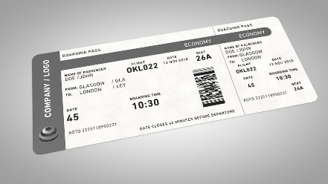
Transaction Management
Flight example
Two users
One Ticket left!
Reception 1
Reception 2
R(A)
R(A)
W(A)
W(A)

Slide 26
Who works with databases?

Slide 27
DBMS Architecture

Slide 28
What is a database?!

