Slide 1
Database Design
Building ER diagram

Slide 2
Chapter 4: Entity Relationship (E-R) Modeling
Basic Modeling Concept
User 1
User 2
User n
External Model
-user’s view
View 1
View 2
…
1. External level
View n
Conceptual Model
-designer’s view
-h/w independent
-s/w independent
ERD
2. Conceptual level
Conceptual Schema
Internal Model
-DBMS’s view
-h/w independent
-s/w dependent
Internal Schema
3. Internal level
-h/w dependent
-s/w dependent
Database
Physical Model
Physical data
organization

Slide 3
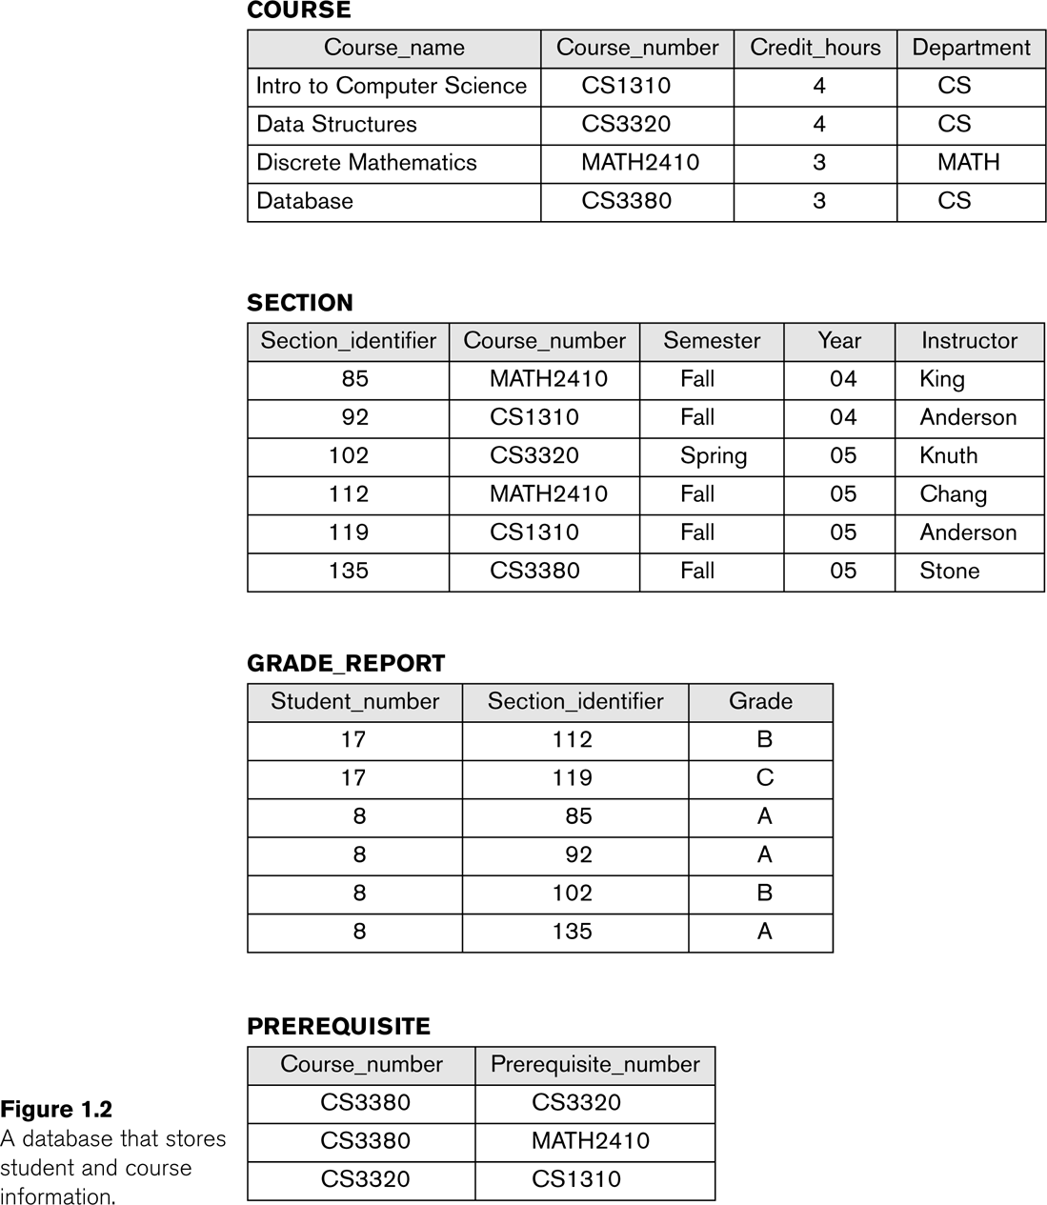
Example of a Database

Slide 4
Main characteristics of the database approach
Self-describing nature of a database system:
  A DBMS catalog stores the description of a particular database (e.g. data structures, types, and constraints).
  The description is called meta-data.
  This allows the DBMS software to work with different database applications.
Insulation between programs and data:
  Called program-data independence.
  Allows changing data structures and storage organization without having to change the DBMS access programs.
Data abstraction:
  A data model is used to hide storage details and present the users with a conceptual view of the database.
  Programs refer to the data model constructs rather than data storage details.
Support of multiple views of the data:
  Each user may see a different view of the database, which describes only the data of interest to that user.

Slide 5
Database Design Process
Two main activities:
  Database design.
  Applications design.
Focus in this course on database design.
  To design the conceptual, logical model for a database application.
Applications design focuses on the programs and interfaces that access the database.
  Generally considered part of software engineering.

Slide 6
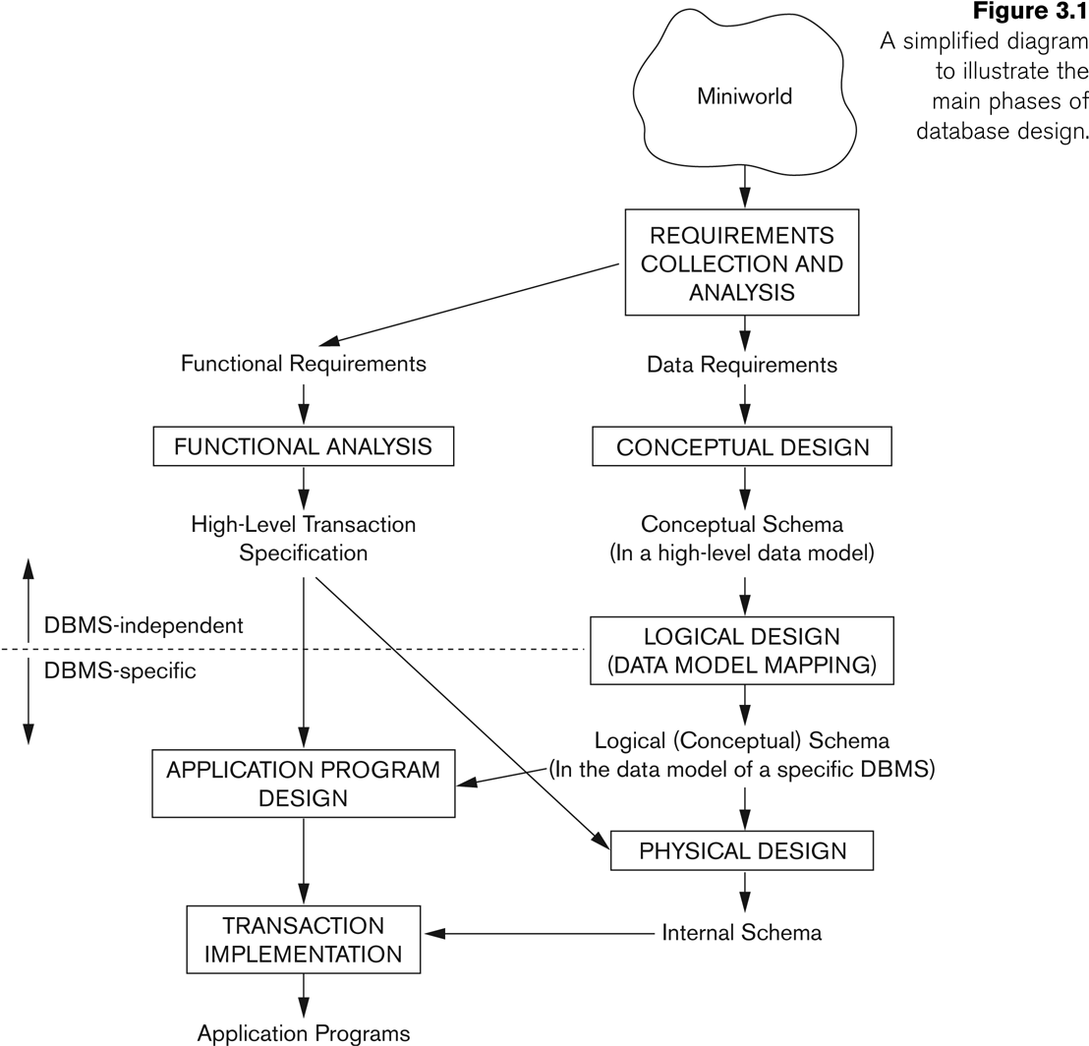
Database Design Process

Slide 7
Overview
Real world
Query
Answer
Model
Database
Processing of
queries and updates
DBMS
Access to stored data
Physical
database

Slide 8
Entity-relationship (ER) model
High-level conceptual data model.
  An overview of the database.
  Easy to discuss with non-database experts.
  Easy to translate to data model of DBMS.
ER diagram.
Based on modelling objects in the real-world.

Slide 9
Entity and Entity type/set
Entity: A ”thing” in the real world with an independent existence.
Attributes: Properties that describes an entity.
Entity type: A collection of entities that have the same set of attributes.
Model
RegNumber
Year
PersonalNumber
Name
Car
Owner

Slide 10
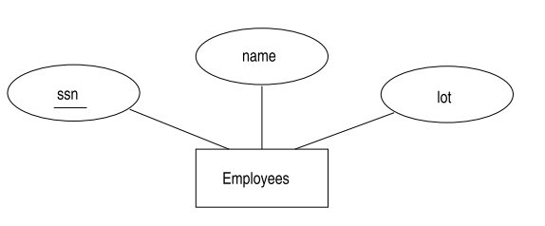


Conceptual Design
Entities
Attributes
Attribute Domain
Key
Primary Key
Candidate Keys

Slide 11
Multi-Valued Attributes
Can have many values.
  Examples:
    A person may have several college degrees.
    A household may have several phones with different numbers
    A student has hobbies
Notes:
23

Slide 12
Constraints on Attributes
Value sets (domains) of attributes.
Key attributes.
Street
City
Name
PersonalNumber
Owner
PhoneNumber
Age

Slide 13
Relationship Type
Relationship type: Association among entity types.
Model
RegNumber
PersonalNumber
Name
Year
1
owns
N
Owner
Car

Slide 14
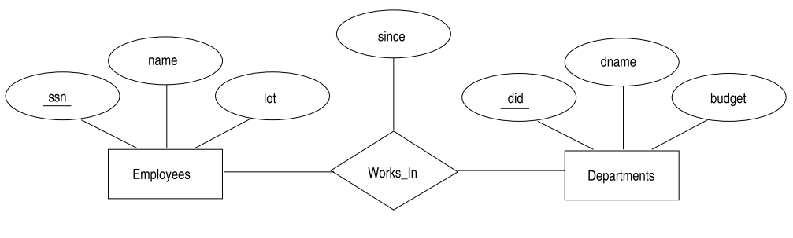
Conceptual Design 2
Relationships
Descriptive Attributes

Slide 15
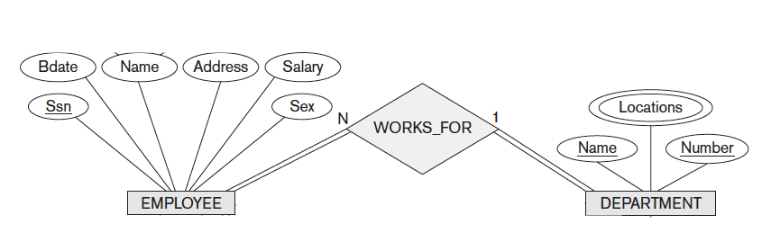
Examples: Employee

Slide 16
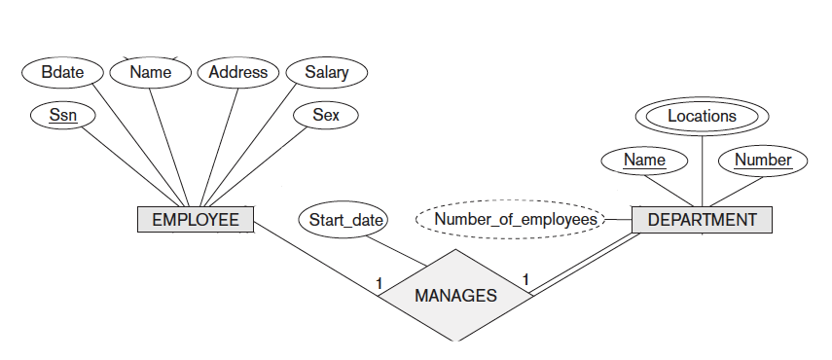
Examples: Manage

Slide 17
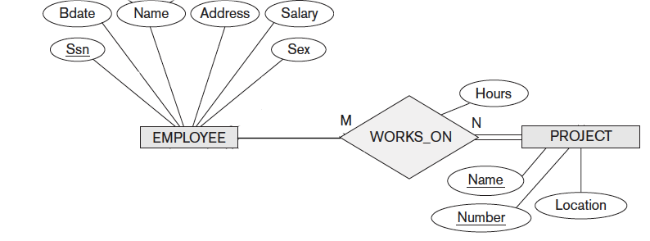

Slide 18
Constraints on relationship types
Cardinality ratio: Maximum number of relationships an entity can participate in.
Possible cardinality ratio: 1:1, 1: N, N:1, and N:M
1
owns
1
Owner
Car
N
owns
1
Owner
Car
N
owns
M
Owner
Car

Slide 19
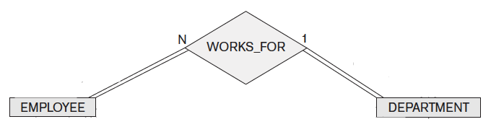
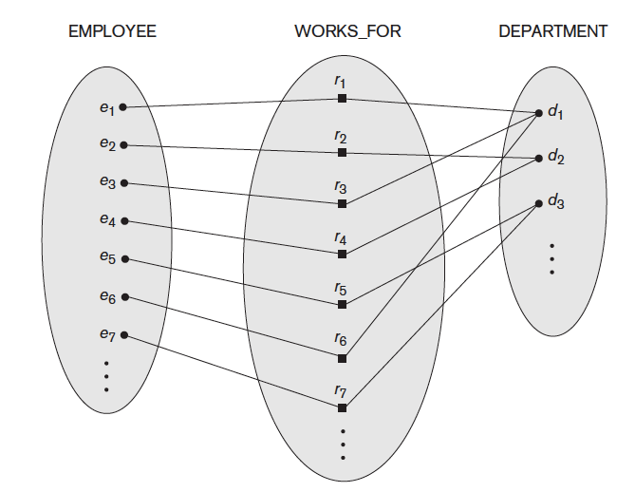
One-to-Many

Slide 20
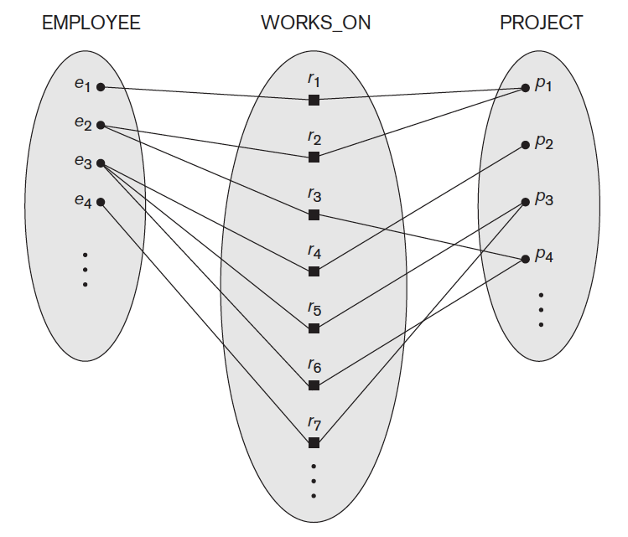
Many-to-Many
Many-to-Many

Slide 21
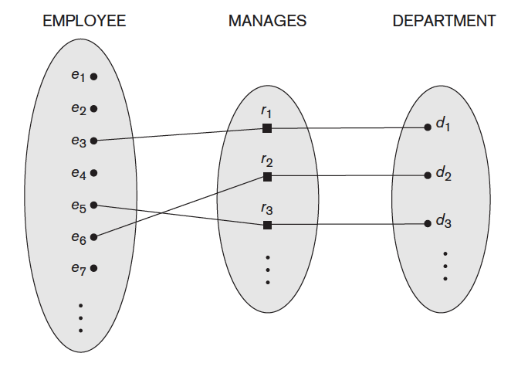
One-to-One

Slide 22
Keys
A super key of an entity set is a set of one or more attributes whose values uniquely determine each entity.
A candidate key of an entity set is a minimal super key
  ID is candidate key of instructor
  course_id is candidate key of course
Although several candidate keys may exist, one of the candidate keys is selected to be the primary key.

Slide 23
Keys for Relationship Sets
The combination of primary keys of the participating entity sets forms a super key of a relationship set.
  (s_id, i_id) is the super key of advisor
  NOTE: this means a pair of entity sets can have at most one relationship in a particular relationship set.
    Example: if we wish to track multiple meeting dates between a student and her advisor, we cannot assume a relationship for each meeting. We can use a multivalued attribute though
Must consider the mapping cardinality of the relationship set when deciding what are the candidate keys
Need to consider semantics of relationship set in selecting the primary key in case of more than one candidate key

Slide 24
Constraints on relationship types
Participant constraint.
  Total participation: Every entity participates in at least one relationship with another entity.
”Every car must be owned by at least one owner.”
PersonalNumber
RegNumber
N
owns
M
Owner
Car

Slide 25
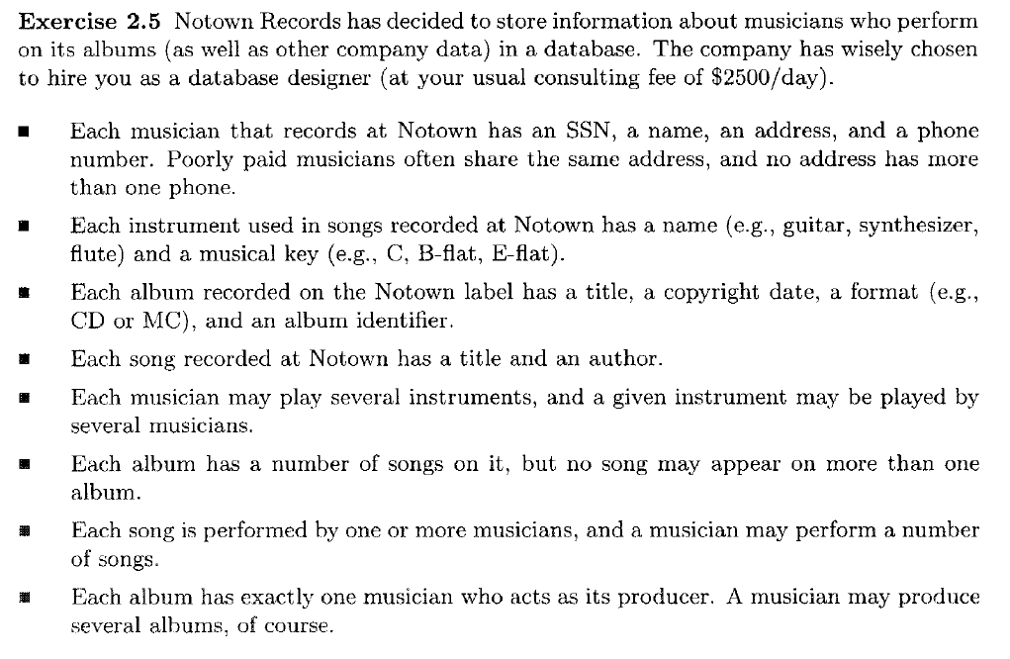
Musicians Example

Slide 27
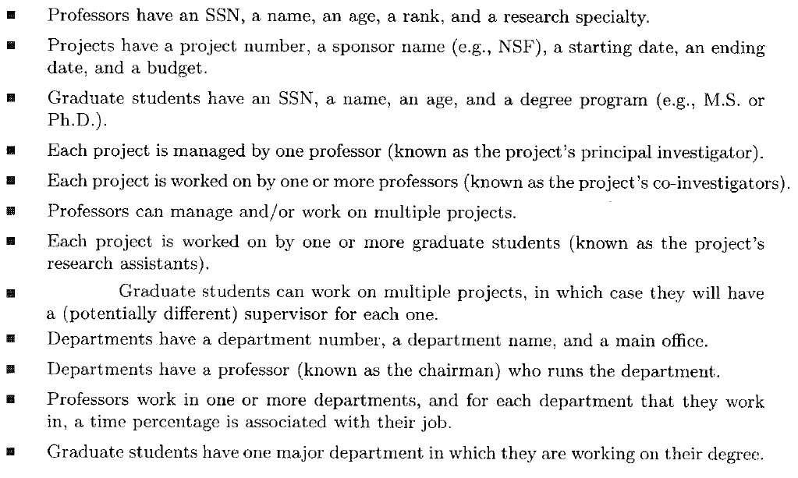
University Example
Each graduate student has another, more senior graduate student (known as a student
advisor) who advises him or her on what courses to take.

Slide 28
Each graduate student has another, more senior graduate student (known as a student
advisor) who advises him or her on what courses to take.

Slide 30

Weak Entity Types
Do not have key attributes of their own
  Identified by being related to specific entities from another entity type
Identifying relationship
  Relates a weak entity type to its owner
Always has a total participation constraint

Slide 31
Constraints on Relationship Types
Weak entity types: They do not have key attibutes of their own.
A weak entity can be identified uniquely by being related to another entity (together with its own attributes).
name
Name
number
1
Plays_on
N
team
players

Slide 32
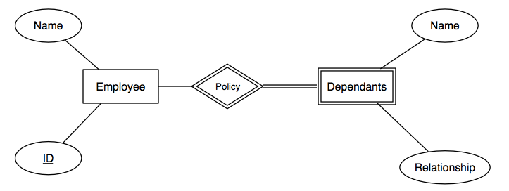
Weak Entity Sets
If an entity set is weak, it will be shown as a rectangle with a double/thick border.
Its supporting many-one relationships will be shown as diamonds with a double border.
If an entity set supplies any attributes for its own key, then those attributes will be underlined.

Slide 33
Requirements for Weak Entity Sets
if E is a weak entity set, then its key consists of:
  Zero or more of its own attributes, and
  Key attributes from entity sets that are reached by certain many-one relationships from E to other entity sets. These many-one relationships are called supporting relationships for E.

Slide 34
Requirements for Weak Entity Sets
In order for R, a many-one relationship from E to some entity set F, to be a supporting relationship for E, the following conditions must be obeyed:
  R must be a binary, many-one relationship from E to F.
  R must have referential integrity from E to F.
  The attributes that F supplies for the key of E must be key attributes of F.
Multiple supporting relationships are possible

Slide 35
Weak Entity Sets Notation
1. If an entity set is weak, it will be shown as a rectangle with a double border
2. Its supporting many-one relationship will be shown as diamonds with a double border
3. If an entity set supplies any attributes for its own key, then those attributes will be underlined
Whenever we use an entity set E with a double border, it is weak. The key for E is whatever attributes of E are underlined plus the key attributes of those entity sets to which E is connected by many-one relationships with a double border.
number
name
address
Crews
Stars-in
Studios

Slide 36
Recursive Entity/Relationship
    Entity set that have relationship with the same entity set
    Example: EMPLOYEE entity
employeeSPOUSE
employeeMANAGER
employeeNAME
employeeNAME
employeeNO
employeeNO
1
EMPLOYEE
1
1
EMPLOYEE
n
1
married
manage
employeeNO | employeeNAME | employeeSPOUSE
111 | Ali | 444
222 | Ah Chong
333 | Bazil
444 | Sheriz | 111
employeeNO | employeeNAME | employeeMANAGER
111 | Ali | 333
222 | Bassem | 333
333 | Sobhi | 444
444 | Allan

Slide 37
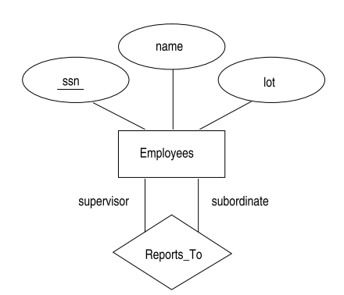
Recursive Entity/Relationship

Slide 38
N-ary relationships
Example. A person works as an engineer at one company and as a gym instructor at another company.
Company
Employee
JobType
N
N
M
works at
works as
M
Ternary
Employee
K
N
works as
Company
M
JobType

Slide 39
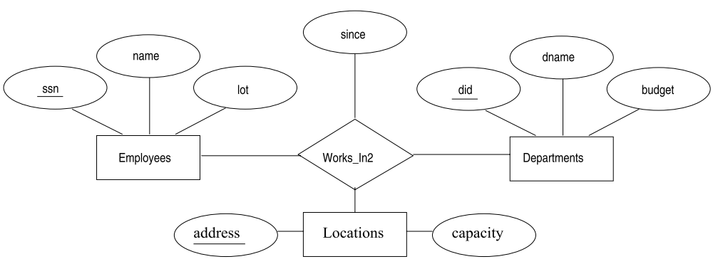
Ternary Relationship

Slide 40
ER Notation
Symbol
Meaning
ENTITY TYPE
WEAK ENTITY TYPE
RELATIONSHIP TYPE
IDENTIFYING RELATIONSHIP TYPE
ATTRIBUTE
KEY ATTRIBUTE
MULTIVALUED ATTRIBUTE
TOTAL PARTICIPATION OF E₂ IN R
CARDINALITY RATIO 1:N FOR E₁:E₂ IN R
E₁
R
E₂
E₁
1
R
N
E₂

Slide 41
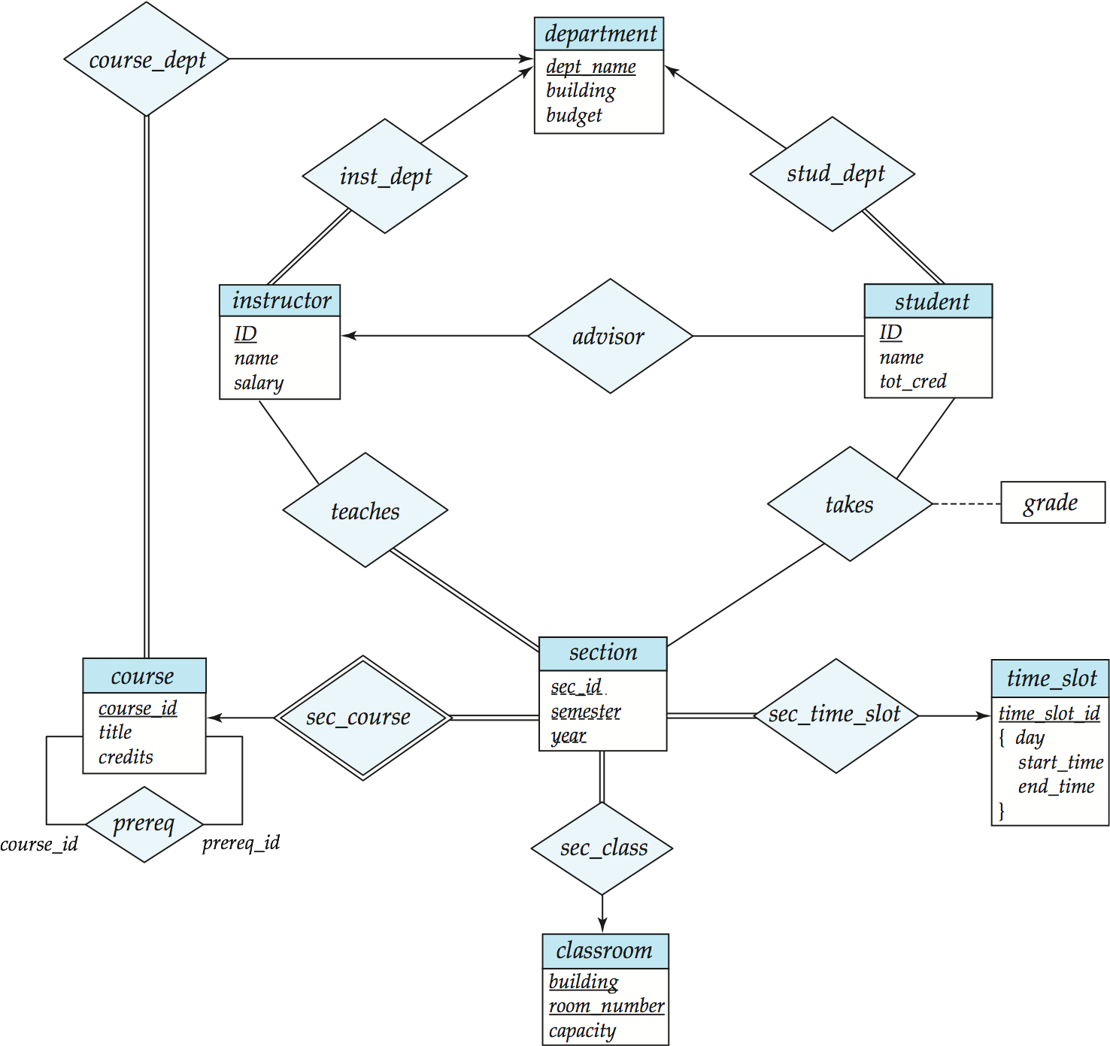
E-R Diagram for a University Enterprise

Slide 42
Enhanced ER (EER) model
Why more? To comply with more complex data requirements.
  Example. Only some employees can use a company car, only managers have to write a monthly report, but all employees have assigned personal number, salary account and a place in the office.
Class Hierarchies
  Subclass/superclass,
  specialization/generalization,
  union/category, and
  attribute and relationship inheritance.

Slide 43
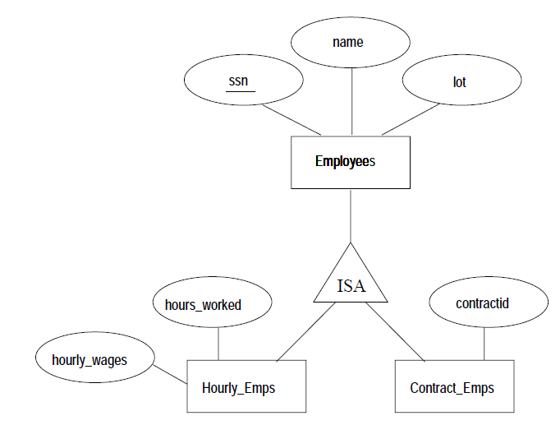
Class Hierarchies

Slide 44
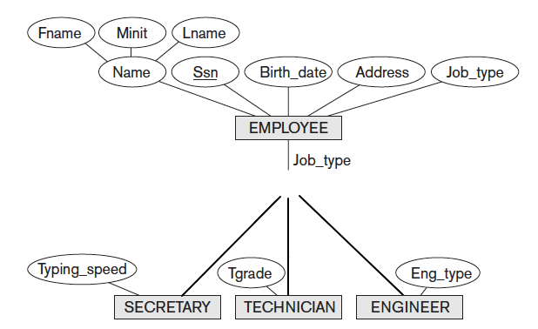
ISA

Slide 45
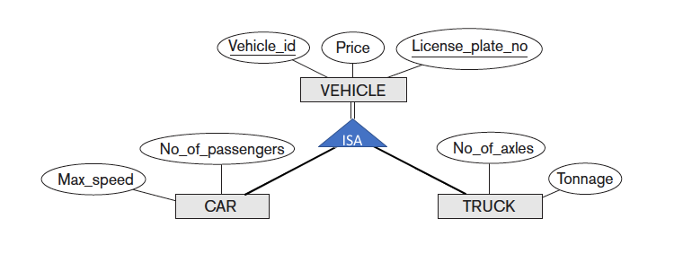

Slide 46
Subclass/superclass
Surname
FirstName
PN
Employee
ISA
Commission
Salesman
Engineer
Manager
ProjectLeader
1
1
uses
writes
1
N
Car
MonthlyReport
RegNumber
ReportID

Slide 47
Class Hierarchies
A UNION subclass represents a collection of entities that is a subset of the UNION of the entities of the super classes.
CNumber
Address
PersonalNumber
Person
Company
“An owner of a car is
either a person or a company.”
BirthDate
ISA
Owner
1
owns
N
Car

Slide 48
Examples
A taxi company needs to model their activities.
There are two types of employees in the company: drivers and operators. For drivers it is interesting to know the date of issue and type of the driving license, and the date of issue of the taxi driver’s certificate. For all employees it is interesting to know their personal number, address and the available phone numbers.
The company owns a number of cars. For each car there is a need to know its type, year of manufacturing, number of places in the car and date of the last service.
The company wants to have a record of car trips (körningar). A taxi may be picked on a street or ordered through an operator who assigns the order to a certain driver and a car. Departure and destination addresses together with times should also be recorded.

Slide 49
Street
Address
PN
Phone
PostNumber
Town
Employee
ISA
TaxiCertifDate
DrivingLicenseDate
DrivingLicenseDate
Driver
Operator
DrivingLicenseType
1
1
DrivingLicenseType
drives
assign
N
DepTime
N
Type
DeparturePlace
Trip
YearOfManuf
RegNumber
Destination
ServiceDate
DestTime
N
made_by
1
Car
Places
ID

Slide 50
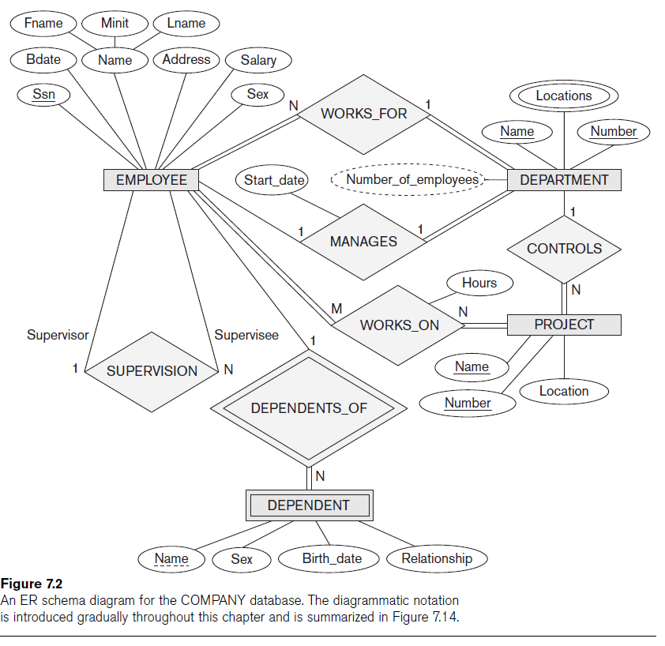

Slide 51
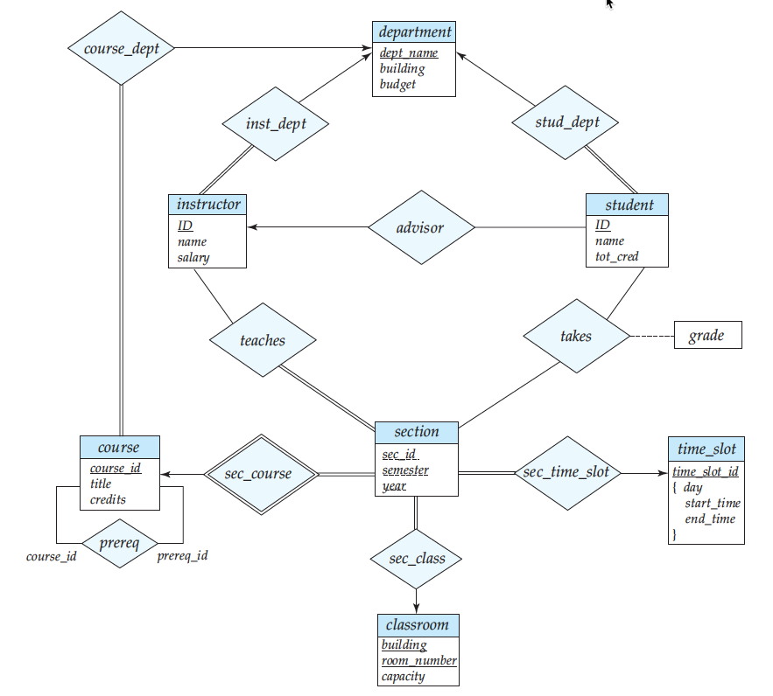

Slide 52
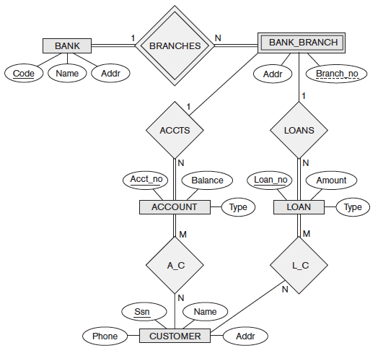

Slide 53
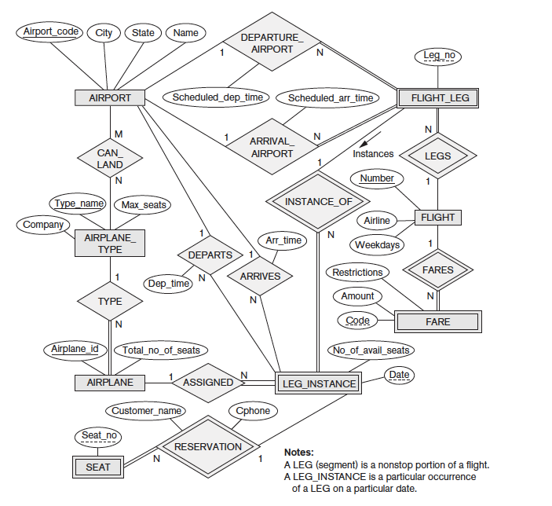

Slide 54
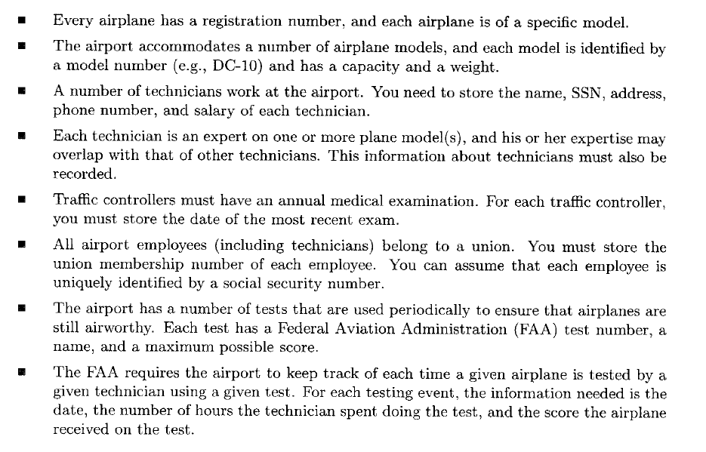

Slide 55
